Slide 1
RHIC Status
Haixin Huang
RSC Meeting
02/18/2011

Slide 2
Past One Week
Fixed the blue dump kicker noise problem last Friday.
Declared physics last Friday.
Smooth run over the weekend.
Cryo power distribution failure. Change it maintenance day.
Physics run on Tuesday.
Wednesday: 9MHz cavity commissioning did not go well due to LLRF problem, which is still a problem at this moment.
Thursday: Rotator ramp development.
Friday: fix LLRF problem, then physics stores.

Slide 3
Status
AGS tune jump quads put into use since Wednesday night for RHIC fill. High polarization seen in AGS and RHIC.
The emittance out of AGS is improved.
Turn on octupoles on the ramp to fight instability since Monday.
Better orbit on the ramp since Tuesday.
Blue horizontal tune is touching 0.7 at store. Need to lower it a little bit.
10Hz orbit feedback was tested at the end of store. The impact is benign. It will moved on to the beginning of store.
Polarization at store is in the mid-40s. Hope for improvement from high injection polarization from AGS.

Slide 4
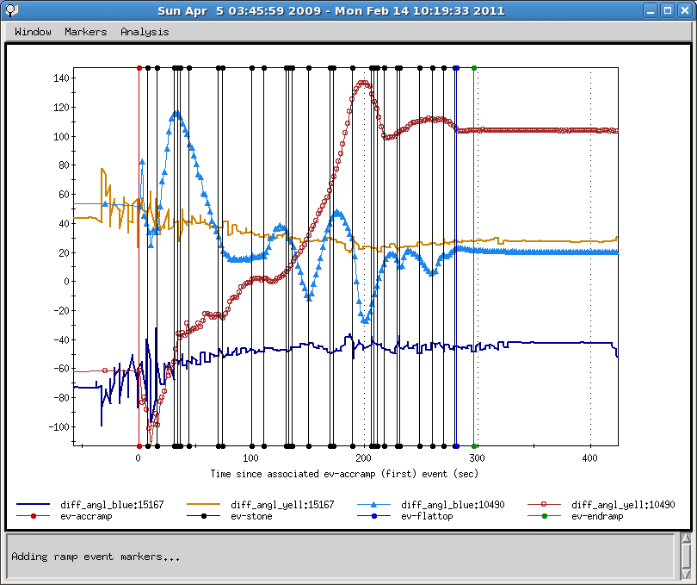
Snake Angle Difference: run11 vs. run9

Slide 5
Unfinished Business
Bump closure issue.
IPM sensitivity to beam positions.
Poor lifetime at beginning of store
Injection drift compensation.
Need snake current scan to set spin tune close to 0.5. This will be done over many stores.
D’ shift ramp. No schedule for it yet.

Slide 6
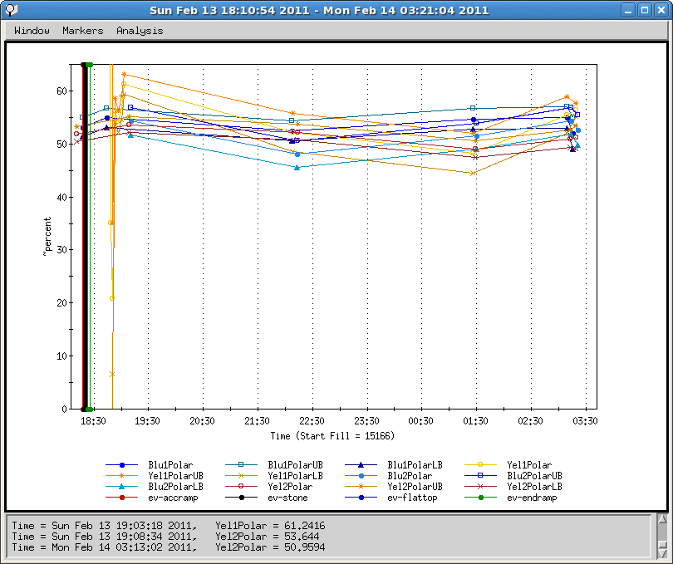
Polarization Through Recent Store

Slide 7
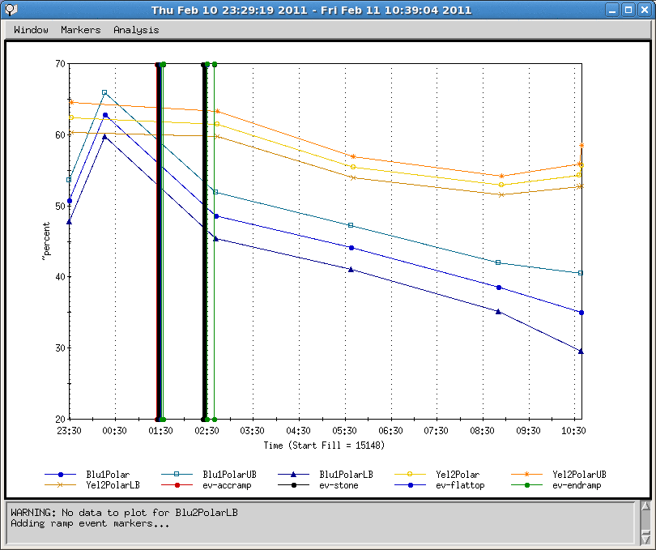
Polarization Through Store with Qx~0.7 in Blue

