Slide 1
AGS Status and Plans
RHIC Spin Collaboration Meeting
Vincent Schoefer / Haixin Huang
1/21/11

Slide 2
Current status
Very fast startup
  Reached 60-65% polarization at 1.5e11 in the first few days.
Polarization and intensity steady over time
  Less orbit drift observed than in previous runs.
Emittance higher than previous runs
    Horizontal and vertical ~20pi at 1.5e11
    Previous runs have been (Hor, Ver) = 12pi, 15pi
    Scraping in the Booster has not been very aggressive
Most development time spent on tune jump system
Still AGS CNI timing issues to be resolved

Slide 3
AGS Commissioning Effort
Tune jump system
  Understanding effect on polarization and emittance
  Small chromaticity gives minimal emittance growth, but why?
Optics correction
  Magnet realignment
  High vertical tune for early acceleration
CNI motion control
AGS Base-band tune R&D

Slide 4
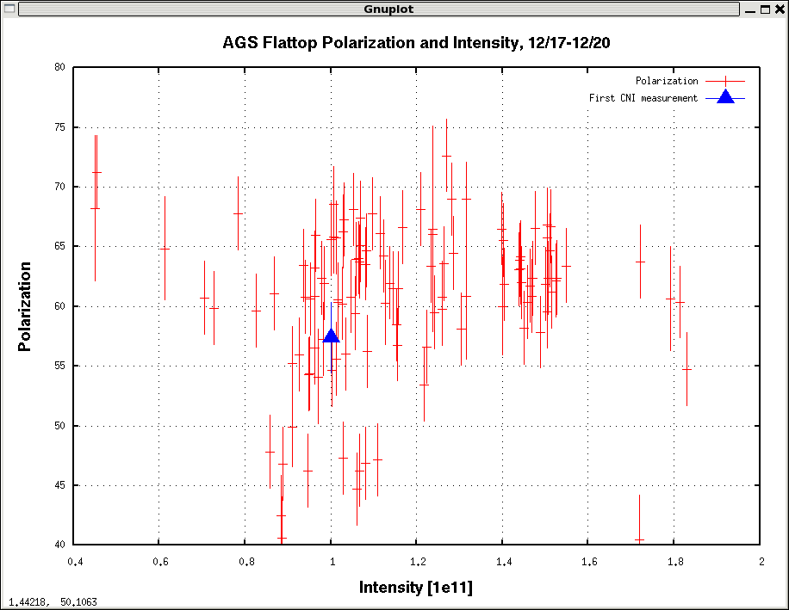
Notes:
First injection on 12/13, first CNI measurement on 12/15. The other measurements start on 12/17 because we first had a calibrated DCCT on that day. The intensity for the ‘First CNI measurement’ data point was measured ‘by hand’ with the calibrate pulse on.

Slide 5
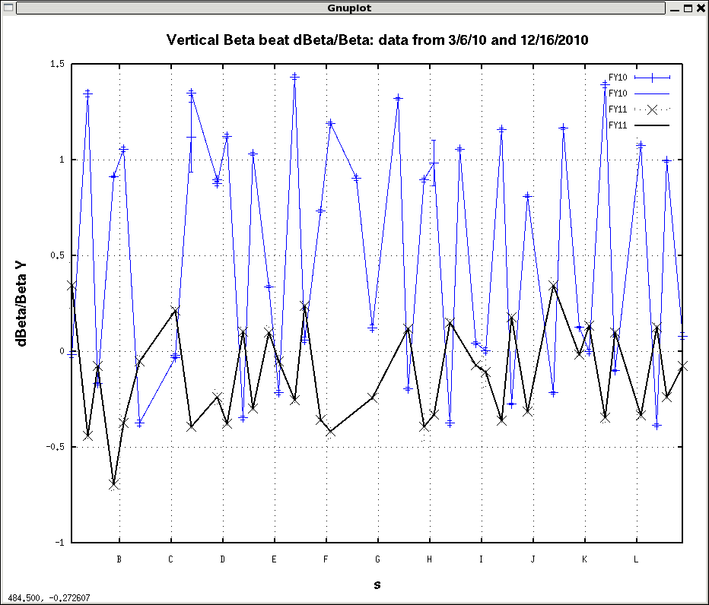
Notes:
Improvement to beta beat. Both data sets have no intentional horizontal 6 theta correction. The sextupole currents, measured tunes and beam energy are the same in both cases. The only difference that we think is relevant is the magnet realignment. Maybe this helped with the quick startup. It must certainly help with sensitivity to a drifting dipole error (like what we experienced last year at 36+ for instance)

Slide 6
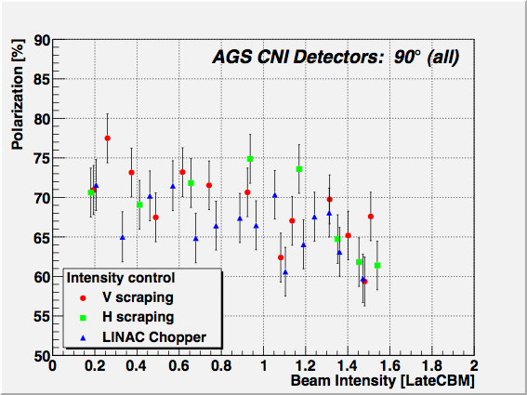
(Andrei Poblaguev)

Slide 7
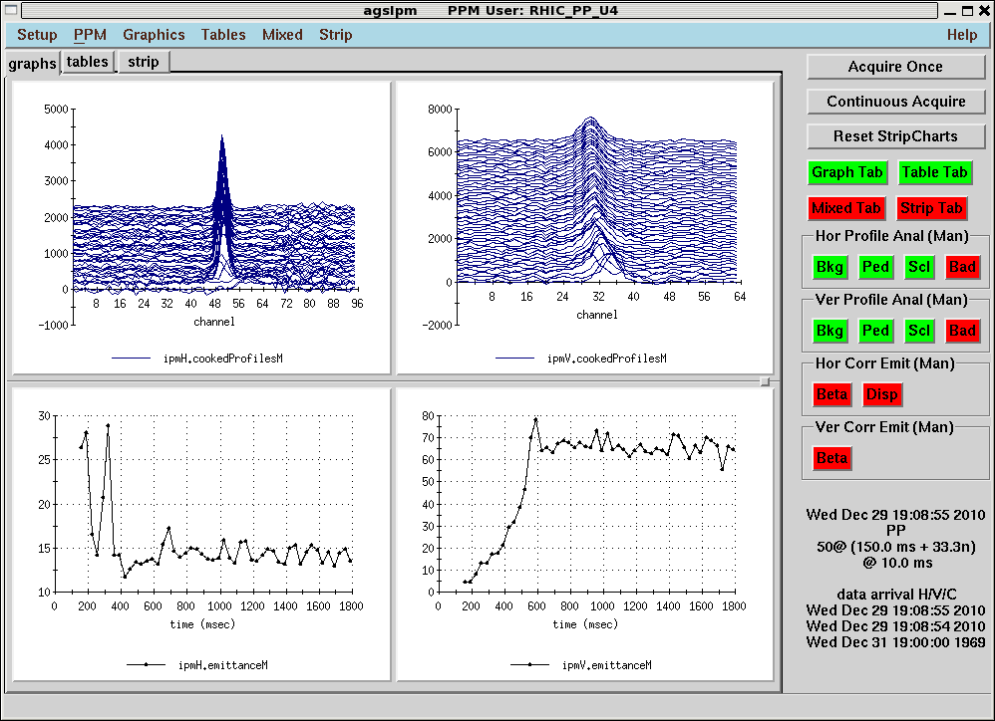
Before reduce horizontal chromaticity

Slide 8
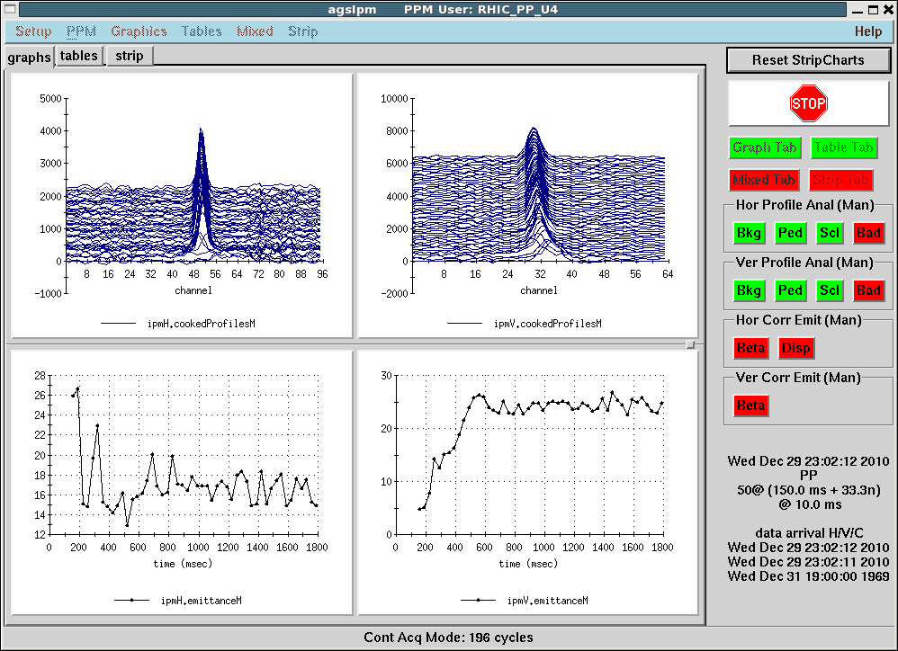
After reduce horizontal chromaticity

Slide 9
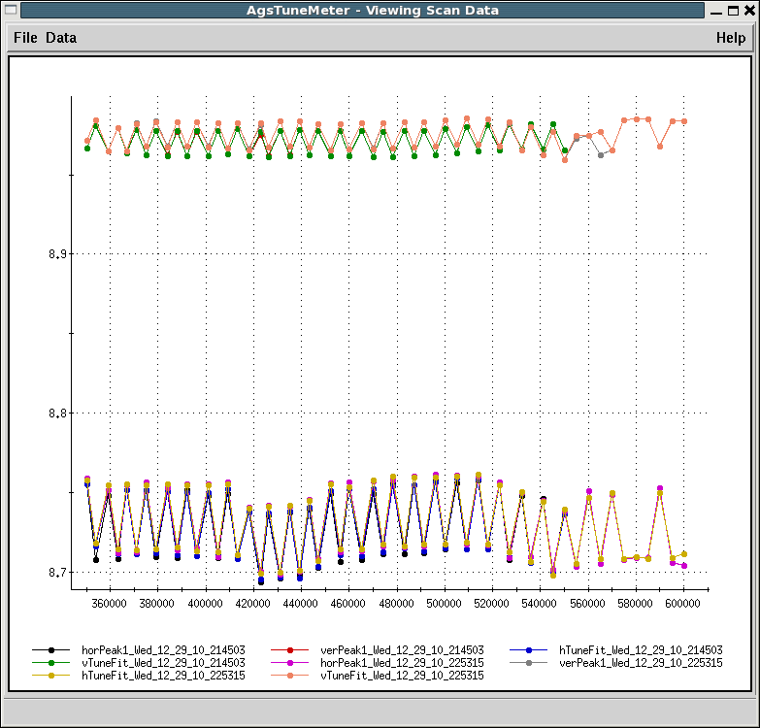
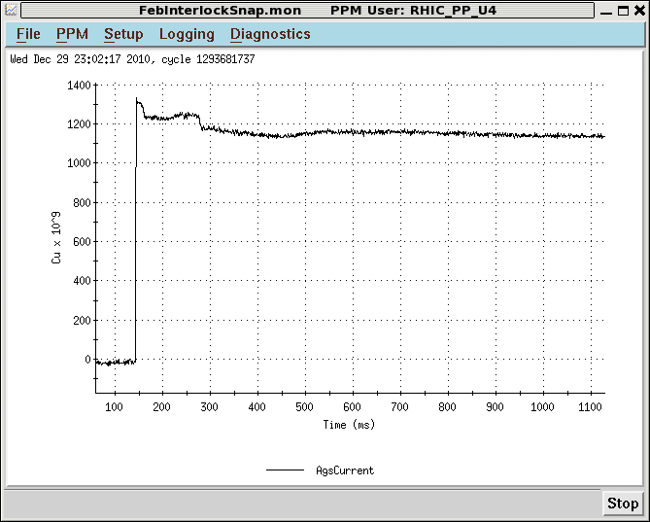
Tune jump amplitude withdQx~0.05
Still beam loss

