Slide 1
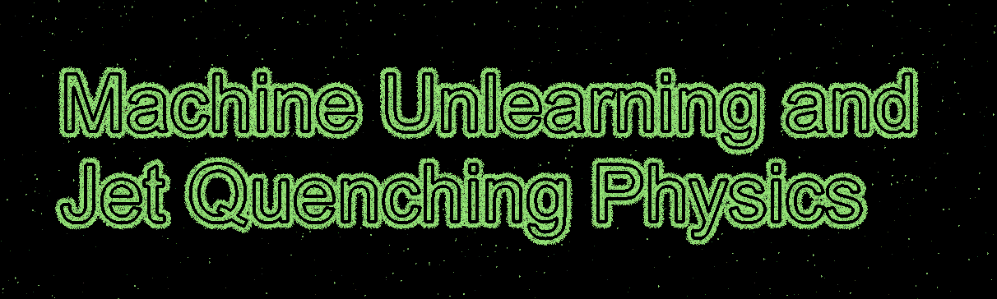


13th International Conference on Hard and Electromagnetic Probes of
High-Energy Nuclear Collisions

Slide 2
Why are we here for this 8:30 am talk?

Slide 3
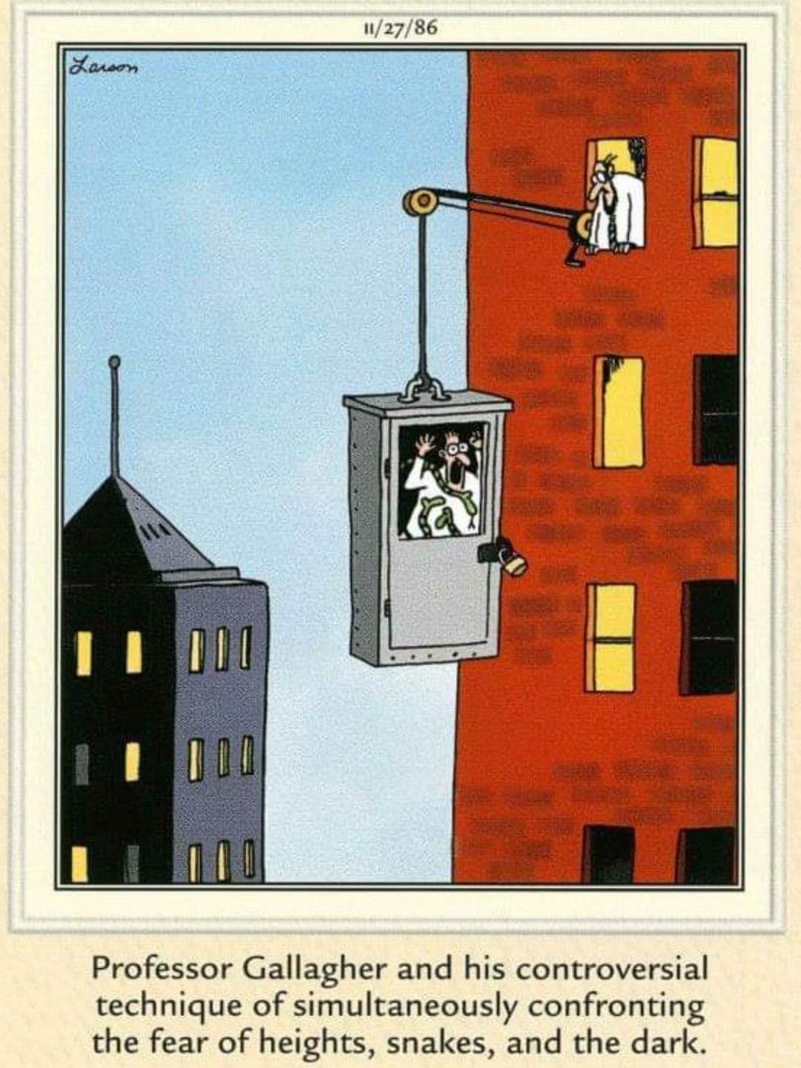
Why are we here for this 8:30 am talk? What do you fear?

Slide 4
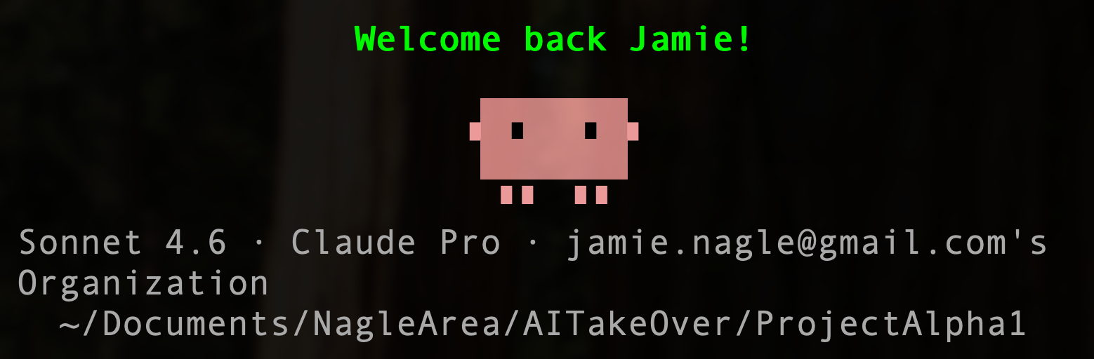
Embrace your fears.
All work here is a collaboration of Nagle & Claude.

Slide 5
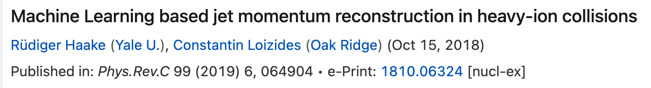
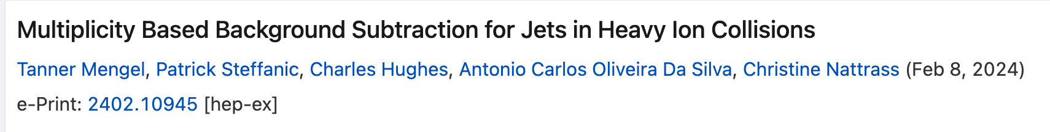
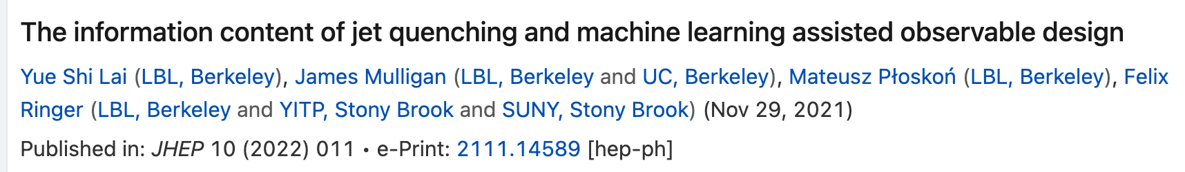
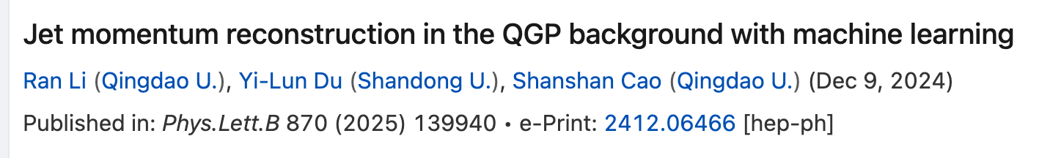
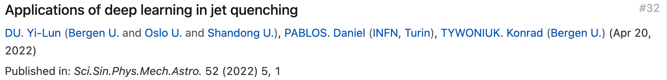
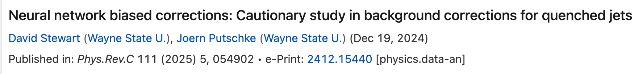
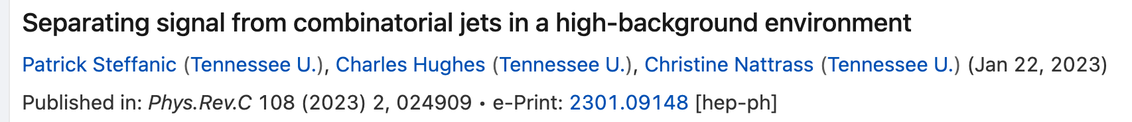
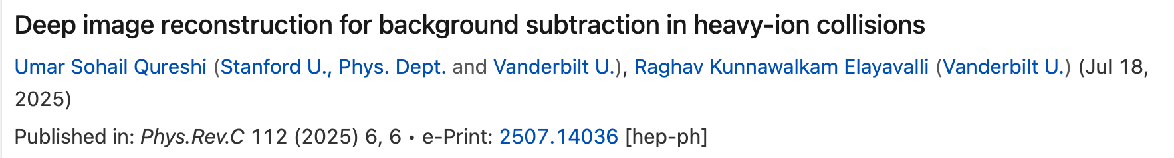
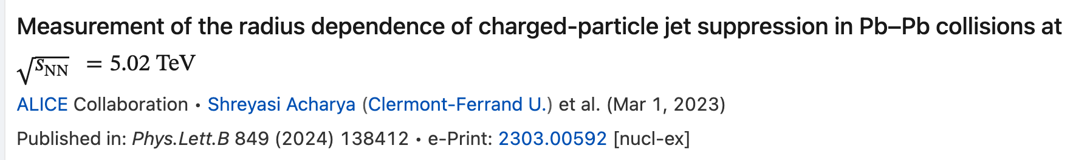
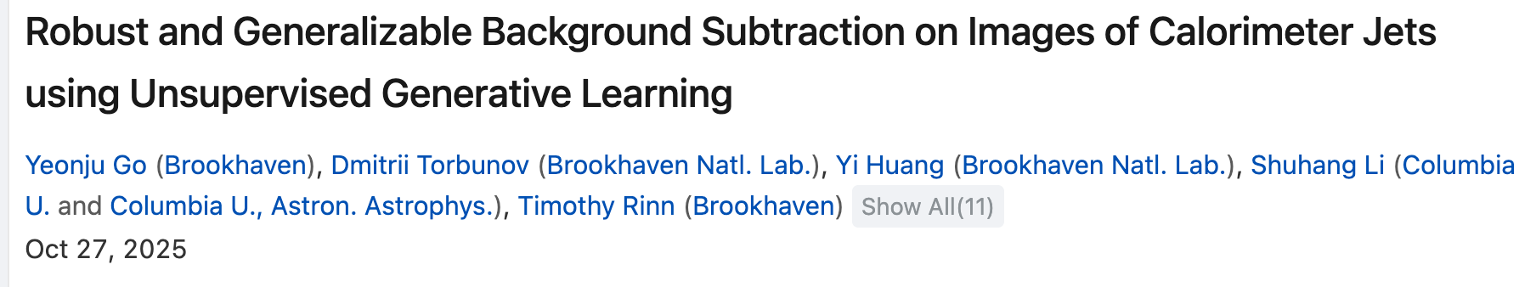
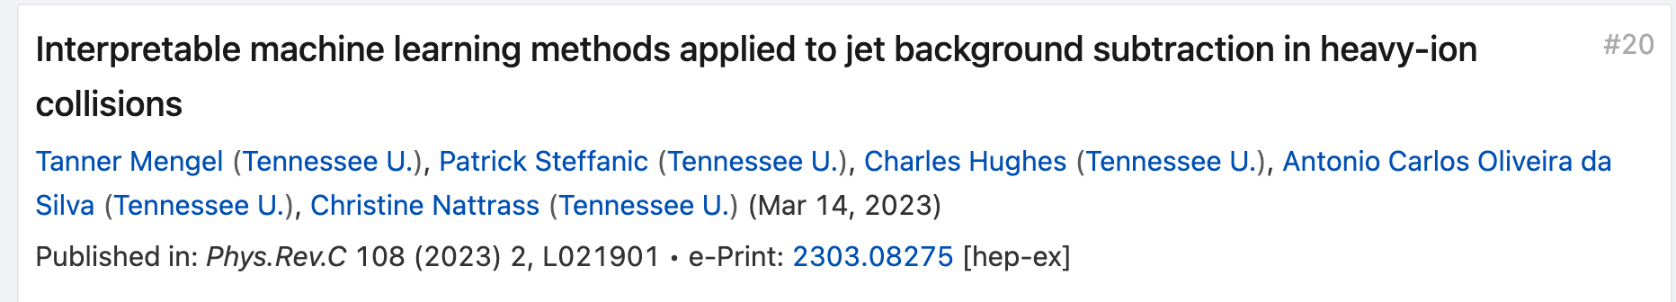
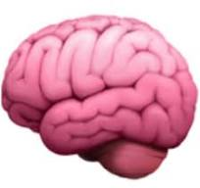

Survey the literature

Slide 6
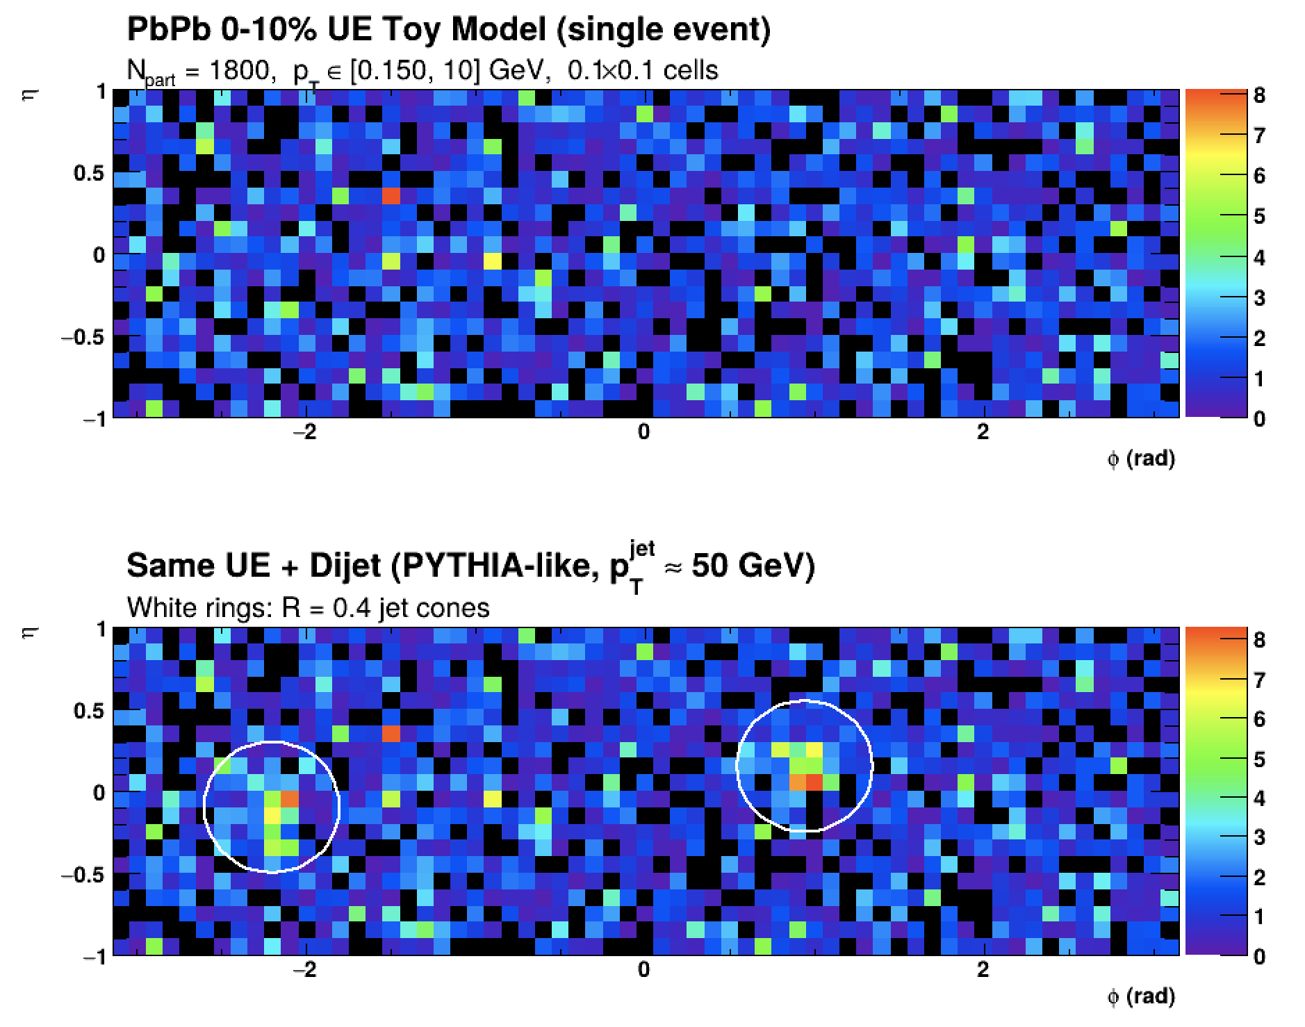
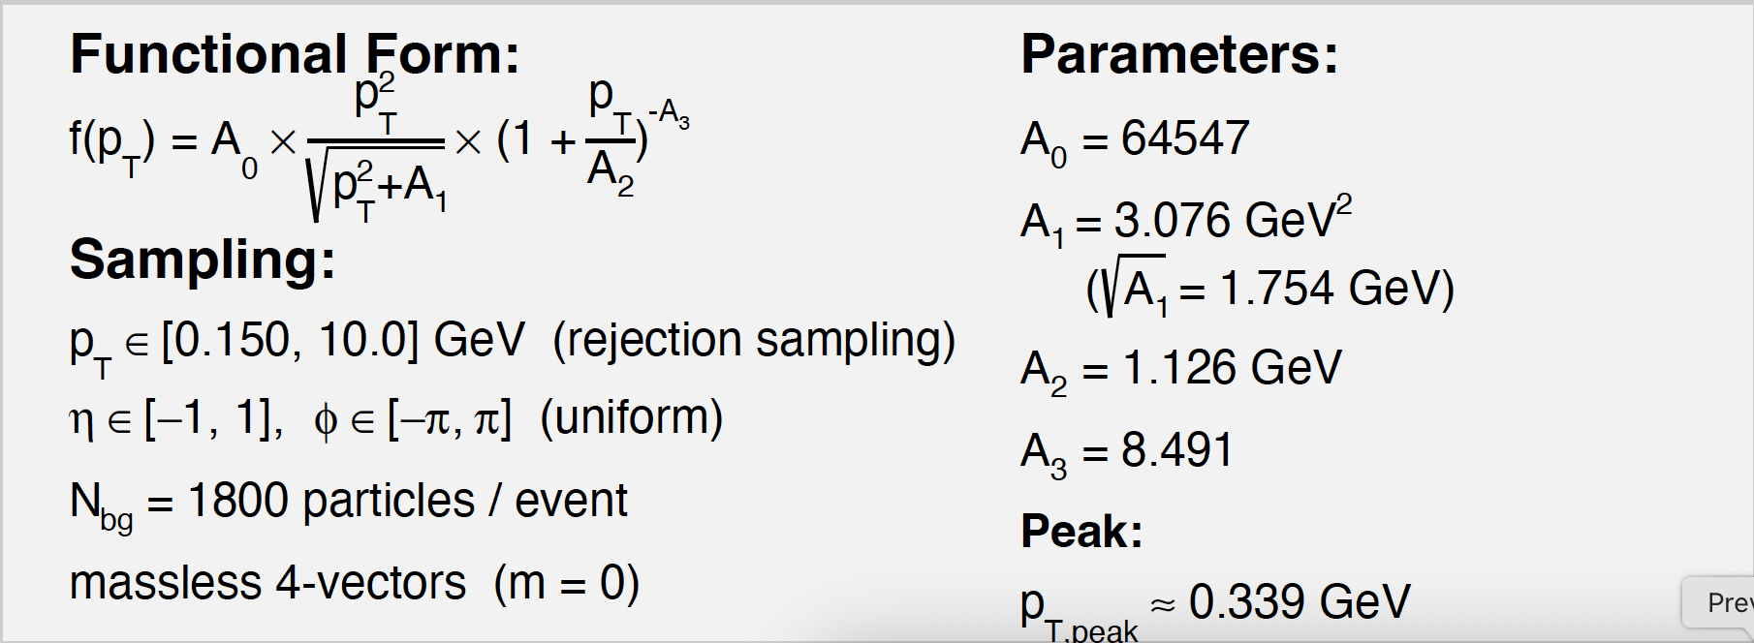
KISS = keep it simple stupid
Underlying event toy model.
Featureless, structureless.
Use charged particle jets only.
Model Pb+Pb 0-10% and train on
PYTHIA-8 anti-k_{t} R=0.4 jets
Focus on jets p_{T} = 40-60 GeV

Slide 7
KISS = keep it simple stupid
over-riding
Underlying event toy model.
Featureless, structureless.
Use charged particle jets only.
Model Pb+Pb 0-10% and train on
PYTHIA-8 anti-k_{t} R=0.4 jets
Focus on jets p_{T} = 40-60 GeV

Slide 8
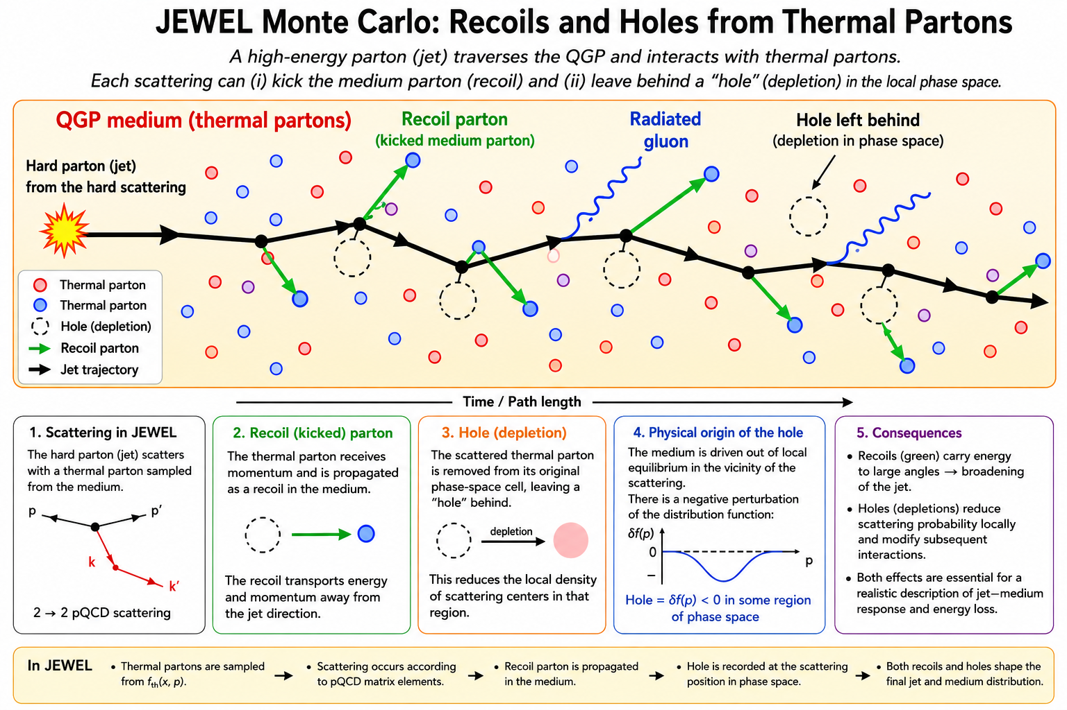
PYTHIA Train & Test, JEWEL Test
JEWEL (no recoils)
JEWEL (w/ recoils)
JEWEL (w/ recoils & 4MomSub*)

Slide 9
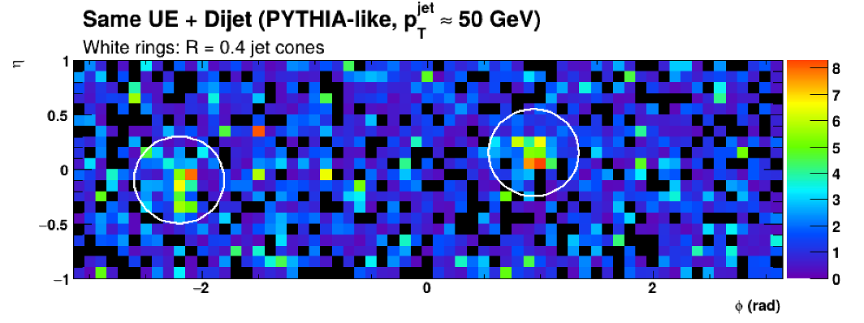
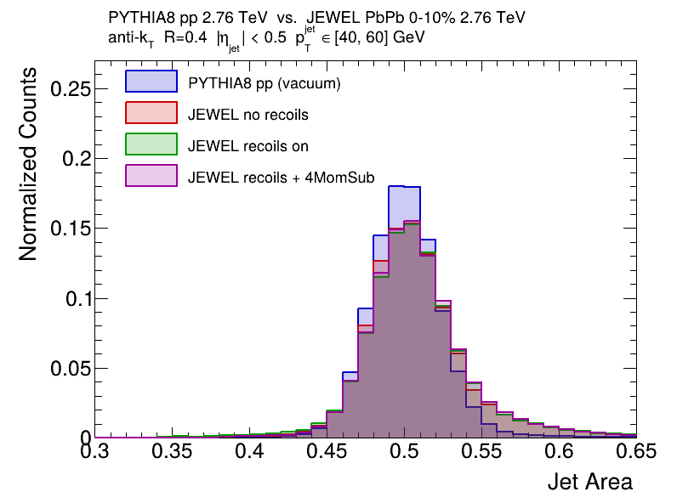
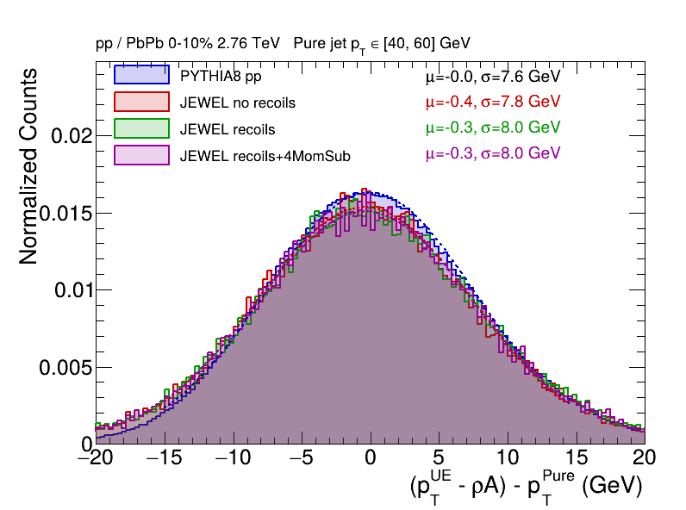

Area Subtraction Algorithm
Simple

Slide 10
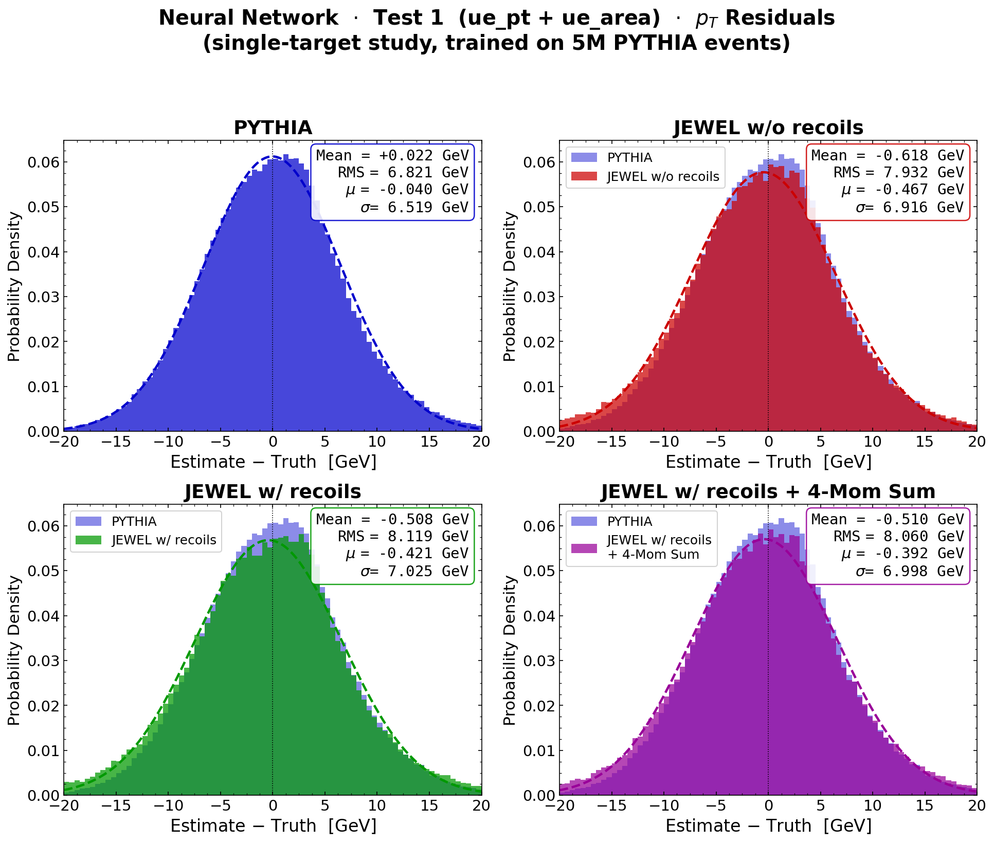
Area Subtraction Algorithm
How about a Neural Net?
Mostly the same as simple equation.
Simple

Slide 11
Constituent Subtraction Algorithm
Proposed simplicity over complexity.

Slide 12
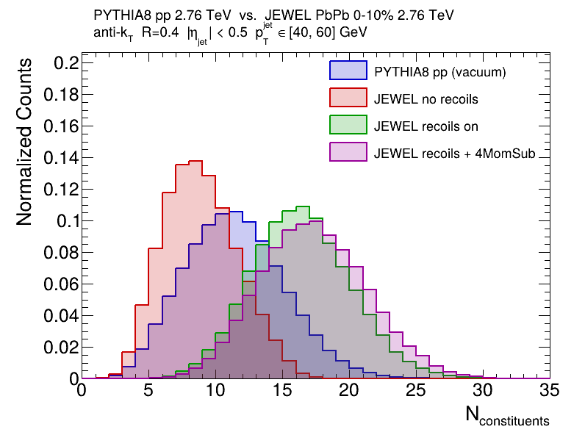
Constituent Subtraction Algorithm
Proposed simplicity over complexity.

Slide 13
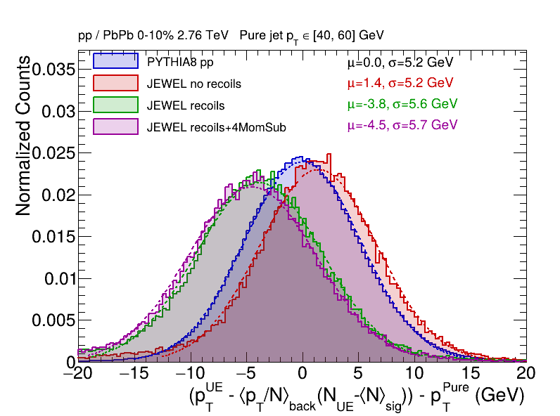
Constituent Subtraction Algorithm
Proposed simplicity over complexity.
Large JEWEL model dependency (bias)
in all cases, but particularly with recoils
(lots more constituents in jet).
No ML test needed here.

Slide 14
Jet Core Subtraction Algorithm
Idea: Find R=0.2 jets which have ¼ the background, and then correct to R=0.4

Slide 15
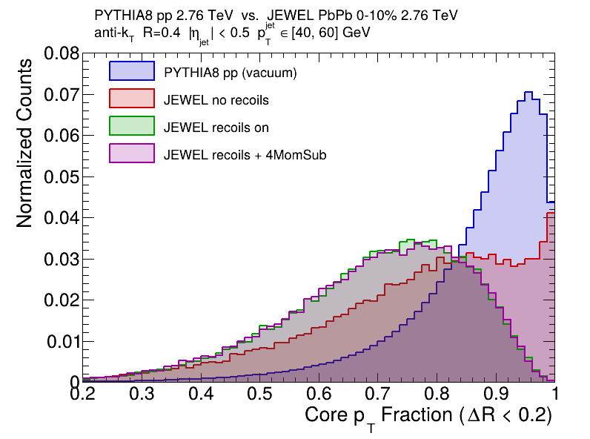
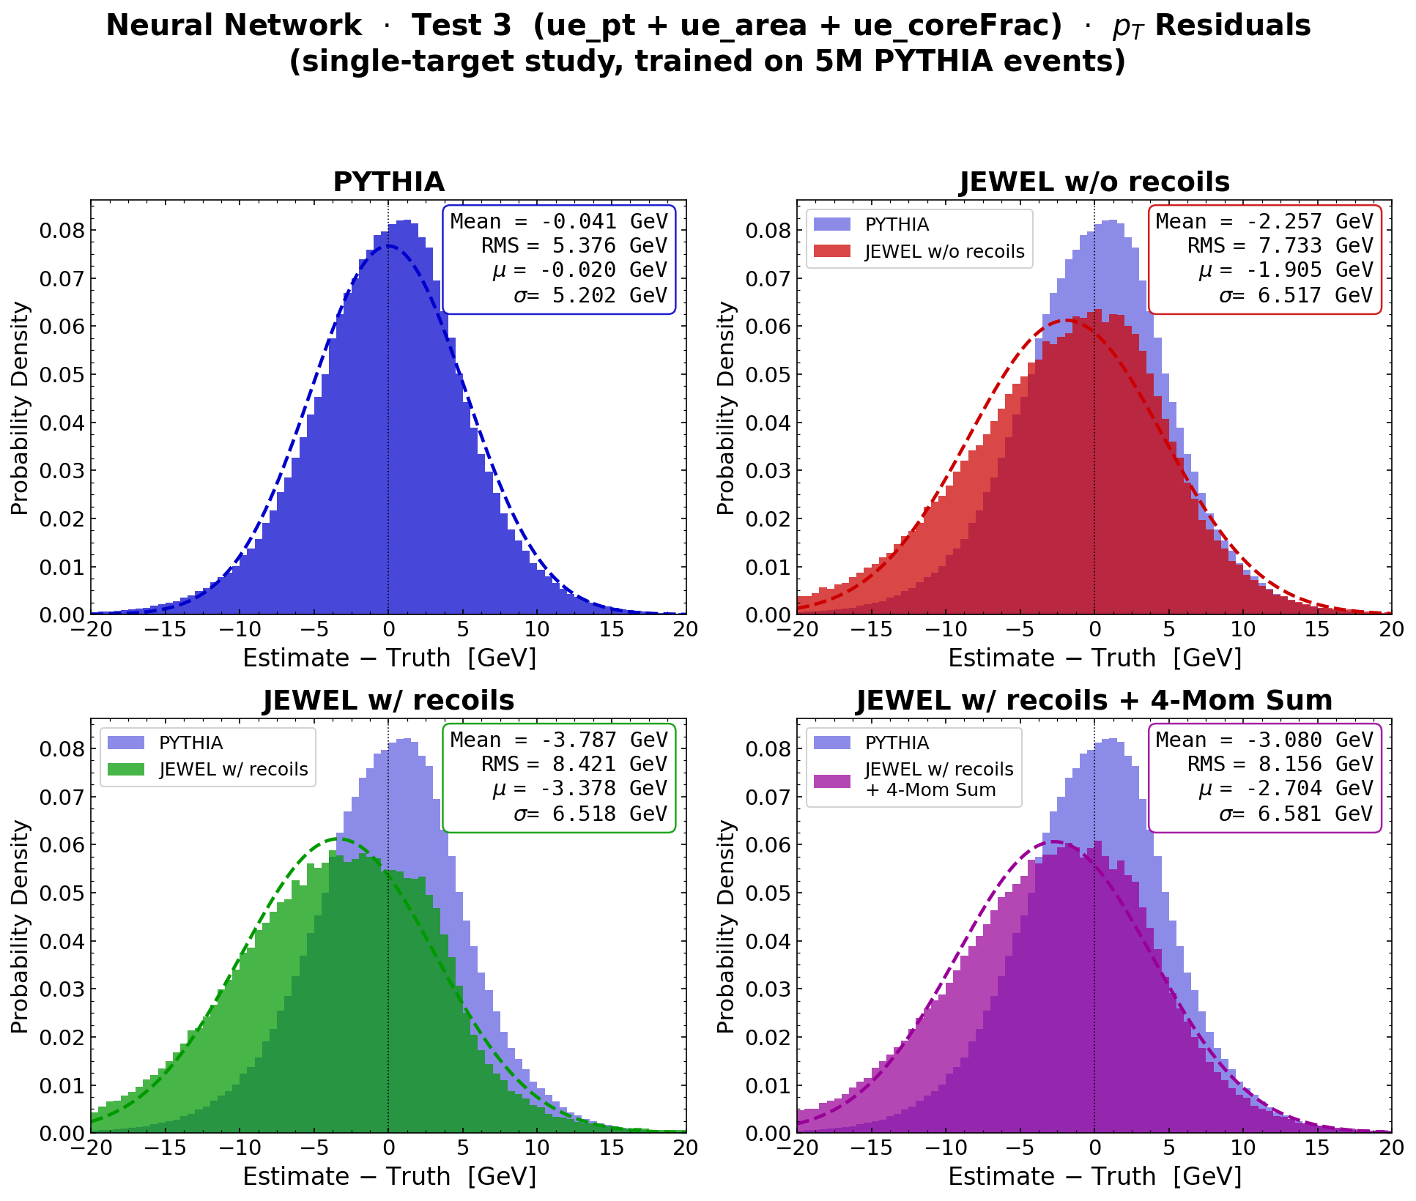
Jet Core Subtraction Algorithm
Idea: Find R=0.2 jets which have ¼ the background, and then correct to R=0.4

Slide 16
Jet Core Subtraction Algorithm
Idea: Find R=0.2 jets which have ¼ the background, and then correct to R=0.4
Turns out to be a bad idea.

Slide 17
Jet Core Subtraction Algorithm
Idea: Find R=0.2 jets which have ¼ the background, and then correct to R=0.4
Turns out to be a bad idea.
I am sure your next idea will be better.

Slide 18
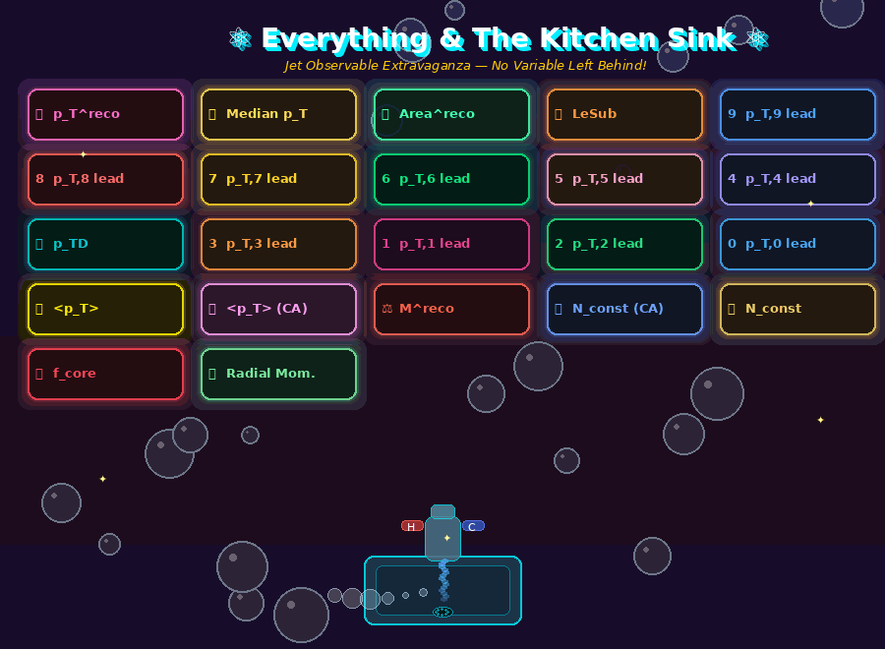
Everything & Kitchen Sink Algorithm

Slide 19
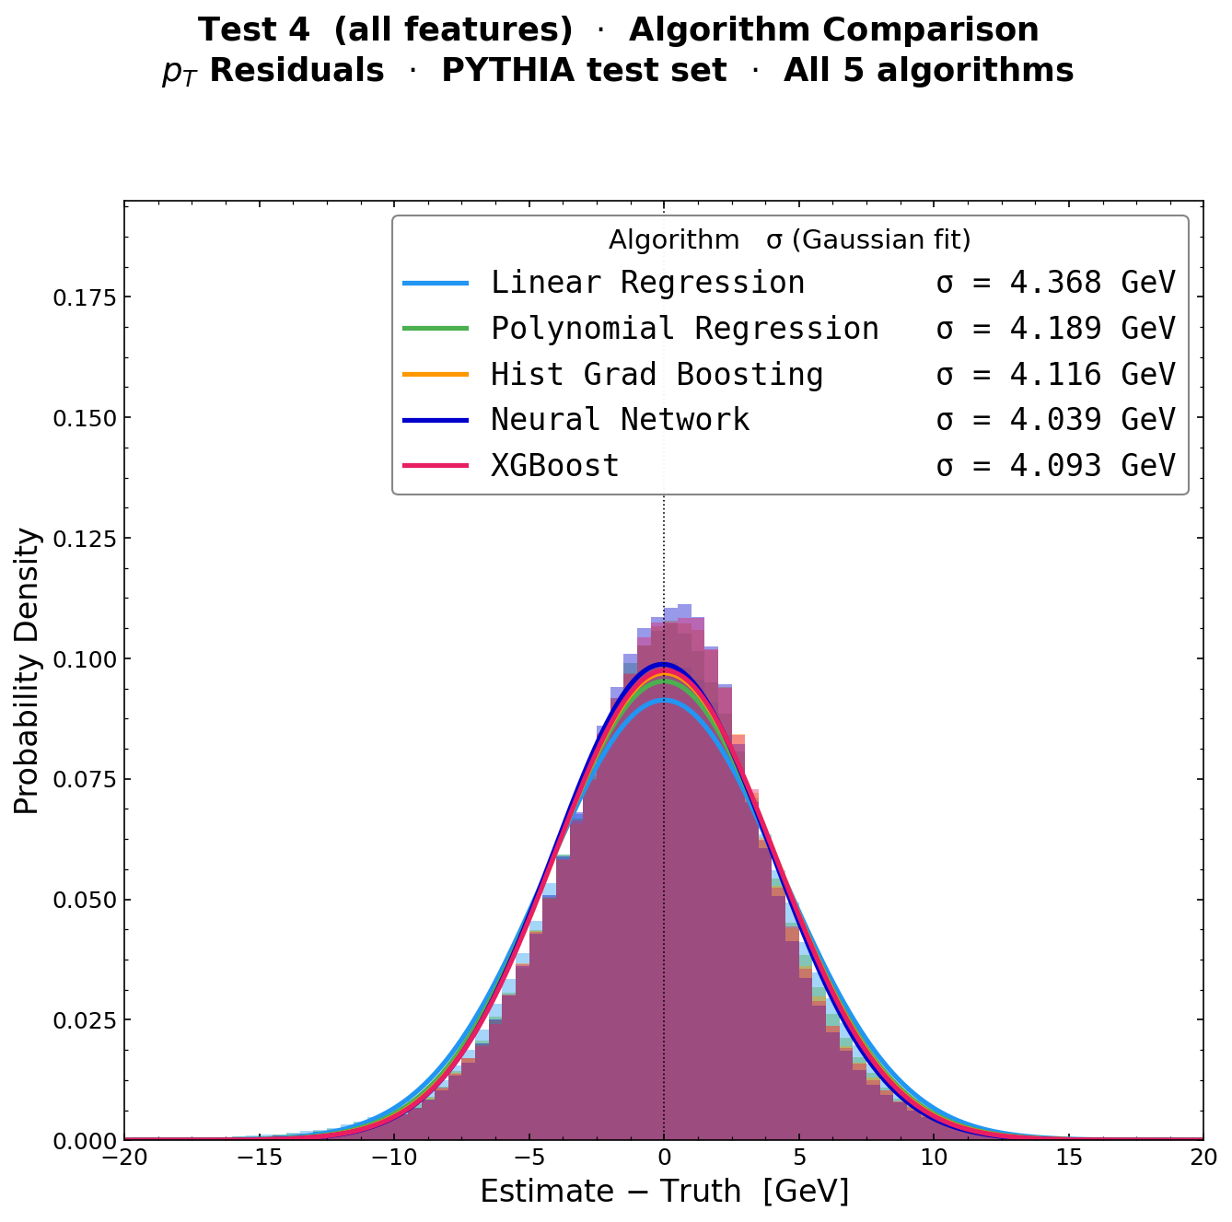
PYTHIA Training & Test Results

Slide 20
PYTHIA Training & Test Results
Would you like me to run:
Gaussian Process Regression
Extremely Randomized Trees
Variational Autoencoder
Symbolic Regression
Bayesian Additive Regression Trees
Stochastic Manifold Cascade Networks

Slide 21
PYTHIA Training & Test Results
Would you like me to run:
Gaussian Process Regression
Extremely Randomized Trees
Variational Autoencoder
Symbolic Regression
Bayesian Additive Regression Trees
Stochastic Manifold Cascade Networks
All algorithms give essentially identical improvement σ << 8 GeV compared to area method

Slide 22
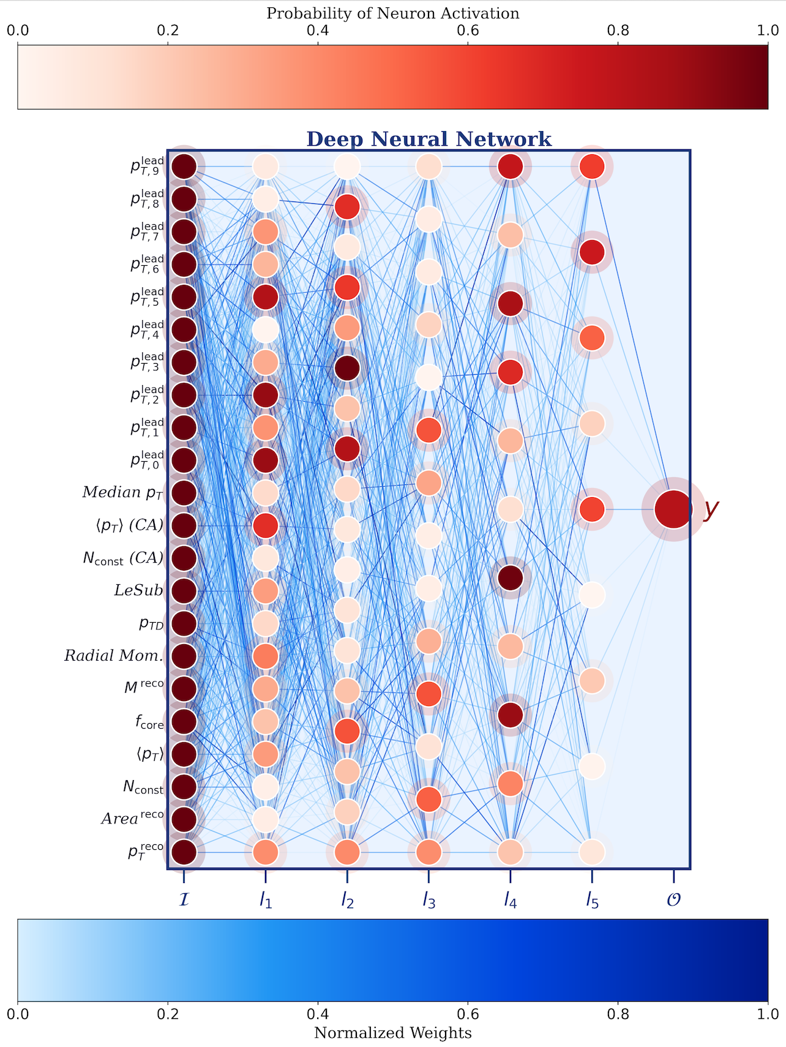
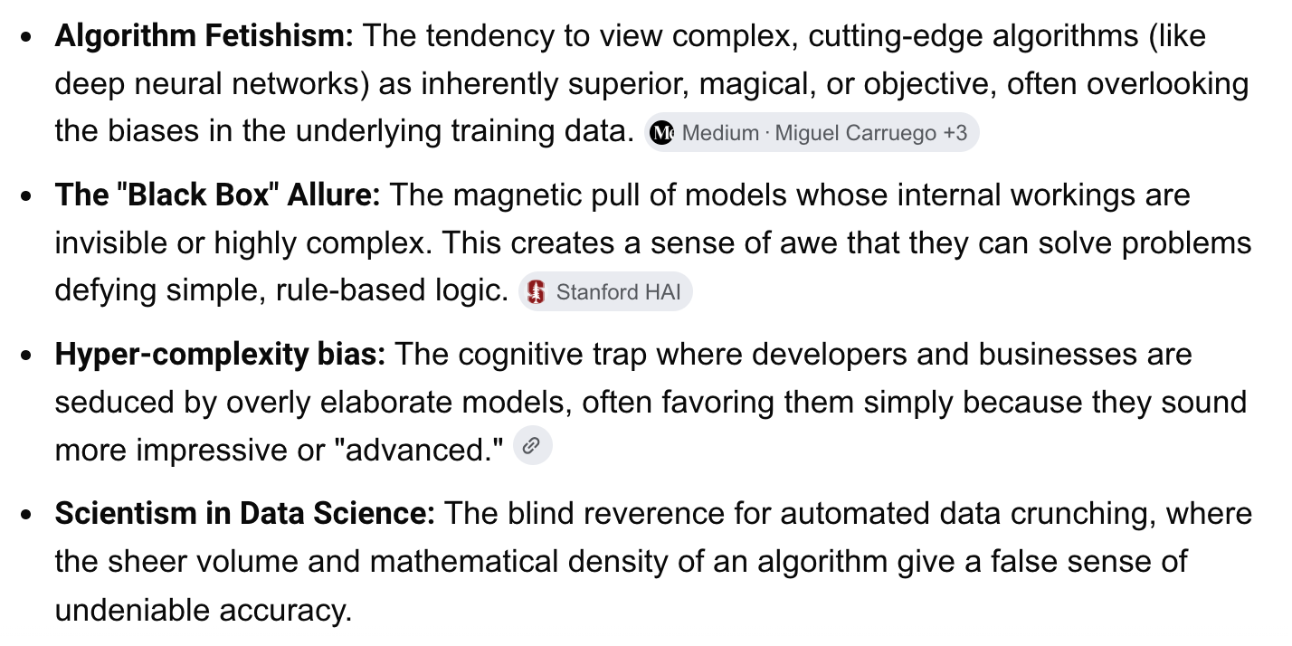

Slide 23
I have other color scheme suggestions for the diagram.
Would you like me to show you alternatives?

Slide 24
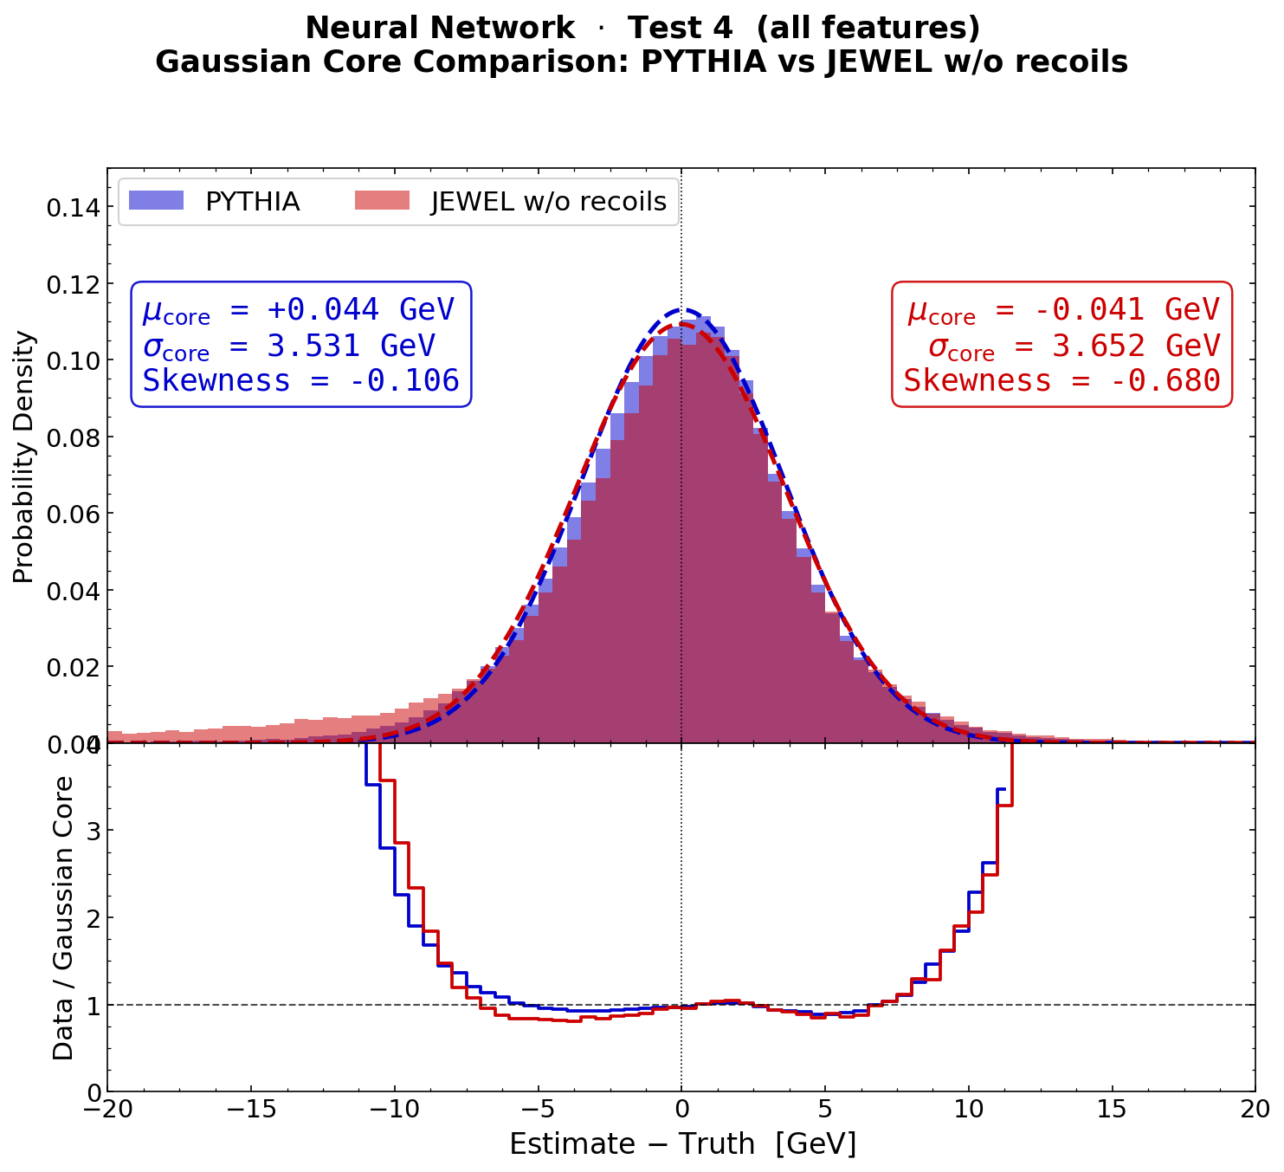
JEWEL w/o Recoils Test

Slide 25
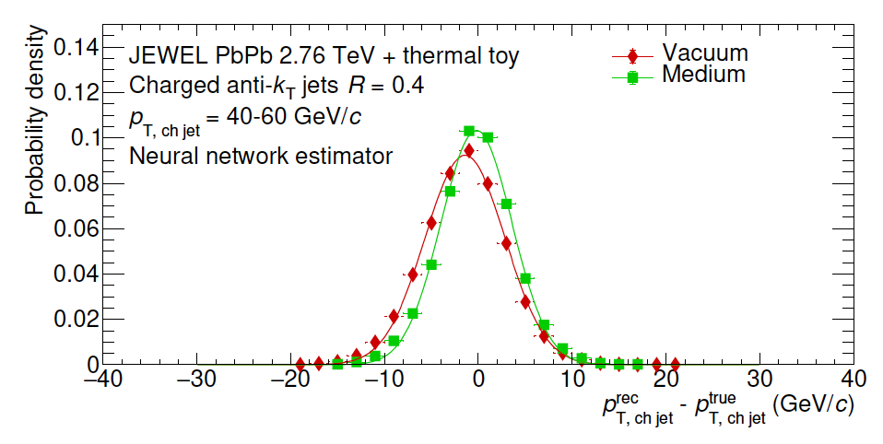
JEWEL w/o Recoils Test
Noted in original paper,
no “huge” bias with
JEWEL w/o recoils

Slide 26
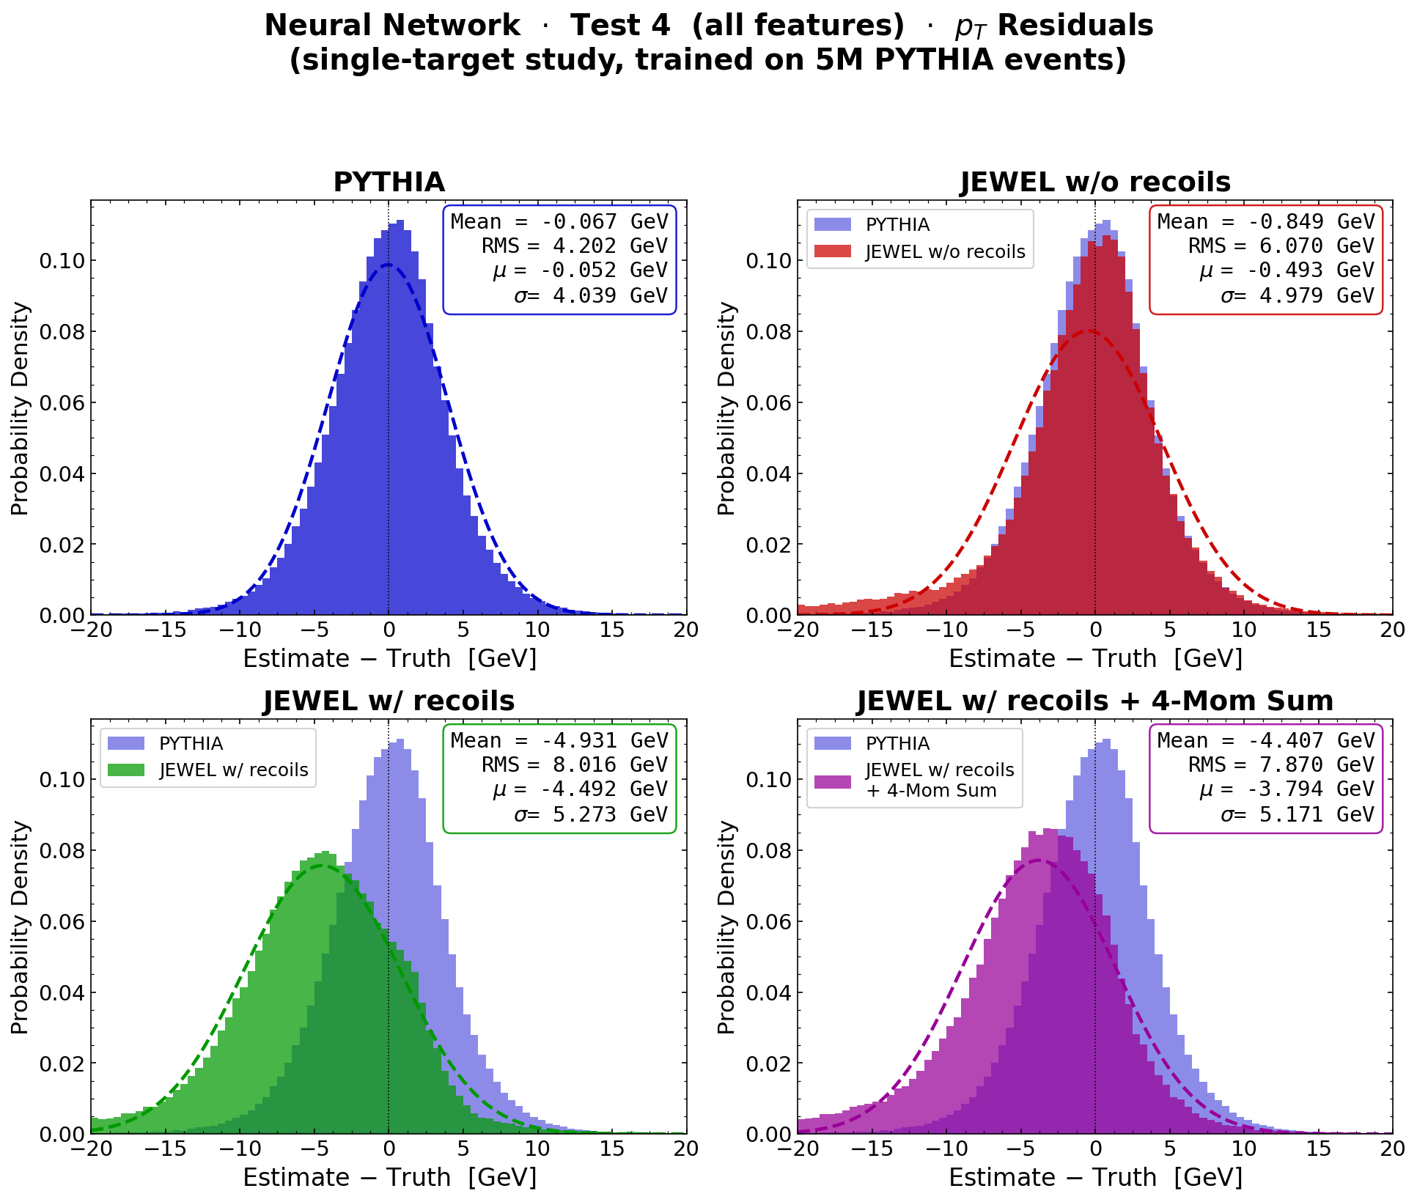
Claims that do not pass the burden of proof….

Slide 27
Claims that do not pass the burden of proof….
Conclusion is clear.
Testing on JEWEL w/o recoils is insufficient to draw conclusions about efficacy of algorithms for real jets!

Slide 28
Claims that do not pass the burden of proof….
Conclusion is clear.
Testing on JEWEL w/o recoils is insufficient to draw conclusions about efficacy of algorithms for real jets!
Similar conclusions reached w/ JETSCAPE and LBT models.

Slide 29
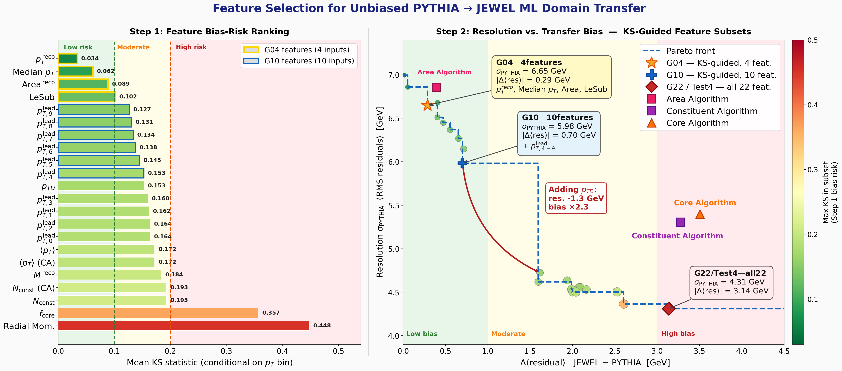
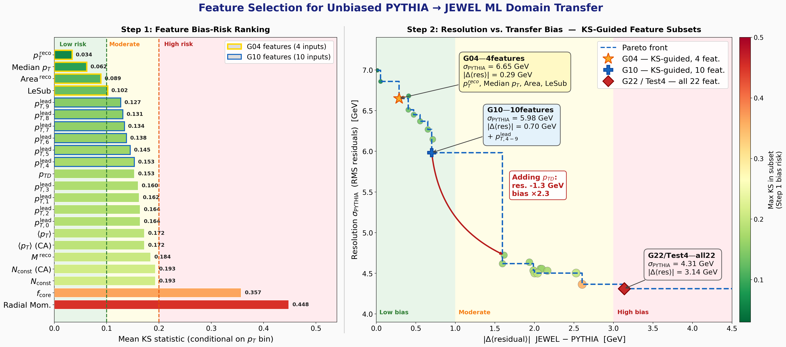

Slide 30
This came from a prompt: “Is there a good diagnostic plot for the domain transfer problem?”

Slide 31
Claude generated a useful idea, but the expert physicist had to validate and correct the output.

Slide 32
ML Domain Transfer Problem
This is a classic domain transfer, covariate shift problem in HEP ML
Would you like me to train on both PYTHIA and JEWEL together?

Slide 33

ML Domain Transfer Problem
This is a classic domain transfer, covariate shift problem in HEP ML
Would you like me to train on both PYTHIA and JEWEL together?
That makes me nervous?

Slide 34
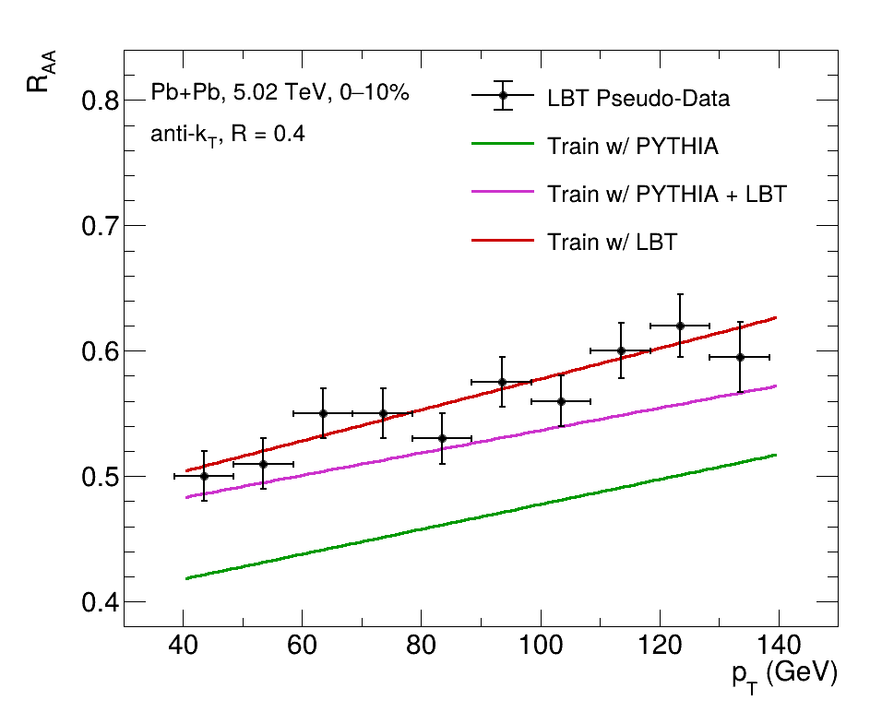
ML Domain Transfer Problem
This is a classic domain transfer, covariate shift problem in HEP ML
Would you like me to train on both PYTHIA and JEWEL together?
That makes me nervous?
We get very similar results to those nicely shown in LBT paper.
Does not seem like the
path forward...

Slide 35
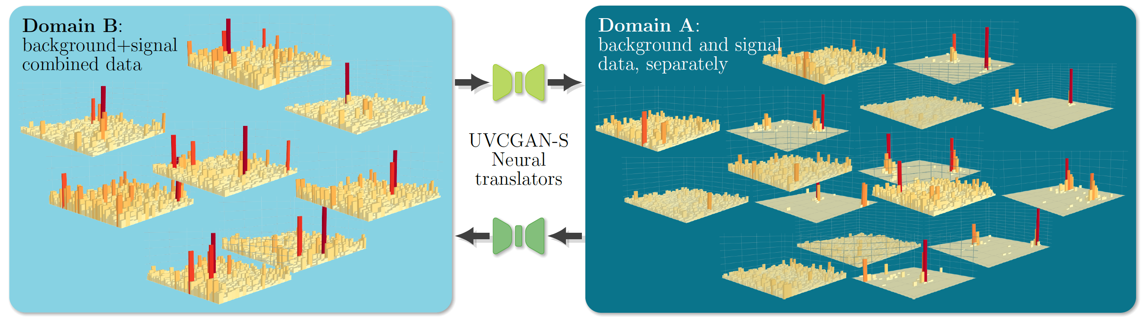
Cycle-GAN Algorithm
Full reco. level image,
unsupervised learning
“Background subtraction …. successfully separates the signal from the background regardless of the jet’s properties.”

Slide 36
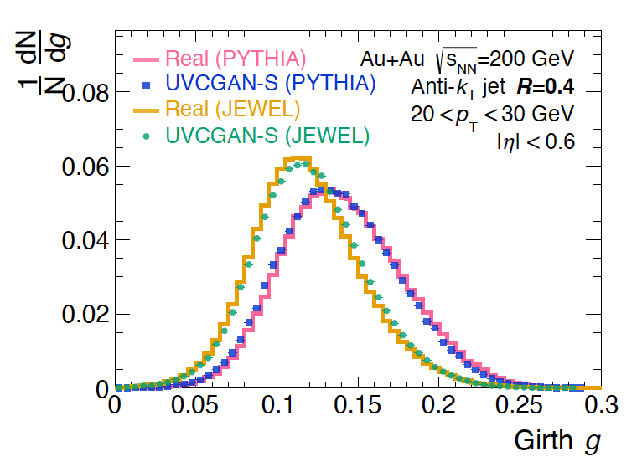
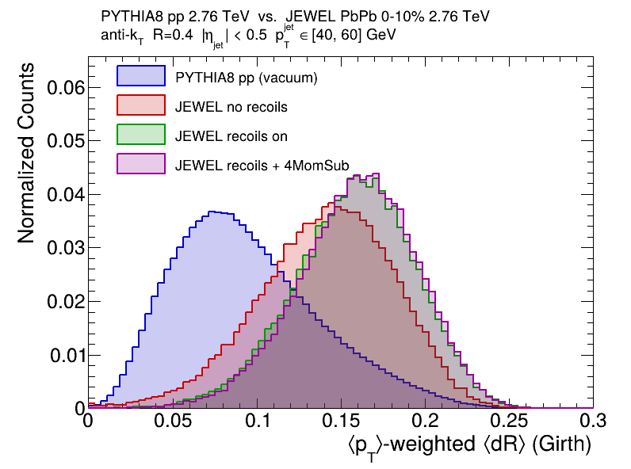
Cycle-GAN Algorithm
Full reco. level image,
unsupervised learning
“Background subtraction …. successfully separates the signal from the background regardless of the jet’s properties.”
“Network achieves near closure under this domain shift”
Test is only on JEWEL w/o recoils
Reco Jet Girth (JEWEL < PYTHIA)
Reco versus Truth
Domain shift test needs to be on physics relevant quantities

Slide 37
Summary
Avoid Algorithm Fetishism
Genesis initiative may have an unintended (or intended)
brain drain consequence.
Our only “value add” is expert knowledge & experience (use it).

Slide 38
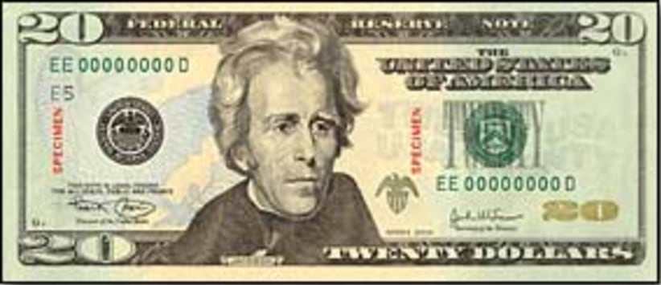
Summary
Avoid Algorithm Fetishism
Genesis initiative may have an unintended (or intended)
brain drain consequence.
Our only “value add” is expert knowledge & experience (use it).
You paid $20 / month and increased your productivity enormously.
Jet quenching studies must be checked with models with recoils (and very carefully).

Slide 39
Summary
Avoid Algorithm Fetishism
Genesis initiative may have an unintended (or intended)
brain drain consequence.
Our only “value add” is expert knowledge & experience (use it).
You paid $20 / month and increased your productivity enormously.
Jet quenching studies must be checked with models with recoils (and very carefully).
I am sure your next talk will be better.

Slide 40
Bonus Slides

Slide 41
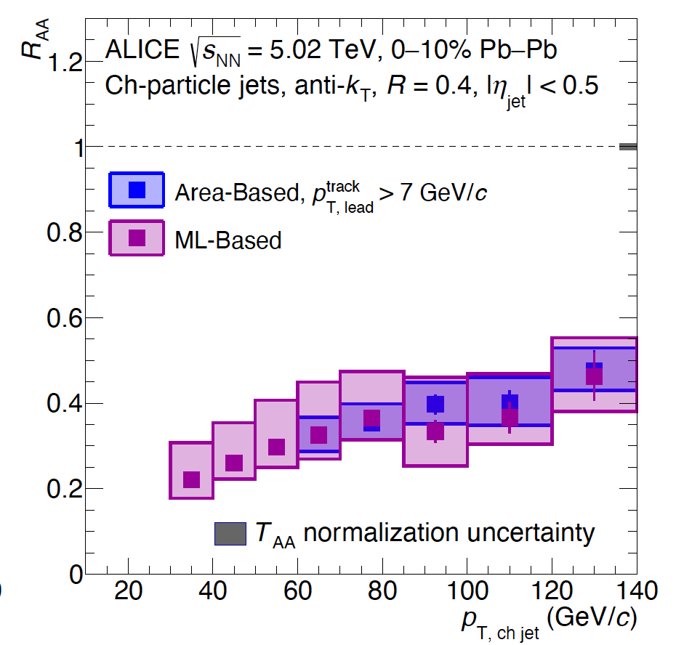
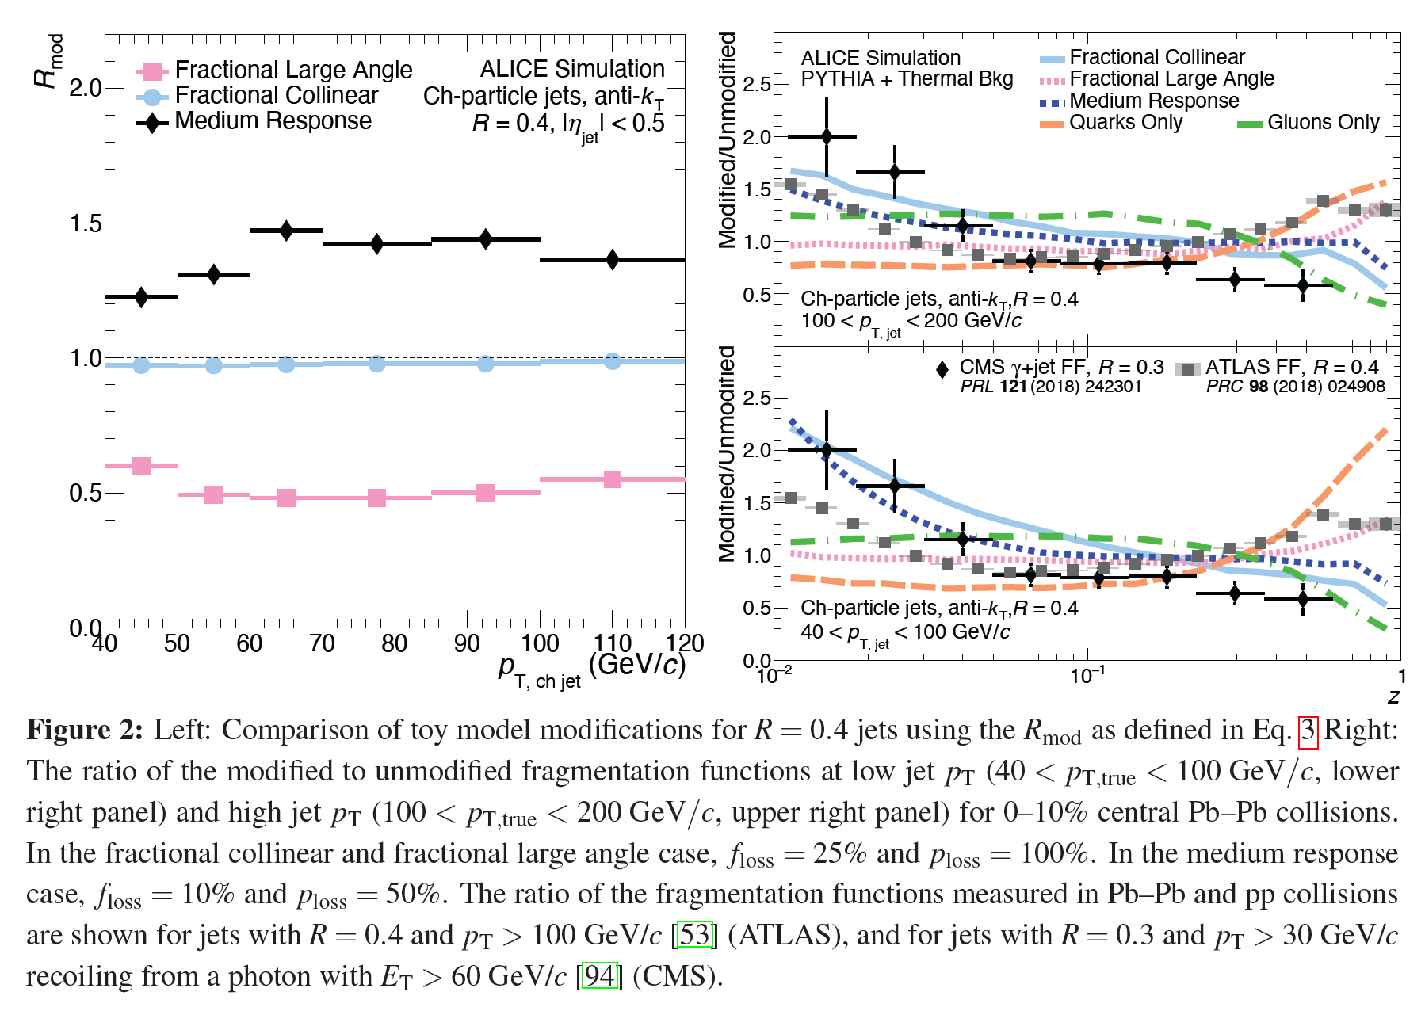
ALICE Result
Markers are not at most likely value.
No real way to know if systematic uncertainties are “conservative.”
Not reliable.

Slide 42
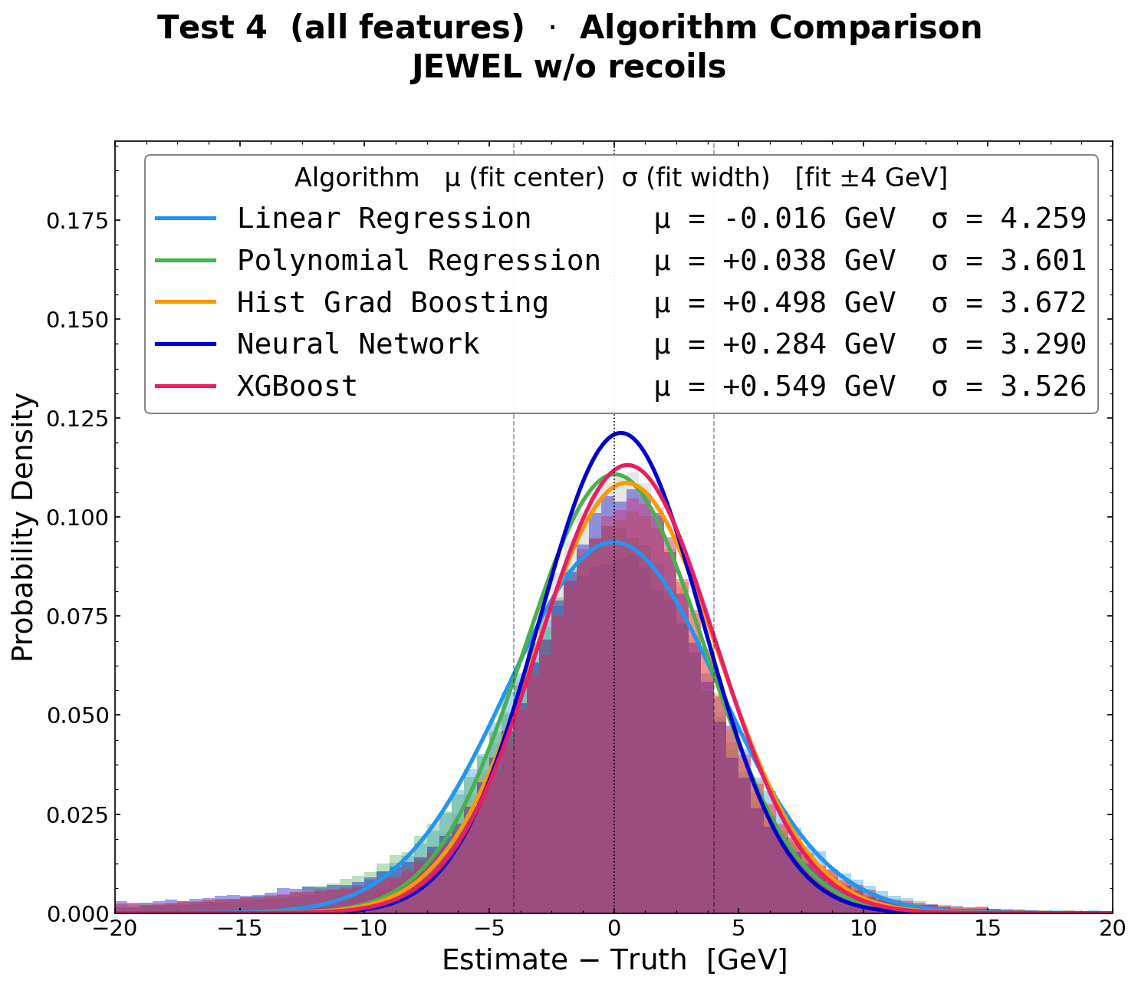
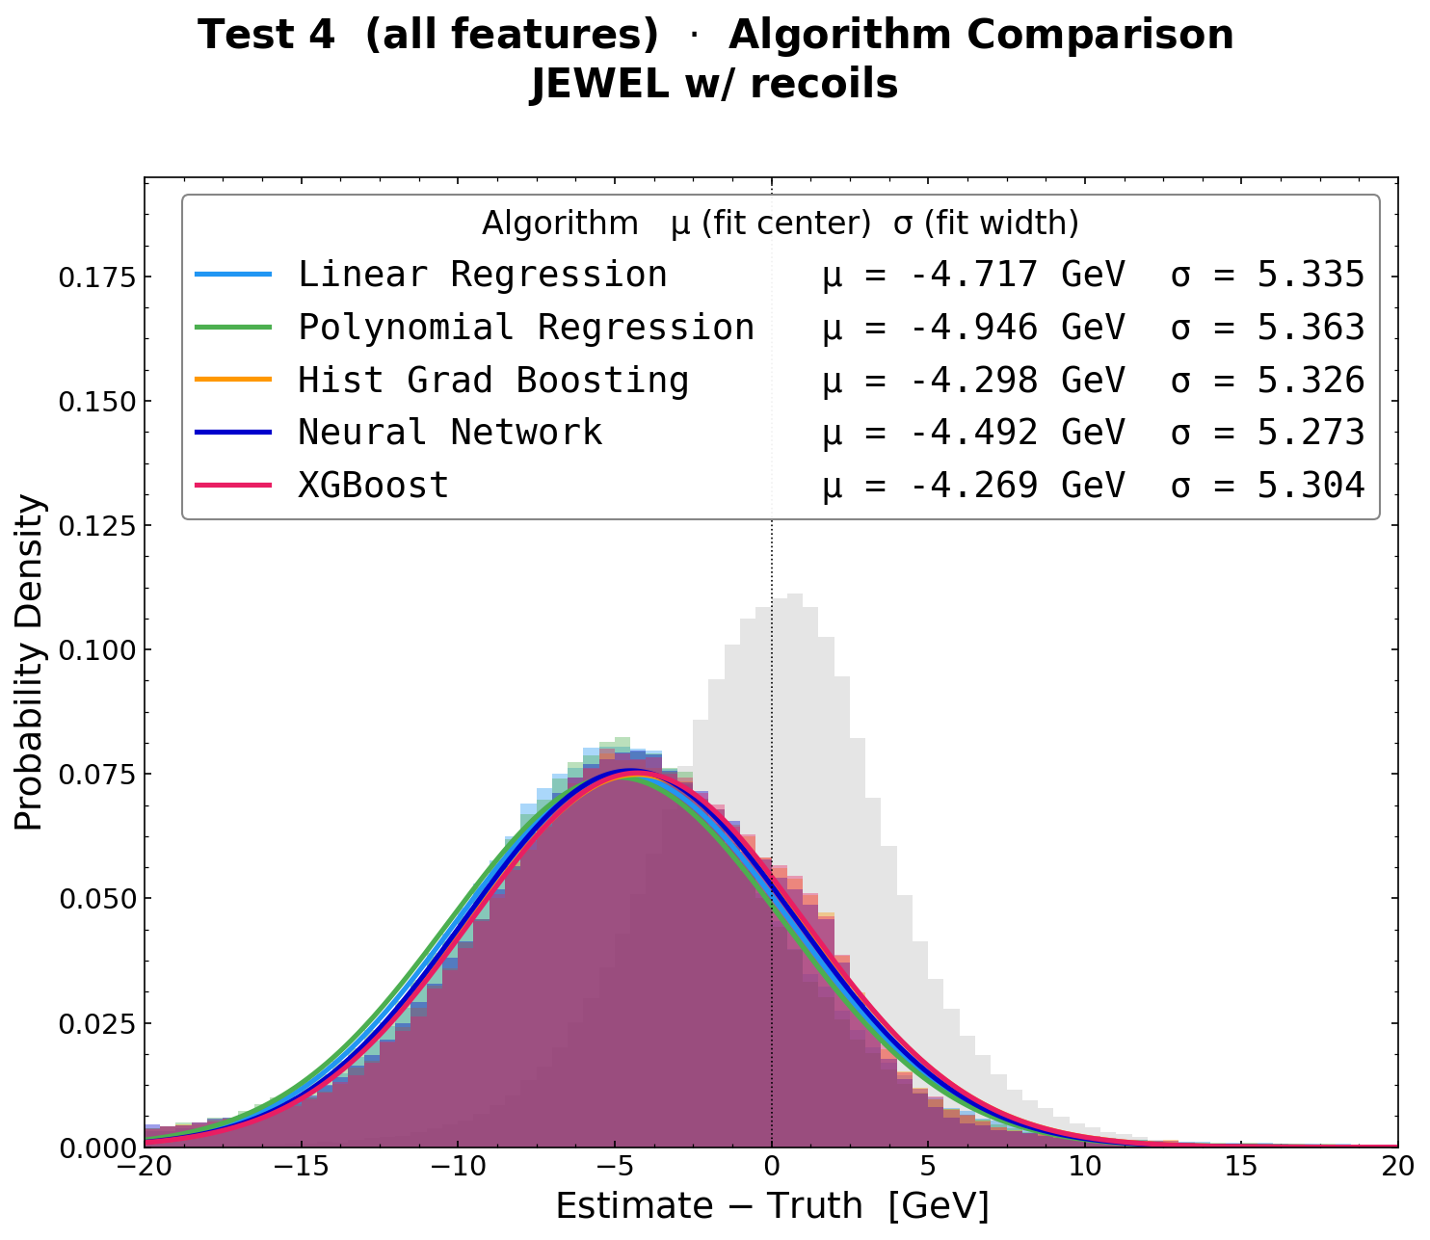

Slide 43
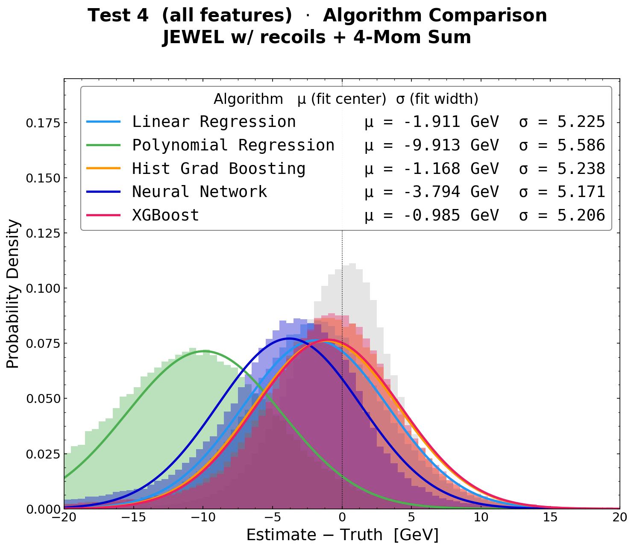
LASSO (Least Absolute Shrinkage and Selection Operator) modifies linear regression by adding an
L1 penalty to the loss function
Often a straightforward fix.

Slide 44
The relationship is genuinely linear. The signal in your data is well-captured by a linear combination of features. More complex models find no additional structure to exploit.
You have a high noise-to-signal ratio. When the irreducible noise dominates, no model can beat a simple one. The other algorithms are learning noise, not signal.

