Slide 1
The Amazing, Nearly Perfect
Quark-Gluon Plasma
Jamie Nagle
University of Colorado Boulder

Slide 2
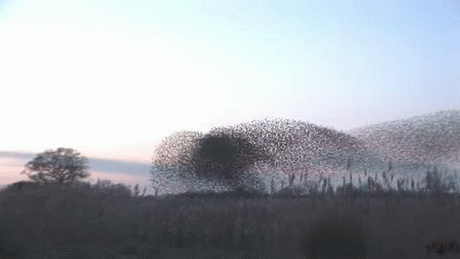
How does this work?
Emergent Phenomena… Collectivity…
What is the underlying origin?
For this flock of birds, it is all short-range interactions

Slide 3
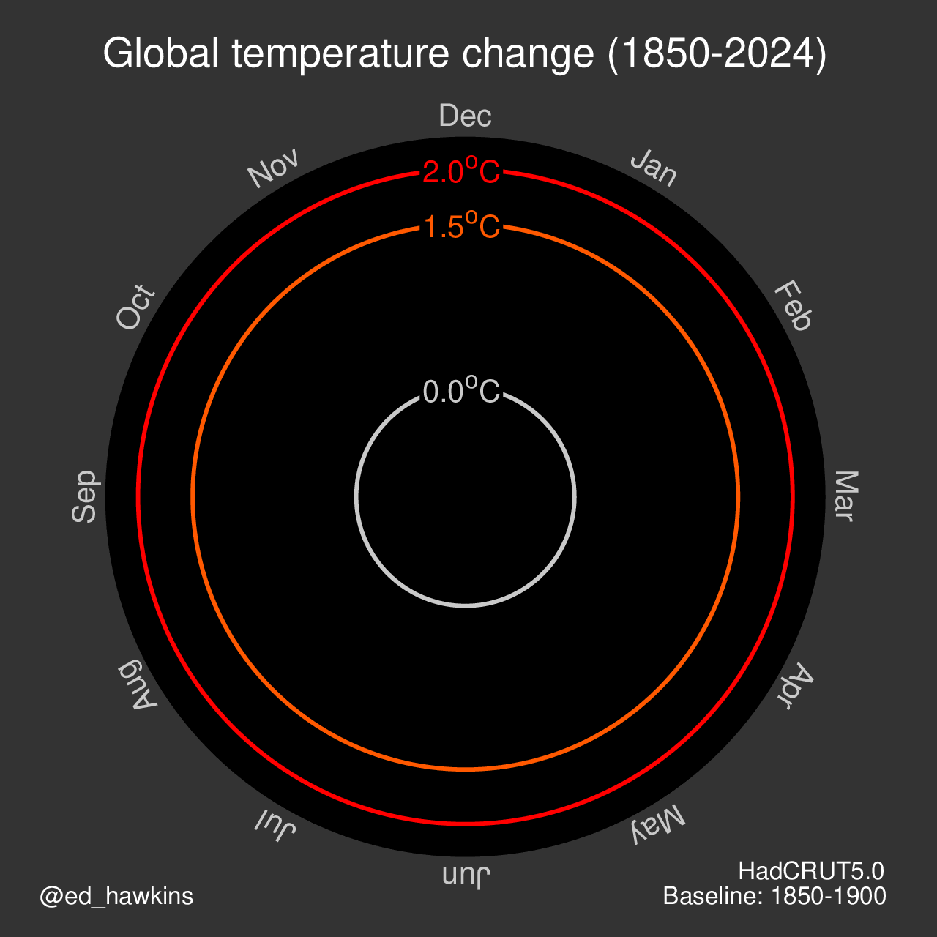
How does this work?
Greenhouse gases.
Positive feedback mechanisms.
Scientific Method is something we need to respect and utilize as input to policy.

Slide 4
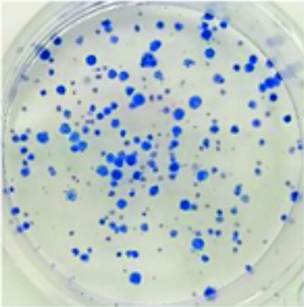
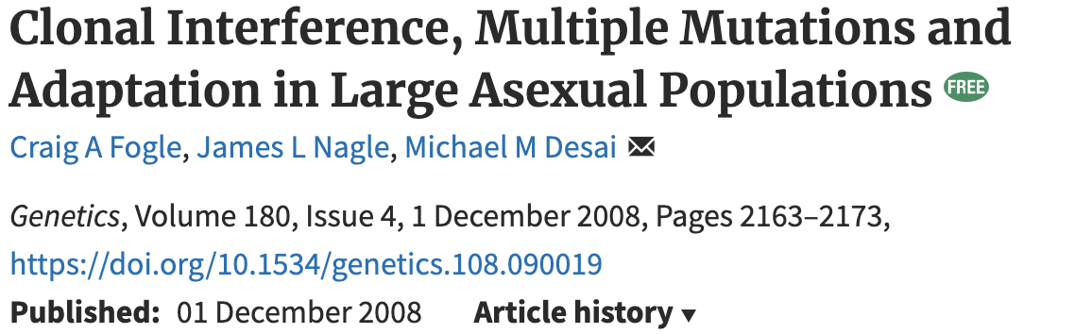
How does this work?
Cloning organism evolution
Is it dominated by many small beneficial mutations
or
fewer large beneficial mutations?

Slide 5
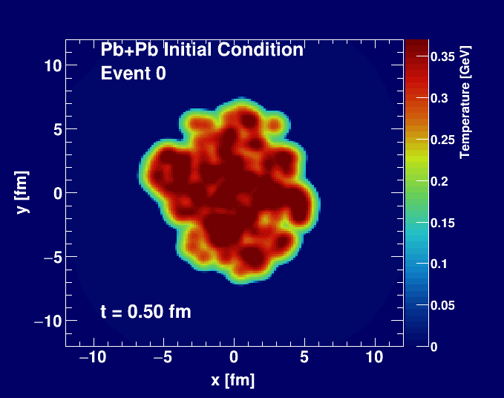

How does this work?
Jet Probes of Quark Gluon Plasma

Slide 6
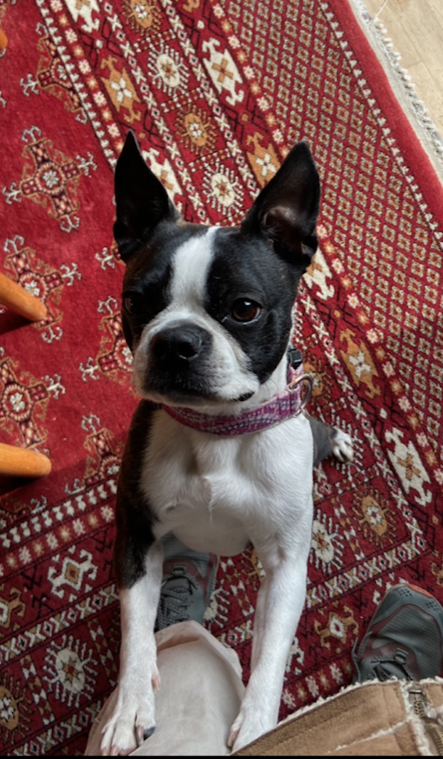
Who am I?
Born in Syracuse, New York
Spent one-year at Columbia University (did not find my people)
Transferred to MIT (found my people) – Physics, Minor Poli. Sci. (1991)
Graduate school Yale University – Ph.D. Physics (1997)
Postdoctoral Researcher Columbia University (1 year)
Assistant Professor Columbia University (4 years)
Professor University of Colorado Boulder (20+ years, never leaving)
My father was the first Nagle generation to attend college.
Met my wife in University – she has 3 MIT degrees (PBW).
Two kids, one cat, one dog.
The dog’s name is …?

Slide 7
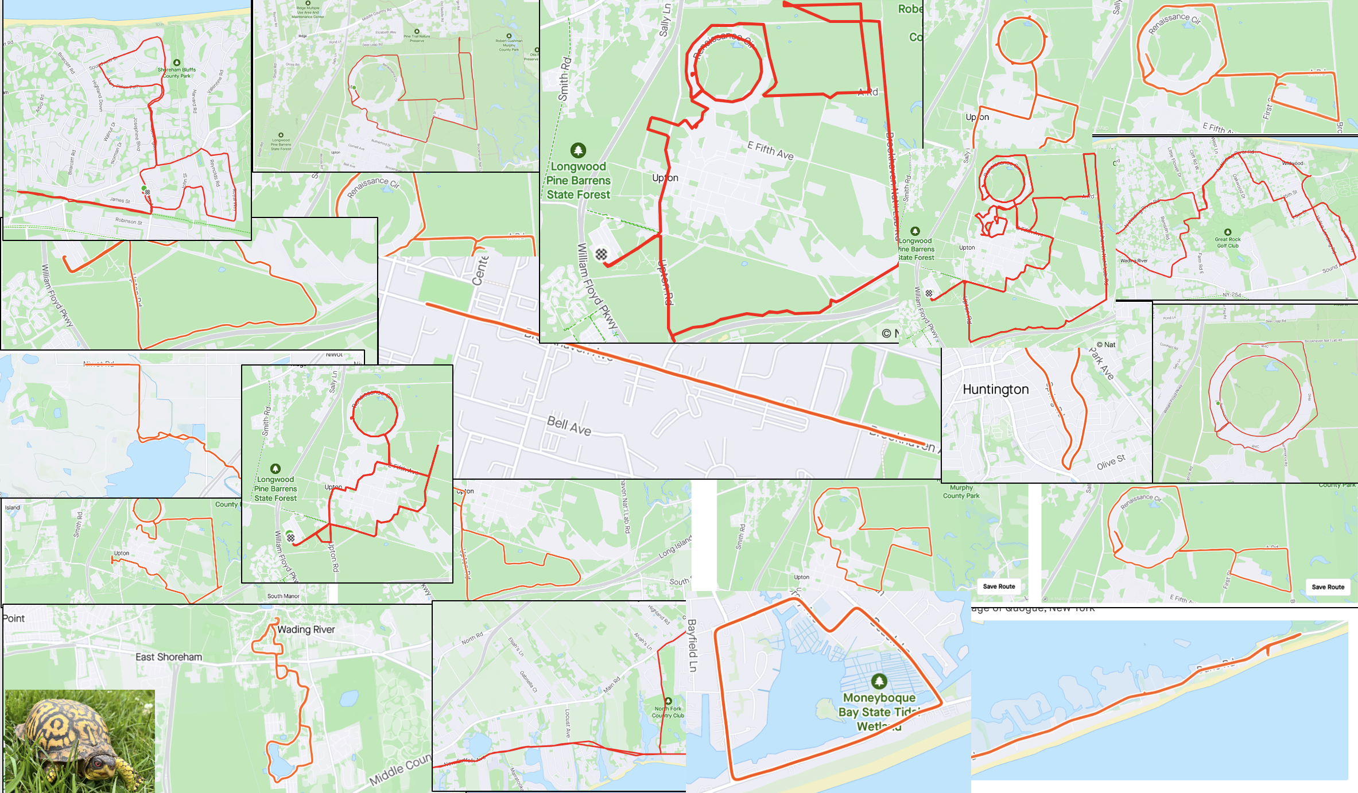
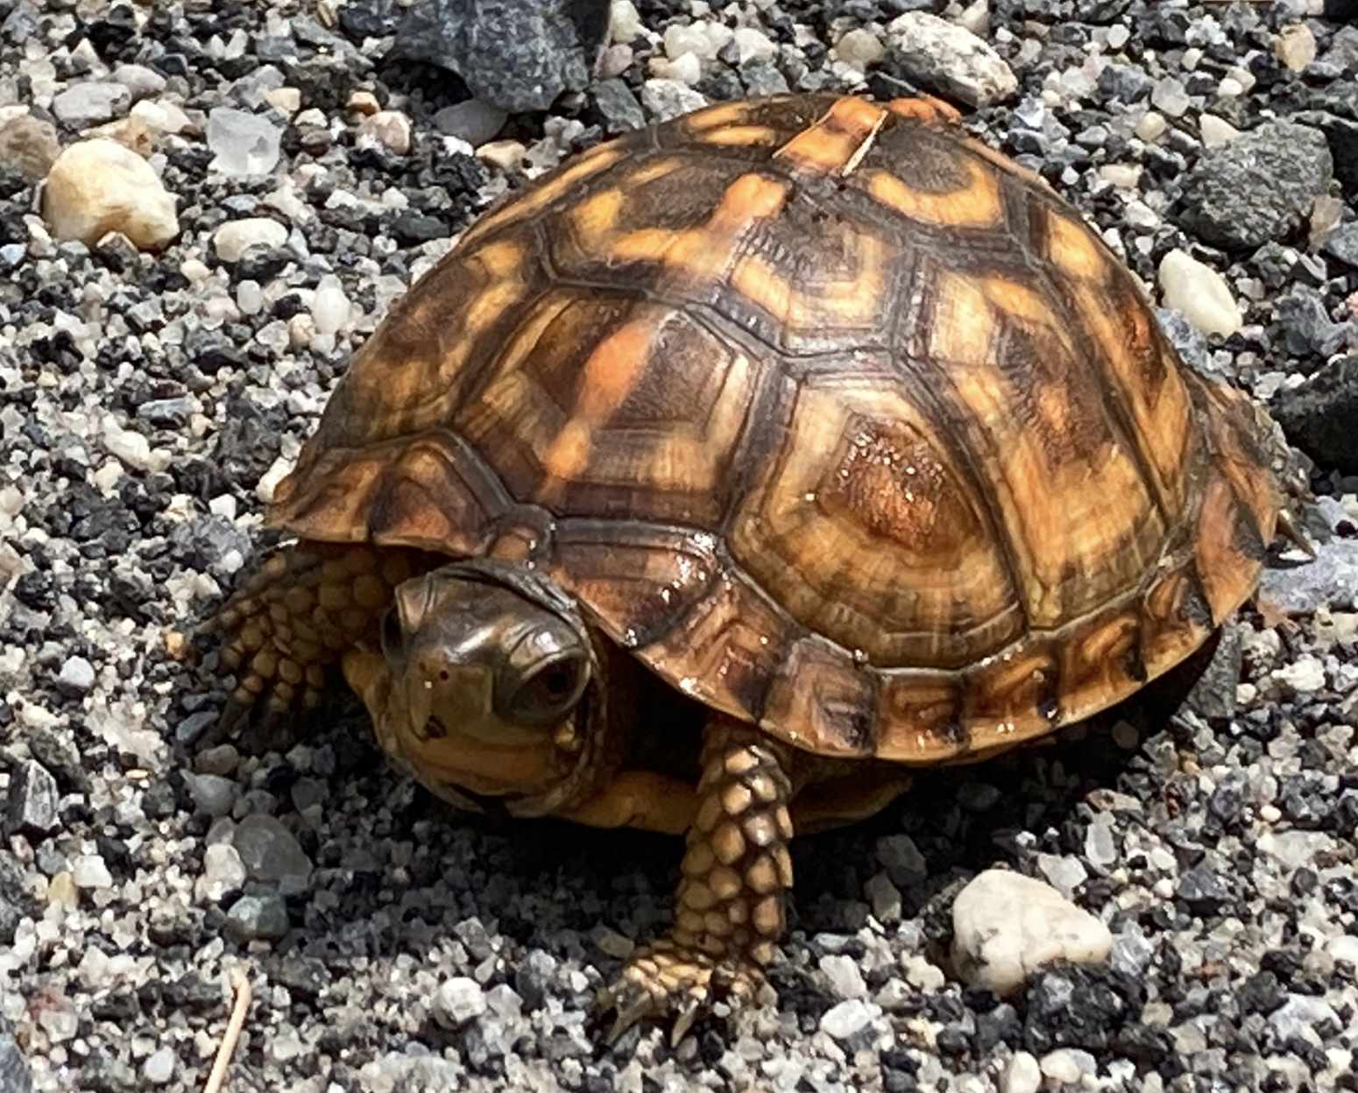
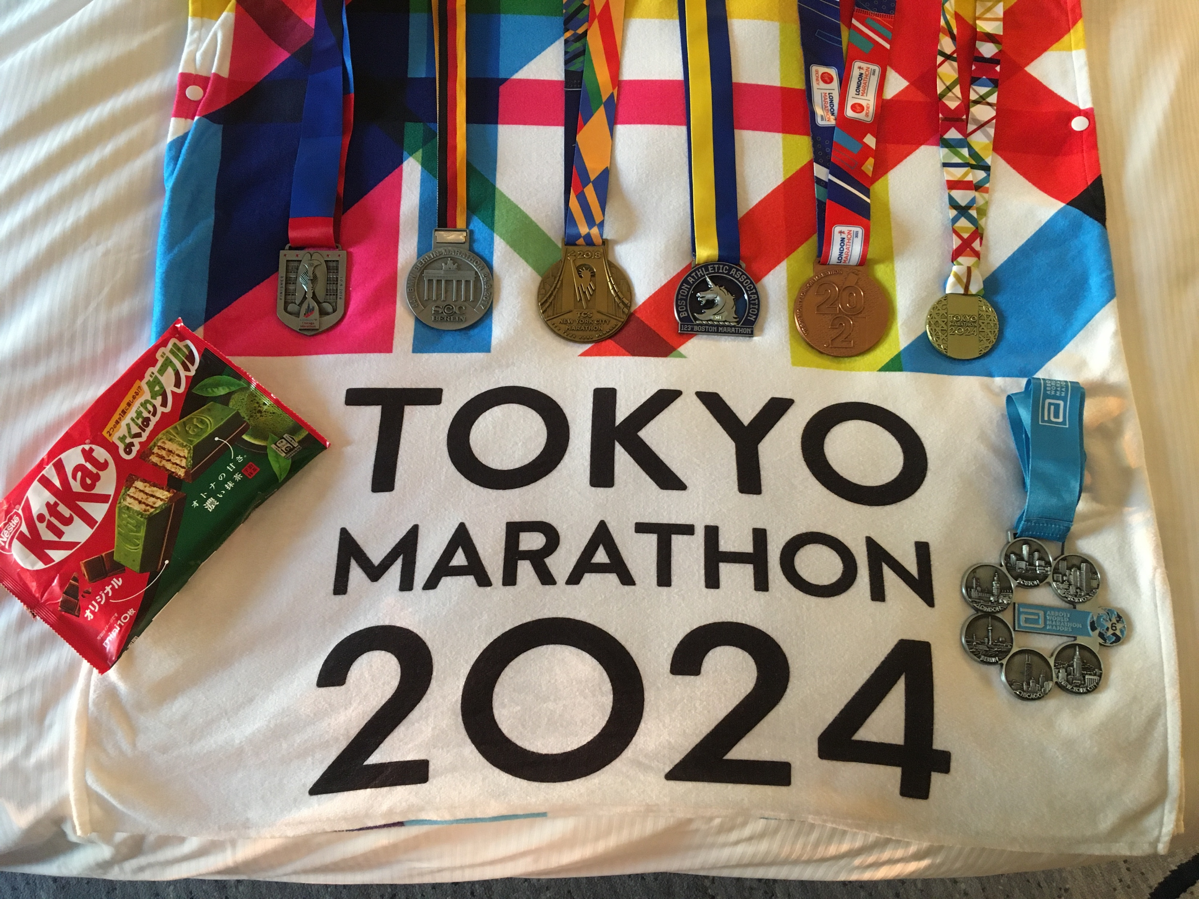
I am the sPHENIX Experiment Run Coordinator 2024.
Marathon running is my mid-life crisis management.
Love it at BNL (working all the time). Striving for discovery.

Slide 8

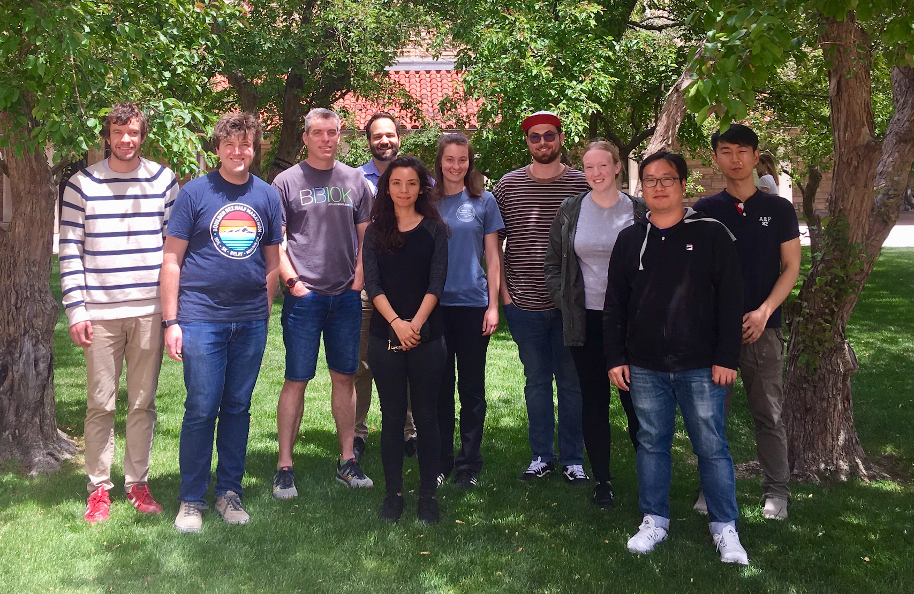
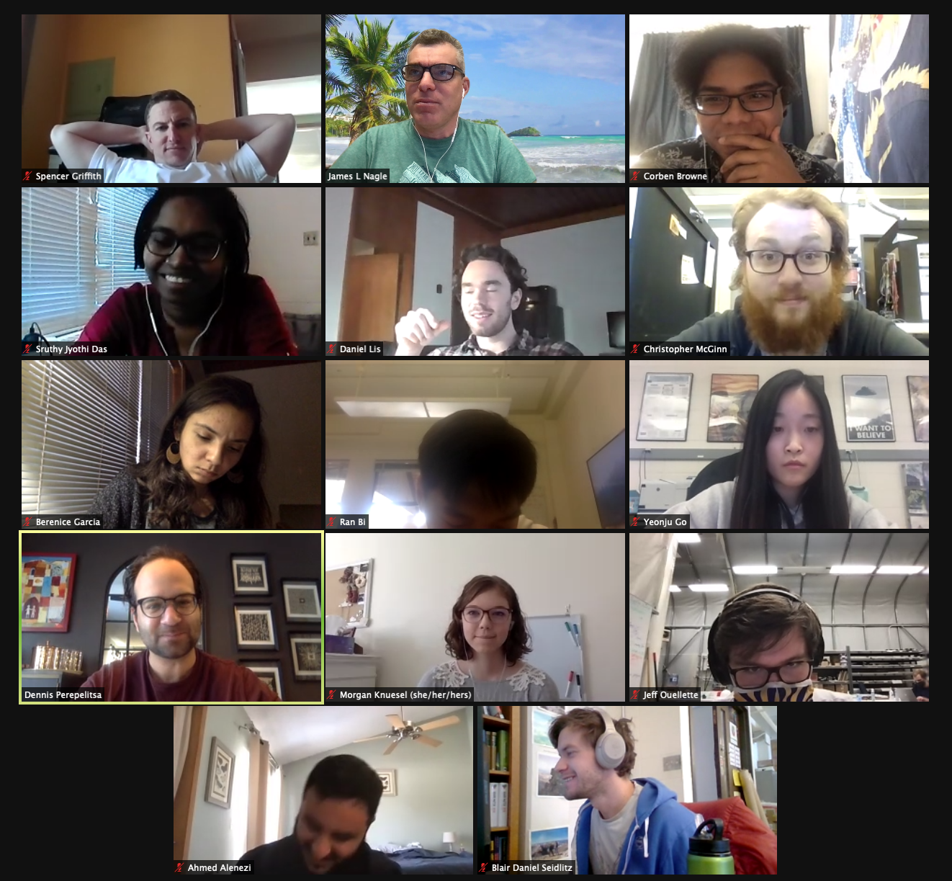

University of Colorado Boulder – Quark-Gluon Plasma Hunters
Javier Orjuela-Koop – RHIC Thesis Award
Kurt Hill – ATLAS Thesis Award

Slide 9
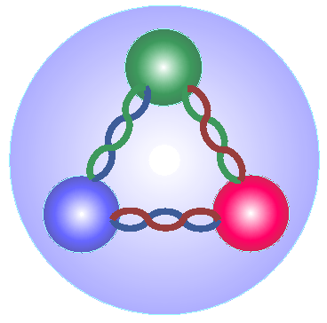
Quark Model
up
up
strange
up
down
up
up
up
down
Proton
Δ++
Λ
New degrees of freedom inside hadrons.
In the 1970s, people started to think about Quark Matter
as being relevant at very high temperatures.

Slide 10
Free Quarks?
No one has ever seen a free quark.
QCD is a “confining” gauge theory.
“Coulomb” “Confining”
V(r)
r

Slide 11
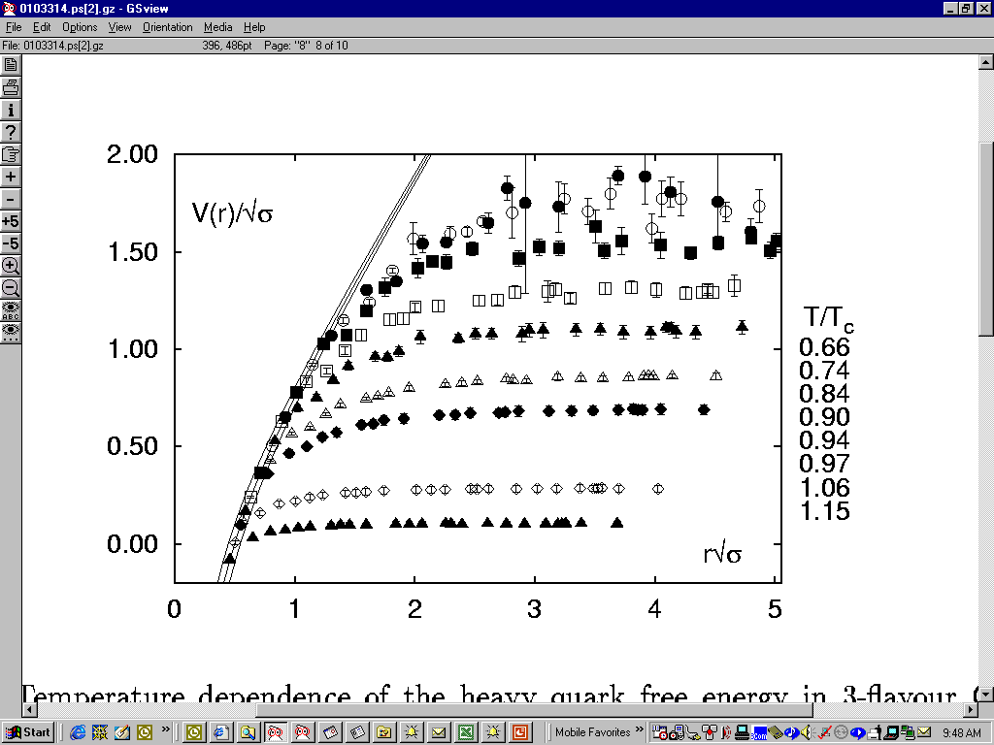
Computer Nuclear Calculations
  Calculations show a screening of the long-range confining potential gradually as one passes
  the transition temperature (2,000,000,000,000 Kelvin).
T =0
0.66 T_{C}
0.90 T_{C}
1.06 T_{C}
F. Karsch, hep-ph/0103314

Slide 12
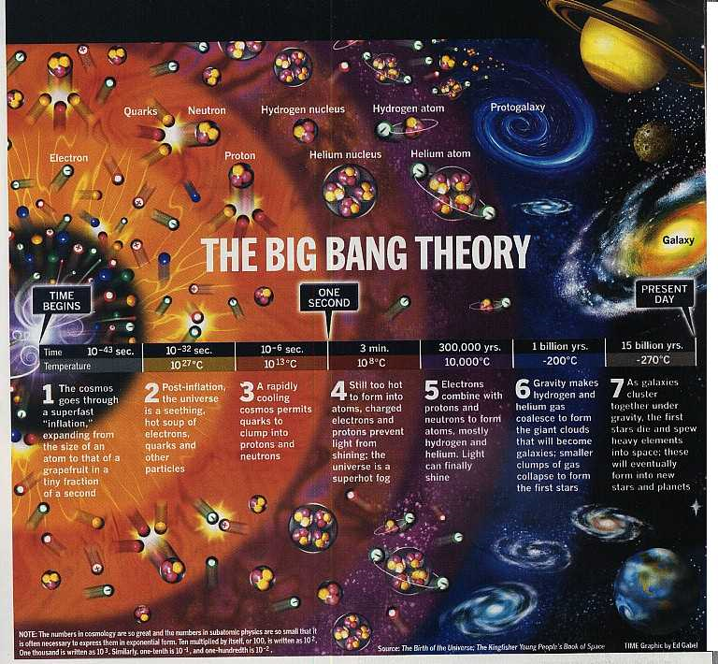
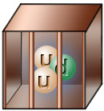
Very early in the universe, quarks and gluons were free in a plasma state
As the universe cooled, they were confined and have remained that way since

Slide 13
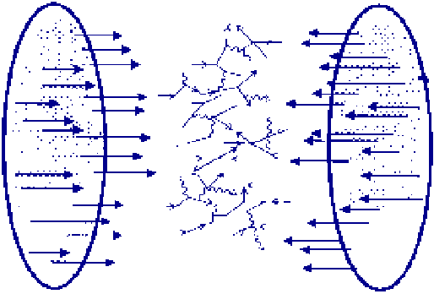
How about in the Laboratory?
Nuclei contain quarks and gluons
confined in protons and neutrons.
Can we free these quarks and gluons at
super high energies and temperatures?

Slide 14
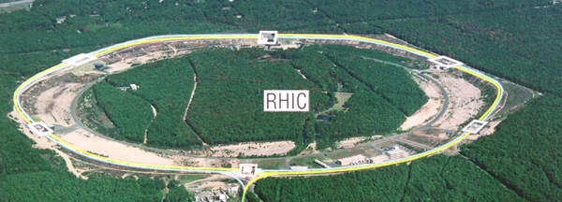
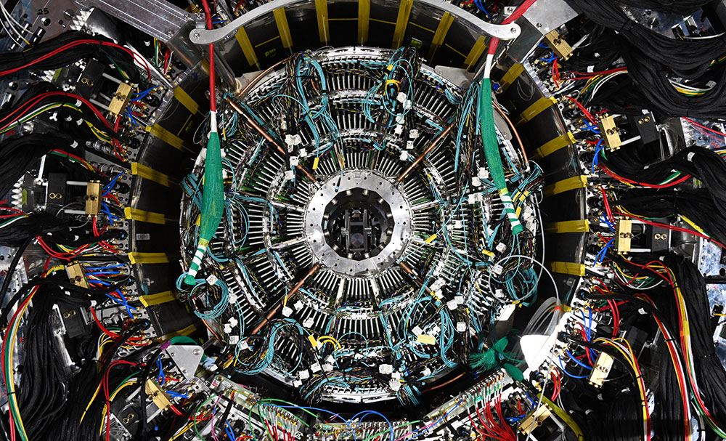
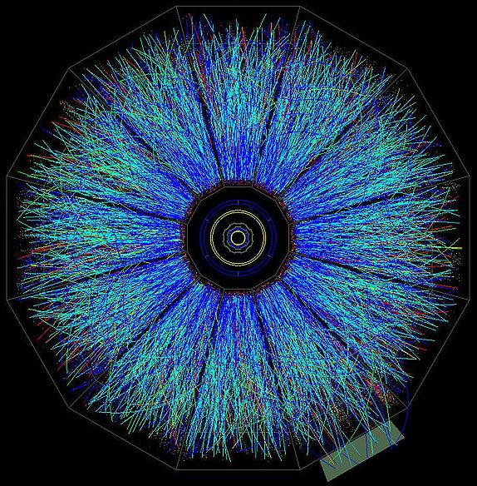
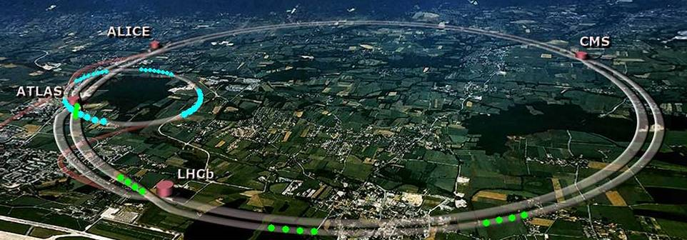
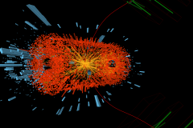
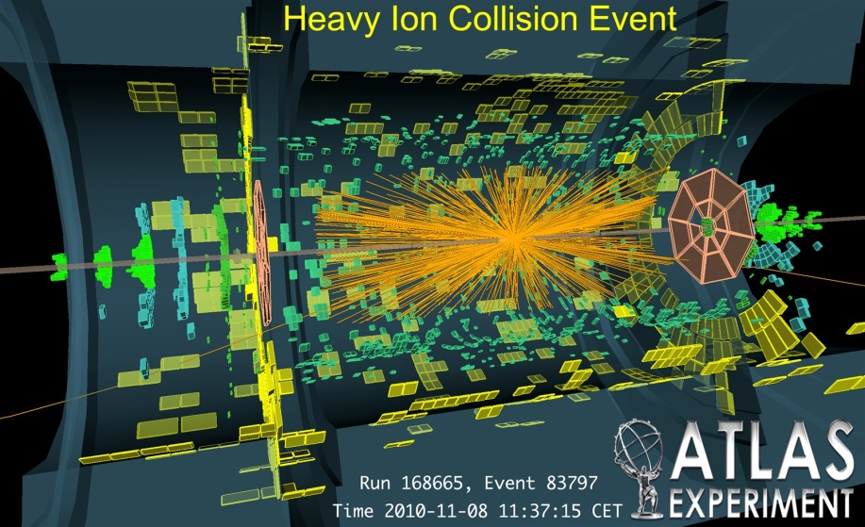
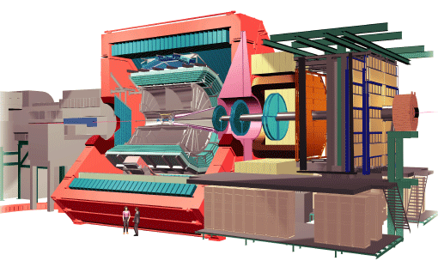
Laboratory Tools
RHIC
sPHENIX
STAR
LHC
CMS
ALICE

Slide 15
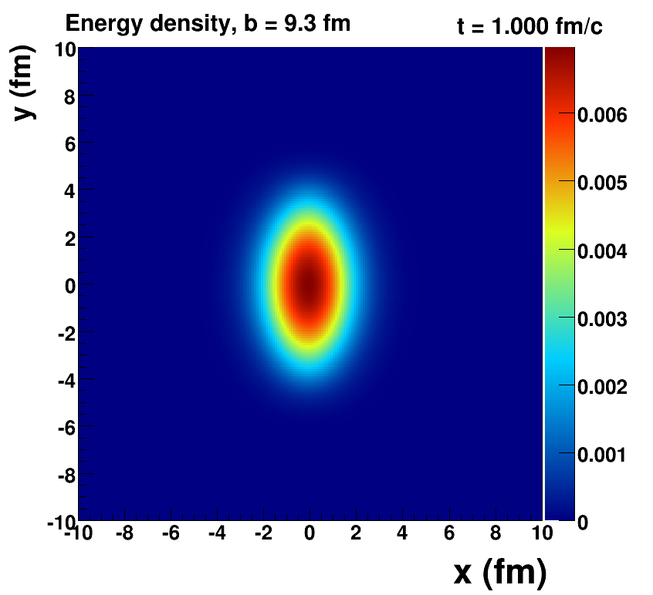
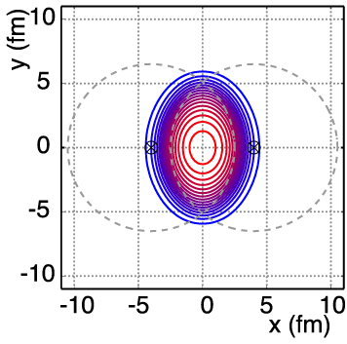
Nucleus-Nucleus Geometry
v₂ = “elliptic flow”

Slide 16
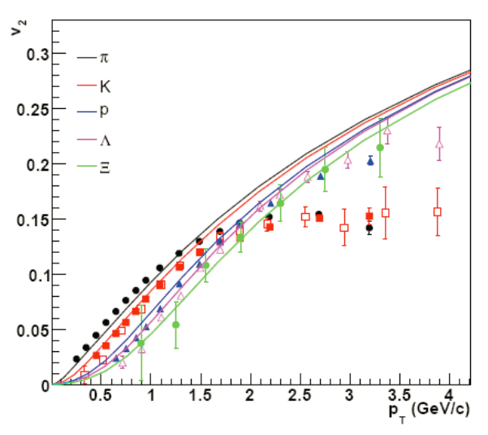
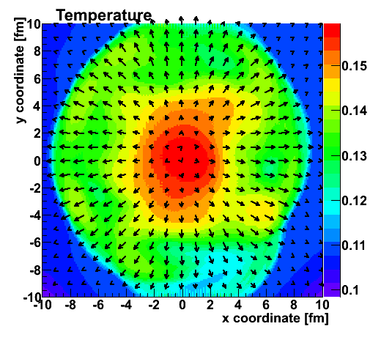
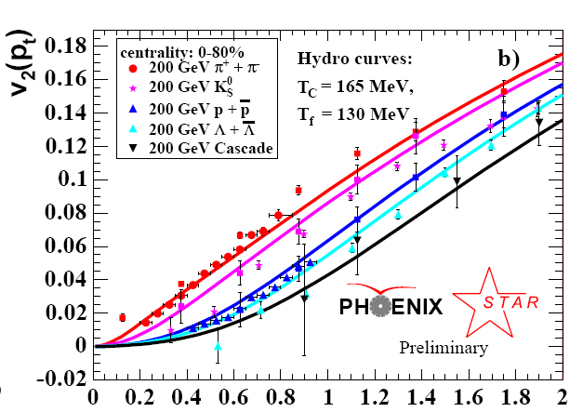
Hydrodynamic fluid cells “freeze-out” and then
Plasma → Quarks Confined in Hadrons
v₂
Temperature Profile + Velocity Vectors
v2
p_{T} (GeV)
Characteristic “fingerprint” flow pattern

Slide 17
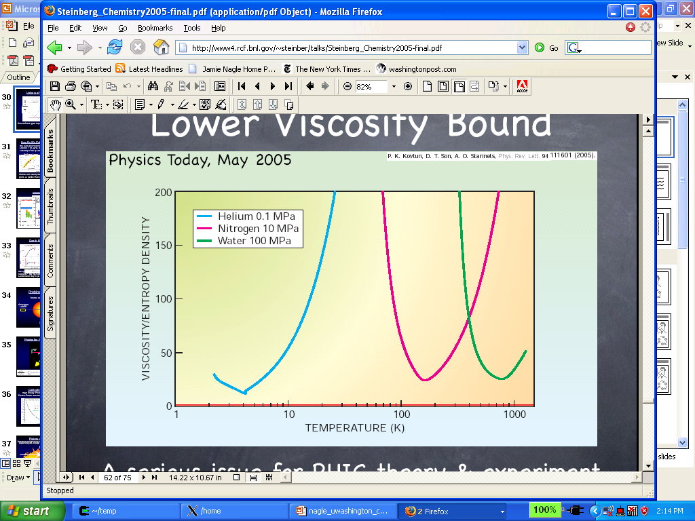
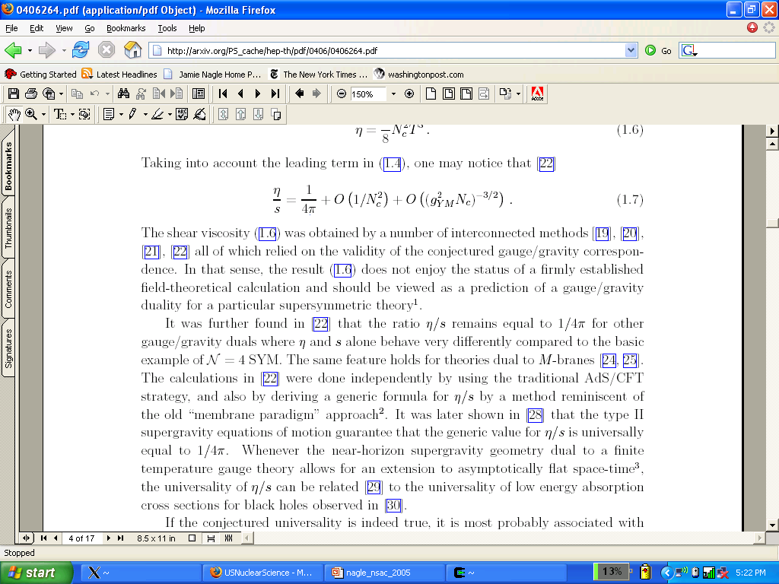
How Close to Perfect is it?
Shear Viscosity / Entropy Density (η/s )
QGP
Gas-Liquid Phase Transition
Superfluidity Transition

Slide 18
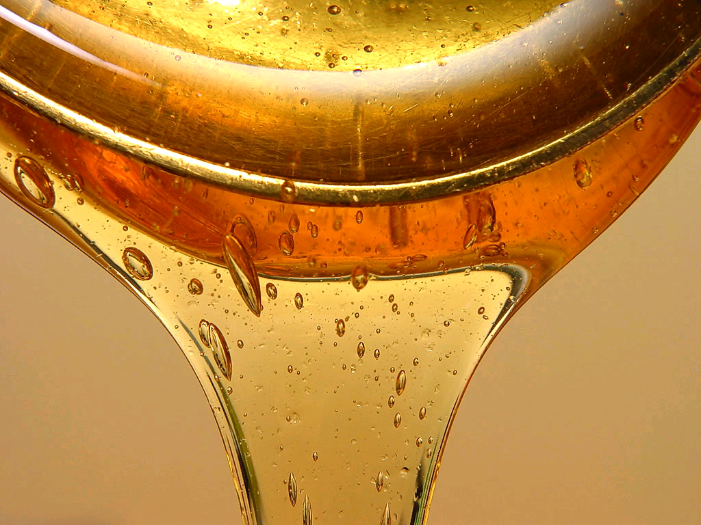
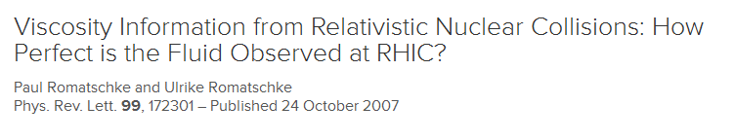
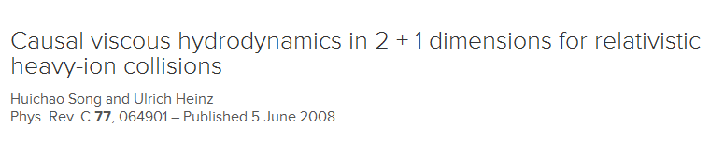
What About Viscosity?
Relativistic Viscous Hydrodynamics
major unsolved numerical problem,
until 2007

Slide 19
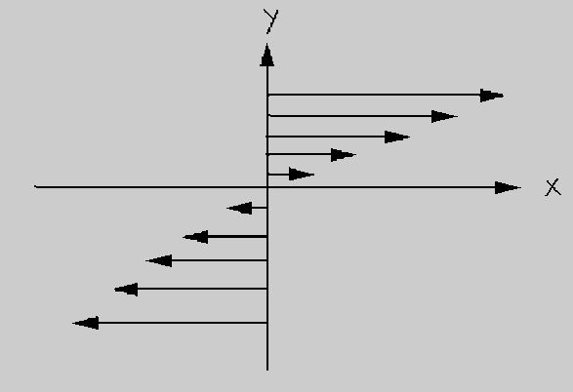
Shear Viscosity

Slide 20
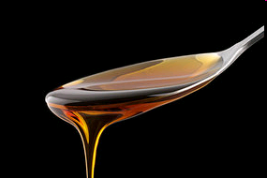
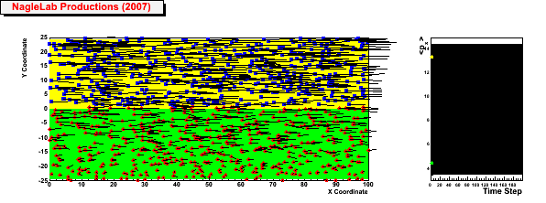
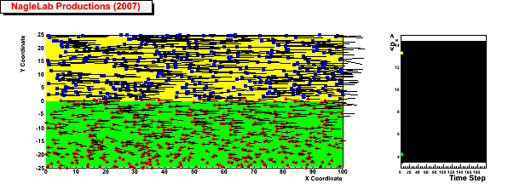
Viscosity Review
Honey – viscosity decreases at higher temperatures
viscosity increases with stronger coupling
Weak coupling (σ=0)
Inhibited
diffusion
↓
Small
viscosity
↓
Almost perfect fluid
↓
Strong Coupled QGP
<p_{x}> top region
<p_{x}> bottom region
Strong coupling (σ ↑)

Slide 21
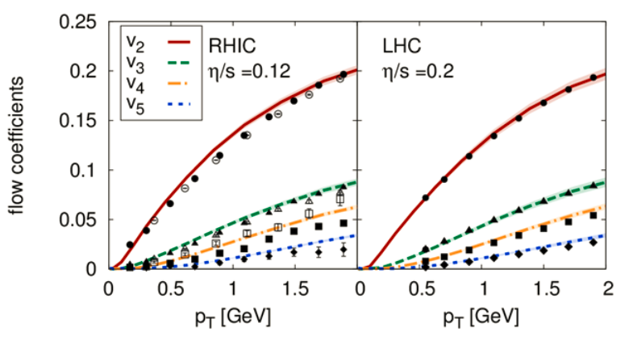
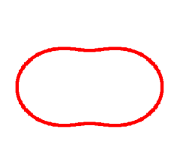
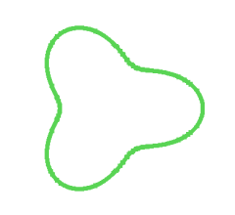
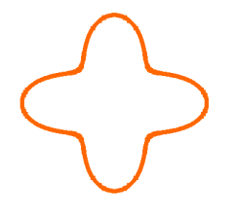
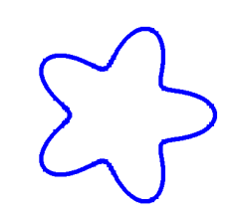
Bjoern Schenke
Hydrodynamic simulation (SONIC from Paul Romatschke) run with
η/s = 0.08 ~ 1/4π and ζ/s = 0.01

Slide 22
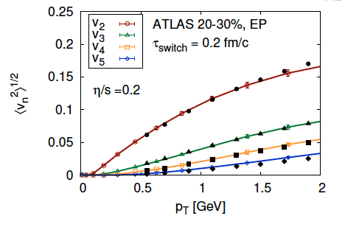
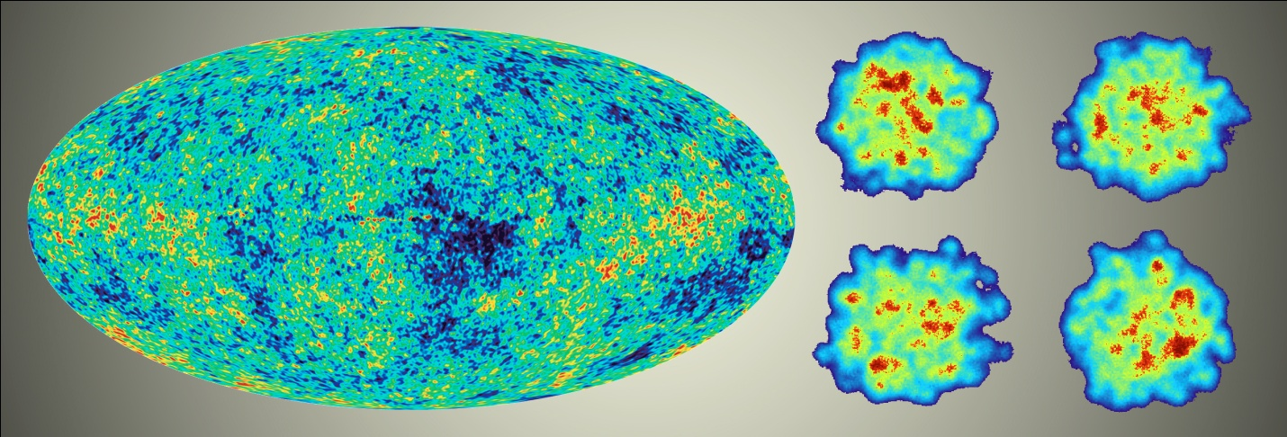
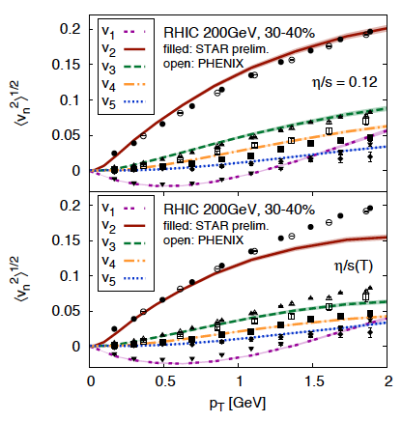
Detailed Fingerprint of Early Time
Calculation from Bjoern Schenke

Slide 23
“Little Bang” Standard Model
Discovery: Quark Gluon Plasma = Almost Perfect Fluid
Standard Model with Hydrodynamic Evolution
Precision: Predictions of Flow Patterns

Slide 24
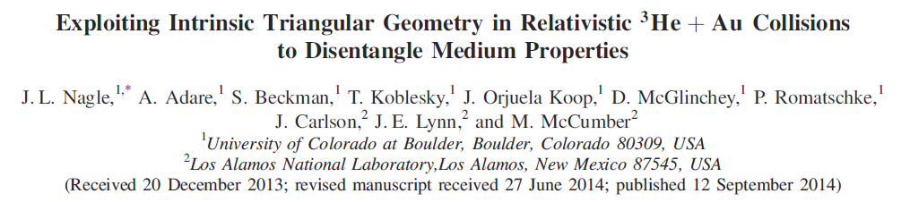
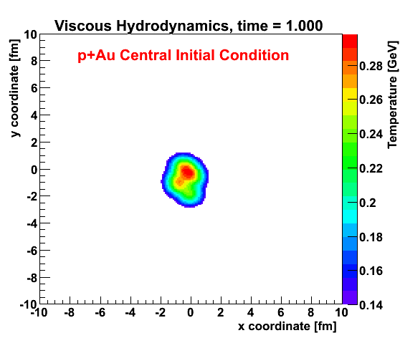
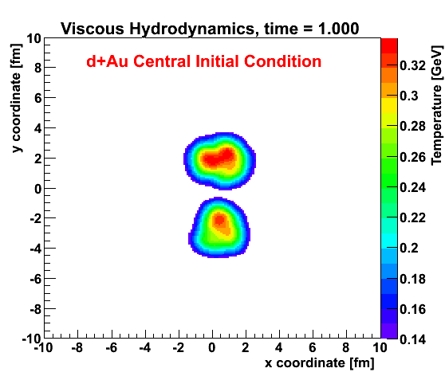
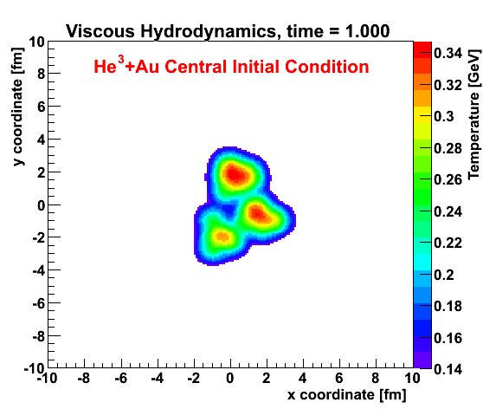
Small Collision System Hypothesis
http://journals.aps.org/prl/abstract/10.1103/PhysRevLett.113.112301

Slide 25
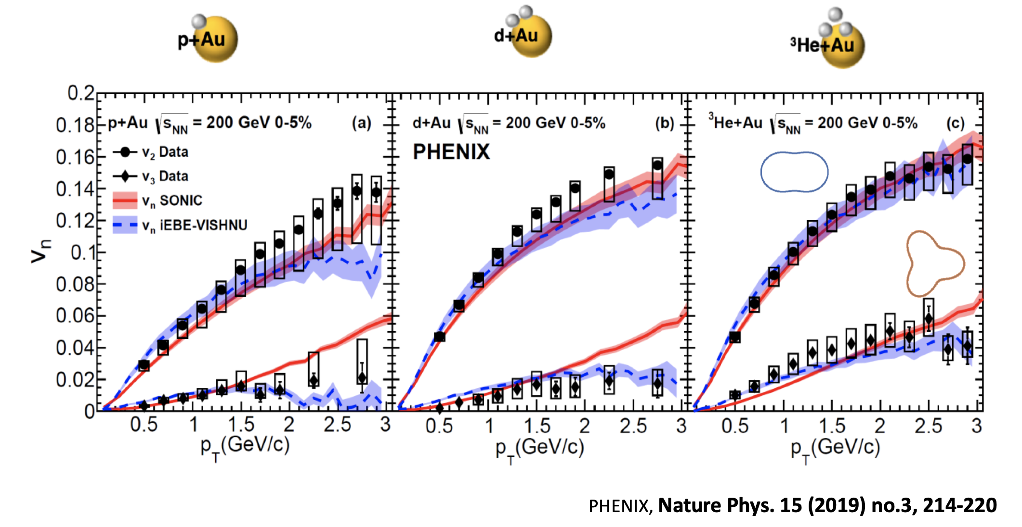
Even Smaller QGP Droplets

Slide 26


Slide 27
How does this work?
Jet Quenching Probes of QGP

Slide 28



Proposed New Experiment at RHIC (2010)

Slide 29


Very Fun to Build Something New!

Slide 30








Top fiber
Bottom fiber

Slide 31

Putting everything together (2023)

Slide 32





Taking data as we speak…

Slide 33
Summary
Discovery of Quark-Gluon Plasma as the Almost Perfect Fluid
Precision Description of Flow
“Little Bang” Standard Model
Exciting data taking with sPHENIX!
New Opportunities to Discover the How the QGP Works!

Slide 34

Stay Curious

Slide 37

How does this work?
Charm and bottom quarks swimming around in the
Quark Gluon Plasma.
What is the
Quark Gluon Plasma?

