Slide 1
Strong constraints on jet modification in centrality-dependent p+Pb collisions
by ATLAS
Jamie Nagle, University of Colorado Boulder
11th International Conference on Hard and Electromagnetic Probes of High-Energy Nuclear Collisions
Aschaffenburg (Germany) , March 26-31, 2023

Slide 2
Jet Quenching in Pb+Pb Collisions
Z
ATLAS: Phys. Rev. Lett. 126 (2021) 072301

Slide 3
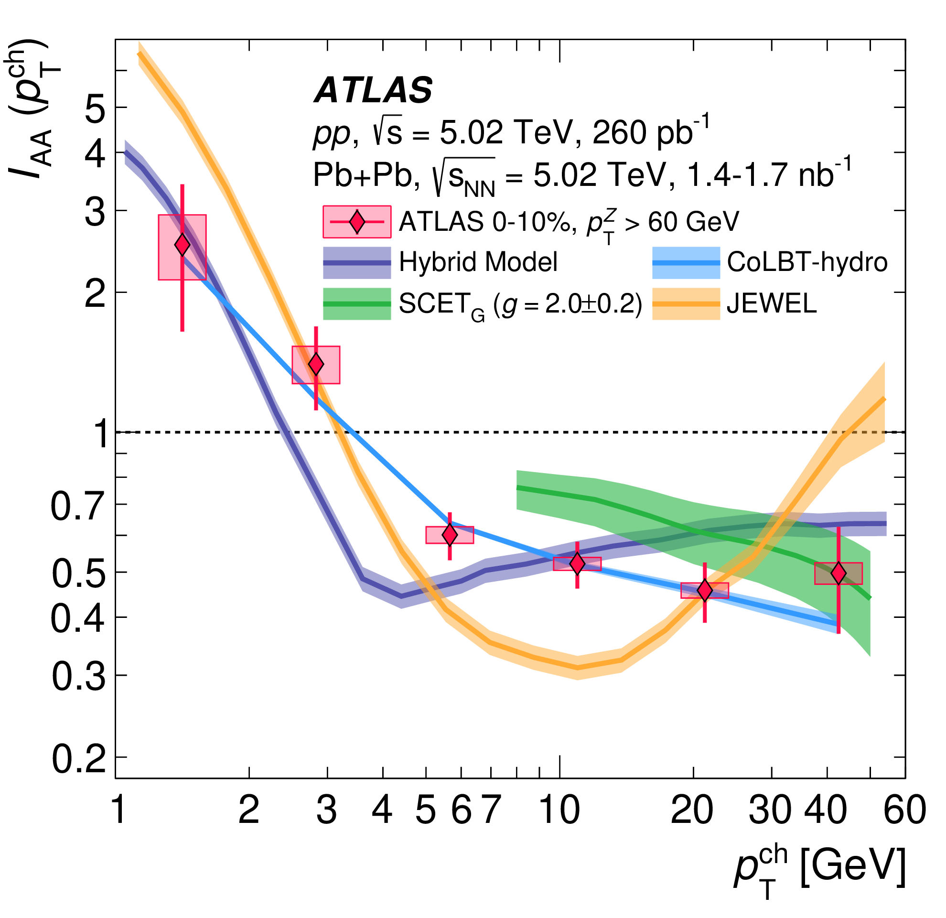
Jet Quenching in Pb+Pb Collisions
Z
QGP significantly suppresses hadrons
(p_{T} > 4 GeV) opposite Z-bosons.
Enhancement of hadrons (p_{T} < 4 GeV), redistribution of lost energy?
ATLAS: Phys. Rev. Lett. 126 (2021) 072301

Slide 4
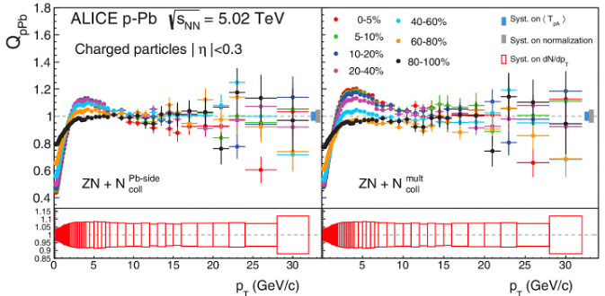
Searches for jet quenching in p+Pb
Single charged particle yields
No large suppression but
uncertainty on event selection bias,<N_{coll}>
Hence referred to as Q_{pPb} instead of R_{pPb}
ALICE: Phys. Rev. C (91) 064905

Slide 5
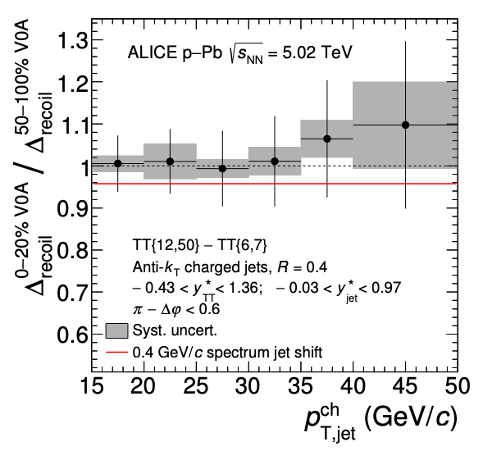
Searches for jet quenching in p+Pb
Single charged particle yields
No large suppression but
uncertainty on event selection bias,<N_{coll}>
Hence referred to as Q_{pPb} instead of R_{pPb}
ALICE: Phys. Rev. C (91) 064905
Hadron-jet correlations as a function of event activity
“average medium-induced out-of-cone energy transport for jets with R=0.4 and 15 < p_{T,ch.jet}< 50 GeV/c
is measured to be
less than 0.4 GeV/c at 90% confidence”
ALICE: Phys. Lett. B 783 (2018) 95

Slide 6
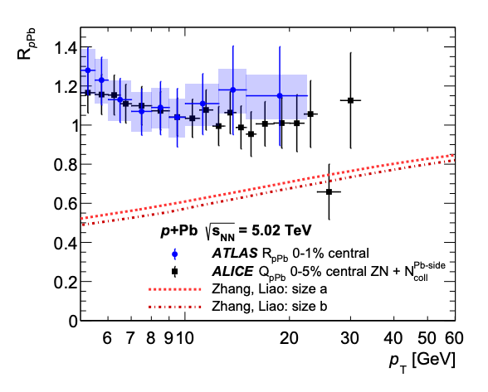
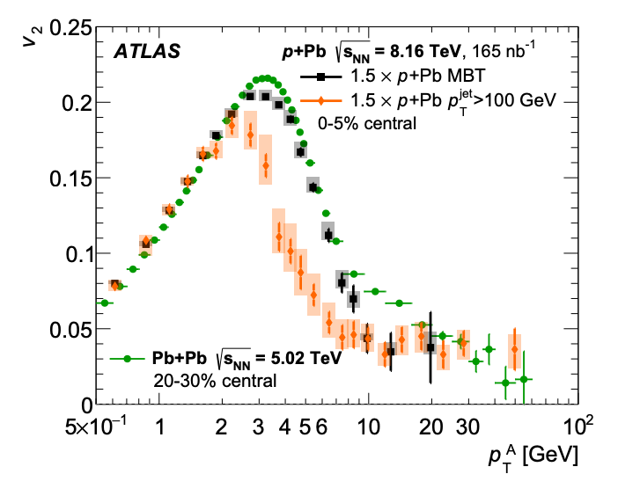
p+Pb high pT puzzle?
High p_{T} v₂ non-zero and
similar to that in PbPb
High pT RpPb consistent with unity
Zhang, Liao model that describes
v₂ via energy loss substantially overpredicts R_{pPb} suppression
ATLAS: Eur. Phys. J. C 80 (2020) 73

Slide 7
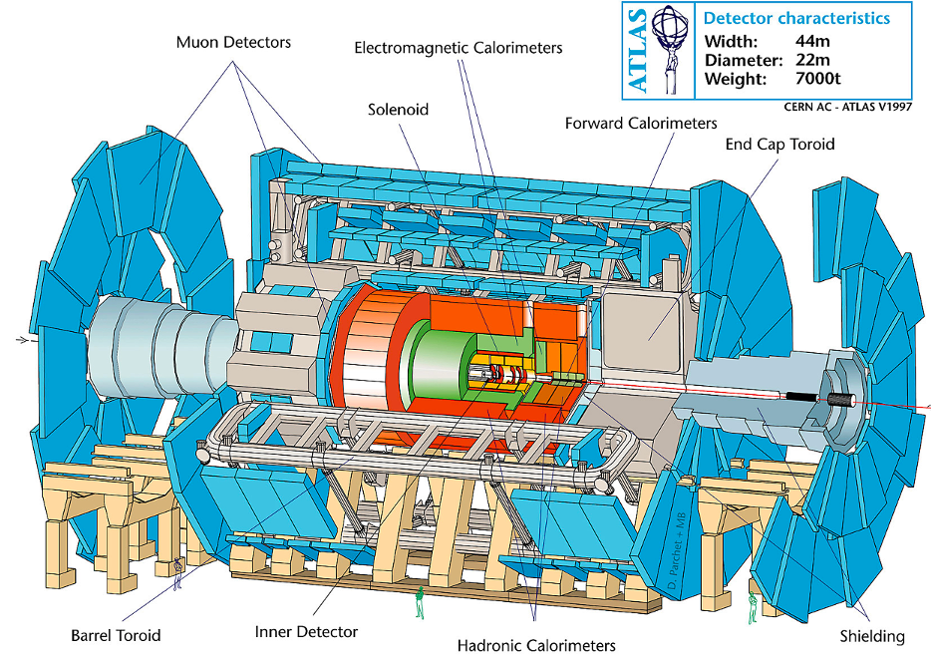
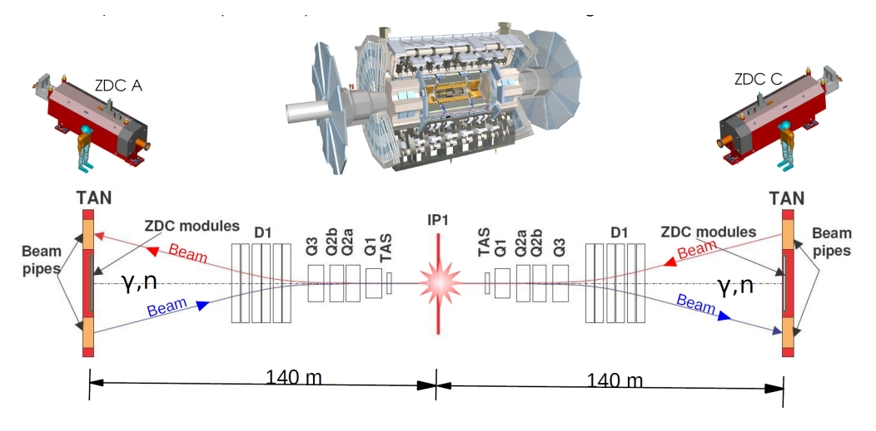
ATLAS data set and analysis
pp collected in 2017
2.6 – 260 pb⁻¹ luminosity
pPb collected in 2016
0.36 nb⁻¹ luminosity
Jets are reconstructed with EMCal and Hcal
Charged particles via inner tracking detectors
Centrality (nuclear overlap) is determined by the ATLAS
Zero Degree Calorimeter (ZDC)

Slide 8
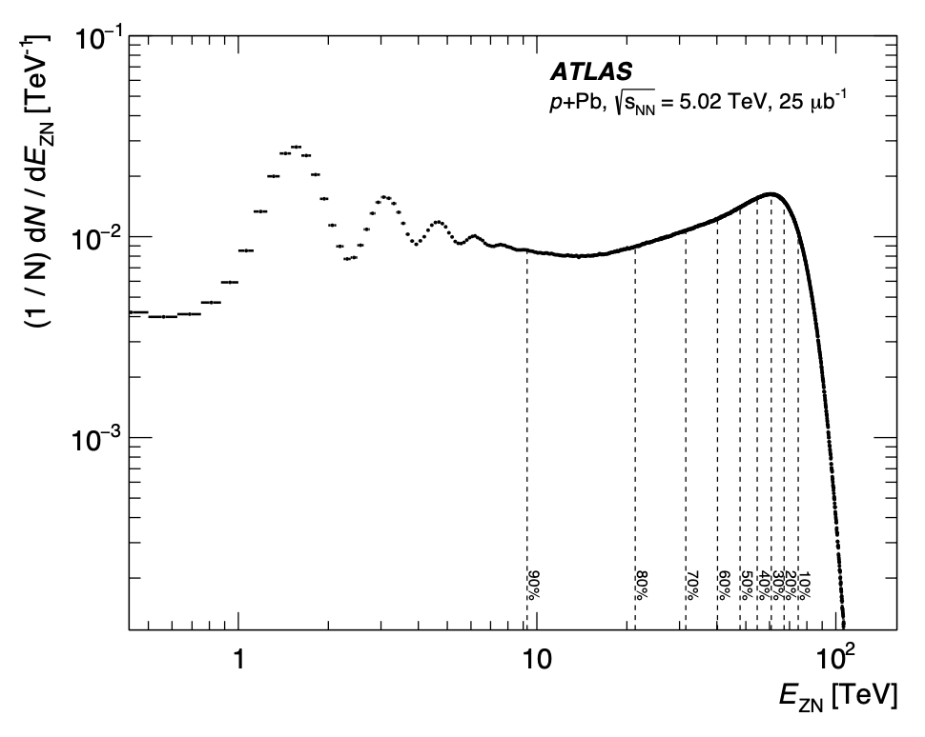
Event Selection in p+Pb Collisions
Select events by Pb-going ZDC energy to reduce any selection correlation with central barrel jets and hadrons
Using ZDC with similar acceptance, ALICE estimated:
<N_{coll}> = 13.6 ± 1.5 (0-20% cent.)
<N_{coll}> = 1.2 ± 1.3 (80-100% cent.)
ALICE: Phys. Rev. C 91 (2015) 064905
ATLAS paper accepted to Phys. Rev. Lett. [https://arxiv.org/abs/2206.01138]

Slide 9
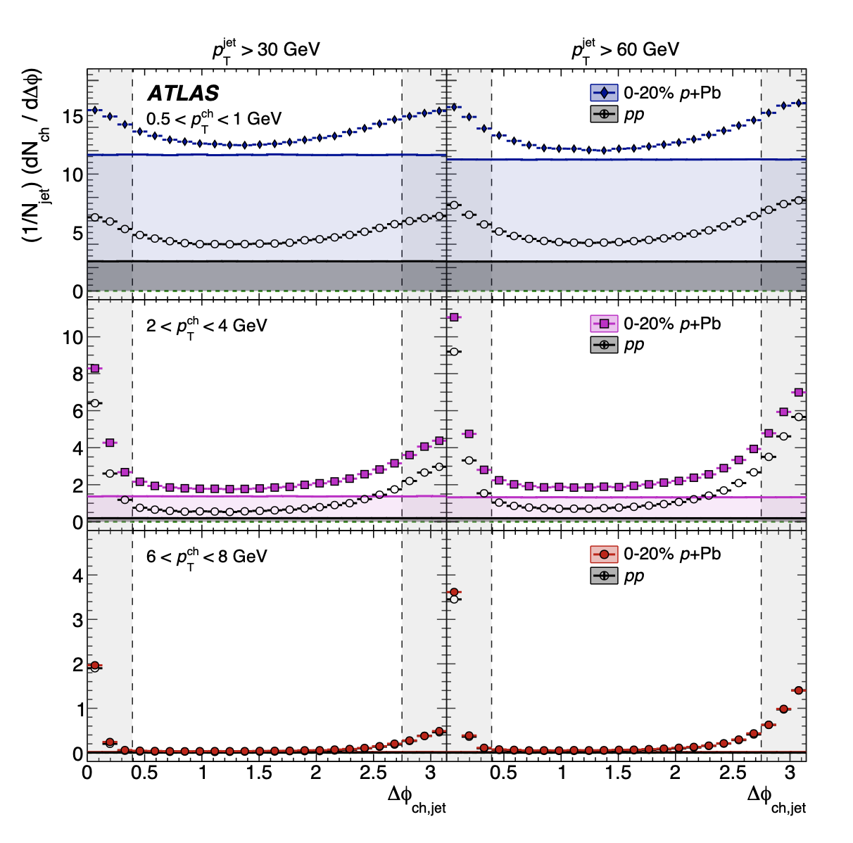
Jet-hadron angular correlations
Jet p_{T} > 30 GeV
Jet p_{T} > 60 GeV
Hadron p_{T} =0.5-1.0 GeV
Hadron p_{T} =2.0-4.0 GeV
Quantify charged hadron yields as a function of p_{T} on
“near-side” (Δφ < π/8) and
“away-side” (Δφ > 7π/8) regions.
Hadron p_{T} =6.0-8.0 GeV

Slide 10
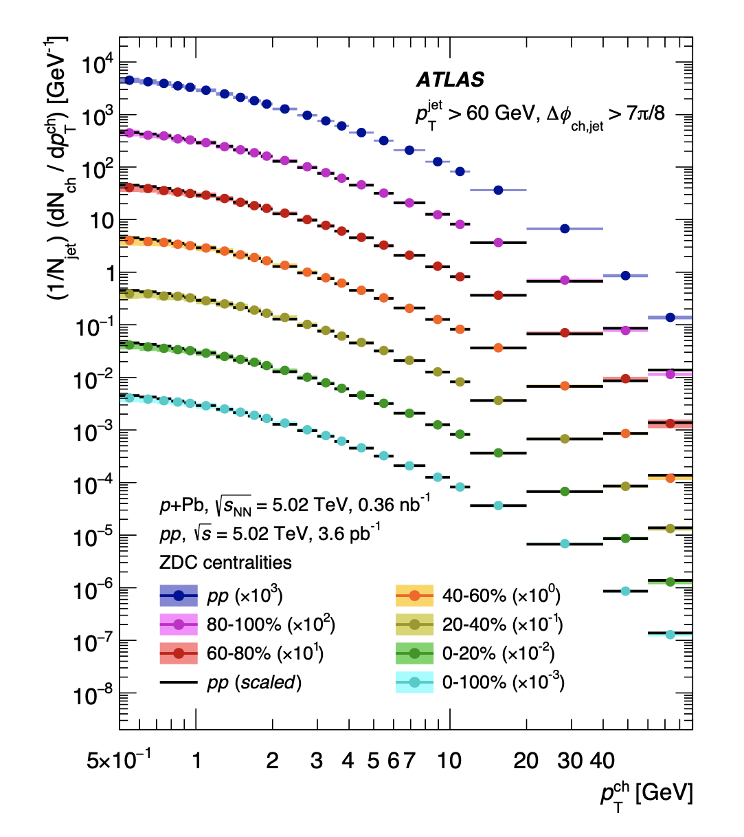
Quantified hadron yields per jet
Then calculation the ratios
No explicit dependence on <N_{coll}>

Slide 11
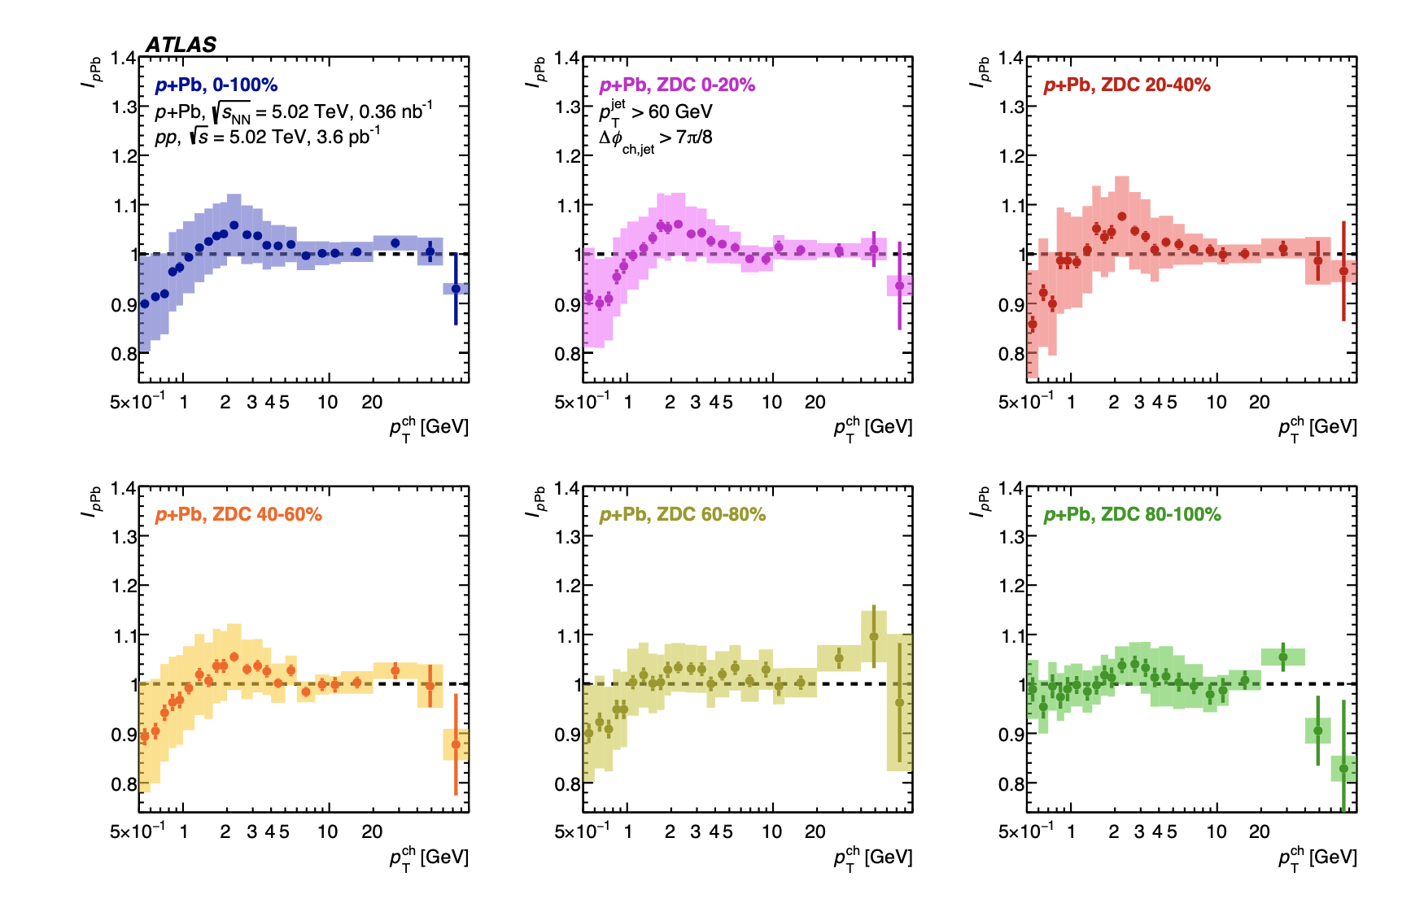
“Away-side” Jet-hadron IpPb
I_{pPb} “away-side” consistent with unity within a few percent for p_{T} > 4 GeV
Hint of enhancement near p_{T} ~ 2 GeV, but within systematic uncertainties

Slide 12
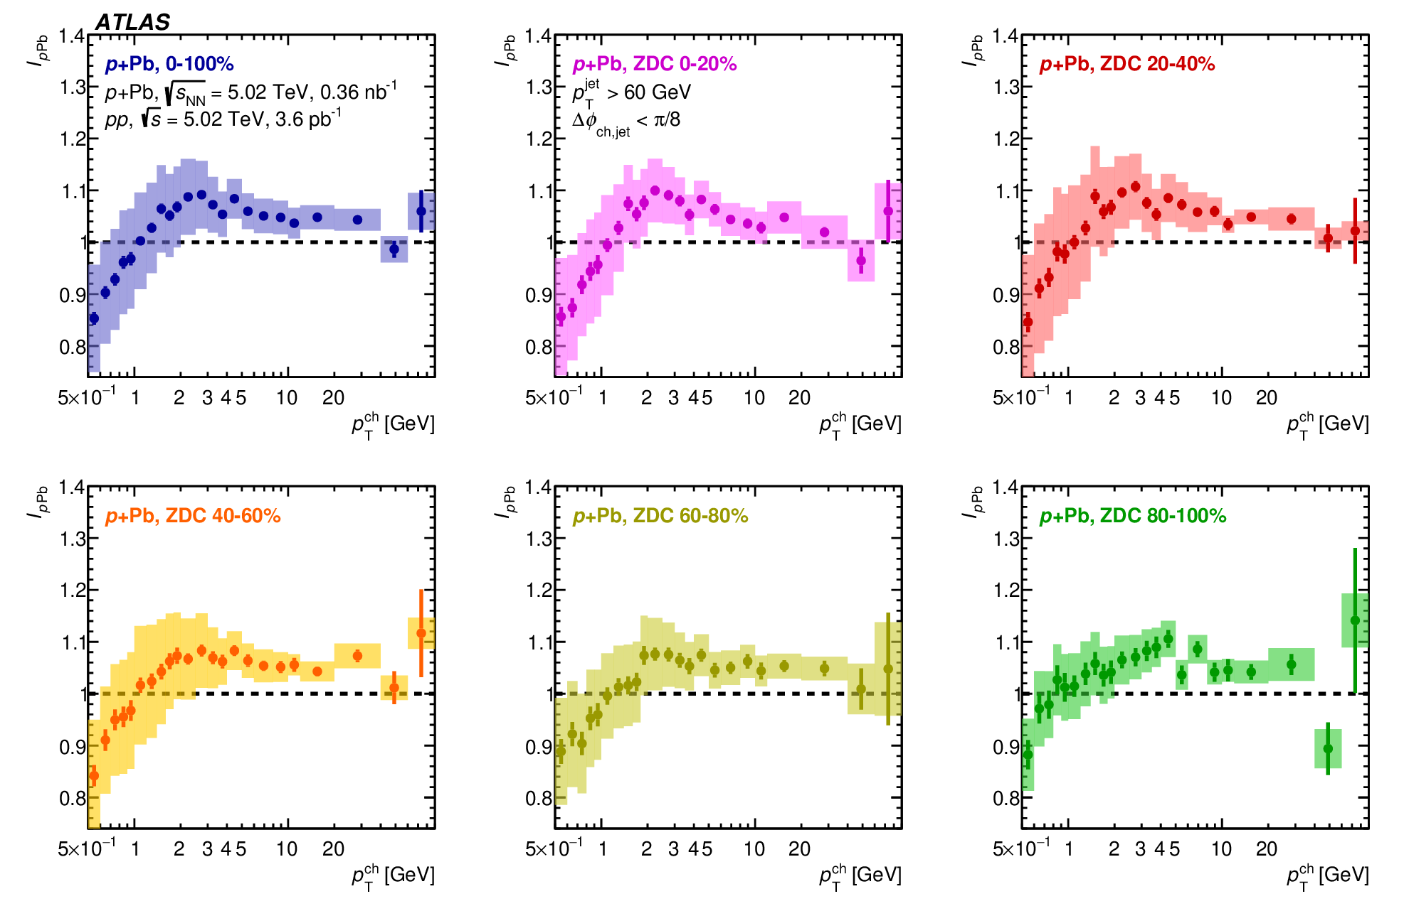
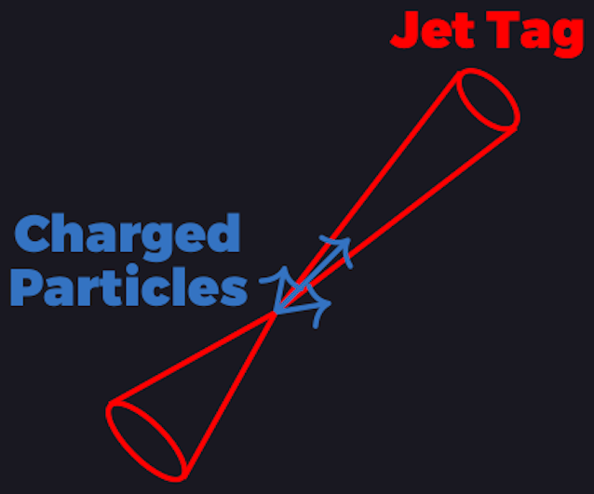
“Near-side” Jet-hadron IpPb
I_{pPb} “near-side” consistent with few percent enhancement above unity
for p_{T} > 4 GeV
Hint of depletion at low p_{T} < 1 GeV

Slide 13
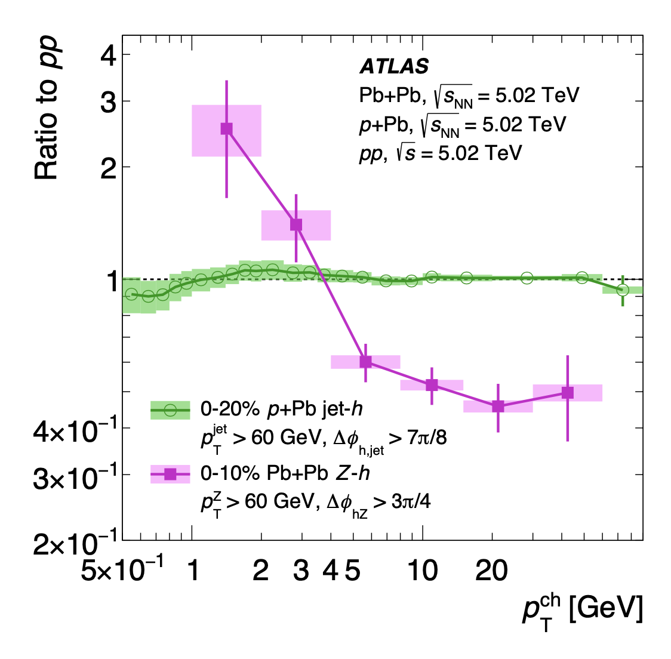
Pb+Pb and p+Pb: Setting the scale
PbPb Z-h
pPb Jet-h
pPb
No evidence of quenching in I_{pPb} observable
PbPb

Slide 14
Pb+Pb and p+Pb: Setting the scale
PbPb Z-h
pPb Jet-h
pPb
No evidence of quenching in I_{pPb} observable
But remember,
high p_{T} v₂ is comparable pPb and PbPb,
and is explained by jet quenching in Pb+Pb case
PbPb

Slide 15
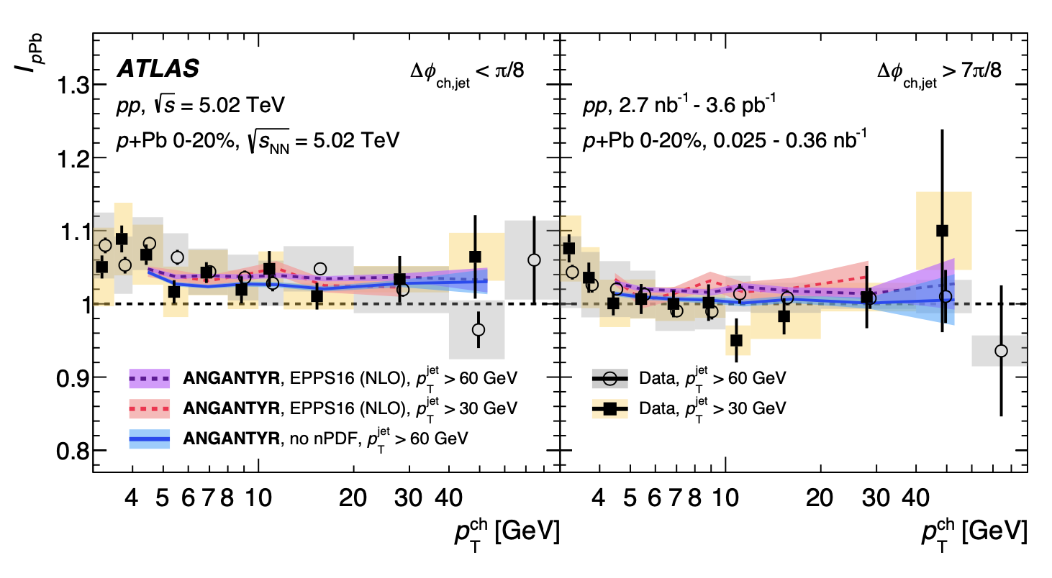
No quenching scenario (Angantyr) comparison
near-side
away-side
Angantyr – extension of PYTHIA for pA, AA physics.
No final state interactions, i.e., no jet quenching
Consistent with data:
~3% enhancement on near side
Consistent with data:
unity value on away side
No large effect from nPDF;
Unclear source of enhancement
Angantyr: J. High Energ. Phys. (2018) 2018: 134

Slide 16
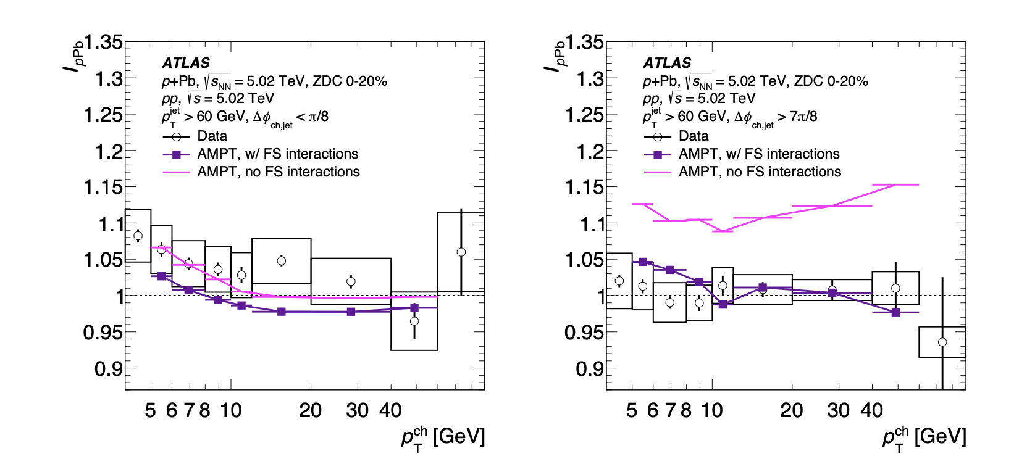
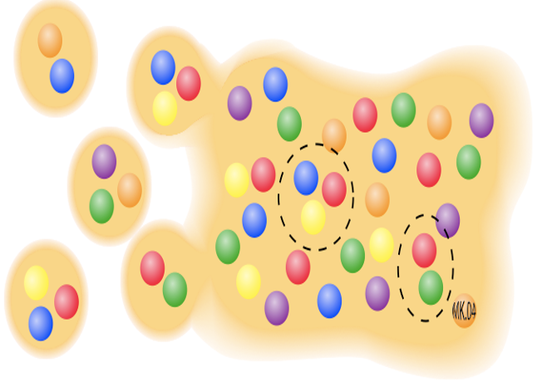
Final state interaction (AMPT) comparison
near-side
away-side
AMPT yields enhancement on
away-side without
final state interactions,
that are cancelled by final state interaction to yield I_{pPb} ~ 1
However, calculations yield R_{pPb} << 1
AMPT: Lin et al., Phys. Rev. C72 (2005) 064901
AMPT with string melting forms all hadrons via coalescence by spatial proximity, no fragmentation.
Not to be used for jet physics, particularly for p_{T} > 3 GeV…

Slide 17
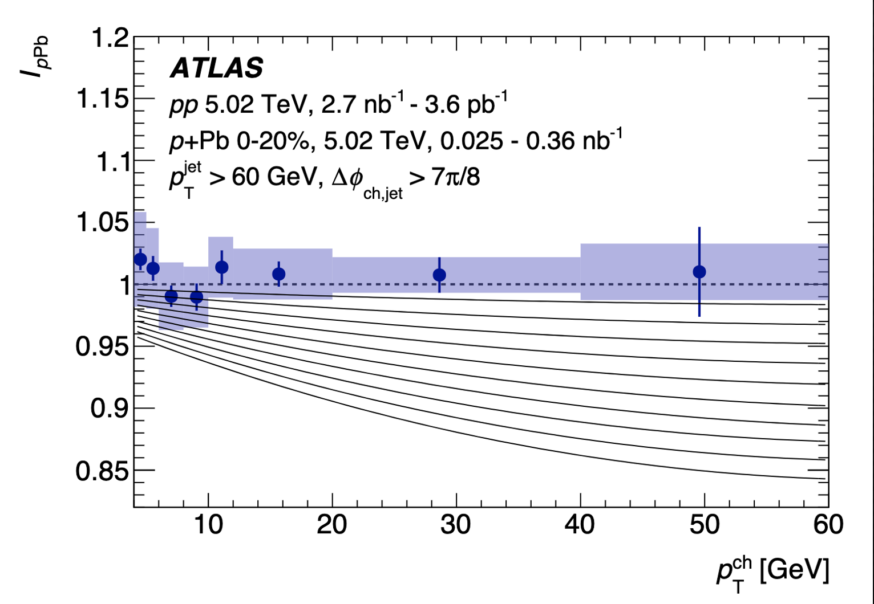
Constraining parton energy loss in p+Pb
Energy loss calculation
Test scenarios where initial parton loses a percentage of its energy before undergoing vacuum-like fragmentation.
Scenarios shown:
0.5%, 1.0%, 1.5%, 2.0% …, 5.0%
Parton energy loss constraint: 0.2 ± 0.5%
and < 1.4% at 90% confidence level

Slide 18
Summary
Strong constraints on jet quenching in centrality-dependent
p+Pb collisions at 5.02 TeV from ATLAS
ATLAS paper accepted to Phys. Rev. Lett. [https://arxiv.org/abs/2206.01138]
Per-jet hadron yields quantified via I_{pPb}
Near-side yields show modest enhancement (few percent) as described by Angantyr
Away-side yields consistent with unity and constrain energy lost by parton before fragmenting in vacuum to hadrons (p_{T} > 4 GeV)
Puzzle remains unsolved with regards to these
non-jet quenching measures and high p_{T} v₂.
Parton energy loss constraint: 0.2 ± 0.5%
and < 1.4% at 90% confidence level
https://twiki.cern.ch/twiki/bin/view/AtlasPublic/HeavyIonsPublicResults

Slide 19
EXTRA SLIDES

Slide 20
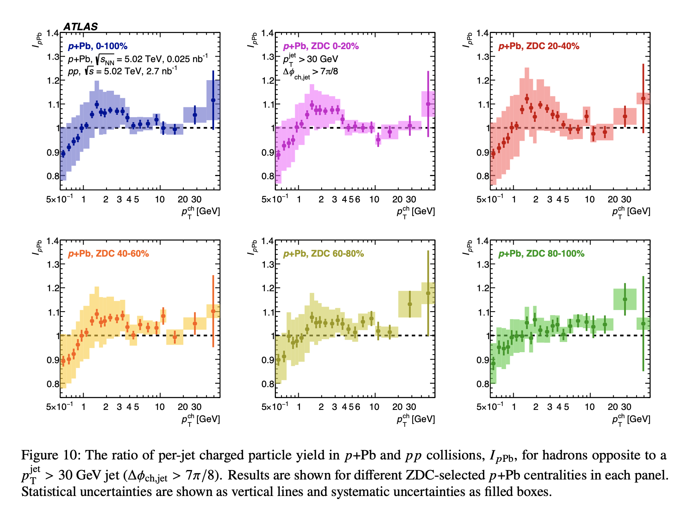

Slide 21
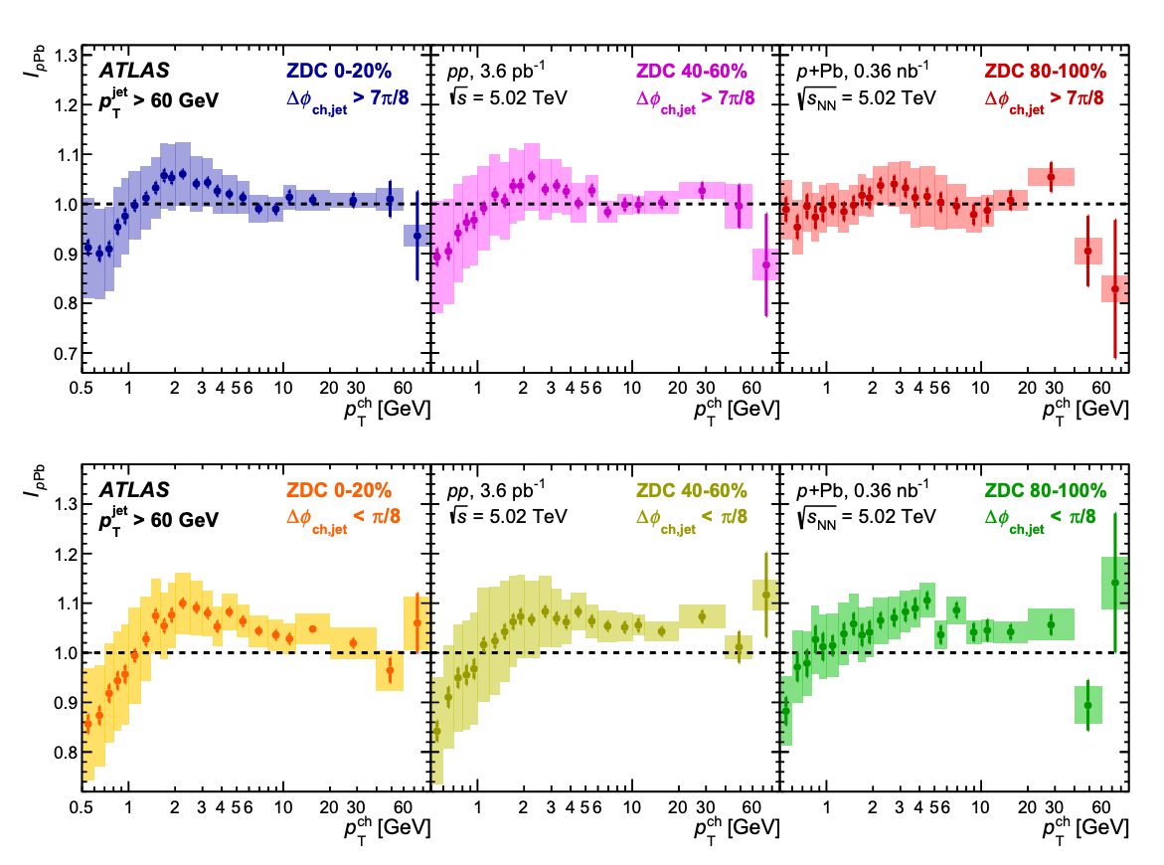

Slide 23
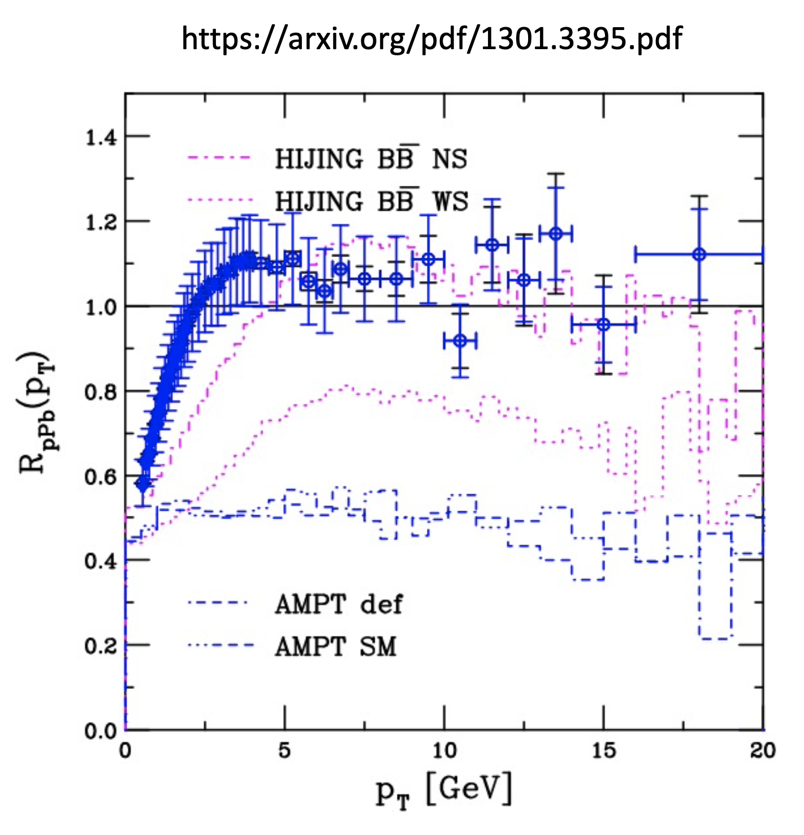

Slide 24
15’ + 5’ (Q&A)

