Slide 1


Heavy ion physicists…
Is there a Nobel Prize in your future?
Jamie Nagle
University of Colorado Boulder
June 14, 2023
ALICE In-Motion Session

Slide 2
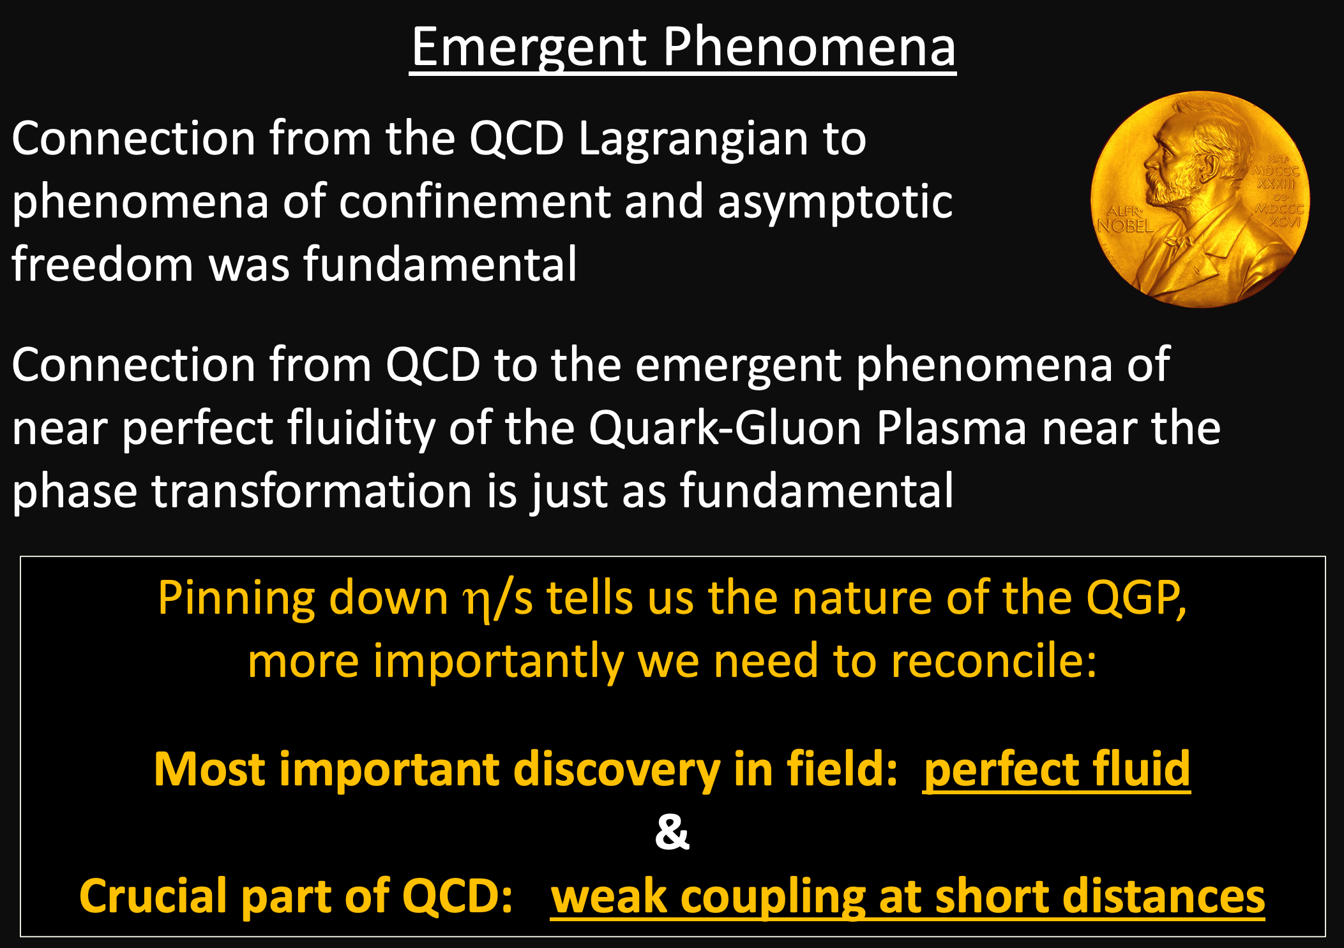
Slide from United States Nuclear Physics Long Range Plan 2015
Full talk links available here: https://www.phenix.bnl.gov/WWW/publish/nagle/Presentations/

Slide 3
This slide inspired the request for this talk
to have me to think about
(and you think about) the larger impact of our field.
Don’t take it too seriously ☺
Slide from United States Nuclear Physics Long Range Plan 2015
Full talk links available here: https://www.phenix.bnl.gov/WWW/publish/nagle/Presentations/

Slide 4
How did Alfred Nobel make his money?

Slide 5
How did Alfred Nobel make his money?
“Alfred Nobel worked hard to improve nitroglycerine as an explosive that could be used in blasting rock and in mining. He made one of his most important discoveries when he found that by mixing nitroglycerine, an oily fluid, with kieselguhr, the mixture could be turned into a paste. This material could be kneaded and shaped into rods suitable for insertion into drilling holes. He called his paste dynamite and went on to develop a blasting cap which could be used to detonate dynamite under controlled conditions.”
He thought the destructive power of dynamite was so great,
it would end all wars.
Not the most accurate prediction !

Slide 6
Who won the first Nobel Prize?

Slide 7
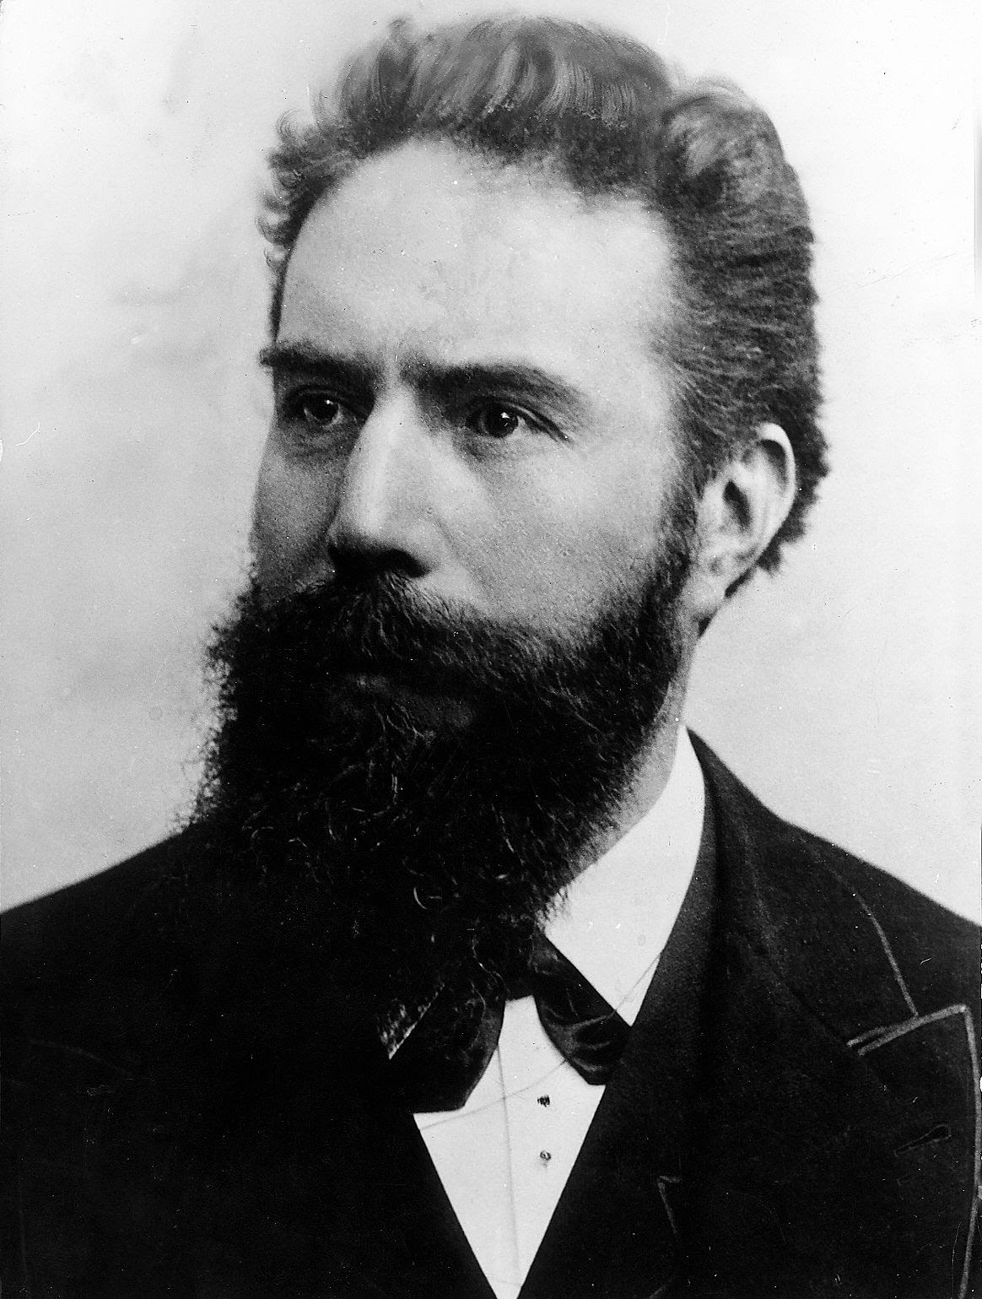
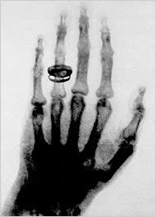
Who won the first Nobel Prize?
Wilhelm Röntgen (1901)
https://en.wikipedia.org/wiki/List_of_Nobel_laureates_in_Physics

Slide 8
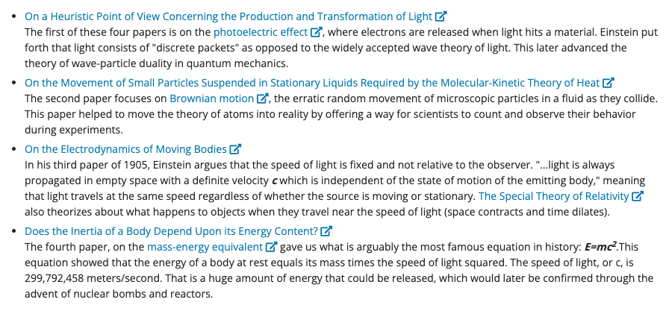
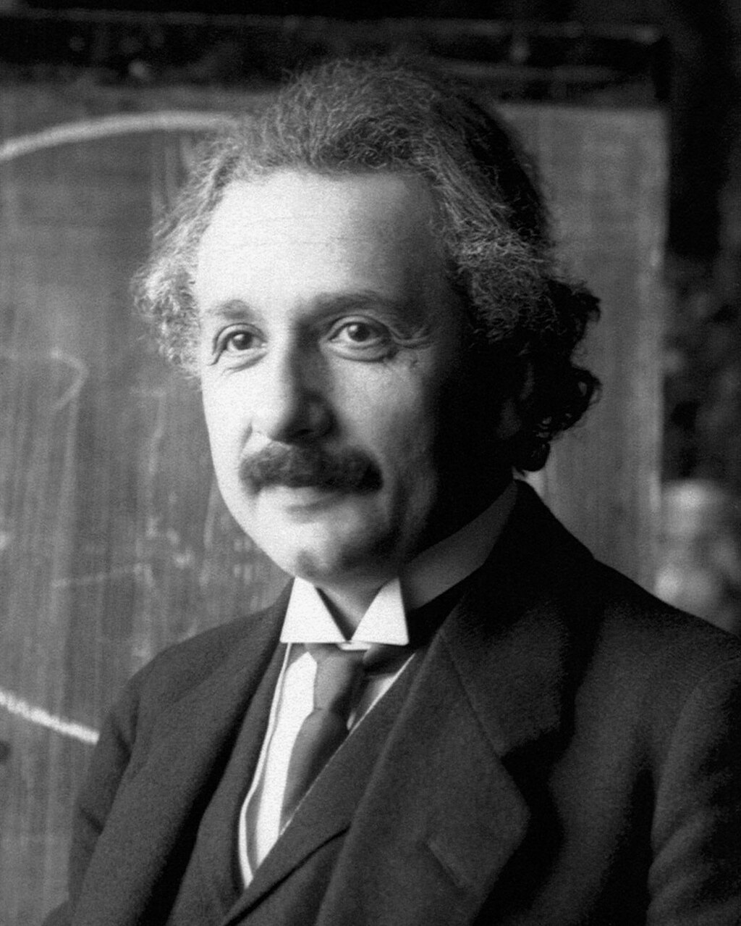
What did Albert Einstein win the Nobel Prize for?

Slide 9
What did Albert Einstein win the Nobel Prize for?
Einstein nominated many times before receiving the prize…
1910, 1912, 1913, 1914, 1916, 1917, 1918, 1919, 1920, 1921, 1922
https://en.wikipedia.org/wiki/List_of_Nobel_laureates_in_Physics
https://en.wikipedia.org/wiki/List_of_nominees_for_the_Nobel_Prize_in_Physics

Slide 10
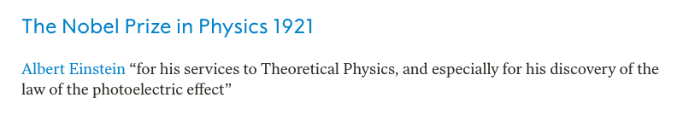
What did Albert Einstein win the Nobel Prize for?
Einstein nominated many times before receiving the prize…
1910, 1912, 1913, 1914, 1916, 1917, 1918, 1919, 1920, 1921, 1922
https://en.wikipedia.org/wiki/List_of_Nobel_laureates_in_Physics
https://en.wikipedia.org/wiki/List_of_nominees_for_the_Nobel_Prize_in_Physics

Slide 11
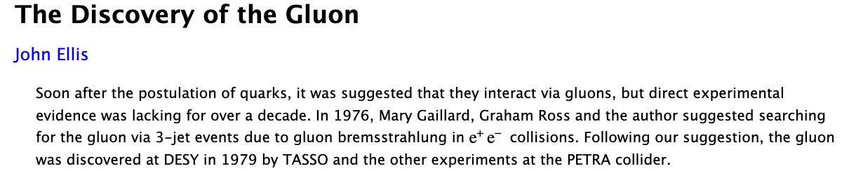
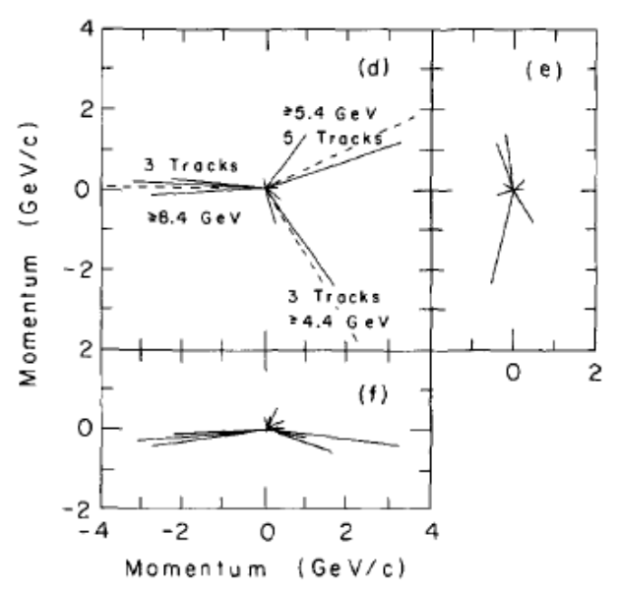
Why wasn’t there a Nobel Prize for the gluon discovery?
https://arxiv.org/abs/1409.4232
Too many experiments with ‘simultaneous’ discovery?
Also, a number of relevant theorists?
All past nominations made public after 50 years, so,
it will be interesting to see what nominations were submitted for the gluon discovery in
1979 + 50 = 2029++
https://en.wikipedia.org/wiki/List_of_nominees_for_the_Nobel_Prize_in_Physics

Slide 12
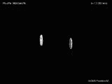
Why hasn’t there a Nobel Prize for
“New State of Matter” Discovery at CERN 2000?
“Compelling evidence for the existence of a new state of matter in which quarks, instead of being bound up into more complex particles such as protons and neutrons, are liberated to roam freely.”
“There is still an entirely new territory to be explored concerning the physical properties of quark-gluon matter. The challenge now passes to the Relativistic Heavy Ion Collider at the Brookhaven National Laboratory and later to CERN's Large Hadron Collider.”
URQMD
https://home.cern/news/press-release/cern/new-state-matter-created-cern
https://arxiv.org/abs/nucl-th/0002042v1

Slide 13
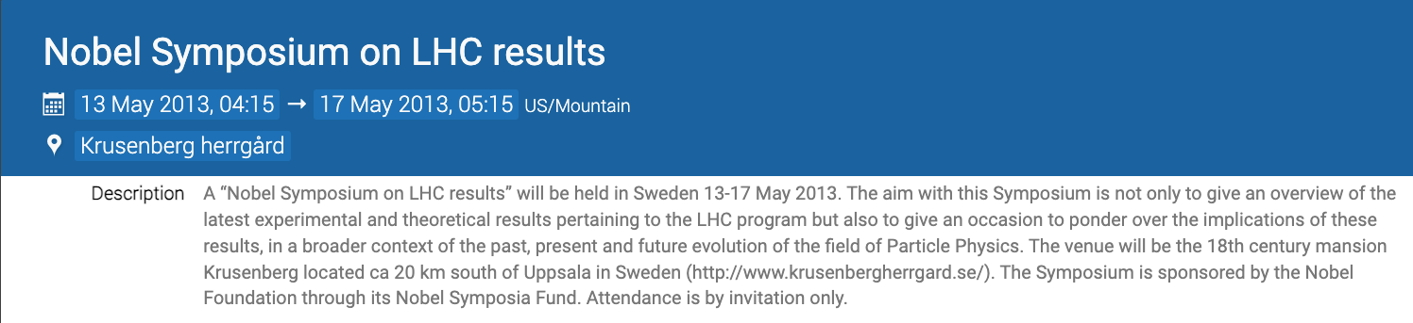
Higgs discovery Nobel Prize (2013)
https://indico.cern.ch/event/239571/
Interesting to review the talks by Jurgen Schukraft and Berndt Mueller.

Slide 14
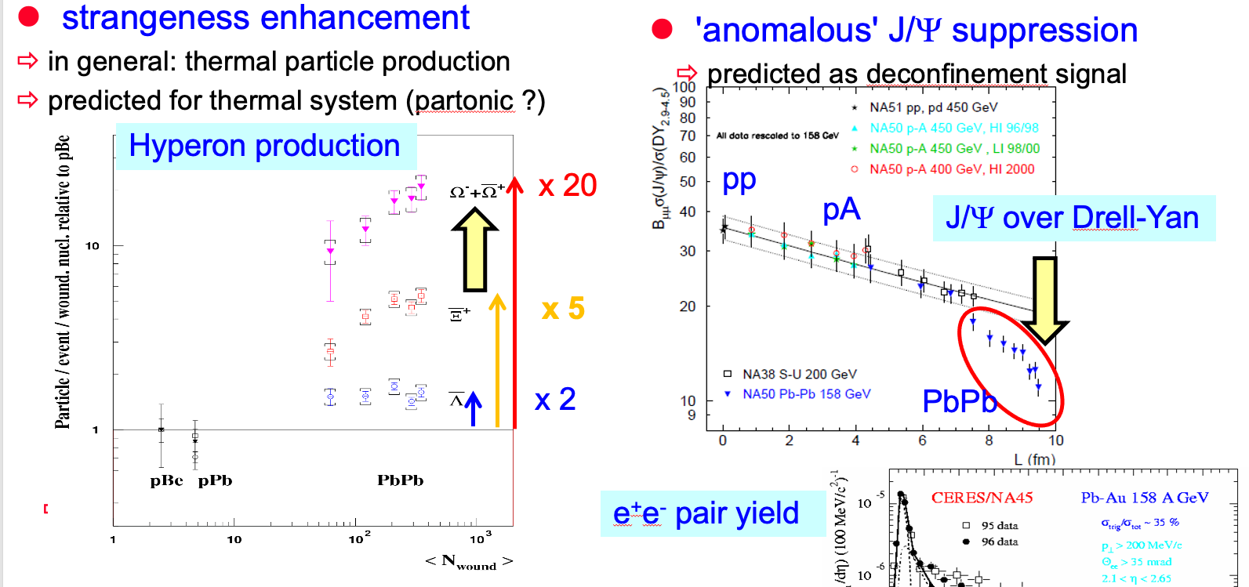
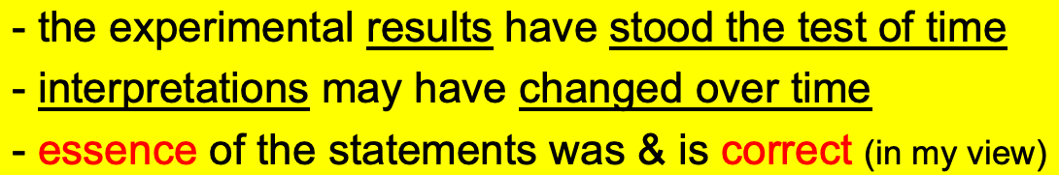
Higgs discovery Nobel Prize (2013)
https://indico.cern.ch/event/239571/
Interesting to review the talks by Jurgen Schukraft and Berndt Mueller.
CERN press release based on an
“(unpublished) ‘common assessment’ of results from ~ half dozen experiments collected and published” from the SPS program (1994-2000).
NA57
Jurgen Schukraft (2013)
Maybe, but our paradigm for
QGP is now completely different!
J. Nagle (2023)
Fun / relevant comments from Jurgen (2008)

Slide 15
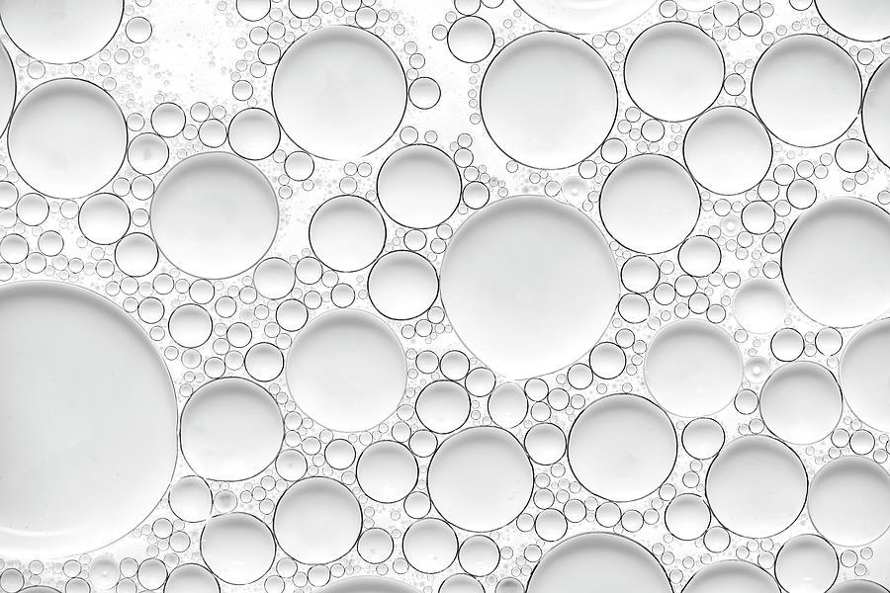
Quarkonia Suppression at CERN-SPS
“A clear onset of the anomaly is observed. It excludes models based on hadronic scenarios since only smooth behavior with monotonic derivatives can be inferred from such calculations”
NA50, Phys. Lett. B 450, 456 (1999).
D. Kharzeev, Nucl. Phys. A638, 279a (1998).

Slide 16
Monotonic Derivatives
Even with the rudimentary skills of PAW (Physics Analysis Workstation),
the derivatives are monotonic.
Very important to be mathematically precise in scientific claims.

Slide 17
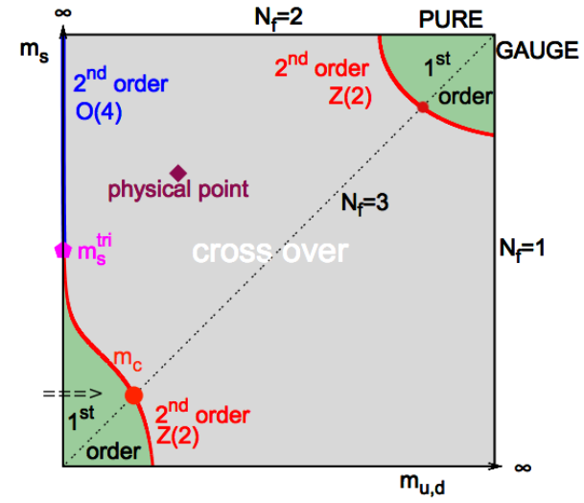
Huge Paradigm Change in the Field (!)
When I started in the field in 1990 as an undergraduate student,
for μ_{B} = 0, many thought the QGP transition was 1st order.

Slide 18
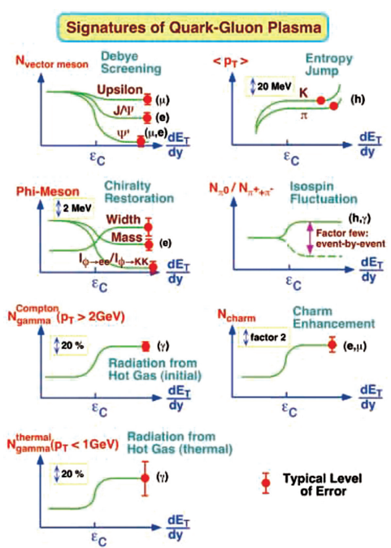
Huge Paradigm Change in the Field (!)
No bubble nucleation
No mixed phase
No sudden “onset”
☹
When I started in the field in 1990 as an undergraduate student,
for μ_{B} = 0, many thought the QGP transition was 1st order.
☹
PHENIX Proposal
Shoji Nagamiya, https://academic.oup.com/ptep/article/2015/3/03A101/1584228

Slide 19
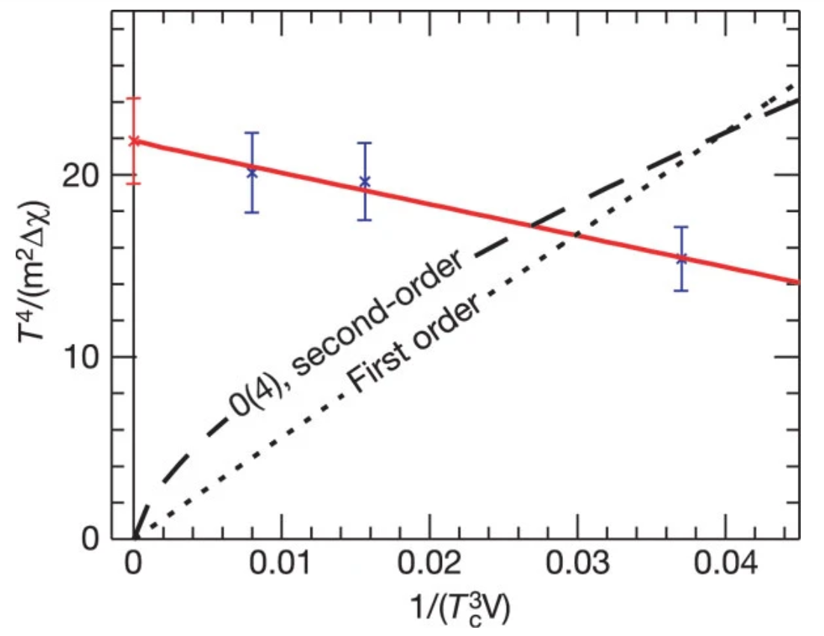
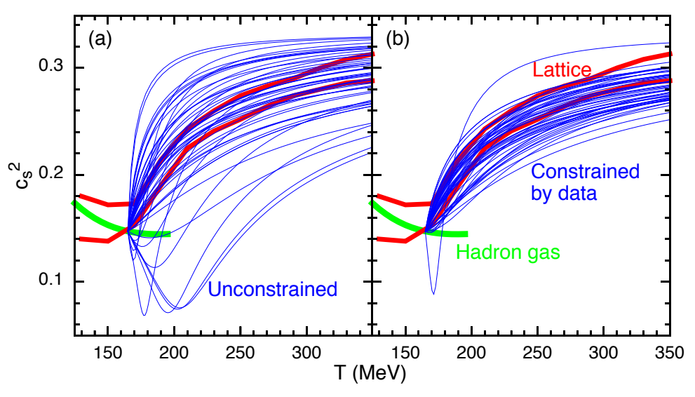
Smooth Crossovers are Cool Too!
“In a strong first-order phase transition the quark–gluon plasma supercools before bubbles of hadron gas are formed. These bubbles grow, collide and merge, during which gravitational waves could be produced⁸. Baryon-enriched nuggets could remain between the bubbles, contributing to dark matter. The hadronic phase is the initial condition for nucleosynthesis, so inhomogeneities in this phase could have a strong effect on nucleosynthesis⁹. As the first-order phase transition weakens, these effects become less pronounced. Our calculations provide strong evidence that the QCD transition is a crossover, and thus the above scenarios—and many others—are ruled out.”
Lattice QCD, https://www.nature.com/articles/nature05120
Experimentally, we have Bayesian constraints on the
Equation of State and earlier constraints on the
maximum latent heat [D. Teaney et al., https://arxiv.org/abs/nucl-th/0110037];
however, the nature of the transition rests on theory.
The field is still permeated with “old-school thinking”
See how many plots have T_{c}
https://link.aps.org/accepted/10.1103/PhysRevLett.114.202301

Slide 20
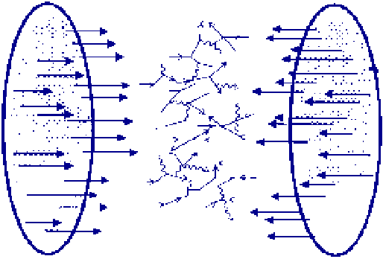
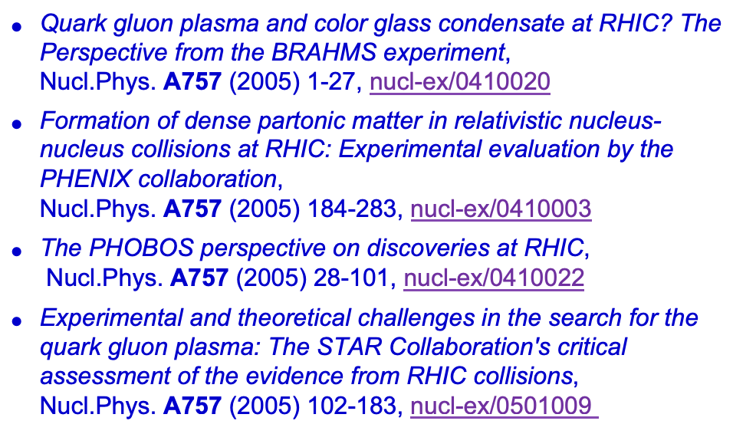
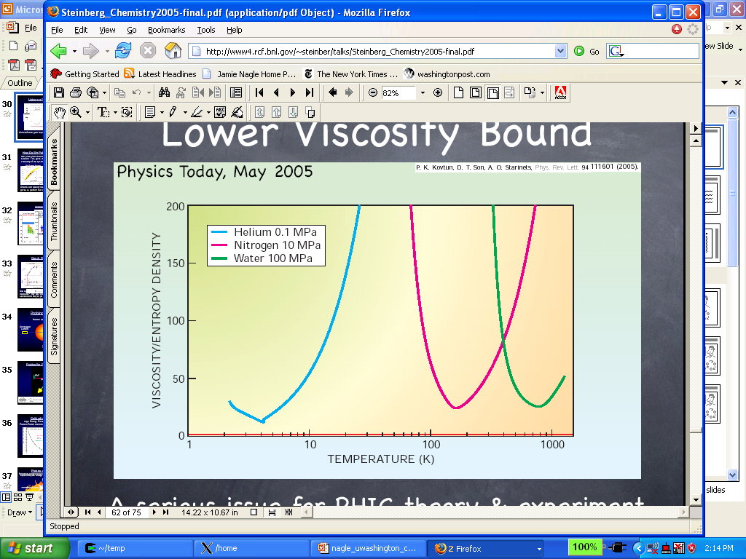

RHIC Perfect Fluid Discovery (2006)
Full set of published results in refereed journal.
https://www.sciencedirect.com/journal/nuclear-physics-a/vol/757/issue/1

Slide 21
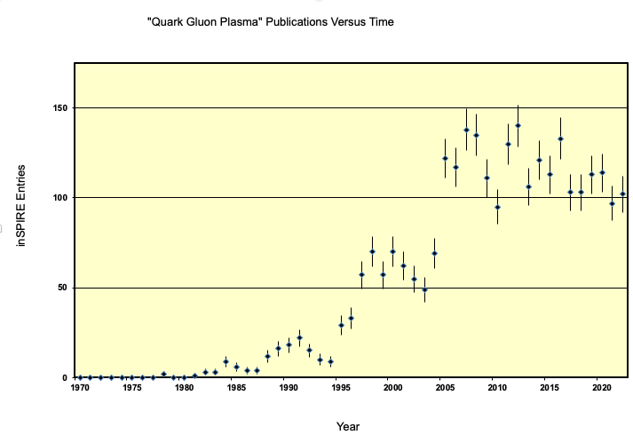
Non-monotonic derivatives?
Plot from Bill Zajc
But there is no single paper with the “proof” and definition.

Slide 22
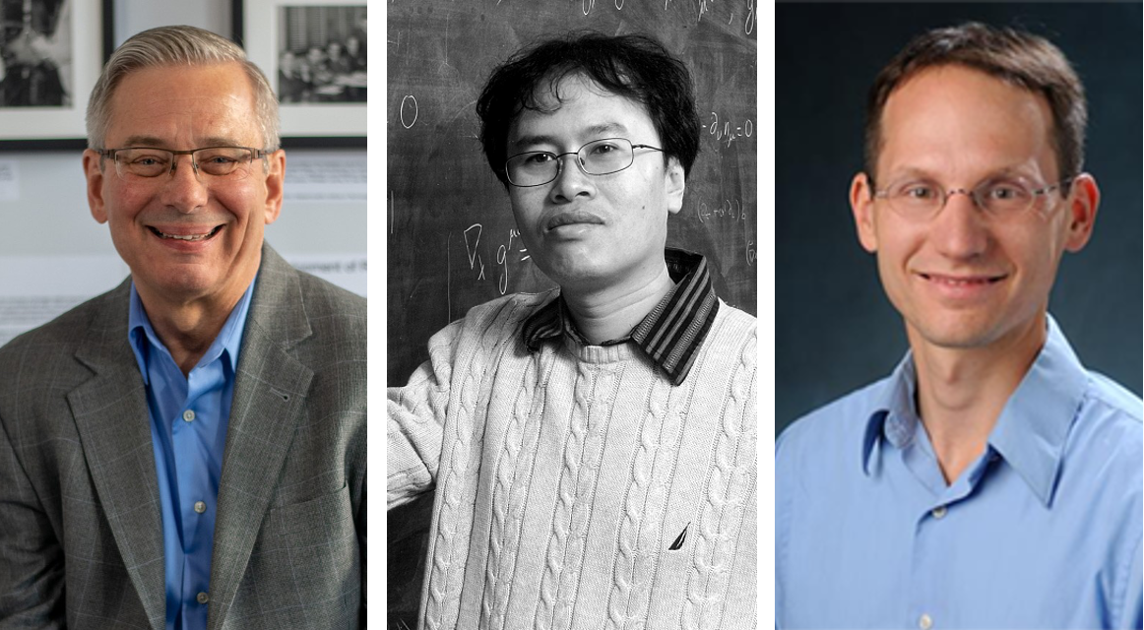
My nomination -- of course I never get asked for nominations ☺
Emergent phenomena
QGP Near Perfect Fluid, Fundamental Property of Nature
Connection to string theory (AdS/CFT)
Withstands the test of time
Problems – many, many more people (RHIC, LHC & experiment, theory)
no phase transition, no quasi-particle explanation

Slide 23
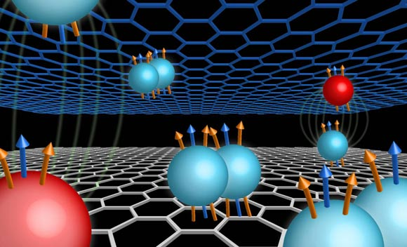
Emergent Phenomena Nobel Prize Example
Fractional quantum hall effect
https://www.nature.com/articles/s41567-019-0547-z
Exciting condensed matter
emergent phenomena.
Simple quasi-particle explanation!
Very crisp experimental signature.
Right number of people (3)!

Slide 24
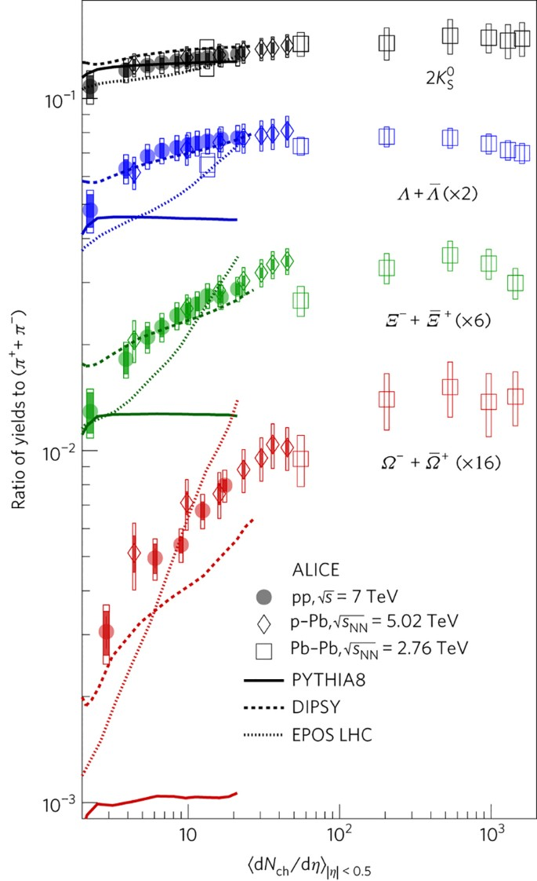
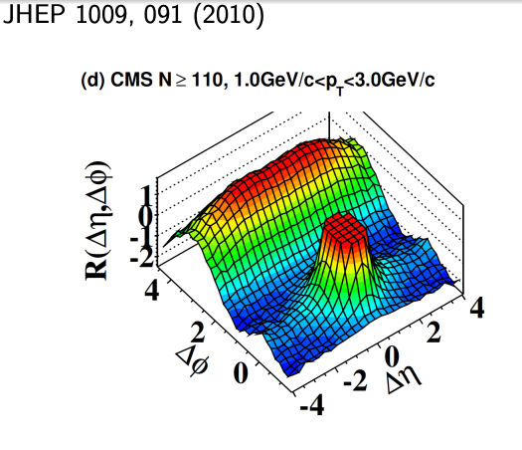
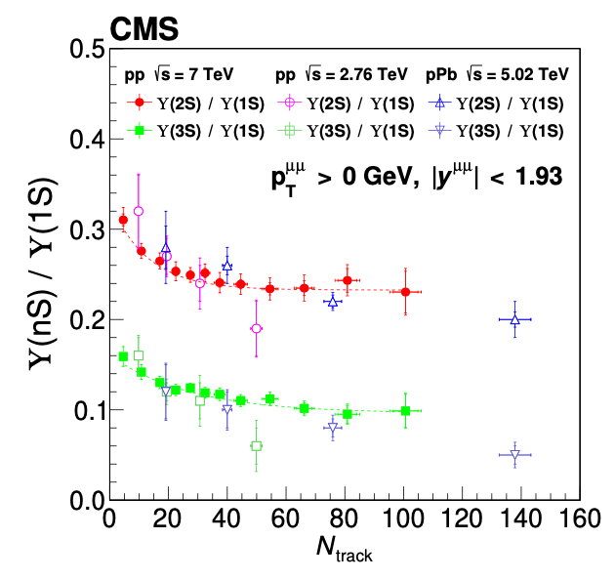
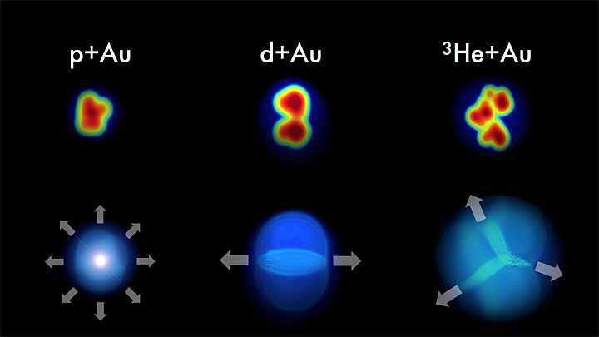
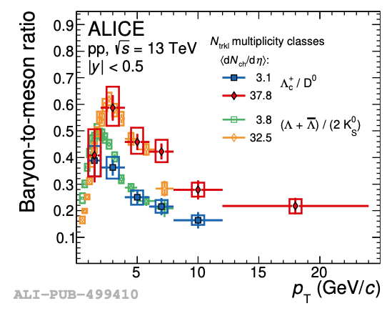
LHC-Led Small System Revolution
https://www.nature.com/articles/nphys4111

Slide 25
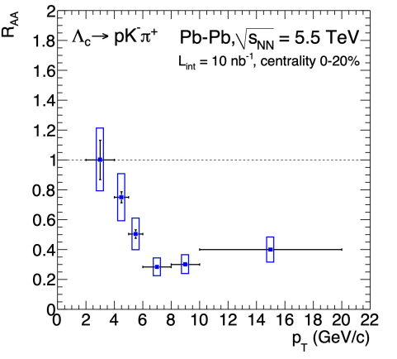
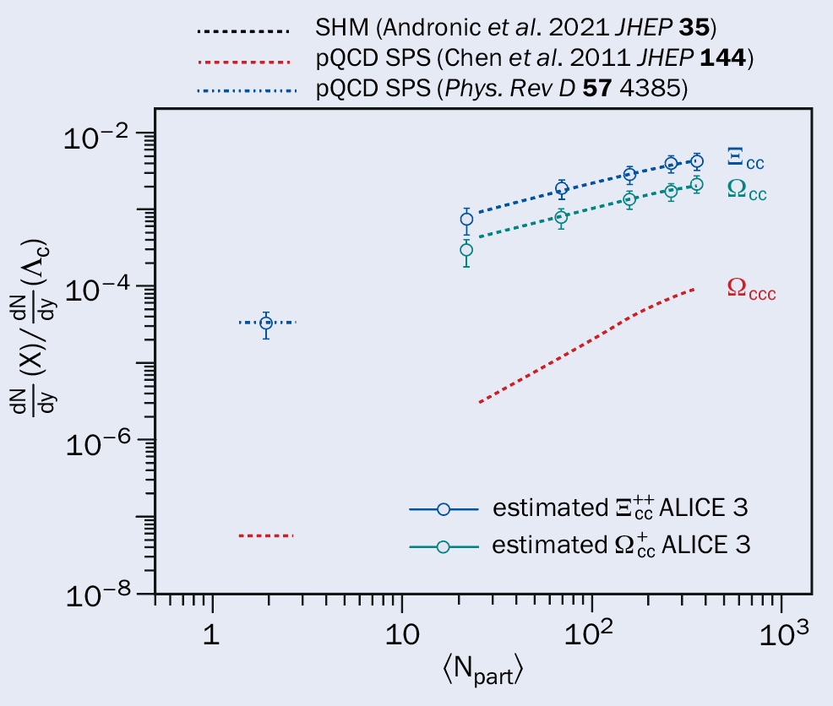
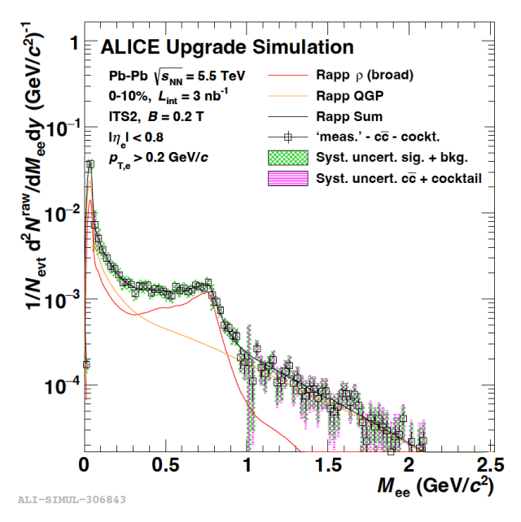
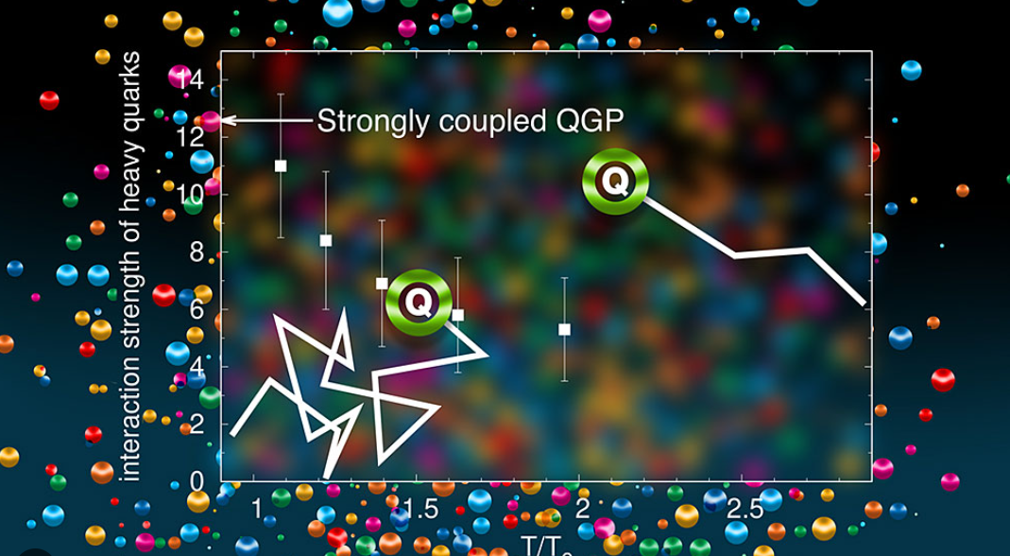
ALICE Probing Deconfinement and Chiral Symmetry Restoration
ALICE Simulation
Two (among many) exciting areas from ALICE Run-3 → Run-5 upgrades.
Constraining heavy flavor D_{s} (diffusion coefficient) or a model of ρ broadening is important, but deeper connections remains the challenge!

Slide 26
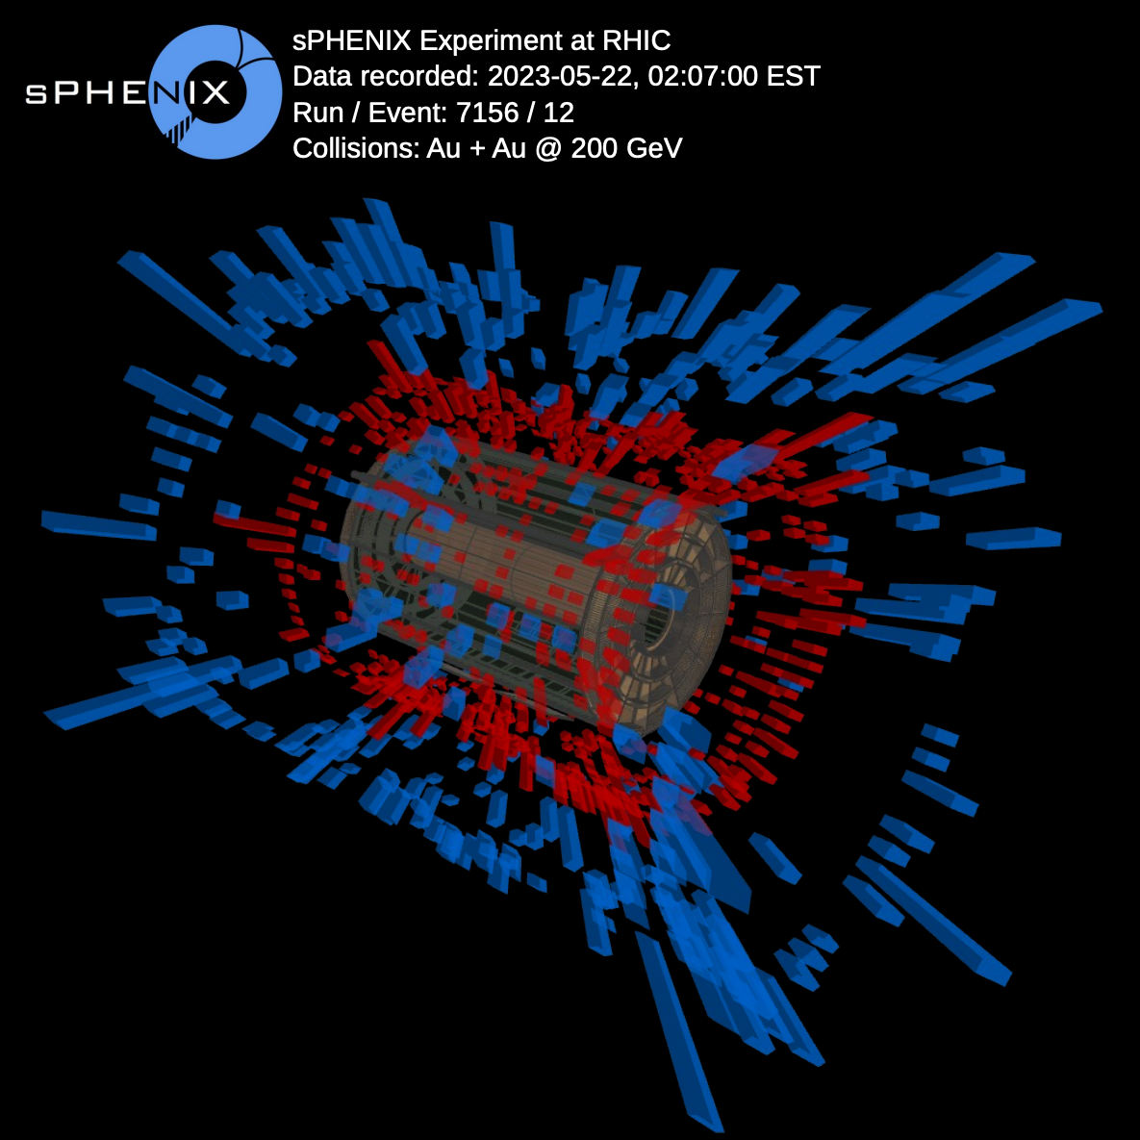
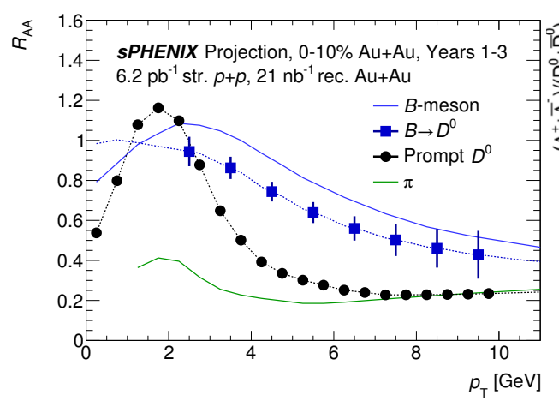
sPHENIX Now Commissioning with Beam
The field has always benefitted from excitation function of observables

Slide 27

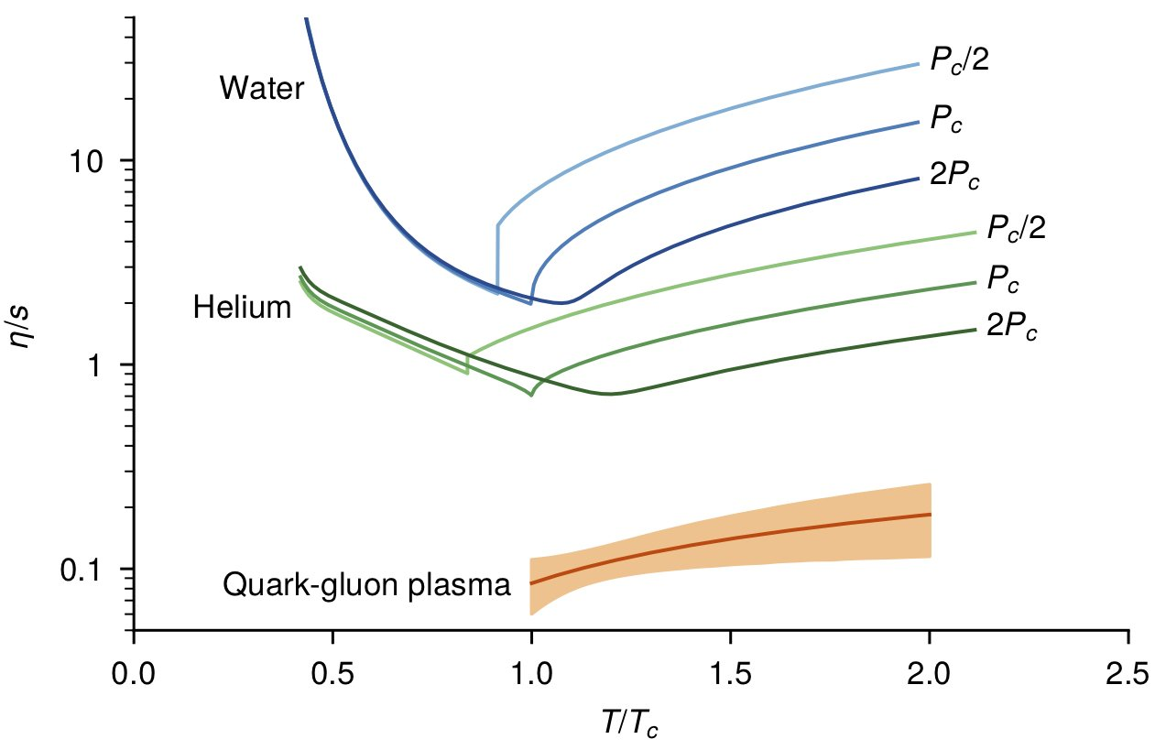

Fundamental
Puzzles
Stamp Collecting
Perfect Fluid
Heavy flavor R_{AA} and v_{n}
v_{n} also in small systems
Absence of jet quenching in small systems and maybe peripheral AA
Ultra-central puzzle
High differential flow, momentum correlations,
When do jets “see” inside the fluid – quasi-particles?
….
QCD Smooth Crossover
No phase transition
Many cosmological implications
Small System Implications
Hydrodynamic Applications
Attractors, strong field theory
More?
Future?

Slide 28
Fundamental
Puzzles
Stamp Collecting
?
Perfect Fluid
Heavy flavor R_{AA} and v_{n}
v_{n} also in small systems
Absence of jet quenching in small systems and maybe peripheral AA
Ultra-central puzzle
High differential flow, momentum correlations,
When do jets “see” inside the fluid – quasi-particles?
Low mass dilepton yields, distributions…
?
QCD Smooth Crossover
No phase transition
Many cosmological implications
Small System Implications
Hydrodynamic Applications
Attractors, strong field theory
More?
Future?
?

Slide 29
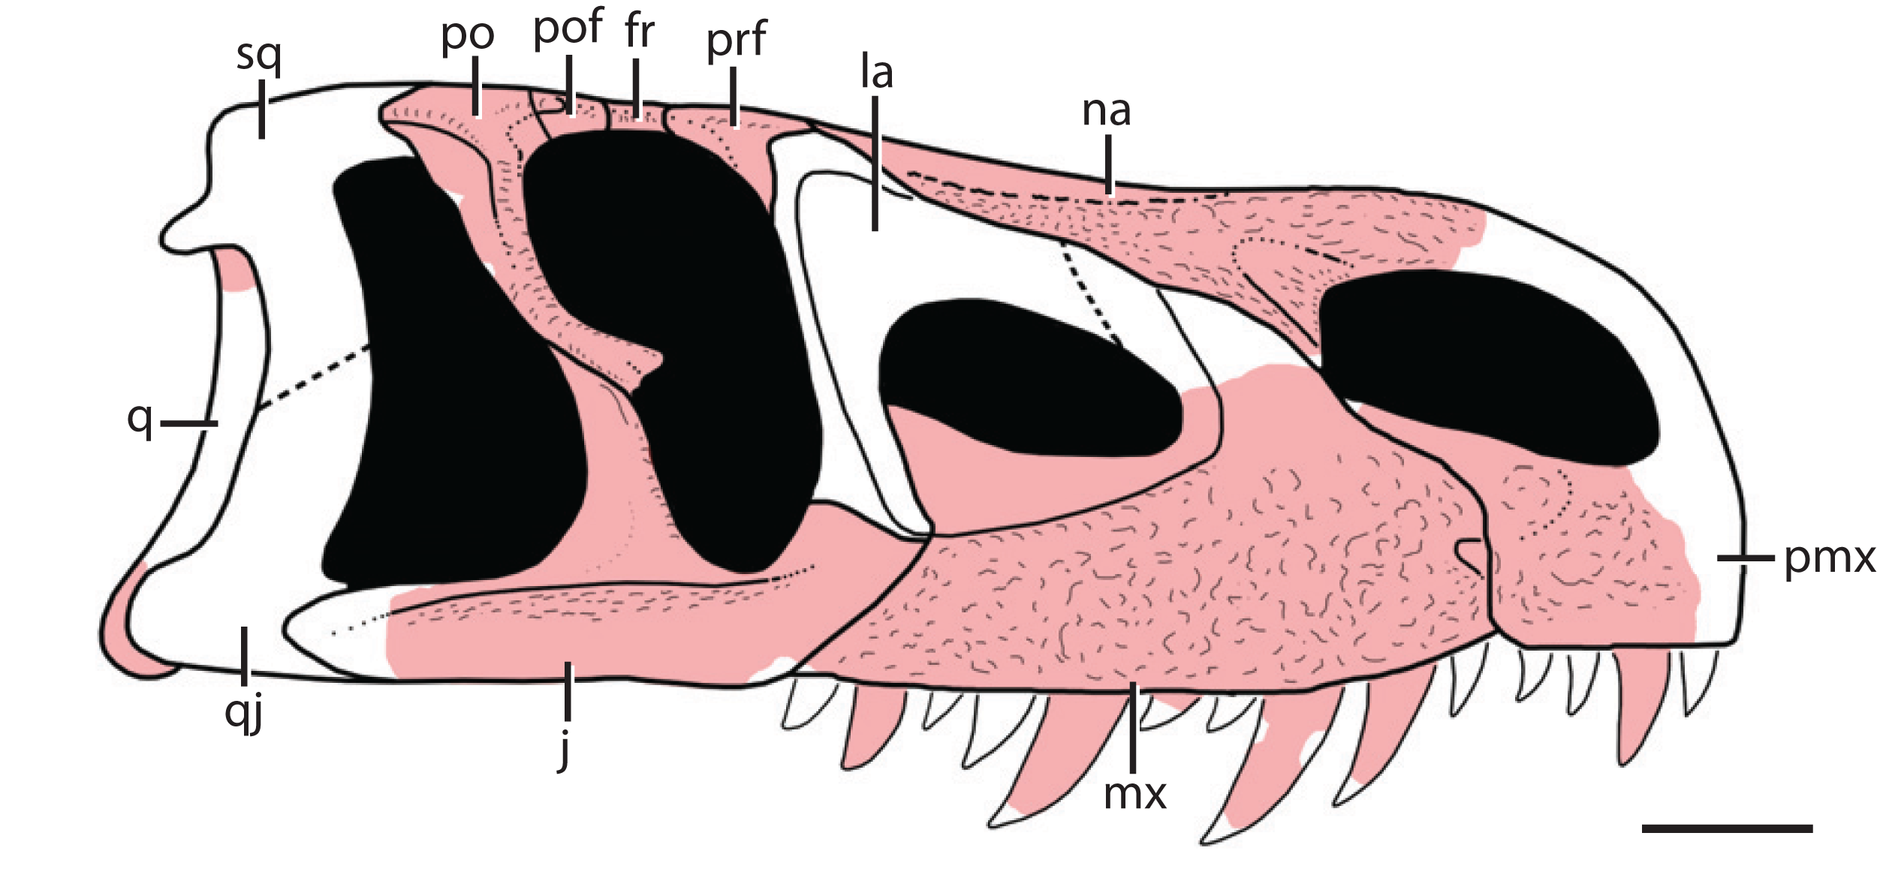
Ideas
Tested
Eventual Outcome
Chiral Magnet Effect Many, many, many, tests Footnote in field
Highlights key null tests by LHC
Color Glass Condensate Many, many many, tests Footnote in field
No observational confirmation EIC?
Critical Point at μ_{B} > 0 Now underway (STAR, CBM, …) ???
BES final understanding will depend critically on critical thinking
Avoid history of
horn, kink, step, dale

Slide 30

Title: Nobel Dreams: Quark-Gluon Plasma?
Scientists work tirelessly for knowledge gain, both personal and for humankind. At the same time, we seek external affirmation, and there is no bigger prize than the Nobel Prize in Physics. Why is there no Nobel Prize for the Quark-Gluon Plasma discovery or for the unearthing of its nature? In this talk we explore the broader context of the Quark-Gluon Plasma and its implications and recognition beyond our field. At the same time, we examine what we have learned and where that may take us.

Slide 31

Title: Nobel Dreams: Quark-Gluon Plasma?
Scientists work tirelessly for knowledge gain, both personal and for humankind. At the same time, we seek external affirmation, and there is no bigger prize than the Nobel Prize in Physics. Why is there no Nobel Prize for the Quark-Gluon Plasma discovery or for the unearthing of its nature? In this talk we explore the broader context of the Quark-Gluon Plasma and its implications and recognition beyond our field. At the same time, we examine what we have learned and where that may take us.
With or without a Nobel Prize for the field, the science is rich and with many interesting puzzles to attack.

Slide 32
EXTRAS

Slide 33
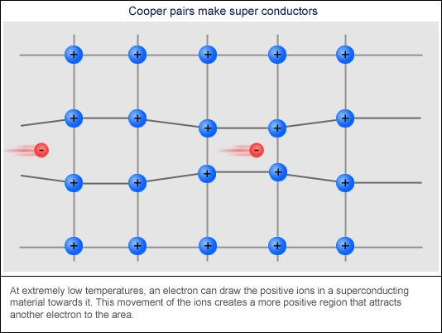
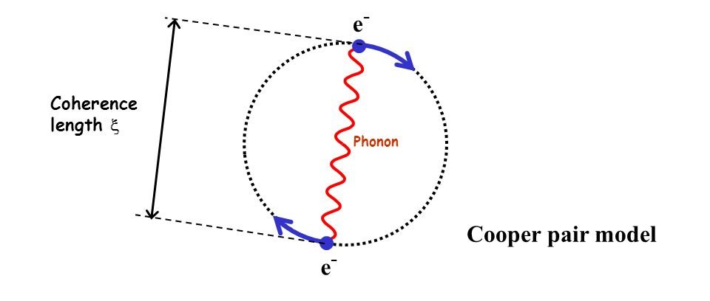
Emergent Phenomena Nobel Prizes
BCS-Theory of Superconductivity (1972)
https://journals.aps.org/pr/abstract/10.1103/PhysRev.108.1175
Exciting condensed matter
emergent phenomena.
Simple quasi-particle explanation!

Slide 34
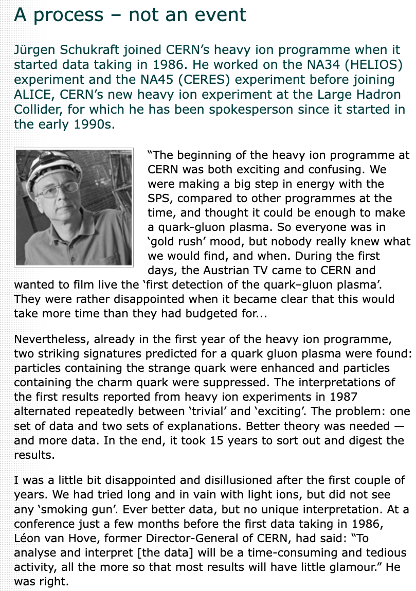
https://public-archive.web.cern.ch/en/People/Schukraft-en.html

Slide 35
