Slide 1
Longitudinal decorrelation measurements from pp to A+A with the ATLAS detector
Jamie Nagle, University of Colorado Boulder
20th International Conference on Strangeness in Quark Matter
13-17 June 2022 Busan, Republic of Korea

Slide 2
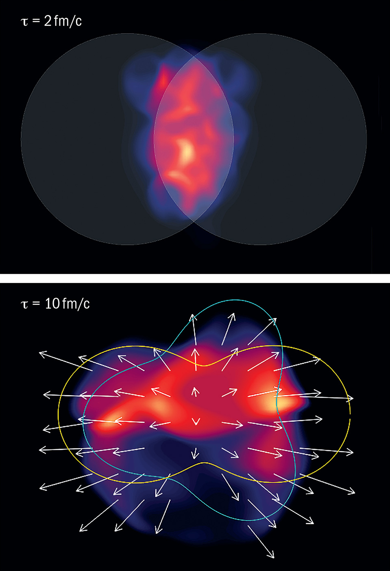
Flow in Heavy Ion Collisions
Spatial geometry of the initial state translates into momentum anisotropy in the final state
How does this picture translate from
large systems (e.g., PbPb, AuAu, XeXe)
to small systems (e.g., pp, pPb, OO)?
What about a full
3-dimensional picture?
https://cerncourier.com/a/going-with-the-flow/

Slide 3
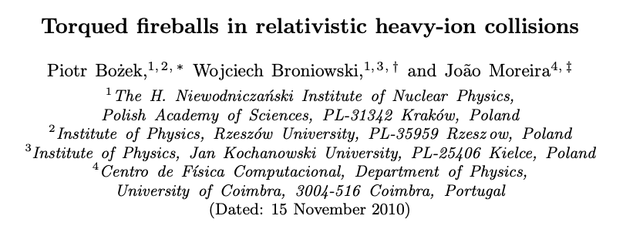
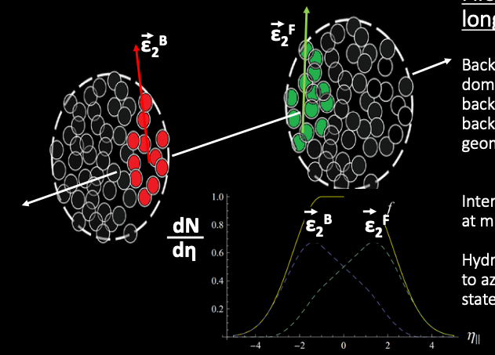
Pseudorapidity dependent geometry
Phys.Rev.C 83 (2011) 034911, e-Print: 1011.3354 [nucl-th]
Can we constrain the initial deposition of energy in both the transverse and longitudinal directions?

Slide 4
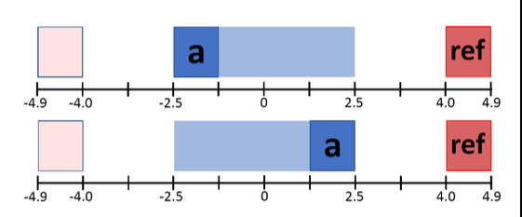
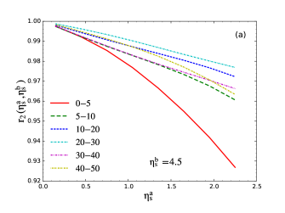
How to quantify?
Measure two-particle correlations between particle pairs (-a and ref) and (+a and ref)
Calculate ratio of Fourier coefficients as r_{n}
Then calculate the “linear” slope F_{n}
-
+
PbPb AMPT + Hydrodynamics
Xiang-Yu Wu, Long-Gang Pang, Guang-You Qin, and X-N Wang
Phys. Rev. C 98, 024913

Slide 5
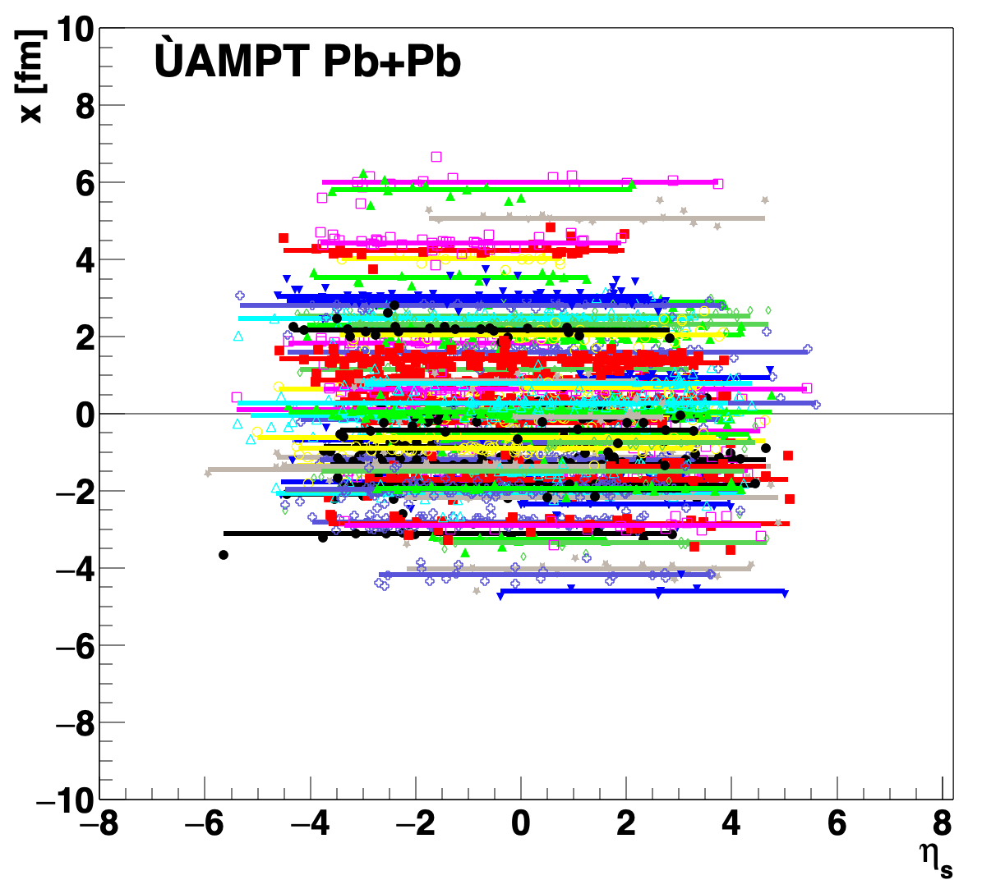
Pb+Pb: ATLAS Data and Theory
η-dependent geometry from strings in AMPT
Decorrelation via φ (direction) and M (magnitude) and both together
Reasonable agreement with ATLAS measurement!
* Note that this is not the overall decorrelation, but the relative decorrelation between (-a and ref) & (+a and ref)
F₂
F₃
F₄
Pb+Pb
https://link.springer.com/article/10.1140/epjc/s10052-018-5605-7

Slide 6
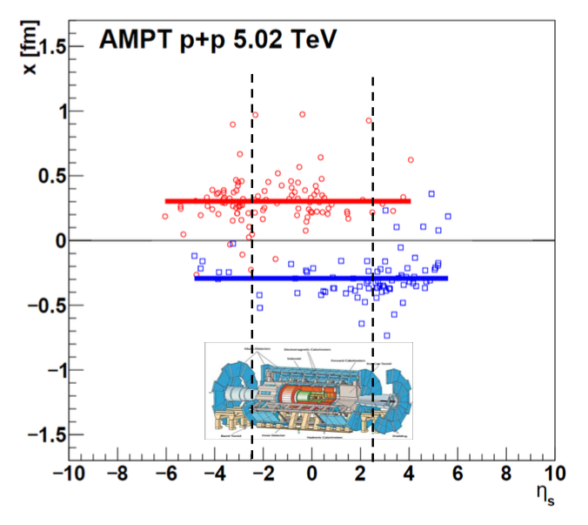
What about smaller systems?
Single string per participant produces a simple geometry in pp collisions
One can have large geometry variations with pseudorapidity due to fluctuations in the initial partons emitted
However, the relative decorrelation between (-a and ref) & (+a and ref)
will be the same and hence F_{n} ≅ 0
Nice, testable prediction.

Slide 7
ATLAS Analysis
ATLAS Data Sets:
pp 13 TeV, pp 5.02 TeV, XeXe 5.44 TeV
Step #1:
Two-particle correlations between midrapidity and reference forward rapidity and measure the Fourier moments
Step #2:
(New) Must also perform a non-flow subtraction for each correlation
Step #3:
Calculate r_{n} and F_{n}
a-objects are reconstructed charged tracks
ref-objects are calorimeter clusters (pp) and calorimeter towers (XeXe)
https://atlas.web.cern.ch/Atlas/GROUPS/PHYSICS/
CONFNOTES/ATLAS-CONF-2022-020/00

Slide 8
v_{2,2}(η_{a}) and non-flow subtraction
Dominant effect is non-flow, i.e., when
particle-a is close to particle-ref, there is a larger “dijet/jet” contribution
Decorrelation is the remaining η_{a} dependence!

Slide 9
v_{2,2}(η_{a}) and non-flow subtraction

Slide 10
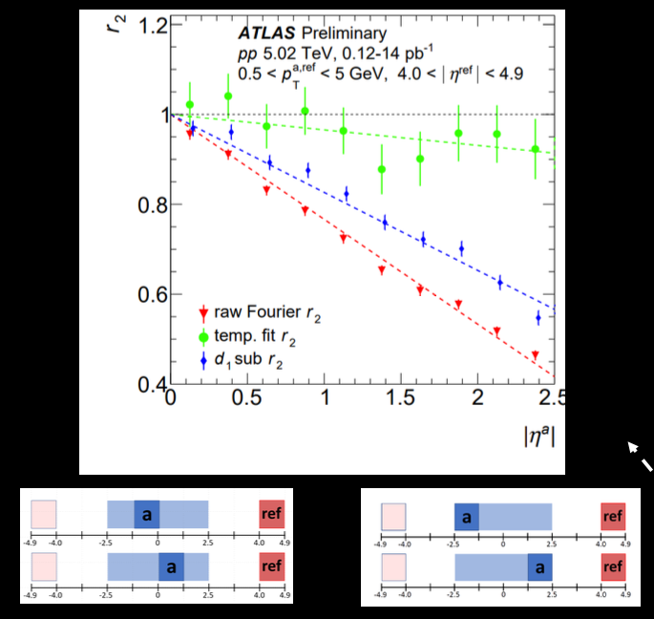
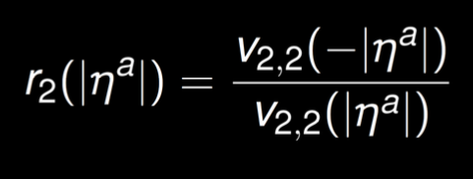
Raw Fourier F₂: combination of decorrelation and η_{a}-dependent nonflow (i.e., dijets,jets)
Template Fit F₂: subtracts off ~85% of the raw decorrelation as nonflow
d₁ subtraction F2: subtracts off ~25% of raw decorrelation as nonflow

Slide 11
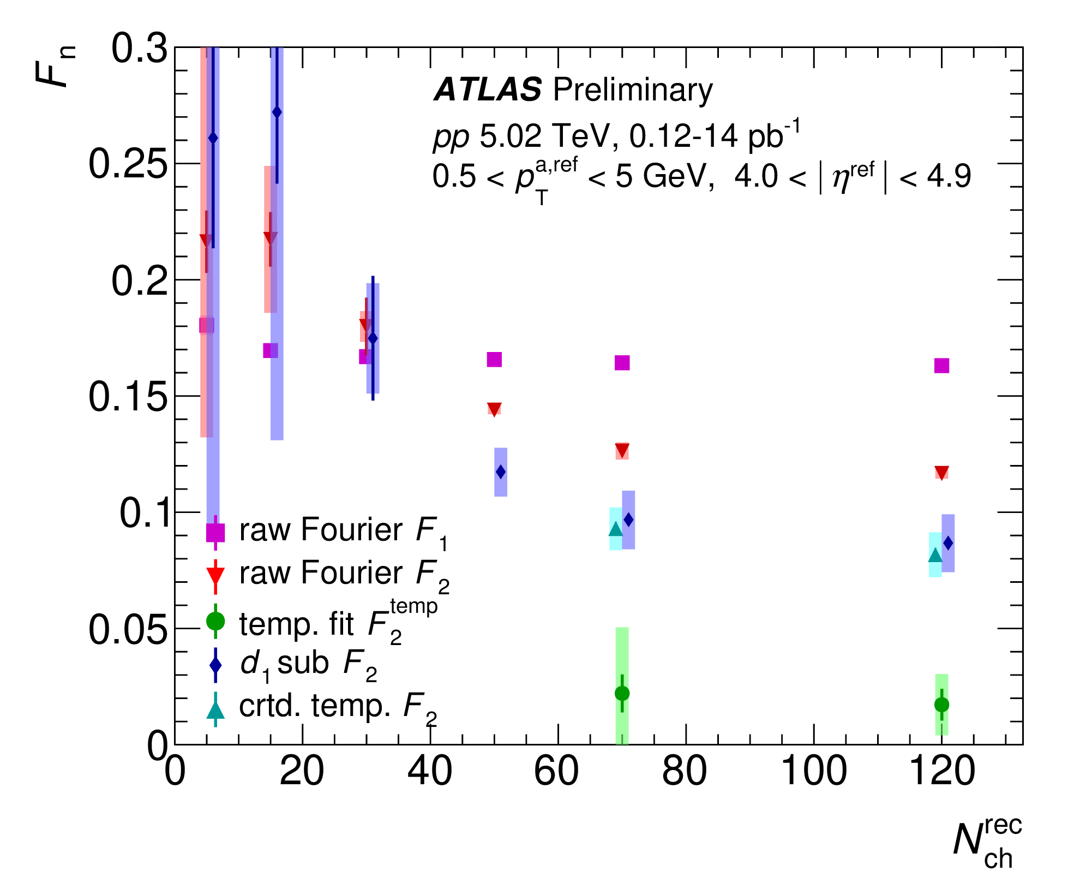
Quantification
Raw F₁ – essentially all nonflow and hence independent of N_{ch}
Raw Fourier F₂: combination of decorrelation and η_{a}-dependent nonflow (i.e., dijets, jets)
Template Fit F₂: subtracts off
~85% of the raw decorrelation
as nonflow
d₁ subtraction F₂: subtracts off ~25% of the raw decorrelation
as nonflow

Slide 12
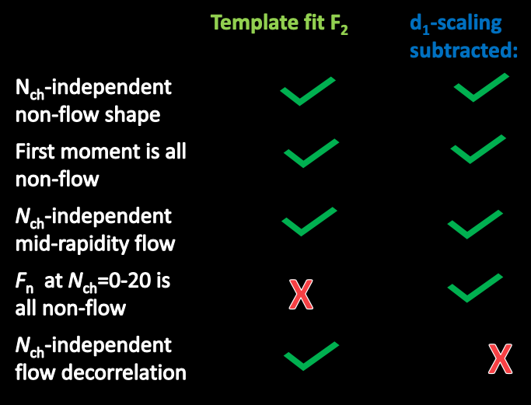
Where does the truth lie?
One new method added (”corrected template”) that corrected for
the last assumption in the template fitting method

Slide 13
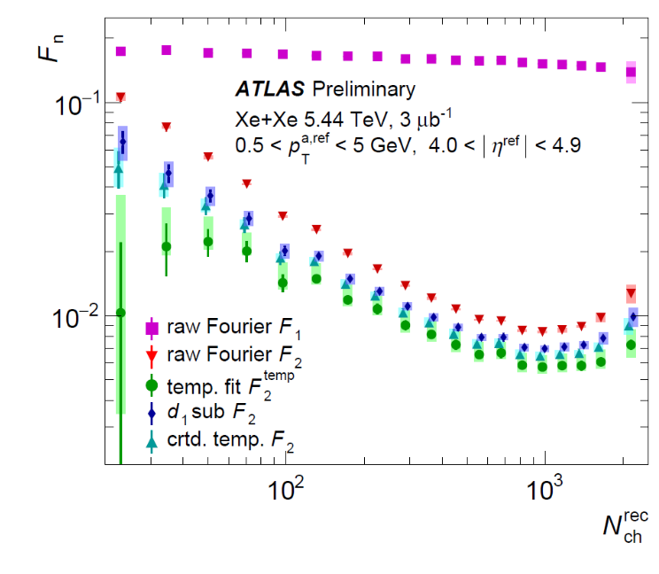
Xe+Xe Results
Raw F₁ – essentially all nonflow and hence independent of N_{ch}
Raw Fourier F₂: combination of decorrelation and η_{a}-dependent nonflow (i.e., dijets, jets)
Template Fit F₂: subtracts off
~30% of the raw decorrelation
as nonflow
d₁ subtraction F₂: subtracts off ~20% of the raw decorrelation
as nonflow
Much smaller nonflow subtraction contribution; however,
quantitative results are sensitive even in the most central collisions.

Slide 14
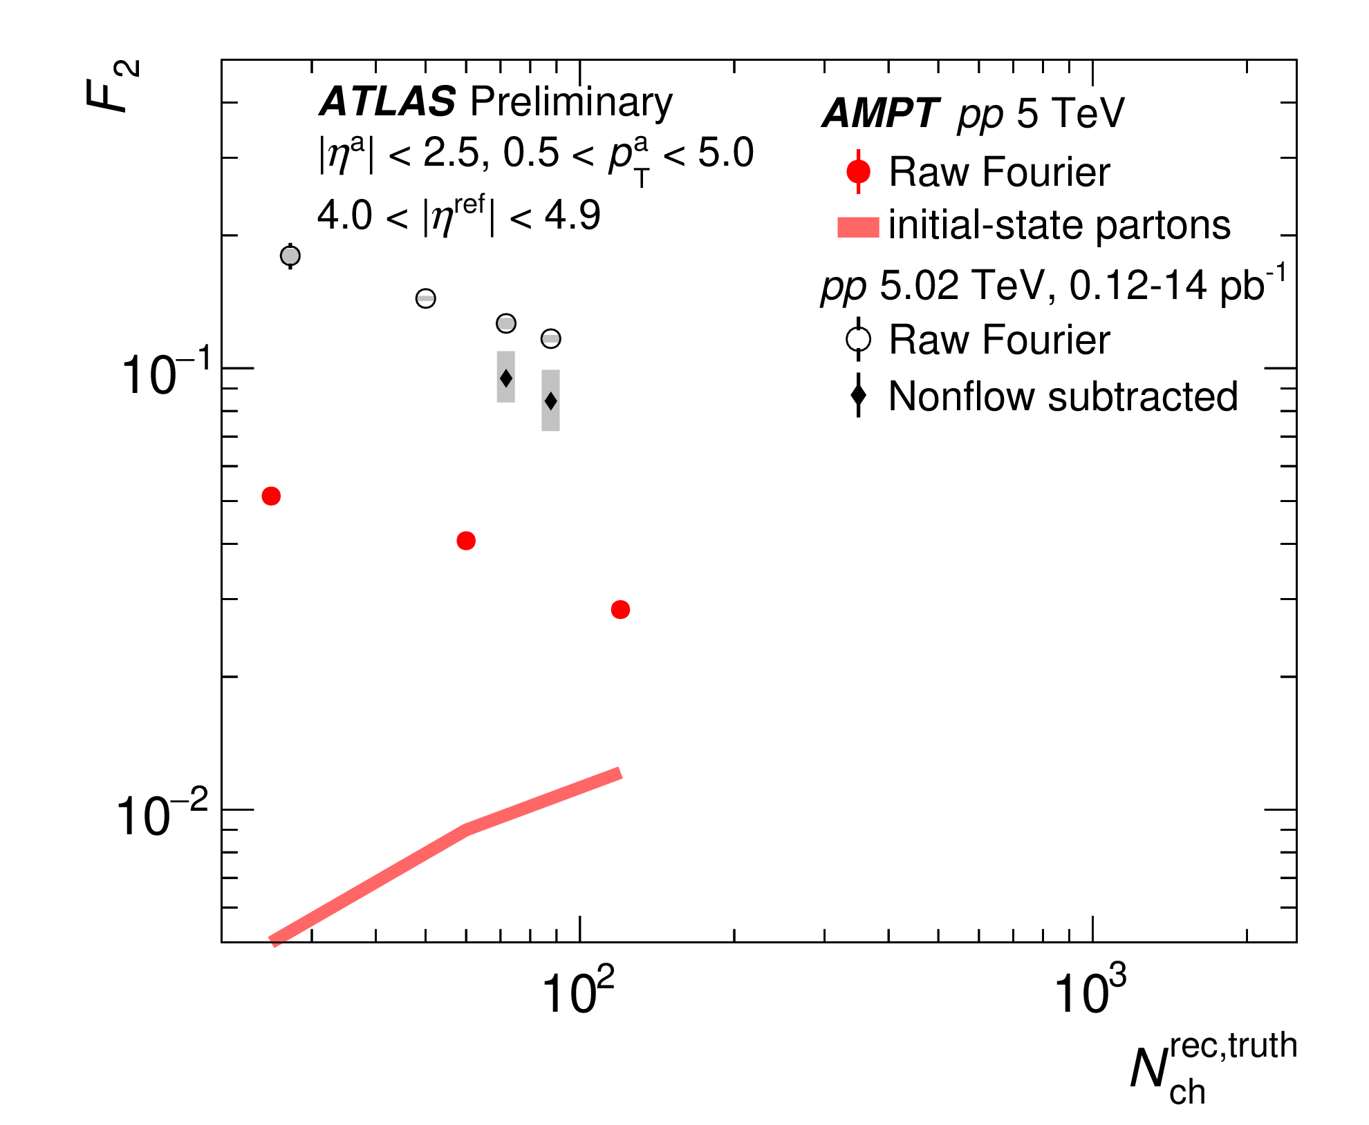
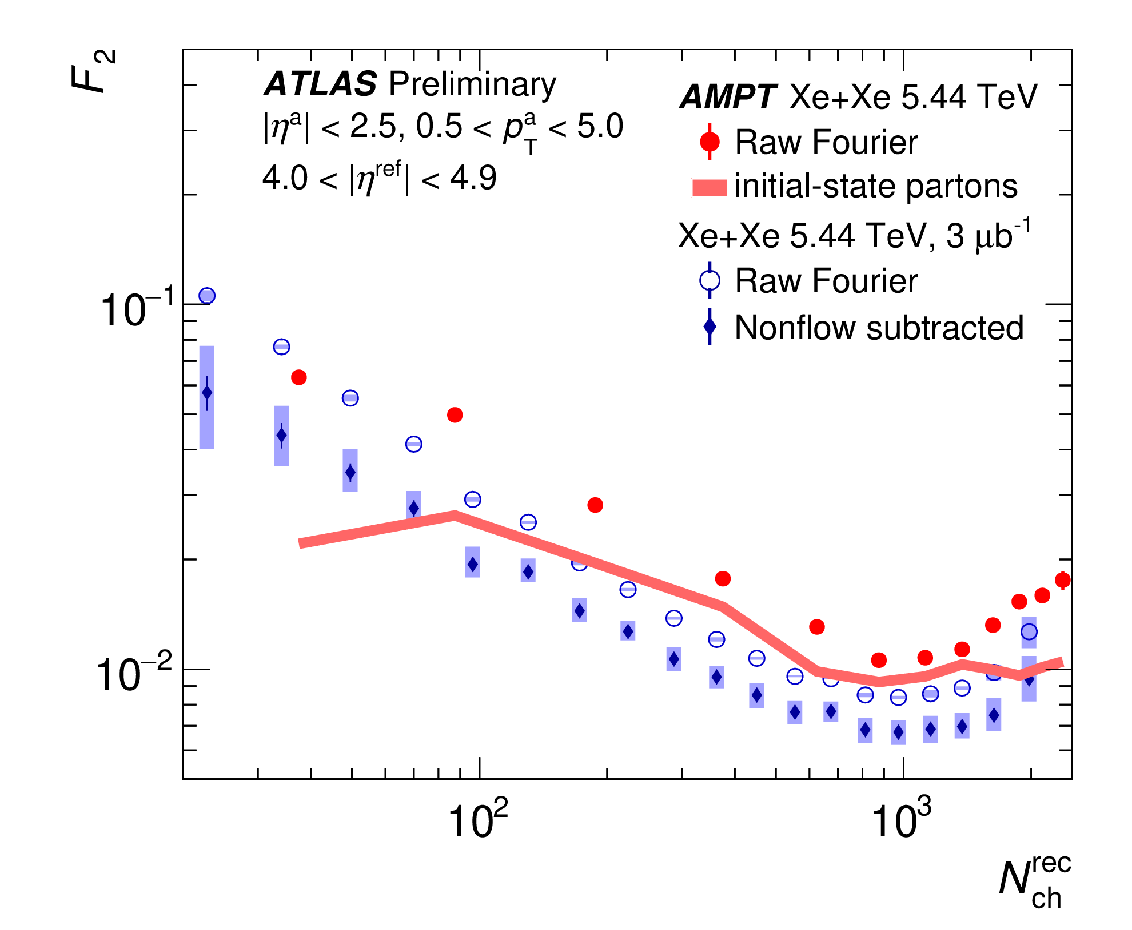
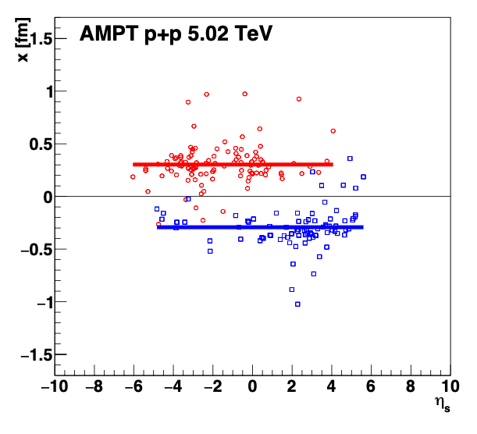
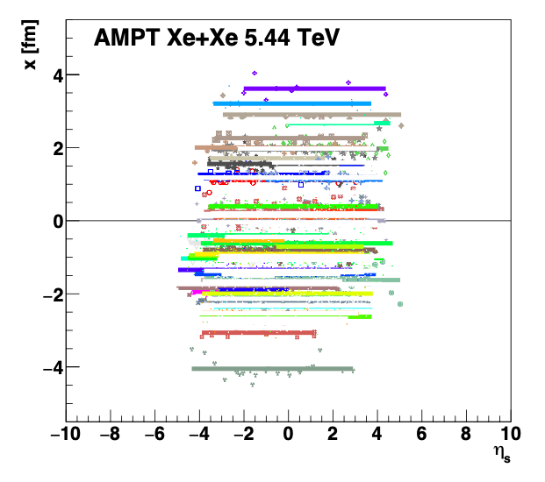
pp and Xe+Xe longitudinal decorrelations

Slide 15
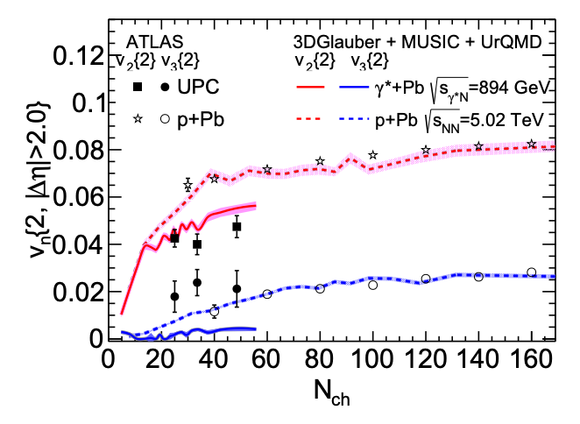
Ultraperipheral Collisions
Treat γ* + Pb
at single E = 894 GeV,
two valance quarks
(vector meson dominance),
regular min. bias impact parameter
A lot of simplifications… but
What really matters to making
v₂ (γ∗Pb) < v₂ (pPb)?
p+Pb
γ*+Pb
e-Print: 2203.06094

Slide 16
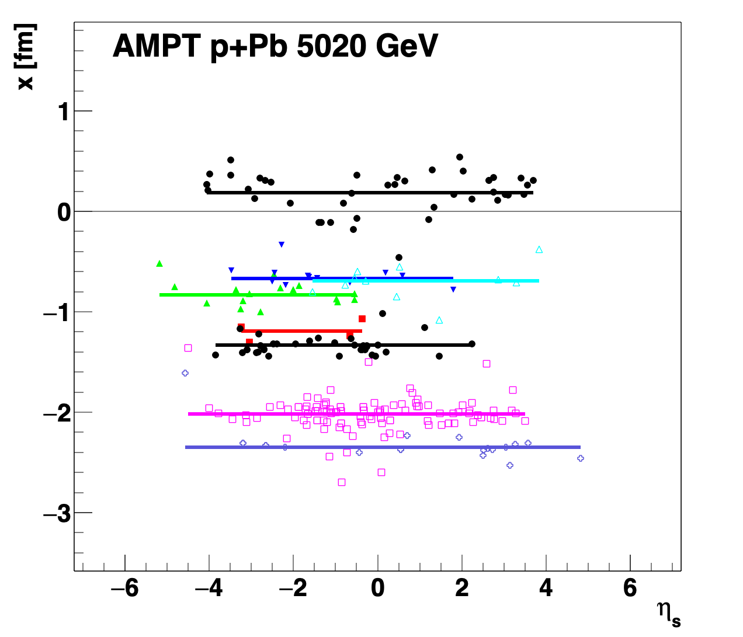
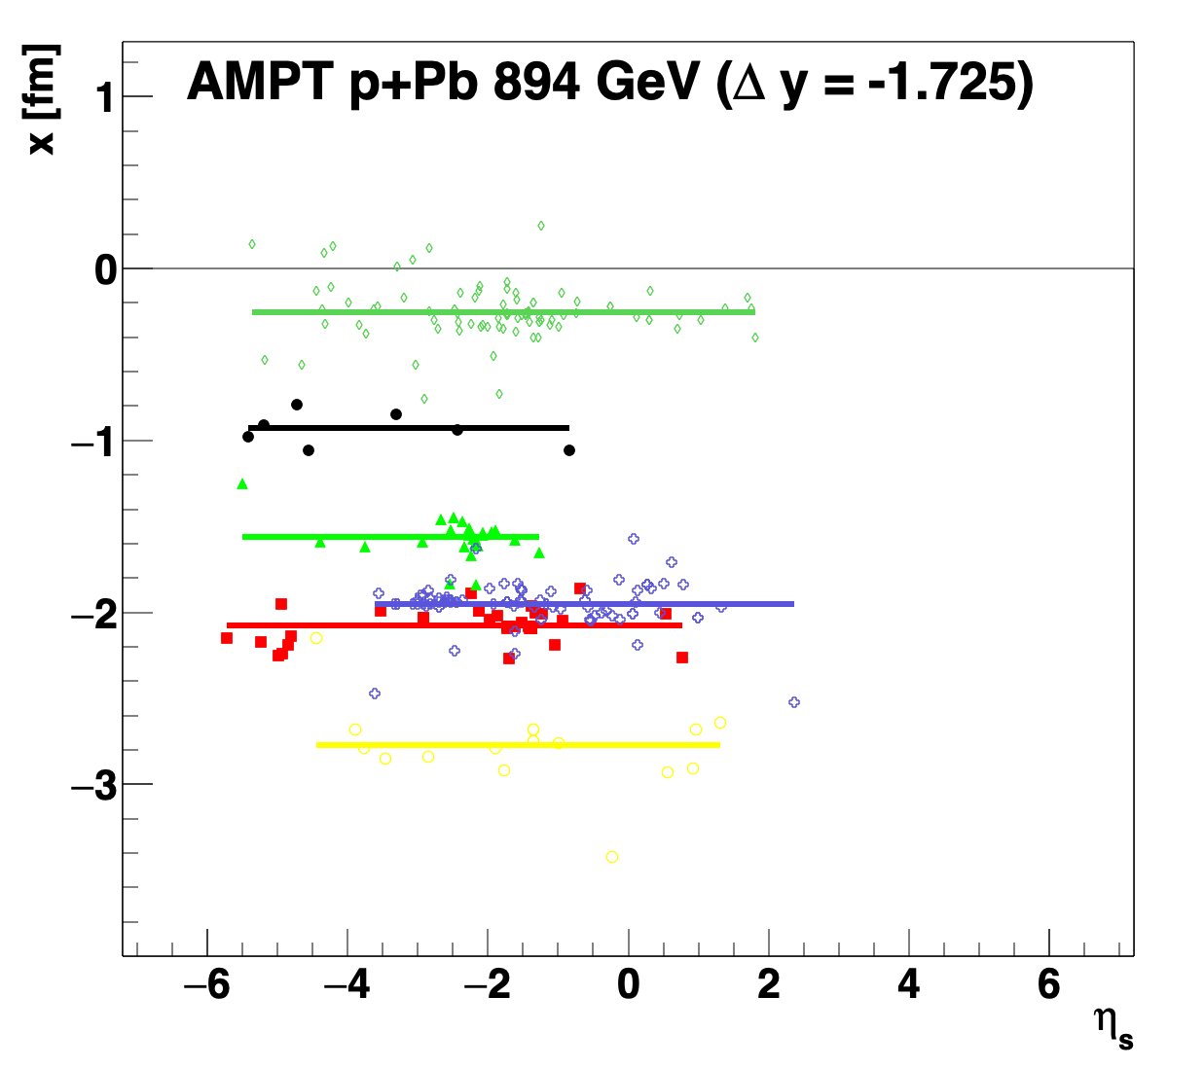
What really matters to making
v₂ (γ∗Pb) < v₂ (pPb) ?
ρ
v₂ is from a two-particle correlation with|Δη| > 2 gap.
γ*Pb is like ρPb at 894 GeV, but shifted in rapidity
Much larger longitudinal decorrelation!

Slide 17
Summary
Preliminary ATLAS results for longitudinal decorrelations
from pp 5.02, 13 TeV and Xe+Xe 5.44 TeV shown
Theoretical calculations (string type) capture
key decorrelation features in Xe+Xe mid to central;
however, pp and peripheral Xe+Xe
substantially underpredict the data
Future tests on nonflow subtraction assumptions are an important next step combined with additional theoretical comparisons for initial state longitudinal geometry
* See Blair Seidlitz’s talk at Quark Matter 2022 for additional details https://indico.cern.ch/event/895086/contributions/4716148/

Slide 18
EXTRA SLIDES

Slide 20
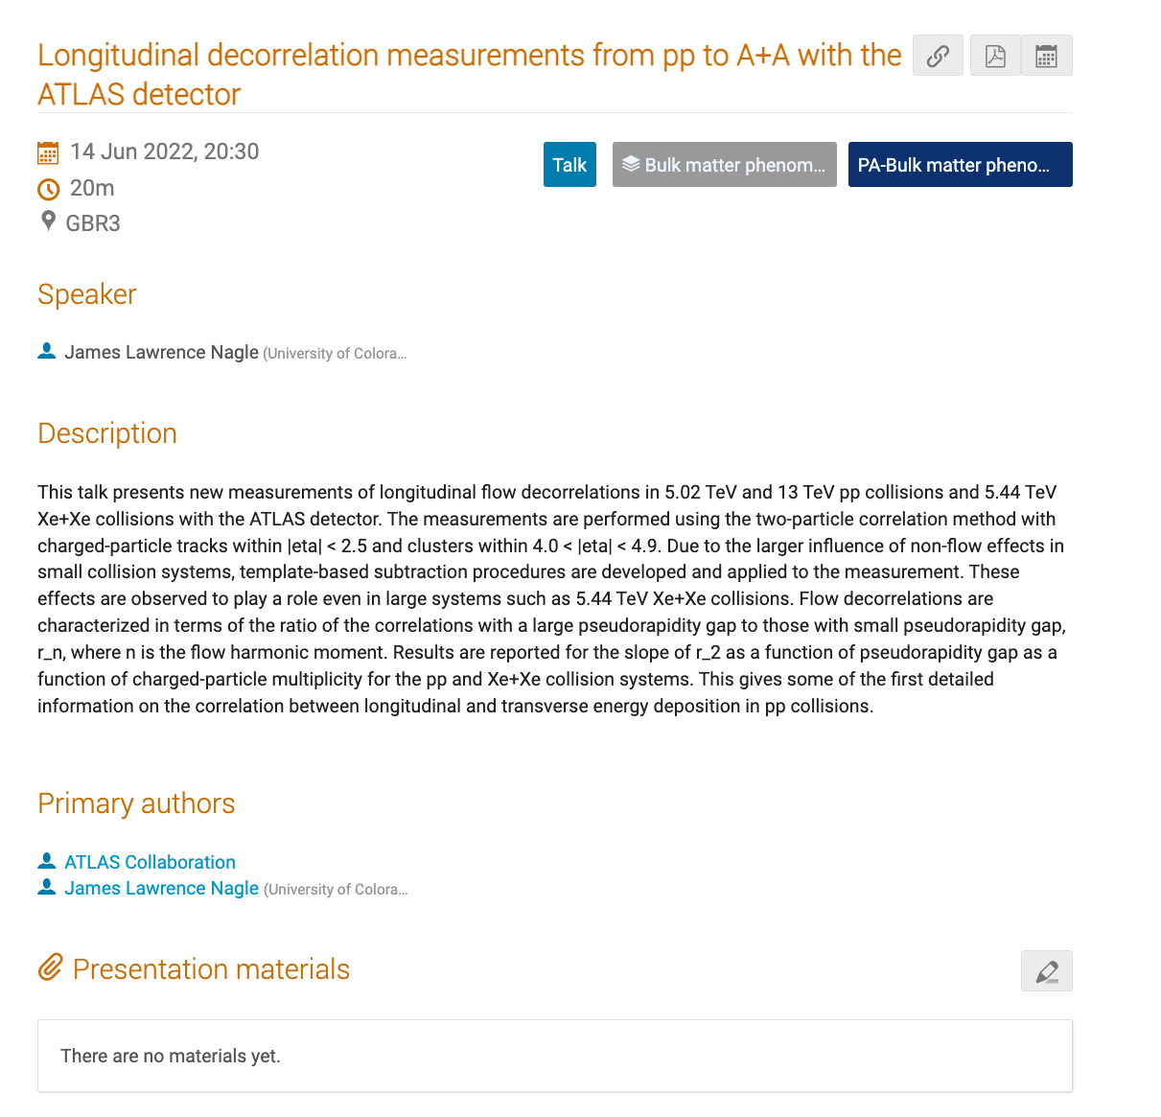
15’ + 5’ (Q&A)

