Slide 1
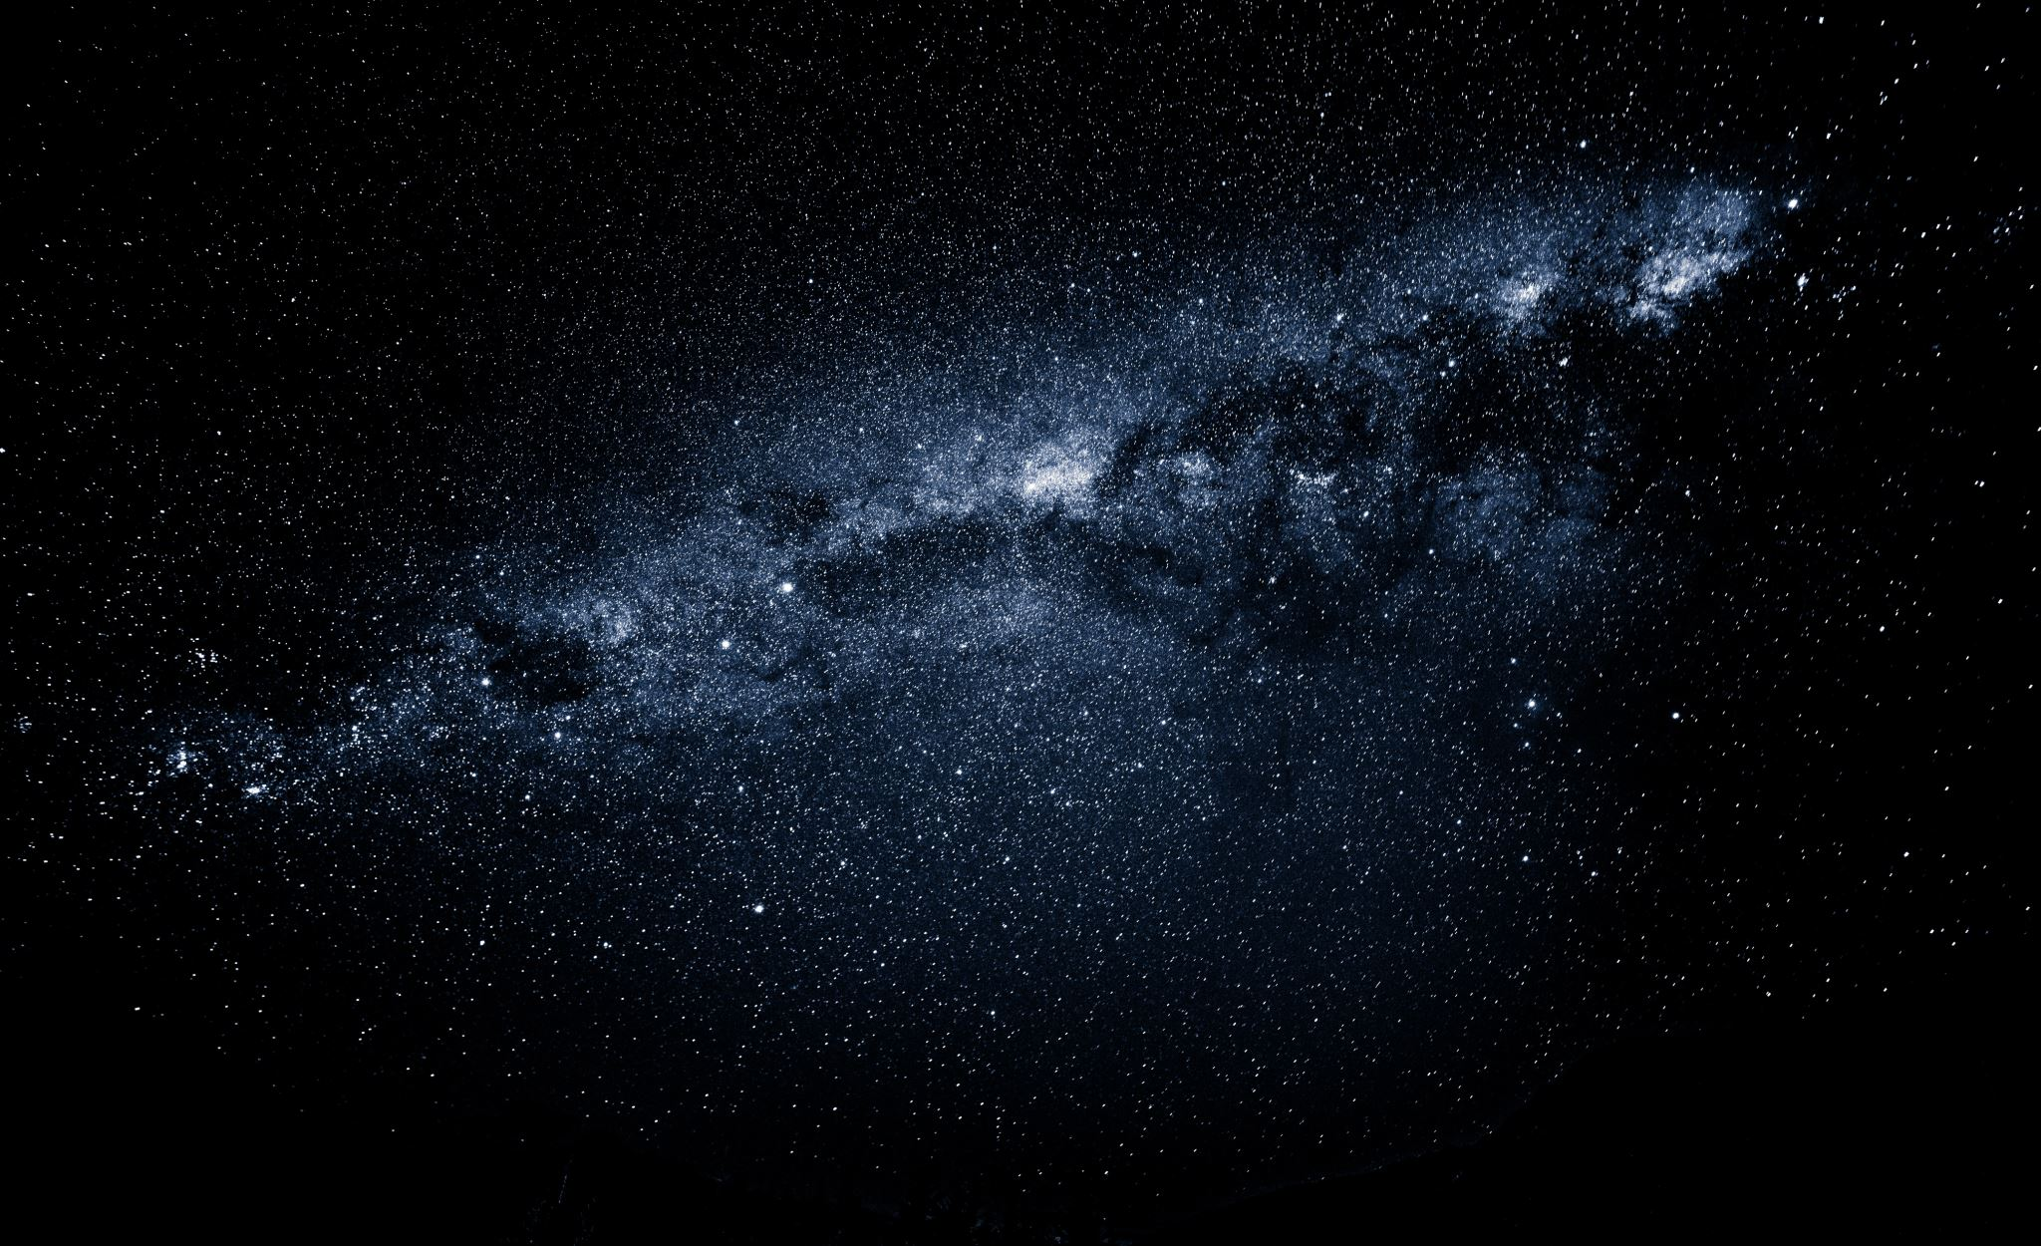
Exciting Developments in Nuclear Physics
Jamie Nagle
University of Colorado Boulder
Looking back at the early universe

Slide 2
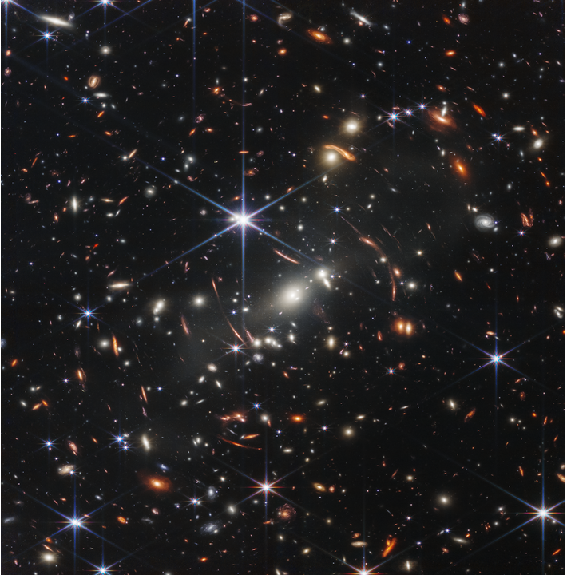
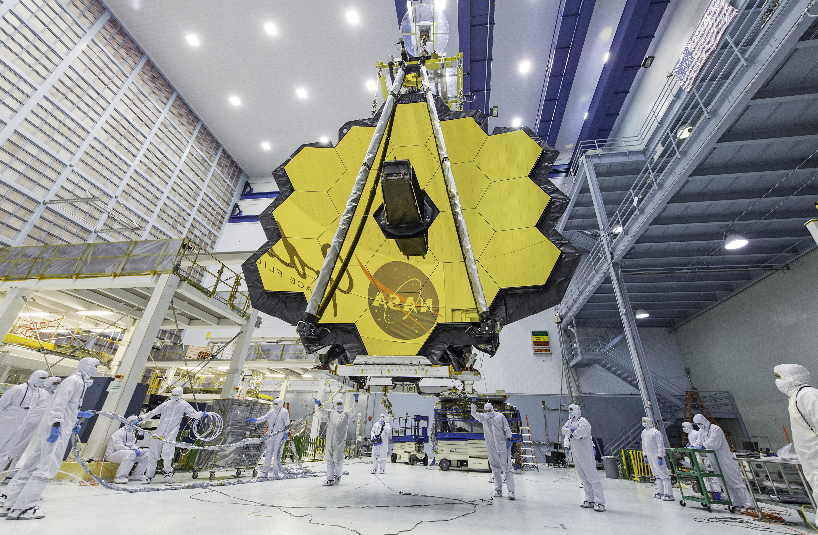
The Webb Telescope
is providing images
of the universe from
235 million years
after the big bang
out of 13.77 billion years.

Slide 3
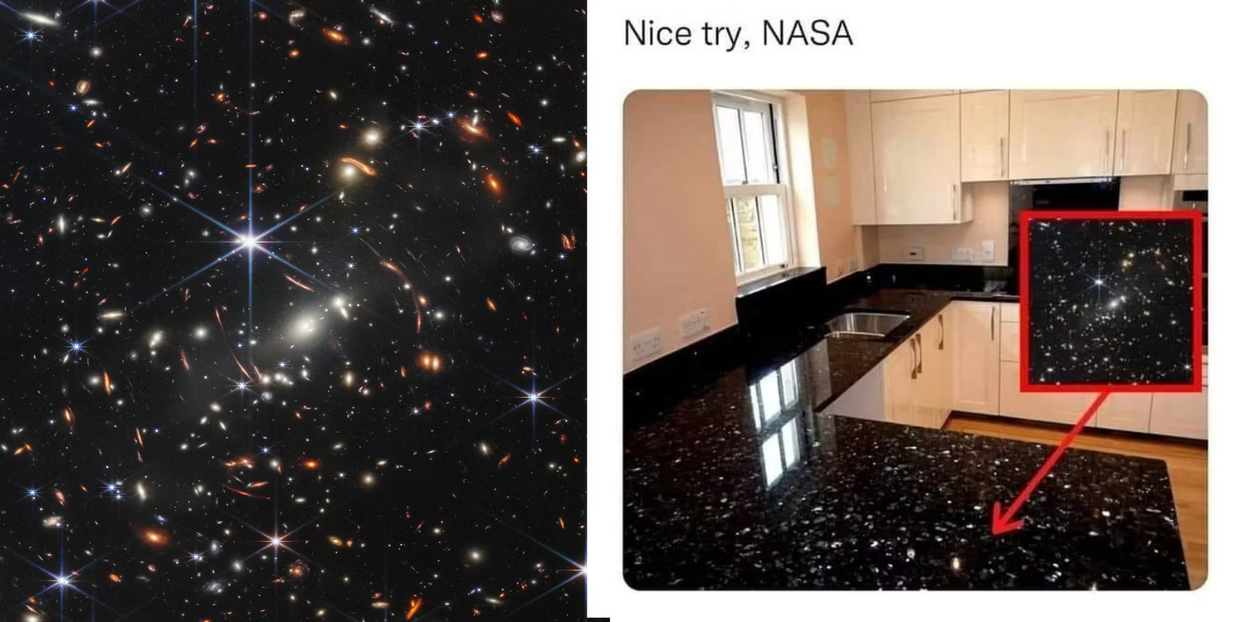

Slide 4
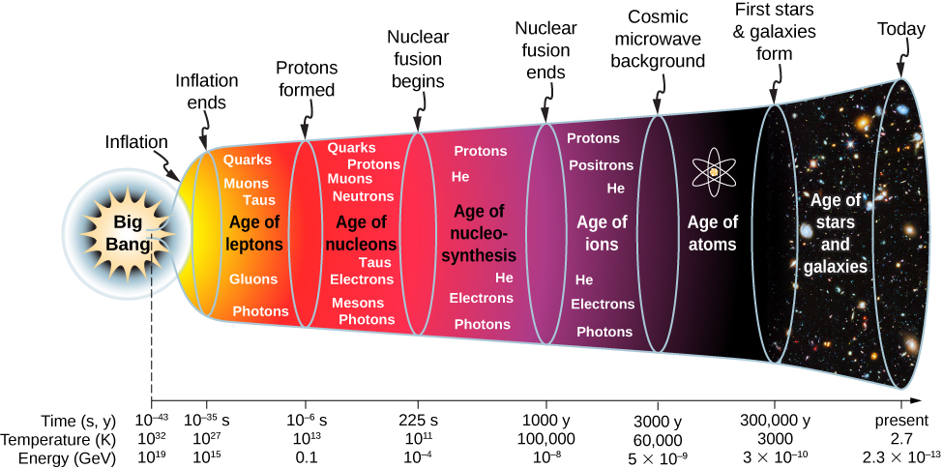
Webb is looking at light from here
Nuclear physicists are interested in matter here at 2,000,000,000,000 ⁰F

Slide 5
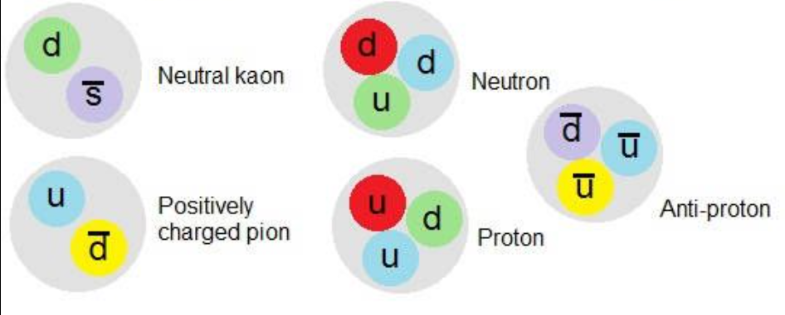
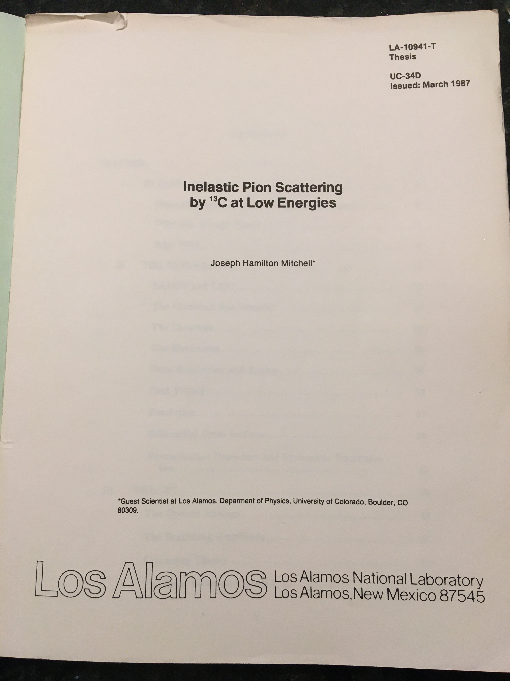
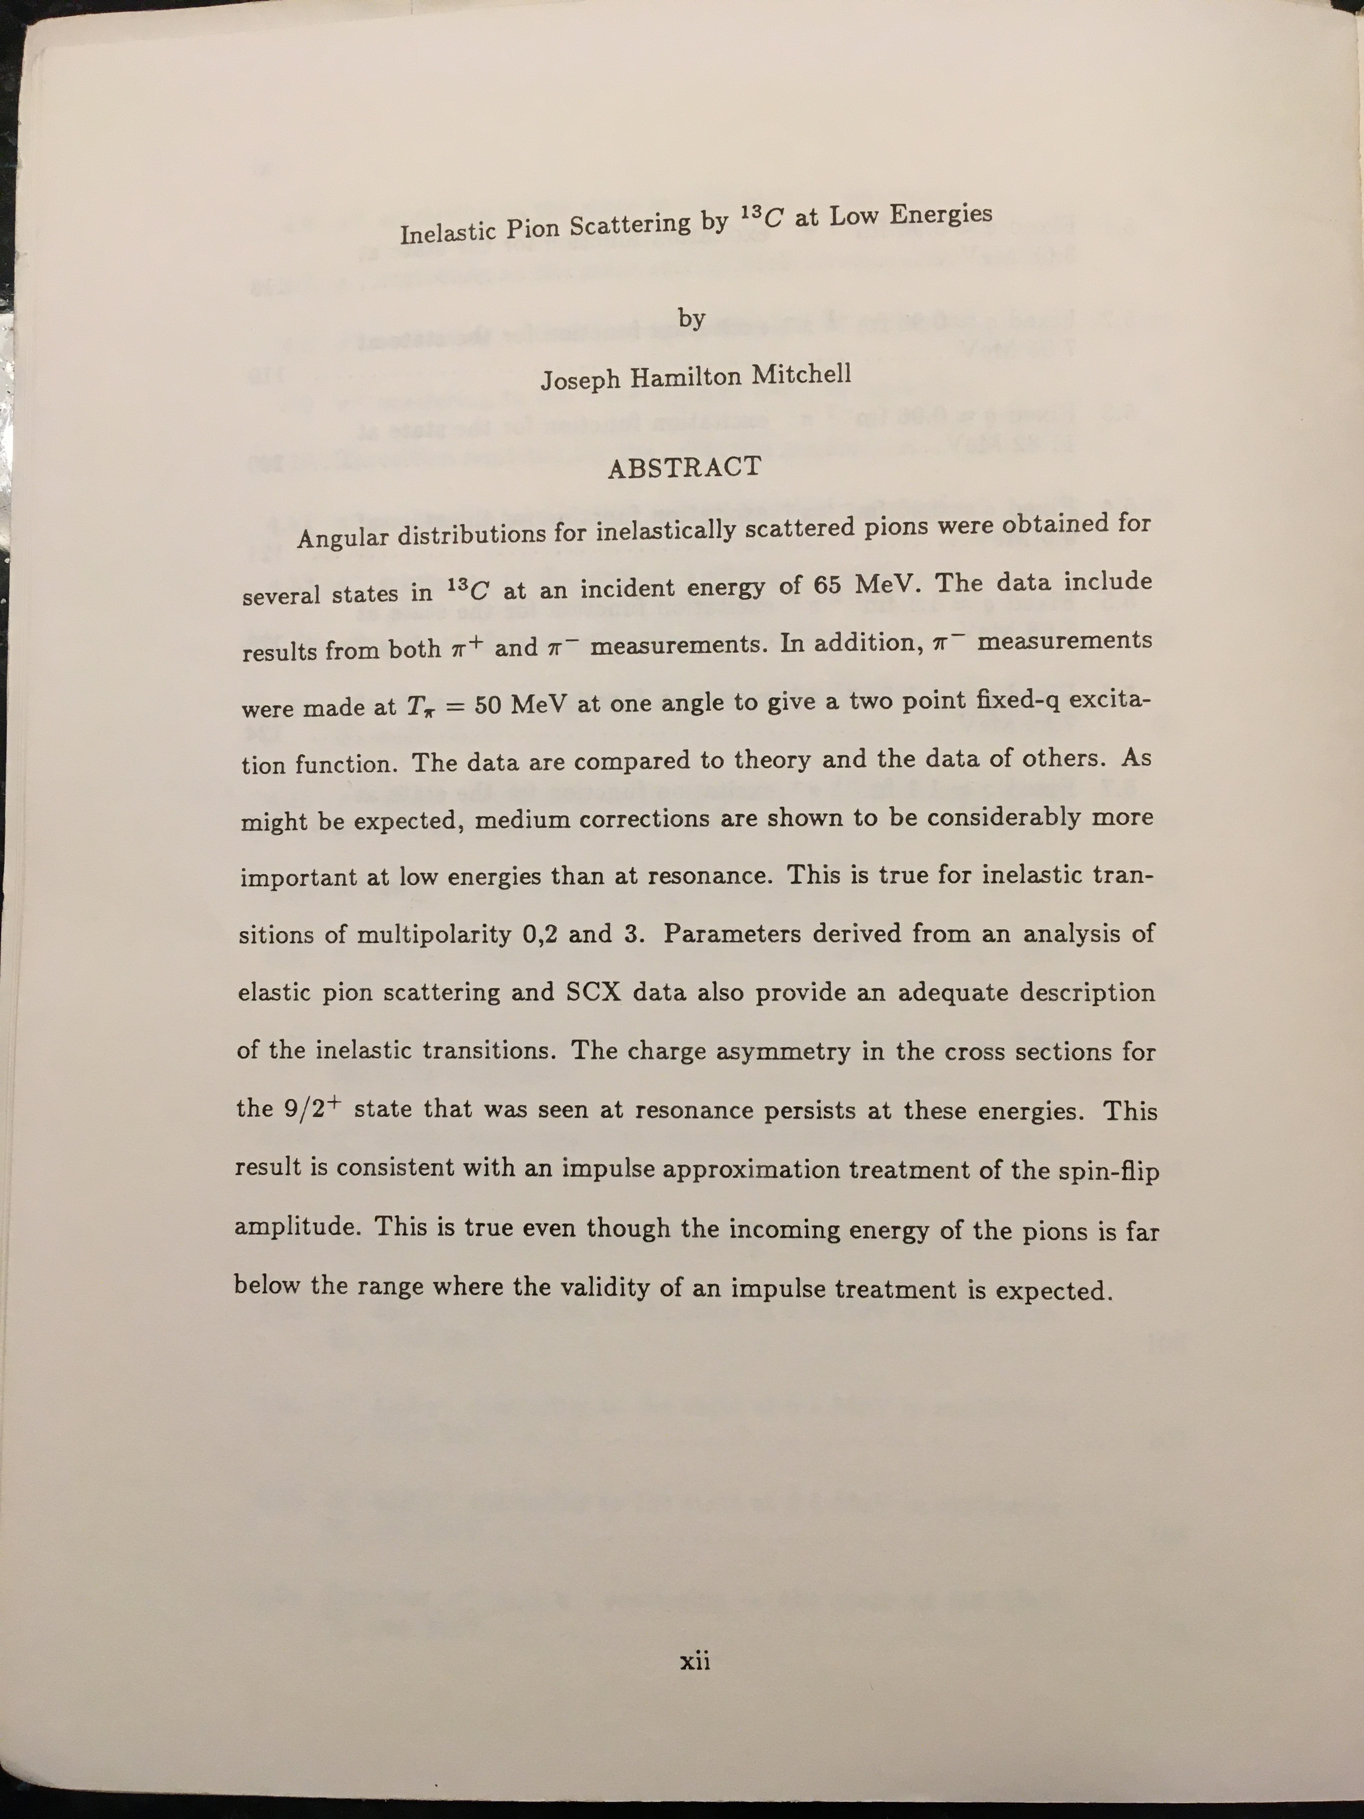
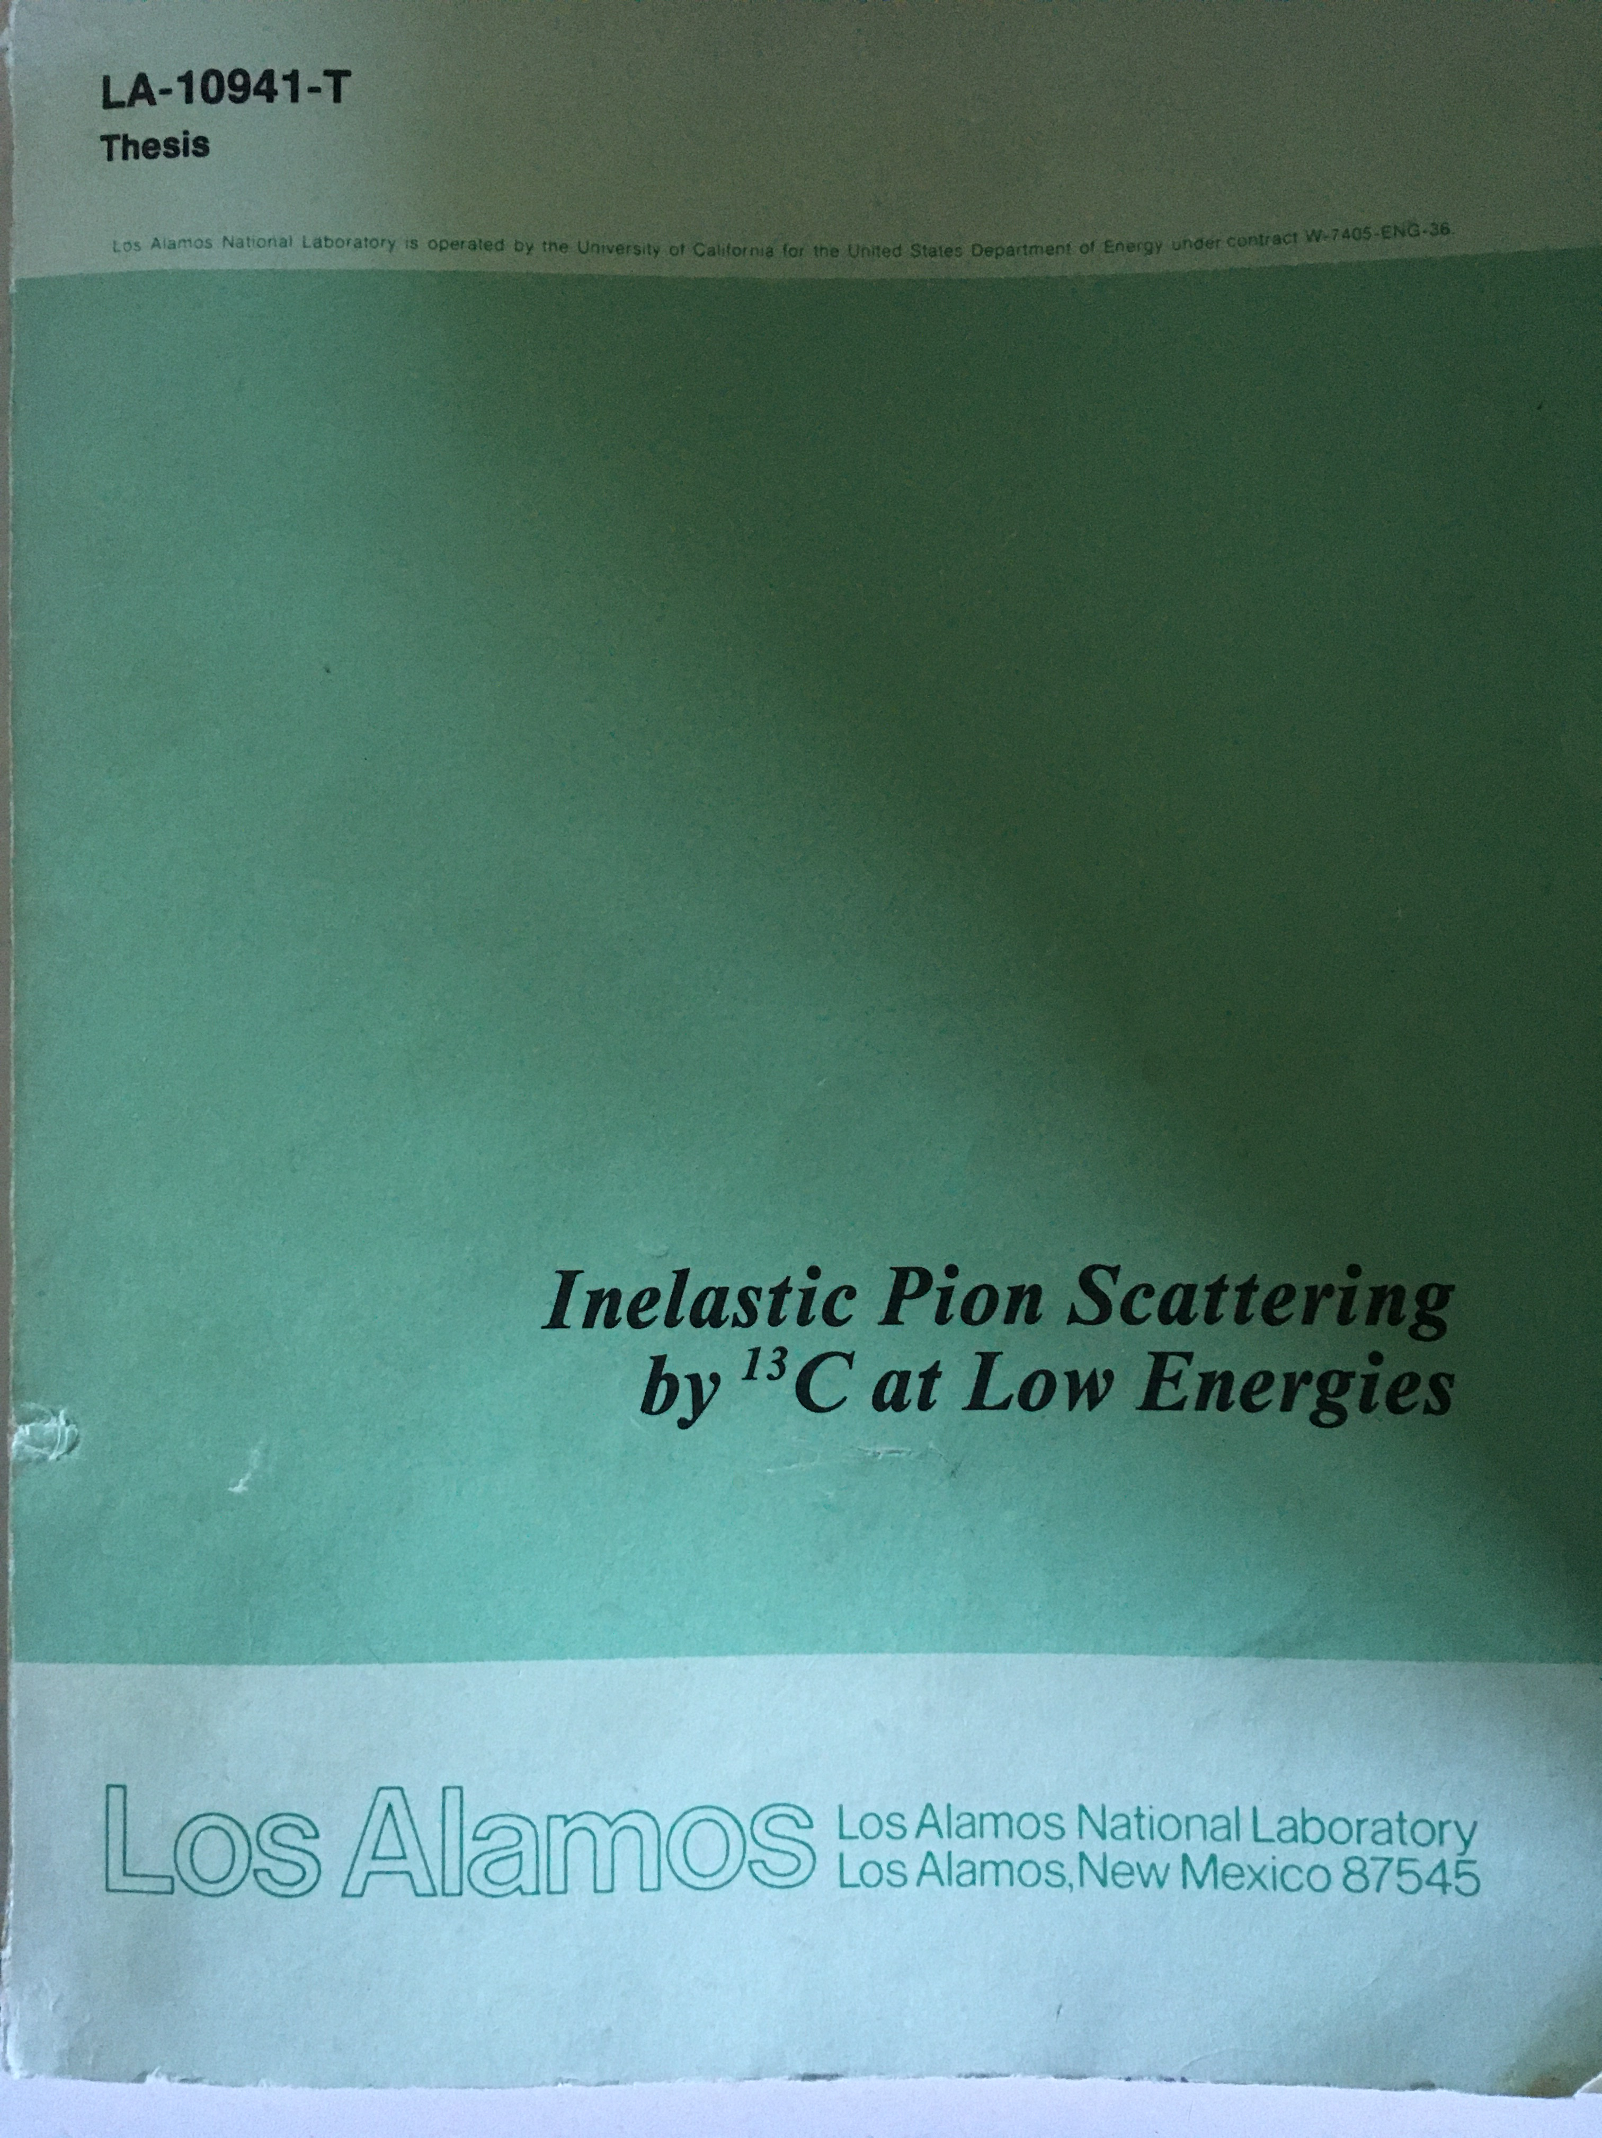
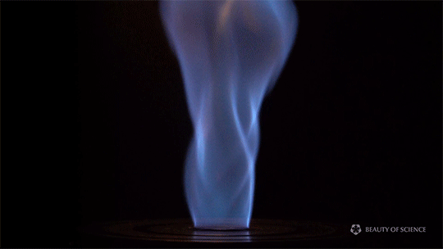
Studying quarks inside “hadrons”
Now we want to tear the “hadrons” apart and study quarks in a plasma state
We need a very hot
Bunsen burner to get above 2,000,000,000,000 ⁰F

Slide 6
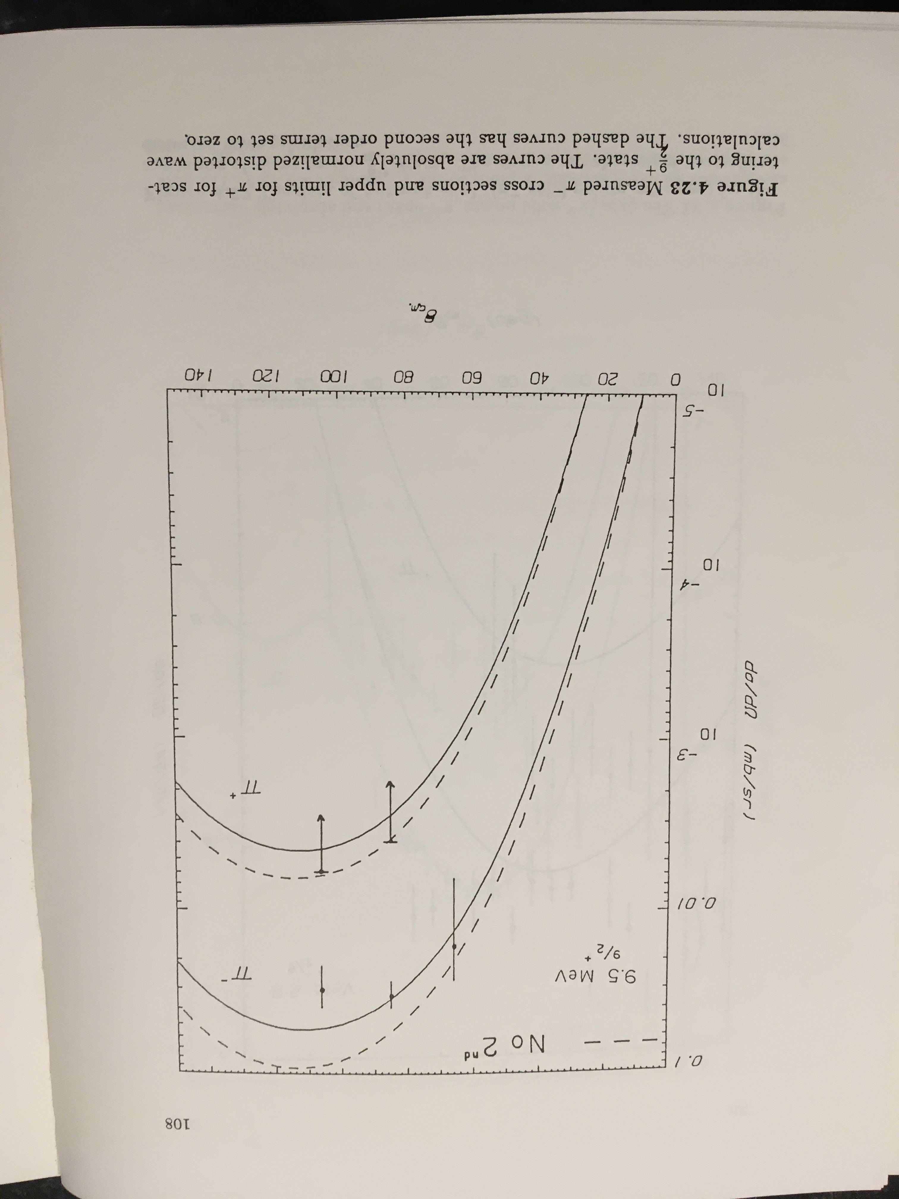
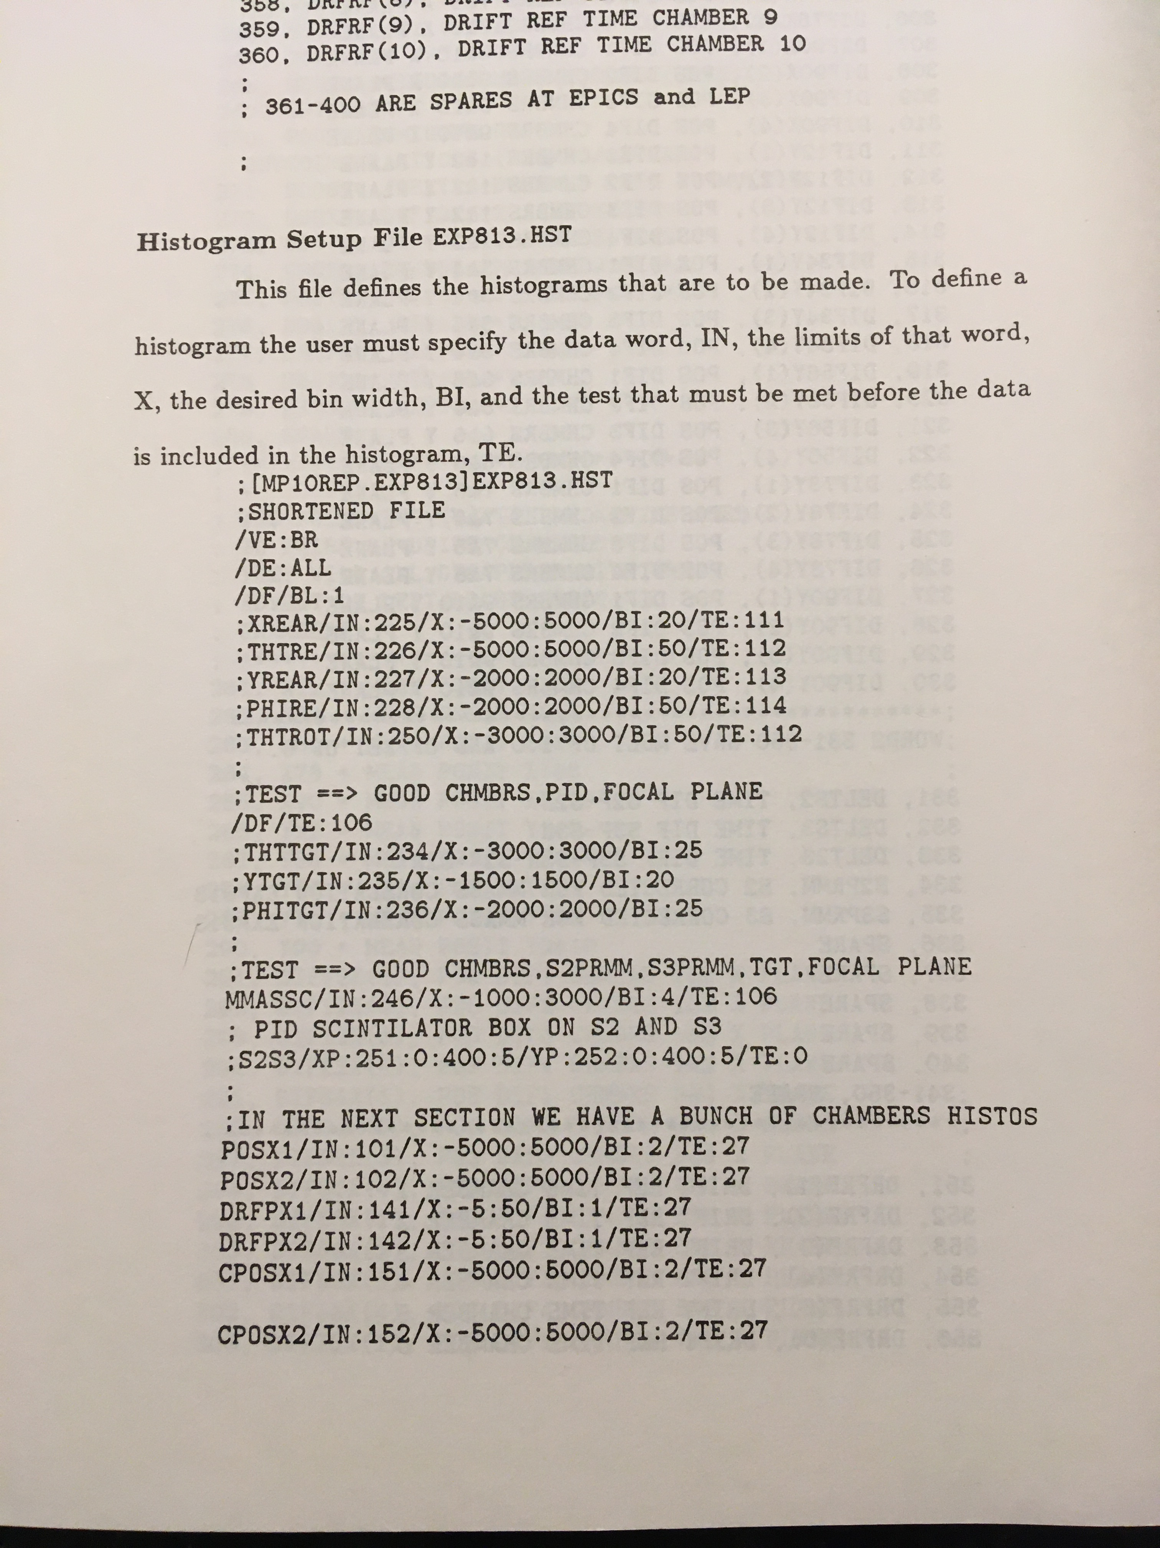
Aside…
It warmed my heart to see the code documentation.
I often miss the good old days with Fortran.

Slide 7
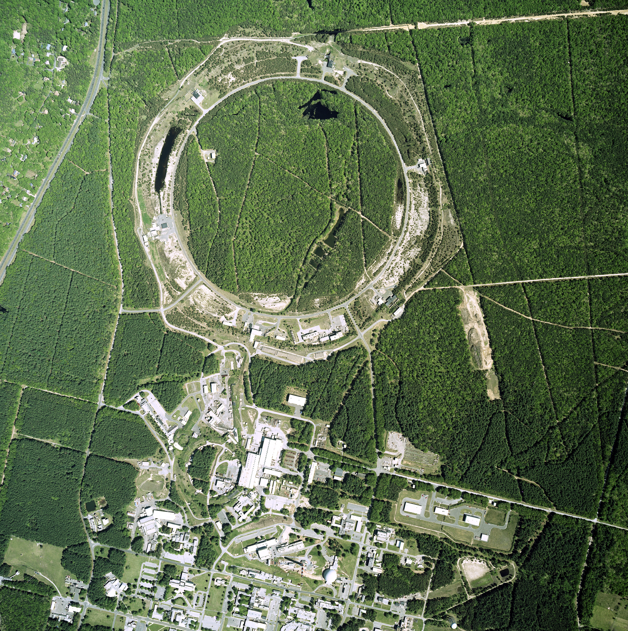
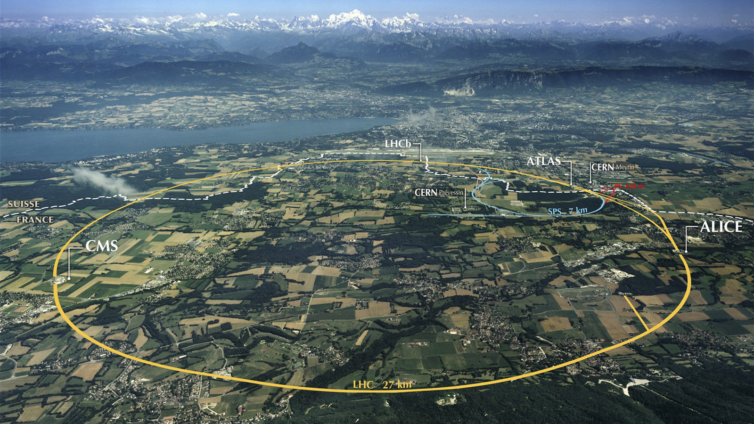
super Bunsen burner (sBb)
Creating droplets of quark-gluon plasma at 2 trillion
Relativistic Heavy Ion Collider
Upton, New York
Large Hadron Collider
Geneva, Switzerland

Slide 8
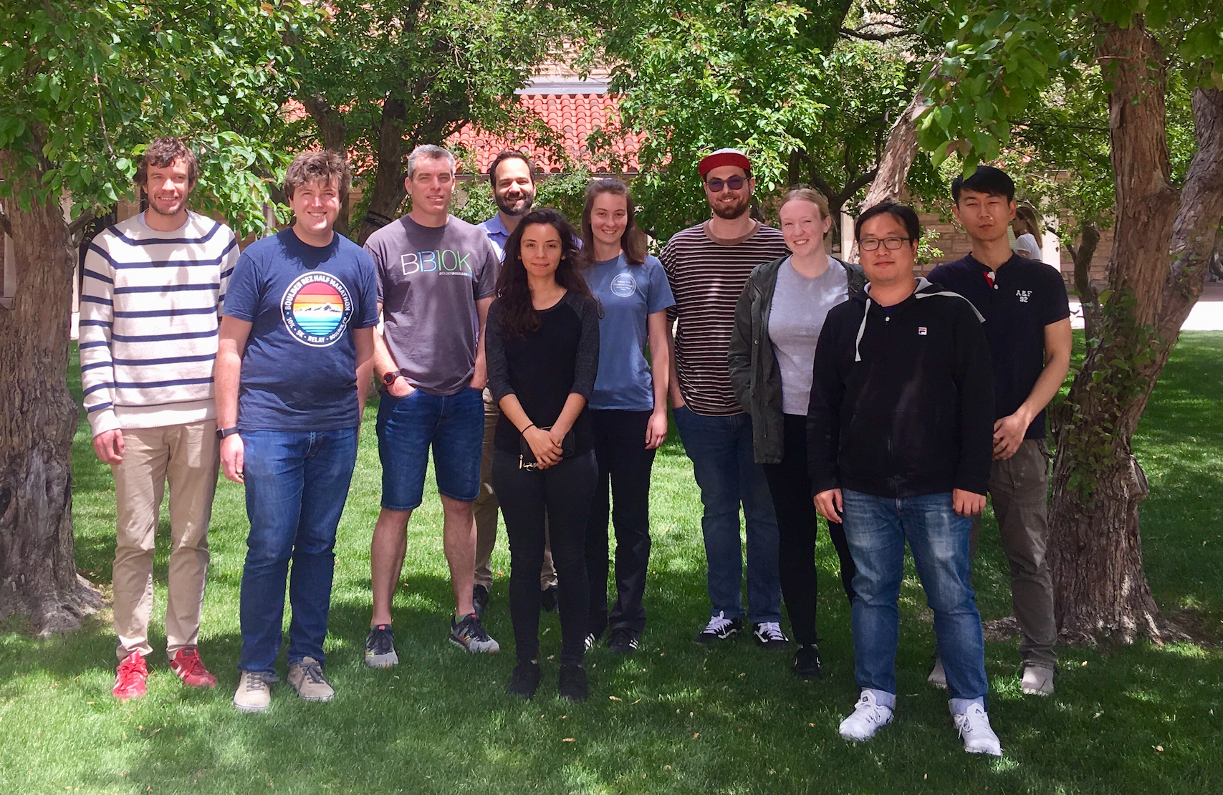
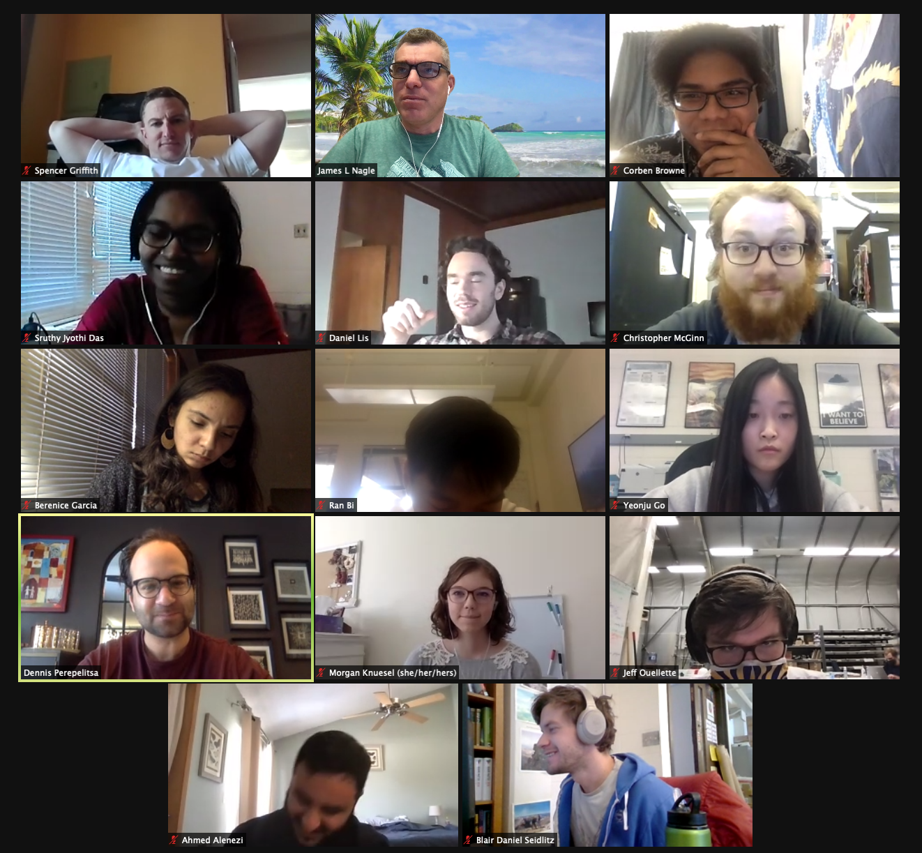

University of Colorado Boulder – Quark-Gluon Plasma Hunters
Javier Orjuela-Koop – RHIC Thesis Award
Kurt Hill – ATLAS Thesis Award

Slide 9
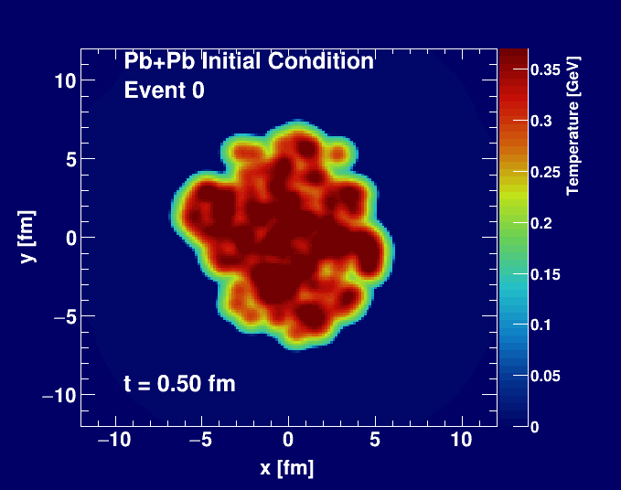
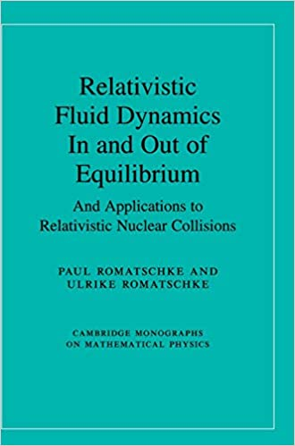
Hydrodynamic expansion of plasma droplet
World expert on fluid dynamics here at University of Colorado Boulder

Slide 10
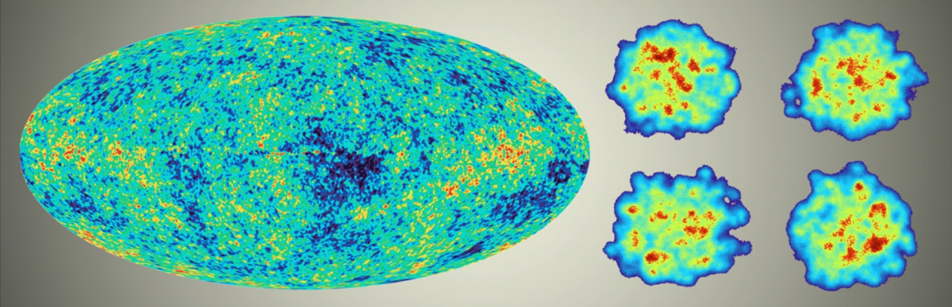
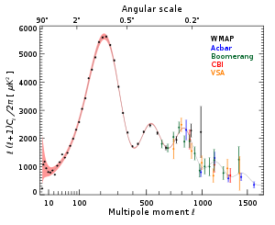
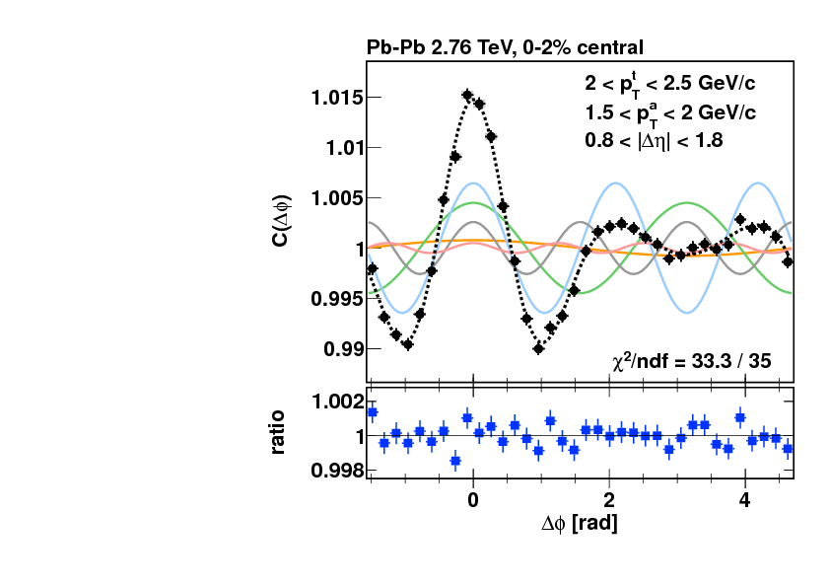
Just like Cosmic Microwave Background, droplet patterns tell us a lot!

Slide 11
Plasma Droplet Engineering

Slide 12
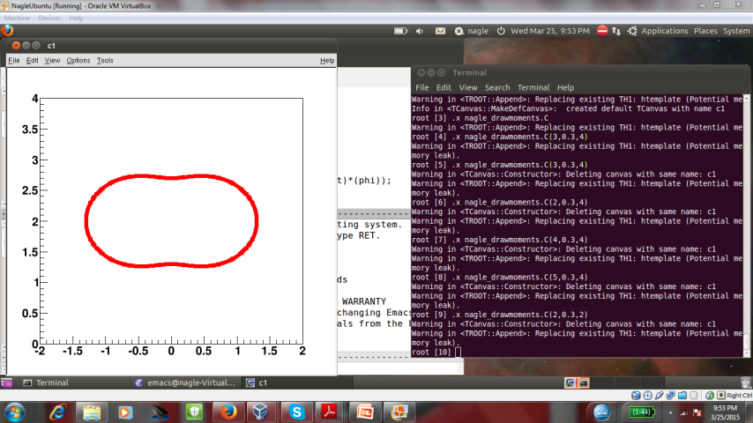
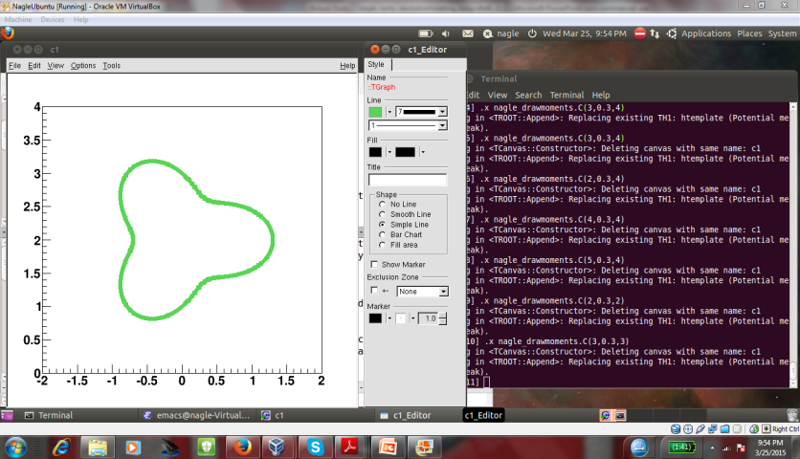
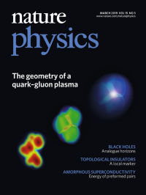
Hypothesis confirmed → droplets engineered!
PHENIX, Nature Phys. 15 (2019) no.3, 214-220

Slide 13
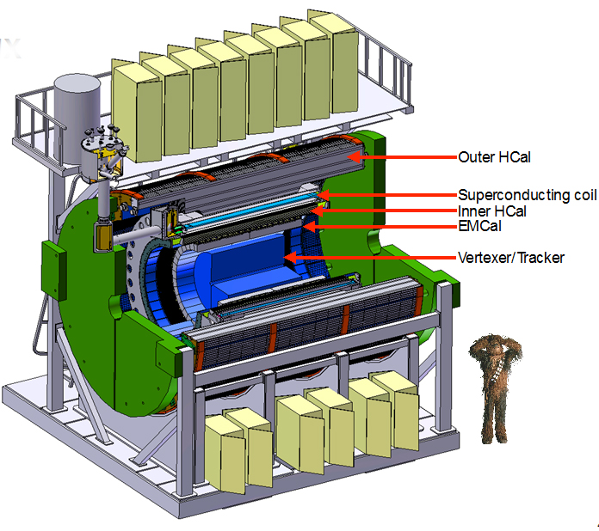
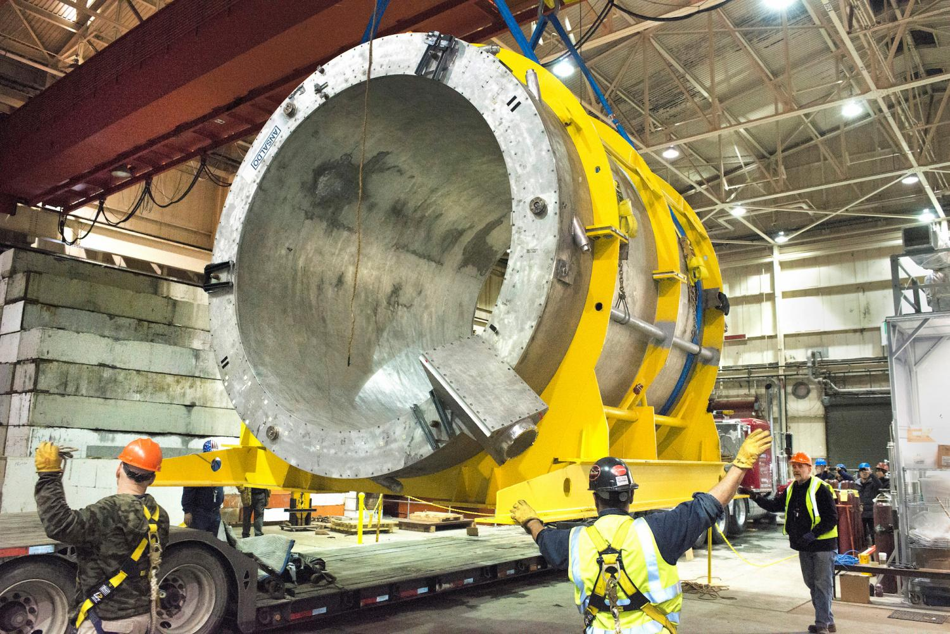
New project under construction → sPHENIX at RHIC
Probing the droplets with jets and heavy quarks
Superconducting magnet arrives!

Slide 14
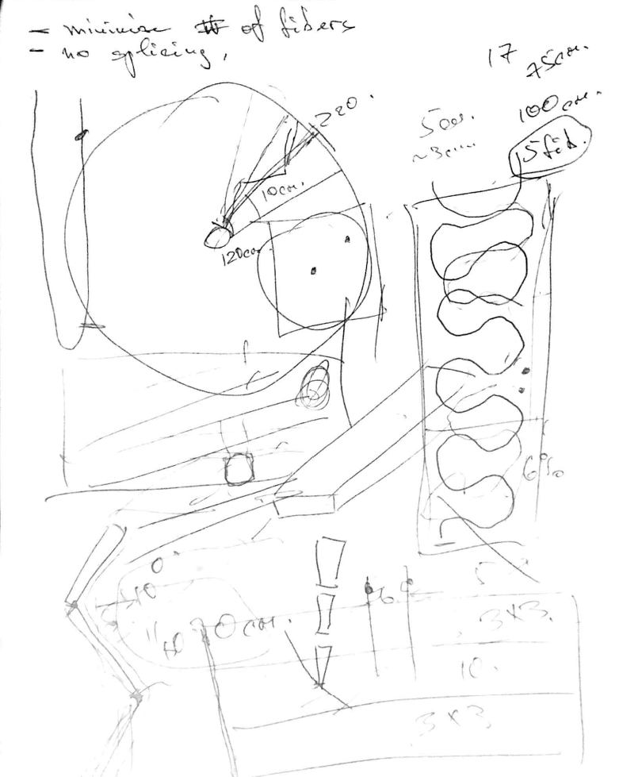
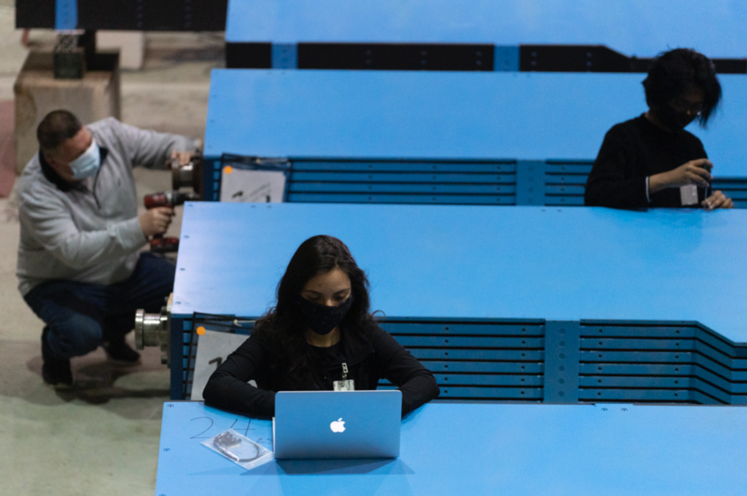
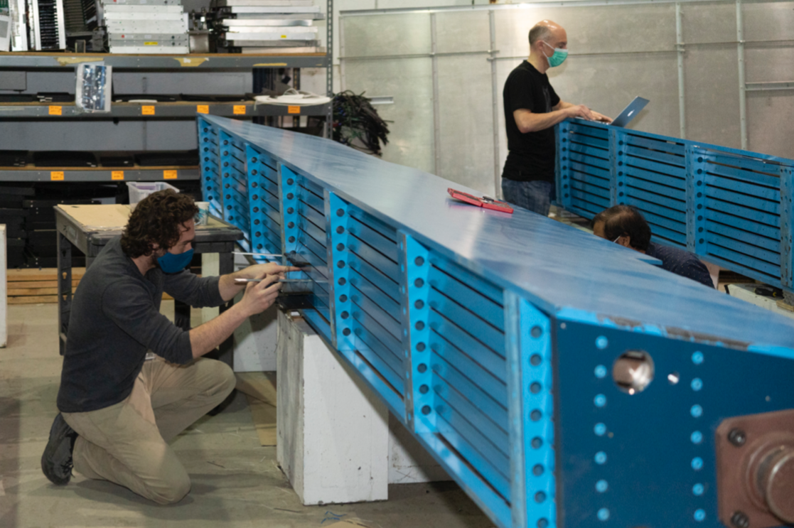
Building the next generation detector
Literal Napkin Sketch
Training the next generation scientist

Slide 15
Thank you for your time... and your support…
I am glad to answer any questions

Slide 17
