Slide 1

Flow in small systems
and the
scientific method
11th RHIC-BES online seminar (Series IV)
April 26, 2022
Jamie Nagle
University of Colorado Boulder

Slide 2
What have we learned?
What remains?
How does it end?

Slide 3
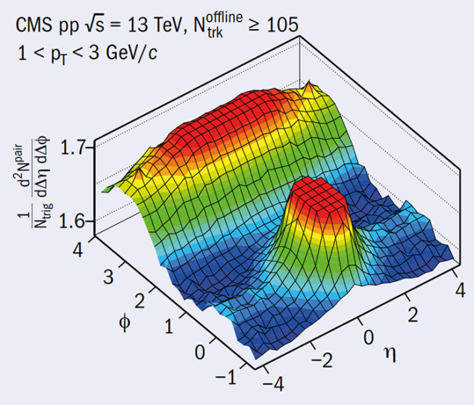
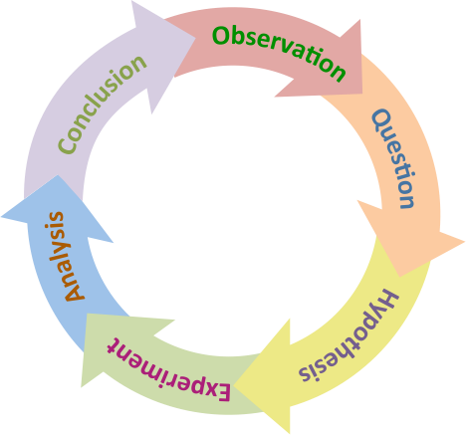
Scientific Method
https://link.springer.com/article/10.1007/JHEP09(2010)091
Observation: long-range, near-side angular correlation
Question: could this be hydrodynamic flow?
could this be glasma weak-coupled physics?

Slide 4
Scientific Method
Question:
Could this be hydrodynamic flow?
Could this be glasma weak-coupled physics?
Hypothesis:
Flow correlations should follow geometry and minimal collision energy dependence
Glasma diagrams correlations should scale as 1/N_{domains}
Experimental Test:
Compare p+Au, d+Au, ³He+Au

Slide 5
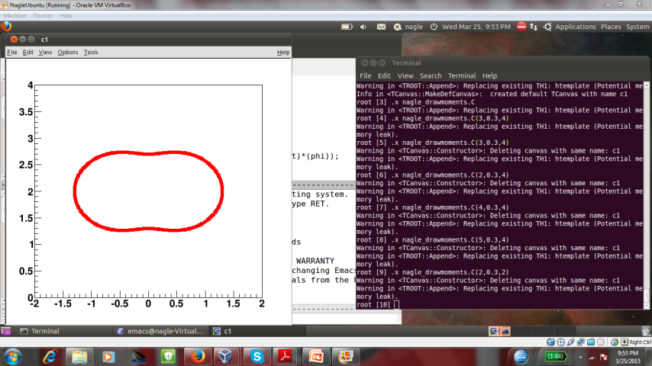
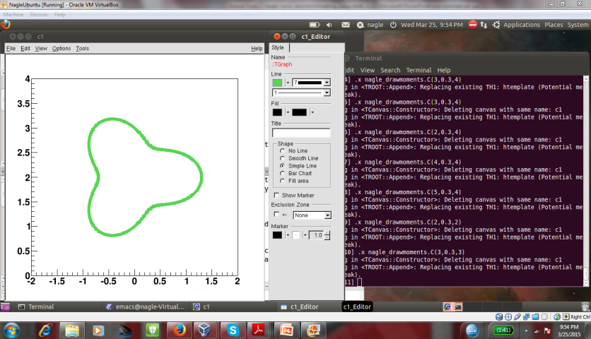
Scientific Method
PHENIX, Nature Phys. 15 (2019) no.3, 214-220

Slide 6
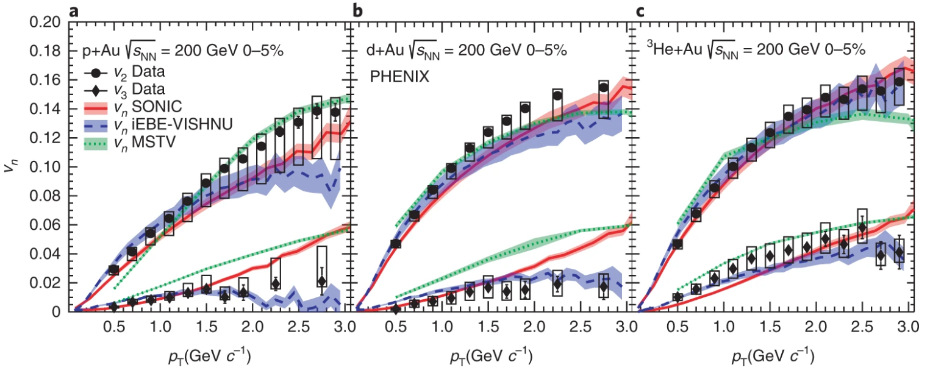
Scientific Method
MSTV Phys.Rev.Lett. 121 (2018) no.5, 052301
MSTV Phys.Lett. B788 (2019) 161-165
MSTV https://arxiv.org/abs/1901.10506
2018 - new glasma calculations

Slide 7
Deuteron is big and so
more disconnected, uncorrelated domains
Simple domain expectation
v₂(dAu) < v₂ (pAu)
deuteron
Color Domains → Initial State Correlations
Color Domains → Initial State Correlations

Slide 8
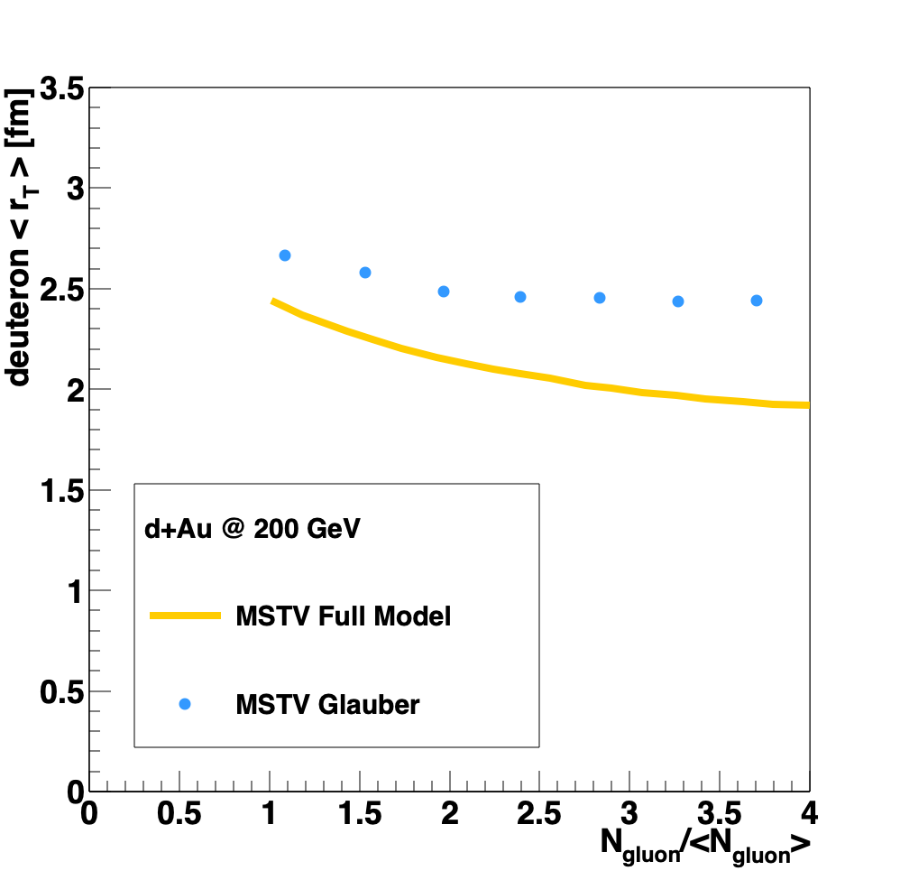
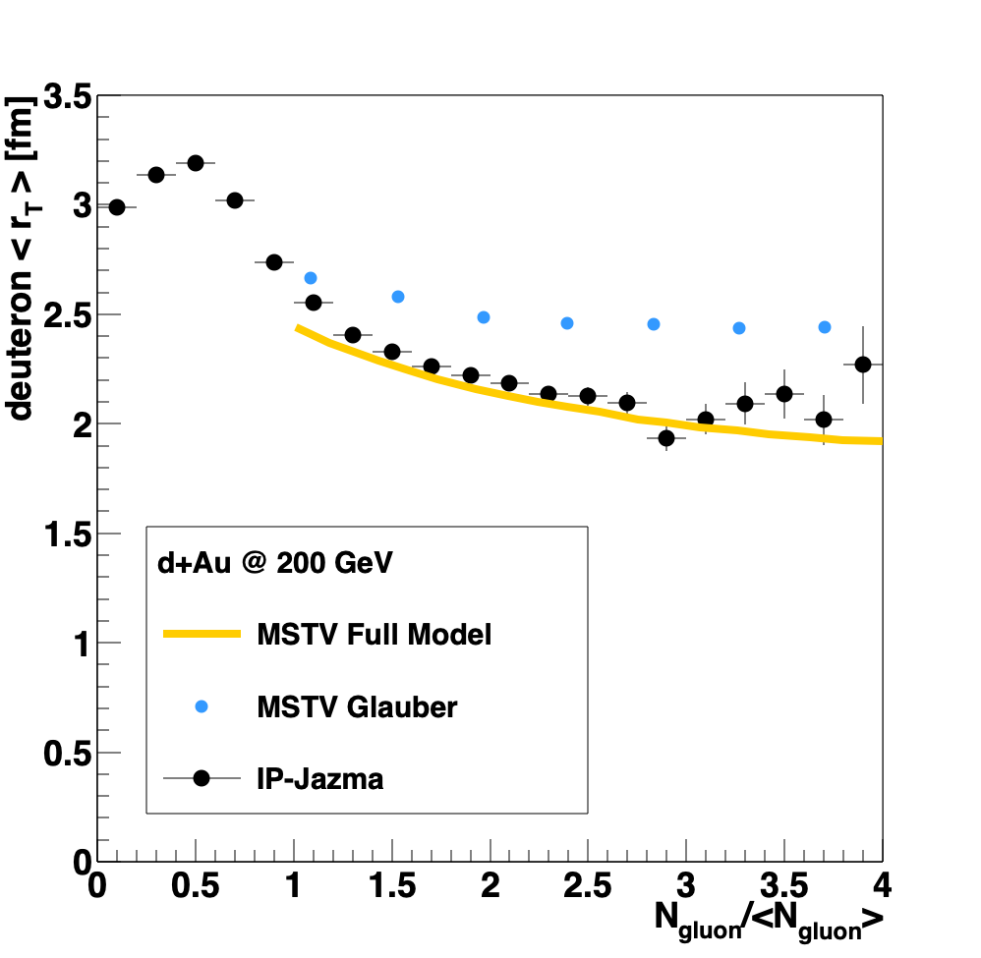
Scientific Method
“Quantum statistics of gluons are the dominant cause of the nontrivial
many-body correlations that
enhance contributions to the tails of the multiplicity distributions from overlapping nucleon configurations”.
r_{T}
MSTV https://arxiv.org/abs/1901.10506
IP-Jazma model is trivial
(no quantum, no many-body, etc.)
and can disprove these assertions.
https://journals.aps.org/prc/abstract/10.1103/PhysRevC.99.054908

Slide 9
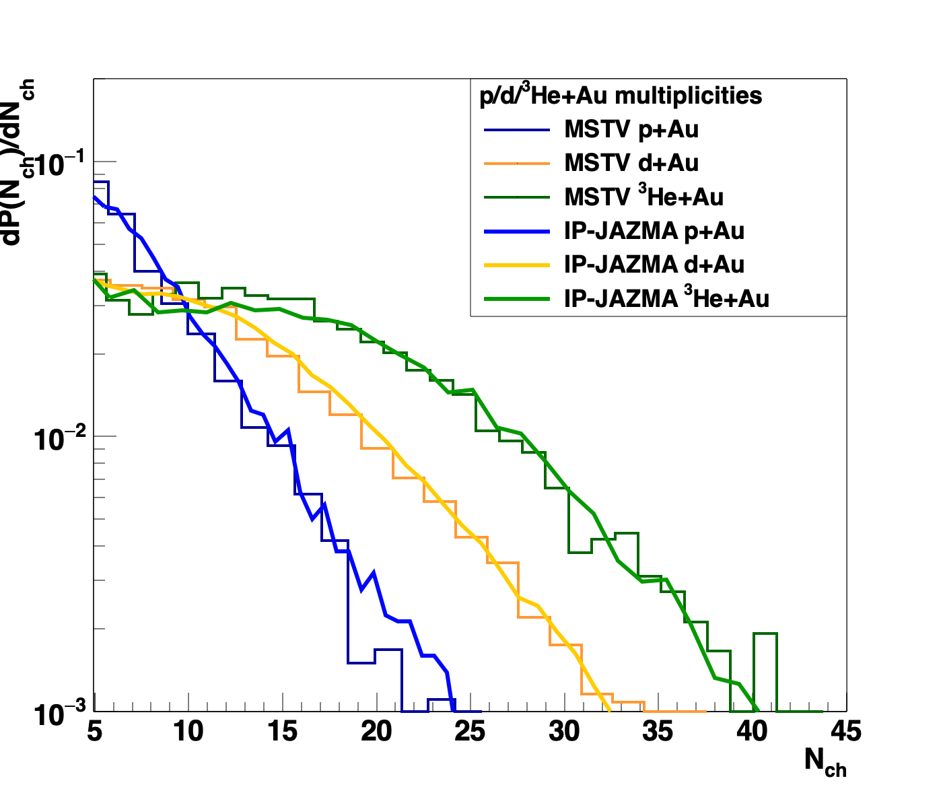
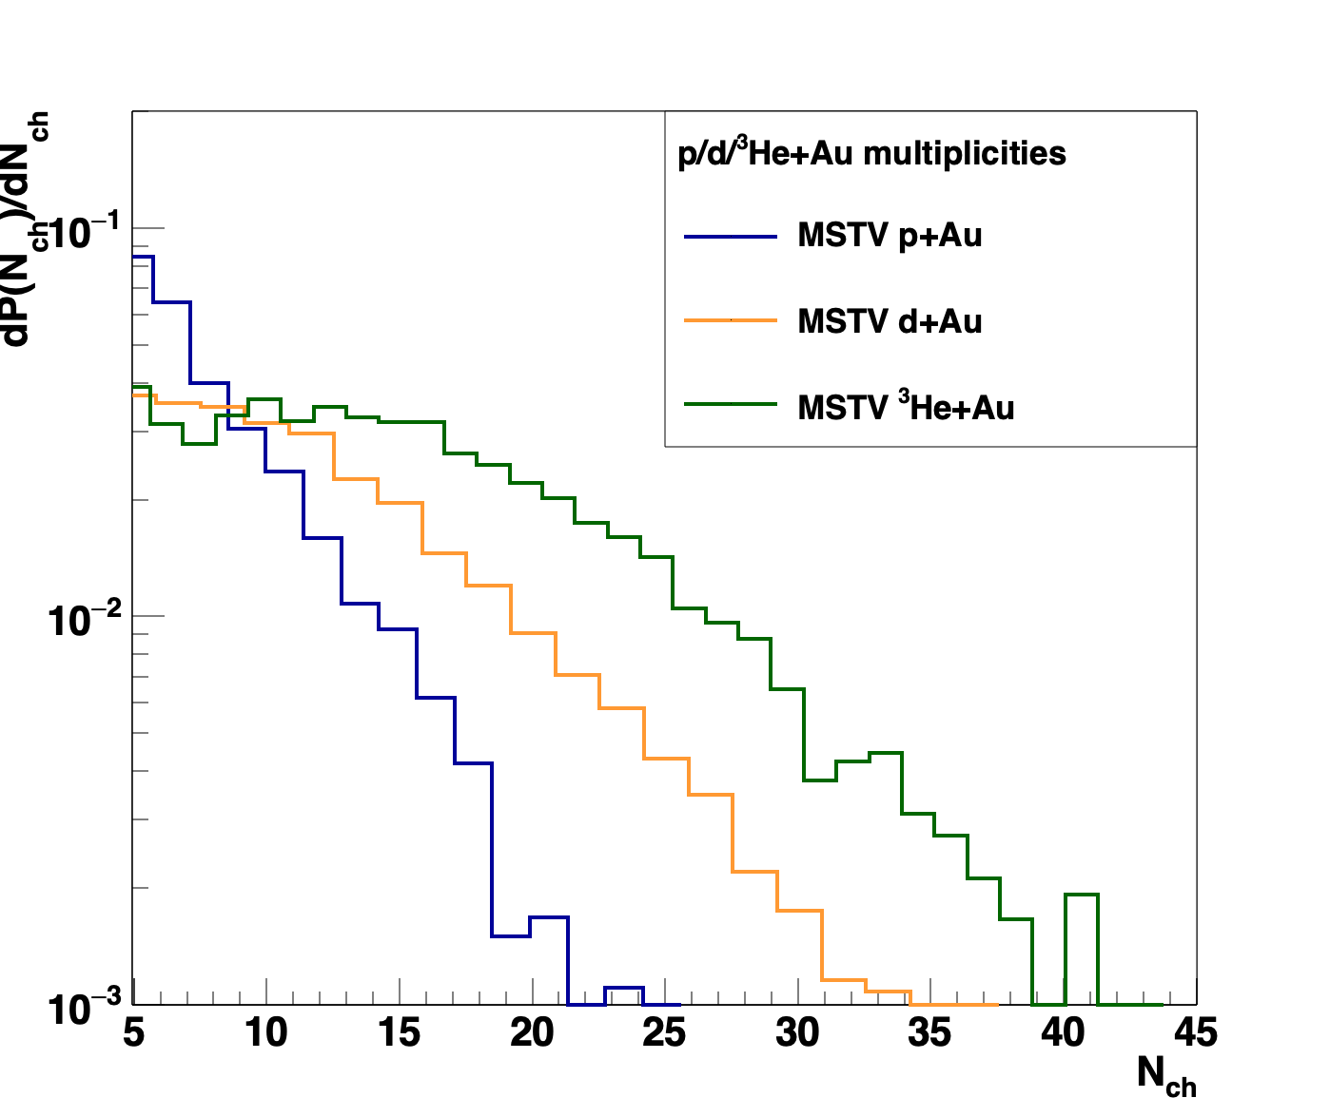
Scientific Method
Glittering Glasma – ab initio result for Negative Binomial Fluctuations
MSTV https://arxiv.org/abs/1901.10506
IP-Jazma model is trivial
(no glittering, etc.)
and can disprove these assertions.
https://journals.aps.org/prc/abstract/10.1103/PhysRevC.99.054908

Slide 10

Scientific Method
Some realistic expectation that authors check their own basic hypotheses / self-consistency themselves.
I think that is part of the scientific method.
Under pressure, in cleaning up code to make it public, MSTV found an error of units ($ℏc$)

Slide 11
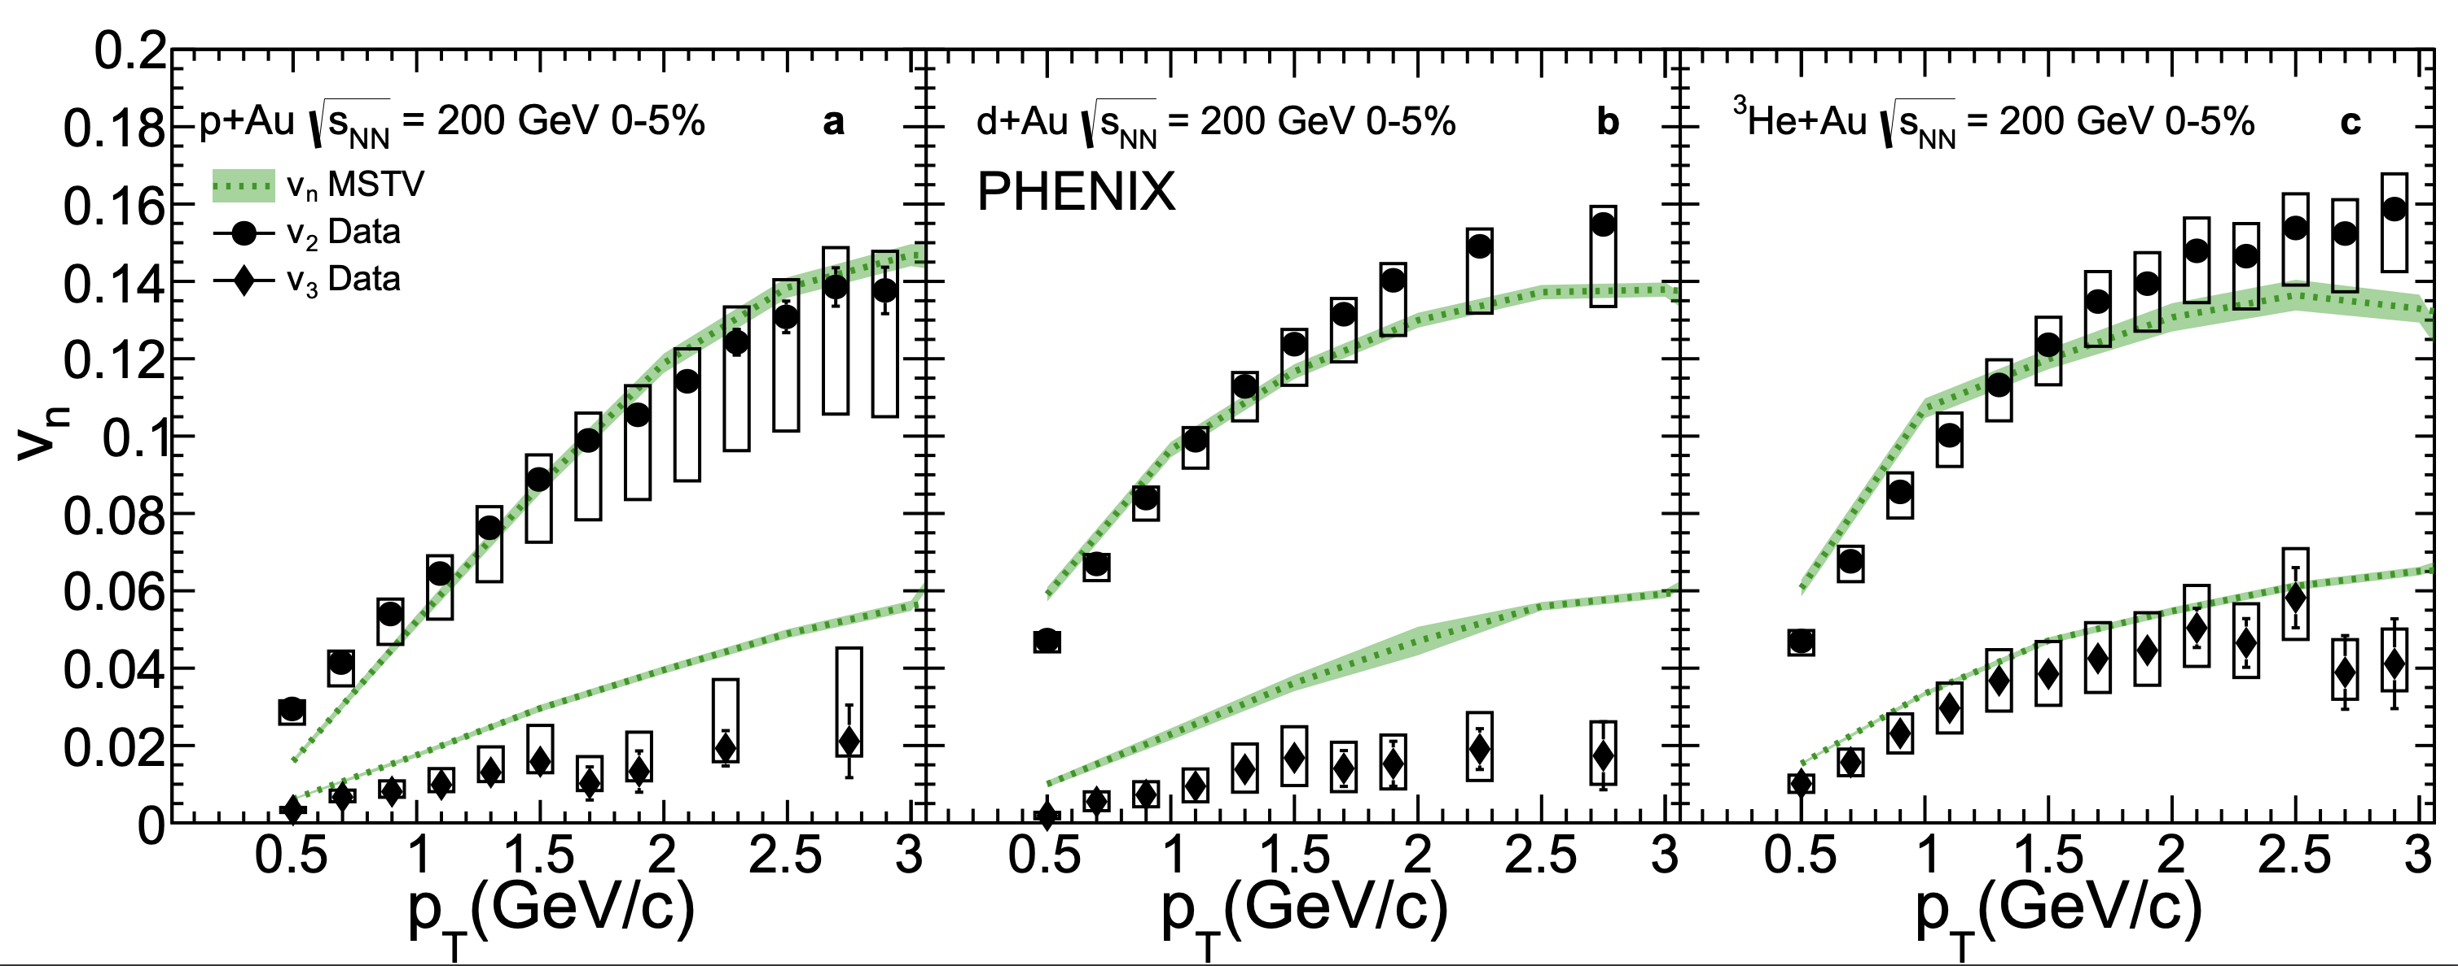
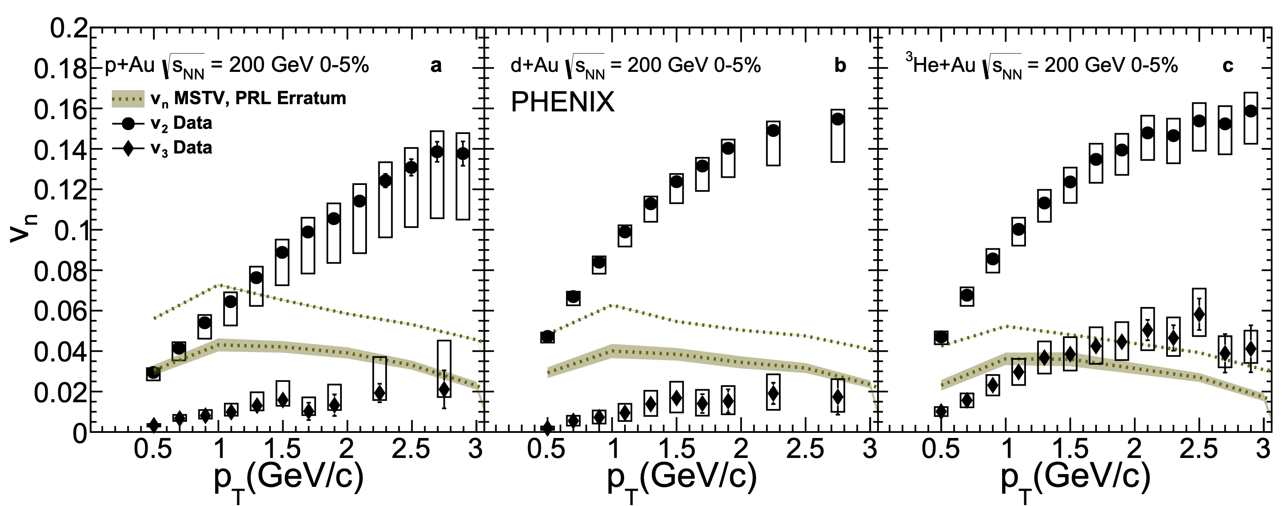
“In summary, due to the numerical error specified,
the hierarchy of v₂;₃ seen in the PHENIX data is not seen in our model.
It cannot therefore provide a viable description of the data.”
Erratum: Phys.Rev.Lett. 121 (2018) no.5, 052301
Corrigendum: Phys.Lett. B788 (2019) 161-165

Slide 12
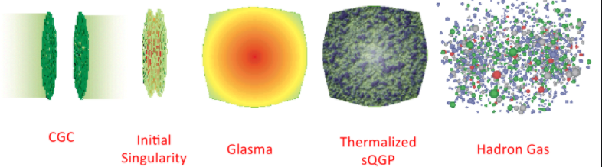
After more than two decades at RHIC and one decade at the LHC, there is no real evidence for color glass condensate,
saturation effects, glasma physics.
It is incorporated into many successful models
(e.g., IP-Glasma + MUSIC) but does not reflect any non-trivial physics.

Slide 13
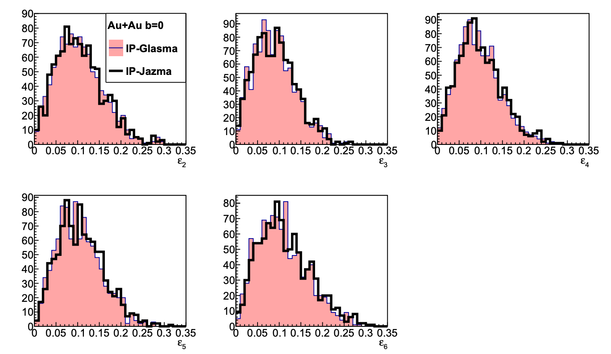
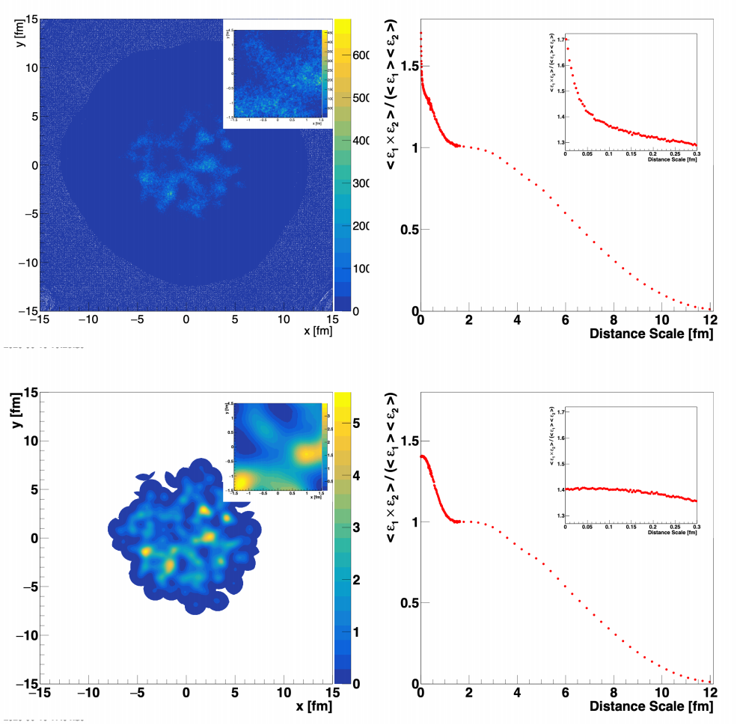
IP-Glasma
IP-Jazma
IP-Glasma as part of evolution package has been very successful
(see for example https://arxiv.org/abs/2005.14682);
however, that really has nothing to do with weak coupling, color domains, etc.
Essentially just T_{AB} scaling of Gaussian nucleons or 3 quarks and
Q_{s}² fluctuations put in by hand (also in IP-Glasma).
https://arxiv.org/abs/2008.08729

Slide 15
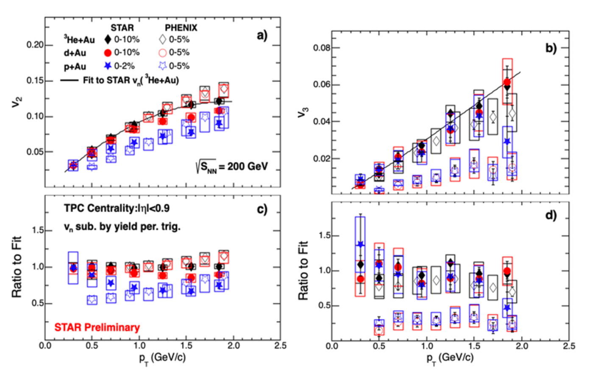
Scientific Method
Important to confirm key
experimental results
STAR Preliminary 2019 (#3)
v₂ roughly agrees (very rough)
v₃ disagrees in pAu, dAu)
Non-flow corrected
Not in matching centrality selection
e.g., pAu 0-2% based on TPC has 50% higher multiplicity

Slide 16
Scientific Method
BNL Task Force (PHENIX/STAR) was formed…
PHENIX has done due diligence with a full independent analysis to check
experimental results.
PHENIX publication Phys.Rev.C 105 (2022) 2, 024901
includes tables with all 2-particle correlation coefficients (c₁, c₂, c₃, c₄) to enable future studies.
STAR says they are confirming their results with an independent analysis. Important to include results with matched PHENIX centrality selection and
extend to p_{T} = 3 GeV to show when / where non-flow corrections break down.
dAu data by STAR in 2021 taken w/ sEPD
and future pAu sPHENIX data in 2024 could prove useful.

Slide 17

Scientific Method
BNL Task Force reports that both sets of results are likely correct.
However, 2.5 years since STAR third preliminary on small system flow and now…
This is not following the scientific method.
Wasting my time and yours…

Slide 18
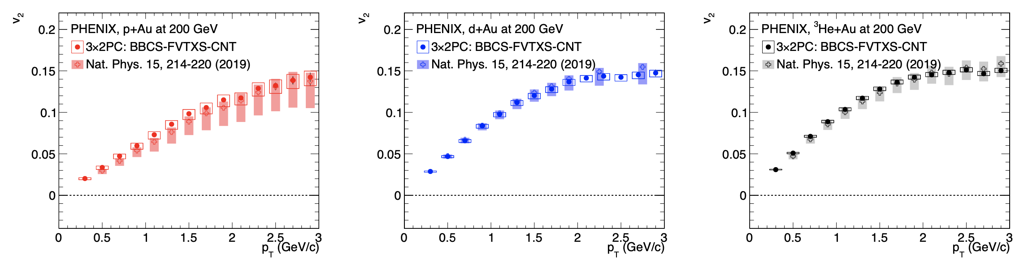
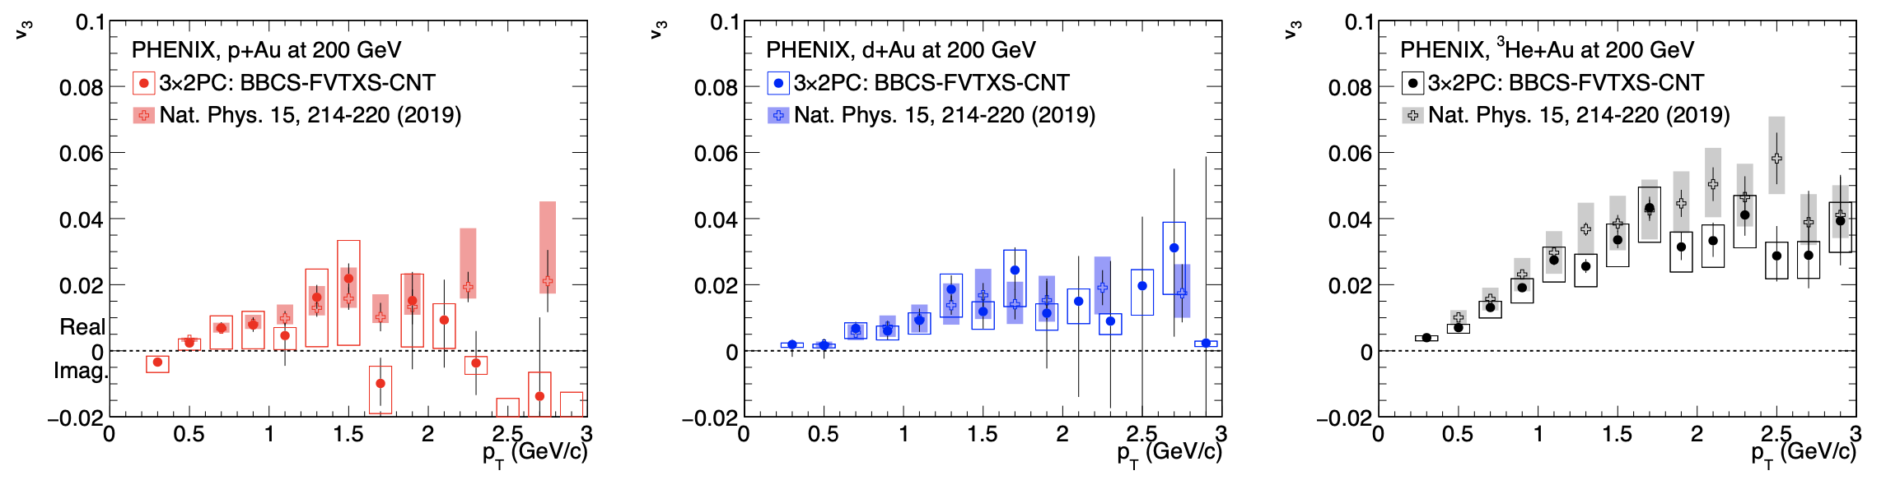
Scientific Method
Phys.Rev.C 105 (2022) 2, 024901

Slide 19
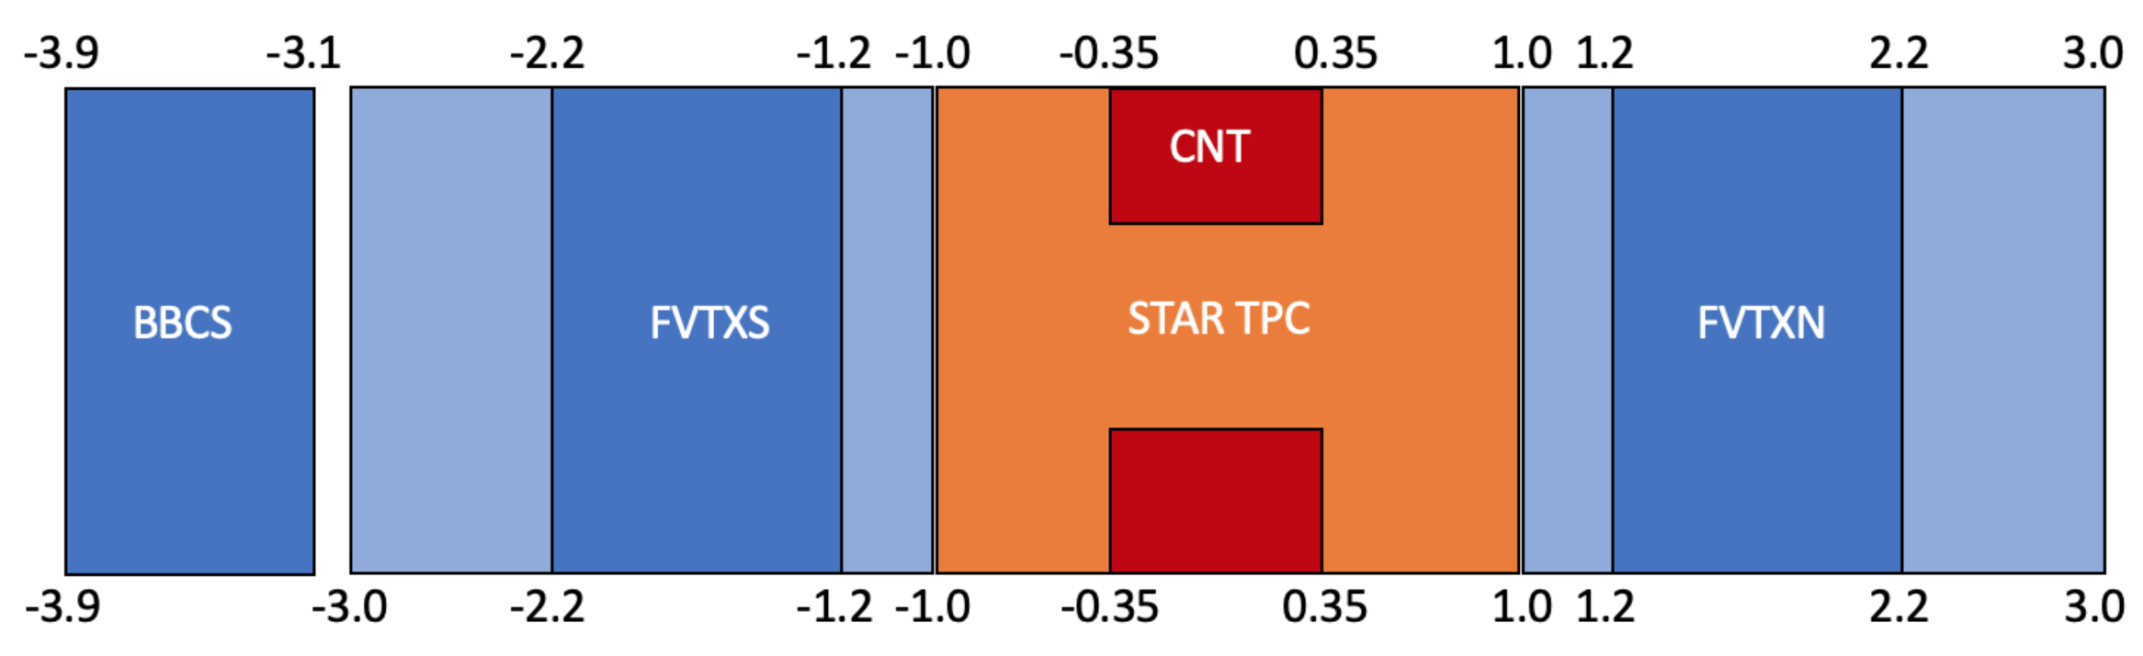
Scientific Method
PHENIX results use BBCS-FVTXS-CNT combination.
Minimizes non-flow contributions.
Three sets of 2-particle correlations needed since asymmetric system.
What if we try FVTXS-CNT-FVTXN combination?

Slide 20
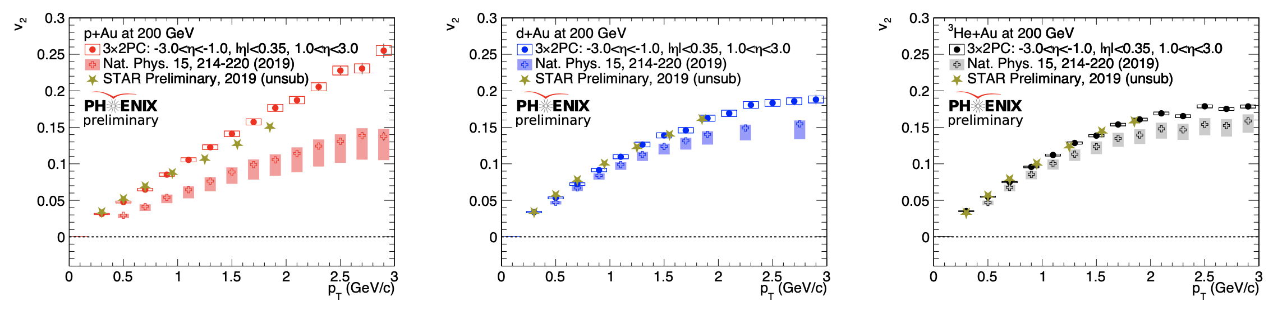
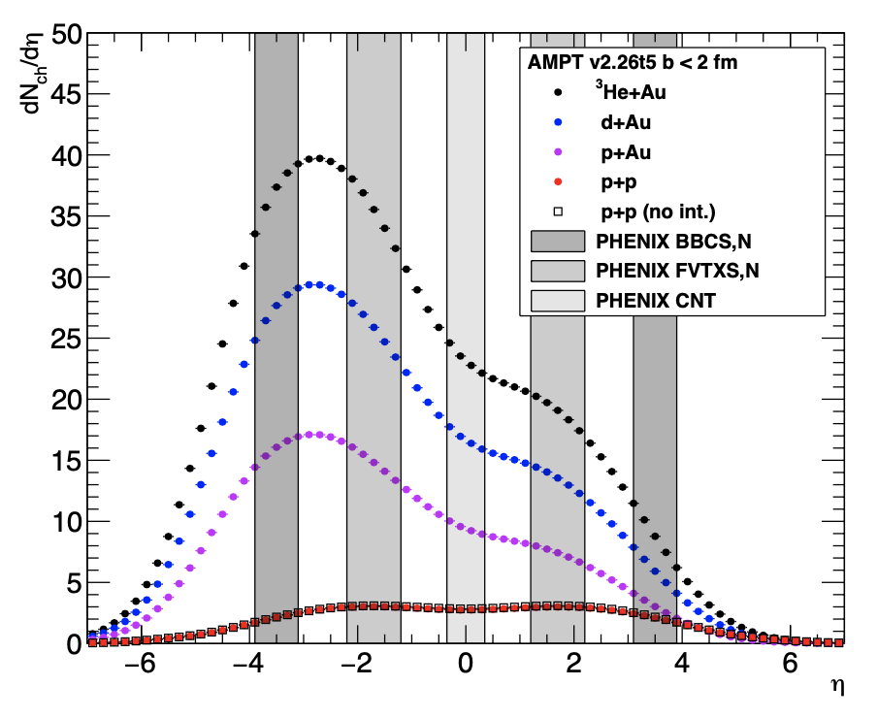
Scientific Method
What if we try FVTXS-CNT-FVTXN combination?
Very large increase in non-flow contribution
v₂ increases significantly, even 2x in pAu!
PHENIX/STAR preliminary (#3) v₂ agree

Slide 21
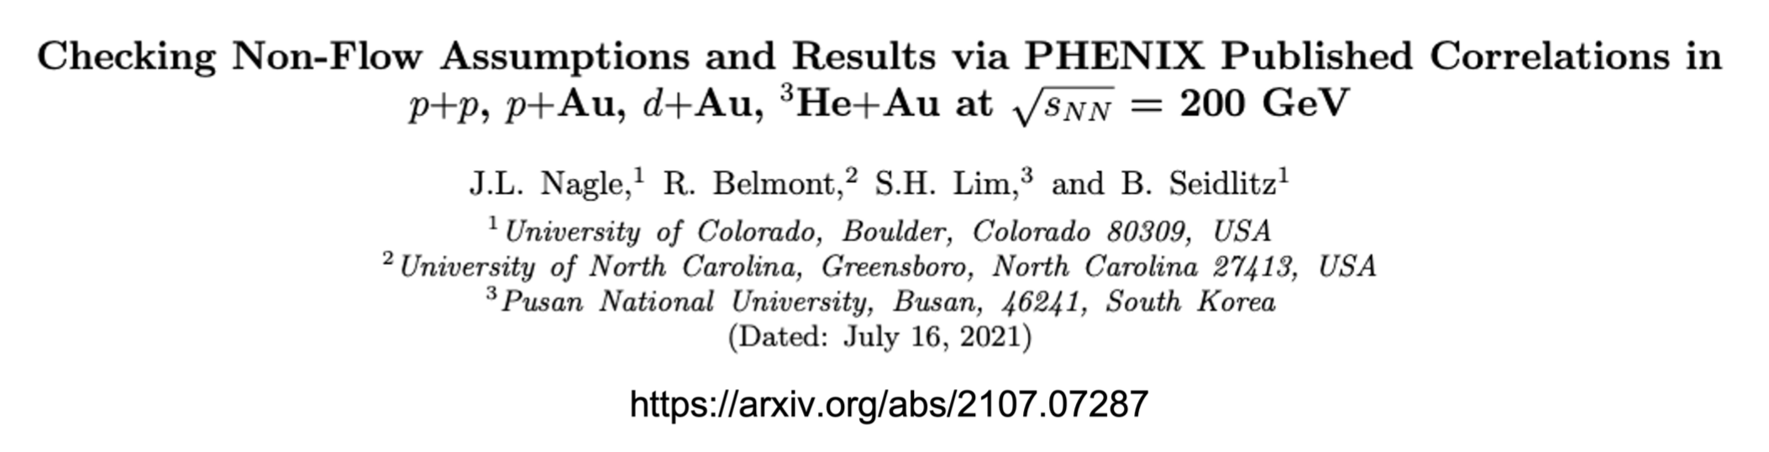
Scientific Method
PHENIX has refrained from using non-flow corrections, and rather used our kinematics to minimize them.
Phys.Rev.C 105 (2022) 2, 024906 • e-Print: 2107.07287

Slide 22
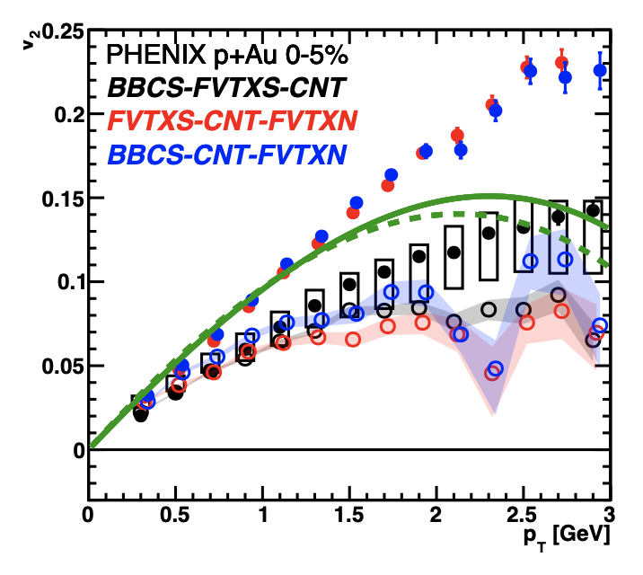
Scientific Method
Template-style
non-flow subtraction
(closed → open)
Minimal effect on
BBC-FVTX-CNT for p_{T} < 2 GeV as expected.
x2 non-flow correction when using FVTXN and brings all three sets into qualitative agreement (open points)

Slide 23
Scientific Method
Does that mean for
p_{T} > 2 GeV, the open points are the
”right” flow answer?

Slide 24
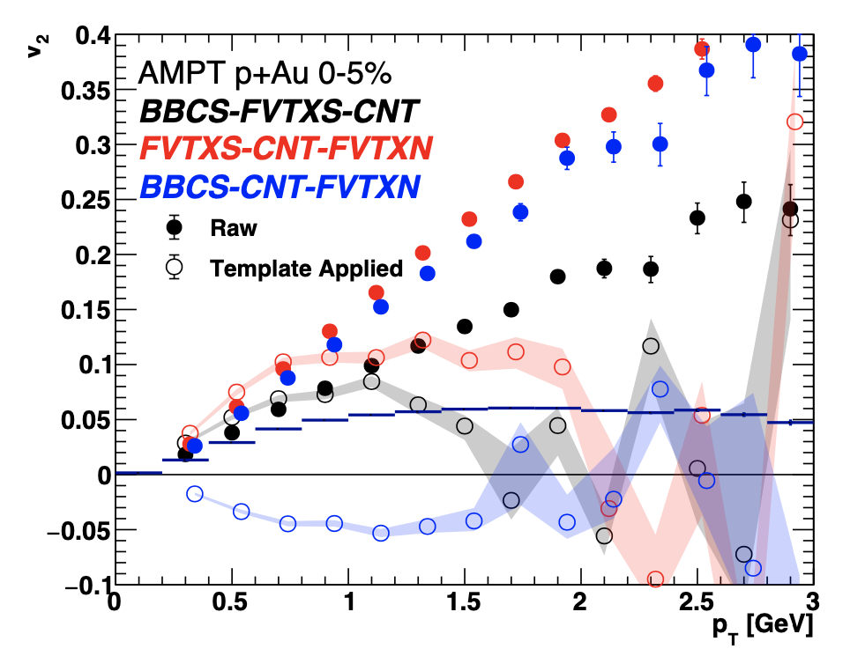
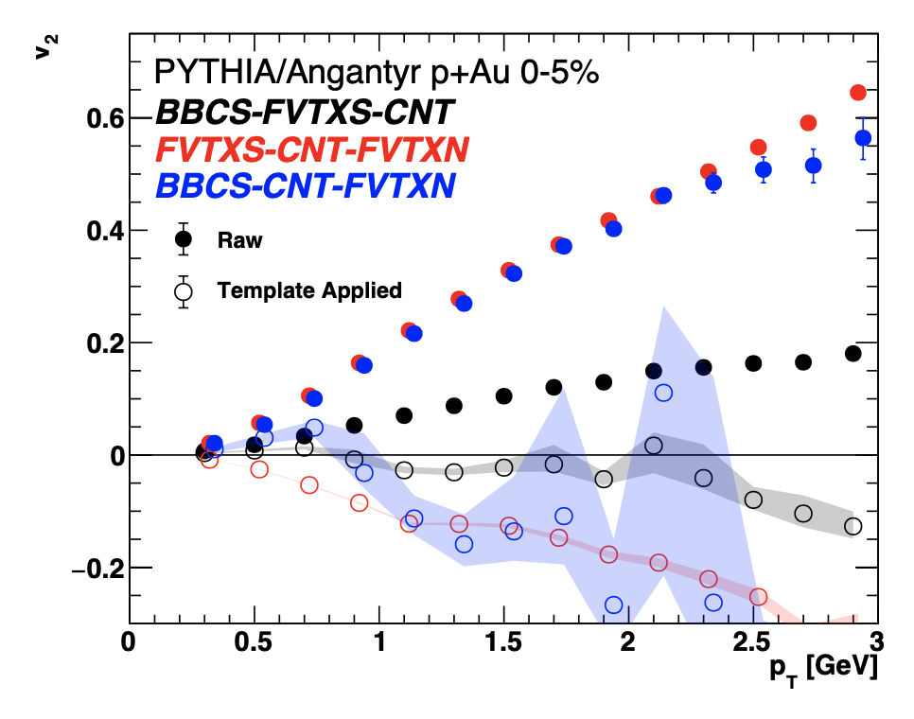
AMPT and Angantry
Closure tests for v₂ show clear large violation (overcorrection), particularly when non-flow is large

Slide 25
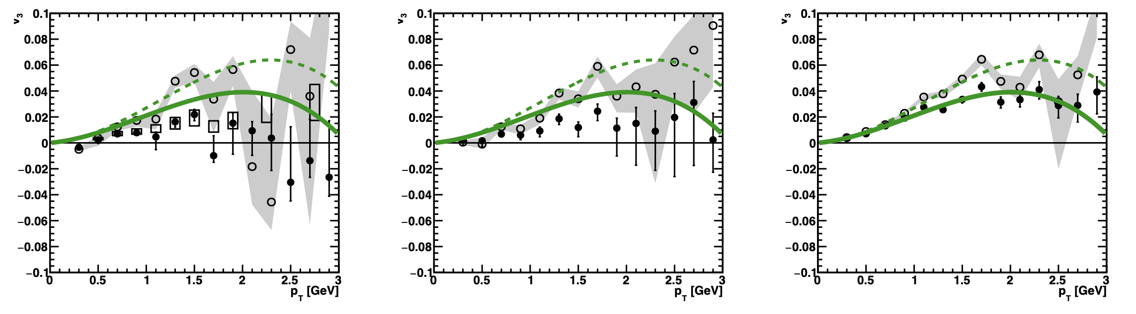
Scientific Method
v₃ non-flow correction moves points up (closed → open)
Even with BBCS-FVTXS-CNT, this indicates a significant correction.

Slide 26
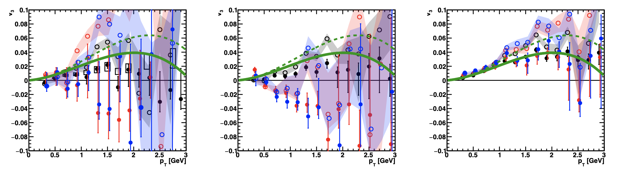
Scientific Method
v₃ non-flow correction moves points up (closed → open)
Other detector combinations with larger non-flow (red/blue)
show large overcorrection particularly in pAu

Slide 27
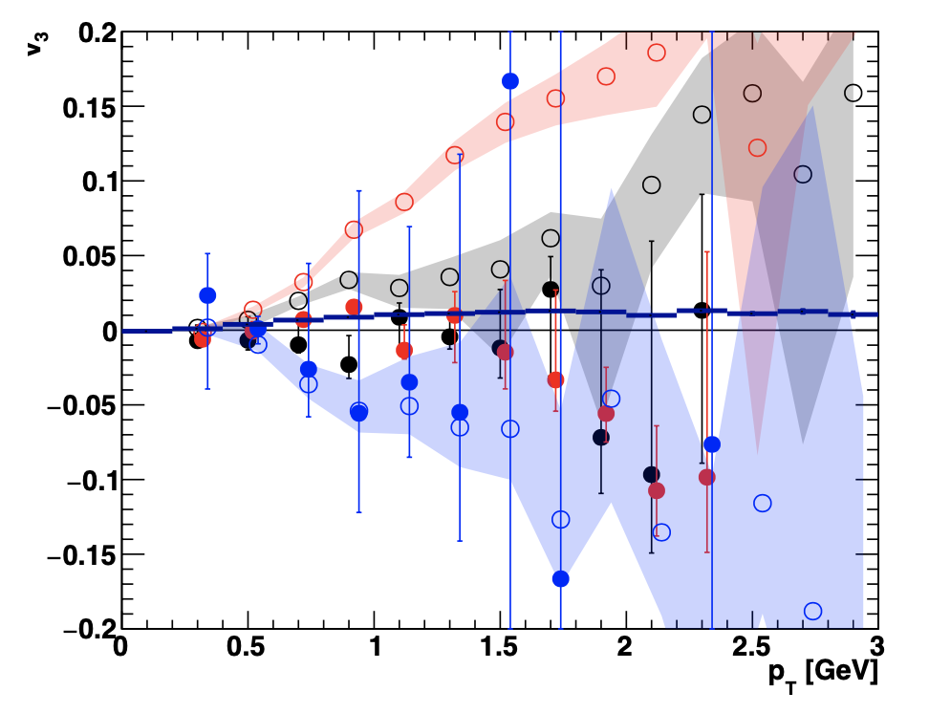
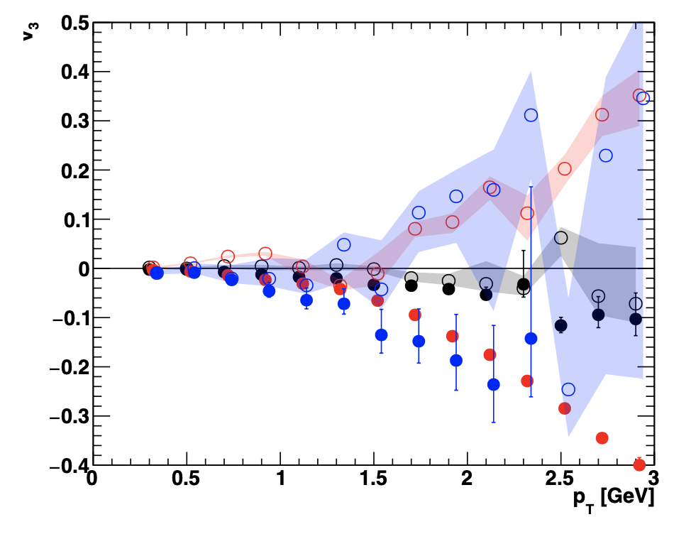
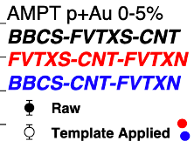
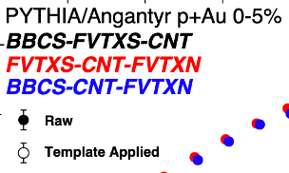
AMPT and Angantyr
Closure tests for v₃ show clear large violation (overcorrection) particularly when non-flow is large

Slide 28
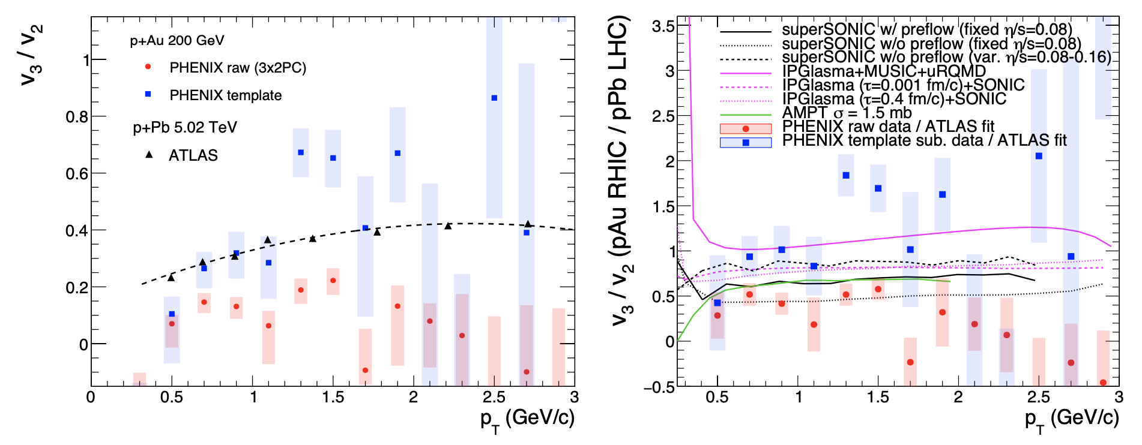
Ratio Test
v₃/v₂ (RHIC) < v₃/v₂ (LHC) for raw PHENIX results
v₃/v₂ (RHIC) > v₃/v₂ (LHC) with non-flow corrected PHENIX results

Slide 29
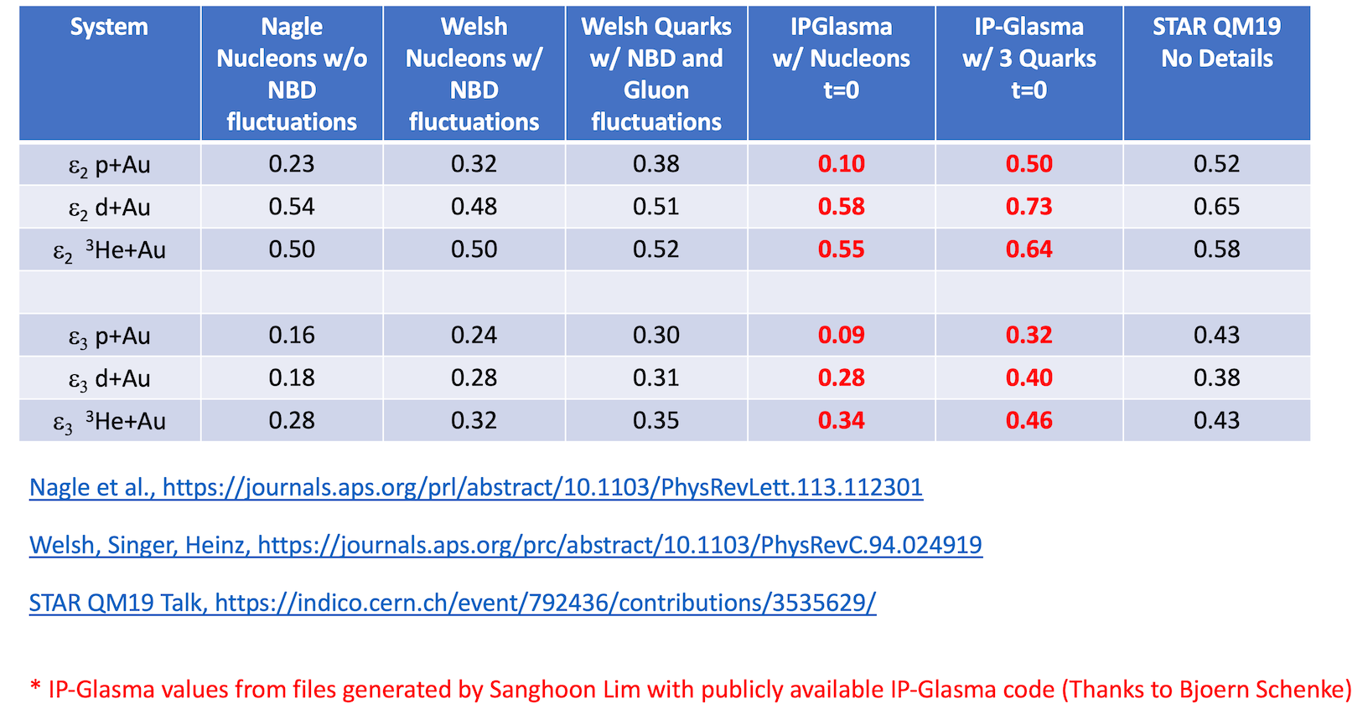
Initial Geometry Sensitivity
⬆
No details 2.5 years later

Slide 30
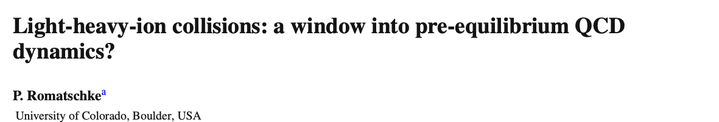
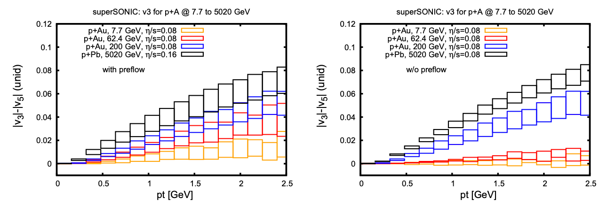
At some point, QGP lifetime too short and v₃ collapses
Strongly-coupled pre-flow helps mitigate this effect
30

Slide 31
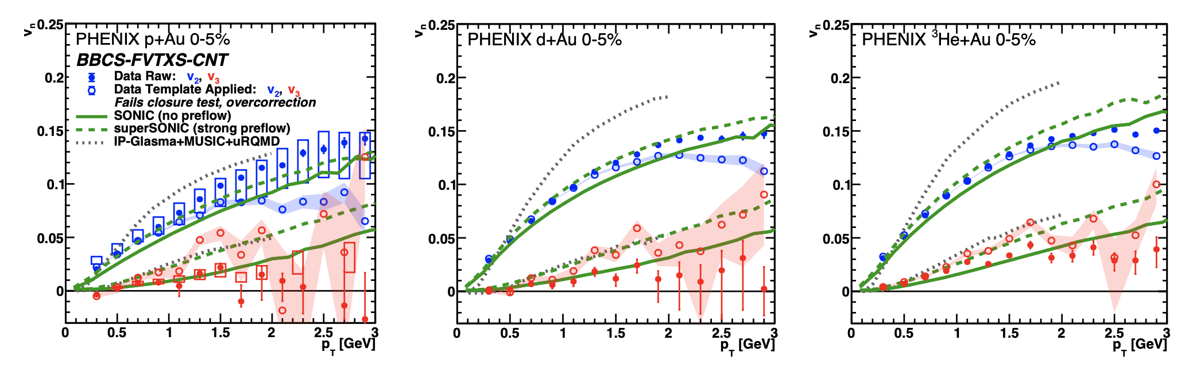
What have we really learned?
Closed points – Raw
Open points – Non-flow corrected
Elliptic flow ordering and geometry effect rather clear
Triangular flow follows geometry; however,
Non-flow correction is large, and many indicators that it is an overcorrection
Larger v₃ in pAu could be from strong pre-flow or
geometry fluctuations > intrinsic geometry

Slide 32
Everything reasonably explained by
geometry + final state hydrodynamics
Detailed for pre-hydrodynamics not resolved
No confirmation of glasma nor initial state correlations
but…

Slide 33
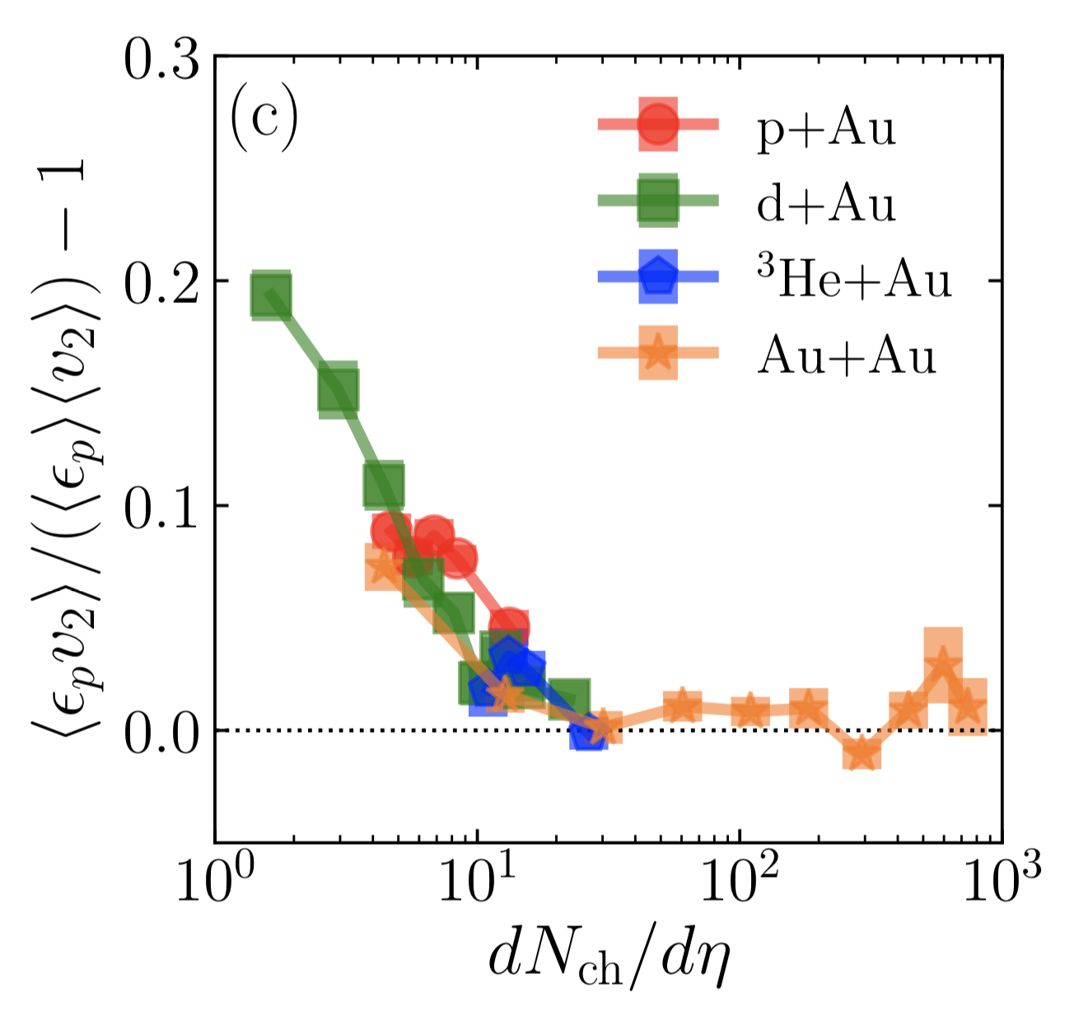
Scientific Method
Hybrid picture – both glasma correlations encoded via initial T^{μν} and final-state hydrodynamics
Glasma correlations might dominate when dN_{ch}/dη ~ 2-6
Scientific method demands we question basic assumptions
Now saturation physics
(high gluon density effects) only to be seen in very low multiplicity pA?
https://arxiv.org/abs/1908.06212
Initial State
Final State
0-5% Central pAu, dAu, ³HeAu
PHENIX: Phys.Rev.Lett. 121 (2018) no.22, 222301

Slide 34
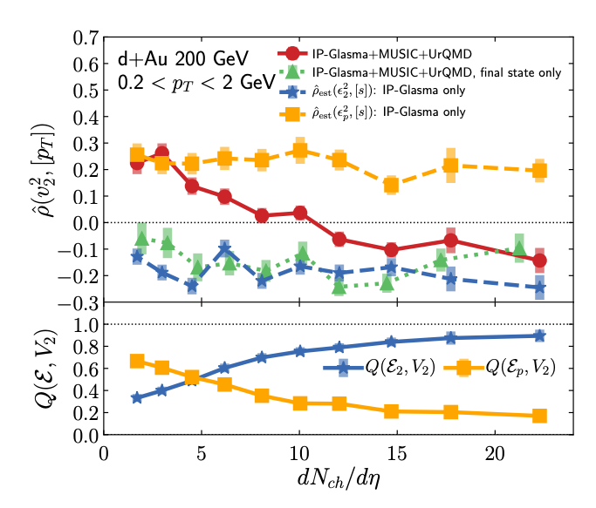
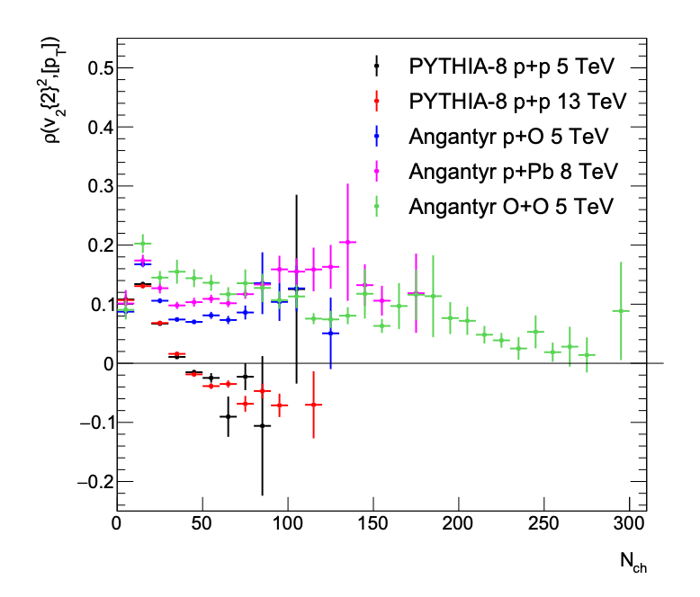
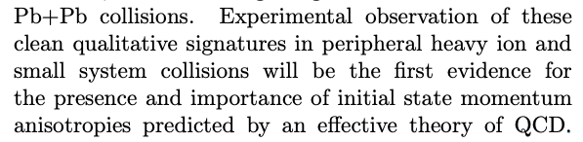
ρ(v_{n}-p_{T}) correlations
Very interesting observable – sensitive to shape-volume correlations
However, proposed “clean qualitative signature” of glasma is incorrect
https://arxiv.org/abs/2103.01348
https://arxiv.org/abs/2102.05200
https://arxiv.org/abs/2006.15721
Same effect in PYTHIA.
How can glasma diagrams be enhanced due to high gluon density at dN_{ch}/dη = 2?

Slide 35
A few other thoughts…
if time allows

Slide 36
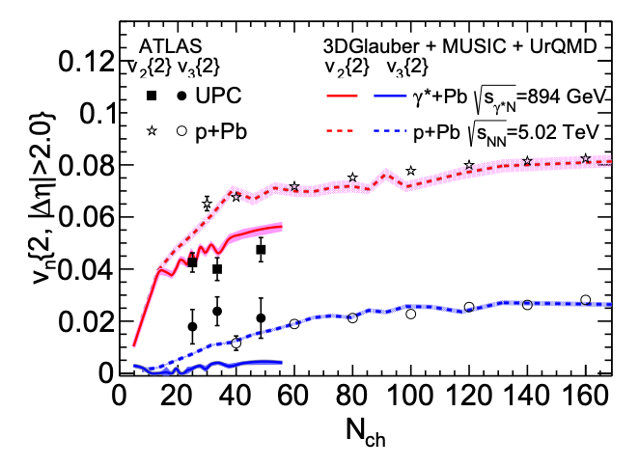
(1) Flow in Ultraperipheral Collisions
Treat γ* + Pb
at single E = 894 GeV,
two valance quarks
(vector meson dominance),
regular min. bias impact parameter
A lot of simplifications, including impact parameter distribution will be way off…
What really matters to making
v₂ (γ∗Pb) < v₂ (pPb)?
e-Print: 2203.06094

Slide 37
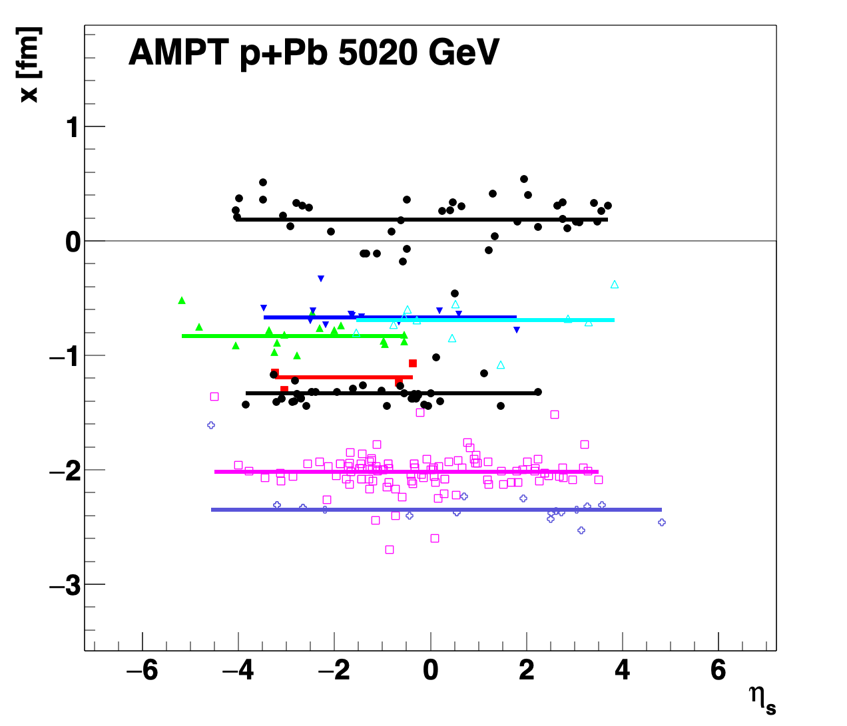
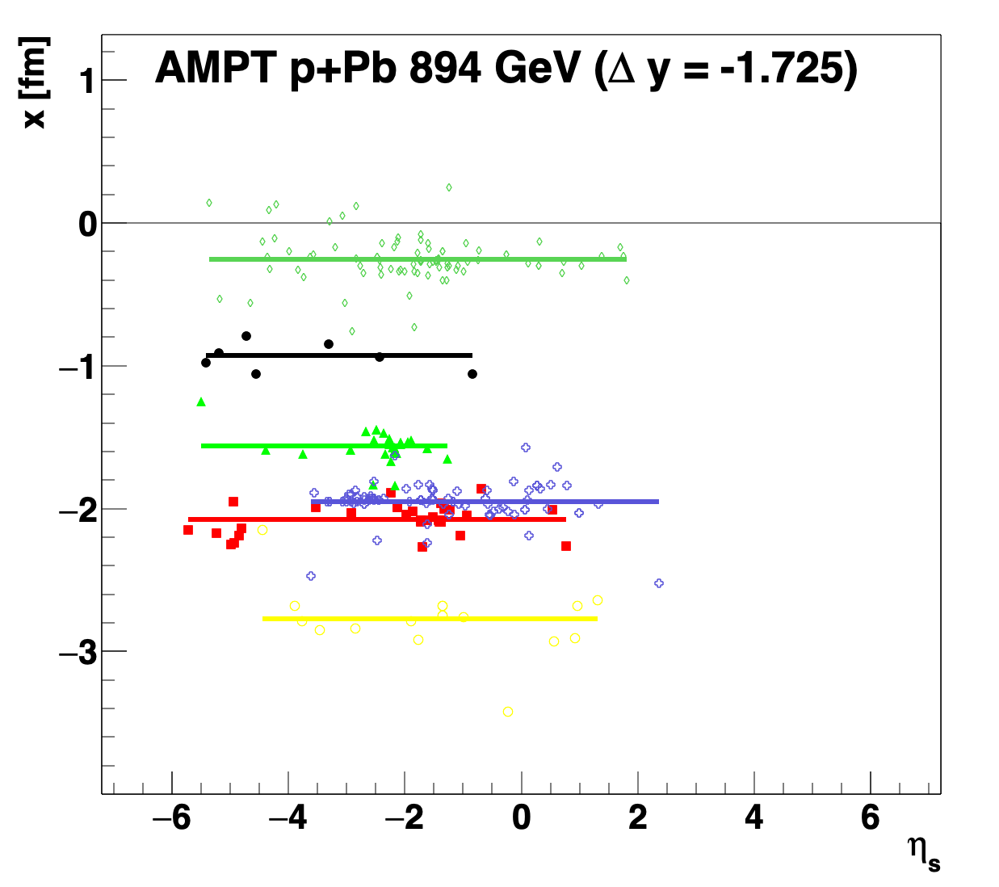
What really matters to making
v₂ (γ∗Pb) < v₂ (pPb) ?
ρ
v₂ is from a two-particle correlation with a |Δη| > 2 gap.
γ*Pb is like ρPb at 894 GeV but shifted in rapidity
Much larger longitudinal decorrelation!

Slide 38
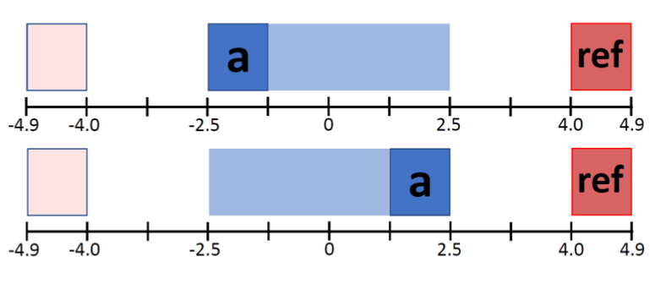
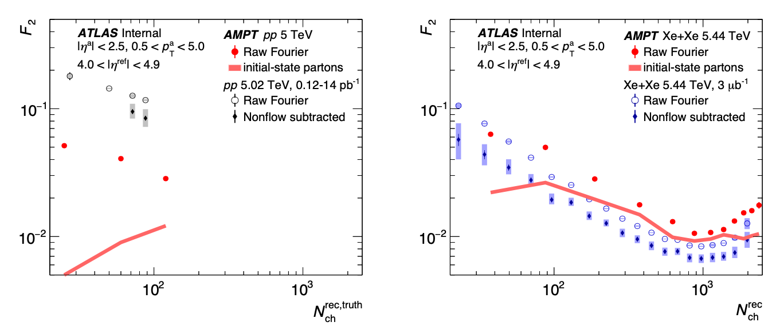
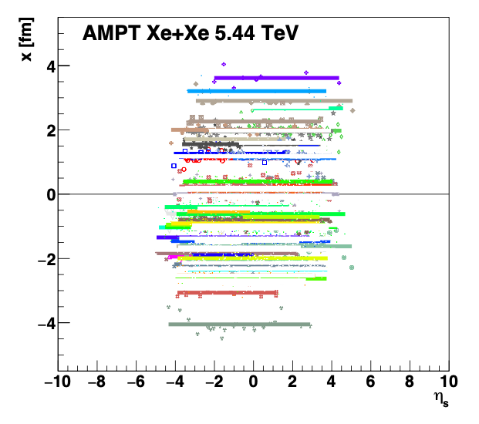
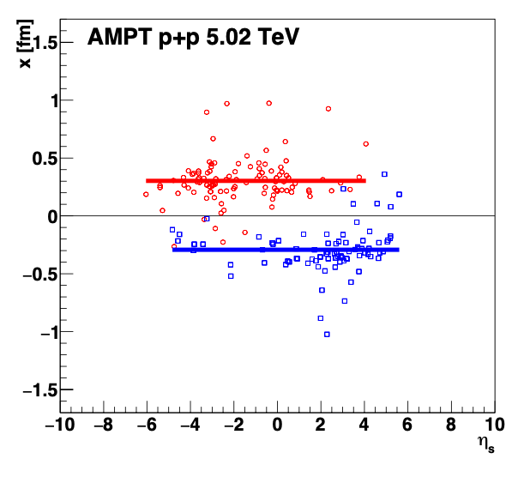
pp and XeXe longitudinal decorrelations
http://cdsweb.cern.ch/record/2806460

Slide 39

(2) Lessons about Bayesian analysis

Slide 40
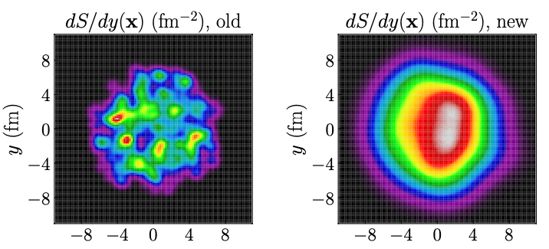
Mis-attribution of physics versus nuisance parameters
GG
How did we “unlearn” the Alver & Roland physics?
Bayesian statistics is meant to supplement human thinking,
not replace it
New JETSCAPE Bayesian determined parameters:
w = 1.12 fm - really big (unphysical) proton
d_{min} = 1.44 fm - nice and even spacing
- cannot be hard core repulsion

Slide 41
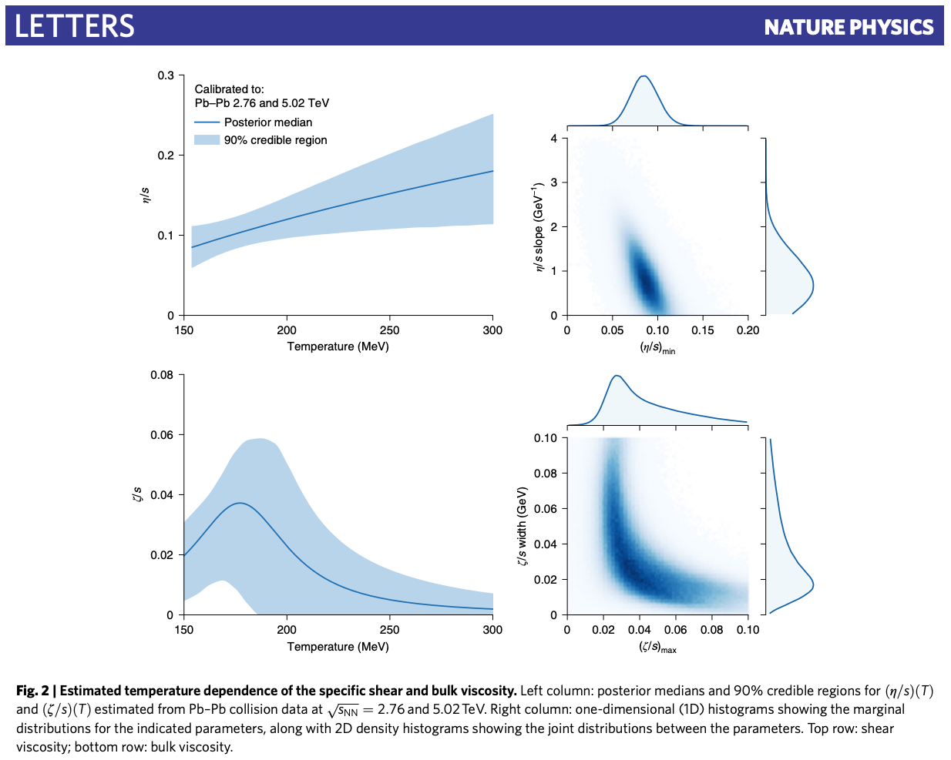
Mis-understanding of physics constraint
Cannot constrain bulk viscosity without considering pre-hydro scenarios of strong coupling
No Coupling - free streaming
(too often used)
Weak coupling – Color Glass Condensate / Glasma (α_{s} → 0)
Strong Coupling – AdS/CFT (α_{s} → ∞)
We must openly discuss the limitations… and not be awed by the machinery.

Slide 42
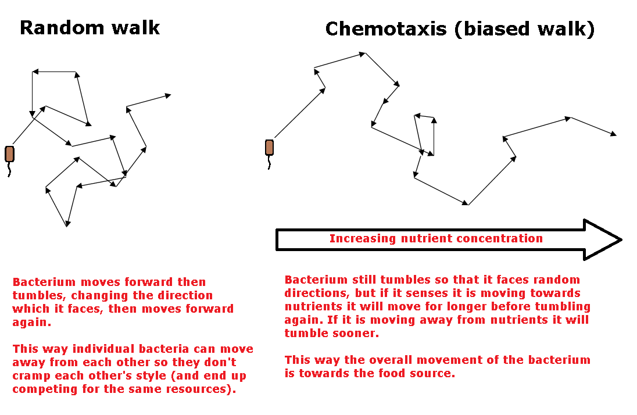

Slide 43
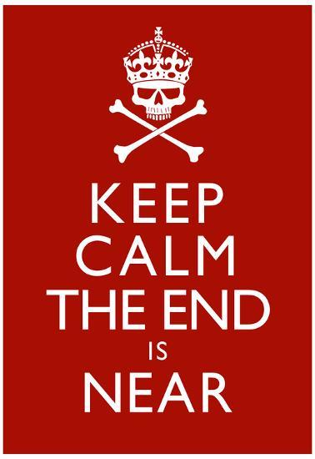
Summary
Small systems are still the best way to test the limits of our QGP standard time evolution model
Geometry + hydrodynamics
Pre-hydrodynamic evolution still an open question and an uncertainty to include
Keep actively thinking

Slide 44
Bonus

Slide 45

0-5% BBC
0-2% TPC
PHENIX pAu v₃/v₂ < ATLAS pPb v₃/v₂
STAR pAu v₃/v₂ > ATLAS pPb v₃/v₂

Slide 46

(3) Energy Loss in Small Systems
If there is no jet quenching (e.g., virtuality time > system time),
then where does high p_{T} v₂ in pPb and heavy flavor v₂ in pp, pPb originate from?

Slide 47






What is the standard evolution model of heavy ion collisions?

Slide 48
What is the standard evolution model of heavy ion collisions?
Pre-equilibrium, pre-thermalization → Pre-hydrodynamization
The field has still not come fully to grips with the fact that the QGP never equilibrates.
Remember all the conference sessions on the “fast equilibration puzzle”?
After 20 years, is there really any experimental evidence for very weakly coupled initial state
(glasma, CGC, free stream)?
Just like strangeness as a QGP signal, pushing to smaller (pp, pA) systems has been insightful.
How do small system collisions fit into this timeline?

Slide 49


How to Address Non-Flow?
Including in published results up to
p_{T} = 3 GeV is critical.
https://arxiv.org/abs/1902.11290

