Slide 1

What is the
end game
in heavy ion
physics?
Jamie Nagle
University of Colorado Boulder
Physics PAN
Wayne State University
September 03, 2021

Slide 2
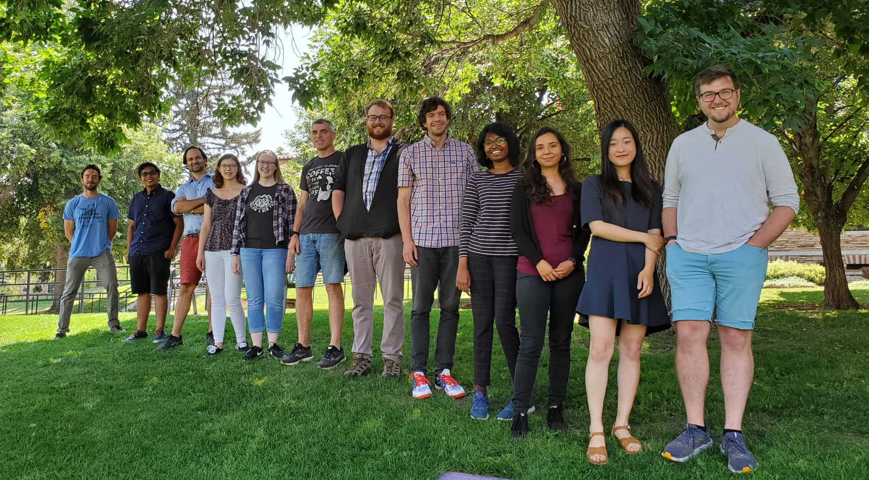



University of Colorado Boulder Group
College Scholar Award
Emilie du Chatelet grant from P2IO at CEA / Saclay
Key additional contributors
Professor Ron Belmont (UNCG) and Professor Sanghoon Lim (PNU),
both former postdocs in Boulder

Slide 3


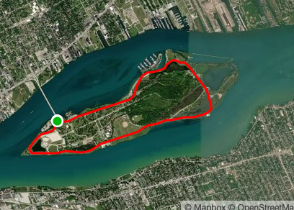
I miss Detroit !

Slide 4
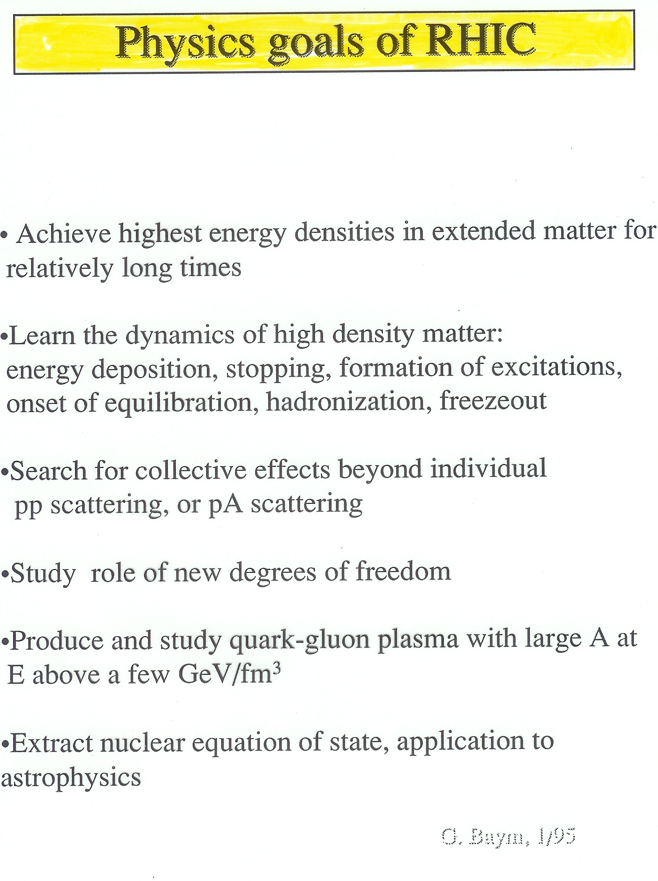
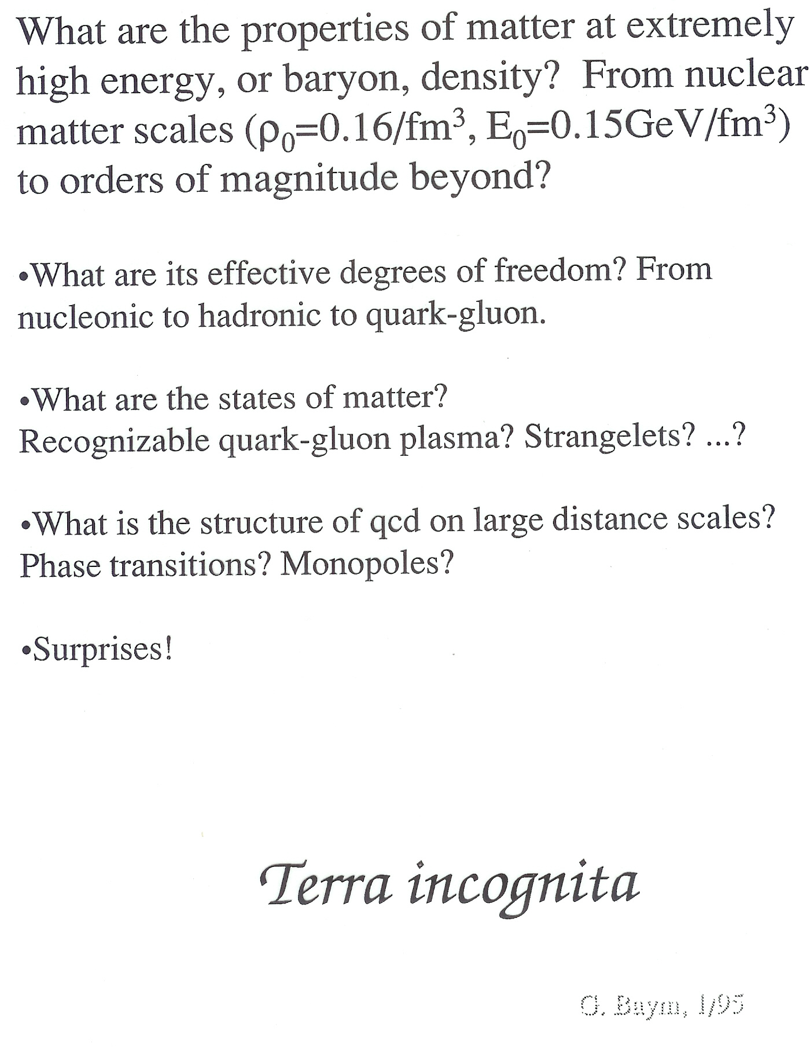

Slide 5
RHIC Heavy Ion Program will be ending in the next 5 years or so
to make way for the Electron Ion Collider…
sPHENIX and STAR with forward upgrades still ahead and
longer term LHC Heavy Ion program
Good to take stock of what we have learned and
what we have not learned…

Slide 6
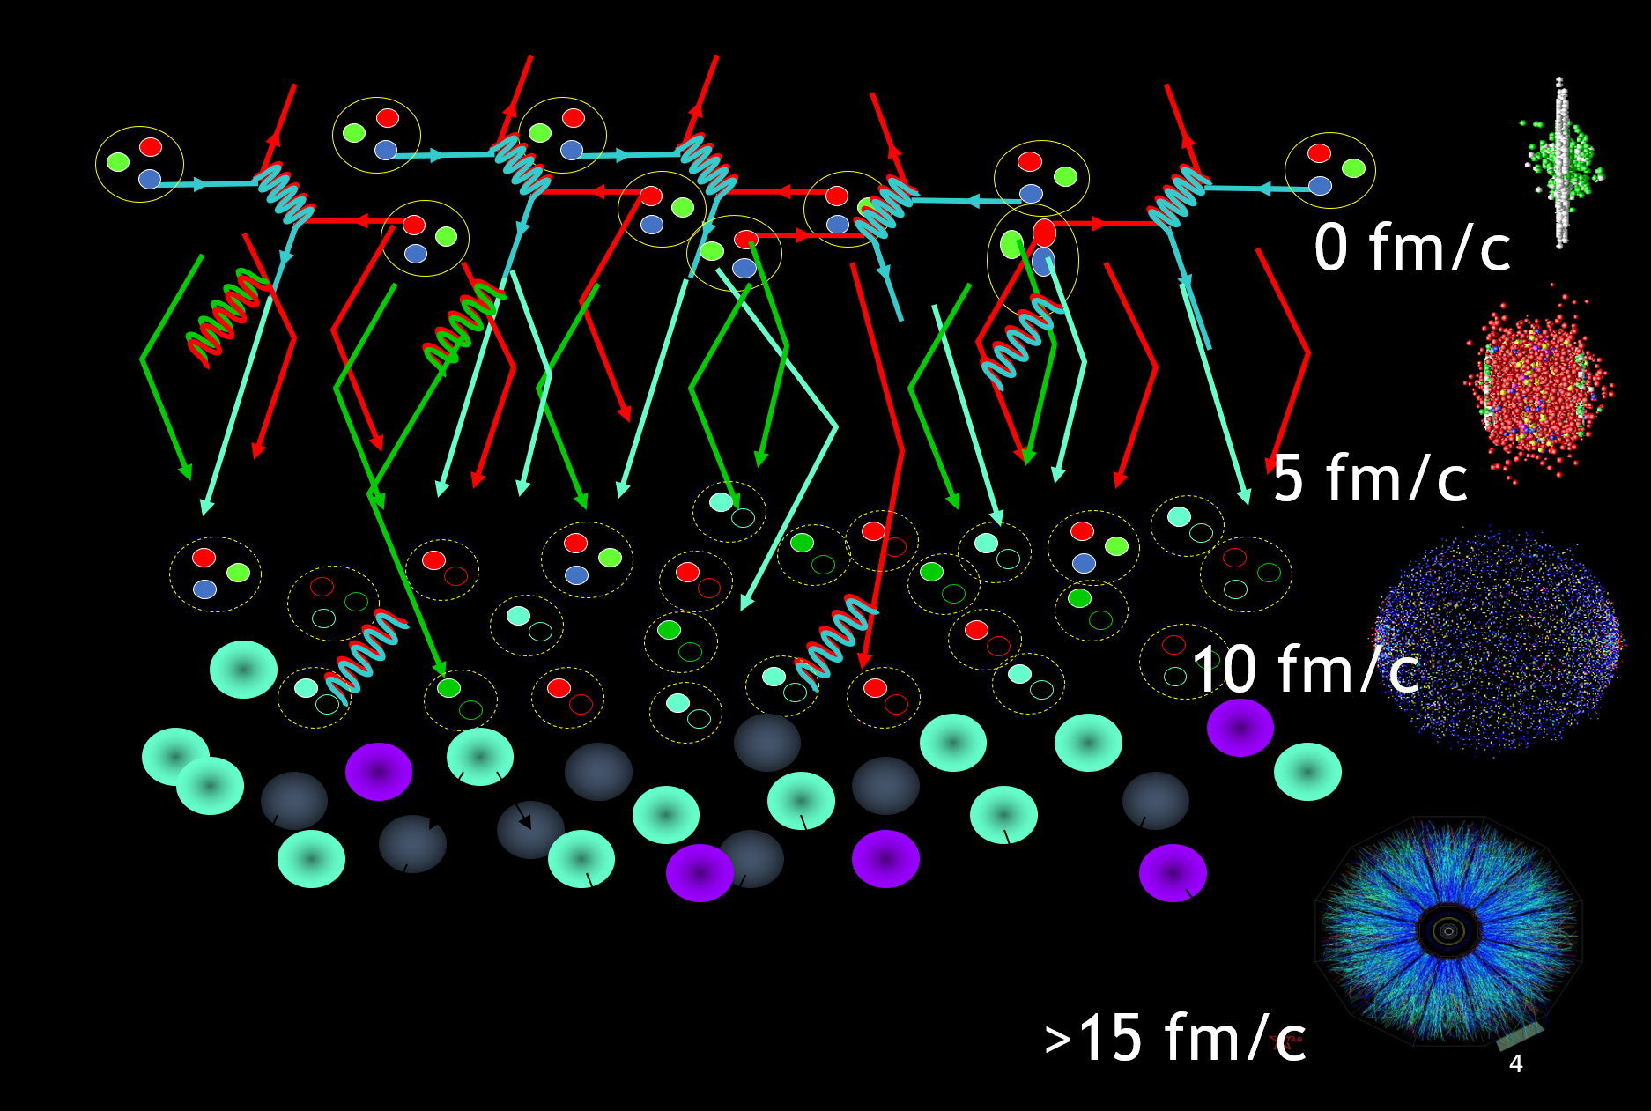
Standard Time Evolution Model of Heavy Ion Collisions
Initial State – nPDF, saturation physics, color domains?
QGP State – hydrodynamics, parton scattering
Hadron State – hadronization, hadron scattering
Free Streaming State – measured by experiment
6

Slide 7
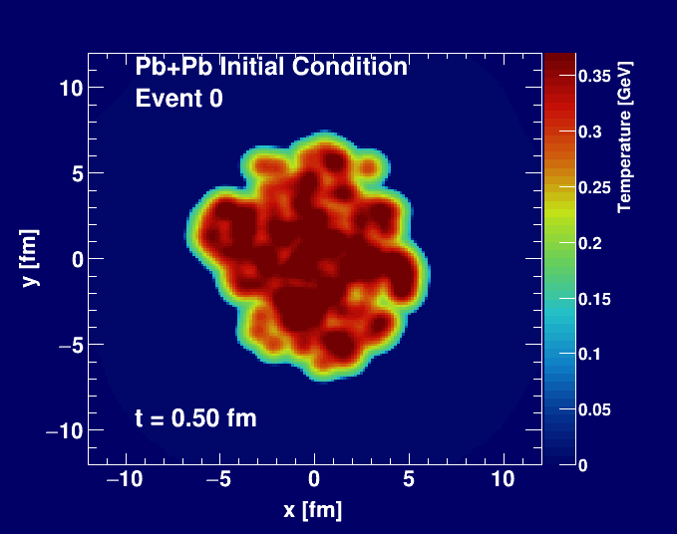
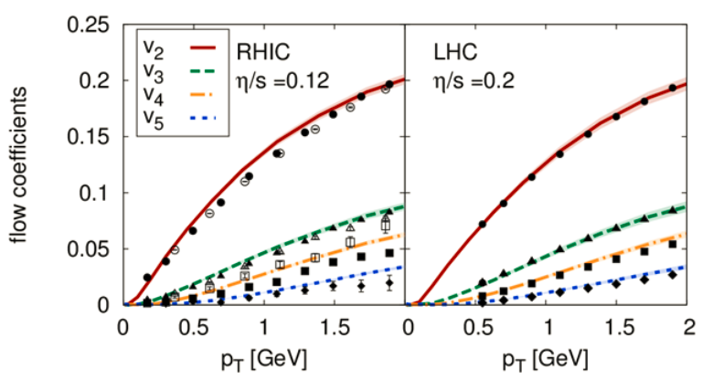
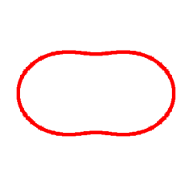
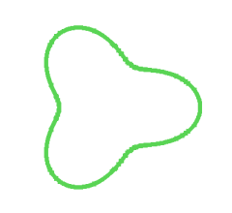
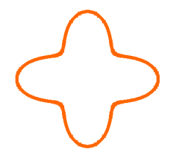
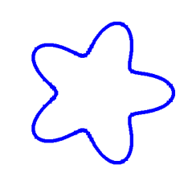
Standard Time Evolution Model of Heavy Ion Collisions
Bjoern Schenke
Hydrodynamic simulation (SONIC from Paul Romatschke) run with
η/s = 0.08 ~ 1/4π and ζ/s = 0.01

Slide 8
“One fluid to rule them all”
Pb+Pb
p+Pb
p+p
Weller and Romatschke, https://arxiv.org/abs/1701.07145

Slide 10
Experimental Data
v₂
Follows ordering of eccentricities
v₃
PHENIX, Nature Phys. 15 (2019) no.3, 214-220

Slide 11
Hydrodynamic – Data Comparison
PHENIX, Nature Phys. 15 (2019) no.3, 214-220
Hydrodynamic agreement with v₂, v₃ (p_{T}) for all three systems

Slide 12
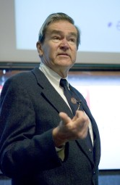
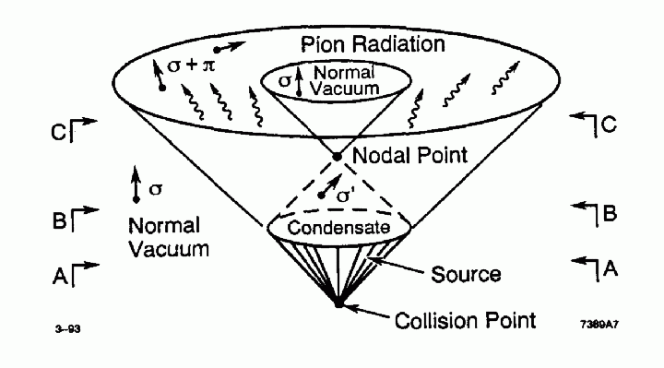
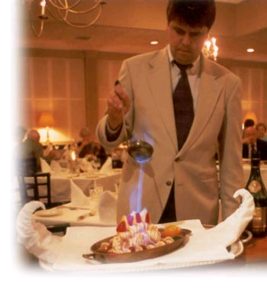
Back to a little history
Bjorken speculated that in the
“interiors of large fireballs produced in very high-energy pp collisions; vacuum states of the strong interactions are produced with anomalous chiral order parameters.”
“Baked Alaska”
“Disoriented Chiral Condensate” Domains

Slide 13
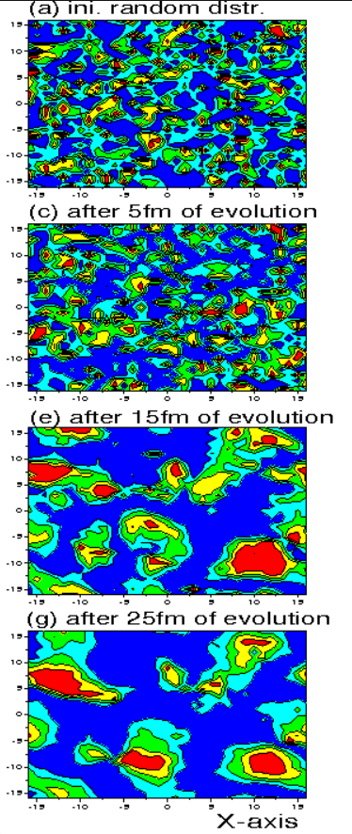
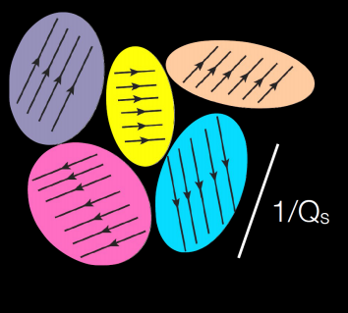
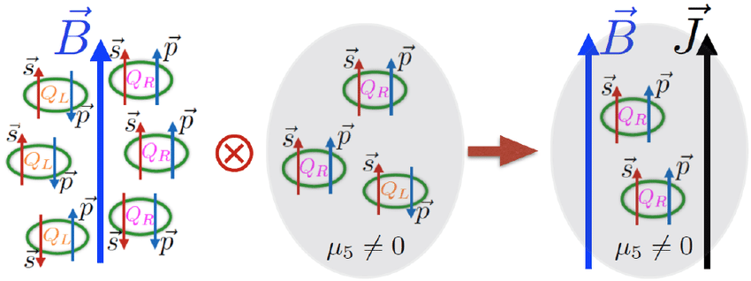
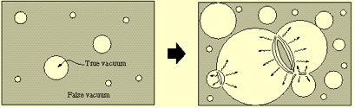
Other types of “domains”

Slide 14
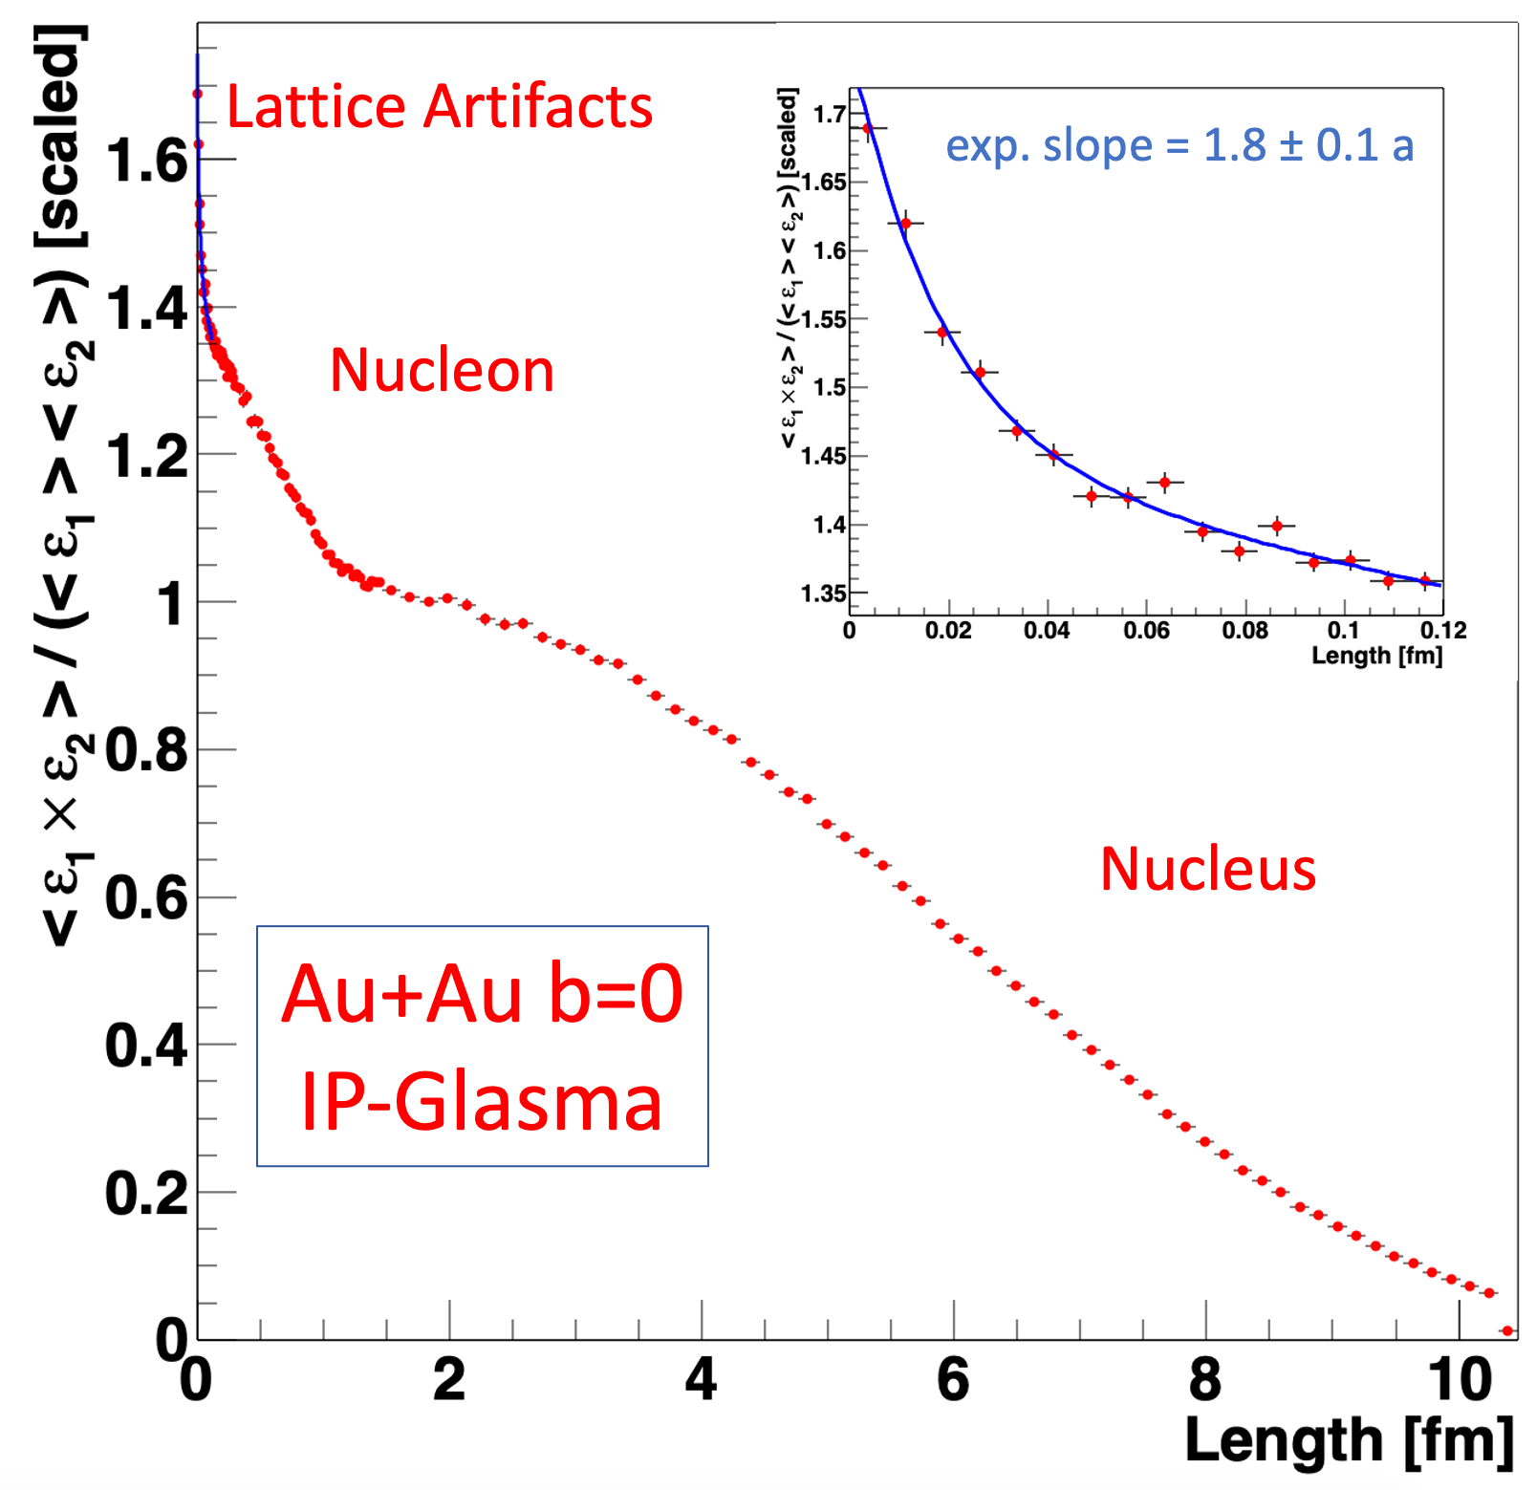
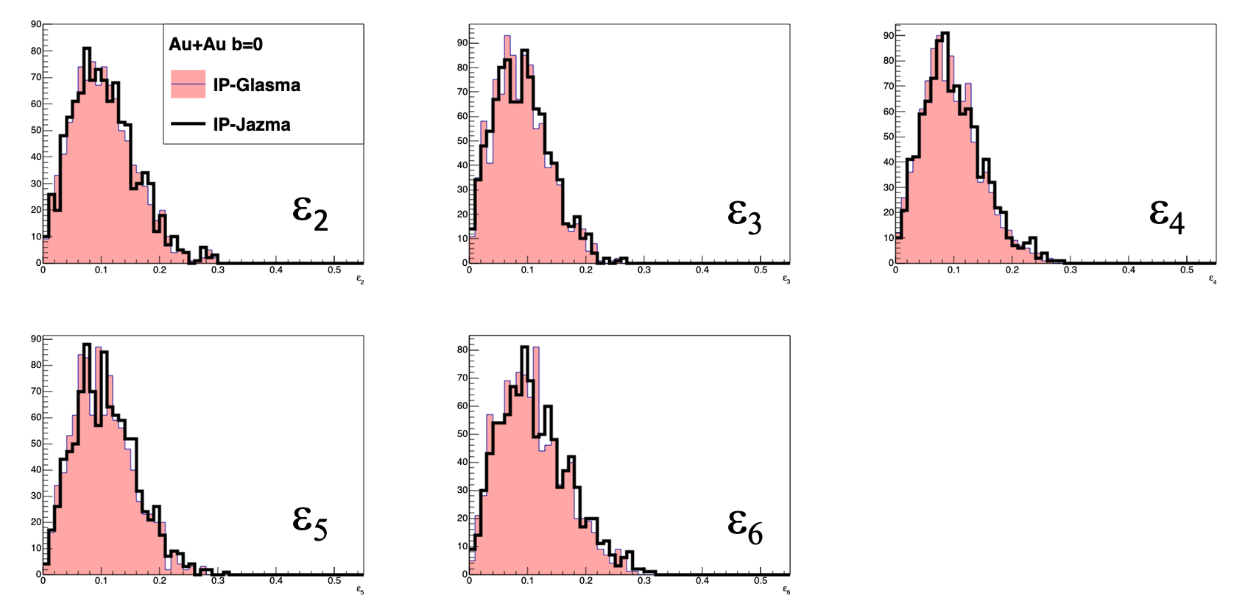
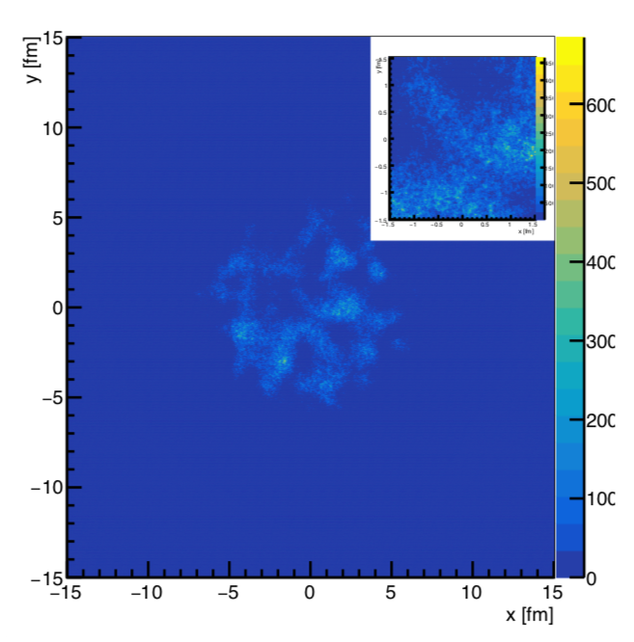
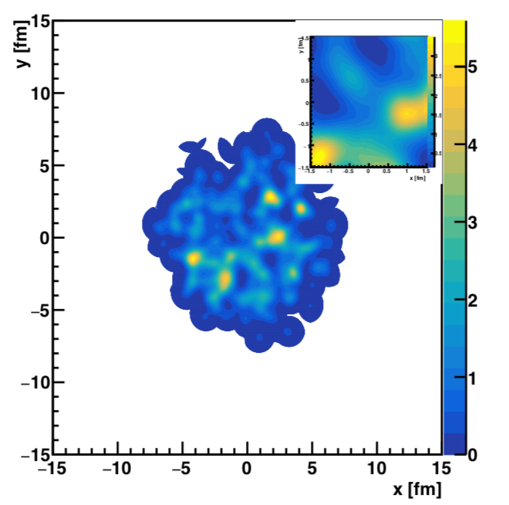
Other types of “domains”
Apples to Apples Comparison at τ=0.000015 fm/c
IP-Glasma AuAu b=0
IP-Jazma AuAu b=0
None of the features tested by
IP-Glasma + hydrodynamics give any evidence of saturation physics or color domains.
Only feature not seen in IP-Jazma is the lattice artifact component in the correlator.
IP-Glasma “color domain” lessons learned or not…

Slide 15
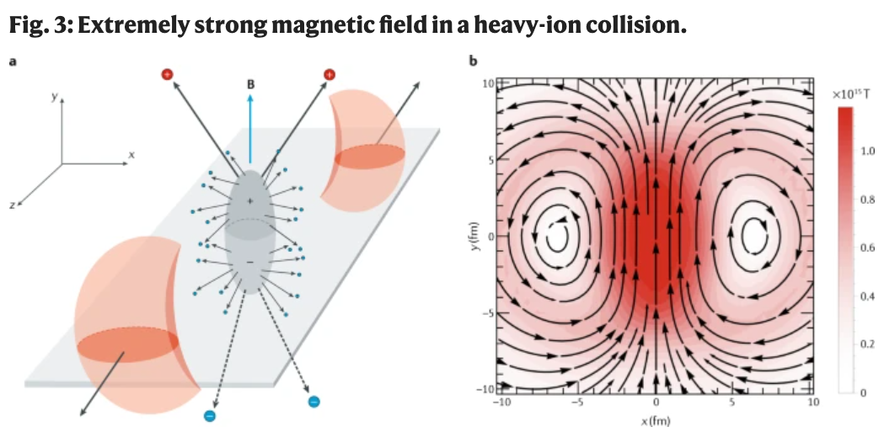
Other types of “domains”
https://www.nature.com/articles/s42254-020-00254-6
https://journals.aps.org/prc/abstract/10.1103/PhysRevC.96.024901
Simplified pictures, even as schematic,
often mislead the field in its critical thinking.
Much harder to imagine observing a
CME effect here.

Slide 16
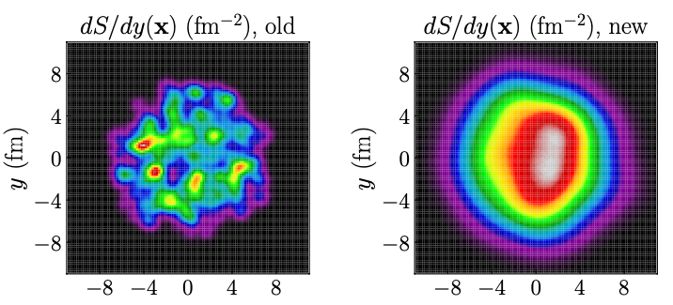
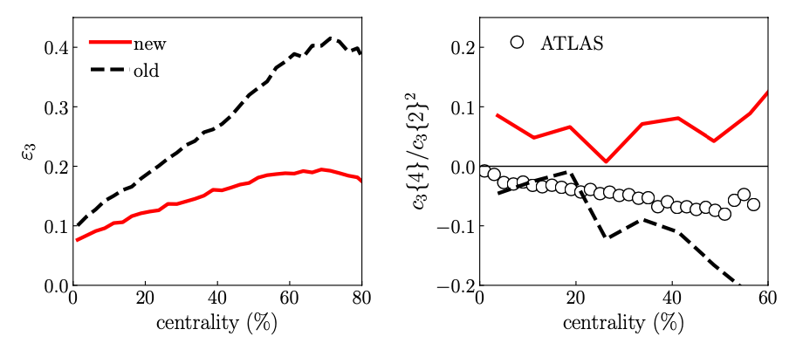
Other types of “domains” – are we unlearning “hot spots”
JETSCAPE Bayesian analysis
From Giuliano Giacalone
New parameters:
w = 1.12 fm - really big proton
d_{min} = 1.44 fm - nice and even spacing
- cannot be hard core repulsion
https://journals.aps.org/prc/pdf/10.1103/PhysRevC.103.05490
16
Progress with Bayesian analysis, but maybe losing sight of the goal of the field

Slide 17
Deep dive…
Is there any experimental evidence for CGC effects at RHIC (or LHC)?
Is there any experimental evidence for weakly coupling stage between strongly coupled incoming nuclei and strongly coupled QGP?
3) Is there any experimental (or theoretical) evidence for equilibration?
The answers have important implications for what we have (and also can) learn about QCD from heavy ion collisions.

Slide 18

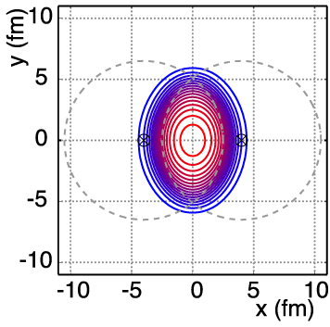
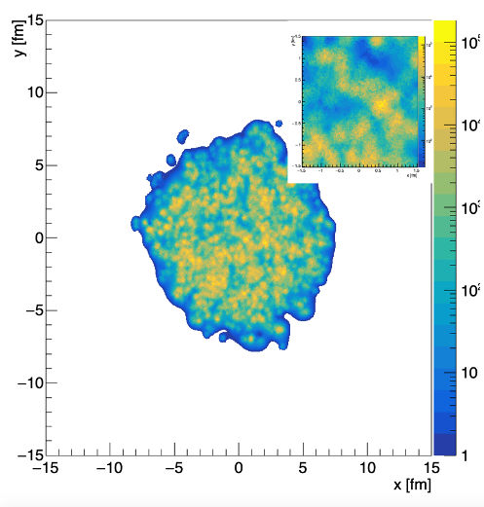
So, what have we learned?
Three valance quarks are the important DOF?
Color Glass Condensate Domains are important?
Chiral Magnetic Domains are important?
Nuclei are not smooth.
Nucleon fluctuations are important.
Sub-nucleonic geometry is important.

Slide 19
Small System Challenge #1

Slide 20
15 days after the PHENIX paper was posted, CGC post-dictions appeared
Mace, Skokov, Tribedy, Venugopalan [MSTV], https://arxiv.org/abs/1805.09342

Slide 21
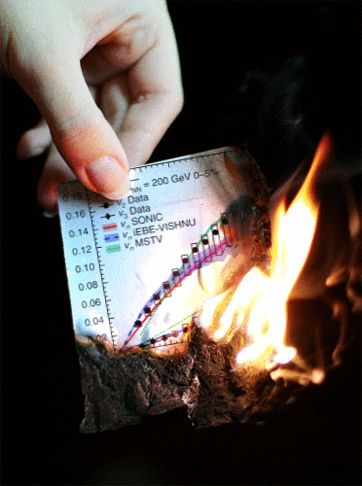


Slide 22
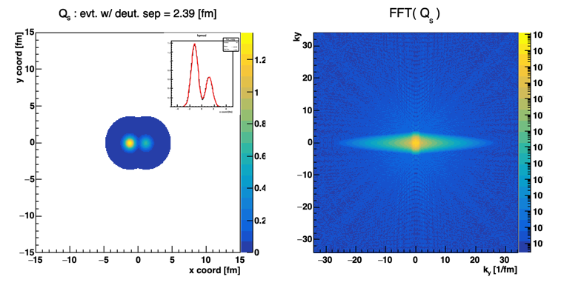
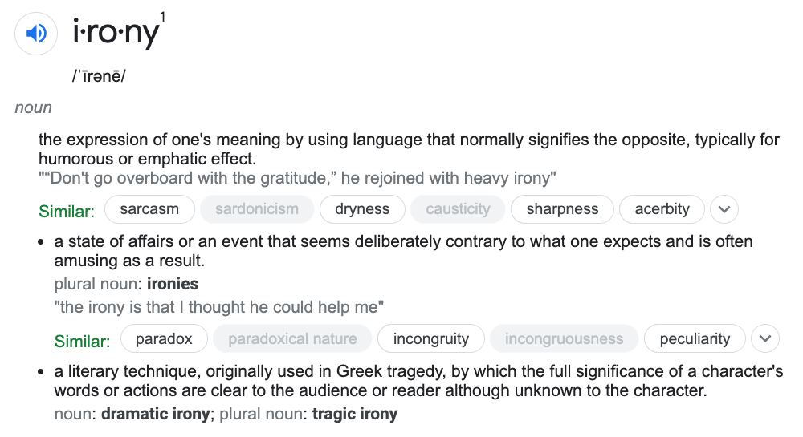
While on sabbatical in 2018 traveling around Europe,
I kept thinking “how can the CGC calculation follow the geometry ordering?”
In the calculation, there is a Fourier Transform of the spatial distribution into momentum space…
Many esteemed theorists explained that such a geometric ordering from the Fourier Transform would be at much lower momentum and thus,
is not the explanation.
J.N. and W.A. Zajc
https://arxiv.org/abs/1808.01276
Open-source code:
http://www.phenix.bnl.gov/WWW/publish/nagle/IPJAZMA

Slide 23
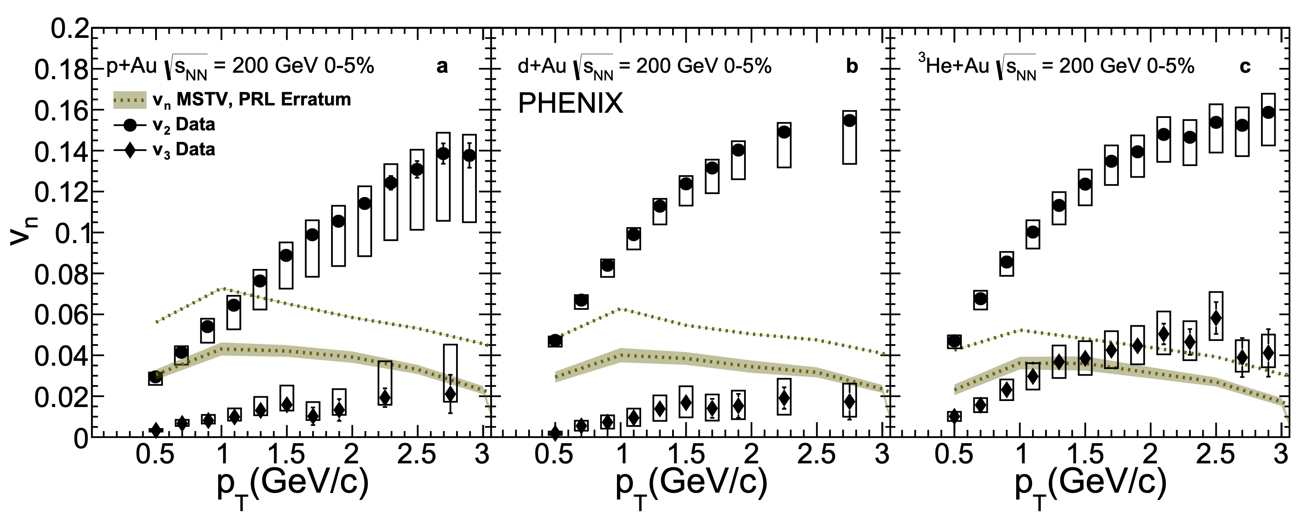

After a year of work (by many) and multiple workshops,
missing converting fm to GeV was found missing from the momentum scale.
$$ℏc$$
“In summary, due to the numerical error specified,
the hierarchy of v₂;₃ seen in the PHENIX data is not seen in our model.
It cannot therefore provide a viable description of the data.”
Erratum: Phys.Rev.Lett. 121 (2018) no.5, 052301
Corrigendum: Phys.Lett. B788 (2019) 161-165

Slide 24
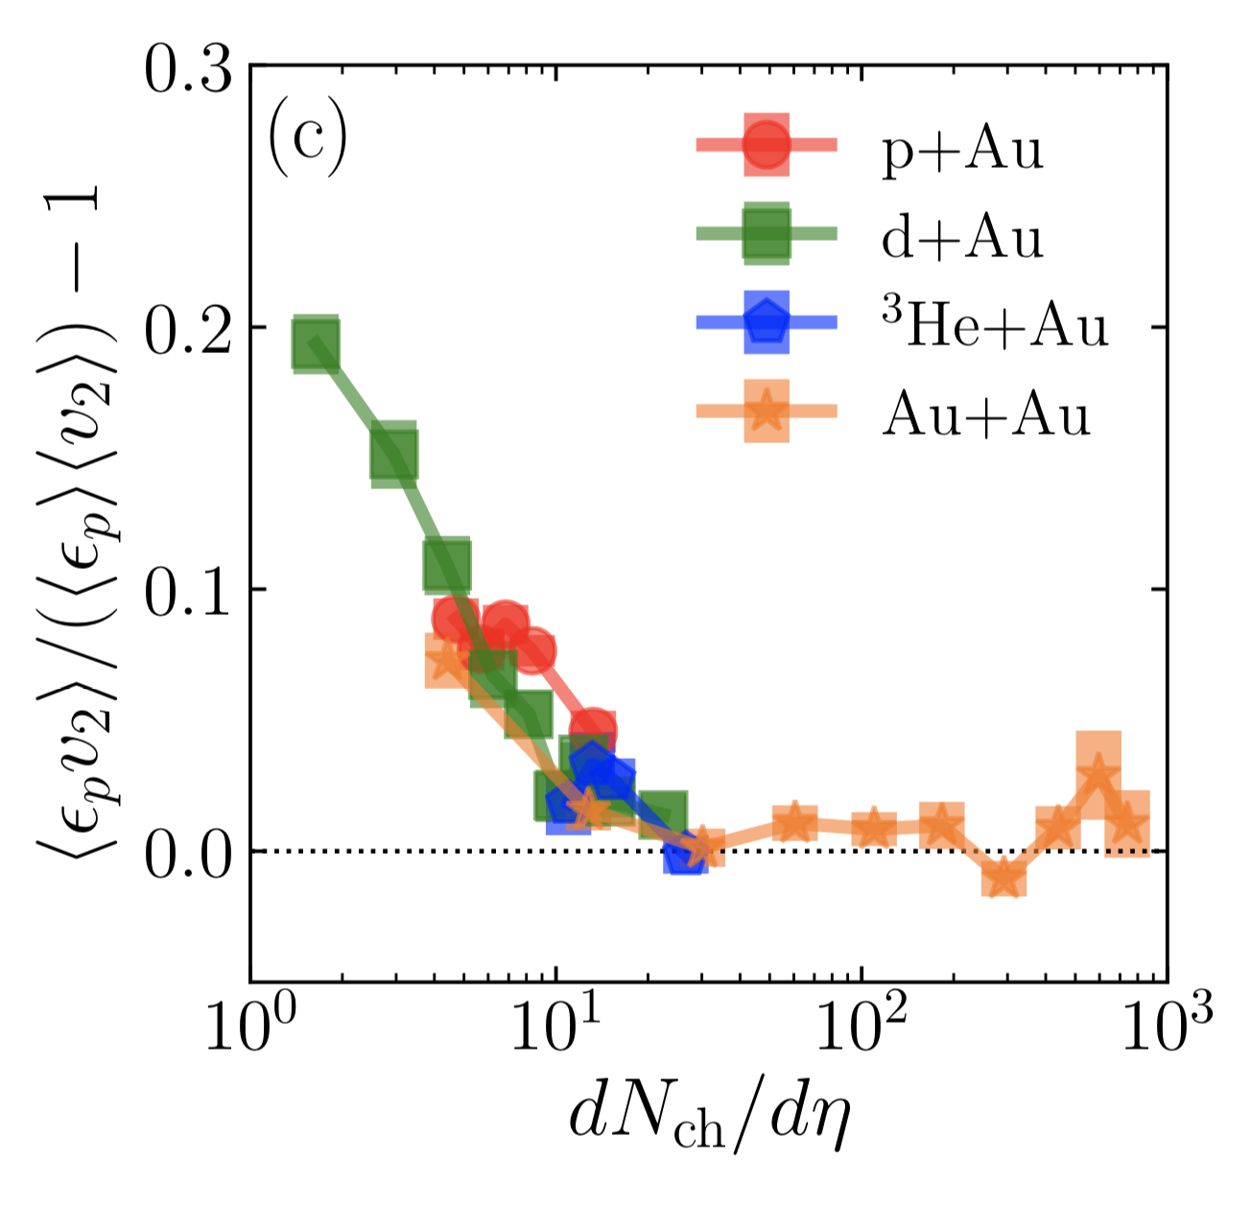
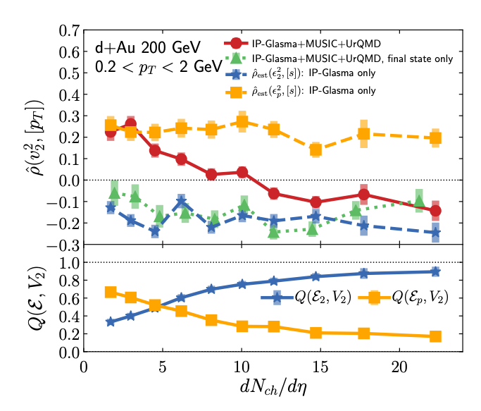
Weakly coupled initial state followed by strong coupling hydrodynamics
https://arxiv.org/abs/1908.06212
https://arxiv.org/abs/2006.15721
Initial State
Initial State
Final State
Final State
0-5% Central pAu, dAu, ³HeAu
p_{T} – v_{n} Correlator
PHENIX: Phys.Rev.Lett. 121 (2018) no.22, 222301

Slide 25
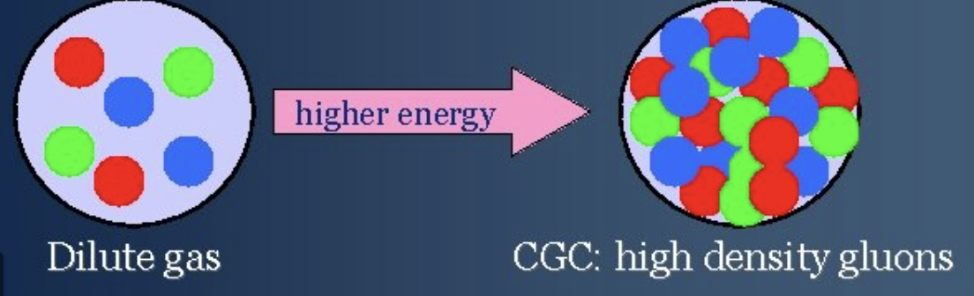
A post-modern CGC
Saturation physics sets a scale Q_{s} corresponding to gluon occupation number exceeding unity.
Beautiful weak-coupled theory with
phenomenology that has been used to explain literally everything at RHIC
(read the 20+ year literature).
Now with no evidence everywhere else,
one is led to believe we should look in
dN/dy ~ 2-5 pAu collisions at midrapidity for CGC signatures?

Slide 26
Small System Challenge #2

Slide 27
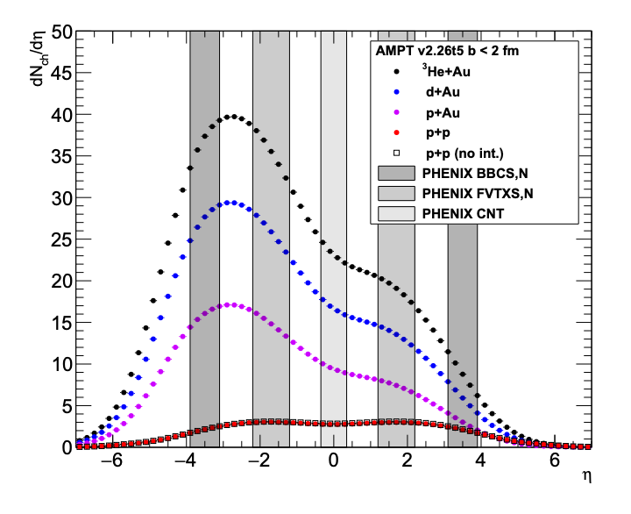
STAR Preliminary (#1) from Geometry Scan
QM18: STAR preliminary result with
TPC tracks and small Δη gap,
thus, huge non-flow subtraction!
https://indico.cern.ch/event/656452/contributions/2869833/attachments/1649479/2637419/QM18-smallsystem-shengli-10.pdf
Treats asymmetric system as symmetric
Appears to be over-subtraction of non-flow
Methods give different answers

Slide 28
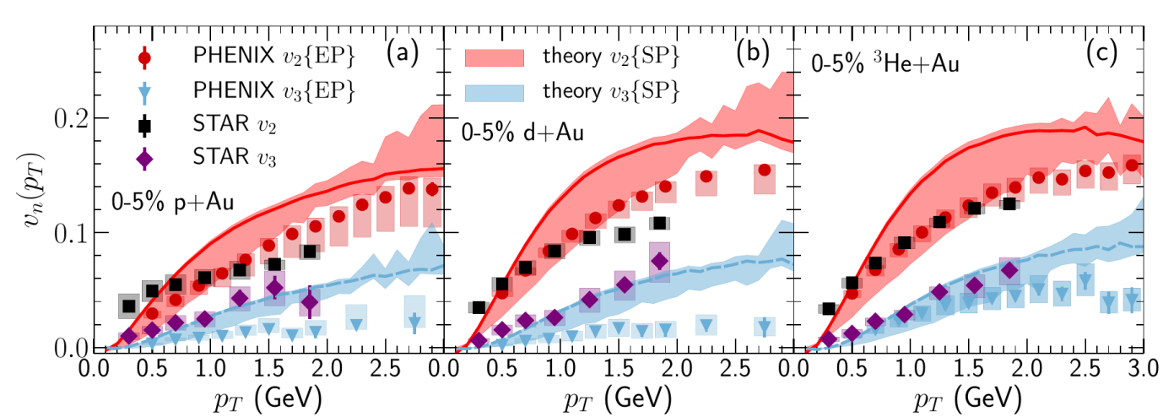
STAR Preliminary (#2) from Geometry Scan
At QM19 in Wuhan the STAR Collaboration showed new results
v₂ results “consistent”, tension in pAu/dAu
v₃ results differ in pAu, dAu by x2-3
*Note pAu is now 0-2% and p_{T} > 2 removed…
28

Slide 30
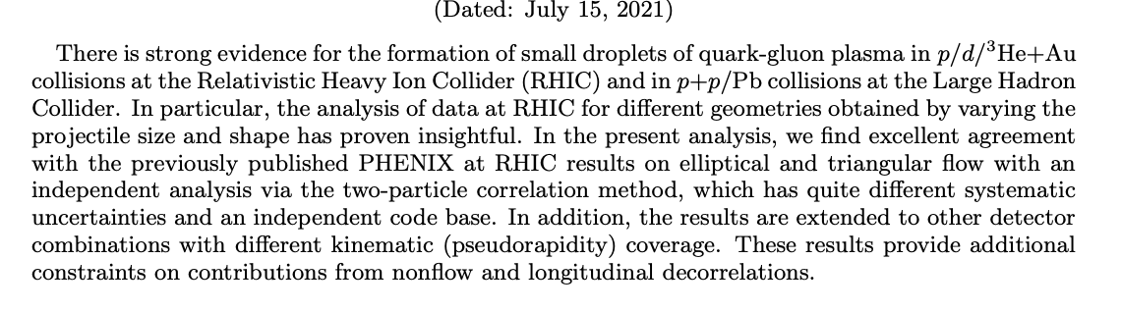
https://arxiv.org/abs/2107.06634
Utilizing two-particle correlations instead of event-plane method.
Utilizes FVTX tracks instead of hits.
Independent code base and different analyzers.
Beam offset and angle, carriage offset accounted for via event mixing.
Publish or Perish

Slide 31
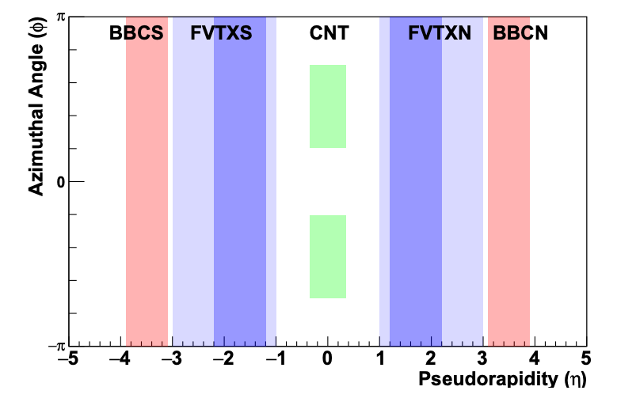
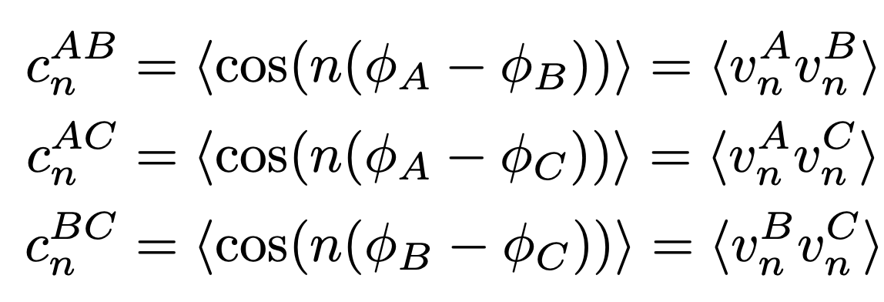
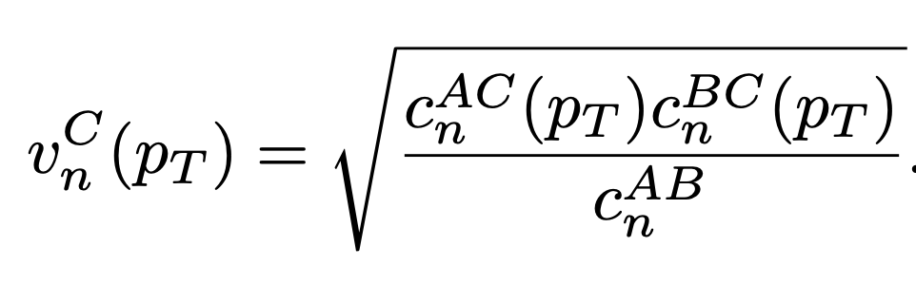
PHENIX Detector Systems

Slide 32
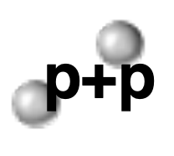
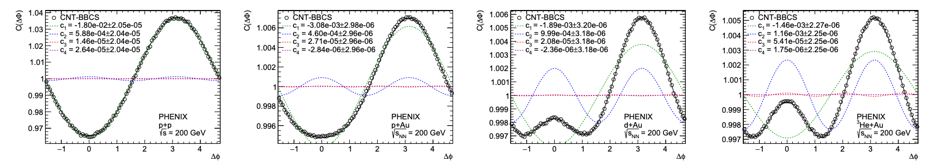
PHENIX Example Correlations after Event Mixing Correction
PHENIX Collaboration agreement to focus on the data analysis, systematic uncertainties, additional checks,
and extended kinematics.
PHENIX End Game

Slide 33
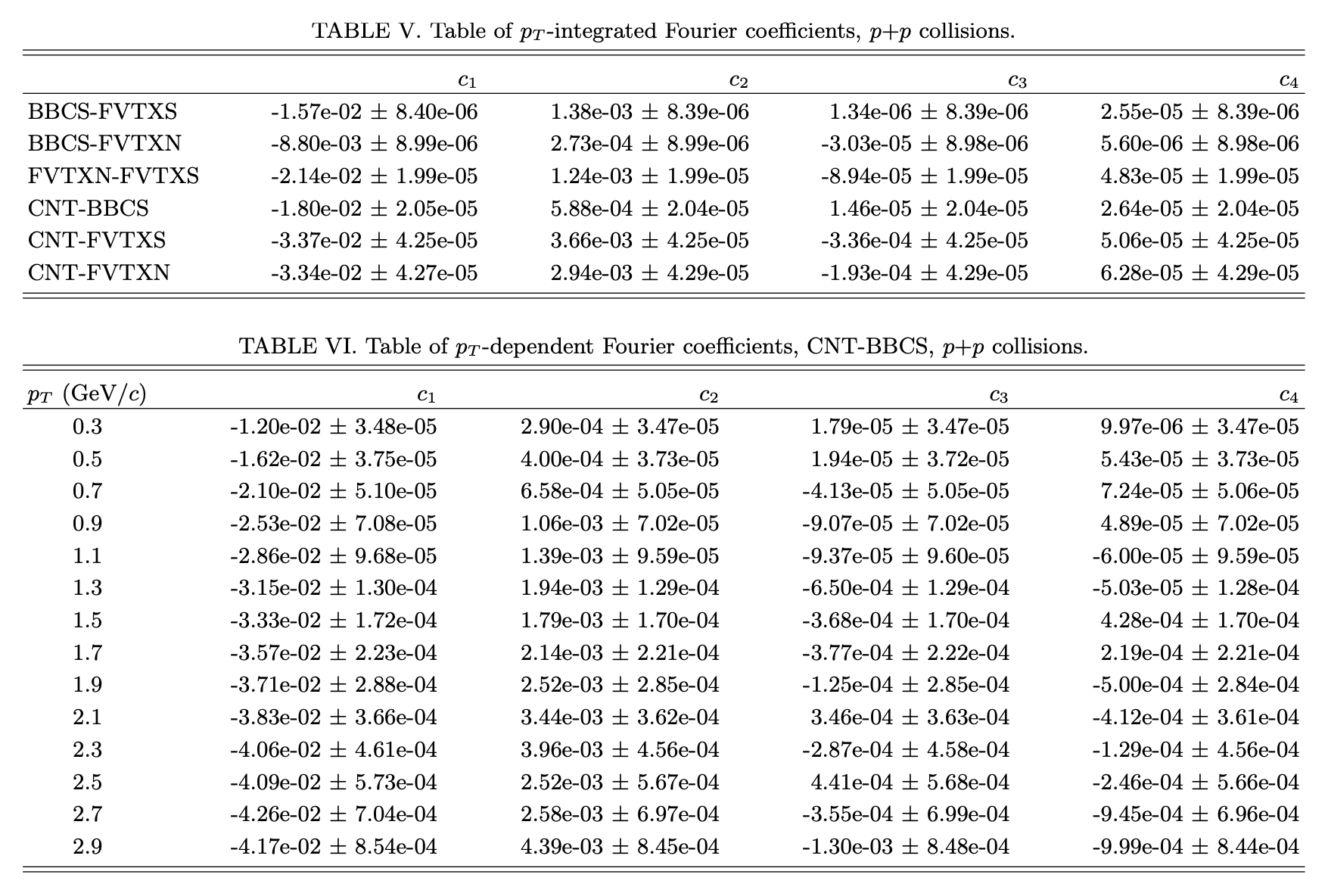
PHENIX paper includes archival Appendix
with tables of all coefficients from all correlation functions

Slide 34
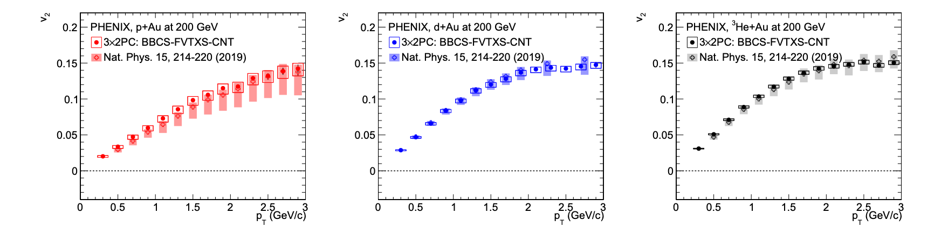
PHENIX previous publications utilize BBCS-FVTXS-CNT to have the combination of the largest rapidity gaps and highest multiplicities (to minimize non-flow)
Elliptic Flow v₂
Excellent confirmation of published results.

Slide 35
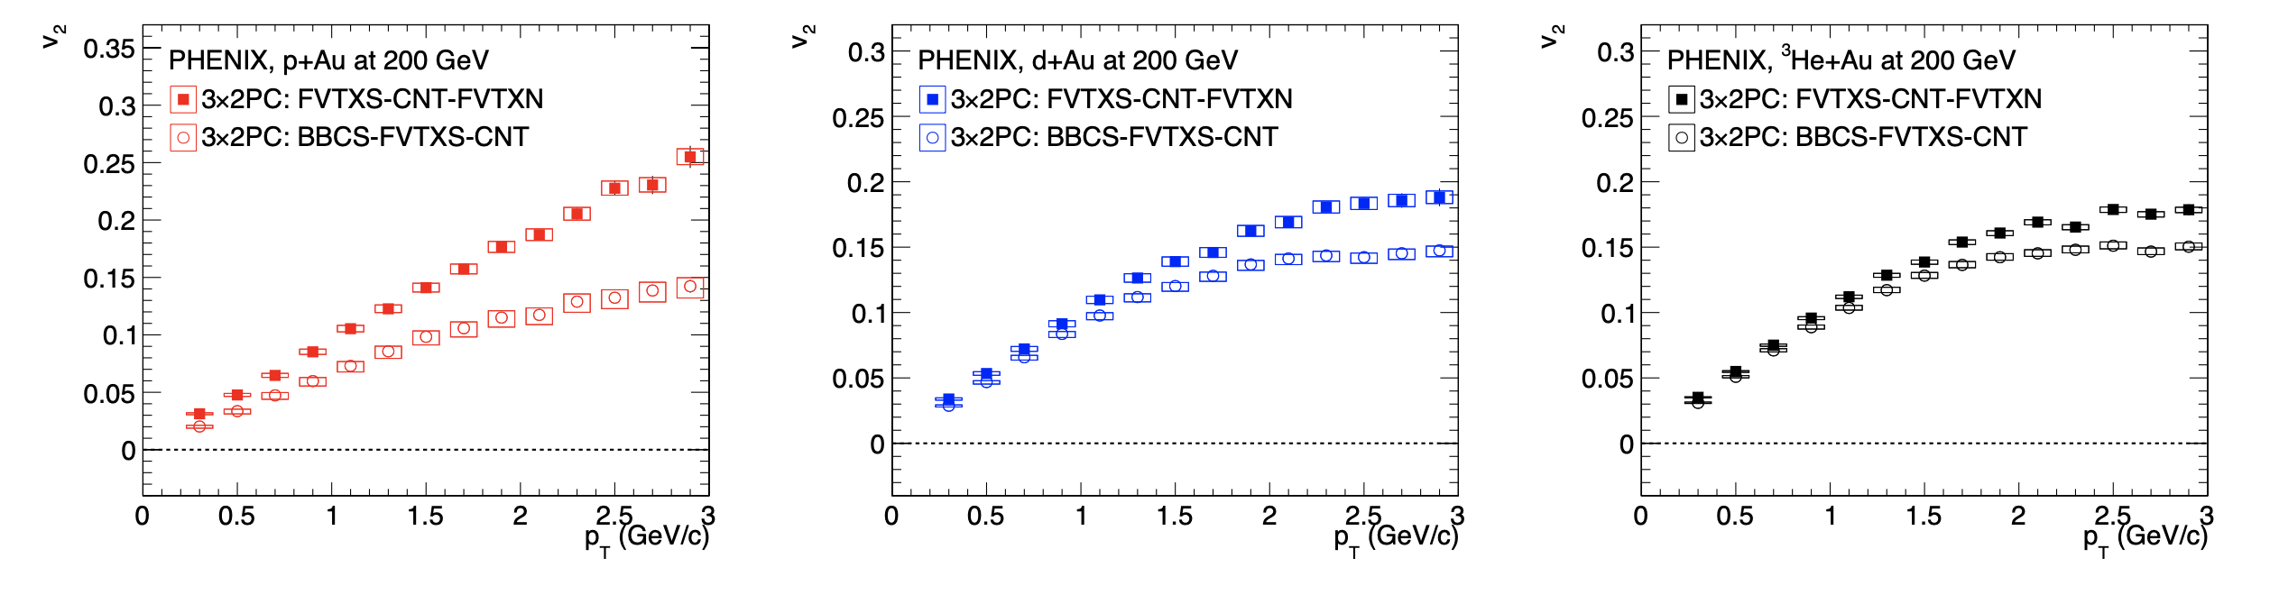
Now utilize combination with FVTXS-CNT-FVTXN which has lower multiplicity, smaller rapidity gap, lower v₂.
Elliptic Flow v₂
Larger non-flow contribution as expected

Slide 36
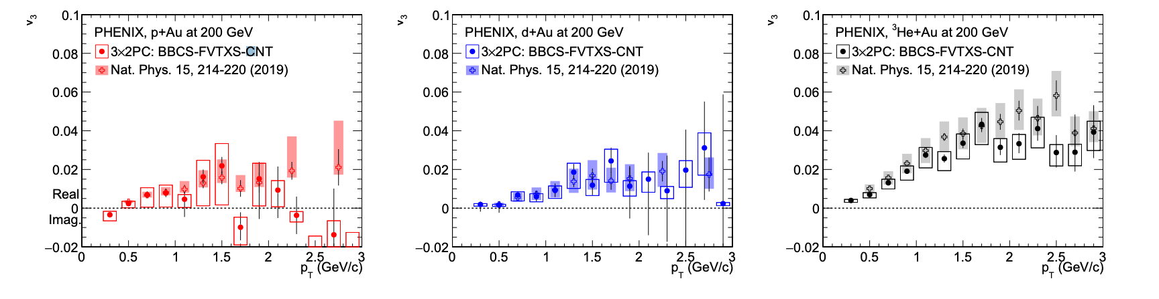
PHENIX previous publications utilize BBCS-FVTXS-CNT to have the combination of the largest rapidity gaps and highest multiplicities (to minimize non-flow)
Triangular Flow v₃
Excellent confirmation of published results.

Slide 37
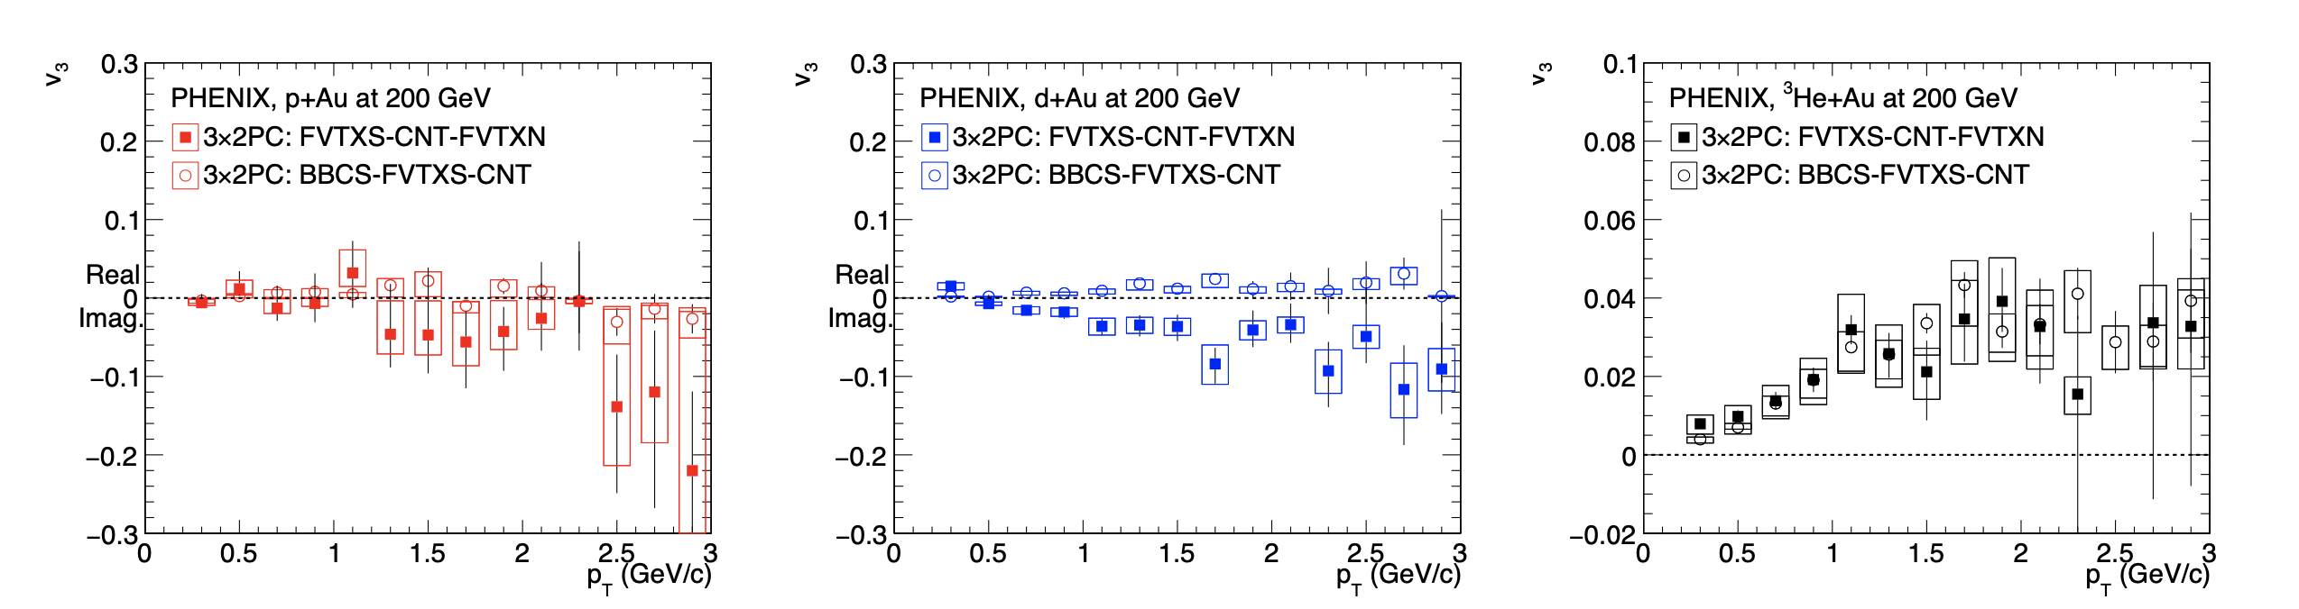
Now utilize combination with FVTXS-CNT-FVTXN which has lower multiplicity, smaller rapidity gap, lower v₂.
Triangular Flow v₃
Larger non-flow contribution as expected, pAu, dAu v₃ imaginary

Slide 38
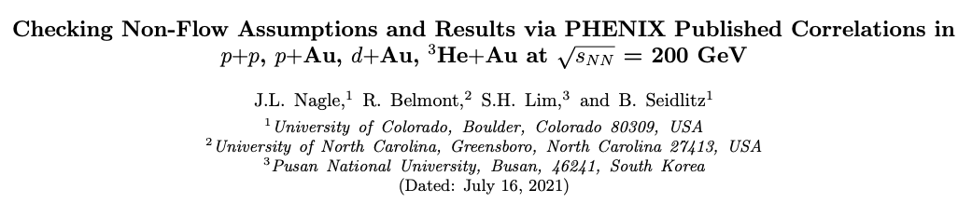
https://arxiv.org/abs/2107.07287

Slide 39
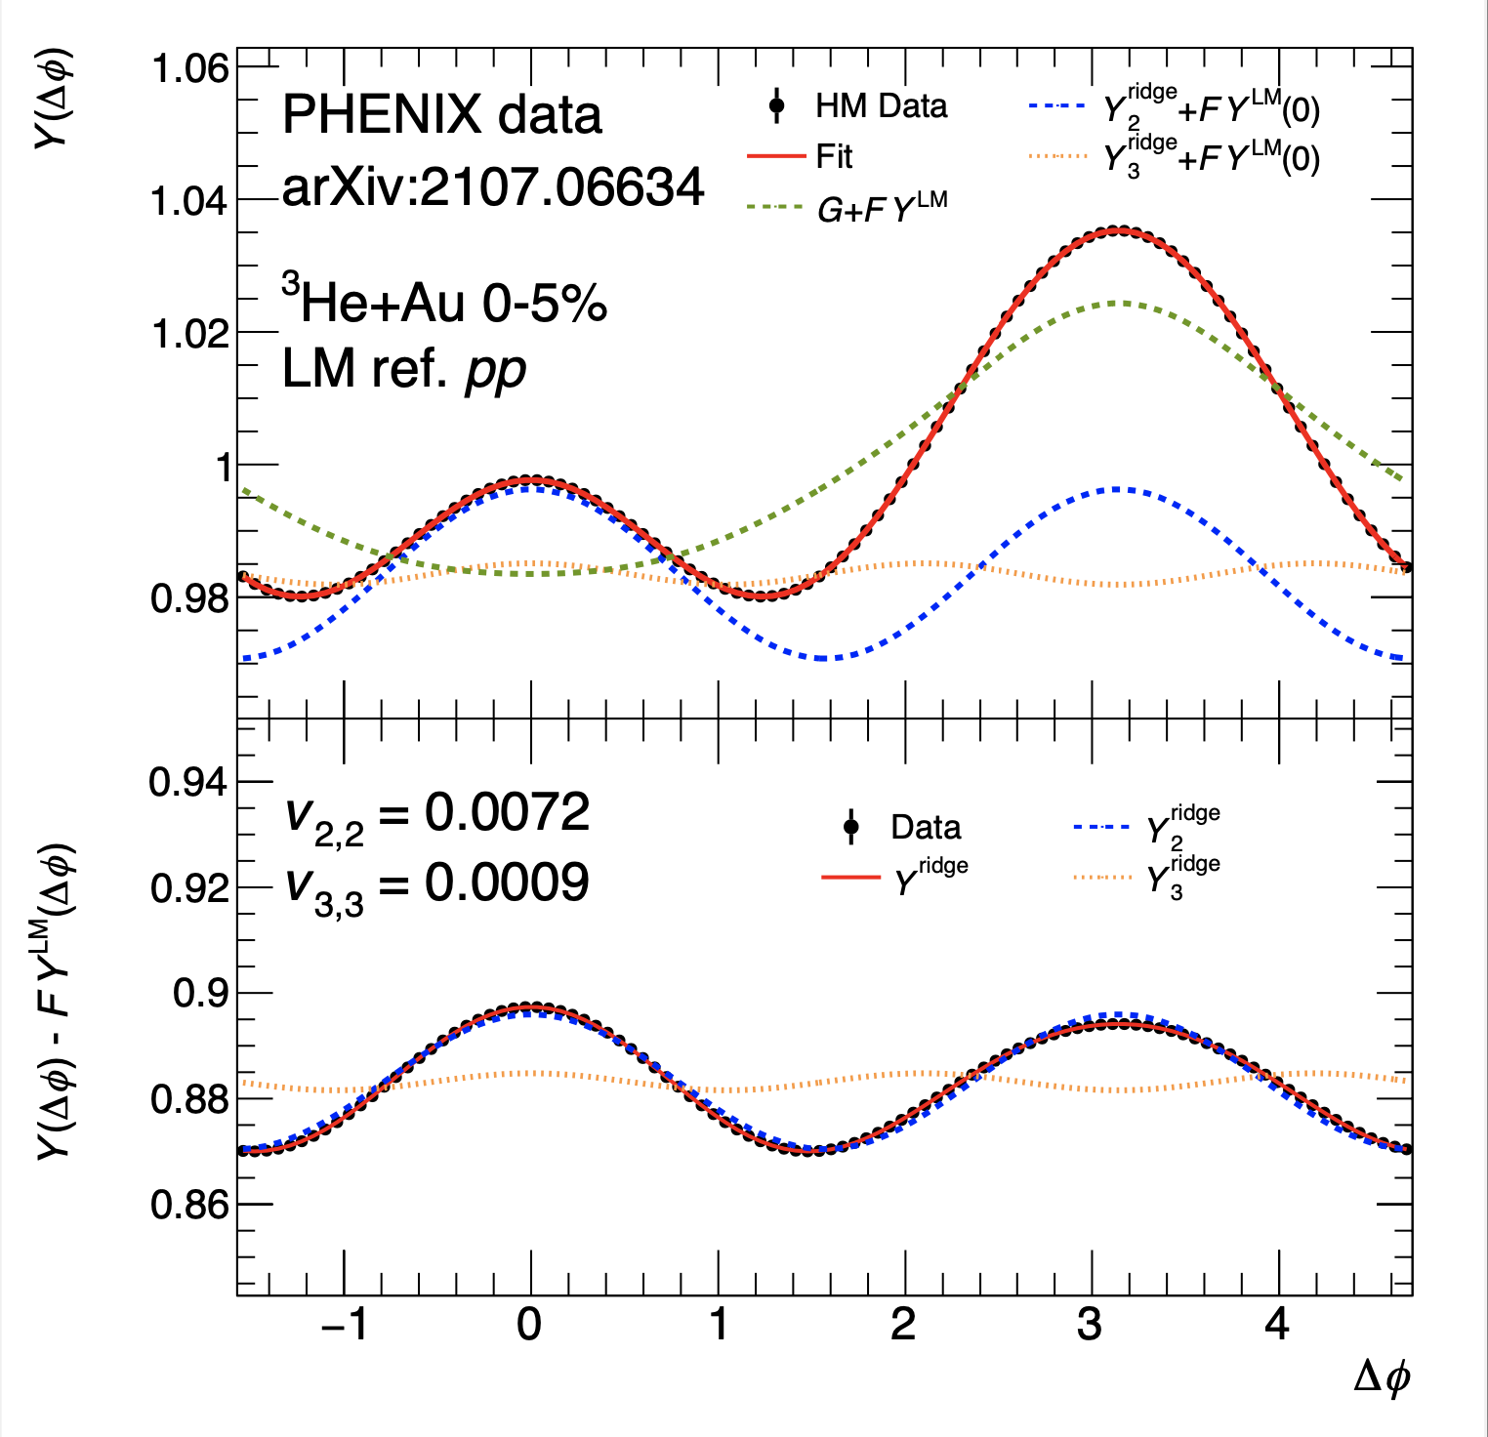
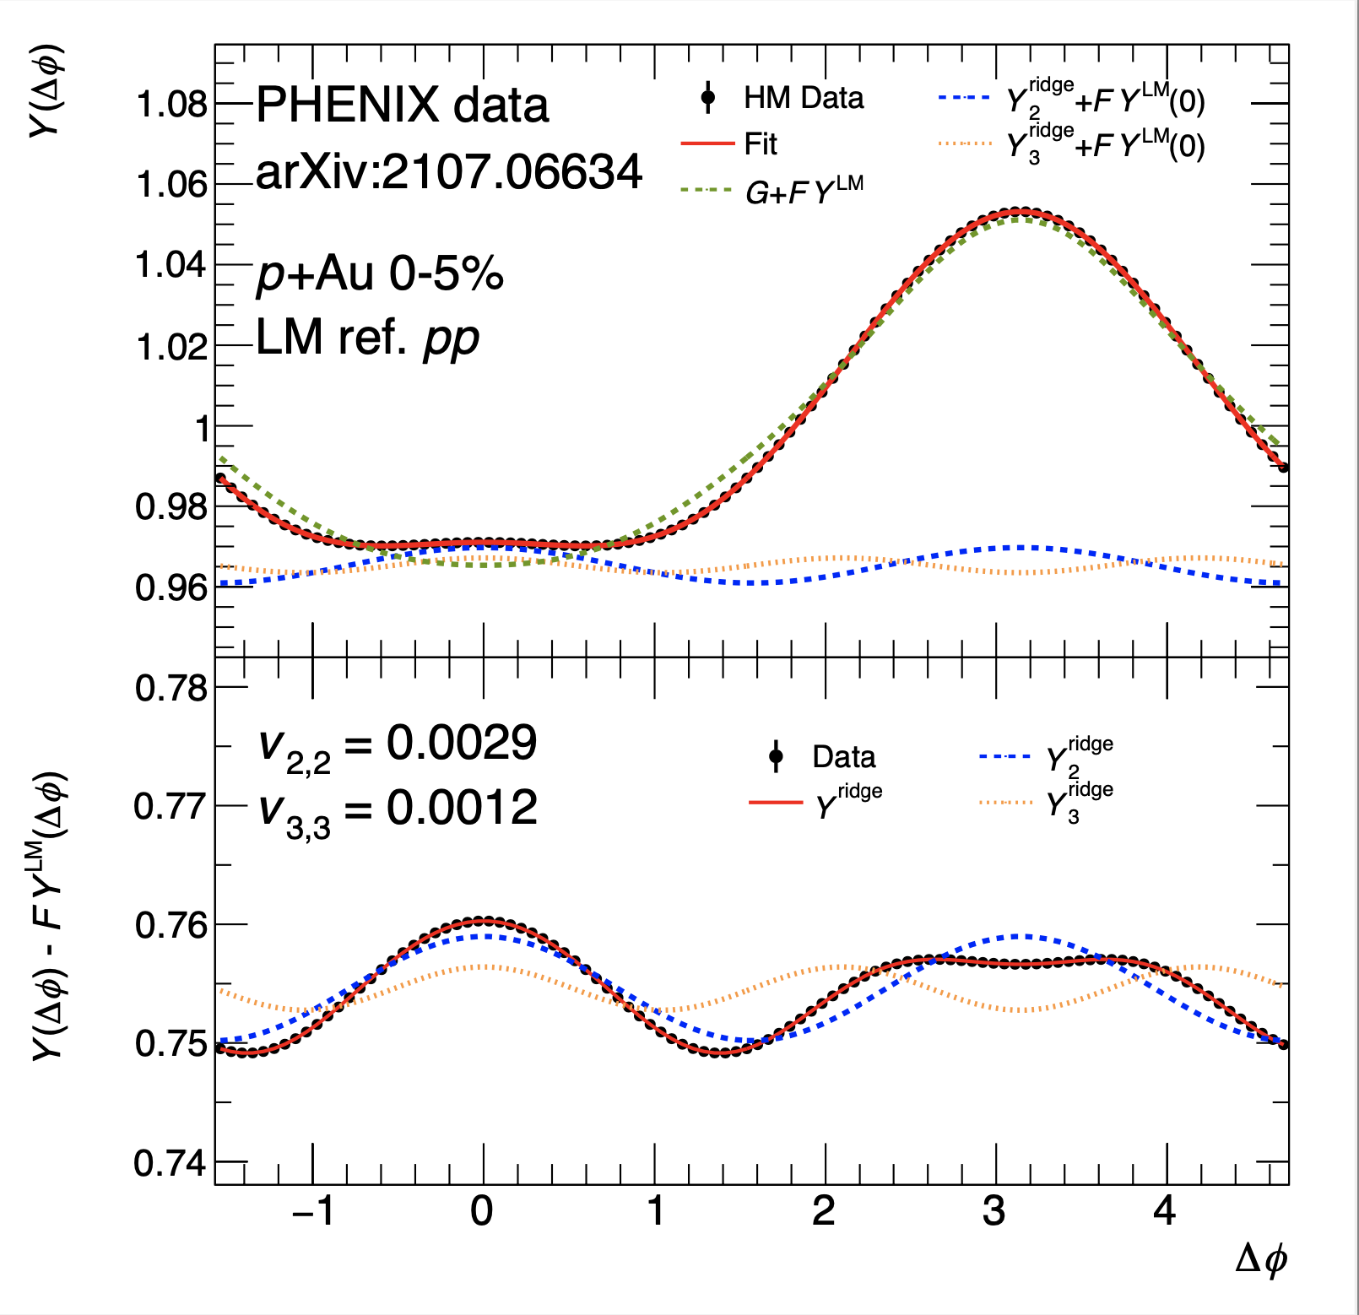
Non-Flow Template Fits
Qualitatively similar results with Standard ATLAS template fit, c₁ scaling fit, ZYAM fit…

Slide 40

Elliptic flow v₂
Template method w/ 3 detector combinations
Largest correction at high p_{T} and in pAu
BBCS-FVTXS-CNT
FVTXS-CNT-FVTXN
BBCS-CNT-FVTXN
Closed = raw, Open = template adjusted

Slide 41

Elliptic flow v₂
Template method / 3 detector combinations
Largest correction at high p_{T} and in pAu
BBCS-FVTXS-CNT
FVTXS-CNT-FVTXN
BBCS-CNT-FVTXN
Ratio shows reasonable agreement between 3 detector combinations and 30-40% low v₂ pAu relative to ³HeAu

Slide 42


Triangular flow v₃
Template method with 1 detector combination
Significant increase in v₃ in all systems
BBCS-FVTXS-CNT
FVTXS-CNT-FVTXN
BBCS-CNT-FVTXN
Non-flow corrected v₃ now 15%-25% lower in pAu & dAu compared to ³HeAu

Slide 43


Triangular flow v₃
Template method w/ 3 detector combinations
Significant increase in v₃ in all systems
BBCS-FVTXS-CNT
FVTXS-CNT-FVTXN
BBCS-CNT-FVTXN
Uncontrolled correction in other combinations
FVTXS-CNT-FVXTN &
BBCS-CNT-FVTXN

Slide 44


Are these non-flow corrected numbers correct? Test via closure checks…
Closure check fail badly
for p+Au with
AMPT and PYTHIA-Angantyr
Also, all non-flow subtractions have a common subset of assumptions

Slide 45



Are these non-flow corrected numbers correct? Test via data checks…
Most theory calculations have v₃/v₂ (RHIC) < v₃/v₂ (LHC) → short QGP lifetime damps v₃ more
PHENIX raw results have v₃/v₂ (RHIC) < v₃/v₂ (LHC)
PHENIX non-flow template adjusted results have v₃/v₂ (RHIC) $≥$ v₃/v₂ (LHC)
Seems likely the non-flow adjustment is over-correcting, and the truth lies in between.

Slide 46

Where do the STAR preliminary #2 points sit?
STAR preliminary #2 points are substantially
above one
Publish or Perish:
RHIC has just taken more dAu data based on 3 years of preliminary results

Slide 47

What does it all mean?
PHENIX – closed points (raw), open points (non-flow template applied)
SONIC = hydro (η/s = 1/4π) + hadron scatter (B3D)
- - - - superSONIC = strong preflow + hydro (η/s = 1/4π) + hadron scatter (B3D)
Strong preflow has big impact on v₃, particularly in pAu due to
short QGP lifetime.
SONIC matches “raw”
superSONIC matches “template”
Truth likely in between

Slide 48

What does it all mean?
More blurring and more fluctuations lead to larger eccentricities and
smaller differences between systems.
Even in IP-Glasma with quark constituents, ε₂ in dAu is 1.5x in pAu and
ε₃ in ³HeAu is 1.4x in pAu.

Slide 49
End Game?
Amazing accomplishments through 20 years at RHIC and a decade at the LHC
Standard picture with low η/s fluid QGP expansion confirmed from large to small systems
No evidence for inclusion of saturation physics (CGC) as weakly coupled initial stage in standard picture, nor of any exotic domains
Small systems remain an excellent testing ground for early-stage dynamics where many questions remain
Excited for BES II results. Excited for sPHENIX hard probes program.
Thinking a lot about longer term EIC program and longer term LHC program.

Slide 50
Extras

Slide 51
Hydrodynamics matches
the splitting

Slide 52


Slide 53


