Slide 1
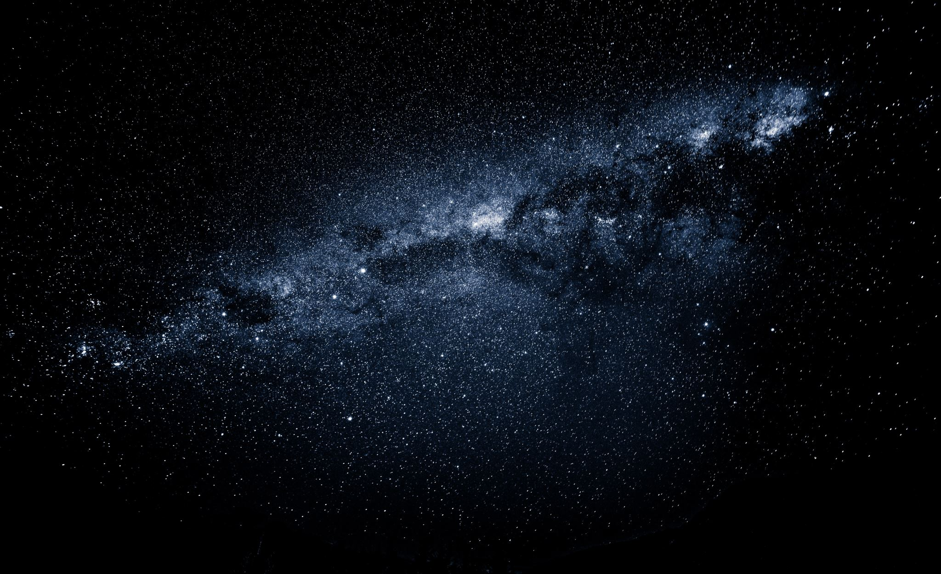
The hottest matter in the universe
These stars are 10,000
times too cold
Where can we find matter
T > 2 trillion Kelvin (2,000,000,000,000 K)?
Professor Jamie Nagle
University of Colorado Boulder

Slide 2
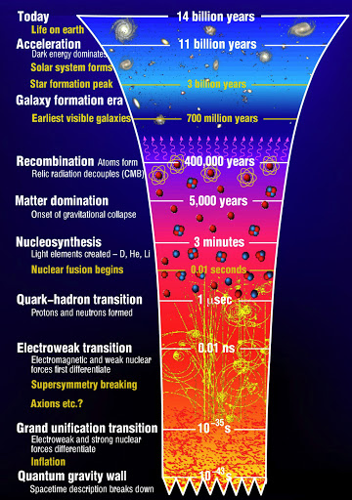
Time
Today – cool enough for me
400,000 years – cool enough for atoms
3 minutes– cool enough for nuclei
1 microsecond – cool enough for protons
Before that T > 2 trillion Kelvin
Quarks and Gluons dominate the universe

Slide 3
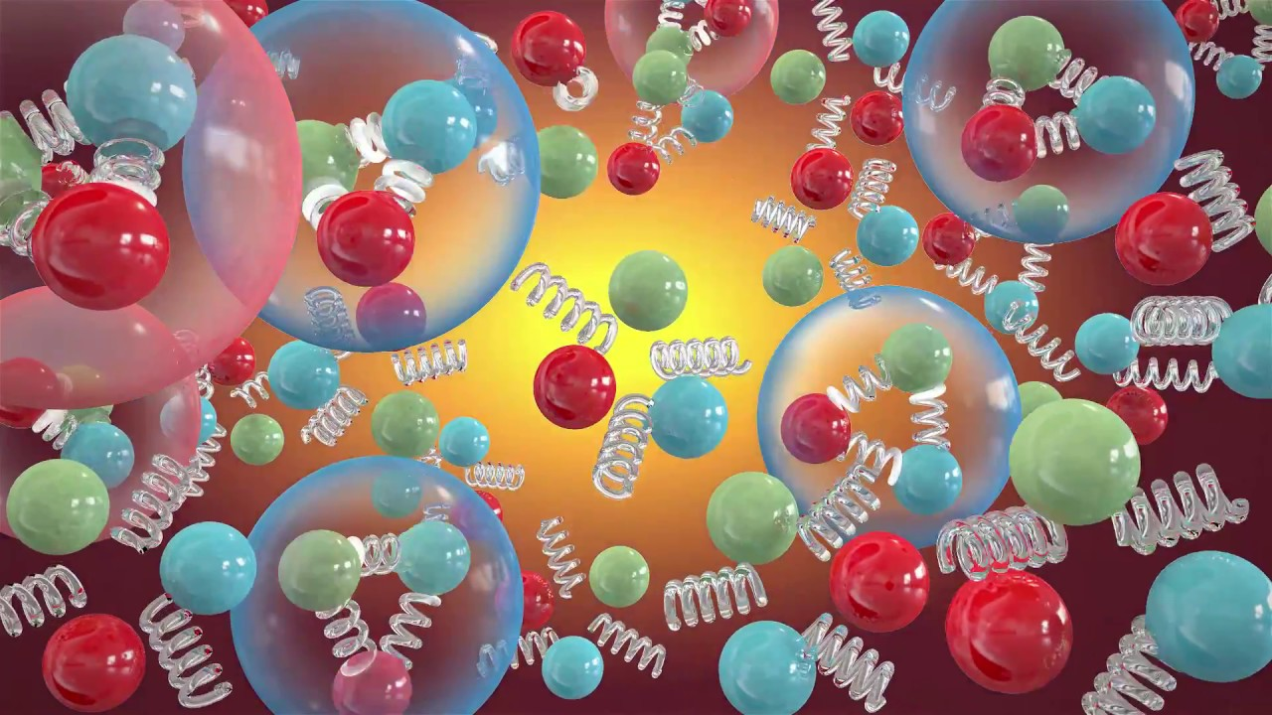
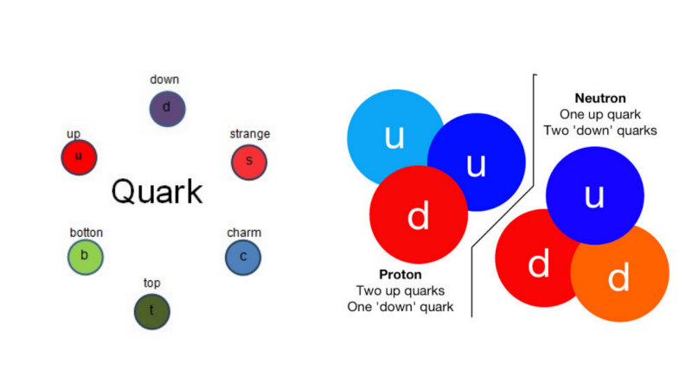
Quark-Gluon Plasma

Slide 4
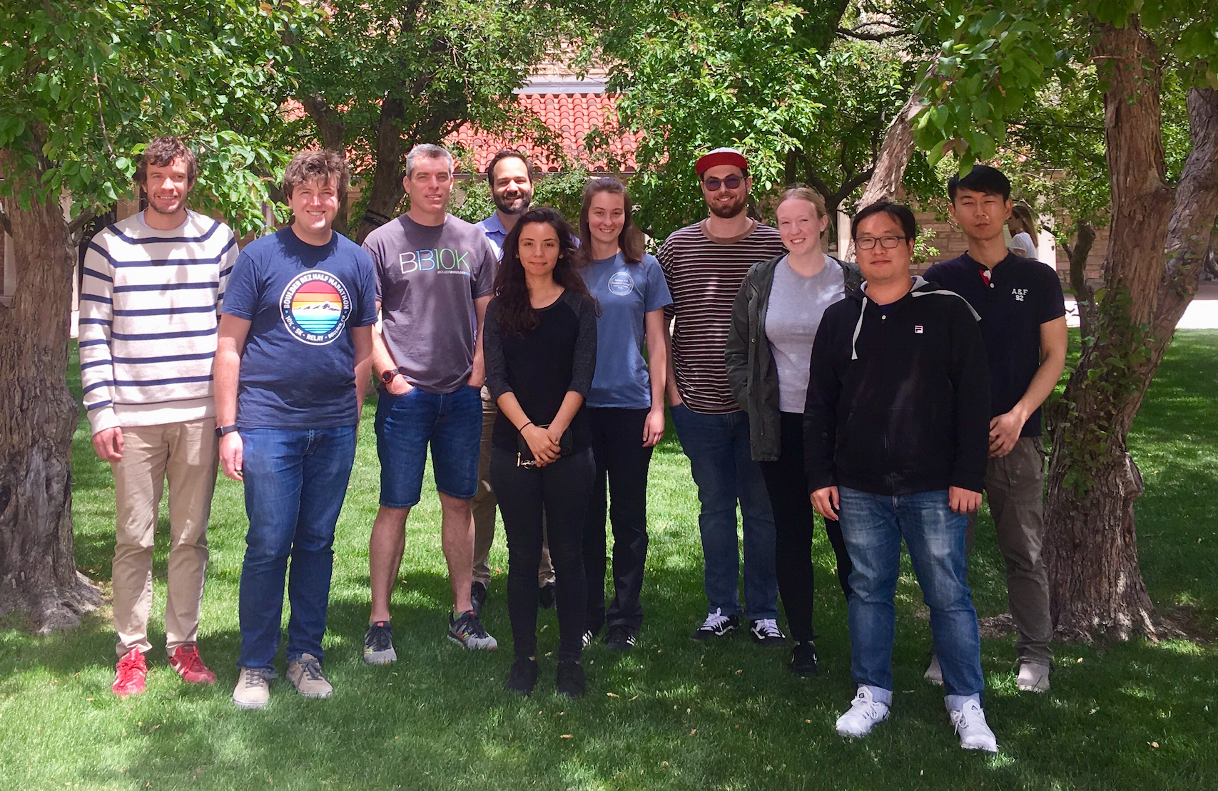
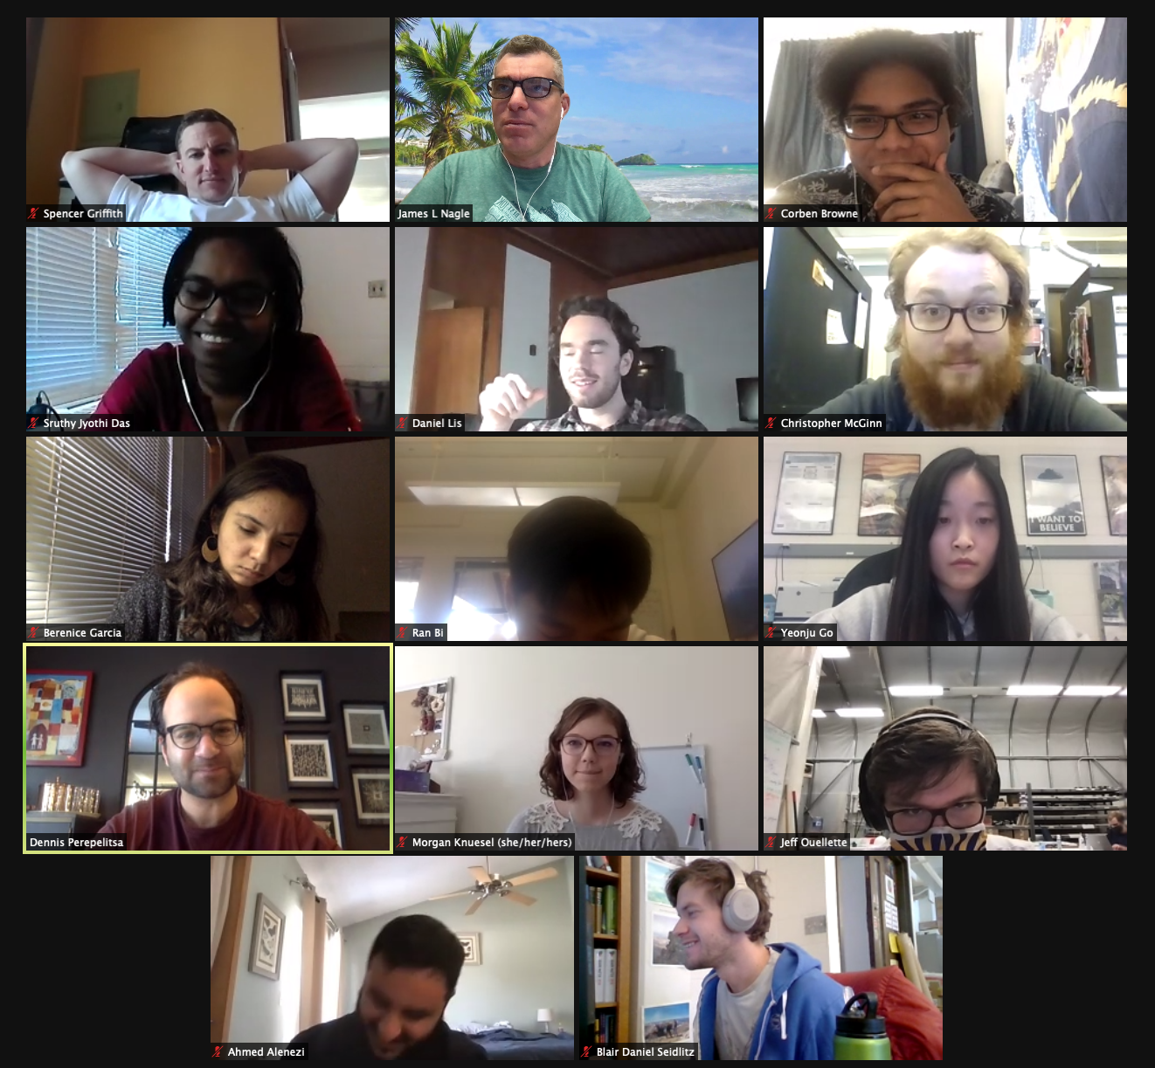

University of Colorado Boulder – Quark-Gluon Plasma Hunters
Javier Orjuela-Koop – RHIC Thesis Award
Kurt Hill – ATLAS Thesis Award

Slide 5
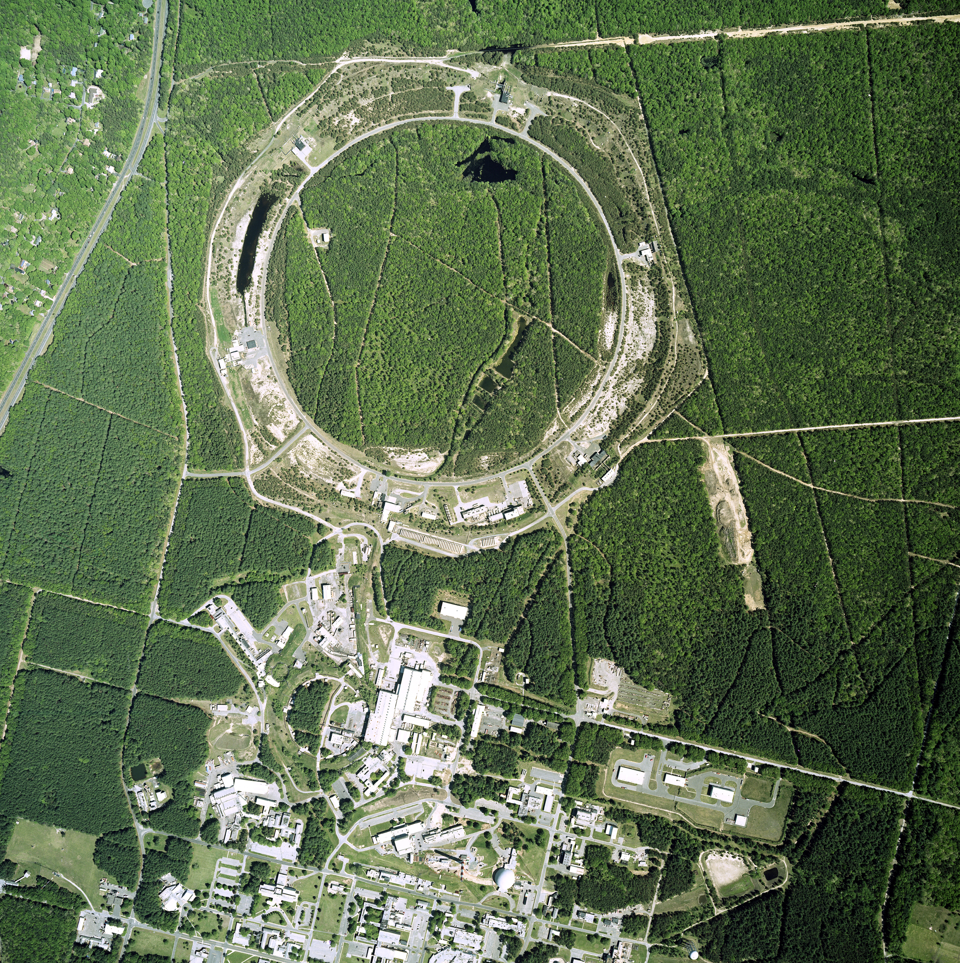
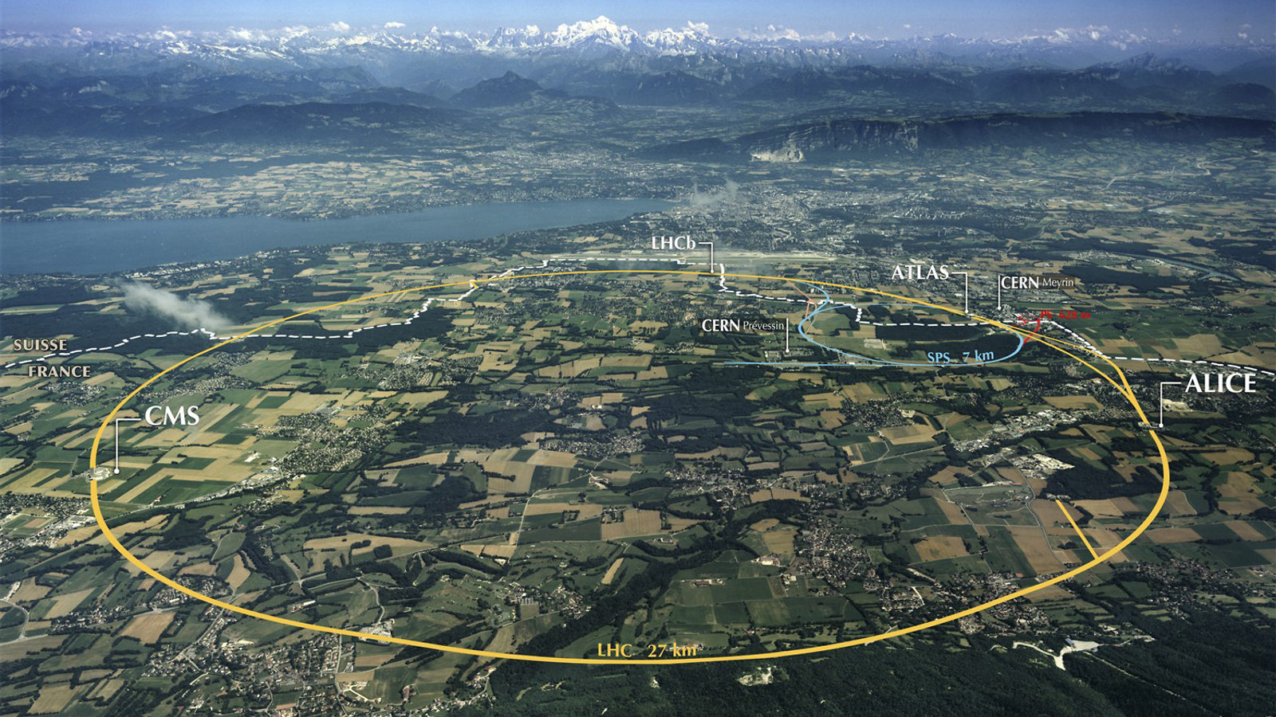
Creating droplets of quark-gluon plasma in the laboratory
Relativistic Heavy Ion Collider
Upton, New York
Large Hadron Collider
Geneva, Switzerland

Slide 6
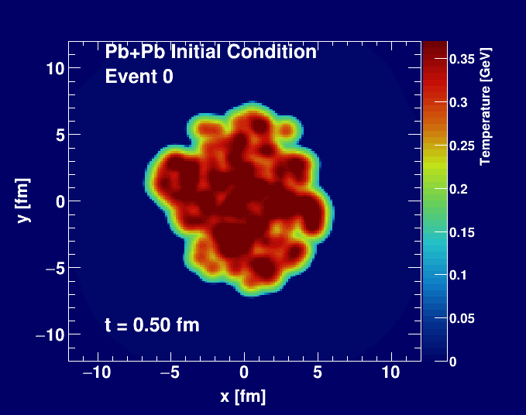
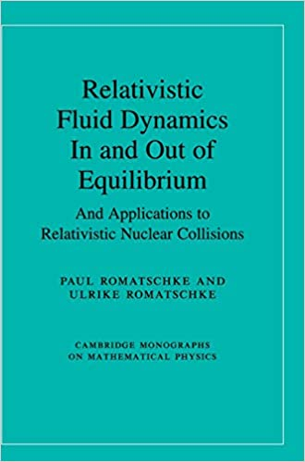
Hydrodynamic expansion of plasma droplet
World expert on fluid dynamics here at University of Colorado Boulder

Slide 7
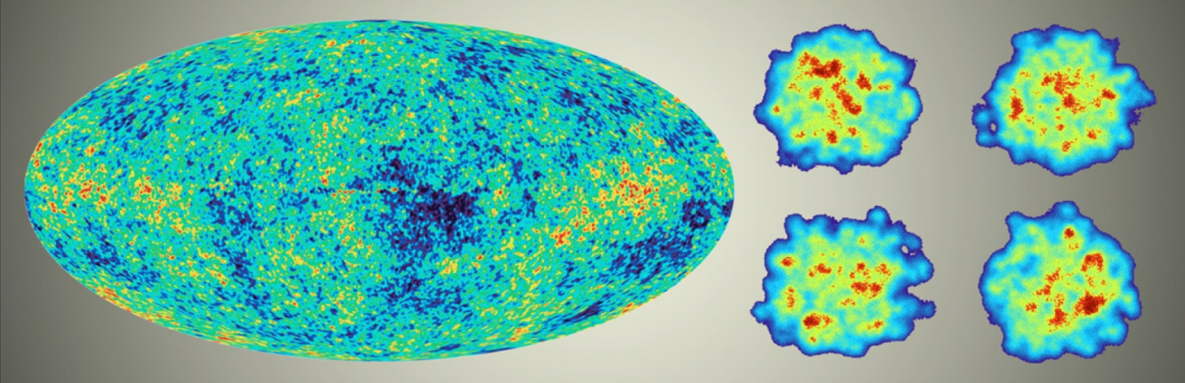
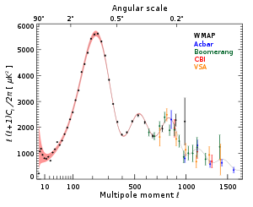
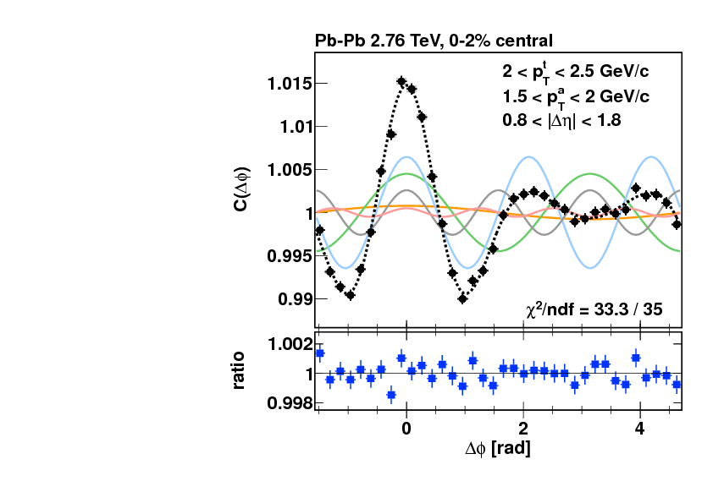
Just like Cosmic Microwave Background, droplet patterns tell us a lot!

Slide 8
Plasma Droplet Engineering

Slide 9
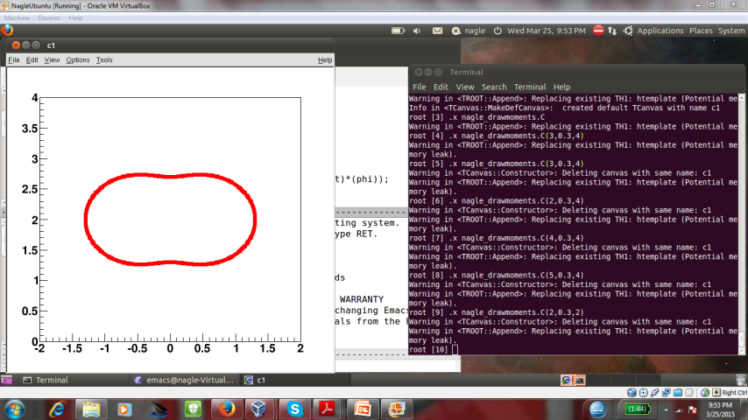
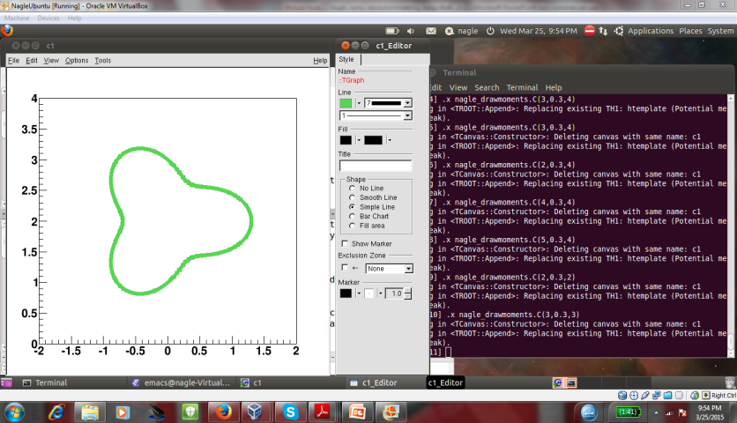
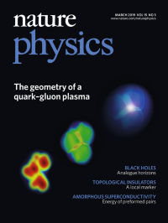
Hypothesis confirmed → droplets engineered!
PHENIX, Nature Phys. 15 (2019) no.3, 214-220

Slide 10
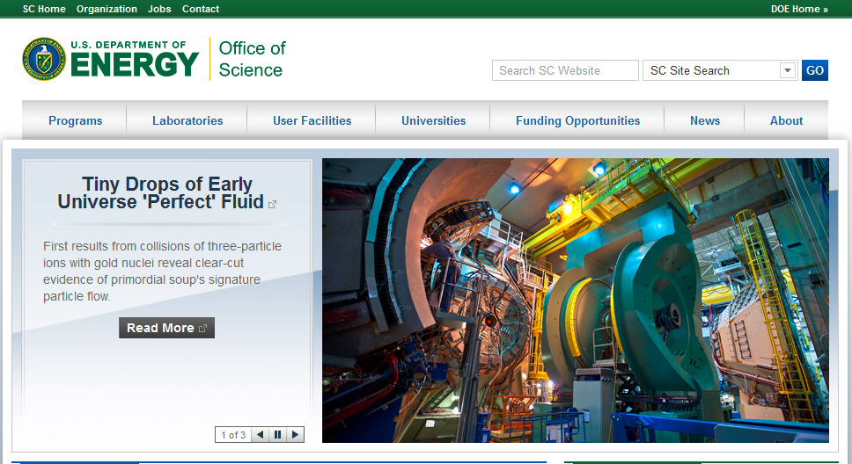

Slide 11
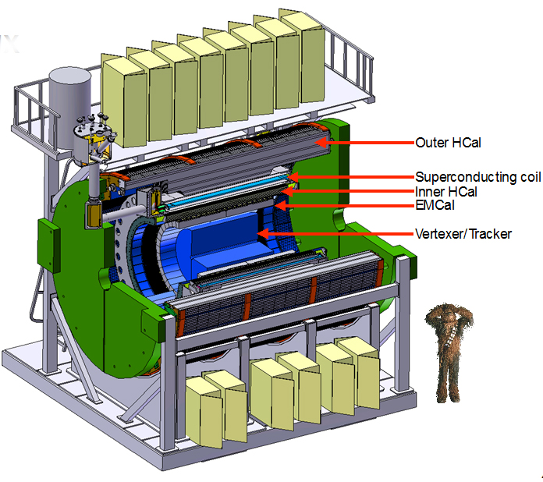
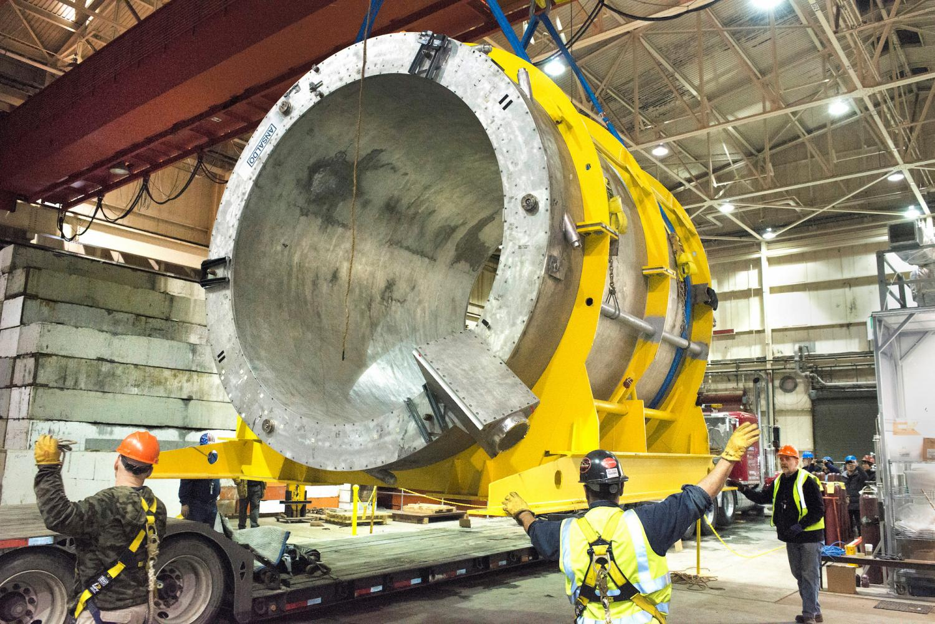
New project under construction → sPHENIX at RHIC
Probing the droplets with jets and heavy quarks
Superconducting magnet arrives!

Slide 12
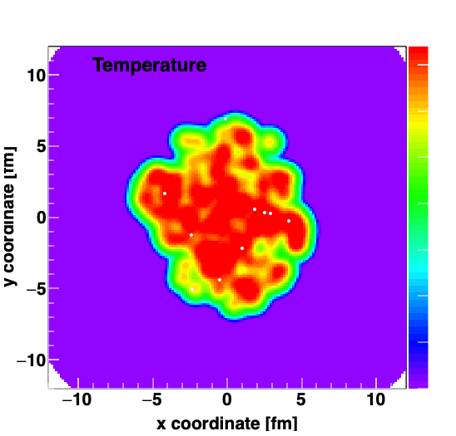
Heavy quark-antiquark pairs in the plasma droplet

Slide 13

Very hard for heavy quarks to swim upstream!

Slide 14
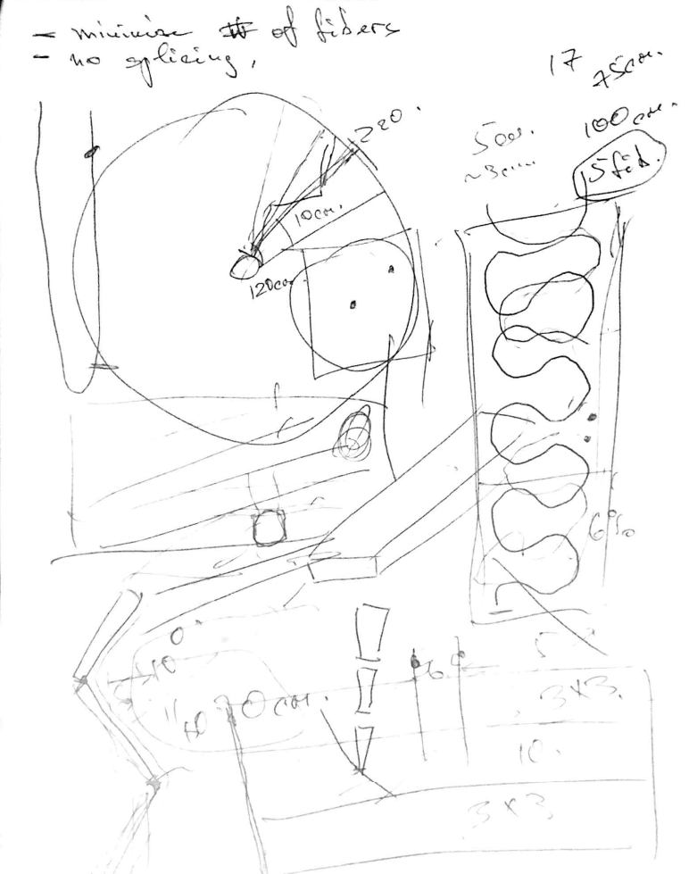

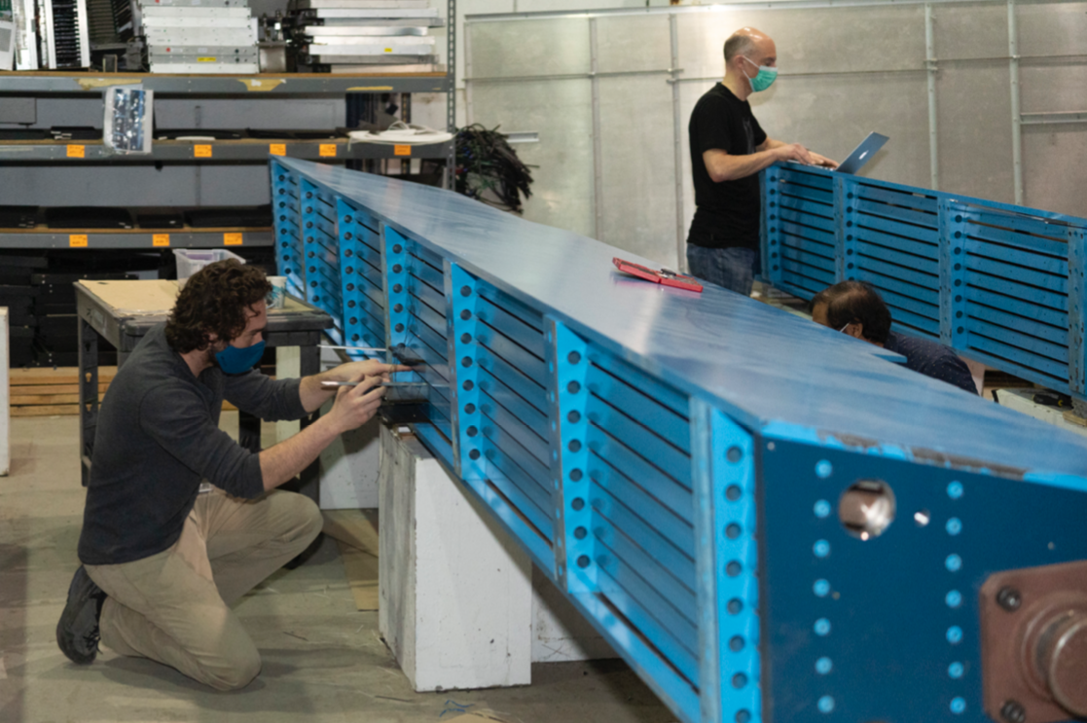
Building the next generation detector
Literal Napkin Sketch
Training the next generation scientist

Slide 15
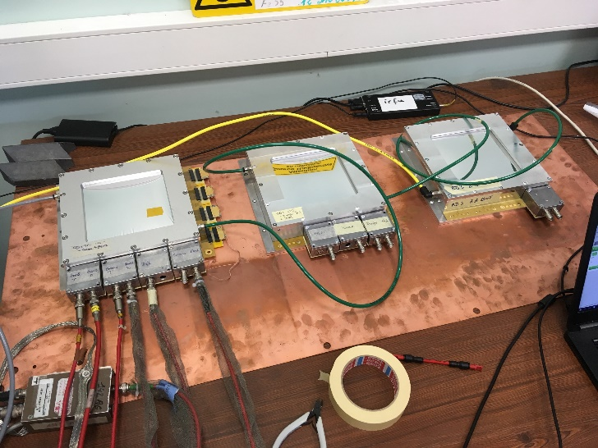
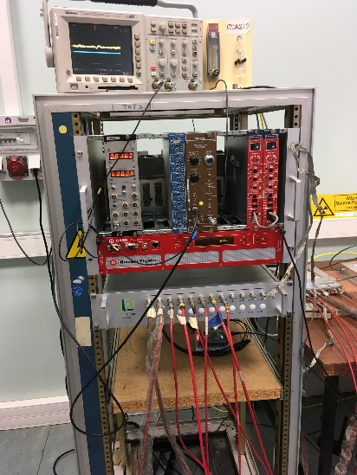
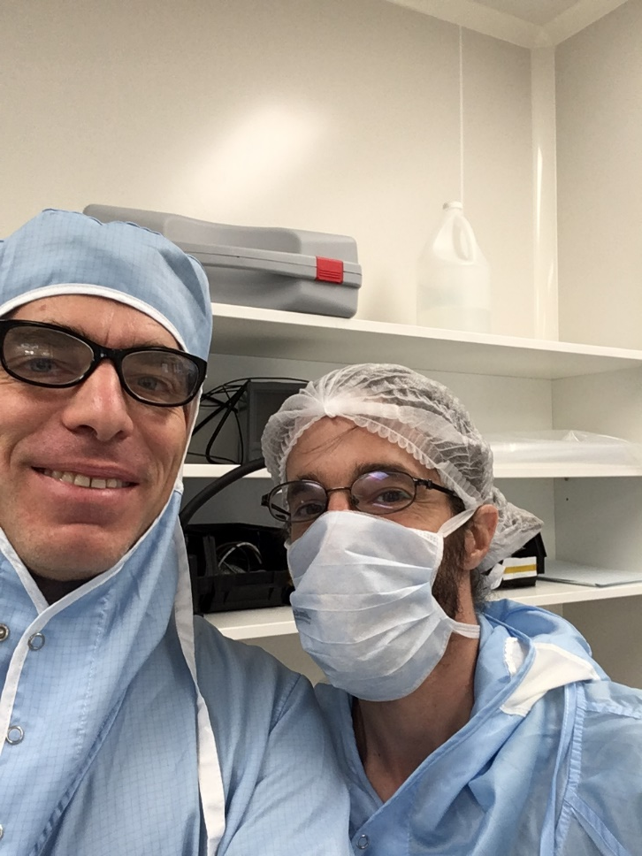
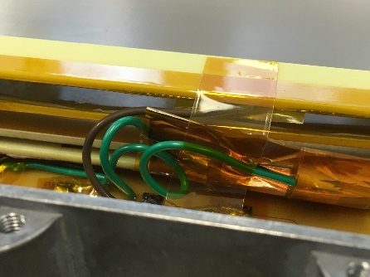
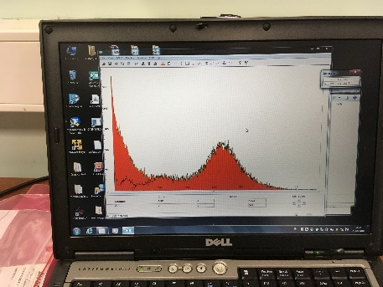

sPHENIX work on MicroMegas during sabbatical at Saclay
Working in the lab like a graduate student reminded me that those were the best years!

Slide 16
Thank you for your time...
I am glad to answer any questions

