Slide 1
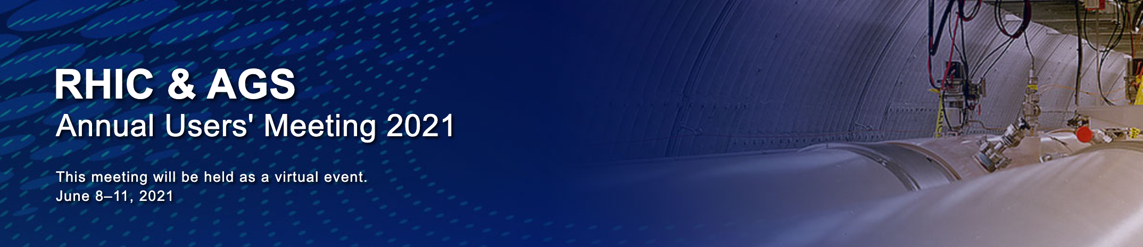
Experimental results on
collective flow in small system
collisions at RHIC
Jamie Nagle
University of Colorado Boulder

Slide 2
What are we trying to learn?
Are QGP droplets formed in small collisions?
Is the pre-hydrodynamic state strongly, weakly, un-coupled?
What are the factors for initial entropy production?
Do we have a well-formulated plan to gain this knowledge?
We thought so → p/d/³He+Au collisions
→ d+Au beam energy scan
More data at RHIC?
Where does this knowledge gained lead us?
Let’s wait until the end… which is soon…

Slide 3
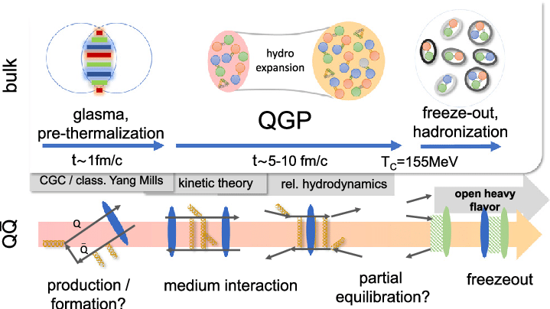
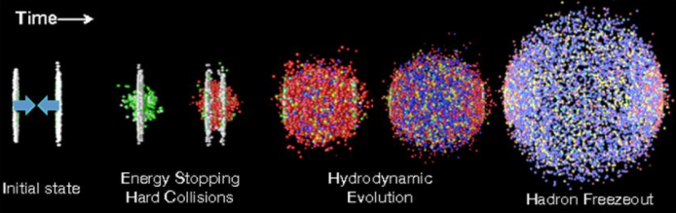
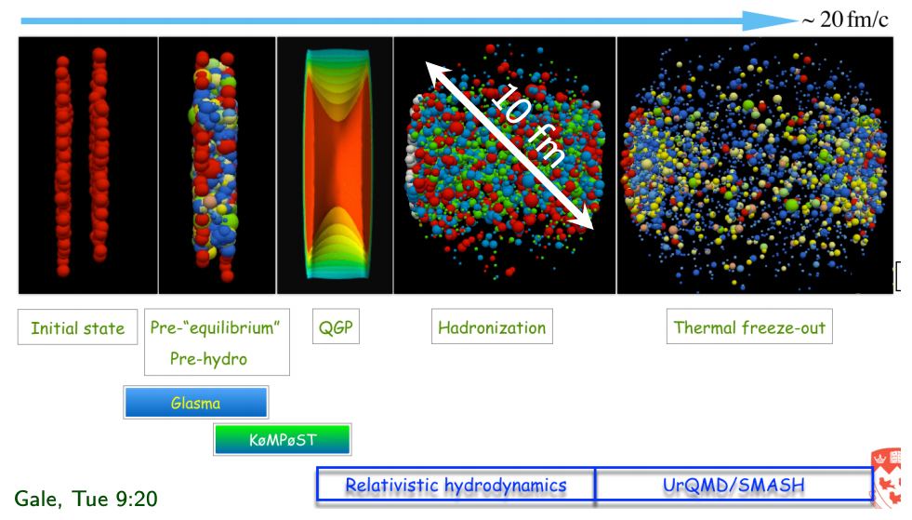
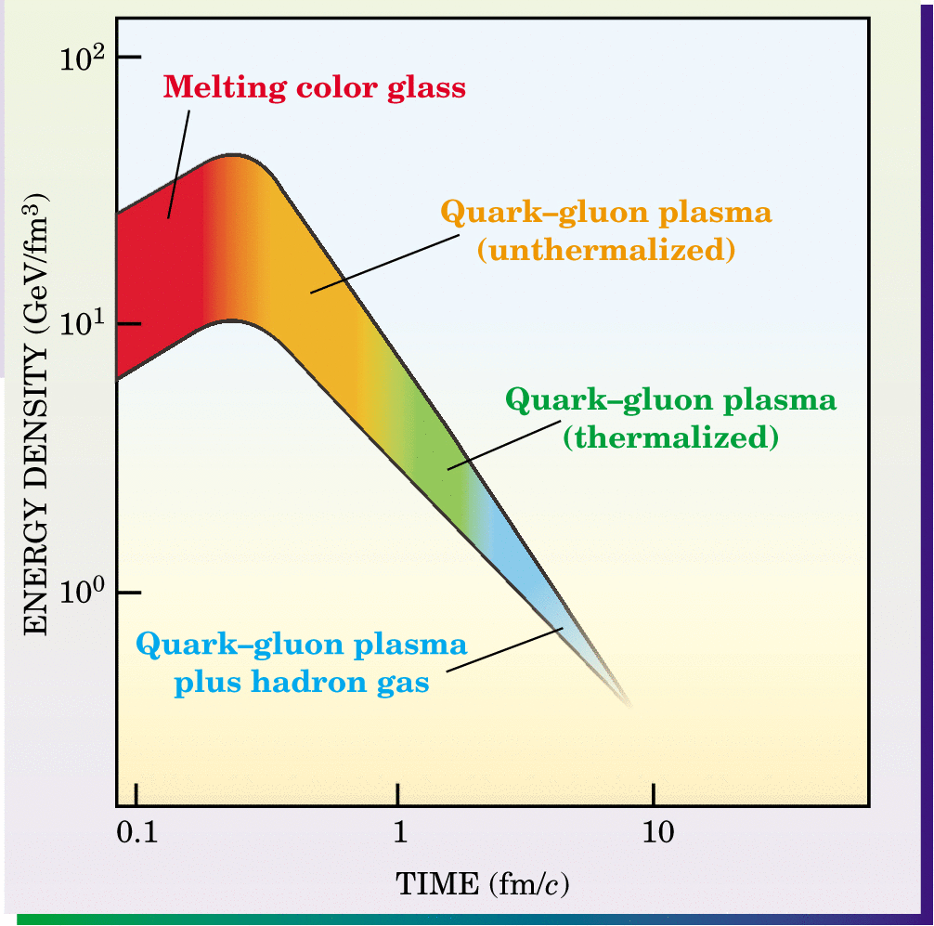
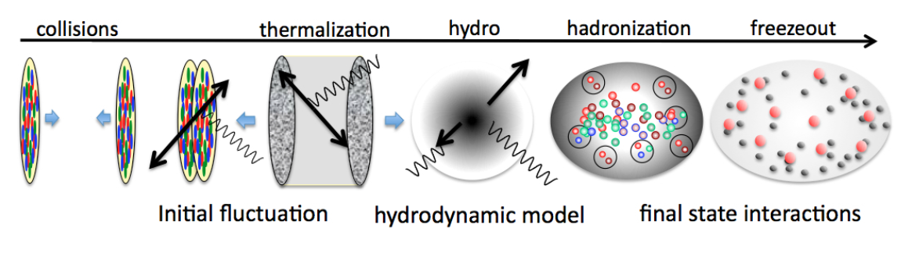
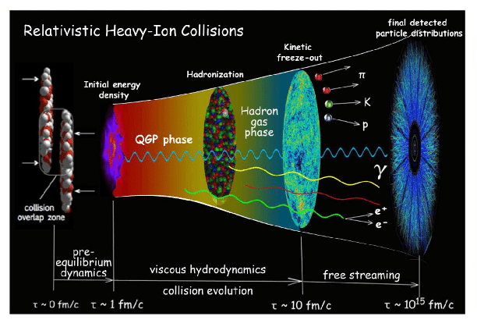
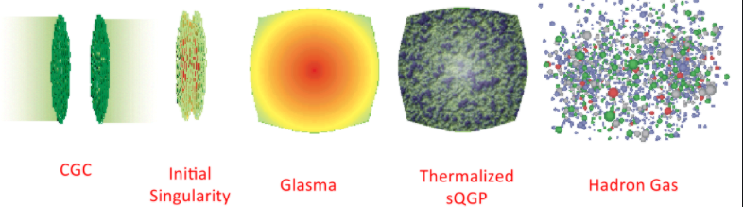
What is the standard evolution model of heavy ion collisions?

Slide 4
What is the standard evolution model of heavy ion collisions?
Pre-equilibrium, pre-thermalization → Pre-hydrodynamization
The field has still not come fully to grips with the fact that the QGP never equilibrates.
Remember all the conference sessions on the “fast equilibration puzzle”?
After 20 years, is there really any experimental evidence for very weakly coupled initial state
(glasma, CGC, free stream)?
Just like strangeness as a QGP signal, pushing to smaller (pp, pA) systems has been insightful.
How do small system collisions fit into this timeline?

Slide 5
Weak versus Strong Coupling in Initial State?
No Coupling - free streaming (too often used)
Weak coupling – Color Glass Condensate / Glasma (α_{s} → 0)
Strong Coupling – AdS/CFT (α_{s} → ∞)

Slide 6
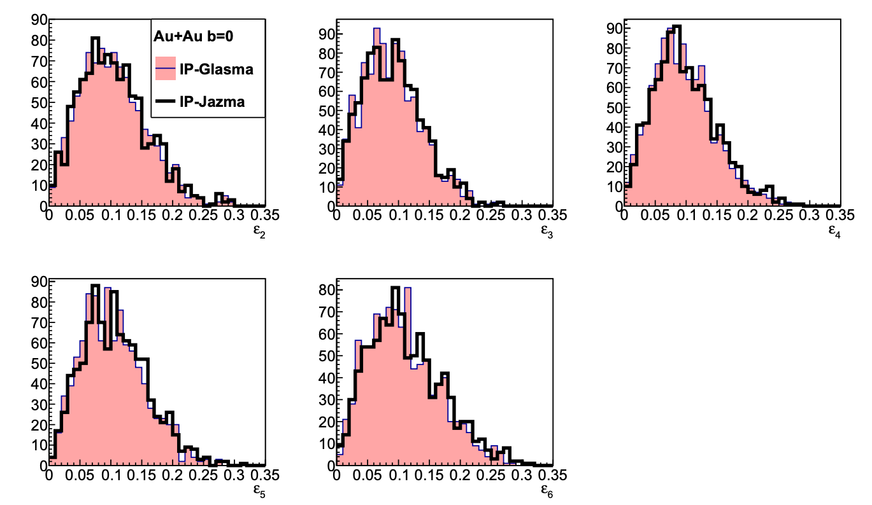
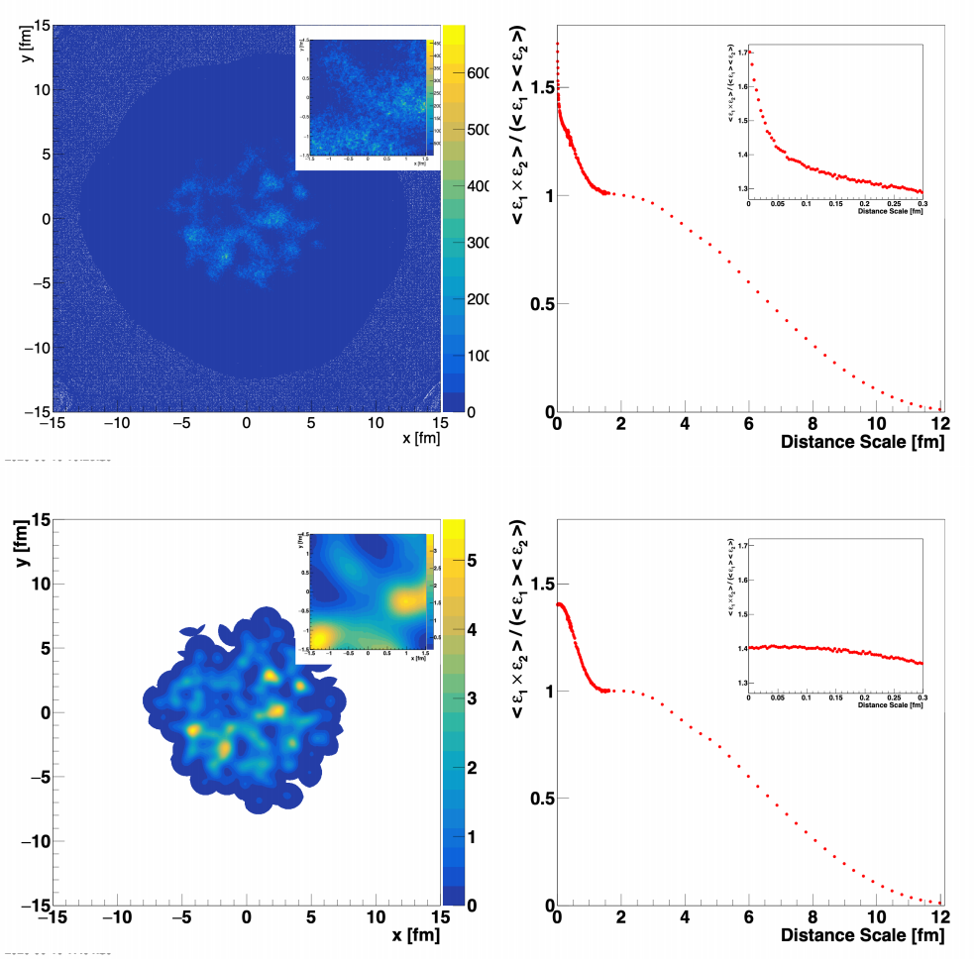
No evidence for weakly coupled initial state in A+A Collisions
IP-Glasma
IP-Jazma
IP-Glasma as part of evolution package has been very successful (see for example https://arxiv.org/abs/2005.14682); however, that really has nothing to do with weak coupling, color domains, etc.
Essentially just T_{AB} scaling of Gaussian nucleons or 3 quarks and Q_{s}² fluctuations put in by hand (also in IP-Glasma).
https://arxiv.org/abs/2008.08729

Slide 7
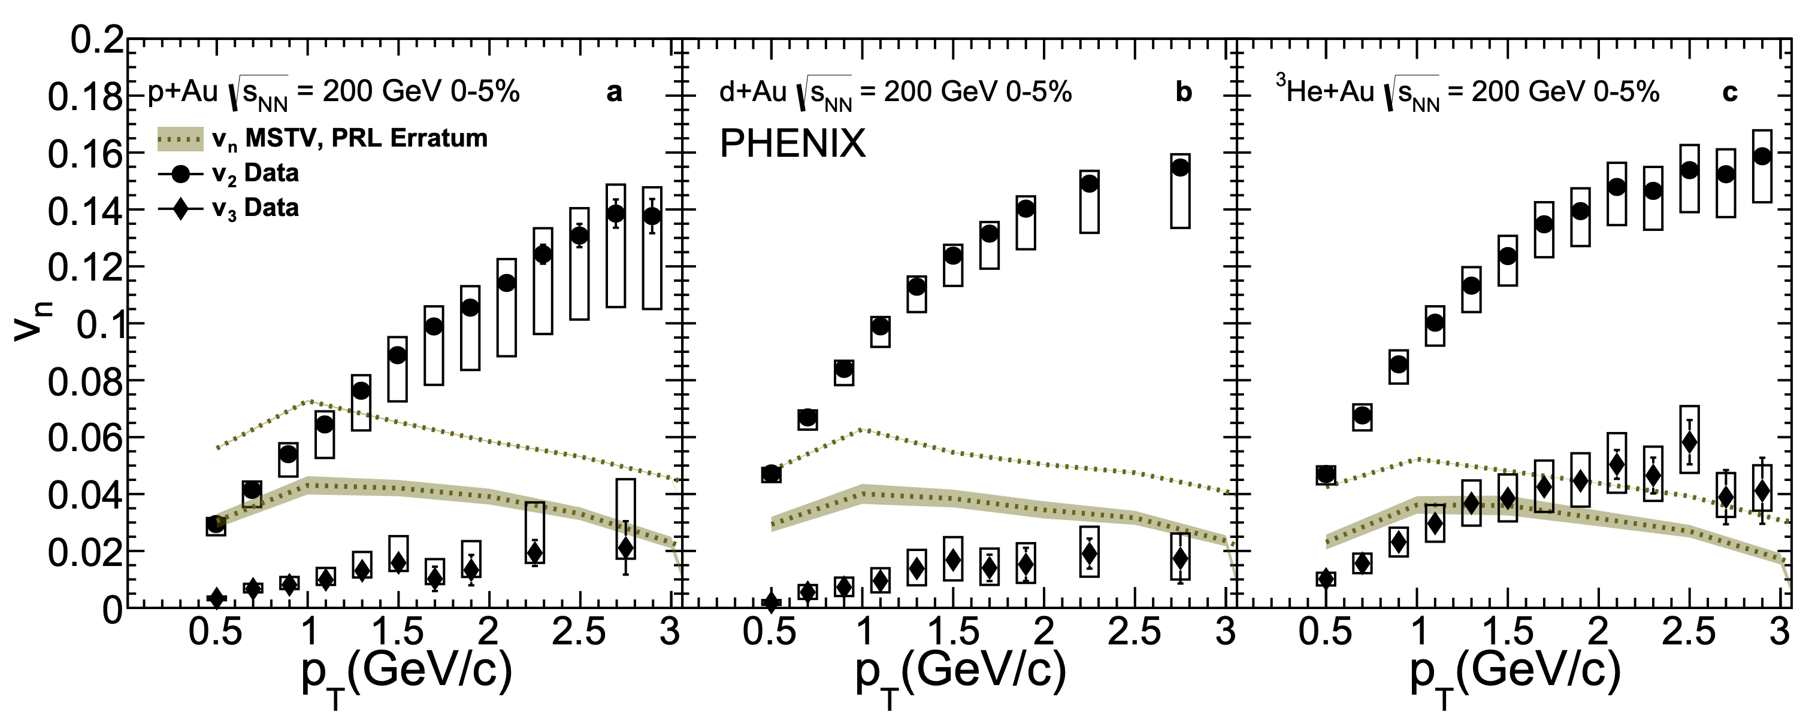
No evidence for weakly coupled initial state in small collisions systems
“In summary, due to the numerical error specified,
the hierarchy of v₂;₃ seen in the PHENIX data is not seen in our model.
It cannot therefore provide a viable description of the data.”
Erratum: Phys.Rev.Lett. 121 (2018) no.5, 052301
Corrigendum: Phys.Lett. B788 (2019) 161-165

Slide 8
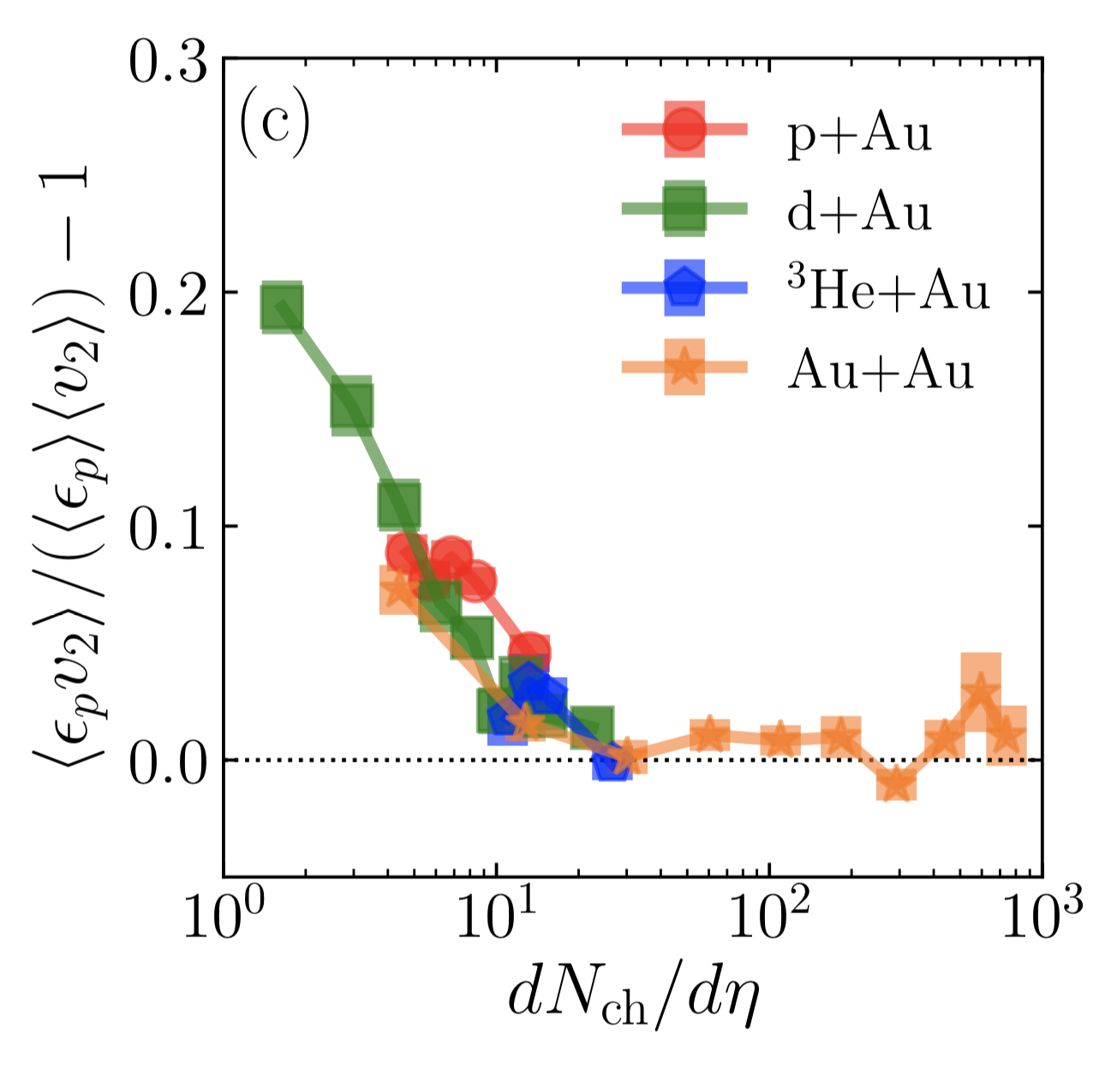
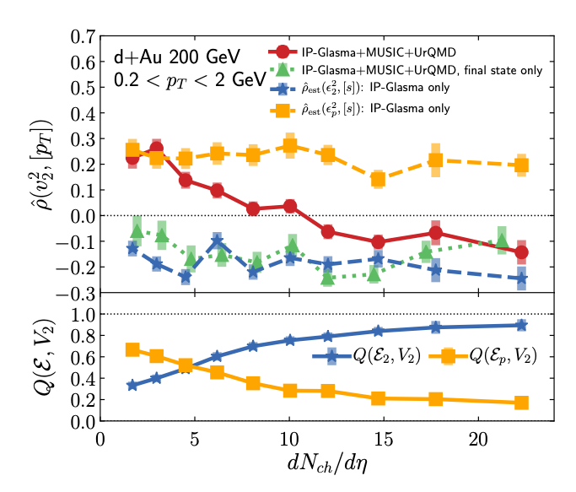
New idea: weakly coupled initial state in small collisions systems
https://arxiv.org/abs/1908.06212
https://arxiv.org/abs/2006.15721
Initial State
Initial State
Final State
Final State
p_{T} – v_{n} Correlator
0-5% Central pAu, dAu, ³HeAu
PHENIX: Phys.Rev.Lett. 121 (2018) no.22, 222301

Slide 9
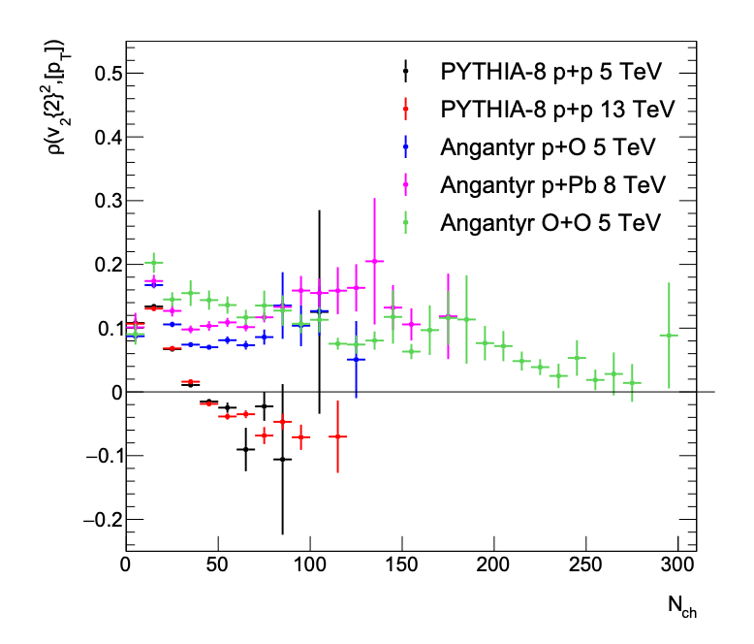
Forwards or Backwards?
https://arxiv.org/abs/2103.01348
https://arxiv.org/abs/2102.05200
https://arxiv.org/abs/2006.15721
Odd to propose a clean signature for “exotic” glasma diagrams
as positive ρ at dN_{ch}/dη ~ 2-6
when standard QCD hard scattering diagrams (PYTHIA)
produce the same sign effect.

Slide 10


If he cannot guess your weight,
you can win anything…
“Anything in this three inches.
Right in here, this area, that includes the Chiclets, but not the erasers."
So now we can only see CGC effects in collisions with dN_{ch}/dη ~ 2
I must be missing something about dense packing of gluons…
Who knows which movie this is from?

Slide 11
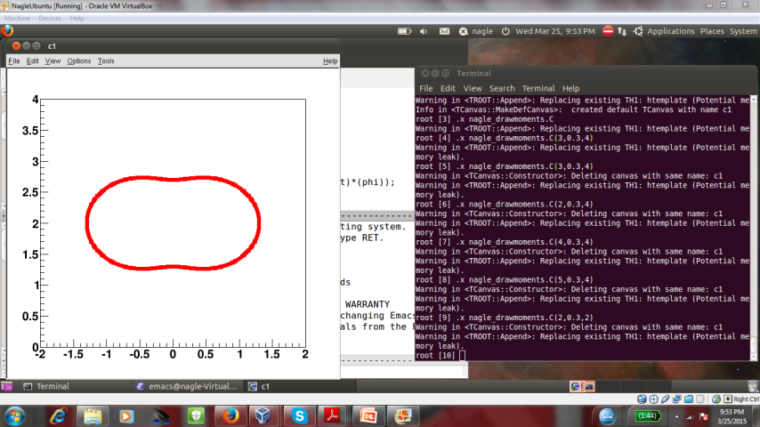
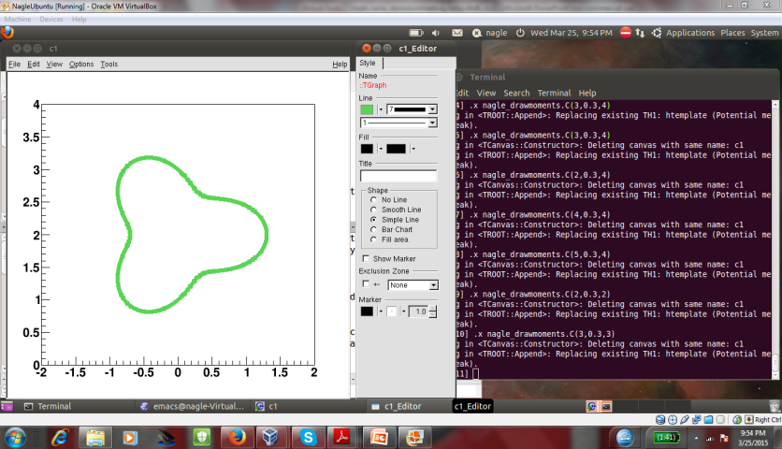
PHENIX, Nature Phys. 15 (2019) no.3, 214-220
(More) Definitive Proof of Geometry & Hydrodynamics

Slide 12
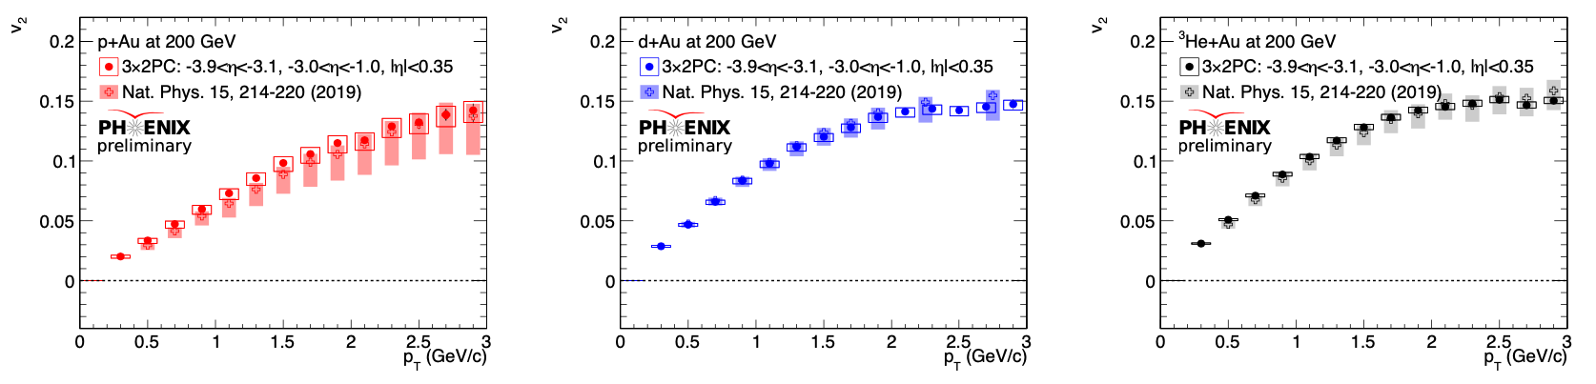
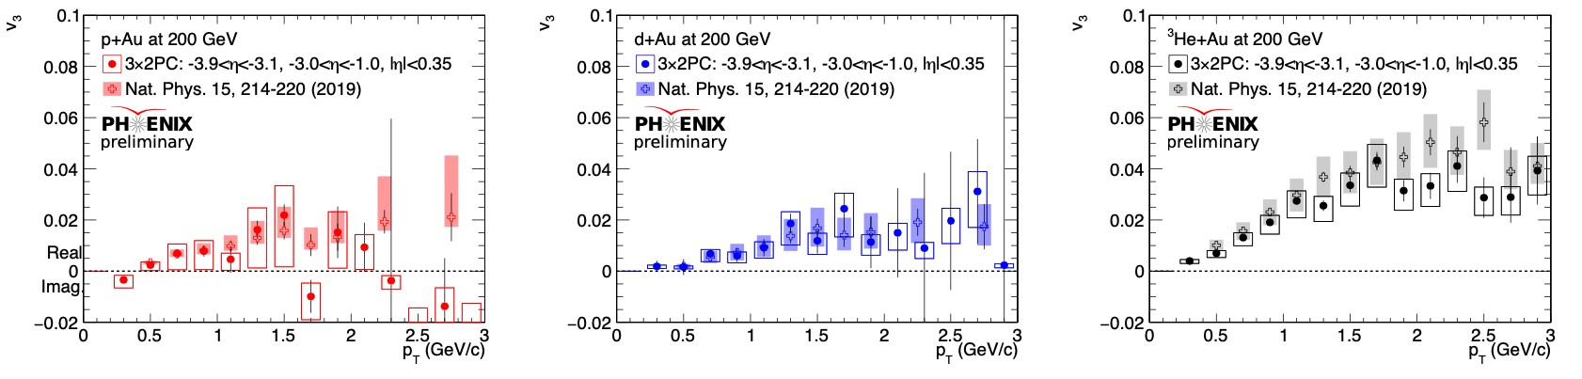
Are we done?
1) At QM19 in Wuhan the STAR Collaboration challenged the validity of the PHENIX measurements
PHENIX has carried out a new, 3 x PC analysis for all systems with (a) a new code base, (b) different analyzer, (c) FVTX tracks instead of hits, (d) additional systematic checks.
Nature Physics measurements confirmed.
PHENIX manuscript with these results and additional kinematic selections to be submitted in the next month.

Slide 13
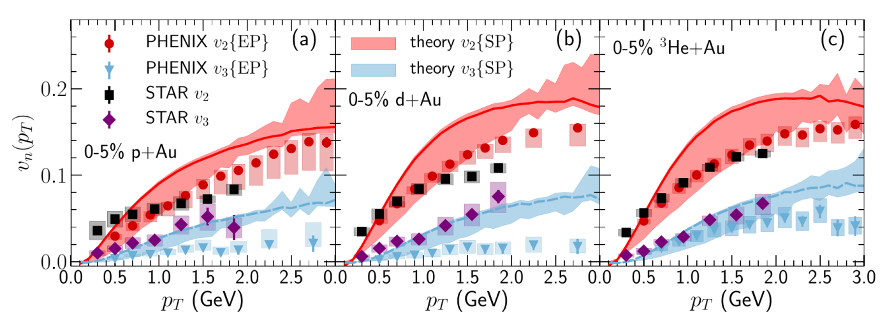
Are we done?
2) At QM19 in Wuhan the STAR Collaboration showed new
preliminary experimental results.
v₂ results “consistent”, tension in pAu/dAu
v₃ results “differ” in pAu, dAu
→ How to understand, resolve?
STAR Preliminary
Non-flow corrected
Not in matching centrality selection
e.g. pAu 0-2% based on TPC has 50% higher multiplicity

Slide 14
How to Address Experimentally?
PHENIX has done due diligence to confirm experimental results. PHENIX manuscript submission forthcoming. Manuscript will include tables with all
2-particle correlation coefficients (c₁, c₂, c₃, c₄) to enable future studies.
STAR is confirming their results with an independent analysis. Publication of results will be highly beneficial. Important to include results with matched PHENIX centrality selection and extend to p_{T} = 3 GeV to show when / where non-flow corrections break down.
Future measurements in pAu by sPHENIX and STAR could be elucidating as well.
Recently taken O+O data by STAR adds significantly to the program.

Slide 15
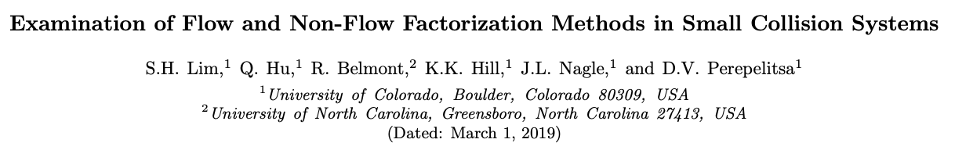
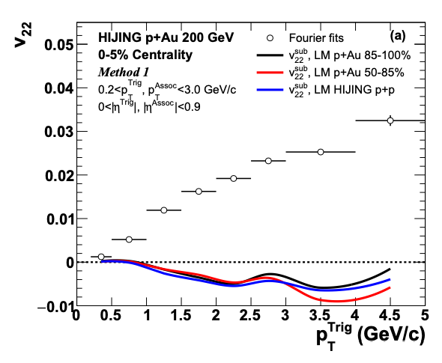
How to Address Non-Flow?
Including in published results up to
p_{T} = 3 GeV is critical.
https://arxiv.org/abs/1902.11290

Slide 16
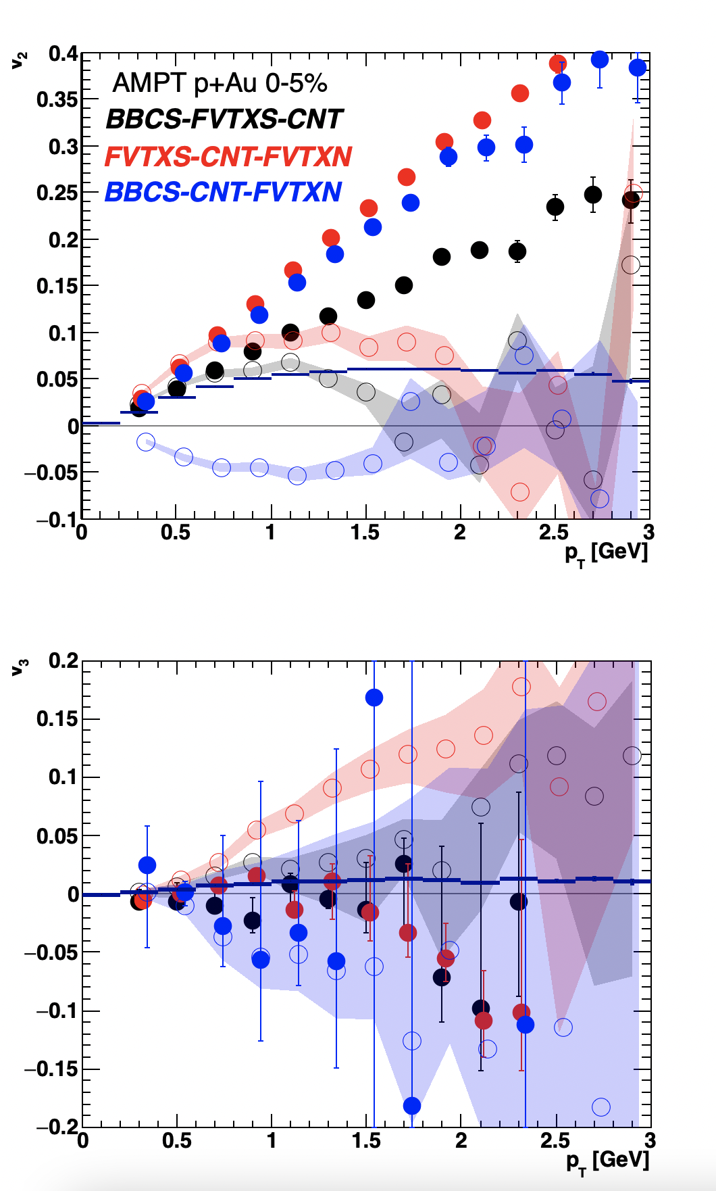
How to Address Non-Flow?
Full AMPT modeling of 3 x 2-particle correlations
Filled markers = raw
Open markers = c₁ non-flow applied
Non-flow method not validated by AMPT.
AMPT does have larger non-flow compared to data.
What are other options to test “closure” on models with both flow and non-flow?

Slide 17
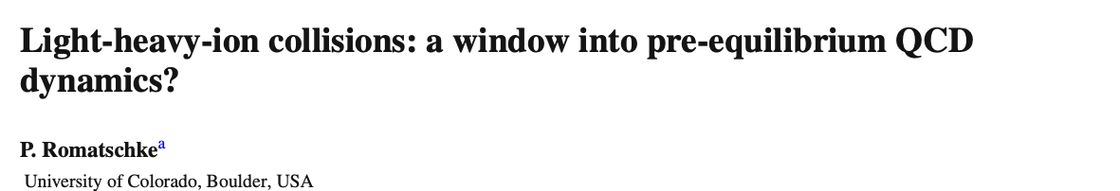
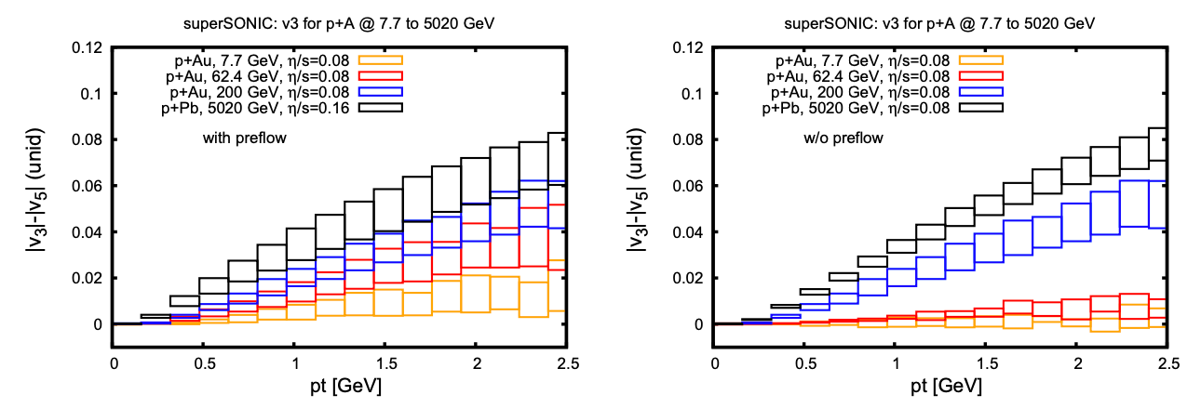
At some point, QGP lifetime too short and v₃ collapses
Strongly-coupled pre-flow helps mitigate this effect

Slide 18
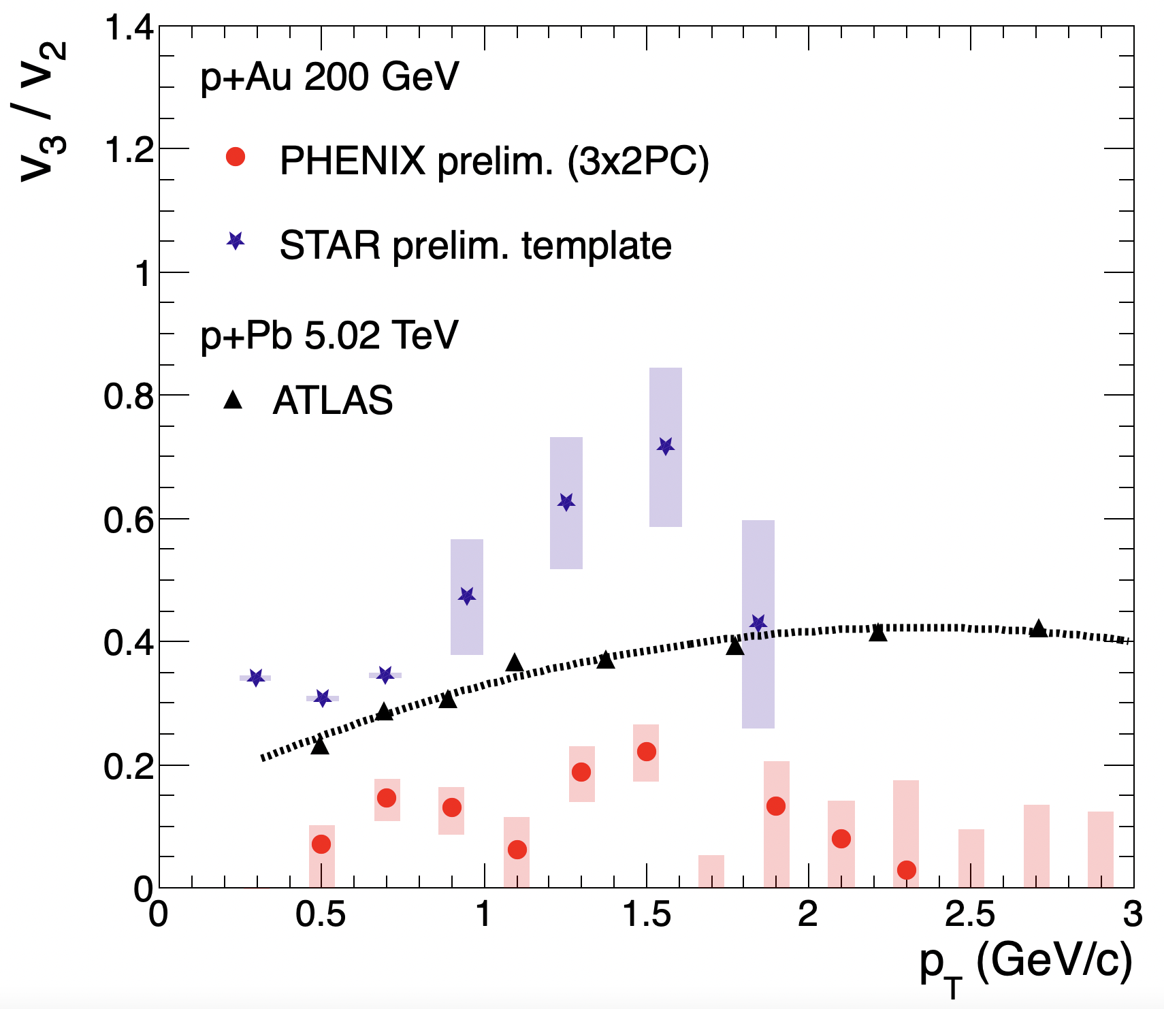
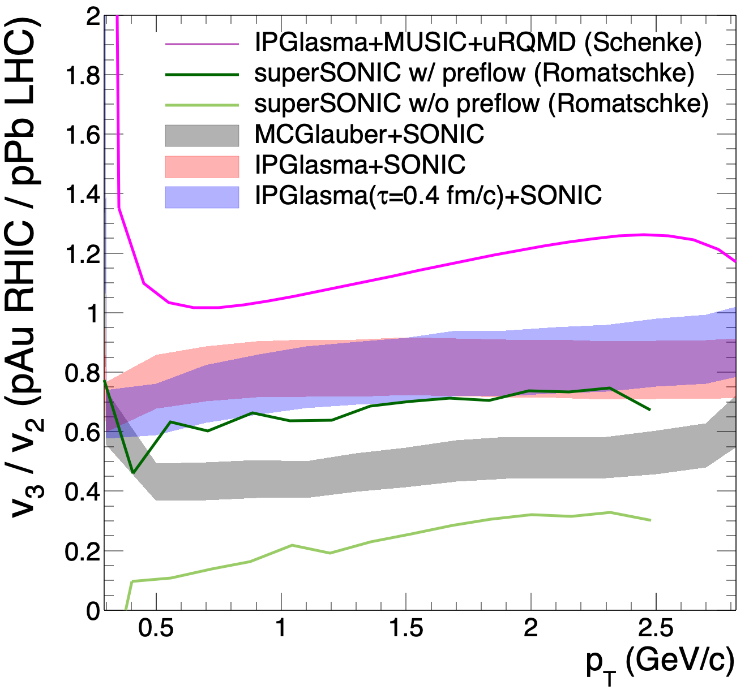
How to Address Experimentally (and Theoretically)?
Experiment
Theory
0-5% BBC
0-2% TPC
v₃/v₂ (pAu) / v₃/v₂ (pPb)
PHENIX pAu v₃/v₂ < ATLAS pPb v₃/v₂
Most calculations have larger damping of higher moments at lower energy
STAR pAu v₃/v₂ > ATLAS pPb v₃/v₂

Slide 19
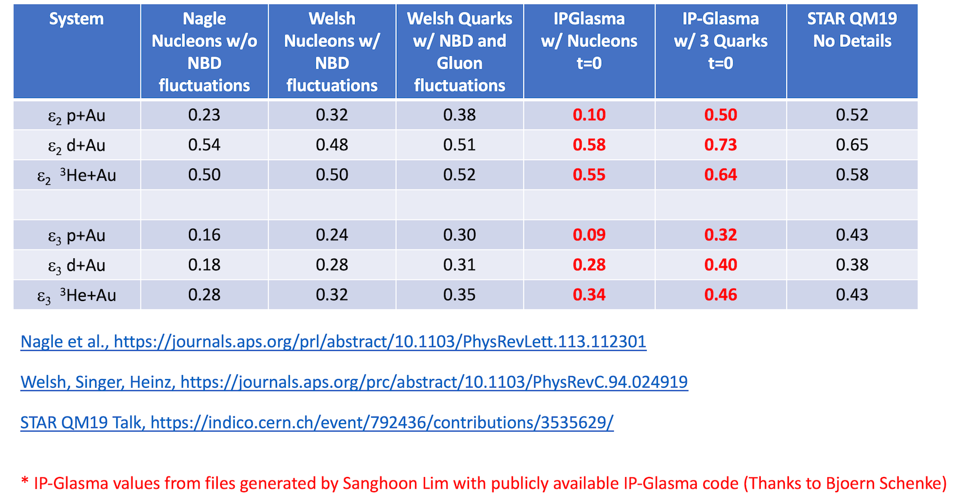
Initial Geometry also matters…

Slide 20
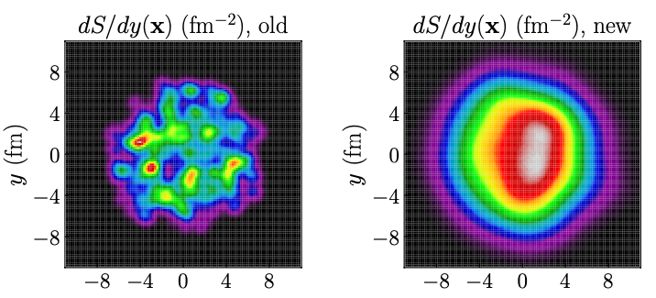
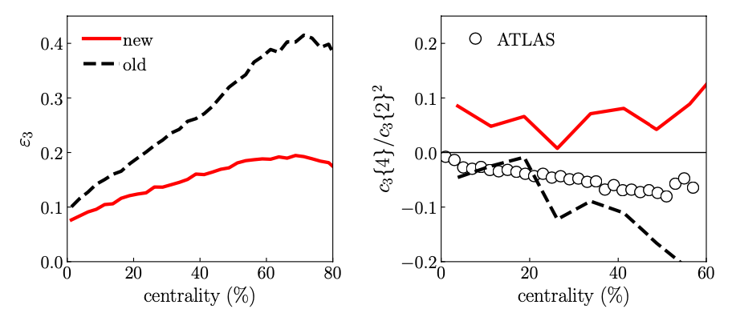
JETSCAPE Bayesian analysis
https://journals.aps.org/prc/pdf/10.1103/PhysRevC.103.05490
From Giuliano Giacalone
New parameters:
w = 1.12 fm - really big proton
d_{min} = 1.44 fm - nice and even spacing
- cannot be hard core repulsion
Progress with Bayesian analysis, but maybe losing sight of the goal of the field

Slide 21
Call to action…
Plug-n-play module for free stream, IP-Glasma evolution, AdS/CFT parameterized evolution
Bayesian analysis must compare these scenarios to make strong conclusions regarding bulk viscosity for example…
Does not make sense to over-machine things without this part, particularly in small systems
Relaxation times are (often) hidden knobs. Cannot go from free streaming (weak) to QGP η/s=0.08 (strong) without some bumps in the road

Slide 22

What is the point of our scientific enterprise if we never learn anything?
With RHIC heavy ion running ending in a handful of years, what is the real knowledge gained from this endeavor?

Slide 23

Extras

Slide 24
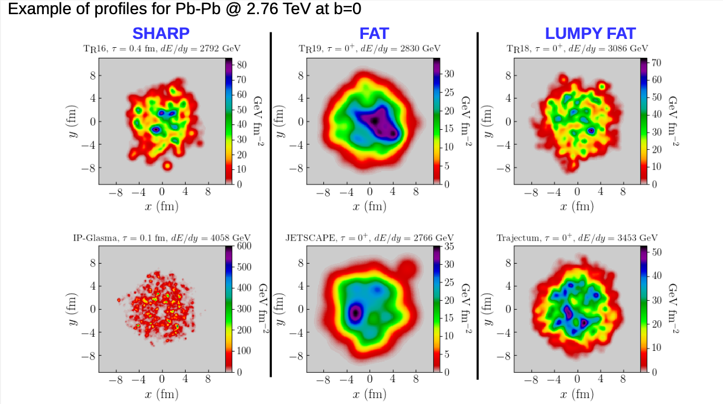
From Giuliano Giacalone

