Slide 1
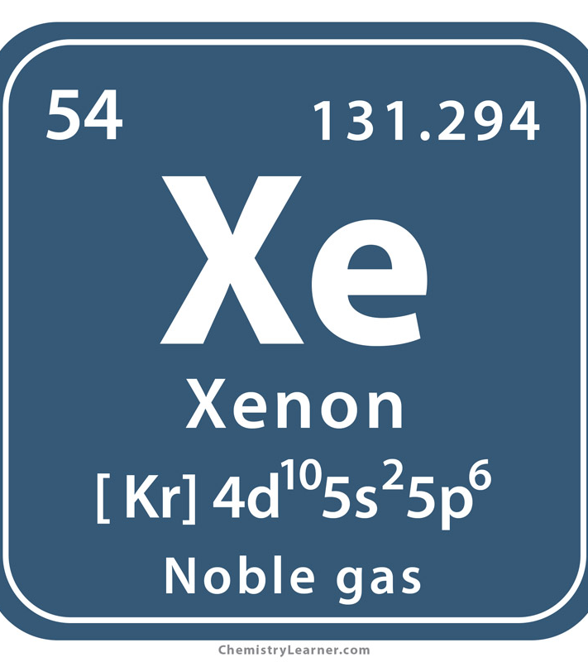
Heavy ions:
what do we learn from
small systems like
Xenon and forthcoming Oxygen?
Jamie Nagle (for the ATLAS Heavy Ion Group)
University of Colorado Boulder

Slide 2
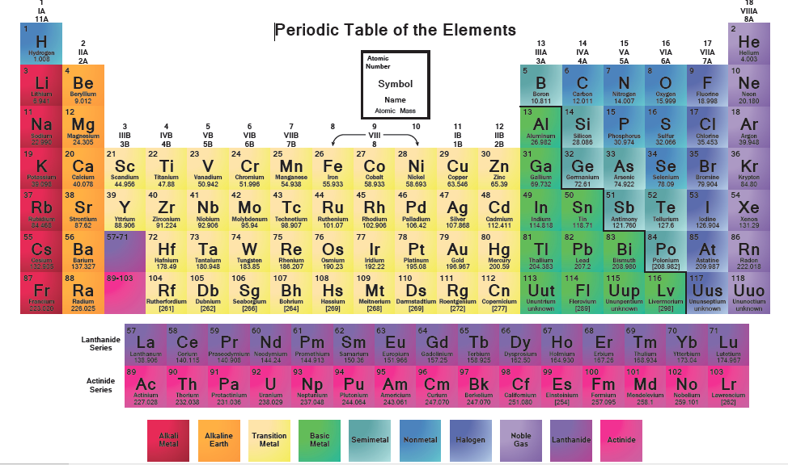
Oxygen ≅ small , Xenon ≠ small
String Structure

Slide 3
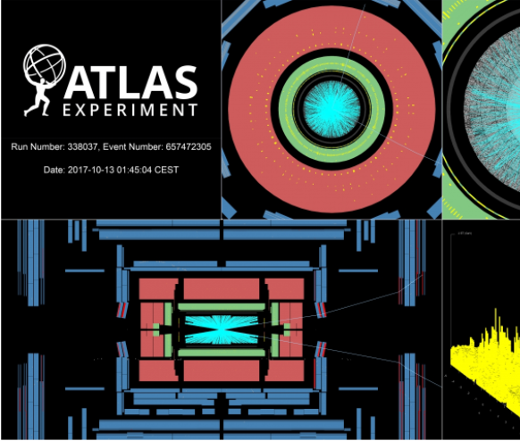
Heavy ion community
did not pick Xe+Xe,
it picked us…
“On Thursday 12 October, 2017 a new species joined this particle zoo. Fully stripped xenon (Xe) nuclei were successfully injected into both beam pipes, accelerated and collided for the very first time. This special heavy-ion physics run was added into the schedule just after a high-intensity proton physics fill and was completed in less than one day. The four LHC experiments collected Xe-Xe collisions at a centre-of-mass energy of 5.44 TeV per colliding nucleon pair.”

Slide 4
ATLAS Heavy Ion Xe+Xe Results
Flow decorrelation in XeXe and PbPb
https://journals.aps.org/prl/abstract/10.1103/PhysRevLett.126.122301
Charged particle flow in XeXe collisions at 5.44 TeV
https://journals.aps.org/prc/abstract/10.1103/PhysRevC.101.024906
Measurement of v_n-p_T correlations in Xe+Xe collisions
https://cds.cern.ch/record/2748818 [CONF]
Charged hadron spectra and dijet correlations in 5.44 TeV/NN Xe+Xe collisions
https://cds.cern.ch/record/2318588 [CONF]
One paper per hour of running !!!

Slide 5
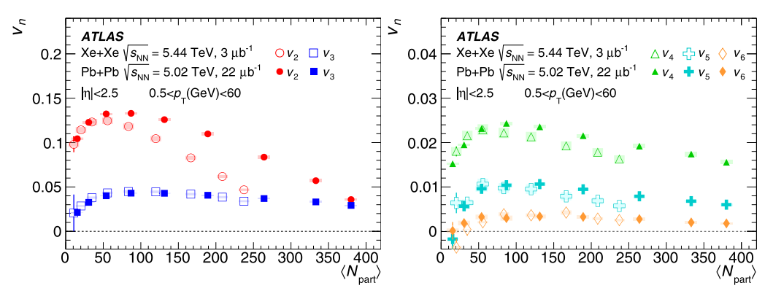
Bulk Quark-Gluon Plasma Properties
Constrained by the QGP response to initial conditions (e.g., geometry)
https://journals.aps.org/prc/abstract/10.1103/PhysRevC.101.024906

Slide 6
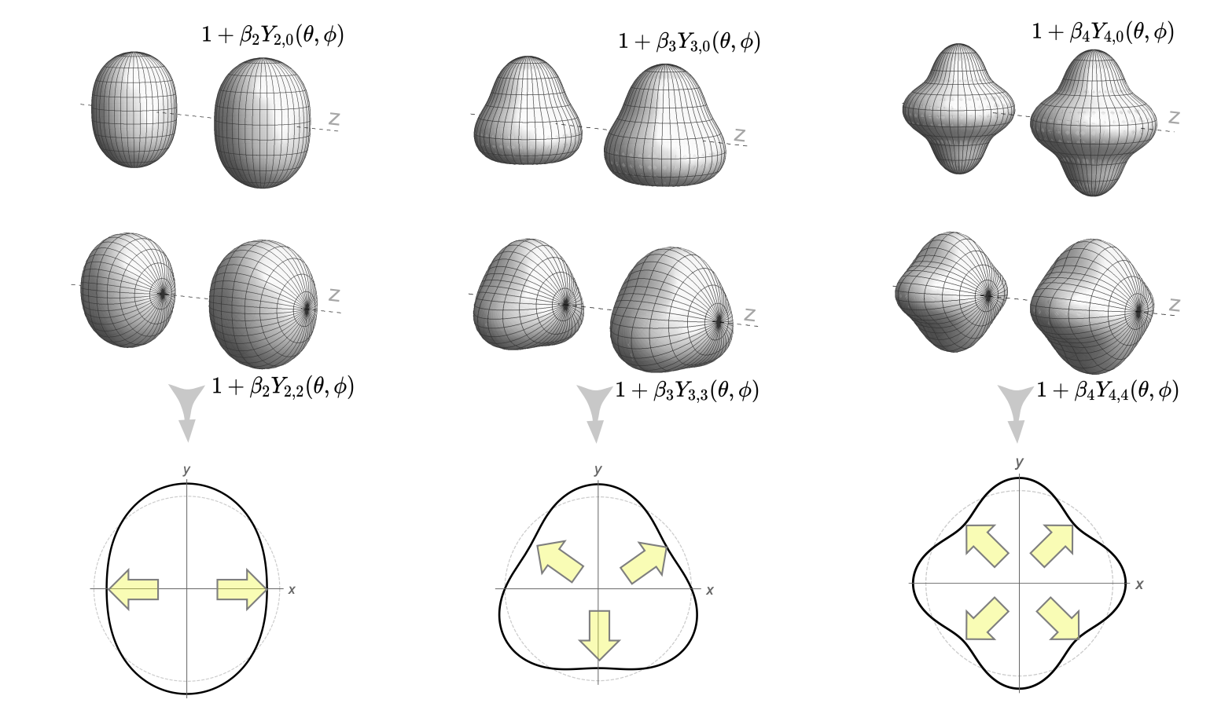
Nuclear Deformations
Impact parameter b=0 events have non-circular geometry from deformations and fluctuations
Xe+Xe is one such example.
Calculations qualitatively match these trends.
J. Jia, https://arxiv.org/abs/2106.08768
https://journals.aps.org/prl/abstract/10.1103/PhysRevLett.126.122301

Slide 7
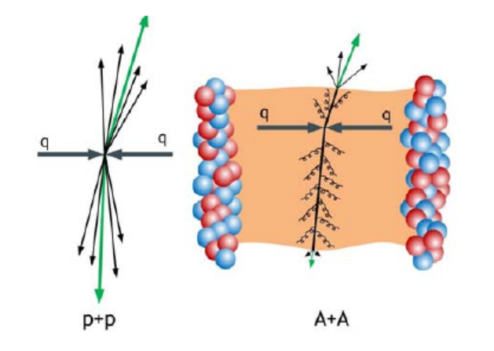
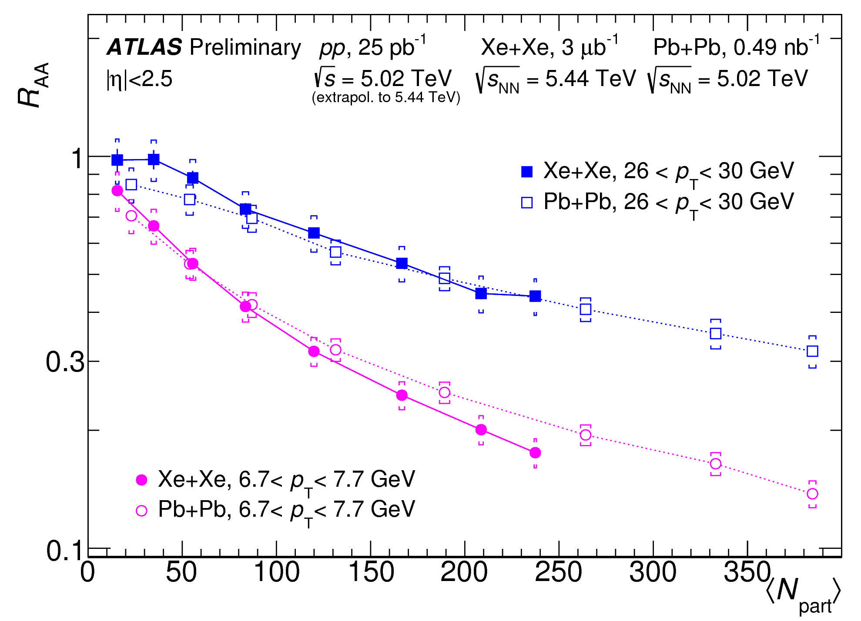
Jet Quenching
https://cds.cern.ch/record/2318588
Small differences between Xe+Xe and Pb+Pb could indicate QGP density differences, or perhaps ultraperipheral / centrality bias in
low N_{part} collisions

Slide 8
Oxygen chose us,
and that is exactly
what we wanted…
Why?

Slide 9
Excellent Workshop in February 2021
https://indico.cern.ch/event/975877/

Slide 10
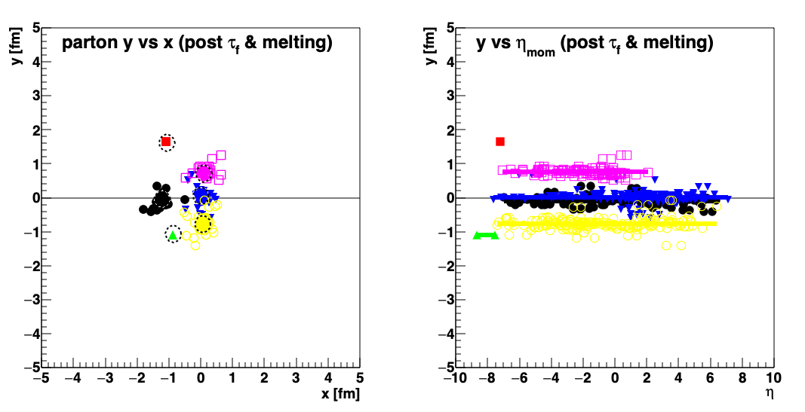
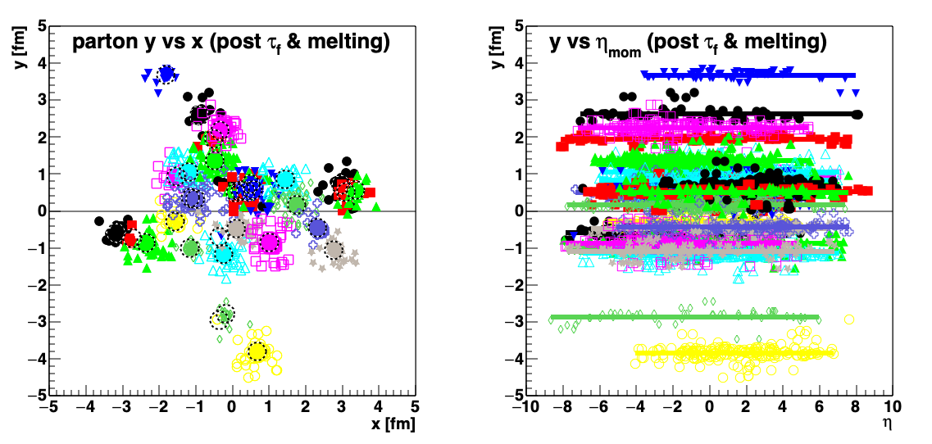
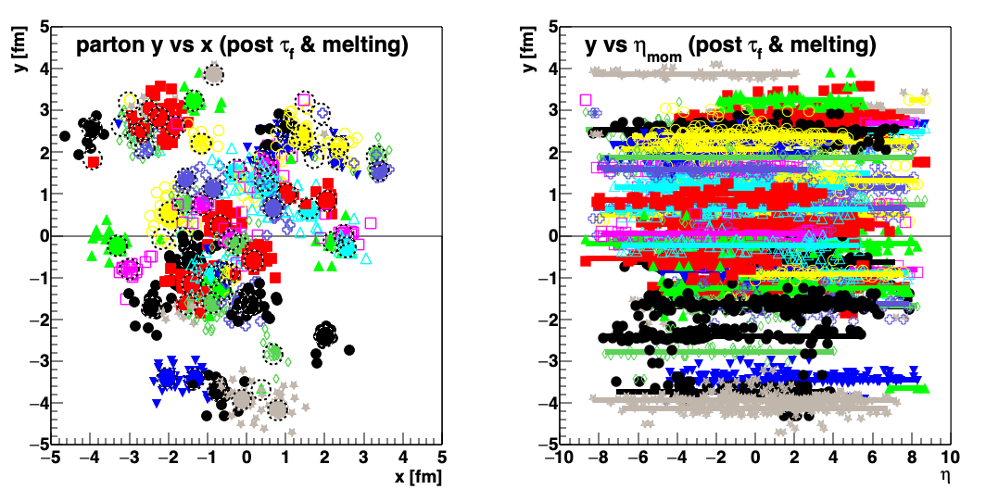
AMPT simulations
ATLAS observes signatures of collectivity, small QGP droplets in pp and pPb
but no jet quenching
p+O
?
O+O
ATLAS observes signatures of collectivity, large QGP droplets in XeXe and PbPb and with jet quenching
Xe+Xe

Slide 11
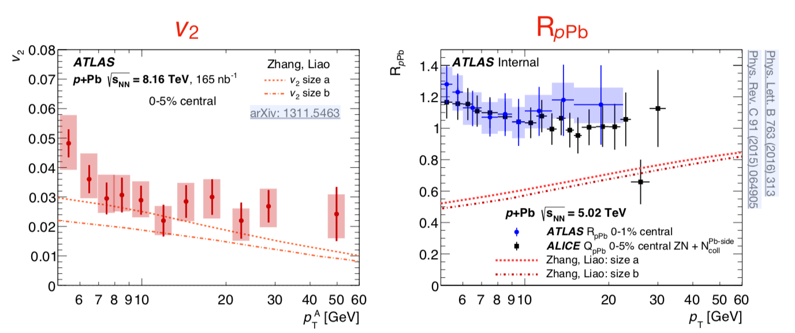
Jet Quenching in Small Systems?
pPb: Flow, even at high p_{T}, but no jet quenching

Slide 12
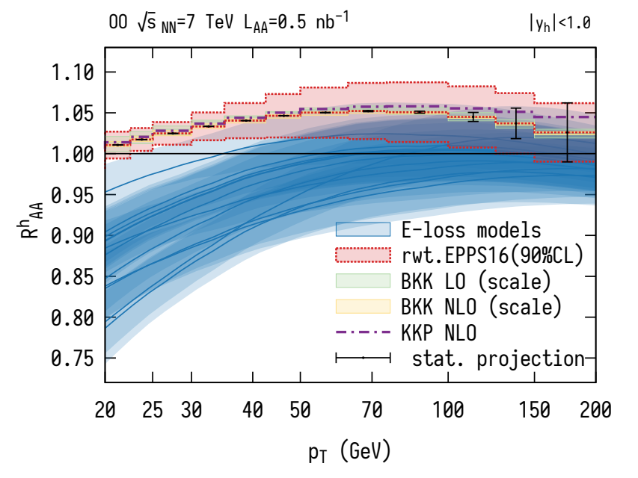
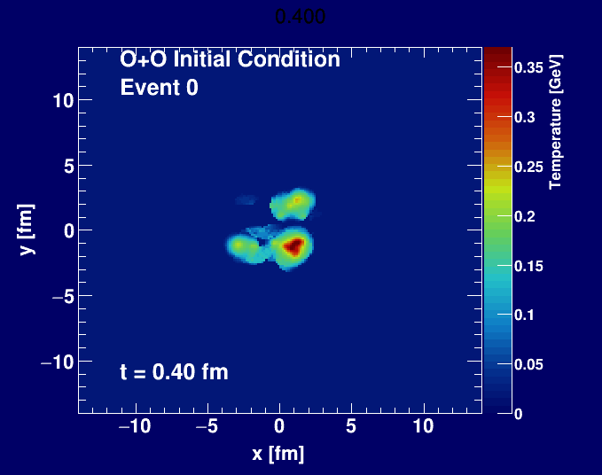
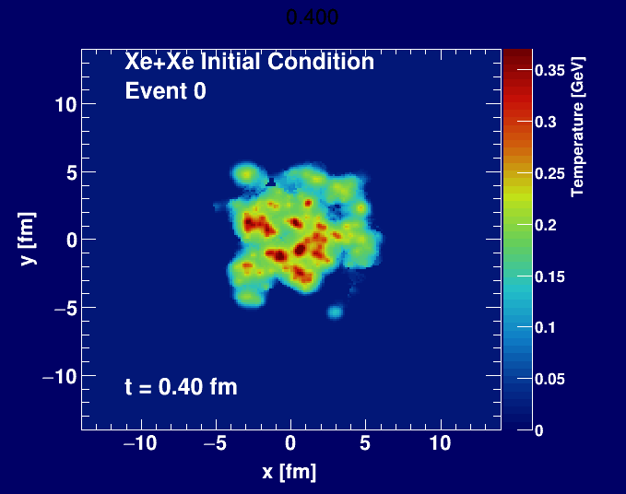
Theory ready for testing!
10.1103/PhysRevLett.126.192301
10.1103/PhysRevC.99.044904

Slide 13
Summary
A lot of excitement for pO and OO data at the LHC.
RHIC ran OO in June 2021.
Excellent comparison between collision energies.
Challenges with short run for triggering, good reference data, etc.
Three biggest gains in heavy ion knowledge
High statistics, precision
New collision geometries
Variation in collision energy (e.g., LHC and RHIC)

Slide 14
EXTRAS

Slide 15
https://indico.cern.ch/event/1026676/

