Slide 1
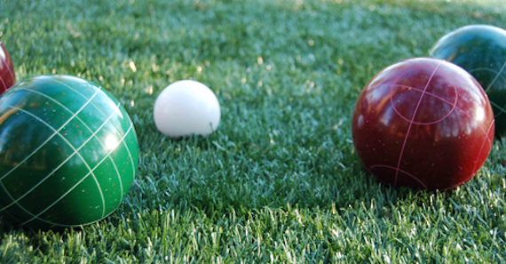
Heavy flavor production
and modification in ATLAS
15+5
Strange Quark Matter Conference
Online (2021)
James Nagle, University of Colorado Boulder
For the ATLAS Collaboration

Slide 2
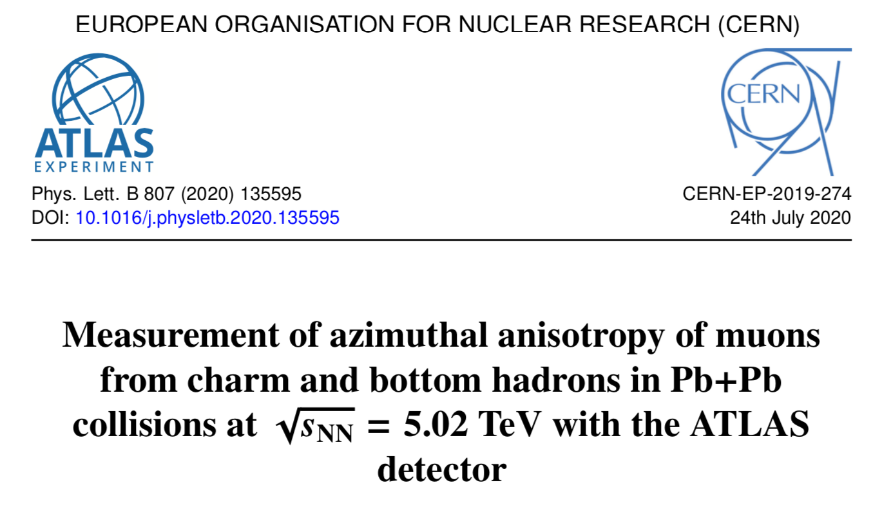
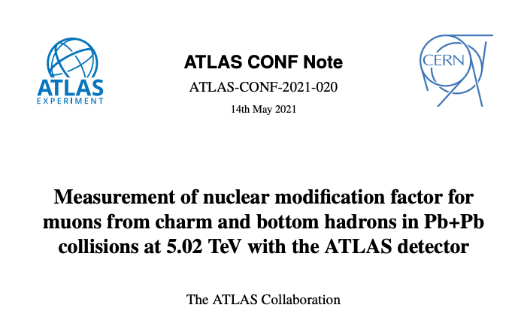
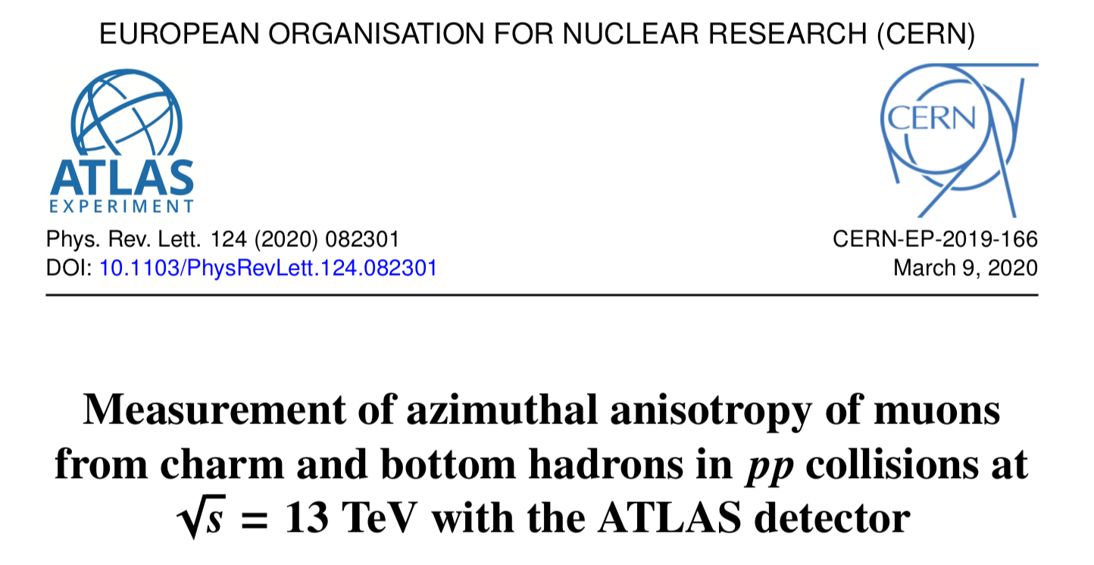
Wealth of ATLAS results on open heavy flavor*
In these 15 minutes, focus on three recent measurements
* https://twiki.cern.ch/twiki/bin/view/AtlasPublic/HeavyIonsPublicResults
HF muon+hadron correlations in 13 TeV pp, Phys.Rev.Lett. 124 (2020) 8, 082301
HF muon flow in 5 TeV PbPb, Phys. Lett. B 807 (2020), 135595
HF muon nuclear modification in 5 TeV PbPb, CONF Note
https://atlas.web.cern.ch/Atlas/GROUPS/PHYSICS/CONFNOTES/ATLAS-CONF-2021-020/

Slide 3
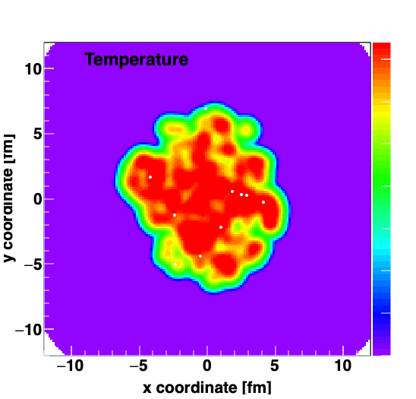
Key features of heavy-ion collisions
Hydrodynamic described “collectivity” of the bulk (p_{T} < 5-6 GeV)
Jet quenching suppresses particles at high p_{T} > 5-6 GeV
A. Adare et al., Phys.Rev.C 90 (2014) 2, 024911
Langevin Drag & Diffusion Modeling
Heavy quarks “flow” with the bulk
Suppression in high p_{T} heavy quarks

Slide 4
Does the charm flow at RHIC?
Phys.Lett.B 557 (2003) 26-32
Charm quarks dragged and diffused in QGP suppresses high p_{T} hadrons
(R_{AA} ↓)
And push generates “flow” (v₂ ↑)
PHENIX Collaboration, Phys.Rev.Lett. 98 (2007) 172301
749 citations to date
Yes, but what about bottom quarks?

Slide 5
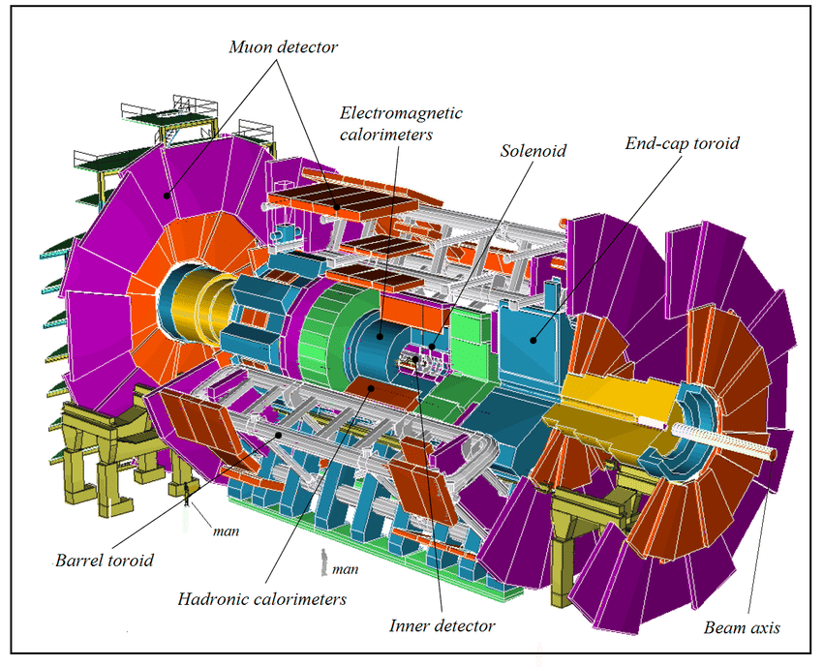
ATLAS Detector at the LHC
Data Sets
pp 5.02 TeV (2017)
pp 13 TeV (2017)
PbPb 5.02 TeV (2015 & 2018)
Open heavy flavor measurements via decay muons

Slide 6
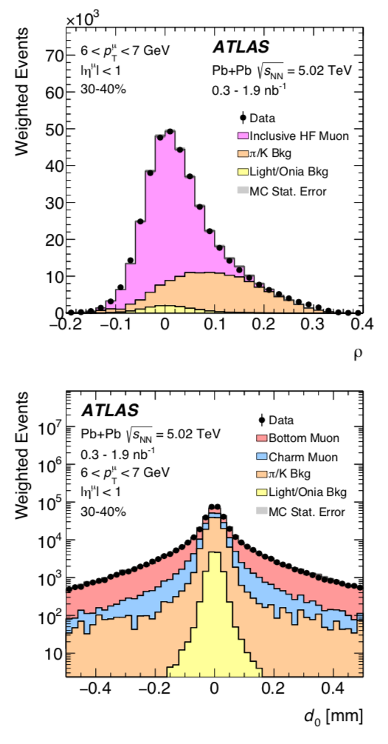
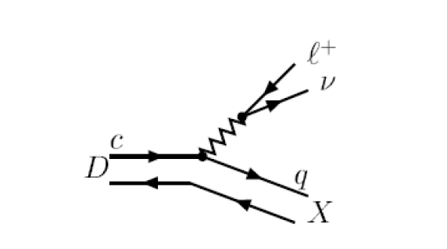
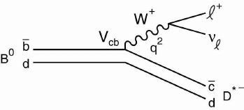
Muons from open charm and bottom
Are separated from light flavor decay muons and from each other via:
Momentum imbalance between the measurements in the inner tracking detector and the muon spectrometer
Distance of Closest Approach distribution and template fitting

Slide 7
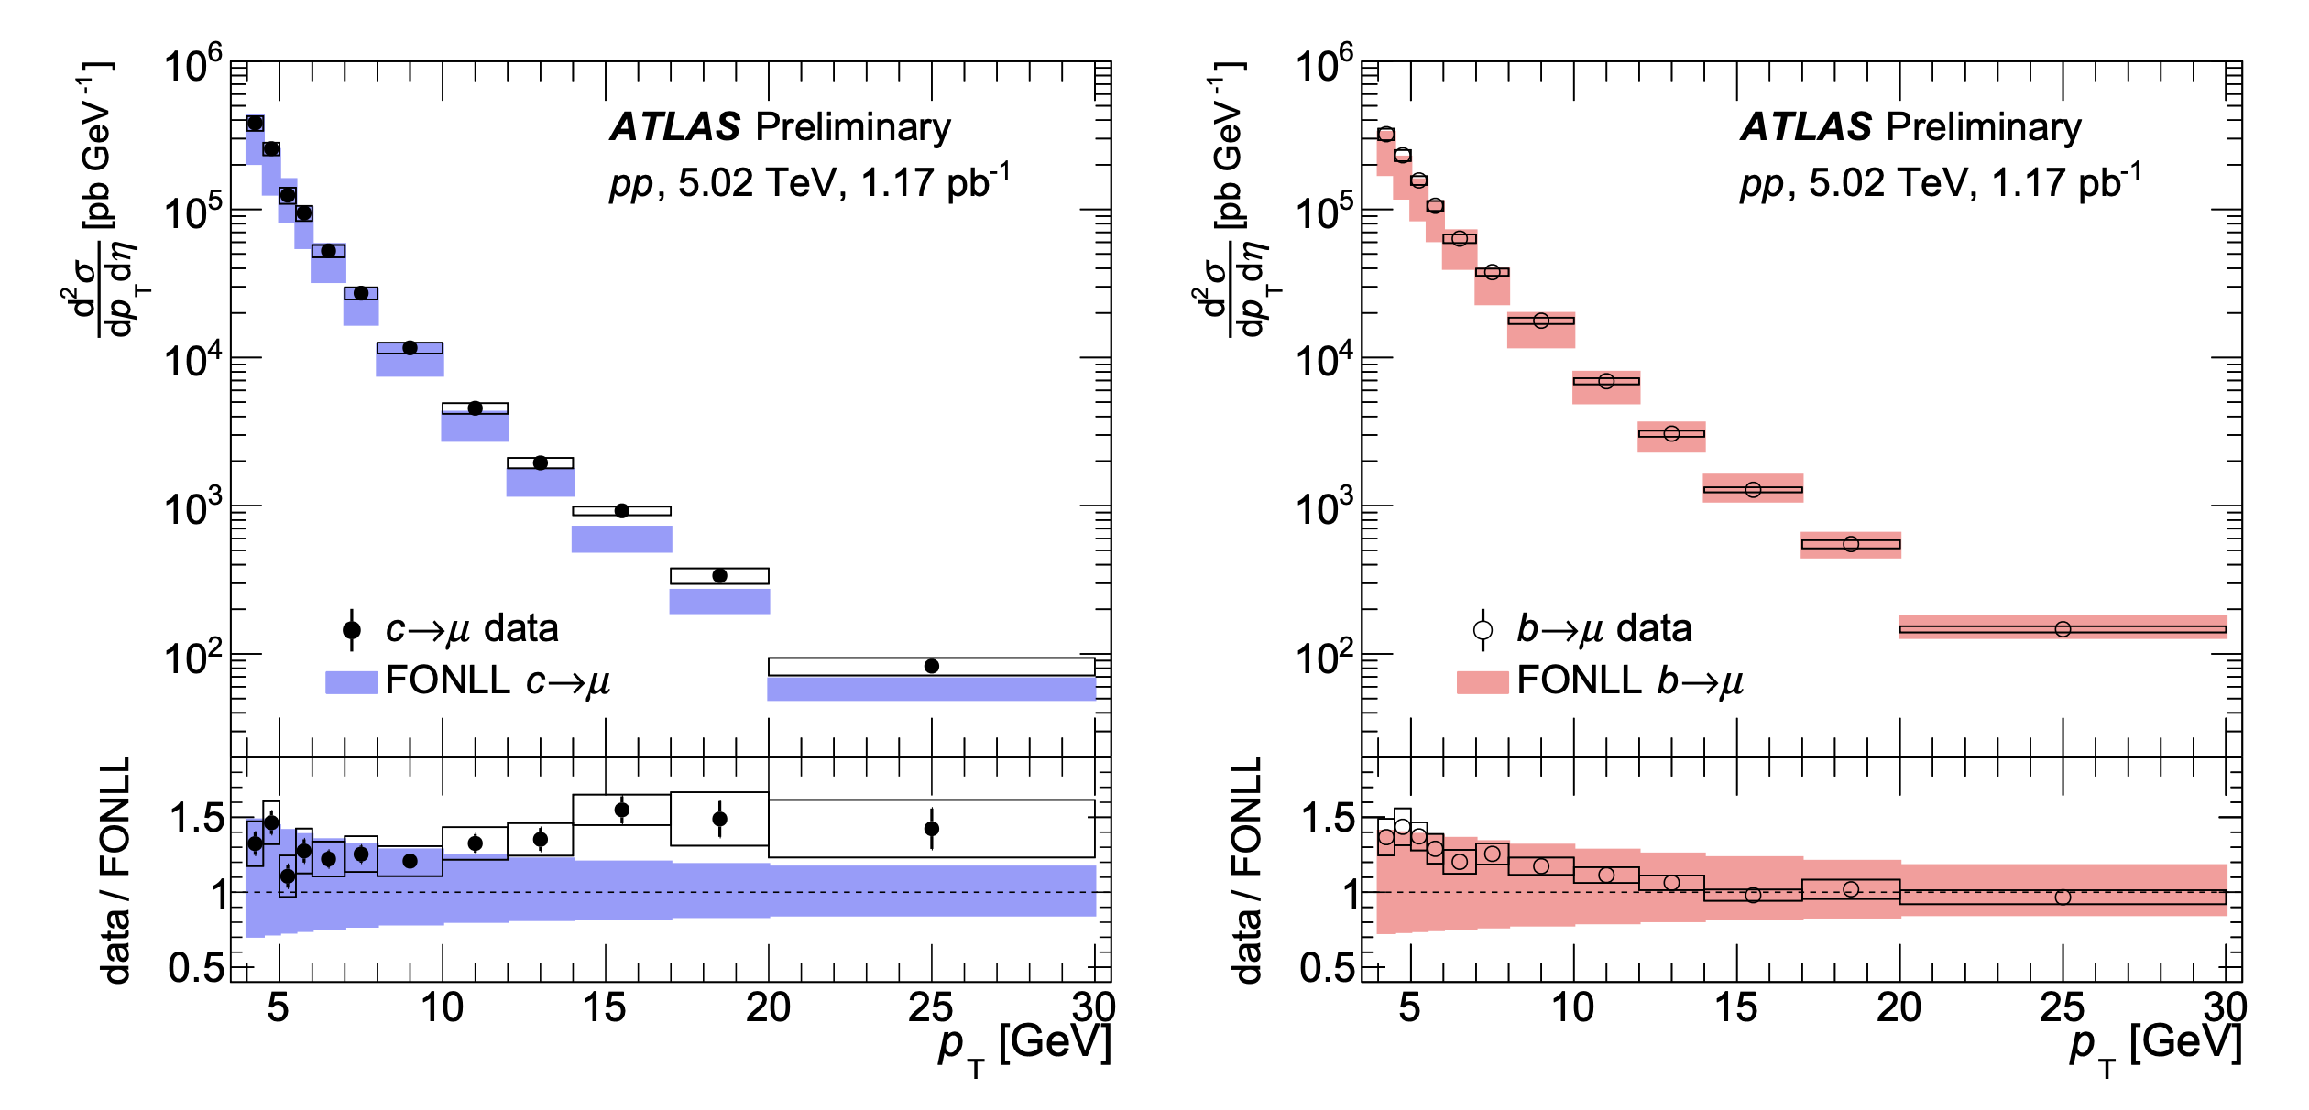
Proton-Proton Spectra and FONLL Comparison

Slide 8
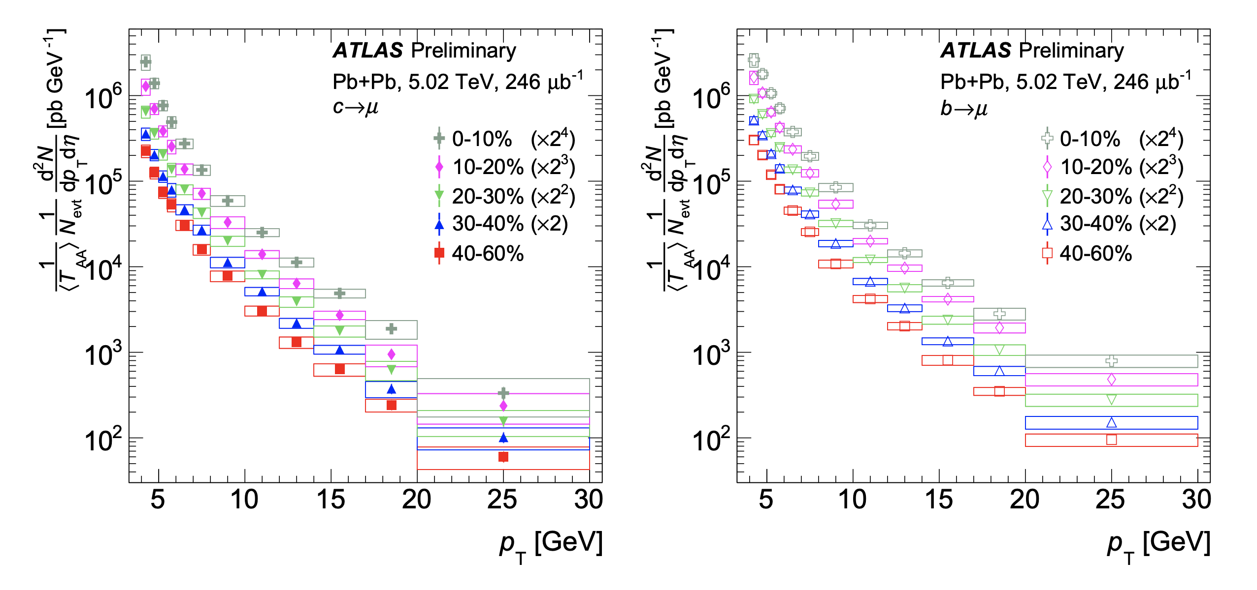
Pb+Pb 5 TeV Spectra

Slide 9
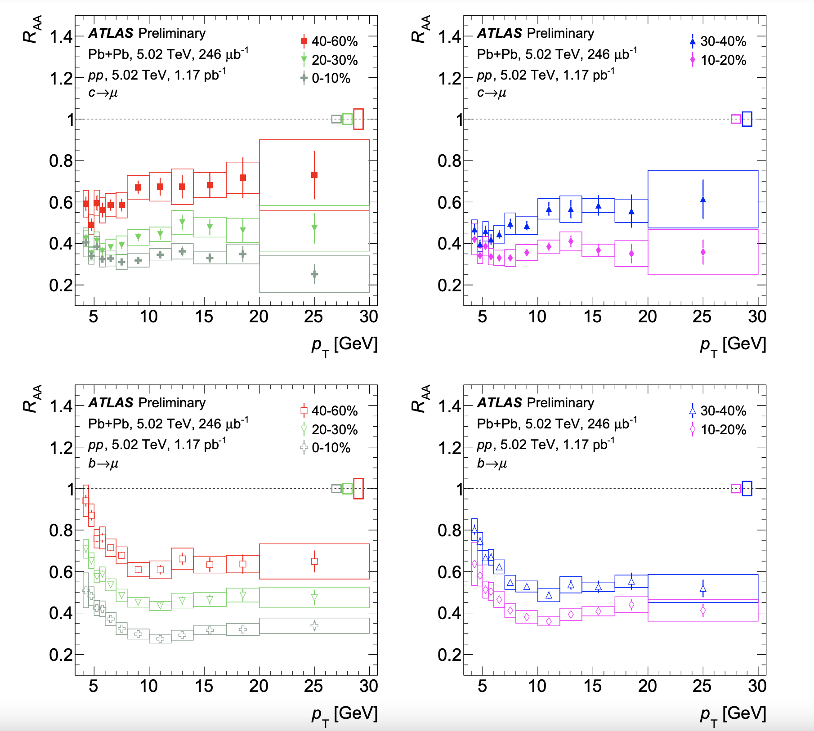
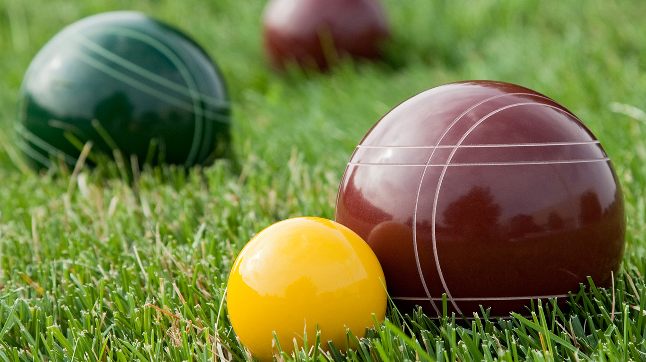
Nuclear Modification Factors
Charm
Bottom

Slide 10
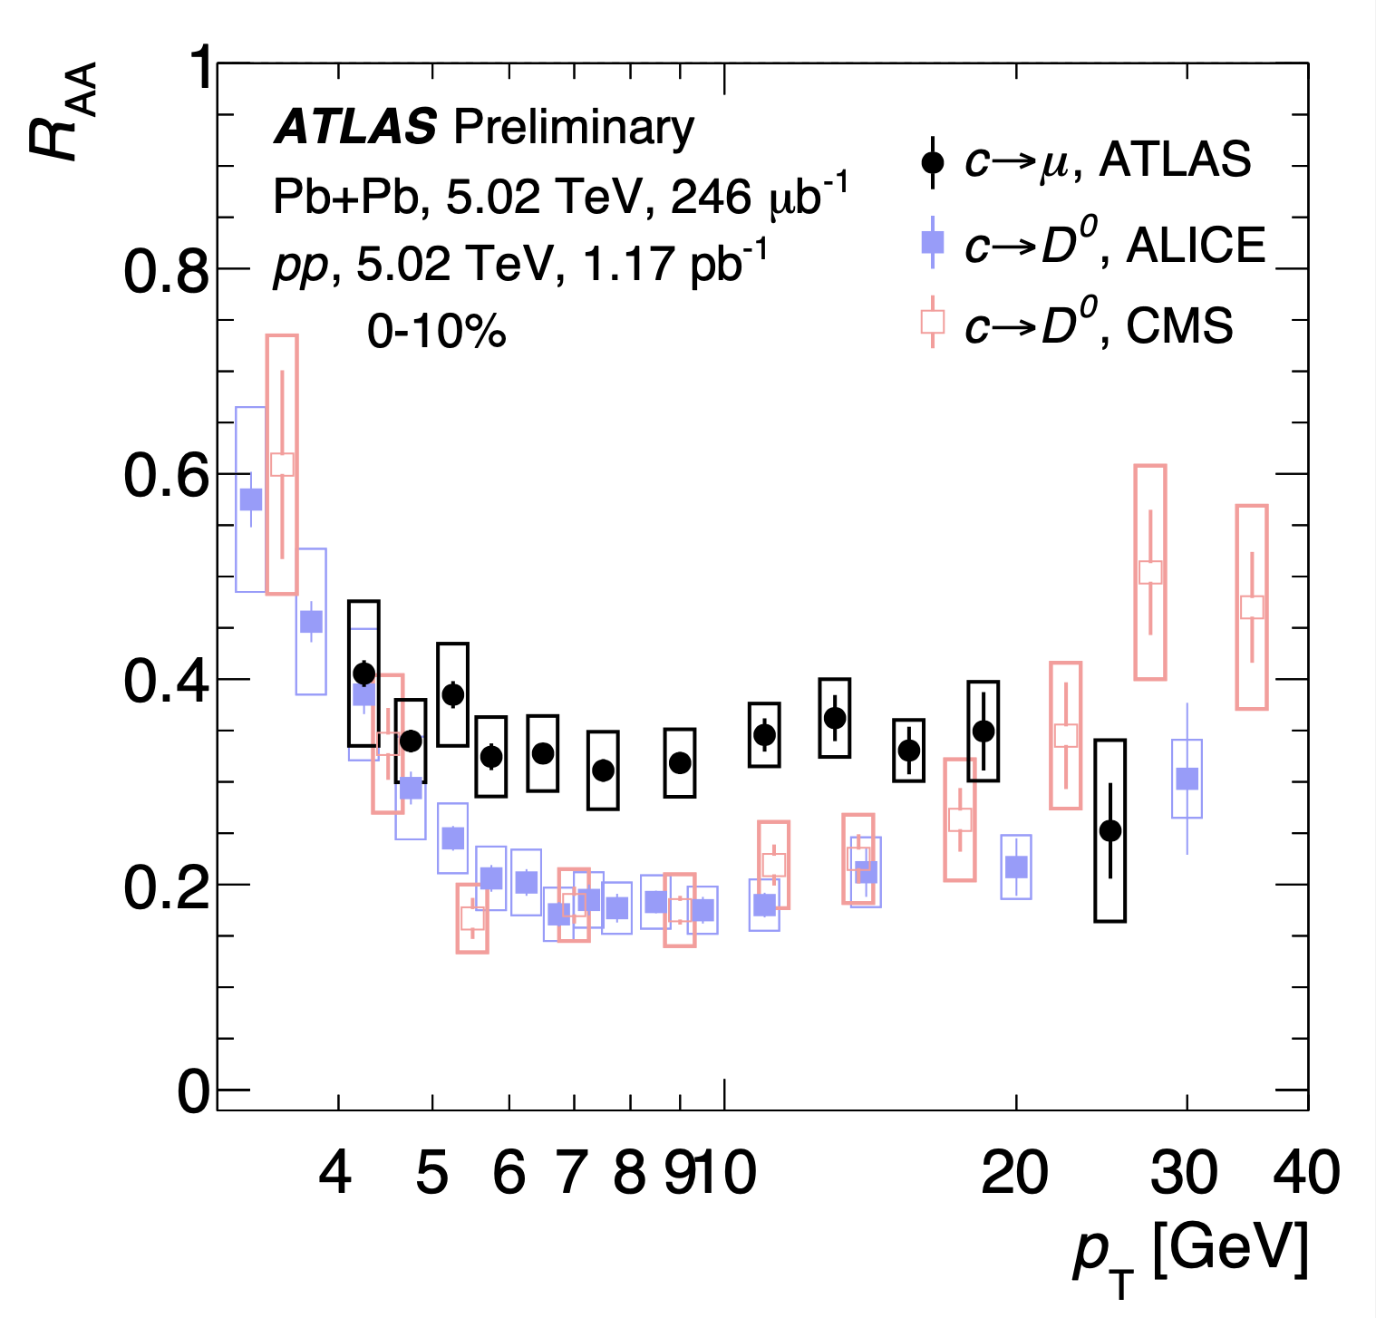
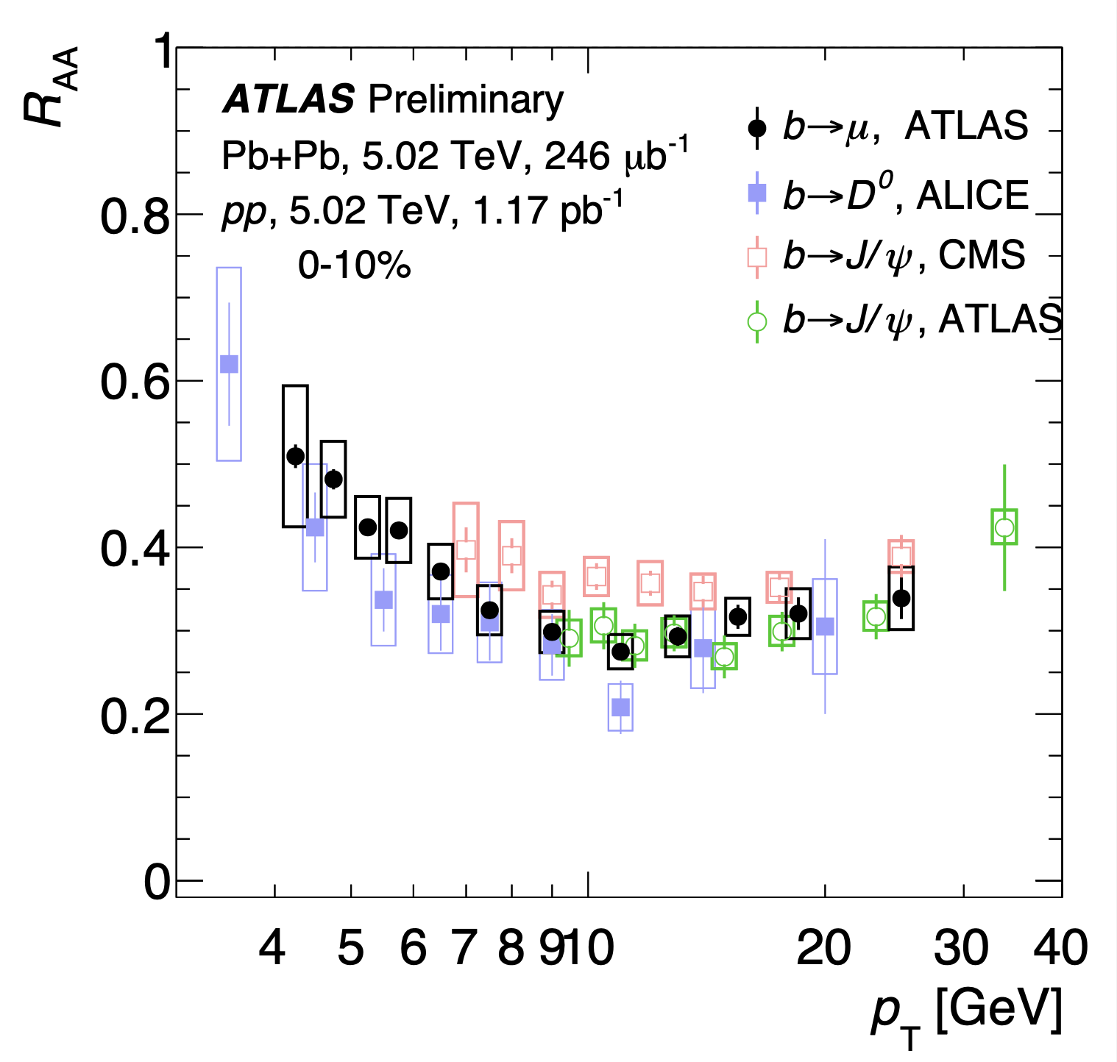
Comparison with other measurements

Slide 11
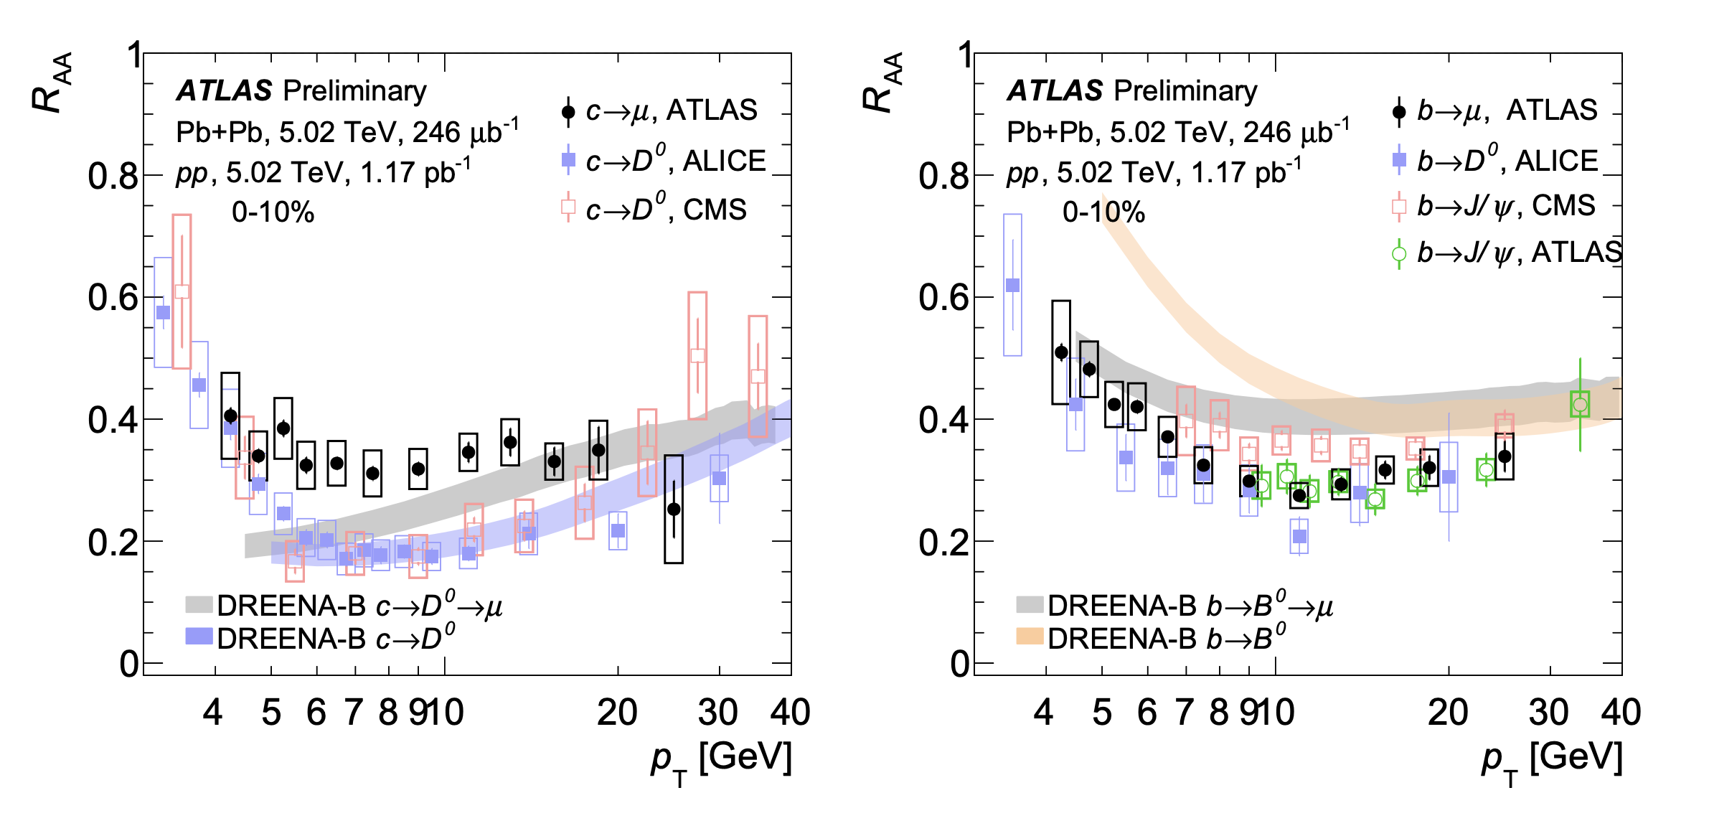
Comparison with other measurements
Heavy flavor channel matters – decay kinematics

Slide 12
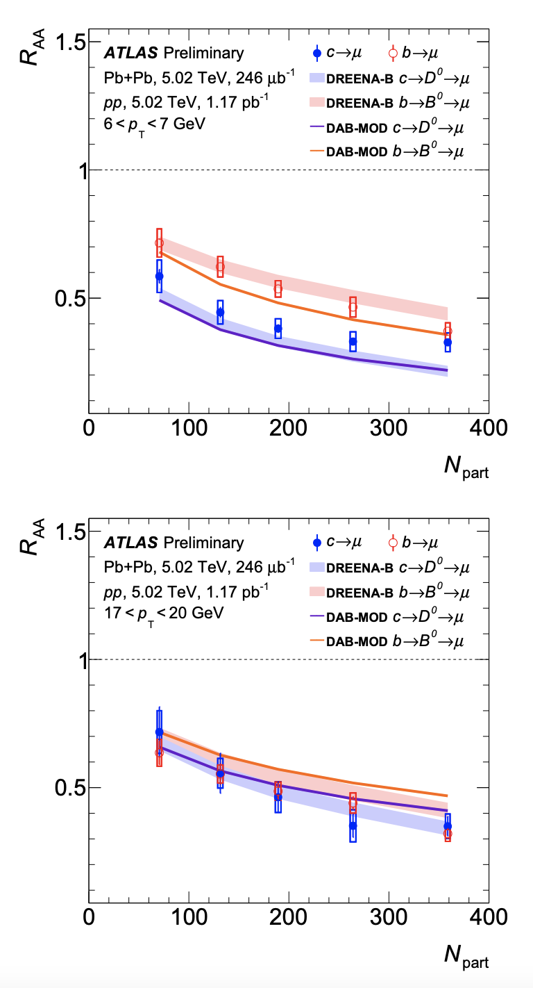
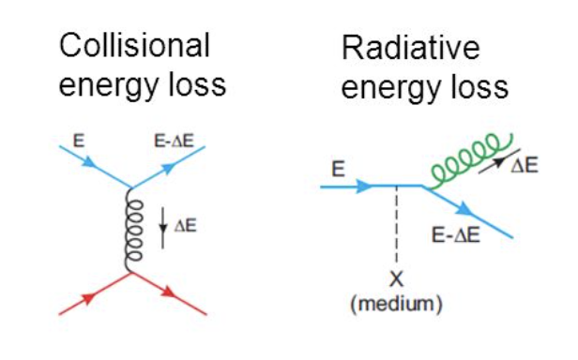
Nuclear Modification Factors
Charm has larger suppression than bottom at lower p_{T}, but similar at higher p_{T}
Radiative energy loss reduced by
“dead-cone” effect when p_{T} << m_{c,b}
Hence larger energy loss for charm compared to bottom at lower p_{T}
Muon p_{T} = 6-7 GeV
Muon p_{T} = 17-20 GeV

Slide 13
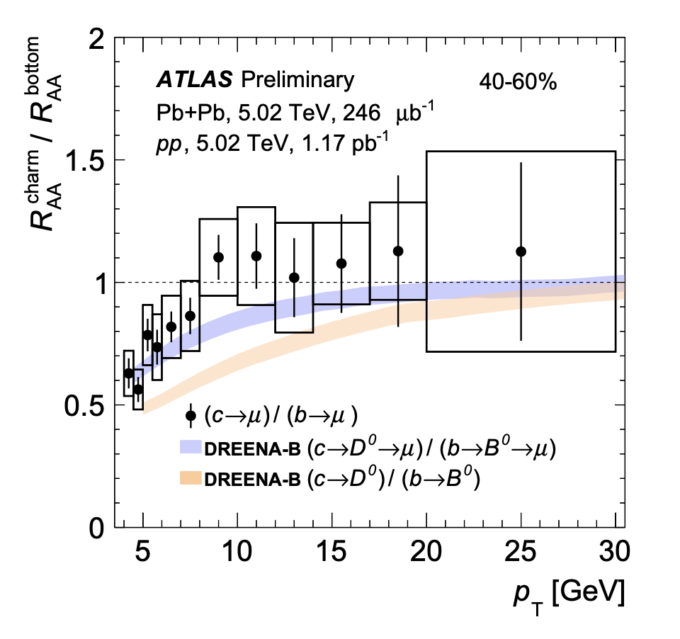

Slide 14
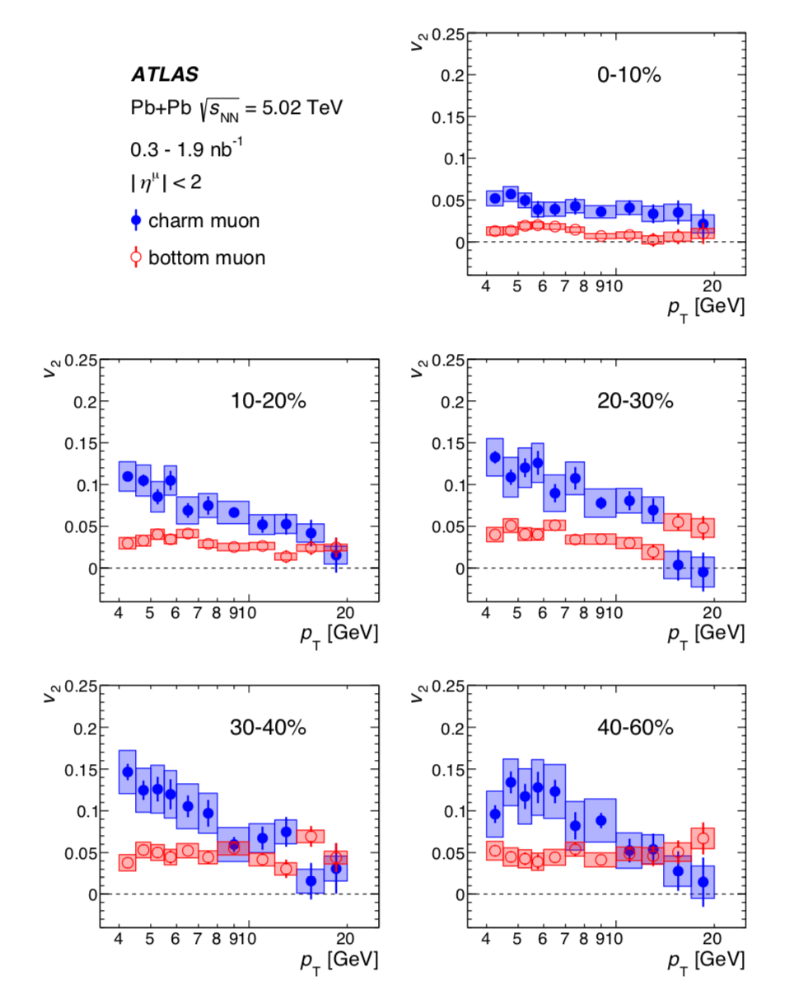
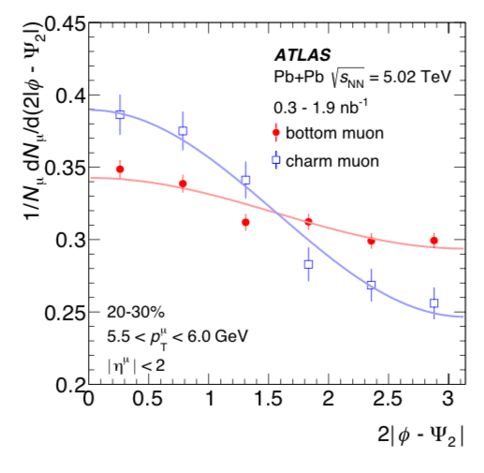
What about flow of heavy quarks?
Measure the yield of charm/bottom muons relative to the reaction plane

Slide 15
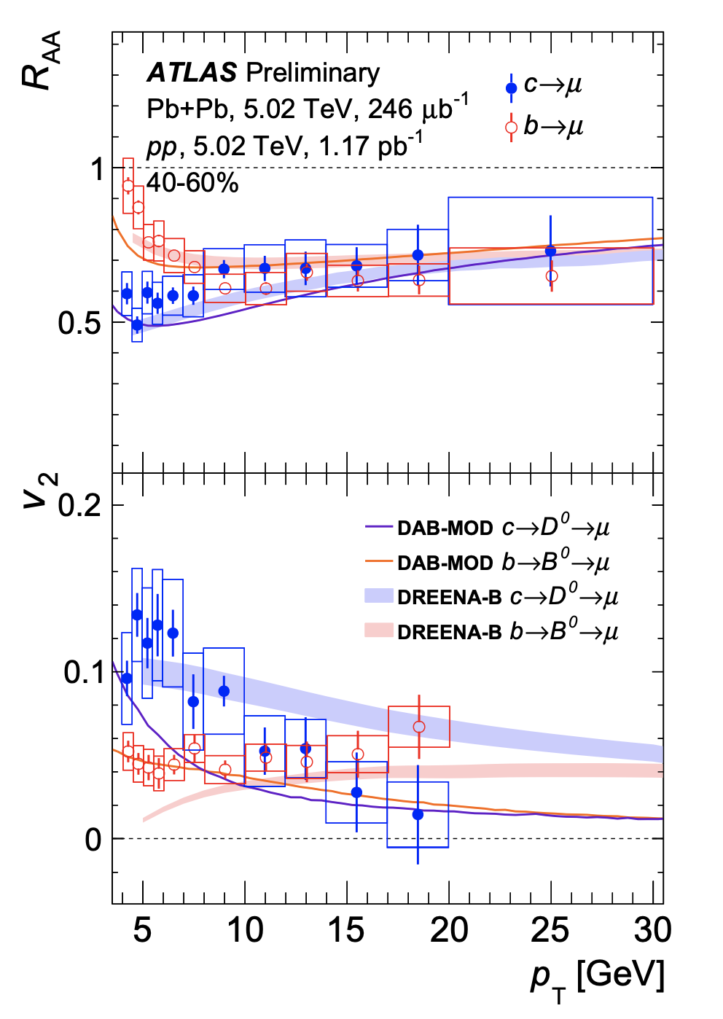
Is this a consistent picture?
State-of-the-art calculations
DREENA-B (arXiv:1805.04786)
Dynamic energy loss in 1+1D expanding QCD medium
DAB-MOD (arXiv: 1906.10768)
2D+1 viscous hydrodynamic expansion with event-by-event fluctuations
Both match mass splitting in R_{AA} at low p_{T}
DREENA-B has closer match to elliptic flow v₂
It would be ideal to test both energy loss calculations on identical expanding QGP background
(challenge to the theorists)

Slide 16
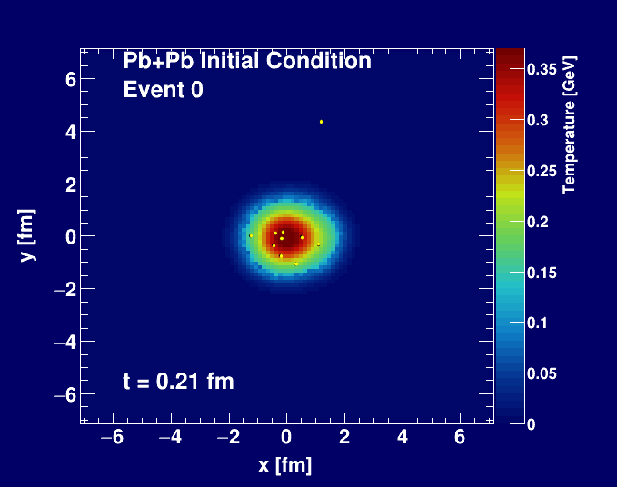
What about a mini-QGP droplet in proton+proton collisions?
A. Adare et al., Phys.Rev.C 90 (2014) 2, 024911
Proton + Proton
SONIC Hydrodynamics
with proton (3 quark) geometry
Heavy Quark Langevin

Slide 17
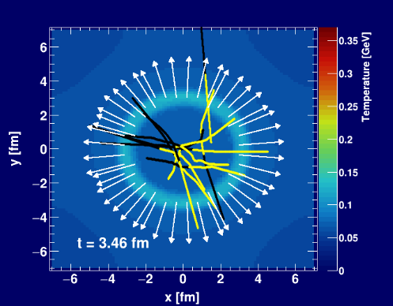
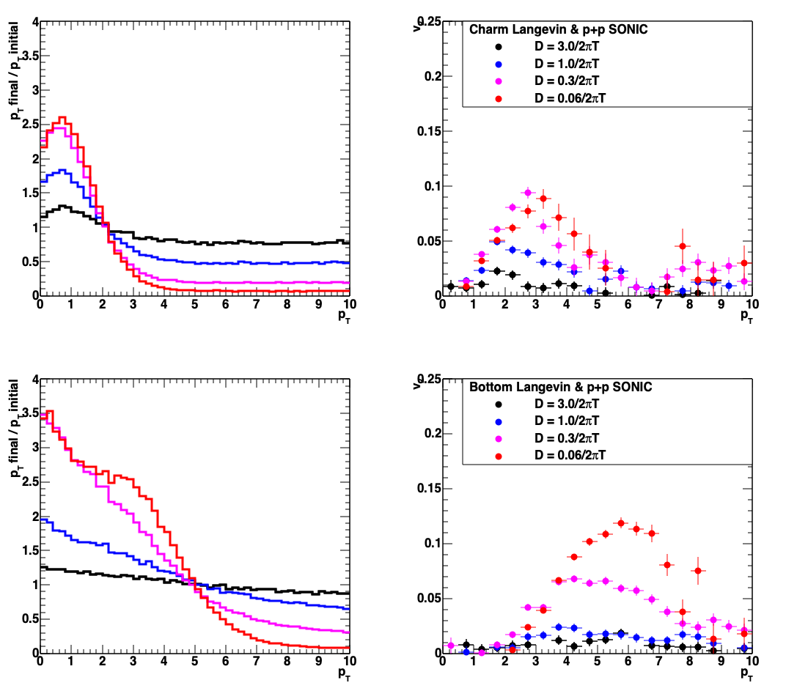
What about a mini-QGP droplet in proton+proton collisions?
elliptic flow v₂
Heavy quark flow might not be so surprising
However,
such calculations also predict very significant p_{T} modifications
(not seen ?)
p_{T} modification
SONIC Hydrodynamics
with proton (3 quark) geometry
Heavy Quark Langevin

Slide 18
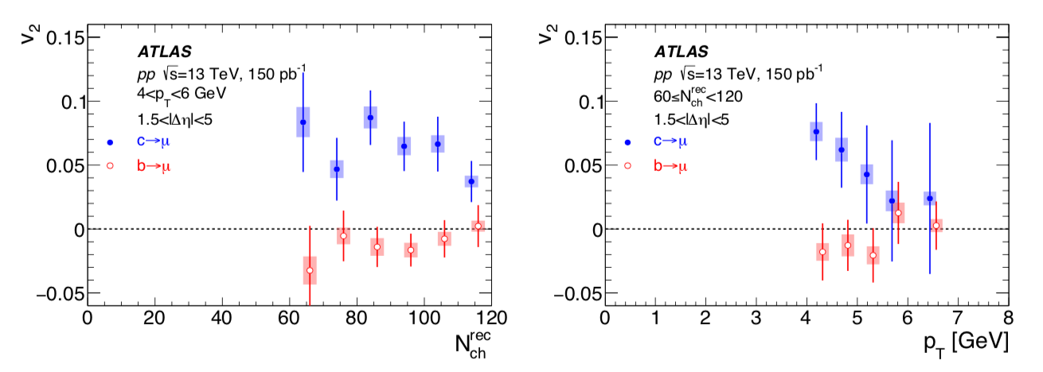
In pp, charm also “flows” (v₂ > 0) !
i.e. azimuthal correlation with low p_{T} hadrons…
Bottom consistent with v₂ = 0 in pp.

Slide 19
Summary
New ATLAS results on charm/bottom muon R_{AA} presented
Combined with previously published v₂, v₃ for charm/bottom muons gives strong constraints on energy loss mechanisms (radiative/collisional) and QGP expansion modeling
Published v₂ for charm/bottom muons in pp 13 TeV remains a significant puzzle

Slide 20
Extra

Slide 21
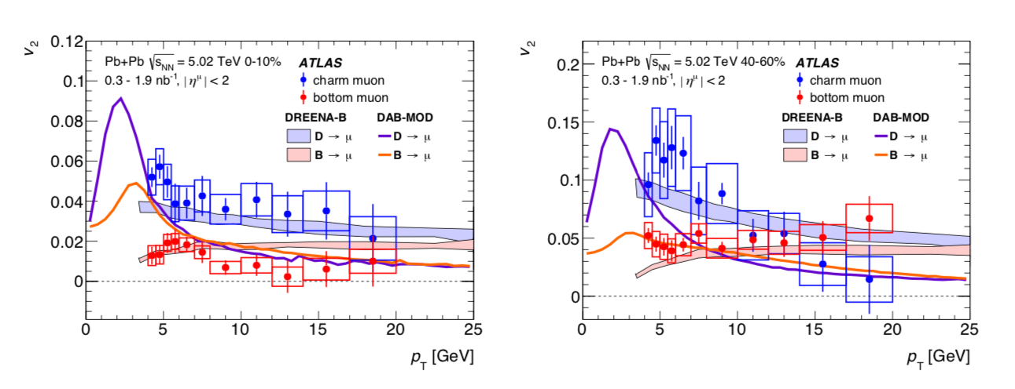

Slide 22
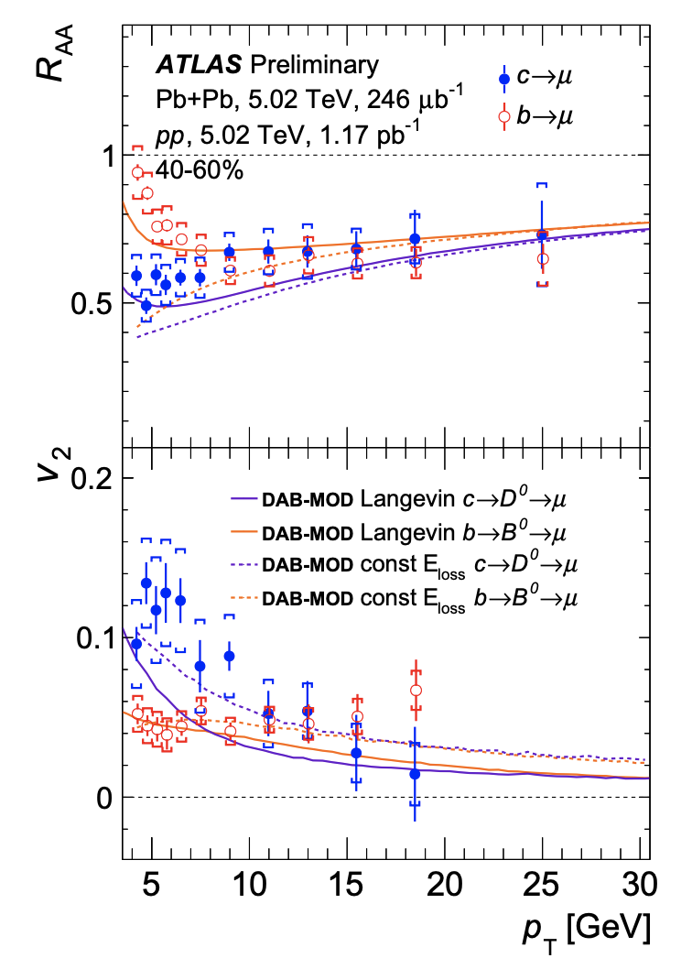
Model Variations
State-of-the-art calculations
DAB-MOD (arXiv: 1906.10768)
2D+1 viscous hydrodynamic expansion
with event-by-event fluctuations
Langevin versus constant E_{loss}

