Slide 1
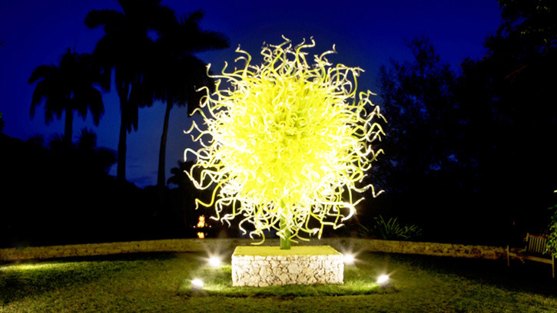
QGP Production in Small Systems
Jamie Nagle
University of Colorado Boulder
Zimanyi School
December 7-11,2020
From darkness, the light

Slide 2
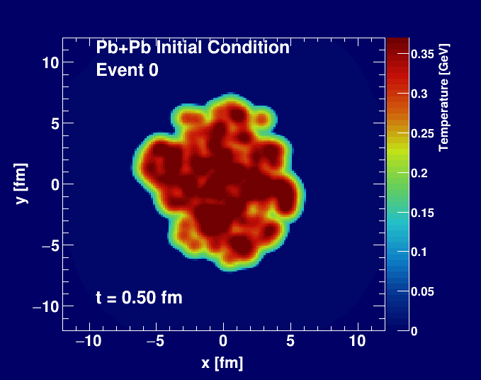
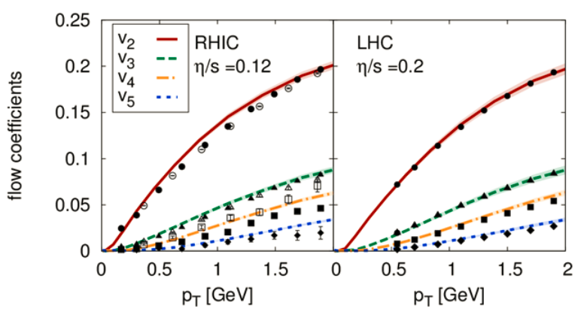
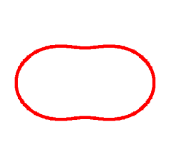
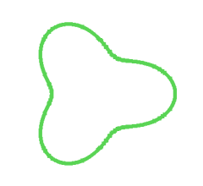
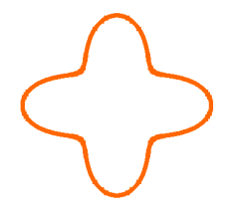
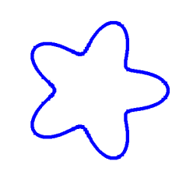
Standard Time Evolution Model of Heavy Ion Collisions
Bjoern Schenke
Hydrodynamic simulation (SONIC from Paul Romatschke) run with
η/s = 0.08 ~ 1/4π and ζ/s = 0.01

Slide 3

Jet Quenching Signature of QGP

Slide 4
Key features of heavy-ion collisions
Hydrodynamic described “collectivity” of the bulk (p_{T} < 5-6 GeV)
Jet quenching, suppression of high p_{T} partons / jets / hadrons (p_{T} > 10-12 GeV)
Low p_{T} bulk particles are azimuthally correlated with
high p_{T} jet particles
steeper density gradients,
more bulk particles along x-axis
shorter path out of medium,
more jets along x-axis

Slide 5
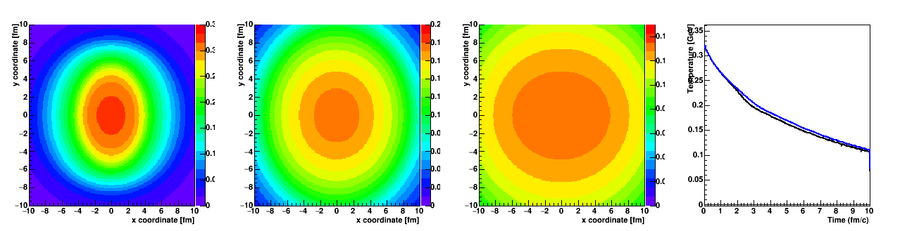
An Ancient (15-year-old) Puzzle
PHENIX
Jet quenching suppressed high p_{T} hadrons (R_{AA} ↓)
Differential jet quenching generates “flow” (v₂ ↑)
However, jet quenching calculations have great difficulty matching both!
Simple reason – different paths from the middle see very similar fluid until late times (at lower T)

Slide 6
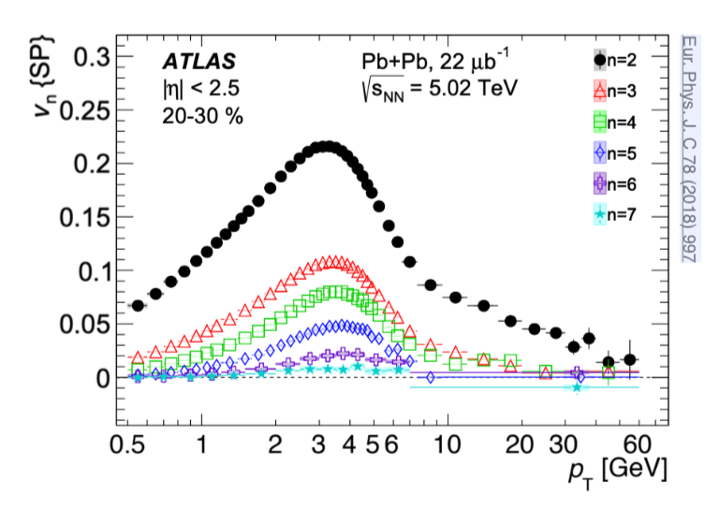
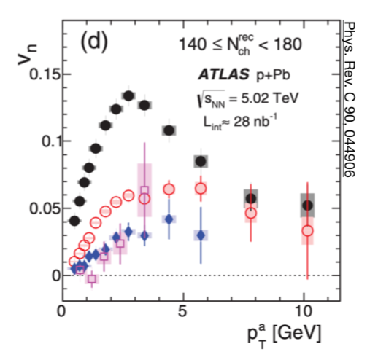
Azimuthal Correlations
Pb+Pb Collisions
p+Pb Collisions
Hydrodynamics
Transition
Jet Quenching
Hydrodynamics
Jet Quenching?
Are low p_{T} (bulk) and high p_{T} particles azimuthally correlated in small systems, p+Pb?

Slide 7
Pb+Pb Tension → p+Pb Contradiction?
p+Pb shows no clear R_{pPb} modification, but there is an indication of high p_{T} v₂ (!?#$%)

Slide 8
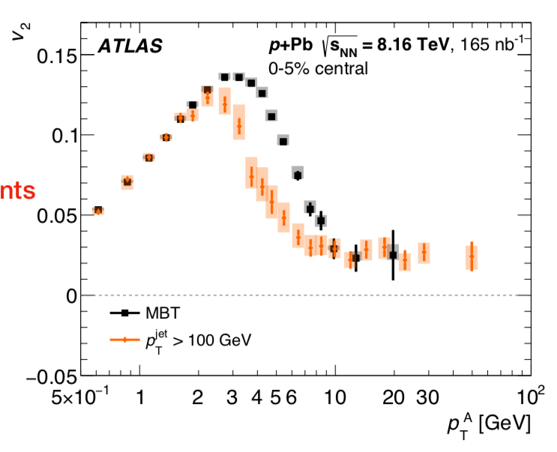
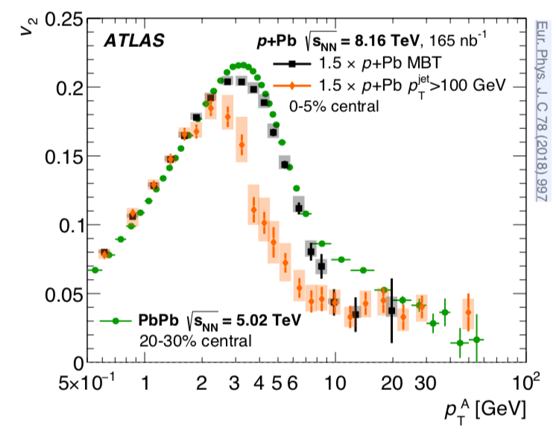
New Experimental Physics Result
Low p_{T} “bulk” flow
High p_{T} flow / jet quenching?
What is really measured is azimuthal correlation of
low and high p_{T} particles.
Transition region, with differences in minimum bias and jet samples.

Slide 9
p+Pb and Pb+Pb Comparison
Pb+Pb and
p+Pb (scaled x1.5) appear very similar
Common hydrodynamic explanation for
p_{T} < 4 GeV?
Common explanation for p_{T} > 10 GeV?

Slide 10
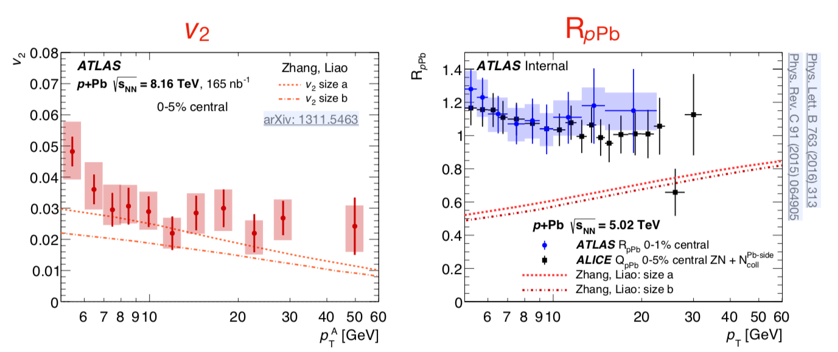
Jet Quenching Model for p+Pb
Cannot describe both azimuthal anisotropy and lack of change in p_{T} spectra

Slide 11
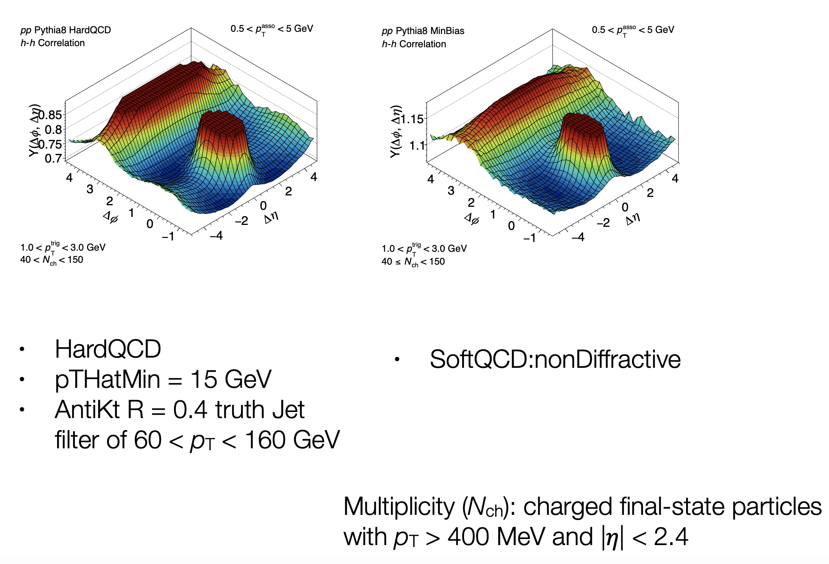
PYTHIA’s revenge?
PYTHIA initial-state radiation:
“SpaceShower::phiIntAsym”
implementing azimuthal asymmetries in the radiation pattern from colour coherence considerations.
This is without the
“string shoving” option!
https://doi.org/10.1016/j.physletb.2018.01.069
PYTHIA8 – no long-range ridge
PYTHIA8 – dijet events
However, effect is biggest in LOW multiplicity events and is
watered down in HIGH multiplicity events

Slide 12
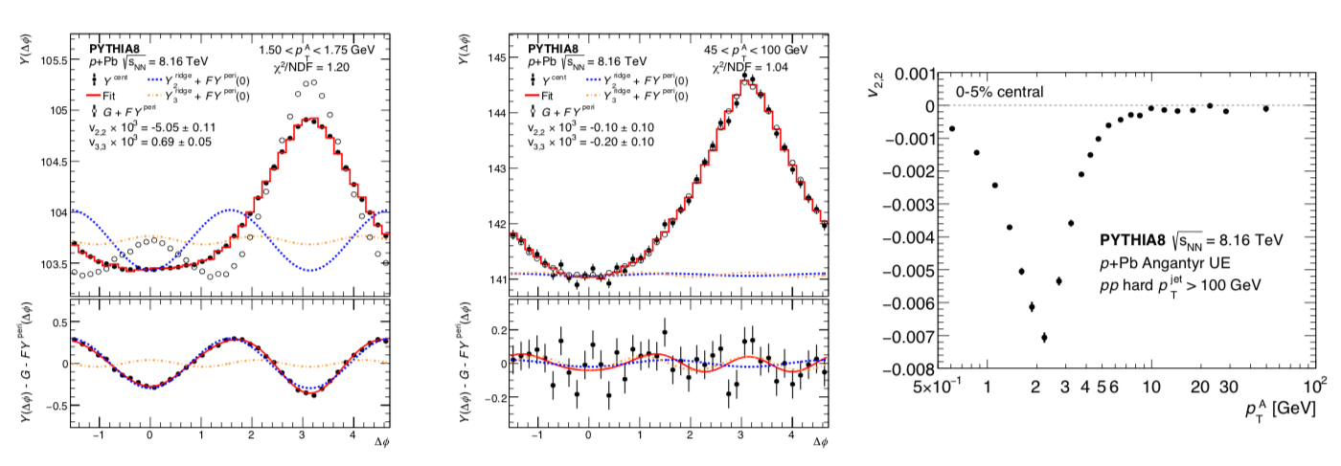
Quantitative PYTHIA Angantyr Prediction
How can the
Oracle of Delphi
be wrong?
Because correlation is stronger in low-multiplicity, template subtraction yields negative correlation in high-multiplicity events. Opposite sign and trend from experimental data. Problem with any explanation involved n << N_{total} particles.

Slide 13
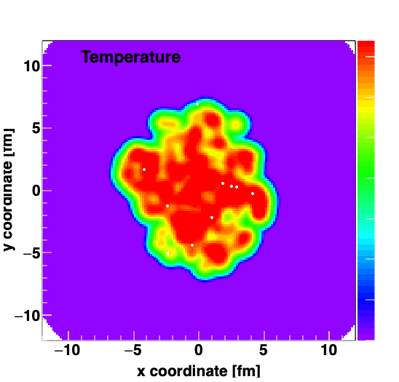
Heavy Quarks in the QGP

Slide 14
An Ancient (15-year-old) Solution
Heavy quarks dragged and diffused in QGP suppresses high p_{T} hadrons (R_{AA} ↓)
And push generates “flow” (v₂ ↑)

Slide 15
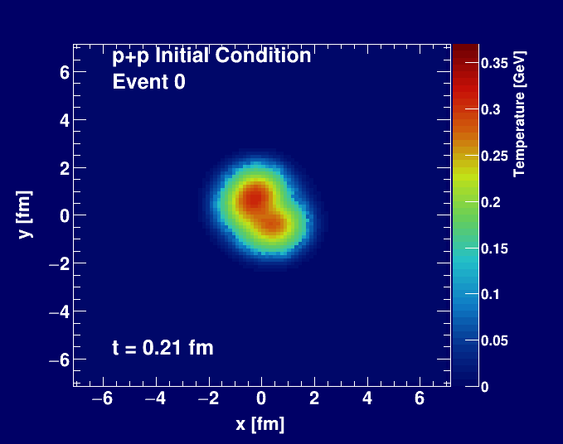
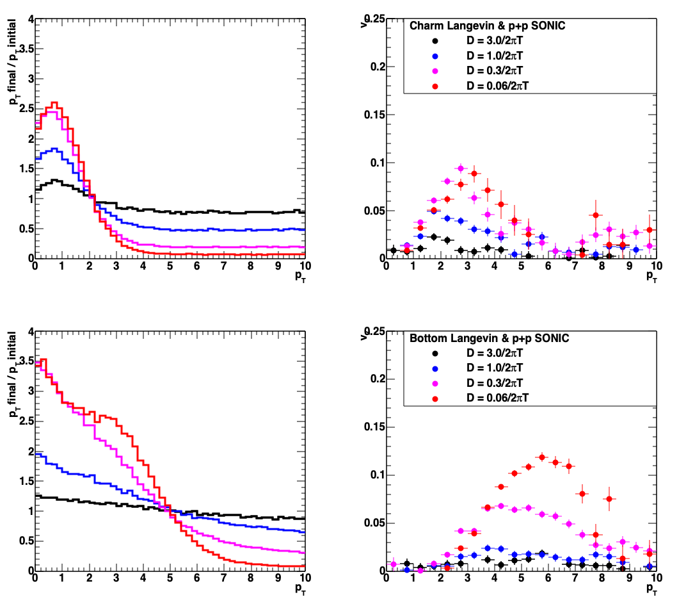
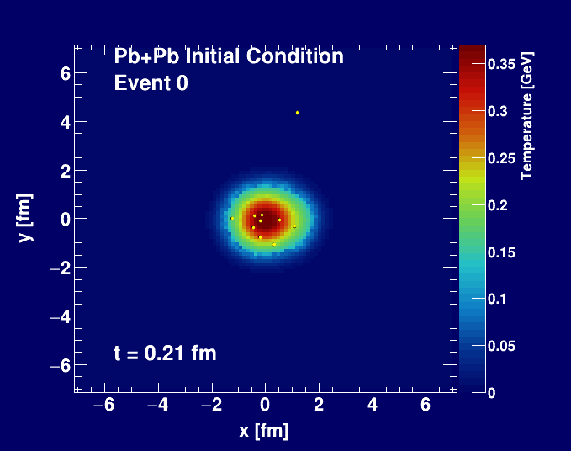
What about even in p+p?
p_{T} modification
elliptic flow v₂
Charm
Bottom
SONIC with proton (3 quark) geometry
Heavy Quark Langevin (Nagle)
Do the experiment!

Slide 16

Very hard for heavy quarks to swim upstream!

Slide 17
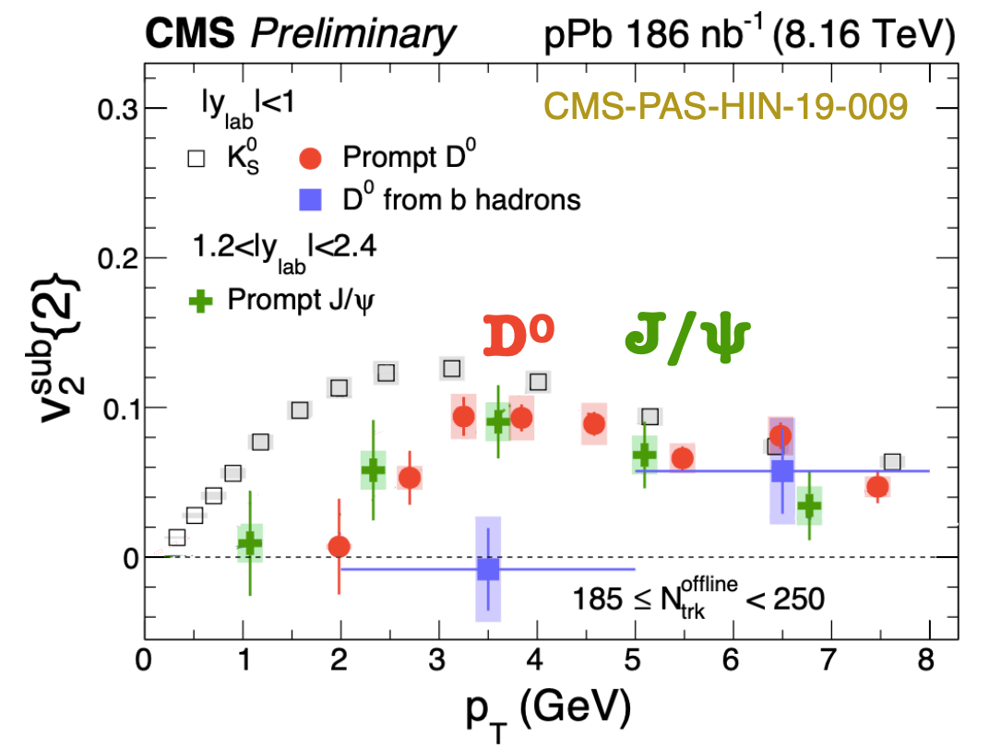
Charm Does Have Flow (!)

Slide 18
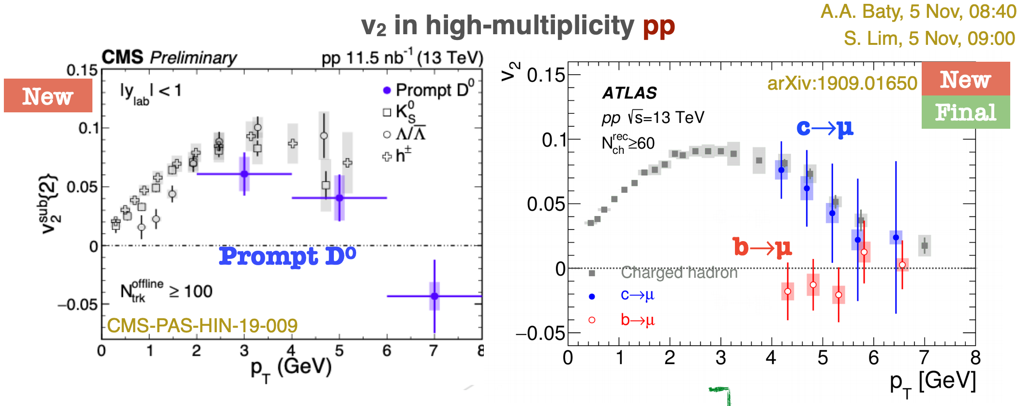
Charm Does Have Flow in p+p too (!)
Excellent overview from Jin Wang (MIT) at QM2019
https://indico.cern.ch/event/792436/contributions/3570559/attachments/1941842/3220059/1_20191108_HF_QM19_JingWang_v4.pdf

Slide 19
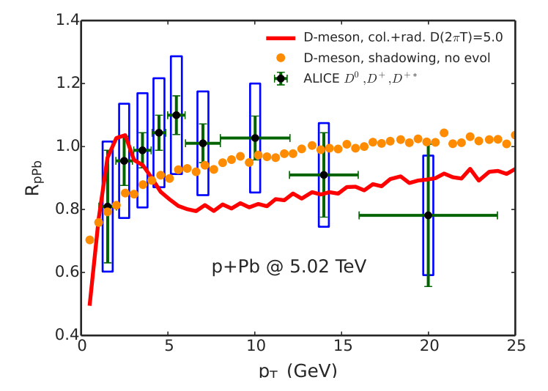
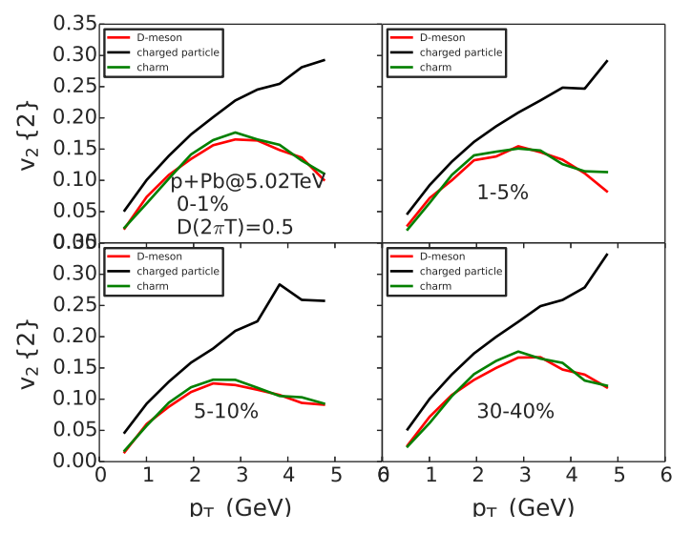
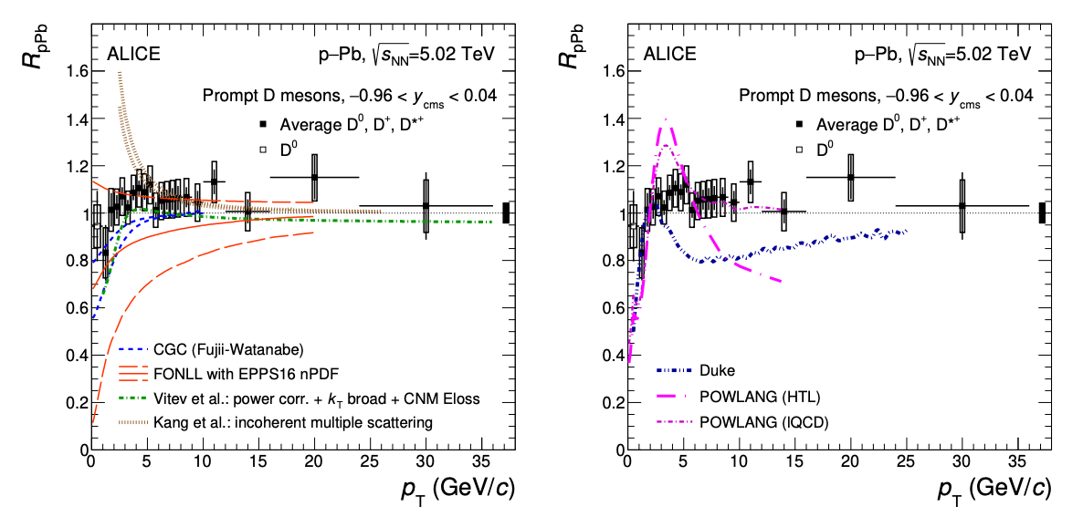
Heavy Flavor p+Pb Puzzle
Yingru et al. (Duke) https://arxiv.org/abs/1510.07520
10x Stronger Coupling
https://arxiv.org/abs/1906.03425

Slide 20
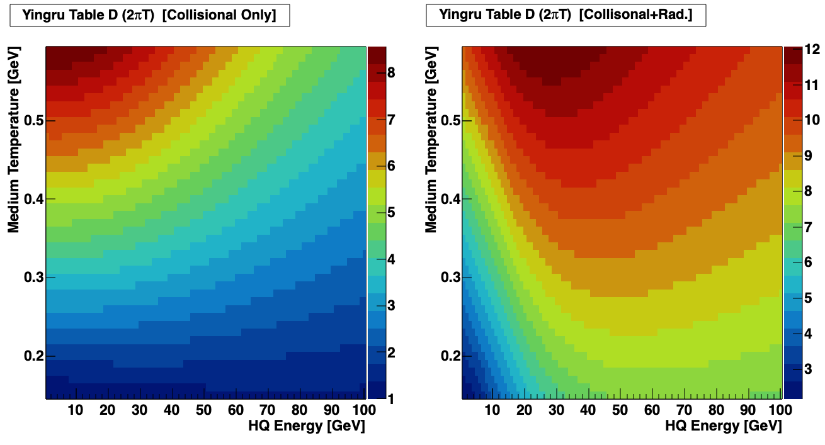
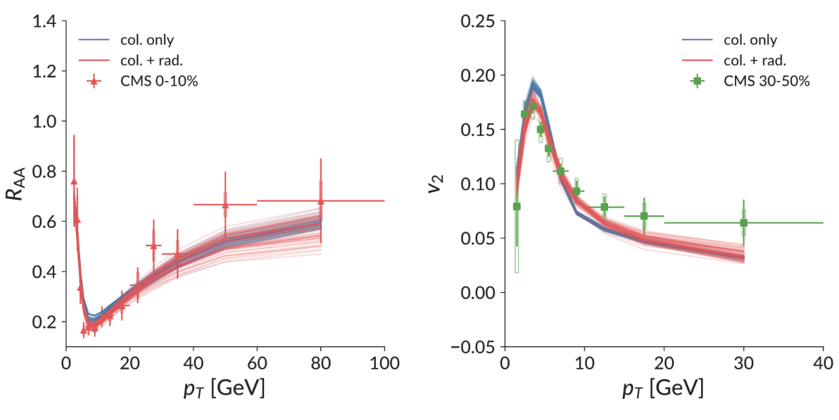
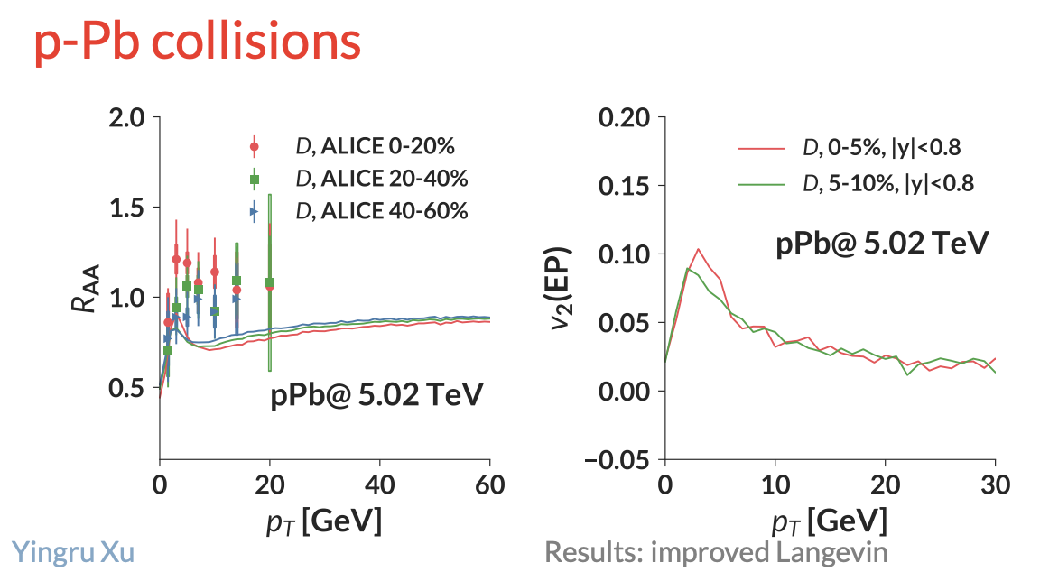
Attempts to Reconcile
https://www.bnl.gov/aum2018/content/workshops/Workshop_1f/XU_OpenJFTransport.pdf
Bayesian determination of heavy quark coupling D(p,T)
10x stronger coupling near T=0.15 GeV compared with T = 0.50 GeV
Improved agreement, but still tension in Pb+Pb and problems in p+Pb
Pb+Pb collisions

Slide 21
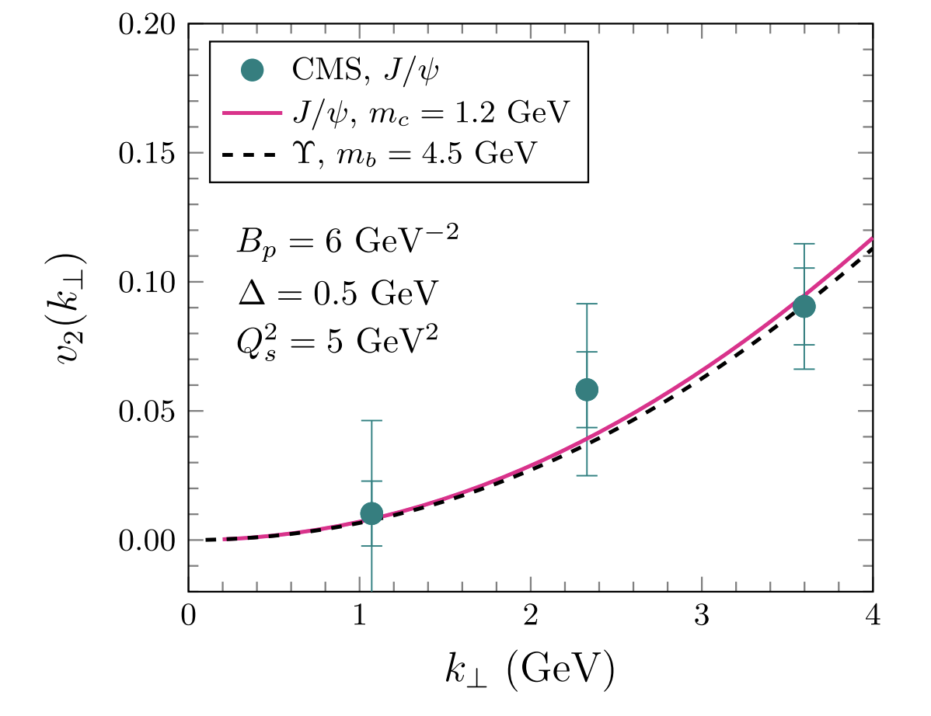
Heavy-Flavor Color Domain Effect?
Alternative Proposal: Color Domain Effect
Do not think v₂. Think v_{2,2} correlation between J/ψ and bulk low p_{T} hadrons.
IF bulk medium v₂ is hydro + geometry
and J/ψ v₂ is color domains…
IF geometry orientation and color domain orientations are uncorrelated…
THEN, v_{2,2} (J/ψ –h) is zero!
We cannot have both explanations.
Uncertainty drawn from
variation of Q_{s}² = 3 –7 GeV²

Slide 22
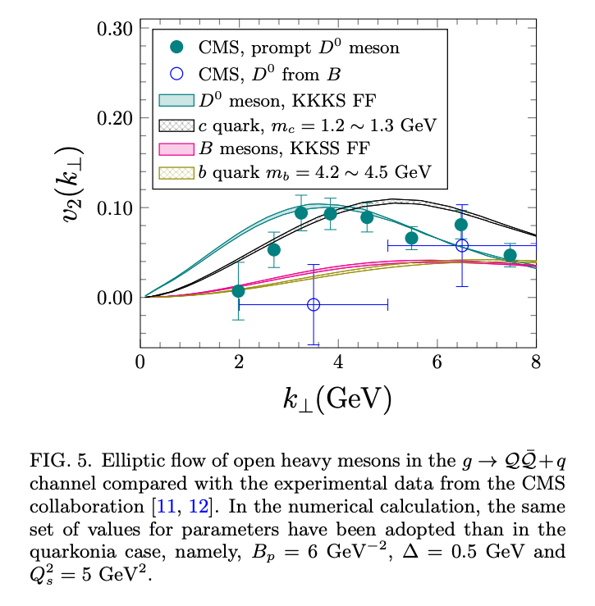
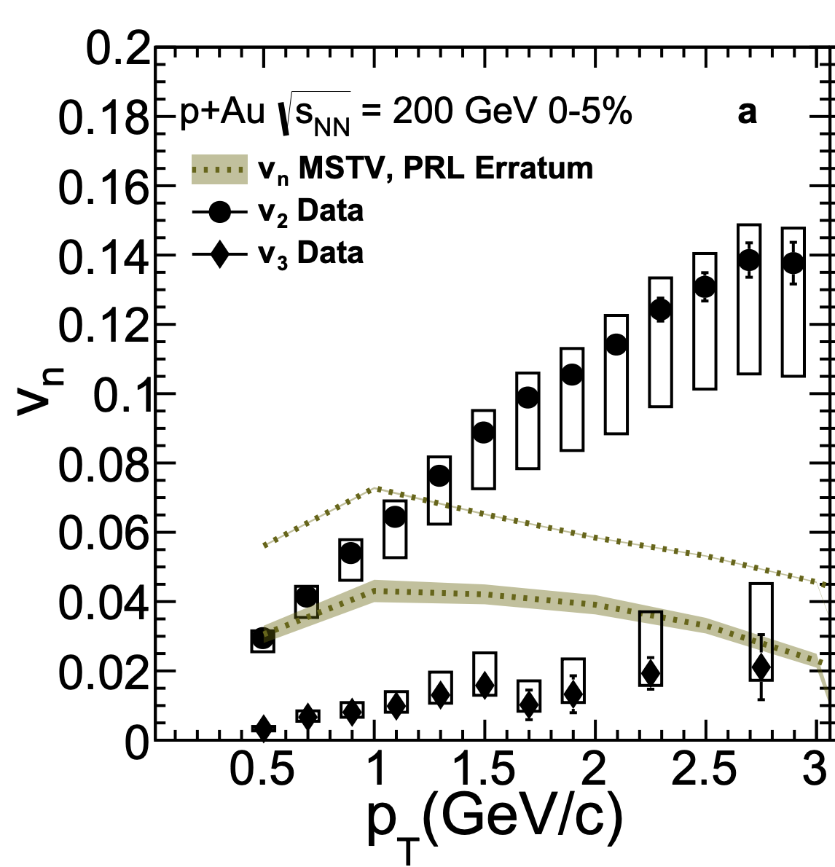

CGC
Alternative CGC Correlation
Needs to be reconciled.
Heavy flavor and light hadron correlations
Very large parameter space – mostly unconstrained
← These CGC calculations seem to contradict updated MSTV (↑) and IP-Glasma results for light hadrons

Slide 23
Summary
Heavy ion paradigm: flowing QGP + jet quenching
flowing QGP + heavy quark drag/diffusion
Some tension, but perhaps reconcilable
Small system paradigm: flowing mini-QGP
Natural consequence of very modest pT modification in p+Pb (and p+p) is there should be almost no v₂ for heavy quarks or high p_{T} hadrons
– but there is !
Alternatives currently not presenting a consistent picture either

Slide 24
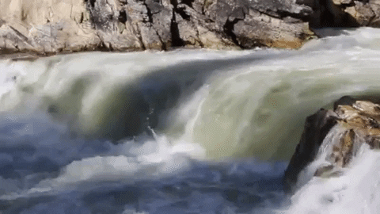
Questions?

Slide 25
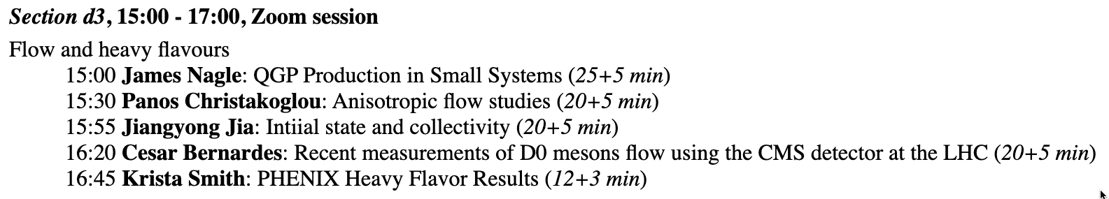

25+5 Zimanyi School Talk
http://zimanyischool.kfki.hu/20/agenda

