Slide 1
Recent results
on collectivity
in small systems
from ATLAS
James Nagle, University of Colorado Boulder
For the ATLAS Collaboration

Slide 2
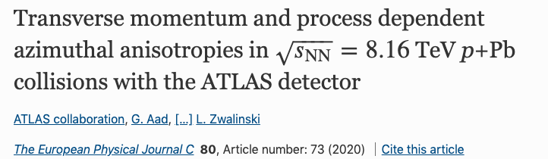
Wealth of ATLAS results on small systems.*
In these 15 minutes, focus on one recent measurement.
Kurt Hill Ph.D. Thesis: https://arxiv.org/abs/2004.07920
* https://twiki.cern.ch/twiki/bin/view/AtlasPublic/HeavyIonsPublicResults
HF muon+hadron correlations in 13 TeV pp, Phys.Rev.Lett. 124 (2020) 8, 082301
Z-tagged ridge in pp, Eur. Phys. J. C80 (2020) 1, 64
Photonuclear Ridge, ATLAS-CONF-2019-022
Azimuthal dijets in p+Pb, PRC 100 (2019) 034903
vn-pt correlations in 5.02 TeV Pb+Pb and p+Pb, Eur.Phys.J. C (2019) 12, 985

Slide 3
Key features of heavy-ion collisions
Hydrodynamic described “collectivity” of the bulk (p_{T} < 5-6 GeV)
Jet quenching, suppression of high p_{T} partons / jets / hadrons (p_{T} > 10-12 GeV)
Low p_{T} bulk particles are azimuthally correlated with
high p_{T} jet particles
steeper density gradients,
more bulk particles along x-axis
shorter path out of medium,
more jets along x-axis

Slide 4
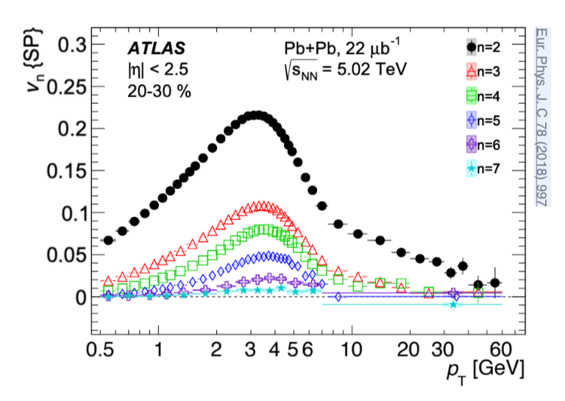
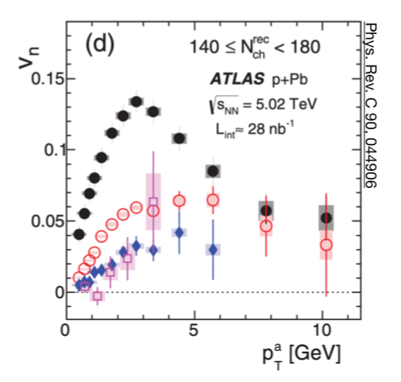
Azimuthal Correlations
Pb+Pb Collisions
p+Pb Collisions
Hydrodynamics
Transition
Jet Quenching
Jet Quenching?
Are low p_{T} (bulk) and high p_{T} particles azimuthally correlated in small systems, p+Pb?

Slide 5
ATLAS Analysis

Slide 6
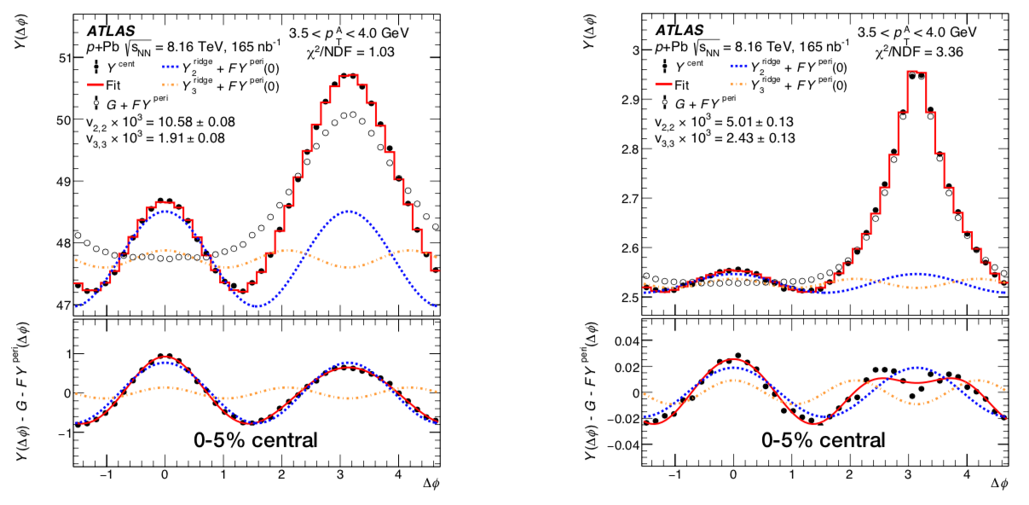
p+Pb Two-Particle Correlations
Minimum Bias Events
Events with Jet > 100 GeV
Jet events have much larger non-flow background.
(small signal/background)
Standard subtraction
of non-flow via
template method leads
to distortions.
SIGNAL
”Bulk” particles with “flow” modulation
Need to reduce background
BACKGROUND
“Jet” particles with “non-flow” modulation

Slide 7
Restricting Associated Particles in Events with 100 GeV Jets
To reduce the non-flow impact of jet correlations:
associated particle must be |Δη| > 2 from the trigger particle
associated particle must be |Δη| > 1 relative to all jets p_{T} > 15 GeV in the event

Slide 8
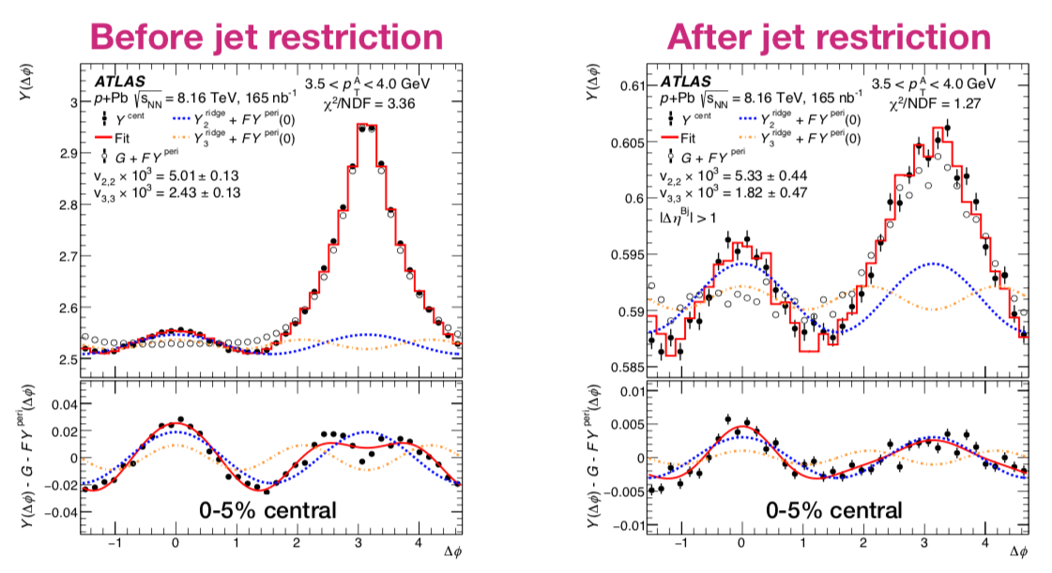
Jet rejection drastically improves ‘signal-to-background’
Reduces sensitivity to template method assumptions

Slide 9
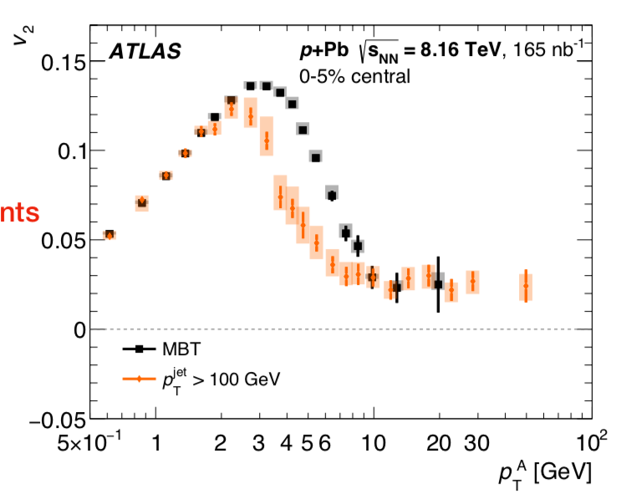
Physics Result
Low p_{T} “bulk” flow
High p_{T} flow / jet quenching?
What is really measured is azimuthal correlation of
low and high p_{T} particles.
Transition region, with differences in minimum bias and jet samples.
Systematic uncertainties shown as boxes with contributions from multiple sources.

Slide 10
p+Pb and Pb+Pb Comparison
Pb+Pb and
p+Pb (scaled x1.5) appear very similar
Common hydrodynamic explanation for
p_{T} < 4 GeV?
Common explanation for p_{T} > 10 GeV?

Slide 11
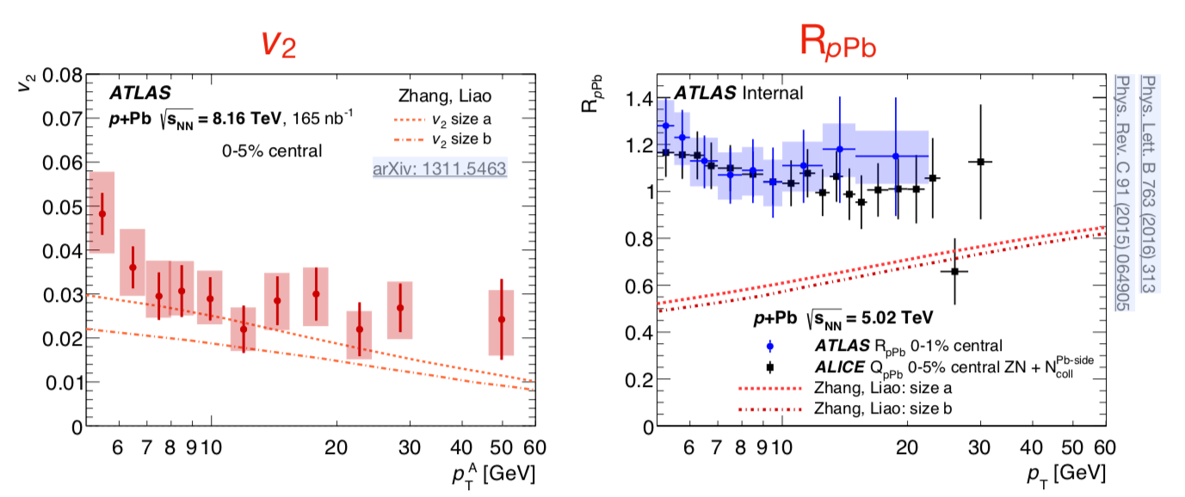
Jet Quenching Model for p+Pb
Cannot describe both azimuthal anisotropy and lack of change in p_{T} spectra

Slide 12
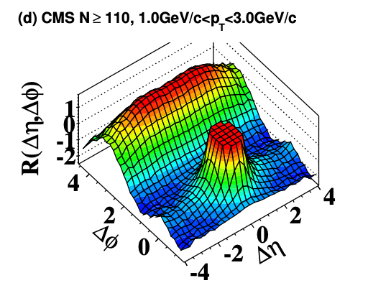
Initial State Effect Model?
A key check for the original pp “ridge” correlation observation by CMS was checking PYTHIA – CMS Collaboration JHEP 09 (2010) 091
Data
PYTHIA
Ridge
No Ridge

Slide 13
PYTHIA’s revenge?
PYTHIA initial-state radiation:
“SpaceShower::phiIntAsym”
implementing azimuthal asymmetries in the radiation pattern from colour coherence considerations.
This is without the
“string shoving” option!
https://doi.org/10.1016/j.physletb.2018.01.069
PYTHIA8 – no long-range ridge
PYTHIA8 – dijet events
However, effect is biggest in LOW multiplicity events and is
watered down in HIGH multiplicity events

Slide 14
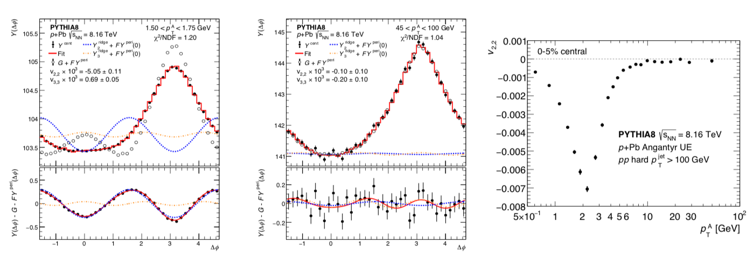
Quantitative PYTHIA Angantyr Prediction
How can the
Oracle of Delphi
be wrong?
Because correlation is stronger in low-multiplicity, template subtraction yields negative correlation in high-multiplicity events. Opposite sign and trend from experimental data. Problem with any explanation involved n << N_{total} particles.

Slide 15
Summary
New ATLAS result in p+Pb
Definitive correlation of high and low p_{T} particles, where low p_{T} particle azimuthal anisotropy explained via hydrodynamics
Fundamental conflicts with jet quenching and initial-state explanations.
Good puzzle ready to be solved.

Slide 16
Extra
Talk Logistics:
The talk is 15 + 3
The talk is in a parallel sessions with 4 talks all with the same title for theory, ALICE, CMS, and then ATLAS (this talk).
https://indico.cern.ch/event/856696/sessions/330883/#20200528

