Slide 1
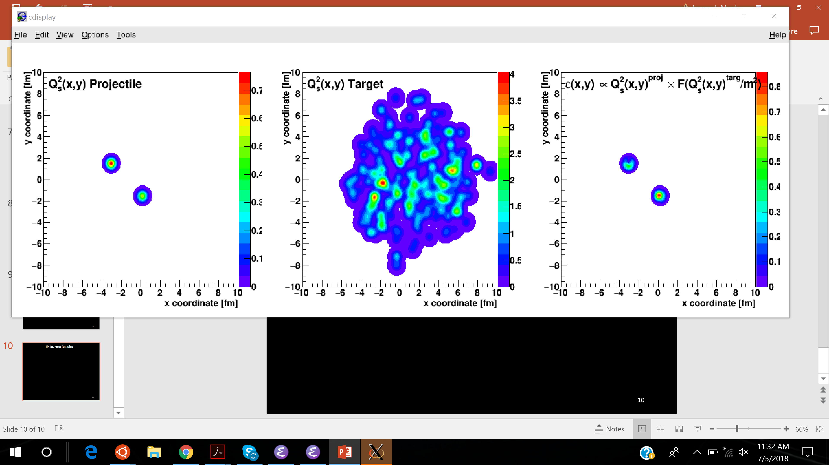
Lessons from IP-Jazma
Jamie Nagle
University of Colorado Boulder
Work carried out with W.A. Zajc (Jazma) and Sanghoon Lim (Glasma)
https://arxiv.org/abs/1808.01276
https://github.com/jamienagle/IPJazma

Slide 2
What is IP-Jazma?
IP-Glasma (dense-dense), MSTV (dilute-dense) calculations have many ingredients (A+B+C+D)
some very phenomenological (A+B+C)
some weakly-coupled effective field theory (D)
How to determine which ingredients are dominant for which observables?
That is the goal of the IP-Jazma framework (A+B+C).
The goal is not to match data, but to understand theory.
IP-Jazma is publicly available (https://github.com/jamienagle/IPJazma)
IP-Jazma results shown have zero free parameters, in the sense that we match exactly the A+B+C parameters from IP-Glasma or MSTV when making comparisons.

Slide 3
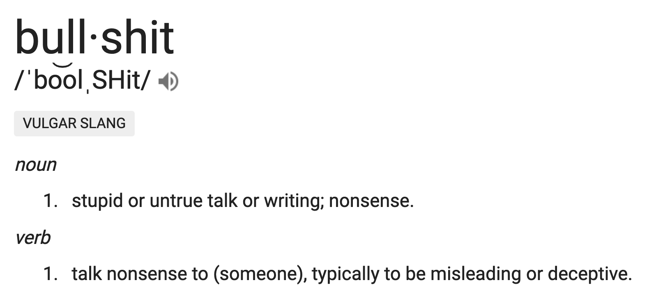
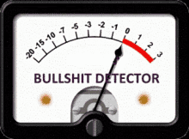
What is IP-Jazma?
Maybe IP-Jazma is a bullshit model with no physics
OR
Maybe IP-Jazma is a bullshit meter used to test other models
* Check out the Bullshit Asymmetry Principle for guidance.

Slide 4
IP-Jazma
1. MC Glauber to obtain nucleon x,y positions in each event
Use IP-Sat (impact parameter saturation model) to calculate the Q_{s}² distribution on an x,y lattice
Just a uniform Gaussian with σ = 0.32 fm at RHIC and narrower (0.29) at the LHC
3. Simple linear sum Q_{s}² (projectile) and Q_{s}² (target)
4. Then calculate the resulting energy density in the interaction
Q_{s}² (x,y) = Q_{s,0}² x Exp(-r_{T}²/(2σ²))
T_{A}(x,y) = Σ Q_{s}²(x,y) [proj] and T_{B}(x,y) = Σ Q_{s}² (x,y) [targ]
ε $∝$ g² T_{A}(x,y) x T_{B}(x,y) (when in the dense-dense limit)

Slide 5
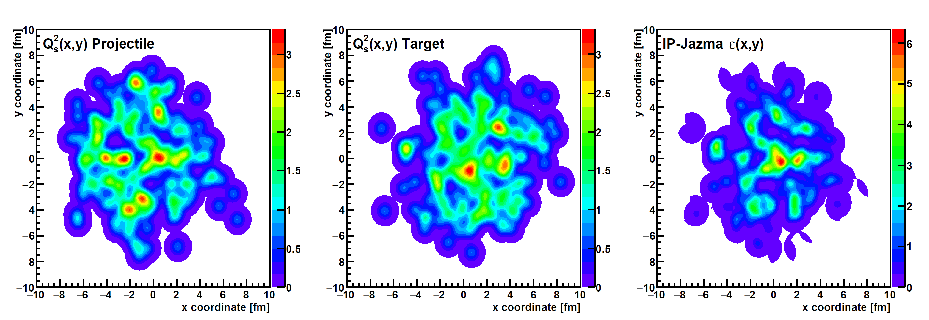
IP-Jazma A+A Result
T_{A}(x,y) = Σ Q_{s}²(x,y) [proj] T_{B}(x,y) = Σ Q_{s}² (x,y) [targ] ε $∝$ g² T_{A}(x,y) x T_{B}(x,y)

Slide 6
Start with IP-Glasma as a positive case…
Recently Bjoern Schenke has made a github version of IP-Glasma available to us - thanks!!!
Reading the code leads to clarity on important issues, and also more meaningful comparisons.
example (1) – finding important details: Glauber d_{min} value (const double d_min = 0.9)
example (2) – regulator –wrong in equation in many papers but right in the code
example (3) – output of Glauber nucleon positions as input for IP-Jazma
permits true apples-to-apples comparison

Slide 7
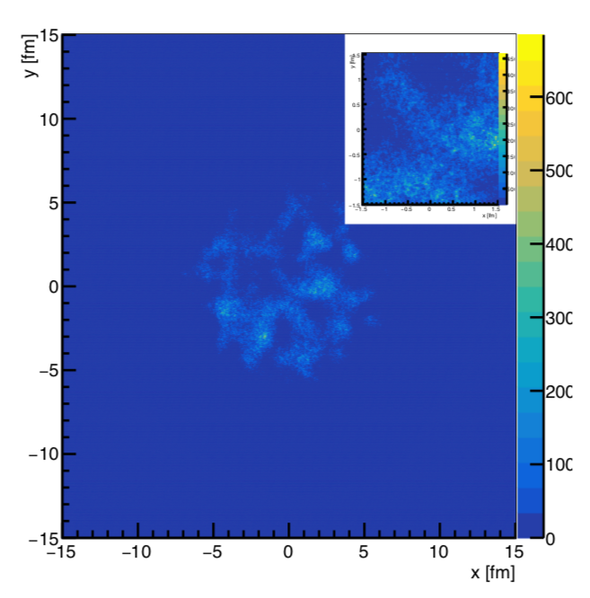
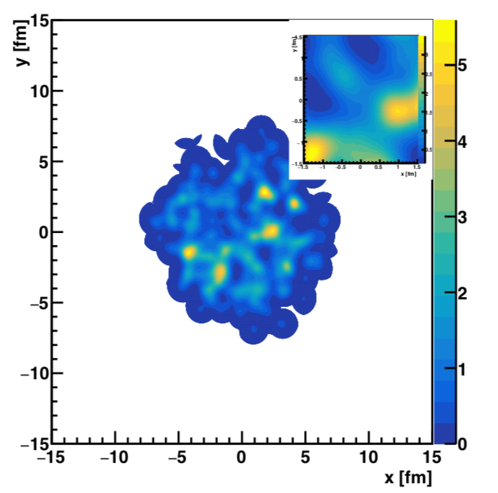
Identical MC Glauber Nucleon Event
IP-Glasma AuAu b=0 Energy Density
IP-Jazma AuAu b=0 Energy Density
What observables are sensitive to what physics?

Slide 8
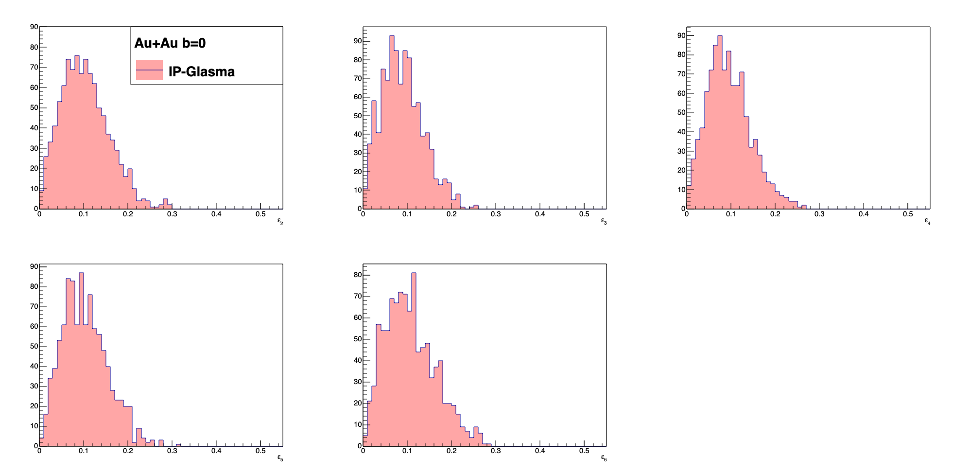
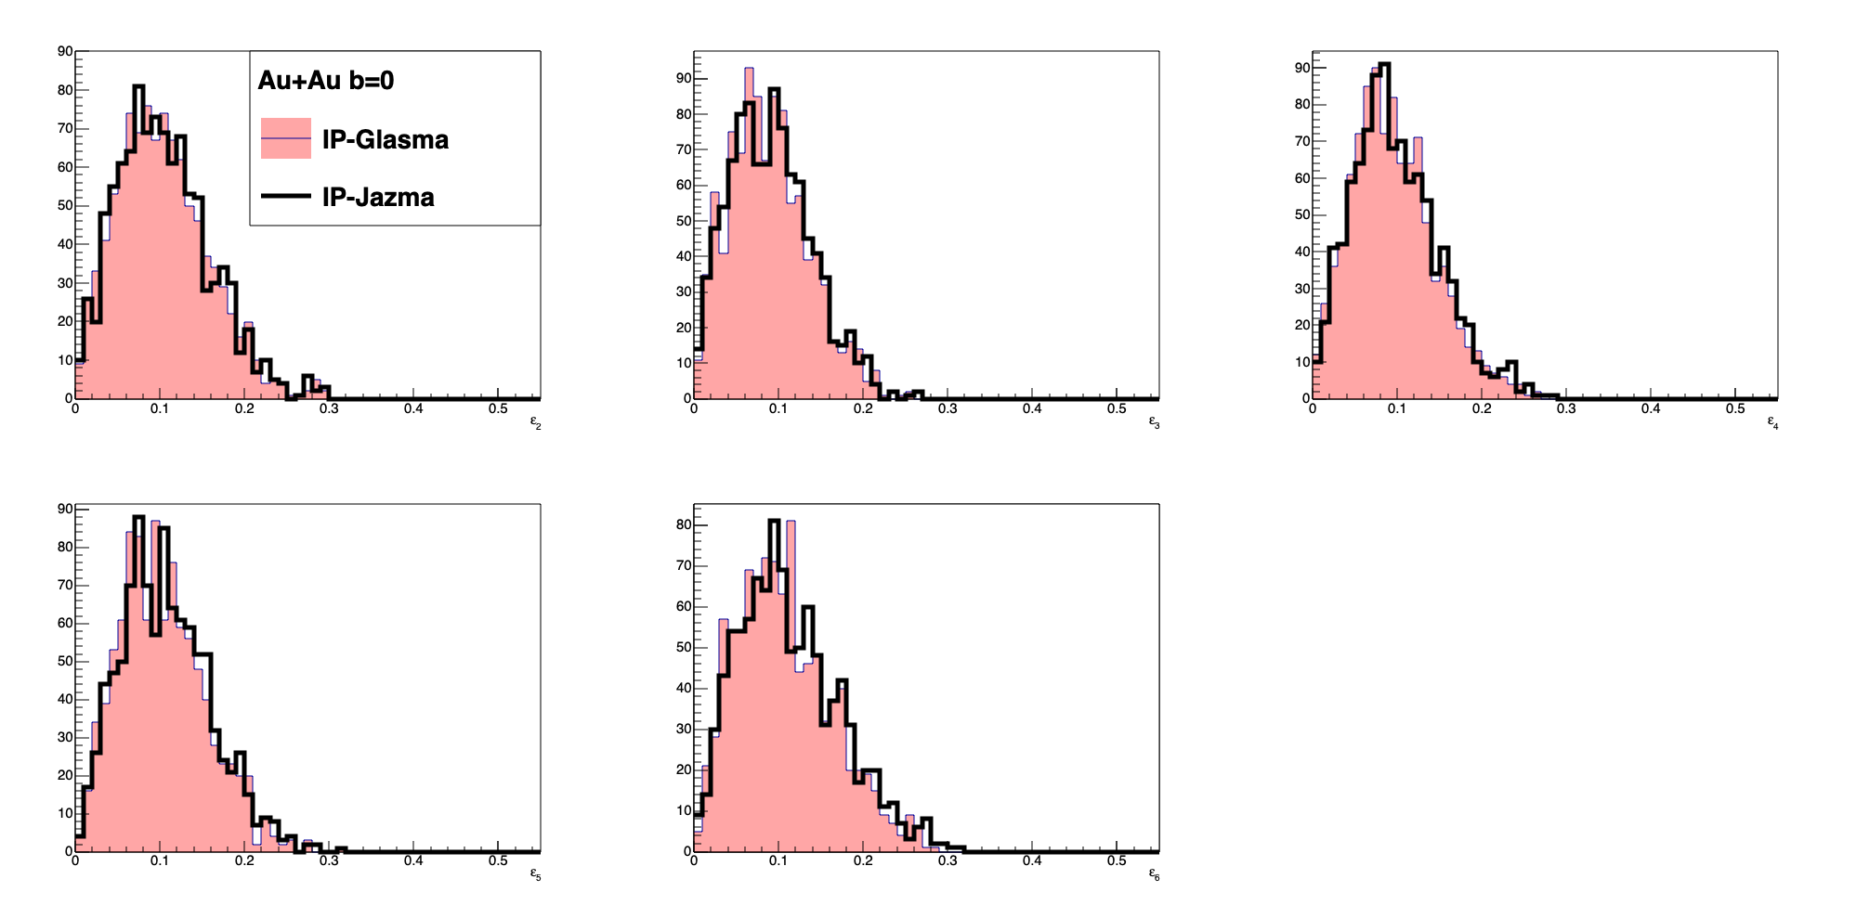
Apples to Apples Comparison at τ=0.000015 fm/c
ε₂
ε₃
ε₄
ε₅
ε₆
Example numbers – ε₂ mean (IPG 0.104, IPJ 0.105), rms (IPG 0.054, IPJ 0.054), kurtosis (IPG 0.27, IPJ 0.30)
ε₃ mean (IPG 0.089, IPJ 0.091), rms (IPG 0.047, IPJ 0.047), kurtosis (IPG -0.023, IPJ -0.030)

Slide 9
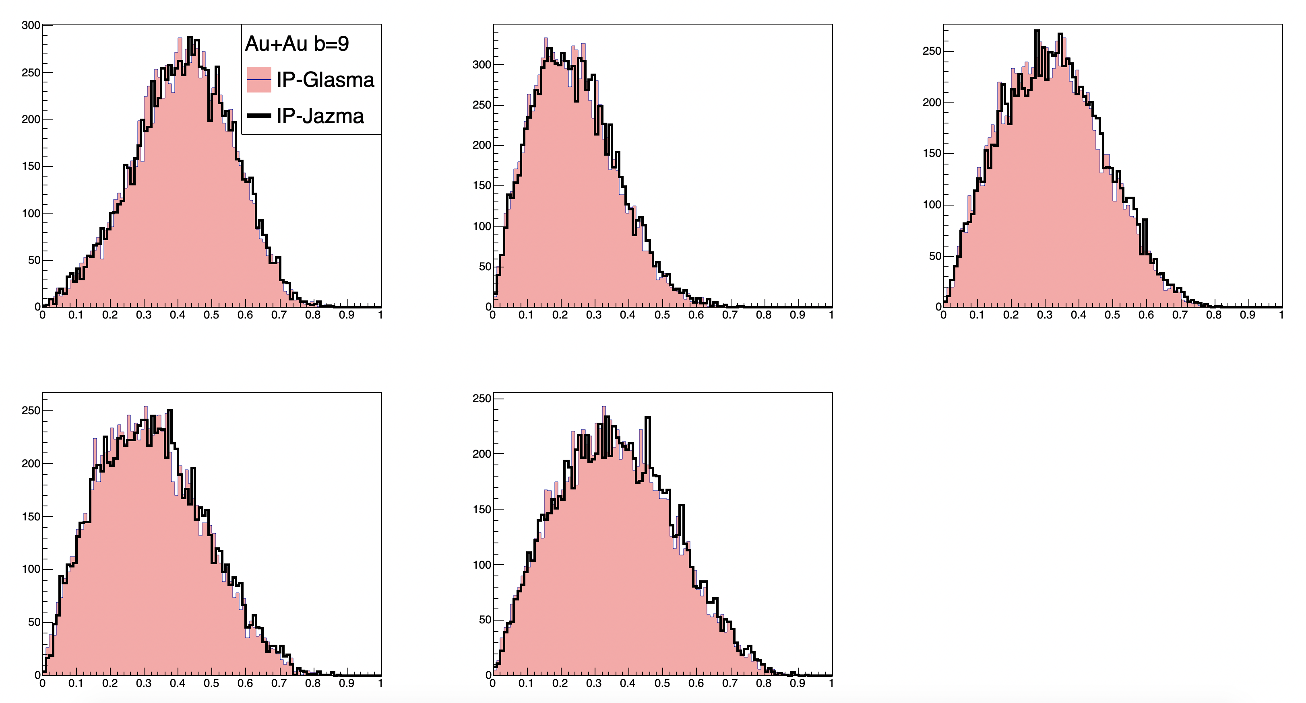
Apples to Apples Comparison at τ=0.000015 fm/c
ε₂
ε₃
ε₄
ε₅
ε₆
Key point – at this Au+Au larger impact parameter, (b=9 fm), the higher moment eccentricities have a sensitivity to the extent of the IP-Sat Gaussians (i.e. r_{max} = 3 σ or 10 fm) and a lowest energy cutoff.

Slide 10
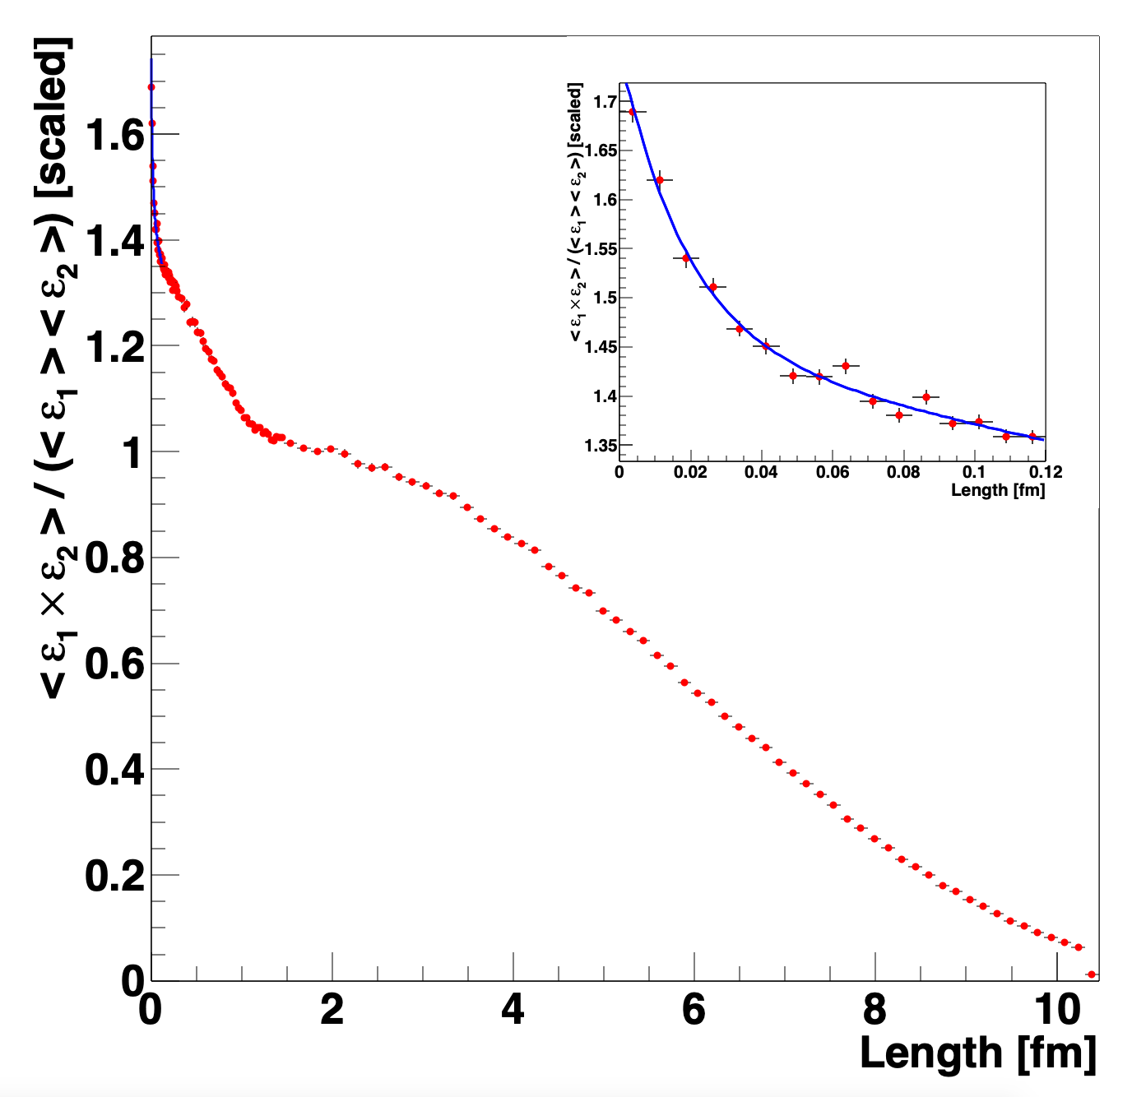

No impact on IP-Glasma +hydro results, but are there:
color domains? (length scale $∼$1/Q_{s})
lattice artifacts? (length scale $∼$ 1-2 a)
Two-point Energy-Energy Correlator reveals three clear length scales:
Nucleus
Nucleon
Lattice Artifact (exp. slope $≈$ 2a)
Now substantiated.
Lattice Artifacts
exp. slope = 1.8 ± 0.1 a
Nucleon
Nucleus
Au+Au b=0
IP-Glasma

Slide 11
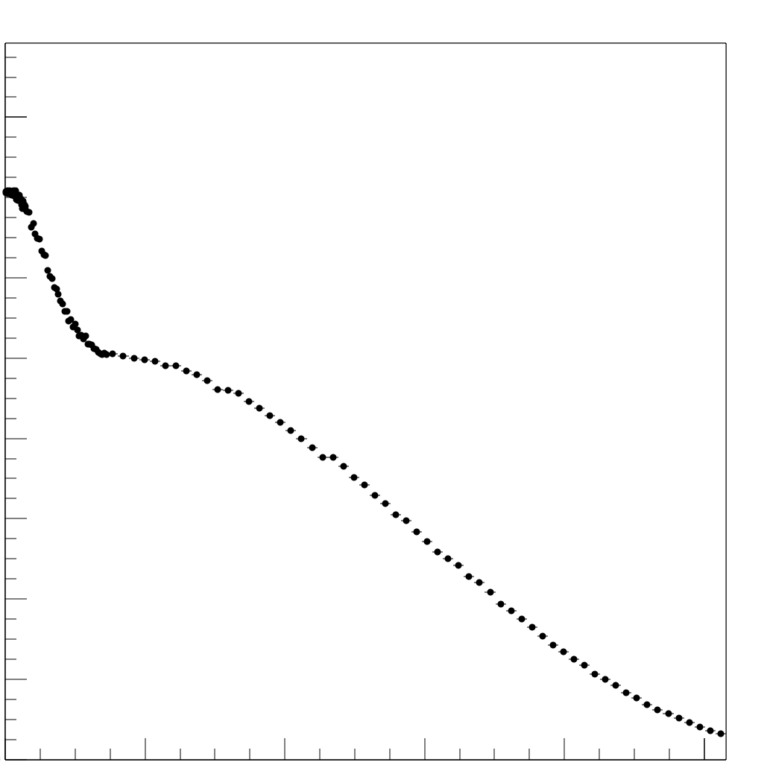
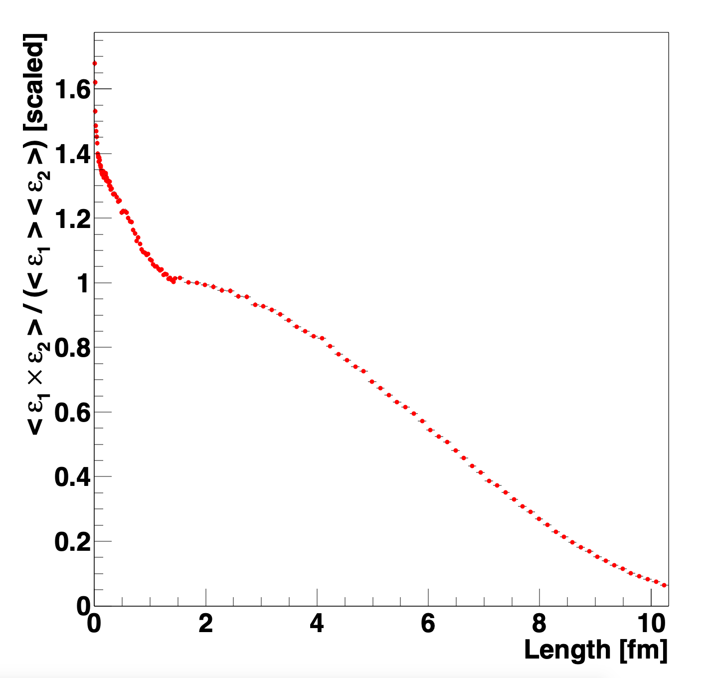

No impact on IP-Glasma +hydro results, but are there:
color domains (length scale $∼$1/Q_{s})
lattice artifacts (length scale $∼$ 1-2 a)
Two-point Energy-Energy Correlator reveals three clear length scales:
Nucleus
Nucleon
Lattice Artifacts (exp slope $≈$ 2a)
Now substantiated.
Lattice Artifacts
Nucleon
Nucleus
Au+Au b=0
IP-Glasma
IP-Jazma
IP-Jazma very similar, except artifacts
IP-Glasma - no strong evidence for domain contributions.
Challenge to the proponents!

Slide 12
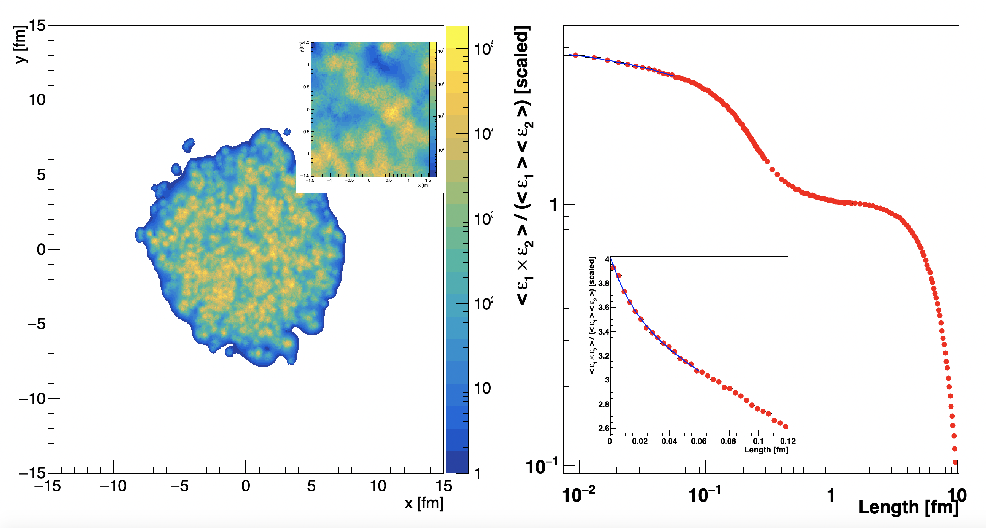
If we do not see domains in IP-Glasma, can we see other sub-nucleon structure?
IP-Glasma run in 3 constituent quark substructure mode.
Lattice Artifacts (exp slope = 0.02 fm)
Constituent Quark
Nucleon
Nucleus

Slide 13
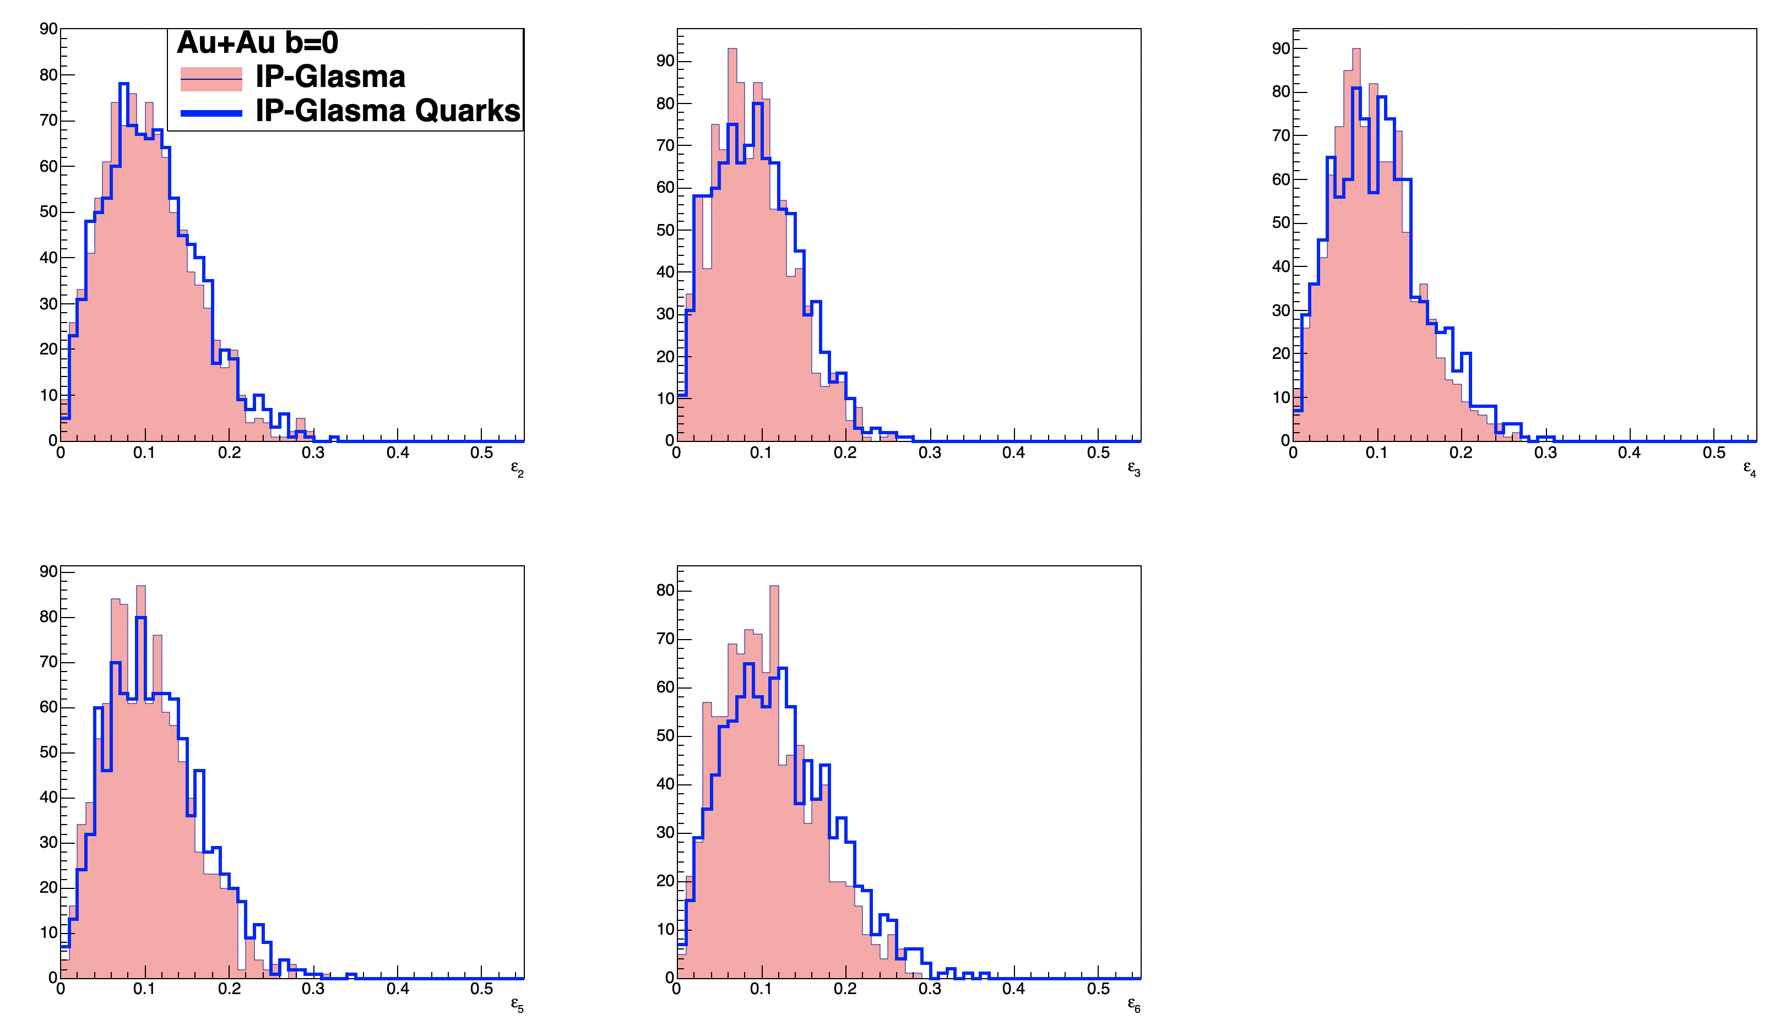
Eccentricities (at higher order) very mildly sensitive to sub-nucleon length scales
ε₂
ε₃
ε₄
ε₅
ε₆

Slide 14
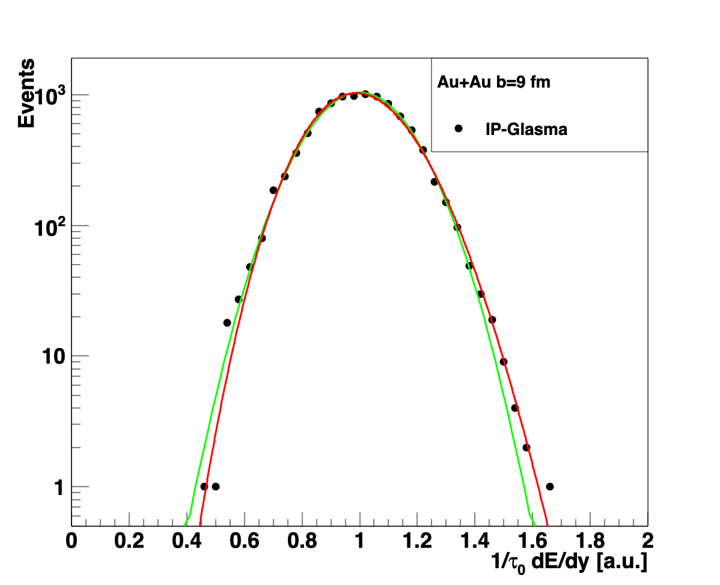
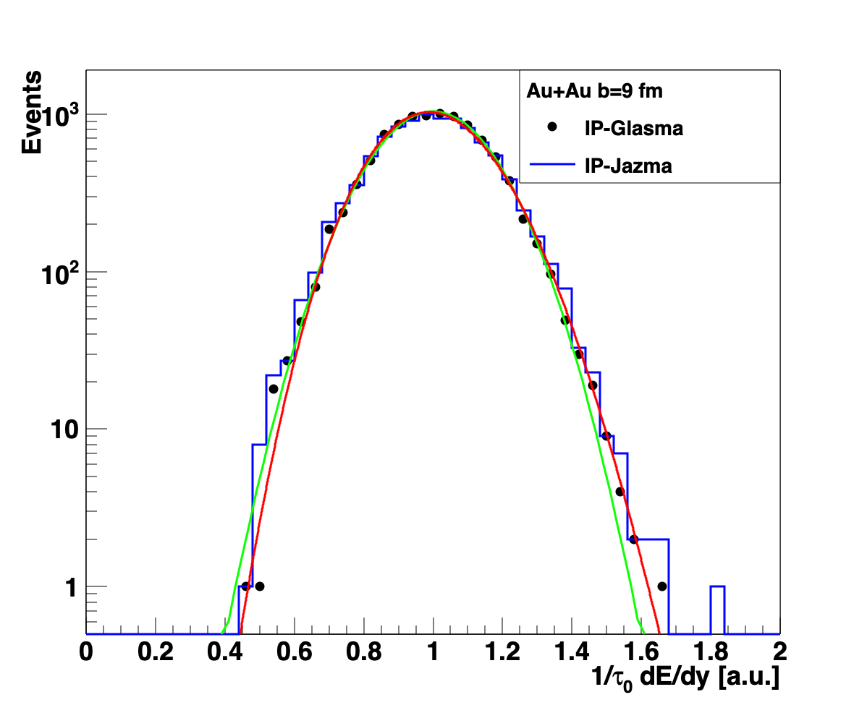
Glittering Glasma – ab initio result for Negative Binomial Fluctuations
“The best fit is given by a NBD distribution, as predicted in the Glasma flux tube framework [37]; our results adds further confirmation to a previous non-perturbative study [38]”
IP-Glasma [https://arxiv.org/abs/1202.6646v2]
Really must be a Gamma (Γ) distribution…
Test this confirmation by using identical
Au+Au b = 9 fm MC Glauber events run through
IP-Jazma.
No evidence for “Glittering Glasma”
Gaussian
Gamma
Gaussian
* Note this is a purely geometric effect. No Q_{s}² fluctuations are in either calculation here.

Slide 15
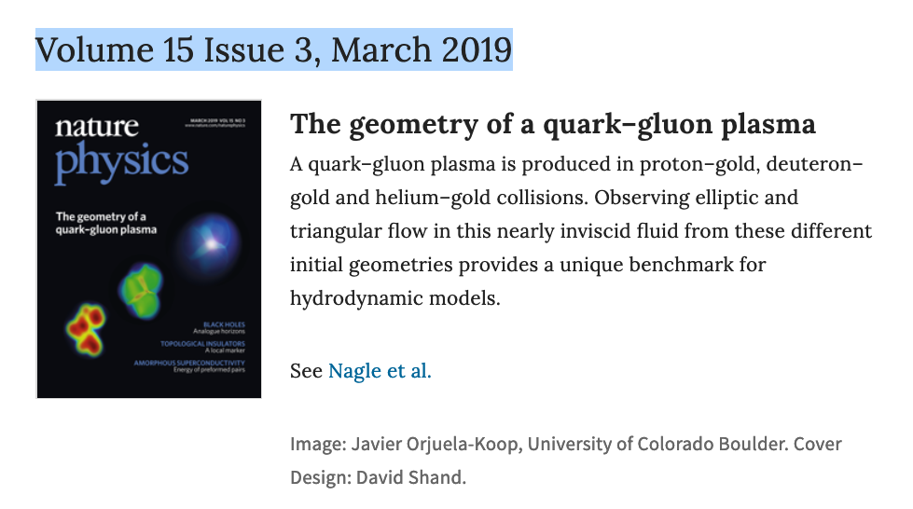
Small Systems

Slide 16
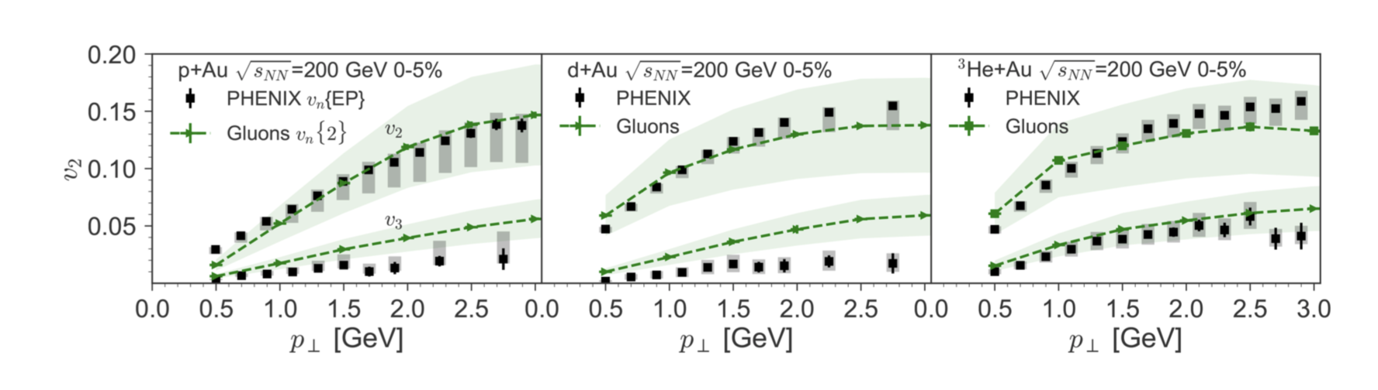
MSTV Postdictions
[MSTV2] https://arxiv.org/abs/1901.10506 (addition of uncertainty bands)
[MSTV] https://arxiv.org/abs/1805.09342 (original postdiction)
Dilute-Dense framework and some additional ingredients (A+B+C+D)
Is it really true that we have no way to discriminate scenarios of
(i) geometry + final state interactions and (ii) all initial state interactions?

Slide 17
Fluctuations put in by hand
Q_{s} Fluctuations
MSTV includes nucleon-by-nucleon fluctuations in Q_{s,0} ² (the amplitude of the IP-Sat Gaussian). Thus, each nucleon is still a perfect Gaussian, just different amplitudes.
Implemented with RMS of 0.5 on log(Q_{s}²) – i.e. high side tail.
Non-perturbative on many scales
Not part of the standard CGC framework
Ad hoc not ab initio
IP-Jazma code: bool qsfluc = true

Slide 18
Dilute-Dense Framework
The dilute-dense limit implies that Q_{s}(proj) < k_{T} < Q_{s}(targ) and one obtains on average:
where m is the infrared cutoff (= 0.3 GeV in MSTV).
N_{gluon} $∝$ g² Q_{s}²(proj) x F( Q_{s}(targ)/ m ) (dilute-dense limit)
F( Q_{s}(targ)/ m )
Once you hit a thick enough part of the target,
you free all the projectile gluons and no more.
IP-Jazma code: bool dilutedense= true

Slide 19
IP-Jazma d+A Results
At this point, none of these fluctuations are ab initio.
All MC Glauber and “put-in-by-hand” Q_{s,0} ² fluctuations (as per MSTV).

Slide 20
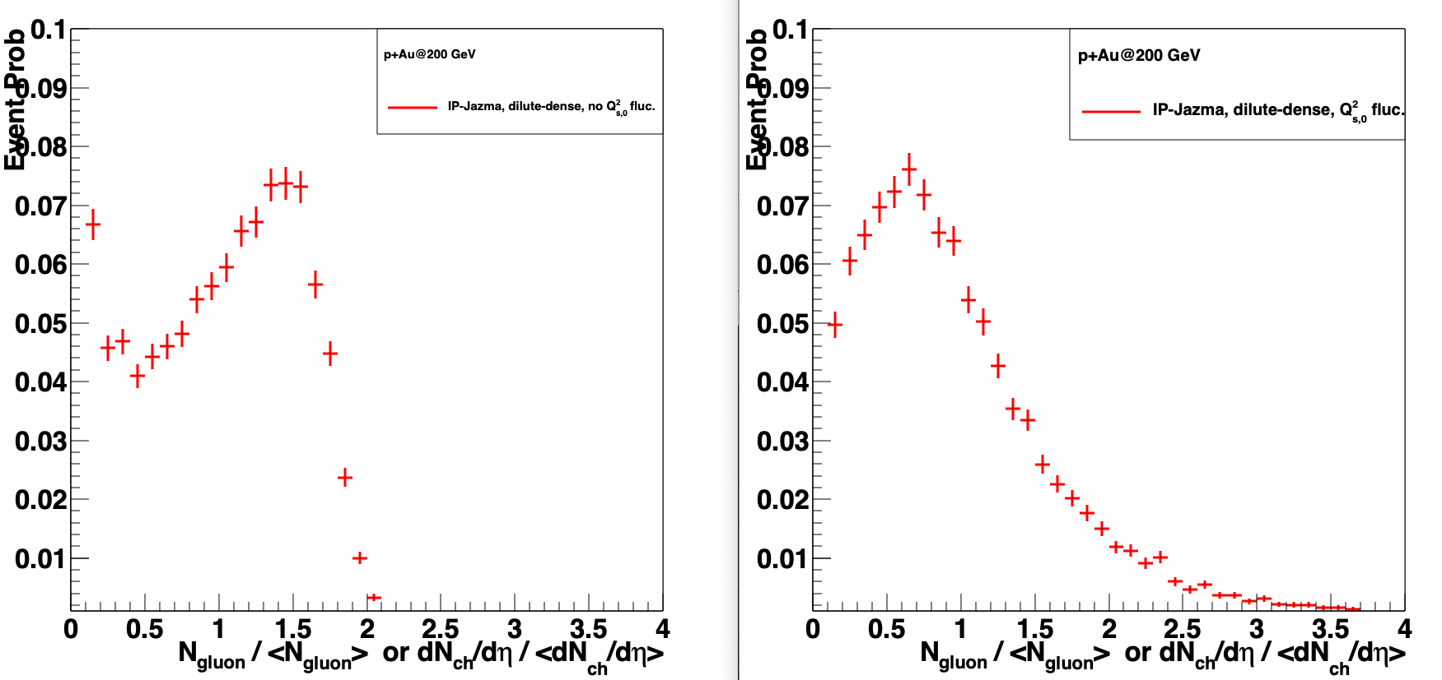
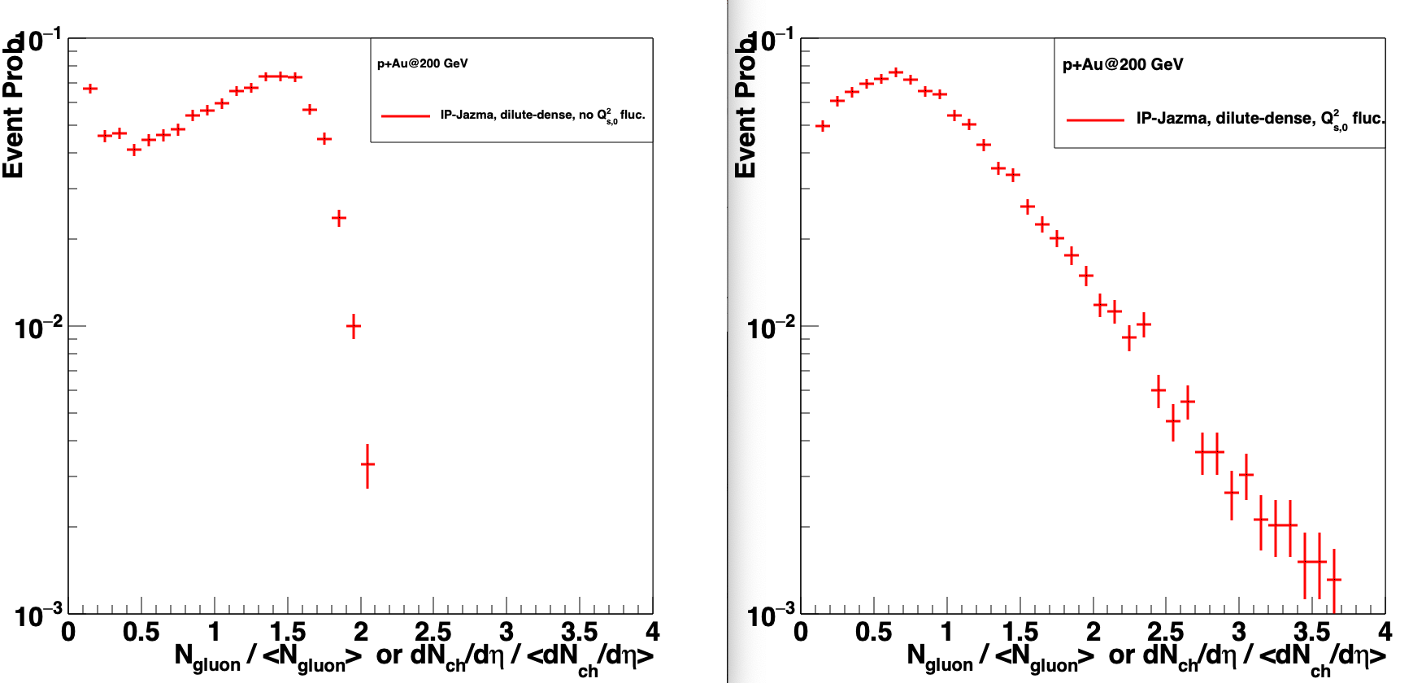
Example of “Put-in-by-Hand” Fluctuations
IP-Jazma p+Au
No Q_{s}² Fluctuations
IP-Jazma p+Au
Yes Q_{s}² Fluctuations

Slide 21
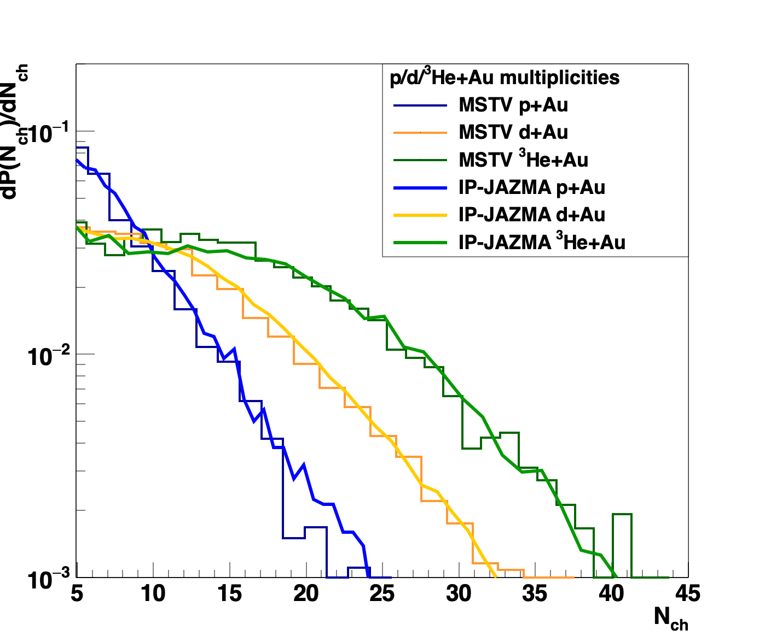
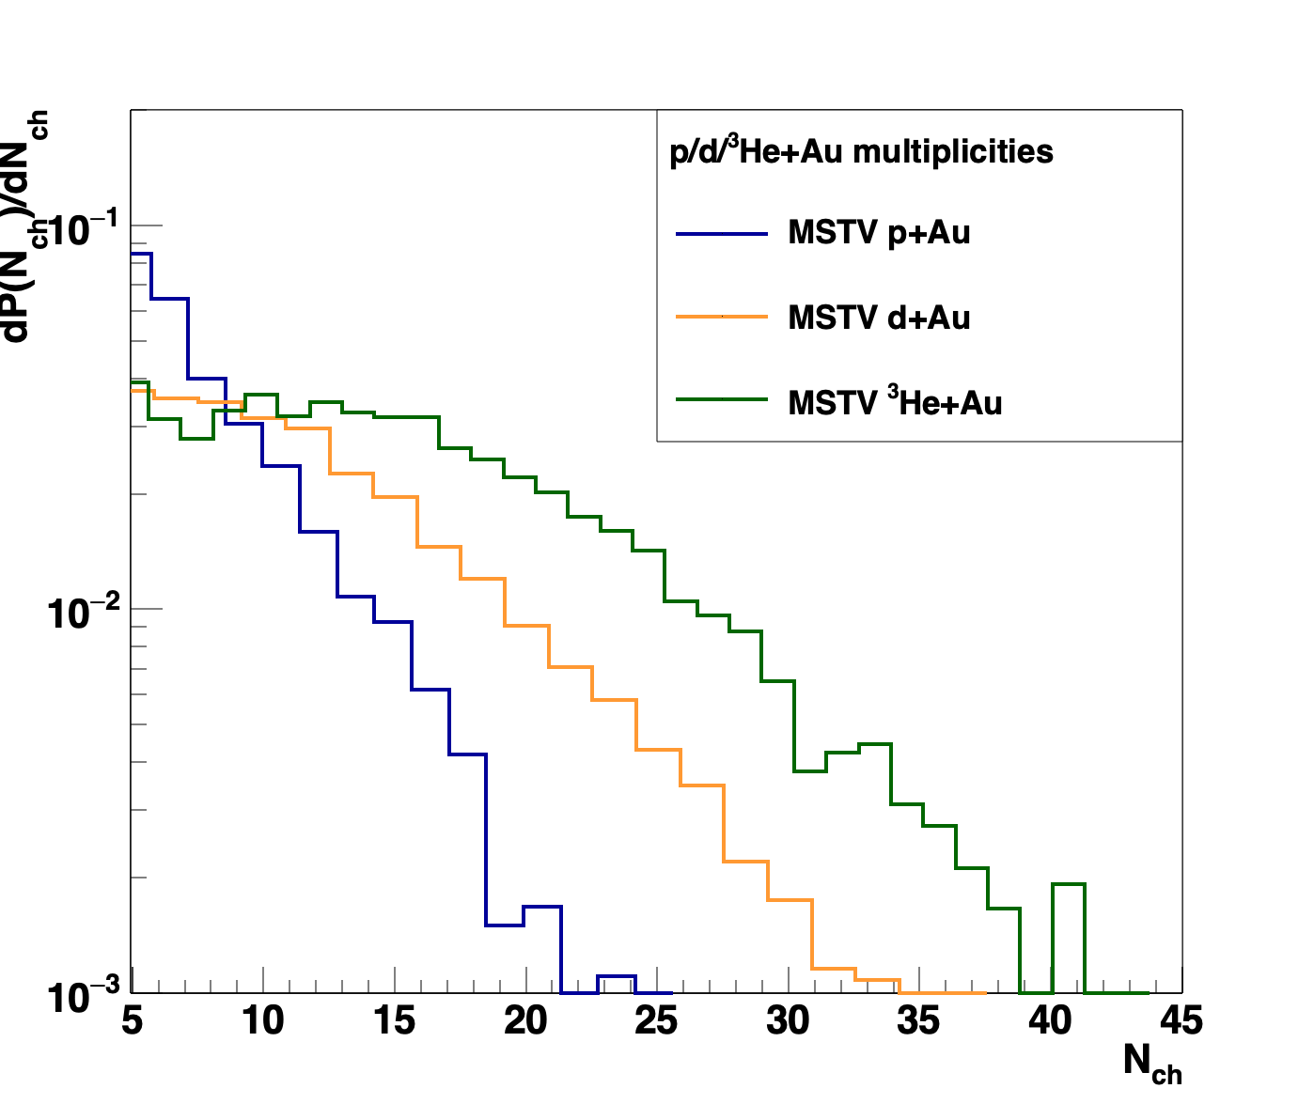
Multiplicity Distributions
“[The figure] shows strikingly that all three systems satisfy Koba-Nielsen-Olesen (KNO scaling).”
Glittering Glasma – ab initio result for Negative Binomial Fluctuations
Counter Proof: Everything here is just
MC Glauber fluctuations and the Q_{s}² fluctuations put in by hand, that are fit to data.
Small differences might be in MSTV
MC Glauber, which could be resolved with
publicly available code.
Other sources of fluctuations are
completely subdominant.
BTW – at RHIC how can you have such Q_{s}² fluctuations in the proton in p+A but not in p+p? See MSTV2.

Slide 22
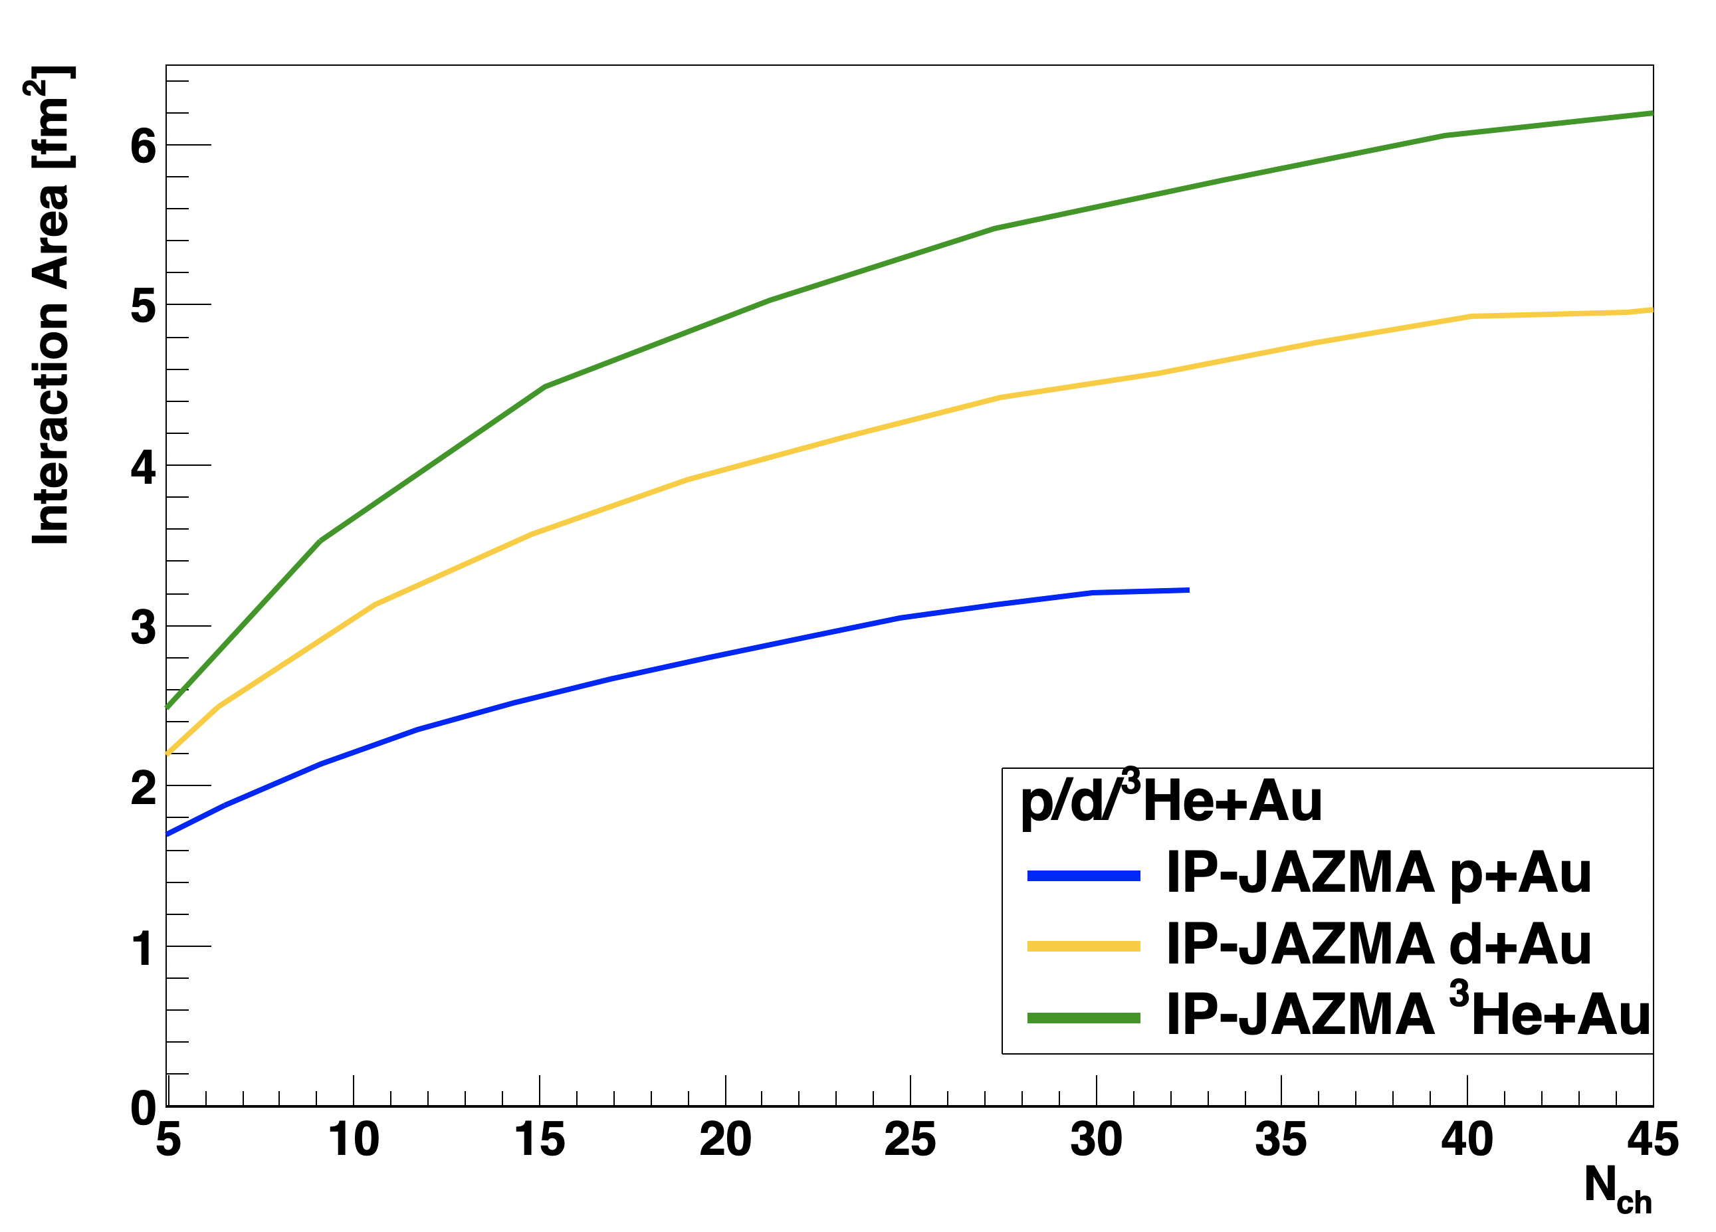
In dilute-dense limit, the color charge density is linearly proportional to the
charged particle multiplicity.
Higher d+Au v₂ is because higher mult d+Au 0-5% has larger color charge density than p+Au 0-5%. [MSTV]
Al Mueller took less than 5 seconds to say this cannot be correct for the deuteron,
the overlap area is just larger.
Yes, he is correct.

Slide 23
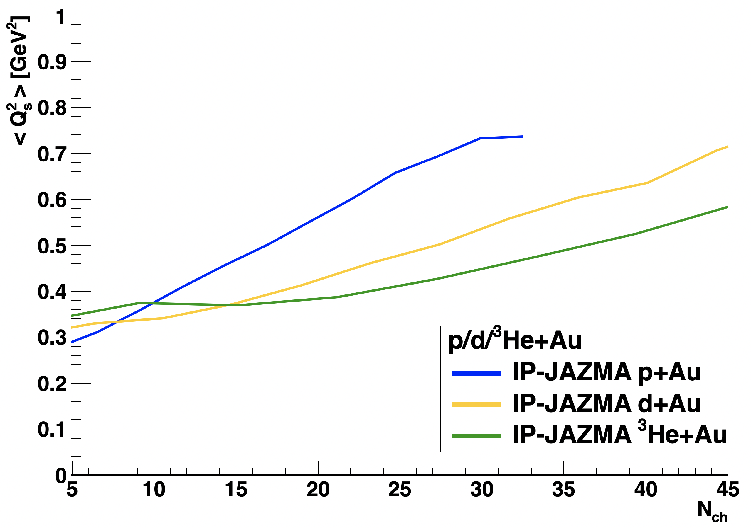
< Q²_{s} >
Yes, for a single system (e.g. p+Au), the
<Q_{s}²> is proportional to N_{ch}.
However, this is not true between systems
(and never is).
We quote the following average values in
the IP-Jazma paper.
These numbers have not been refuted with MSTV alternative numbers.
Area
IP-Jazma shows this is definitely not true.
<Q_{s}²> [GeV²] Area [fm²]
d+Au 0-5% 0.53 4.5
p+Au 0-5% 0.56 2.8

Slide 24
MSTV scaling of N_{ch} with Q_{s}²(proj) leads them to predict “that v_{2,3}(p_{T}) for high multiplicity events across
small systems should be identical for the same N_{ch}.”
Hydrodynamics matches
the splitting

Slide 25
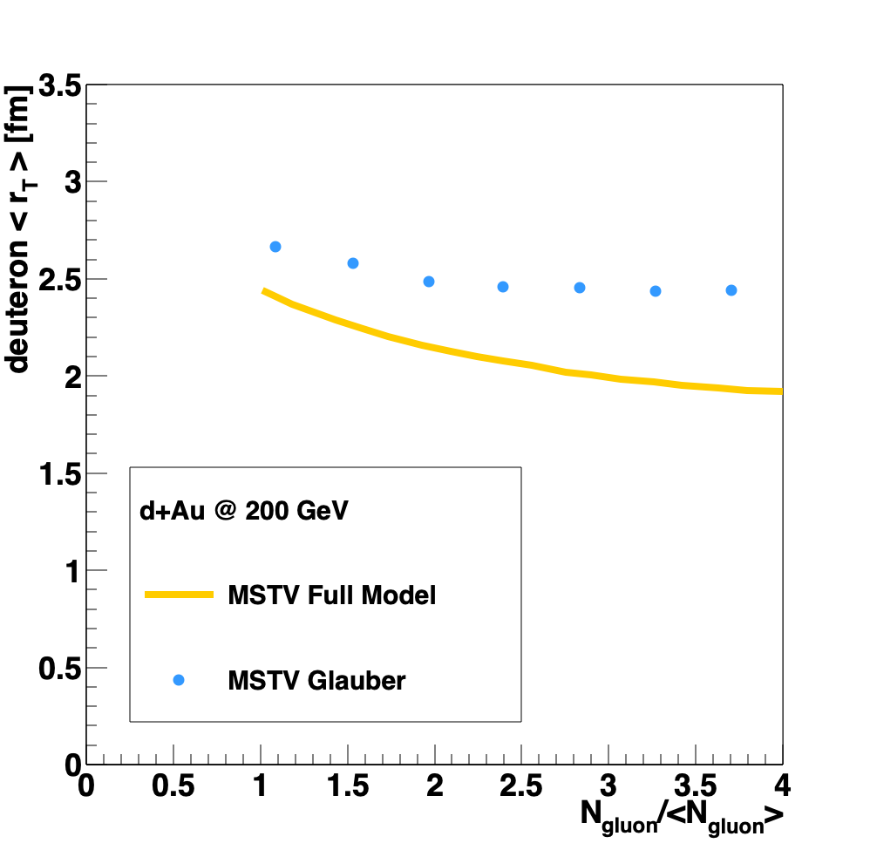
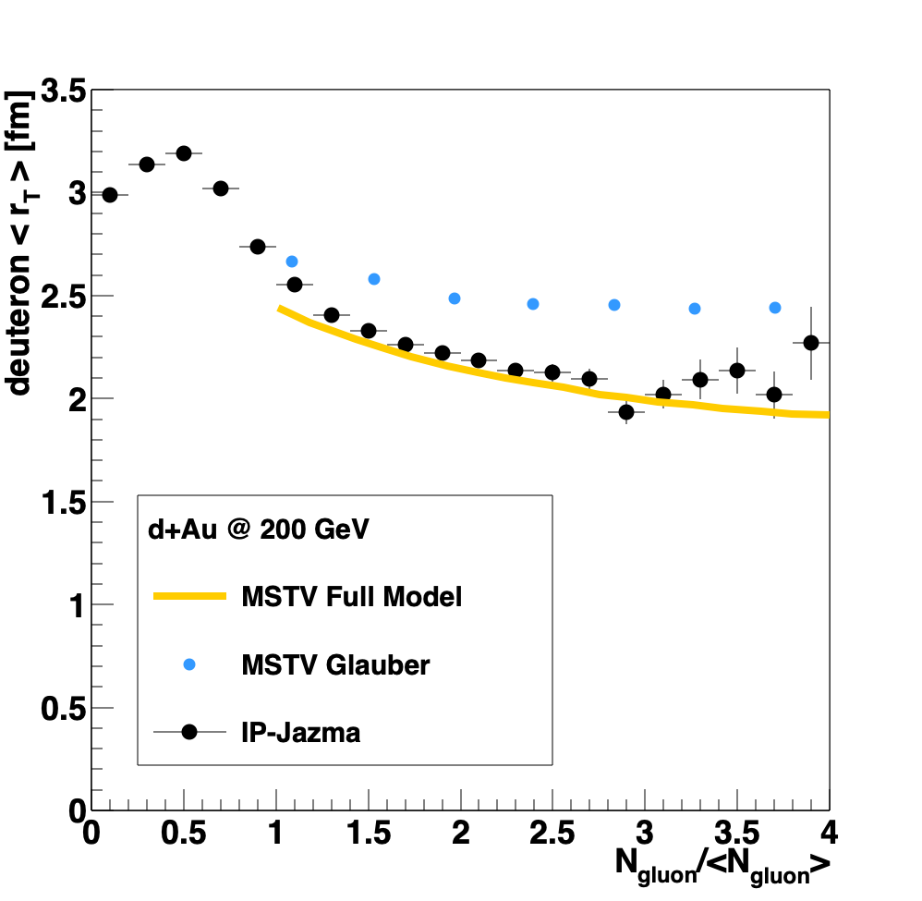
How could our calculation be wrong? i.e. is Q_{s} really larger in d+Au 0-5% events?
Maybe the full MSTV result enhances cases where the n and p overlap!
“We have emphasized the quantum statistics of gluons as the dominant cause of the nontrivial many-body correlations that enhance contributions to the tails of the multiplicity distributions from overlapping nucleon configurations”. [MSTV]
Prediction: IP-Jazma should fail to reproduce the decrease in r_{T}.
False. This is a minor effect having nothing to do with many-body quantum physics.

Slide 26
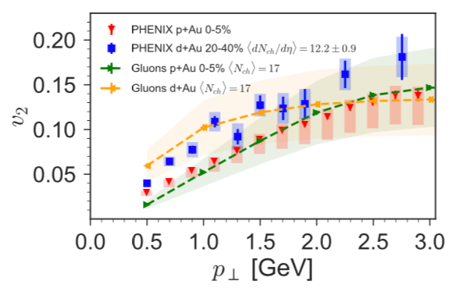
Postdictions and Post-Postdictions
“The [earlier identical] prediction was however based upon a color domain argument rather than explicit computation; … the full dilute-dense framework includes HBT and Bose-enhancement contributions which can modify this expectation.
The results for p+Au and d+Au for the same <N_{g}> are not identical; this is likely because the <N_{g}> in this case are not in the scaling regime”. [MSTV]
In the previous paper, the argument for being identical was explicitly that the color charge density is proportional to N_{ch}. As seen on the earlier figure, there is
no “scaling regime” where this is valid between p+Au and d+Au!

Slide 27
Explanations and Explanations
MSTV1: v₂ (dAu 0-5%) > v₂ (pAu 0-5%) because of
larger <Q_{s}²>
MSTV2: v₂ (dAu 20-40%) > v₂ (pAu 0-5%) because of
HBT and Bose Enhancement effects
Could it be that the geometric eccentricities are almost the same in
d+Au 20-40% (ε₂ = 0.536) and d+Au 0-5% (ε₂ = 0.543)?

Slide 28
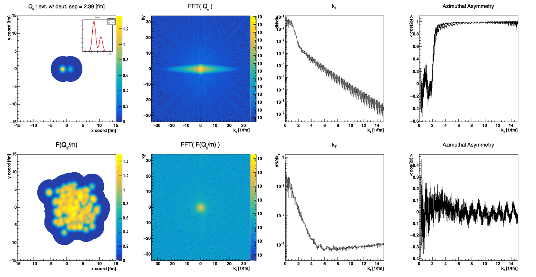
Fourier Transforms
These calculations are done entirely in momentum space (immediate FFT of spatial distributions)
<cos(2φ)>
Enormous azimuthal asymmetries in the FFT,
and
not just at low k_{T}.
How does this influence the MSTV results?
Test 1: Calculate v₂ with respect to deuteron axis.
Test 2: Reorganize Q_{s} lattice cells to be azimuthally symmetric for each event and recalculate v₂.

Slide 29
The expression in the MSTV papers (below) is incorrect. This is the two-particle correlation c₂(p_{T},ref) between a particle in a p_{T} bin and a reference particle between p_{T} = 0 and UV cutoff. BTW where is the IR cutoff here?
Is the expression just wrong and what is actually calculated? Answered night before workshop.
One cannot just take the square-root to get v₂(p_{T}). It is not what experiments measure. This is just wrong and should be corrected in the MSTV literature.
Major anisotropies at low k_{T} will be included in
this correlation that arise from the FFT.

Slide 30
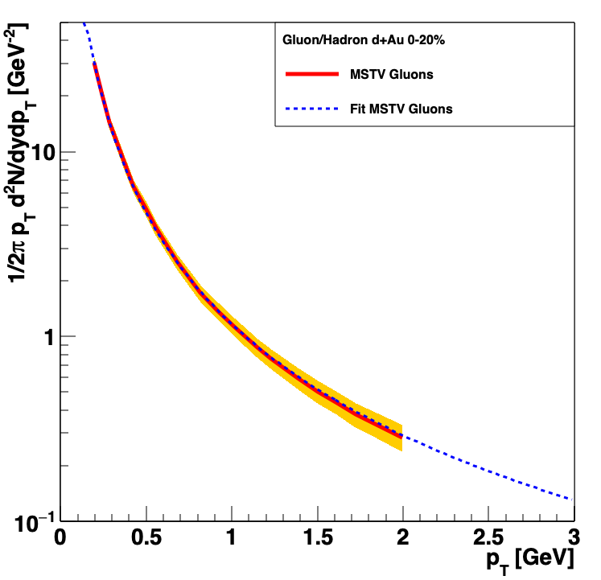
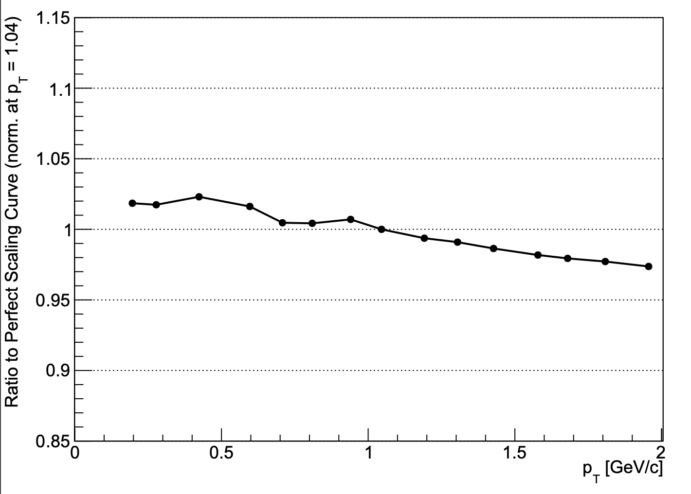
Gluon Momentum Distribution
In fact, spectrum is almost exactly (within < 3%) just 1/p_{T}²
Why are the Ω terms essentially k_{T} independent?
There is a huge k_{T} dependence in the projectile FFT ρ_{p}.
In IP-Jazma we can compute v₂ , v₃ contributions from the FFT terms, but without matching the gluon p_{T} distribution it is unclear what this means (?)
Highlight, it would be useful to see a 2-D plot from MSTV of k_{T1}, k_{T2} for final gluons at p_{T} = 0.5, 1.5, 2.5 GeV (then we can compare as well).
MSTV
Ratio =
1/p_{T}²

Slide 31
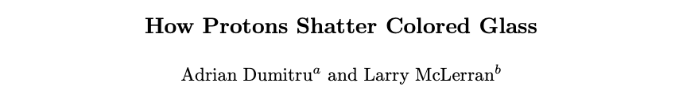
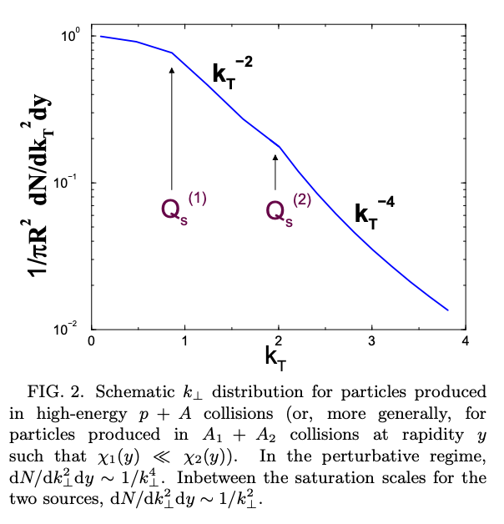
Can we get some numbers here?
https://arxiv.org/abs/hep-ph/0105268
1/k_{T}⁴ scaling reflects the perturbative "dilute/dilute" limit; 1/k_{T}² scaling reflects the deep saturation regime k_{T}² << Q_{s}²
In MSTV, what are the numerical values of
Q_{s} (projectile) and Q_{s} (target)?
Plot the distributions as determined via step following IP-Sat and Q_{s}² fluctuations.
Many hand-waving arguments about 1/k_{T} > 1/Q_{s} (proj) meaning that one interacts with domains over the entire deuteron seem off by an order of magnitude.
Need real numbers to validate approximations.

Slide 32
Gluons versus Hadrons
“The sole point of our comparison is to note that the shape of the p_{T} distribution in the numerator and denominator of v_{2,3}(p_{T}) is similar to that of the data at low p_{T}, modulo the overall normalization factor that cancels between numerator and denominator.” [MSTV]
That is an assertion we can test.
Dennis Perepelitsa generated PYTHIA back-to-back gluons via HadronLevelStandAlone
and we extract the leading pion distribution,
as well as the relative angle between the gluon and pion.
Reasonable agreement…. with no tuning.
http://home.thep.lu.se/~torbjorn/pythia81html/HadronLevelStandalone.html

Slide 33
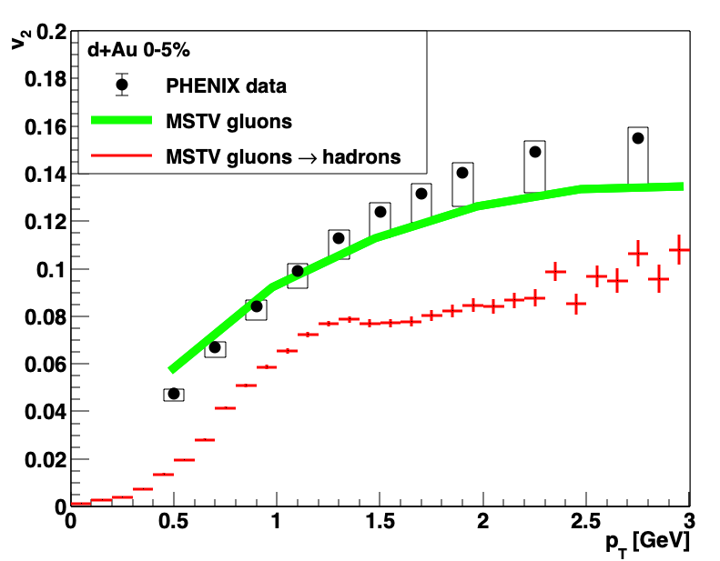
Gluon → Hadron: Big Impact on v₂
Two substantial effects:
Hadron p_{T} < Gluon p_{T}
Angle Δφ (hadron , gluon)
Systematic uncertainty in MSTV2 paper, not including gluon → hadron mapping.
Adding uncertainties in quadrature.
Results in a good p-value ☺

Slide 34
Where to go from here?
Need to clearly differentiate between speculation, educated guess,
and really fully tested hypotheses.
IP-Jazma helps test such statements.
Most MSTV results scale with eccentricity (just like hydro).
Hypothesis – this enters via FFT and thus scales with eccentricity.
We have proposed specific tests of this hypothesis.
In cases like this, the need to publicly release documented code is paramount.
As essential element of the scientific method
New ideas for measurements are great. However, spending $1, 10, 100M to test an idea where the code is not available and major (simple) questions remain,
is not the right way to proceed.

Slide 35
Bonus Material

Slide 36
Ab initio or non pertinet
Many have stated that these color domains effects are calculated ab initio
However, saturation physics in the proton at x > 0.01 challenges the whole picture of the formalism
One estimate has Q_{s,0}² (gluon) = 0.67 GeV² for x = 0.01 at the very center of the proton, and averaged over
r = 0.67 fm the value would be Q_{s}² (gluon) = 0.28 GeV²
MSTV2 claims that the IP-Jazma saturation scale values differ significantly from theirs.
Prove it – show us the numbers.

Slide 37
Trento Comment… arXiv:1412.4708v2
Trento p=0 is similar to Ncoll scaling (with extra sqrt) with an impact parameter dependence for N-N collisions. Thus, with the right parameters, quite comparable to IP-Glasma, IP-Jazma (dense-dense)

Slide 38
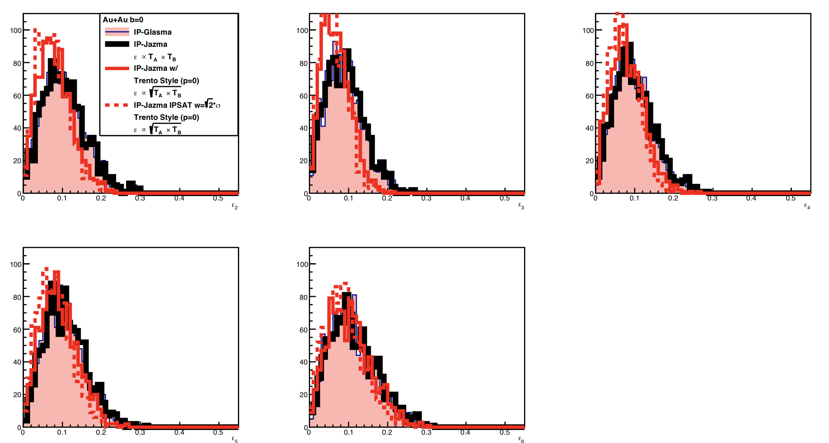
Trento Style p=0 Comparison (Isolating one effect)
ε₂
ε₃
ε₄
Trento is only a very approximate match to IP-Glasma.
ε₅
ε₆
* Highlight this is only the geometric piece, and there will be other differences when adding NBD fluctuations etc.

Slide 39
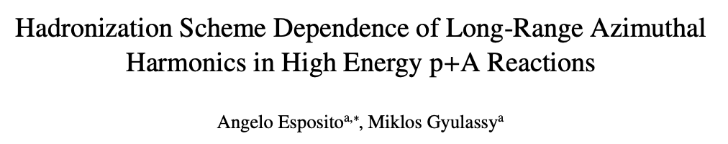
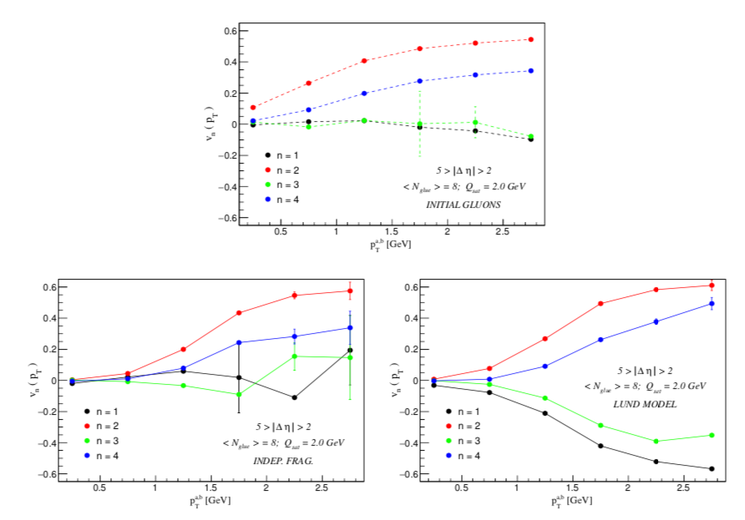
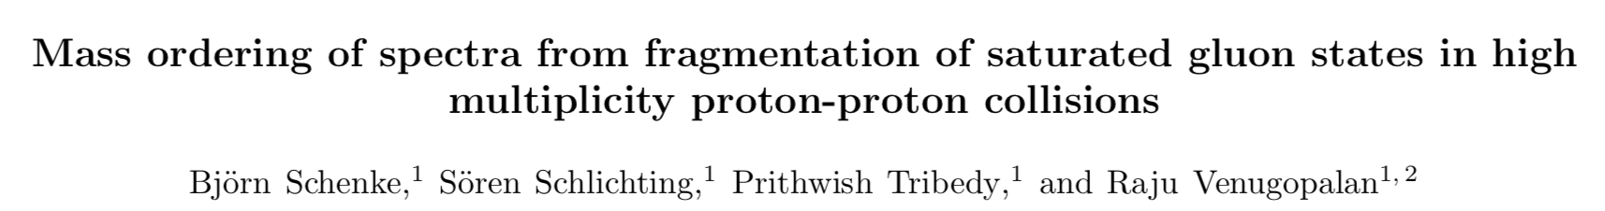
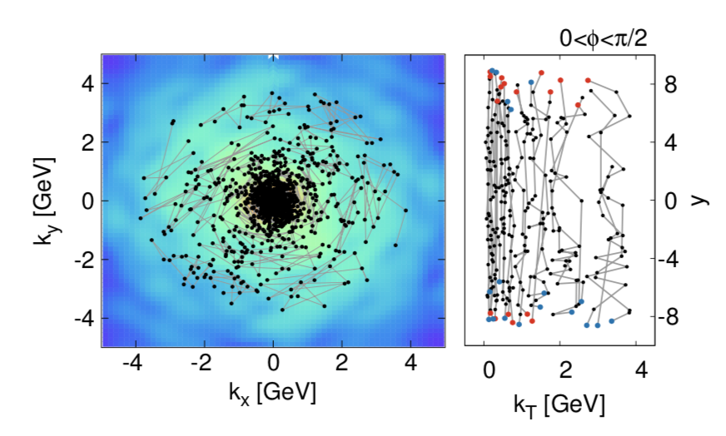
Hadronization Schemes
https://arxiv.org/abs/1505.03734
Very large decrease in hadron v₂ relative to gluon v₂ for p_{T} < 2 GeV
Result also depends on gluon p_{T} spectrum, which is not shown.
https://arxiv.org/abs/1607.02496
Very different hadronization scheme.
No gluon and hadron p_{T} spectra shown, only <p_{T}> for hadrons.
It would be great to see that comparison.
Models like AMPT increase v₂(p_{T}) via parton coalescence.
However, if one started with CGC gluons this would have too hard a p_{T} spectrum.

Slide 40
Took one hour to code (while watching Avengers Infinity War on airplane)
Yes, there are uncertainties,
but previous IP-Glasma papers
(e.g. arXiv:1311.3636) point out huge differences between gluons and hadrons

Slide 41
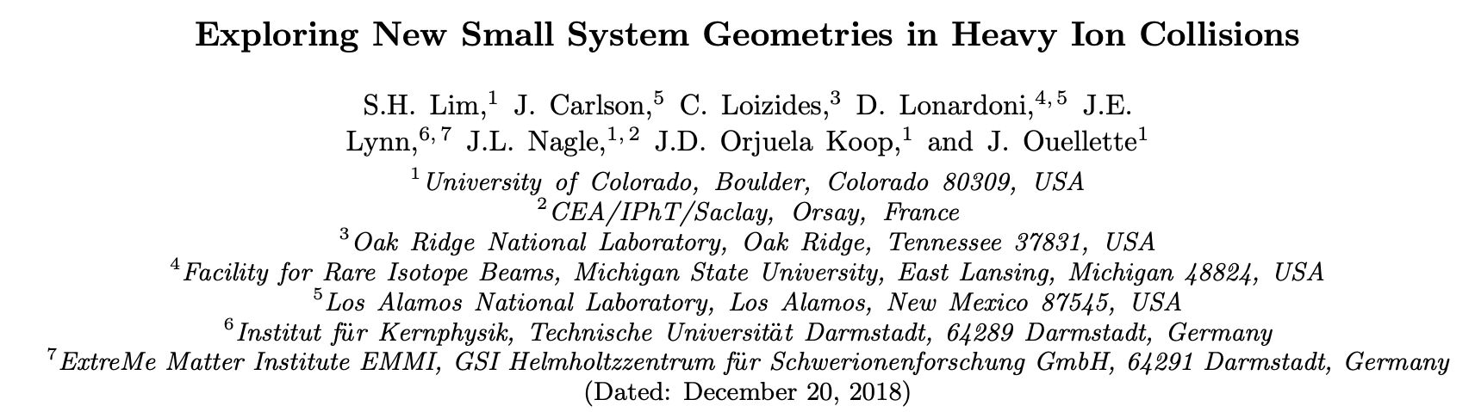
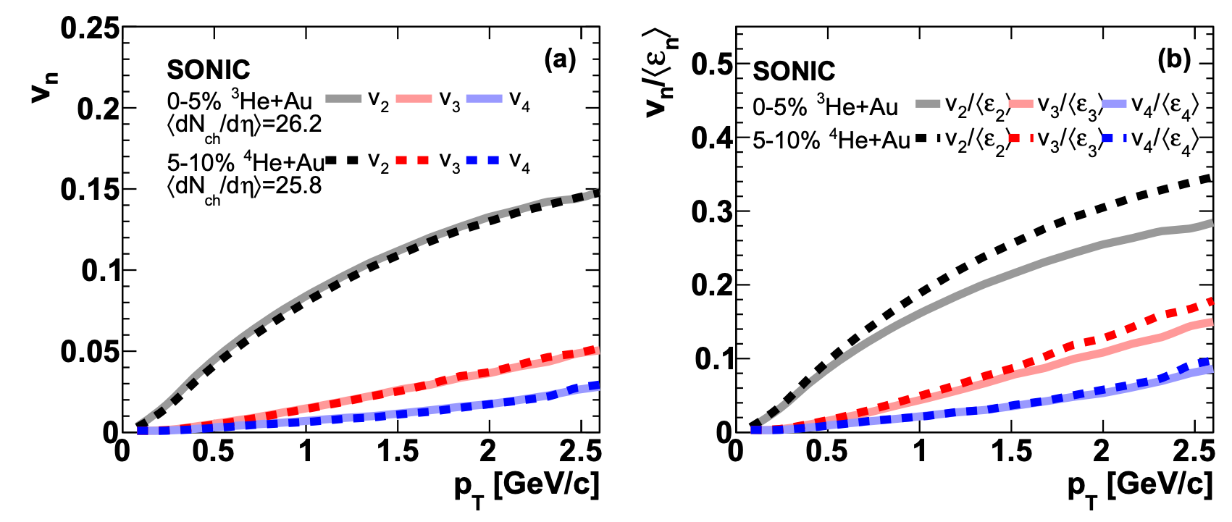
Other Geometries?
https://arxiv.org/abs/1812.08096
⁴He has a slightly more compact source and thus a slightly larger translation of geometry to flow
Additional studies of p+O and O+O are interesting, though not testing a very specific hydrodynamic unique case.
Worth more discussion on different systems at both RHIC and the LHC.

Slide 42
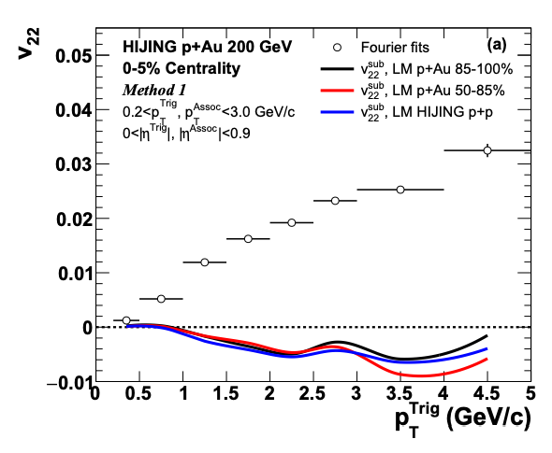
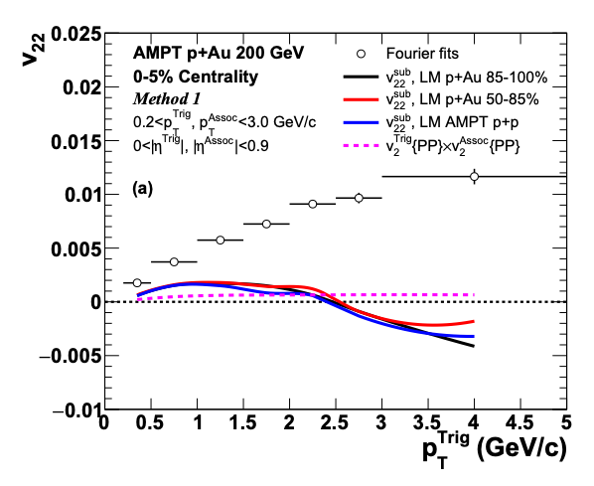
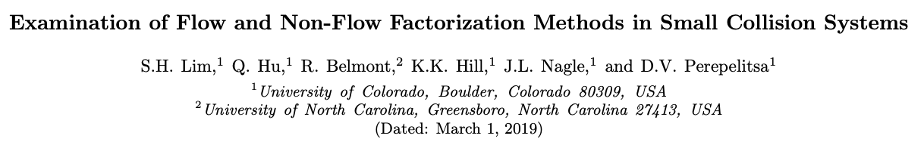
Flow and Non-Flow
https://indico.cern.ch/event/656452/contributions/2869833/attachments/1649479/2637419/QM18-smallsystem-shengli-10.pdf
STAR result has a small Δη gap, and thus a huge non-flow contribution
(even at low p_{T}).
That is why they are so sensitive to the non-flow subtraction.
PHENIX results checked with Δη gap of 3 units and in systematic uncertainties.
https://arxiv.org/abs/1902.11290
HIJING and AMPT closure tests indicate significant over-subtraction by template method with STAR kinematics for p_{T} > 1-2 GeV

Slide 43
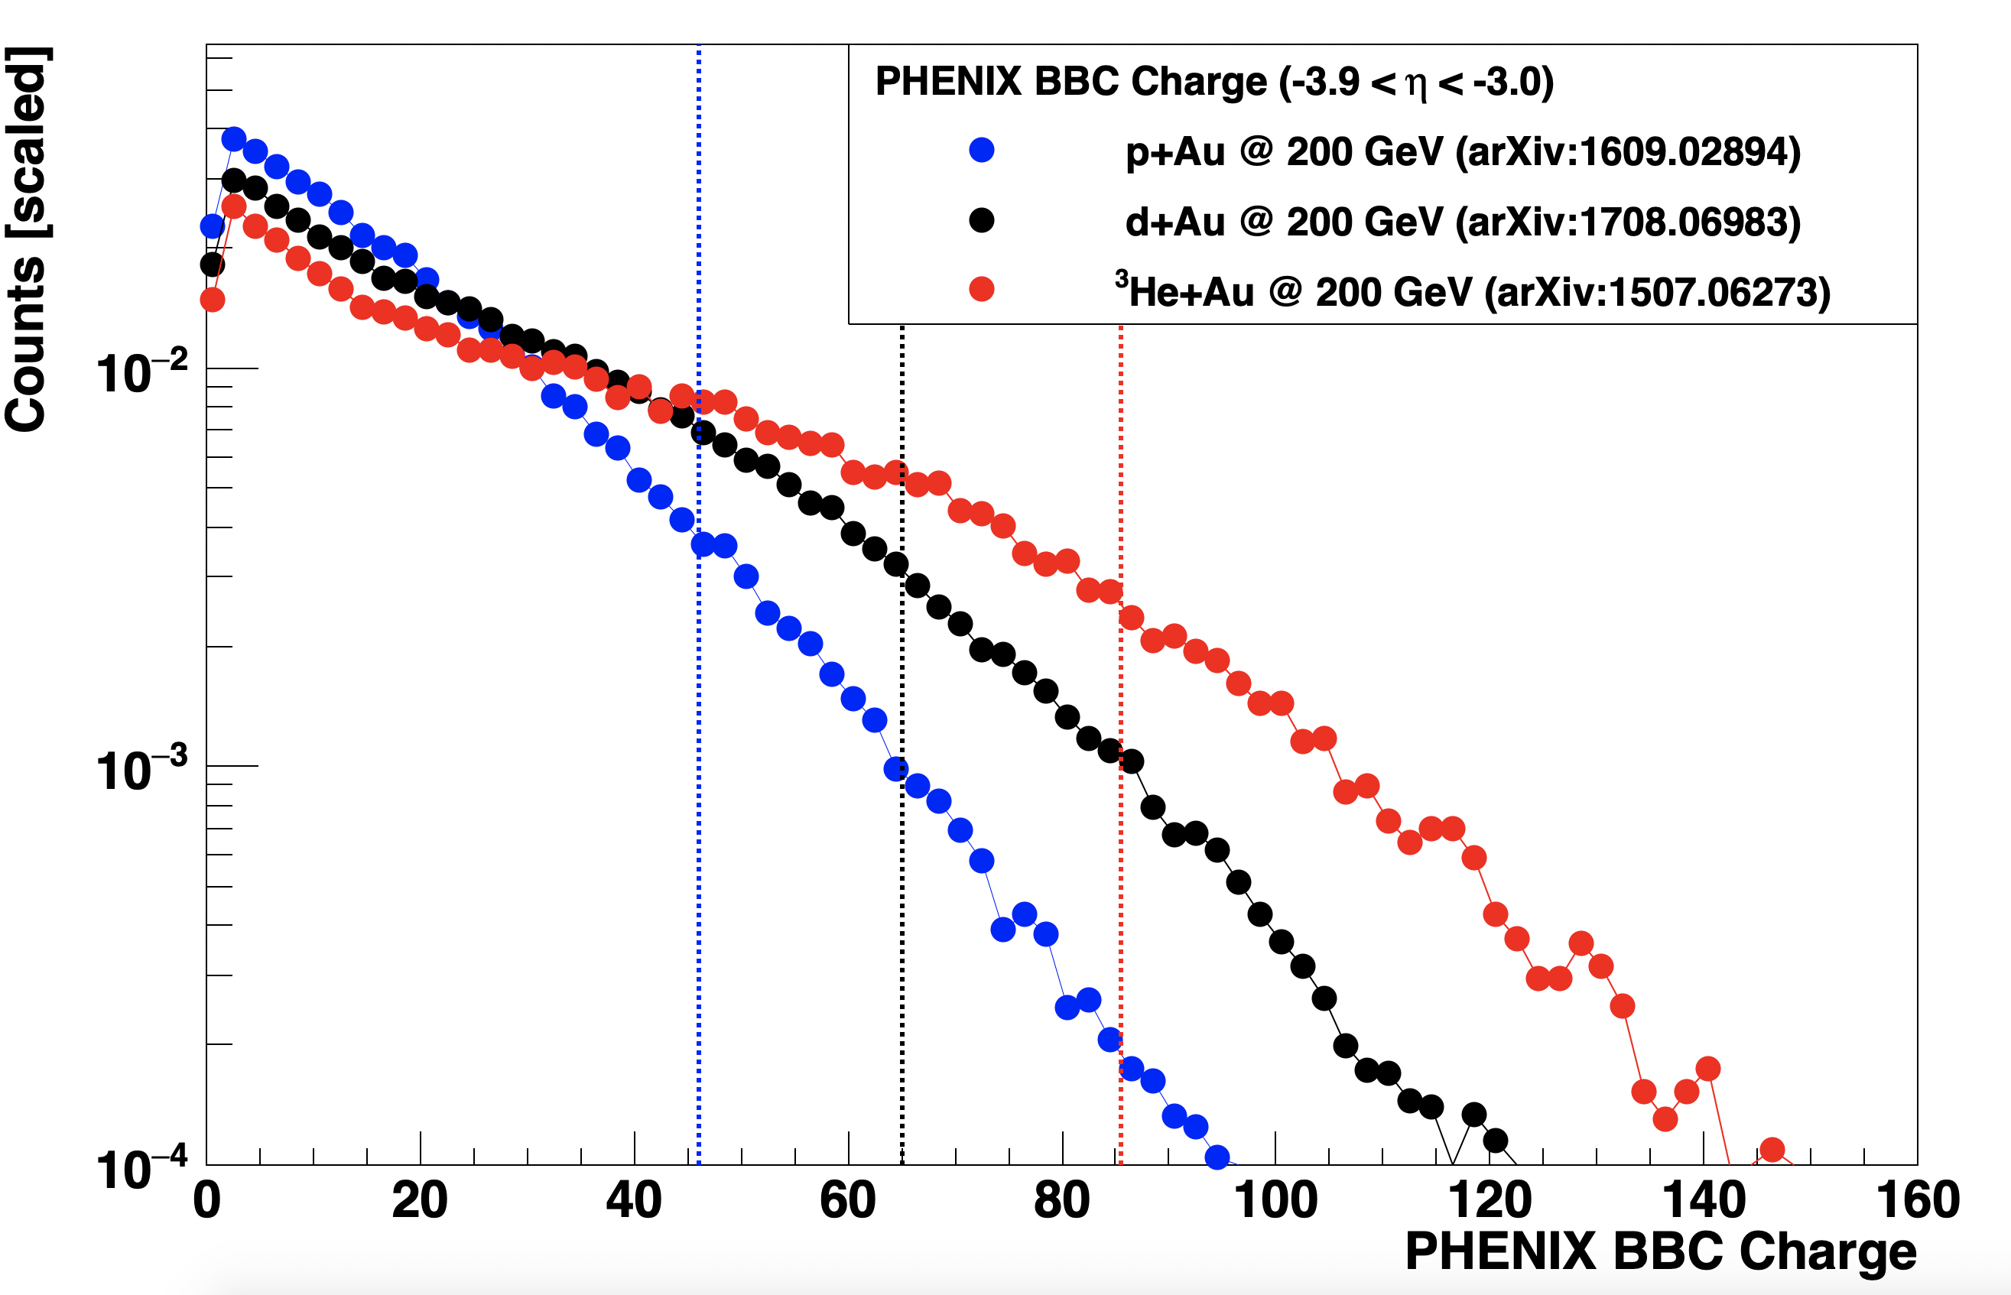
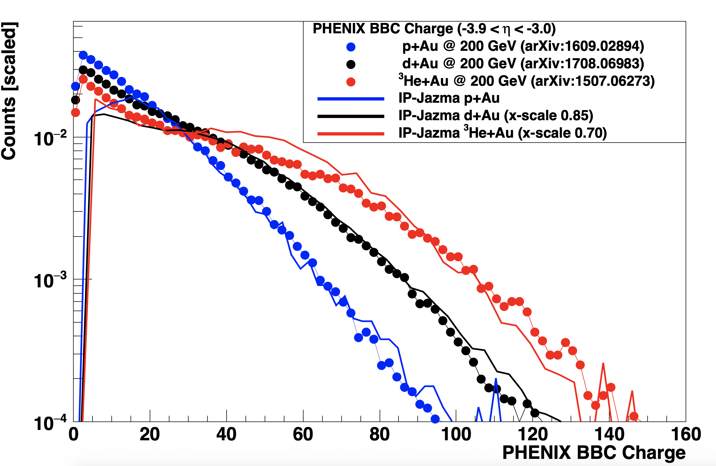
Multiplicity Distributions at Forward Rapidity (where PHENIX & STAR select events)
Already published data.
Caution – the BBC charge is normalized for single charged particle MIP (minimum ionizing particles), but it is also sensitive to lots of other produced and scattered particles.
PHENIX uses the 5% top selection for the centrality 0-5% category – indicated by the vertical dashed lines.
IP-Jazma gives a reasonable (not perfect) description, but with a different x-axis scale factor for the different systems. No tuning the F(Q_{s}/m) parameter (m=0.3 GeV).
Not so surprising, the scaling of midrapidity and very backward rapidity production between systems is not the same.

Slide 44
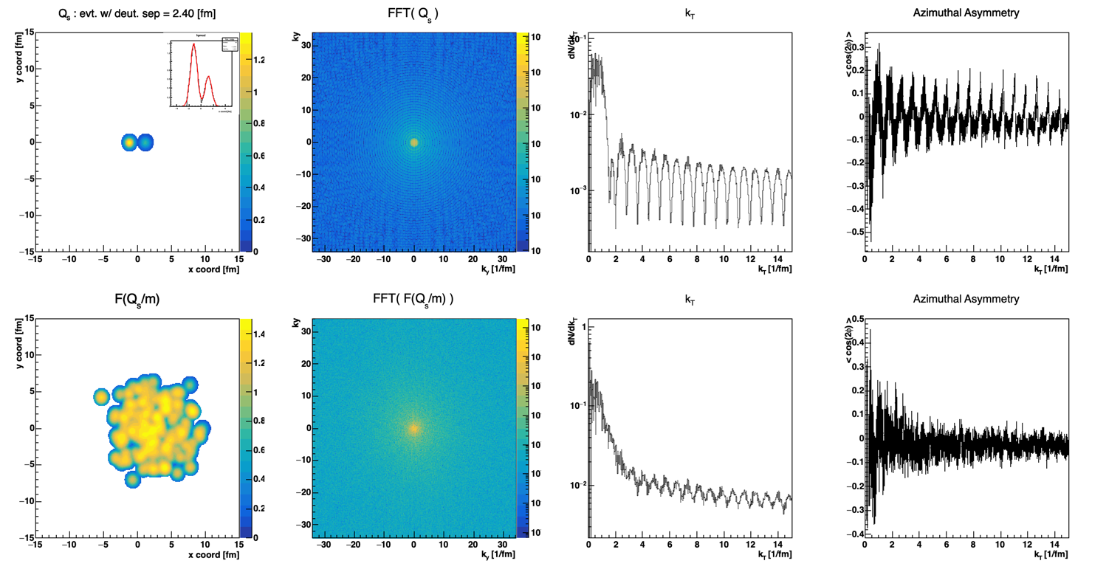
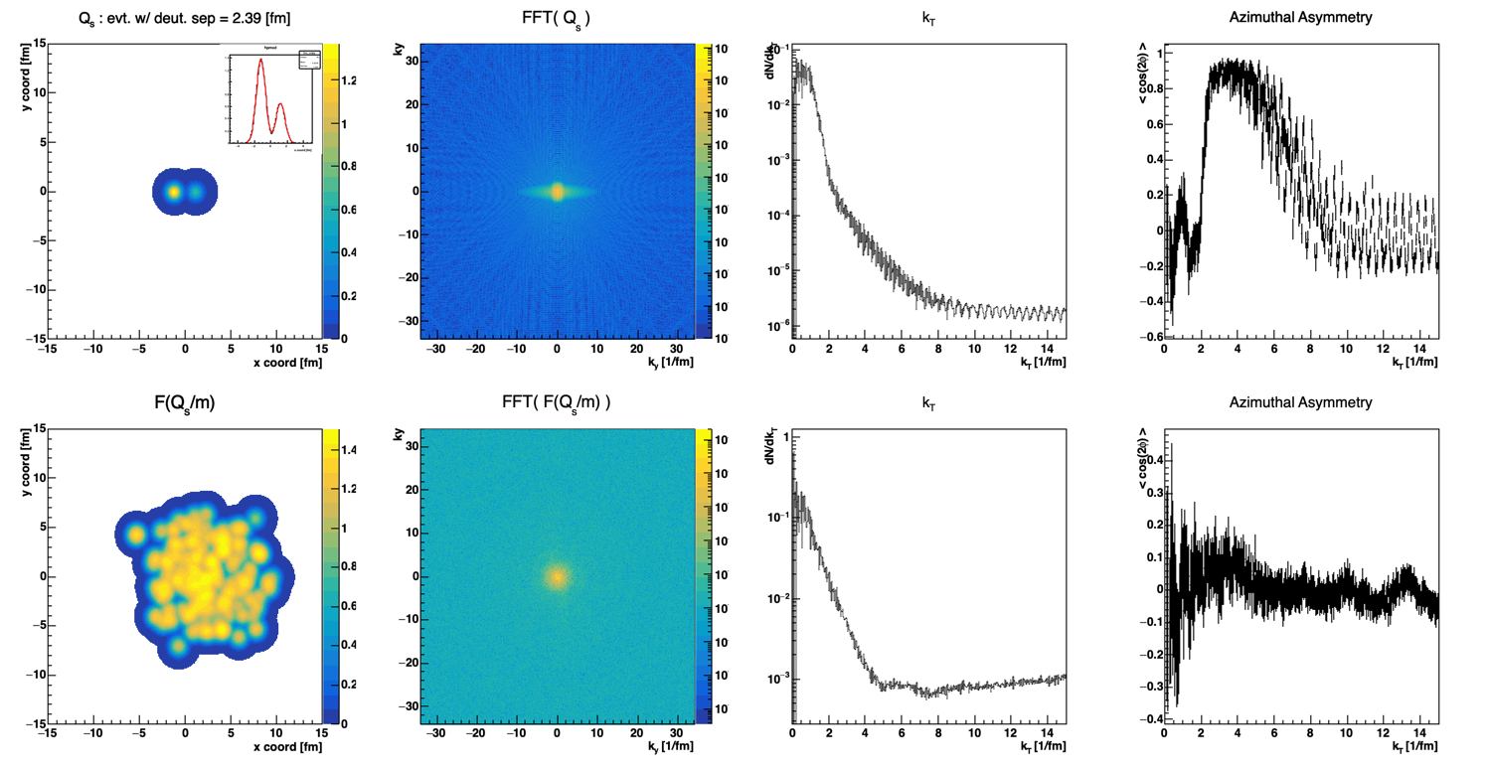
Fourier Transforms
These calculations are done entirely in momentum space (immediate FFT of spatial distributions)
Carrying Gaussian color charge distribution to
3, 6, 9 σ makes a big difference in avoiding artifacts at larger k_{T}.
At 9 sigma results seem to stabilize.
Enormous azimuthal asymmetries in the FFT, and not just at low k_{T}.
How does this influence the MSTV results?
Test 1: Calculate v₂ with respect to deuteron axis.
Test 2: Reorganize Q_{s} lattice cells to be azimuthally symmetric for each event and recalculate v₂.

Slide 45
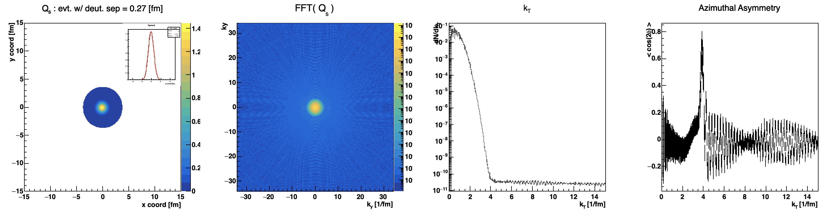


FFT artifacts even carrying Q_{s} Gaussian out to 9 sigma.
Non-trivial anisotropies.

