Slide 1
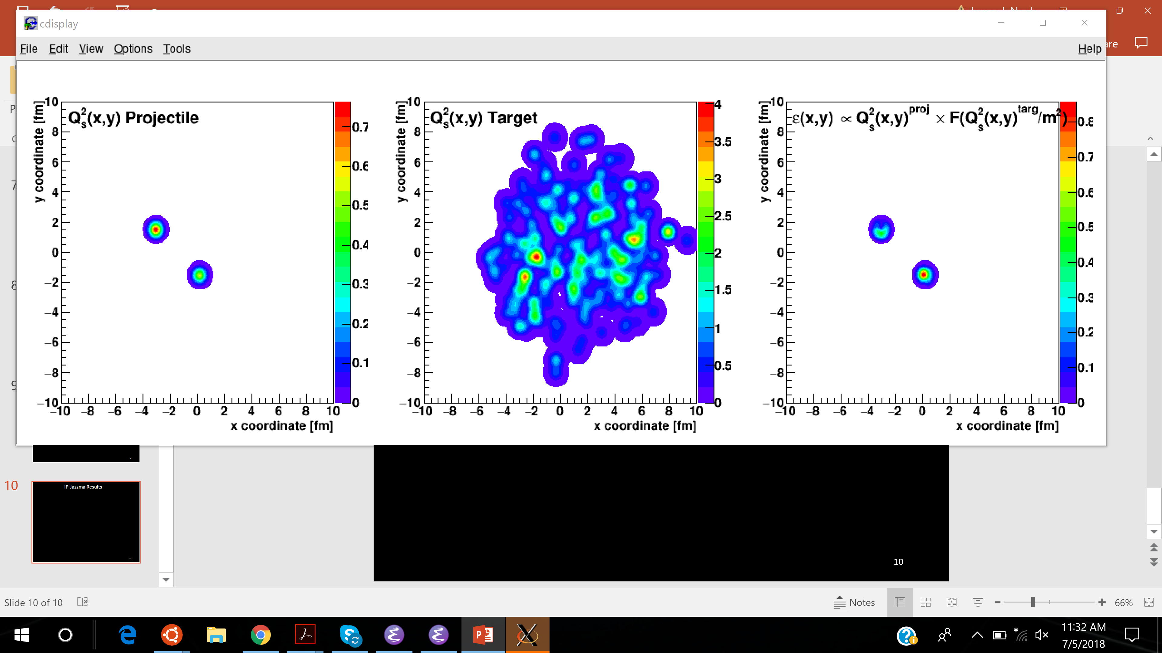
An experimenter’s assessment of
correlations and flow in
small systems
Jamie Nagle
University of Colorado Boulder
Wuhan, China, November 4-8, 2019
The 28th International Conference on Ultrarelativistic Nucleus-Nucleus Collisions

Slide 2
The field has been fully engaged in a debate on the interpretation of experimental data from small systems
Geometry → Final State Flow
Color Domains → Initial State Correlations
This talk focuses on major resolutions since the last QM in Venice
Resolutions provide new context for accessing early stage dynamics and for newly emerging challenges

Slide 3
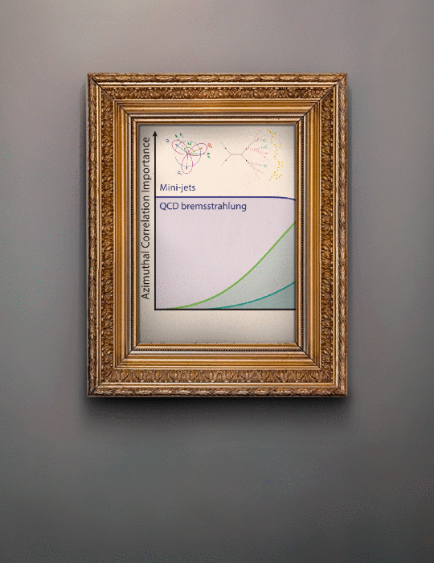
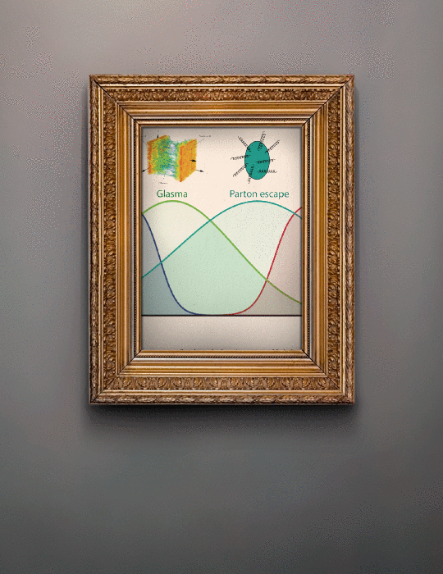
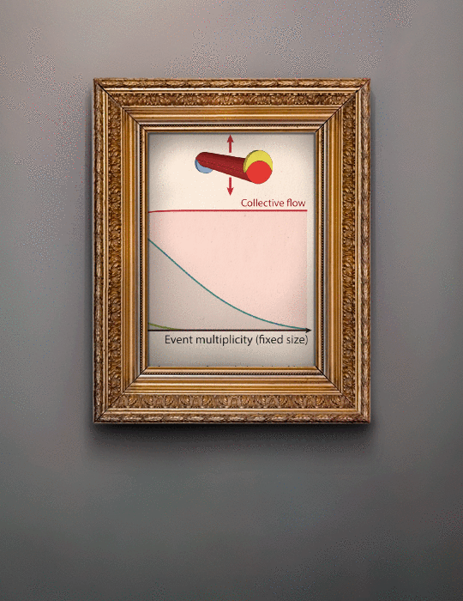
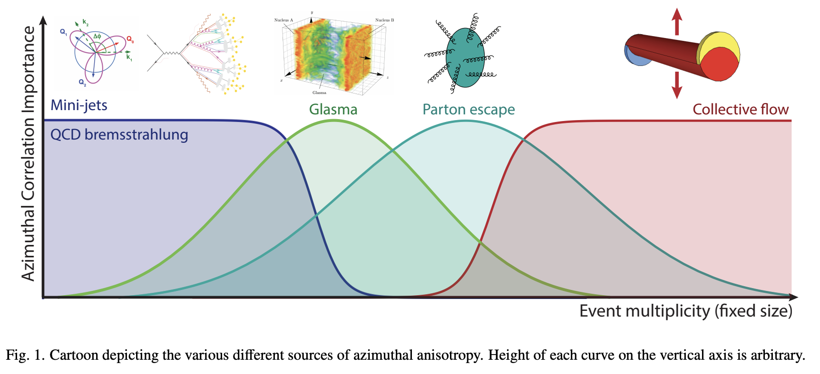
We have had 5 years with non-quantitative axes and self-contradictions
Real progress allows us to stop showing
arbitrary horizontal and arbitrary vertical axis figures

Slide 4
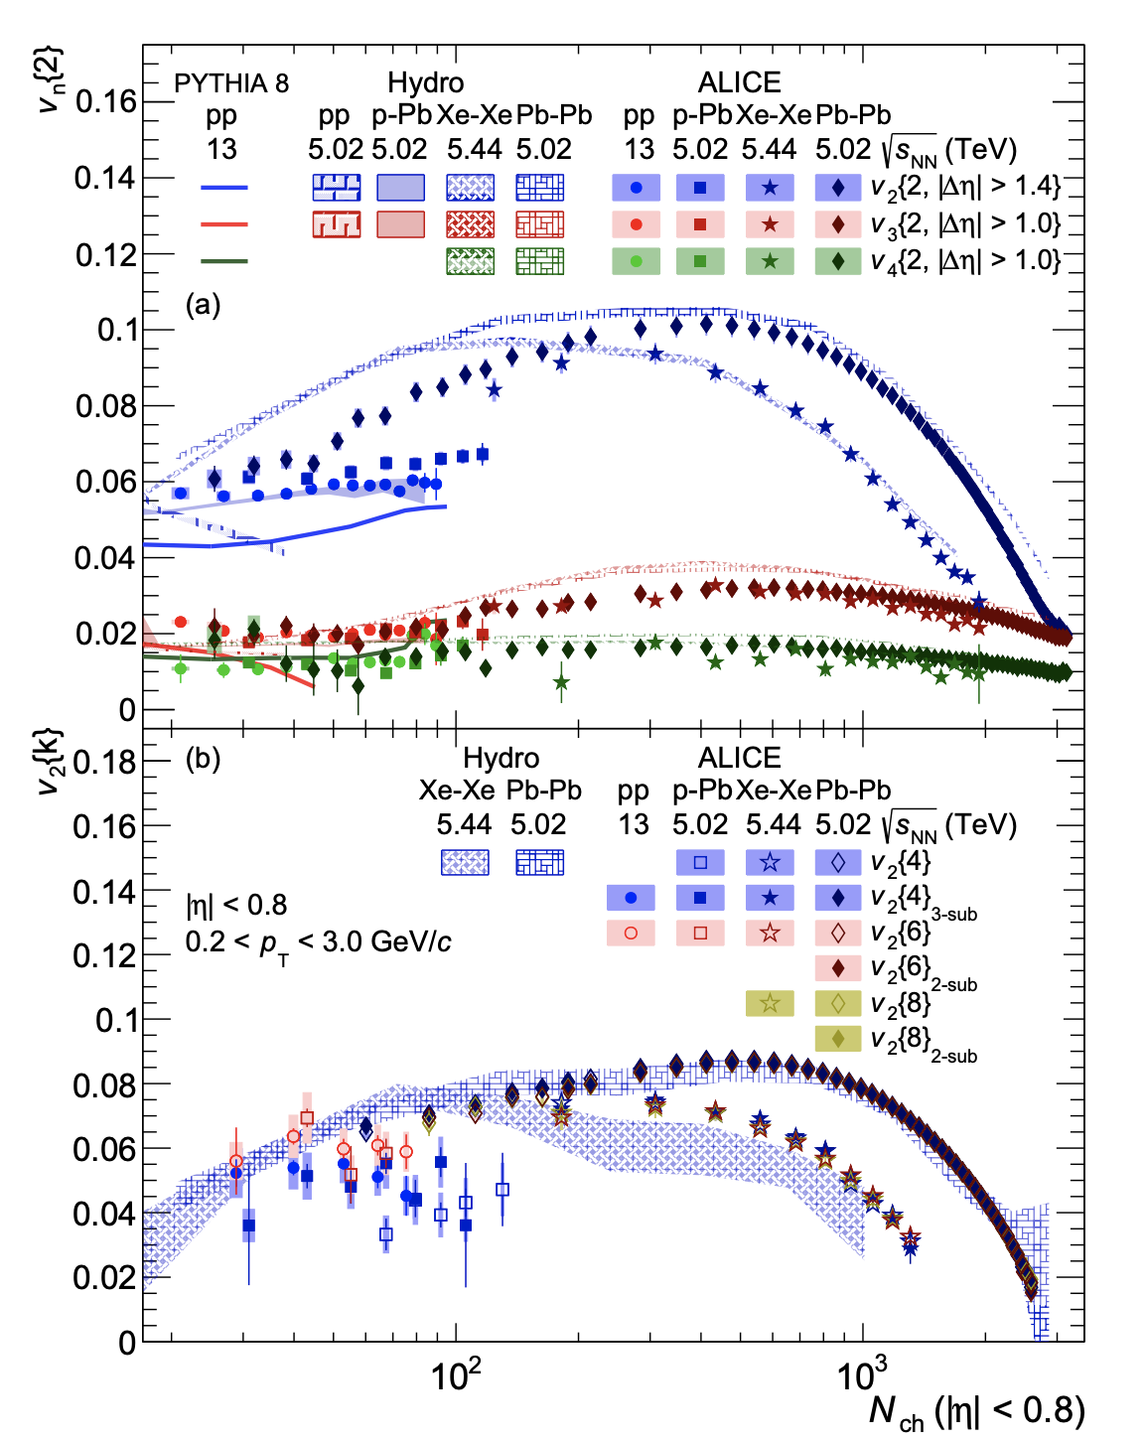
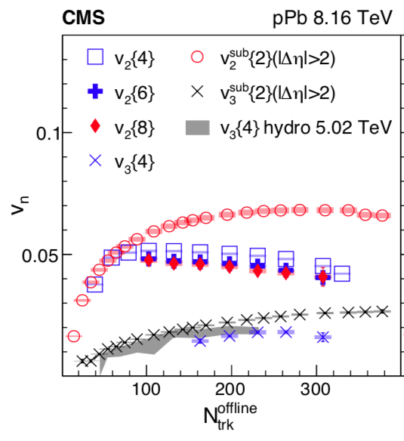
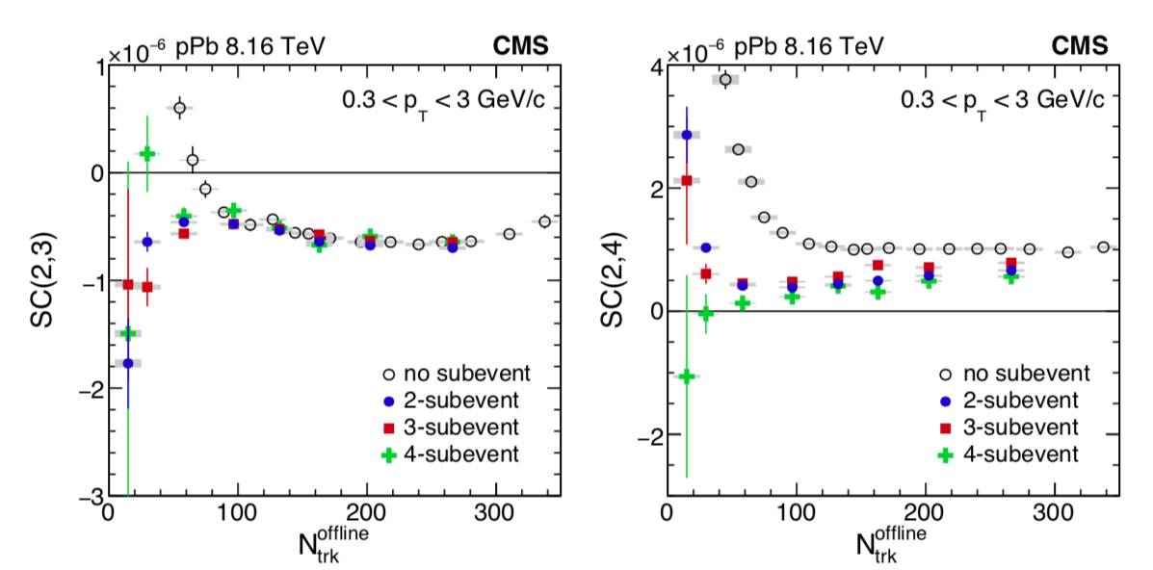
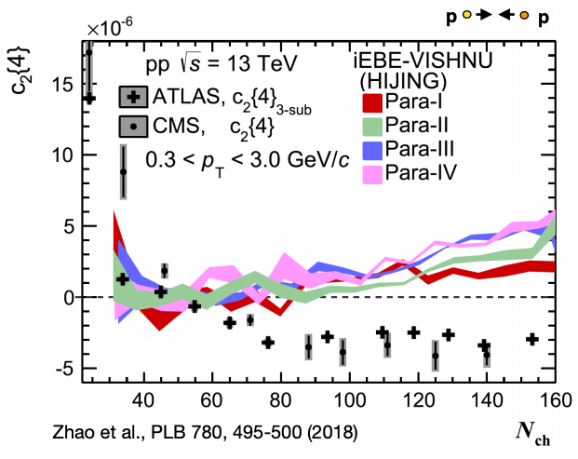
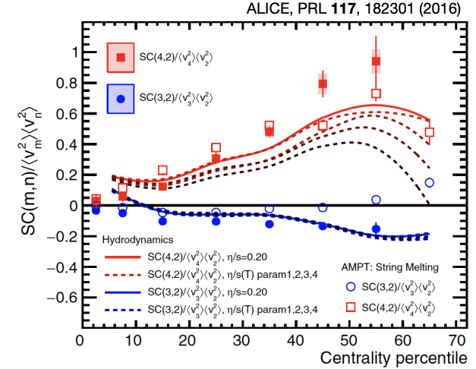
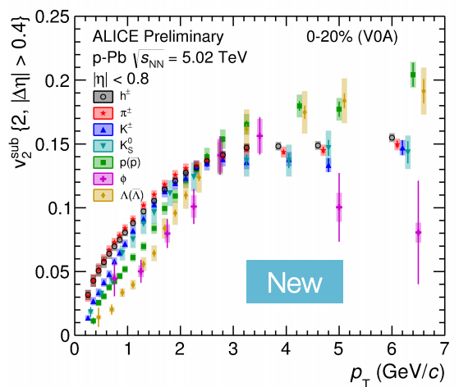
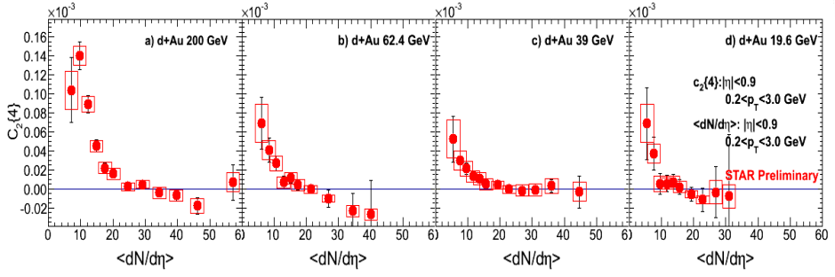
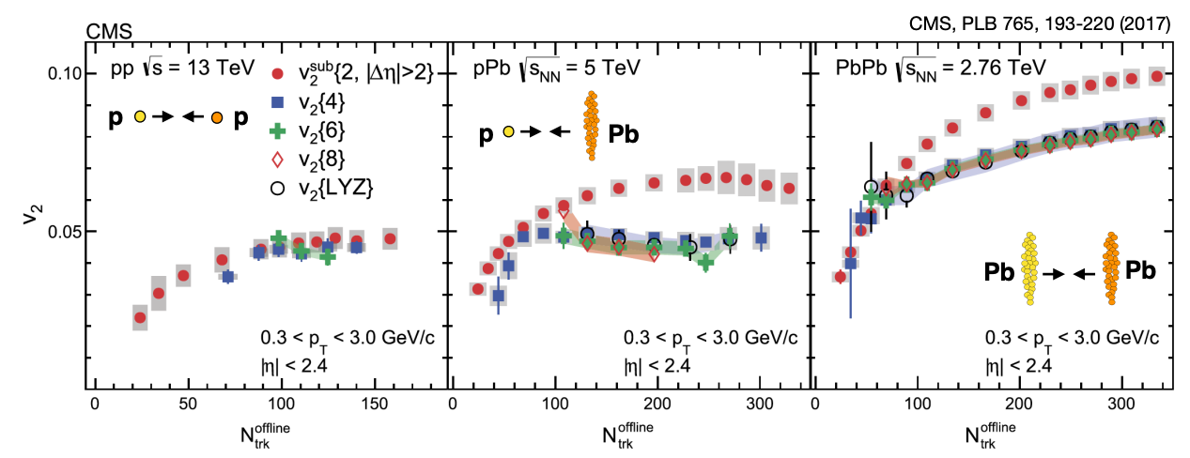
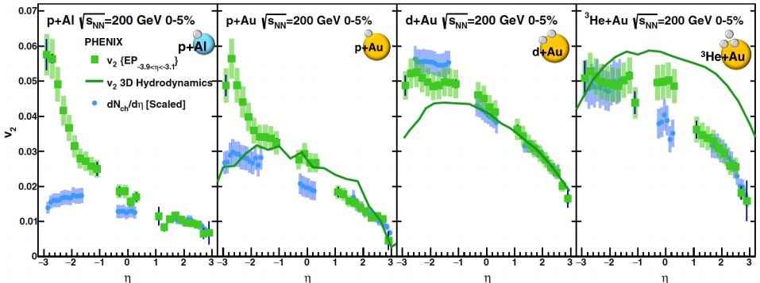
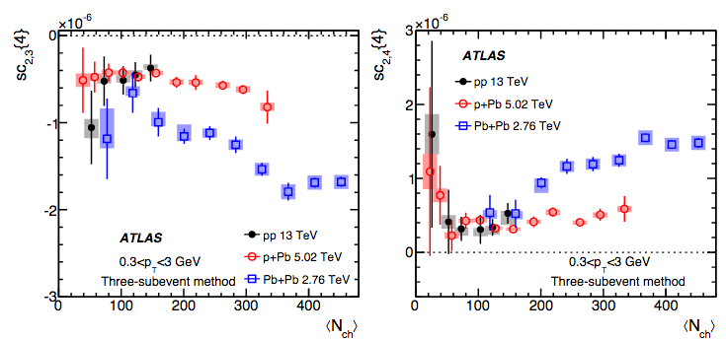
Wealth of experimental data, with most debates over details and higher order, more differential observables
Focus not on showing all data, but rather our global understanding

Slide 5
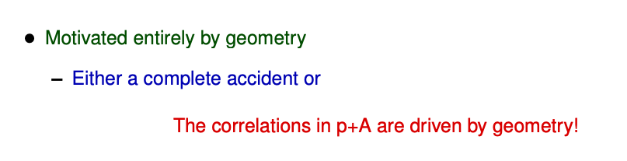
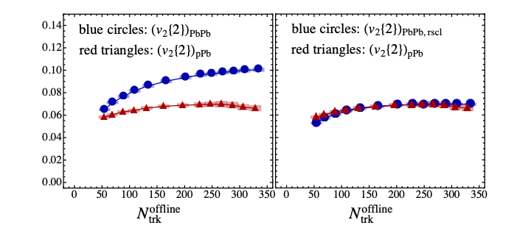
Geometry Tests
Derek Teaney (2013)
Intrinsic Geometry
Fluctuation Geometry
PbPb
Removing PbPb intrinsic geometry
pPb
CMS data
http://www.ectstar.eu/sites/www.ectstar.eu/files/talks/teaney_pa.pdf
https://arxiv.org/pdf/1312.6770.pdf

Slide 6
“One fluid to rule them all”
Pb+Pb
p+Pb
p+p
R.W. and P.R. https://arxiv.org/abs/1701.07145

Slide 7
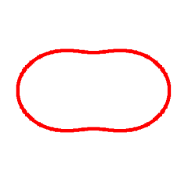
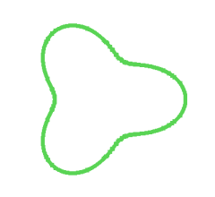
Geometry, Geometry, Geometry
Ordering of eccentricities
v₂
v₃
PHENIX, Nature Phys. 15 (2019) no.3, 214-220

Slide 8
PHENIX, Nature Phys. 15 (2019) no.3, 214-220
(More) Definitive Proof of Geometry & Hydrodynamics

Slide 9
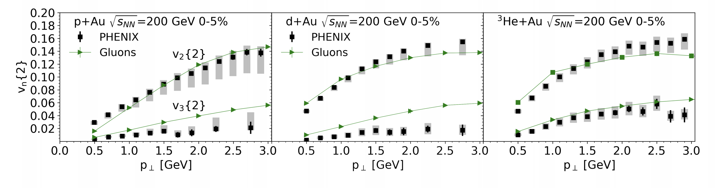
Deuteron is big and so more
disconnected, uncorrelated domains
Simple domain expectation v₂(dAu) < v₂ (pAu)
deuteron
Color Domains → Initial State Correlations
Color Domains → Initial State Correlations
But then surprising v₂(dAu) > v₂(pAu) shown in Venice!
MSTV Phys.Rev.Lett. 121 (2018) no.5, 052301
MSTV Phys.Lett. B788 (2019) 161-165
MSTV https://arxiv.org/abs/1901.10506

Slide 10
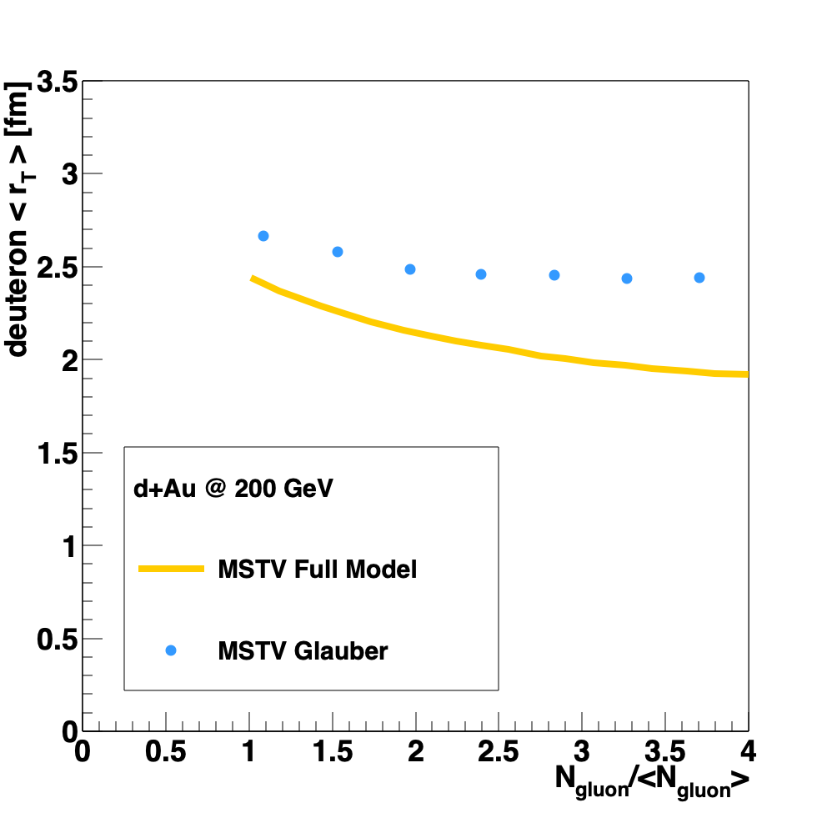
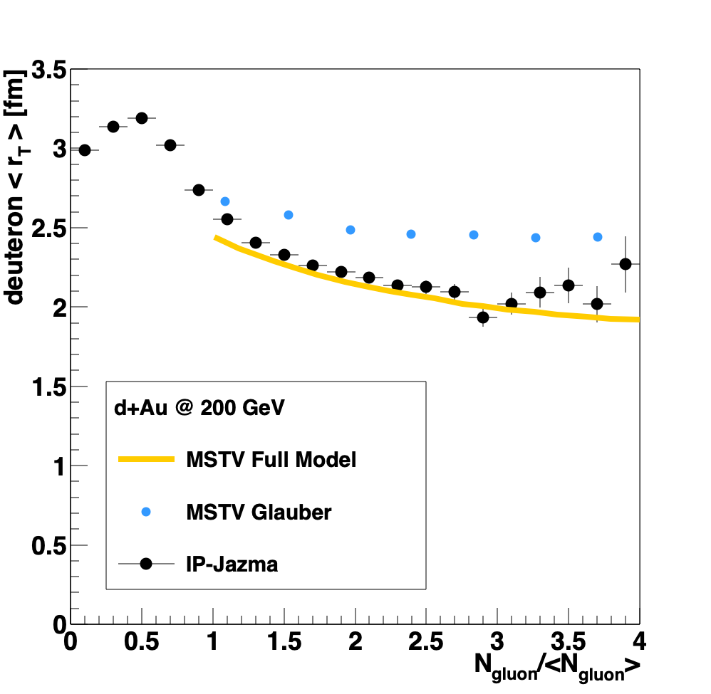

Rice Workshop (March 2019) to Resolve
https://indico.cern.ch/event/771998/timetable/#20190314
“Quantum statistics of gluons are the dominant cause of the nontrivial
many-body correlations that
enhance contributions to the tails of the multiplicity distributions from overlapping nucleon configurations”.
r_{T}
MSTV https://arxiv.org/abs/1901.10506
IP-Jazma model is trivial
(no quantum, no many-body, etc.)
and can disprove these assertions.
https://journals.aps.org/prc/abstract/10.1103/PhysRevC.99.054908
Non-trivial many-body

Slide 11
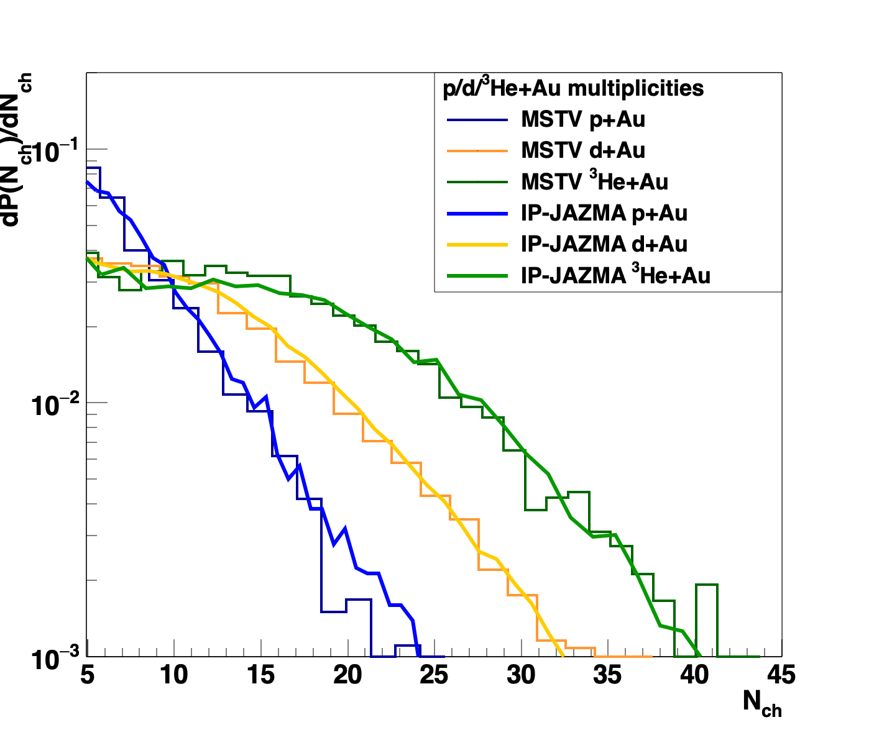
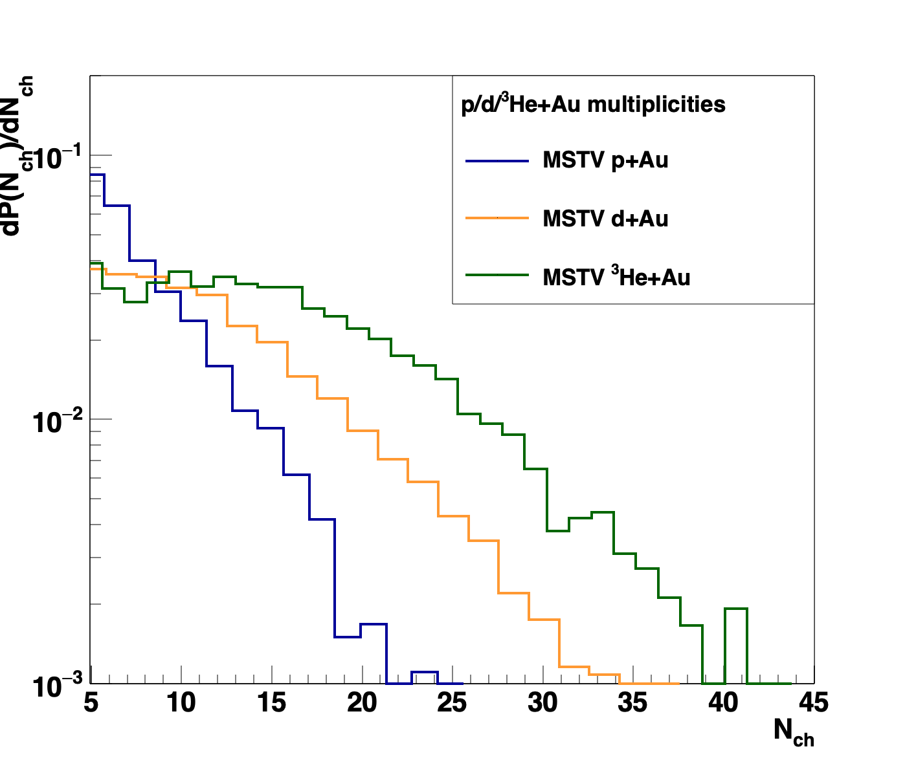

Rice Workshop (March 2019) to Resolve
https://indico.cern.ch/event/771998/timetable/#20190314
Glittering Glasma – ab initio result for Negative Binomial Fluctuations
MSTV https://arxiv.org/abs/1901.10506
IP-Jazma model is trivial
(no glittering, etc.)
and can disprove these assertions.
https://journals.aps.org/prc/abstract/10.1103/PhysRevC.99.054908
Welcome development post-workshop was public release of MSTV code.
In this process errors were found; missing converting fm to GeV.
Proof of ab initio NBD
$$ℏc$$

Slide 12
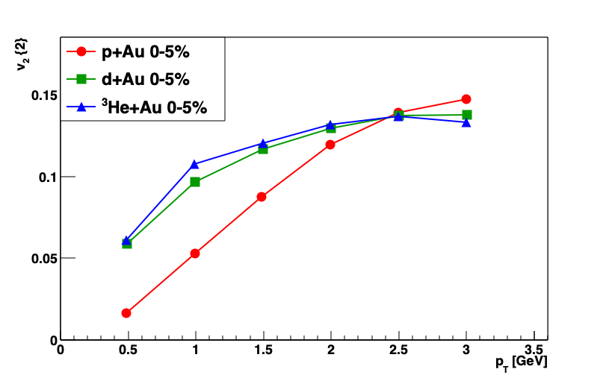
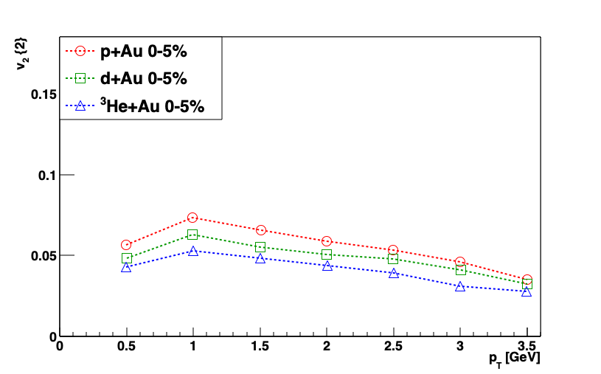
v₂ (dAu) > v₂ (pAu)
v₂ (pAu) > v₂ (dAu)
WITH FIX
“In summary, due to the numerical error specified,
the hierarchy of v₂;₃ seen in the PHENIX data is not seen in our model.
It cannot therefore provide a viable description of the data.”
Erratum: Phys.Rev.Lett. 121 (2018) no.5, 052301
Corrigendum: Phys.Lett. B788 (2019) 161-165

Slide 13
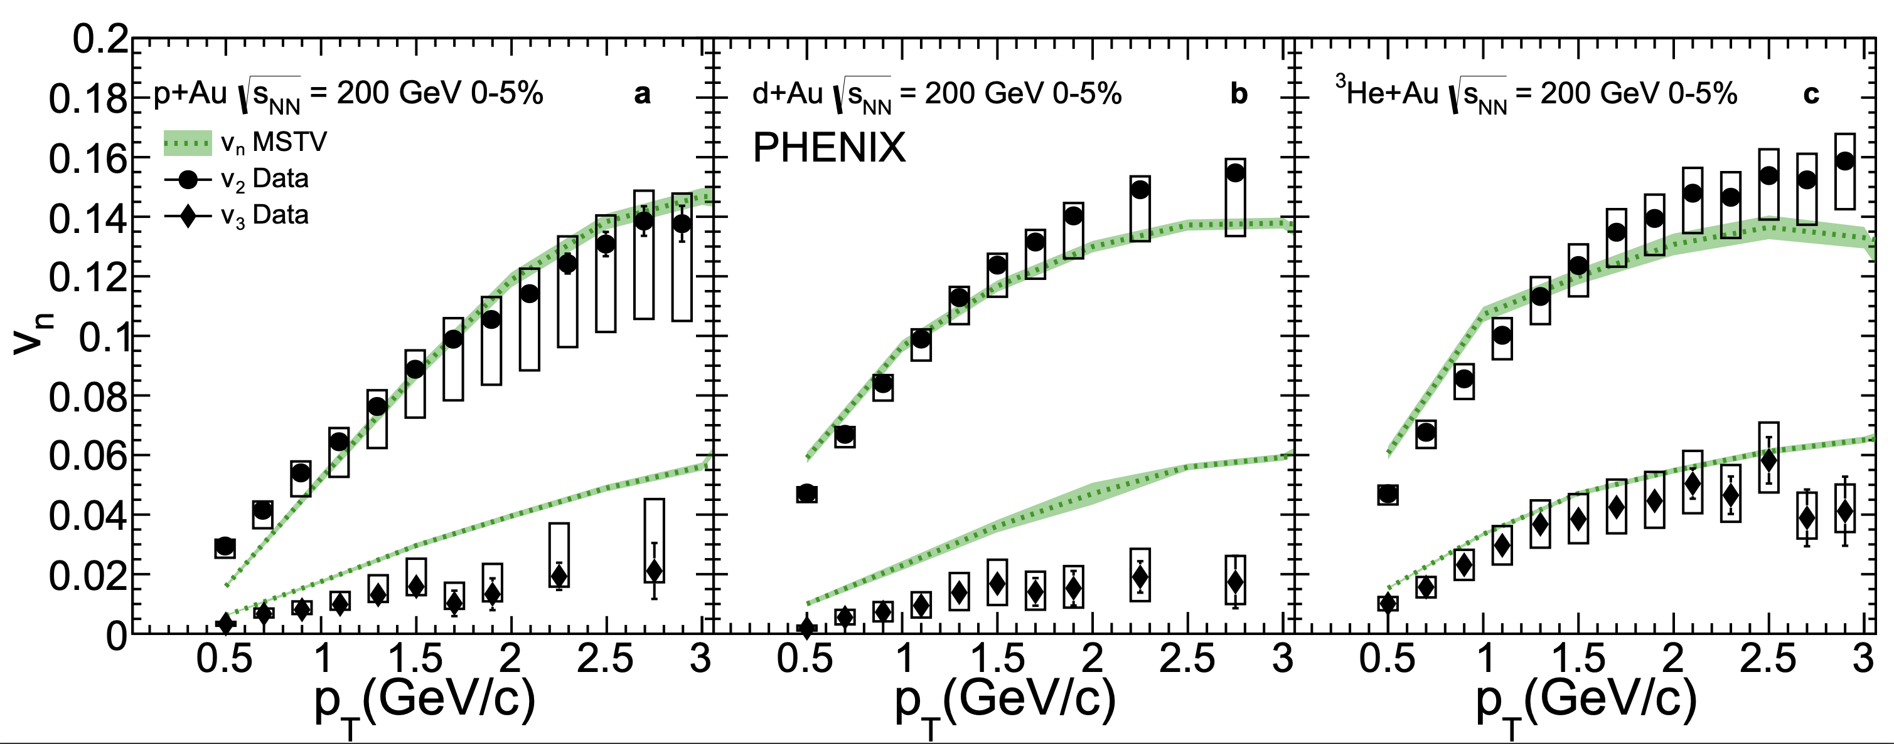
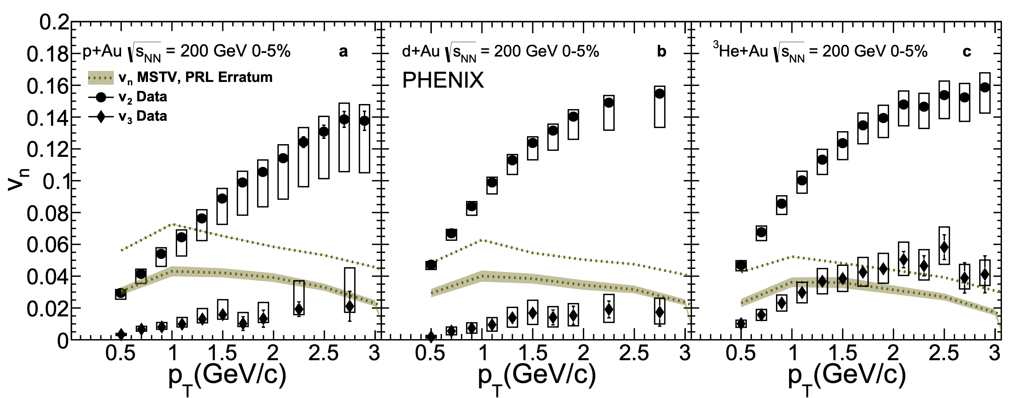
“In summary, due to the numerical error specified,
the hierarchy of v₂;₃ seen in the PHENIX data is not seen in our model.
It cannot therefore provide a viable description of the data.”
Erratum: Phys.Rev.Lett. 121 (2018) no.5, 052301
Corrigendum: Phys.Lett. B788 (2019) 161-165

Slide 14

Feynman was asked at a Princeton Tea
Would you like cream or lemon in your tea?
Both! (he replied)
Surely you’re joking, Mr. Feynman
Geometry is dominant (the cream),
but maybe there is a sub-dominant role
for initial state correlations (the lemon).
*Try the experiment of both cream and lemon during the break

Slide 15
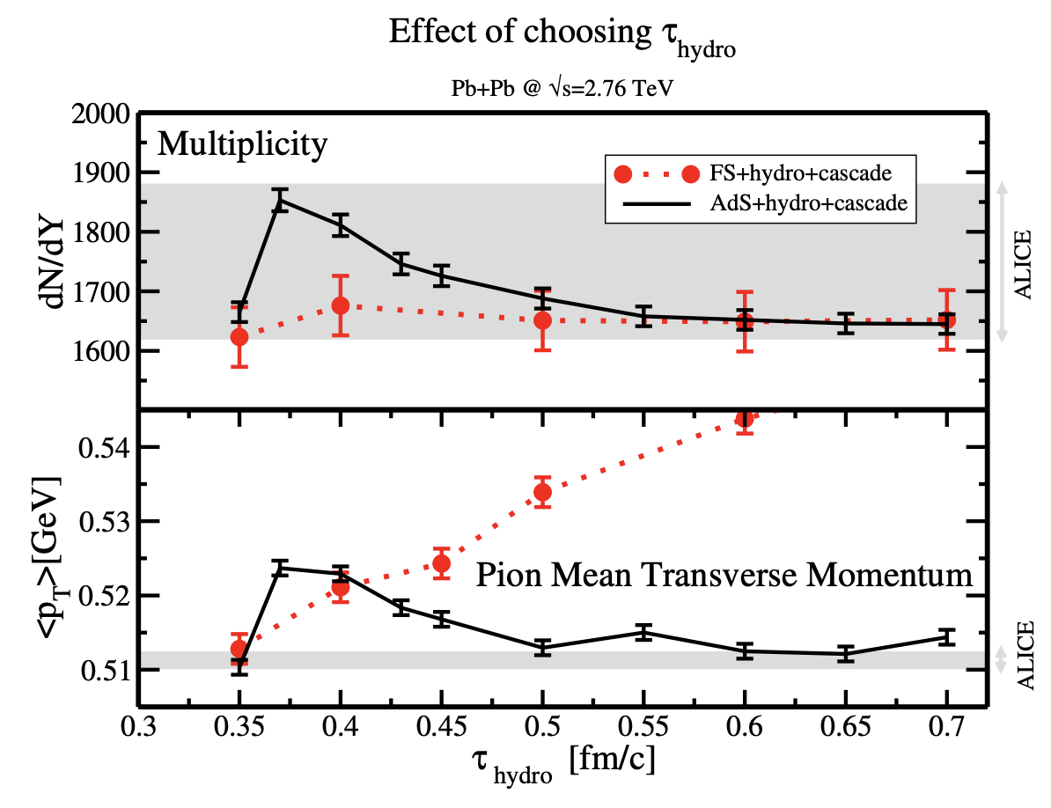
New Window on Pre-Hydro Stage
Strong Coupling (AdS/CFT) – used in superSONIC
Free Streaming (FS) – used in many implementations
Kinetic Theory (KT) – example KøMPøST
Weak Coupling (IP-Glasma) – used in new Hybrid Hydro Approach
All of the above publicly available code!
Test if domain correlations persist through geometry driven hydrodynamics.
IP-Glasma (and FS to a lesser extent)
lead to stronger initial radial flow.
https://arxiv.org/abs/1307.2539

Slide 16
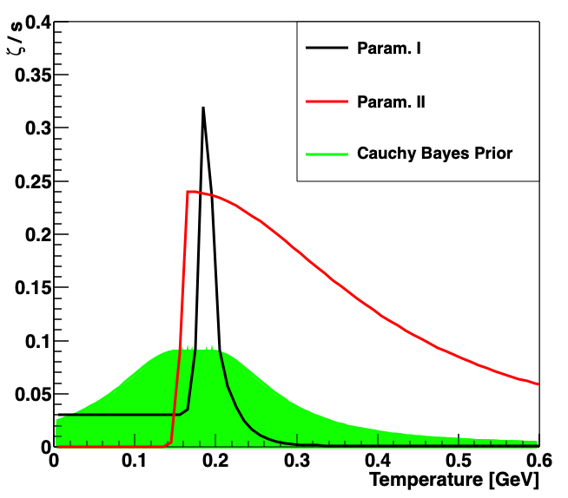
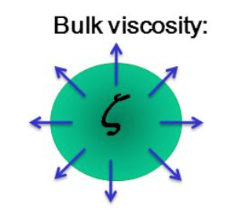
Bulk Viscosity and Cavitation
Bulk viscosity ζ/s
as fundamental in QCD
as shear viscosity η/s
Most modeling has modest bulk ζ/s=0.01
e.g. superSONIC (“one fluid to rule them all”)
However, Hybrid approach with IP-Glasma initial conditions needs large bulk
over a very broad temperature range
Param. I, often used, but based on incorrect sum rule
see Romatschke, Son: https://arxiv.org/pdf/0903.3946.pdf
Param. II used with new Hybrid IP-Glasma
Bayesian Prior Space in
Moreland, Bernhard, Bass, https://arxiv.org/abs/1808.02106
B. Schenke, C. Shen, P. Tribedy, https://arxiv.org/abs/1901.04378
https://arxiv.org/abs/1908.06212

Slide 17
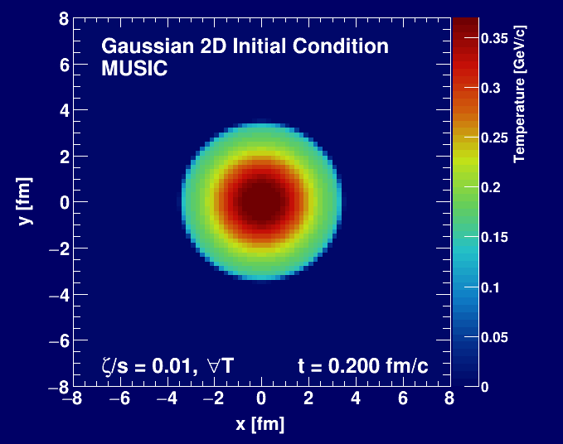
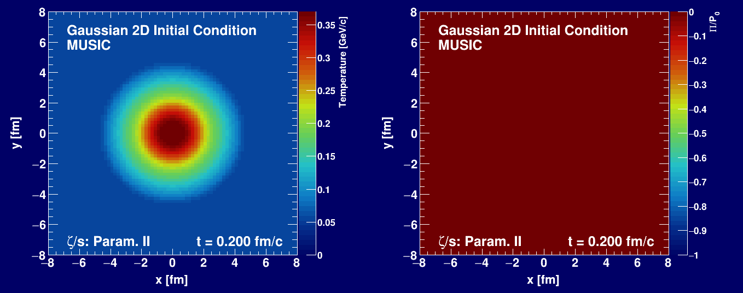
Simple test A – ζ/s = 0.01
Simple test B – ζ/s large
If QCD has such a large ζ/s,
fundamental knowledge gained
However, I believe the hydrodynamics results are unreliable in this regime.
Can the field formalize these studies to understand if cavitation is ruled out by data!
Would that rule out IP-Glasma initial conditions with large radial flow?
Pressure_{effective} = P₀ + Π
Entire volume at
negative pressure
while at high T
Cavitation!
Bubbles forming
Hydrodynamics:
Stop out of bounds!
Π /P₀ < -1 then negative P_{eff}
Π /P₀
M. Byres, https://arxiv.org/abs/1910.12930

Slide 18
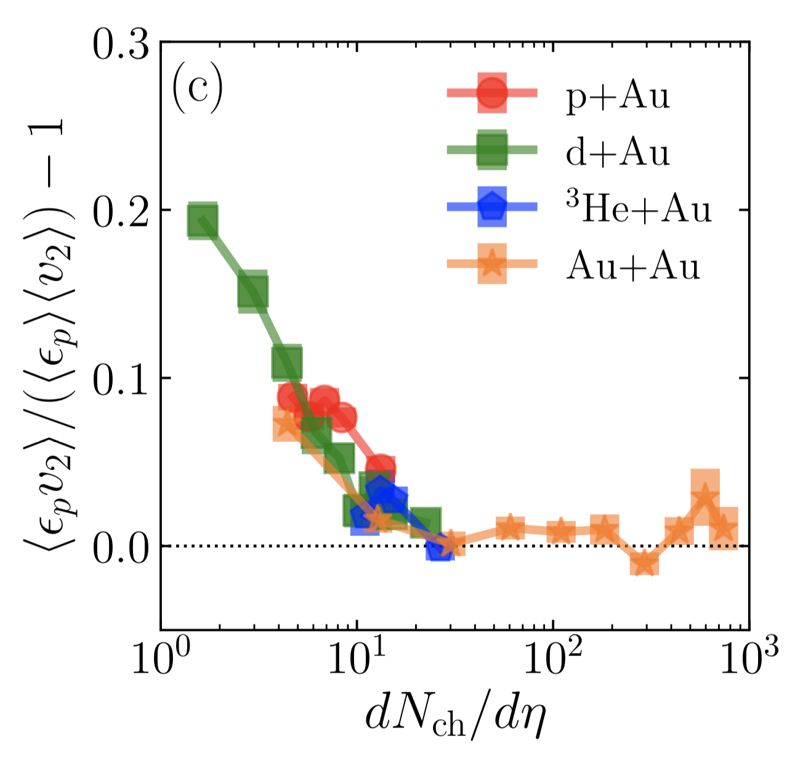
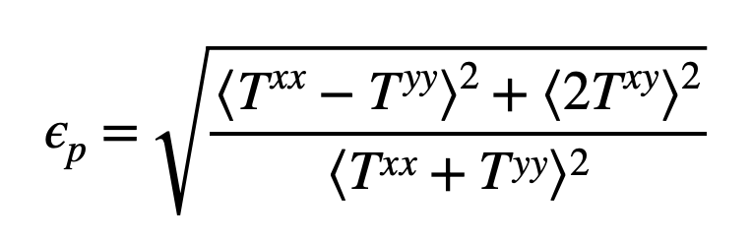
Both Cream and Lemon
IP-Glasma + BAMPS (not public code)
0-5% Central pAu, dAu, ³HeAu
https://arxiv.org/abs/1903.00314
Phys.Rev.Lett. 121 (2018) no.22, 222301
IP-Glasma T_{μν} + Hydrodynamics
https://arxiv.org/abs/1908.06212
Stress-Energy Tensor T _{μν} Asymmetry
(IP-Glasma τ=0.4 fm/c) encodes
initial state correlations
Some correlation (influence) survives hydro evolution for dN_{ch}/dη < 15

Slide 19
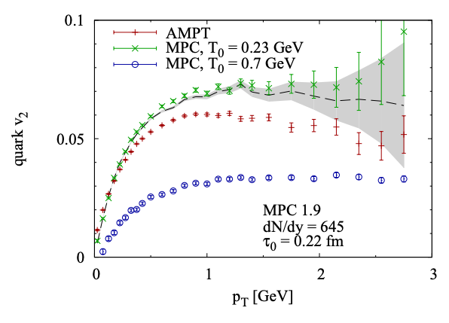
Quasiparticles instead of Hydrodynamics
Key RHIC theory input for strongly-coupled sQGP
How AMPT generates large elliptic flow with small cross sections
D. Molnar https://arxiv.org/abs/1906.12313
T₀ = 700 MeV vs 230 MeV
45 mb
https://arxiv.org/abs/nucl-th/0104073
Now understood conflict between the conventional “wisdom” from MPC and the newer AMPT
2→2 angular distribution highly dependent on momentum distribution (T₀) of partons
However, initial population of nearly massless (anti) quarks in AMPT cannot be the answer!
More work with realistic quasi-particles necessary; be clear about what is constrained by QCD.

Slide 20
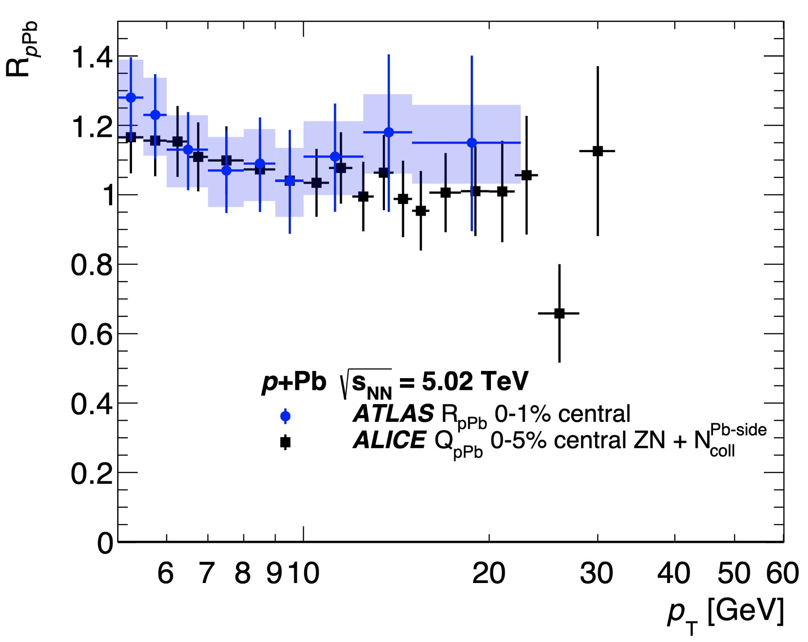
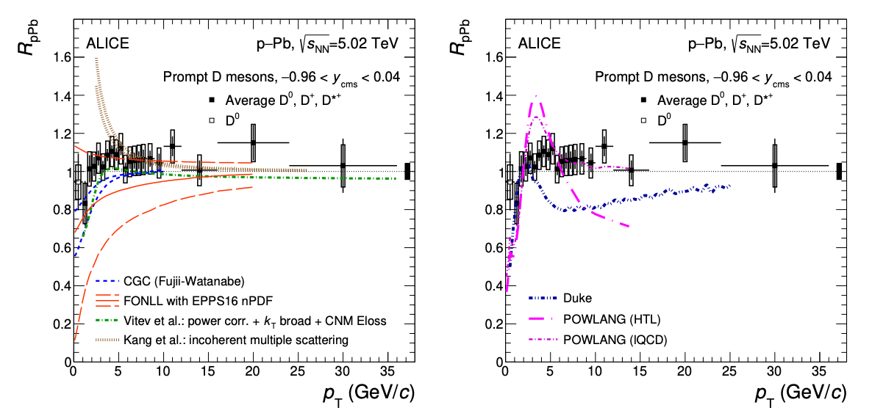
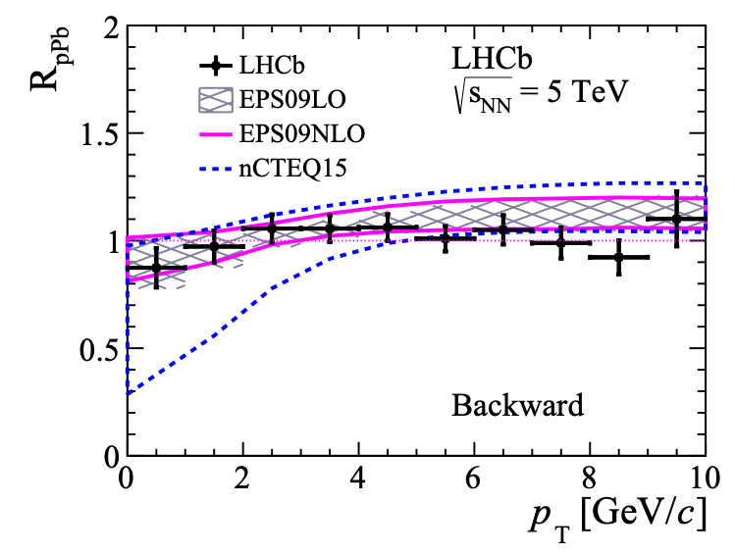
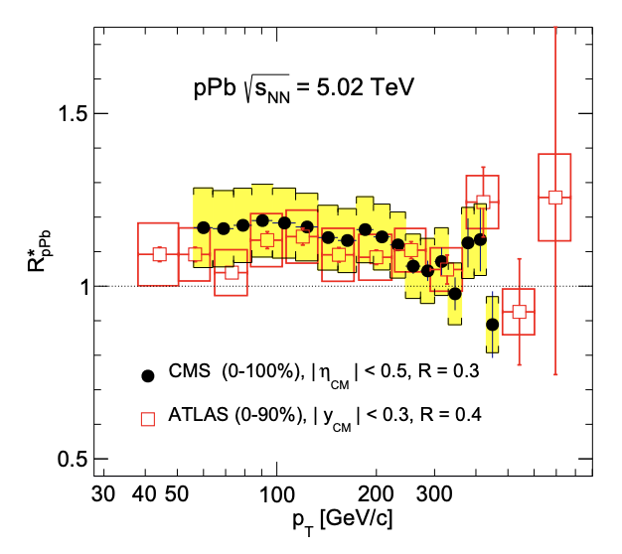
What about hard processes and jet quenching?
https://arxiv.org/abs/1707.02750
https://arxiv.org/abs/1910.13978
https://arxiv.org/abs/1906.03425
https://arxiv.org/abs/1601.02001
Experiments have ruled out changes to the p_{T} distribution larger than ~ 10%
v₂ at high p_{T} in A+A associated with differential energy loss…

Slide 21
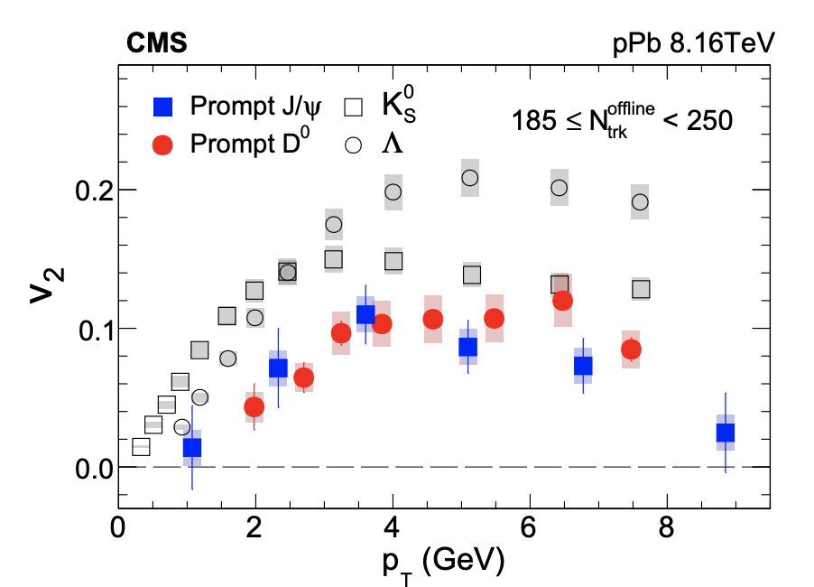
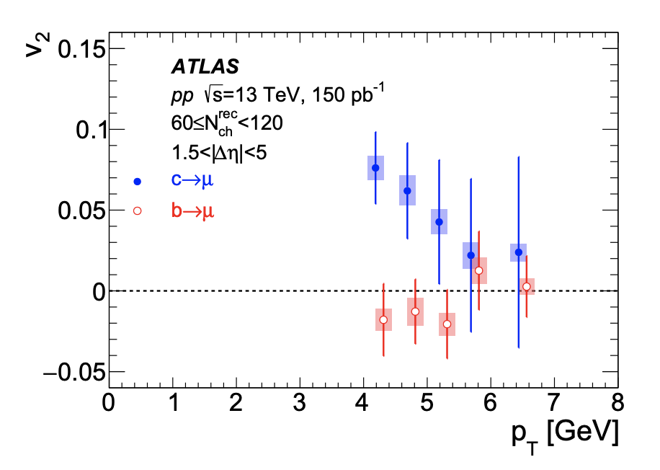
Heavy-Flavor Flow
pPb
pp high mult.
Charm
https://arxiv.org/abs/1810.01473
D⁰
https://arxiv.org/abs/1909.01650
J/ψ
Bottom
dN_{ch}/dη > 80
dN_{ch}/dη > 25
More exciting results already shown this morning!

Slide 22
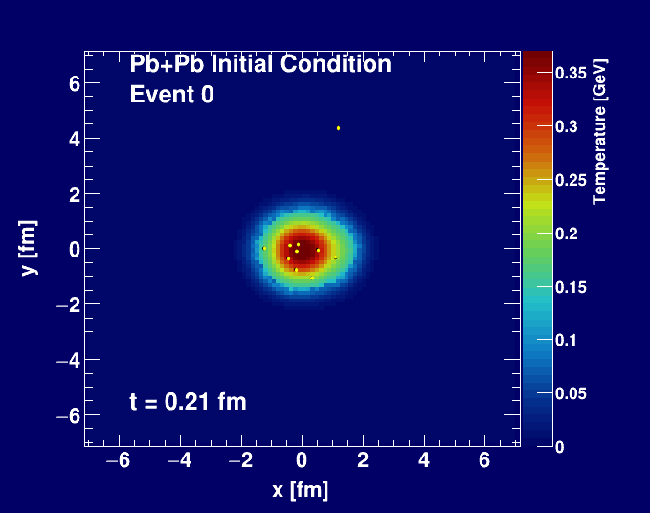
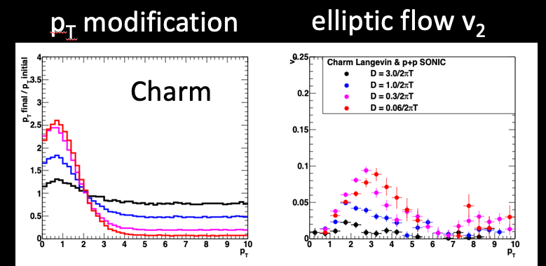
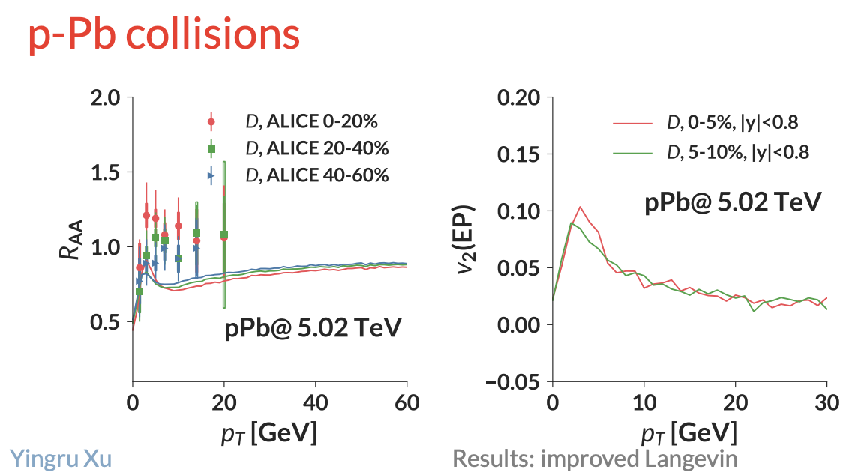
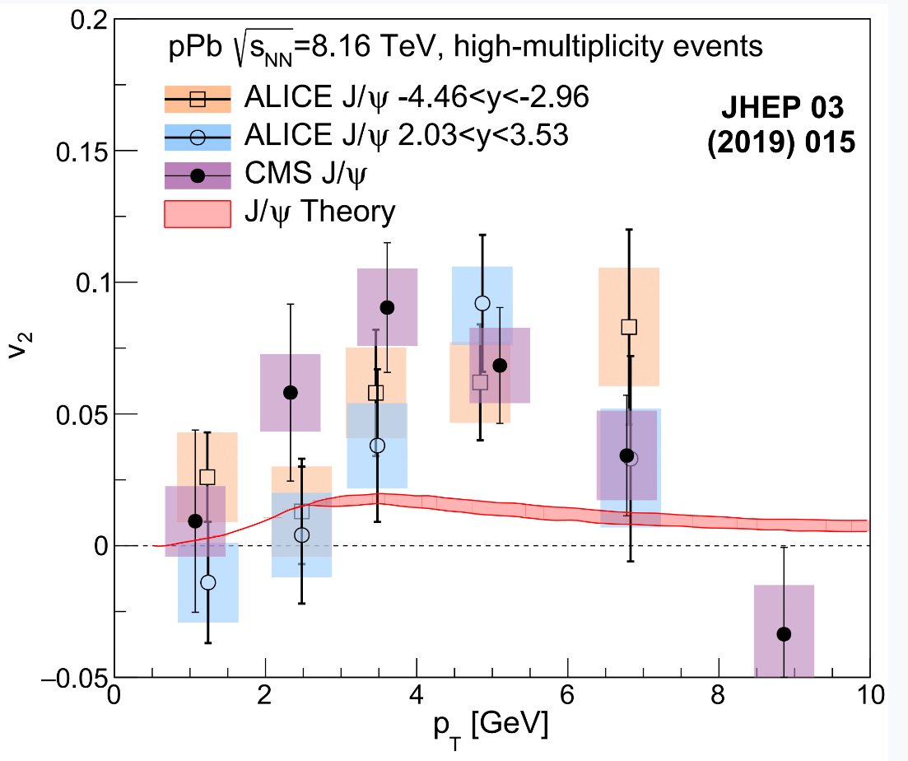
Langevin-Type Flow ?
Drag & Diffusion:
no v₂ without p_{T} change
Very hard to reconcile
State-of-the-Art Calculations
even with much stronger coupling, D(p,T) dependencies, cannot describe the data
p+p Initial Condition
https://arxiv.org/abs/1808.10014
https://www.bnl.gov/aum2018/content/workshops/Workshop_1f/XU_OpenJFTransport.pdf

Slide 23
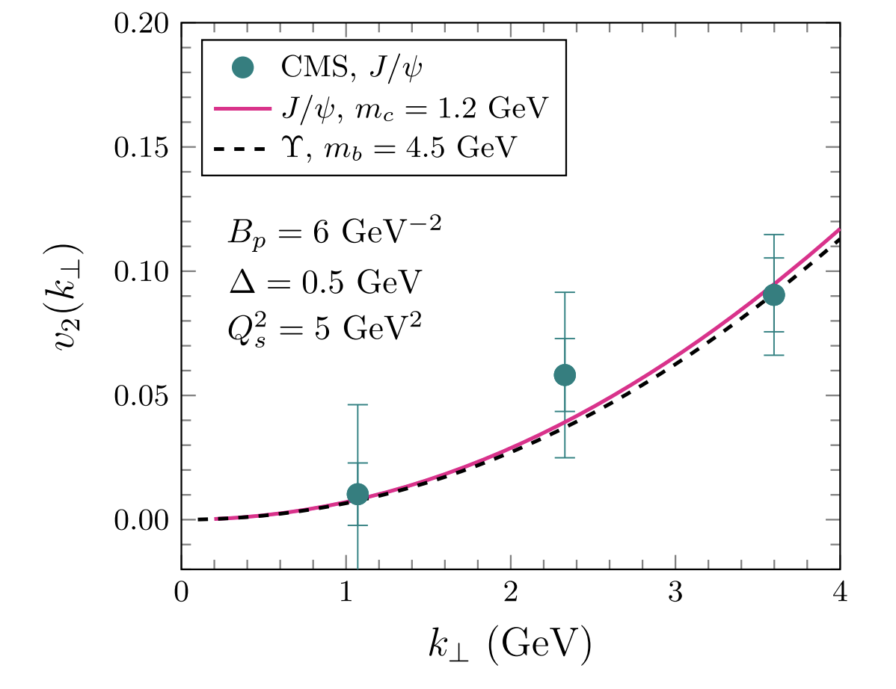
Heavy-Flavor Color Domain Effect?
Alternative Proposal: Color Domain Effect
Do not think v₂. Think v_{2,2} correlation between J/ψ and bulk low p_{T} hadrons.
IF bulk medium v₂ is hydro + geometry
and J/ψ v₂ is color domains…
IF geometry orientation and color domain orientations are uncorrelated…
THEN, v_{2,2} (J/ψ –h) is zero!
We cannot have both explanations.
https://journals.aps.org/prl/abstract/10.1103/PhysRevLett.122.172302
Uncertainty drawn from
variation of Q_{s}² = 3 –7 GeV²

Slide 24
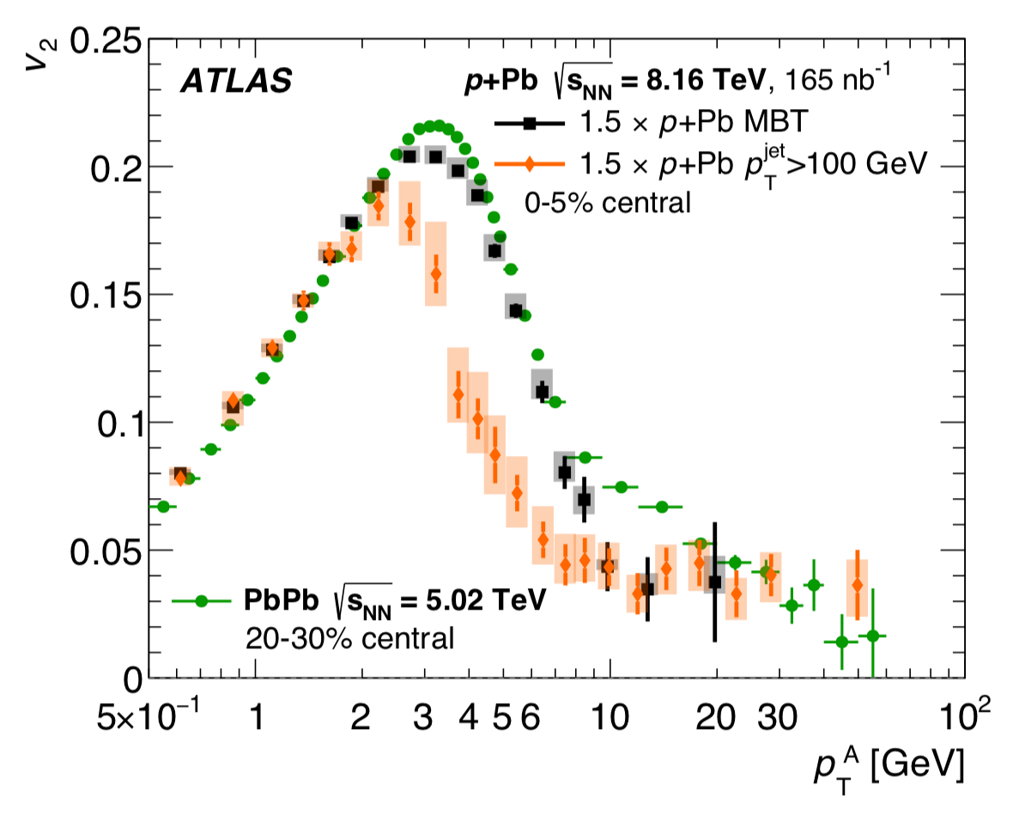
Differential Jet Quenching?
R_{pPb}
v₂
Definitive evidence for
high p_{T} ~ 50 GeV v₂ in p+Pb using
jet triggered events
How can there be differential jet quenching without jet quenching!
Unknown source.
Hint in p+Pb
https://arxiv.org/abs/1910.13978
Tension in A+A both in jet quenching and heavy quarks (R_{AA} and v₂) should now be viewing in conjunction with these small system results

Slide 25
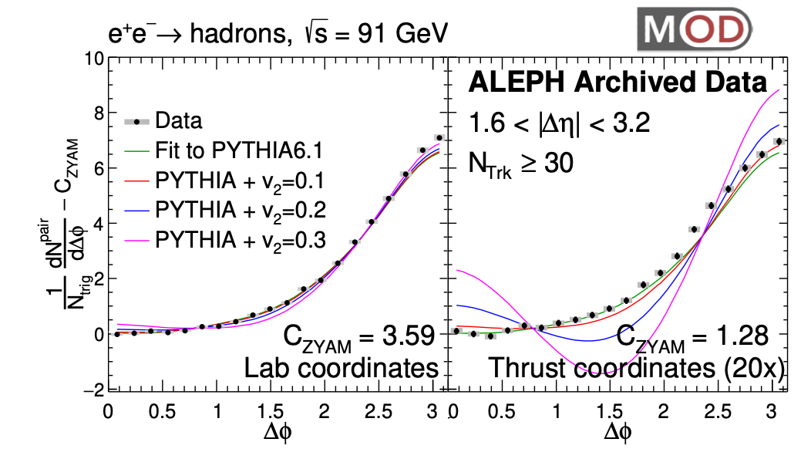
Other Systems
e⁺e⁻ - extra congratulations to that team!
No signal, but if ε₂ small, then little sensitivity
by this measure
ep – not stat. & sys. significant yet
UPC - Ultraperipheral Pb+Pb Collisions
https://arxiv.org/abs/1906.00489
We need a geometry model to quantitatively incorporate all this new exciting data!
https://atlas.web.cern.ch/Atlas/GROUPS/PHYSICS/CONFNOTES/ATLAS-CONF-2019-022/

Slide 26

Non-Summary
Whether you agree or disagree, we all need to work harder on this scientific enterprise to
rise to the occasion and
really learn something fundamental about QCD.
I look forward to all the exciting results and ideas this week!

Slide 27
Fini

Slide 28
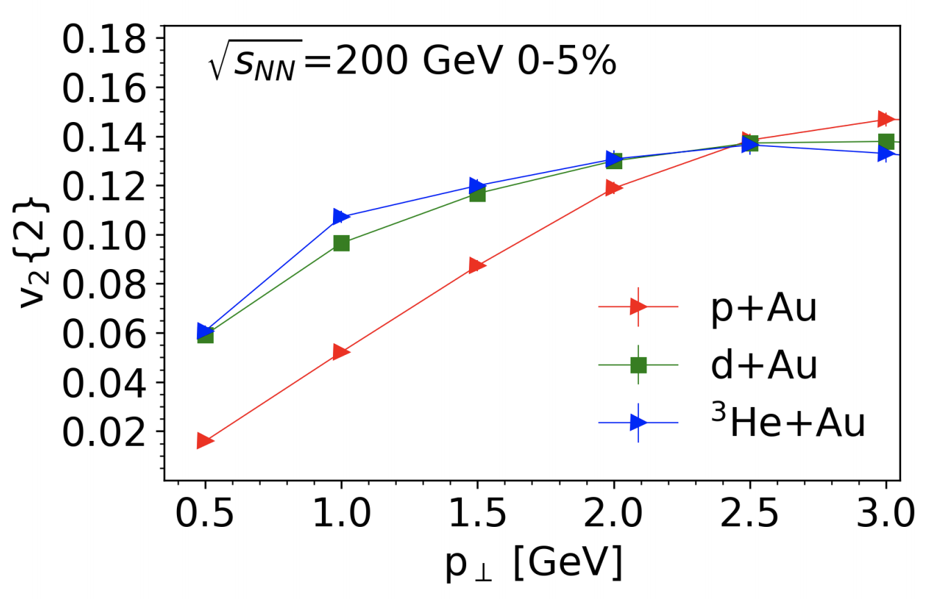


MSTV Erratum and Corrigendum
Erratum: Phys.Rev.Lett. 121 (2018) no.5, 052301
Corrigendum: Phys.Lett. B788 (2019) 161-165

Slide 29


I was asked if the PHENIX Nature Physics needed an erratum since the incorrect theory curves are shown.
OK – Time to move forward!

Slide 30
Beware the statement that initial state correlations are
ab initio and have to be there. Not true.
Dilute-Dense (MSTV)
makes sense that the proton is “dilute”
However, should be called “Dense – More Dense” because the formalism still requires the proton to be in the saturation regime.
Dense-Dense (IP-Glasma)
But is also used for describing p+p and p+A.
Utilizing this formalism for proton at x ~ 10⁻² at RHIC
is not ab initio. If it was, why would we need an EIC.

Slide 31
Ab initio or non pertinet
Many have stated that these color domains effects are calculated ab initio
However, saturation physics in the proton at x > 0.01 challenges the whole picture of the formalism
One estimate has Q_{s,0}² (gluon) = 0.67 GeV² for x = 0.01 at the very center of the proton, and averaged over r = 0.67 fm the value would be
Q_{s}² (gluon) = 0.28 GeV²
War is Peace
Love is Hate
Dilute is Dense

Slide 32

STAR Small Systems Flow Too
Five years after first PHENIX d+Au flow paper (Phys.Rev.Lett. 111, 212301, 2013),
STAR has a preliminary result for confirmation.
New STAR Preliminary results
including ³He+Au (!)
shown this morning.
Will be very interesting to compare in detail when results are published.
STAR measurement with small rapidity gap has significant non-flow.
Two different subtraction methods applied give reasonable agreement ~ 20% level.
https://indico.cern.ch/event/656452/contributions/2869833/attachments/1649479/2637419/QM18-smallsystem-shengli-10.pdf

Slide 33



p+Au Comparison
STAR result has a small Δη gap
huge non-flow contribution (even at low p_{T})
Super sensitive to the non-flow subtraction.
https://arxiv.org/abs/1902.11290
HIJING and AMPT closure tests indicate significant over-subtraction by template method with STAR kinematics for p_{T} > 1-2 GeV

Slide 34


PYTHIA’s Revenge
No long-range ridge
Jet trigger: long-range ridge
Major PYTHIA effect via initial-state radiation:
“SpaceShower::phiIntAsym”
implementing azimuthal asymmetries in the radiation pattern from colour coherence considerations.
This is without the “string shoving” option!
However, the effect is biggest in LOW multiplicity events and is watered down in HIGH multiplicity events.

Slide 35

Charged Particle Multiplicities
Phys.Rev.Lett. 121 (2018) no.22, 222301
Midrapidity Values
dN_{ch}/dη ~ 12 p+Au 0-5%
dN_{ch}/dη ~ 18 d+Au 0-5%
dN_{ch}/dη ~ 22 ³He+Au 0-5%

Slide 36
Not sure how to make major progress on this front.
Lots of parameter space, initial parton number and distribution, QCD calculations do not constrain parton-parton cross section nor 2→2 angular distribution.
Two major questions:
1). What good is a particle picture calculation with only quarks at m=0.015 GeV that ignores important many-body effects (and α_{s}~0.5)?
What does it mean that 2 → 2 calculations get some qualitative features right
(i.e. translation of geometry into flow coefficients) but as not self-consistent?
Models like AMPT are very useful tools.
However, unclear what they mean since they have unrealistic quasi-particles and violate their own assumptions.
Is it really just solving hydrodynamics via Boltzmann equations?
de Broglie Wavelength Radius
Uncertainty Principle Radius
p = 0.81 GeV

Slide 37

https://arxiv.org/abs/1905.05139
Needs careful examination…
If p+Pb, d+Au completely dominated by non-hydrodynamic excitations,
why do the patterns look so similar?

Slide 38

Very different approach…
Using transport approach as a solution to hydrodynamics, that also enables study of non-equilibrium effects.
No implication at η/s = 1/4π that the quasi-particles are “real”.
https://arxiv.org/abs/1907.11287

Slide 39


IP-Jazma AuAu b=0
Identical MC Glauber Nucleon Event
IP-Glasma AuAu b=0
IP-Glasma AuAu b=0 Energy Density
IP-Jazma AuAu b=0 Energy Density
Note that these are the identical MC Glauber events – that way all the IP-Glasma Glauber specifics are matched
(e.g. d_min = 0.9 fm, nonspherical Au, etc).
One can see the two event displays are the same MC Glauber event, and the EEC results are very similar, except the lattice spacing effect in the IP-Glasma case.

Slide 40


Apples to Apples Comparison at τ=0.000015 fm/c
ε₂
ε₃
ε₄
IP-Glasma initial conditions are useful, but provide no clear evidence for
sub-nucleon domain structures!
We should stop showing all the ”spiky displays” and saying quantum fluctuations!
ε₅
ε₆
Example numbers – ε₂ mean (IPG 0.104, IPJ 0.105), rms (IPG 0.054, IPJ 0.054), kurtosis (IPG 0.27, IPJ 0.30)
ε₃ mean (IPG 0.089, IPJ 0.091), rms (IPG 0.047, IPJ 0.047), kurtosis (IPG -0.023, IPJ -0.030)

Slide 41
One string, two string, red string, blue string…
e+e- → Z → one string
hypothetical two strings
Two string geometry correlation
over all rapidity
generates the signal
It does not mean the physics is fundamentally different in the two cases
https://arxiv.org/abs/1707.02307

