Slide 1


Small System Puzzles and Non-Puzzles
Jamie Nagle
University of Colorado Boulder
Random tings I have been thinking about…

Slide 2
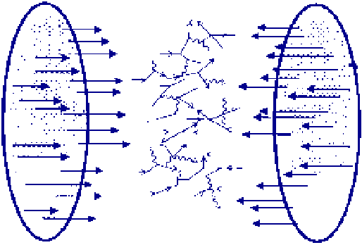
10,000 virtual gluons, quarks, and antiquarks
from the nuclear wavefunctions
are made physical in the laboratory !
What is their nature?

Slide 3
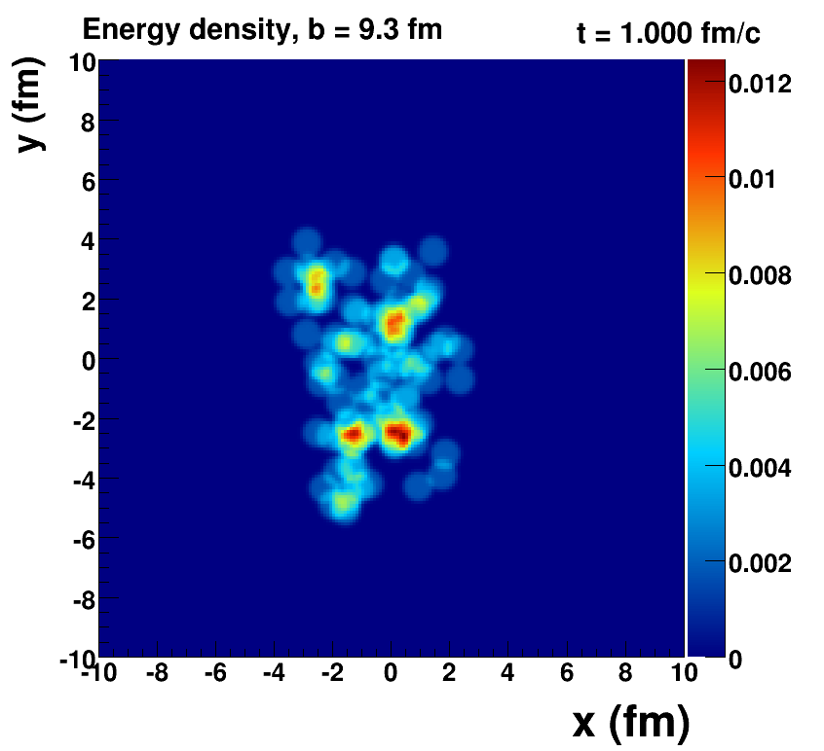

Slide 4
“Little Bang” Evolution Standard Model of Heavy Ions
Perfect Fluid picture tested in innumerable ways

Slide 5
Random Comment #1
“Geneva, 10 February 2000. At a special seminar on 10 February, spokespersons from the experiments on CERN's Heavy Ion programme presented compelling evidence for the existence of a new state of matter in which quarks, instead of being bound up into more complex particles such as protons and neutrons, are liberated to roam freely.”
https://home.cern/news/press-release/cern/new-state-matter-created-cern
“This material closely resembles a perfect fluid, as the strongly interacting quarks and gluons are free to move through the material…”
December 2018 – a quote I recently read…
Maybe free from hadron binding, but perfect fluid means very short mean free path!

Slide 6
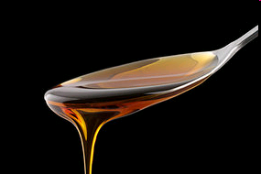
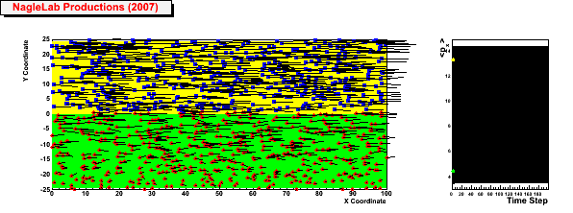
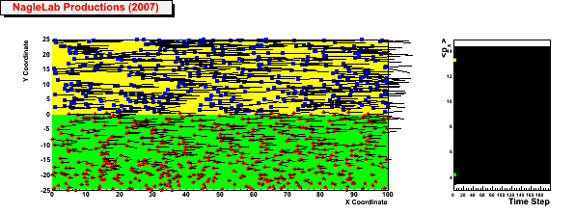
Viscosity Review
Honey – viscosity decreases at higher temperatures
viscosity increases with stronger coupling
Weak coupling (σ=0)
Inhibited
diffusion
↓
Small
viscosity
↓
Perfect fluid
↓
Strong Coupled QGP
(i.e. sQGP)
<p_{x}> top region
<p_{x}> bottom region
Strong coupling (σ ↑)

Slide 7
Random Comment #2
QGP is very inhomogeneous (part of the standard model)
With this knowledge in mind, why do so many models ignore this fact.
Initial Magnetic Field Map

Slide 8
If the hydrodynamic standard picture works on these very lumpy initial conditions and for higher moments that probe smaller length scales, why not in smaller systems…

Slide 9
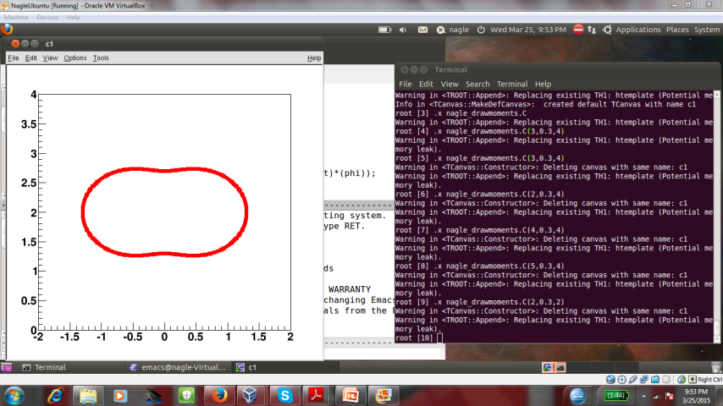
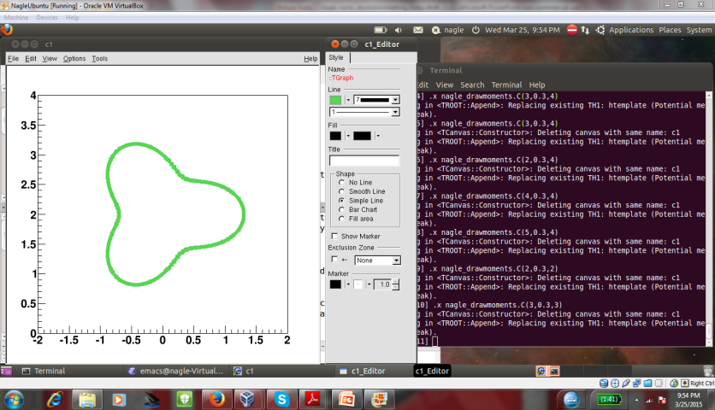
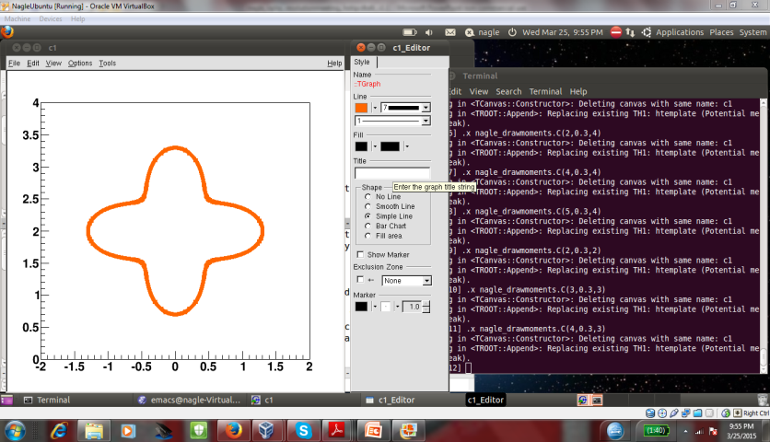
“One fluid to rule them all”
p+p
p+Pb
Pb+Pb
Weller and Romatschke, https://arxiv.org/abs/1701.07145

Slide 10
Hydrodynamic Comparison
PHENIX, https://arxiv.org/abs/1805.02973, Published in Nature Physics
Agreement with v₂, v₃ (p_{T}) for all three systems
SONIC hydrodynamic published prediction has very good p-value
Alternative hydrodynamics iEBE-VISHNU confirms results

Slide 11
What does it all mean?
I thought hydrodynamics only applies if
system is near equilibrium
system has a size scale L >> mean free path
How can these be true in p+p, p+Au, d+Au, etc.?
Maybe they are NOT!
String Theory Dual (completely solvable at strong coupling)
Systems very far from equilibrium still described by hydrodynamics as long as non-hydrodynamic modes are damped → hydrodynamic attractor.
Major re-thinking well beyond field of heavy ion physics.

Slide 12
Puzzles or Non-Puzzles

Slide 13
There are a multitude of experimental indicators that small systems and large systems follow the same physics.
Bulk observables are generally (*) described by the standard perfect fluid model without any tuning.
That presents a high burden of proof to accept that the similar observables are the result of completely different physics.

Slide 14
I do not find these cartoons useful…
Event multiplicity at fixed size = density (?)
But then p+p collisions produce very high density and so are not to the left.
RHIC and LHC small systems and intermediate systems overlap.
The idea that “true collective flow” only for “Ntrk > 100” [Strickland QM18] seems bizarre.
Exercise, try defining the x-axis properly and plot all RHIC and LHC systems (and not by tracks!)
Puzzling to me…

Slide 15


Non-Puzzle and Puzzle at the same time!
Many overview talks equivocate – “we still do not know if the correlations are all initial state or all final state effects”
Ruled out N++ times…
→ v3, cumulants, geometry, …
→ “identical” = “similar”
New postdictions
Repeat
Worthy of study, but do not equivocate!

Slide 16
Jet Quenching Puzzle(s)
If QGP perfect fluid in small systems, shouldn’t there by jet quenching?
Many p+Pb and d+Au minimum bias measurements indicating no suppression
(at least less than the 10-15% level).
System is small, so maybe effect is small < 15% ?
These are minimum bias collisions, and the effect should be larger in high multiplicity collisions ?
What do we expect theoretically?

Slide 17
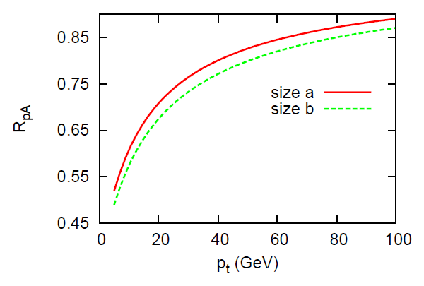
Likely this slide is out of date, but effects could be 10-20% even in 1% central p+Pb events
Measurements for RAA in p+Pb high multiplicity are hard because of bias on <Ncoll>
ZDC tag is good for 0-20% (ALICE)
More differential observables? I_{AA}
http://arxiv.org/abs/1311.5463
p+Pb Central

Slide 18
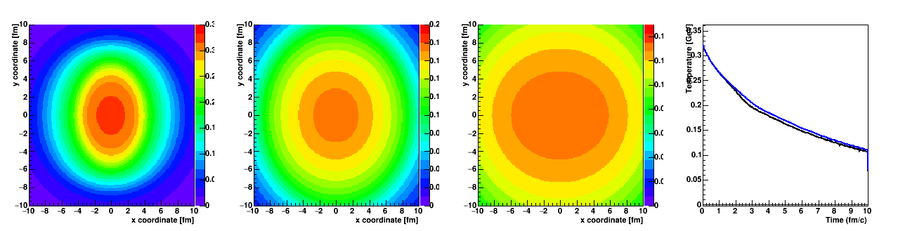
A+A Quenching Challenge
Looks like a large path difference for high momentum partons → hence significant v₂ at high p_{T} from differential energy loss
However, realistic time evolution indicates almost identical temperature cells traversed except at later (> 2.5 fm/c) times
That is why it is hard to generate significant v₂ at high p_{T}

Slide 19
Simultaneous Constraint of R_{AA} and v₂
Many solutions proposed over the years…
Stronger coupling near Tc →
emphasizes later time quenching when cells are at different temperatures
Event-by-event fluctuations
Many parameterized e-loss explanations
Always confuses me because I thought R_{AA} at RHIC was dominated by the Poisson probablity to have zero emissions (am I just old…)

Slide 20
Caveat Emptor
Here is a JEWEL calculation that appears to perfectly describe high pT azimuthal anisotropy.
Again, always need to see the simultaneous match.
However, in this case there is a different explanation… the default JEWEL medium does not expand in the transverse plane…

Slide 21
High p_{T} Anisotropy in p+A
Standard view
Hydrodynamics
Differential energy loss
Something in between (?)
Pattern looks identical in PbPb and pPb!
How can there be differential energy loss if there is no energy loss?
Even if there is some energy loss, how could it result in such a large v₂?
More measurements!

Slide 22
Recall: high burden of proof to accept that the similar observables are the result of completely different physics
Nagle Hypothesis - The high p_{T} anisotropy in PbPb is not due to differential energy loss
A high momentum quark cannot hadronized without a color connection back to the medium. These anisotropies are always correlating low and high momentum hadrons and so maybe this is a hadronization / color reconnection effect.
More measurements of hadron, jet, … anisotropies needed.

Slide 23
Back to Jet Quenching Puzzle
10+ year old PHENIX paper
https://arxiv.org/pdf/nucl-ex/0611007.pdf
Pion RAA as a function of centrality and orientation
X-Axis - <density weight path> from toy model
(static → bad, but over 13 years ago)

Slide 24
New Geometries
Can we constrain this minimum length / time scenario?

Slide 25
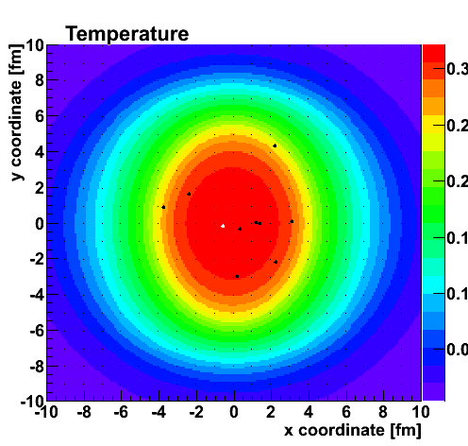
Heavy Quarks
Again key constraint of R_{AA} and v₂
Drag & Diffusion Calculations

Slide 26
ALICE discovers yet another theory calculation
No clear perfect match… but a clear trade off with more suppression and larger anisotropy
Drag & diffusion calculations have many unproven assumptions… and then hadronization

Slide 27
Heavy quarks in small systems…
Already drag & diffusion have problems in p+A,
but the problem just got a lot worse for everyone!

Slide 28
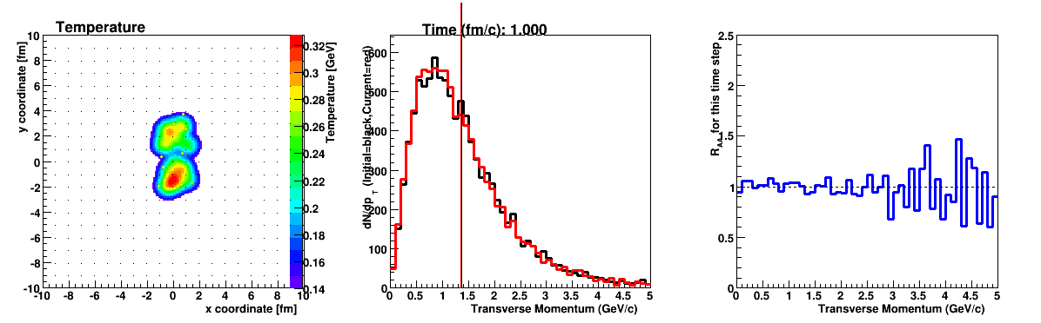

Slide 29
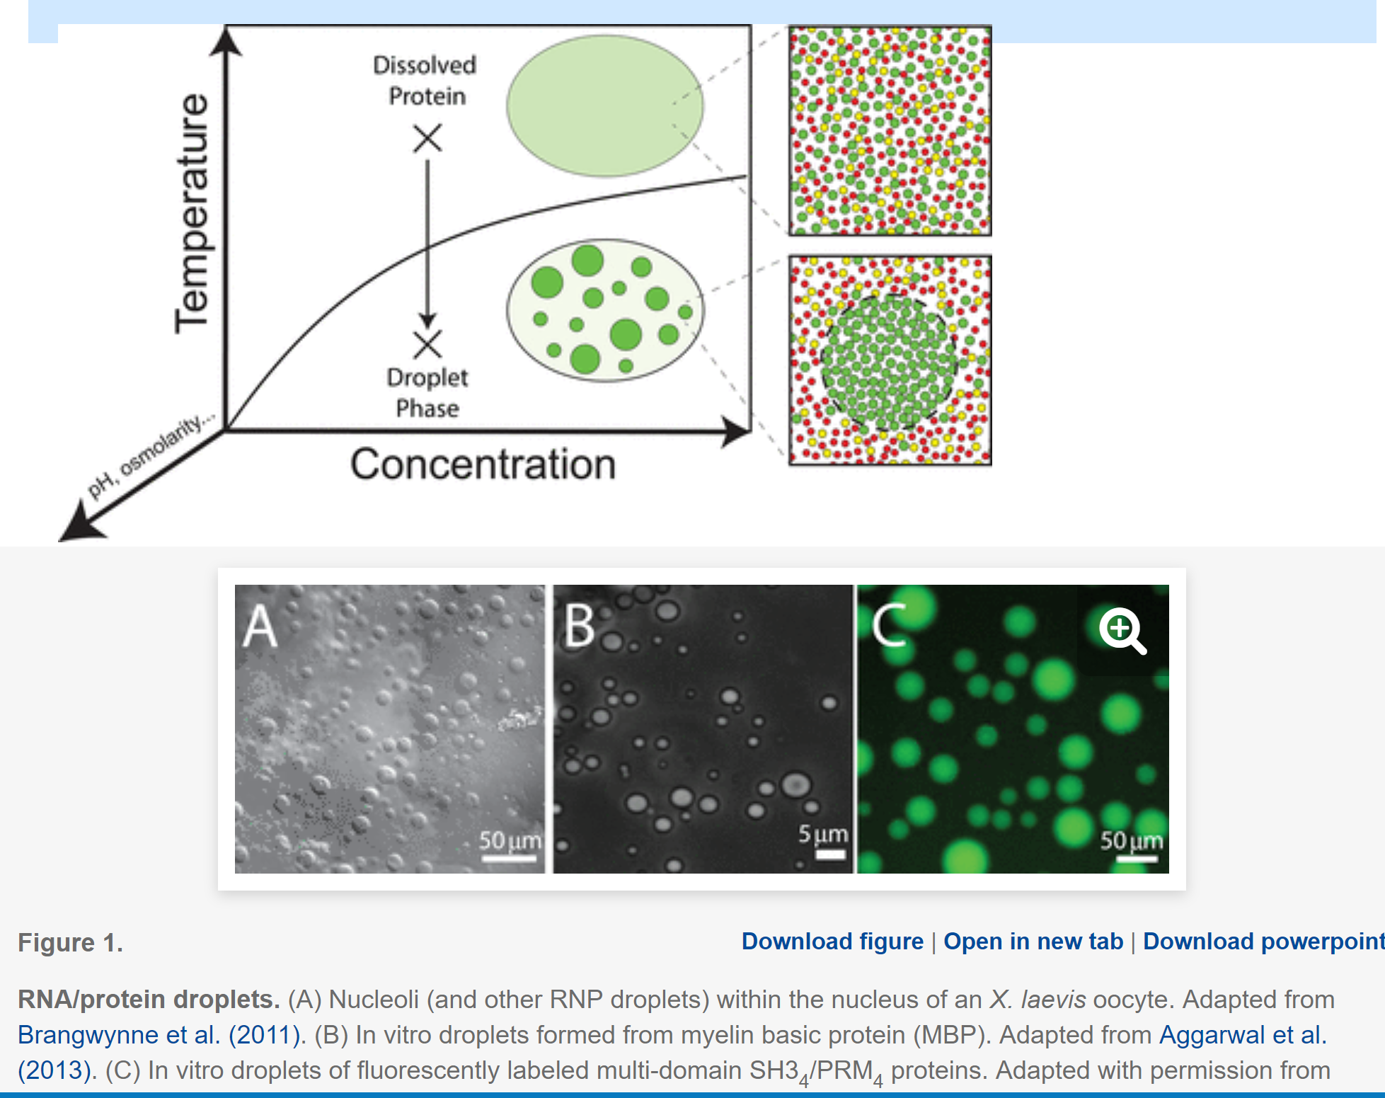
How small a droplet of matter can exist?
RNA/Protein droplets via a first order phase transition
Questions of size and structure actively researched
QGP near μ_{B}=0 is a smooth cross over
When does it make sense to talk of a smallest droplet?
A different question is
when is a system too small to see specific observables or be described accurately by a set of equations

Slide 30
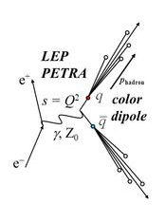
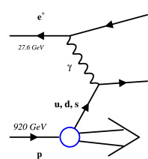
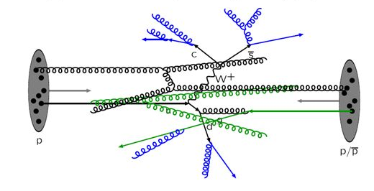
Smallest Systems
e⁺+e⁻
e+p
p+p
d+Au beam energy scan
at RHIC in 2016
200, 62.4, 39, 19.6 GeV
Pb+Pb UPC (?)

Slide 31
e+p
Exciting ZEUS results at QM18
Many scientists concluded, no “flow signal” and thus “turning off of QGP”…
However, closer examination indicates v₂ ~ 3-5% could be
hiding in the uncertainties
My guestimate says the same is true for the e⁺e⁻ results shown

Slide 32
One string, two string, red string, blue string…
e+e- → Z → one string
hypothetical two strings
Two string geometry correlation
over all rapidity
generates the signal
It does not mean the physics is fundamentally different in the two cases
https://arxiv.org/abs/1707.02307

Slide 33
Ending Slide
A good starting point given all the evidence is that A+A and small+small and small+A are similar physics.
That may cause us to re-evaluate the physics going on in A+A!
Worthwhile to continue investigating alternatives but
without simply equivocating.
We need to think selectively about the best observables else we get buried and hence confused.

Slide 34
Fini

Slide 35
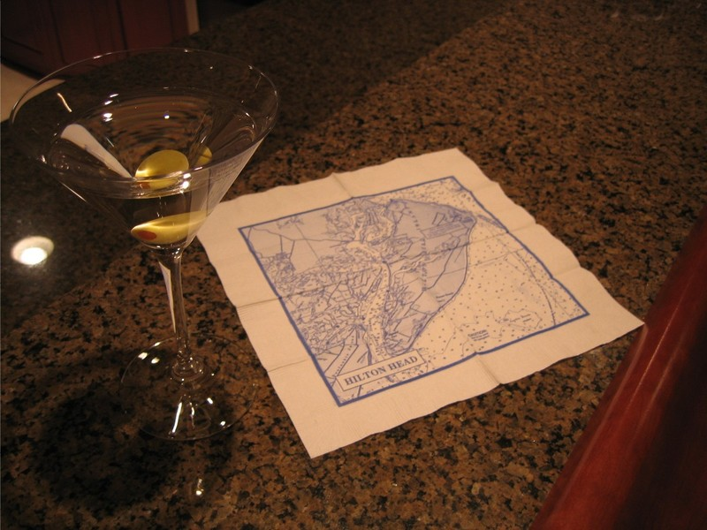
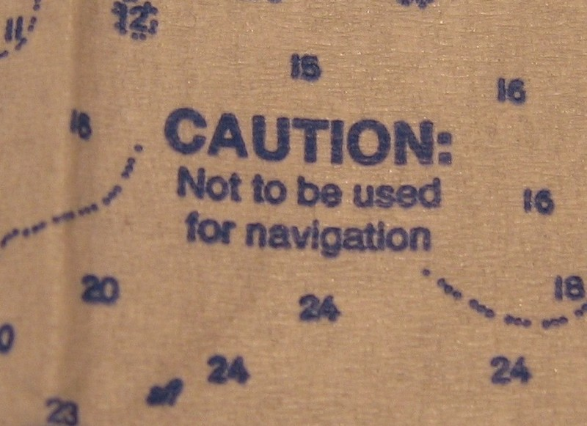
Smooth initial conditions
Caution: Not to be used for real calculation

Slide 36
