Slide 1
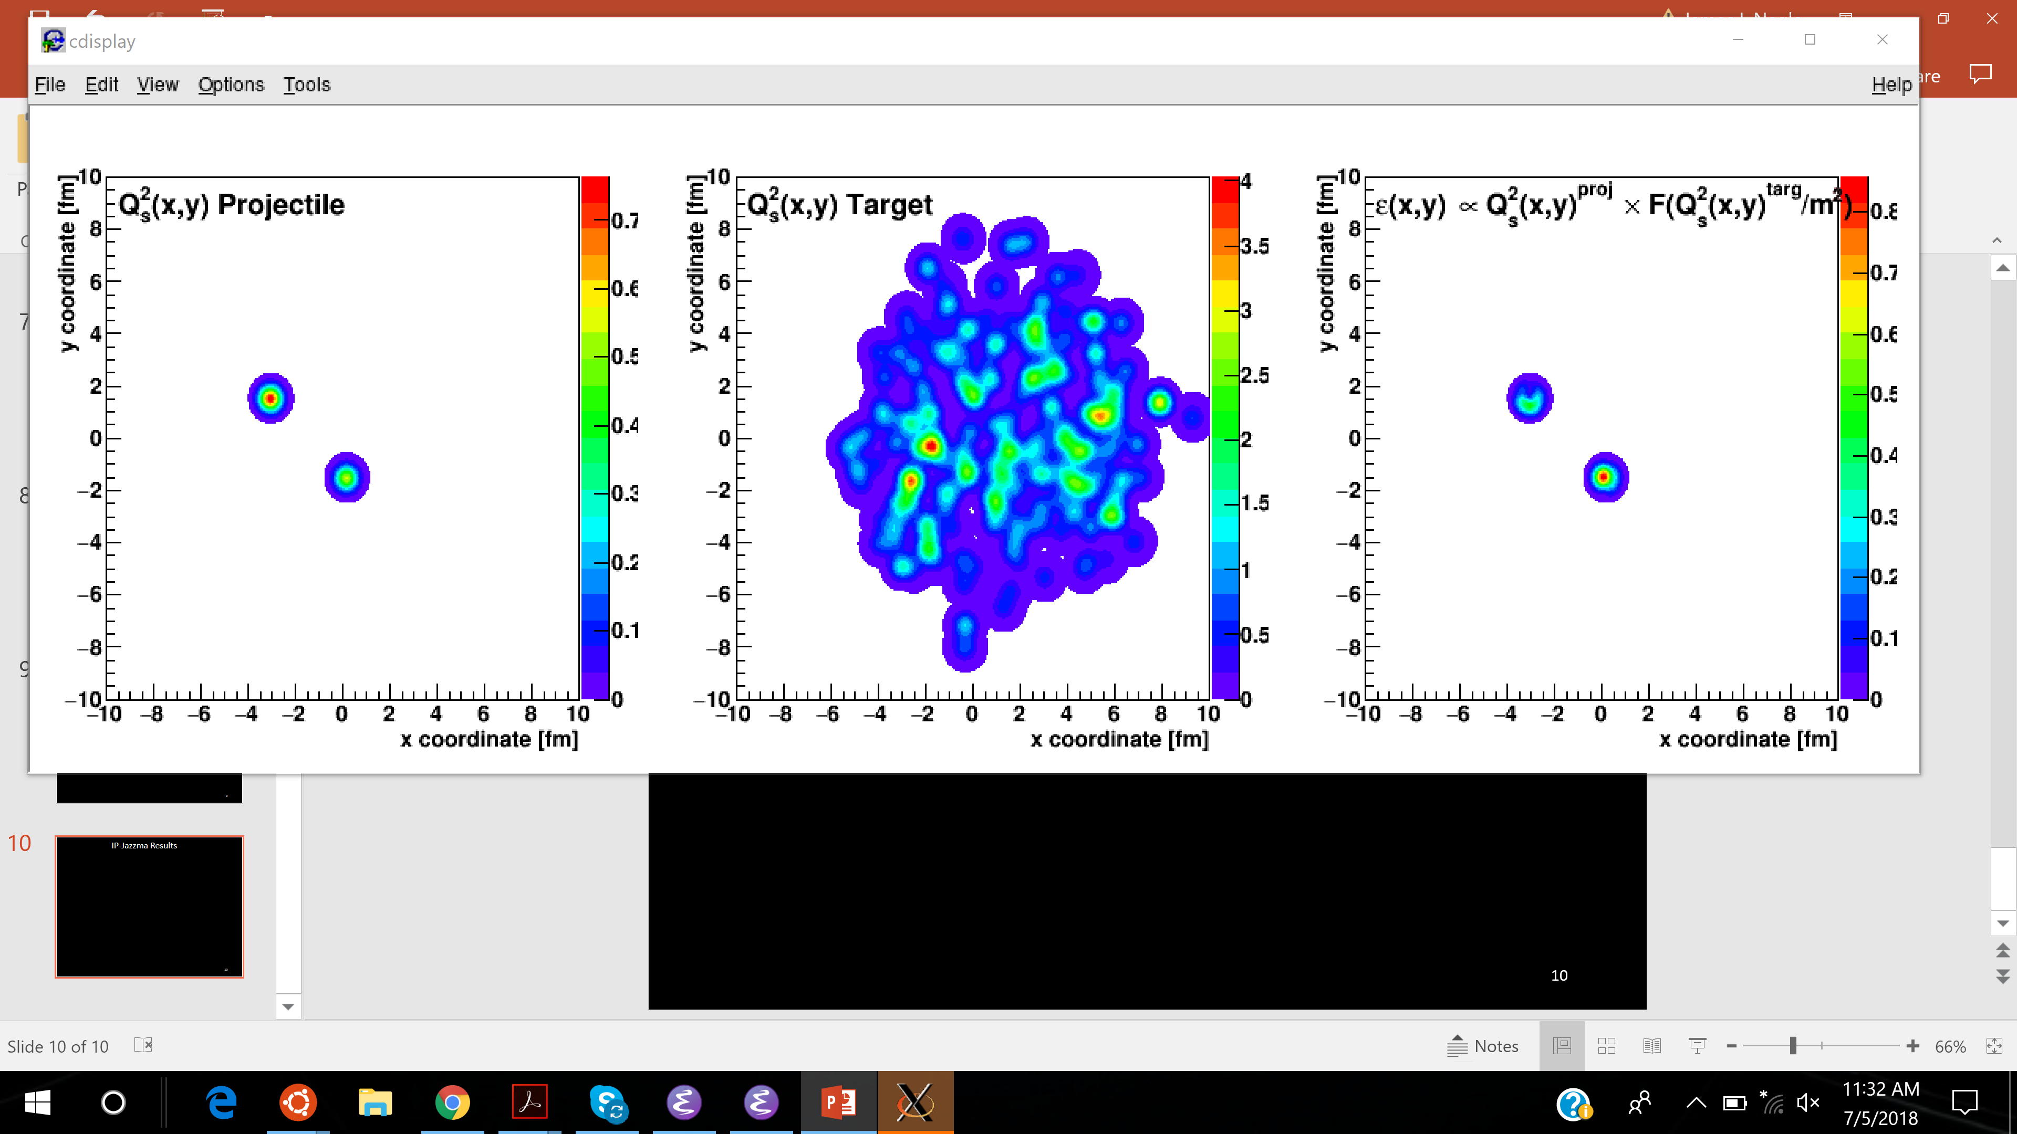

Dissecting the Small Collision System Frog
Jamie Nagle
University of Colorado Boulder
Work carried out with W.A. Zajc (Jazma) and
Sanghoon Lim (Glasma)
https://arxiv.org/abs/1808.01276
https://github.com/jamienagle/IPJazma

Slide 2
Does not make sense to give a full reprisal of the Rice Workshop IP-Jazma talk here
https://indico.cern.ch/event/771998/timetable/ - all.detailed
We are making good progress working together – that is what the INT is for!
Highlight some key points and some new points for discussion – not always pretty.

Slide 3
What is IP-Jazma?
IP-Glasma (dense-dense), MSTV (dilute-dense) calculations have many ingredients (A+B+C+D)
some very phenomenological (A+B+C)
some weakly-coupled effective field theory (D)
How to determine which ingredients are dominant for which observables?
That is the goal of the IP-Jazma framework (A+B+C).
The goal is not to match data, but to understand theory.
IP-Jazma is publicly available (https://github.com/jamienagle/IPJazma)
IP-Jazma results shown have zero free parameters, in the sense that we match exactly the A+B+C parameters from IP-Glasma or MSTV when making comparisons.

Slide 4
IP-Jazma
1. MC Glauber to obtain nucleon x,y positions in each event
Use IP-Sat (impact parameter saturation model) to calculate the Q_{s}² distribution on an x,y lattice
Just a uniform Gaussian with σ = 0.32 fm at RHIC and narrower (0.29) at the LHC
3. Simple linear sum Q_{s}² (projectile) and Q_{s}² (target)
4. Then calculate the resulting energy density in the interaction
Q_{s}² (x,y) = Q_{s,0}² x Exp(-r_{T}²/(2σ²))
T_{A}(x,y) = Σ Q_{s}²(x,y) [proj] and T_{B}(x,y) = Σ Q_{s}² (x,y) [targ]
ε $∝$ g² T_{A}(x,y) x T_{B}(x,y) (when in the dense-dense limit)

Slide 5
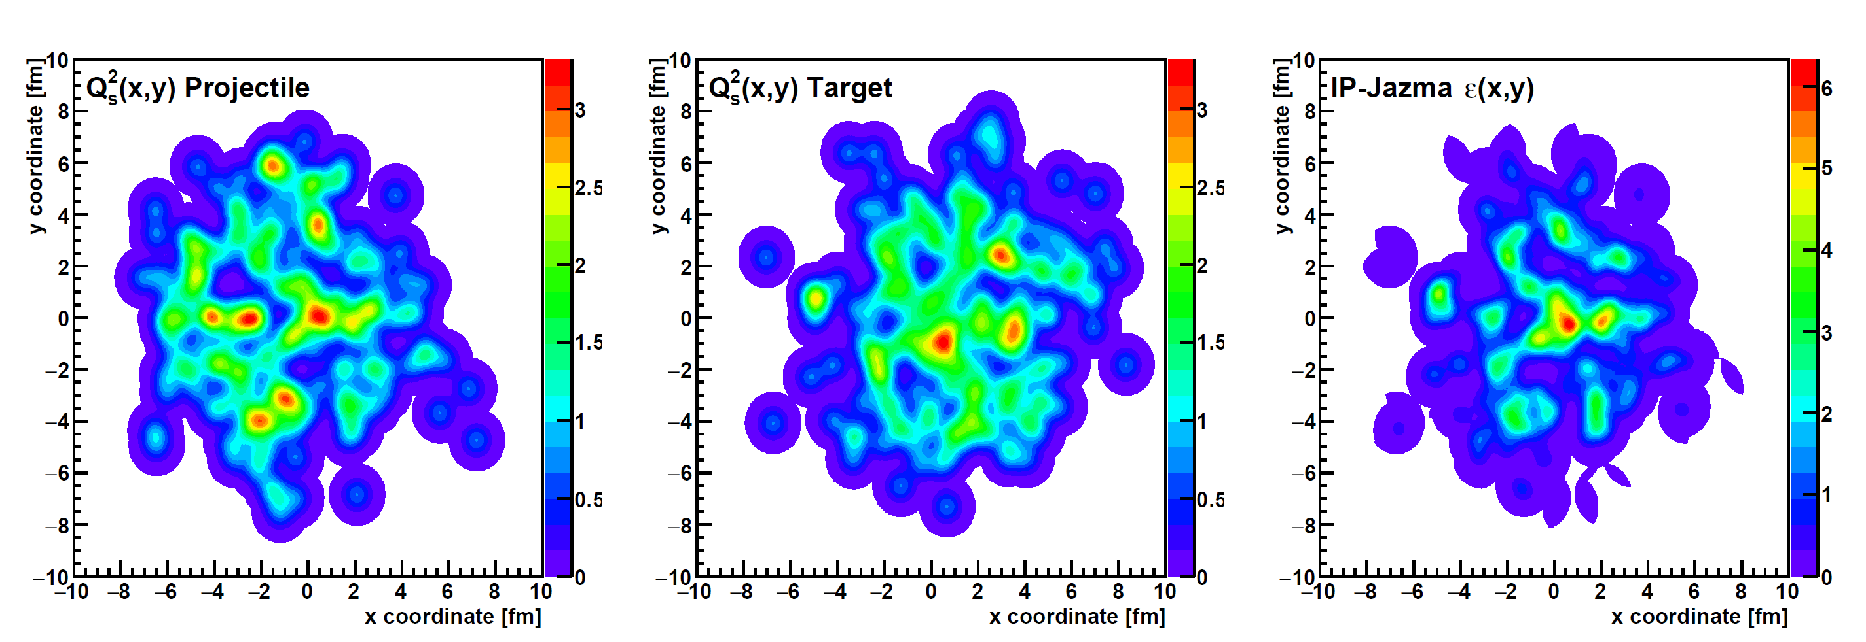
IP-Jazma A+A Result
T_{A}(x,y) = Σ Q_{s}²(x,y) [proj] T_{B}(x,y) = Σ Q_{s}² (x,y) [targ] ε $∝$ g² T_{A}(x,y) x T_{B}(x,y)

Slide 6
Start with IP-Glasma as a positive case…
Recently Bjoern Schenke has made a github version of IP-Glasma available - thanks!!!
Reading the code leads to clarity on important issues, and also more meaningful comparisons.
example (1) – finding important details: Glauber d_{min} value (const double d_min = 0.9)
example (2) – regulator –wrong in equation in many papers but right in the code
example (3) – output of Glauber nucleon positions as input for IP-Jazma
permits true apples-to-apples comparison

Slide 7
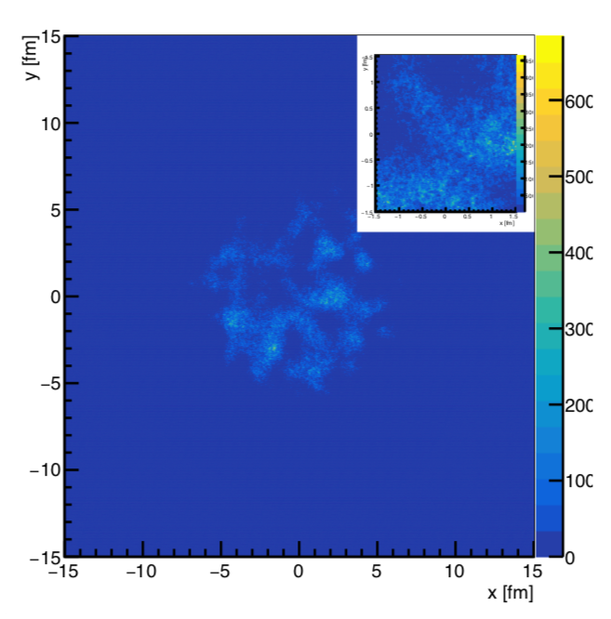
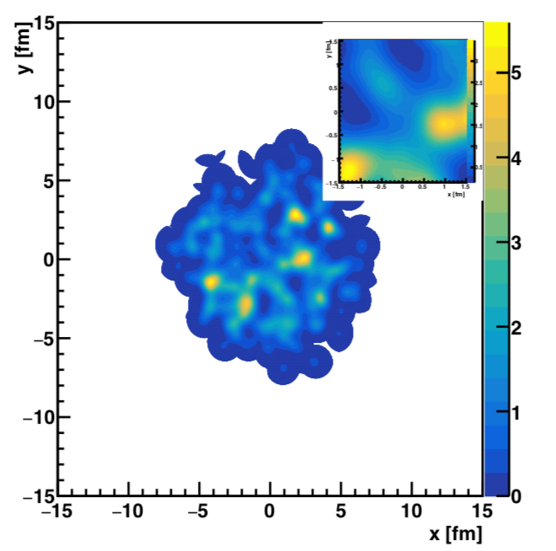
Identical MC Glauber Nucleon Event
IP-Glasma AuAu b=0 Energy Density
IP-Jazma AuAu b=0 Energy Density
What observables are sensitive to what physics?

Slide 8
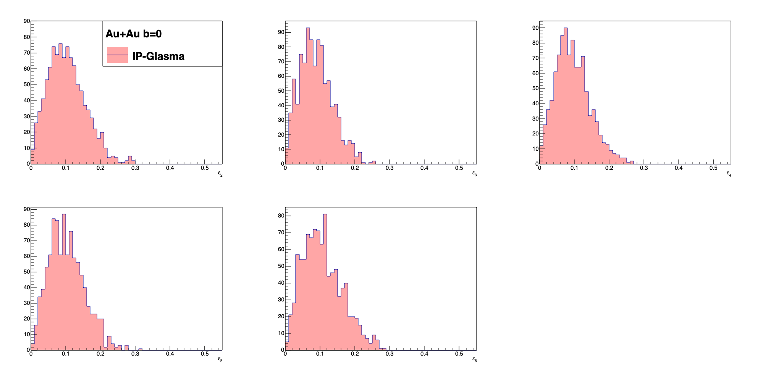
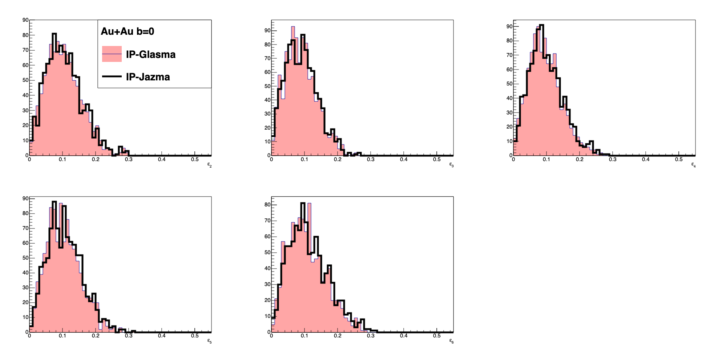
Apples to Apples Comparison at τ=0.000015 fm/c
ε₂
ε₃
ε₄
ε₅
ε₆
Example numbers – ε₂ mean (IPG 0.104, IPJ 0.105), rms (IPG 0.054, IPJ 0.054), kurtosis (IPG 0.27, IPJ 0.30)
ε₃ mean (IPG 0.089, IPJ 0.091), rms (IPG 0.047, IPJ 0.047), kurtosis (IPG -0.023, IPJ -0.030)

Slide 9
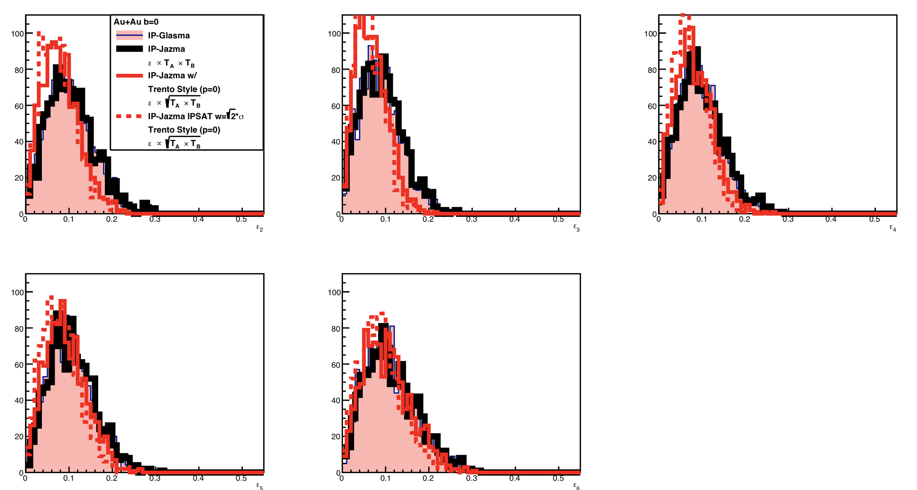
Trento Style p=0 Comparison (Isolating one effect)
ε₂
ε₃
ε₄
Trento is only a very approximate match to IP-Glasma.
ε₅
ε₆
* Highlight this is only the geometric piece, and there will be other differences when adding NBD fluctuations etc.
Please stop saying Trento (p=0) is ab initio QCD motivated.

Slide 10
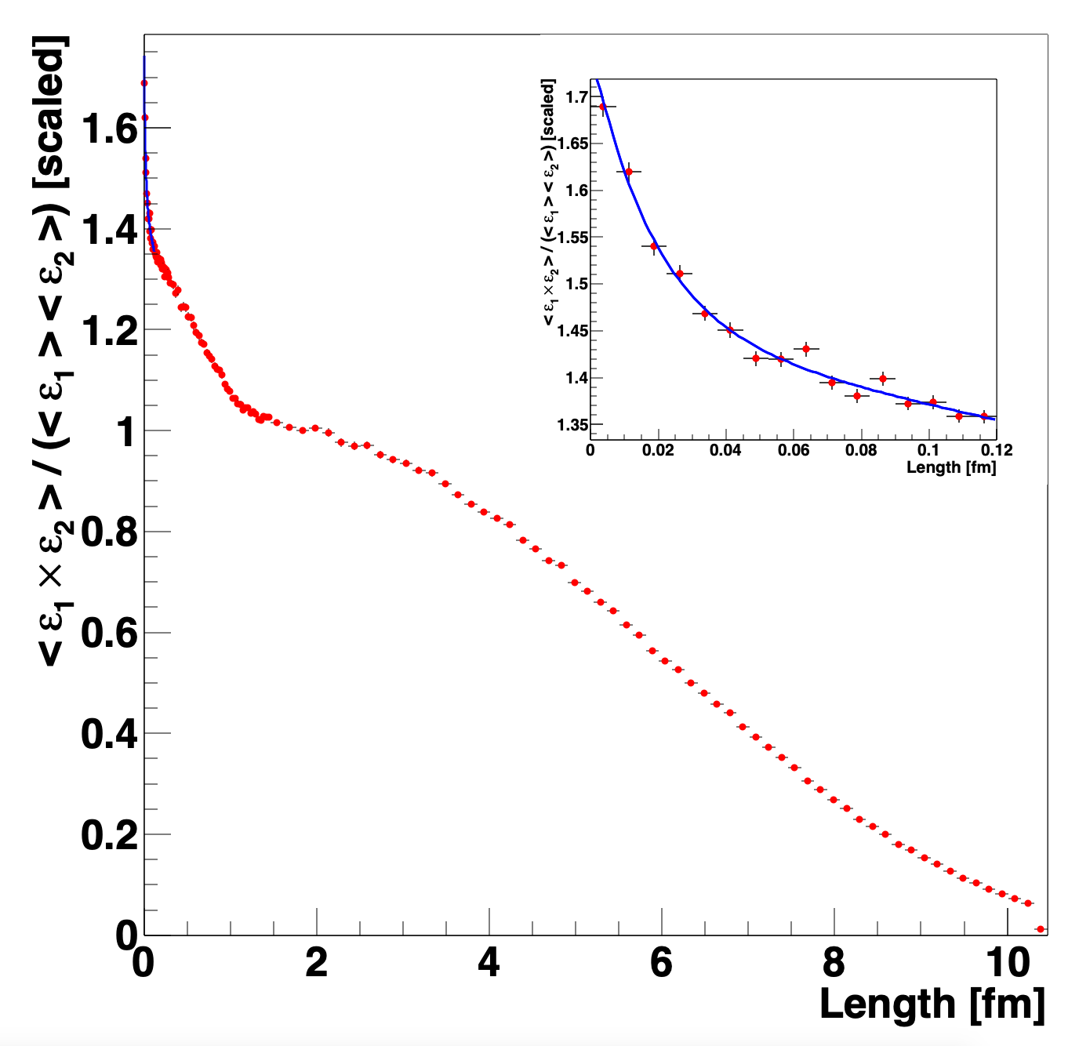

No impact on IP-Glasma +hydro results, but are there:
color domains? (length scale $∼$1/Q_{s})
lattice artifacts? (length scale $∼$ 1-2 a)
Two-point Energy-Energy Correlator reveals three clear length scales:
Nucleus
Nucleon
Lattice Artifact (exp. slope $≈$ 2a)
Now substantiated.
Lattice Artifacts
exp. slope = 1.8 ± 0.1 a
Nucleon
Nucleus
Au+Au b=0
IP-Glasma

Slide 11
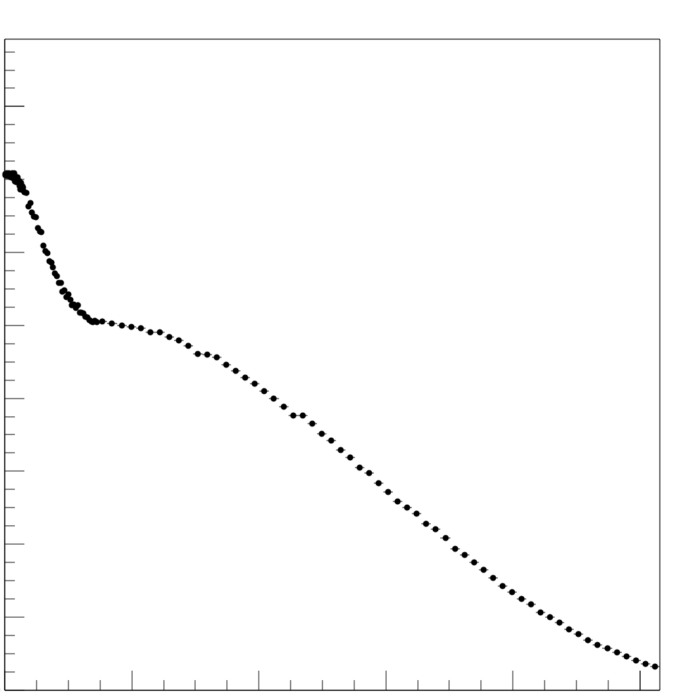
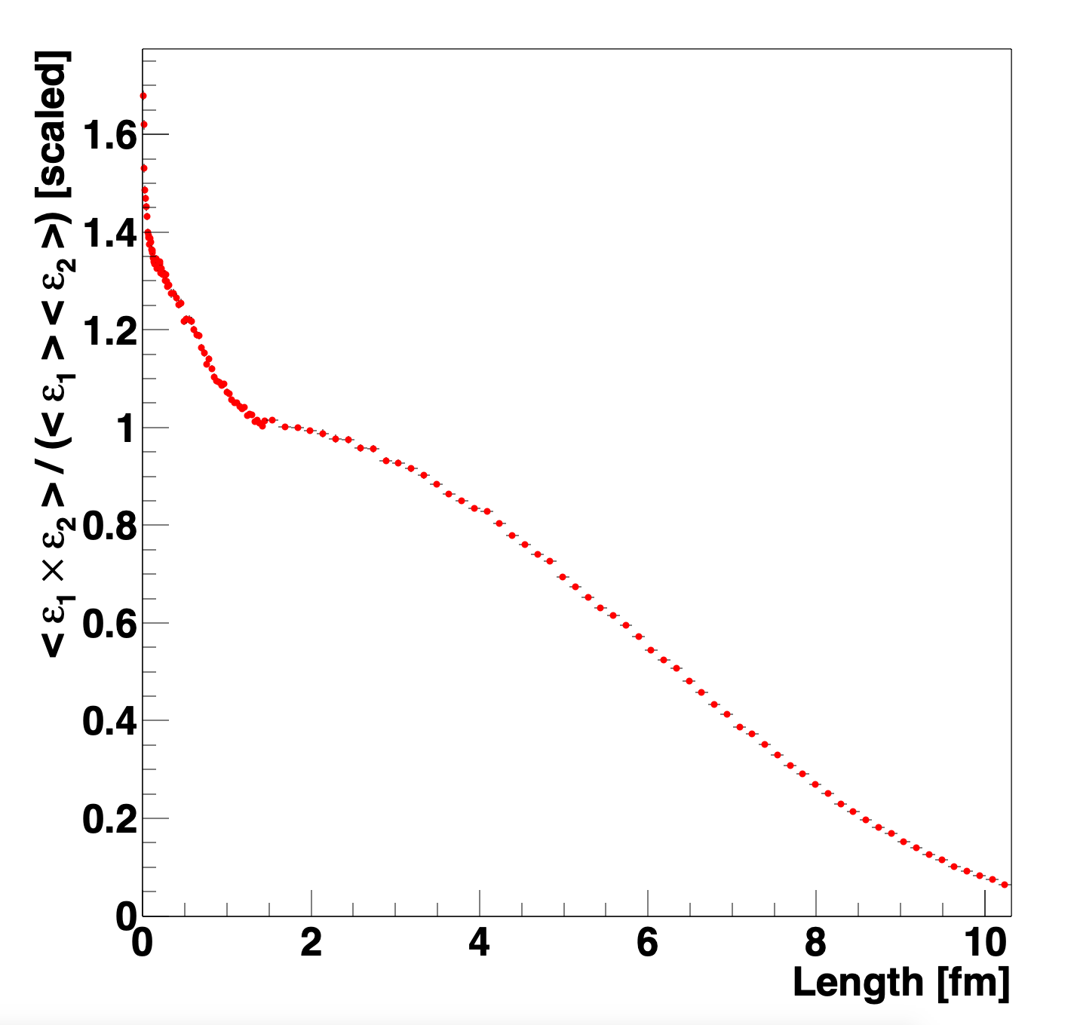

No impact on IP-Glasma +hydro results, but are there:
color domains (length scale $∼$1/Q_{s})
lattice artifacts (length scale $∼$ 1-2 a)
Two-point Energy-Energy Correlator reveals three clear length scales:
Nucleus
Nucleon
Lattice Artifacts (exp slope $≈$ 2a)
Now substantiated.
Lattice Artifacts
Nucleon
Nucleus
Au+Au b=0
IP-Glasma
IP-Jazma
IP-Jazma very similar, except artifacts
IP-Glasma - no strong evidence for domain contributions.
Challenge to the proponents!

Slide 12
Are those color domains?

Slide 13
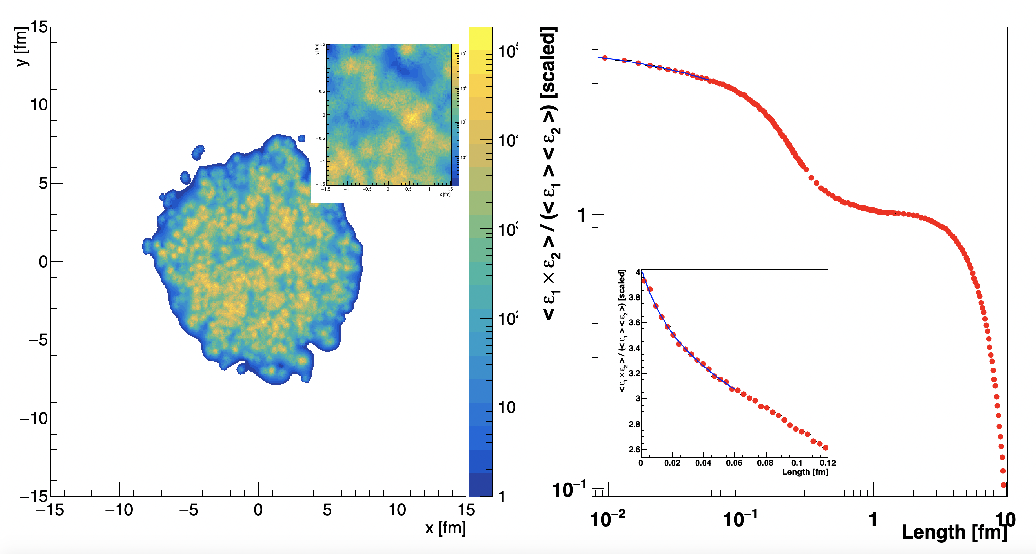
If we do not see domains in IP-Glasma, can we see other sub-nucleon structure?
IP-Glasma run in 3 constituent quark substructure mode.
Lattice Artifacts (exp slope = 0.02 fm)
Constituent Quark
Nucleon
Nucleus

Slide 14
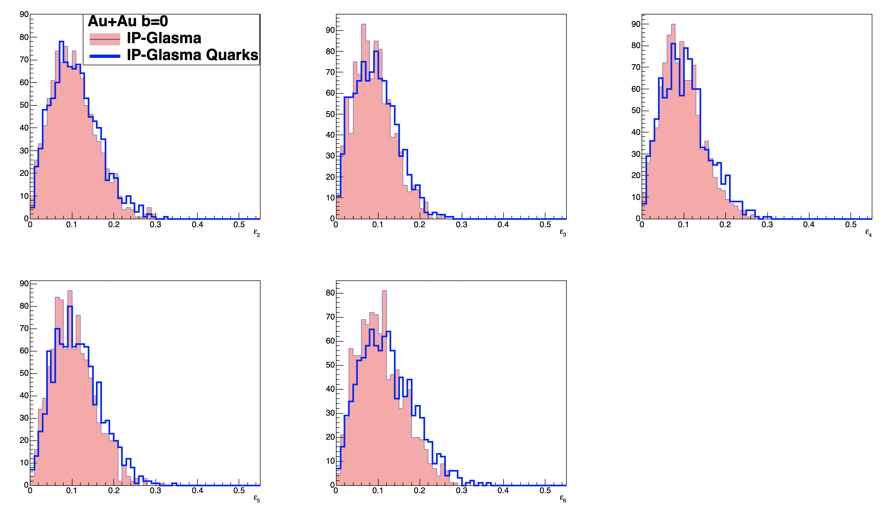
Eccentricities (at higher order) very mildly sensitive to sub-nucleon length scales
ε₂
ε₃
ε₄
ε₅
ε₆

Slide 15
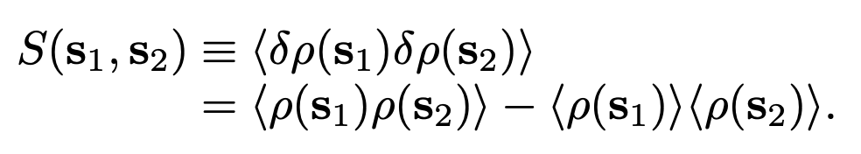
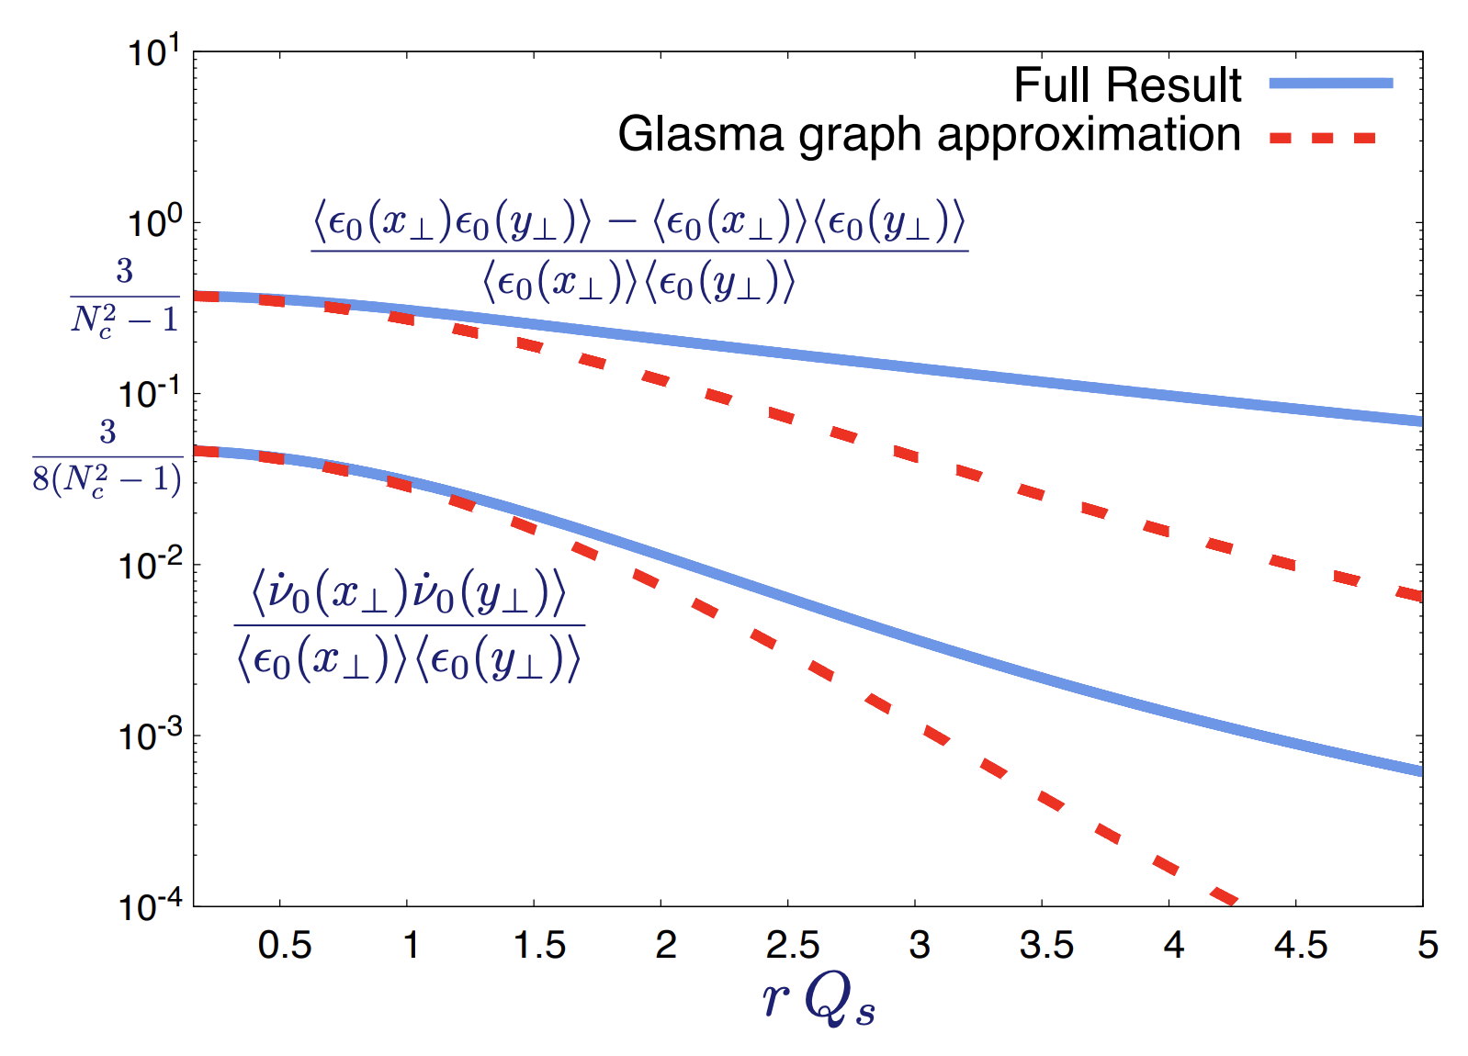
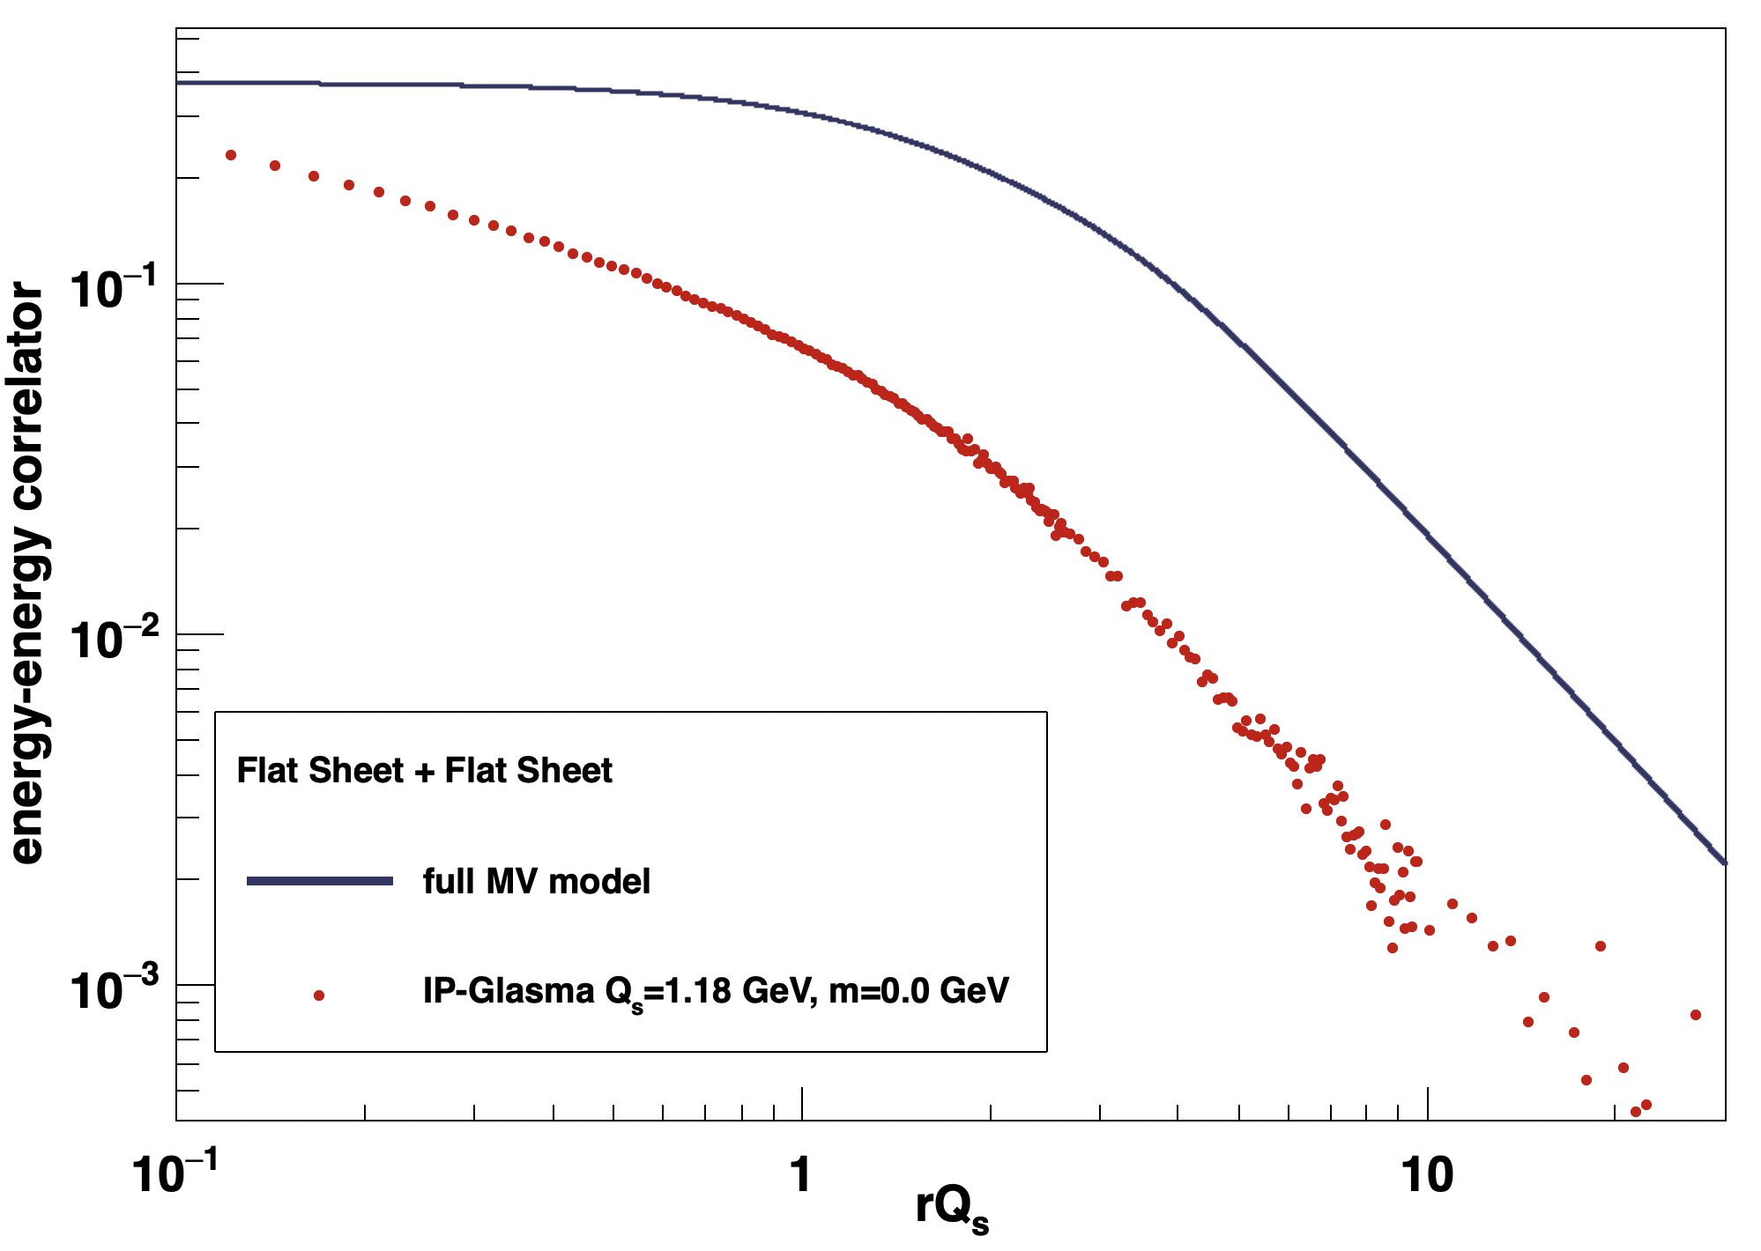
https://arxiv.org/abs/1902.07168
Claim to describe geometry just from CGC two-point correlator (i.e. no nucleons)
Sanghoon Lim/JN – working with authors on comparisons
IP-Glasma also goes to 0.3 at rQ_{s}=0

Slide 16
Are those two QGP droplets?

Slide 17
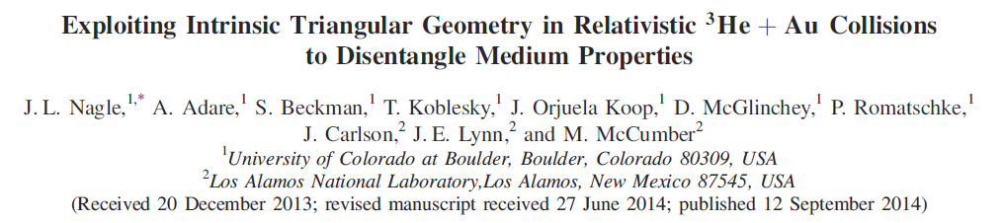
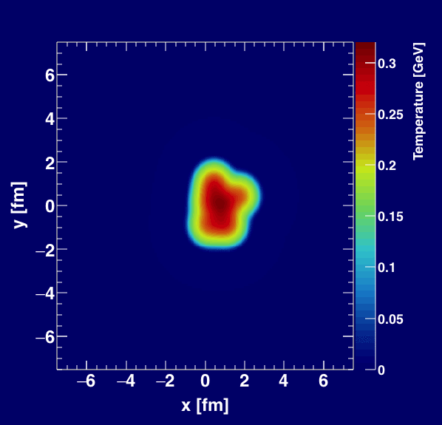
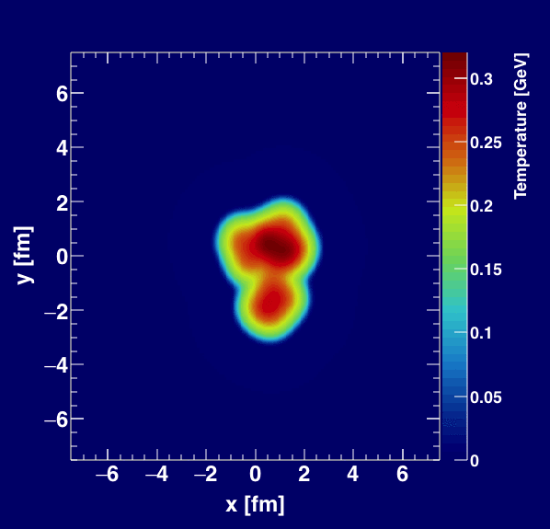
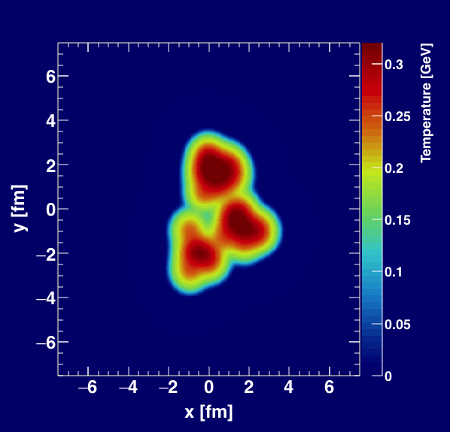
Geometry Tests at RHIC
http://journals.aps.org/prl/abstract/10.1103/PhysRevLett.113.112301

Slide 18
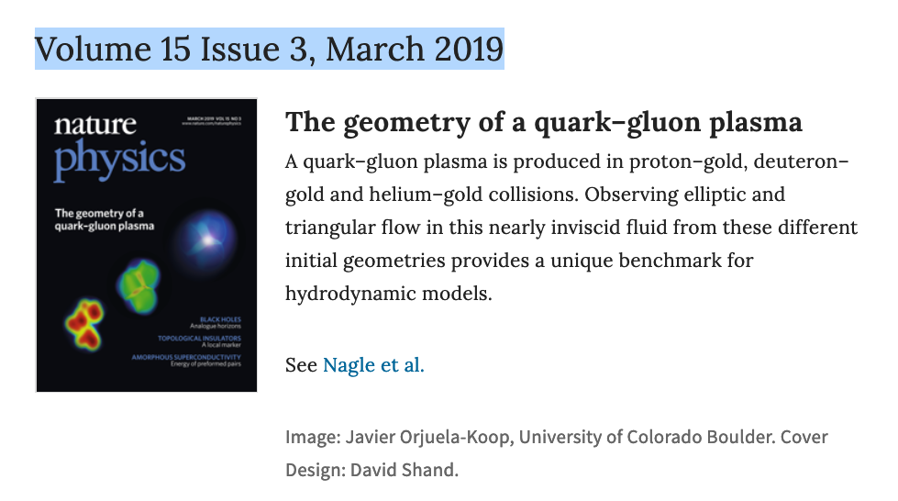
Small Systems

Slide 19
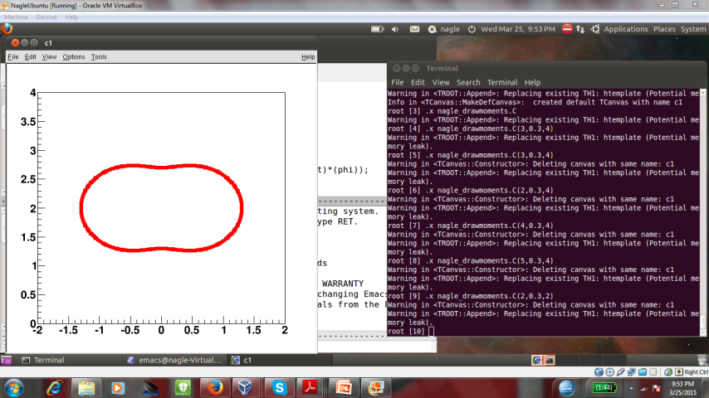
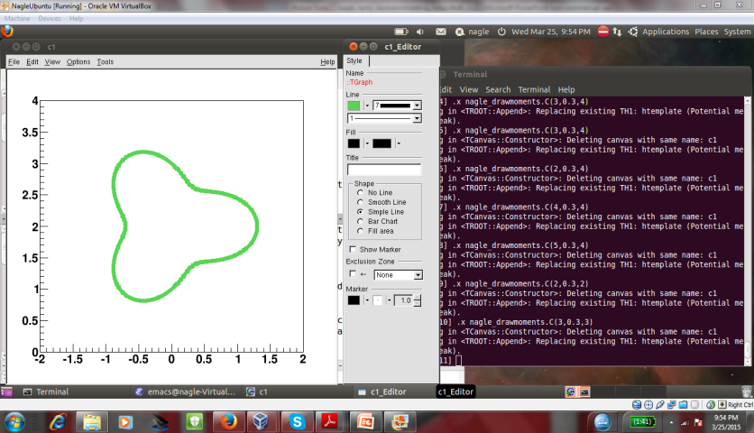
Hydrodynamic Comparison
PHENIX, Nature Phys. 15 (2019) no.3, 214-220 - https://arxiv.org/abs/1805.02973
SONIC good agreement with v₂, v₃ (p_{T}) for all three systems
Alternative hydrodynamics iEBE-VISHNU confirms results

Slide 20
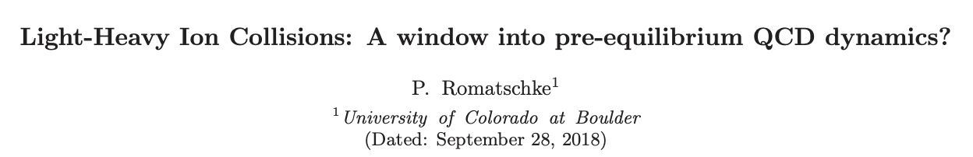
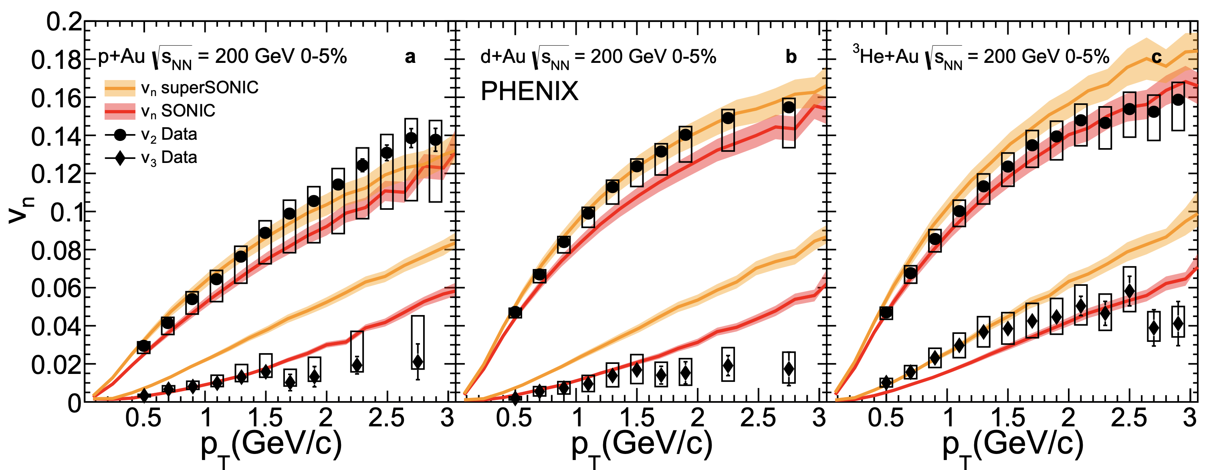
Important details remain to be explored in this framework – particularly in the early time domain
Pre-hydro (AdS/CFT) model yields a large increase in v₃ in the smallest systems.
Need to double check that the two calculations have identical initial conditions etc. – i.e. only changing one thing.

Slide 21
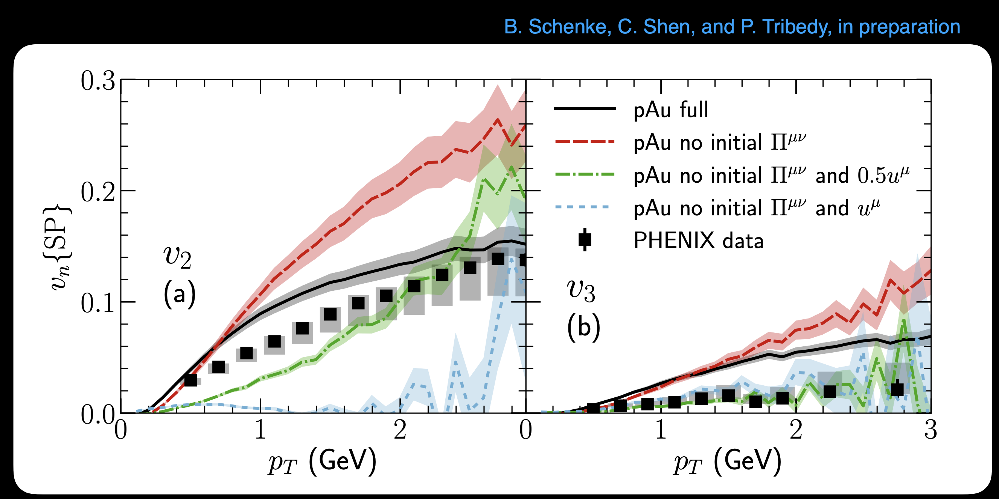
Also, nicely highlighted in Chun Shen’s Rice Talk
https://indico.cern.ch/event/771998/contributions/3339235/subcontributions/276910
Very interesting to compare pre-equilibrium cases: AdS/CFT, free streaming, IP-Glasma

Slide 22
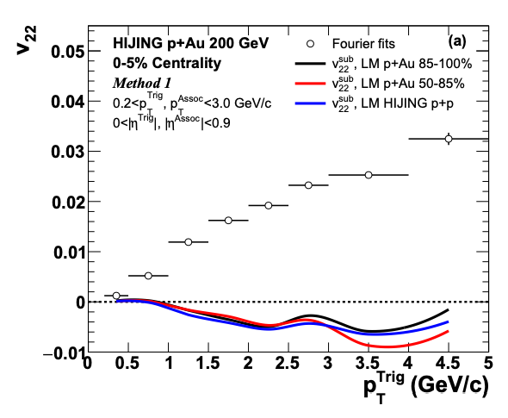
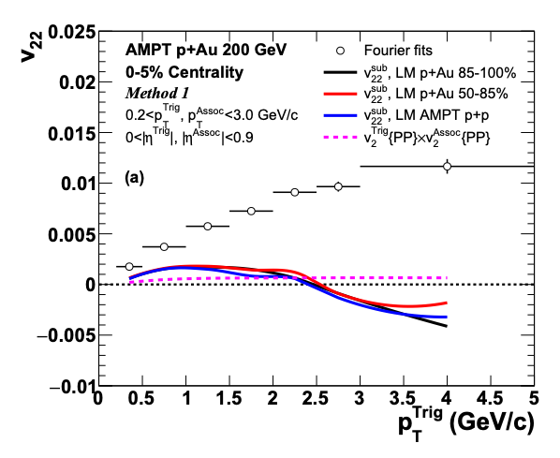
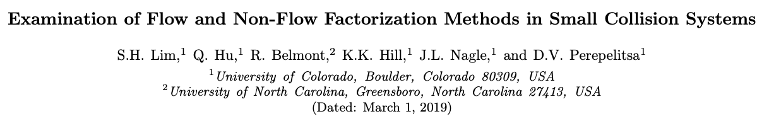
Flow and Non-Flow
https://indico.cern.ch/event/656452/contributions/2869833/attachments/1649479/2637419/QM18-smallsystem-shengli-10.pdf
STAR result has a small Δη gap, and thus a huge non-flow contribution (even at low p_{T})
Hyper-sensitive to non-flow subtraction
Still agreement for p_{T} < 1.5 GeV, then divergence
https://arxiv.org/abs/1902.11290
HIJING and AMPT closure tests
indicate significant over-subtraction
by template method with
STAR kinematics for p_{T} > 1-2 GeV

Slide 23
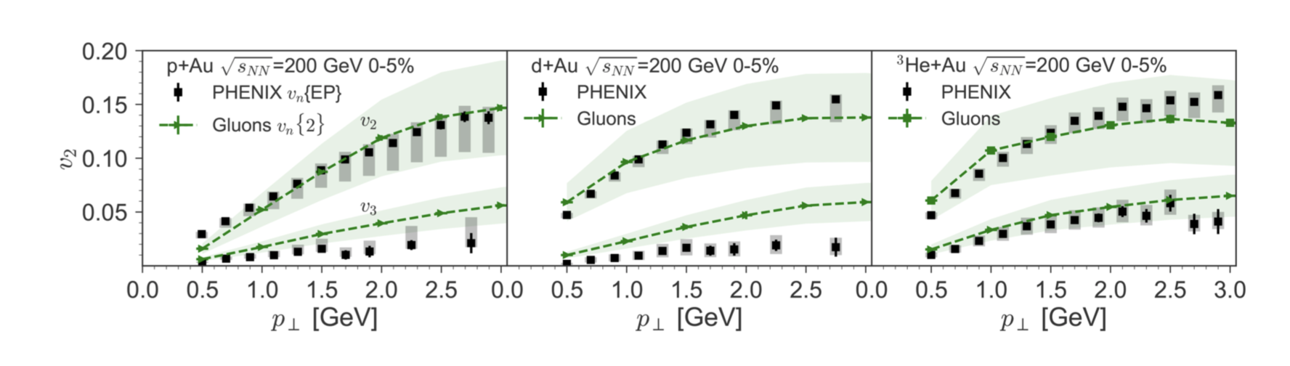
MSTV Postdictions
[MSTV2] https://arxiv.org/abs/1901.10506 (addition of uncertainty bands)
[MSTV] https://arxiv.org/abs/1805.09342 (original postdiction)
Dilute-Dense framework and some additional ingredients (A+B+C+D)
Is it really true that we have no way to discriminate scenarios of
(i) geometry + final state interactions and (ii) all initial state interactions?

Slide 24
The expression in the MSTV papers (below) is incorrect.
This is the two-particle correlation c₂(p_{T},ref) between a particle in a p_{T} bin and a reference particle between p_{T} = 0 and UV cutoff.
One cannot just take the square-root to get v₂(p_{T}).
It is not what experiments measure.
This is just wrong and should be corrected.
This led to an interesting discussion about whether CGC results factorize.

Slide 25
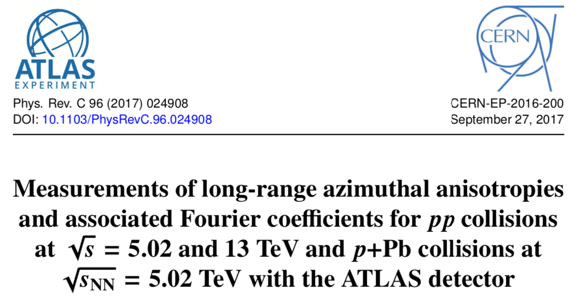
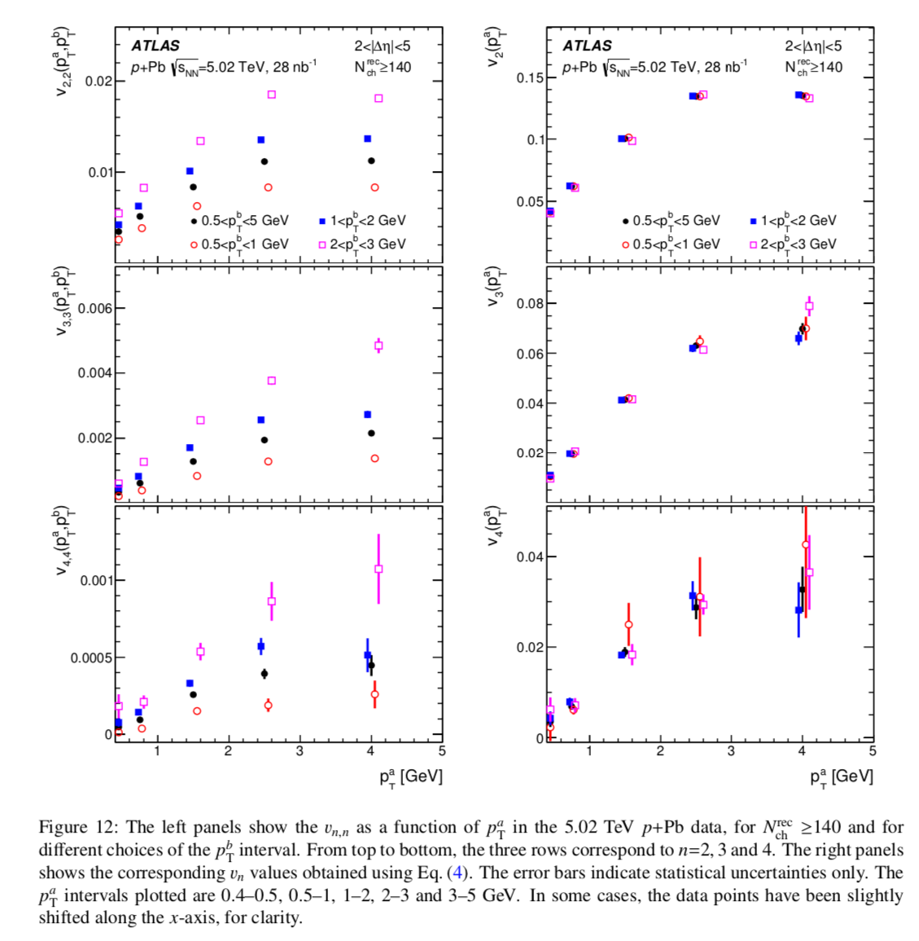
https://arxiv.org/abs/1609.06213
p+Pb correlation data consistent with
v_{n}(p_{T}) for single particles
(i.e. they factorize)
Models should predict c2(p_{TA}, p_{TA}), c2(p_{TB},p_{TB}), c2(p_{TA}, p_{TB}).
Key additional test!

Slide 26
Bug found by MSTV…
-- see M. Mace talk for details
Is that supposed to be in there?
Domains not
resolved
Domains resolved →
I could never understand the scales and speculated last summer that it would make sense if everything were an order of magnitude lower in p_{T}
Mace et al. [MSTV], https://arxiv.org/abs/1805.09342

Slide 27
Domains not
resolved
Domains resolved →
Makes much more sense that transition between regimes is around 0.5 GeV
Now result clearly disagrees with PHENIX Experimental data
Progress…
0.5 GeV
Mace et al. [MSTV], https://arxiv.org/abs/1805.09342
What are some lessons learned?

Slide 28
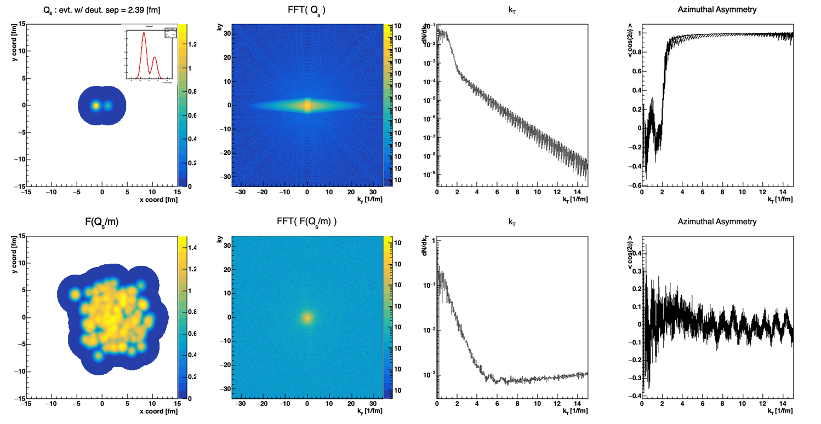
Fourier Transforms
These calculations are done entirely in momentum space (immediate FFT of spatial distributions)
Enormous azimuthal asymmetries in the FFT.
Does this explain the dAu larger v₂ for p_{T} < 0.5 GeV?
<cos(2φ)>
Test: Calculate v₂ with respect to deuteron axis.

Slide 29
Dilute-Dense Framework
The dilute-dense limit implies that Q_{s}(proj) < k_{T} < Q_{s}(targ) and one obtains on average:
where m is the infrared cutoff (= 0.3 GeV in MSTV).
N_{gluon} $∝$ g² Q_{s}²(proj) x F( Q_{s}(targ)/ m ) (dilute-dense limit)
F( Q_{s}(targ)/ m )
Once you hit a thick enough part of the target,
you free all the projectile gluons and no more.
IP-Jazma code: bool dilutedense= true

Slide 30
MSTV Added Ingredients: Fluctuations put in by hand
Q_{s} Fluctuations
MSTV includes nucleon-by-nucleon fluctuations in Q_{s,0} ² (the amplitude of the IP-Sat Gaussian). Thus, each nucleon is still a perfect Gaussian, just different amplitudes.
Implemented with RMS of 0.5 on log(Q_{s}²) – i.e. high side tail.
Non-perturbative on many scales
Not part of the standard CGC framework
Ad hoc not ab initio
IP-Jazma code: bool qsfluc = true

Slide 31
IP-Jazma d+A Results
At this point, none of these fluctuations are ab initio.
All MC Glauber and “put-in-by-hand” Q_{s,0} ² fluctuations (as per MSTV).

Slide 32
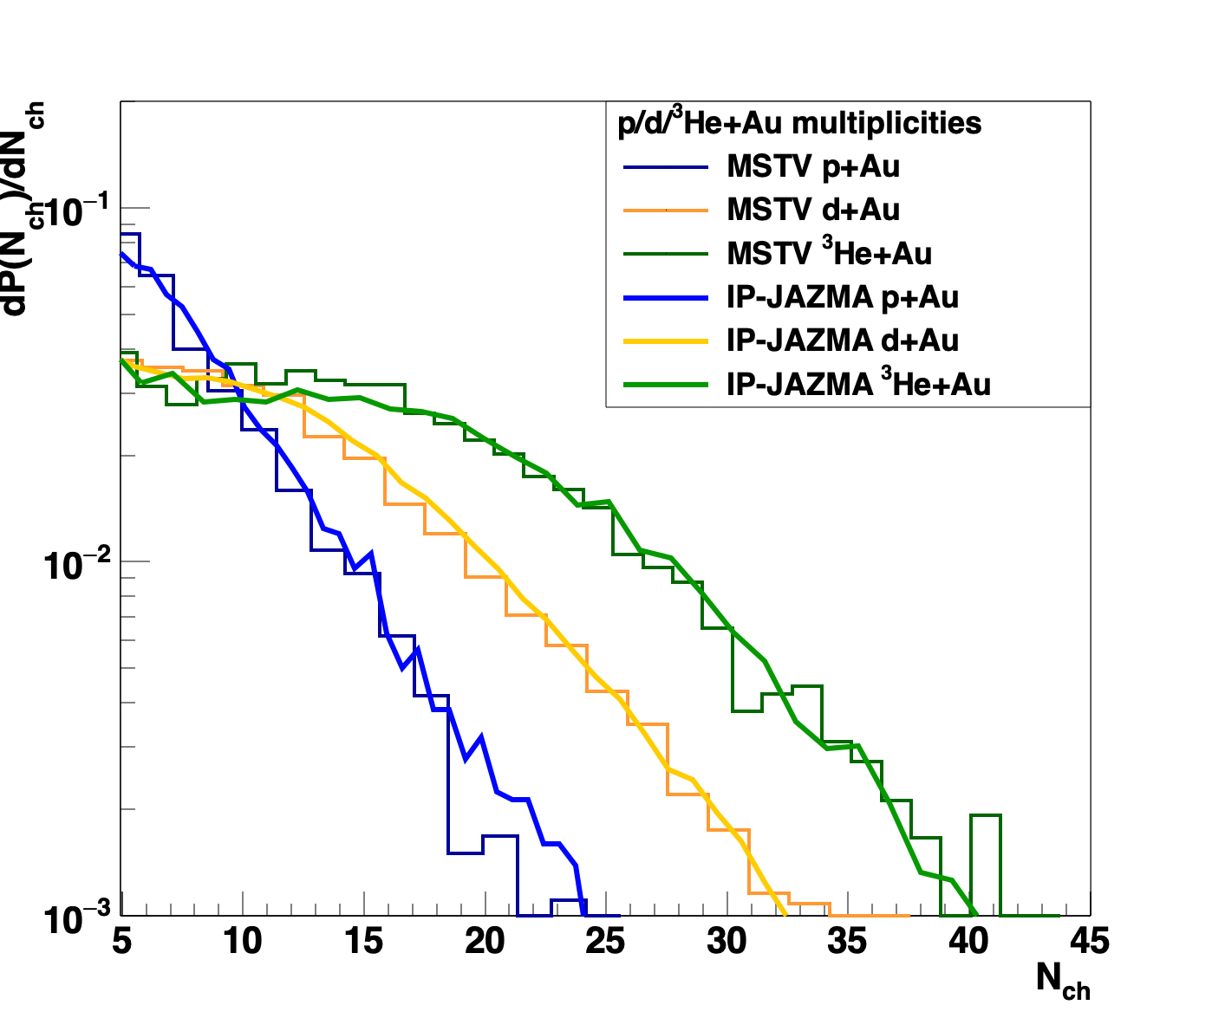
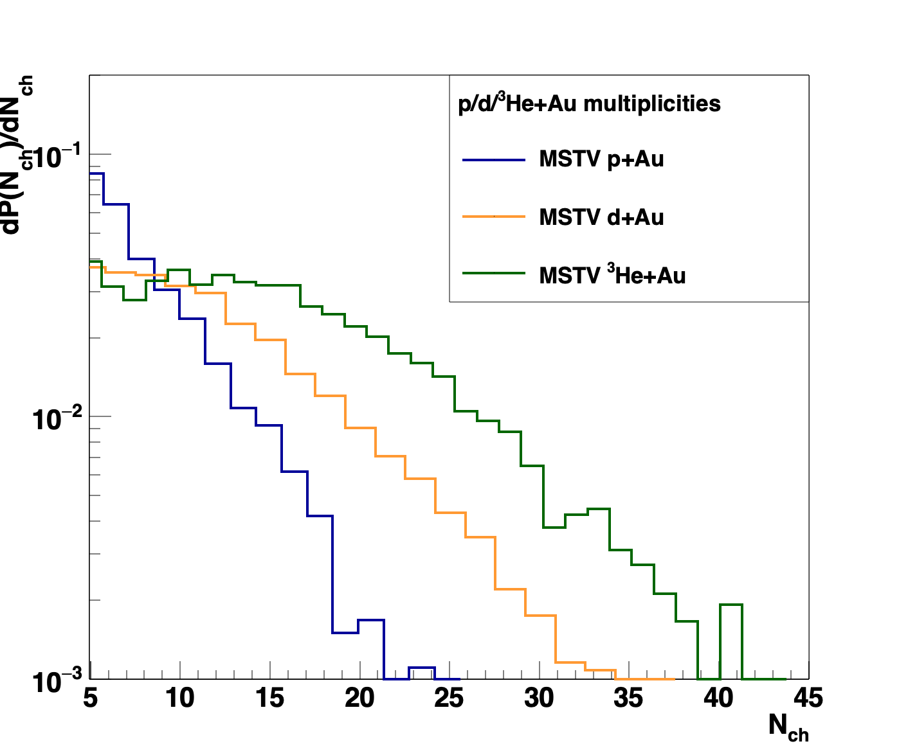
Multiplicity Distributions
“[The figure] shows strikingly that all three systems satisfy Koba-Nielsen-Olesen (KNO scaling).”
Glittering Glasma – ab initio result for Negative Binomial Fluctuations
Counter Proof: Everything here is just
MC Glauber fluctuations and the Q_{s}² fluctuations put in by hand, that are fit to data.
Small differences might be in MSTV
MC Glauber, which could be resolved with
publicly available code.
Other sources of fluctuations are
completely subdominant.

Slide 33
d+Au @ 200 GeV
Settings: Dense-Dense, no Q_{s,0} ² fluctuations
Different CGC choices have big physics implications.
Is it all Q_{s} fluctuations in the projectile or fluctuations in the lumpy target?
How do we decide?
We also obtain a reasonable (slightly worse) description of the data.
Modest adjustment of IP-Sat σ would allow better tuning.
N.B. No correlation between Q_{s,0}² projectile and gluon multiplicity.

Slide 34
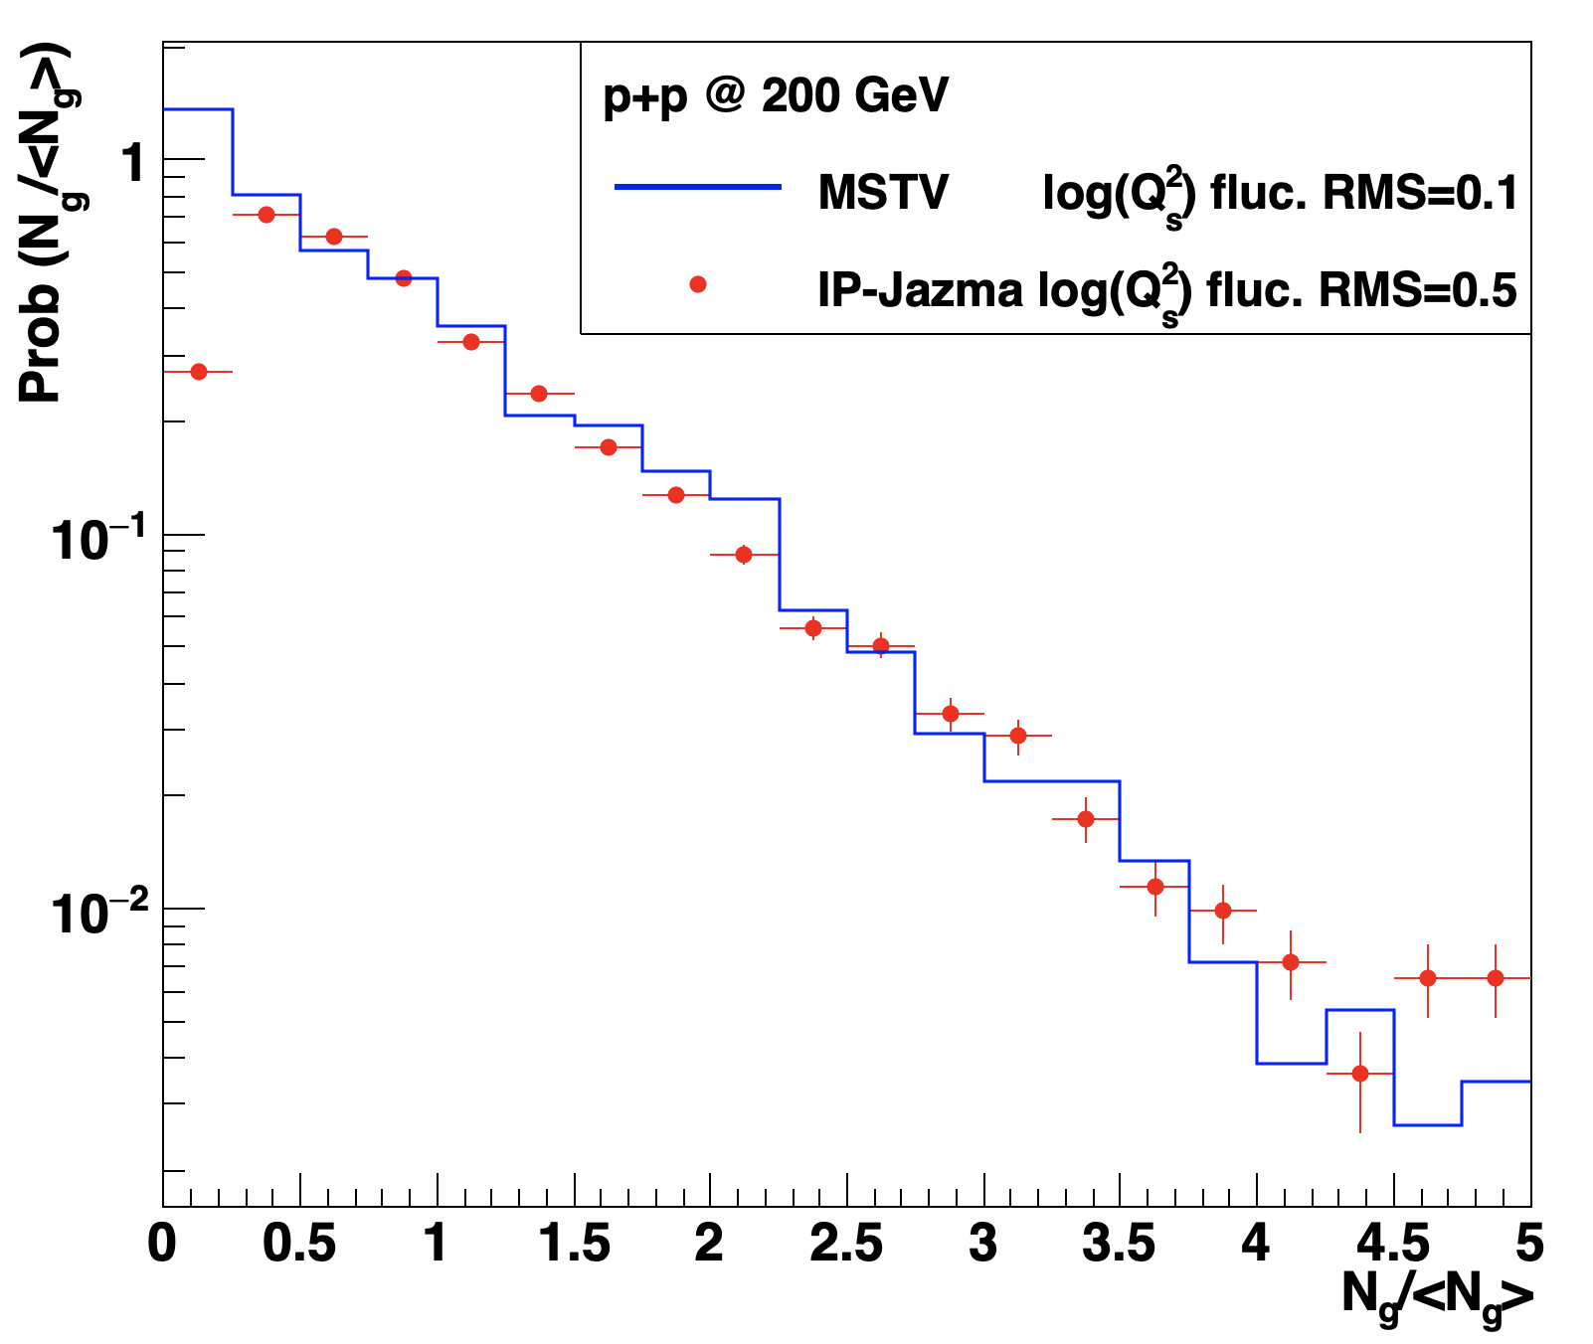
p+p Distribution Too
Identical IP-Jazma parameters give a good description of the p+p multiplicity data
In contrast, MSTV have to remove the log(Q_{s}²) fluctuations
(which makes no sense) because there are other NBD fluctuations
These are just parameters, not really pinned to specific physics

Slide 35
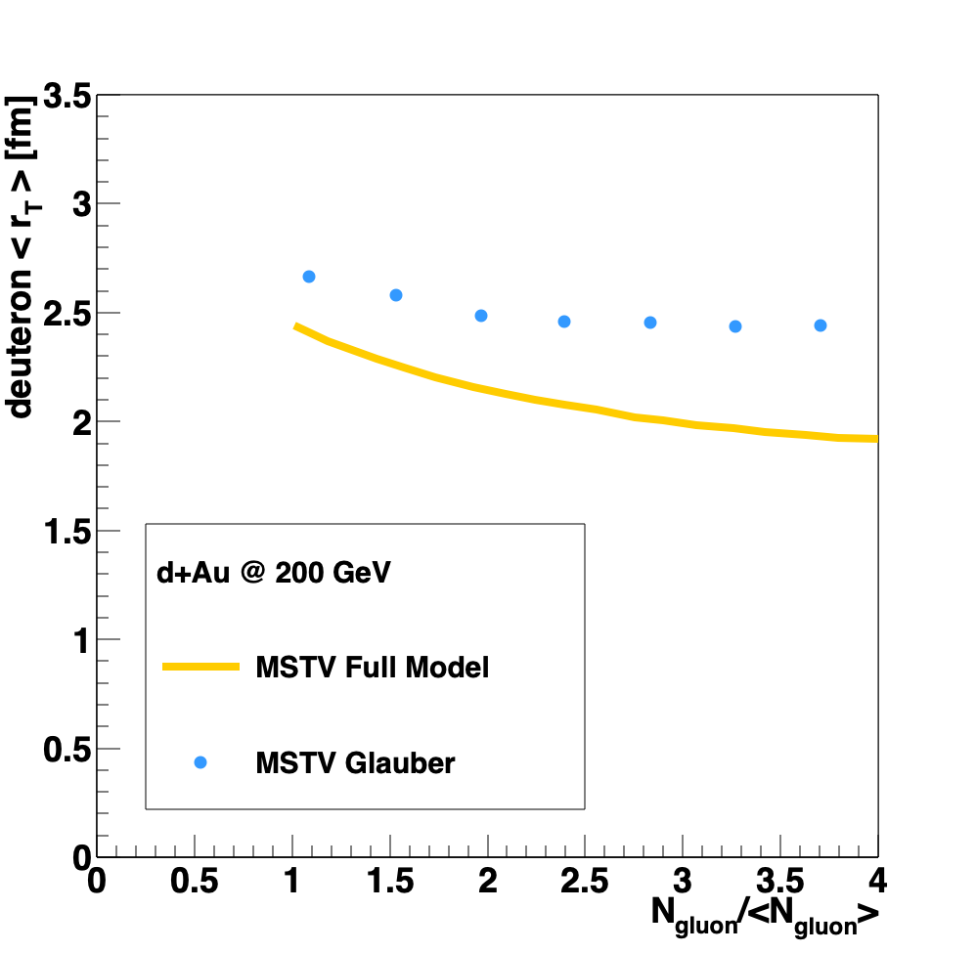
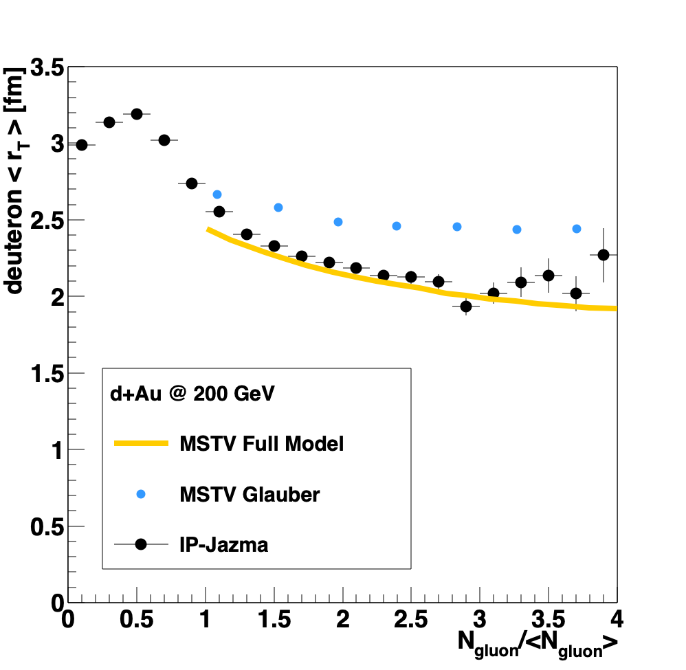
Earlier speculation: Maybe the full MSTV result enhances cases where the n and p overlap!
“We have emphasized the quantum statistics of gluons as the dominant cause of the nontrivial many-body correlations that enhance contributions to the tails of the multiplicity distributions from overlapping nucleon configurations”. [MSTV]
Prediction: IP-Jazma should fail to reproduce the decrease in r_{T}.
False. This is a minor effect having nothing to do with many-body quantum physics.

Slide 36
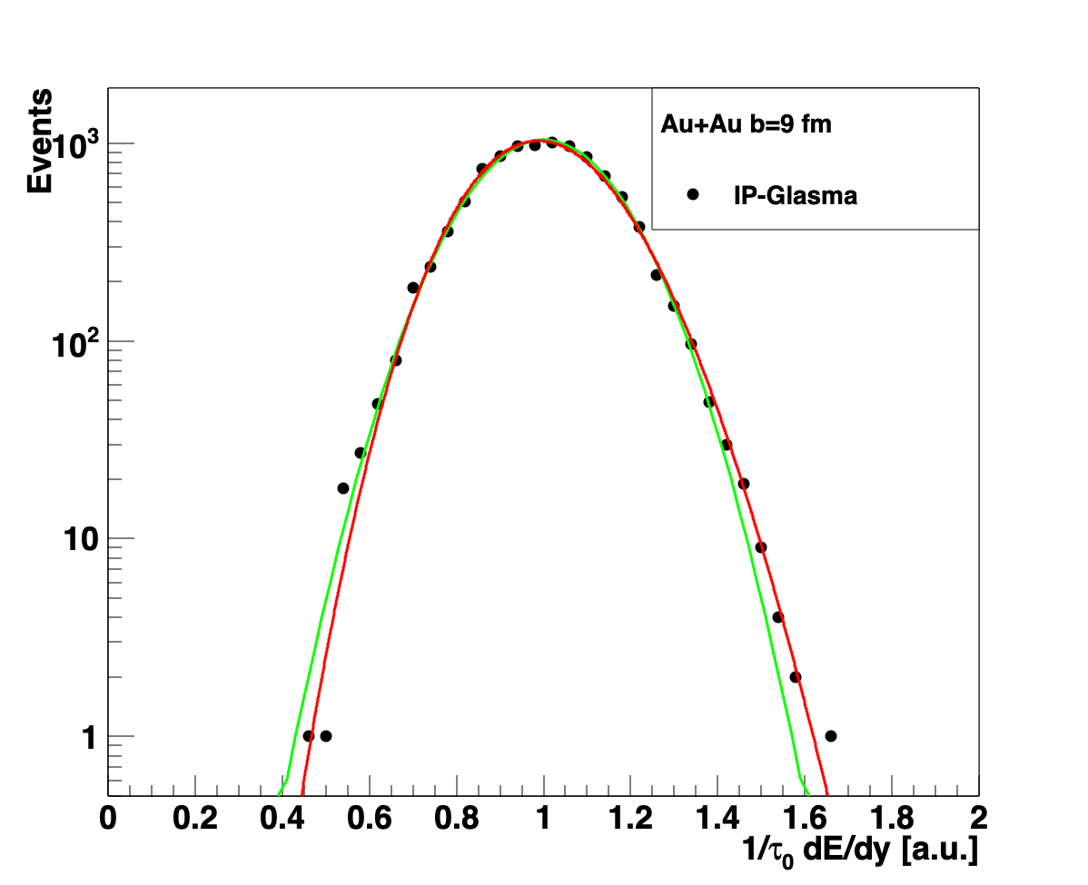
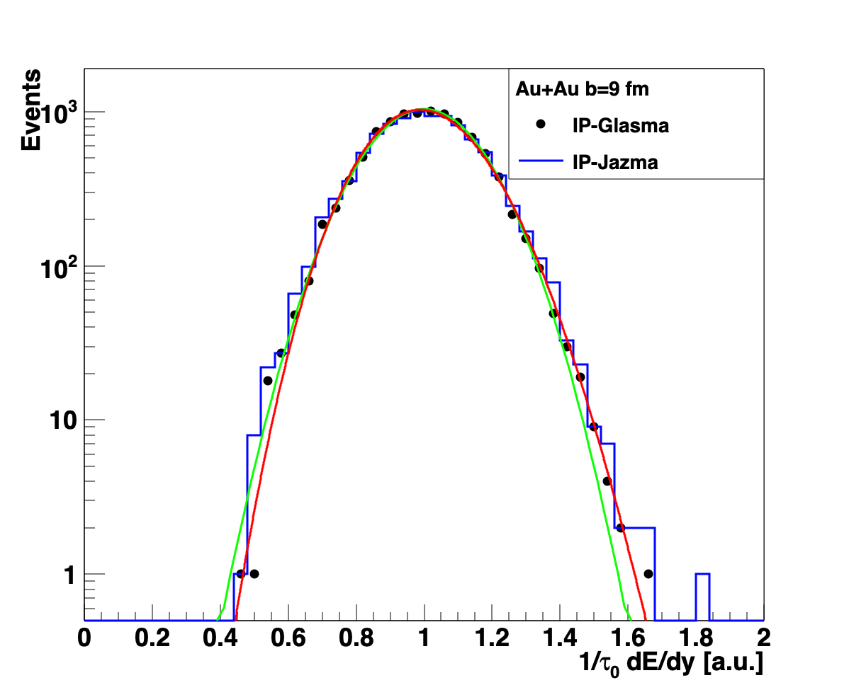
Not the first ”Identification” Problem
“The best fit is given by a NBD distribution, as predicted in the Glasma flux tube framework [37]; our results adds further confirmation to a previous non-perturbative study [38]”
IP-Glasma [https://arxiv.org/abs/1202.6646v2]
Really must be a Gamma (Γ) distribution…
Test this confirmation by using identical
Au+Au b = 9 fm MC Glauber events run through
IP-Jazma.
No evidence for “Glittering Glasma”
Gaussian
Gamma
Gaussian
* Note this is a purely geometric effect. No Q_{s}² fluctuations are in either calculation here.

Slide 37
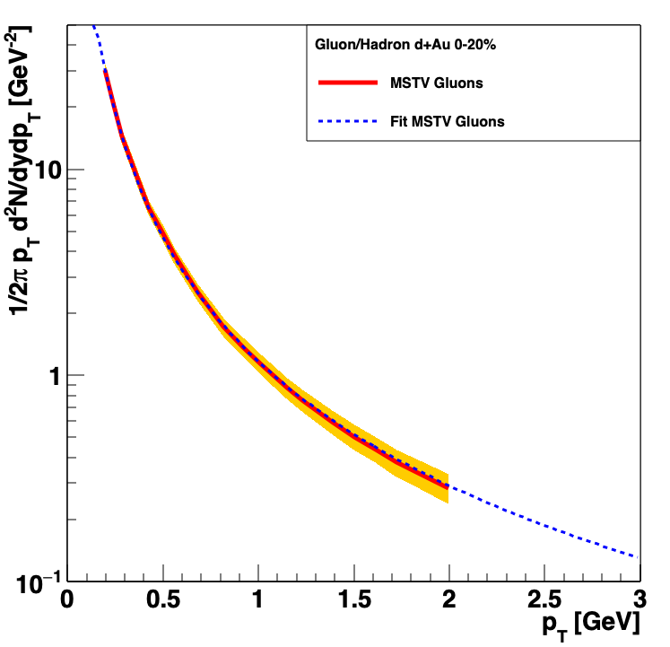
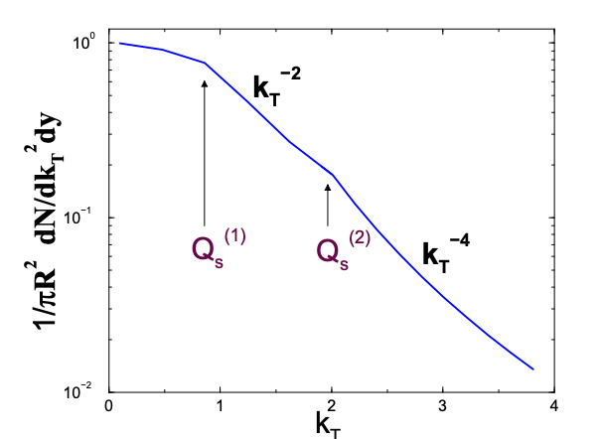
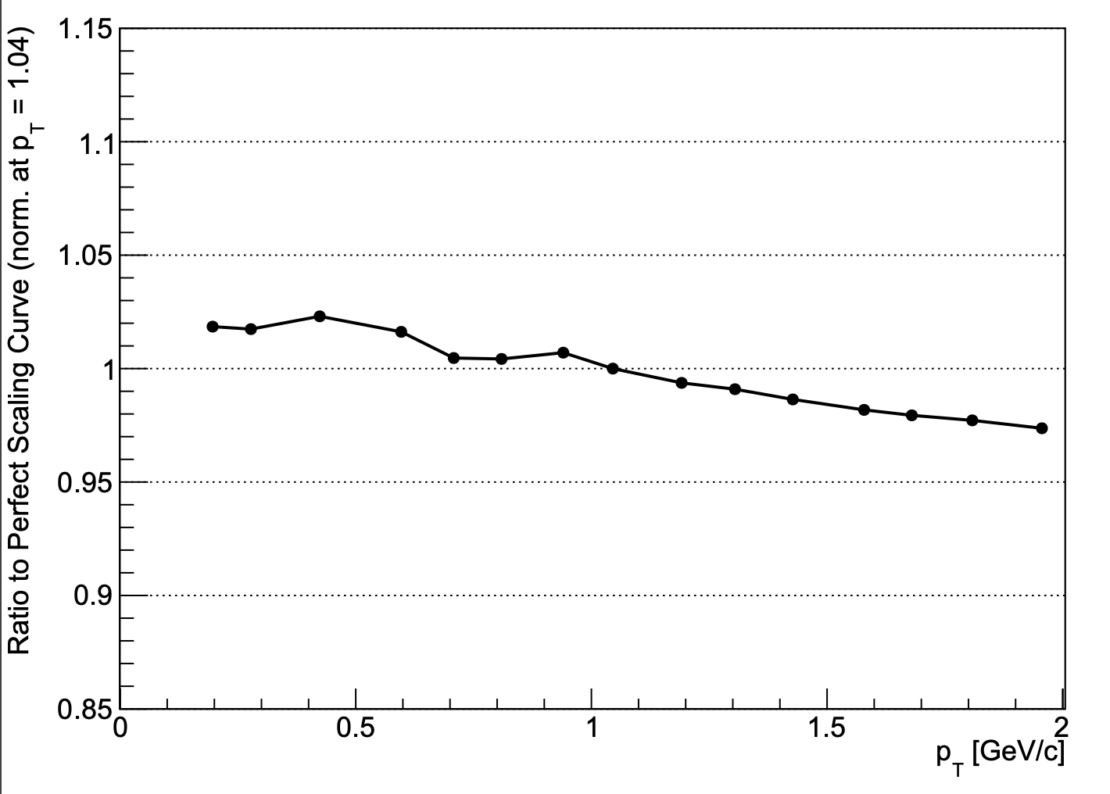
Gluon Momentum Distribution
In fact, spectrum is almost exactly (within < 3%) just 1/p_{T}²
https://arxiv.org/abs/hep-ph/0105268
MSTV
Ratio =
1/p_{T}²
1/k_{T}⁴ scaling reflects the perturbative "dilute/dilute" limit; 1/k_{T}² scaling reflects the deep saturation regime k_{T}² << Q_{s}²

Slide 38
All explanations need to calculate multitude of features in a consistent framework
These photos are composite.
Dilute-dilute lens
Dilute-dense lens
Dense-dense lens
Hadronization model A lens
Hadronization model B lens
etc.
Redo calculations in unified framework rather than just concatenate references.

Slide 39
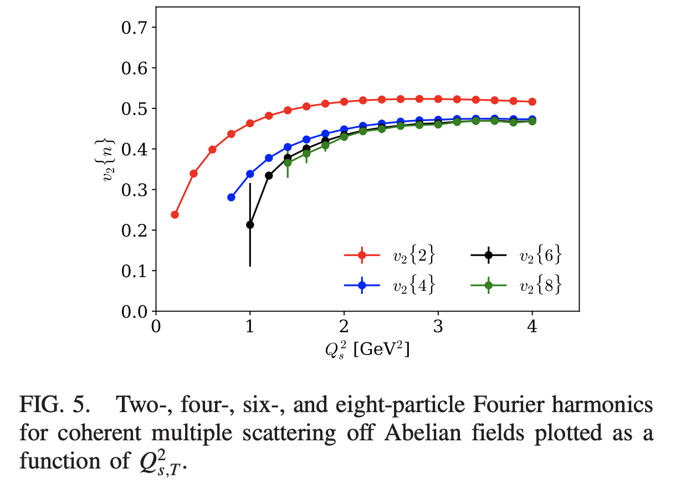
Need some time to absorb these changes into the collective conscience of the field
Both of these results cannot be shown anymore as evidence in support of CGC explanation; quite the contrary!

Slide 40
Where to go from here?
Are we supposed to bring this one back to life?

Slide 42
Bonus Material

Slide 43
Gluons versus Hadrons
“The sole point of our comparison is to note that the shape of the p_{T} distribution in the numerator and denominator of v_{2,3}(p_{T}) is similar to that of the data at low p_{T}, modulo the overall normalization factor that cancels between numerator and denominator.” [MSTV]
That is an assertion we can test.
Dennis Perepelitsa generated PYTHIA back-to-back gluons via HadronLevelStandAlone
and we extract the leading pion distribution,
as well as the relative angle between the gluon and pion.
Reasonable agreement…. with no tuning.
http://home.thep.lu.se/~torbjorn/pythia81html/HadronLevelStandalone.html

Slide 44
Took one hour to code (while watching Avengers Infinity War on airplane)
Yes, there are uncertainties,
but previous IP-Glasma papers
(e.g. arXiv:1311.3636) point out huge differences between gluons and hadrons

Slide 45
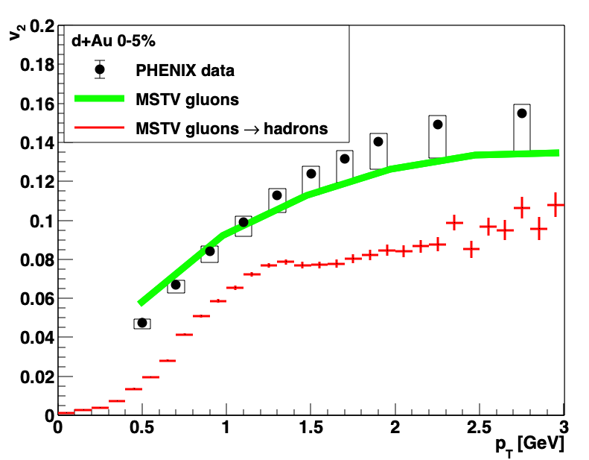
Gluon → Hadron: Big Impact on v₂
Two substantial effects:
Hadron p_{T} < Gluon p_{T}
Angle Δφ (hadron , gluon)
Of course all this needs to be redone noting new p_{T} scale for these results…

Slide 46
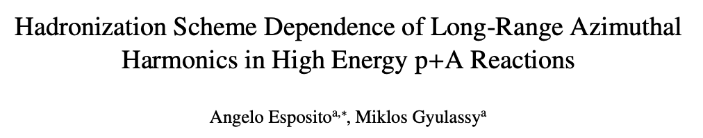
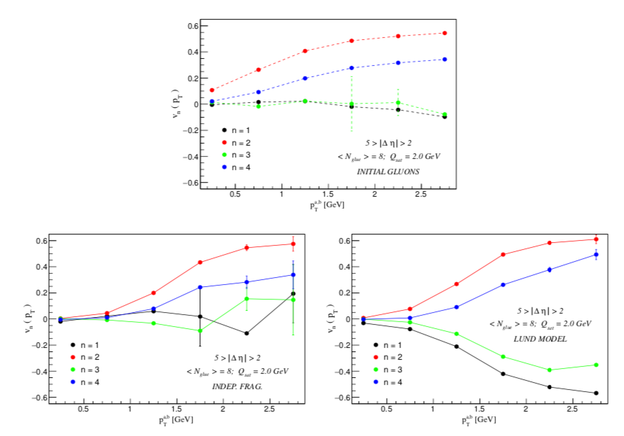
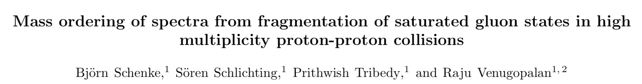
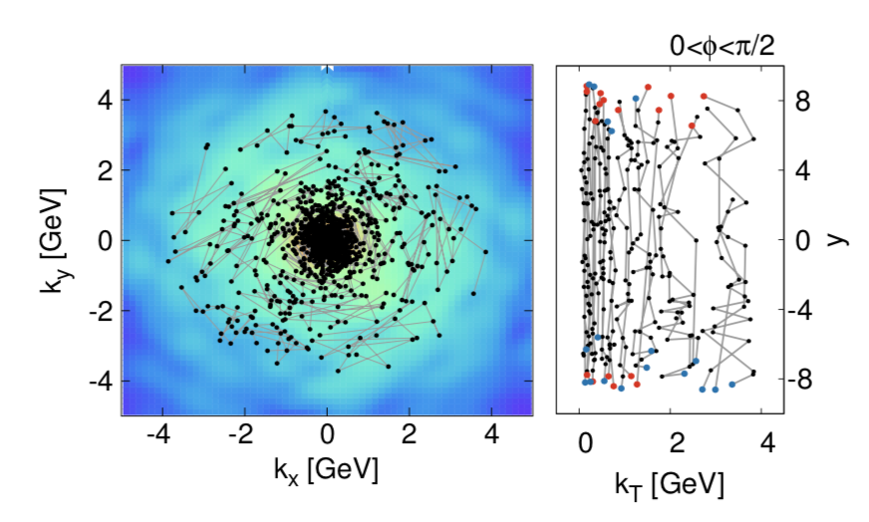
Hadronization Schemes
https://arxiv.org/abs/1505.03734
Very large decrease in hadron v₂ relative to gluon v₂ for p_{T} < 2 GeV
Result also depends on gluon p_{T} spectrum, which is not shown.
https://arxiv.org/abs/1607.02496
Very different hadronization scheme.
No gluon and hadron p_{T} spectra shown, only <p_{T}> for hadrons.
It would be great to see that comparison.
Models like AMPT increase v₂(p_{T}) via parton coalescence.
However, if one started with CGC gluons this would have too hard a p_{T} spectrum.

Slide 47
Ab initio or non pertinet
Many have stated that these color domains effects are calculated ab initio
However, saturation physics in the proton at x > 0.01 challenges the whole picture of the formalism
One estimate has Q_{s,0}² (gluon) = 0.67 GeV² for x = 0.01 at the very center of the proton, and averaged over
r = 0.67 fm the value would be Q_{s}² (gluon) = 0.28 GeV²
MSTV2 claims that the IP-Jazma saturation scale values differ significantly from theirs.
Prove it – show us the numbers.

Slide 48



Interesting Puzzle (Good for INT Work)
3 Quark Proton initial conditions + superSONIC has increasing v₂ with multiplicity
IP=Glasma eccentricites pretty constant
But IP-Glasma + MUSIC + uRQMD shows a decrease
Very interesting to compare pre-equilibrium cases: AdS/CFT, free streaming, IP-Glasma

Slide 49


Other Geometries?
https://arxiv.org/abs/1812.08096
⁴He has a slightly more compact source and thus a slightly larger translation of geometry to flow
Additional studies of p+O and O+O are interesting, though not testing a very specific hydrodynamic unique case.
Worth more discussion on different systems at both RHIC and the LHC.

