Slide 1
Engineering Small QGP Droplets
Jamie Nagle
University of Colorado Boulder
8th Workshop of the APS Topical Group on Hadron Physics
April 10-12, 2019, Denver CO

Slide 2
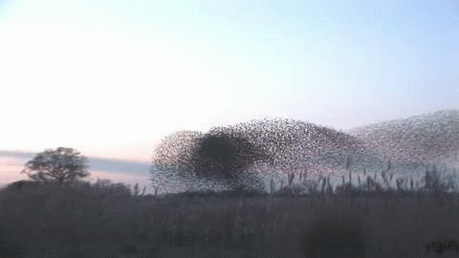
How does this work?
Emergent Phenomena… Collectivity…
What is the underlying origin?
For this flock of birds, it is all short range interactions

Slide 3
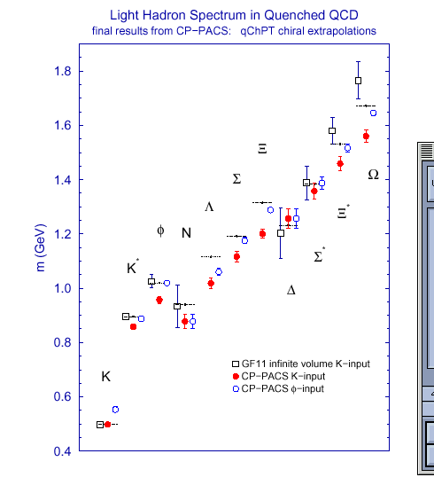
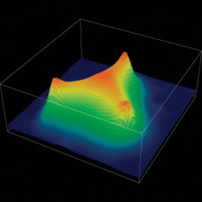
Strong evidence that QCD is the
correct theory of the strong interaction
Perturbative Calculations
Lattice Calculations
The field is about understanding
emergent phenomena from QCD,
just like condensed matter physics from QED.

Slide 4
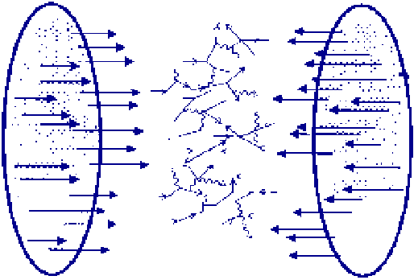
Multi-TeV Kinetic Energy → Heat
10,000⁺⁺ gluons, quarks, antiquarks
How does this matter behave?

Slide 5
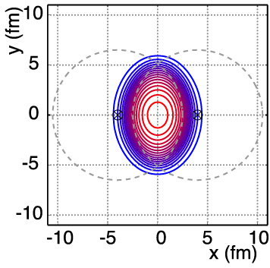
Non-Central A+A Geometry
v₂ = “elliptic flow”

Slide 6
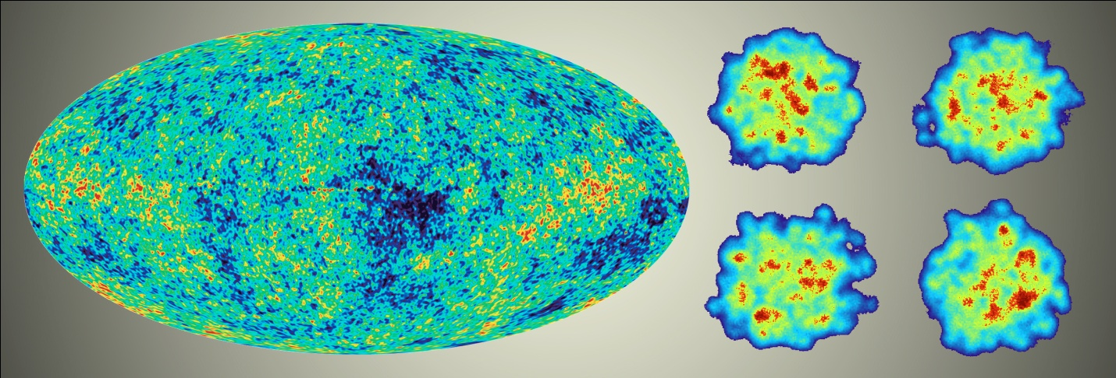
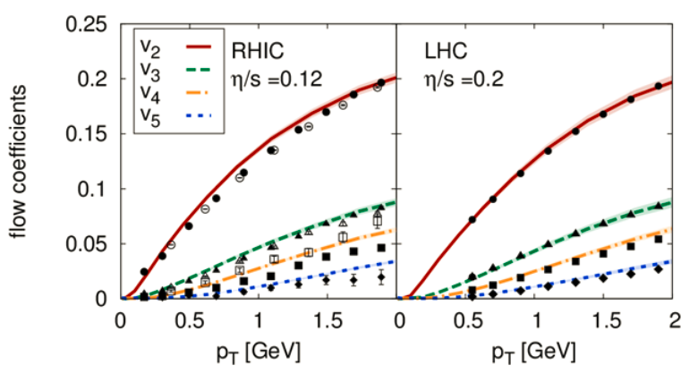
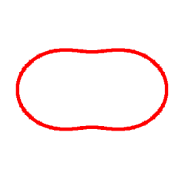
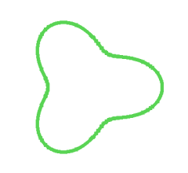
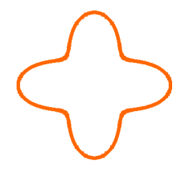
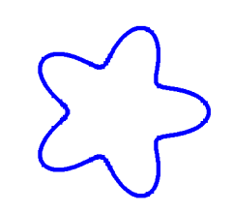
Detailed Fingerprint of Early Time
Bjoern Schenke

Slide 7
“Little Bang” Standard Model
Discovery: Quark Gluon Plasma = Near Perfect Fluid
Standard Model with Hydrodynamic Evolution
Precision: Predictions of Flow Patterns
but…
How does it equilibrate so quickly (or does it)?
What are the degrees of freedom or quasiparticles?

Slide 8
Back to Discovery
A+A
Enough particles to equilibrate, QGP, collective motion
p+p, p+A
Not enough particles to equilibrate, control experiment

Slide 9
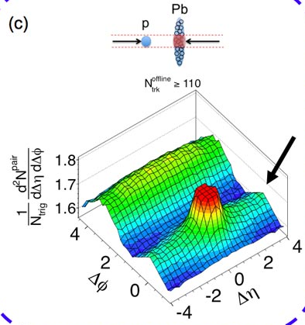
Fall 2012 Revolution – p+Pb Collisions
Signal similar to that seen in A+A
Could it be flow?
Alternative proposal of initial state
momentum domains – nothing to do with geometry!

Slide 10
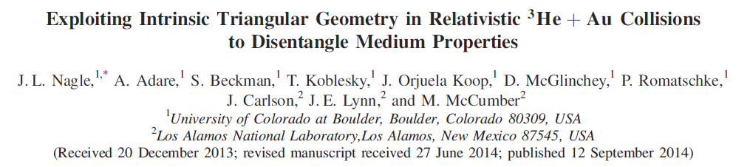
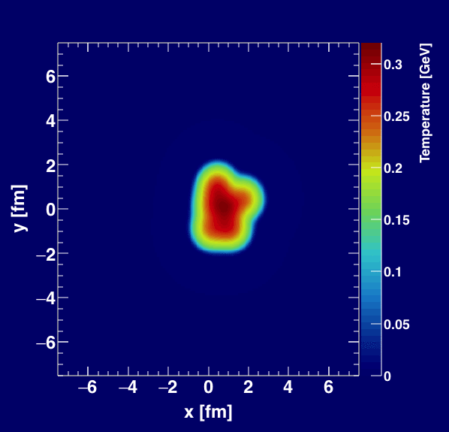
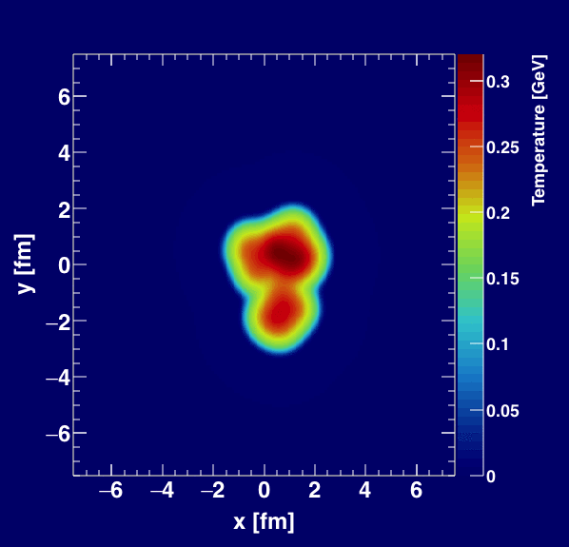
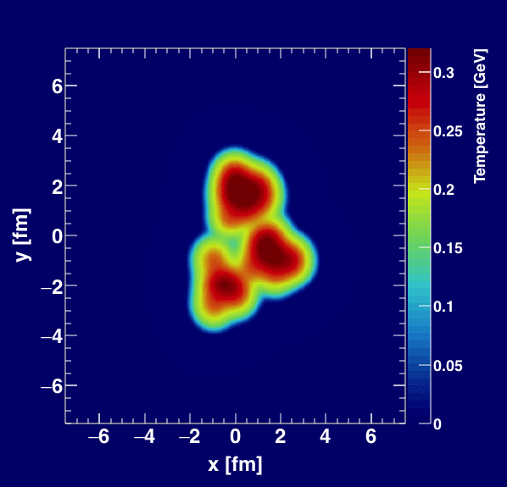
Geometry Tests at RHIC
http://journals.aps.org/prl/abstract/10.1103/PhysRevLett.113.112301

Slide 11
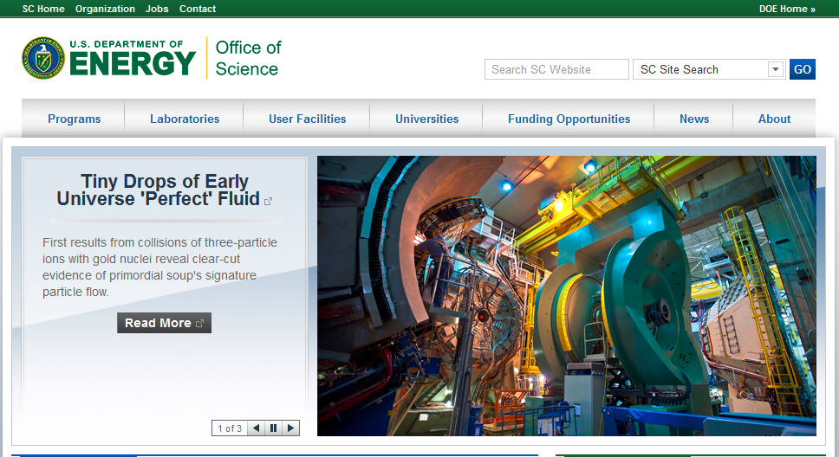
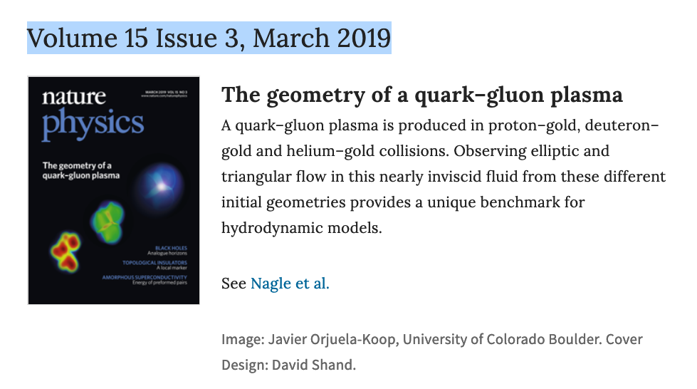

Slide 12
Experimental Data
v₂
Follows ordering of eccentricities
v₃
Multiplicity also plays a role
PHENIX, Nature Phys. 15 (2019) no.3, 214-220 - https://arxiv.org/abs/1805.02973

Slide 13
Hydrodynamic Comparison
PHENIX, Nature Phys. 15 (2019) no.3, 214-220 - https://arxiv.org/abs/1805.02973
Agreement with v₂, v₃ (p_{T}) for all three systems
SONIC hydrodynamic published prediction has very good p-value
Alternative hydrodynamics iEBE-VISHNU confirms results

Slide 14
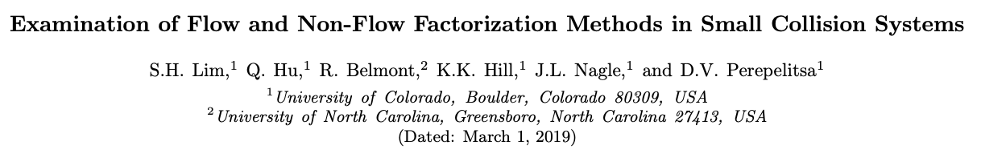
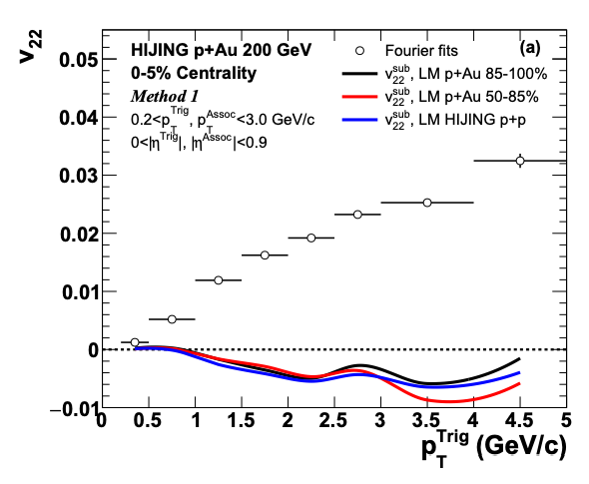
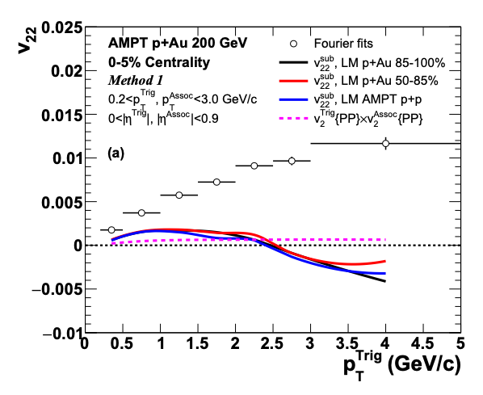
Flow and Non-Flow
https://indico.cern.ch/event/656452/contributions/2869833/attachments/1649479/2637419/QM18-smallsystem-shengli-10.pdf
STAR result has a small Δη gap, and thus a huge non-flow contribution
(even at low p_{T}).
That is why they are so sensitive to the non-flow subtraction.
PHENIX results checked with Δη gap of 3 units and in systematic uncertainties.
https://arxiv.org/abs/1902.11290
HIJING and AMPT closure tests indicate significant over-subtraction by template method with STAR kinematics for p_{T} > 1-2 GeV

Slide 15
“One fluid to rule them all”
p+p
p+Pb
Pb+Pb
Weller and Romatschke, https://arxiv.org/abs/1701.07145

Slide 16
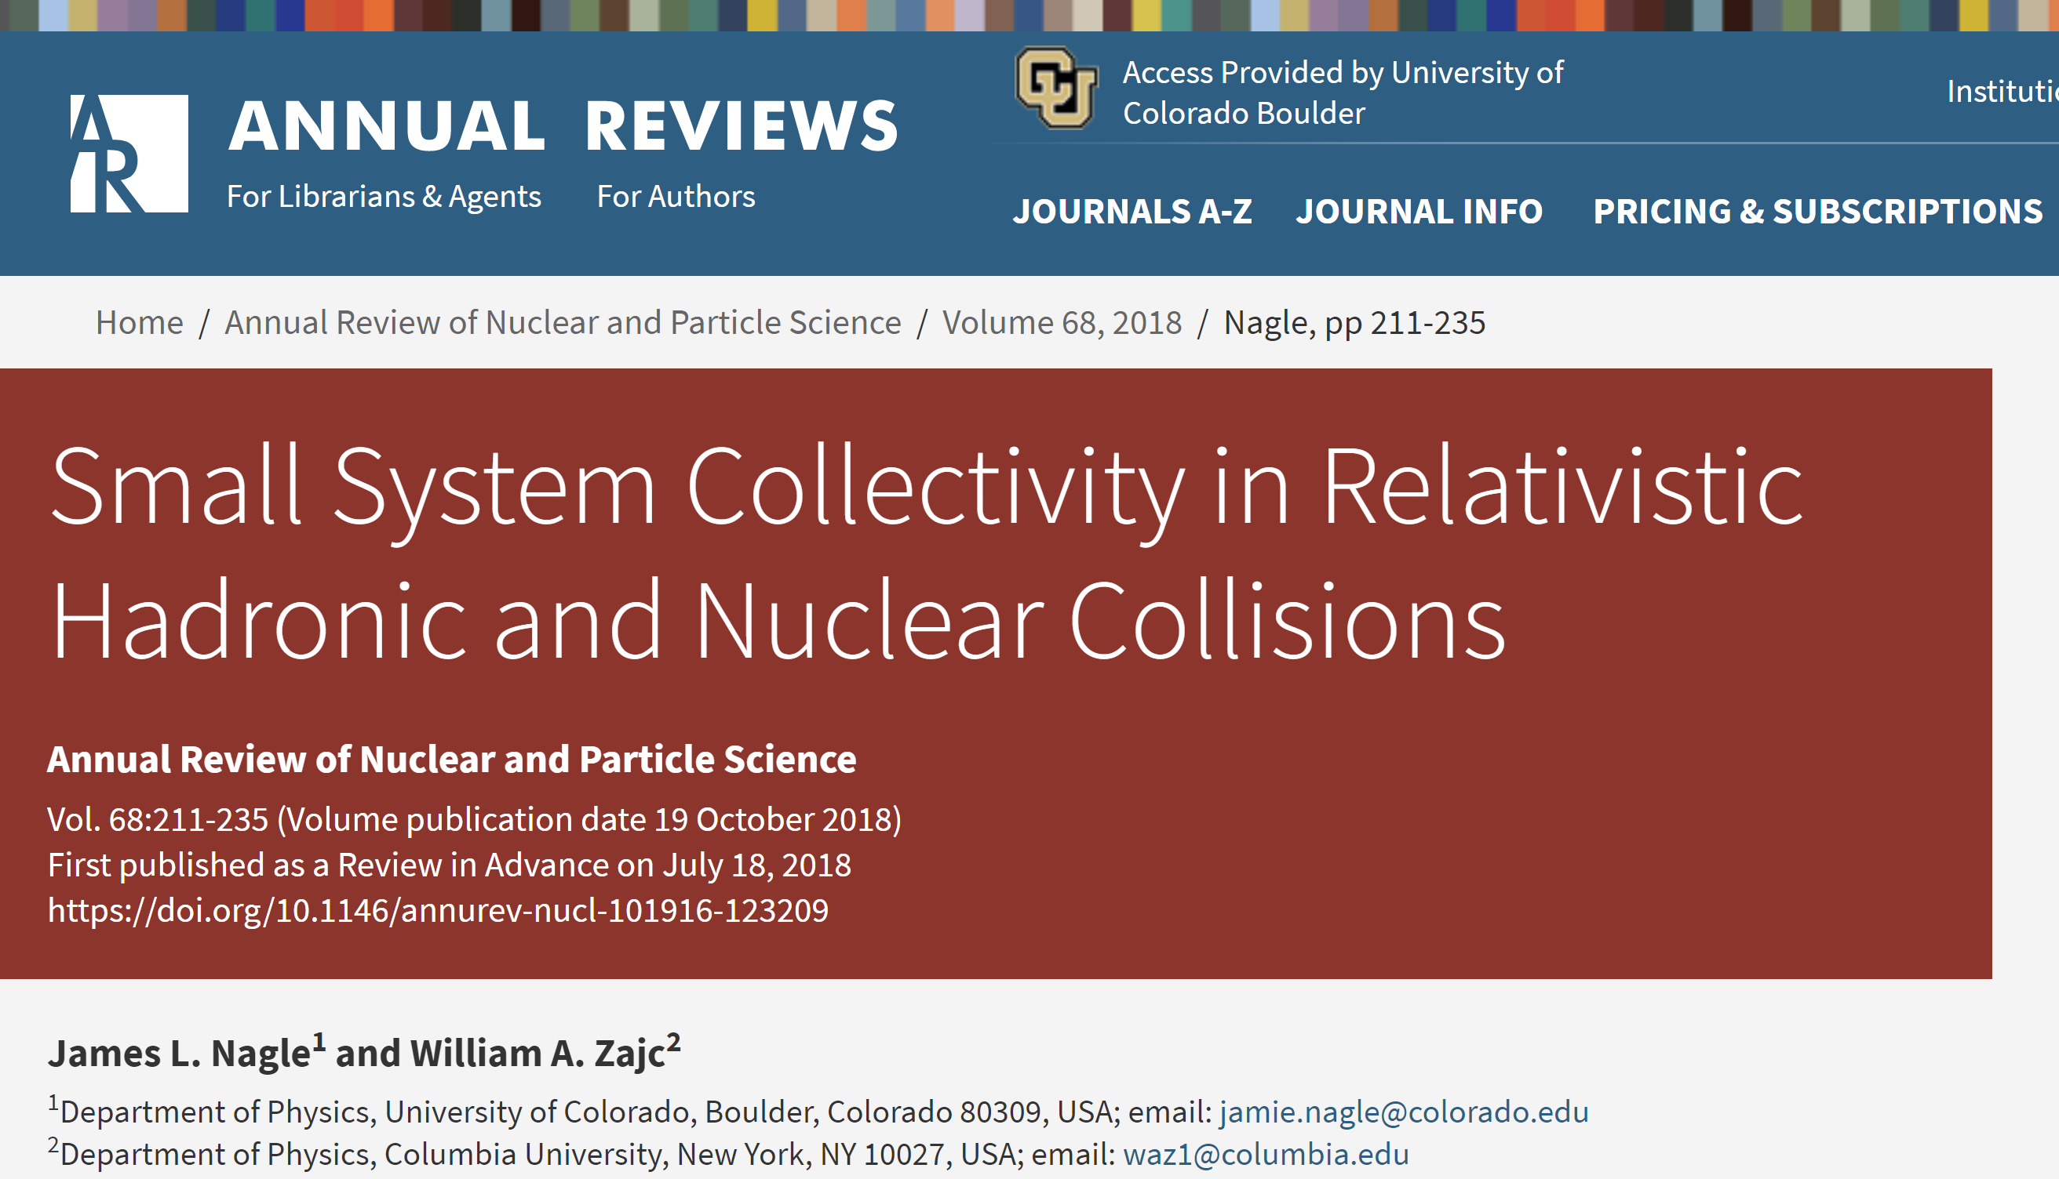
https://www.annualreviews.org/doi/10.1146/annurev-nucl-101916-123209

Slide 17
What does it all mean?
I thought hydrodynamics only applies if
system is near equilibrium
system has a size scale L >> mean free path
How can these be true in p+p, p+Au, d+Au, etc.?
Maybe they are NOT!
String Theory Dual (completely solvable at strong coupling)
Systems very far from equilibrium still described by hydrodynamics as long as non-hydrodynamic modes are damped → hydrodynamic attractor.
Major re-thinking well beyond field of heavy ion physics.

Slide 18
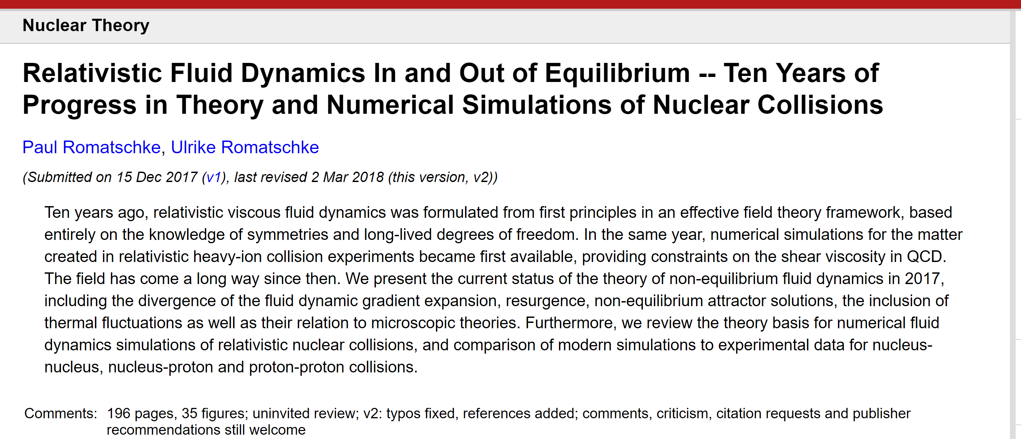
https://arxiv.org/abs/1712.05815

Slide 19
Alternatives
Rice Workshop, March 14-16, 2019 to discuss further…
https://indico.cern.ch/event/771998/timetable/#all

Slide 20
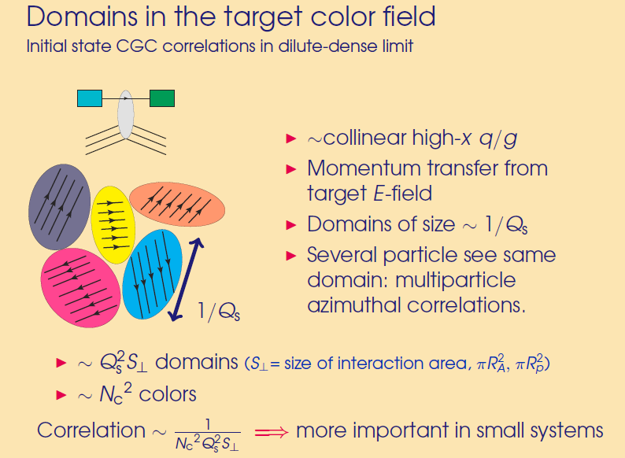
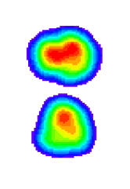
Color Domains
Effective field theory at weak coupling, dense gluon fields
Initial state correlations from domains…
Size scale of domains ~ 0.2-0.4 fm
Deuteron RMS diameter ~ 4 fm
Domains within each hotspot are uncorrelated
(large separation of scale)
Individually resolved domains
v₂ (dAu) < v₂ (pAu)
opposite of data ordering!

Slide 21
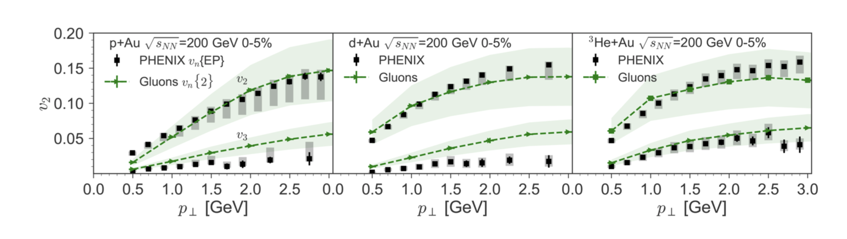
15 days after the PHENIX paper was posted, postdictions appeared
[MSTV2] https://arxiv.org/abs/1901.10506 (addition of uncertainty bands)
[MSTV] https://arxiv.org/abs/1805.09342 (original postdiction)
However, JN/Bill Zajc determined MSTV are
calculating the wrong quantity
(not what the experiments measure).
People should stop showing this comparison until the right quantity is published.
Full details:
https://indico.cern.ch/event/771998/contributions/3339224/

Slide 22
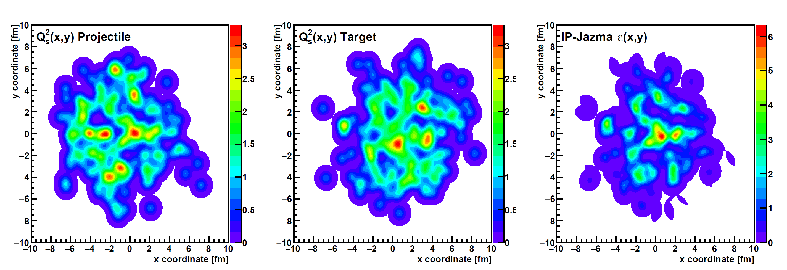
Additional scientific scrutiny is healthy.
To that end, Bill Zajc and I wrote the IP-Jazma model.
It tests what features are geometric and which require deeper physics.
https://arxiv.org/abs/1808.01276
https://github.com/jamienagle/IPJazma

Slide 23
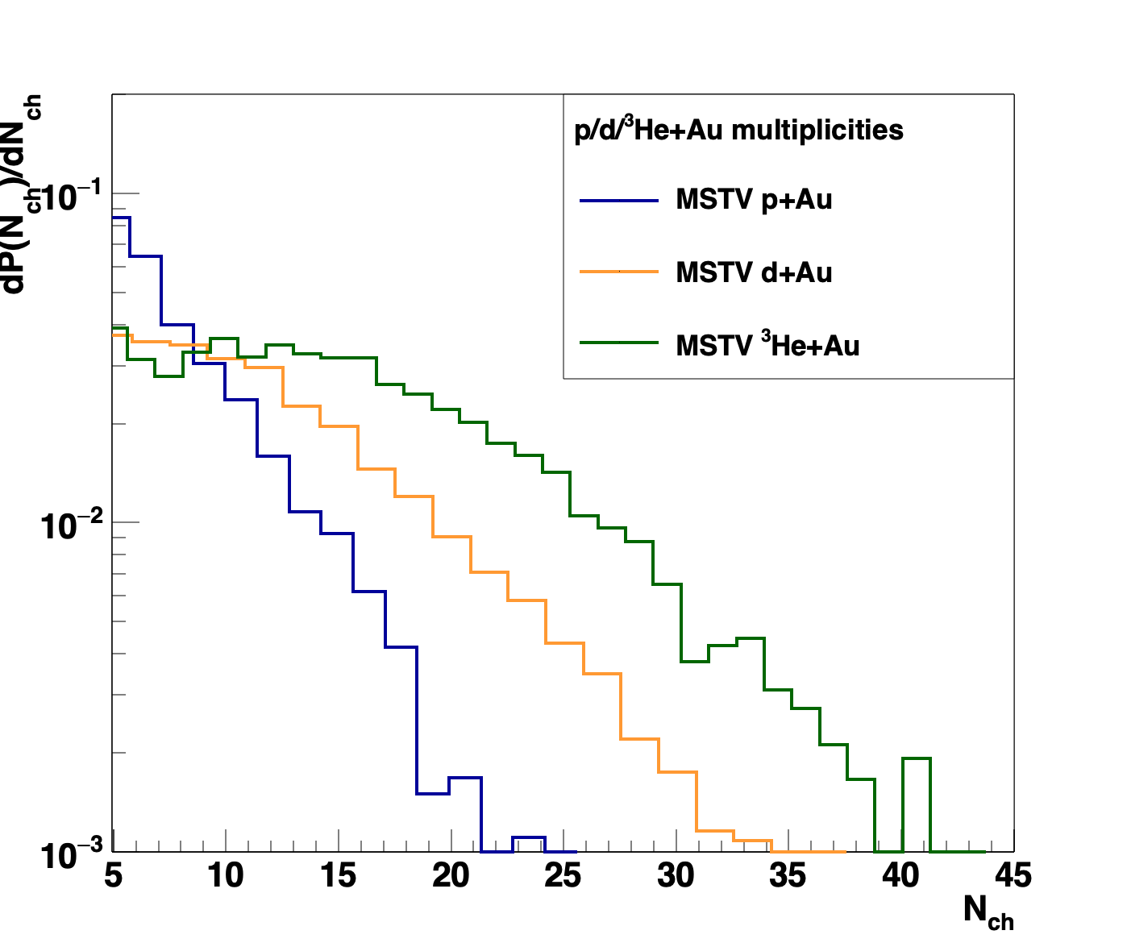
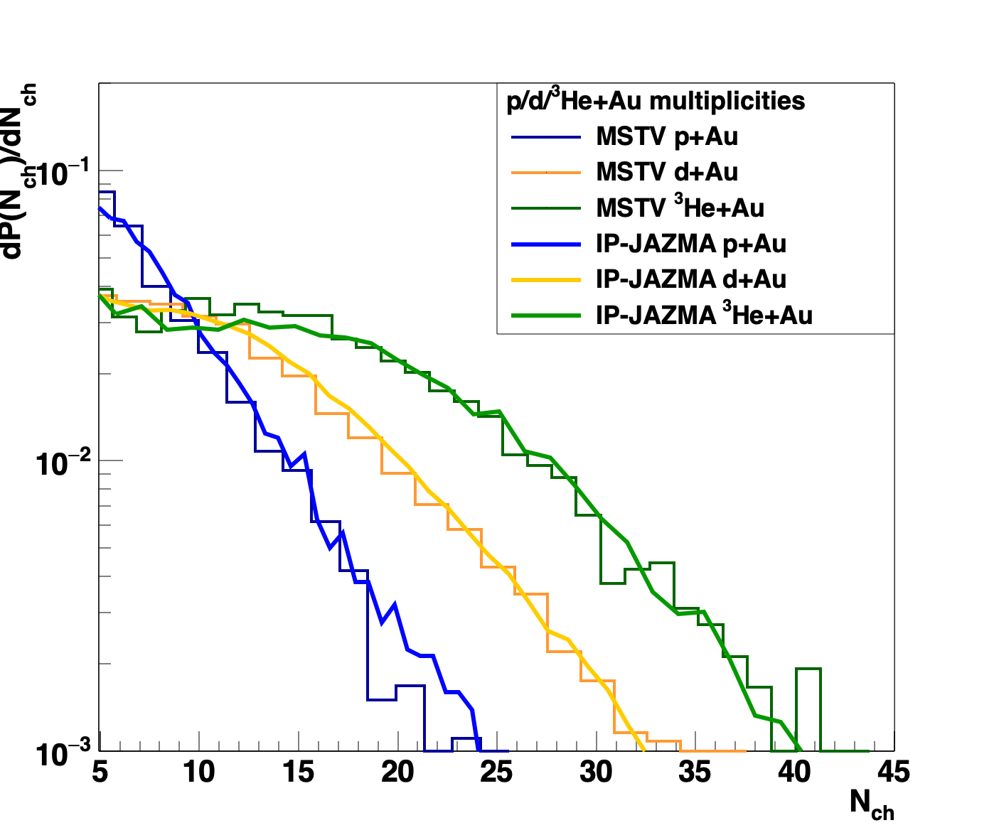
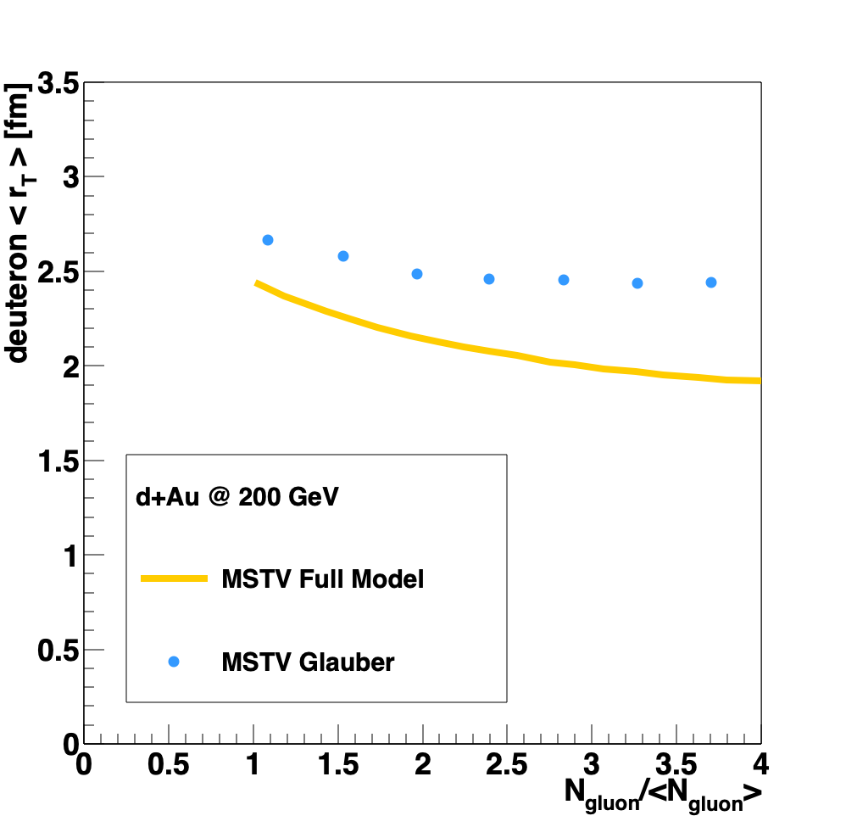
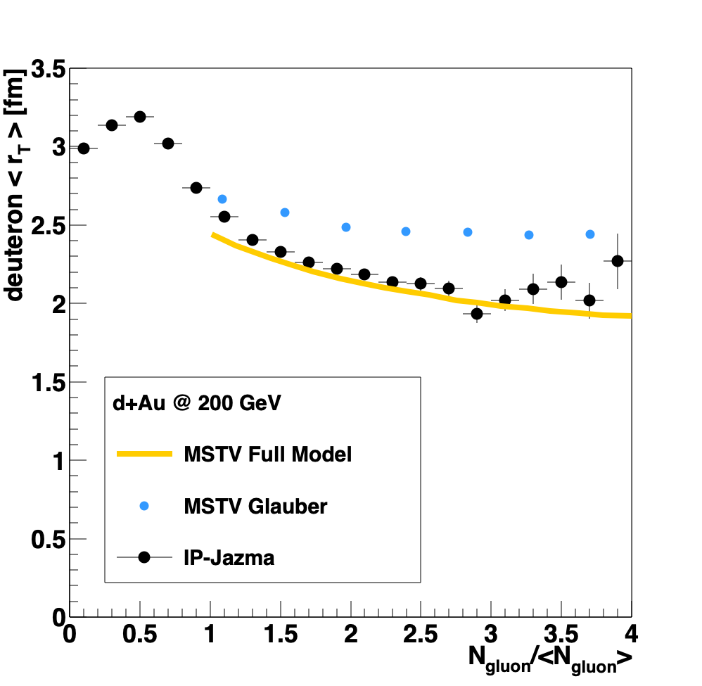
Exposing Identification Problem
Bias to smaller deuteron configurations at
high multiplicity reveals
non-trivial many body correlations in glasma framework
Multiplicity distribution reveals ab initio NBD in
glasma framework
IP-Jazma proves these identifications wrong.

Slide 24
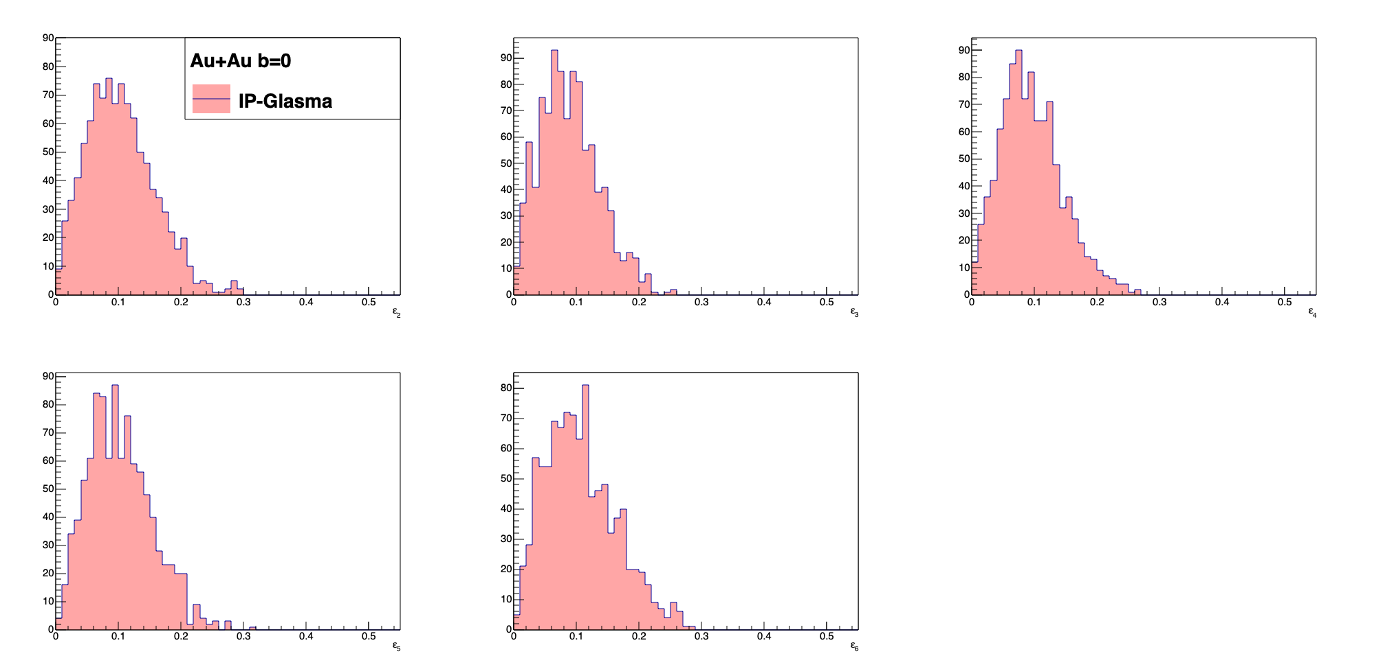
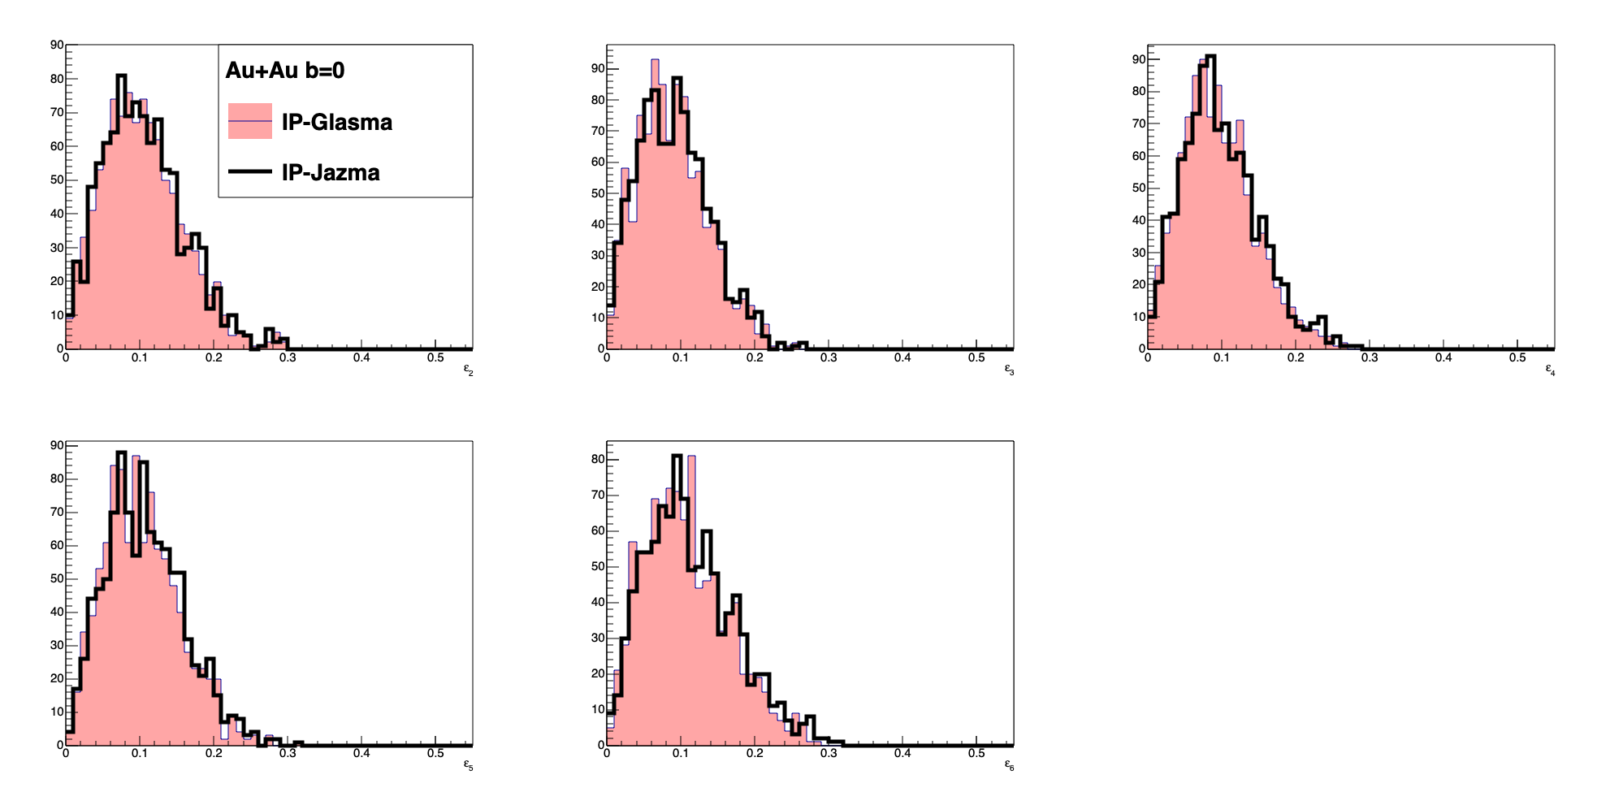
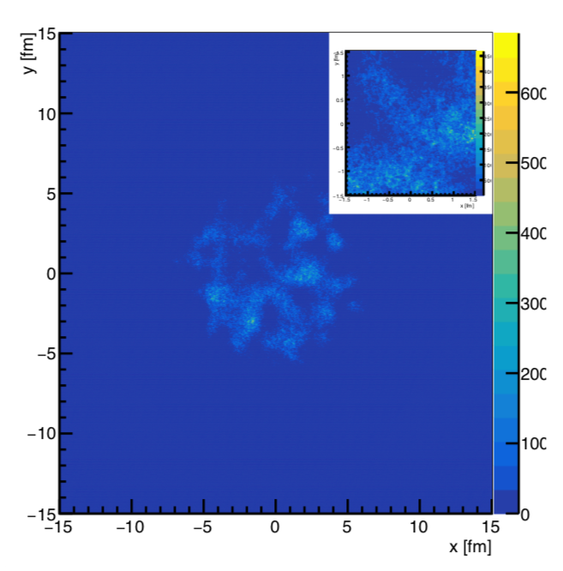
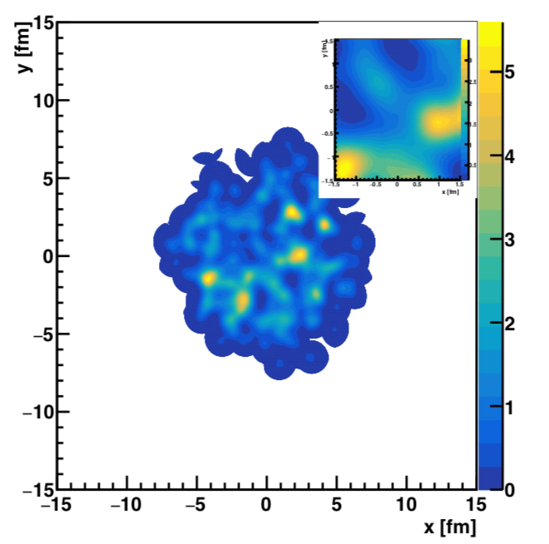
Exposing Identification Problem
IP-Glasma AuAu b=0 Energy Density
IP-Jazma AuAu b=0 Energy Density
ε₂
ε₃
ε₄
ε₅
ε₆
Great benefit of publicly available IP-Glasma: https://github.com/schenke/ipglasma
More detailed investigations underway looking for domains (JN / Sanghoon Lim)

Slide 25
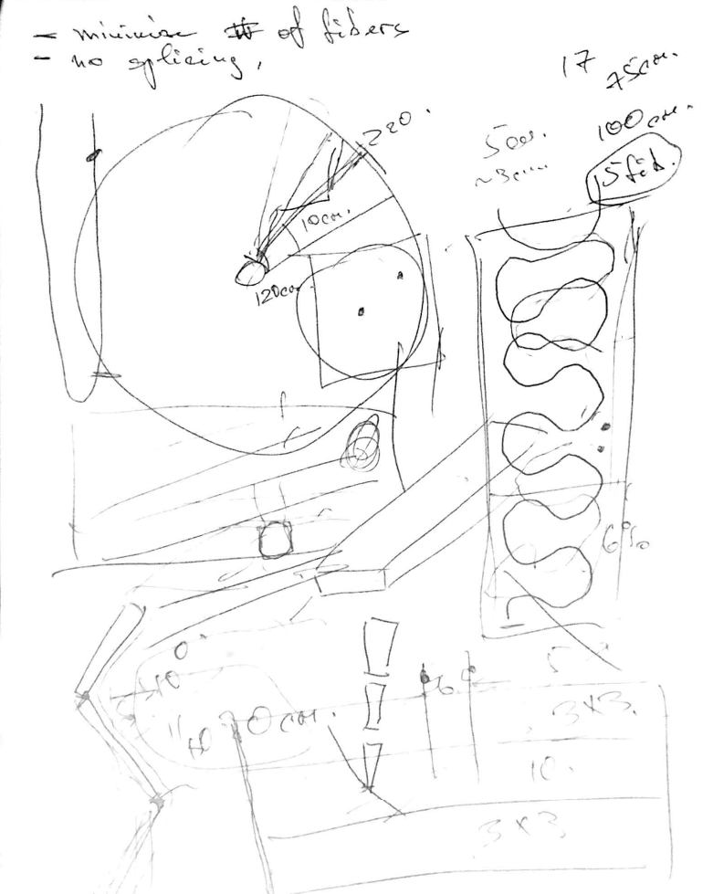
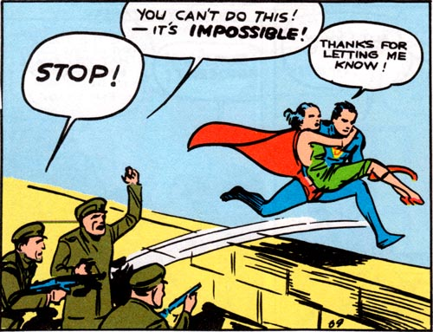

The Future of Perfect Fluid Studies
Is QGP not fully equilibrated even in A+A?
Why does it still behave as a nearly perfect fluid?
At what scale do quasiparticle excitation become relevant?
sPHENIX is designed to answer these questions.
BNL Director’s Review happening literally right now.
PD2-3 Review in May.
Hard to believe it started almost nine years ago with
napkin drawings.

Slide 26
Summary
Discovery of Quark-Gluon Plasma as Perfect Fluid
Precision Description of Flow
“Little Bang” Standard Model
Small QGP Droplets Flow Too
New Opportunities to Discover the How and Why of the QGP

Slide 28
Particle Multiplicities
https://arxiv.org/abs/1807.11928, accepted at Phys. Rev. Lett.
Midrapidity Values
dN_{ch}/dη ~ 12 p+Au 0-5%
dN_{ch}/dη ~ 18 d+Au 0-5%
dN_{ch}/dη ~ 22 ³He+Au 0-5%
Hydrodynamic calculations include the initial geometry differences and match the particle multiplicity for each system

Slide 29
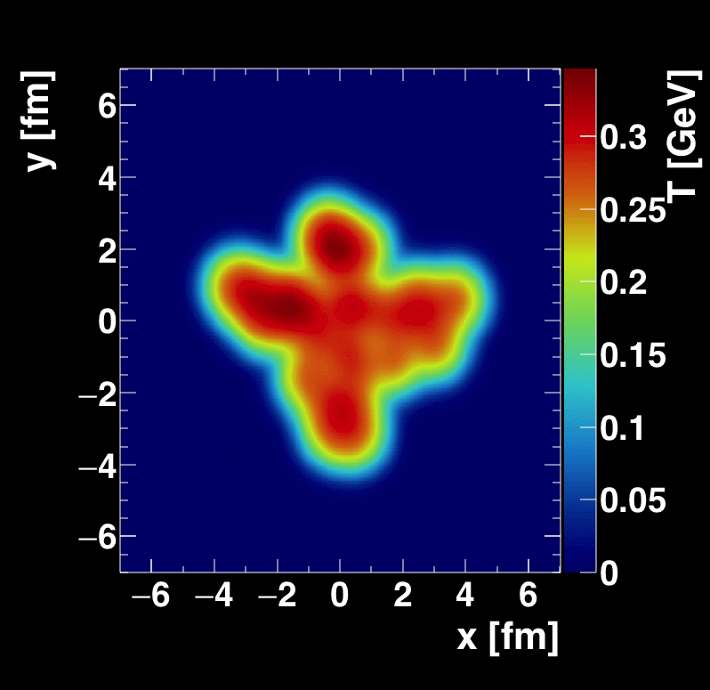
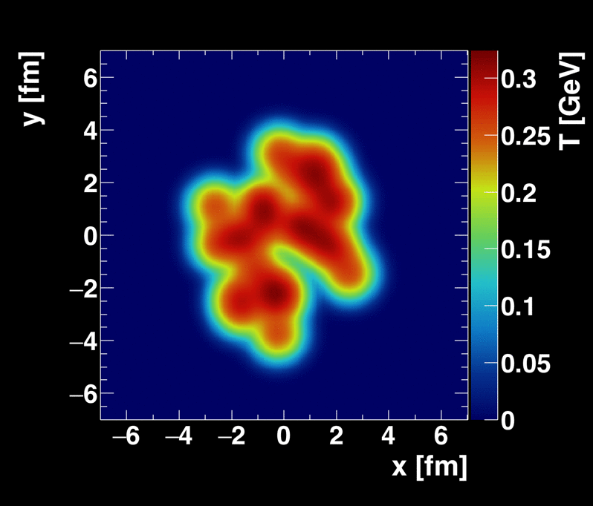
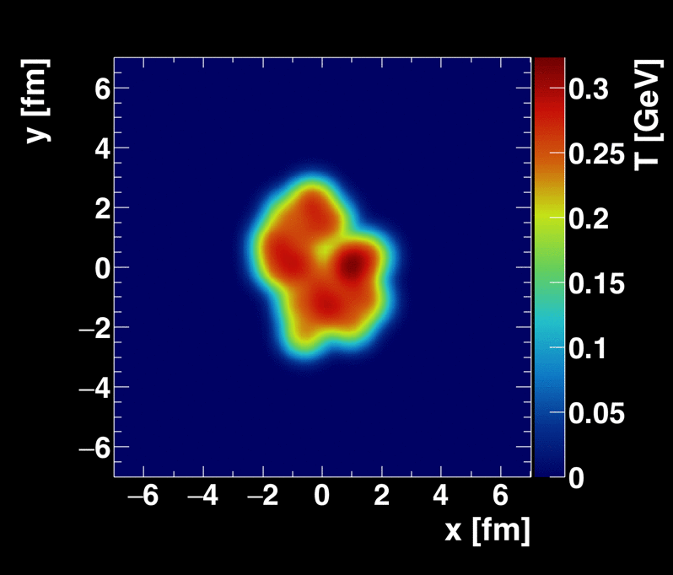
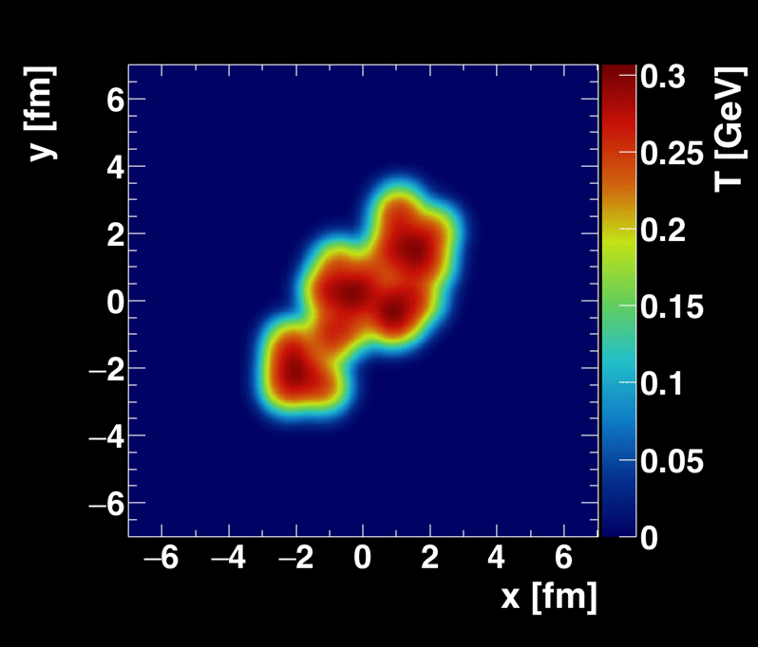
New Geometries Under Consideration
Oxygen + Oxygen, p + Oxygen (LHC)
ALD Berndt Muller
suggested ⁴He+A (RHIC)
Calculations from Sanghoon Lim
Recent proposal (https://arxiv.org/abs/1808.09840)
for polarized deuteron+A collisions.
Unfortunately, at RHIC C-AD does not believe they can maintain this small polarization through acceleration.

Slide 30
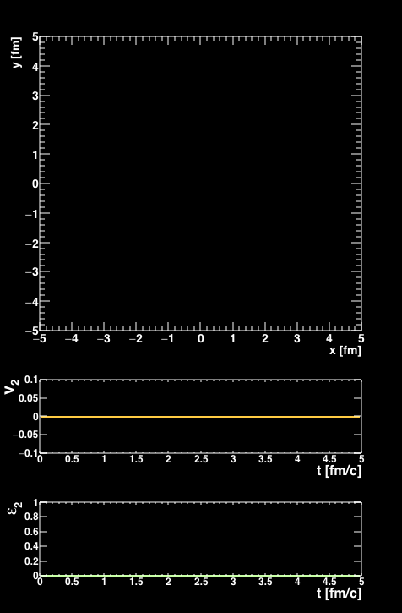
Is there a dual particle description to fluid dynamics?
Some systems really have no quasiparticles
Near perfect fluidity implies uncertainty principle scales
³He+Au Collision
AMPT Parton Cascade
Nagle et al., arXiv:1707.02307,
Orjuela Koop et al., arXiv:1512.06949, arXiv:1501.06880
Bozek, Bzdak, Ma, arXiv:1503.03655

Slide 31
Parton Scattering Results
Poor quantitative description, but rough agreement with v_{n} ordering
Problem with proving/disproving quasiparticle picture …
Cannot calculate QCD 2→2 cross section, angular distributions, etc.
Many free parameters to match the data if desired

Slide 32
Cornucopia of d+Au Data
PID Spectra
v₂(p_{T}) PID
v₂(η)
v₂{2}, {4}, {6}
d+Au beam energy scan → 200 GeV, 62.4, GeV, 39 GeV, 19.6 GeV

