Slide 1

Pulling on the Threads of Small
Quark-Gluon Plasma Explanations
Jamie Nagle
University of Colorado Boulder
Seminar on June 18, 2019

Slide 2
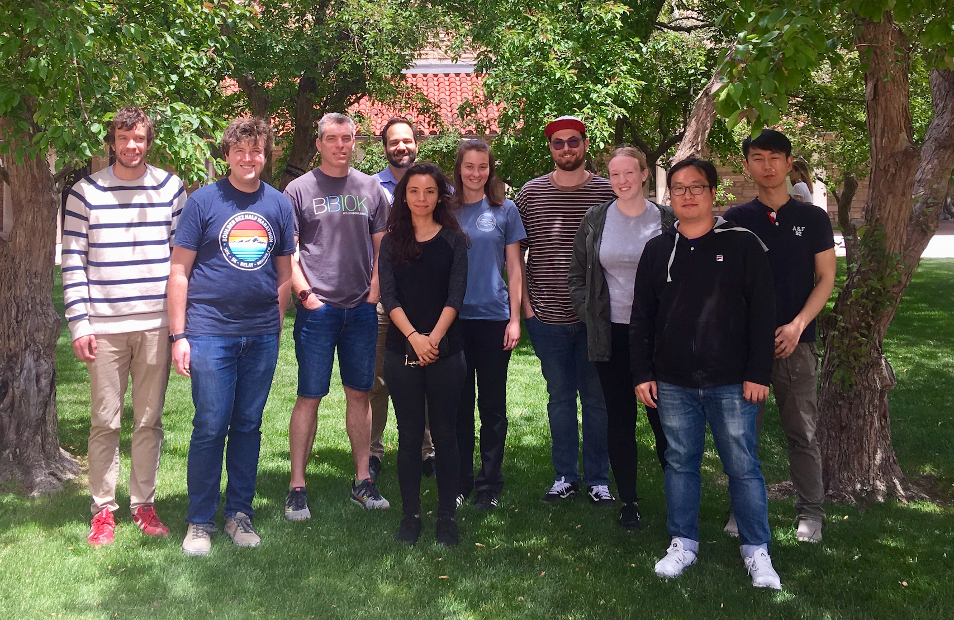

Talk Outline
Brief review of standard evolution model of heavy ion collisions
Extension of model to small collision systems
Skeptic view, pulling at the threads
University of Colorado Boulder Group
JLN on Sabbatical
College Scholar Award
Emilie du Chatelet grant from P2IO at CEA / Saclay
And Kurt Hill and Javier Orjuela-Koop (not in photo).
Javier just won RHIC & AGS Thesis Award in part for small system collectivity.

Slide 3
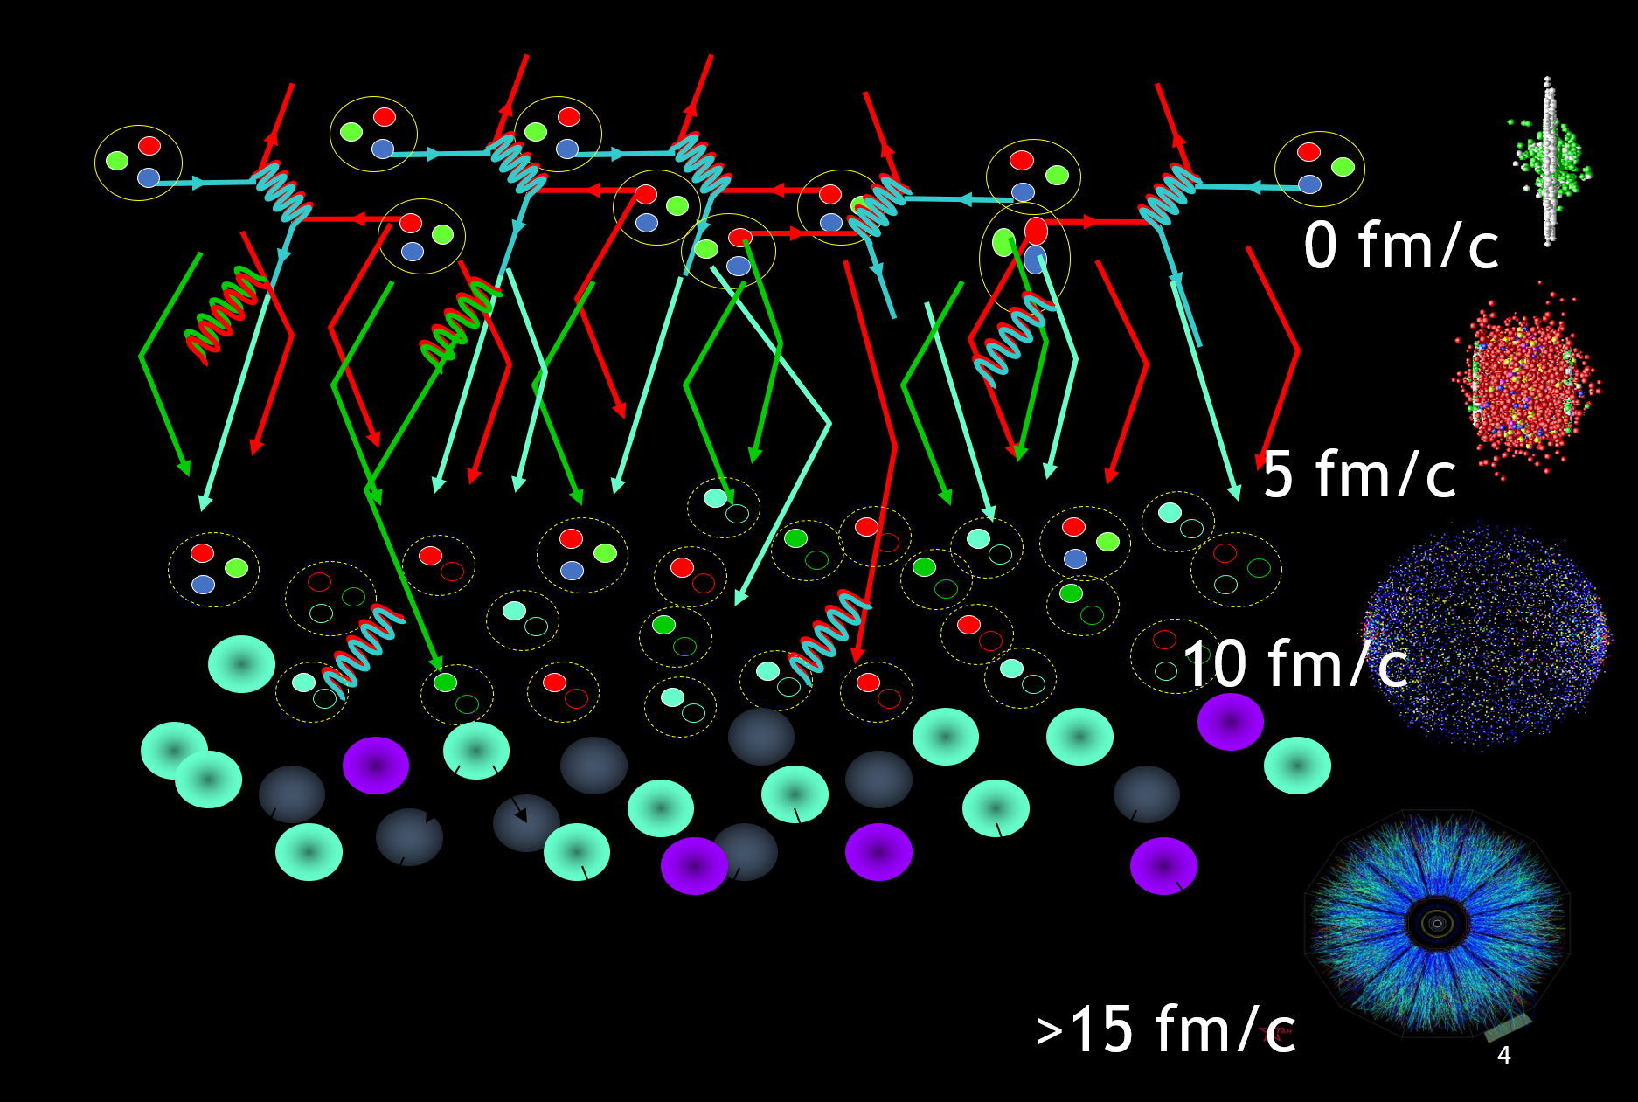
Standard Time Evolution Model of Heavy Ion Collisions
Initial State – nPDF, saturation physics, color domains
QGP State – hydrodynamics, parton scattering
Hadron State – hadronization, hadron scattering
Free Streaming State – measured by experiment
3

Slide 4
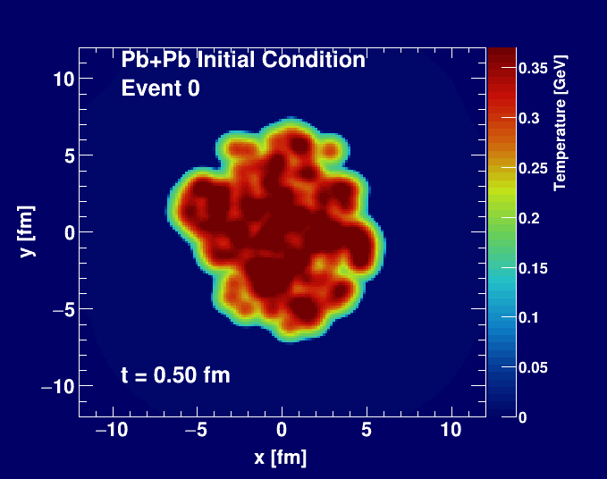
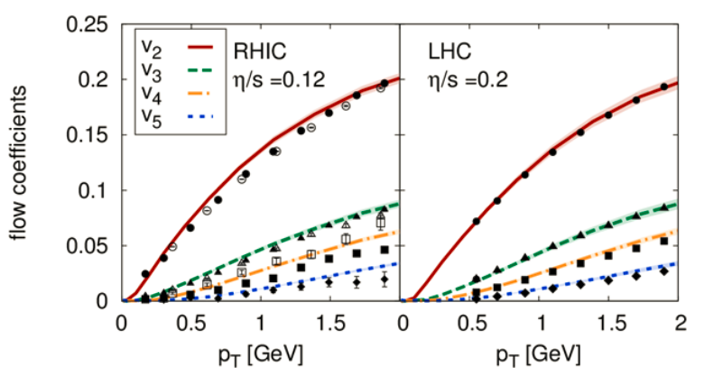
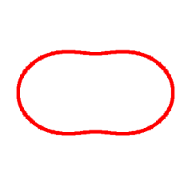
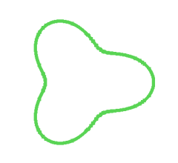
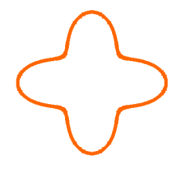
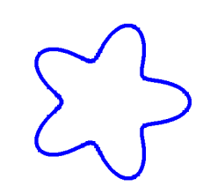
Standard Time Evolution Model of Heavy Ion Collisions
Bjoern Schenke
Hydrodynamic simulation (SONIC from Paul Romatschke) run with
η/s = 0.08 ~ 1/4π and ζ/s = 0.01

Slide 5
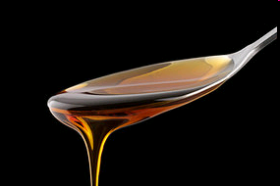
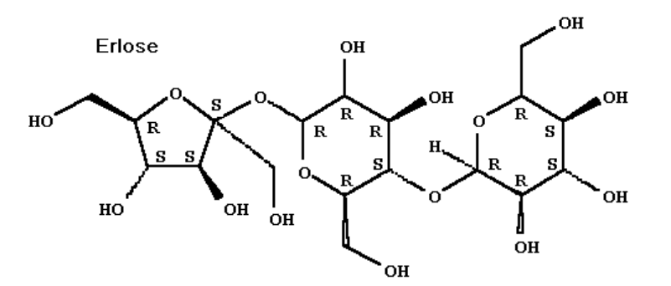
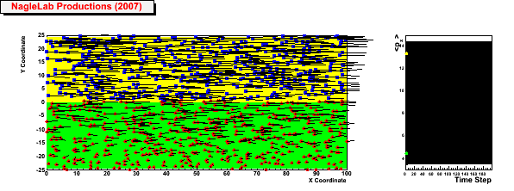
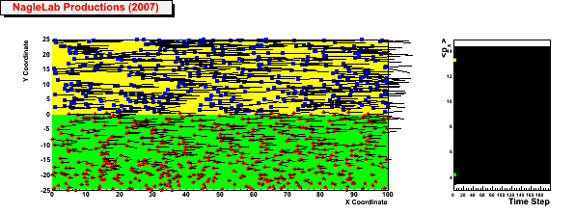
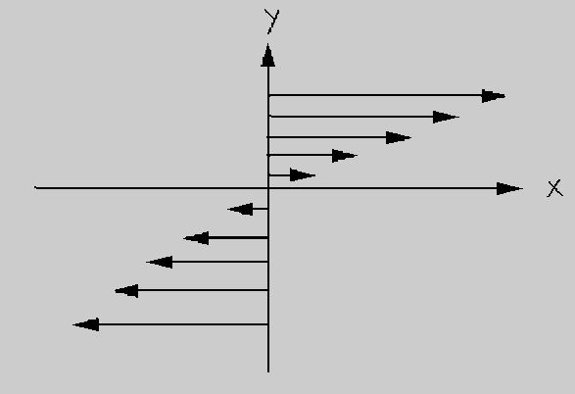
Shear Viscosity and Strong Coupling
Honey – viscosity decreases at higher temperatures
viscosity increases with stronger coupling
Weak coupling (σ=0)
<p_{x}> top region
Inhibited
diffusion
↓
Small
viscosity
↓
Perfect fluid
<p_{x}> bottom region
Strong coupling (σ ↑)
5

Slide 6
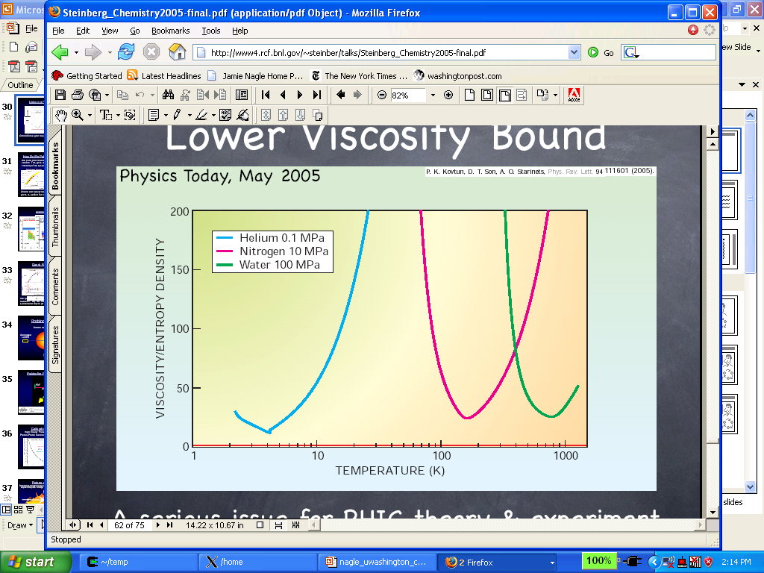
Nearly Perfect Fluid (but not a Superfluid)
Quark-Gluon Plasma
Gas-Liquid Phase Transition
Superfluidity Transition
A roton is a collective excitation (quasiparticle) associated with the rotation of a fluid (often a superfluid). It is a quantum of a vortex.
Quark-Gluon Plasma is very hot, so low level quantum states
(e.g. these kinds of quasiparticles) are not expected to play a role.

Slide 7
“One fluid to rule them all”
Pb+Pb
p+Pb
p+p
Weller and Romatschke, https://arxiv.org/abs/1701.07145

Slide 8
RHIC Geometry Scan

Slide 9
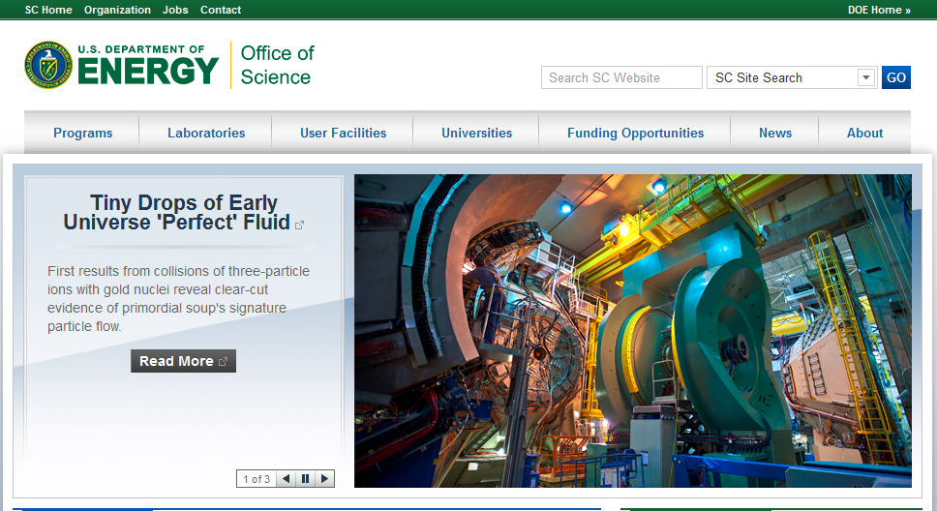
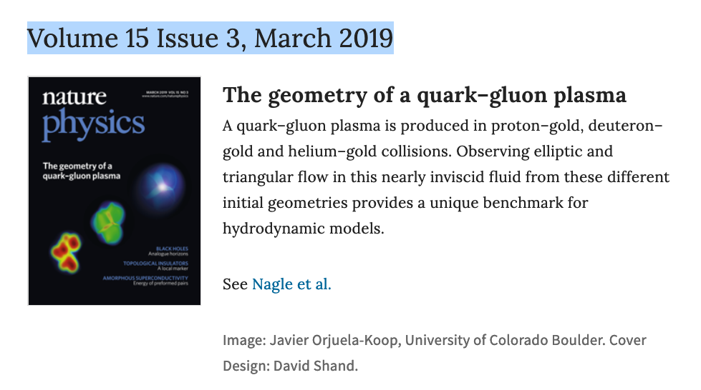

Slide 10
Experimental Data
v₂
Follows ordering of eccentricities
v₃
Multiplicity also plays a role
PHENIX, Nature Phys. 15 (2019) no.3, 214-220

Slide 11
Hydrodynamic – Data Comparison
PHENIX, Nature Phys. 15 (2019) no.3, 214-220
Agreement with v₂, v₃ (p_{T}) for all three systems
SONIC hydrodynamic published prediction has very good p-value
Alternative hydrodynamics iEBE-VISHNU confirms results

Slide 12
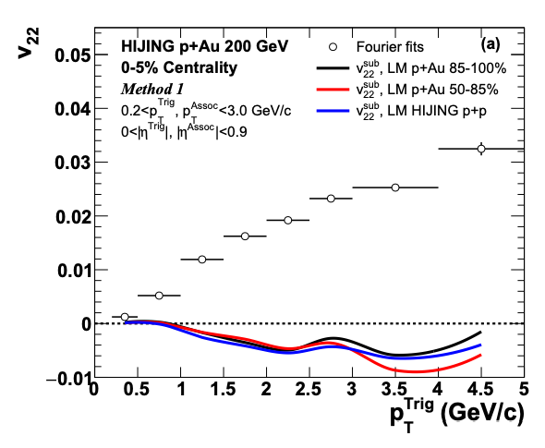
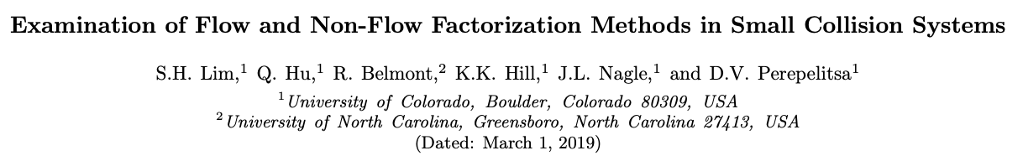
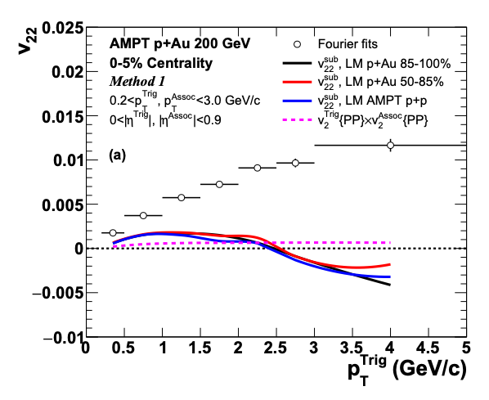
Flow and Non-Flow
Recent STAR preliminary result with small Δη gap, thus huge non-flow subtraction!
Very sensitive to non-flow subtraction.
https://indico.cern.ch/event/656452/contributions/2869833/attachments/1649479/2637419/QM18-smallsystem-shengli-10.pdf
https://arxiv.org/abs/1902.11290
HIJING and AMPT closure tests indicate significant
over-subtraction by template method with STAR kinematics
Useful discussion moving forward, and the details matter…
12

Slide 13
What does it all mean?
I thought hydrodynamics only applies if
system is near equilibrium
system has a size scale L >> mean free path
How can these be true in p+p, p+Au, d+Au, etc.?
Maybe they are NOT!
String Theory Dual (completely solvable at strong coupling)
Systems very far from equilibrium still described by hydrodynamics as long as non-hydrodynamic modes are damped → hydrodynamic attractor.
Major re-thinking well beyond field of heavy ion physics.

Slide 14
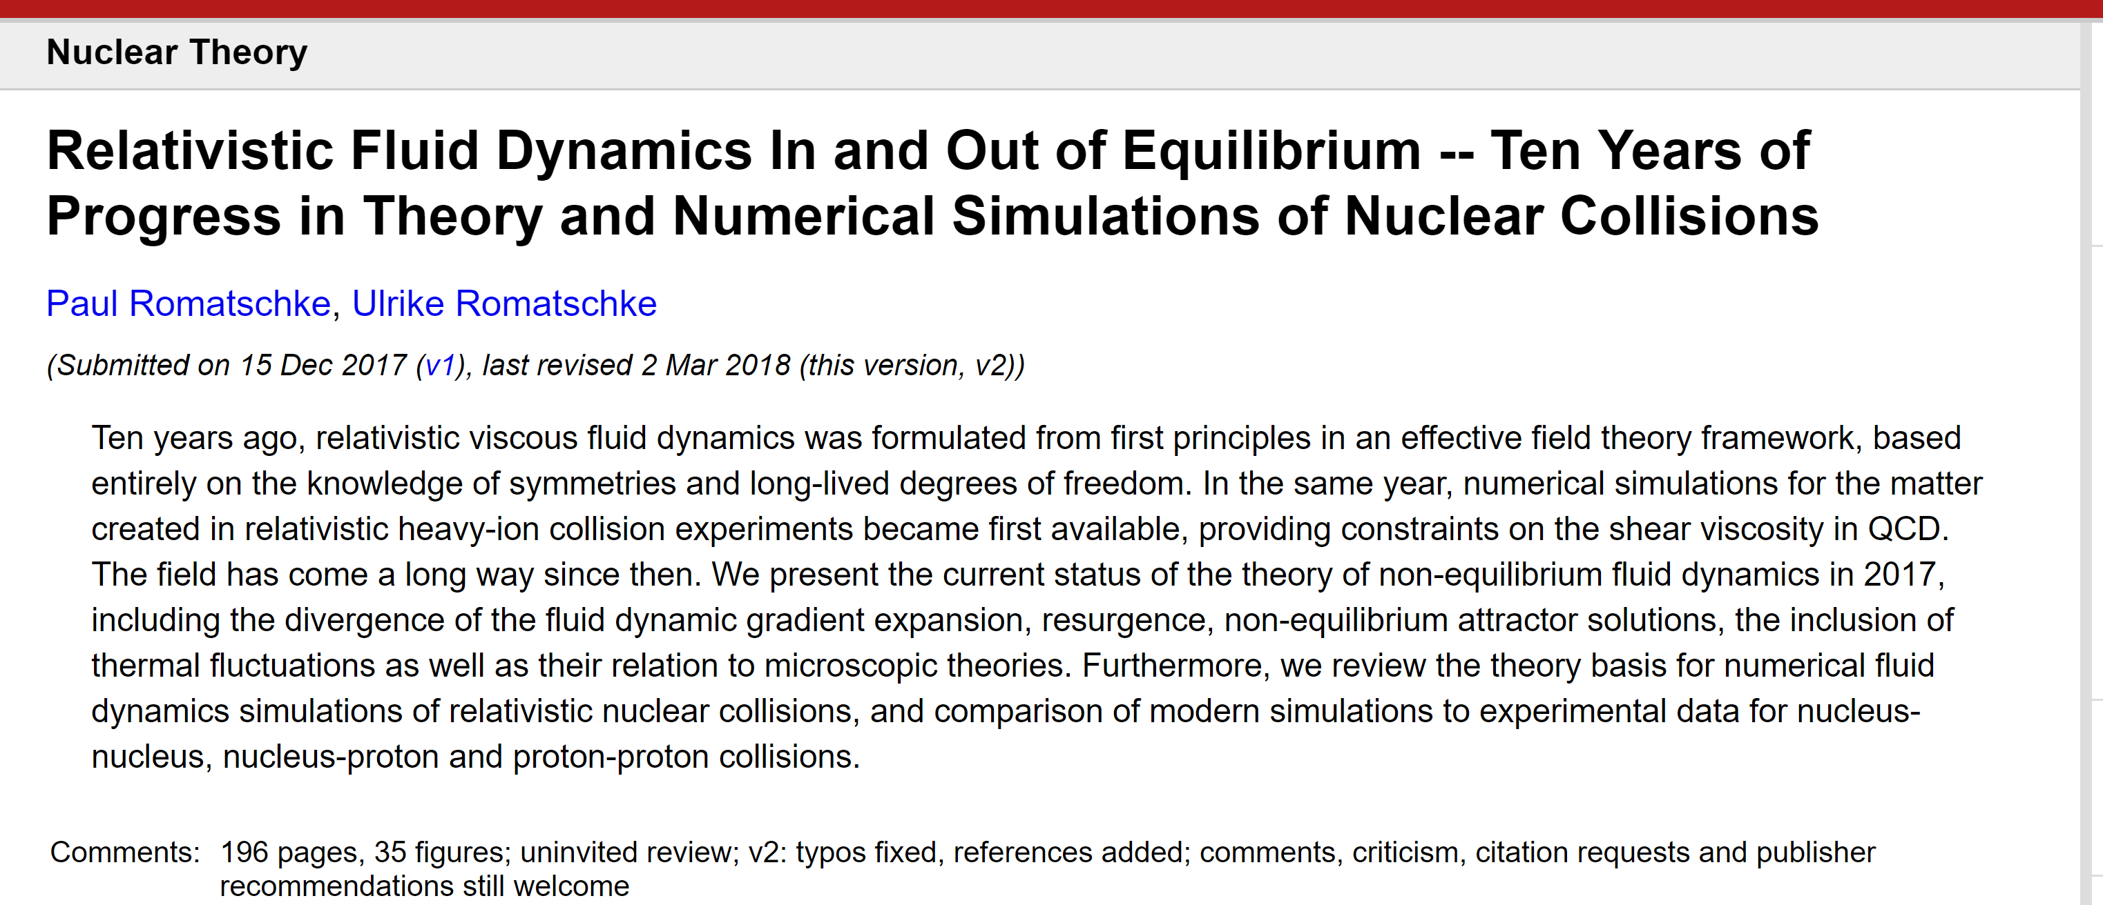
https://arxiv.org/abs/1712.05815
Not a proof for QCD, but a plausible explanation for
perfect fluidity in small systems

Slide 15
Thread #1
Initial State Correlations

Slide 16
Initial State Explanations

Slide 17
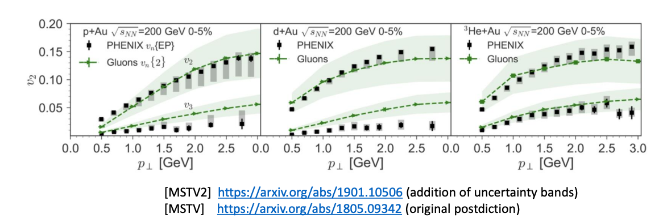
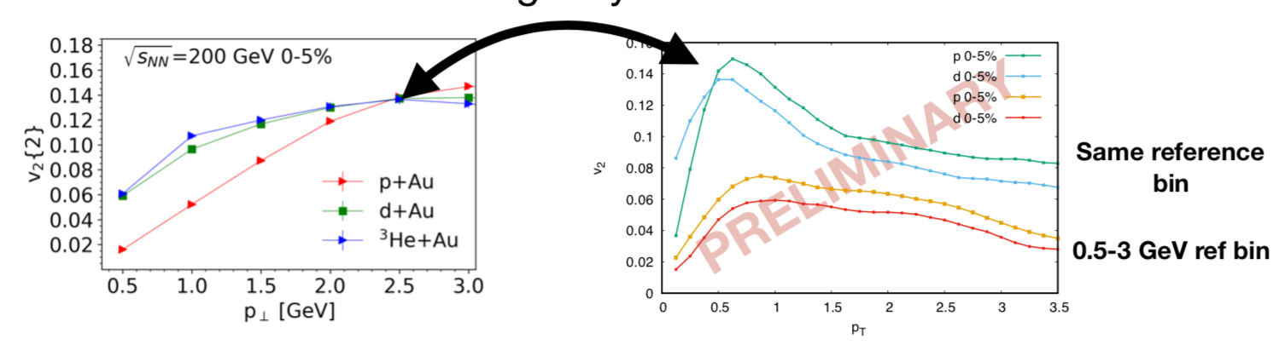
All Initial State Correlations?
Answer = no.
Recently found “bug” in calculation
http://www.int.washington.edu/talks/WorkShops/int_19_1b/People/Mace_M/Mace.pdf
Now predicts v₂ p+Au > v₂ d+Au (opposite the data)
Now indicates v₂ decreasing with p_{T} > 1 GeV (opposite the data)

Slide 18
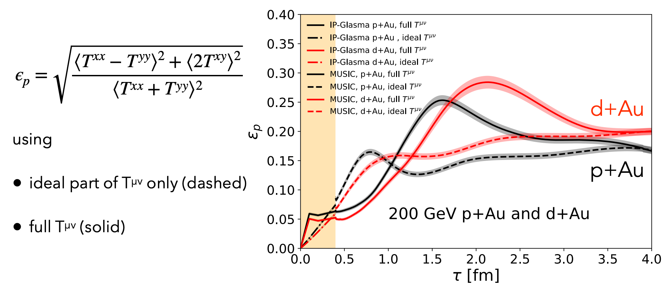
Could there be an interplay of both (initial state and hydrodynamic) contributions?
https://www.bnl.gov/aum2019/content/workshops/Workshop_1d/SCHENKE-AUM.pdf
Orientation of correlations from IP-Glasma phase are uncorrelated with geometry and so there can be a complicated interplay.
How to disentangle what really drives the physics?

Slide 19
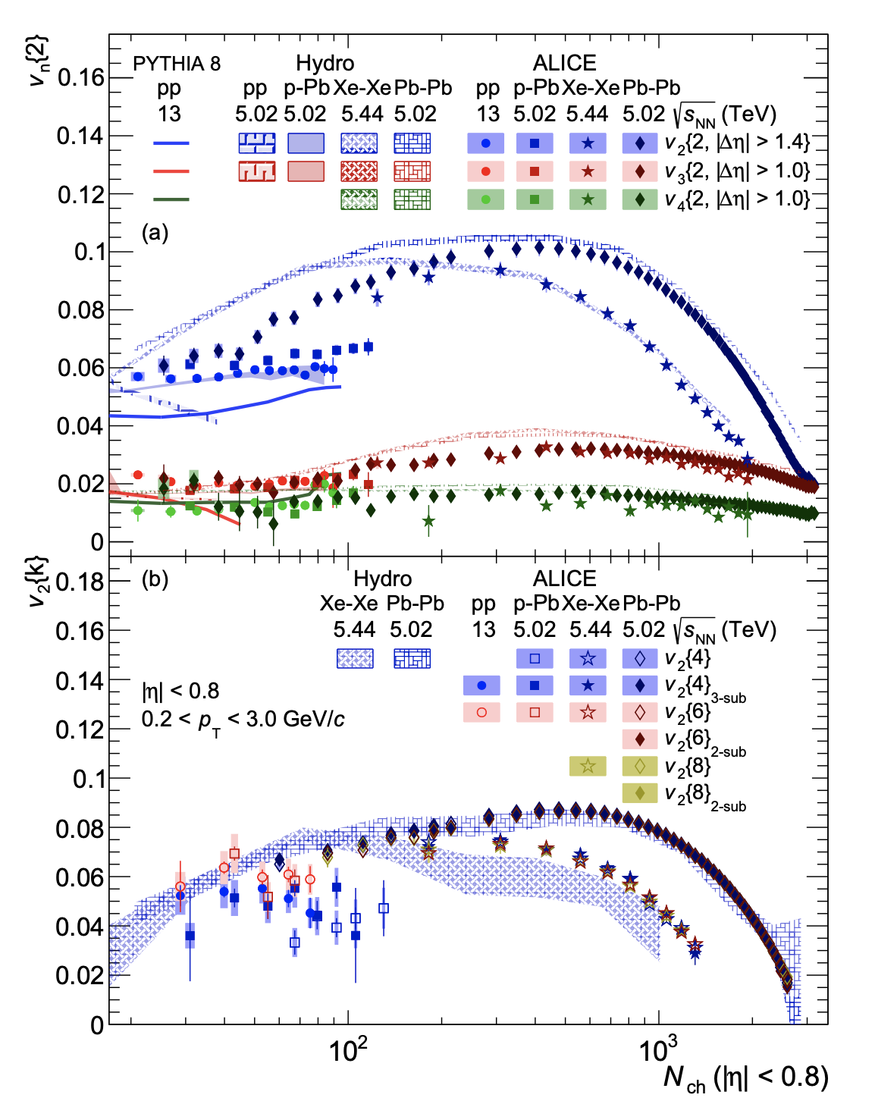
A thread to pull on…
https://arxiv.org/abs/1903.01790
p+p with three-quark geometry + hydrodynamics + hadronic cascade
IP-GLASMA + MUSIC + URQMD ↓
Glauber + SONIC + B3D ↑

Slide 20
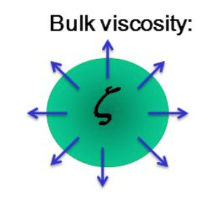
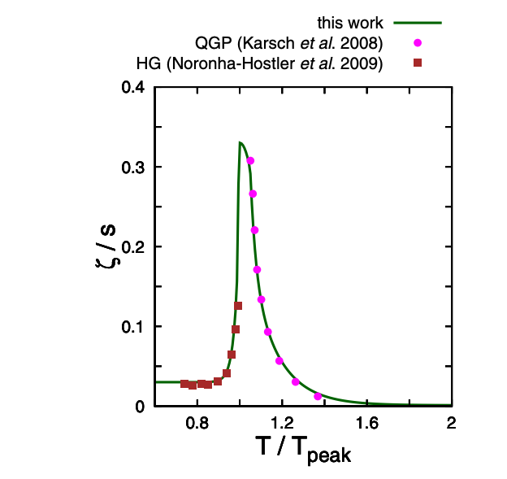
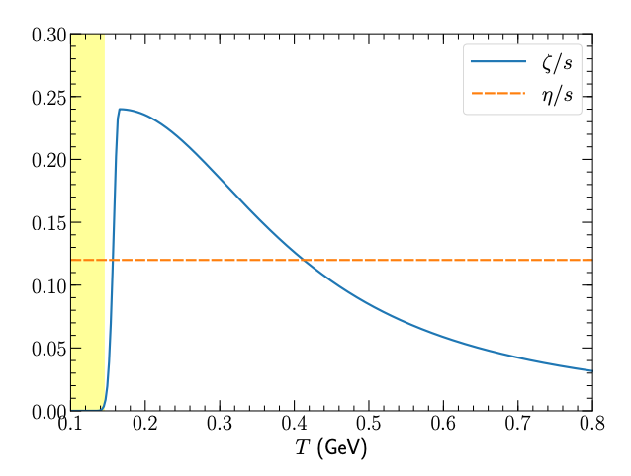
Bulk Viscosity
General notion that it should be peaked and become small as QCD becomes more conformal (high T)
Important note that QGP sum-rule method for extracted ζ/s calculation has been proven incorrect
Romatschke and Son
https://arxiv.org/pdf/0903.3946.pdf
https://journals.aps.org/prc/pdf/10.1103/PhysRevC.97.034910
Schenke et al. https://arxiv.org/pdf/1901.04378.pdf
To better match peripheral A+A, introduced new parameterization of bulk
Huge difference
At T = 0.2 -0.4 GeV the ζ/s > 0.1
whereas above plot has ζ/s ~ 0.01
IP-Glasma initial conditions, more compact source, initial velocities (?) require strong damping.

Slide 21
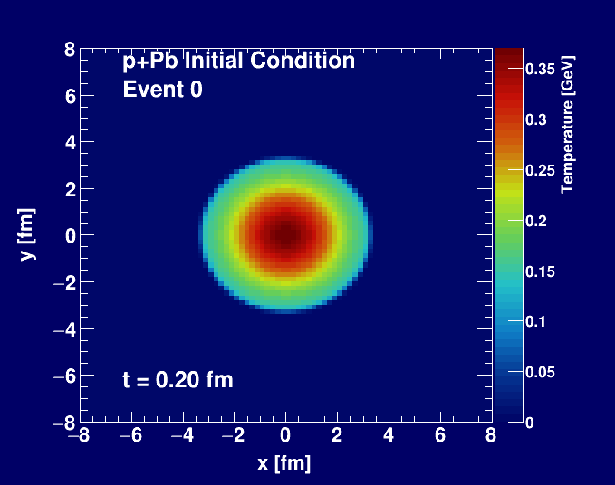
Bulk Viscosity in SONIC
Simple test case: Gaussian initial condition, change only one thing…
ζ/s = 0.0 η/s = 0.08
ζ/s = 0.08 η/s = 0.08
We want to keep pulling on this thread. Large bulk also leads to matching issues: pre-hydro and hydro and hadronization stages.
SONIC results from Megan Byers, Jeff Oullette (Colorado)

Slide 22
Next steps…
Change only one thing at a time, see what happens…
Map out bulk viscosity effects with simple single droplet first
Run SONIC and MUSIC hydro codes for single droplets
Run IP-Glasma initial condition check in both codes

Slide 23
Thread #2
Quasiparticle Alternative

Slide 24
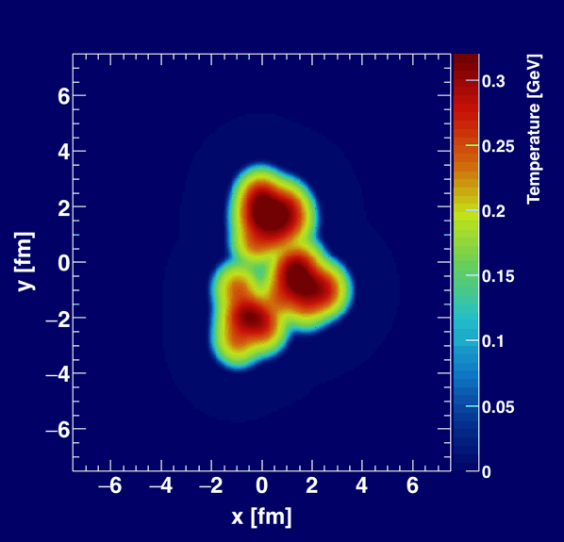
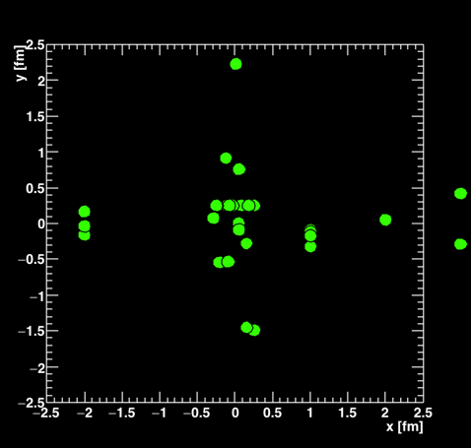
Initial Condition
Geometry
and entropy
Final Condition
E,p distribution
of hadrons
Initial Condition
Geometry
and entropy
Final Condition
E,p distribution
of hadrons
Hydrodynamics can be an effective description dual to a particle picture.
However, that is not always the case.
AdS/CFT strong coupling examples at
η/s = 1/4π simply have no particle excitations at all.

Slide 25
Before AdS/CFT 1/4π Bound…
Danielewicz and Gyulassy (1985)
“By imposing the physical constraints that the mean free path must be larger than both the interparticle spacing and the thermal Compton wavelength, we obtain an approximate lower bound [on shear viscosity].” → η/s > 1/4π
1) There is no such thing as a thermal Compton wavelength
2) Probably they meant the thermal deBroglie wavelength
However, later in the paper they actually seem to just
use the uncertainty principle (very hand waving)
If they had used the thermal deBroglie wavelength, would have gotten η/s > 1/2
25
* Ignoring factors of π, 2π, or saying the deBroglie wavelength = hbar/p seems common in the literature ☹

Slide 26
A-Multi-Phase-Transport (AMPT)
Success in describing small, medium, large system collectivity signals
Code is publicly available: http://myweb.ecu.edu/linz/ampt/
Extra thanks to Zi-Wei Lin for answering our many (∞) detailed questions
26

Slide 27
Small system studies with AMPT
Nagle et al., arXiv:1707.02307, Orjuela Koop et al., arXiv:1512.06949, arXiv:1501.06880
Bozek, Bzdak, Ma, arXiv:1503.03655
AMPT v2.25t5 relative to true geometry defined by initial nucleons
string melting mode, σ_{parton} = 0.75 mb
Poor quantitative agreement with data,
but rough agreement with system v_{n} ordering

Slide 28
de Broglie Wavelength Radius
Uncertainty Principle Radius
p = 0.81 GeV
Not a very good approximation for only 2 → 2 scattering
Two major questions:
1). What good is a particle picture calculation with only quarks at m=0.015 GeV that ignores important many-body effects (and α_{s}~0.5)?
2) What does it mean that 2 → 2 calculations get some qualitative features right (i.e. translation of geometry into flow coefficients)?

Slide 29
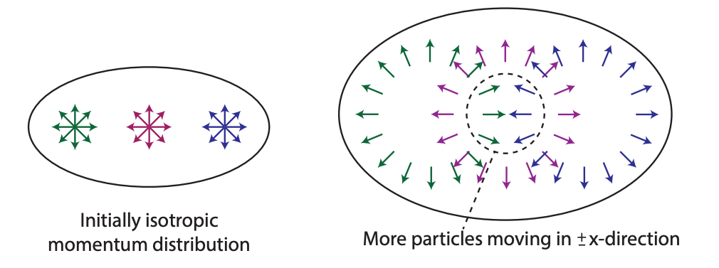
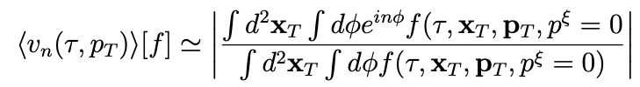
“Single-hit” Theory
Recent analytic approach generates significant v₂ with single scatter
Kurkela, Wiedemann, Wu
arXiv:1805.04081
arXiv: 1803.02072
This is a good avenue to pursue; however, it is just at the start
(only working with p_{T} integrated v₂) – avoid early strong conclusions!
Using eremitic expansion (i.e. around free streaming f₀ + first collision correction f₁), Romatschke (arXiv:1802.06804) points out there is a divergence in the v_{n} integral – how is this handled in all cases?

Slide 30
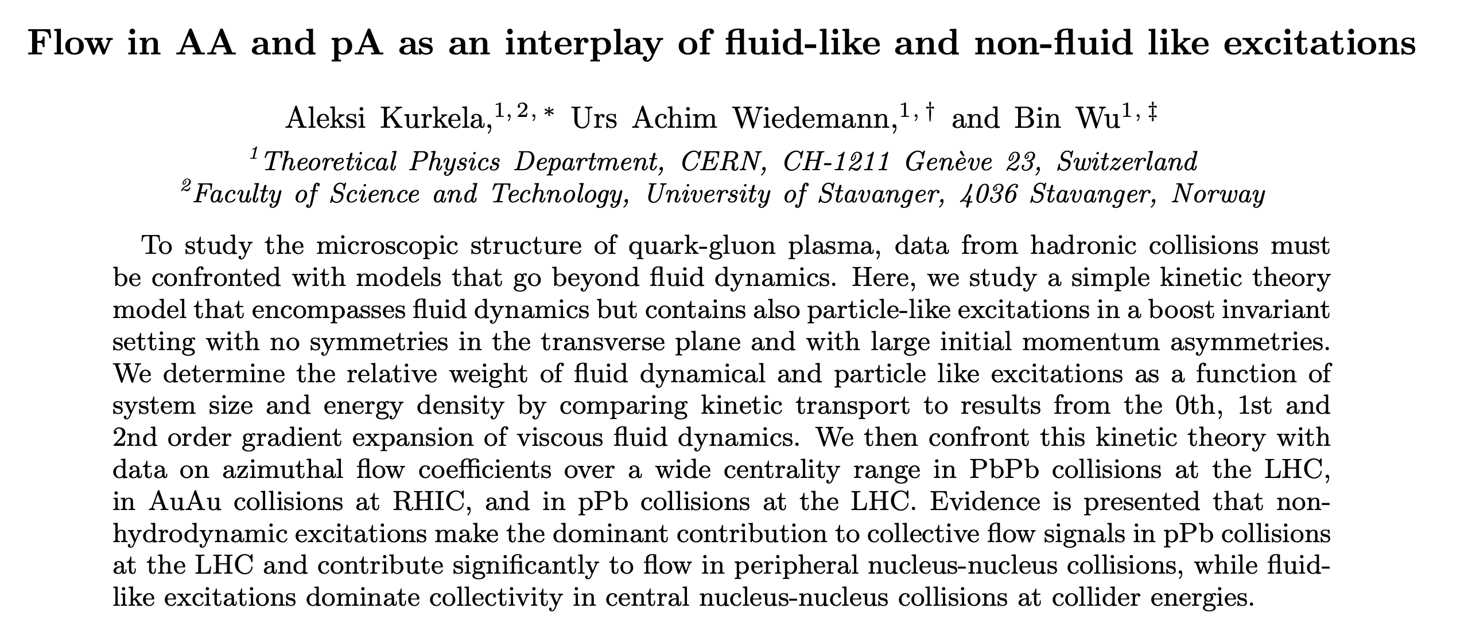
https://arxiv.org/abs/1905.05139
Needs careful examination…
If p+Pb, d+Au completely dominated by non-hydrodynamic excitations,
why do the patterns look so similar?

Slide 31
Thread #3
Hard Process Probes

Slide 32

Jet Quenching Signature of QGP

Slide 33
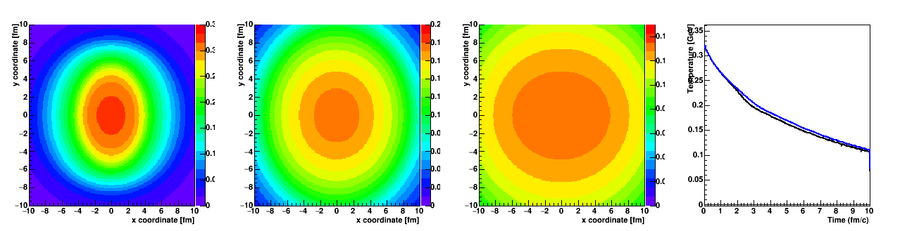
An Ancient (15 year old) Puzzle
Jet quenching suppressed high p_{T} hadrons (R_{AA} ↓)
Differential jet quenching generates “flow” (v₂ ↑)
However, jet quenching calculations have great difficulty matching both!
Simple reason – different paths from the middle see very similar fluid until late times (at lower T)

Slide 34
Pb+Pb Tension → p+Pb Contradiction
p+Pb shows no clear R_{pPb} modification, but there is an indication of high p_{T} v₂ (!?#$%)
Two take-aways…
Maybe high p_{T} > 10 GeV v₂ is not differential jet quenching (even in A+A)!
Need p+Pb v₂ measurement out to 25-50 GeV → Colorado results soon!

Slide 35
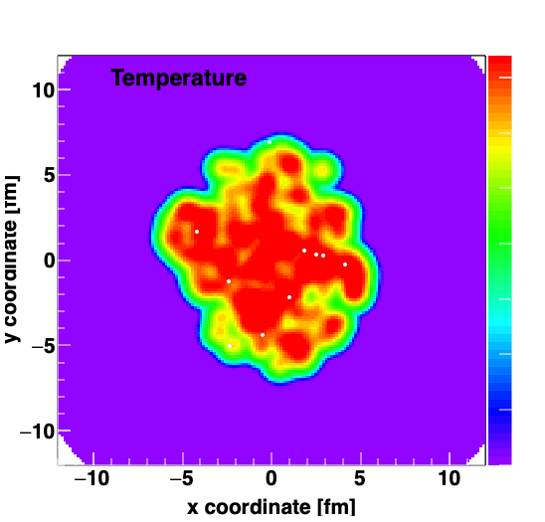
A Less Ancient Puzzle – Heavy Quarks
Again key constraint of R_{AA} and v₂
Drag & Diffusion Calculations
Already one could see a tension
Stronger coupling to match v₂ has too much suppression R_{AA}

Slide 36
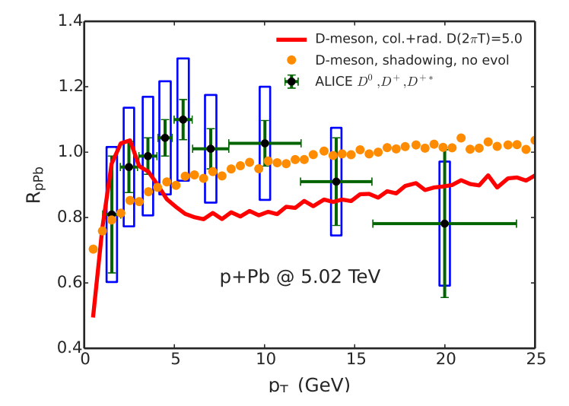
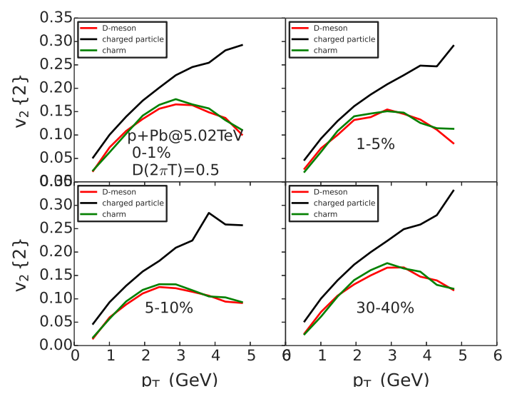
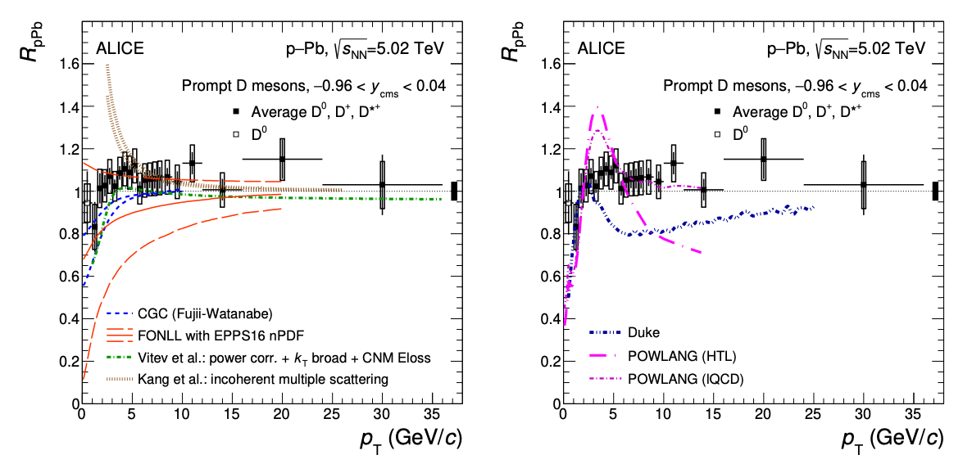
Heavy Flavor p+Pb Puzzle
Yingru et al. (Duke) https://arxiv.org/abs/1510.07520
10x Stronger Coupling
https://arxiv.org/abs/1906.03425

Slide 37
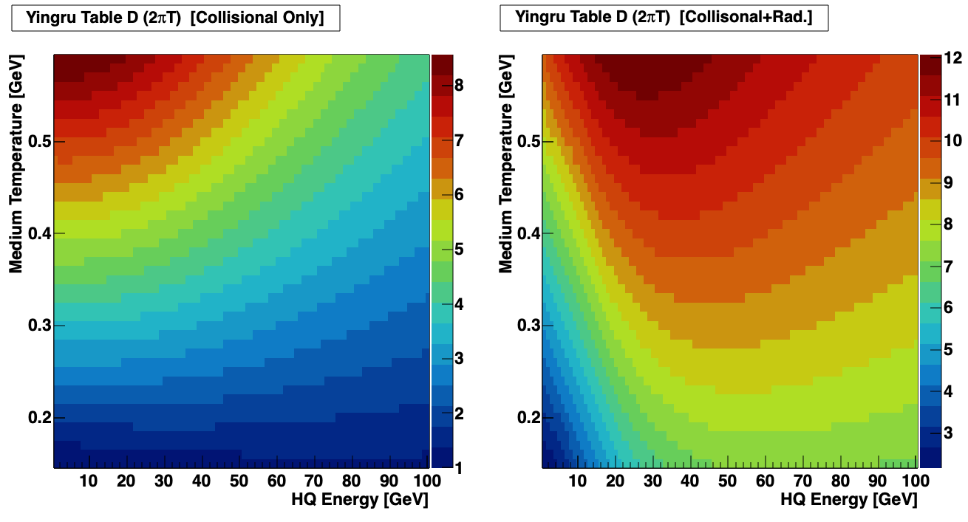
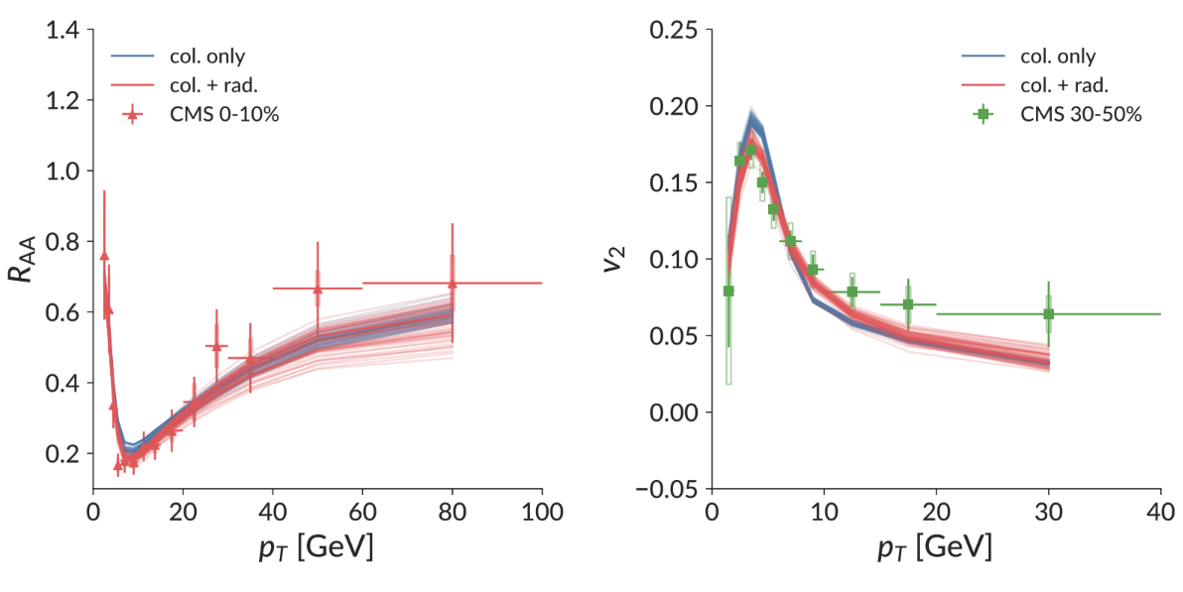
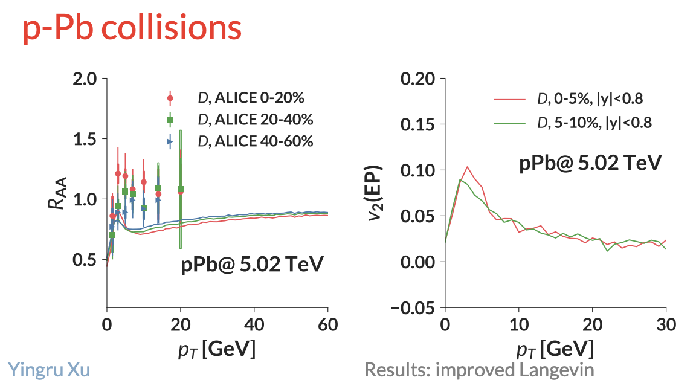
Attempts to Reconcile
https://www.bnl.gov/aum2018/content/workshops/Workshop_1f/XU_OpenJFTransport.pdf
Bayesian determination of heavy quark coupling D(p,T)
10x stronger coupling near T=0.15 GeV compared with T = 0.50 GeV
Improved agreement, but still tension in Pb+Pb and problems in p+Pb
Pb+Pb collisions

Slide 38
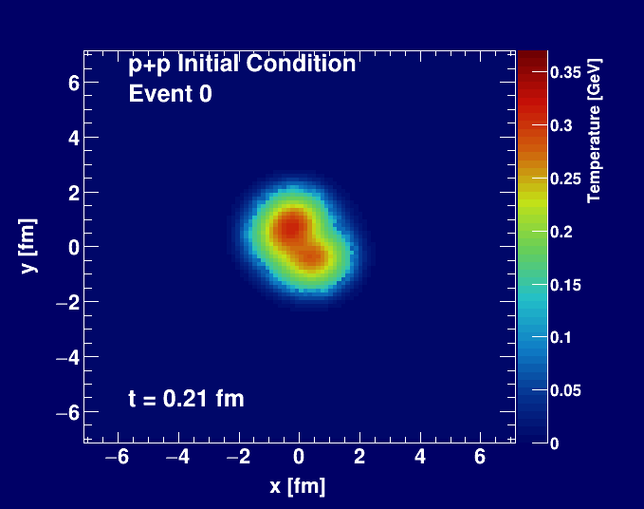
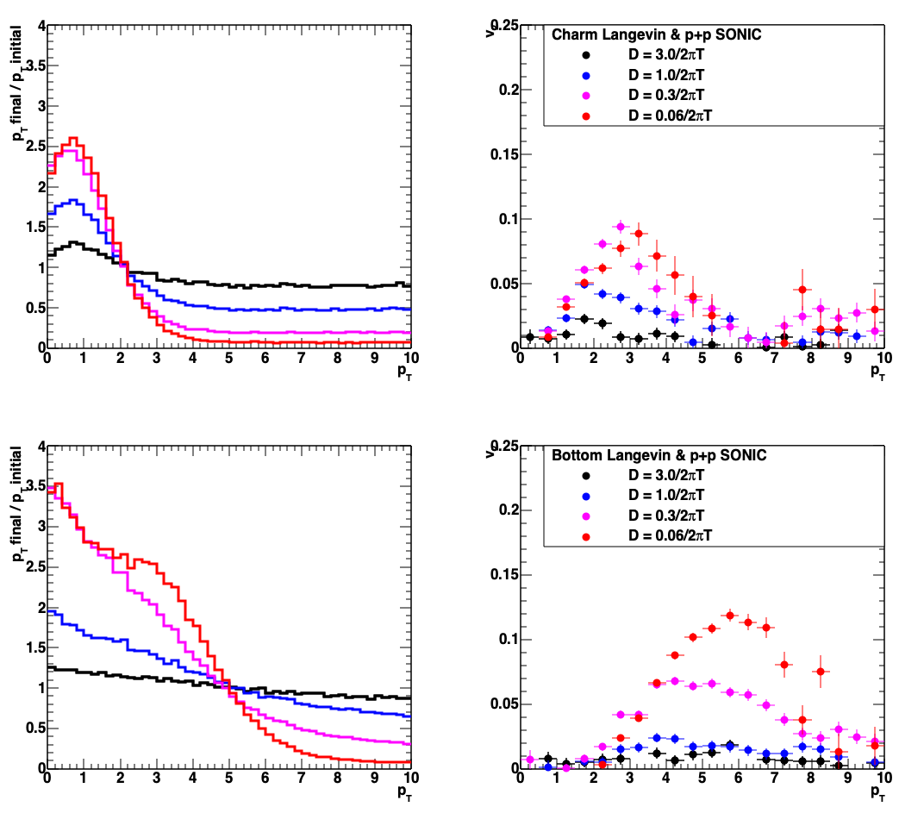
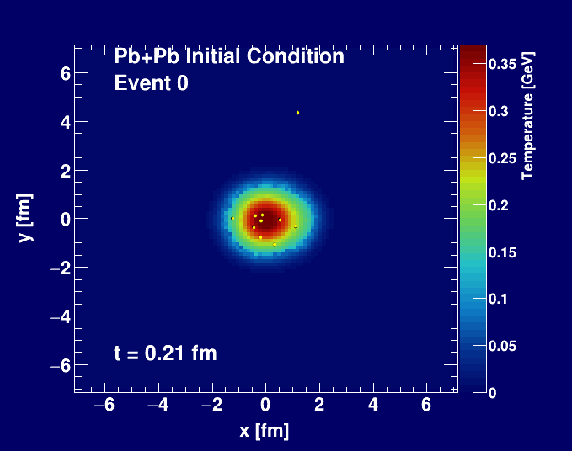
What about even in p+p?
p_{T} modification
elliptic flow v₂
Charm
Bottom
SONIC with proton (3 quark) geometry
Heavy Quark Langevin (Nagle)
Do the experiment!

Slide 39
The Final Thread
Standard time evolution model of heavy ion collisions
(quark-gluon plasma as perfect fluid) remains compelling.
Small system similarities are striking (not yet compelling).
It is worth pulling on various threads to see where it leads!
#1 Initial State Correlations
#2 Quasiparticle Alternative
#3 Hard Process Probes

Slide 40
Extras

Slide 41
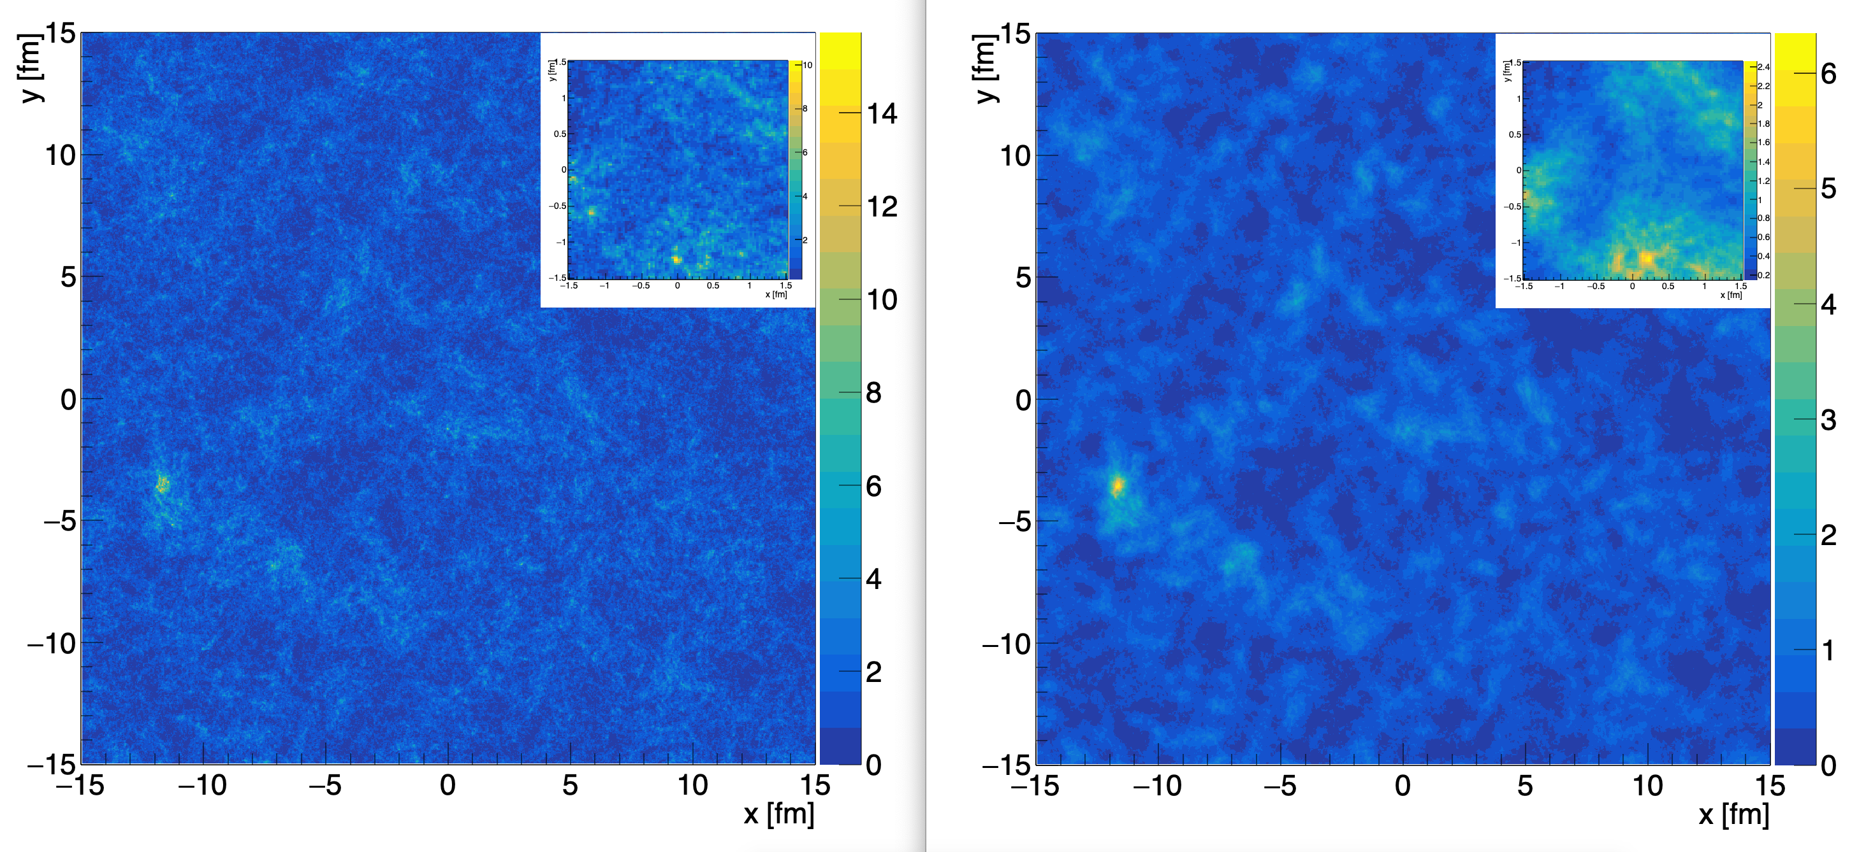

Slide 42
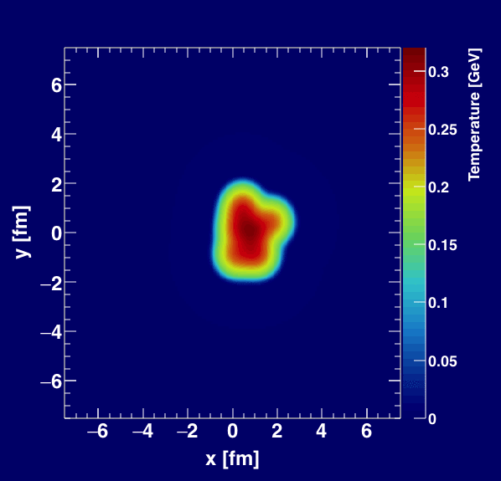
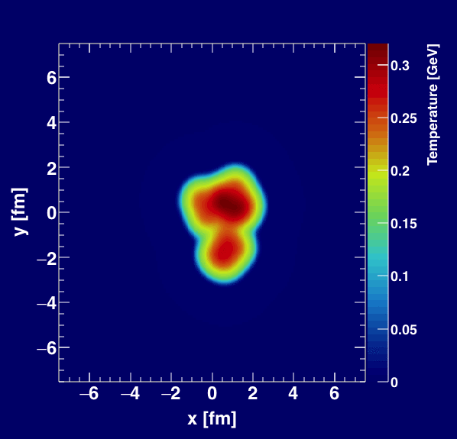
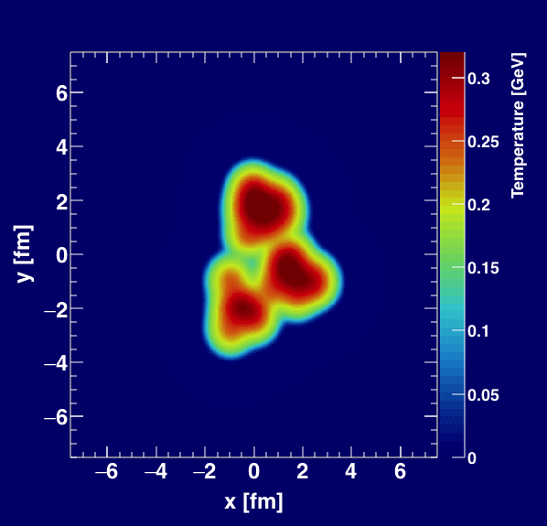

Slide 43
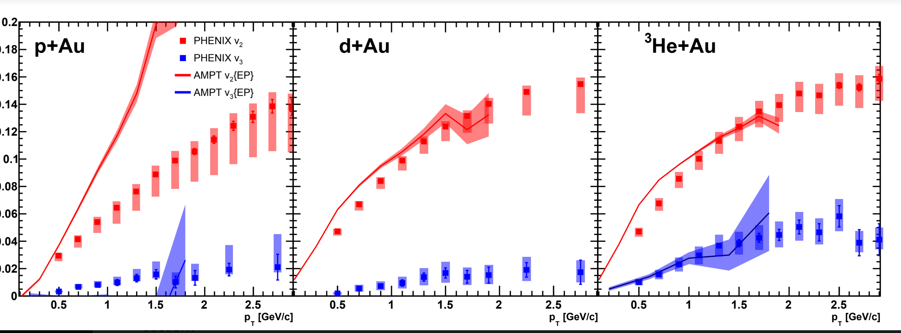
Apples-to-Apples Comparison
AMPT fully modeling the Event Plane method in PHENIX
Better agreement in ³He+Au, but much worse in p+Au (non-flow),
insufficient statistics for v₃ in the smaller systems

Slide 44
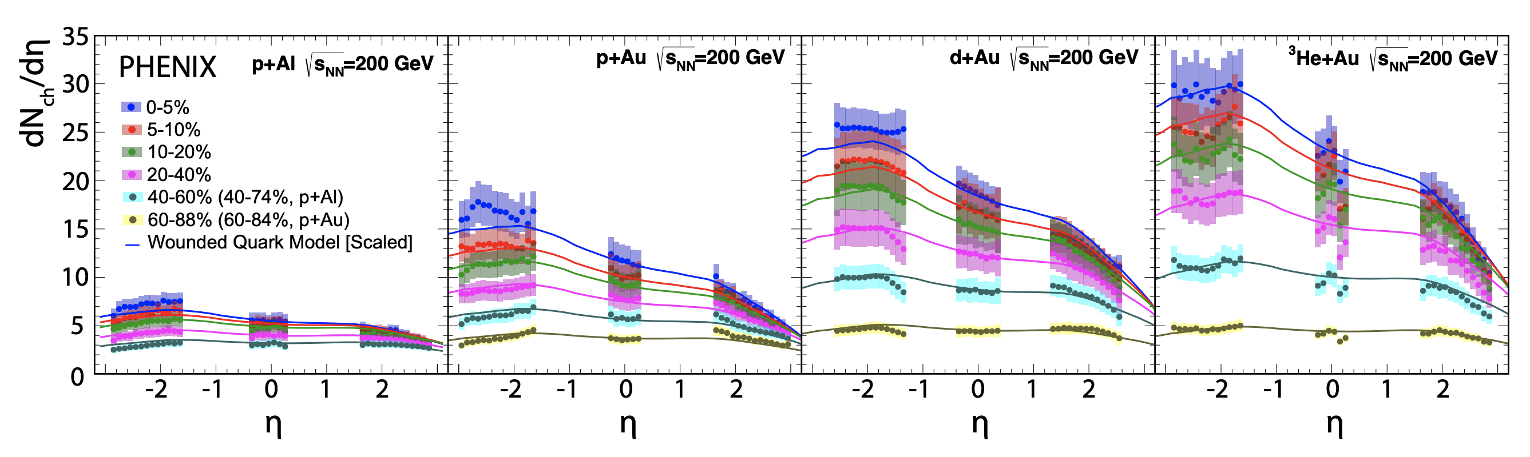
Particle Multiplicities
Phys.Rev.Lett. 121 (2018) no.22, 222301
Midrapidity Values
dN_{ch}/dη ~ 12 p+Au 0-5%
dN_{ch}/dη ~ 18 d+Au 0-5%
dN_{ch}/dη ~ 22 ³He+Au 0-5%
Hydrodynamic calculations include the initial geometry differences and match the particle multiplicity for each system

Slide 45
Angular Distributions
Larger screening mass (μ), smaller cross section but more isotropic angular distribution
Note that these distributions are not directly calculable in QCD!
Counting number of parton-parton scatters is only part of the story.

