Slide 1
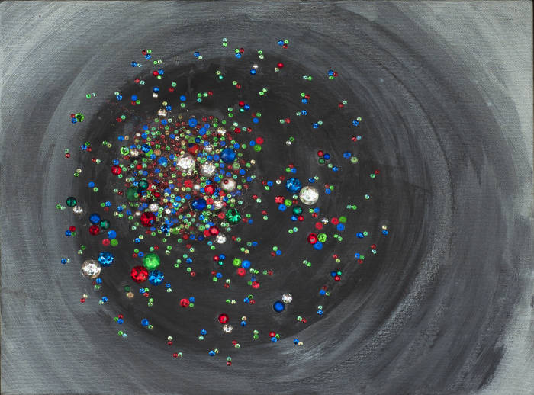
Quark-Gluon Soup
Jet probes of the matter
Artwork by Sarah Szabo
Tomas Snellman
Ph.D. Defense , June 19, 2019
Jamie Nagle (Opponent)
University of Colorado

Slide 2
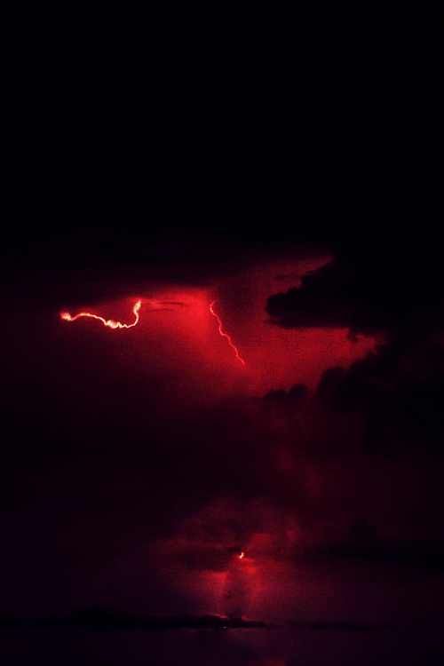
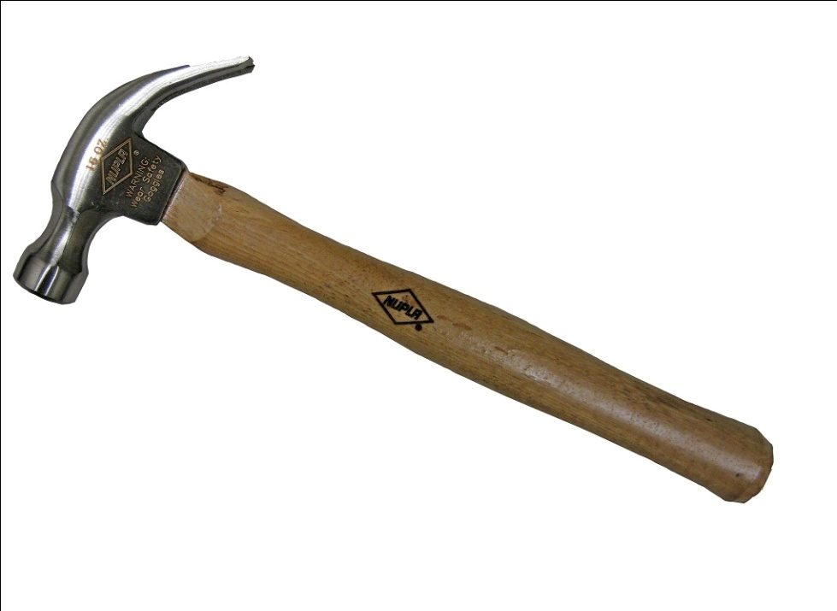
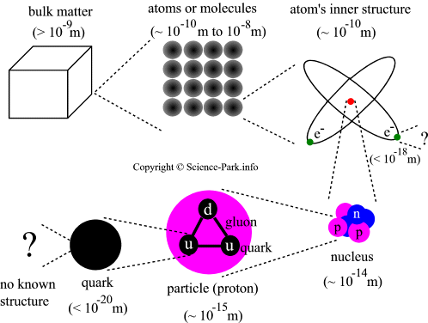
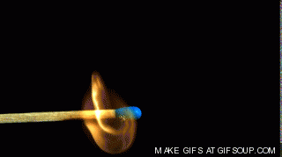
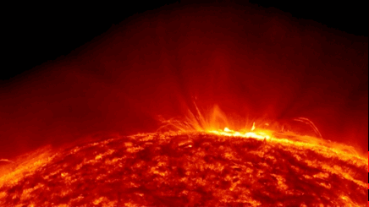
Breaking Down Matter
Million Times
Hotter Than the Sun

Slide 3
Playing the Universe Movie Backwards
Before
that?
Quarks!
First
Protons
1 microsecond
First
Nuclei
3 minutes
First
Atoms
400 kYears
Carbon
Early Stars
300 MYears

Slide 4
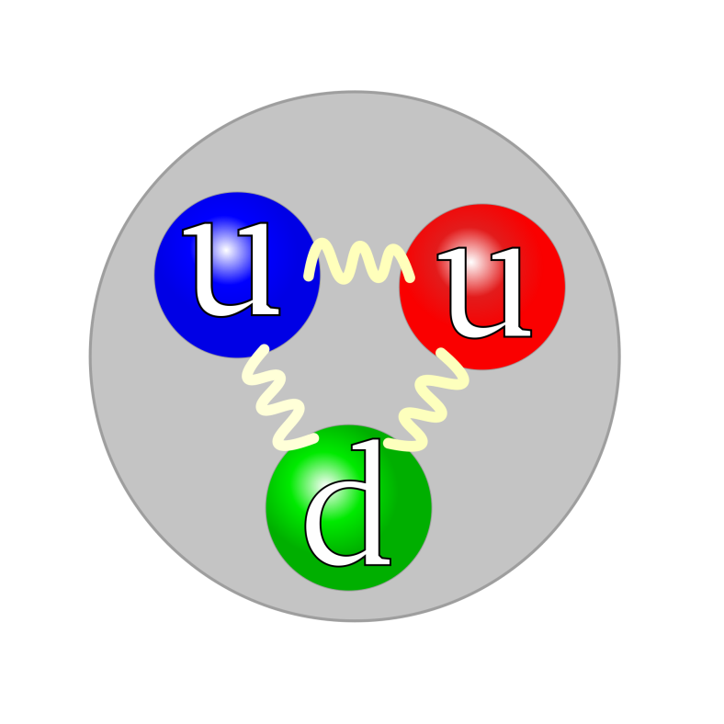
First what are Quarks and Gluons?
“Three quarks on a lark.” James Joyce
Proton
2 Ups
and
1 Down
Up Down Strange
Charm Bottom Top
Why do we never see free Quarks?
Spring like particles (gluons → the glue) binds the
quarks together.
It would take infinite energy to completely pull one of the quarks out of the proton.

Slide 5
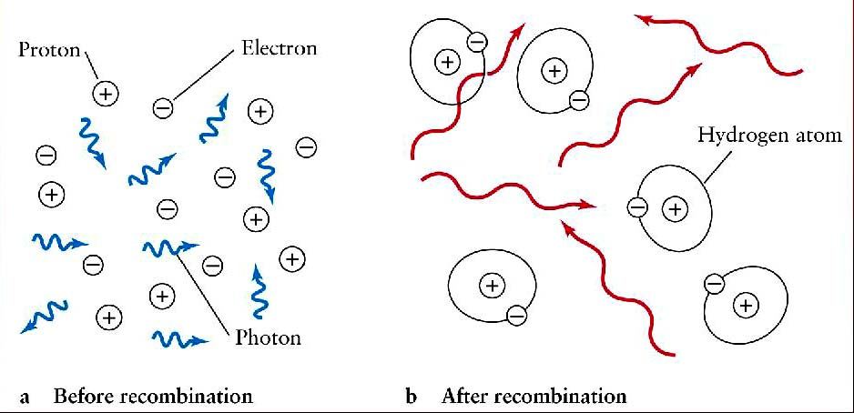
Cooler temperatures → Recombining → New Structures
Atom Formation (400 kYears)
p + e → Hydrogen + X
Measured by atomic physicists and well understood
Big Bang Nucleosynthesis (3 min.)
p + n → Deuteron + γ
Measured by nuclear physicists and well understood

Slide 6
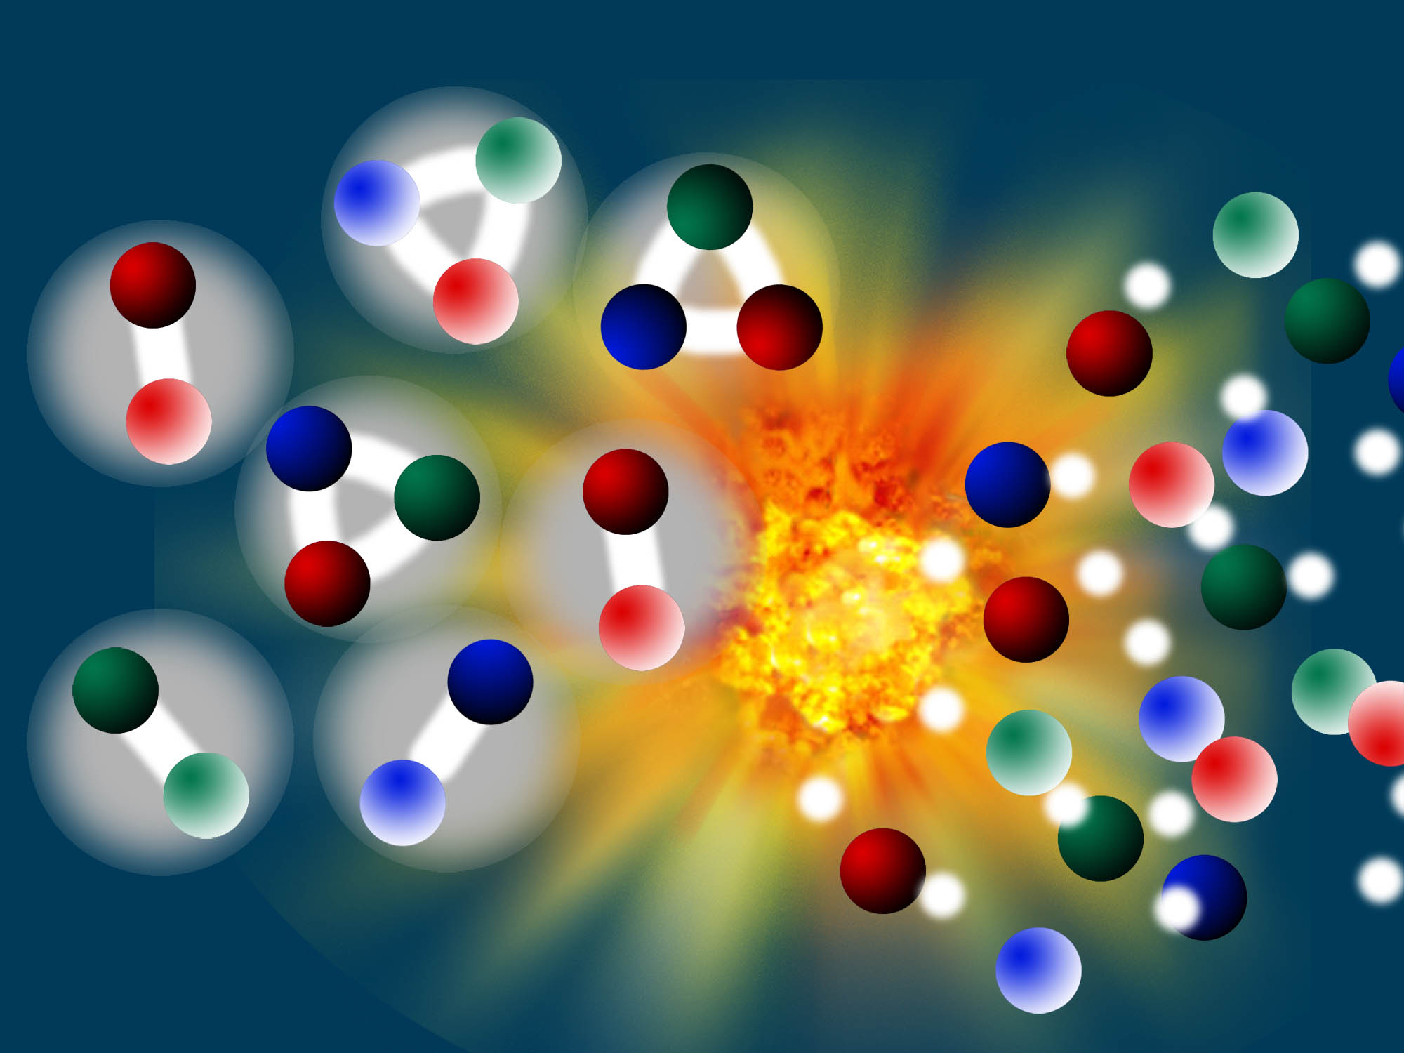
Universe time = 0 + 6 microseconds
Quarks + Gluons
Bound Systems (e.g. Protons)
We do not really understand this transition

Slide 7
Recreating the early Universe in the Laboratory
Collide heavy nuclei at 99.999..% the speed of light
Kinetic Energy → Quark-Gluon Plasma
above 1 trillion degrees

Slide 8
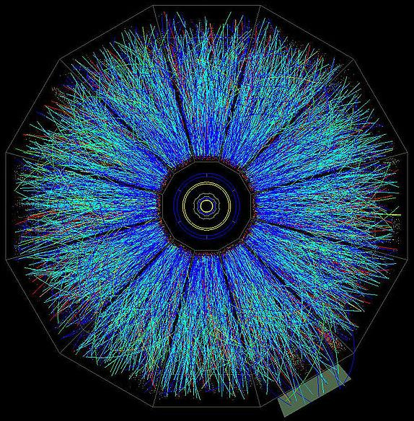
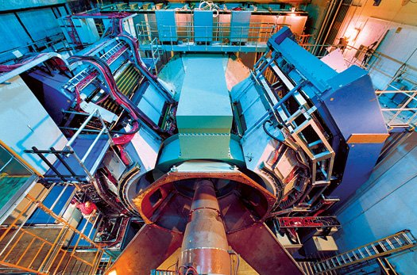
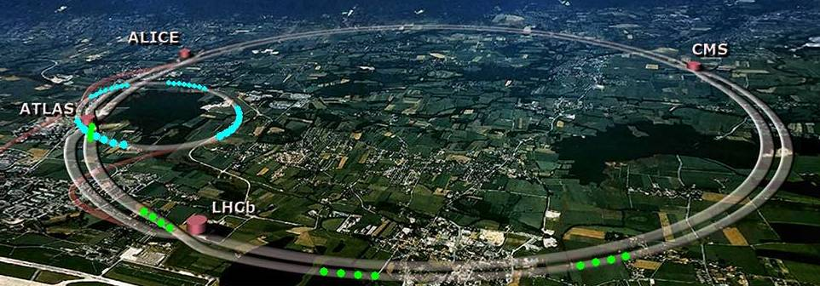
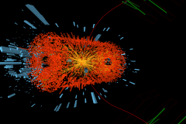
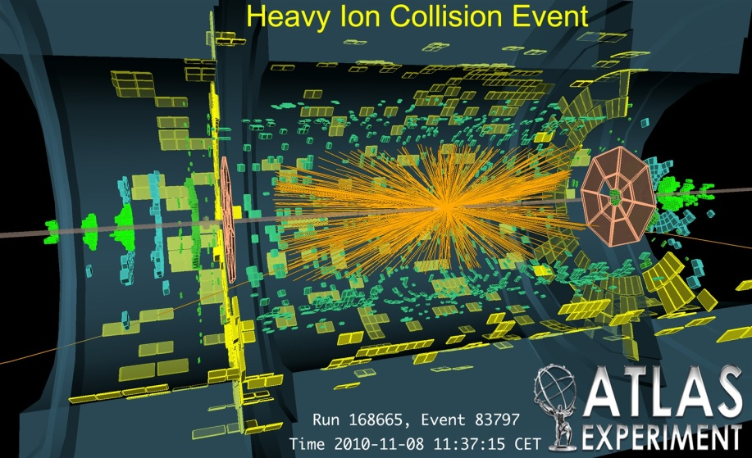
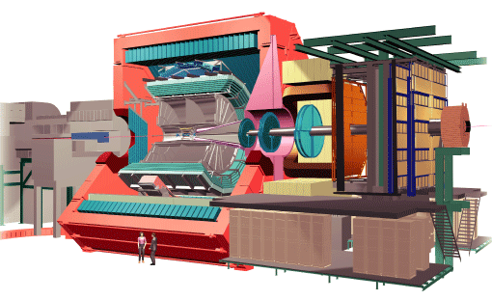
Experimental Facilities
RHIC
PHENIX
STAR
LHC
CMS
ALICE

Slide 9
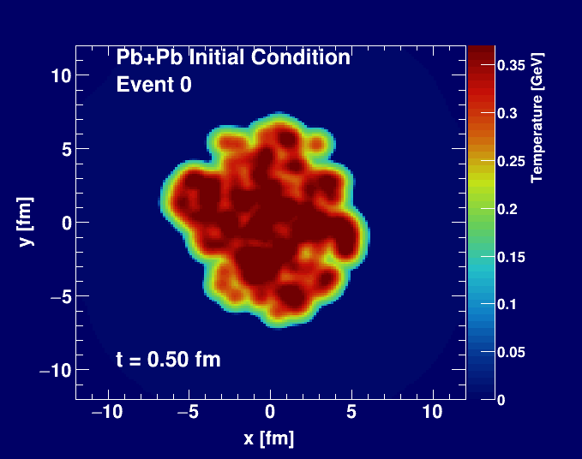
Created fireball flows like a fluid
At the end of the day, fluid →bound quark states

Slide 10
Jet Quenching Signature of QGP
High energy back-to-back quarks (jets) can blast out through the fluid.
How do these jets interact with the fluid?

Slide 11
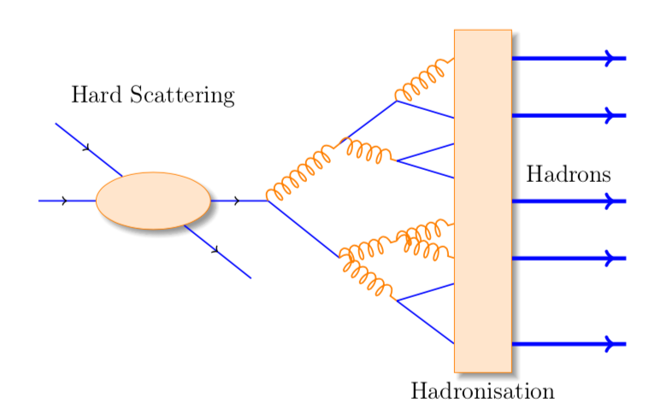
Thesis studies how these “jets” crash through the fluid.
Using proton + lead collisions.
If you ”shake” an electron it will radiate photons (light).
If you “shake” a quark it will radiate gluons!
Measuring the pattern of these gluons tells you about the fluid!

Slide 12
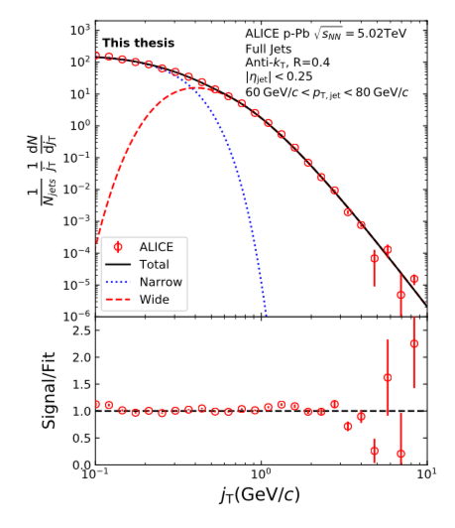
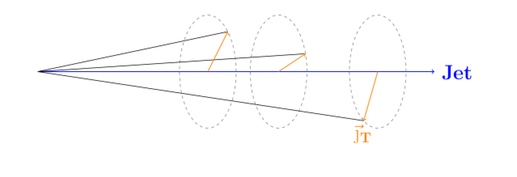
Thesis Results
Brand new results on gluon emission pattern from quarks passing through a trillion degree fluid!
Tomas Snellman is a
world expert on this topic as detailed in his thesis!

