Slide 1


Pushing out of our comfort zone
for quark-gluon plasma formation
Jamie Nagle
University of Colorado Boulder
Vanderbilt University Colloquium November 15, 2018

Slide 2
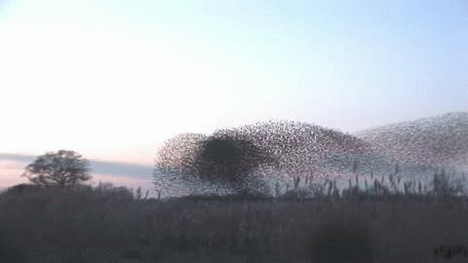
How does this work?
Emergent Phenomena… Collectivity…
What is the underlying origin?
For this flock of birds, it is all short range interactions

Slide 3
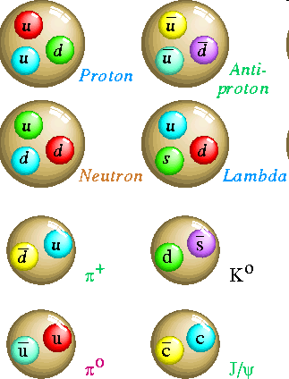
Quantum Chromodynamics
Hadrons are composite objects made of quarks and gluons
QCD is a “confining” gauge theory, with an effective potential
V(r)
“Coulomb” “Confining”
r
No one has ever seen a free quark

Slide 4
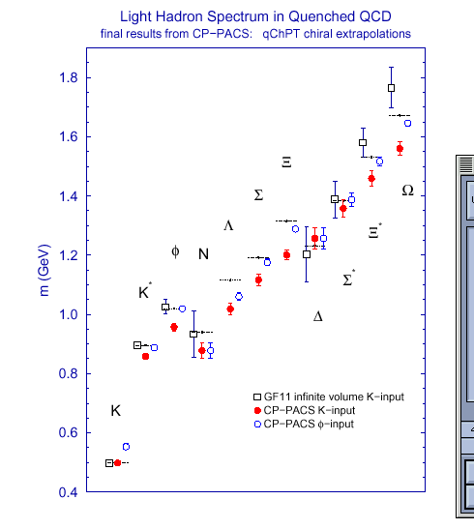
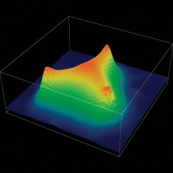
Strong evidence that QCD is the
correct theory of the strong interaction
Perturbative Calculations
Lattice Calculations
The field is about understanding
emergent phenomena from QCD,
just like condensed matter physics from QED.

Slide 5
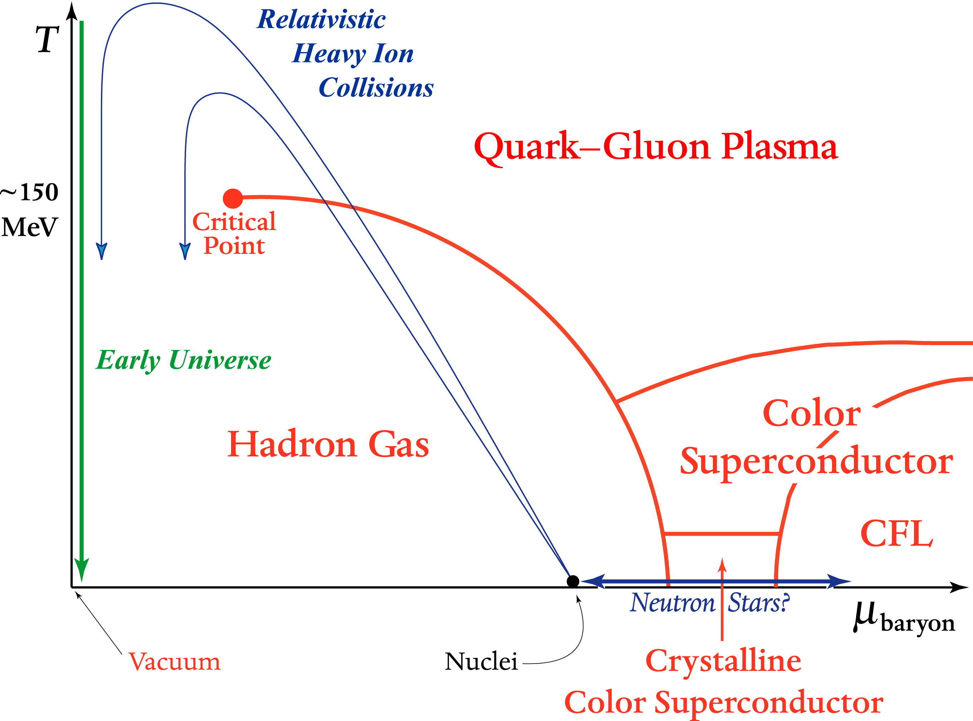
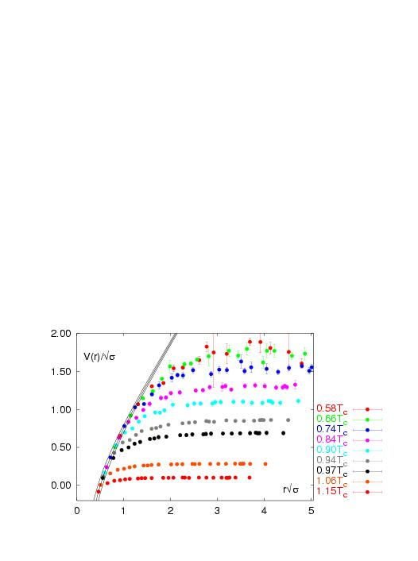
What about Hot QCD Matter?
Quark Gluon Plasma without color confinement
V(r)
r
Lattice QCD
V(r)/√σ
Screening of long range
confining potential at
high temperature or density
r√σ

Slide 6
Energy density for “g” massless degrees of freedom
Hadronic Matter:
3 π with spin=0
Quark Gluon Plasma:
8 gluons;
2 quark flavors, antiquarks, 2 spins, 3 colors
Degrees of Freedom increases x10
Lattice QCD indicates
smooth cross over transition
not 1st or 2nd order

Slide 7
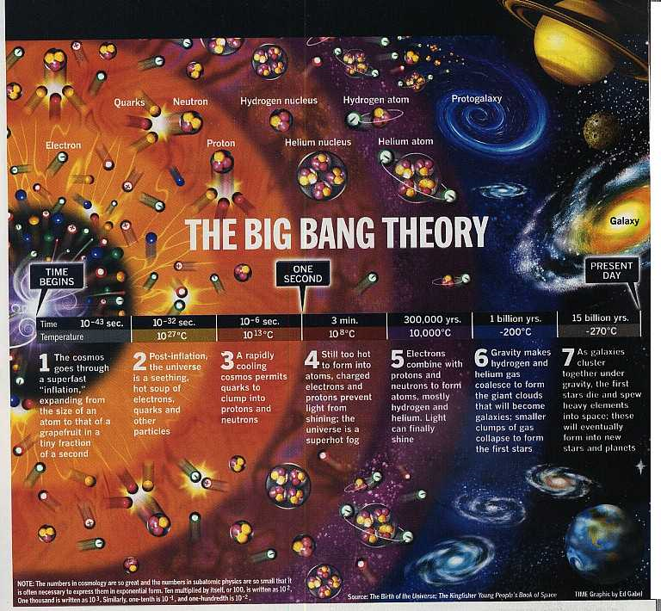

Very early in the universe,
quarks and gluons were free in a plasma state
As the universe cooled, they were confined and have remained that way since

Slide 8
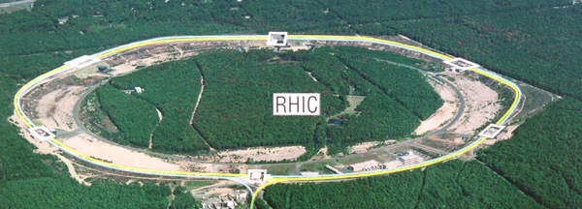
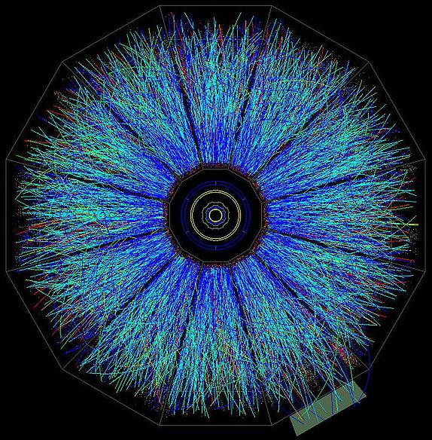
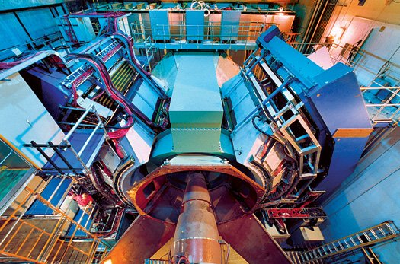
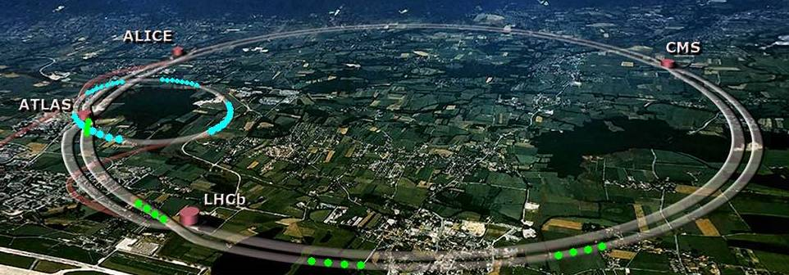
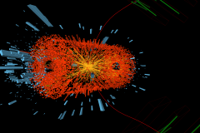
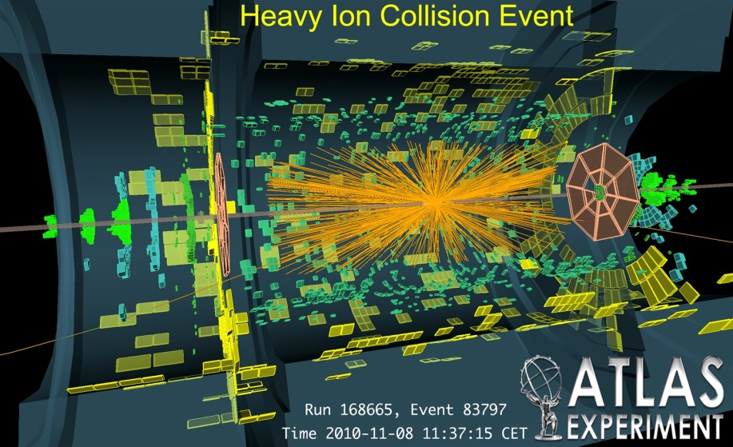
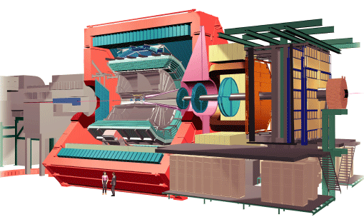
Creating early universe droplets today
RHIC
PHENIX
STAR
LHC
CMS
ALICE

Slide 9
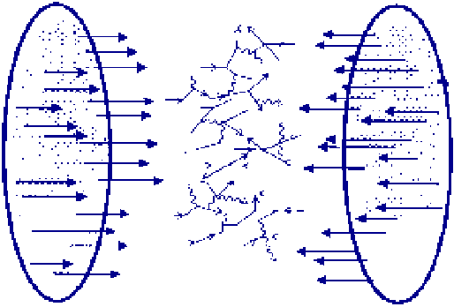
Multi-TeV Kinetic Energy → Heat
10,000++ gluons, quarks, antiquarks
How does this matter behave?

Slide 10
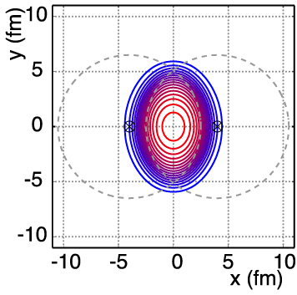
Non-Central A+A Geometry
v₂ = “elliptic flow”

Slide 11
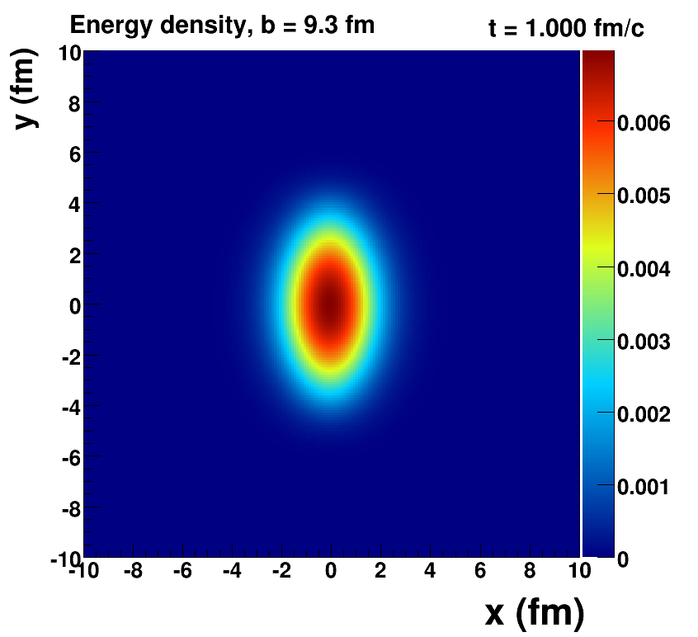
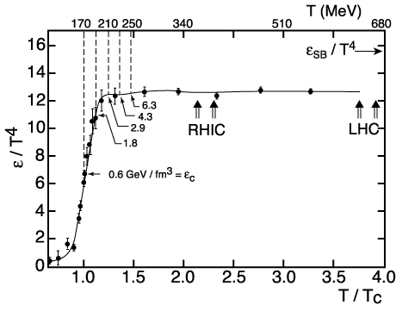
How Large is the Flow?
Assume early equilibration and run ideal hydrodynamics (i.e. no dissipation → zero shear + zero bulk viscosity)
Key Inputs:
Initial Geometry
QCD Equation of State

Slide 12
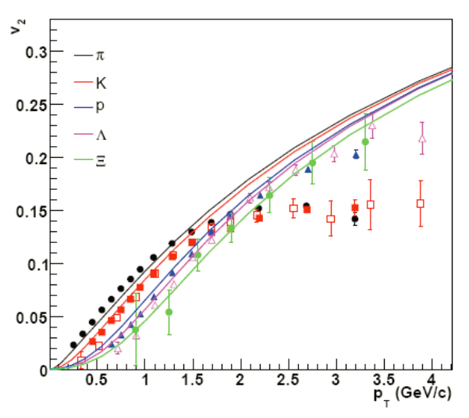
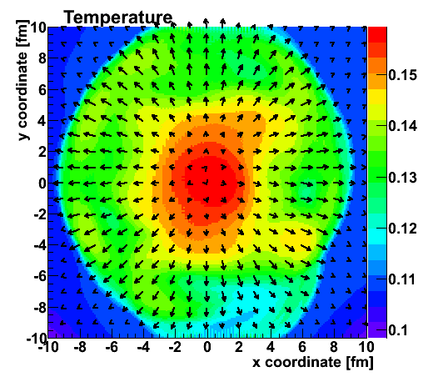
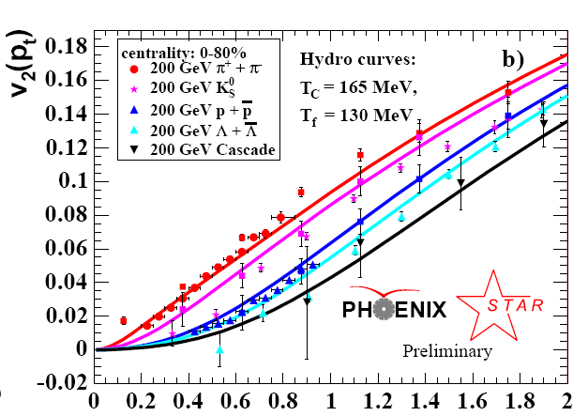
Fluid cells “freeze-out” at transition T
Isotropic hadrons in cell rest frame, then boosted
v₂
Temperature Profile + Velocity Vectors
v2
p_{T} (GeV)
Characteristic “fingerprint” flow pattern
Circa 2005: Quark Gluon Plasma = Perfect Fluid

Slide 13
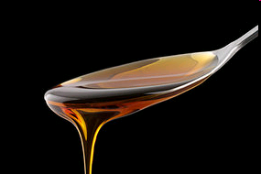
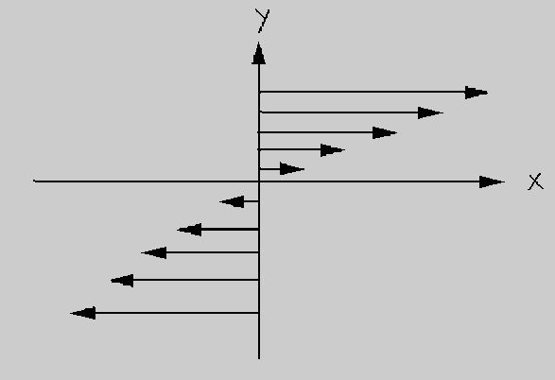
Viscosity Review
Honey – viscosity decreases at higher temperatures
viscosity increases with stronger coupling

Slide 14
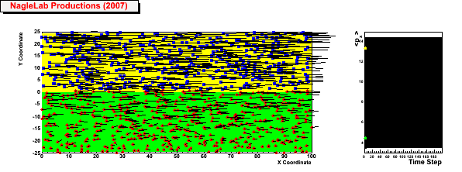
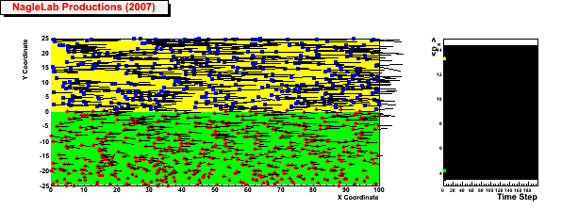
Viscosity Review
Honey – viscosity decreases at higher temperatures
viscosity increases with stronger coupling
Weak coupling (σ=0)
Inhibited
diffusion
↓
Small
viscosity
↓
Perfect fluid
↓
Strong Coupled QGP
(i.e. sQGP)
<p_{x}> top region
<p_{x}> bottom region
Strong coupling (σ ↑)

Slide 15
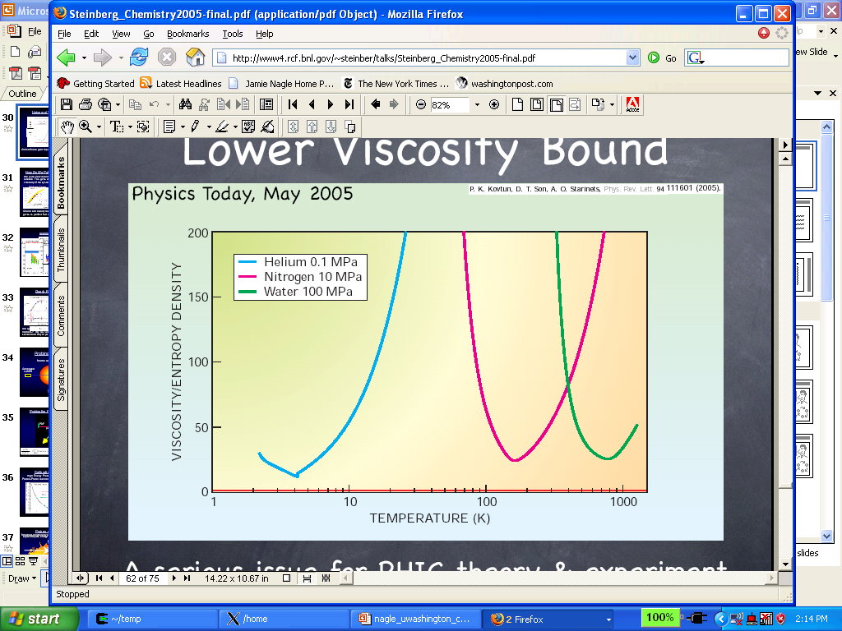
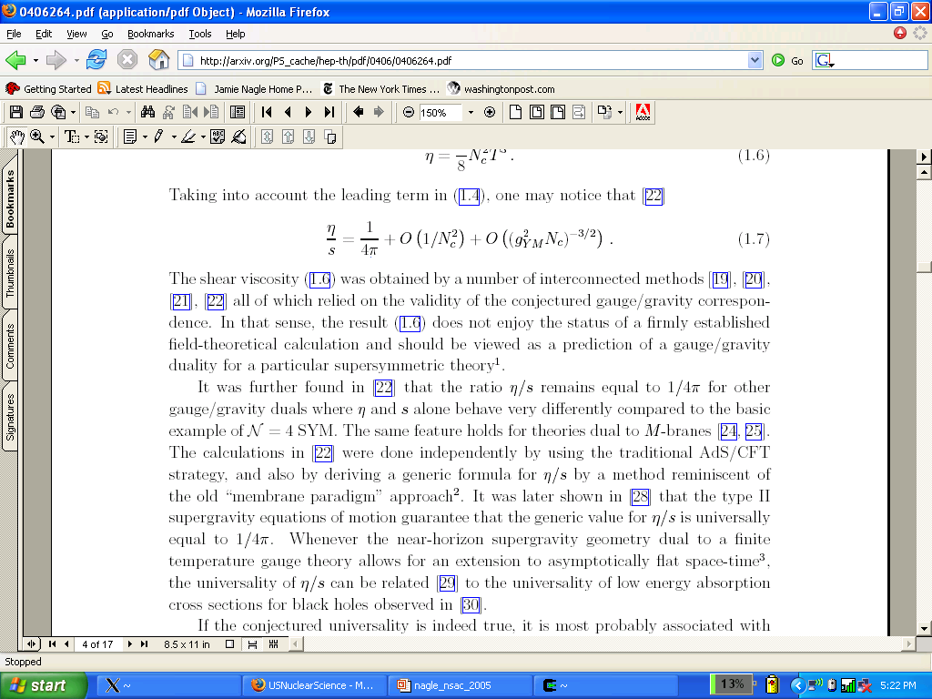
What is η/s for QCD matter at a trillion Kelvin?
String Theory
Lowest Bound!
QGP
Gas-Liquid Phase Transition
Superfluidity Transition

Slide 16
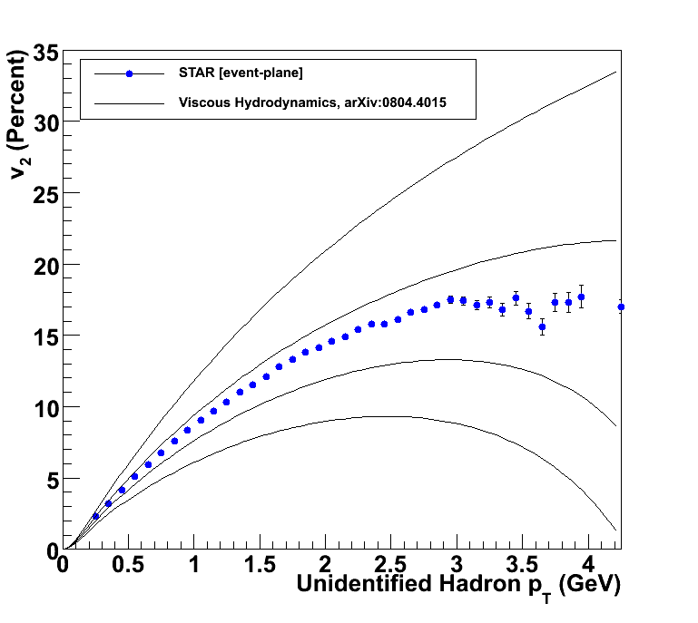
How to Quantify QGP η/s?
Relativistic viscous hydrodynamics compared to data
Luzum, Romatschke, Phys. Rev. C78, 034915 (2008)
η/s ~ 0
η/s = 1/4π
η/s = 2 x 1/4π
η/s = 3 x 1/4π

Slide 17
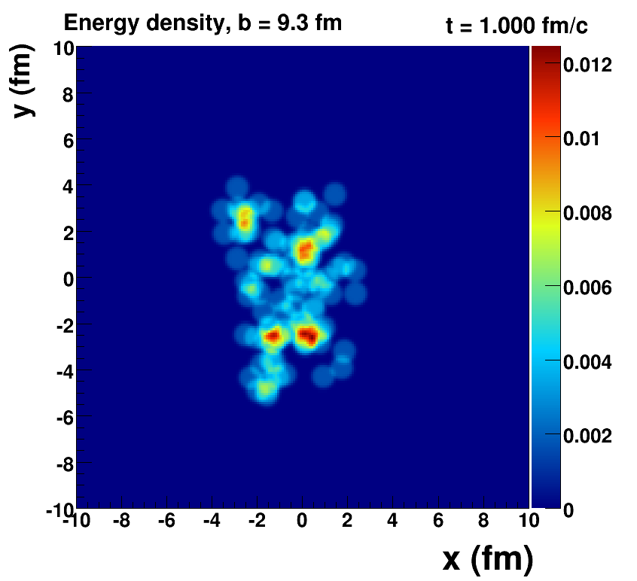
Romatschke=viscous hydrodynamics, McCumber=lumpy conditions + animation

Slide 18
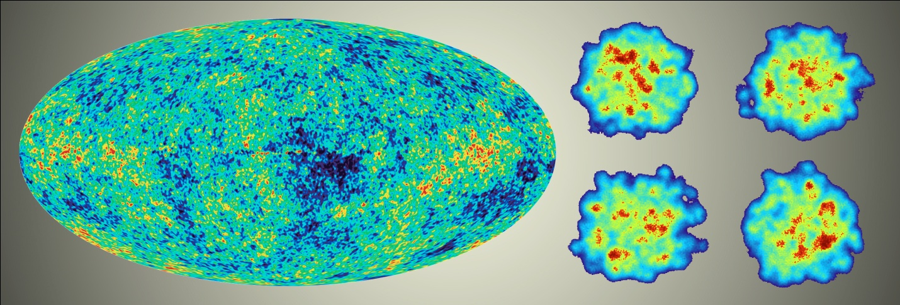
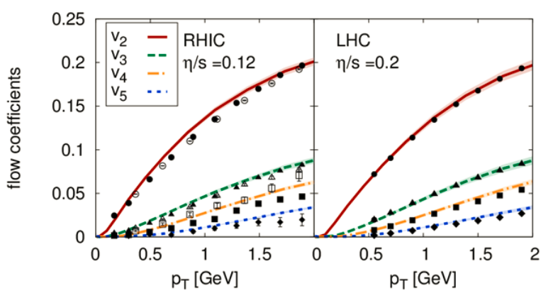
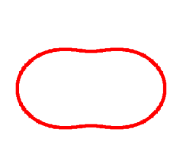
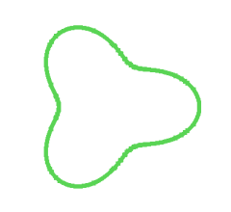
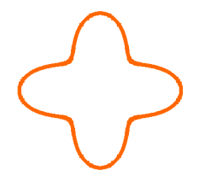
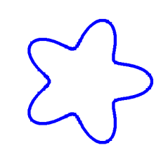
Detailed Fingerprint of Early Time

Slide 19
“Little Bang” Standard Model
Discovery: Quark Gluon Plasma = Near Perfect Fluid
Standard Model with Hydrodynamic Evolution
Precision: Predictions of Flow Patterns
but…
How does it equilibrate so quickly (or does it)?
What are the degrees of freedom or quasiparticles?

Slide 20
Back to Discovery
A+A
Enough particles to equilibrate, QGP, collective motion
p+p, p+A
Not enough particles to equilibrate, control experiment

Slide 21
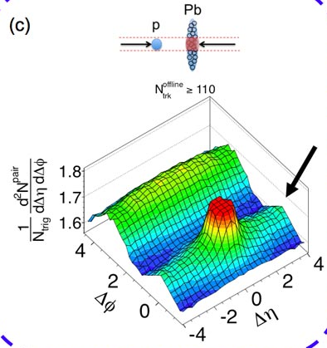
Fall 2012 Revolution – p+Pb Collisions
Signal similar to that seen in A+A
Could it be flow?
Alternative proposal of initial state
momentum domains – nothing to do with geometry!

Slide 22
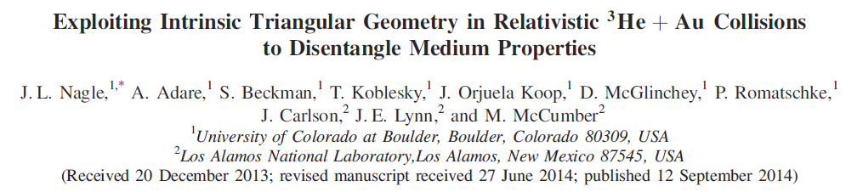
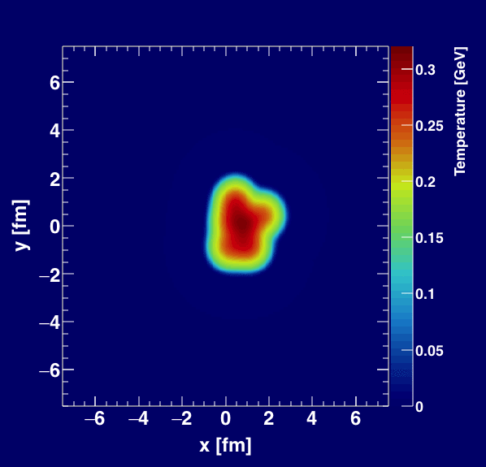
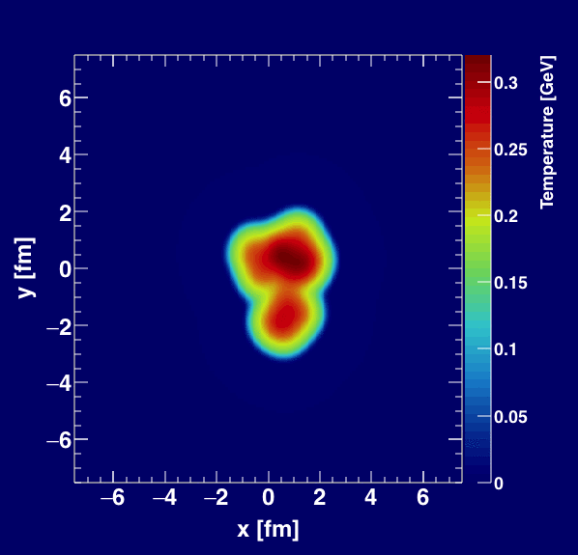
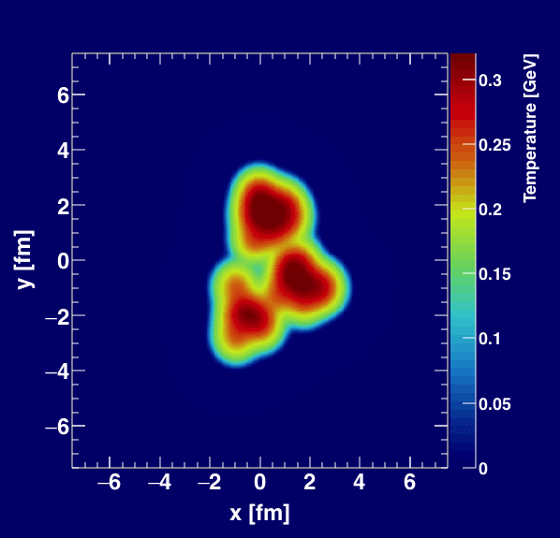
Geometry Tests at RHIC
http://journals.aps.org/prl/abstract/10.1103/PhysRevLett.113.112301

Slide 23
Vanderbilt-Colorado analysis effort!

Slide 24
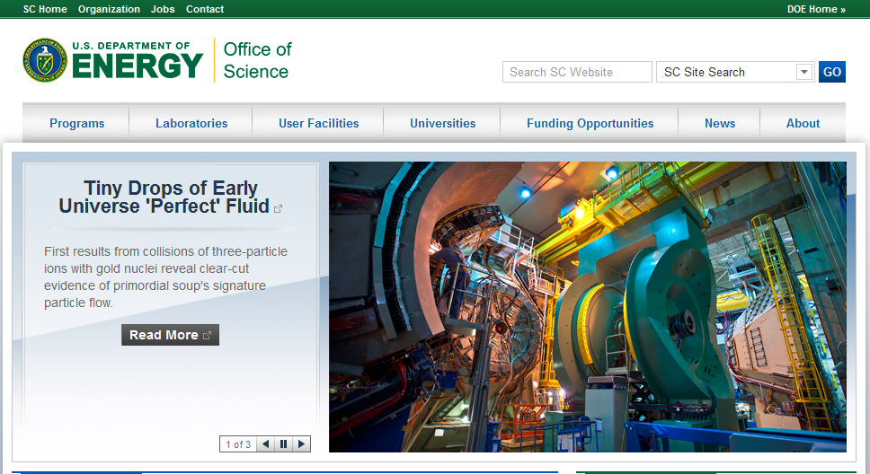

Slide 25
Experimental Data
v₂
Follows ordering of eccentricities
v₃
Multiplicity also plays a role
PHENIX, https://arxiv.org/abs/1805.02973, Accepted in Nature Physics

Slide 26
Hydrodynamic Comparison
PHENIX, https://arxiv.org/abs/1805.02973, Accepted in Nature Physics
Agreement with v₂, v₃ (p_{T}) for all three systems
SONIC hydrodynamic published prediction has very good p-value
Alternative hydrodynamics iEBE-VISHNU confirms results

Slide 27
“One fluid to rule them all”
p+p
p+Pb
Pb+Pb
Weller and Romatschke, https://arxiv.org/abs/1701.07145

Slide 28
What does it all mean?
I thought hydrodynamics only applies if
system is near equilibrium
system has a size scale L >> mean free path
How can these be true in p+p, p+Au, d+Au, etc.?
Maybe they are NOT!
String Theory Dual (completely solvable at strong coupling)
Systems very far from equilibrium still described by hydrodynamics as long as non-hydrodynamic modes are damped → hydrodynamic attractor.
Major re-thinking well beyond field of heavy ion physics.

Slide 29
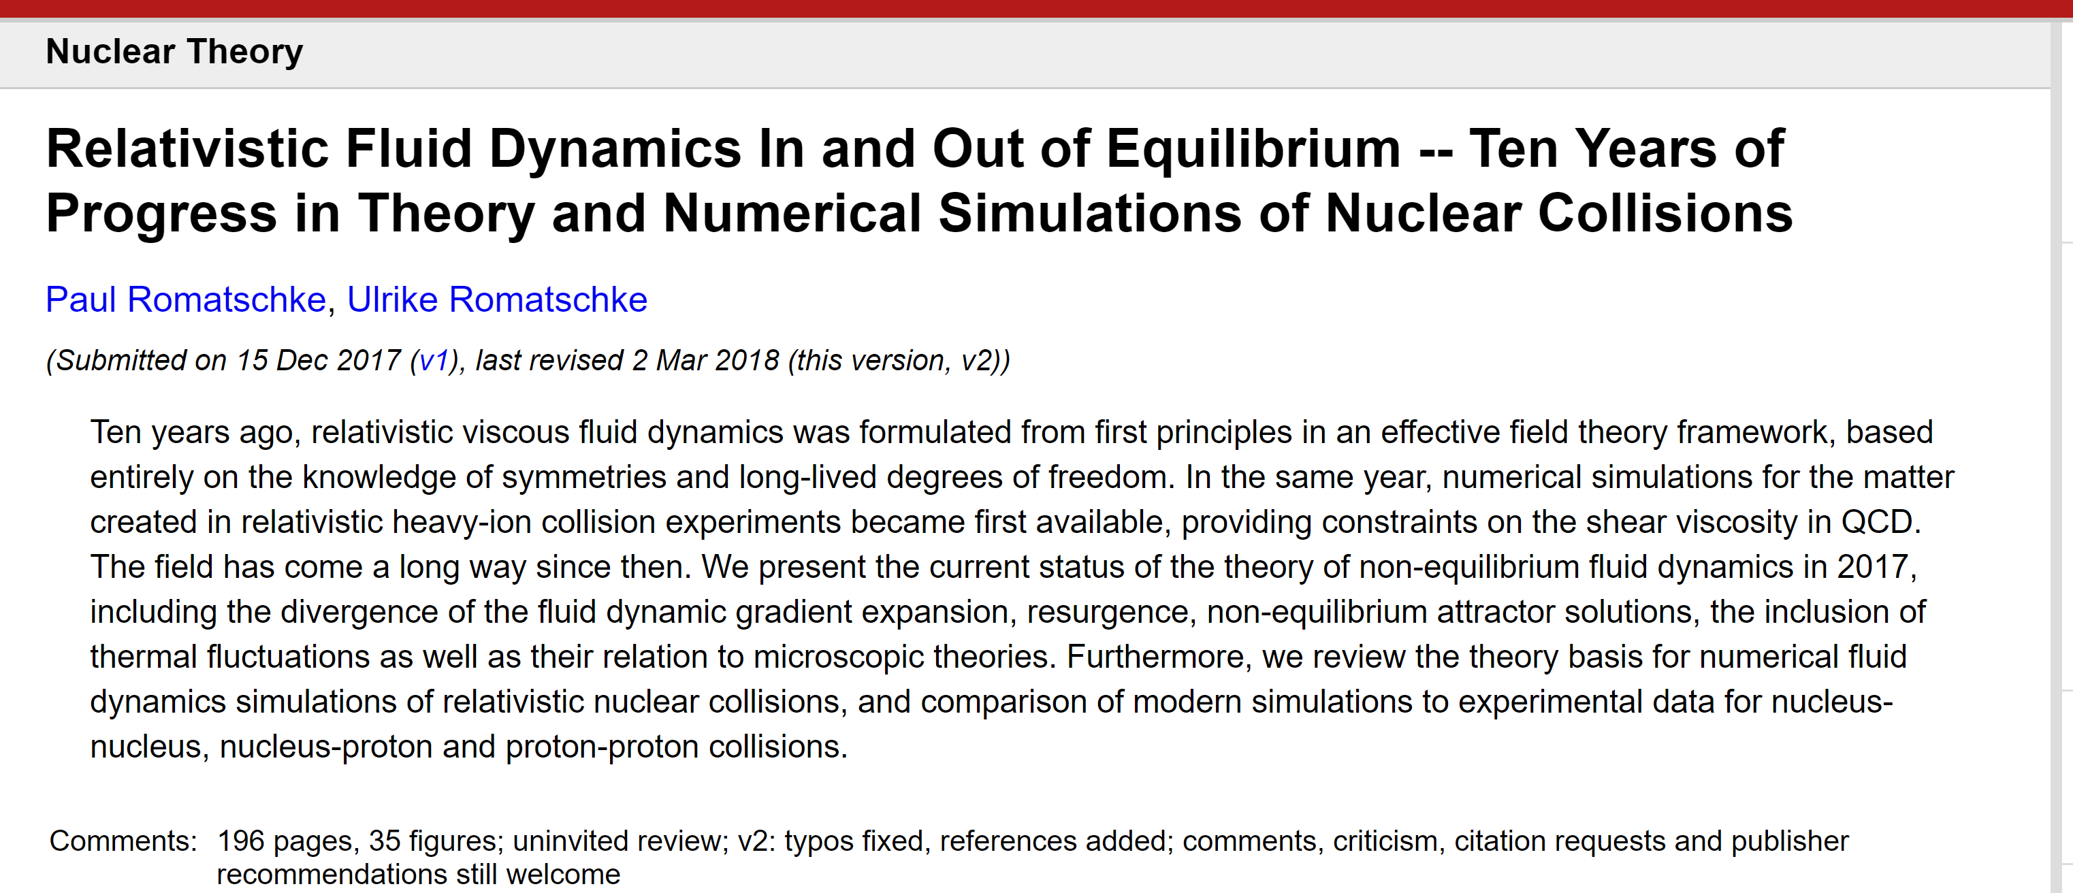
https://arxiv.org/abs/1712.05815

Slide 30
Alternatives

Slide 31
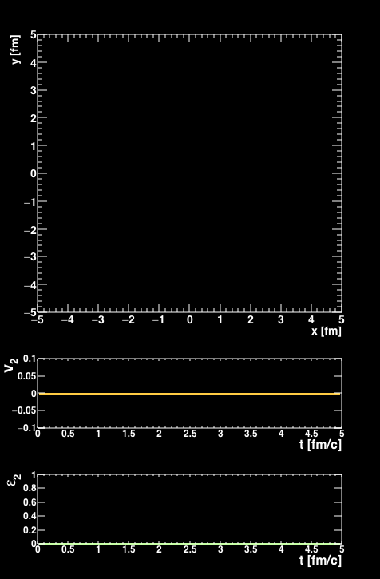
Is there a dual particle description to fluid dynamics?
Some systems really have no quasiparticles
Near perfect fluidity implies uncertainty principle scales
³He+Au Collision
AMPT Parton Cascade
Nagle et al., arXiv:1707.02307,
Orjuela Koop et al., arXiv:1512.06949, arXiv:1501.06880
Bozek, Bzdak, Ma, arXiv:1503.03655

Slide 32
Parton Scattering Results
Poor quantitative description, but rough agreement with v_{n} ordering
Problem with proving/disproving quasiparticle picture …
Cannot calculate QCD 2→2 cross section, angular distributions, etc.
Many free parameters to match the data if desired

Slide 33
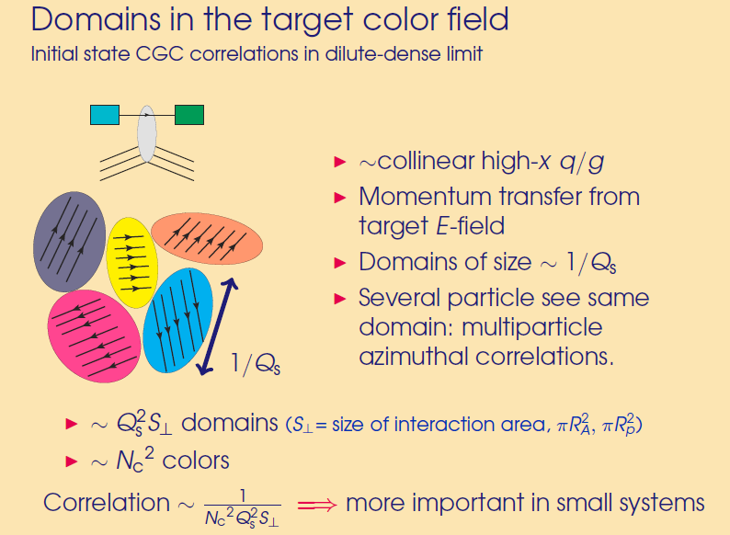
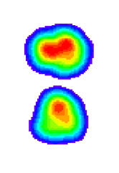
Color Domains
Effective field theory at weak coupling, dense gluon fields
Initial state correlations from domains…
Size scale of domains ~ 0.2-0.4 fm
Deuteron RMS diameter ~ 4 fm
Domains within each hotspot are uncorrelated
(large separation of scale)
Individually resolved domains
v₂ (dAu) < v₂ (pAu)
opposite of data ordering!

Slide 34
15 days after the PHENIX paper was posted, postdictions appeared
Mace et al. [MSTV], https://arxiv.org/abs/1805.09342
Color domain result has very poor p-value.
At the same time, how can the domain calculation have v₂(dAu) > v₂(pAu)?

Slide 35
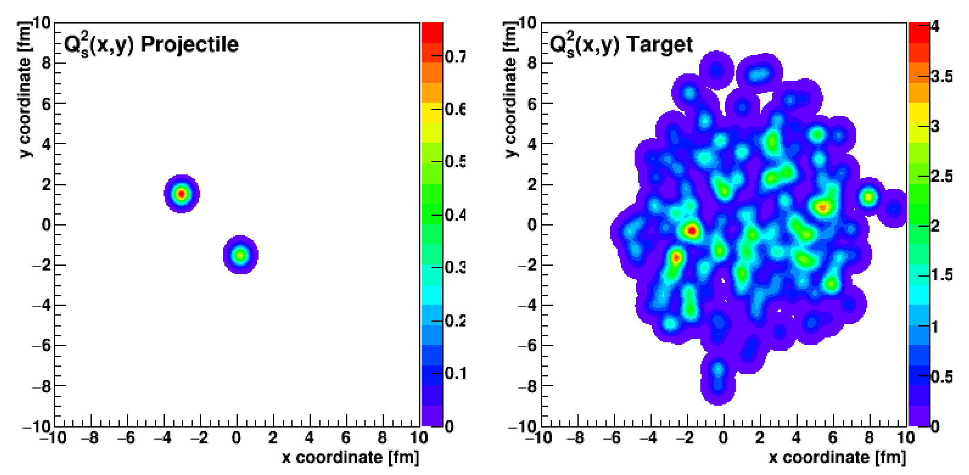
Code is not publicly available, results not yet reproduced.
Claim is that over some momentum range the uncertainty principle results in coherent interaction over many domains.
d+Au central has higher color charge density than p+Au, and hence a stronger v₂ correlation.
Like good experimentalists, we tried our hand at theory ☺
New code (IP-Jazma) from W.A. Zajc and JN reproducing initial steps of the
calculation…
https://arxiv.org/abs/1808.01276
https://github.com/jamienagle/IPJazma

Slide 36
Within IP-Jazma we find the obvious –
central d+Au collisions do not have a higher gluon density, but rather a larger overlap area.
Then why do they find v₂(dAu) > v₂ (pAu)?
We have some ideas…

Slide 37
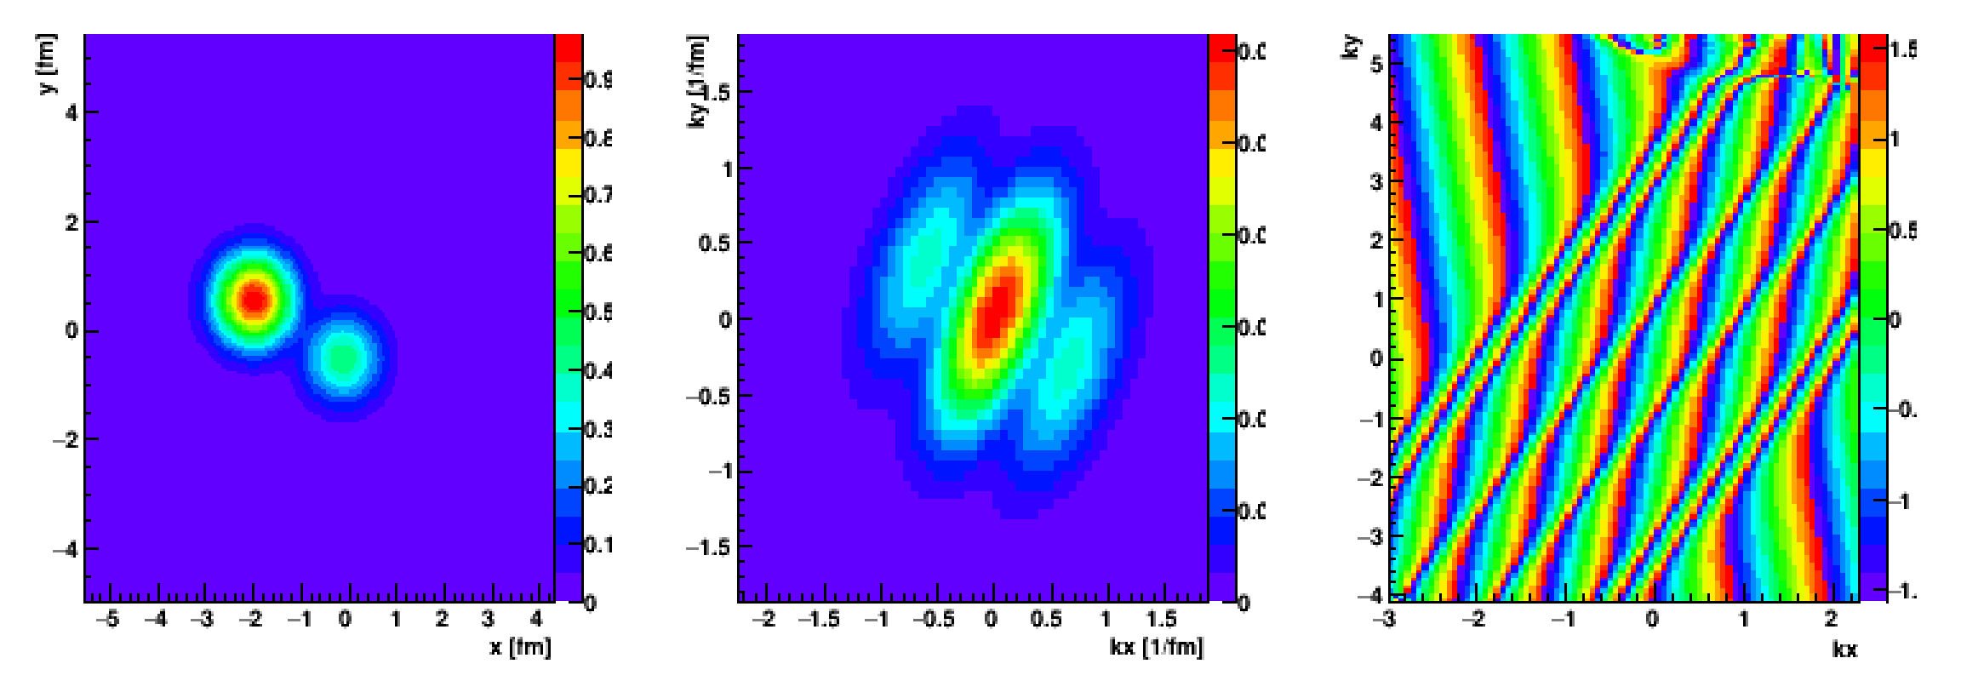
Color Charge
Distribution (x,y)
Fast Fourier Transform
Distribution (kx,ky)
Amplitude Phase
Deuteron
These calculations are done completely in momentum space and so one has to quantitatively demonstate that the geometry is not still the dominant influence –
easy to define such a correlator.

Slide 38
They also predict
“that v_{2,3}(p_{T}) for high multiplicity events across
small systems should be identical for the same N_{ch}.”
Turns out this prediction is actually yet another postdiction
Existing PHENIX measurement already rules this out!

Slide 39
Scientific Method
Have we proven that hydrodynamics describes small system flow?
Yes, by quantitative p-value tests.
Have we proven that real QGP droplets are formed in equilibrium?
Yes and No.
Hydrodynamic calculations say they are droplets that flow but are rather far from equilibrium (also in Au+Au).
Does it make sense to conduct further tests?
And to understand alternative calculations better?
Yes, of course, and at the same time one should not equivocate (see climate science example).

Slide 40
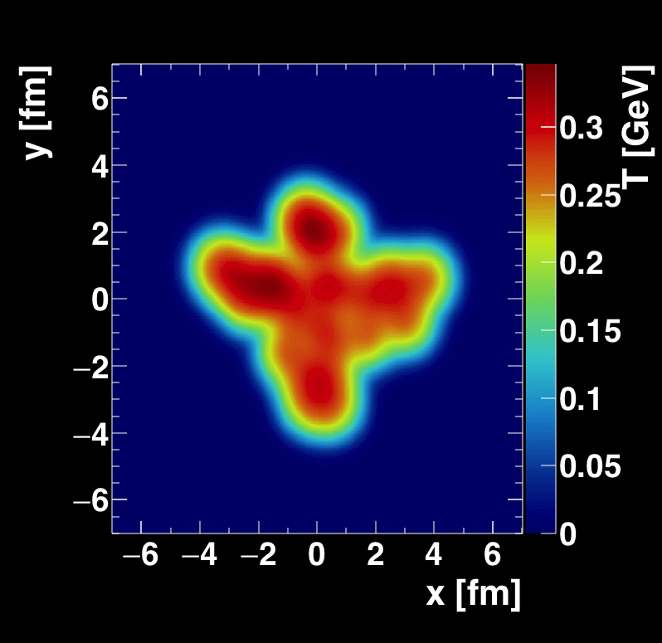
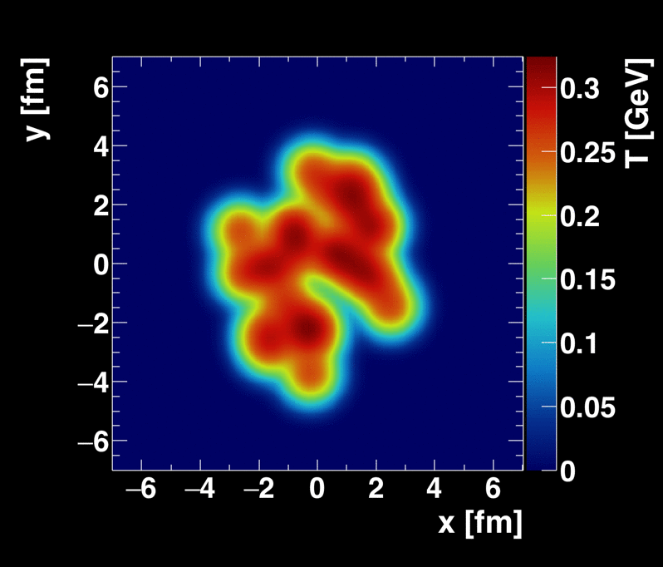
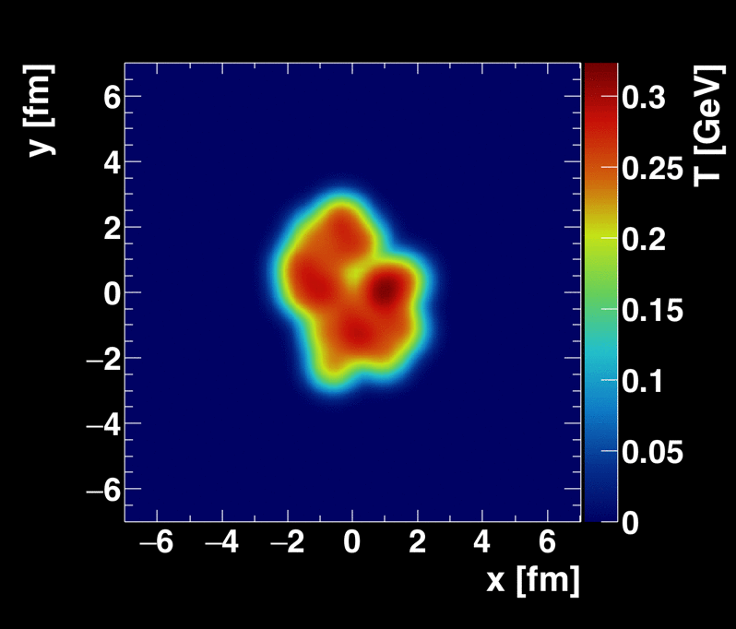

New Geometries Under Consideration
Oxygen + Oxygen, p + Oxygen (LHC)
ALD Berndt Muller
suggested ⁴He+A (RHIC)
Calculations from Sanghoon Lim
Recent proposal (https://arxiv.org/abs/1808.09840)
for polarized deuteron+A collisions.
Unfortunately, at RHIC C-AD does not believe they can maintain this small polarization through acceleration.

Slide 41

Emergent Phenomena
Connection from the Strong Force (QCD)
to the phenomena of confinement and
asymptotic freedom was fundamental
Connection from QCD to the emergent phenomena of near perfect fluidity of the Quark-Gluon Plasma is just as fundamental
Perfect fluidity tells us the nature of the QGP,
more importantly we need to reconcile:
Most important discovery in field: perfect fluid
&
Crucial part of QCD: weak coupling at short distances

Slide 42

Very Fun to Build Something New!
BaBar Magnet 1.5 T
Coverage |η| < 1.1
Inner MAPS tracker
Outer Fast TPC
Electromagnetic
Calorimeter
Hadronic Calorimeter
CD-0 Approval , September 27, 2016 !
CD-1/3A Approval, August 27, 2018 !
Recording billions of Au+Au interactions in one-year
Maximizing efficiency of RHIC running

Slide 43





sPHENIX measures jets and heavy quark probes with precision
Initial hard scatterings act as a microscope on the QGP with varying resolution scale
RHIC Jet Probes
LHC Jet Probes
QGP Influence
Bare Color Charges
Thermal Mass Gluons
Perfect Fluid Only

Slide 44






sPHENIX work on MicroMegas during sabbatical at Saclay
Working in the lab like a graduate student reminded me that those were the best years!

Slide 45
Summary
Discovery of Quark-Gluon Plasma as Perfect Fluid
Precision Description of Flow
“Little Bang” Standard Model
Small QGP Droplets Flow Too
New Opportunities to Discover the How and Why of the QGP

