Slide 1

Creating circular, elliptical, and triangular droplets of
quark-gluon plasma
Jamie Nagle
University of Colorado Boulder
UIUC Nuclear Physics Seminar December 10, 2018

Slide 2
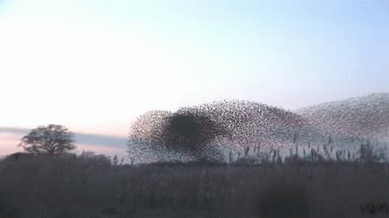
How does this work?
Emergent Phenomena… Collectivity…
What is the underlying origin?
For this flock of birds, it is all short range interactions

Slide 3
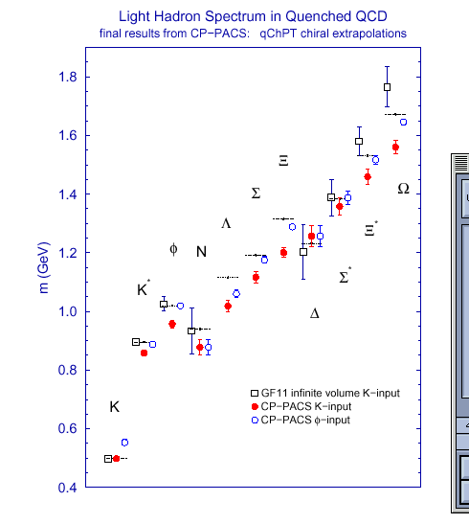
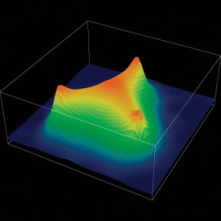
Strong evidence that QCD is the
correct theory of the strong interaction
Perturbative Calculations
Lattice Calculations
The field is about understanding
emergent phenomena from QCD,
just like condensed matter physics from QED.

Slide 4
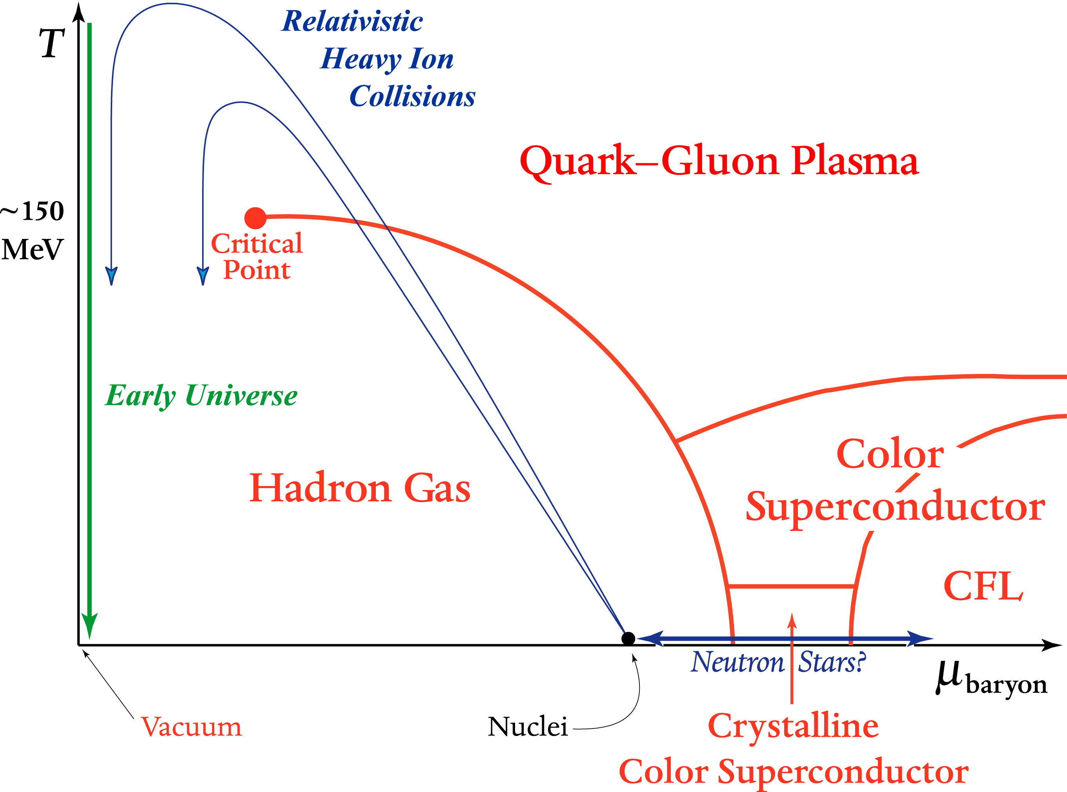
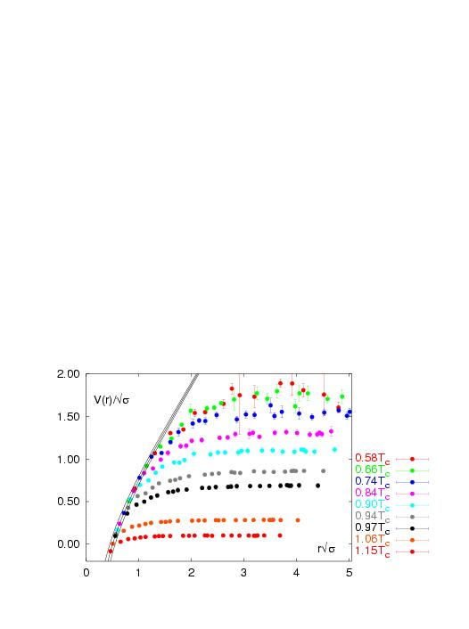
What about Hot QCD Matter?
Quark Gluon Plasma without color confinement
V(r)
r
Lattice QCD
V(r)/√σ
Screening of long range
confining potential at
high temperature or density
r√σ

Slide 5
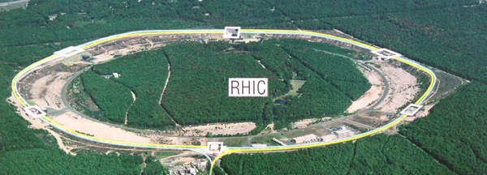
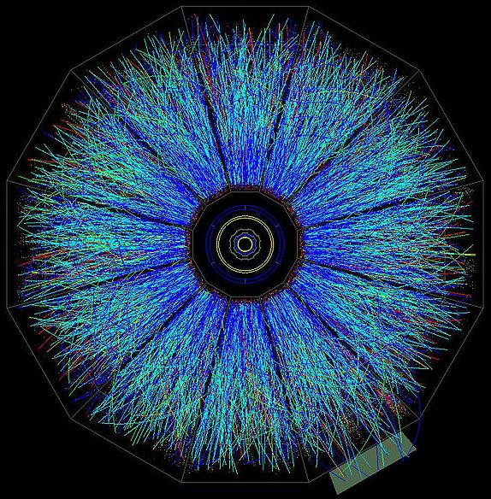
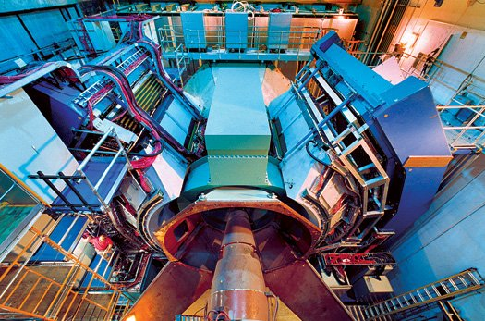
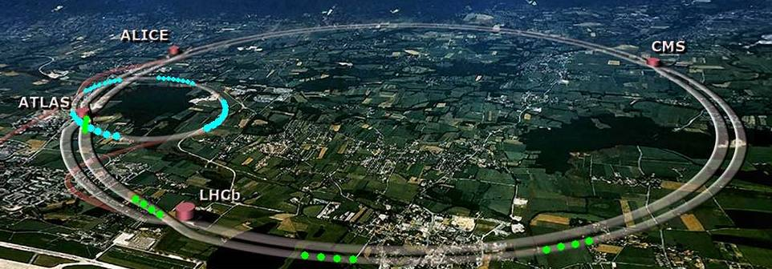
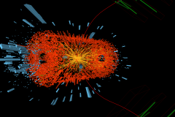
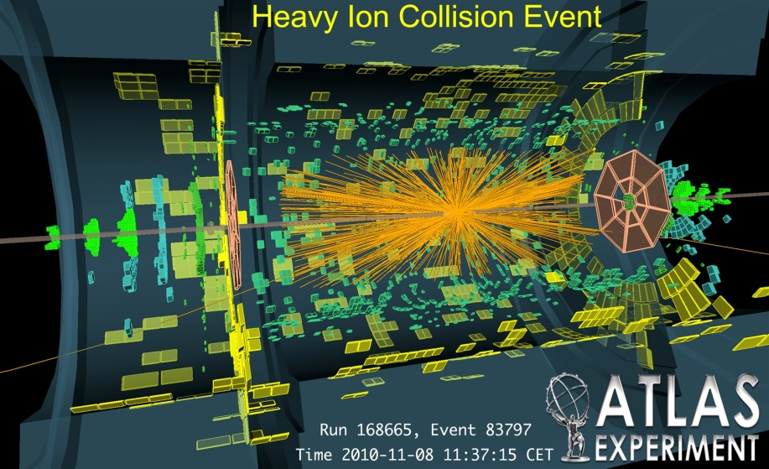
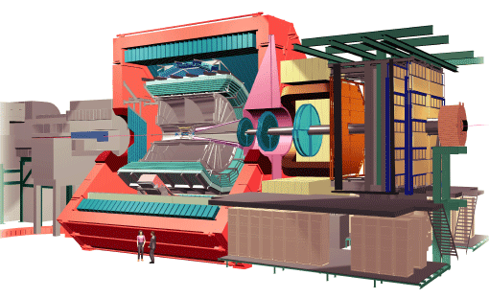
Creating Quark-Gluon Plasma droplets today
RHIC
PHENIX
STAR
LHC
CMS
ALICE

Slide 6
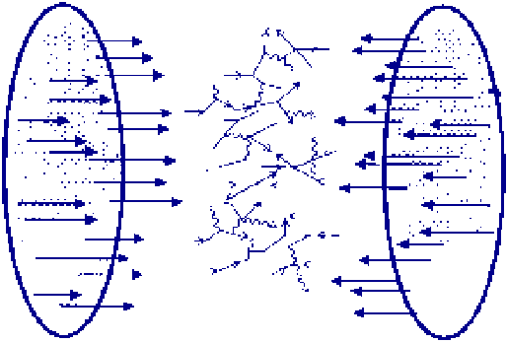
Multi-TeV Kinetic Energy → Heat
10,000++ gluons, quarks, antiquarks
How does this matter behave?

Slide 7
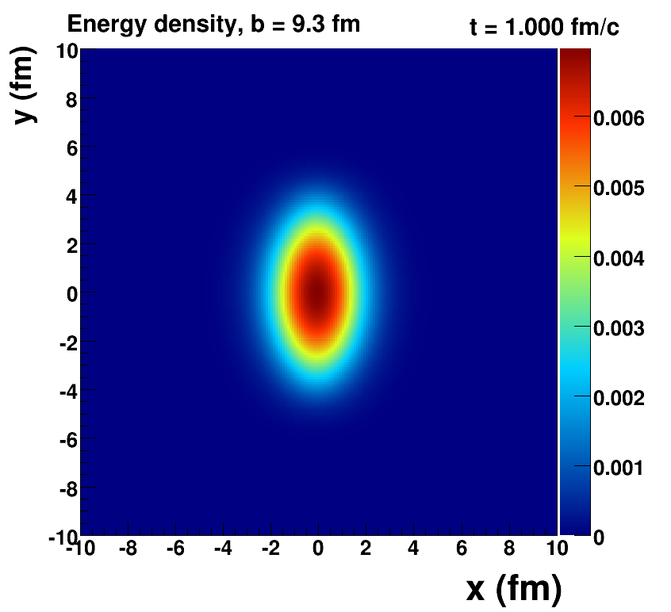
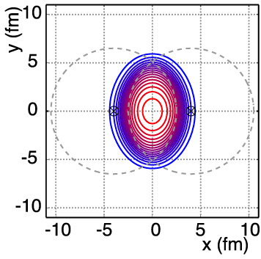
Nucleus-Nucleus Geometry
v₂ = “elliptic flow”

Slide 8
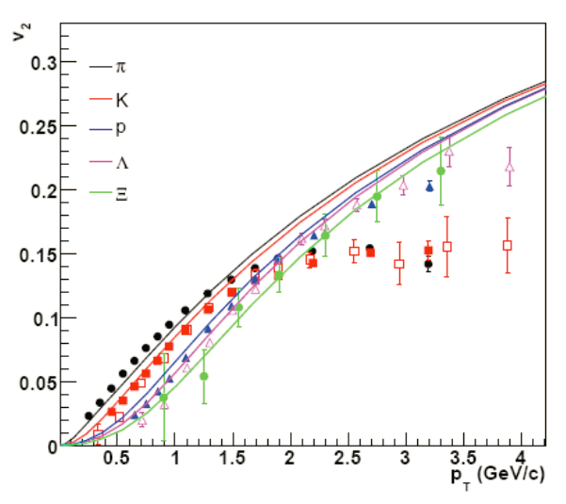
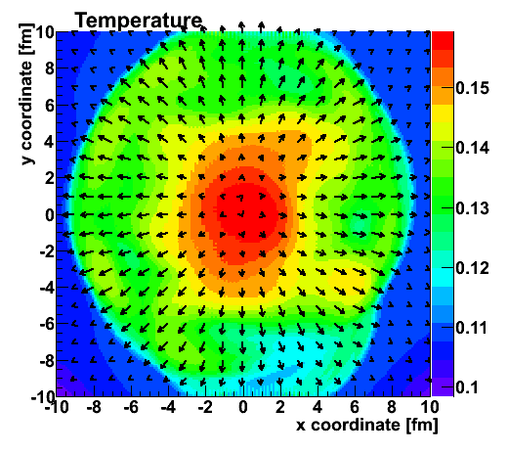
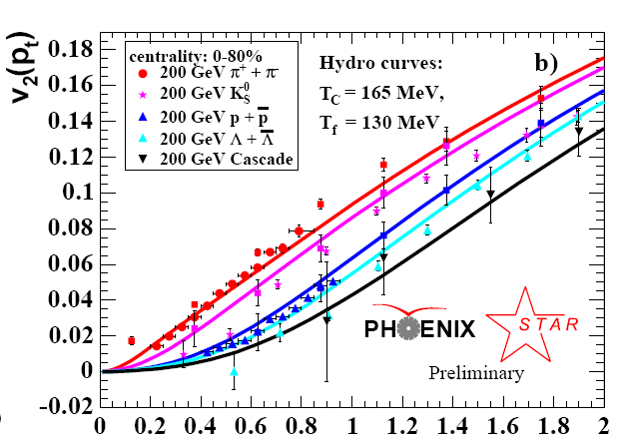
Fluid cells “freeze-out” at transition T
Isotropic hadrons in cell rest frame, then boosted
v₂
Temperature Profile + Velocity Vectors
v2
p_{T} (GeV)
Characteristic “fingerprint” flow pattern
Circa 2005: Quark Gluon Plasma = Perfect Fluid

Slide 9
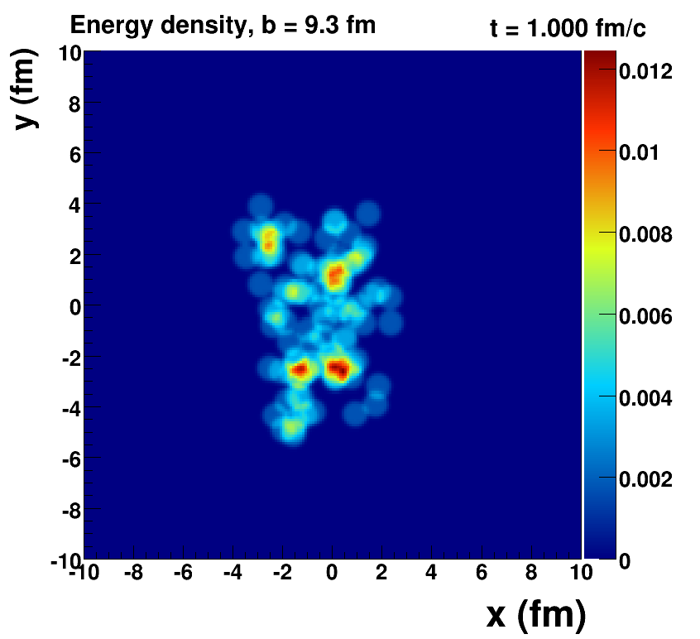
Romatschke=viscous hydrodynamics, McCumber=lumpy conditions + animation

Slide 10
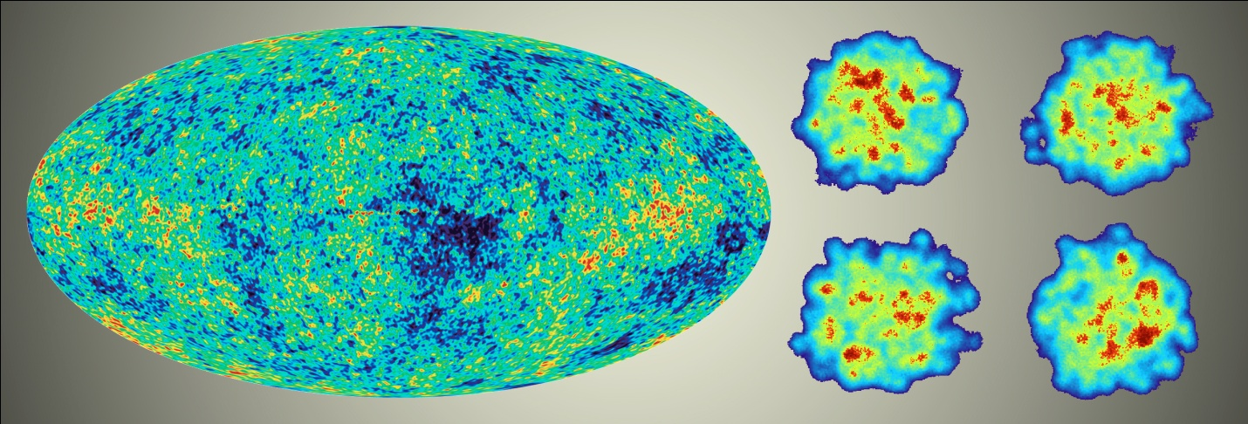
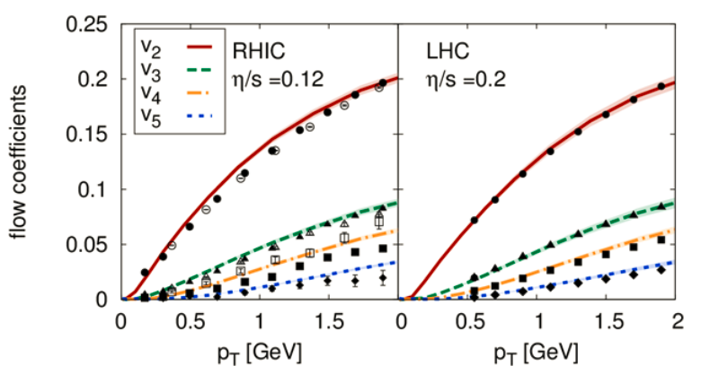
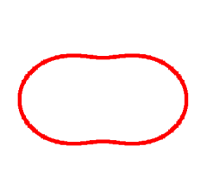
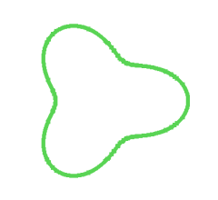
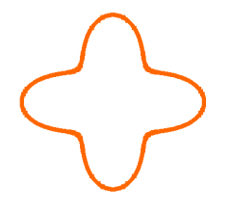
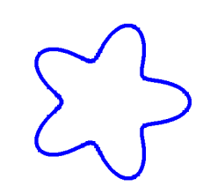
Detailed Fingerprint of Early Time

Slide 11
“Little Bang” Standard Model
Discovery: Quark Gluon Plasma = Near Perfect Fluid
Standard Model with Hydrodynamic Evolution
Precision: Predictions of Flow Patterns
but…
How does it equilibrate so quickly (or does it)?
What are the degrees of freedom or quasiparticles?

Slide 12
Back to Discovery
A+A
Enough particles to equilibrate, QGP, collective motion
p+p, p+A
Not enough particles to equilibrate, control experiment

Slide 13
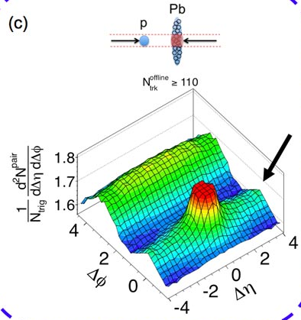
Fall 2012 Revolution – p+Pb Collisions
Signal similar to that seen in A+A
Could it be flow?
Alternative proposal of initial state
momentum domains – nothing to do with geometry!

Slide 14
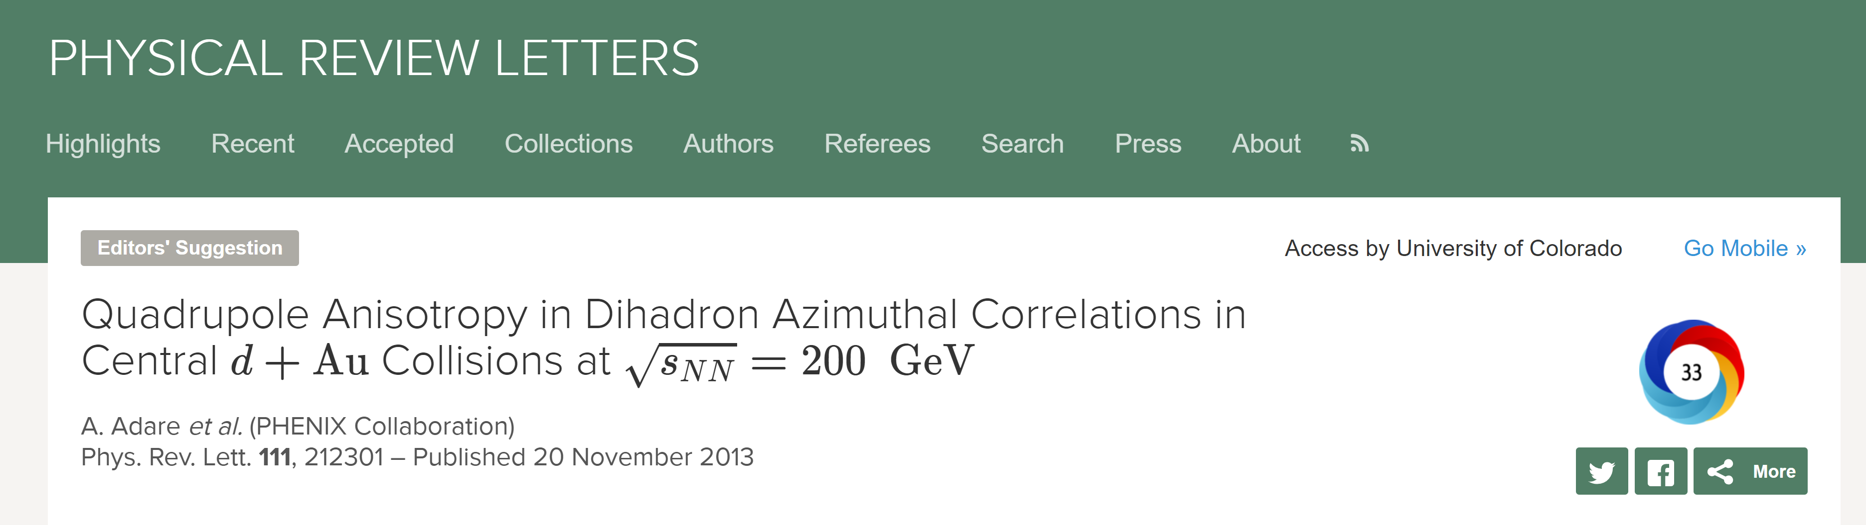
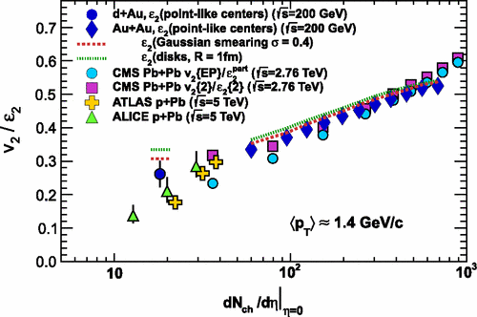
PHENIX Role in the Revolution!
Analysis by Anne Sickles
Indications of
small droplet flow
at RHIC too!
245 citations to date

Slide 15
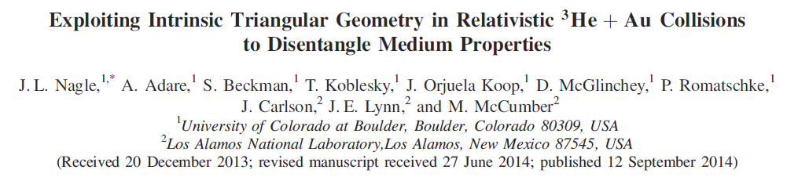
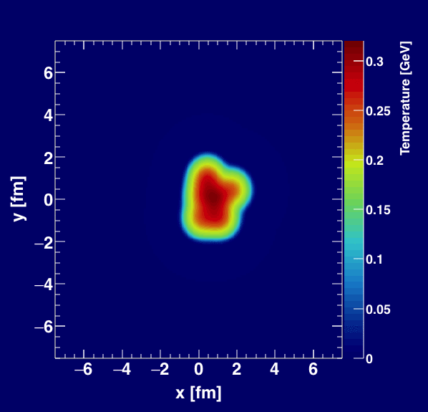
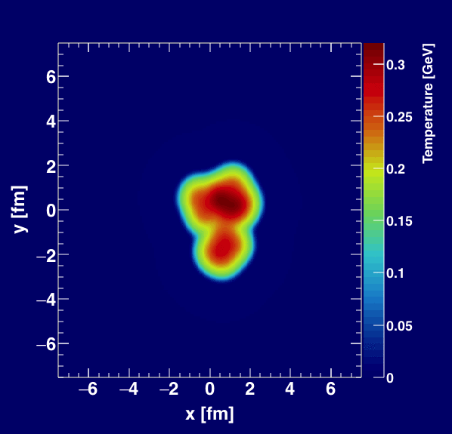
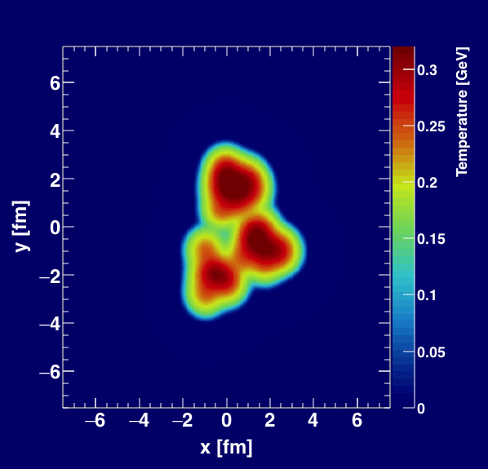
Geometry Tests at RHIC
http://journals.aps.org/prl/abstract/10.1103/PhysRevLett.113.112301

Slide 16
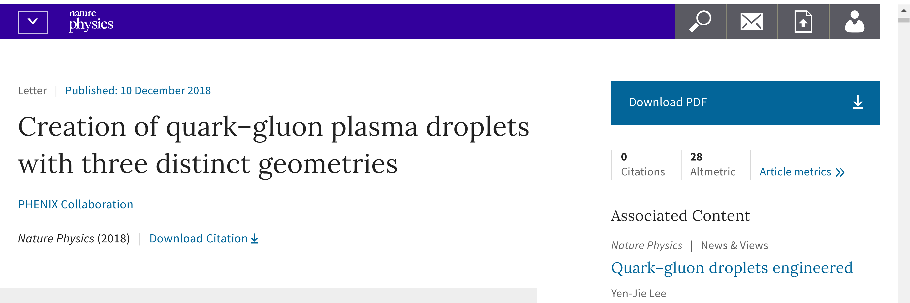
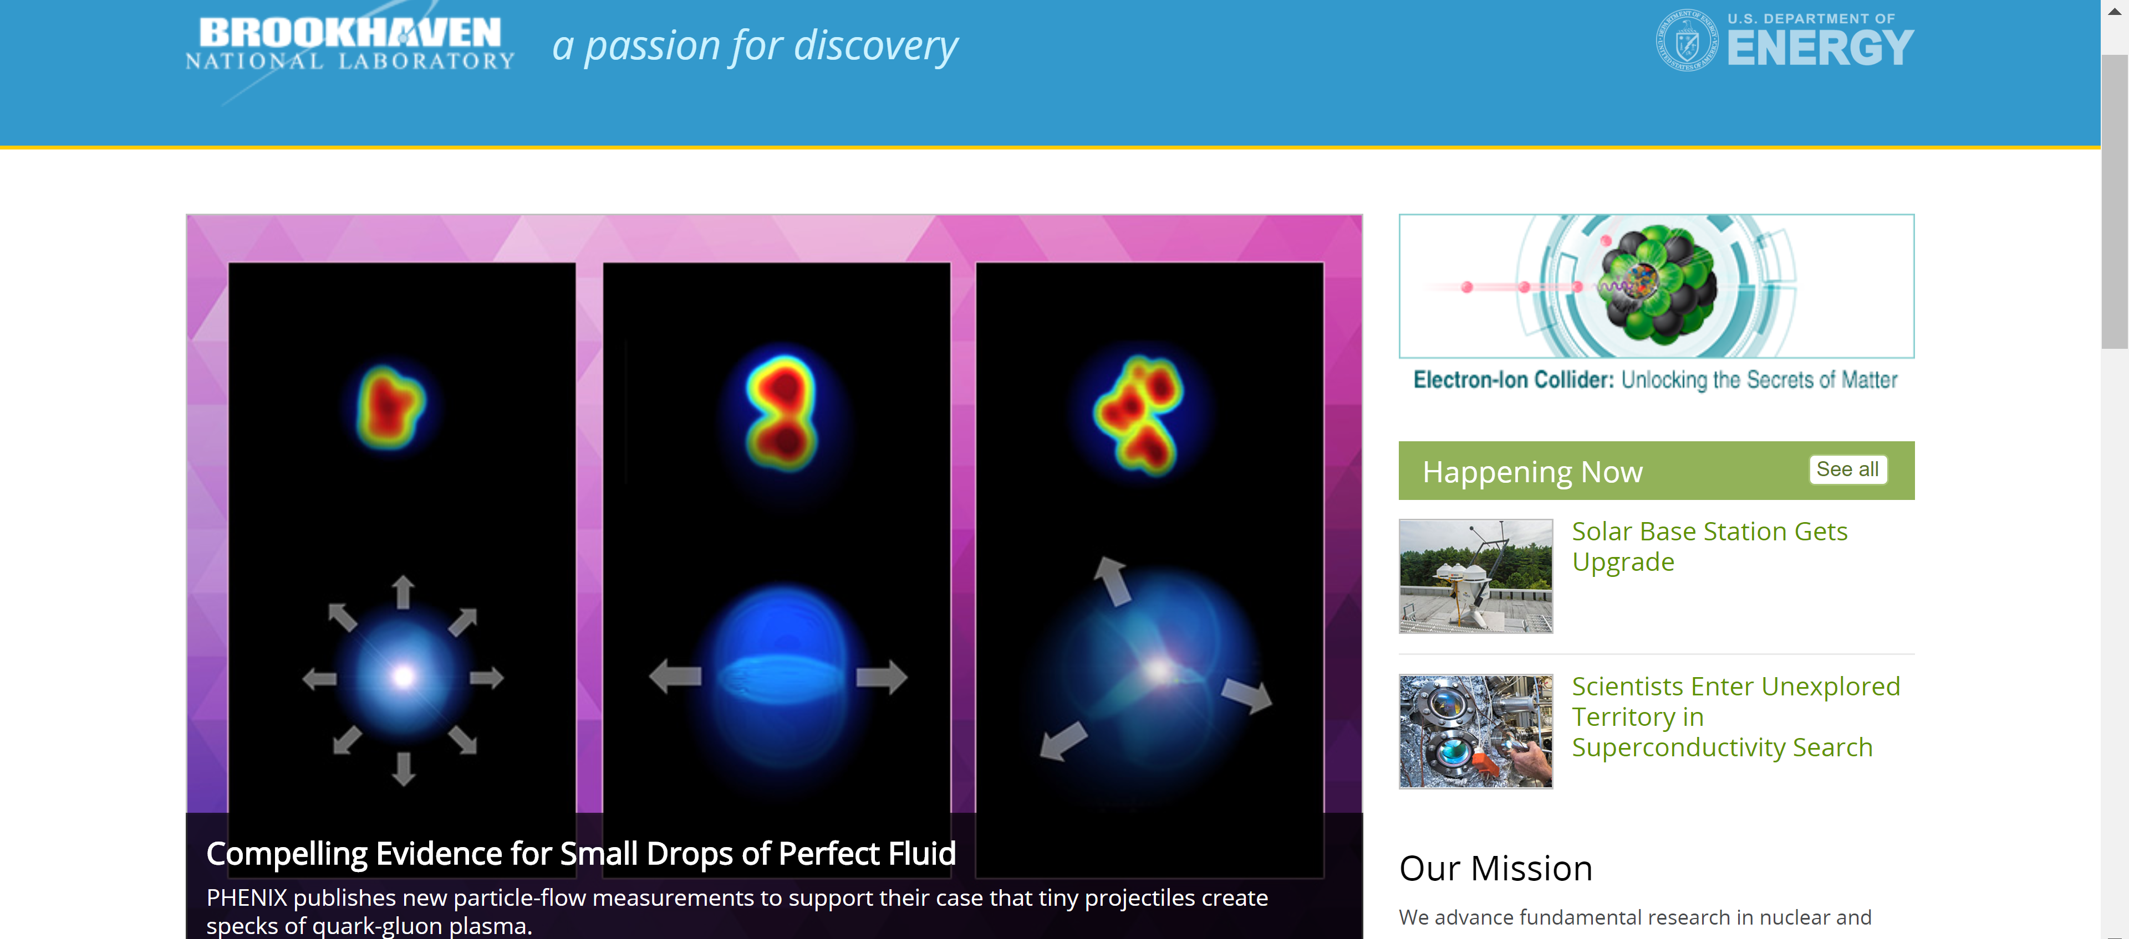
Full Experimental Results Published in Nature Physics
just a few hours ago!

Slide 17
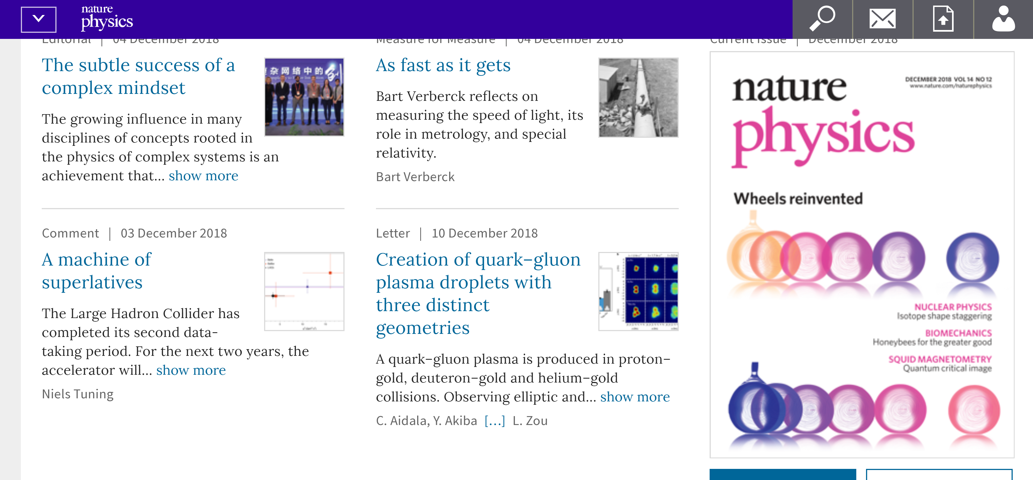

Slide 18
All Three Systems
v₂
Follows ordering of eccentricities
v₃
Multiplicity also plays a role
PHENIX, https://arxiv.org/abs/1805.02973, Published in Nature Physics

Slide 19
Particle Multiplicities
https://arxiv.org/abs/1807.11928, published Phys. Rev. Lett.
Midrapidity Values
dN_{ch}/dη ~ 12 p+Au 0-5%
dN_{ch}/dη ~ 18 d+Au 0-5%
dN_{ch}/dη ~ 22 ³He+Au 0-5%
Hydrodynamic calculations include the initial geometry differences and match the particle multiplicity for each system

Slide 20
Hydrodynamic Comparison
PHENIX, https://arxiv.org/abs/1805.02973, Published in Nature Physics
Agreement with v₂, v₃ (p_{T}) for all three systems
SONIC hydrodynamic published prediction has very good p-value
Alternative hydrodynamics iEBE-VISHNU confirms results

Slide 21
“One fluid to rule them all”
p+p
p+Pb
Pb+Pb
Weller and Romatschke, https://arxiv.org/abs/1701.07145

Slide 22
What does it all mean?
I thought hydrodynamics only applies if
system is near equilibrium
system has a size scale L >> mean free path
How can these be true in p+p, p+Au, d+Au, etc.?
Maybe they are NOT!
String Theory Dual (completely solvable at strong coupling)
Systems very far from equilibrium still described by hydrodynamics as long as non-hydrodynamic modes are damped → hydrodynamic attractor.
Major re-thinking well beyond field of heavy ion physics.

Slide 23
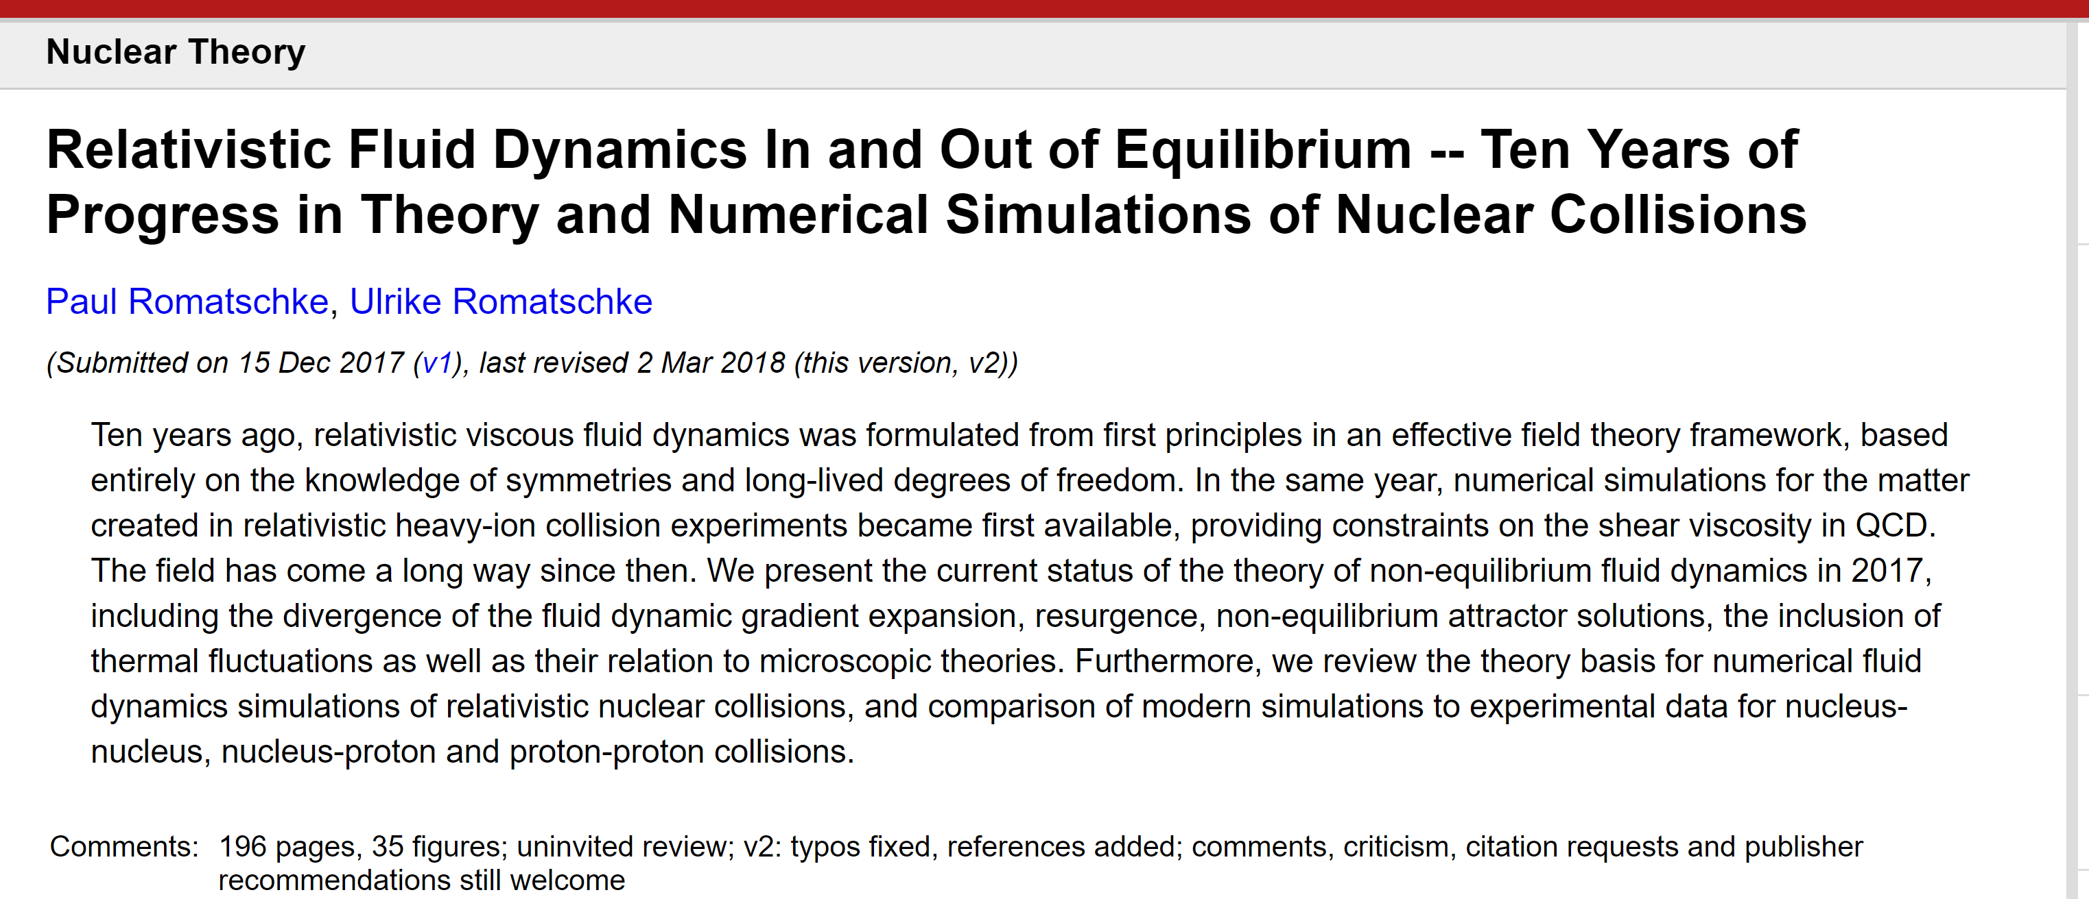
https://arxiv.org/abs/1712.05815

Slide 24
Alternatives

Slide 25
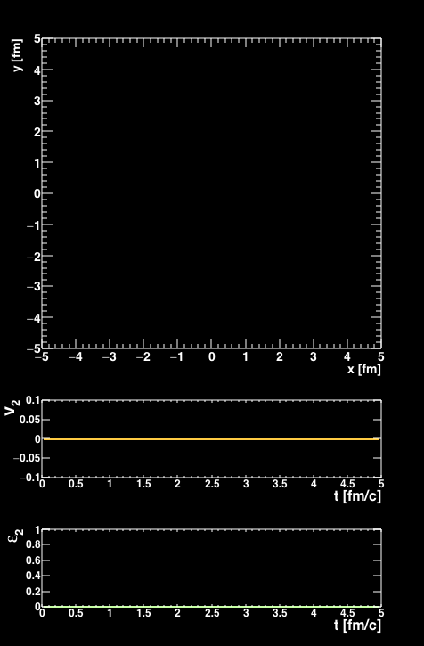
Is there a dual particle description to fluid dynamics?
Some systems really have no quasiparticles
Near perfect fluidity implies uncertainty principle scales
³He+Au Collision
AMPT Parton Cascade
Nagle et al., arXiv:1707.02307,
Orjuela Koop et al., arXiv:1512.06949, arXiv:1501.06880
Bozek, Bzdak, Ma, arXiv:1503.03655

Slide 26
Parton Scattering Results
Poor quantitative description, but rough agreement with v_{n} ordering
Problem with proving/disproving quasiparticle picture …
Cannot calculate QCD 2→2 cross section, angular distributions, etc.
Many free parameters to match the data if desired

Slide 27
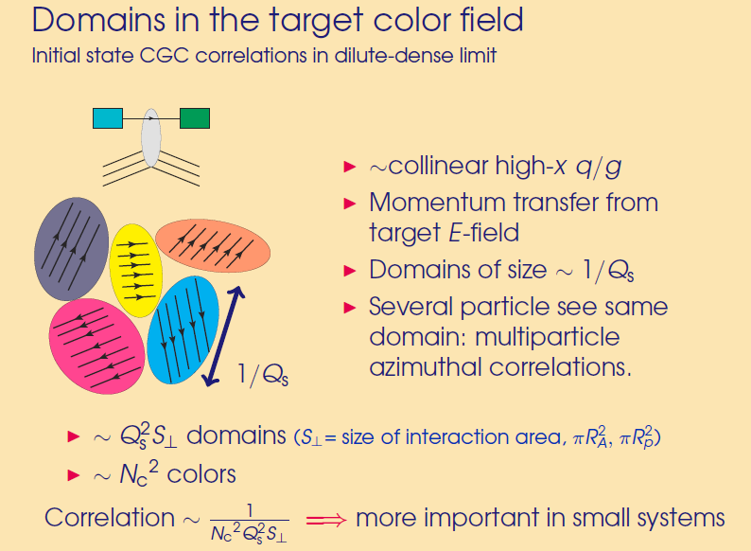
Color Domains
Effective field theory (saturation, color glass condensate)
at weak coupling, dense gluon fields
Theory has color domains…
Size scale ~ 0.2-0.4 fm
Gluons scattering from these domains if they have the right color get a kick (anti) aligned with field.
Correlation is suppressed by a factor 1 / ( S_{T} Q_{s}² N_{c}² )
# Domains = S_{T} Q_{s}²

Slide 28
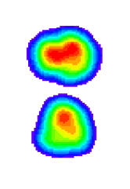
Gluons scattering from these domains if they have the right color get a kick (anti) aligned with field.
Correlation is suppressed by a factor 1 / ( S_{T} Q_{s}² N_{c}² )
# Domains = S_{T} Q_{s}²
Deuteron
Proton-Neutron Separation
Domains within each hotspot are
uncorrelated
Correlation suppressed
v₂ (dAu) < v₂ (pAu)
Opposite of data ordering!

Slide 29
15 days after the PHENIX paper was posted, postdictions appeared
Mace et al. [MSTV], https://arxiv.org/abs/1805.09342
Color domain result has very poor p-value.
At the same time, how can the domain calculation have v₂(dAu) > v₂(pAu)?

Slide 30
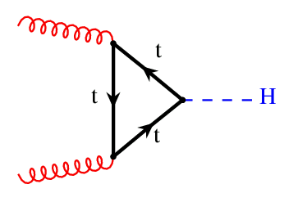
Essential physics
Think of a gluon with k_{T} from the target and its interaction with domains in the projectile…
Proton color domains
Deuteron color domains
Uncertainty principle blurring of gluon allows it to interact with multiple domains.

Slide 31
Uncertainty Principle
Incoming target gluon with k_{T}
uncertainty principle blurs the gluon with radius
r [fm] = hbar/k_{T} = 0.2 / k_{T}[GeV]
If k_{T} = 1 GeV, r = 0.2 fm
Target gluon wave
Projectile (proton) radius ~ 0.9 fm
If Q_{s} = 2 GeV, r_{domain} = 0.1 fm.
Of course this is an absurdly large Q_{s}² = 4 GeV² for the proton x>0.01
Then target gluon sees
(Q_{s}/k_{T})² ~ 4 domains at once,
but still not the size of a deuteron!
Proton
Domains
Size ~ 1/Q_{s}

Slide 32
Code is not publicly available, results not yet reproduced.
Claim is that over some momentum range the uncertainty principle results in coherent interaction over many domains.
Higher multiplicity d+Au central has higher color charge density than p+Au, and hence a stronger v₂ correlation.
Like good experimentalists, we tried our hand at theory ☺
New code (IP-Jazma) from W.A. Zajc and JN reproducing initial steps of the calculation…
https://arxiv.org/abs/1808.01276
https://github.com/jamienagle/IPJazma

Slide 33
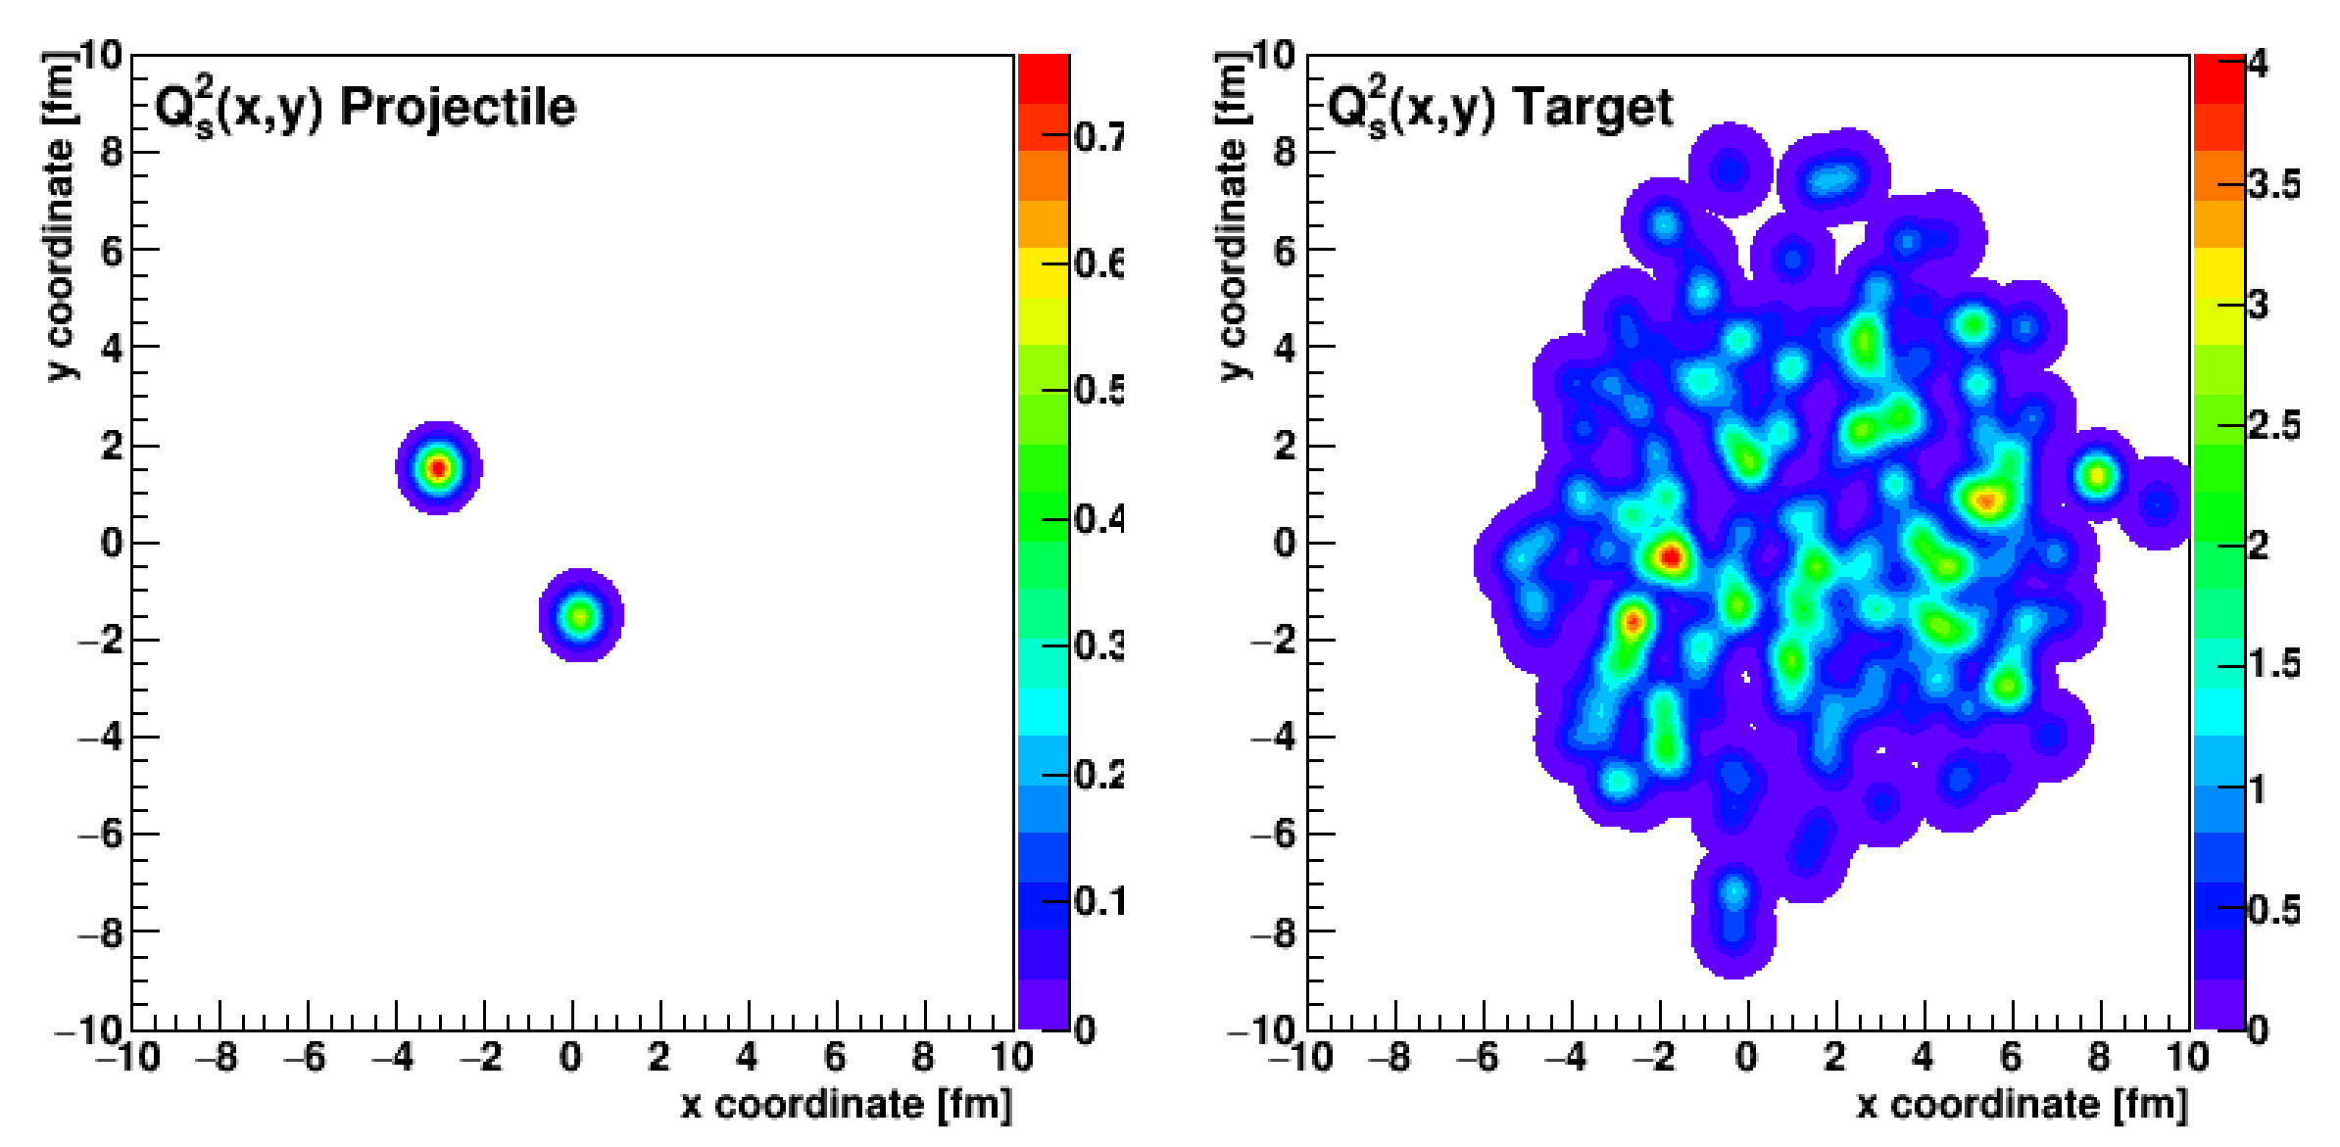
deuteron
+
gold
IP-Jazma
Sum all the color charge contributions for each nucleus.
At this point, none of these fluctuations are ab initio.
All MC Glauber and put-in-by-hand Q_{s,0} ² fluctuations.

Slide 34
d+Au @ 200 GeV
Settings: Dilute-Dense, no Q_{s,0} ² fluctuations
Some collisions where only proton (or neutron) hits,
some collisions where both hit the target)
One reaches the limit of freeing gluons from the projectile,
proton and neutron in the deuteron.

Slide 35
d+Au @ 200 GeV
Settings: Dilute-Dense, Q_{s,0} ² fluctuations
Essentially perfect agreement IP-Jazma and MSTV.
Fluctuations mean high multiplicity events have larger saturation scale Q_{s,0} ². Does that bias the v2 higher?

Slide 36
MSTV: larger correlation in d+Au because of larger color chare density
IP-Jazma: Not true.
Central d+Au collisions do not have a higher gluon density,
but rather a larger overlap area.
Then why do they find v₂(dAu) > v₂ (pAu)?

Slide 37
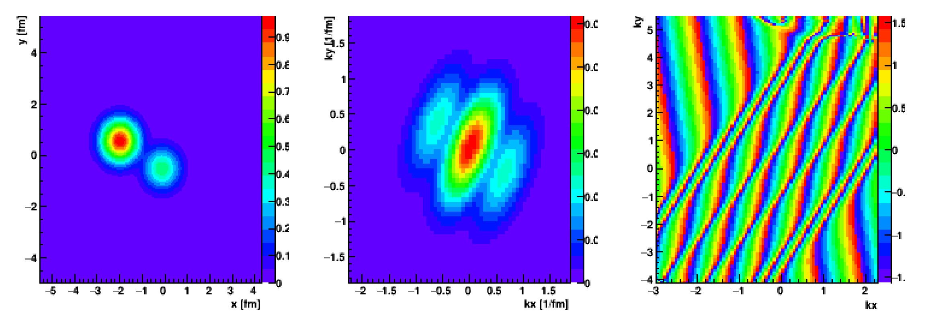
Color Charge
Distribution (x,y)
Fast Fourier Transform
Distribution (kx,ky)
Amplitude Phase
Deuteron
These calculations are done completely in momentum space and so one has to quantitatively demonstate that the geometry is not still the dominant influence –
easy to define such a correlator.

Slide 38
They also predict
“that v_{2,3}(p_{T}) for high multiplicity events across
small systems should be identical for the same N_{ch}.”
Turns out this prediction is actually yet another postdiction
Existing PHENIX measurement already rules this out!

Slide 39
IP-Glasma – Color Manifestations
Success of IP-Glasma Au+Au
initial conditions often highlighted by these very spikey displays
However, IP-Jazma (dense-dense) matches eccentricities ε₂-ε₆
Au+Au
ε₂
ε₃
ε₄
Totally dominated by T_{A} x T_{B} scaling,
not color
fluctuation spikes.
ε₅
ε₆

Slide 40
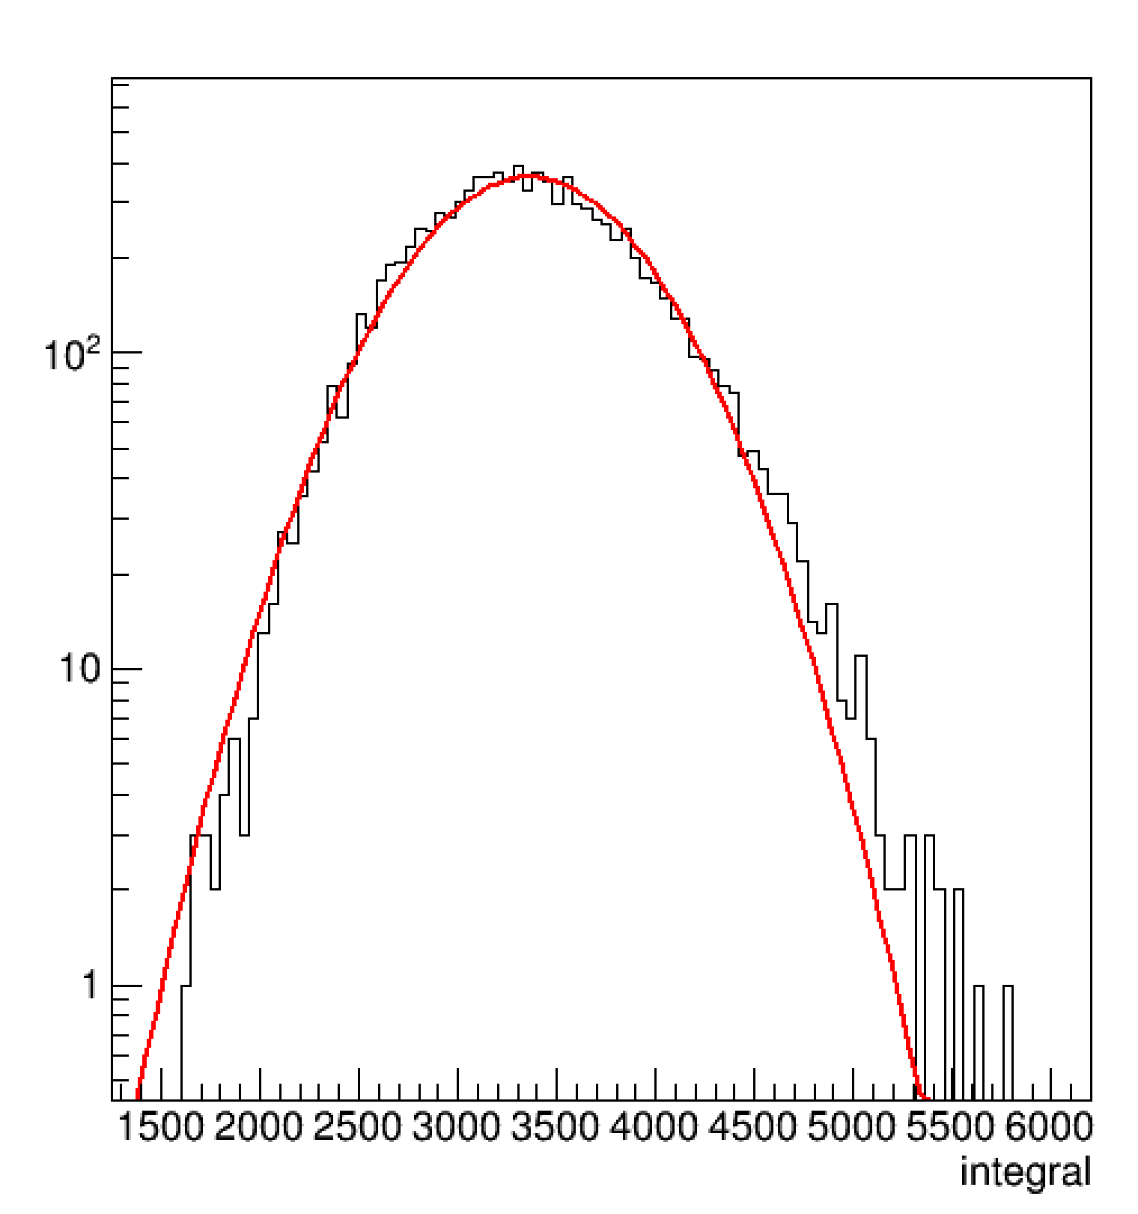
Let the Buyer Beware
IP-Glasma
https://arxiv.org/abs/1202.6646v2
IP-Jazma calculation for Au+Au b=9 fm events in dense-dense limit, no Q_{s,0}² fluctuation,.
Note the gluon distribution is not Gaussian (red line) and has a high side skew (Γ dist.).
Nothing to do with Glasma flux tubes.
IP-Jazma
dET/dy (a.u.)

Slide 41
If there are no non-trivial manifestations of saturation physics (applicability of this weak coupled effective field they) at RHIC or the LHC, how does that inform the Electron Ion Collider program?

Slide 42
Scientific Method
Have we proven that hydrodynamics describes small system flow?
Yes, by quantitative p-value tests.
Have we proven that real QGP droplets are formed in equilibrium?
Yes and No.
Hydrodynamic calculations say they are droplets that flow but are rather far from equilibrium (also in Au+Au).
Does it make sense to conduct further tests?
And to understand alternative calculations better?
Yes, of course, and at the same time one should not equivocate (see climate science example).

Slide 43
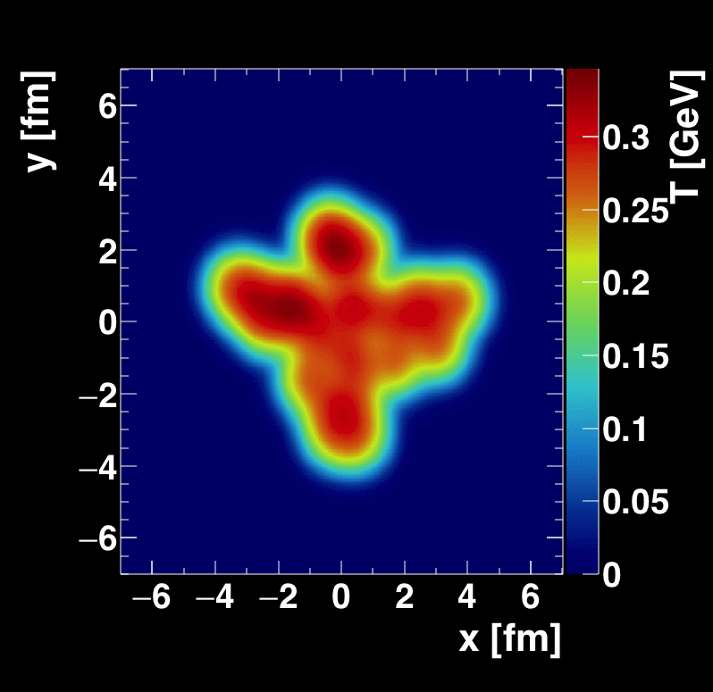
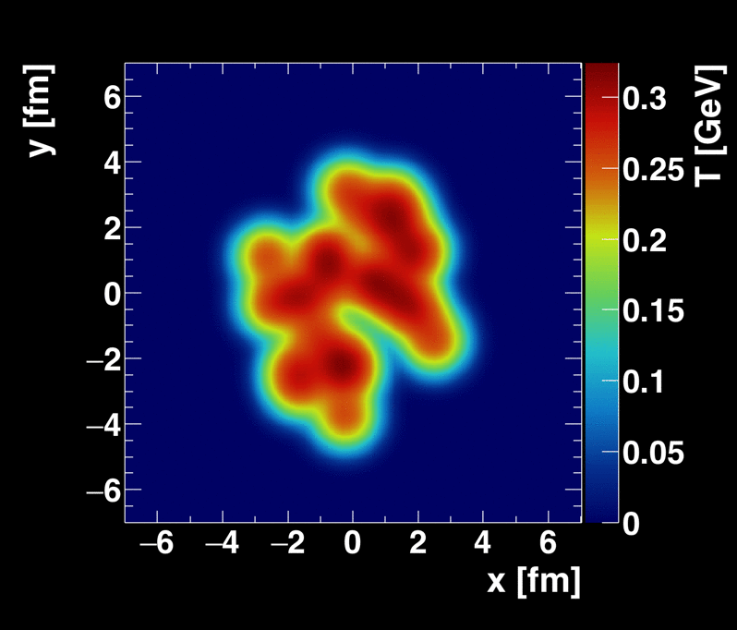
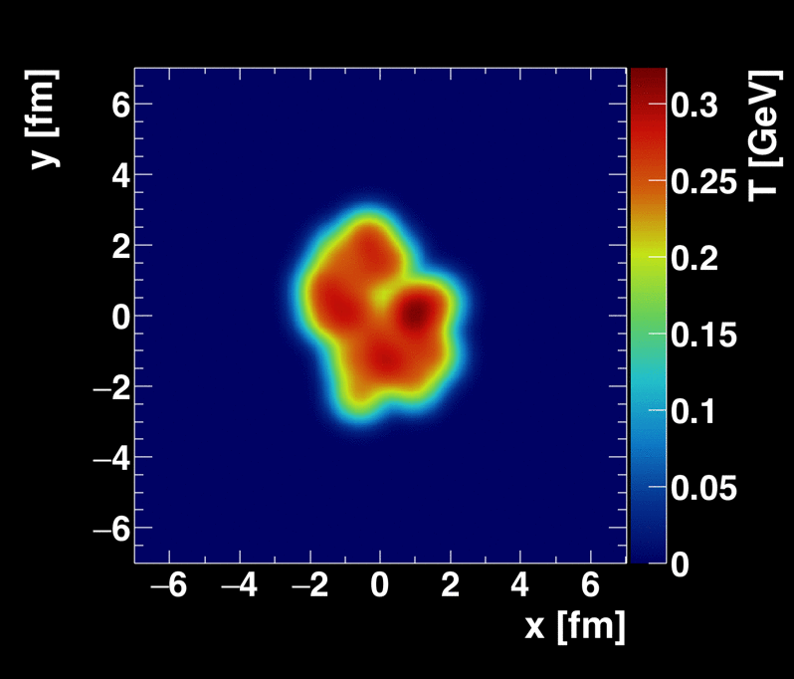
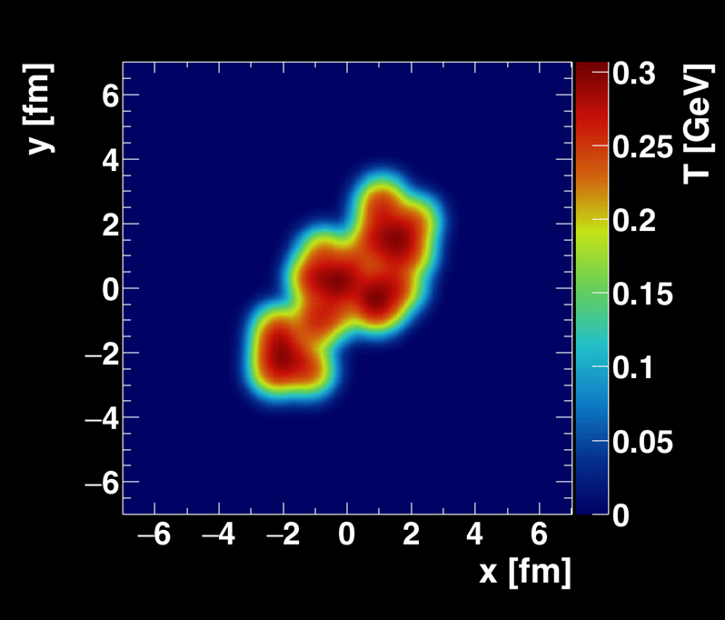
New Geometries Under Consideration
Oxygen + Oxygen, p + Oxygen (LHC)
ALD Berndt Muller
suggested ⁴He+A (RHIC)
Calculations from Sanghoon Lim
Recent proposal (https://arxiv.org/abs/1808.09840)
for polarized deuteron+A collisions.
Unfortunately, at RHIC C-AD does not believe they can maintain this small polarization through acceleration.

Slide 44
⁴He more compact than ³He
⁴He+Au

Slide 45
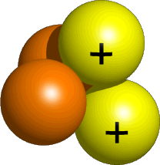
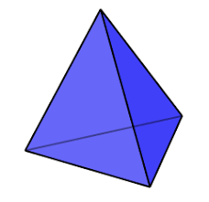
Oxygen = 4-α
Little indication for this 4-α configuration in full 16-nucleon calculation
Triangularity
4-α
Full 16-body config.
Beryllium-9 = 2-α + 1 n
⁹Be+Au

Slide 46

Emergent Phenomena
Connection from the Strong Force (QCD)
to the phenomena of confinement and
asymptotic freedom was fundamental
Connection from QCD to the emergent phenomena of near perfect fluidity of the Quark-Gluon Plasma is just as fundamental
Perfect fluidity tells us the nature of the QGP,
more importantly we need to reconcile:
Most important discovery in field: perfect fluid
&
Crucial part of QCD: weak coupling at short distances

Slide 47

Very Fun to Build Something New!
BaBar Magnet 1.5 T
Coverage |η| < 1.1
Inner MAPS tracker
Outer Fast TPC
Electromagnetic
Calorimeter
Hadronic Calorimeter
CD-0 Approval , September 27, 2016 !
CD-1/3A Approval, August 27, 2018 !
Recording billions of Au+Au interactions in one-year
Maximizing efficiency of RHIC running

Slide 48
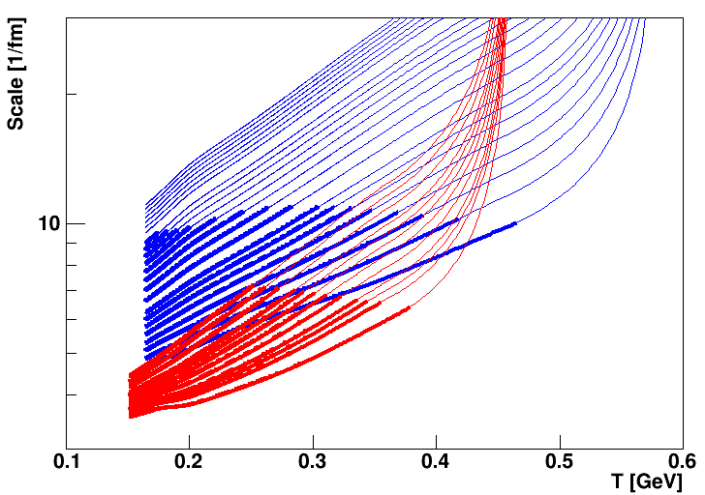




sPHENIX measures jets and heavy quark probes with precision
Initial hard scatterings act as a microscope on the QGP with varying resolution scale
RHIC Jet Probes
LHC Jet Probes
QGP Influence
Bare Color Charges
Thermal Mass Gluons
Perfect Fluid Only

Slide 49






sPHENIX work on MicroMegas during sabbatical at Saclay
Working in the lab like a graduate student reminded me that those were the best years!

Slide 50
Summary
Discovery of Quark-Gluon Plasma as Perfect Fluid
Precision Description of Flow
“Little Bang” Standard Model
Small QGP Droplets Flow Too
New Opportunities to Discover the How and Why of the QGP

Slide 52
A+A collisions release thousands of virtual gluons from the nuclear wavefunction
“The Hammer”
p+A may in fact be a
mini-hammer
A+A
p+A
e+A
Electron-Ion Collider
Tickling the nucleus
Individual hard kicking of partons
or scattering from collective gluonic matter

Slide 53

Electron Ion Collider
Critical to understanding nature of proton and heavy nuclei
Key to picture of gluonic initial starting point for QGP
Detector built around BaBar magnet and sPHENIX serves as excellent foundation for EIC detector
http://arxiv.org/abs/arXiv:1402.1209
http://arxiv.org/abs/1212.1701

