Slide 1
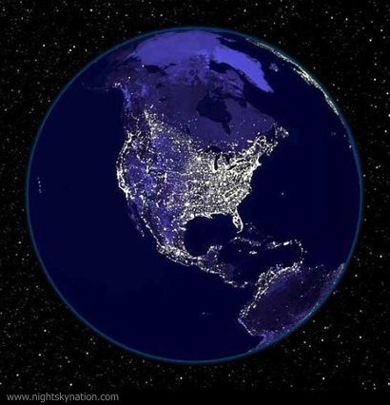

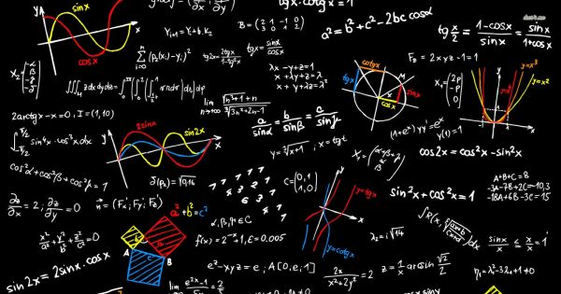
Climate, Physics, and Probability
Jamie Nagle
University of Colorado Boulder

Slide 2

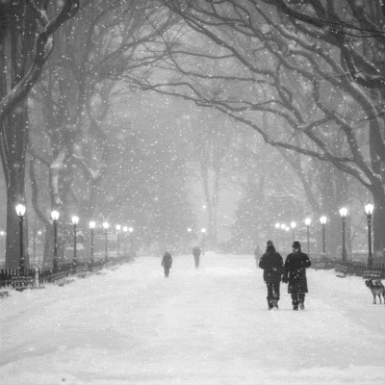
The forecast said only a dusting of snow,
we kept the schools open…
And then got
12 inches of snow ☹
Why do the weather forecasters keep getting it wrong?

Slide 3
What if the forecast predicted a
probability distribution?
40%
Probability
20%
20%
10%
7%
3%
0-2
2-4
4-6
6-8
8-10
10-12
Inches of Snow
How is this helpful – they aren’t predicting anything really?
However, scientists are always thinking in
terms of probabilities.

Slide 4
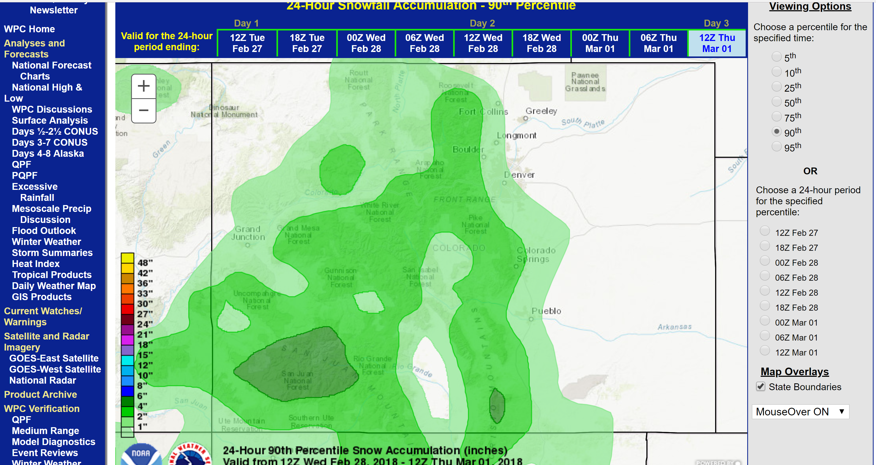
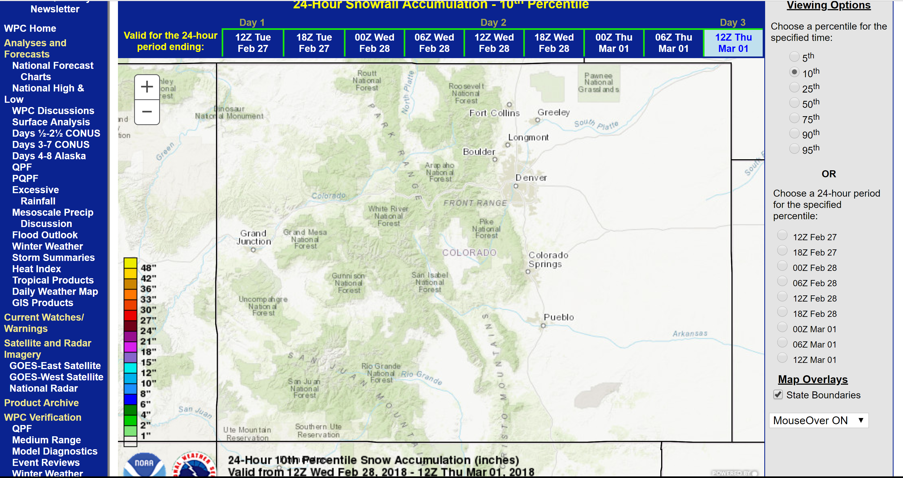
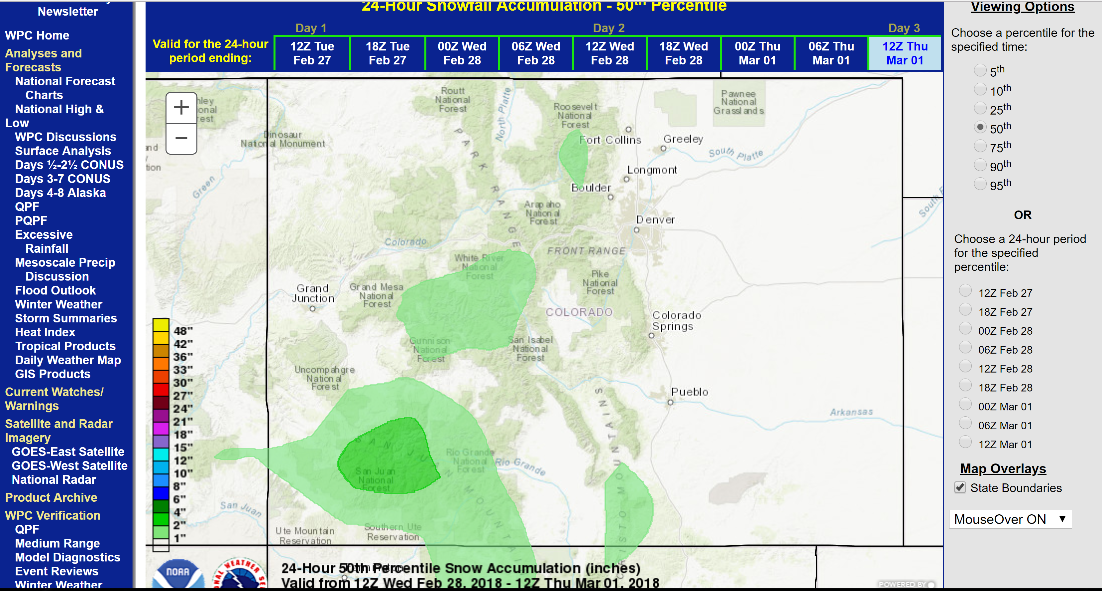
NOAA provides just such probability distributions
http://www.wpc.ncep.noaa.gov
10% lowest snow probability – no snow
10% highest snow probability – 6 inches in San Juan National Forest

Slide 5
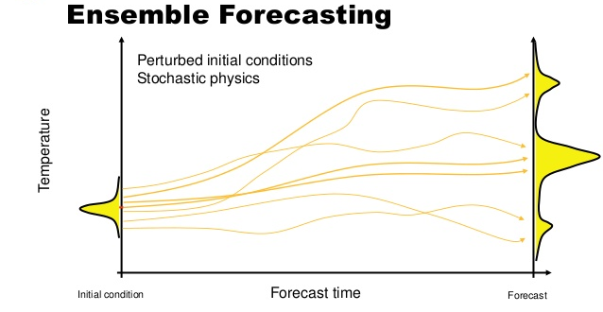
You can only tell if the weather person is making calculational mistakes by checking a
large number of predictions!

Slide 6
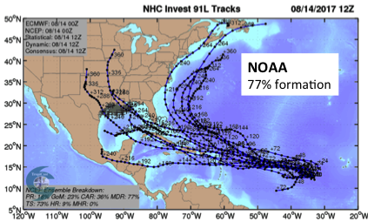
Hurricane Trajectories
“Last time the experts predicted a 60% chance of major flooding, I evacuated, and then there was little rain here.
I am not wasting my time for this hurricane.”
A misunderstanding of probabilities?

Slide 7
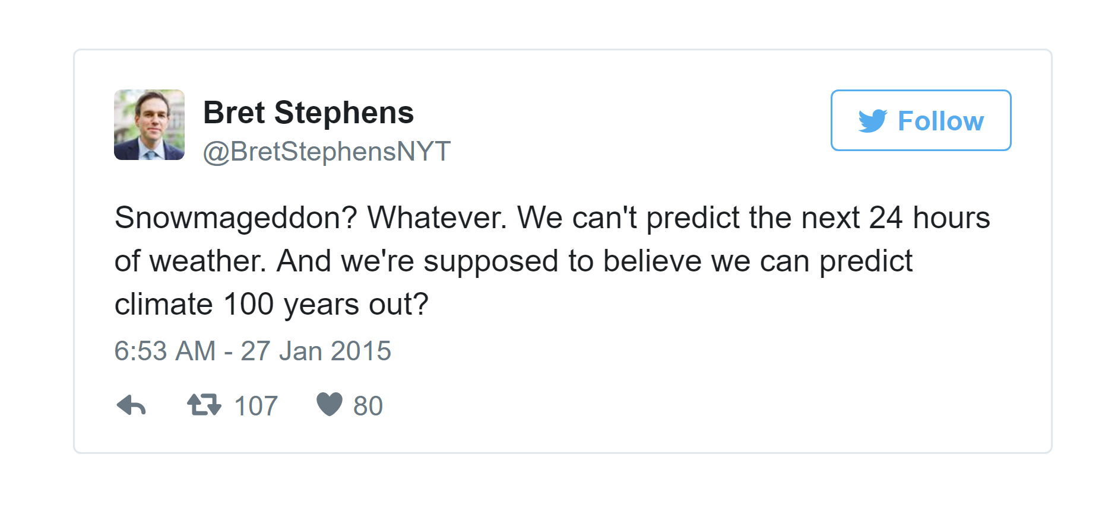
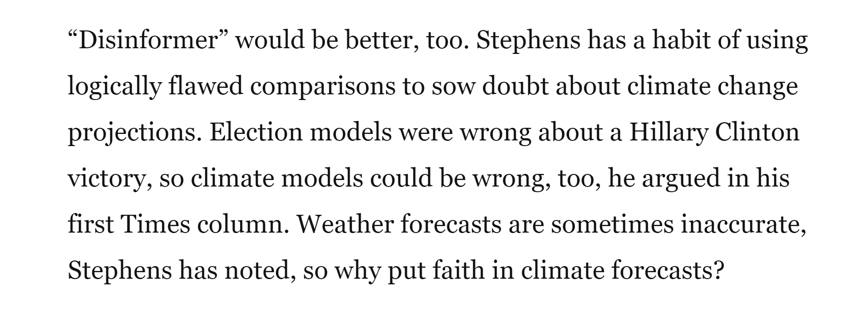

Slide 8
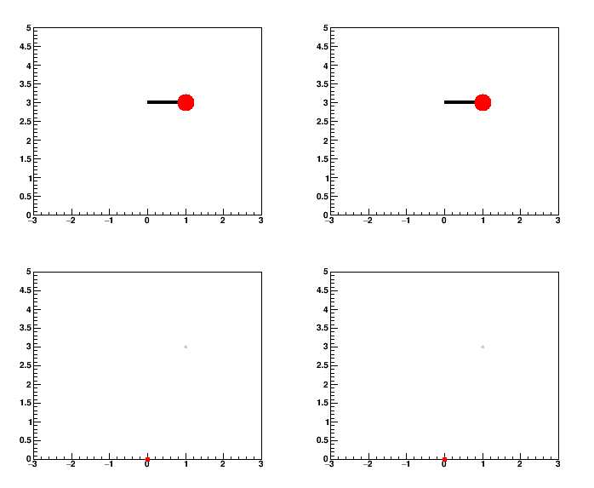
What is predictable in principle or in practice?
Simple Pendulum
θ=90.00⁰
θ=90.01⁰
Even with slightly different initial angles
Nice, Simple, and Predictable.

Slide 9
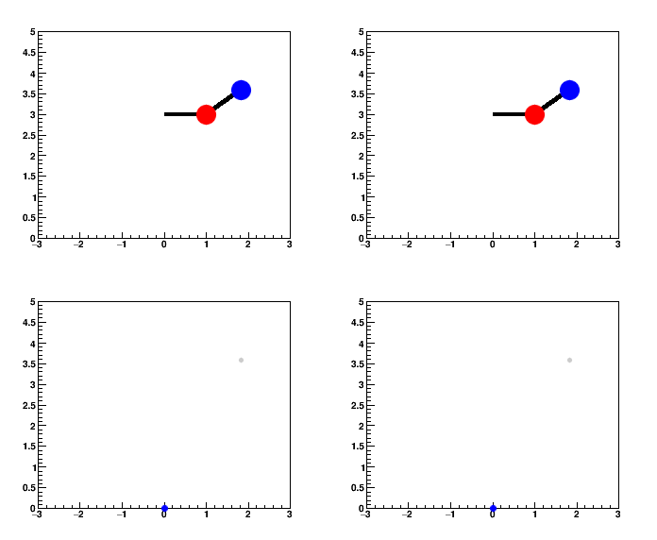
Double Pendulum
A 0.01⁰ change in the initial angle, eventually manifests
a completely different future outcome!

Slide 10
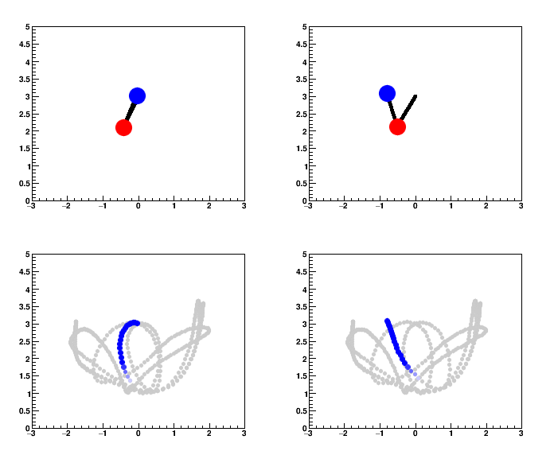
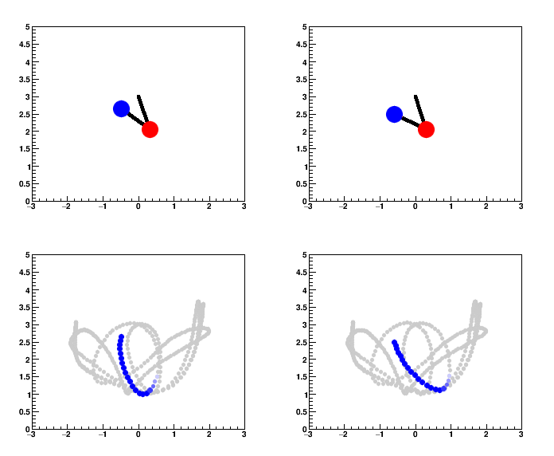
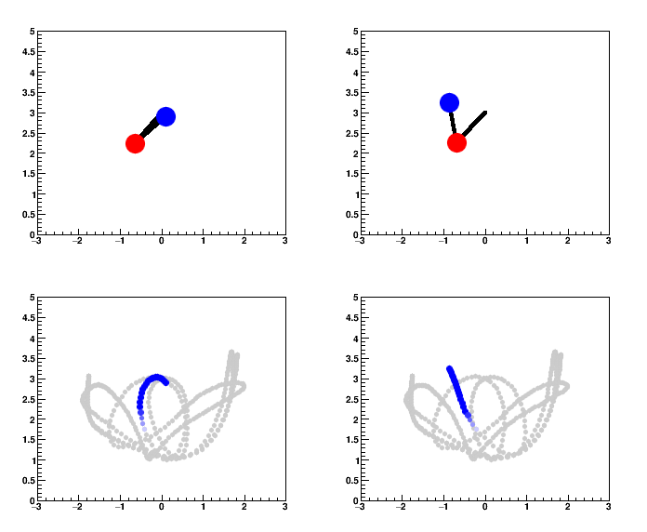
Double Pendulum
A 0.01⁰ change in the initial angle, eventually manifests
a completely different future outcome!

Slide 11
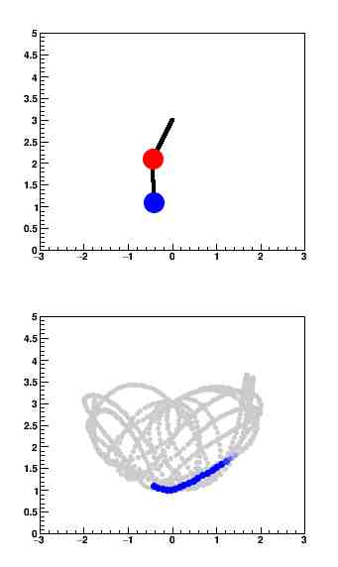
We literally know everything about the problem – i.e. the equations of motion
Better measurement of the initial angles will help our future prediction,
but only for a limited time!
The double pendulum is a “chaotic system”
Chaos is not the same as complicated…
Weather is unpredictable past 2 weeks because it is dominantly chaotic.
It is not a matter of building better models.

Slide 12
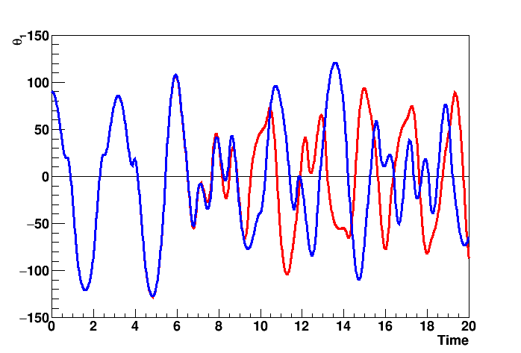
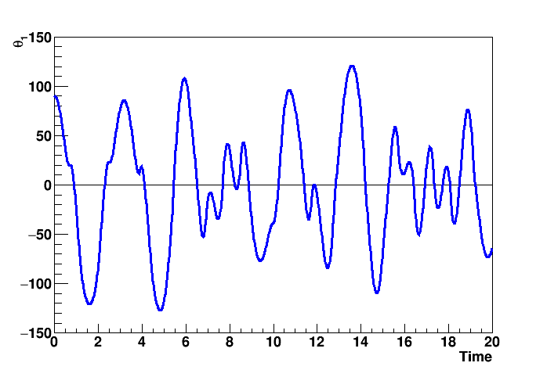
Signature of Chaotic Systems → Quasiperiodic Behavior
(though not always)
There is also a characteristic time scale for small differences to manifest as very different behavior.

Slide 13
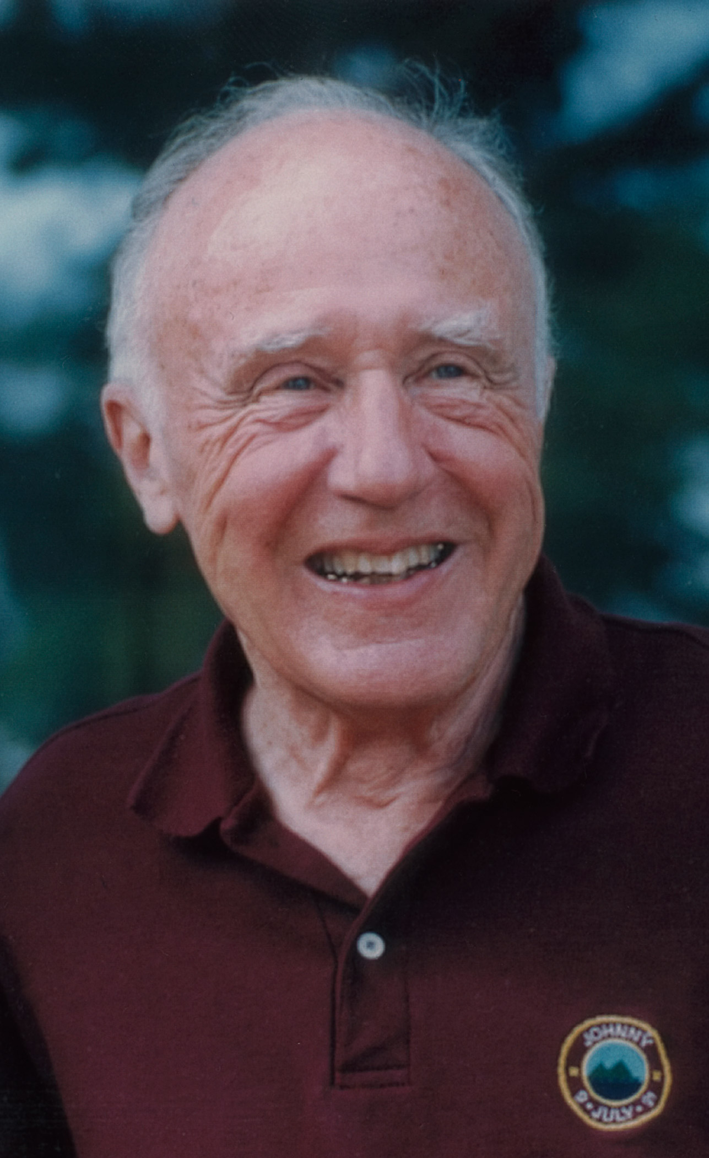

Edward Lorentz discovered chaos.
Back in 1961, he was running a computer weather model with one variable set to 0.506127, and then a day later
he ran the same calculation but
rounded the variable to 0.506
The predicted future weather came out completely different!
Butterfly Effect
A tiny change (like the flapping of a butterfly’s wings) can have exponential changes in the future.

Slide 14


Slide 15
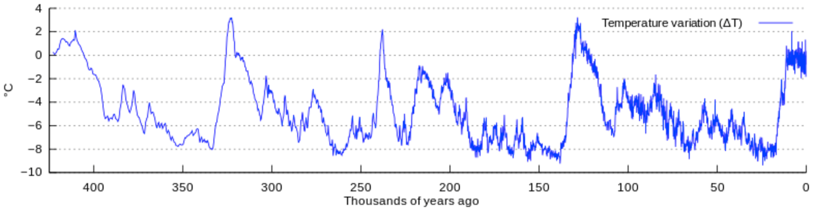
Temperature of the Earth in the Last 500,000 Years
Last major
ice age
Earth’s Climate is not fixed → there is no “right climate”
Many factors: orbit changes T=100,000 years,
tilt T=41,000 years, precession T=23,000 years,
interactions with other planets, land mass distribution…
Might be chaotic on long time scales. Active science debate.
Definitely quasi-periodic and scientists do not fully understand the detailed causes and effects.

Slide 16
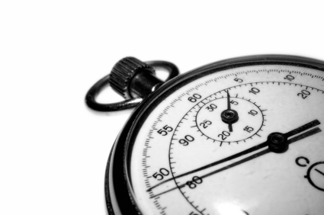
Climate and Time Scales
Ice age type effects might be chaotic on long time scales.
However, on 1000 year time scales we know the orbits etc., but do not fully understand the mechanisms.
On short time scales ~ 100 years our climate is changing….
Why?

Slide 17
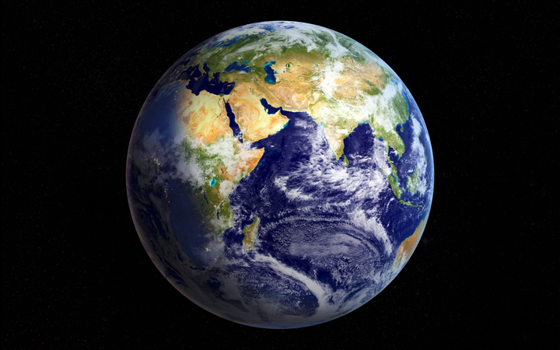
Physics at the Heart of Climate Change Today
The temperature is basically
determined by the balance of
energy inflows and energy outflows
What are the energy inflows?
What are the energy outflows?

Slide 18
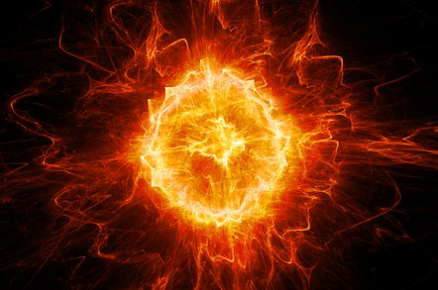
What are the energy inflows?
What are the energy outflows?
The inflow is from the Sun via solar radiation (light).
We can ignore energy from radioactive decay in the Earth’s core (which is much, much smaller).
The outflow of energy is planetary radiation back into space.

Slide 19
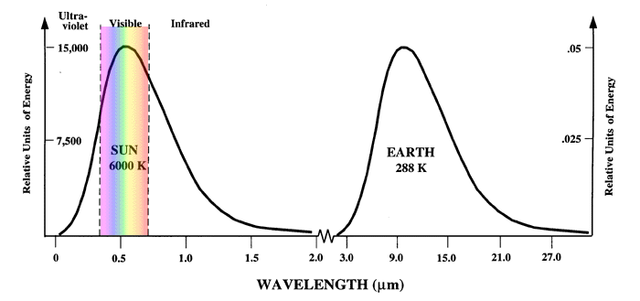
Physics of Radiation
All objects made of charged particles (electrons, atoms, molecules) emit electromagnetic radiation (photons).
Hot objects like the Sun (surface T ≈10,000 ⁰F)
emit more high energy photons.
Cool objects like the Earth or myself (T ≈ 55-98.6 ⁰F)
emit more low energy photons.
← Higher Energy Photons

Slide 20
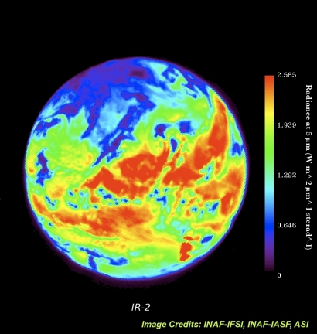
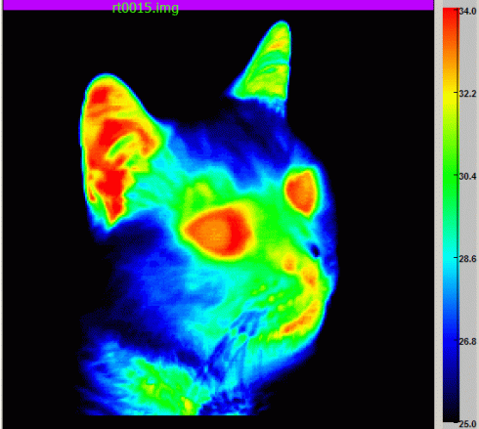
Infrared Radiation

Slide 21
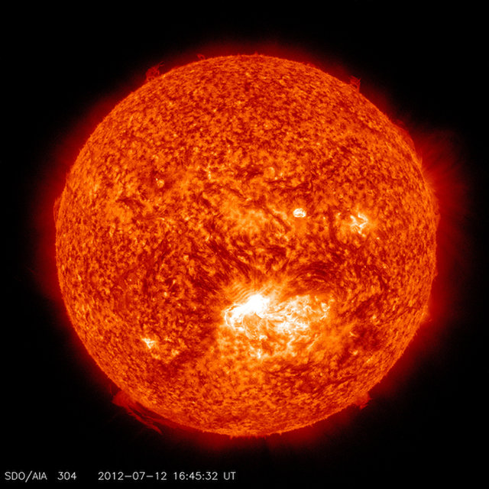
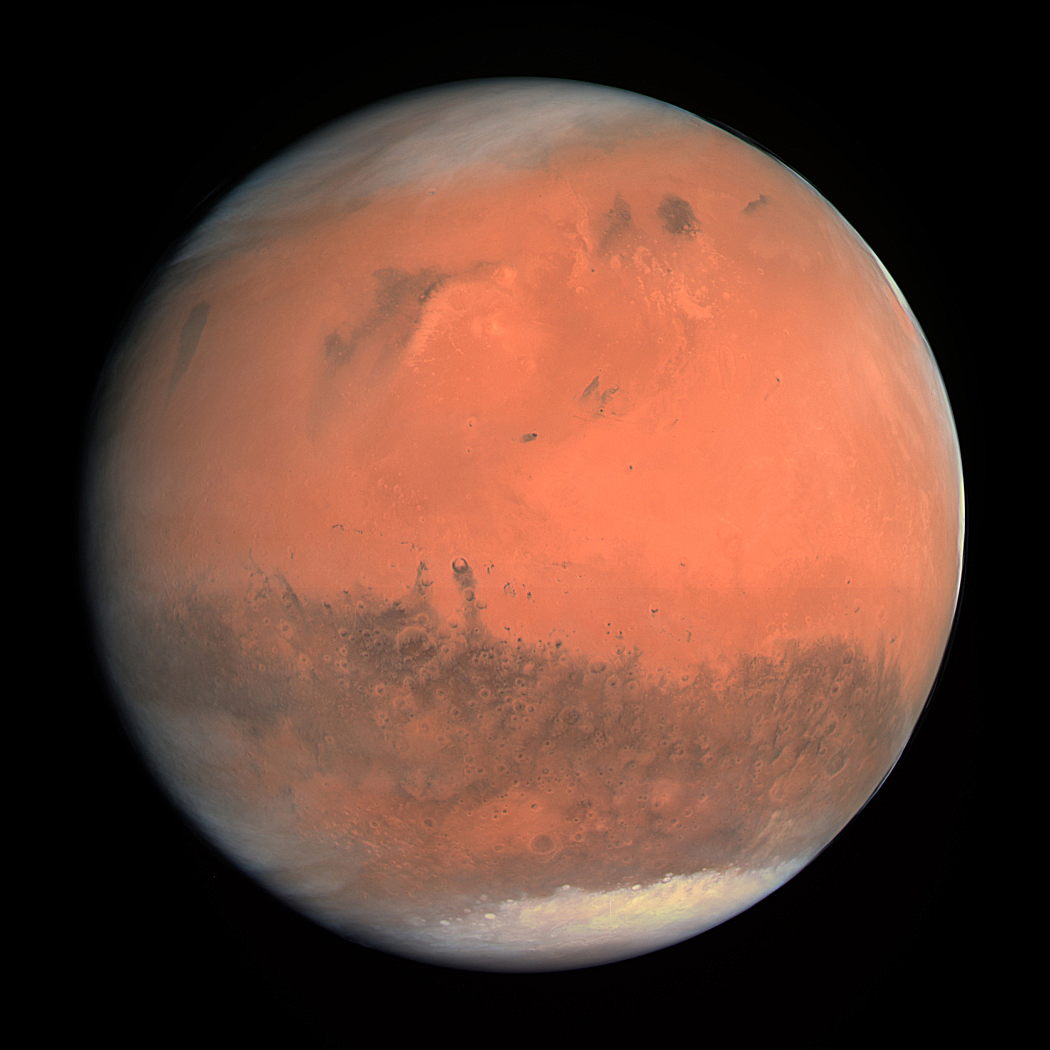
Calculate energy from the Sun hitting Mars.
Mars heats up, and emits more energy into space.
Temperature of Mars set when inflow = outflow.
Solution T(Mars) = -68 ⁰F
Real T(Mars) = -63 ⁰F
This is Conservation of Energy

Slide 22
Calculate energy from the Sun hitting Earth.
Earth heats up, and emits more energy into space.
Temperature of Earth is where inflow = outflow.
Solution T(Earth) = -6 ⁰F (quite cold)
Real T (Earth) = +59 ⁰F (comfortable)
Why is this calculation so far off?

Slide 23
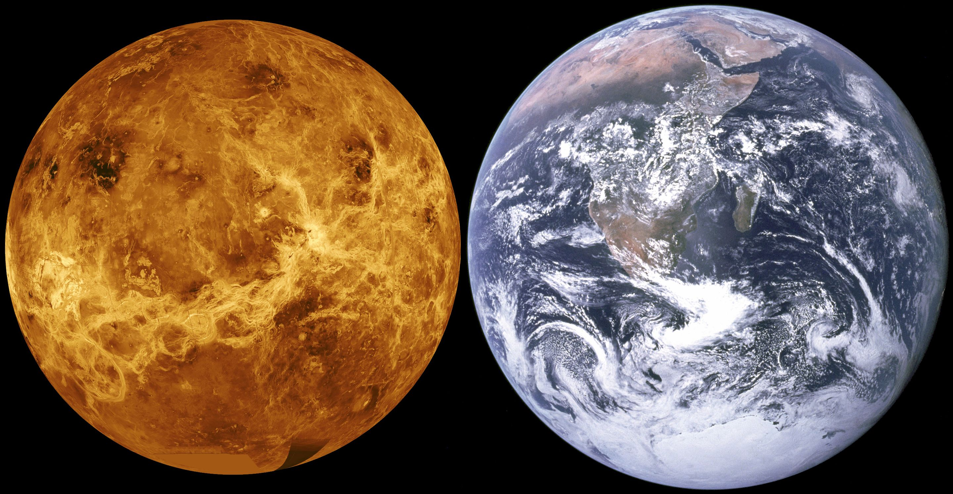
Calculate energy from the Sun hitting Venus.
Venus heats up, and emits more energy into space.
Temperature of Venus is where inflow = outflow.
Solution T(Venus) = 81 ⁰F
Real T (Venus) = 800 ⁰F (very hot)
Why is this calculation very, very far off!

Slide 24
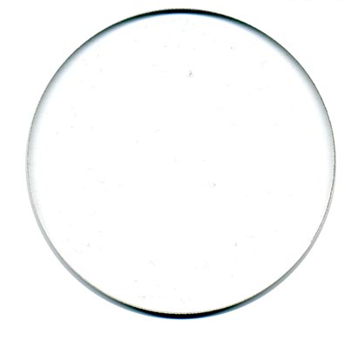
Start with balance of inflow and outflow energy.
Enclose the planet with a glass sphere
that lets the Sun’s higher energy photons in,
but blocks some of the planet’s lower energy photons.
The planet will get hotter.

Slide 25
Start with balance of inflow and outflow energy.
This is called the “Greenhouse Effect”
Instead of glass, the Earth has an atmosphere with gases.
Even without any human generated changes,
the Earth’s atmosphere has a “Greenhouse Effect” that raises the temperature ~ +50 ⁰F.
Venus has a runaway “Greenhouse Effect”, +700 ⁰F.

Slide 26
Gases that absorb light in the infrared range are called “greenhouse” gases.
Absorption Concentration Relative Impact
CO₂ 1 373 ppm 373
CH₄ 21 1.7 ppm 35
NO_{x} 300 0.3 ppm 90
CFC 2000+ 0.003 ppm 6
The temperature increasing effect is
well understood and their abundances
well measured by scientists.

Slide 27
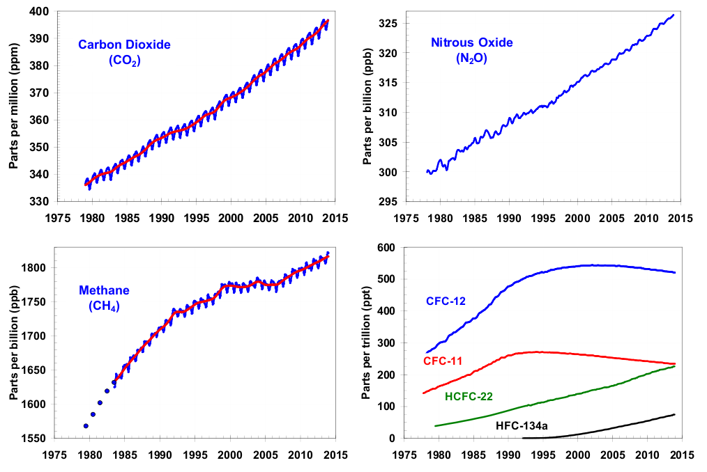
Greenhouse Gas Trends

Slide 28
Example of an Opposite Cooling Effect
Enclose the Earth with a thin mirror that
reflects some of the Sun’s light back into space.
The Earth will get cooler

Slide 29
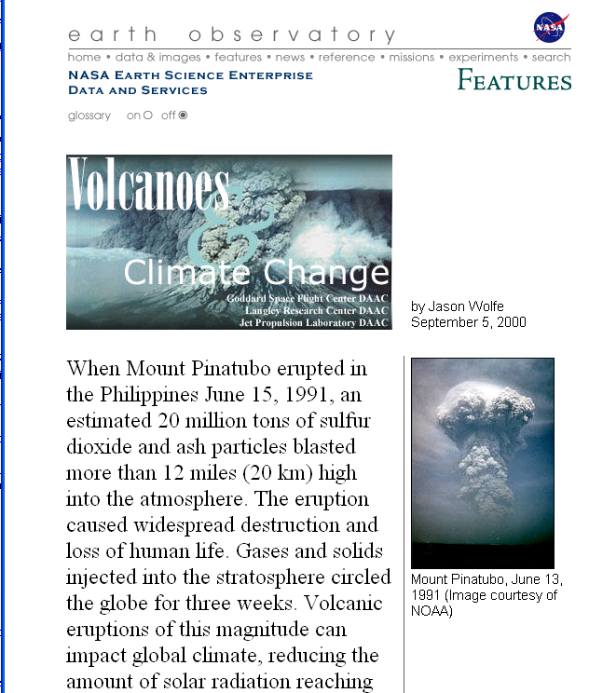
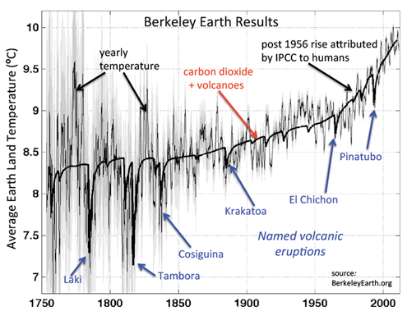
Volcanic Cooling
Mount Pinatubo erupted on
June 15, 1991.
Global temperatures dropped by -0.9 °F due to this volcanic eruption.
However, this has a short time duration as the ash settles out of the atmosphere.

Slide 30
Do the Experiment

Slide 31
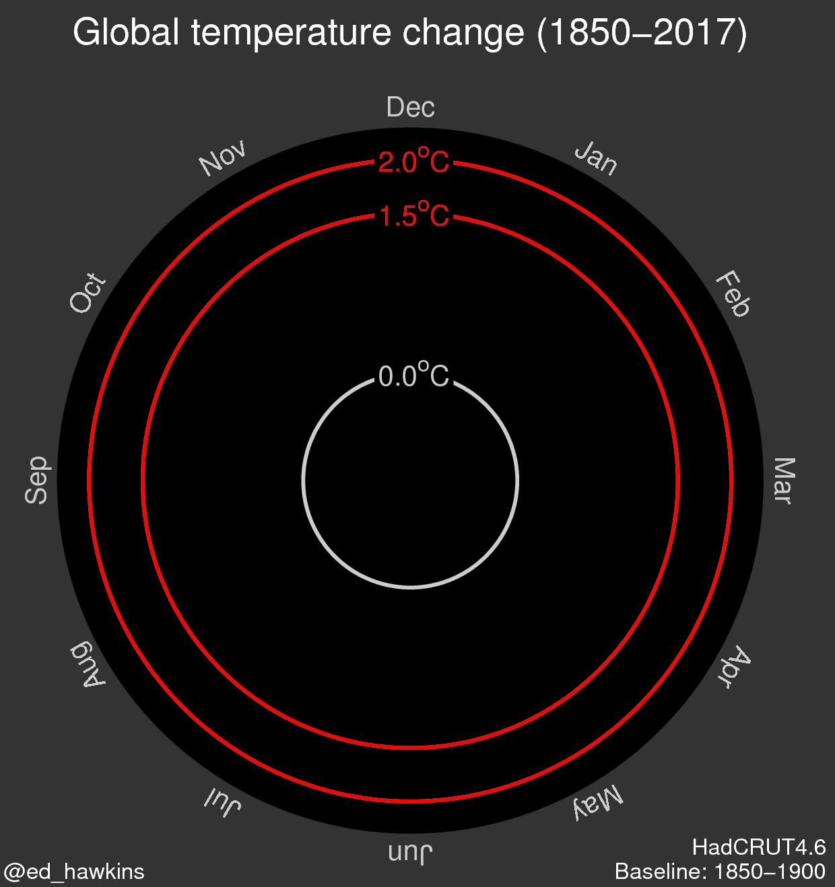
https://www.climate-lab-book.ac.uk/spirals/

Slide 32
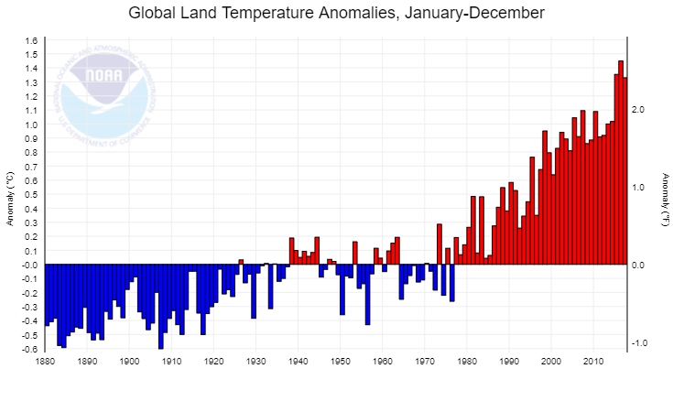
https://www.ncdc.noaa.gov/cag/time-series/global/globe/land/ytd/12/1880-2017
At the NOAA web page, you can plot all the data they have…

Slide 33
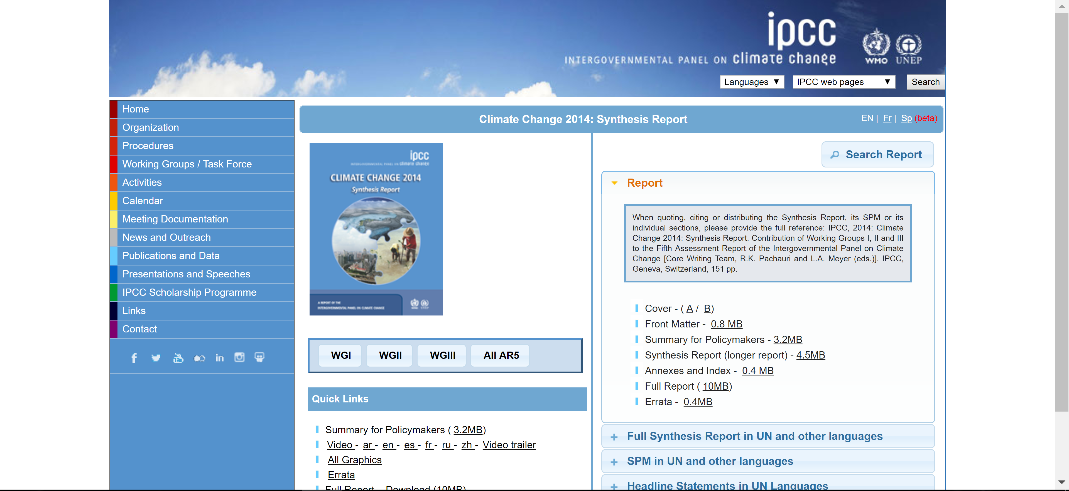
https://www.ipcc.ch/
http://www.ipcc.ch/
IPCC - Intergovernmental Panel on Climate Change
UN organization created in 1988
195 countries participate
IPCC received Nobel Peace Prize in 2007
Findings of assessment reports must be agreed to by consensus

Slide 34
  1st Assessment Report (FAR) 1990
“The unequivocal detection of the enhanced greenhouse effect from observations is not likely for a decade or more.” (1990)
  2nd Assessment Report (SAR) 1995
  3rd Assessment Report (TAR) 2001
  4th Assessment Report (AR4) 2007
"The balance of evidence suggests a discernible human influence on global climate.” (1995)
  5th Assessment Report (AR5) 2014
"There is new and stronger evidence that most of the warming observed over the last 50 years is attributable to human activities.” (2001)
“The [anthropogenic effects] have been detected throughout the climate system and are extremely likely to have been the dominant cause of the observed warming since the mid-20th century.”
(2014)
“Most of the observed increase in global average temperatures since the mid-20th century is very likely due to the observed increase in anthropogenic greenhouse gas concentrations.”
(2007)
Language of Probabilities

Slide 35
Easy to ask:
“why should we
change our fossil fueled based economy, or
turn off the lights, or
live in a smaller house, etc.
just because some possibility is ‘likely’?”
What does “extremely likely” mean?
IPCC uses the definition:
Very likely as > 90%
Extremely likely as > 95%
Of course it depends on the consequences and who suffers those consequences.

Slide 36
Chance of being killed on the drive home from this talk (statistically):
0.0001% (seems small)
Chance of being killed on the drive home from this talk if you are texting on your cell phone (statistically):
0.0004% (still small, but 400% larger)
Of course a major issue is that you are not just taking the risk yourself, you are risking other people’s lives!
Climate change has a high risk –
but not to all people equally.

Slide 37
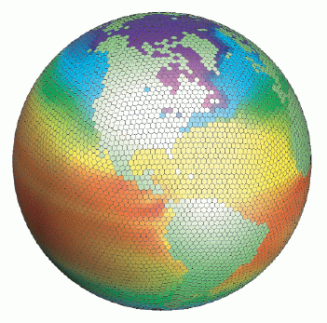
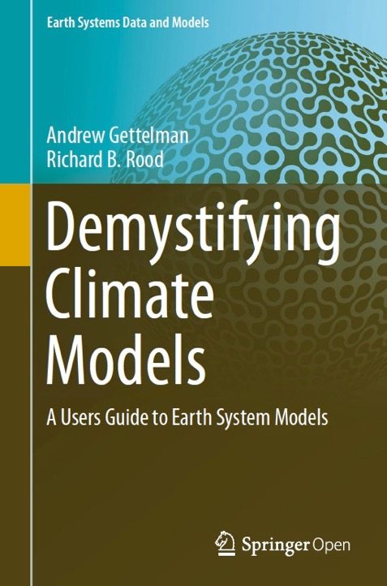
Where does the > 95% probability come from?
Climate Modeling

Slide 38
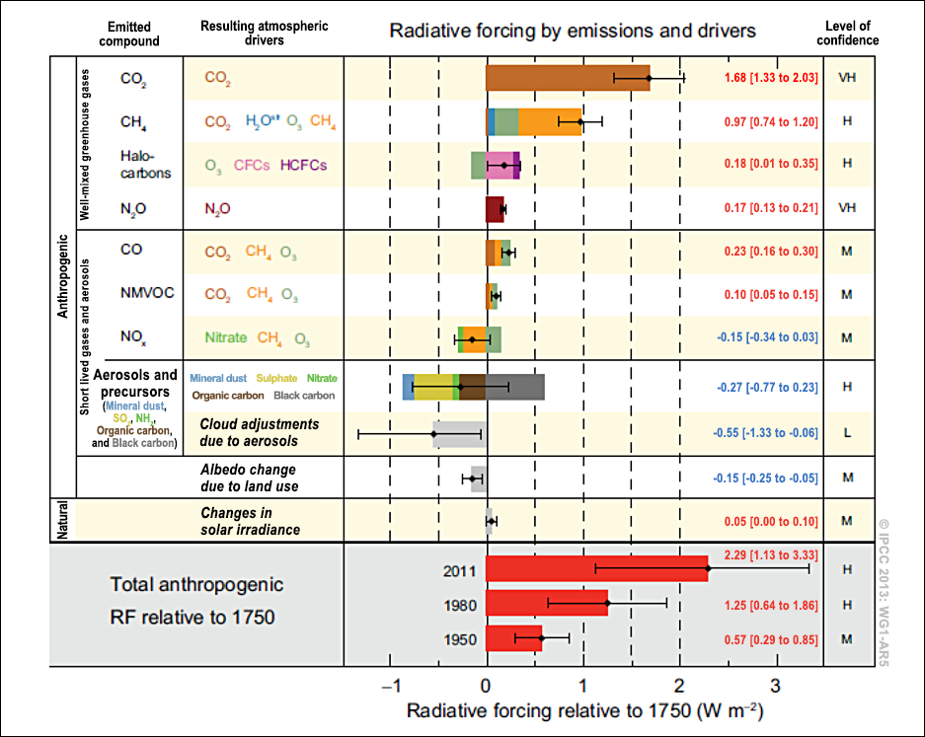
Greenhouse gas effect well understood.
Heating effect.
Cooling effects from dust, cloud formation changes. Less well understood.
Uncertainties are quantified.

Slide 39
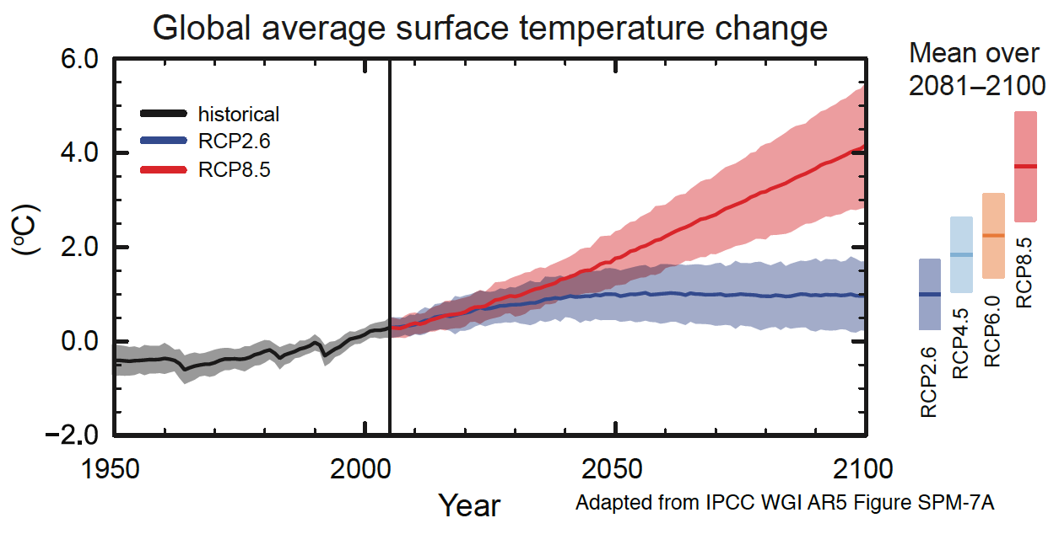
Two lines (red and blue) and each with an uncertainty band.
What do they mean?

Slide 40
Red line assumes greenhouse gas emissions increase along current trends (“business as usual”)
Pink band represents the model uncertainty (probability) dominantly from mechanisms like changing cloud cover,
ice melting rates, etc.

Slide 41
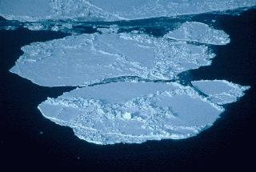
Positive Feedback Mechanisms
Ice reflects
more sunlight back into space compared with
darker water.
Higher temperatures → More ice melt → Less ice
Less ice → more sunlight absorbed → Higher temperatures

Slide 42
Blue line assumes greenhouse gas emissions are
dramatically reduced.
Science cannot predict what people will do!
Notice that in any scenario we live with a higher temperature.

Slide 43
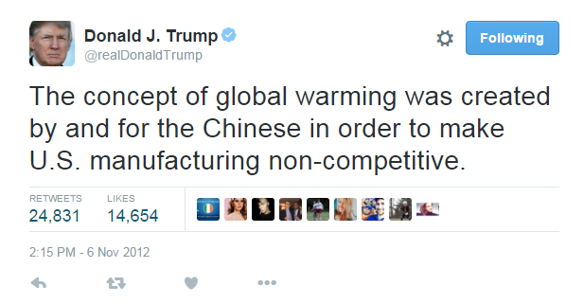
If it is so clear to scientists,
why is there so much controversy?
Scientists are skeptics and are always asking questions. There is a vast literature of debate on
details such as changes in
cloud formation, ice melt rates, etc.
Just not on whether this is all a
hoax perpetrated by the Chinese

Slide 44
This “peer-reviewed” article is quite often cited…
Article in the Journal of American Physicians and Surgeons (?)
Research from the Oregon Institute of Science and Medicine (?)
Essentially a fake science journal with an array of articles with no scientific basis (HIV does not cause AIDS, Obama used hypnosis…)

Slide 45
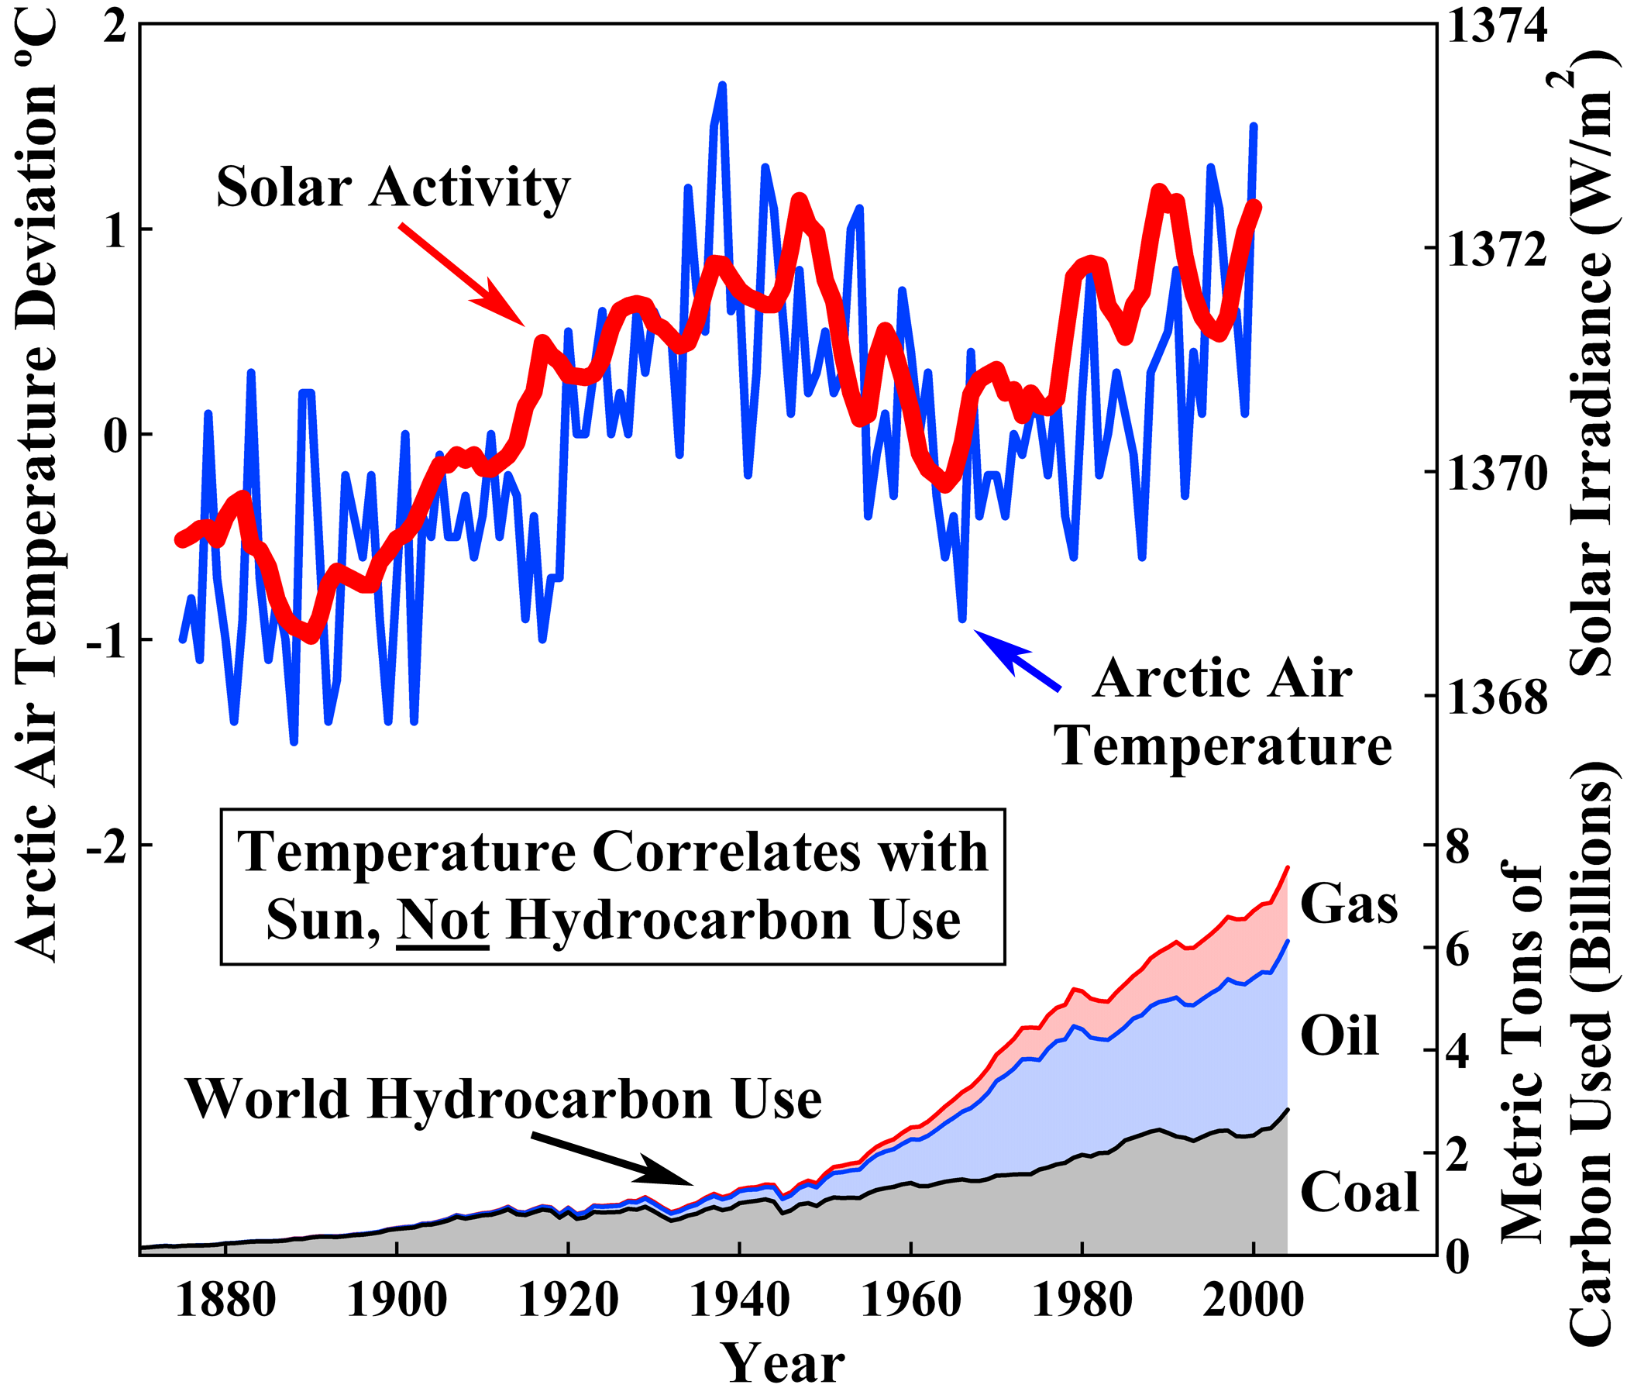
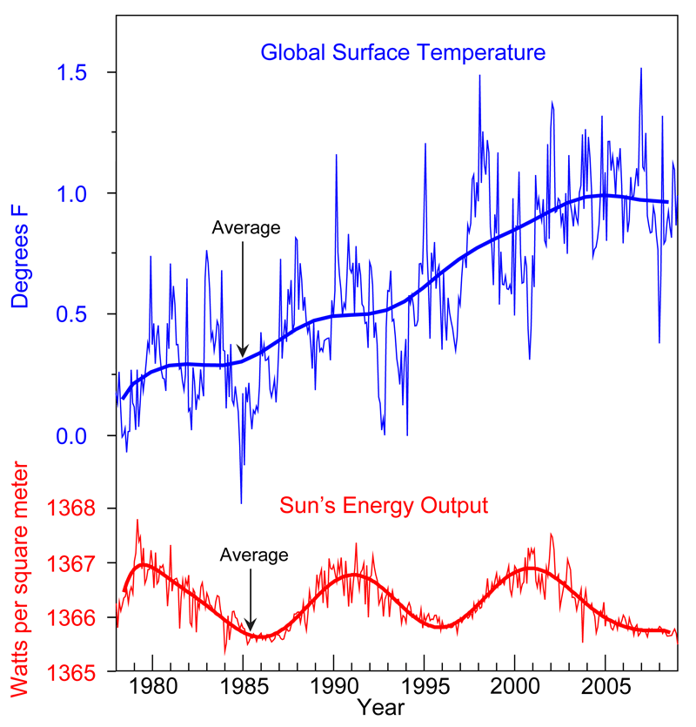
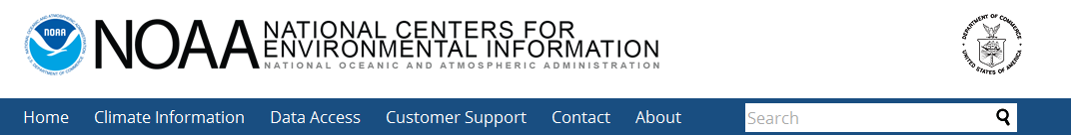
Another oft cited effect – variations in solar activity
Plot looks convincing?
Without feedback mechanisms, temperature changes by a fraction of a degree
Not so convincing!

Slide 46
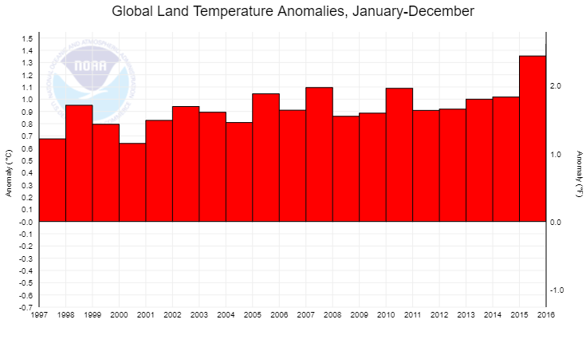
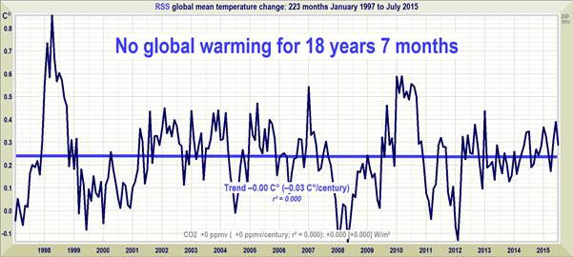
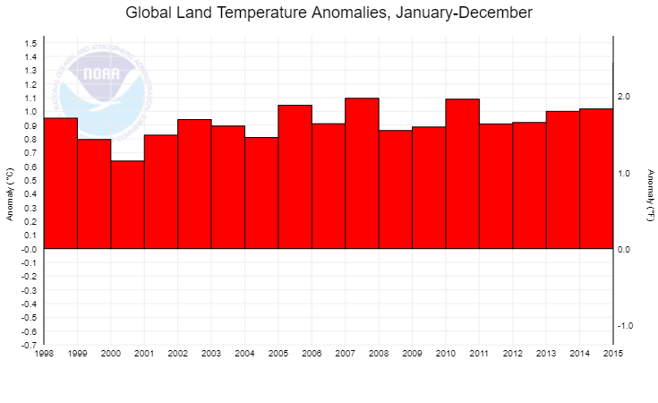
Example Often Shown
https://www.ncdc.noaa.gov/cag/time-series/global/globe/land/ytd/12/1880-2017

Slide 47
Even real data can be manipulated for a message.

Slide 48
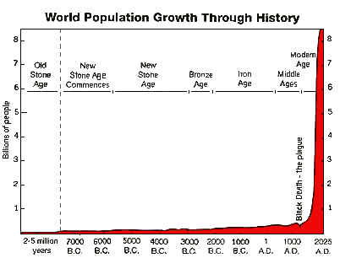
Consequences
“Climate has changed before, and species survive…”
“More CO₂ is good for plant growth…”
The plague killed over 50% of people in Europe.
Yes, the species survived.
Morals (not science) decide our capacity for human suffering

Slide 49
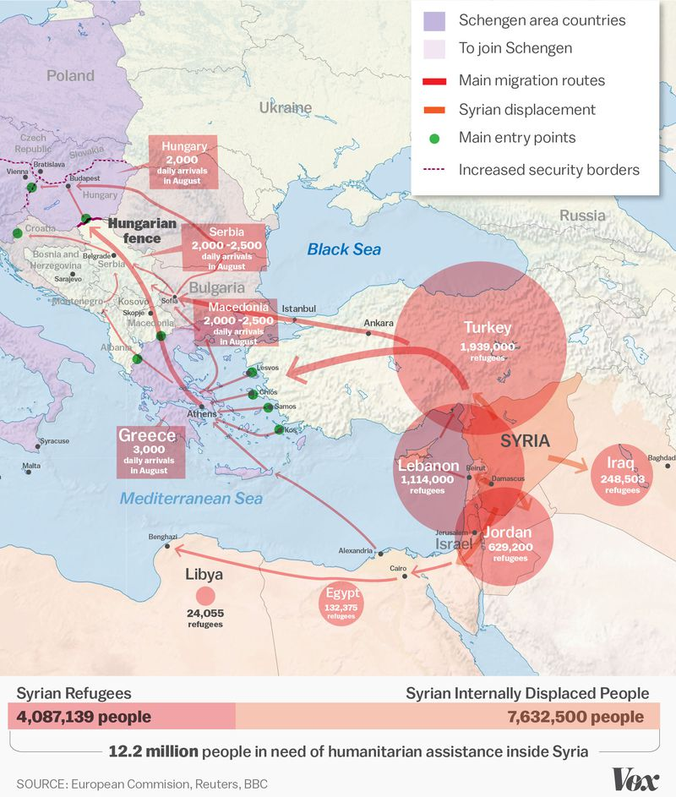
Consider the Syrian crisis and the number of refugees.
Changing climate will create a world-wide refugee crisis. That is why the U.S. Department of Defense considers climate change an issue of
National Security.

Slide 50
Summary

Slide 52



Slide 53

https://earthobservatory.nasa.gov/Features/Milankovitch/milankovitch_2.php
The shape of the Earth’s orbit changes from being elliptical (high eccentricity) to being nearly circular (low eccentricity) in a cycle that takes between 90,000 and 100,000 years. When the orbit is highly elliptical, the amount of insolation received at perihelion would be on the order of 20 to 30 percent greater than at aphelion, resulting in a substantially different climate from what we experience today.

Slide 54

https://earthobservatory.nasa.gov/Features/Milankovitch/milankovitch_2.php
Obliquity (change in axial tilt)
As the axial tilt increases, the seasonal contrast increases so that winters are colder and summers are warmer in both hemispheres. Today, the Earth's axis is tilted 23.5 degrees from the plane of its orbit around the sun. But this tilt changes. During a cycle that averages about 40,000 years, the tilt of the axis varies between 22.1 and 24.5 degrees. Because this tilt changes, the seasons as we know them can become exaggerated. More tilt means more severe seasons—warmer summers and colder winters; less tilt means less severe seasons—cooler summers and milder winters. It's the cool summers that are thought to allow snow and ice to last from year-to-year in high latitudes, eventually building up into massive ice sheets. There are positive feedbacks in the climate system as well, because an Earth covered with more snow reflects more of the sun's energy into space, causing additional cooling.

Slide 55

https://earthobservatory.nasa.gov/Features/Milankovitch/milankovitch_2.php
Precession
Changes in axial precession alter the dates of perihelion and aphelion, and therefore increase the seasonal contrast in one hemisphere and decrease the seasonal contrast in the other hemisphere.

Slide 56


Slide 57


Changes in earth’s orbit (perturbations from other planets), changes in the tilt axis, etc. all have impacts on global climate.
The earth will eventually enter another ice age.

Slide 58



Slide 59


