Slide 1
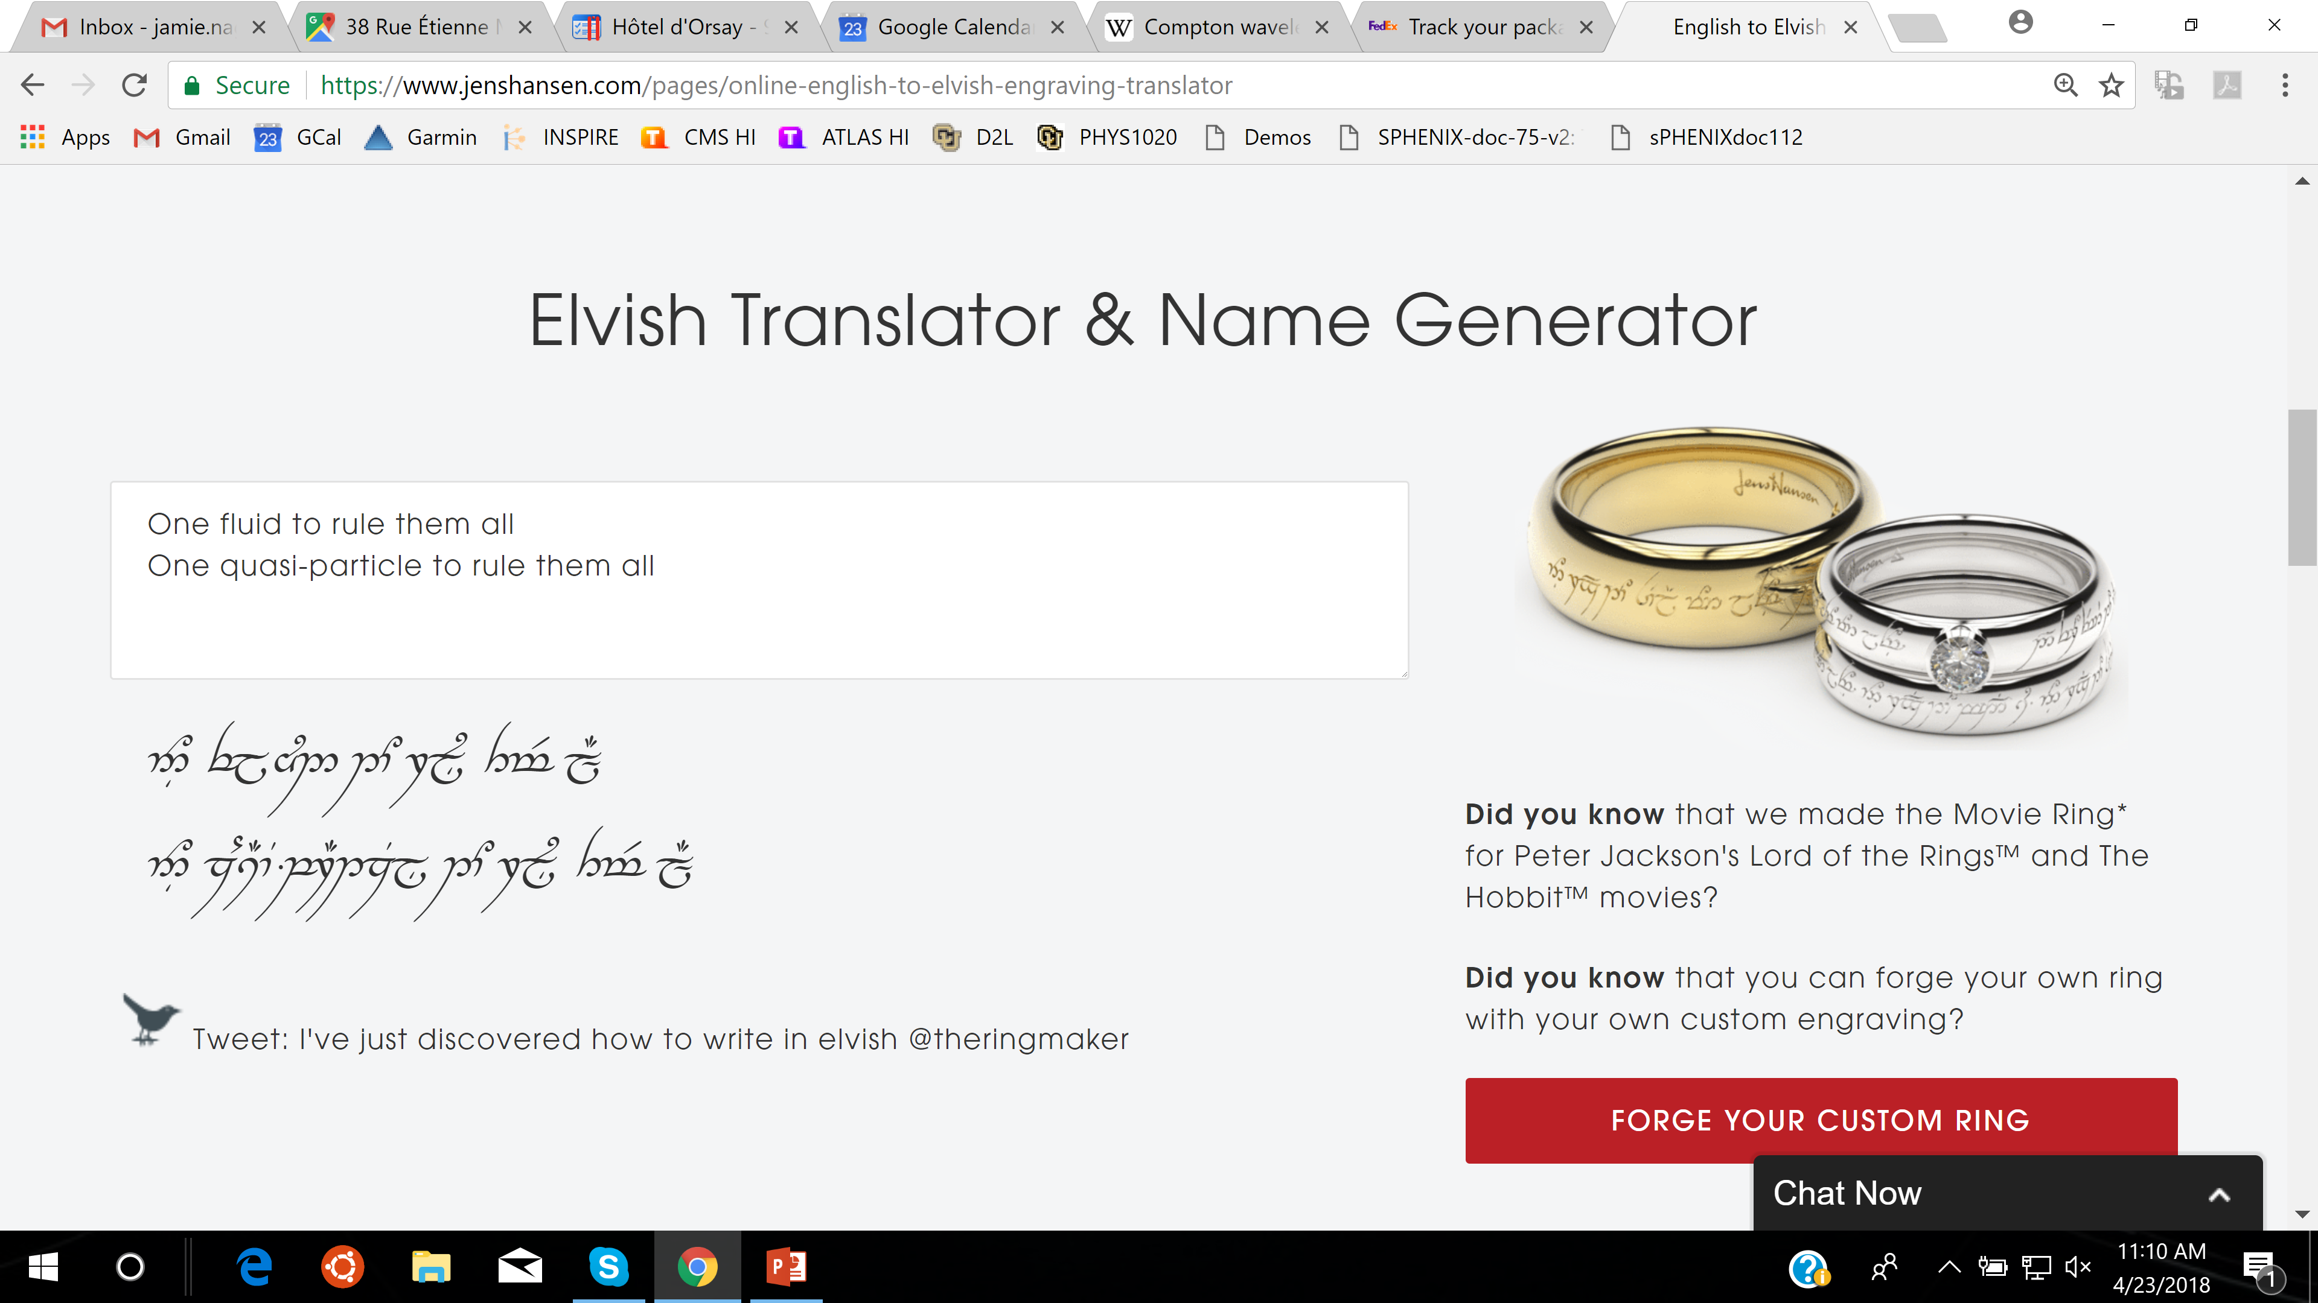

A Quasiparticle Transport Explanation for Collectivity in the
Smallest of Collision Systems (p+p and e⁺e⁻)
Javier Orjuela-Koop and Jamie Nagle
University of Colorado Boulder
One fluid to rule them all
One quasiparticle to rule them all

Slide 2

A-Multi-Phase-Transport (AMPT)
Success in describing small, medium, large system collectivity signals
Code is publicly available: http://myweb.ecu.edu/linz/ampt/
Extra thanks to Zi-Wei Lin for answering our many detailed questions

Slide 3
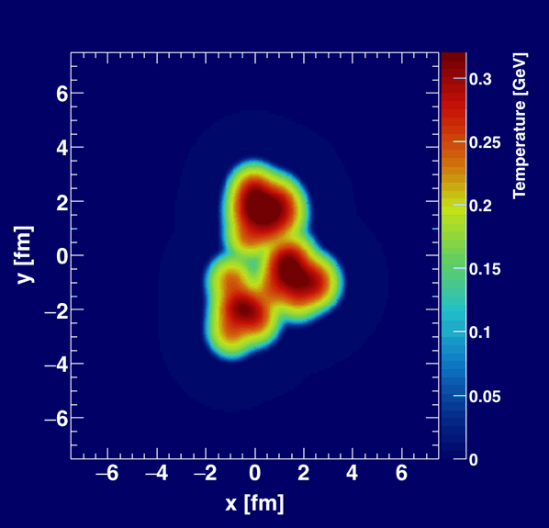
The Black Box
Initial Condition
Geometry
and entropy
Final Condition
E,p distribution
of hadrons
Viscous Hydrodynamics – one fluid to rule them all
Inside the box – steep density gradients, never close to equilibrium, why does it work?
Hydrodynamization in AdS/CFT giving new insights. Need to understand how this changes our interpretation of η/s, phase diagram, etc.

Slide 4
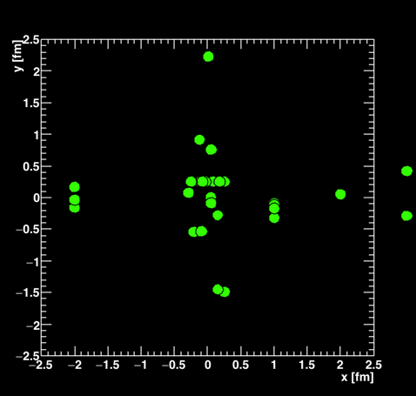
The Black Box
Initial Condition
Geometry
and entropy
Final Condition
E,p distribution
of hadrons
Quasiparticle transport– one quasiparticle to rule them all
Look inside the box –
many parameters, and not always set the same
string melting string→hadrons→quarks+antiquarks
very short parton formation time,
- well defined E,p for semi-classical 2→2 scattering
very few scatterings in small systems, 0 or 1 quite often

Slide 6
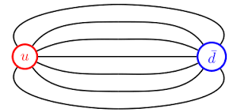
Special AMPT Setup
e⁺e⁻ → Z₀ → qq
Partons quantum tunnel via AMPT string melting with τ_{form} ~ 0.1 fm
Fluctuations yield geometry, but no long range correlations.
Very few scatterings change the parton direction!

Slide 7

Additional Special Case – 2 Strings
0.5 fm
Intrinsic geometry across rapidities → Long Range Correlations
Critical that τ_{form} < 0.5 fm
Critical that head on 2→2 scattering re-orients
* Ask me over coffee about the angular scattering distributions.

Slide 8
Experimental Data in p+p 13 TeV
Can the quasiparticle picture describe p+p collectivity?
* Ask me over coffee about the two subtraction techniques in AMPT

Slide 9
Constituent Quarks in AMPT
Modified version of AMPT with protons composed of 3 constituent quarks
Quark-Quark interactions generate strings, string melting,
everything else in AMPT left the same.

Slide 10
Turn the Crank
Feature of AMPT, run billion events and apply identical procedure as experimental analysis
Apples-to-Apples comparison with ATLAS template-fit method results.
We also verify that this is “flow” in the sense that it is related to initial geometry and translated via final state
parton & hadron interactions

Slide 11
Turn the Crank
Feature of AMPT, run billion events and apply identical procedure as experimental analysis
Apples-to-Apples comparison with ATLAS template-fit method results.

Slide 12
The Black Box
Initial Condition
Geometry
and entropy
Final Condition
E,p distribution
of hadrons
What can we learn looking inside the box?
Quasiparticles cannot really be nearly massless quarks/antiquarks?
But could it still indicate that the quasiparticle description is valid,
and with very few scatters?

Slide 13
Formation Time
AMPT uses an uncertainty principle argument to set the formation time
Treats free streaming before that
(since one does not know how to handle the quantum interaction, multi-body problem).
Treating as well-defined on shell particles even though momentum uncertainty is 100% at this time.
Smearing is due to string melting, and thus the partons start interacting at half the uncertainty principle time or approximately 0.1 x de Broglie Wavelength.
Does it matter? Yes.

Slide 14
Small Systems are Unforgiving
What happens with longer τ_{form} ?
Collectivity rapidly drops!
Can one compensate with a larger
parton-parton cross section?
Yes, up to a point.
But then the v₂ actually gets smaller for larger cross sections – when they encompass the entire system.

Slide 15
A Little History of 2π
Danielewicz and Gyulassy (1985)
“By imposing the physical constraints that the mean free path must be larger than both the interparticle spacing and the thermal Compton wavelength, we obtain an approximate lower bound [on shear viscosity].” → η/s > 1/4π
1) There is no such thing as a thermal Compton wavelength
2) Probably they meant the thermal deBroglie wavelength
However, later in the paper they actually seem to just use the uncertainty principle (very hand waving)
If they had really used the thermal deBroglie wavelength, would have gotten η/s > 1/2
* Ignoring factors of π, 2π, or saying the deBroglie wavelength = seems common in the literature ☹

Slide 16
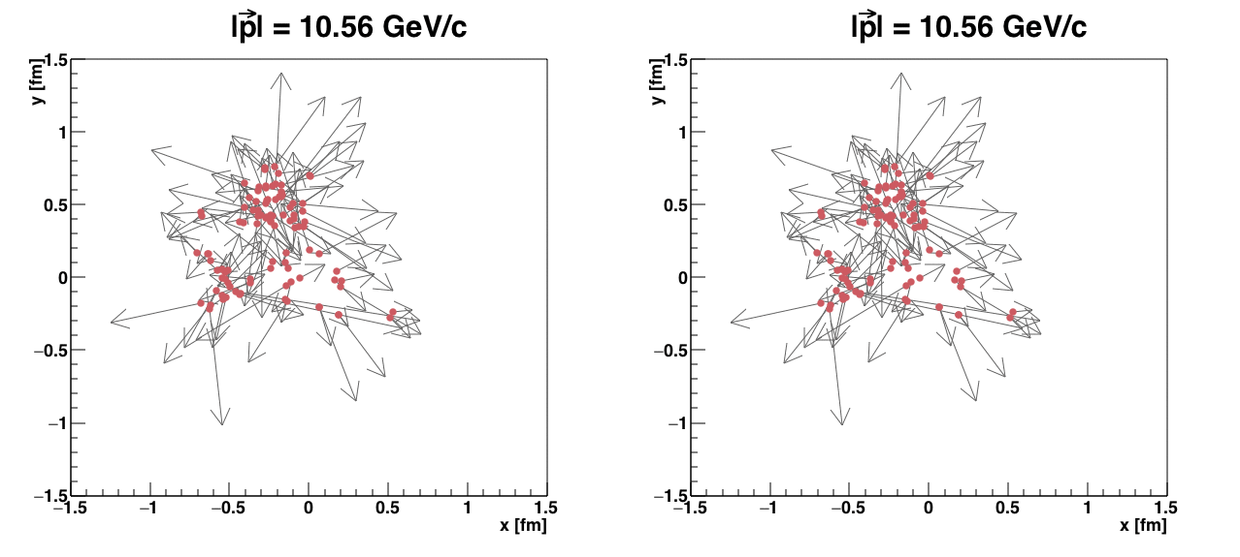
de Broglie Wavelength Radius
Uncertainty Principle Radius
p = 0.81 GeV/c

Slide 17
Concluding Thoughts
Black boxes are okay for a while
Now is the time for looking in detail inside the boxes
Potential breakthrough in understanding why hydrodynamics may be
applicable in this small system regime
Really need a comparable breakthrough in order to advance utilization of
parton cascade (or invalidate them)
It seems one is not in a safe regime to just assume simple scattering picture applies, but one is left slightly troubled by how well the calculations capture key features

Slide 18
Fini

Slide 19
Angular Distributions
AMPT
BAMPS
* Zhe Xu and Carsten Greiner, Phys. Rev. C 71, 064901 (2005)
Note that these distributions are not directly calculable in QCD!
Larger screening mass (μ), smaller cross section but more isotropic angular distribution
* Figure courtesy of Zi-Wei Lin

Slide 20
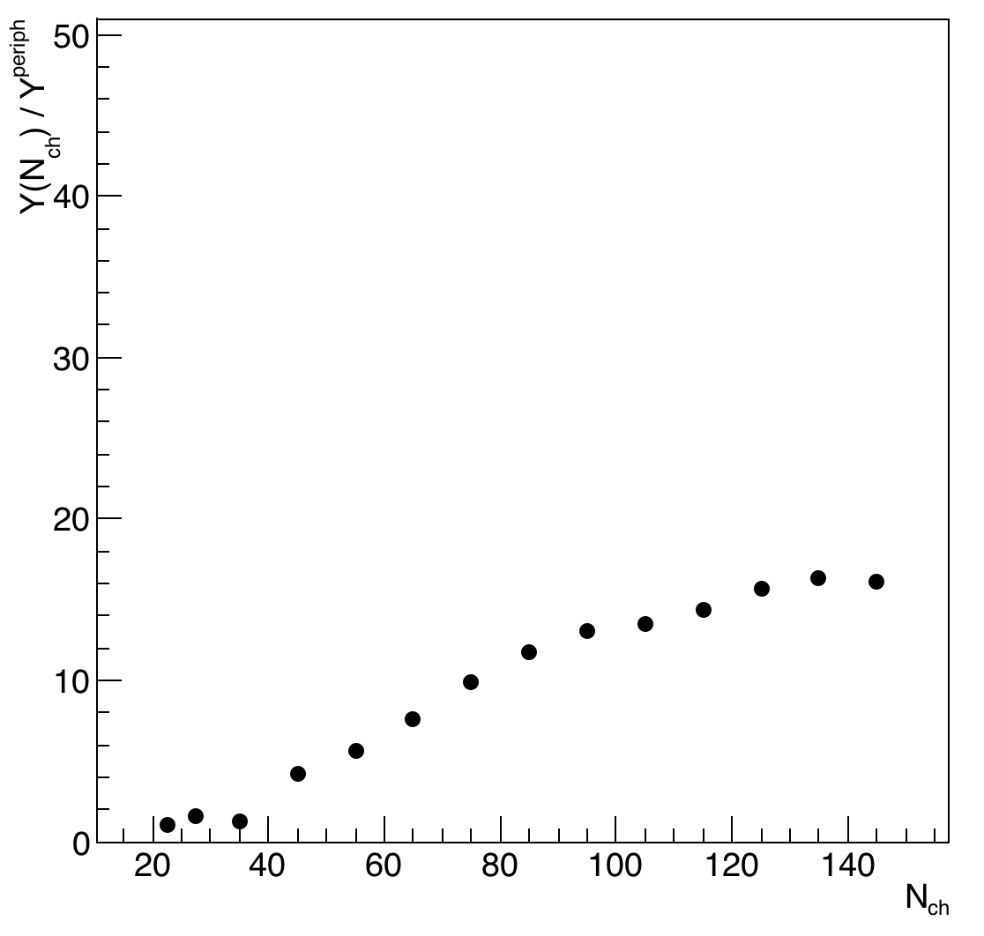
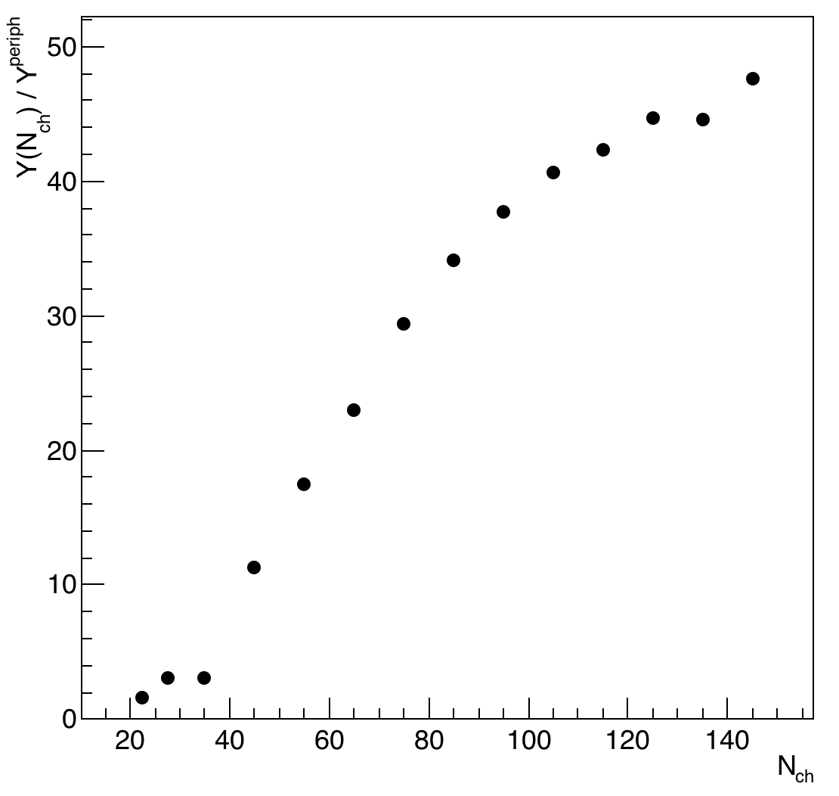
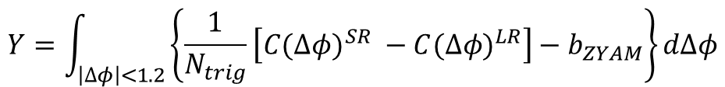
CMS has found that jet contributions in p+p are changed simply by the multiplicity selection bias (seen in PYTHIA for example). They remove this changing jet contribution via the Y factor below. However, in AMPT, this jet contribution is definitely modified by scattering.
This violates the assumption in both ATLAS and CMS non-flow subtraction techniques (does not allow real factorization of flow & nonflow).
$$Y=\int_{\left|Δφ\right|<1.2}{\left\{\frac{1}{N_{trig}}\left[{C(Δφ)}^{SR} −{C(Δφ)}^{LR}\right]−b_{ZYAM}\right\}dΔφ}$$
Hadronic + Partonic Scattering OFF
Hadronic + Partonic Scattering ON
AMPT p+p
AMPT p+p

Slide 21
Default t_{form}
t_{form} = 0.5 λ_{Β}
t_{form} = λ_{Β}
t_{form} = 2 λ_{Β}

