Slide 1
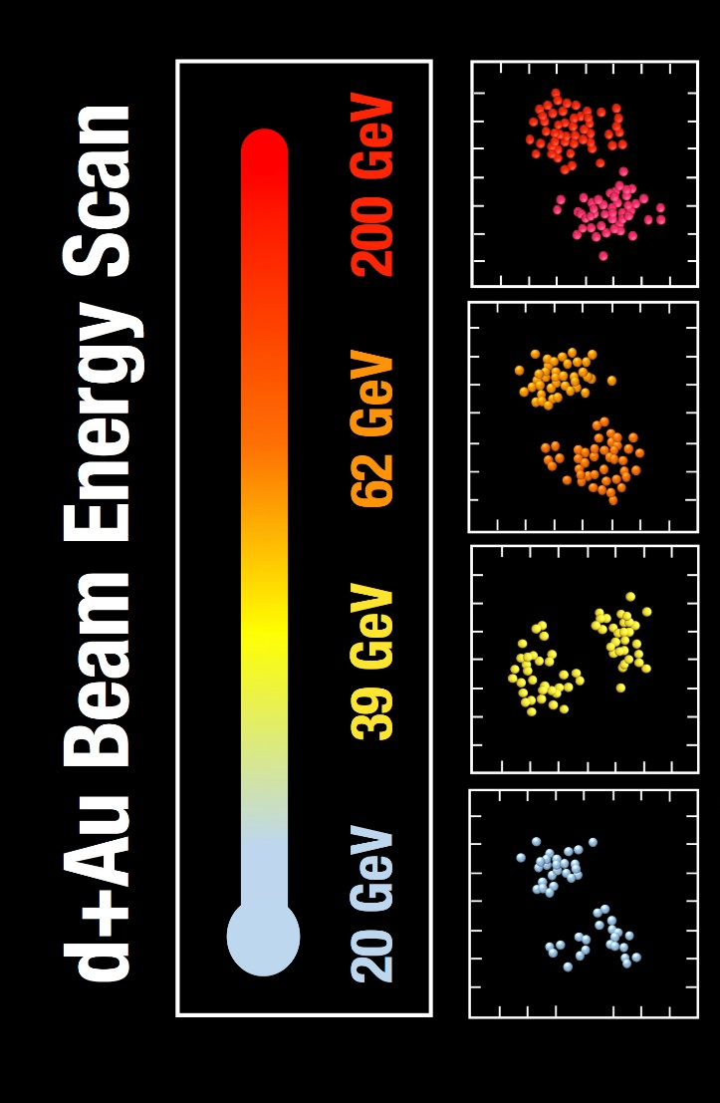
Small Thoughts on Small Nuclear Systems
Jamie Nagle
University of Colorado Boulder
and CEA/IPhT/Saclay
MIAPP Workshop – September 6, 2018
* Note that IP-Jazma and geometry scan discussed in earlier 2+ hour MIAPP talk (check it out)

Slide 2
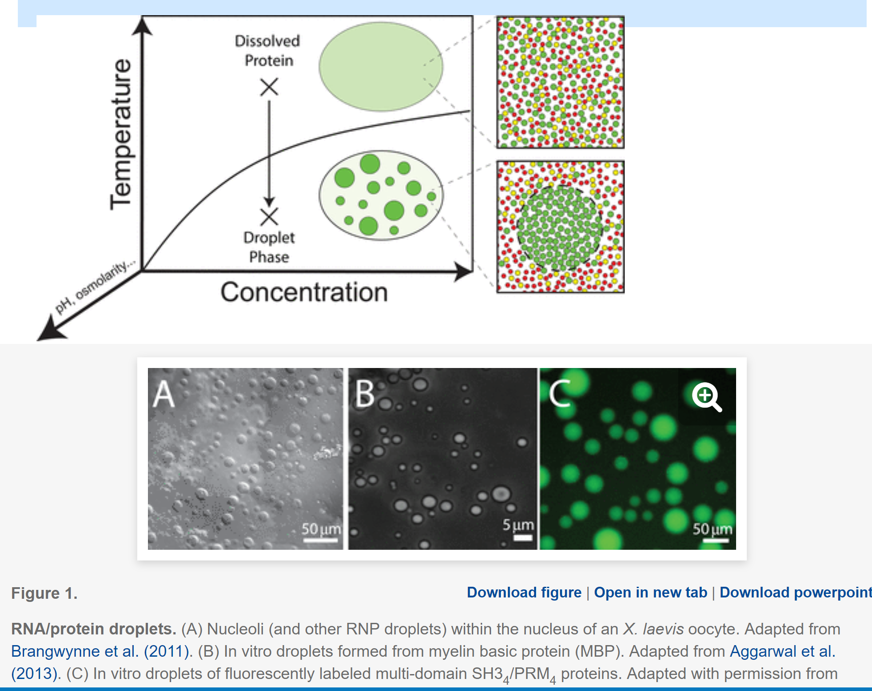
How small a droplet of matter can exist?
RNA/Protein droplets via a first order phase transition
Questions of size and structure actively researched
QGP near μ_{B}=0 is a smooth cross over
When does it make sense to talk of a smallest droplet?
A different question is
when is a system too small to see specific observables or be described accurately by a set of equations

Slide 3
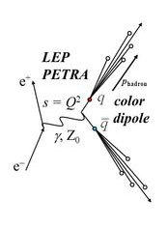
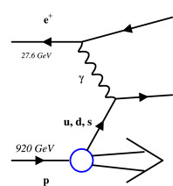
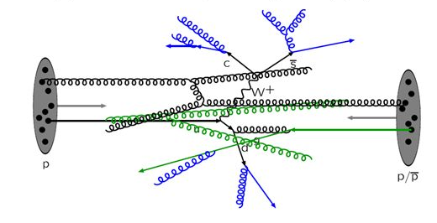
Small Systems
e⁺+e⁻
e+p
p+p
d+Au beam energy scan
at RHIC in 2016
200, 62.4, 39, 19.6 GeV

Slide 4
e+p
Exciting ZEUS results at QM18
Many scientists concluded, no “flow signal” and thus “turning off of QGP”…
However, closer examination indicates v₂ ~ 3-5% could be
hiding in the uncertainties
My guestimate says the same is true for the e⁺e⁻ results shown

Slide 5
One string, two string, red string, blue string…
e+e- → Z → one string
hypothetical two strings
Two string geometry correlation
over all rapidity
generates the signal
It does not mean the physics is fundamentally different in the two cases
https://arxiv.org/abs/1707.02307

Slide 6
In p+p with > 2 strings, small number of scatters is enough
https://arxiv.org/abs/1807.04619
How to understand if this physics picture makes sense?
Very sensitive to formation times, geometry model, scattering angles…
New tools and studies needed

Slide 7
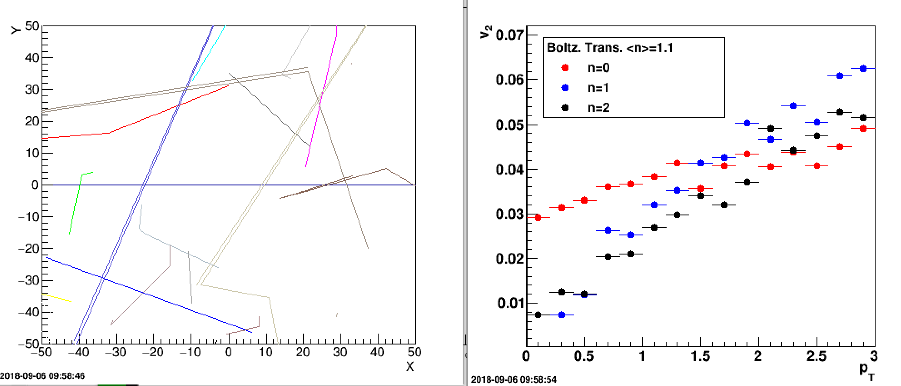
AMPT uses Zhang Parton Cascade (ZPC) but not in the Boltzmann limit
Quasiparticles are nearly massless 10-15 MeV quarks, no gluons and with very short formation times
How to make progress on the transport / quasiparticle front?
One example, using Boltzmann
code from Jean-Yves for
comparison

Slide 8
d+Au Beam Energy Scan 2016
Lots of good published experimental data…
Please take a look!
Pseudorapidity dependence of particle production and elliptic flow in asymmetric nuclear collisions of p+Al, p+Au, d+Au, 3He+Au at 200 GeV
https://arxiv.org/abs/1807.11928
Measurements of azimuthal anisotropy and charged particle multiplicity in d+Au collisions at 200, 62.4, 39, 19.6 GeV
https://arxiv.org/abs/1708.06983
Measurements of multiparticle correlations in d+Au collisions at 200, 62.4, 39, 19.6 GeV and p+Au collisions at 200 GeV and implications for collective behavior
https://arxiv.org/abs/1707.06108

Slide 9
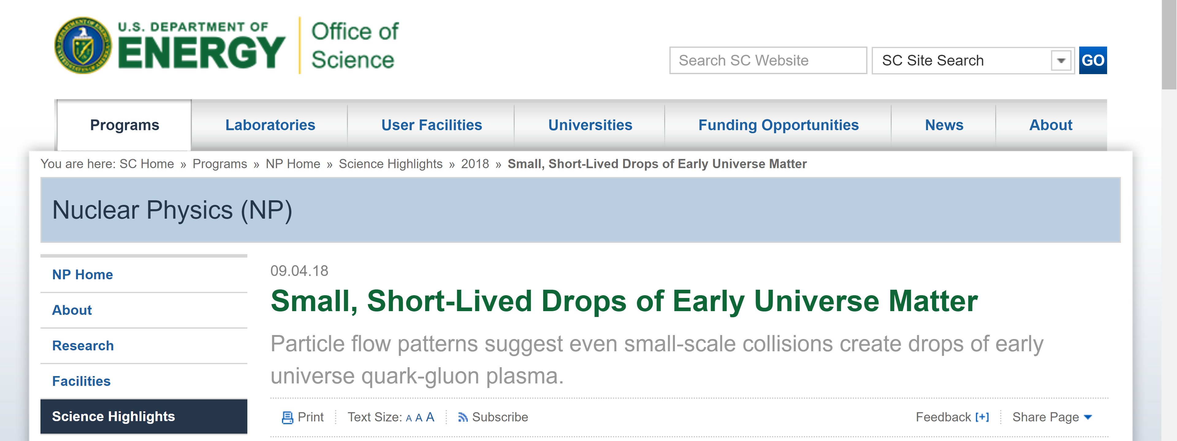
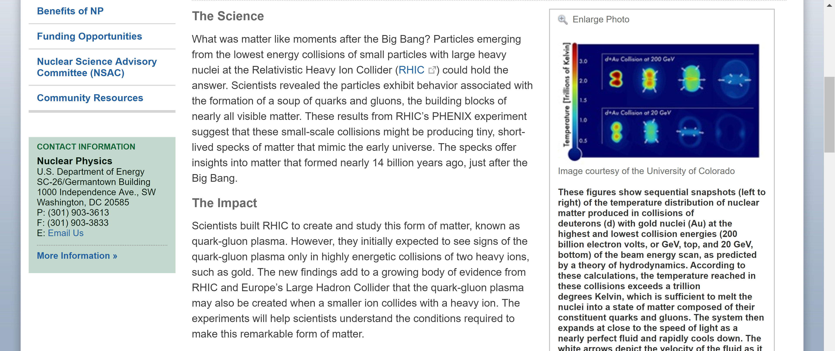

Slide 10
Constraints on longitudinal initial state models
https://arxiv.org/abs/1807.11928
Described by wounded quark model (https://arxiv.org/abs/1712.02618)
↑ d+Au Beam Energy Scan results too ↑

Slide 11
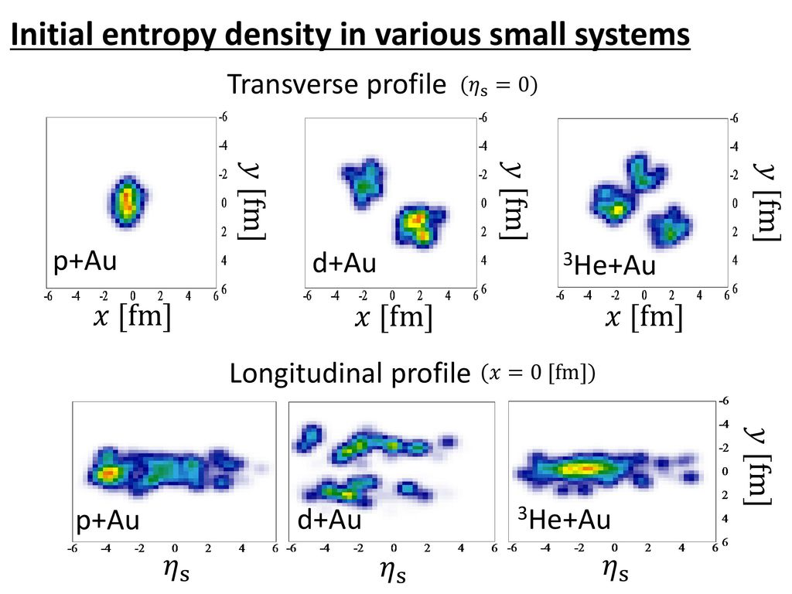
Testing ground for modeling initial state and decorrelations
Slide from Koji Kawaguchi, Koichi Murase, Tetsufumi Hirano
Slide from Darren McGlinchey
AMPT longitudinal strings

Slide 12
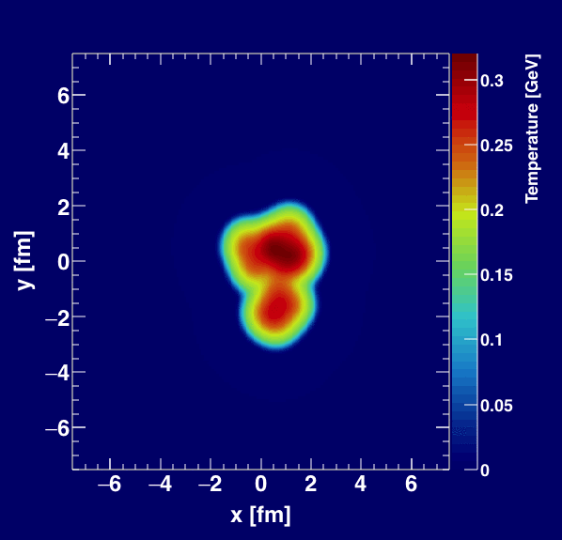
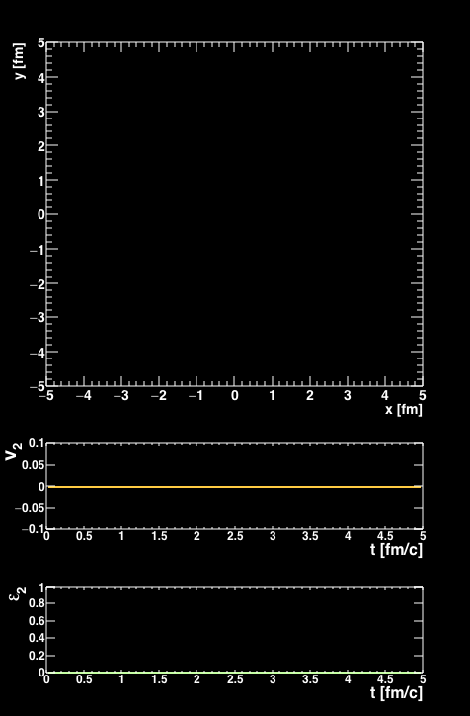
Compare two classes of calculations which
translate initial geometry → momentum anisotropies
Fluid Dynamics
Parton (Quasi-Particle) Transport

Slide 13
PHENIX Experimental Data
Integrated over p_{T},
thus dominated by low p_{T}
Data in the raw. Event plane method. No non-flow correction.
https://arxiv.org/abs/1708.06983

Slide 14
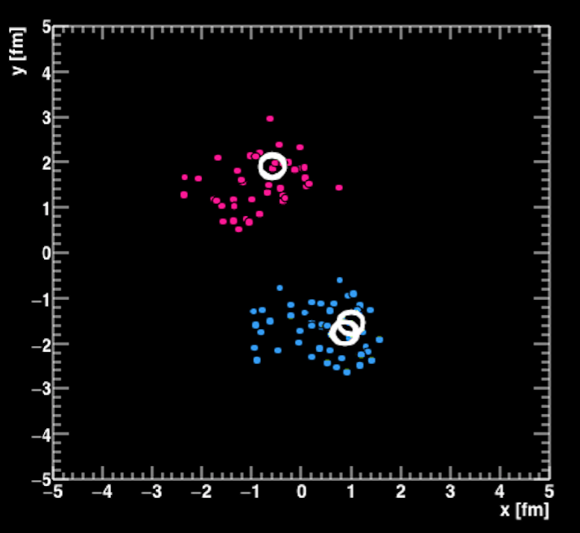
Working Definitions
“FLOW” = momentum anisotropy correlated with geometry
Hydrodynamic calculations are 100% “FLOW”.
In AMPT, define
- v₂ (truth initial parton plane) = “FLOW”
- v₂ final hadrons modeling the
measurement = “FLOW ⊗ NONFLOW”
In the data, we do not subtract “NONFLOW” and thus our quoted
v₂ is a combination of both effects
No factorization/template method proposed passes the AMPT closure test to date – see next slide*
Ψ_{P}
AMPT d+Au Event

Slide 15
Non-Flow Subtraction Techniques
CMS p+p method (arXiv:1606.06198)
Higher multiplicity selections have larger jet yield, so scale this out via the near side jet Y_{jet}
Try a closure test with AMPT (a system with both “flow” and “nonflow”)…
and both CMS and ATLAS methods massively fail the test!
That is because in AMPT the jet yields are significantly modified when partonic and hadronic interactions are turned on.
That simply means that “flow” and “nonflow” do not factorize in AMPT.
That is an interesting physics observation in the model.
https://arxiv.org/abs/1807.04619

Slide 16
d+Au BES and Parton Transport
Integrated over p_{T},
thus dominated by low p_{T}
AMPT with FLOW ⊗ NONFLOW
AMPT with only FLOW
NONFLOW importance grows at higher p_{T} and lower d+Au energy.
FLOW / NONFLOW not additive!

Slide 17
d+Au @ 62 GeV vs Multiplicity
AMPT with FLOW ⊗ NONFLOW
AMPT with only FLOW
High Mult. 0-5%
10-20%
10-20%
20-40%
40-60%
Low Mult. 60-74%

Slide 18
Hydrodynamics
Integrated over p_{T},
thus dominated by low p_{T}
Hydrodynamic agreement in d+Au @ 200, 62 GeV and then underpredicting in d+Au @ 39, 19 GeV particularly at higher p_{T}

Slide 19
d+Au BES Cumulants
d+Au @ 200 GeV
d+Au @ 62 GeV
d+Au @ 39 GeV
d+Au @ 19 GeV
v₂{2}
v₂{4}
v₂{6}
d+Au @ 200 GeV
v₂{2}, v₂{4}, v₂{6} expected pattern from N-body correlation.
Real valued v₂{4} in
d+Au @ 62, 39, 19 GeV

Slide 20
p+Au @ 200 GeV
v₂{4} Complex
d+Au @ 200 GeV
v₂{4} Real
Au+Au @ 200 GeV
v₂{4} Complex→Real
AMPT with MC Glauber initial conditions and fluctuations qualitatively describes the real / complex v₂{4} pattern
Nonflow, decorrelations, fluctuations – what dominates?

Slide 21
In small systems, eccentricities do not tell the whole story
d+Au @ 200 GeV
SONIC Hydro Response
v₂ versus ε₂
LHC data with d+Pb and other asymmetric systems would be great.
Perhaps we should have a workshop on the physics enabled by a second ion source for the LHC, rather than dismissing it out of hand.

Slide 22
Summary
Lots of ways to push to smaller systems
p+p, ee, ep, AA UPC (?), d+Au beam energy scan
Wealth of data from RHIC small system program
d+Au heavy flavor flow too!
Good connection of d+Au BES program with constraining models for full BES program

Slide 25
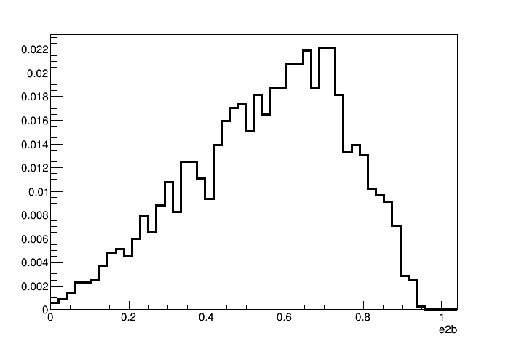
Au+Au peripheral

Slide 27
RHIC Geometry Scan

Slide 28
Experimental Data
Follows ordering of eccentricities
However, multiplicity also plays a role
PHENIX, https://arxiv.org/abs/1805.02973

Slide 29
Hydrodynamic Comparison
Good agreement with v₂, v₃ (p_{T}) for all three systems
SONIC is a published prediction
No tuning of parameters or options for different systems

