Slide 1
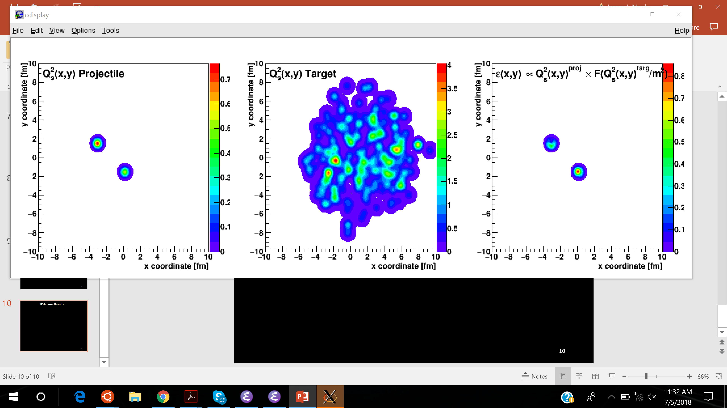
Creating circular, elliptical, and triangular droplets of quark-gluon plasma
Jamie Nagle
University of Colorado Boulder
and CEA/IPhT/Saclay
CEA/Saclay Seminar – August 24, 2018

Slide 2
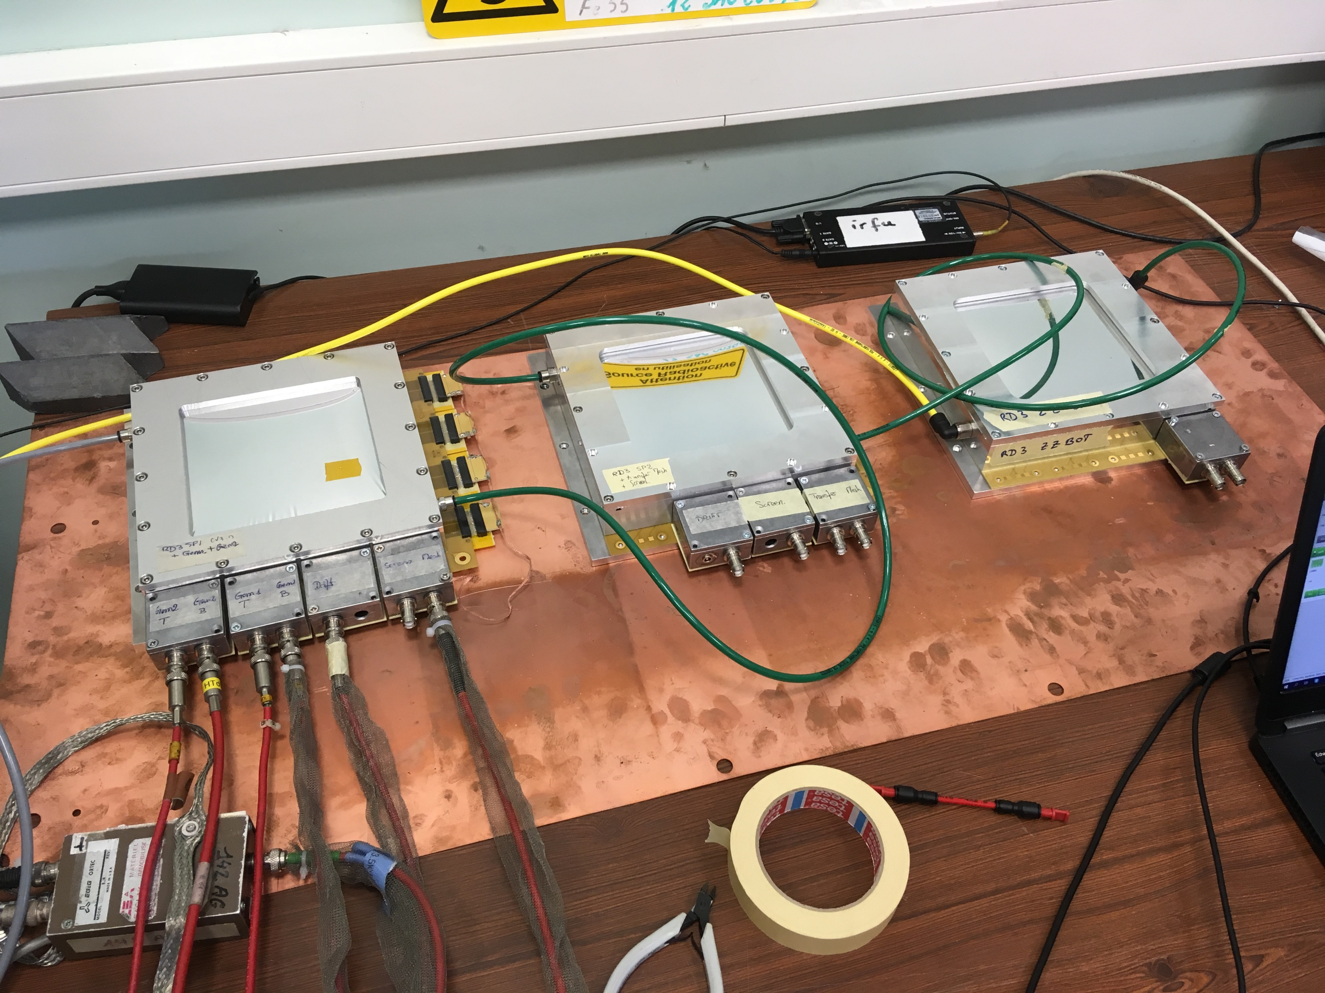
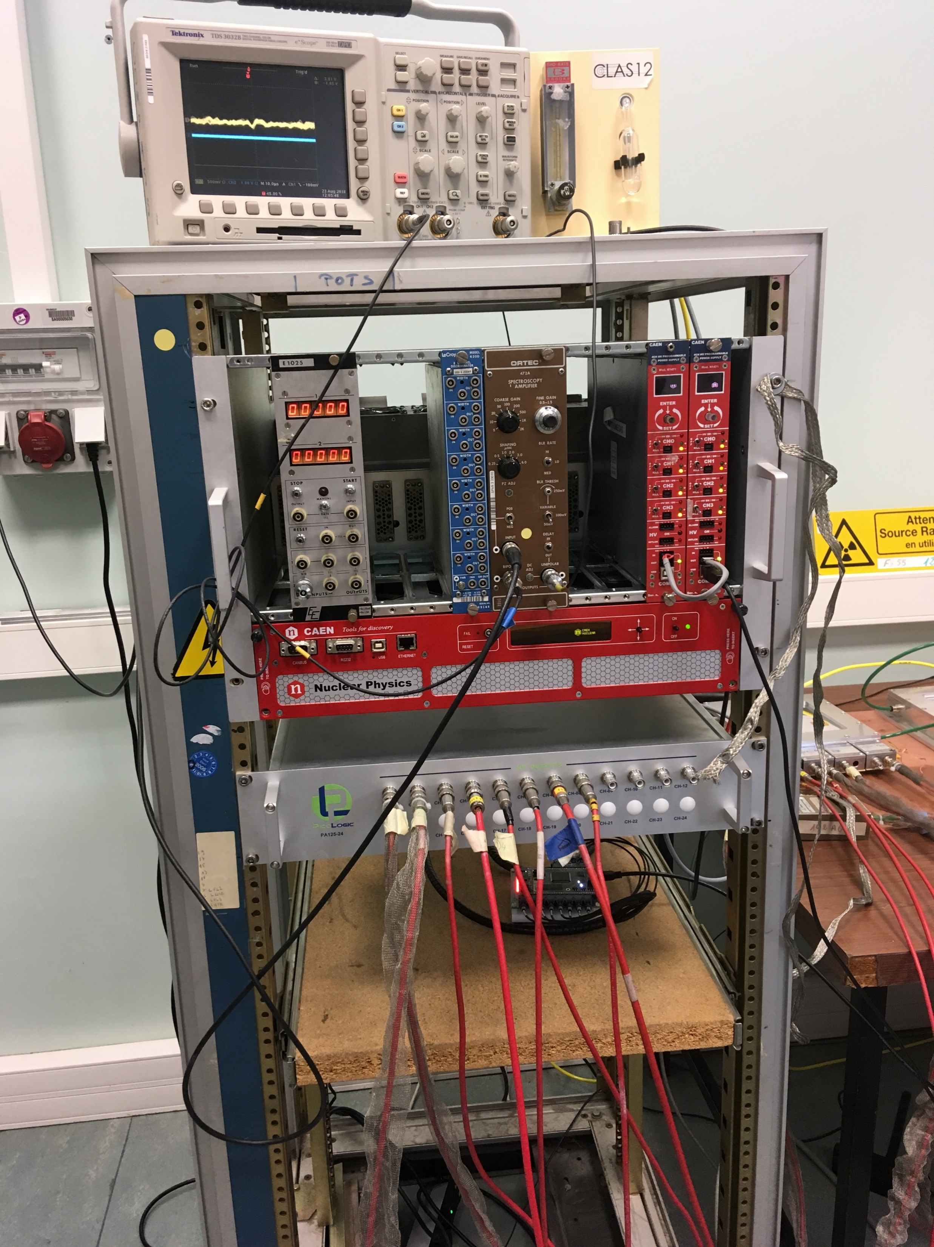
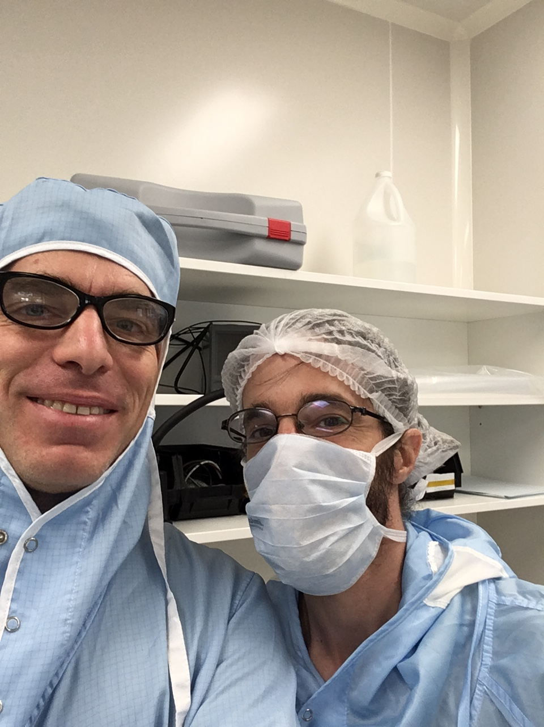
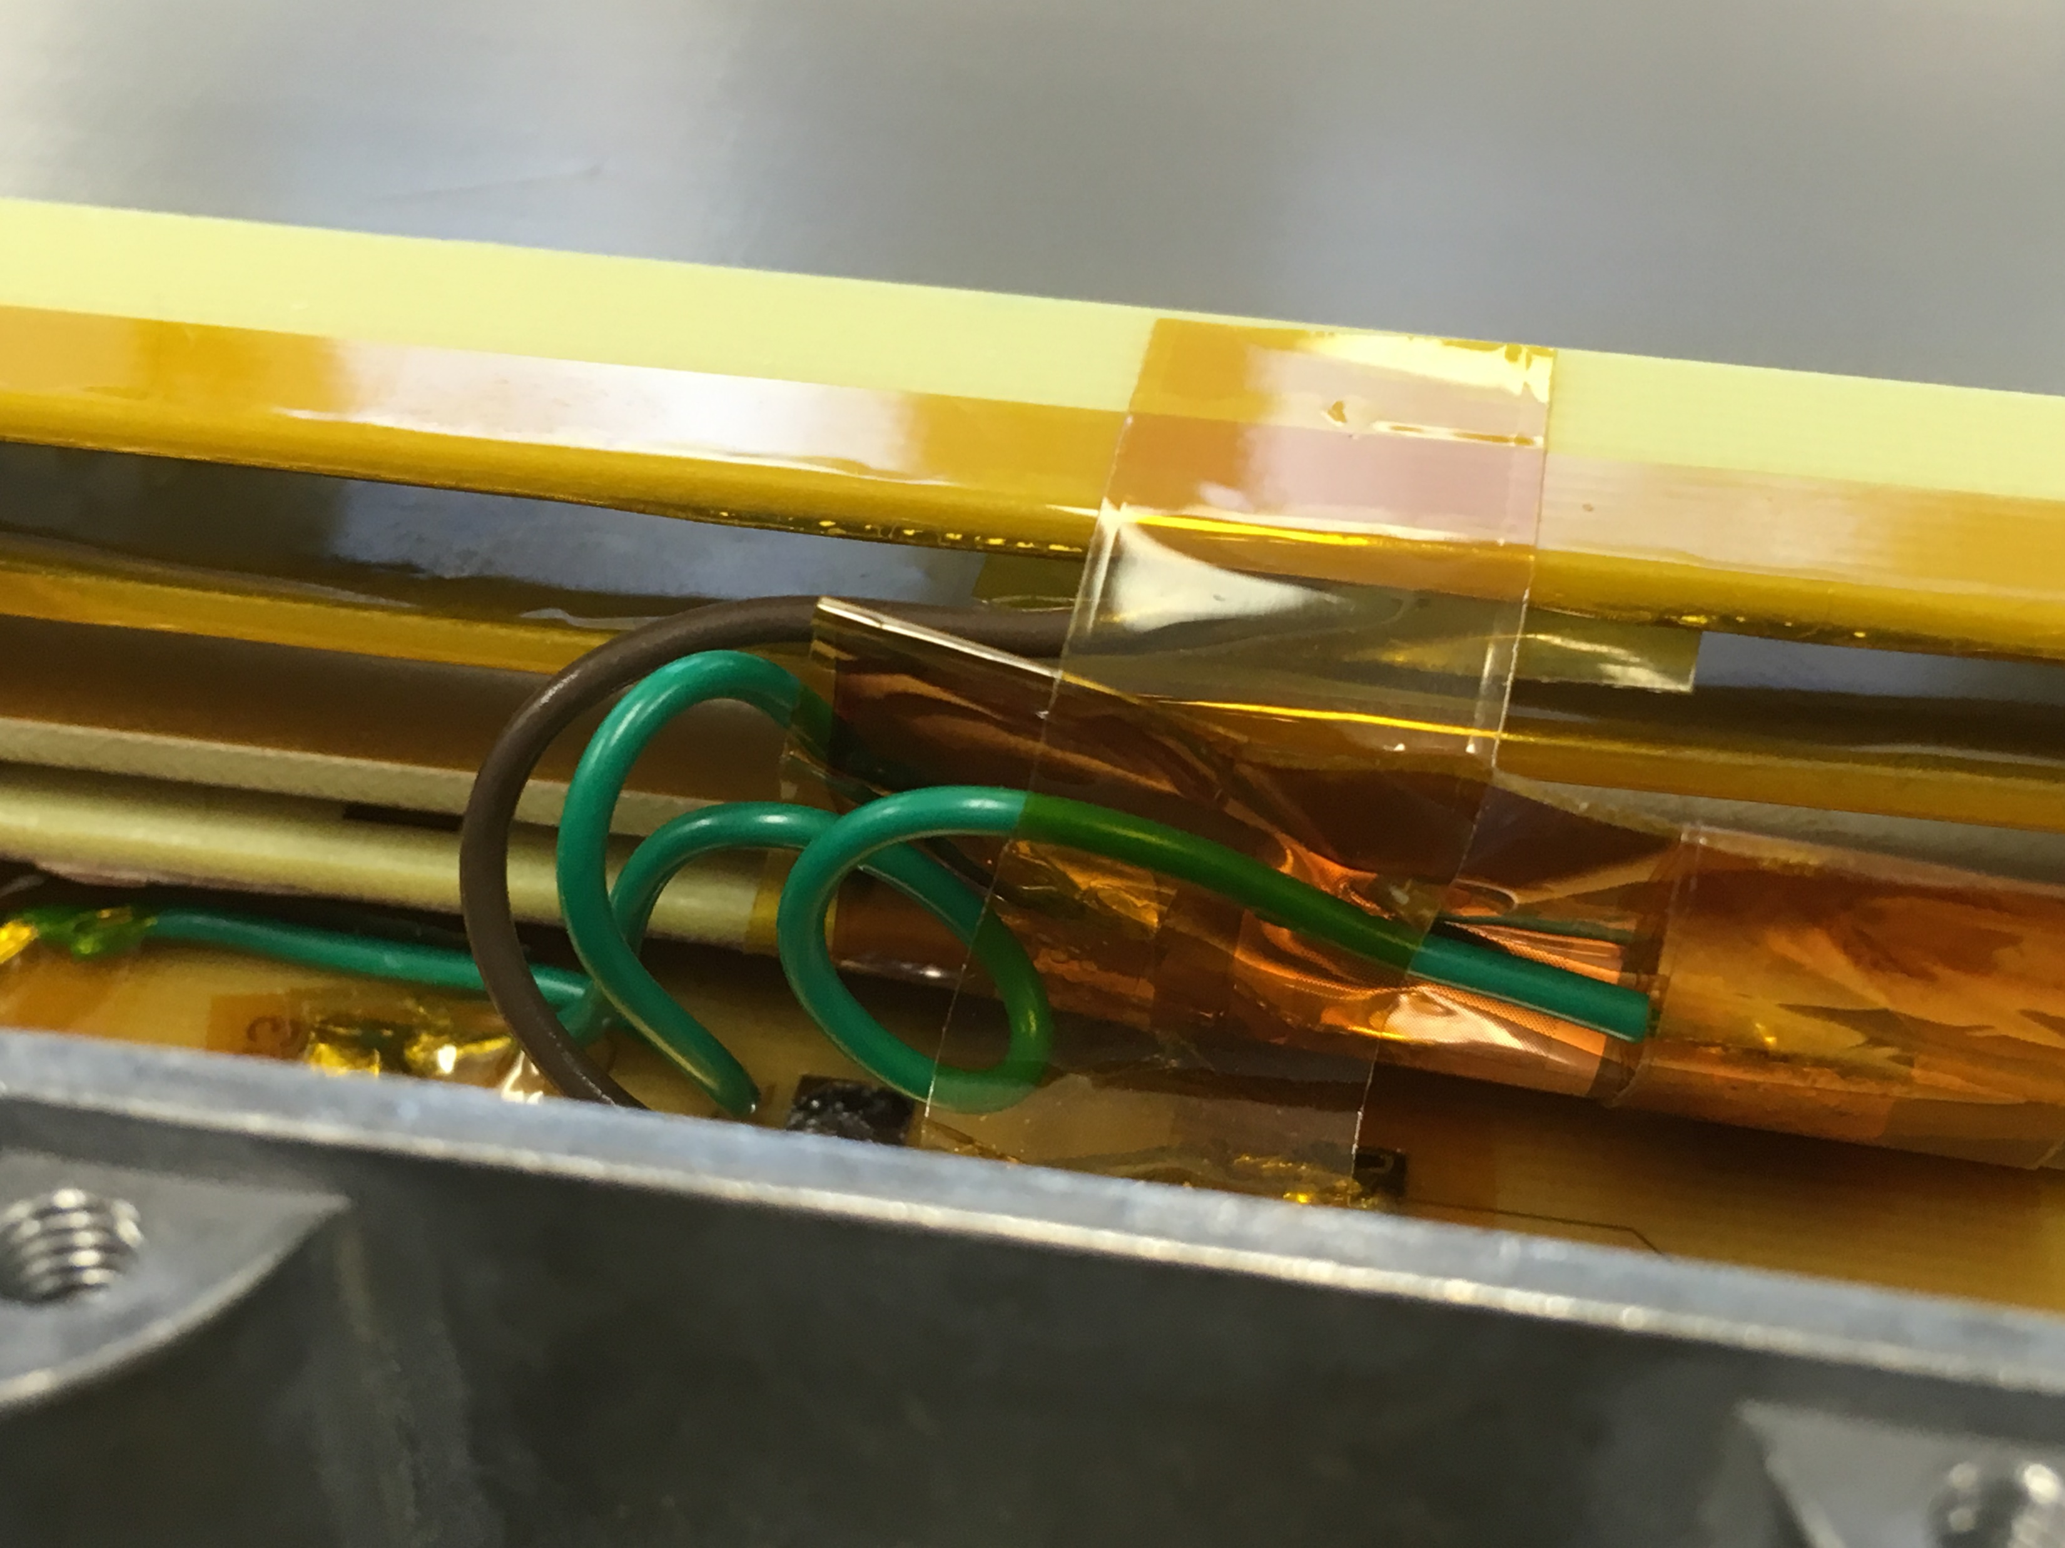
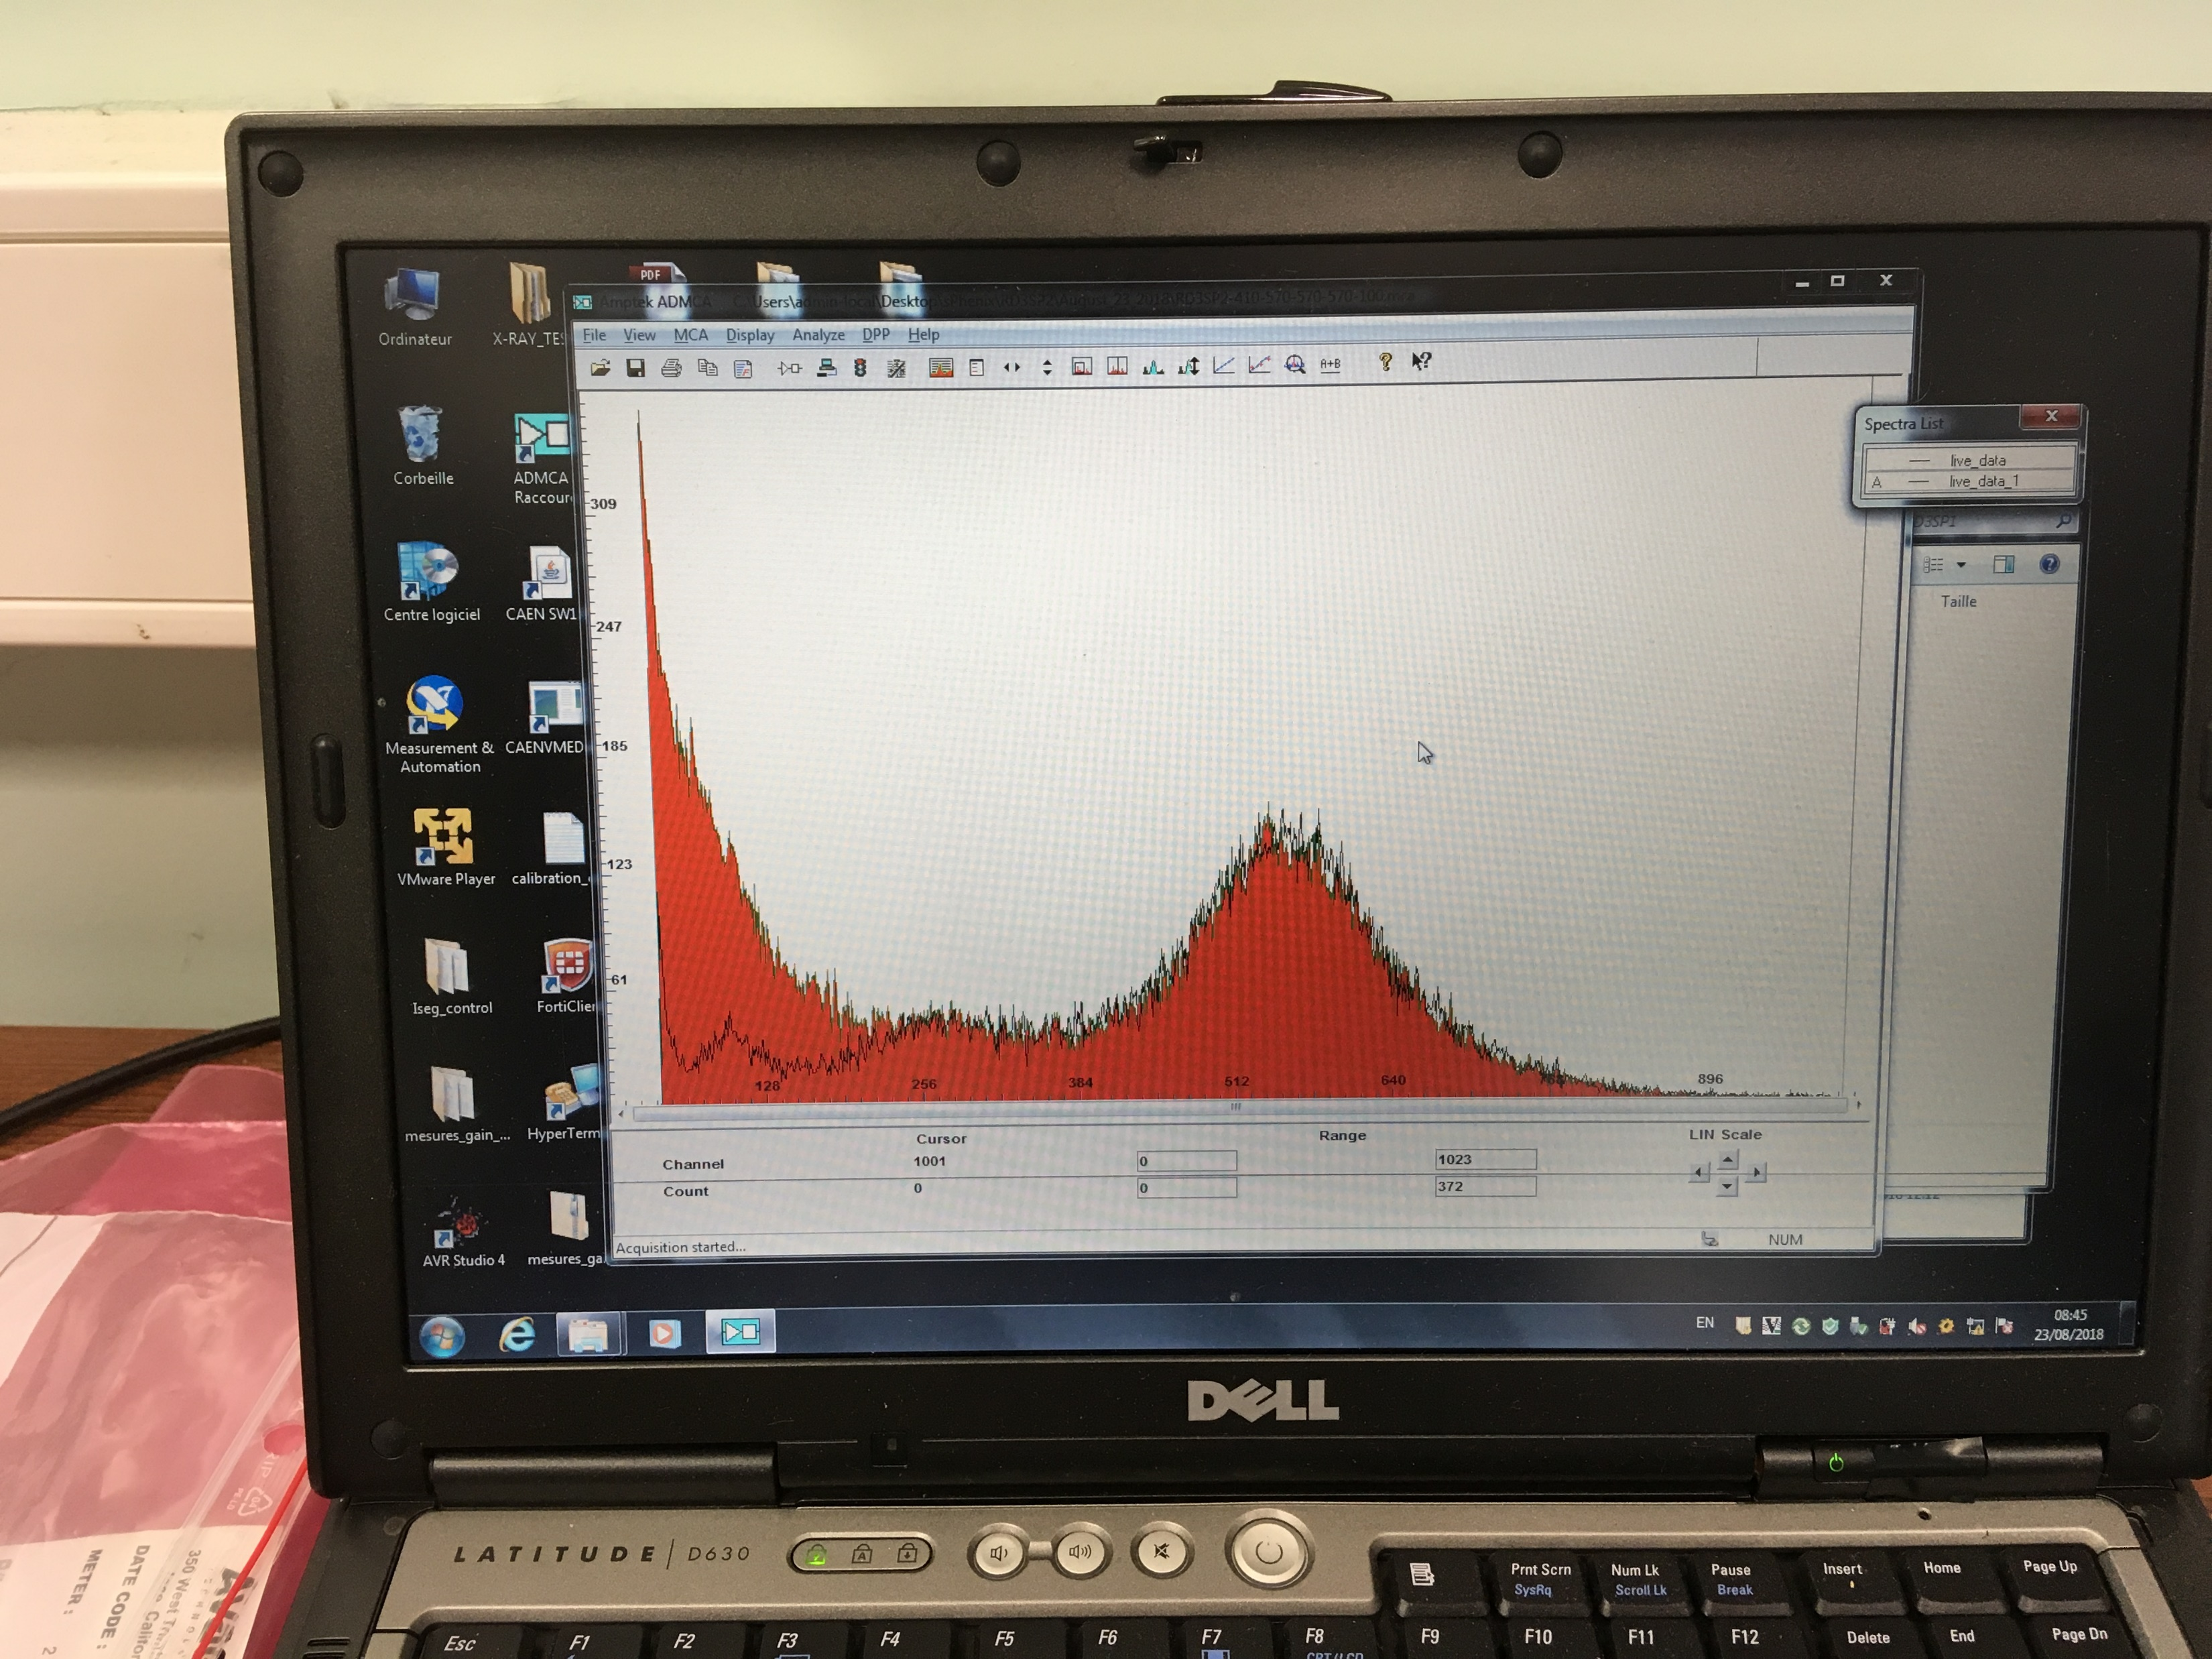
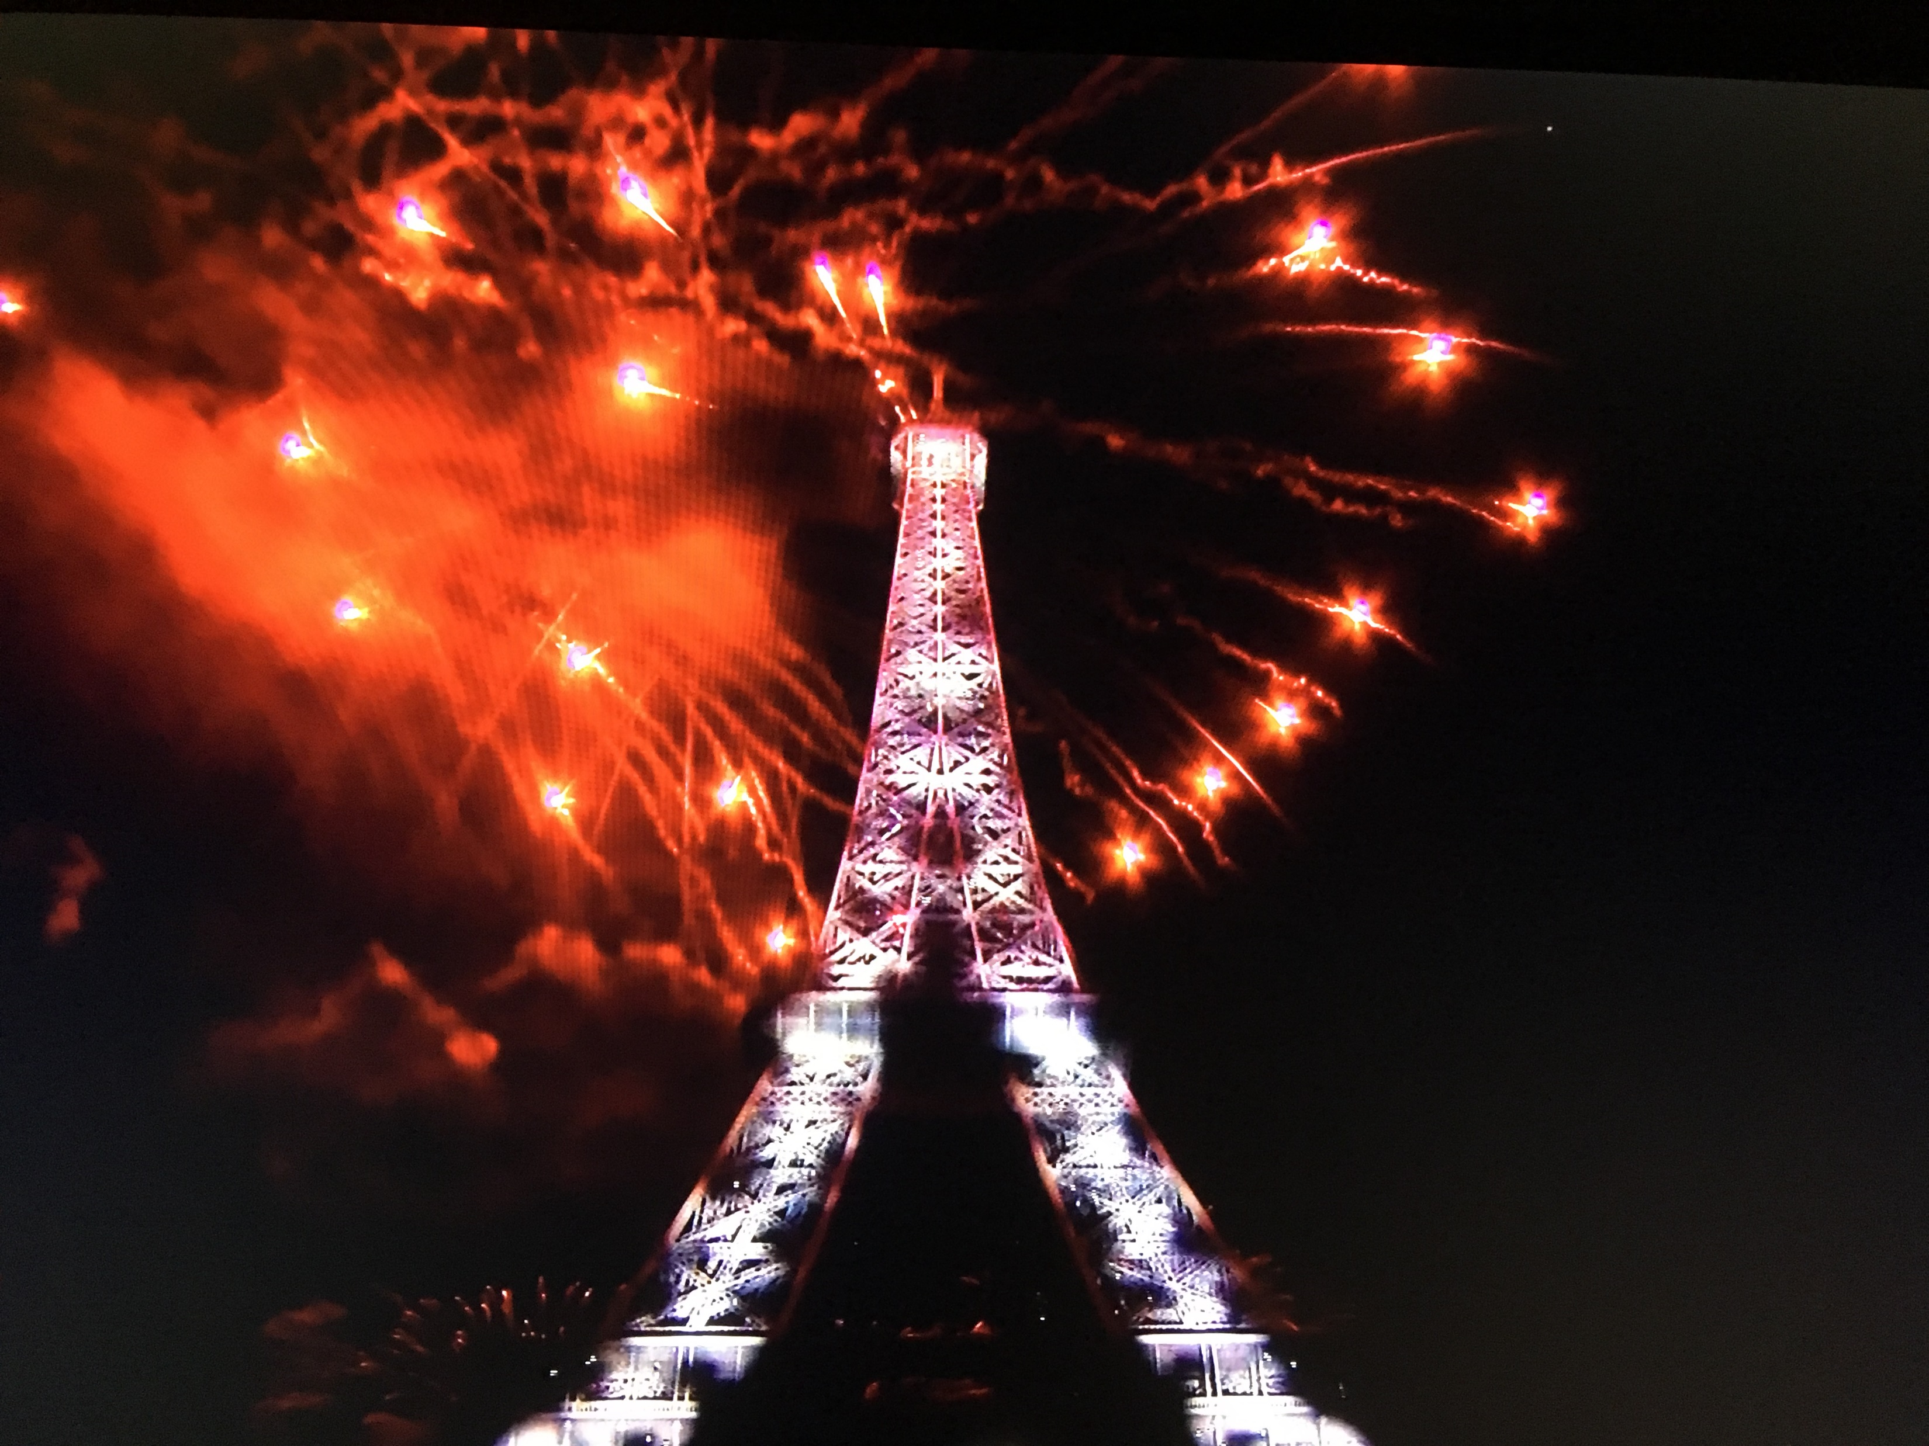
sPHENIX work on MicroMegas during 4 months in Saclay…
Department of Energy CD-1 and CD-3A approval!
Hopefully an exciting sPHENIX seminar in 4-5 years
with new physics!

Slide 3
Standard Model of Heavy Ion Collisions
At RHIC and LHC, energy deposit over system R >> λ_{mfp}, hydrodynamic evolution of quark-gluon plasma
followed by hadronization and scattering
Standard Model tested in great detail and with precision
Nagle and Zajc, Annual Review, https://arxiv.org/abs/1801.03477
Snellings and Heinz, Annual Review, https://arxiv.org/abs/1301.2826

Slide 4
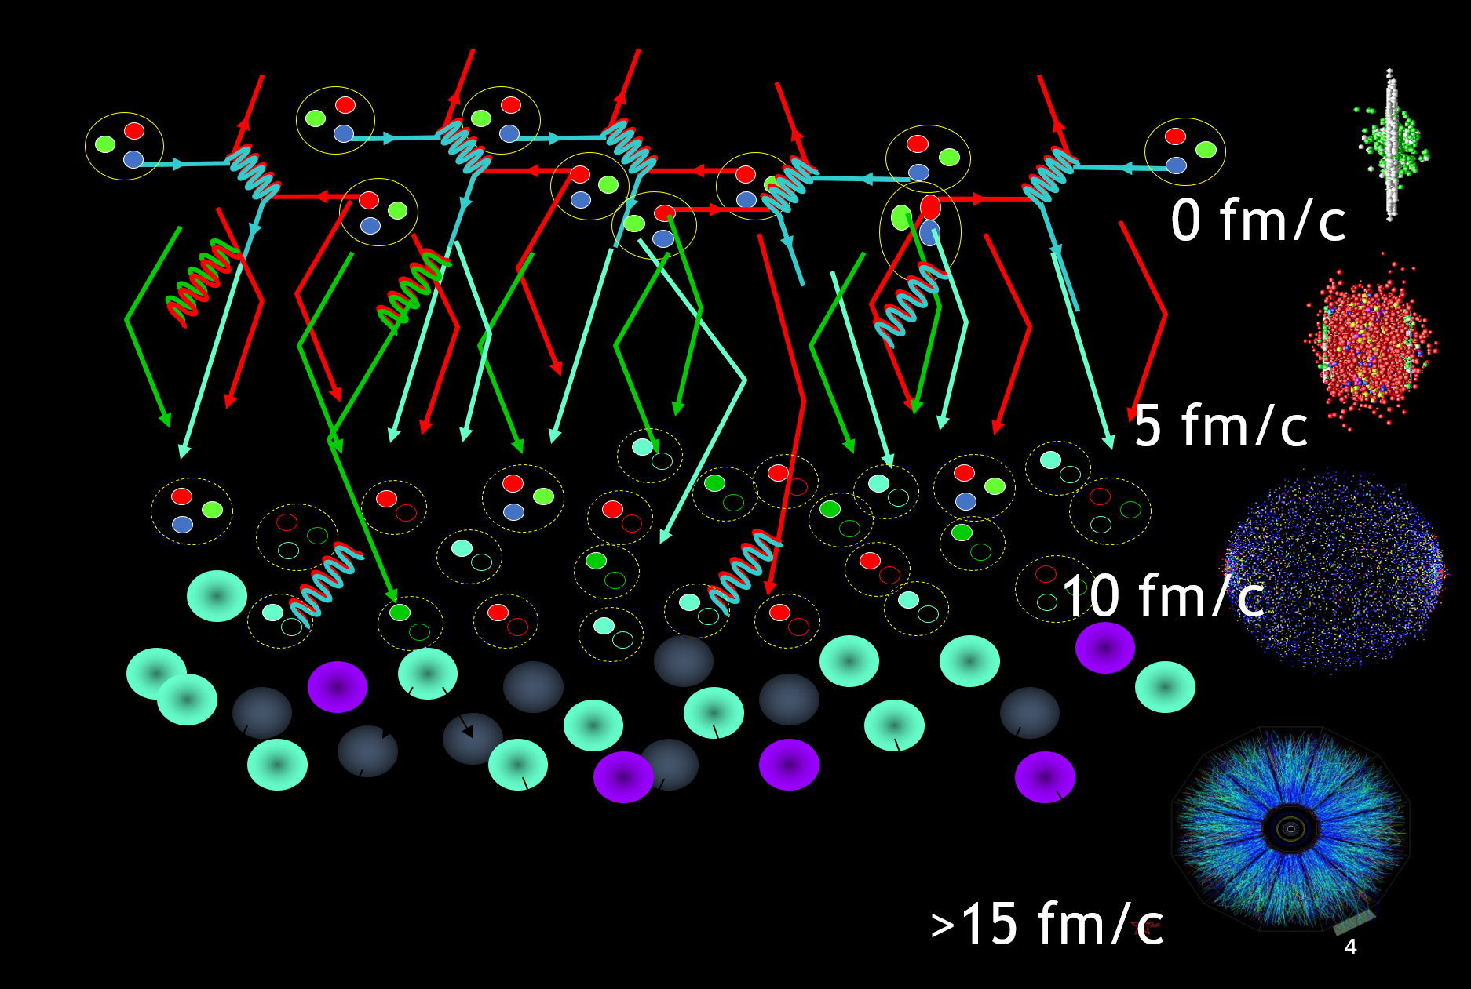
Initial State – nPDF, saturation physics, color domains
QGP State – hydrodynamics, parton scattering
Hadron State – hadronization, hadron scattering
Free Streaming State – measured by experiment
4

Slide 5
Mini Quark-Gluon Plasma?
In 2010, hints of similar phenomena in super
high-multiplicity p+p collisions (1/100,000)
CMS
Long ago Bjorken postulated QGP formation in p+pbar via the creation of a modified vacuum state and was not concerned about the small number of final state hadrons
Nagle and Zajc, Annual Review, https://arxiv.org/abs/1801.03477

Slide 6
Alternative Menu of Options
Initial-State
QGP Hydrodynamics
Non-Flow
Quasiparticle Scattering
M. Strickland https://arxiv.org/abs/1807.07191
Cartoon does not make physics. What is the x-axis really?
Consider different geometries, system size, different energies, etc.
Also, each needs to mimic all the signals

Slide 7
“One fluid to rule them all”
Weller and Romatschke, https://arxiv.org/abs/1701.07145

Slide 8
Code is all publicly available and documented.
Multiple groups cross checking and producing consistent results (for example iEBE-VISHNU).
What are the systematic uncertainties, open items?
MC Glauber + Constituent Quarks needed for p+p and includes some Gaussian σ value for local “gluon cloud”
Bulk viscosity important to temper large radial expansion in p+p, but not as critical in A+A
Pre-equilibrium (superSONIC) or not (SONIC)
Unknown η/s(T) value. superSONIC results with η/s = 1/4π for all systems.
Hadronic cascade model (B3D in superSONIC)
Important questions about hydro far from equilibrium which is an entire other talk (!)

Slide 9
RHIC Geometry Scan

Slide 10
Cornucopia of d+Au Data
PID Spectra
v₂(p_{T}) PID
v₂(η)
v₂{2}, {4}, {6}
d+Au beam energy scan → 200 GeV, 62.4, GeV, 39 GeV, 19.6 GeV →

Slide 11
Deuteron wavefunction is well known and the geometry validated by experiment
d+Au
Sometimes the neutron
misses
http://journals.aps.org/prc/abstract/10.1103/PhysRevC.90.034902

Slide 12
Experimental Data
Follows ordering of eccentricities
However, multiplicity also plays a role
PHENIX, https://arxiv.org/abs/1805.02973

Slide 13
Particle Multiplicities
https://arxiv.org/abs/1807.11928
Midrapidity Values
dN_{ch}/dη ~ 12 p+Au 0-5%
dN_{ch}/dη ~ 18 d+Au 0-5%
dN_{ch}/dη ~ 22 ³He+Au 0-5%
Hydrodynamic calculations include the initial geometry differences and match the particle multiplicity for each system

Slide 14
Hydrodynamic Comparison
Good agreement with v₂, v₃ (p_{T}) for all three systems
SONIC is a published prediction
No tuning of parameters or options for different systems

Slide 15
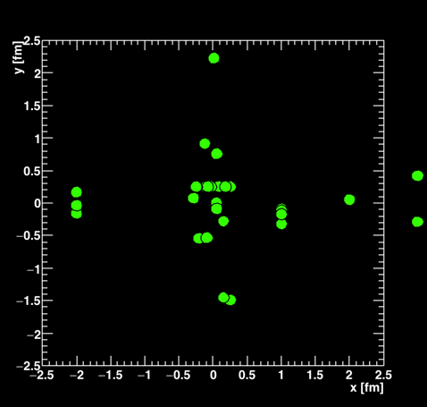
Parton Transport Explanation
In limit of many scatters per parton (> 4-5), this might be a dual picture to hydrodynamics
However, if most partons have zero scatters and others have just one, that seems different
AMPT Escape Mechanism paper finds very few scatterings
He et al., https://arxiv.org/abs/1601.00878
Recent analytic approach generates significant v₂ with single scatter
Kurkela, Wiedemann, Wu
arXiv:1805.04081
arXiv: 1803.02072

Slide 16
Small system studies with AMPT (publicly available code)
Nagle et al., arXiv:1707.02307, Orjuela Koop et al., arXiv:1512.06949, arXiv:1501.06880
Bozek, Bzdak, Ma, arXiv:1503.03655
AMPT v2.25t5 relative to true geometry defined by initial nucleons
string melting mode, σ_{parton} = 0.75 mb
Poor quantitative agreement with data,
but rough agreement with system v_{n} ordering

Slide 17
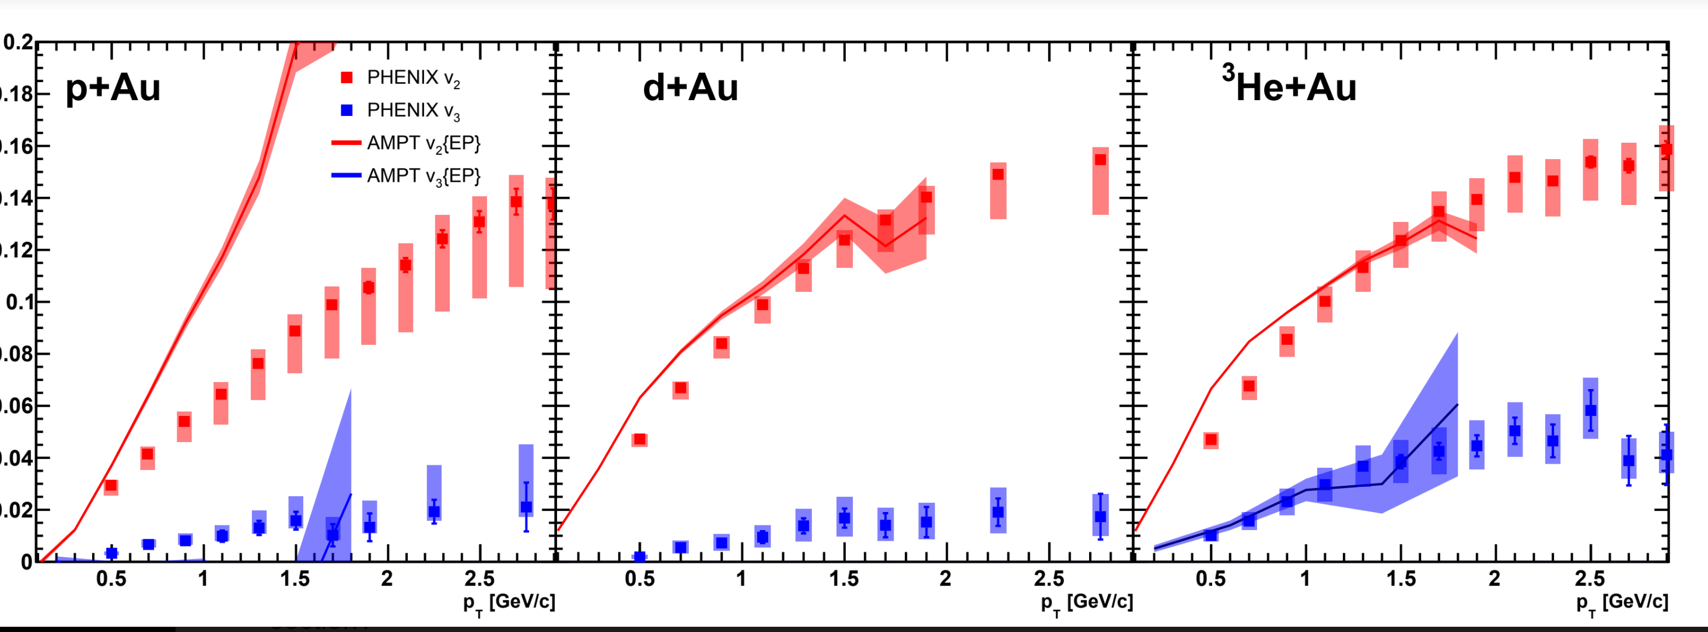
Apples-to-Apples Comparison
AMPT fully modeling the Event Plane method in PHENIX
Better agreement in ³He+Au, but much worse in p+Au (non-flow),
insufficient statistics for v₃ in the smaller systems (working on it)

Slide 18
Thoughts on AMPT and parton transport calculations:
Quasiparticle picture only useful if one can correctly identify quasiparticles and their properties (think Condensed Matter Physics)
→ which in AMPT are nearly massless < 20 MeV quarks, no gluons
Also, one then needs to describe the “cornucopia” of other observables. For example, AMPT achieves the v2 PID dependence roughly via hadron rescattering.
Very important for the field to have multiple tools (beyond AMPT) to assess how this picture works…

Slide 19
Initial State Explanations

Slide 20
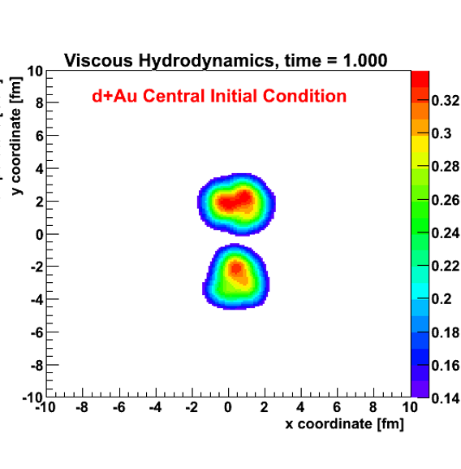
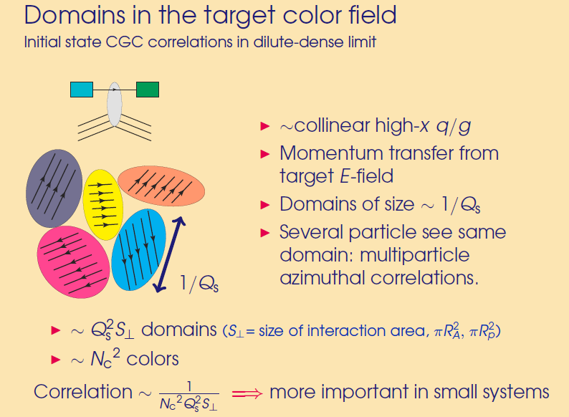
More domains that are
not aligned,
correlation effect is washed out.
Nice separation of scales
Deuteron size >> Domain Size
20
Exactly the opposite of what is observed in data !
Definitively rule out scenario where initial state correlations dominate via resolved domains of size 1/Q_{s}

Slide 21
15 days after the PHENIX paper was posted, postdictions appeared
Mace et al. [MSTV], https://arxiv.org/abs/1805.09342
Remarkable results are counterintuitive
Code is not publicly available, many details missing so
not possible to reproduce results yet
There are a number of steps — all of which are “essential”

Slide 22
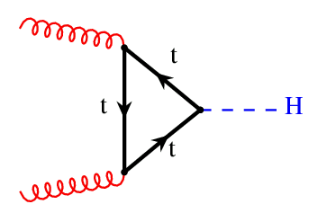
Essential physics
Think of a gluon from the target and its interaction with domains in the projectile…
If the k_{T} < Q_{s} (proj) then the target cannot resolve individual domains and interacts with many of them “coherently” or “simultaneously”
Proton color domains

Slide 23
Incoming target gluon with k_{T}
uncertainty principle blurs the gluon with radius
r [fm] = hbar/k_{T} = 0.2 / k_{T}[GeV]
If k_{T} = 1 GeV, r = 0.2 fm
Target gluon wave
Projectile (proton) radius ~ 0.9 fm
If Q_{s} = 2 GeV, r_{domain} = 0.1 fm.
Of course this is an absurdly large Q_{s}² = 4 GeV² for the proton x>0.01
Then target gluon sees
(Q_{s}/k_{T})² ~ 4 domains at once.
Proton
Domains
Size ~ 1/Q_{s}

Slide 24
d+Au case
In the overlap region,
one sees more “smaller” domains with larger color fields since larger Q_{s}.
Probability of two gluons hitting the overlap region is very small.
However, lots of cases where two target gluons see completely uncorrelated regions!
Neutron
Proton

Slide 25
Domains just starting to be resolved →
← Domains not resolved
Mace et al. [MSTV], https://arxiv.org/abs/1805.09342
v₂ (d+Au) > v₂(p+Au) for p_{T} < 2.5 GeV
MSTV: Q_{s} (deut) > Q_{s} (prot) since N_{ch} (0-5% d+Au) > N_{ch} (0-5% p+Au)
and v₂ scales with Q_{s}(proj)
k_{T} < Q_{s} (proj) → does that mean Q_{s}(proj) = 1.5-2.5 GeV?
Need exact definitions and numbers for k_{T} distributions

Slide 26

IP-Jazma
J.N. and W.A. Zajc
https://arxiv.org/abs/1808.01276
Open source code:
http://www.phenix.bnl.gov/WWW/publish/nagle/IPJAZMA
Just like jazz music, some people will not appreciate it.

Slide 27
IP-Jazma Details
1. MC Glauber to obtain nucleon x,y positions in each event
Use IP-Sat (impact parameter saturation model) to calculate the Q_{s}² distribution on an x,y lattice
Note that this is just a uniform Gaussian with σ = 0.32 fm at RHIC
Q_{s}² is proportional to g⁴μ² , where μ² is the number density of color charge per unit transverse area
Q_{s} is proportional to g²μ and is Gaussian with σ = 0.45 fm
MSTV (private comm.) says that “our choice of B_{G}” corresponds to slightly larger σ = 0.56 fm, so I will match that in IP-Jazma

Slide 28
MSTV includes nucleon-by-nucleon fluctuations in Q_{s,0} ²
(the amplitude of the IP-Sat Gaussian). Thus, each nucleon is still a perfect Gaussian, just different amplitudes.
Implemented with variance 0.5 on log(Q_{s}²) – i.e. high side tail.
Non-perturbative on many scales
Not part of the standard CGC framework
Questions regarding the constraints on the functional form

Slide 29
Originally proposed by McLerran (arXiv:1508.03292v2) to explain high multiplicity tail of LHC p+p N_{ch} distributions.
Q_{s,0}² fluctuates to 5-6 times average value to
explain the high N_{ch} tail.
* It is a mistake to assume such matching confirms dynamical fluctuations, instead of from hadronization effects, finite rapidity window, experiment acceptance, etc.

Slide 30
deuteron
+
gold
IP-Jazma
Sum all the Q_{s}² contributions for each nucleus.
Example - nucleons from deuteron as perfect Gaussians from IP-Sat just with different amplitudes from Q_{s,0} ² fluctuations.
At this point, none of these fluctuations are ab initio.
All MC Glauber and put-in-by-hand Q_{s,0} ² fluctuations.

Slide 31

Dilute-Dense Framework
In the MSTV paper, they utilize the dilute-dense framework
(hep-ph/0402256, hep-ph/0402257, arXiv:0711.3039)
The dilute-dense limit implies that Q_{s}(proj) < k_{T} < Q_{s}(targ) and one obtains on average:
N_{gluon} $∝$ g² Q_{s}²(proj) x F( Q_{s}(targ)/ m ) (dilute-dense limit)
where m is the infrared cutoff (= 0.3 GeV in MSTV).
What justifies some small system papers (many) using the dense-dense limit and others (many) using the dilute-dense limit?
Also coherence condition k_{T} < Q_{s}(proj) seems in conflict with both!

Slide 32
IP-Jazma Dilute-Dense
Cyrille Marquet (thanks) sent me this function F.
In the limit of large Q_{s}(targ)/m, it scales as log(Q_{s}(targ)/m).
N_{g} $∝$ g² Q_{s}²(proj) x F( Q_{s}(targ)/m) ) (dilute-dense limit)
Once you hit a thick enough part of the target,
you free all the projectile gluons and no more.

Slide 33
IP-Jazma Results
Right panel shows the density distribution for this event in the dilute-dense limit.
There are no sharp spikes in the energy density as often highlighted with IP-Glasma because there are no lattice site color fluctuations – though these are in part artifacts in IP-Glasma.

Slide 34
Aside on Spiky IP-Glasma
Success of IP-Glasma Au+Au
initial conditions often highlighted by these very spikey displays
However, IP-Jazma (dense-dense) matches eccentricities ε₂-ε₆
Au+Au
ε₂
ε₃
ε₄
Totally dominated by T_{A} x T_{B} scaling,
not color
fluctuation spikes.
ε₅
ε₆

Slide 35
p+Au @ 200 GeV
Settings: Dilute-Dense, no Q_{s,0} ² fluctuations,
no running α_{s}, r_{max} = 3.0 σ [leave these last two the same]
Distribution of number of gluons (N_{g}/<N_{g}>)
Once the proton is hitting the mid-region of the target the gluon production
reaches a limit
i.e. one has freed all the gluons from the projectile proton

Slide 36
p+Au @ 200 GeV
Settings: Dilute-Dense, yes Q_{s,0} ² fluctuations
In the Monte Carlo, keep track of the Q_{s,0} ² thrown for each projectile nucleon.
As expected, there is an almost linear increase in gluon number with Q_{s,0} ² in the projectile once one is hitting a thick enough part of the nucleus.
For 0-5% high-multiplicity, the value is 2.2 times higher than average.

Slide 37
d+Au @ 200 GeV
Settings: Dilute-Dense, no Q_{s,0} ² fluctuations
Some collisions where only proton (or neutron) hits,
some collisions where both hit the target)
One reaches the limit of freeing gluons from the projectile,
proton and neutron in the deuteron.

Slide 38
d+Au @ 200 GeV
Settings: Dilute-Dense, yes Q_{s,0} ² fluctuations
Essentially perfect agreement IP-Jazma and MSTV.
Common with MSTV we have MCGlauber fluctuations,
IP-Sat Q_{s,0} ² fluctuations.
The additional color fluctuations in MSTV do not appear to be evident
Reasonable agreement with STAR up to 0.5%.
Blue line at 5% central.

Slide 39
d+Au @ 200 GeV
Settings: Dilute-Dense, yes Q_{s,0} ² fluctuations
As expected there is a correlation of higher multiplicity events with larger Q_{s,0} ² fluctuations.
Smaller than in p+Au because the deuteron nucleons
fluctuate separately.

Slide 40
Define an “overlap area” and then calculate <Q_{s}²> within that area
For 0-5% selection in IP-Jazma, here are the results…
p+Au d+Au
Area [fm²] 2.81 4.52
<Q_{s}²> [GeV²] 0.56 0.53
d+Au has larger area, but the saturation scale is the same

Slide 41
In the dilute-dense framework, multiplicity scales with Q_{s}² projectile.
Thus for 0-5% centralities, Q_{s}² (deuteron) > Q_{s}² (proton). [MSTV]
We find this MSTV statement is not reproduced.
The area is larger, not the saturation scale!
The MSTV statement is essential since v₂ is directly related to Q_{s} and this is what they say gives them v₂(dAu) > v₂(pAu)

Slide 42
MSTV scaling of N_{ch} with Q_{s}²(proj) leads them to predict “that v_{2,3}(p_{T}) for high multiplicity events across
small systems should be identical for the same N_{ch}.”
Hydrodynamics matches
the splitting
Turns out this prediction is actually yet another postdiction
Existing PHENIX measurement already rules this out!

Slide 43
Summary (So Far)
Exciting times for studying small system collectivity
Experimental geometry scan at RHIC complete
Best agreement via hydrodynamics with QGP stage
All theory approaches deserve full scrutiny
IP-Jazma new, open source tool for identifying the dominant source of fluctuations in the saturation physics framework
Further work to resolve differences in explanations with MSTV result

Slide 44

Episode V – IP-Jazma strikes back
MSTV do all calculations in momentum space, and so first Fourier Transform geometry

Slide 45
Extras

Slide 46
In previous IP-Glasma papers (e.g. arXiv:1311.3636) they point out the huge difference between gluons and hadrons.
Why is this effect ignored in the MSTV paper?
It would be good to compare the MSTV gluon p_{T} distribution with the published hadron p_{T} distribution.

Slide 47
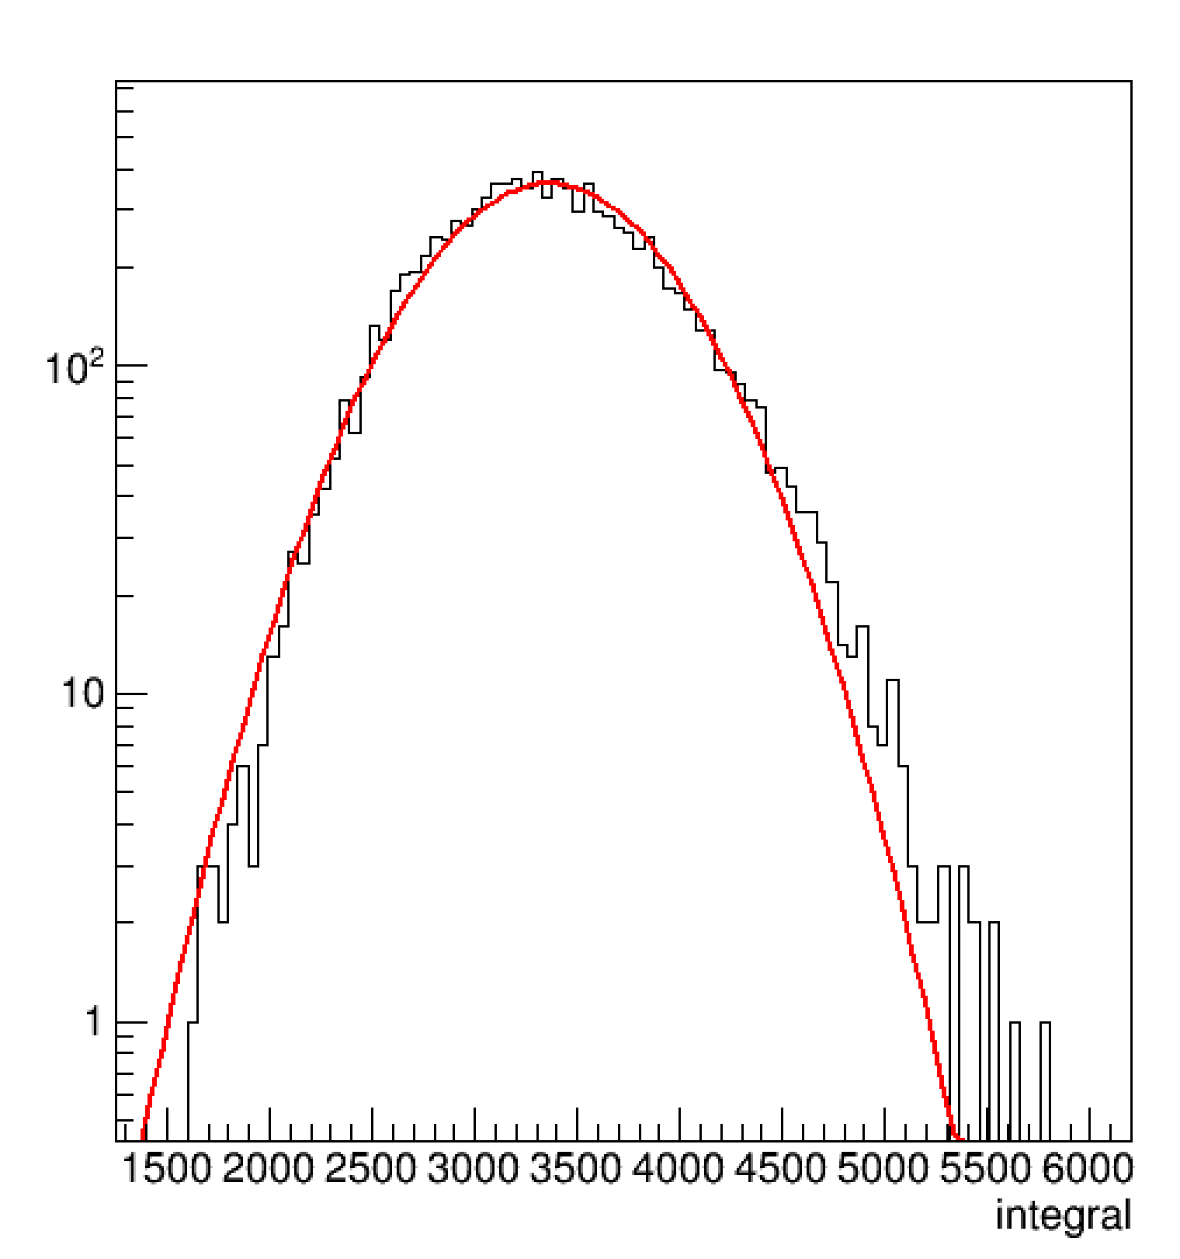
Let the Buyer Beware
IP-Glasma
https://arxiv.org/abs/1202.6646v2
IP-Jazma calculation for Au+Au b=9 fm events in dense-dense limit, no Q_{s,0}² fluctuation,.
Note the gluon distribution is not Gaussian (red line) and has a high side skew (Γ dist.).
Nothing to do with Glasma flux tubes.
IP-Jazma
dET/dy (a.u.)

Slide 48
Trento Comment… arXiv:1412.4708v2
Trento p=0 is similar to Ncoll scaling (with extra sqrt) with an impact parameter dependence for N-N collisions. Thus, with the right parameters, quite comparable to IP-Glasma, IP-Jazma (dense-dense)

Slide 49
STAR Preliminary results shown at QM 2018
https://indico.cern.ch/event/656452/contributions/2869833/attachments/1649479/2637419/QM18-smallsystem-shengli-10.pdf
Due to a small Δη gap, they have a huge non-flow contribution
(even at low p_{T}).
That is why they are so sensitive to the non-flow subtraction.
PHENIX results checked with Δη gap of 3 units and in systematic uncertainties.

Slide 50
Romatschke & Romatschke (https://arxiv.org/abs/1712.05815)
At RHIC energies, resulting Gaussian in Q_{s}² has σ = 0.32 fm. Note that this corresponds to a Gaussian in Q_{s} with σ = 0.45 fm.
Of course this depends on your choice of B_{G}, translating into R in the equation below.
In dense-dense limit, just sum Q_{s}² values for each nucleus.
Then energy density proportional to T_{A1A2} scaling

Slide 51
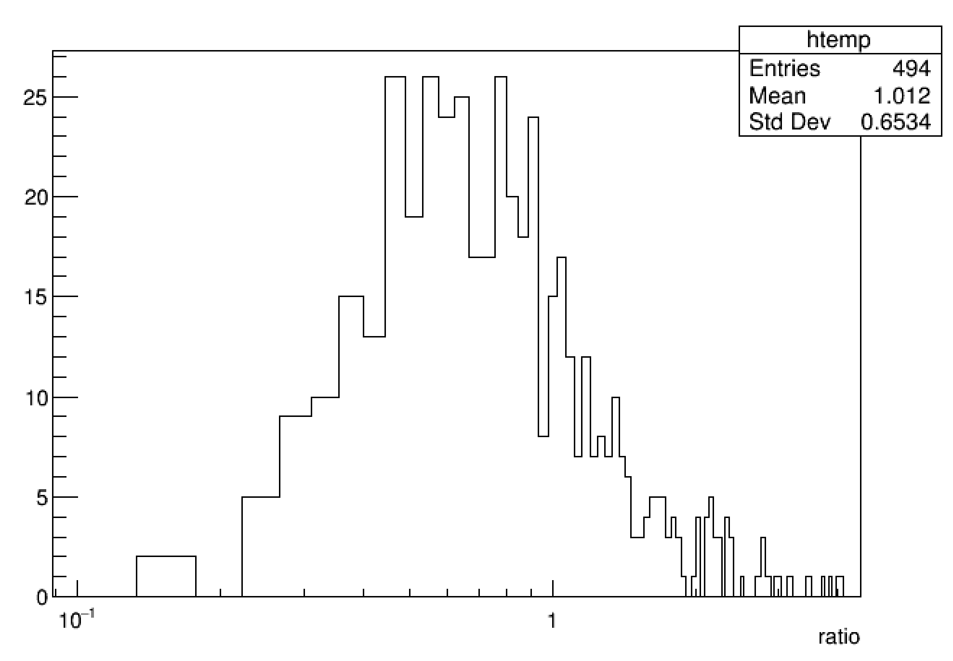
Dilute-Dense?
How valid is the dilute-dense limit when we effectively
select on events that are
larger fluctuations in the projectile saturation scale?
0.2
0.5
1.0
d+Au 0-5% high mult. events
Ratio Q_{s}² (proj) / Q_{s}²(targ)
weighted by the gluon contribution in that lattice cell (dilute-dense)
Q_{s}²(proj)/ Q_{s}²(targ)
Naively might have thought ratio ~ 1 / A^{1/3} ~ 0.2, but here we are selecting out fluctuations and cells with highest Q_{s}² (projectile).

Slide 52
d+Au @ 200 GeV
Settings: Dense-Dense, no Q_{s,0} ² fluctuations
We also obtain a reasonable (slightly worse) description of the data.
Modest adjustment of IP-Sat σ would allow better tuning.
N.B. No correlation between Q_{s,0}² projectile and gluon multiplicity.

Slide 53
d+Au case
If the target gluon was HUGE,
then all target gluons would “see” the same domains (all of them)
and
v₂(dAu) ~ v₂(pAu)
modulo the small overlap
But still need
v₂(dAu) > v₂(pAu)
See later…
Neutron
Proton

Slide 54
Reminder: The Deuteron is Big!
Proton-Neutron Separation

Slide 55

Integrating over Lattice Fluctuations
Romatschke & Romatschke (arXiv:1712.05815) found that integrating over these color fluctuations in IP-Glasma (some are lattice artifacts anyway) one obtains the energy density:
ε $∝$ g² Q_{s}²(proj) x Q_{s}²(targ) (dense-dense limit)
IP-Jazma is thus averaging over these lattice site fluctuations, and then assumes N_{gluon} proportional to energy density.
N.B. IP-Glasma always in the dense-dense limit,
including to obtain initial conditions for
p+Au, d+Au, ³He+Au, p+Pb (e.g. arXiv:1407.7557v1).

Slide 56
Ab initio or non pertinet
Many have stated that these color domains effects are calculated
ab initio
However, saturation physics in the proton at x > 0.01 challenges the whole picture of the formalism
One estimate has
Q_{s,0}² (gluon) = 0.67 GeV² for x = 0.01 at the very center of the proton,
and averaged over
r = 0.67 fm the value would be
Q_{s}² (gluon) = 0.28 GeV²

