Slide 1
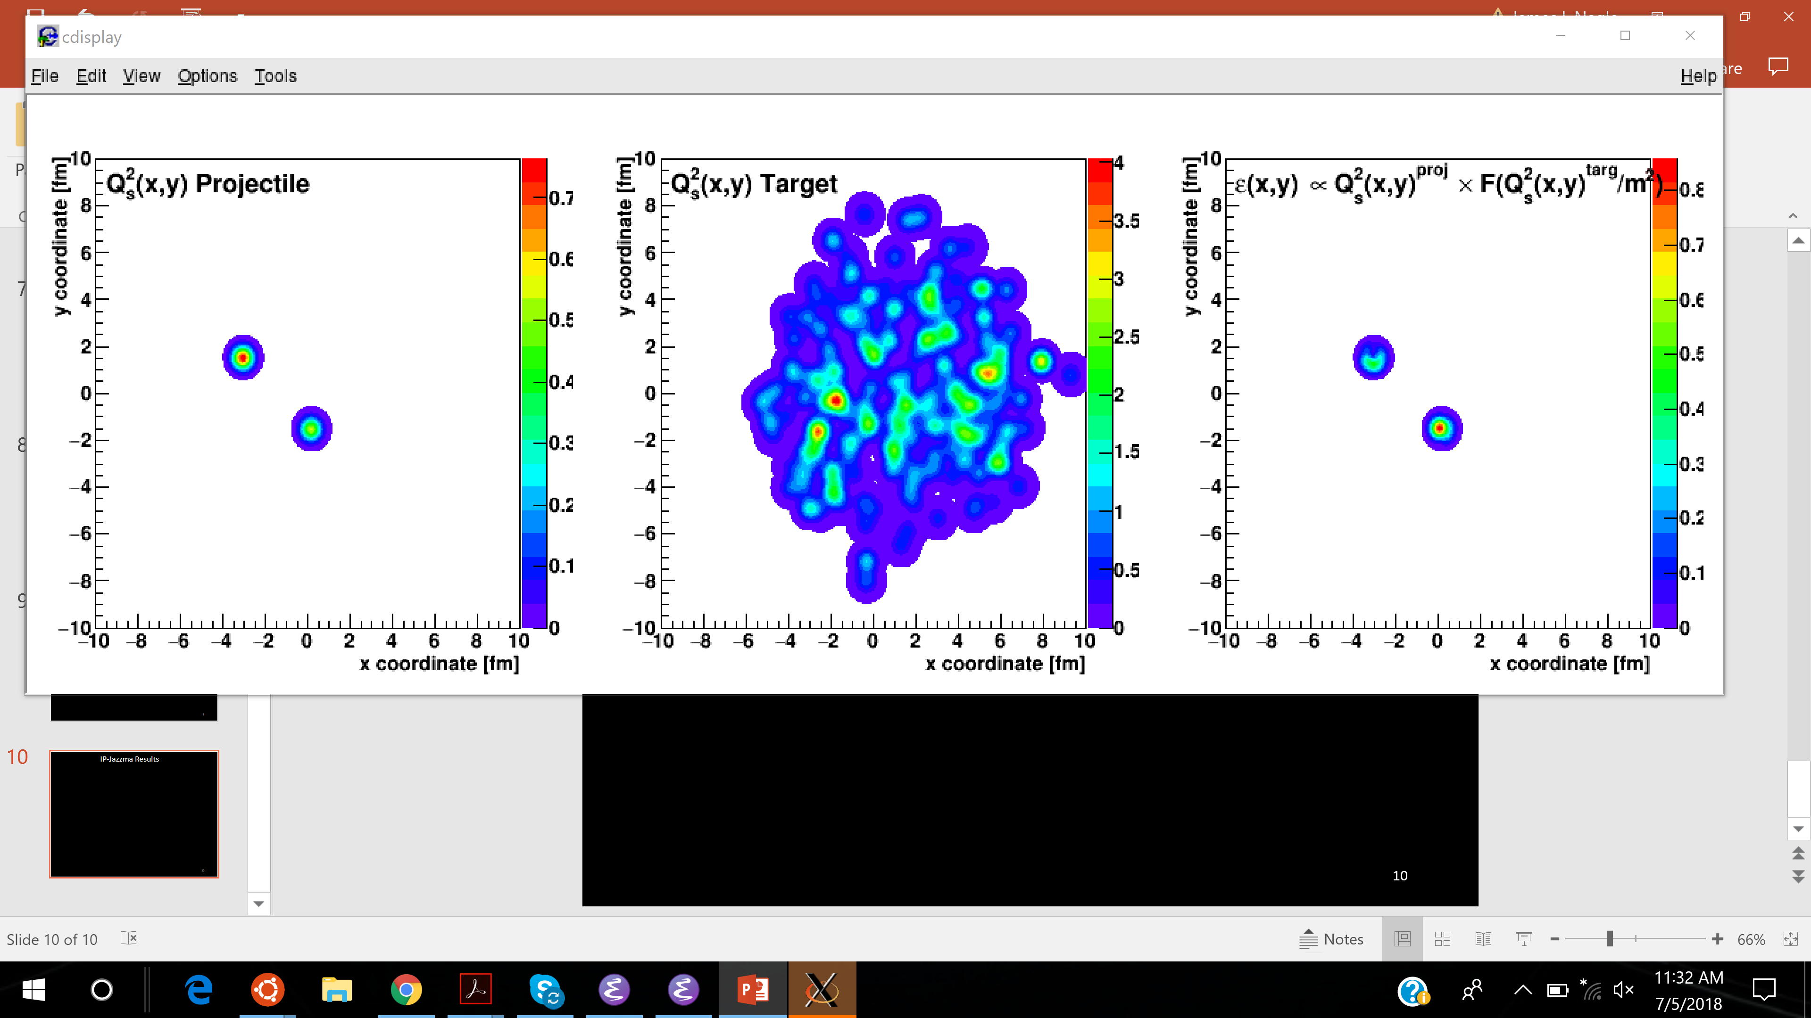
A critical assessment of theoretical explanations for small collision system observables
Jamie Nagle
University of Colorado Boulder and CEA/IPhT/Saclay
* Thank co-collaborators (Bill Zajc on IP-Jazma and Javier Orjuela Koop on AMPT) and many useful discussions at CEA/IPhT/Saclay and elsewhere.

Slide 2
Small System Quark-Gluon Plasma?
Quark-Gluon Plasma created in A+A collisions and described via hydrodynamics
Initial geometry translated into final state momentum anisotropies via pressure gradients
Strikingly similar observations in p+A / d+A as well as p+p
Long ago Bjorken postulated QGP formation in p+pbar via the creation of a modified vacuum state and was not concerned about the small number of final state hadrons
Nagle and Zajc, Annual Review, https://arxiv.org/abs/1801.03477

Slide 3
“One fluid to rule them all”
Weller and Romatschke, https://arxiv.org/abs/1701.07145

Slide 4
Code is all publicly available and documented.
Multiple groups cross checking and producing consistent results (for example iEBE-VISHNU).
What are the systematic uncertainties, open items?
MC Glauber + Constituent Quarks needed for p+p and includes some Gaussian σ value for local “gluon cloud”
Bulk viscosity important to temper large radial expansion in p+p, but not as critical in A+A
Pre-equilibrium (superSONIC) or not (SONIC)
Unknown η/s(T) value. superSONIC results with η/s = 1/4π for all systems.
Hadronic cascade model (B3D in superSONIC)
Important questions about hydro far from equilibrium which is an entire other talk (!)

Slide 5
RHIC Geometry Scan

Slide 6
PHENIX Experimental Data
New v₃ in p+Au, d+Au completes the set!
Following the ordering of eccentricities.
However, multiplicity also plays a role.
PHENIX, https://arxiv.org/abs/1805.02973

Slide 7
New PHENIX Multiplicity Measures
https://indico.cern.ch/event/656452/contributions/2869993/
Midrapidity Values
dN_{ch}/dη ~ 12 p+Au 0-5%
dN_{ch}/dη ~ 18 d+Au 0-5%
dN_{ch}/dη ~ 22 ³He+Au 0-5%
Hydrodynamic calculations include the initial geometry differences and match the particle multiplicity for each system

Slide 8
Hydrodynamic Comparison
Good agreement with v₂, v₃ (p_{T}) for all three systems
SONIC is a published prediction
No tuning of parameters or options for different systems

Slide 9
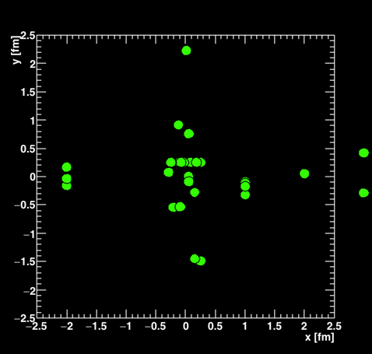
Parton Transport Explanation
In limit of many scatters per parton (> 4-5), this might be a dual picture to hydrodynamics
However, if most partons have zero scatters and others have just one, that seems different
AMPT Escape Mechanism paper finds very few scatterings
He et al., https://arxiv.org/abs/1601.00878
Recent analytic approach generates significant v₂ with single scatter
Kurkela, Wiedemann, Wu
arXiv:1805.04081
arXiv: 1803.02072

Slide 10
Small system studies with AMPT (publicly available code)
Nagle et al., arXiv:1707.02307, Orjuela Koop et al., arXiv:1512.06949, arXiv:1501.06880
Bozek, Bzdak, Ma, arXiv:1503.03655
AMPT v2.25t5 relative to true geometry defined by initial nucleons
string melting mode, black disk σ_{NN}, σ_{parton} = 0.75 mb
Poor quantitative agreement with data, but rough
qualitative agreement with system v_{n} ordering

Slide 11
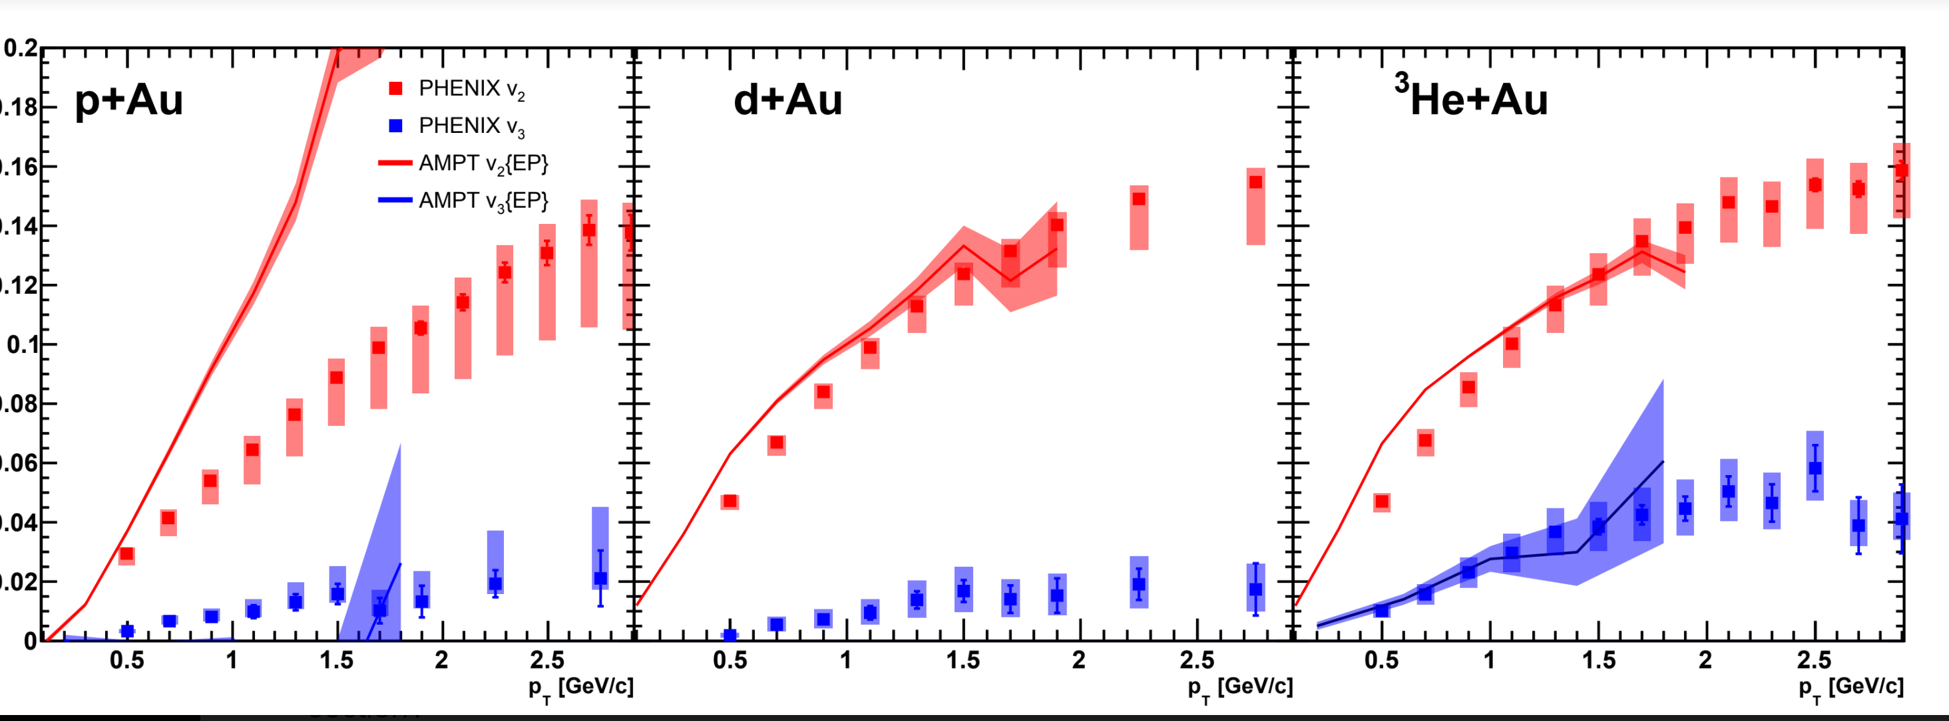
Apples-to-Apples Comparison
AMPT fully modeling the Event Plane method in PHENIX
Better agreement in ³He+Au, but much worse in p+Au (non-flow),
insufficient statistics for v₃ in the smaller systems (working on it)

Slide 12
Proton-Proton Case
Extend AMPT to include sub-nucleonic structure (3 quarks)
Rough qualitative agreement

Slide 13
Parameters, parameters, parameters
→ without too much physics behind them
Quasiparticle picture only useful if one can correctly identify quasiparticles and their properties (think Condensed Matter Physics)
→ which in AMPT are nearly massless < 20 MeV quarks, no gluons
AMPT uses Zhang Parton Cascade to model the Boltzmann equation.
However, only valid when Dilution parameter D = λ/ l << 1
(violated in AMPT)
Also, extremely short “formation times”

Slide 14
Initial State Explanation(s)

Slide 15
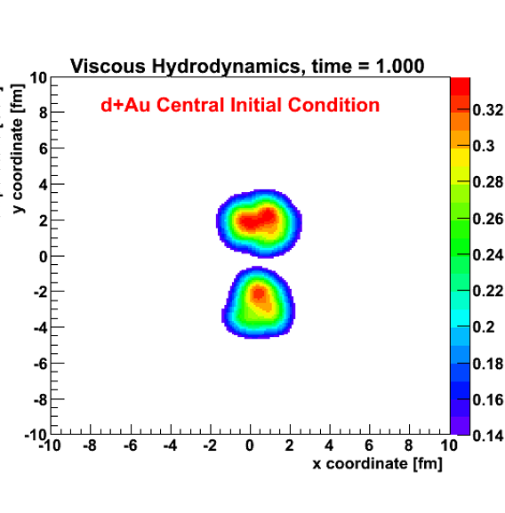
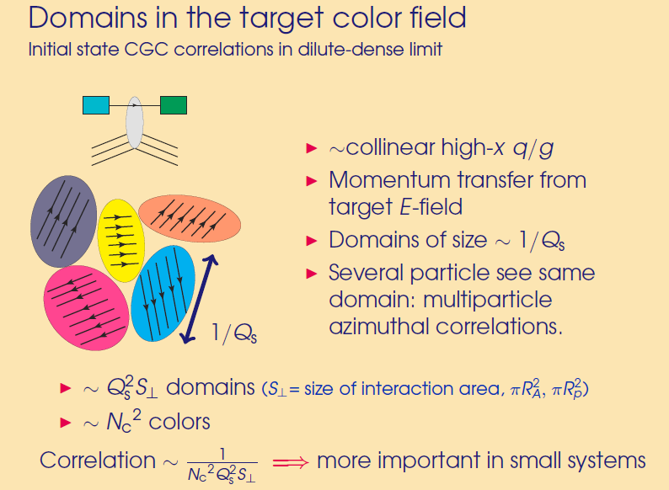
More domains that are
not aligned,
correlation effect is washed out.
Nice separation of scales
Deuteron size >> Domain Size
15
Exactly the opposite of what is observed in data !
Definitively rule out scenario where initial state correlations dominate via resolved domains of size 1/Q_{s}

Slide 16
15 days after the PHENIX paper was posted, postdictions appeared
Mace et al. [MSTV], https://arxiv.org/abs/1805.09342
Remarkable results seem counter-intuitive
Code is not publicly available, many details missing so not possible to
reproduce results yet
“There are a number of steps — all of which are essential”

Slide 17
What is essential to the physics result?
Think of a gluon from the target and its interaction with domains in the projectile…
Thus, applying saturation physics to the proton at RHIC for midrapidity particle production up to p_{T} ~ 3 GeV/c (?)
If the k_{T} < Q_{s} (proj) then the target cannot resolve individual domains and interacts with many of them “coherently”.
Color fields aligned over 2 fm distance?
Violates color confinement?
Not sure if that is their picture…
In d+Au, deuteron is “big” – average transverse separation > 2 fm

Slide 18
← Domains not resolved
Domains resolved →
Q_{s} (deut) > Q_{s} (prot) since 0-5% d+Au is higher multiplicity than p+Au,
and v₂ scales with Qs(proj), thus v₂ (d+Au) > v₂(p+Au)
k_{T} < Q_{s} (proj) → does that mean Q_{s}(proj) = 2.5 GeV (?)
Not exactly and need exact definition and numbers for k_{T}

Slide 19

IP-Jazma
Jamie Nagle and Bill Zajc’s attempt to understand a subset of the ingredients in recent saturation physics calculations for small systems.
Just like Jazz, some people will not appreciate it.
Note, I am glad to learn of mistakes, hidden assumptions, etc. That is how I learn.

Slide 20
IP-Jazma Details
1. MC Glauber to obtain nucleon x,y positions in each event
Use IP-Sat (impact parameter saturation model) to calculate the Q_{s}² distribution on an x,y lattice
Note that this is just a uniform Gaussian with σ = 0.32 fm at RHIC
Q_{s}² is proportional to g⁴μ² , where μ² is the number density of color charge per unit transverse area
Q_{s} is proportional to g²μ and is Gaussian with σ = 0.45 fm
MSTV (private comm.) says that “our choice of B_{G}” corresponds to slightly larger σ = 0.56 fm, so I will match that in IP-Jazma

Slide 21
MSTV includes nucleon-by-nucleon fluctuations in Q_{s,0} ²
(the amplitude of the IP-Sat Gaussian). Thus, each nucleon is still a perfect Gaussian, just different amplitudes.
Implemented with variance 0.5 on log(Q_{s}²) – i.e. high side tail.
Non-perturbative on many scales
Not derivable from any first principles calculation
No explicit constraint on magnitude or shape

Slide 22
Originally proposed by McLerran (arXiv:1508.03292v2) to explain high multiplicity tail of LHC p+p N_{ch} distributions.
Q_{s,0}² fluctuates to 5-6 times average value to
explain the high N_{ch} tail.
* It is a mistake to assume such matching confirms dynamical fluctuations, instead of from hadronization effects, finite rapidity window, experiment acceptance, etc.

Slide 23
deuteron
+
gold
IP-Jazma
Sum all the Q_{s}² contributions for each nucleus.
Example - nucleons from deuteron as perfect Gaussians from IP-Sat just with different amplitudes from Q_{s,0} ² fluctuations.
At this point, none of these fluctuations are ab initio. All from MC Glauber and put-in-by-hand Q_{s,0} ² fluctuations.

Slide 24

Integrating over Lattice Fluctuations
Romatschke & Romatschke (arXiv:1712.05815) found that integrating over these color fluctuations in IP-Glasma (some are lattice artifacts anyway) one obtains the energy density:
ε $∝$ g² Q_{s}²(proj) x Q_{s}²(targ) (dense-dense limit)
IP-Jazma is thus averaging over these lattice site fluctuations, and then assumes N_{gluon} proportional to energy density.
N.B. IP-Glasma always in the dense-dense limit,
including to obtain initial conditions for
p+Au, d+Au, ³He+Au, p+Pb (e.g. arXiv:1407.7557v1).

Slide 25

Dilute-Dense Framework
In the MSTV paper, they utilize the dilute-dense framework
(hep-ph/0402256, hep-ph/0402257, arXiv:0711.3039)
The dilute-dense limit implies that Q_{s}(proj) < k_{T} < Q_{s}(targ) and one obtains on average:
ε $∝$ g² Q_{s}²(proj) x F( Q_{s}(targ)/ m ) (dilute-dense limit)
where m is the infrared cutoff (= 0.3 GeV in MSTV).

Slide 26
IP-Jazma Dilute-Dense
Cyrille Marquet (thanks) sent me this function F.
In the limit of large Q_{s}(targ)/m, it scales as log(Q_{s}(targ)/m).
ε $∝$ g² Q_{s}²(proj) x F( Q_{s}(targ)/m) ) (dilute-dense limit)
Once you hit a thick enough part of the target,
you free all the projectile gluons and no more.

Slide 27
IP-Jazma Results
Right panel shows the energy density distribution for this event in the dilute-dense limit
There are no sharp spikes in the energy density as often highlighted with IP-Glasma because there are no lattice site color fluctuations – though these are in part artifacts in IP-Glasma.
ε $∝$ g² Q_{s}²(proj) x F( Q_{s}(targ)/m ) (dilute-dense limit)

Slide 28
p+Au @ 200 GeV
Settings: Dilute-Dense, no Q_{s,0} ² fluctuations,
no running α_{s}, r_{max} = 3.0 σ [leave these last two the same]
Distribution of number of gluons (N_{g}/<N_{g}>)
Makes intuitive sense…
Once the proton is hitting the mid-region of the target nucleus the gluon production
hits the limit --
i.e. one has freed all the gluons from the projectile proton

Slide 29
p+Au @ 200 GeV
Settings: Dilute-Dense, yes Q_{s,0} ² fluctuations
In the Monte Carlo, keep track of the Q_{s,0} ² thrown for each projectile nucleon.
As expected, there is an almost linear increase in gluon number with Q_{s,0} ² in the projectile once one is hitting a thick enough part of the nucleus.
For 0-5% high-multiplicity, the value is 2.2 times higher than average.

Slide 30
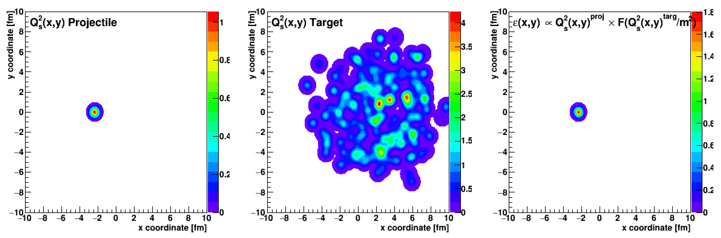
p+Au @ 200 GeV
Settings: Dilute-Dense, yes Q_{s,0} ² fluctuations
Define AREA by region where
ε > minvalue
Calculate Q_{s}²(x,y) projectile averaged over the AREA
Average Q_{s}²proj
Area
Higher multiplicity →
Larger Area
Larger saturation scale
within that Area

Slide 31
d+Au @ 200 GeV
Settings: Dilute-Dense, no Q_{s,0} ² fluctuations
Similar feature as in p+Au case with no Q_{s0}² fluctuations.
One hits the limit of freeing gluons from the projectile, proton and neutron in the deuteron
Broader than p+Au due to more possible geometry variations

Slide 32
d+Au @ 200 GeV
Settings: Dilute-Dense, yes Q_{s,0} ² fluctuations
Agreement with STAR data and MSTV calculation.
Common with MSTV we have MCGlauber fluctuations, IP-Sat Q_{s,0} ² fluctuations.
The additional color fluctuations in MSTV do not appear to be evident as dominant features in this particular comparison.

Slide 33
Ponder this figure. All the discussion of YM solutions,
color fluctuations, CGC natural derivation of NBD,
and IP-Jazma reproduced Prob(N_{gluon}) without any of this…
The only difference is at N_{g}/<N_{g}> > 4.2 where the MSTV calculation diverges from the data (less than 0.5% highest multiplicity)

Slide 34
d+Au @ 200 GeV
Settings: Dilute-Dense, yes Q_{s,0} ² fluctuations
As expected there is a correlation of higher multiplicity events with larger Q_{s,0} ² fluctuations.
Not as large an effect as in p+Au because the deuteron nucleons fluctuate separately.

Slide 35
d+Au @ 200 GeV
Settings: Dilute-Dense, yes Q_{s,0} ² fluctuations
Average Q_{s}²proj
Area
r_{T}
0-5% p+Au d+Au
Area (fm²) 2.81 4.52
< Q_{s}² > proj 0.56 0.53
In IP-Jazma, dilute-dense, Q_{s,0}² fluc.
in 0-5% central events
N_{g}(d+Au)/N_{g}(p+Au) ~ 1.5
The area ratio ~ 4.52/2.81 = 1.6
while < Q_{s}² >proj is the same.
* Also deuteron n-p mean transverse separation remains > 2 fm.

Slide 36
“In the dilute-dense framework, the multiplicity of an event
scales with Q_{s}² projectile.
Thus for 0-5% centralities, Q_{s}² (deuteron) > Q_{s}² (proton).” [MSTV]
IP-Jazma dilute-dense, Q_{s,0}² fluc
d+Au
p+Au
d+Au
p+Au
Circles are in the mid-range of 0-5% central…
Above “parametric” relation is just not true in IP-Jazma.
I am not sure how this can be true in the full MSTV, and it is essential to their result since v₂ is directly related to Q_{s}.

Slide 37
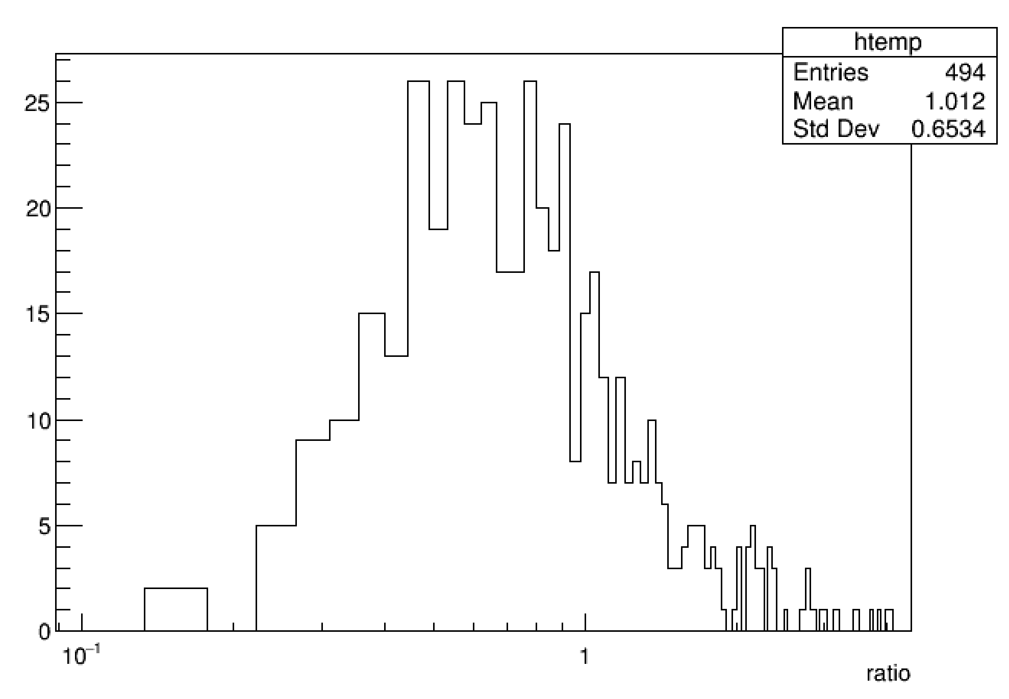
Dilute-Dense?
How valid is the dilute-dense limit when we effectively
select on events that are
larger fluctuations in the projectile saturation scale?
0.2
0.5
1.0
d+Au 0-5% high mult. events
Ratio Q_{s}² (proj) / Q_{s}²(targ)
weighted by the gluon contribution in that lattice cell (dilute-dense)
Q_{s}²(proj)/ Q_{s}²(targ)
Naively might have thought ratio ~ 1 / A^{1/3} ~ 0.2, but here we are selecting out fluctuations and cells with highest Q_{s}² (projectile).

Slide 38
d+Au @ 200 GeV
Settings: Dense-Dense, no Q_{s,0} ² fluctuations
We also obtain a reasonable (slightly worse) description of the data.
Modest adjustment of IP-Sat σ would allow better tuning.
N.B. No correlation between Q_{s,0}² projectile and gluon multiplicity.

Slide 39
IP-Jazma (dilute-dense, Q fluc)
One obtains similar agreement in
a picture assuming large fluctuations in the projectile saturation scale
(2) a picture with a fixed projectile and an increasingly thick nuclear target
Of course the v₂ glasma correlations implied are completely different in the two scenarios
IP-Jazma (dense-dense, no Q fluc)
Scenario (2) is just called wounded nucleon scaling

Slide 40
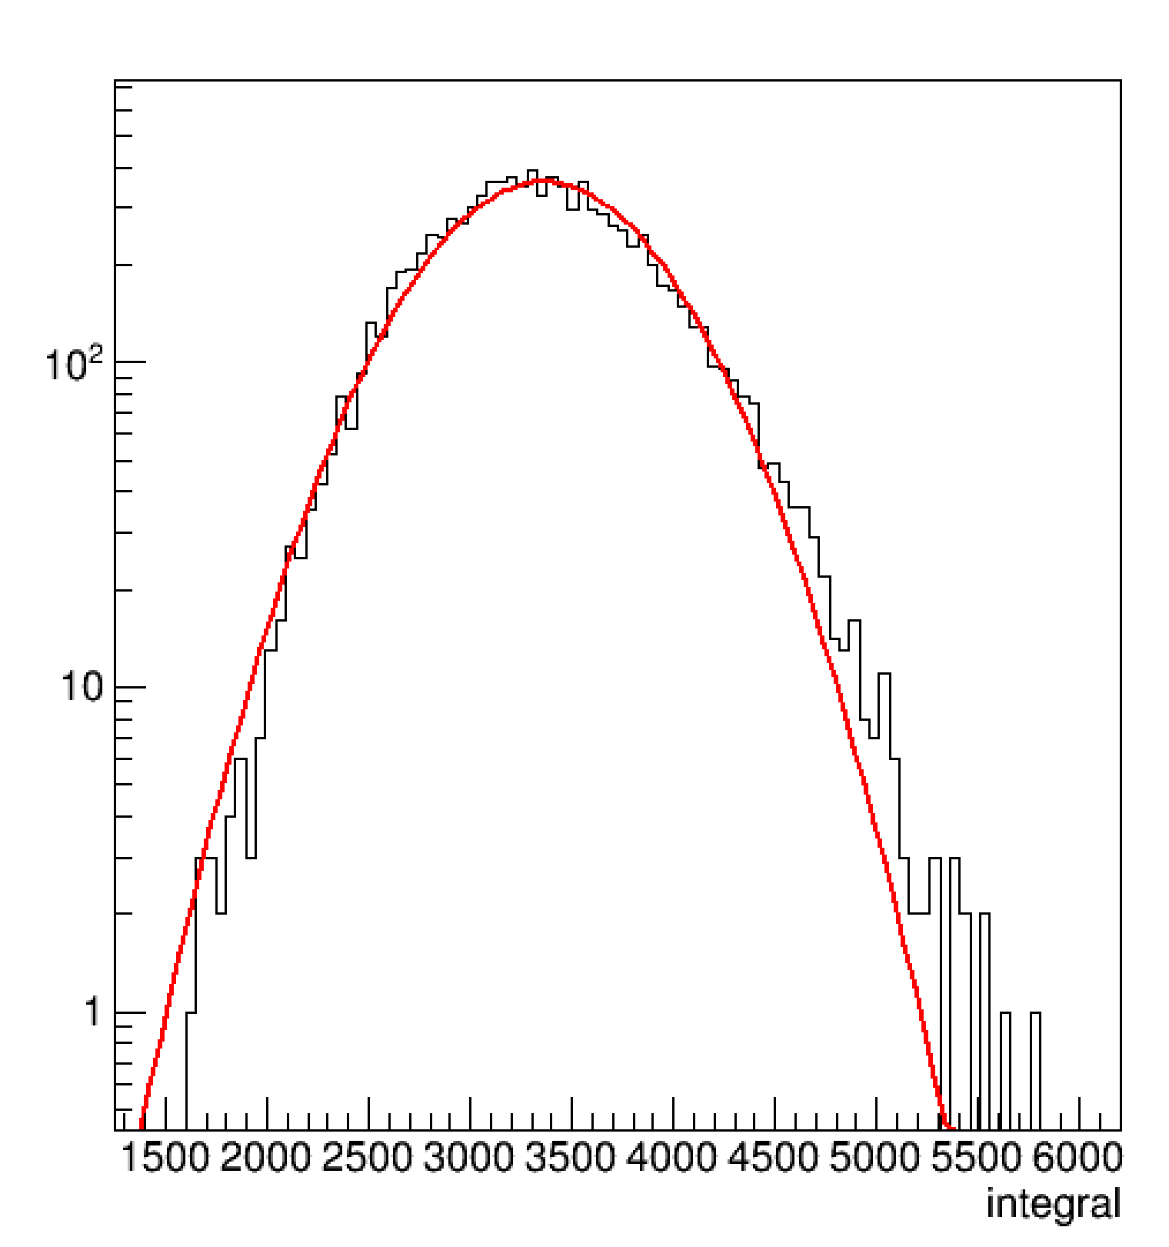
Let the Buyer Beware
IP-Glasma
https://arxiv.org/abs/1202.6646v2
IP-Jazma calculation for Au+Au b=9 fm events in dense-dense limit, no Q_{s,0}² fluctuation,.
Note the gluon distribution is not Gaussian (red line) and has a high side skew (Γ dist.).
Nothing to do with Glasma flux tubes.
IP-Jazma
dET/dy (a.u.)

Slide 41
Where do the checks stand?
We are unable to reproduce MSTV explanation of ordering.
Need to have a complete set of comparison figures with the full MSTV calculation to resolve.
Publicly available code?
IP-Jazma with v₂/v₃ calculation?
Length scale of aligned color fields? Color confinement?
Saturation physics in RHIC proton?
Do these large Q_{s} fluctuations make sense?
Dilute-dense means Q_{s}(proj) < k_{T} < Q_{s}(targ)
Target gluon “seeing” a single domain for k_{T} < Q_{s}(proj)
All k_{T} values need strict definition and numbers in all cases

Slide 42
One thing is clear…
MSTV prediction that turns out to be another postdiction…
Existing PHENIX measurement already rules this out!
MSTV d+Au
MSTV p+Au

Slide 43
Summary (So Far)
Exciting times for studying small system collectivity
Completion of experimental geometry scan at RHIC
Best agreement via hydrodynamics with QGP stage
All theory approaches deserve full scrutiny
IP-Jazma new tool for identifying the dominant source of fluctuations in the saturation physics framework
Further work to resolve differences in explanations with MSTV result

Slide 44
Extras

Slide 45
In previous IP-Glasma papers (e.g. arXiv:1311.3636) they point out the huge difference between gluons and hadrons.
Why is this effect ignored in the MSTV paper?
It would be good to compare the MSTV gluon p_{T} distribution with the published hadron p_{T} distribution.

Slide 46
Trento Comment… arXiv:1412.4708v2
Trento p=0 is like Ncoll scaling with an impact parameter dependence for N-N collisions. Thus, with the right parameters, quite comparable to
IP-Glasma, IP-Jazma (dense-dense)

Slide 47
STAR Preliminary results shown at QM 2018
https://indico.cern.ch/event/656452/contributions/2869833/attachments/1649479/2637419/QM18-smallsystem-shengli-10.pdf
Due to a small Δη gap, they have a huge non-flow contribution
(even at low p_{T}).
That is why they are so sensitive to the non-flow subtraction.
PHENIX results checked with Δη gap of 3 units and in systematic uncertainties.

Slide 48
Romatschke & Romatschke (https://arxiv.org/abs/1712.05815)
At RHIC energies, resulting Gaussian in Q_{s}² has σ = 0.32 fm. Note that this corresponds to a Gaussian in Q_{s} with σ = 0.45 fm.
Of course this depends on your choice of B_{G}, translating into R in the equation below.
In dense-dense limit, just sum Q_{s}² values for each nucleus.
Then energy density proportional to T_{A1A2} scaling

Slide 49
Different Parameters
Qs^2 fluctuations, 0.5 variance in log(Qs^2). 0.5 is said to be fit to the d+Au Nch distribution, but it happens to be identical to the value for LHC p+p from an earlier paper.
R in IP-Sat based on B_G value, nominally constrained by HERA data
Infrared cutoff m = 0.3 GeV seems large. Previous paper had systematics with 0.1-0.2 GeV
Rmax on IP-Sat – how far to carry the Gaussian tails out…
In the IP-Jazzma calculation we extend the Gaussian out 3.0 sigma.
In IP-Glasma, communication with the authors indicates that this is often extended to 10 fm (!) and this can make a difference in epsilon_3 values and other epsilon_n values in ultra-central A+A where fluctuations dominate.
-- side note, the HERA constraint on IP=Sat must only constrain something like a couple of moments and not the tail of the distribution (this is unconstrained). Similarly, 3-quark configurations have a HERA constraint on parameters, but the 3-quark part is just an ansatz (totally unconstrained).
Evaluating running of alpha_s (g^2). Some IP-Glasma papers do this at the scale max(Qsproj, Qstarg). This can have a major impact on the spatial distribution…

Slide 50
MSTV paper says:
0-5% p+Au d+Au
Area (fm²) 2.81 4.52
< Q_{s}² > proj 0.56 0.53
We do not find the effect they state between systems!
We find the rather intuitive result (more area).

Slide 51
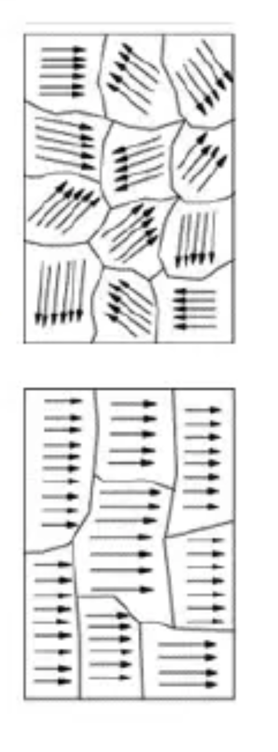
MSTV basic mechanism for v₂
“gluons in the target will coherently interact with (Q_{s}^{proj}/k_{T})² domains”
Think of ferromagnetic material.
If one scatters only from individual domains, more domains washes out the v₂ (all agree on that point).
If one scatters over all of them at once (individual domains not resolved), is it obvious why the effect is not still washed out?
Or is it a set of k_{T} kicks like a random walk and so more domains means a larger <k_{T}> from the walk?

Slide 52
Kurkela et al. (arXiv:1805.04081) comment
Note that at η/s = 0.2, l_{mfp} = 1/T (i.e. the typical wave packet size)
Thus, even at η/s = 0.4, l_{mfp} ~ 2 * typical wave packet size
(not much of a separation of scales)
Also, factors or 2 and π really matter here. Check the 1/T prefactors.

