Slide 1
(Non) Random Thoughts I Think…
Jamie Nagle (University of Colorado Boulder)

Slide 2
What are small system results telling us?
Small system results need to be viewed together as a whole…
So many things appear the same…
the idea that the physics is completely different at RHIC and the LHC, completely different in p+p and p+Pb, completely different in p+Au and d+Au seems vanishingly small…
What can we find consensus on?

Slide 3
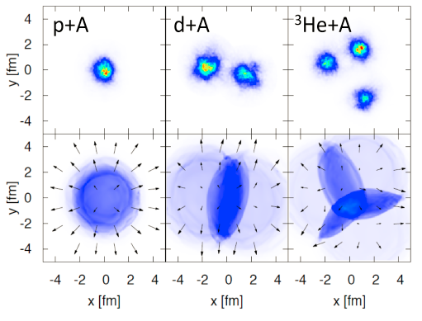
ε₂^{IPGlasma} = 0.099
ε₂^{Glauber} = 0.231
ε₂^{IPGlasma} = 0.595
ε₂^{Glauber} = 0.540
ε₂^{IPGlasma} = 0.555
ε₂^{Glauber} = 0.504
p+p and p+A have significant
model dependent initial geometry.
Not so for d+A and ³He+A.

Slide 4
Deuteron wavefunction is well known and the geometry validated by experiment.
d+Au
Sometimes the neutron
misses
http://journals.aps.org/prc/abstract/10.1103/PhysRevC.90.034902

Slide 5
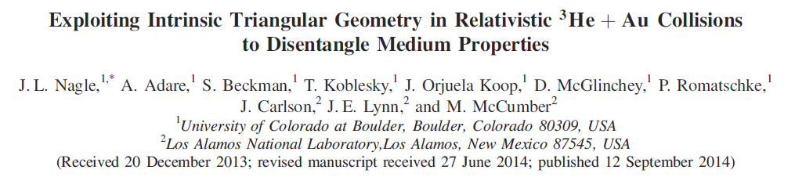
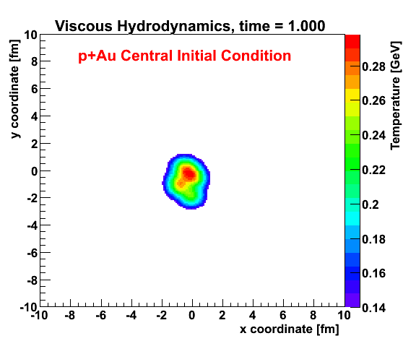
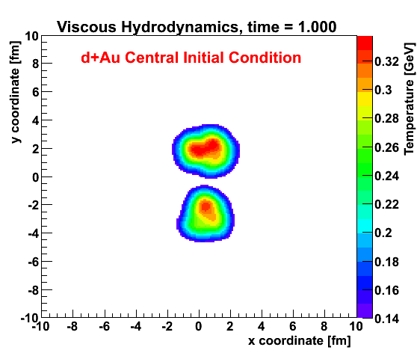
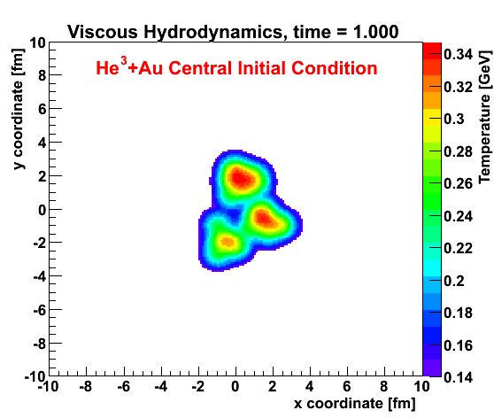
Geometry Tests at RHIC
http://journals.aps.org/prl/abstract/10.1103/PhysRevLett.113.112301

Slide 6
Experimental results and hydrodynamic predictions

Slide 7
Experimental results and hydrodynamic predictions

Slide 8
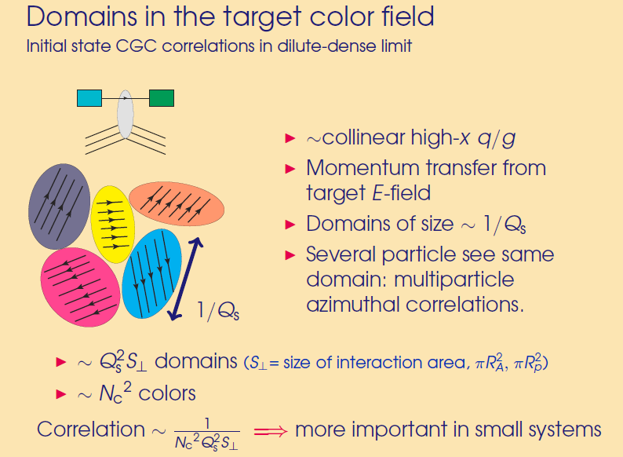
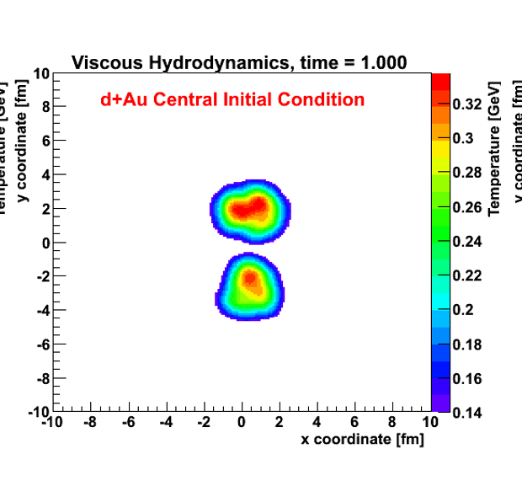
Key Point on “Momentum Domains” Explanation
Non-Geometry correlations in momentum space
In a d+Au system,
domains from two hot spots are uncorrelated.
Thus, v₂ has a dilution effect.
v₂ (d+Au) < v₂ (p+Au)
Needs a full calculation.
Then falsifiable theory.

Slide 9
Extend small system data from
19.6 GeV → 200 GeV → 5.02 TeV

Slide 10
PHENIX d+Au Beam Energy Scan
See Darren McGlinchey’s QM17 Talk

Slide 11
Two- and Four- Particle Cumulants
Higher cumulants themselves are not unique to
hydrodynamics or collectivity.
However, they are a powerful constraint on model calculations.
See Ron Belmont’s QM17 Talk

Slide 12
Multi-Particle Cumulants at the LHC
https://arxiv.org/abs/1606.06198
v{2}² = <v>² + σ² + δ²
v{4}² = <v>² – σ²
Detailed relation of cumulants with geometry fluctuations… Why is p+p different?

Slide 13
AMPT Shows v₂{2} and v₂{4} splitting dominated by geometry fluctuations… and mean agrees with “true geometry” result.
Explanation of cumulants in terms of geometry fluctuations fails in p+p case, and also breaking down in lower energy d+Au?
σ_{ε2}/ε₂ ∼ σ_{v2}/v₂
σ_{ε2}/ε₂ ∼ σ_{v2}/v₂

Slide 14
In p+A, proton substructure matters
Not ³He but rather 3 constituent quarks
Simplest extension to proton substructure…

Slide 15
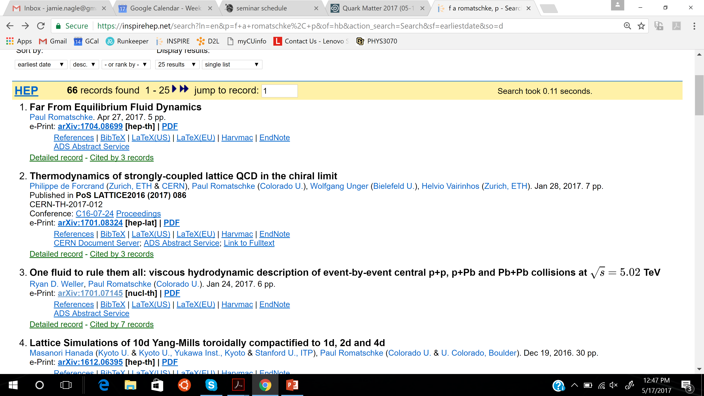

Slide 16
Really? Where does low-multiplicity
d+Au @ 39 GeV fit (mini-jets?)
This paradigm does not address the data as a whole (RHIC & LHC, pp-pA-dA-HeA, …)

Slide 17
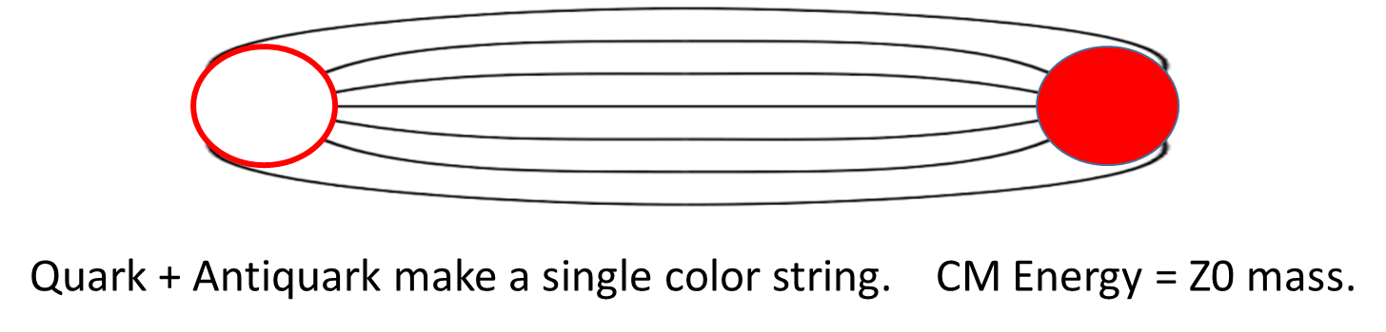
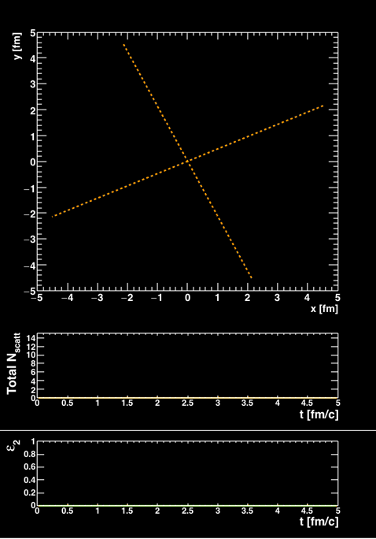
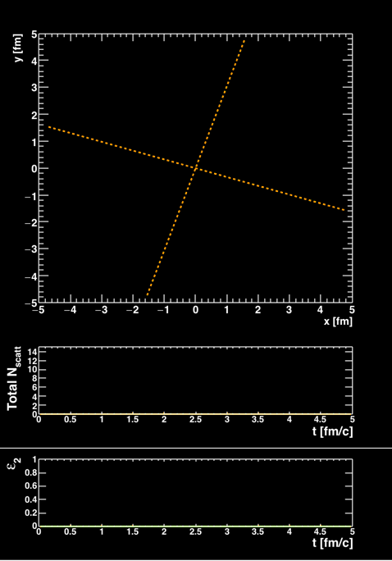
What about in e⁺e- collisions?
Study with modified AMPT underway. Geometry only from fluctuations in parton generation from a single string.

Slide 18
What are small system results telling us?
What are predictions or consequences of hydrodynamics or final state parton scattering in small systems?
Jet Quenching Effects?

Slide 19
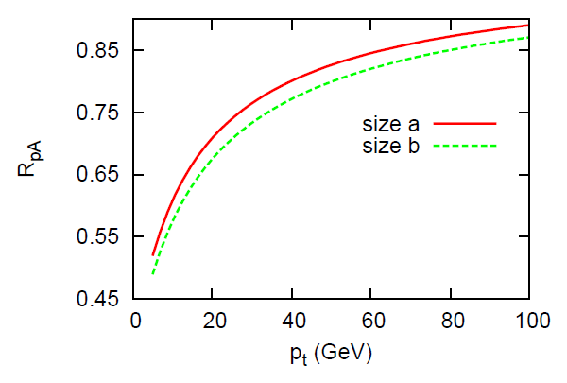
http://arxiv.org/abs/1311.5463
p+Pb Central

Slide 20
p+Pb Experimental Results (Minimum Bias)
Hard to find min. bias modifications at high p_{T},
though non-negligible systematic uncertainties.
Multiplicity (“centrality”) selection is still an open issue…

Slide 21
How to resolve?
Is the auto-correlation with any centrality measure too big to overcome?
Exact physics model? Is that enough?
ALICE method with Pb-spectator neutrons might help, but a very broad central bin (nothing like 0-1%)…

Slide 22
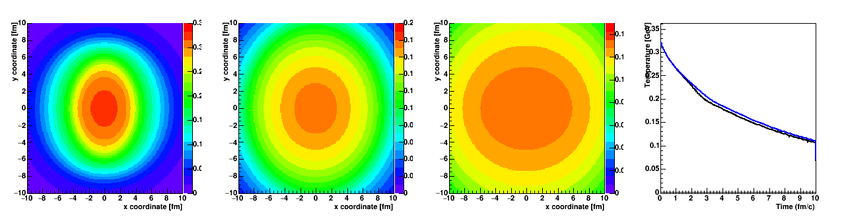
Jet quenching and high p_{T} v₂
Looks like a big path dependence (up vs. down)
However, hydrodynamic evolution washes most of this out. Only very modest temperature difference at late time between paths.
This is why quenching models invoke “near Tc enhancement”.
Trying to amplify this late time small difference.

Slide 23
JEWEL – question of path dependence versus jet shape…
The default JEWEL medium
does not expand in the
transverse plane…
Pb+Pb agreement with high
pT jet v2.
However….

Slide 24
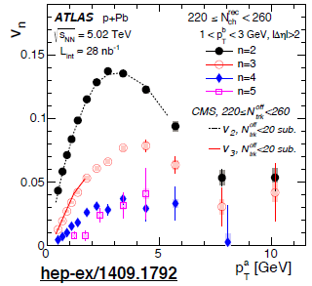
More than a hint in p+Pb at high p_{T}…
Would love to have more statistics extending up in pT…
Also with measurements at RHIC in p/d+Au…

Slide 25
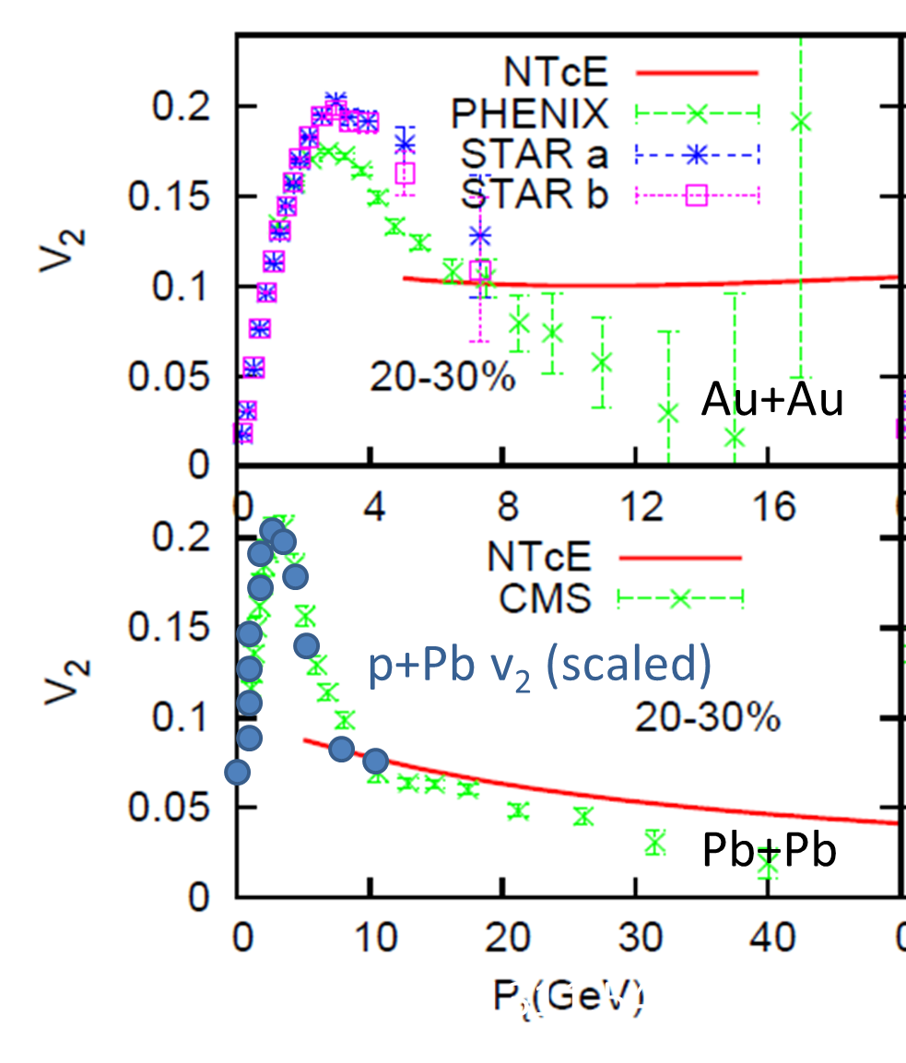
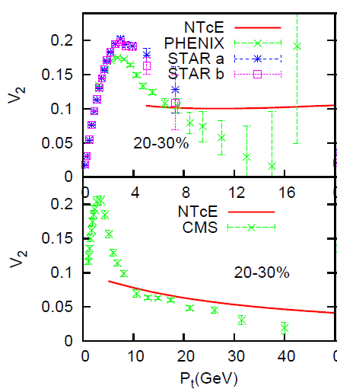
NTcE – Near T_{c} Enhancement of medium coupling boosts the v2 at high p_{T}.
3 Regions
Low pT → Hydro
High pT → E-loss
Mid pT → ???
Scaled p+Pb points
match the Pb+Pb pattern
What does that tell us about the 3 regions?

Slide 26
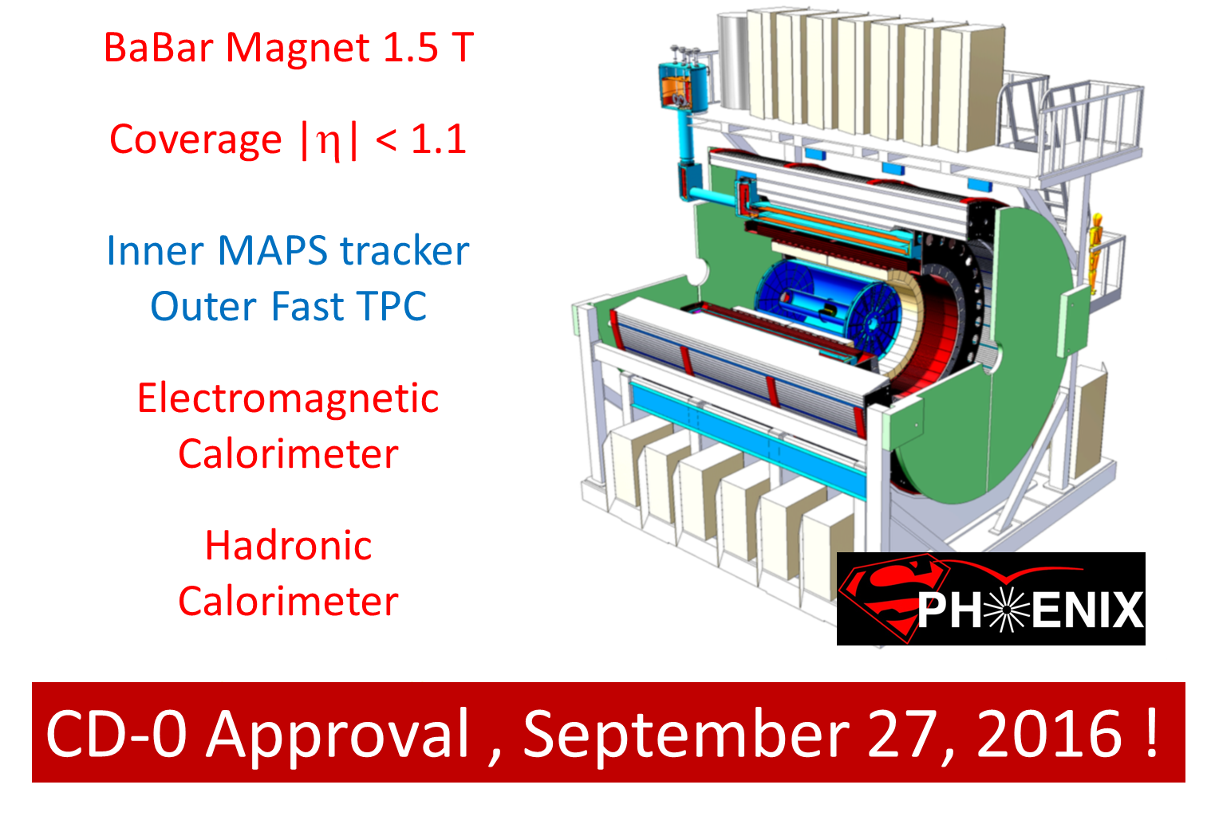

Slide 27
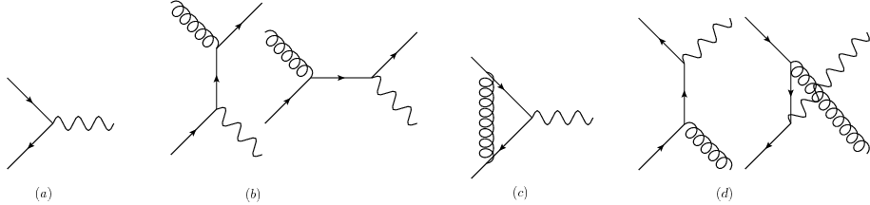
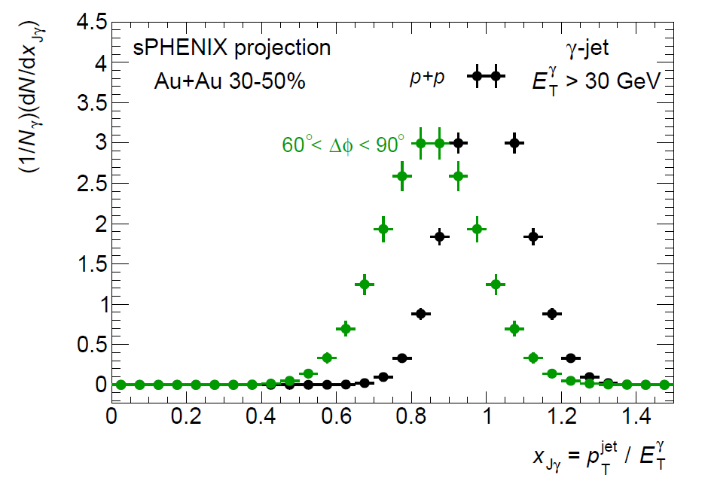
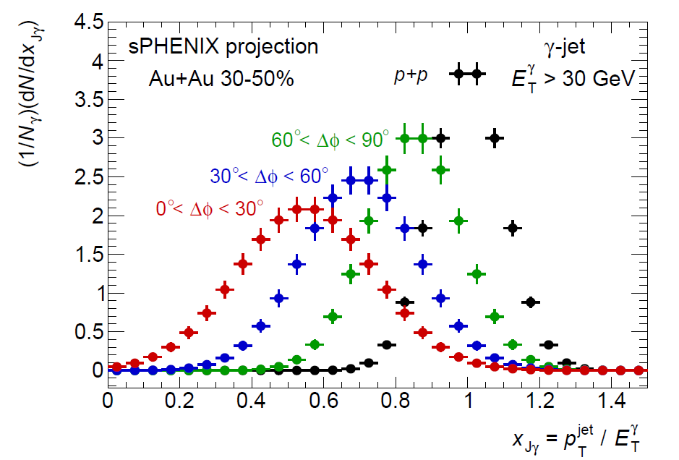
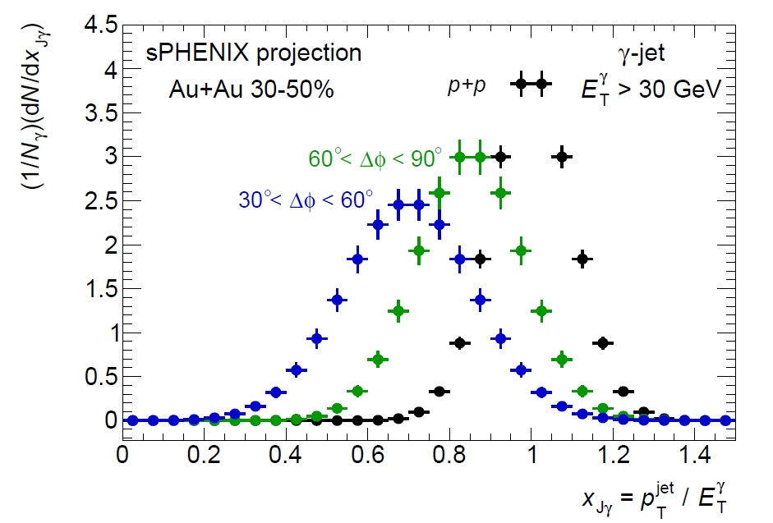
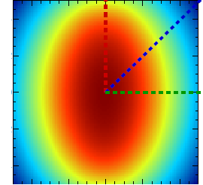
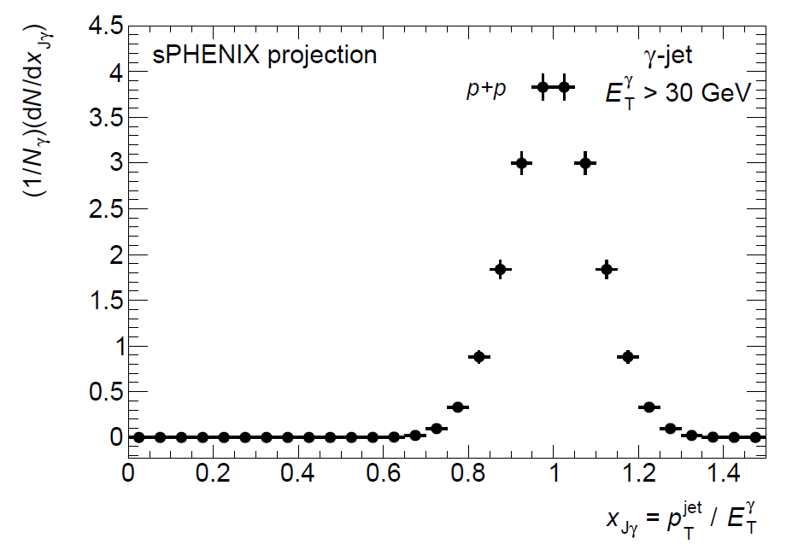
Precision measurements at RHIC and the LHC
γ
Golden channel where photon
calibrates quark energy
q
E_{quark}
E_{photon}

Slide 28
What are small system results telling us?
What are predictions or consequences of hydrodynamics or final state parton scattering in small systems?
Heavy Quark Effects?

Slide 29
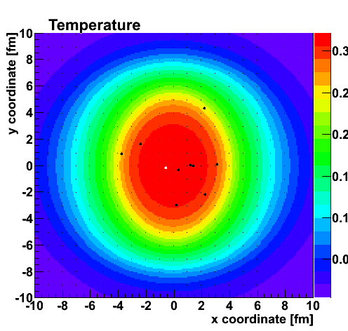
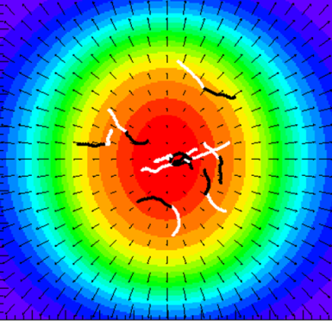
Geometry and Shadowing Question
Shadowing suppressed charm x2 for pT < 3 GeV.
Key for description. What about the spatial correlation?

Slide 30
Heavy quarks in small systems…

Slide 31
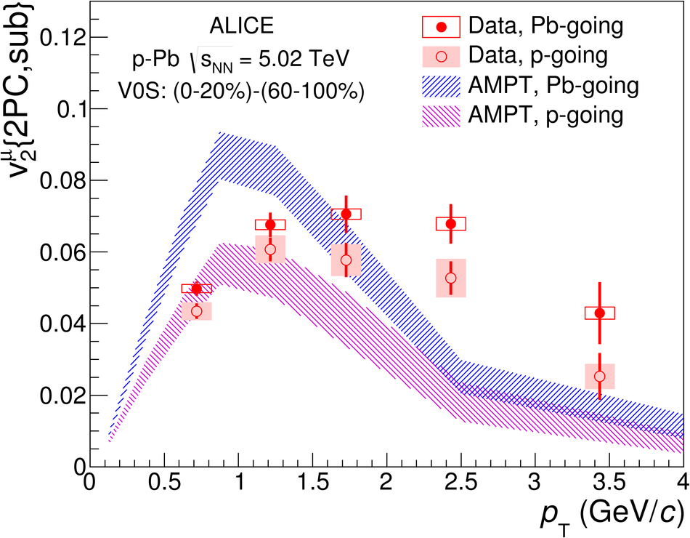
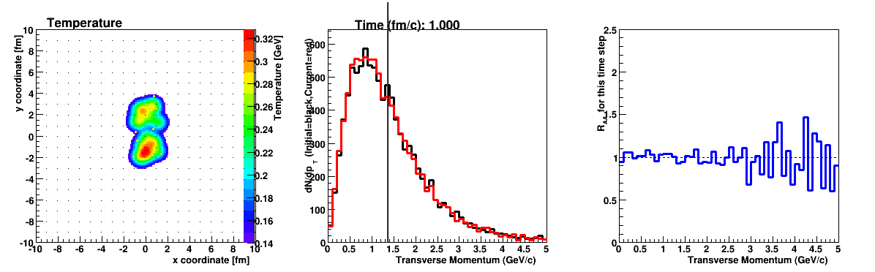
Charm in Small Systems
Field needs tests of medium in small systems.
Heavy flavor shows signals already. Need calculations for full understanding and
more data.

Slide 32
Small Systems
and
Big Questions

Slide 33
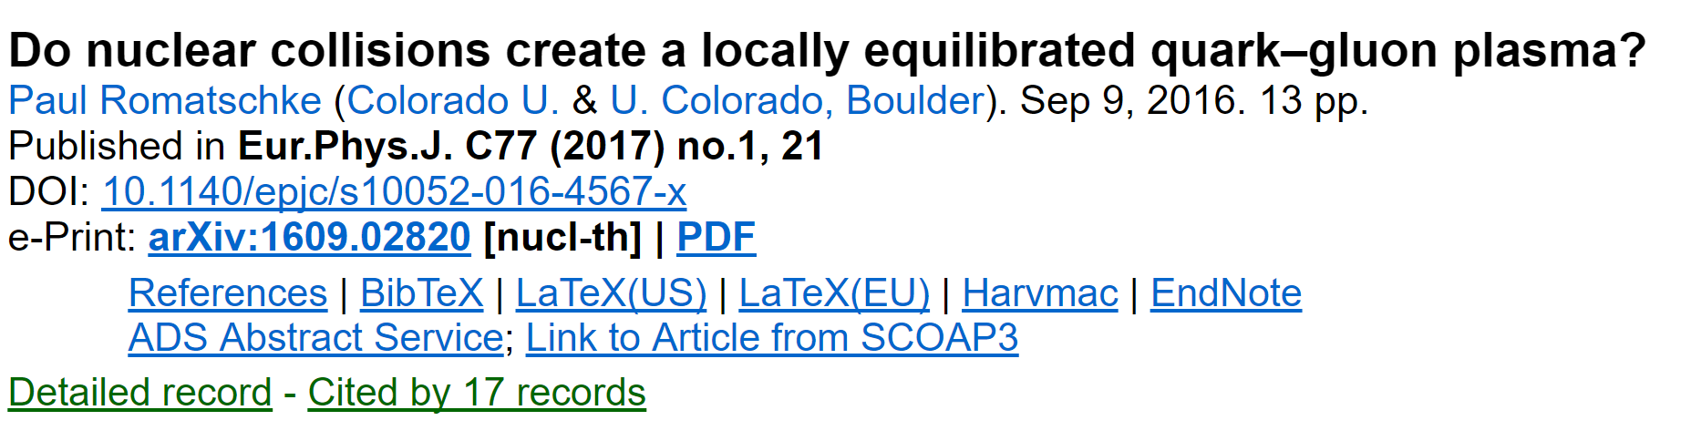
Papers I am trying to understand…
What if the conjectures are correct – always far from equilibrium?
How to test if the conjectures are correct?

Slide 34
Equilibration – is this required to call system a Quark-Gluon Plasma?
Isotropization – thought to be a required condition….
Hydrodynamization – just means the hydrodynamic description works

Slide 35
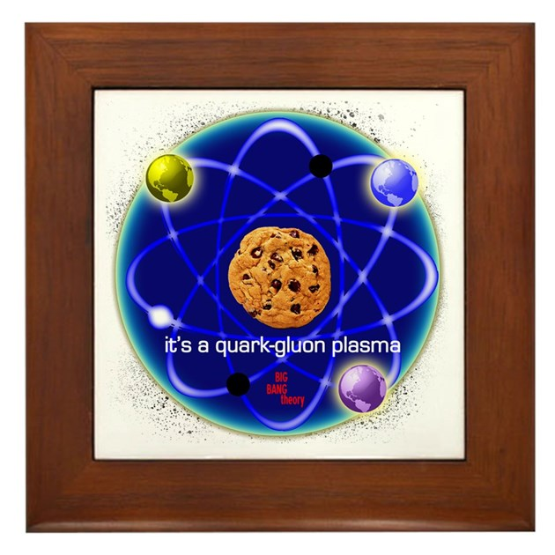
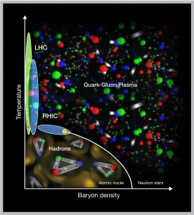
If heavy ion collisions create matter that is never very close to local equilibrium (big if), in what sense do we call it a quark-gluon plasma?
What does it then mean to say “heavy quarks are thermalized”, “energy lost by the jet is equilibrated”?
Maybe it is just a chocolate chip cookie.

