Slide 1

Pushing the Limits of
Quark-Gluon Plasma Formation
Jamie Nagle
University of Colorado Boulder
APS Four-Corners Meeting, October 21, 2017

Slide 2
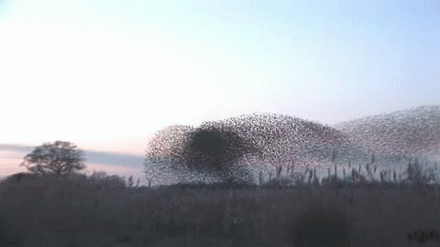
How does this work?
Emergent Phenomena… Collectivity…
What is the underlying origin?
For this flock of birds, it is all short range interactions

Slide 3
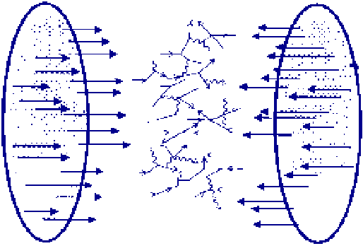
How does this work?
Nuclei contain quarks and gluons
confined in protons and neutrons.
Can we free these quarks and gluons at super high energies and temperatures?
How does that matter behave?

Slide 4
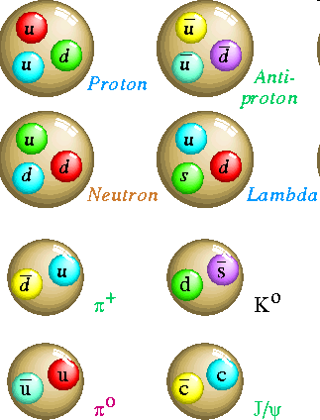
Nuclear Force
Hadrons are composite objects made of quarks and gluons
QCD is a “confining” gauge theory, with an effective potential
V(r)
“Coulomb” “Confining”
r
No one has ever seen a free quark

Slide 5
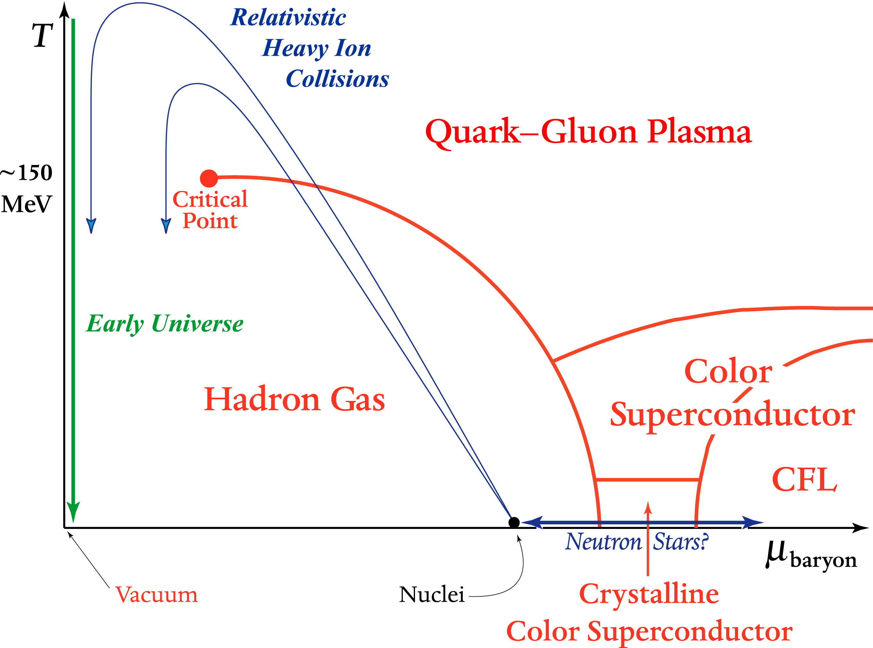
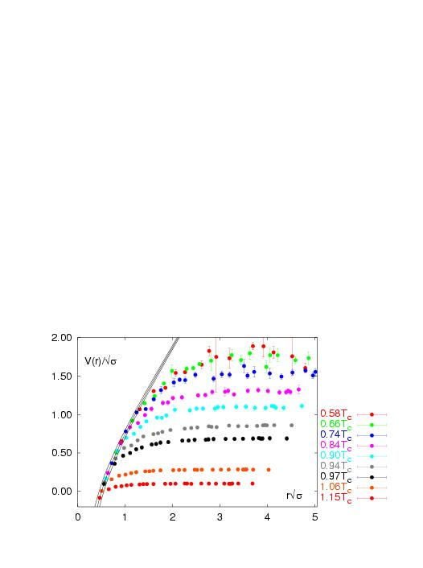
What about Super Hot Nuclear Matter?
Quark Gluon Plasma without confinement
V(r)
r
Lattice QCD
V(r)/√σ
Screening of long range confining potential expected at high enough temperature or density
r√σ

Slide 6
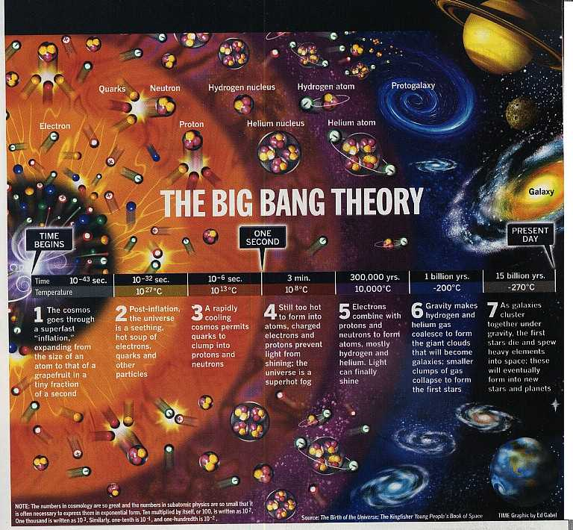

Very early in the universe, quarks and gluons were free in a plasma state
As the universe cooled, they were confined and have remained that way since

Slide 7
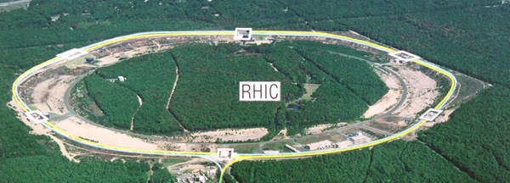
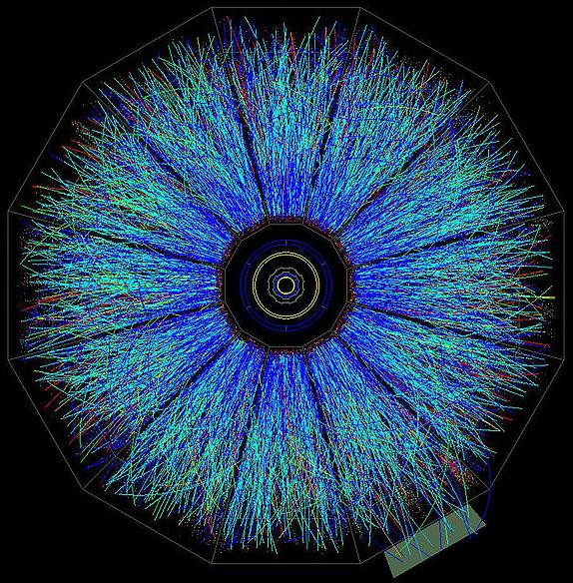
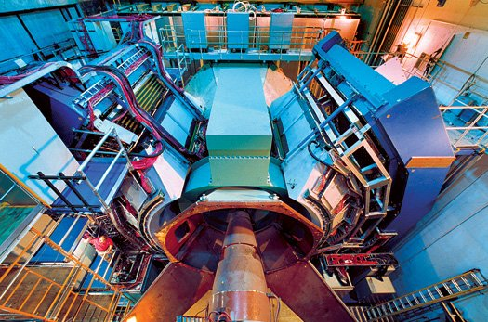
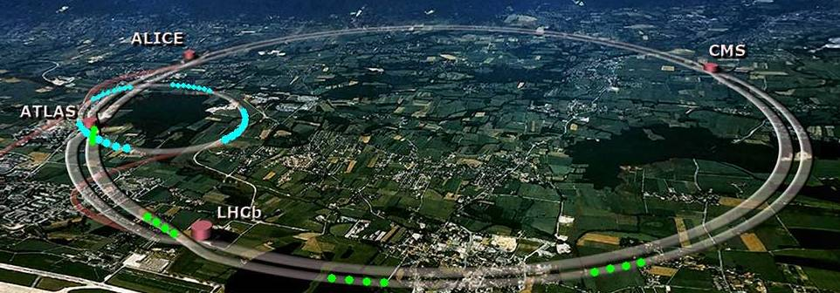
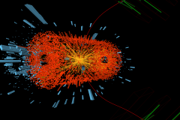
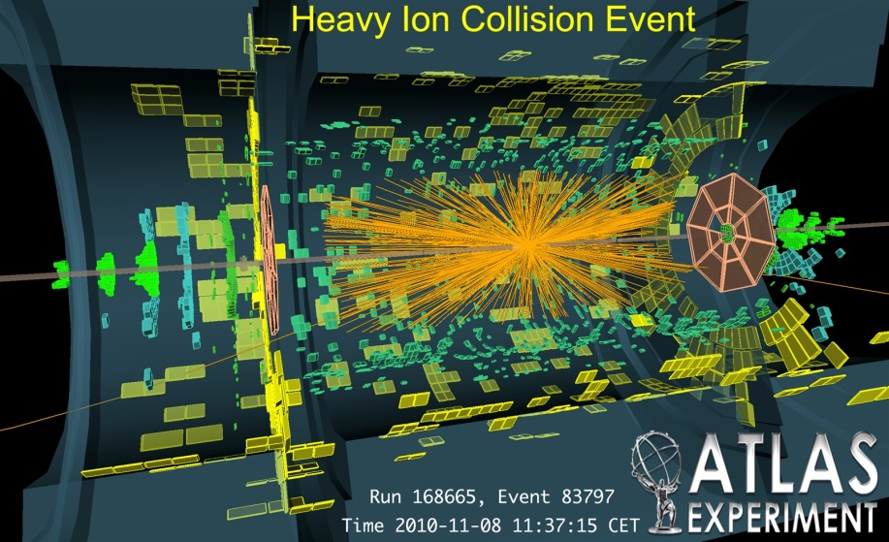
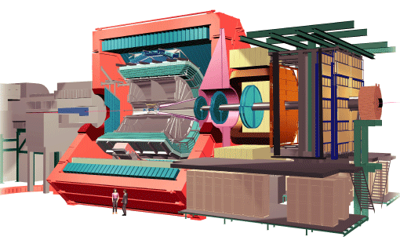
Laboratory Microscopes
RHIC
PHENIX
STAR
LHC
CMS
ALICE

Slide 8
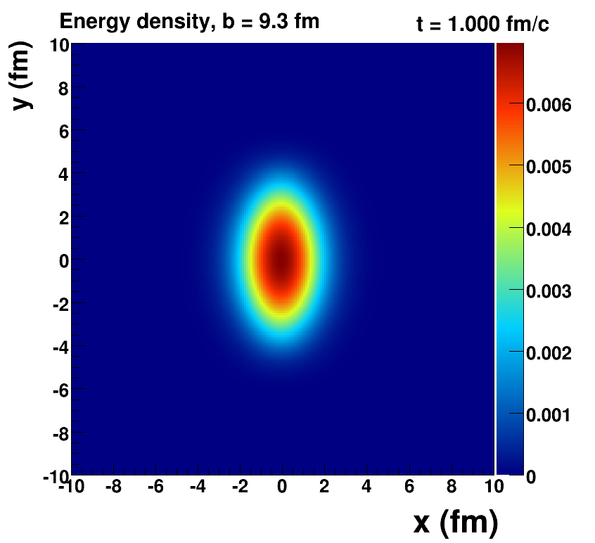
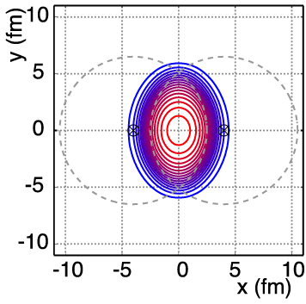
Nucleus-Nucleus Geometry
v₂ = “elliptic flow”

Slide 9
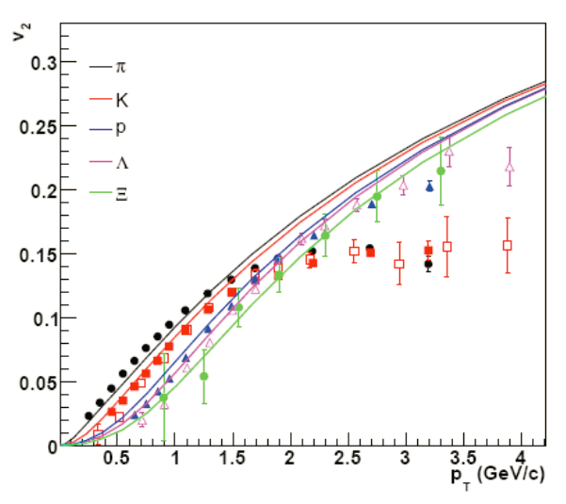
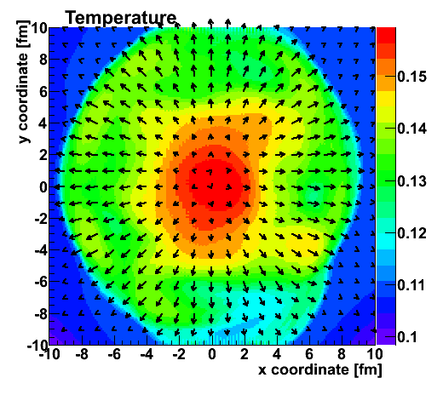
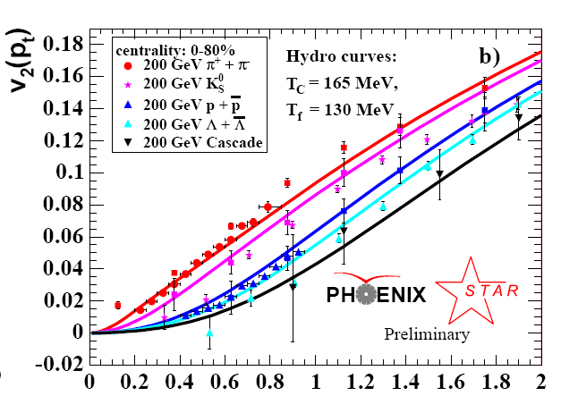
Hydrodynamic fluid cells “freeze-out” and then
Plasma → Quarks Confined in Hadrons
v₂
Temperature Profile + Velocity Vectors
v2
p_{T} (GeV)
Characteristic “fingerprint” flow pattern

Slide 10
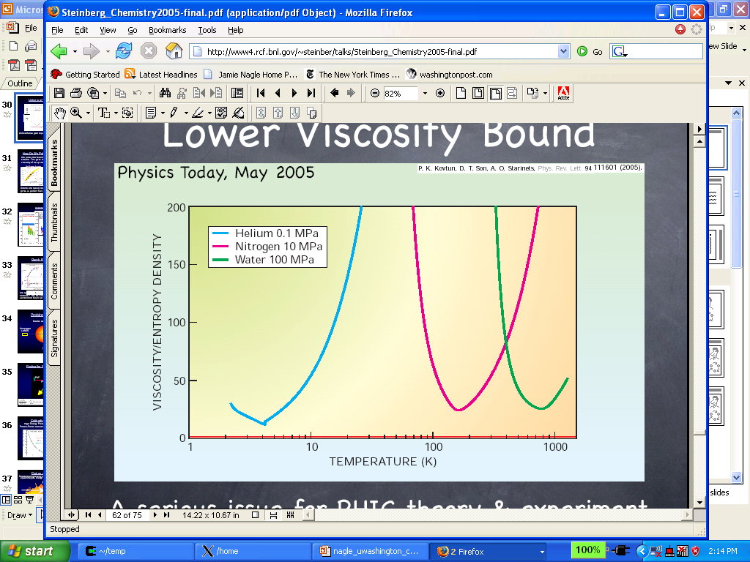
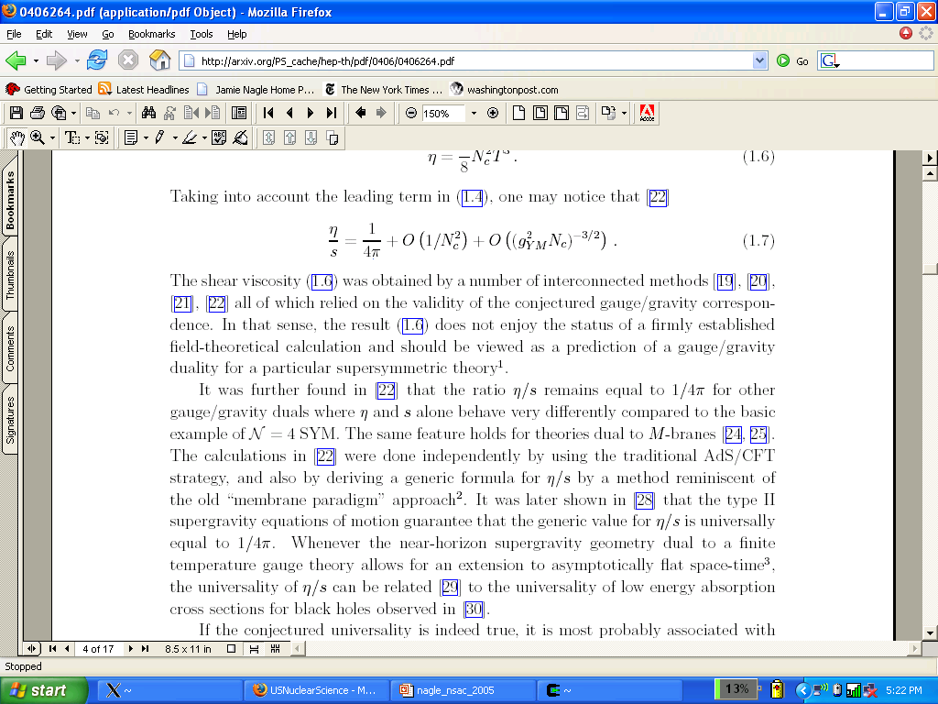
How Close to Perfect is it?
Shear Viscoty / Entropy Density (η/s )
QGP
Gas-Liquid Phase Transition
Superfluidity Transition

Slide 11
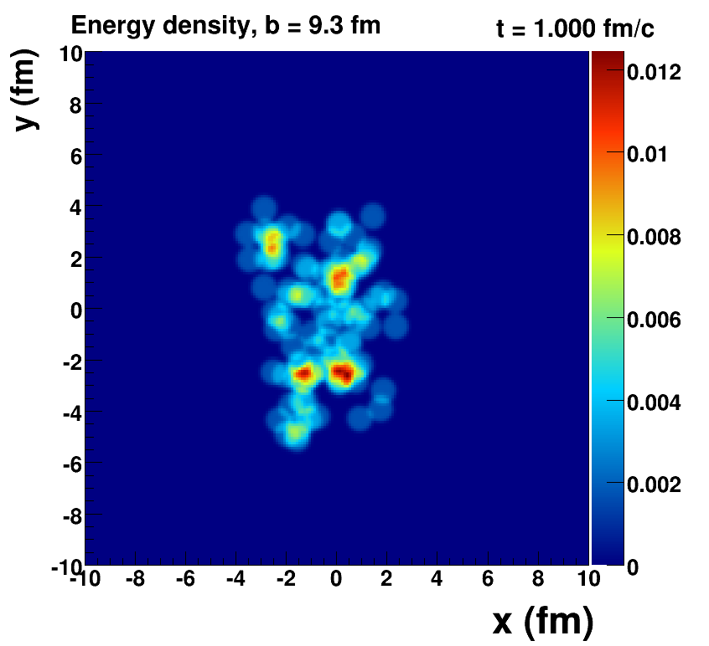
Romatschke=viscous hydrodynamics, McCumber=lumpy conditions + animation

Slide 12
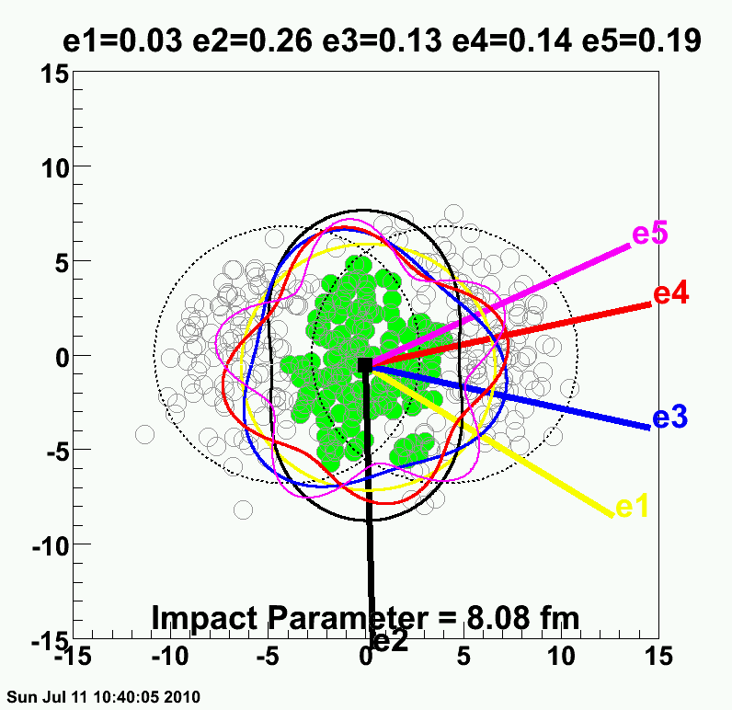
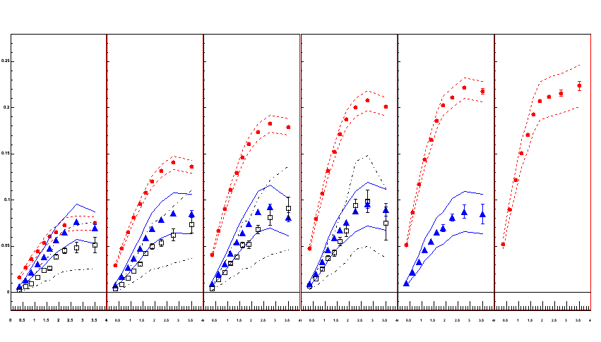
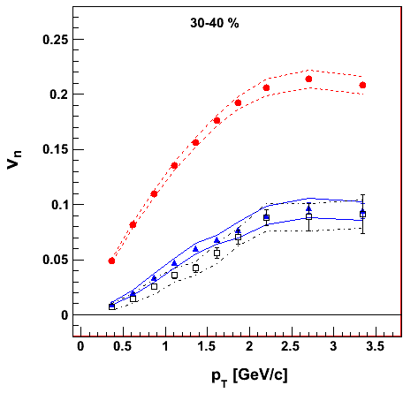
PHENIX Experiment
v₂ {Φ₂ forw.η}
v₃ {Φ₃ forw.η}
v₄ {Φ₄ forw.η}
TT
v_{n} {EP}
Au+Au at 30-40% Central
200 GeV AuAu – 30-40% Central
PHENIX Preliminary
0.20
Elliptic
Triangular
ε₂ ≈ 2 x ε₃ ≈ 2 x ε₄
0.10
Early geometric features survive through QGP evolution because of very small dissipation
0.0
Quadrangular
0.0
1.0
2.0
3.0
p_{T} (GeV/c)

Slide 13
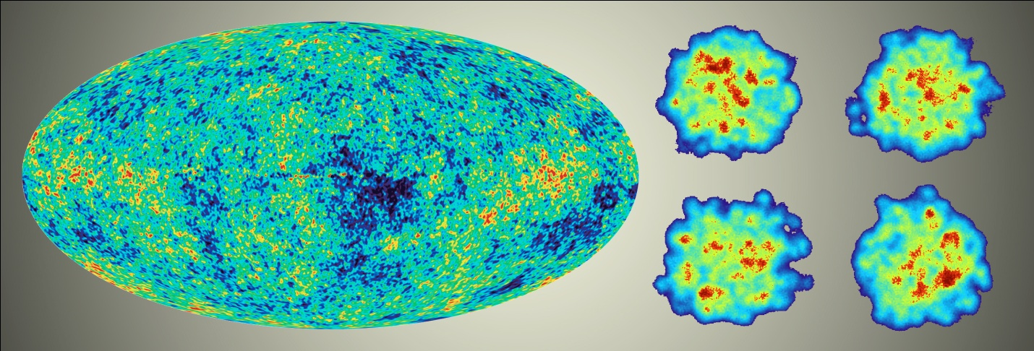
“Little Bang” Standard Model
Discovery: Quark Gluon Plasma = Near Perfect Fluid
Standard Model with Hydrodynamic Evolution
Precision: Predictions of Flow Patterns
but…
How does it thermalize so quickly?
What are the degrees of freedom or quasiparticles?

Slide 14
Big and Small Systems
A+A
Enough particles to equilibrate, QGP, collective motion
p+A
Not enough particles to equilibrate, control experiment

Slide 15
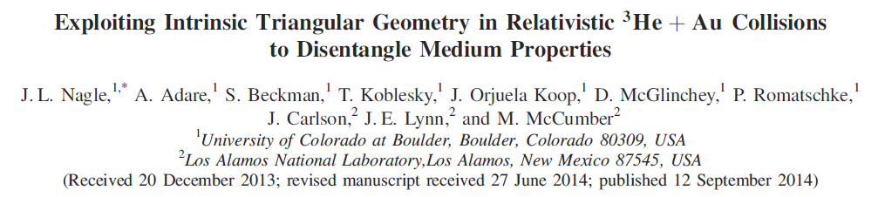
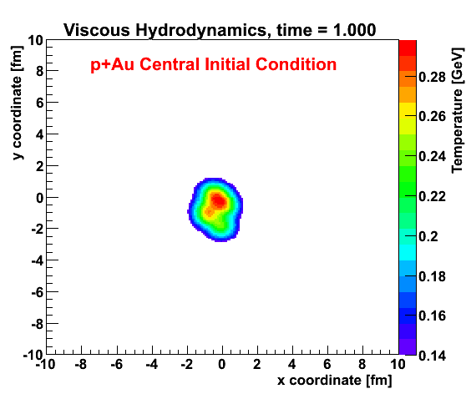
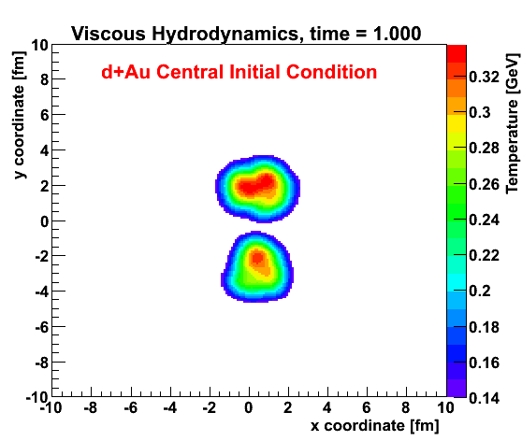
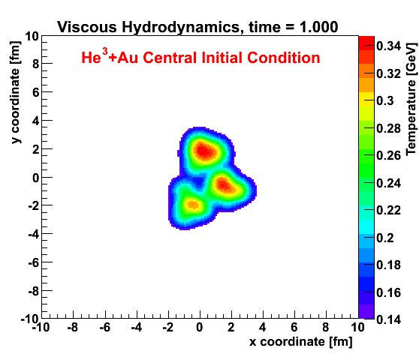
Small Collision System Hypothesis
http://journals.aps.org/prl/abstract/10.1103/PhysRevLett.113.112301

Slide 16
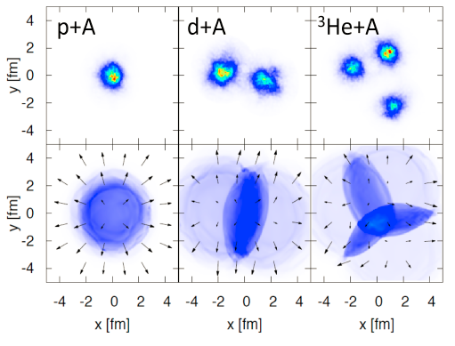
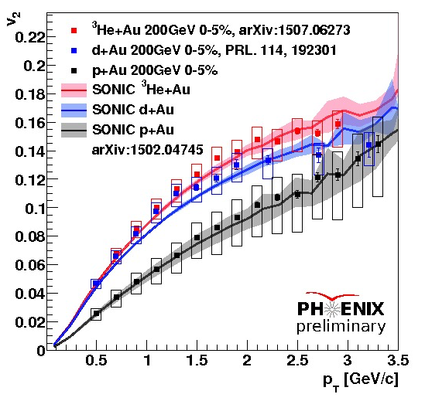
Flow Pattern Predictions
Romatschke, Nagle et al. , http://journals.aps.org/prl/abstract/10.1103/PhysRevLett.113.112301

Slide 17
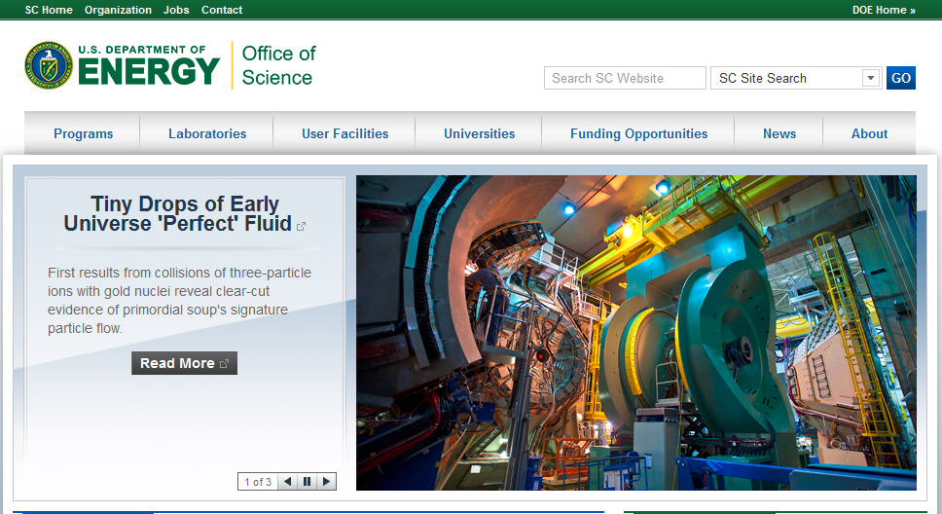

Slide 18

Probing the Plasma on Shorter Length Scales
BaBar SuperConducting
Magnet 1.5 T
Inner MAPS tracker
Outer Fast TPC
Electromagnetic
Calorimeter
Hadronic Calorimeter
CD-0 Approval (Mission Need)

Slide 19
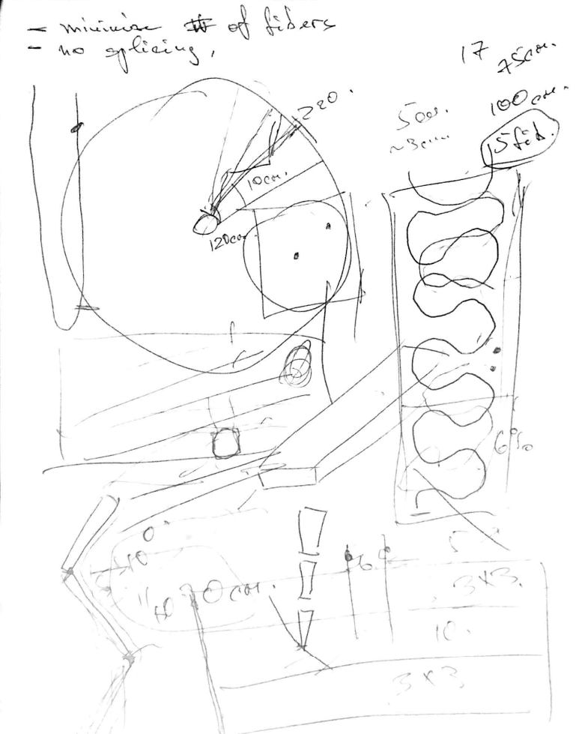
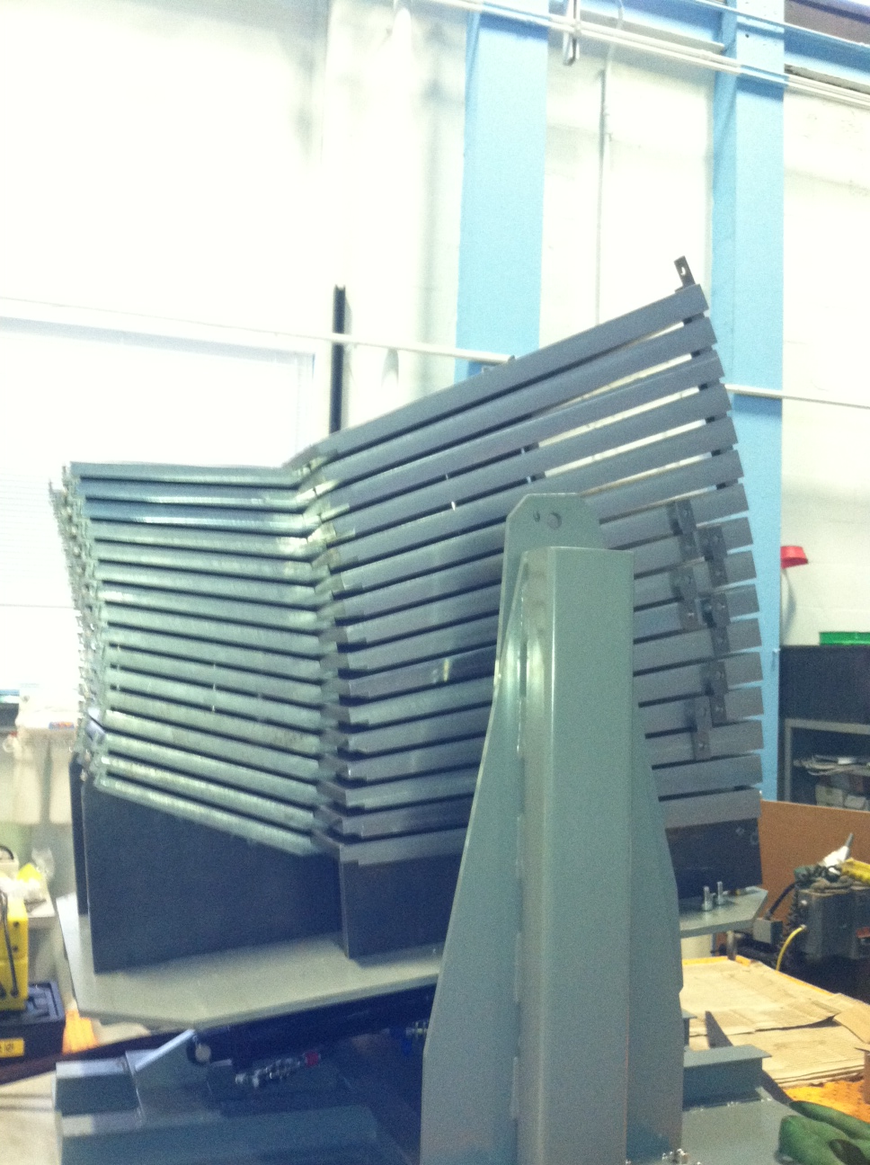
Very Fun to Build Something New!

Slide 20
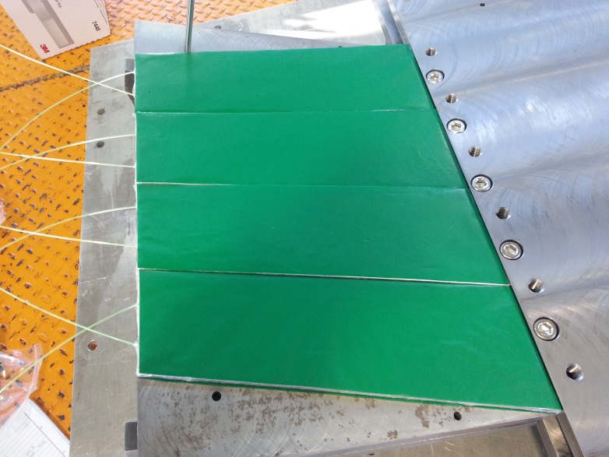
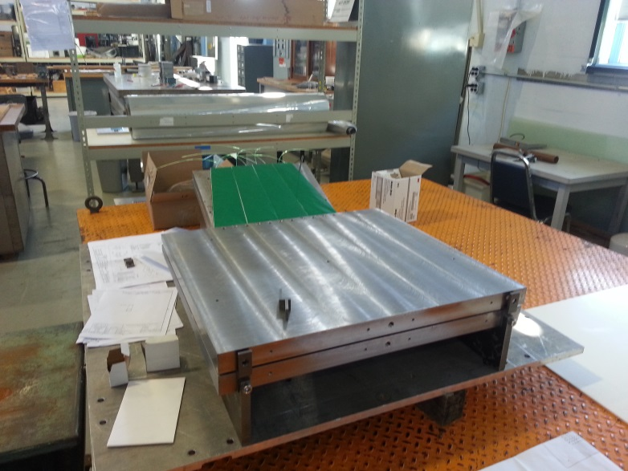
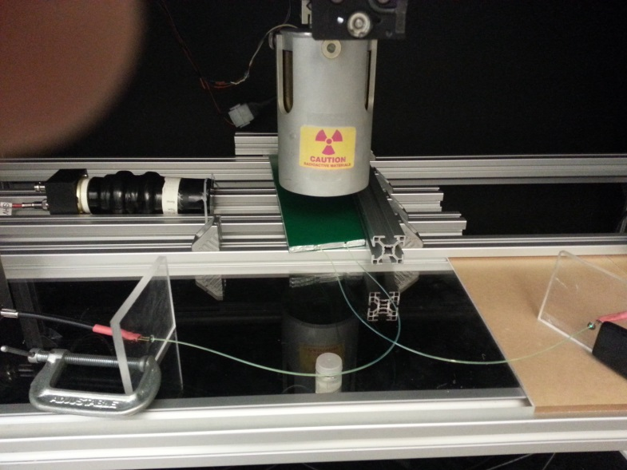
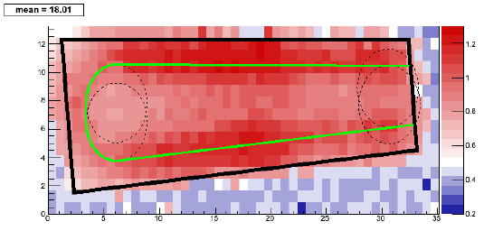
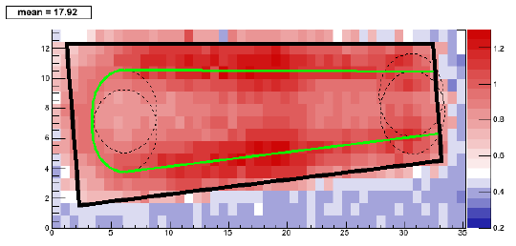
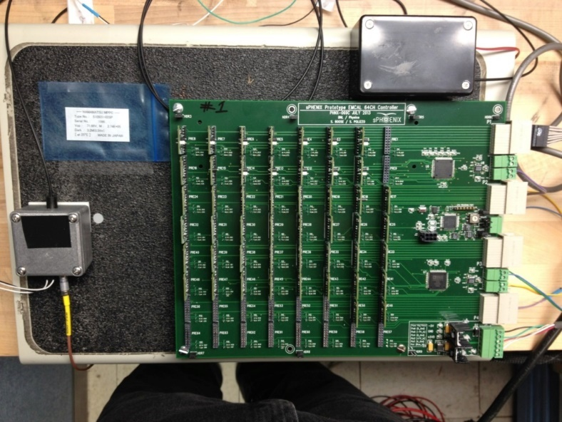
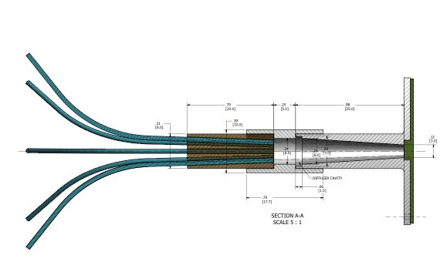
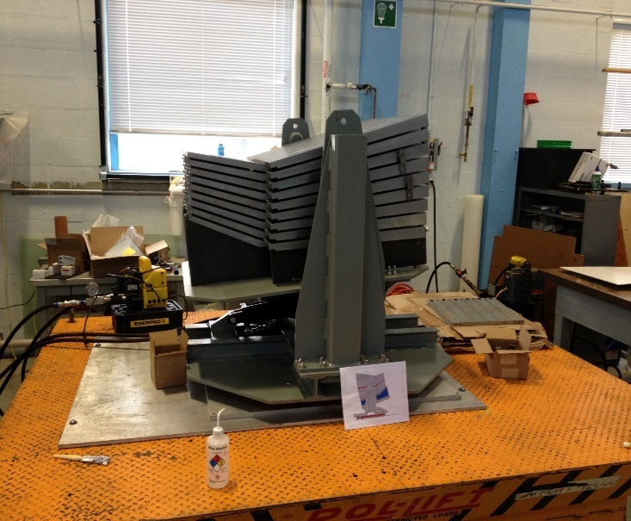
Top fiber
Bottom fiber

Slide 21
Summary
Discovery of Quark-Gluon Plasma as Perfect Fluid
Precision Description of Flow
“Little Bang” Standard Model
New Questions about Small QGP
New Opportunities to Discover the How the QGP Works!

Slide 22
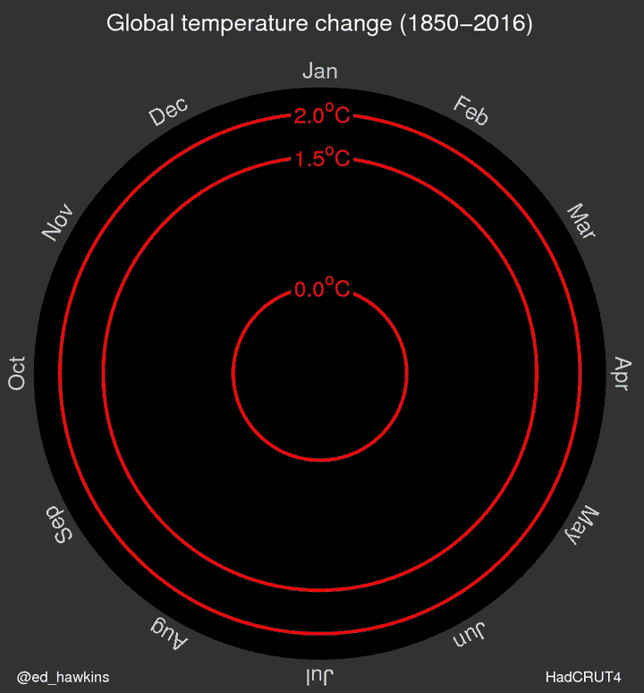
Science and Society
Scientific Method is something we need to respect and utilize as input to policy.
As a society,
we embrace
ignorance at our peril.

