Slide 1
Nominal Lecture #3 Start

Slide 2
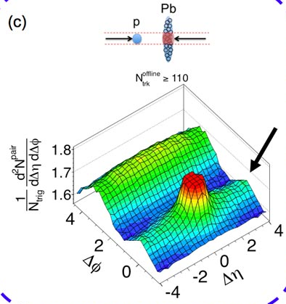
Fall 2012 Revolution – p+Pb Collisions
Very clear ridge
Higher moments
Particle dependence
Cumulants
Almost every Pb+Pb collective flow signature by
ALICE, ATLAS, CMS now seen in p+Pb!

Slide 3
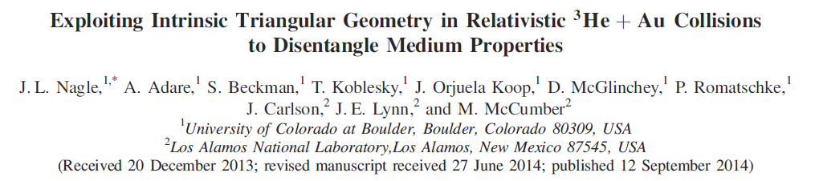
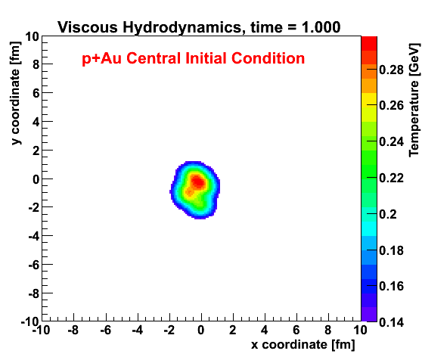
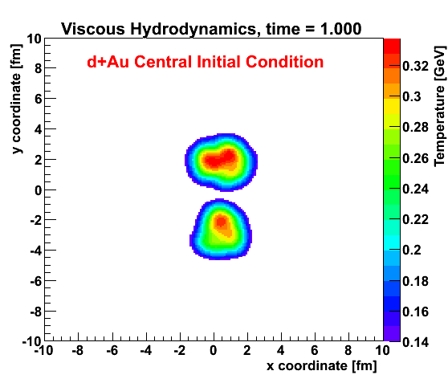
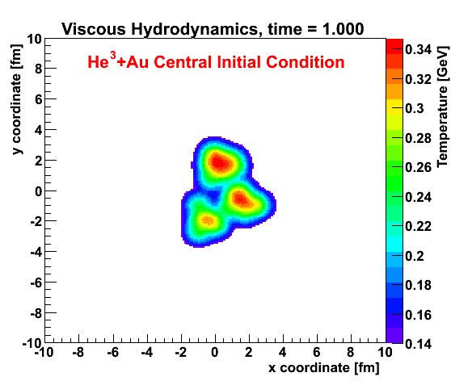
Geometry Tests at RHIC
http://journals.aps.org/prl/abstract/10.1103/PhysRevLett.113.112301

Slide 4
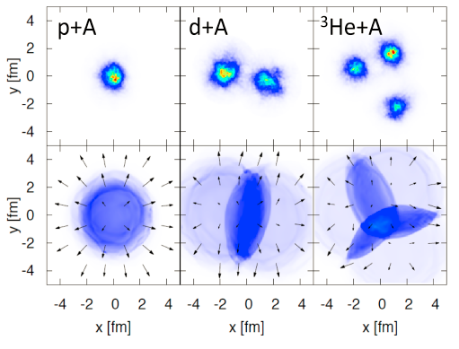
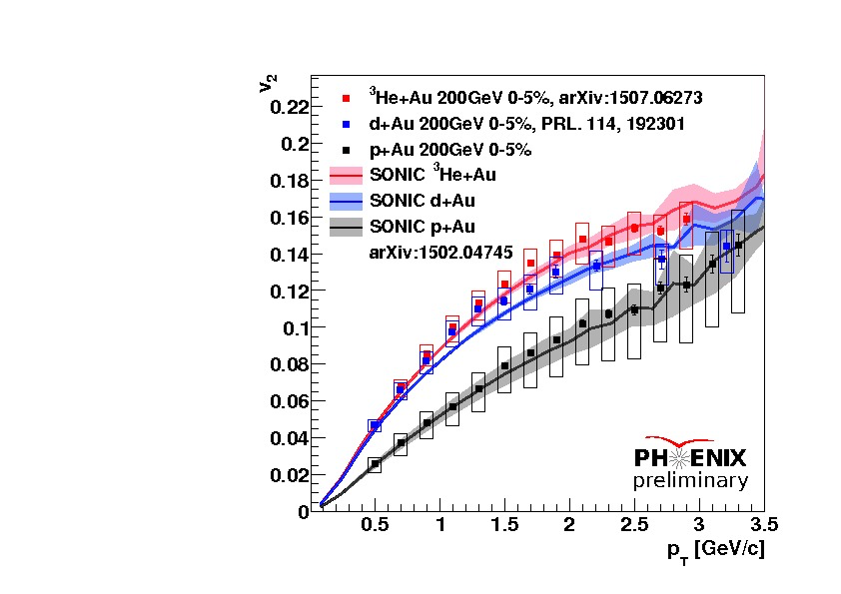
Glauber +Hydrodynamics+Cascade Predictions
Romatschke, Nagle et al. , http://journals.aps.org/prl/abstract/10.1103/PhysRevLett.113.112301

Slide 5
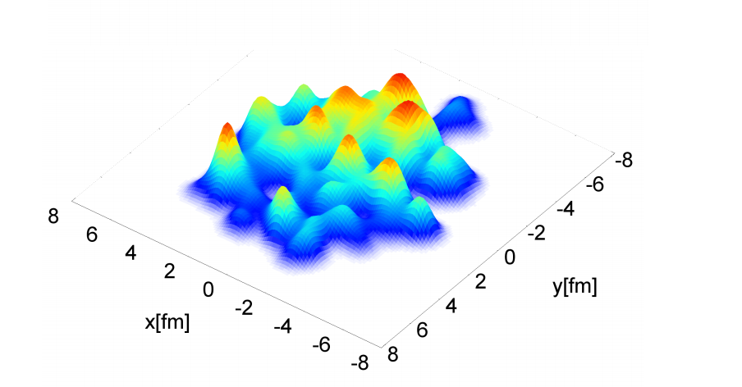
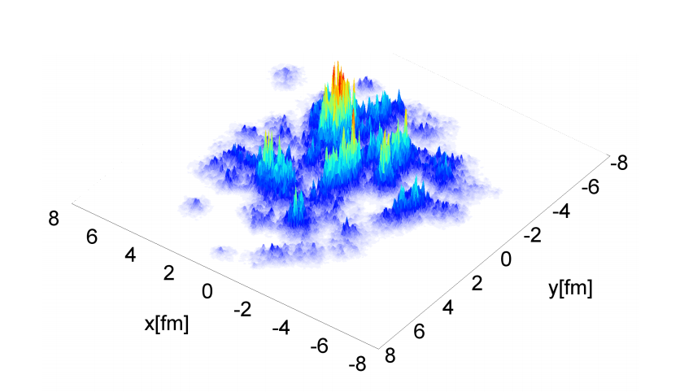
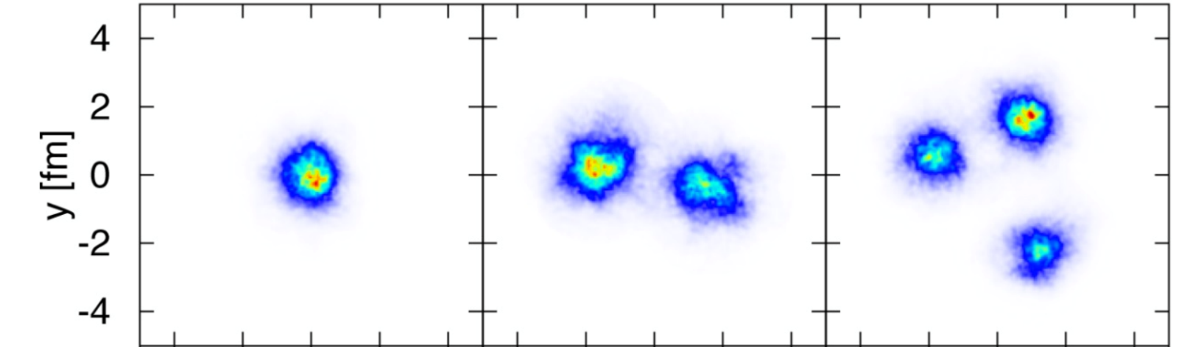
Initial Geometry Uncertainty
MC Glauber
IPGlasma
p+Au
d+Au
³He+Au)
ε₂^{IPGlasma} = 0.10
ε₂^{Glauber} = 0.23
ε₂^{IPGlasma} = 0.59
ε₂^{Glauber} = 0.54
ε₂^{IPGlasma} = 0.55
ε₂^{Glauber} = 0.50

Slide 6
In p+A, proton substructure matters
Not ³He but rather 3 constituent quarks

Slide 7
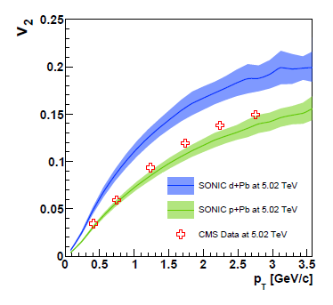
Benefits of an LHC d+Pb Run
10% geometry uncertainty
130% geometry uncertainty
Basic scientific method – constrain hydrodynamic inputs with d+Pb, and then use them to constrain proton substructure in p+Pb

Slide 8
New p+p @ 13 TeV (!) data
Ridge correlation clear observed in high multiplicity events.
However, it may also remain just under the surface in regular p+p events – big question!

Slide 9
LHC – p+p is now the hottest small topic!
https://arxiv.org/abs/1606.06198
Splitting in Pb+Pb from mostly Gaussian fluctuations
v{2}² = <v>² + σ²
v{4}² = <v>² – σ²
What is really happening in p+p is unclear…

Slide 10
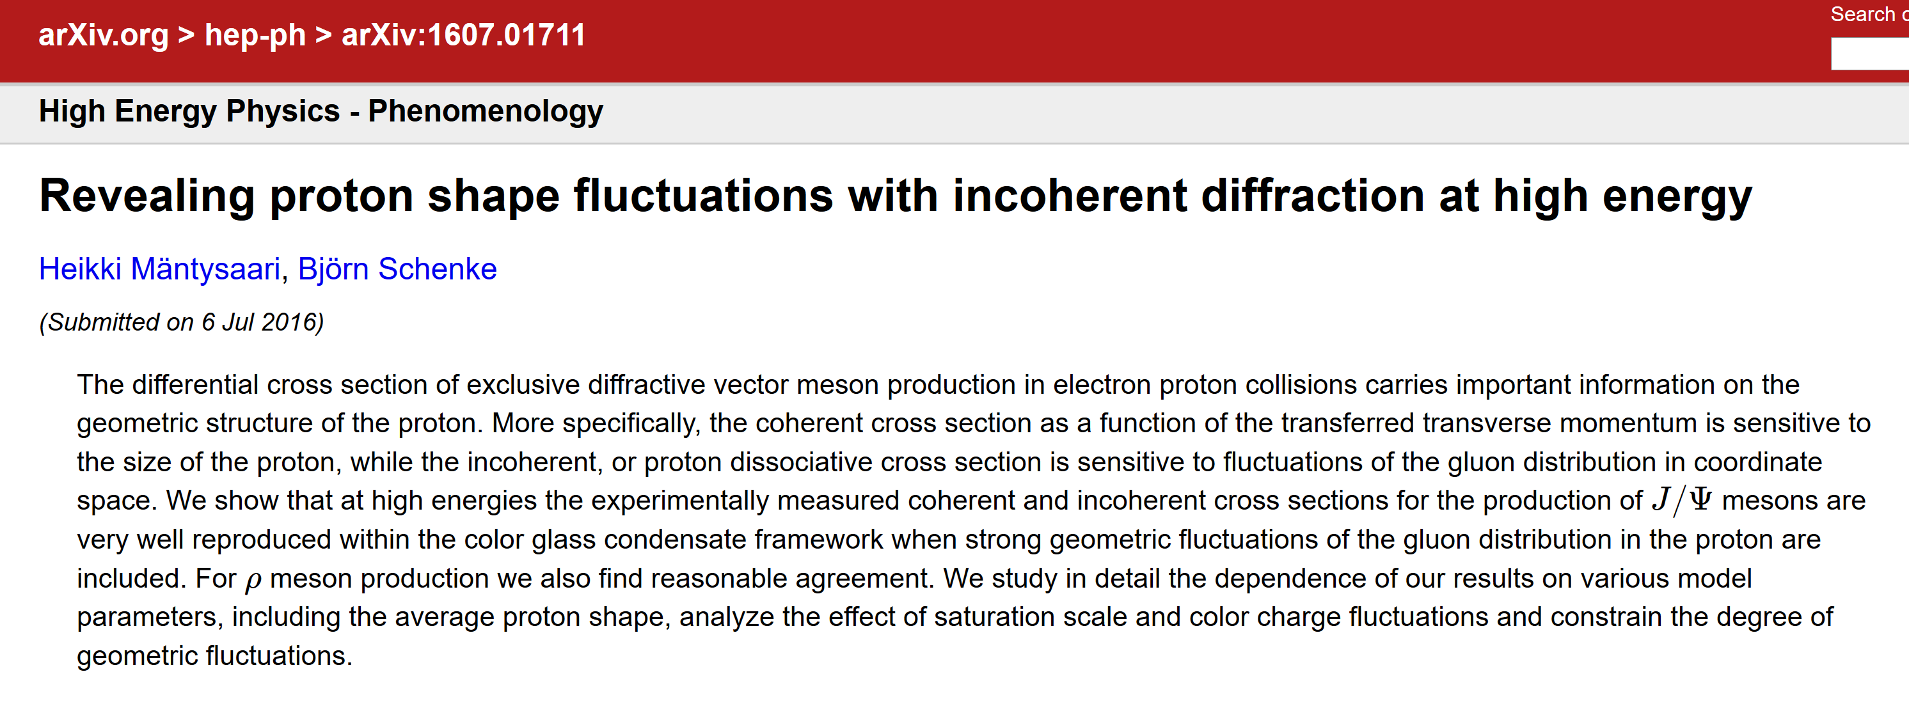
Proton Imagined on the Yoctosecond Time Scale
https://arxiv.org/abs/1607.01711

Slide 11
Hydrodynamics Applied to p+p
Small, but very dense system
Huge radial expansion can lead to cavitation (bulk viscosity important)
With smooth proton geometry, high multiplicity correlates with small impact parameter and eventually circular shape!
https://arxiv.org/abs/1512.05354

Slide 12
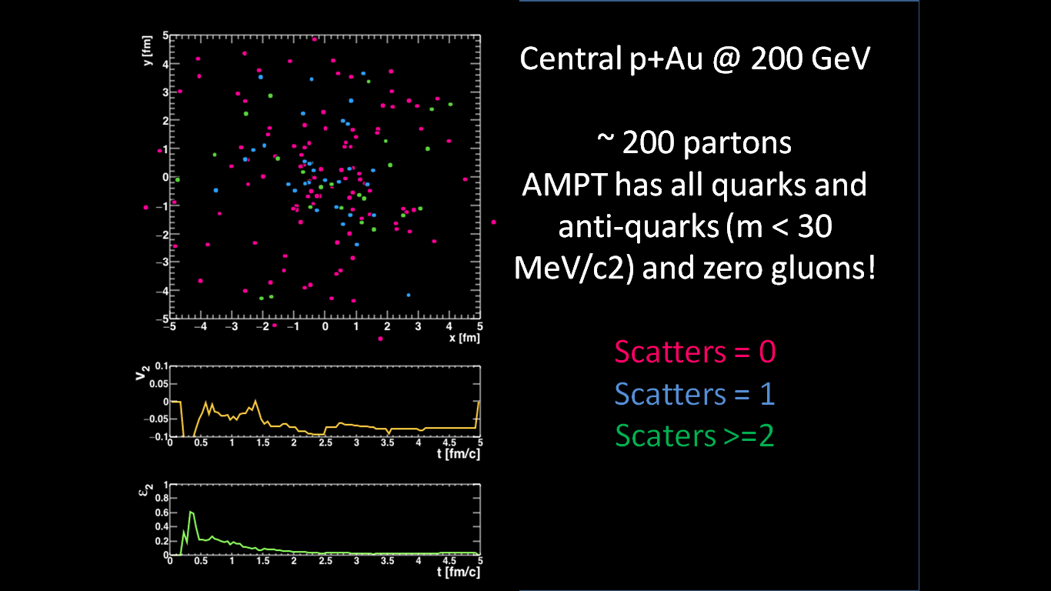
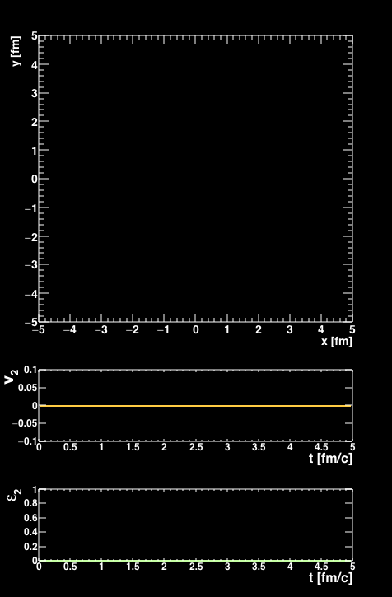
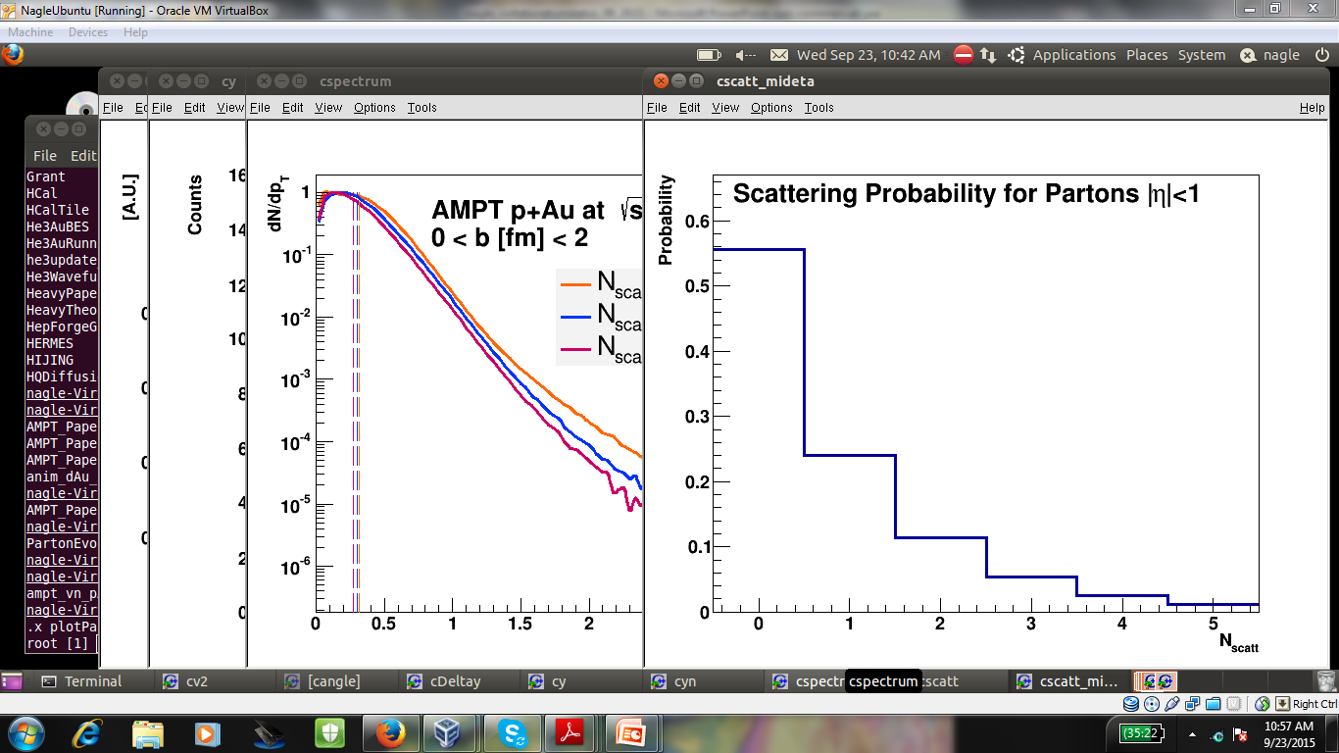
Revisiting Parton Kinetic Theory Models
Central p+Au @ 200 GeV
~ 200 partons
AMPT has all (anti)quarks
m < 30 MeV/c²
and zero gluons!
~ 45 parton-parton scatterings
Not approximating flow through many collisions.
Azimuthal dependence to scatter probability…
55% of partons do not scatter

Slide 13
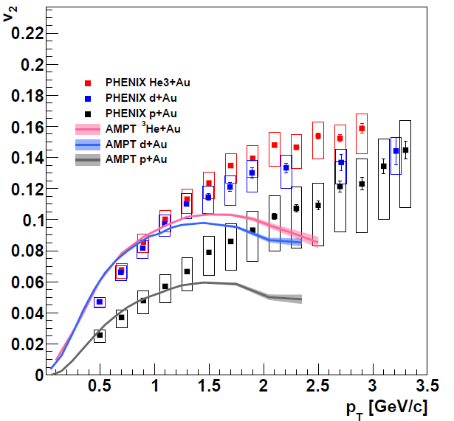
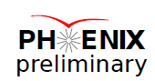
Parton Cascade (AMPT)
Modified
Initial Glauber including ³He wavefunction
(same I.C. as SONIC)
String melting
Lots of partons
= 1.5 mb
Hadron Cascade
Orjuela Koop et al. http://arxiv.org/abs/1501.06880

Slide 14
What does the future hold?
RHIC d+Au energy scan (200, 62, 39, 20 GeV)
LHC p+p really just first quantitative results, more to come in the near future…
Full confrontation with theory and new developments

Slide 15
Jet Quenching

Slide 16
Probing the Matter
Matter we want to study
Calibrated
Light Meter
Calibrated
LASER
Calibrated
Heat Source

Slide 17
Autogenerated Quark “LASER”
D(z)
PDF
pQCD

Slide 18
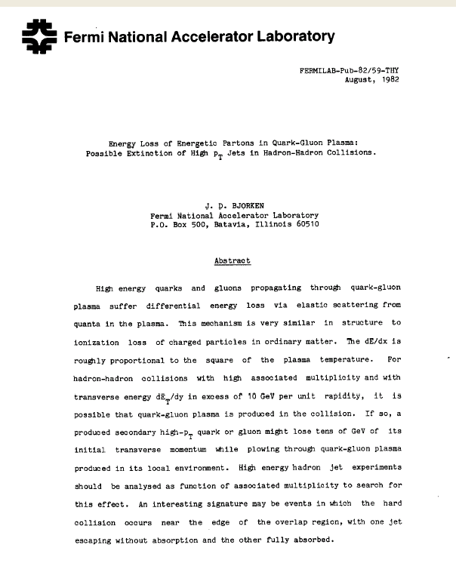

Slide 19
Gluon Radiation
Partons are expected to lose energy via induced gluon radiation in traversing a dense partonic medium.
Coherence among these radiated gluons can lead to ΔE α L²
q
q
L
Look for an effective modification in the jet fragmentation properties.
Baier, Dokshitzer, Mueller, Schiff, hep-ph/9907267
Gyulassy, Levai, Vitev, hep-pl/9907461
Wang, nucl-th/9812021
and many more…..

Slide 20
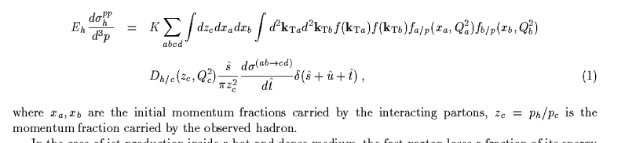
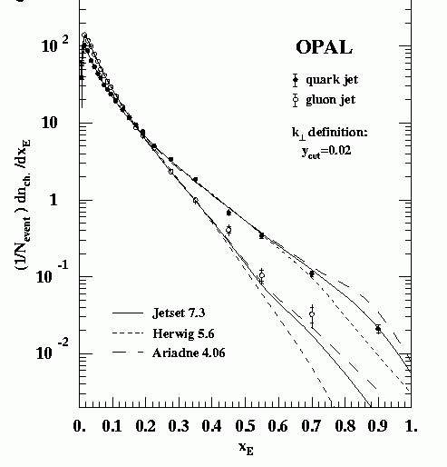
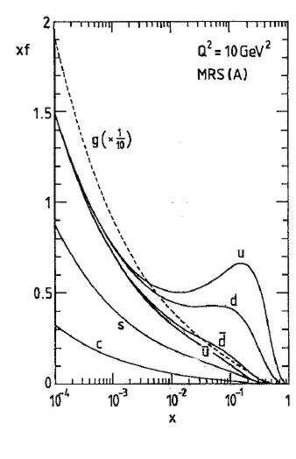
pQCD + Factorization + Universality
In heavy ion collisions we can calculate the yield of high p_{T} hadrons
Flux of incoming partons (structure functions) from Deep Inelastic Scattering
Perturbative QCD
Fragmentation functions D(z) in order to relate jets to observed hadrons

Slide 21
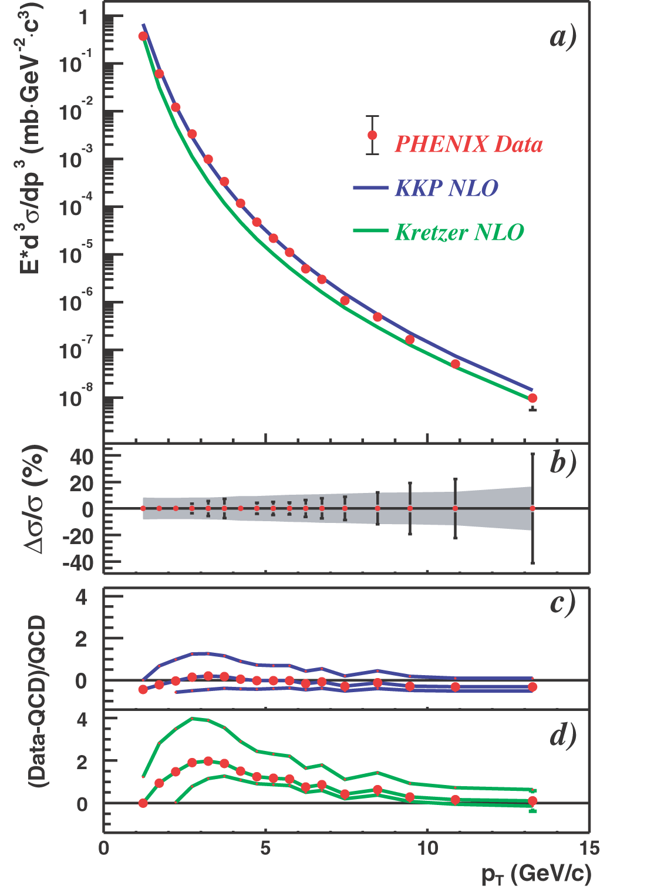
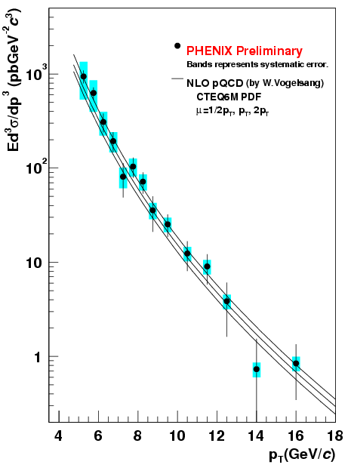
Calibrating Our Probes
High energy probes are well described in
proton-proton reactions by NLO Perturbative QCD.
Single Hadrons and Photons
Produced pions
Produced photons

Slide 22
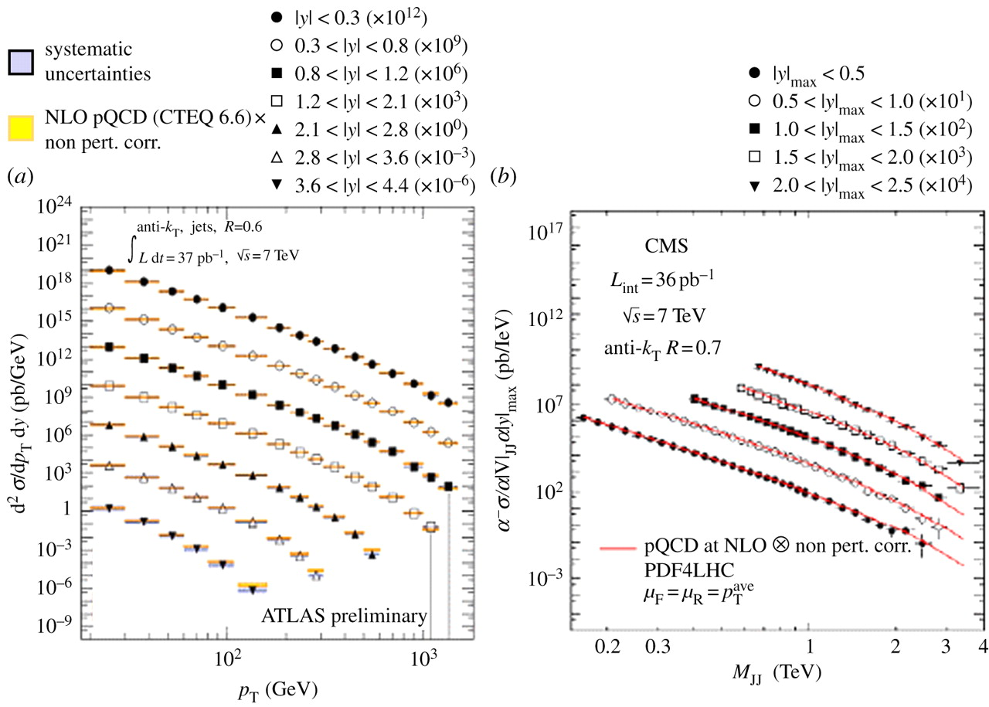
Calibrating Our Probes
High energy probes are well described in
proton-proton reactions by NLO Perturbative QCD.
Reconstructed Jets
What are Jets?

Slide 23
Jets-to-Parton Map
Jet algorithm sums the energy (typically in calorimeters) and can approximate catching an individual parton’s energy.
Very useful in particle physics, but often used in a different way in heavy ion physics.

Slide 24
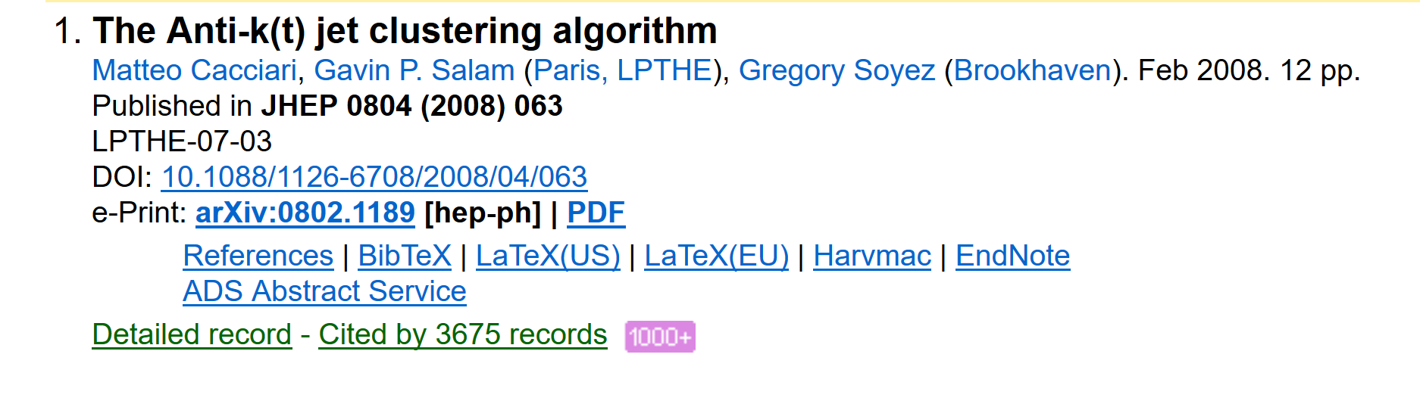
Jet Algorithms
Different methods to “group” energies.

Slide 25
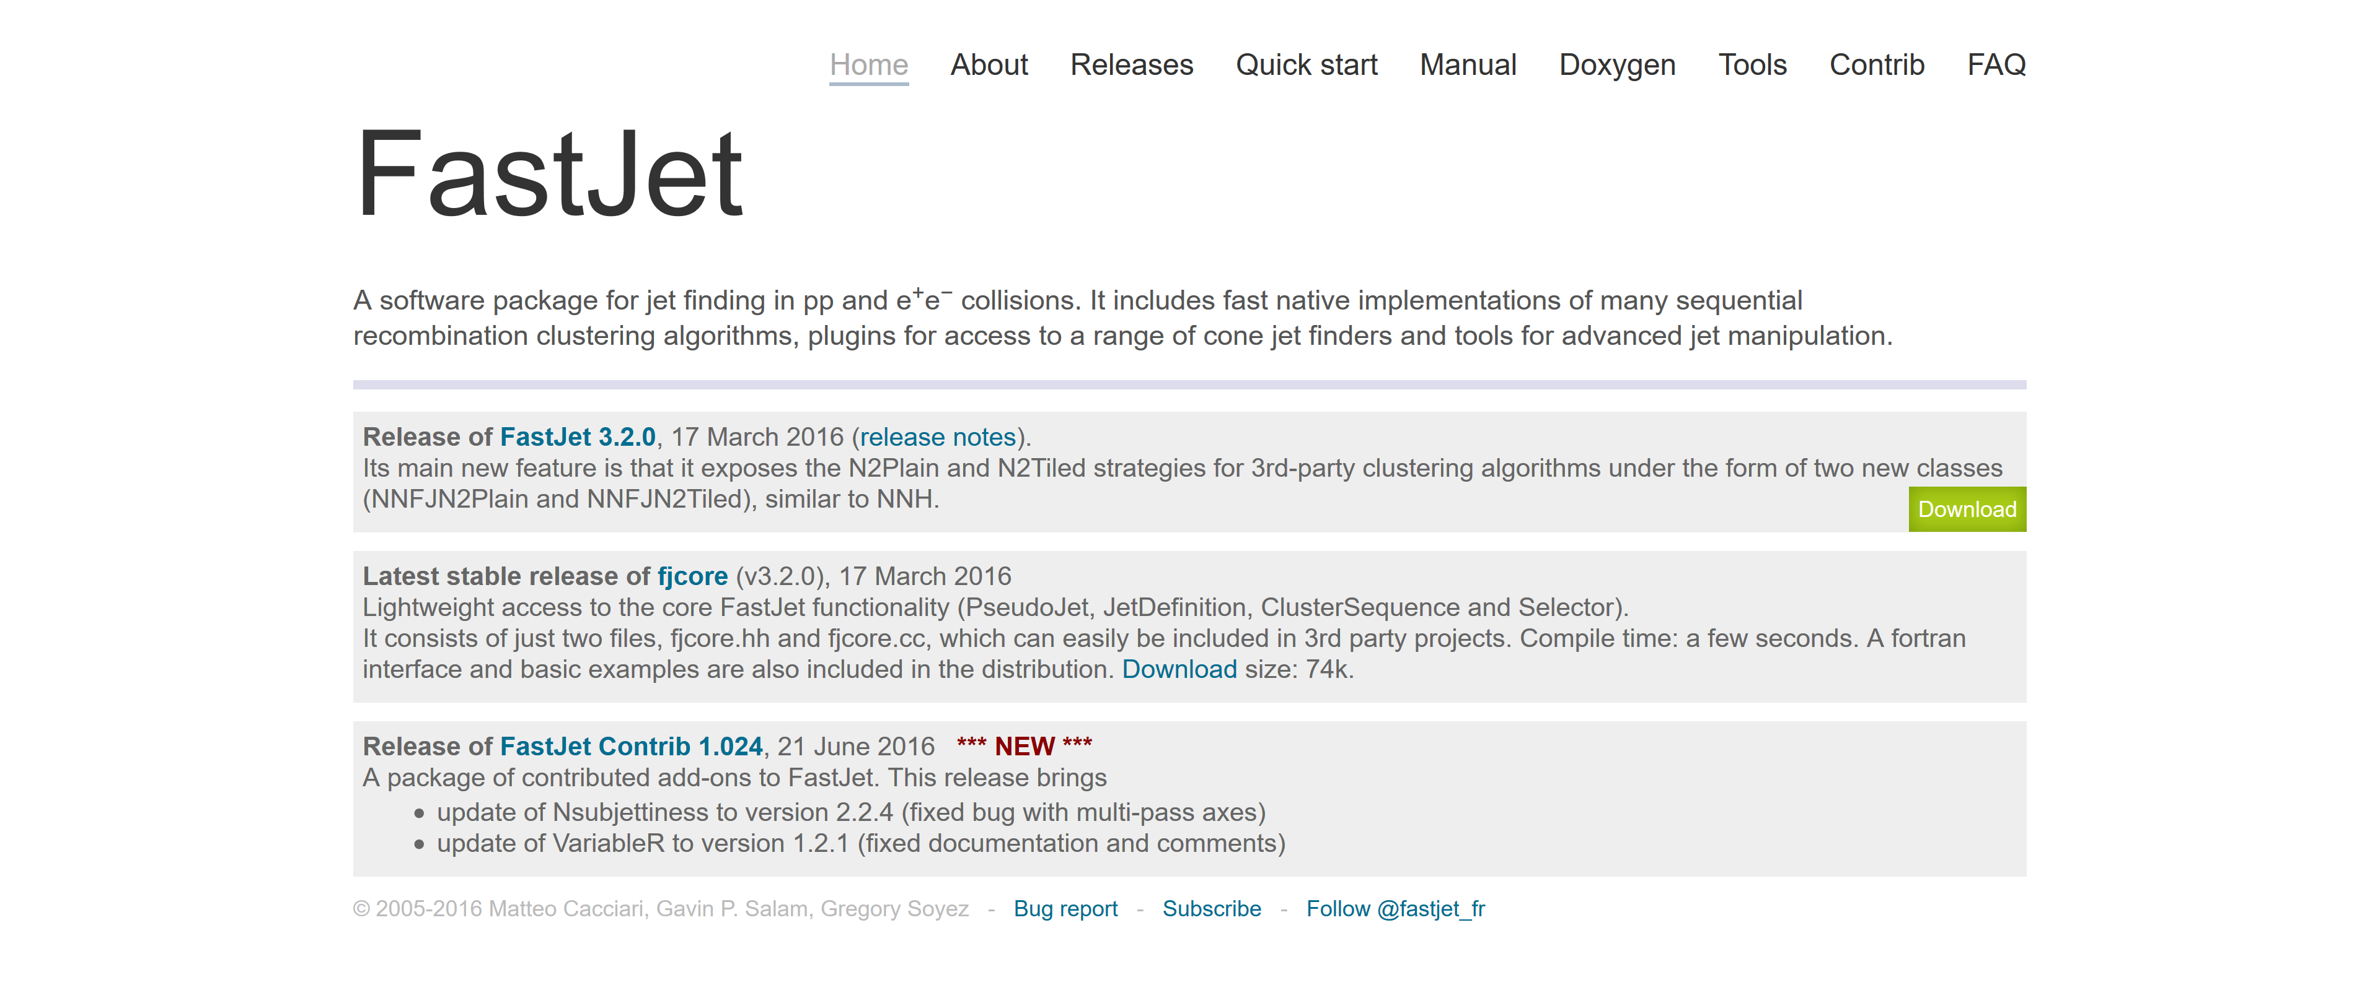
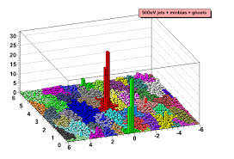
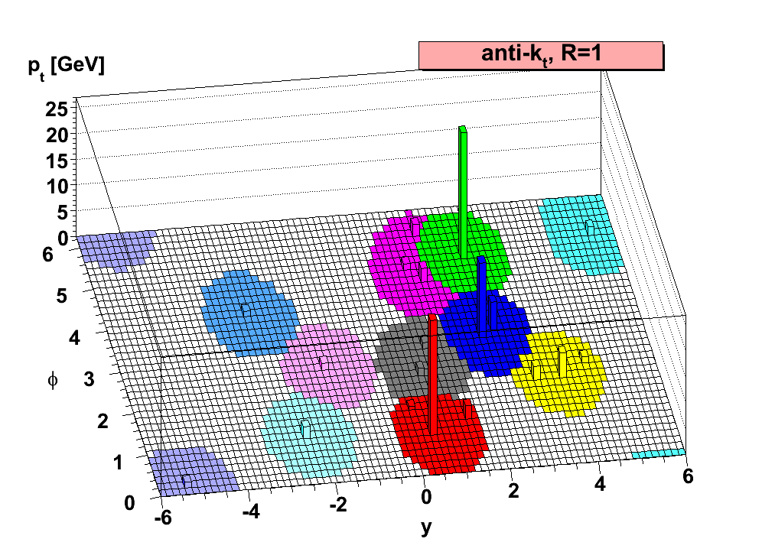
FastJet Code Publicly Available
http://fastjet.fr/

Slide 27
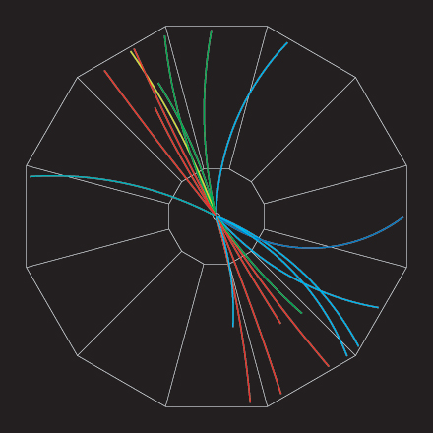
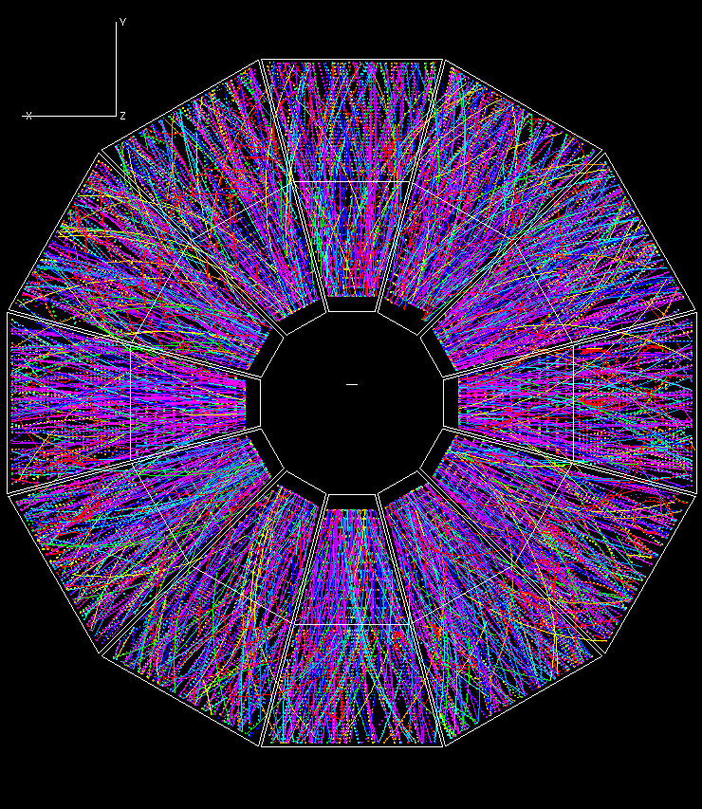
Jets in Heavy Ions
Start with single hadrons, then go to jets.

Slide 28
Much Higher Energy Jets at the LHC

Slide 29
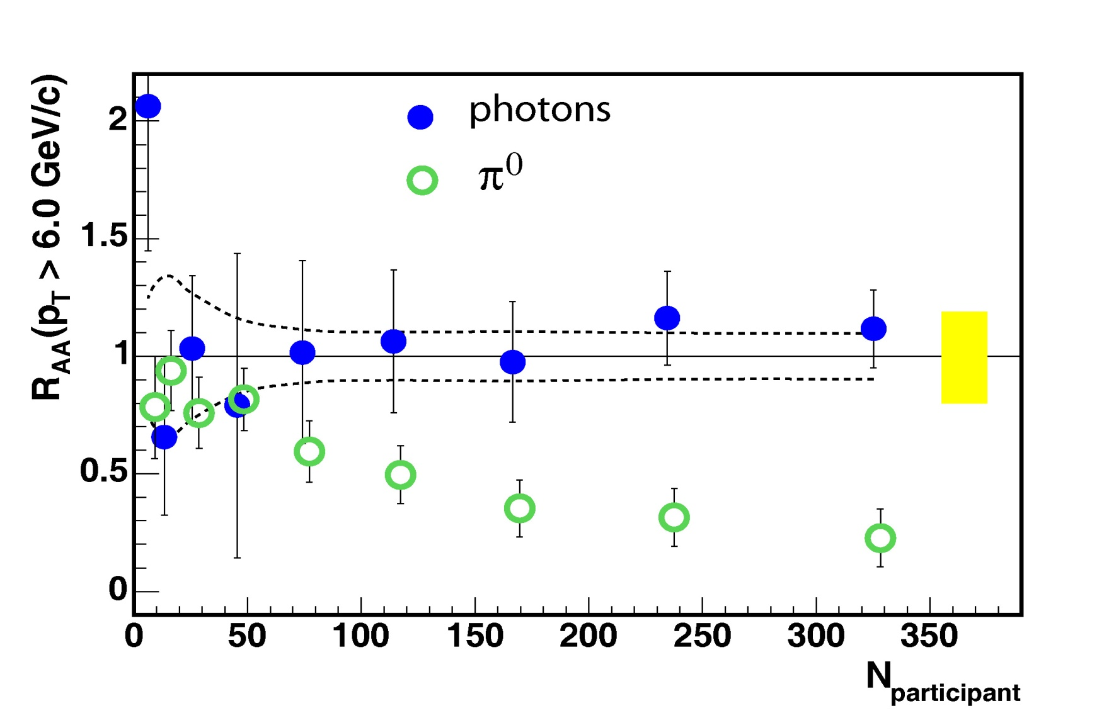
Nuclear Modification Factor
A+A yield
Scaled p+p yield
=
(from quark and gluon jets)
Size of Medium
Photons unaffected by medium, pizeros suppressed

Slide 30
W,Z Bosons
Hadrons

Slide 31
Opaque Medium – Jet Quenching
Massive induced gluon radiation thermalizes the
parton energy.
Example – 100 GeV quark shot through medium and
comes out the other side as large number of hadrons.
Thermalized? or Collective Modes?

Slide 32
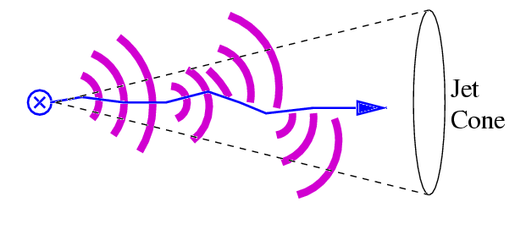
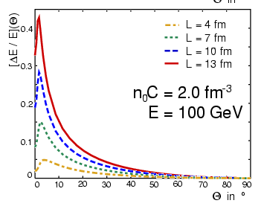
Wider Angular Distribution
The induced gluon radiation may be measurable due to the broader angular energy distribution than from the jet.
θ<20⁰ - 80% of jet energy contained
5% loss of energy outside
θ<12⁰ - 70% of jet energy contained
8% loss of energy outside
Possible observation of reduced “jet” cross section from this effect depending on the jet algorithm R value.
U.A. Wiedemann, hep-ph/0008241.
BDMS, hep-ph/0105062.

Slide 33
Jet Observables
Single jets (R=0.4) are suppressed.
Massive change to dijet distribution.
At Leading Order, dijets should be transverse energy balanced.

Slide 34
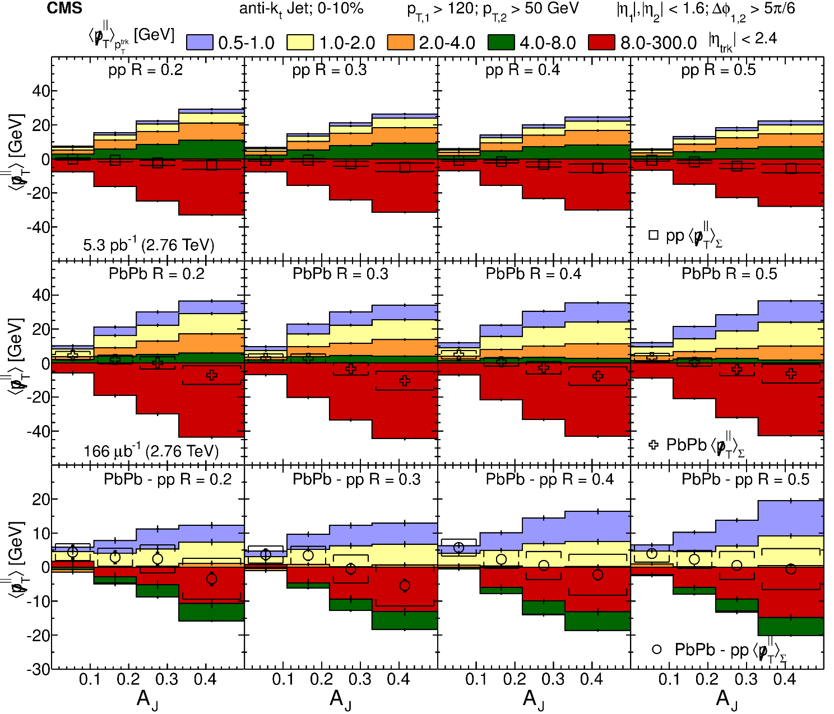
Jet Energy Redistributed
Experiment is out in front of theory…

Slide 35
Confined vs Deconfined Color?
Are we sensitive to deconfinement?
Beams of hard probes: colored quarks
Colorless
Hadrons
Colored
QGP
Not really !
If the coherent energy loss scale is large, then we probe short distances and would “see” the color charges inside hadrons anyway (like in DIS).
Only if the energy loss scale is small would we be sensitive, but this does not seem to be our regime.

Slide 37
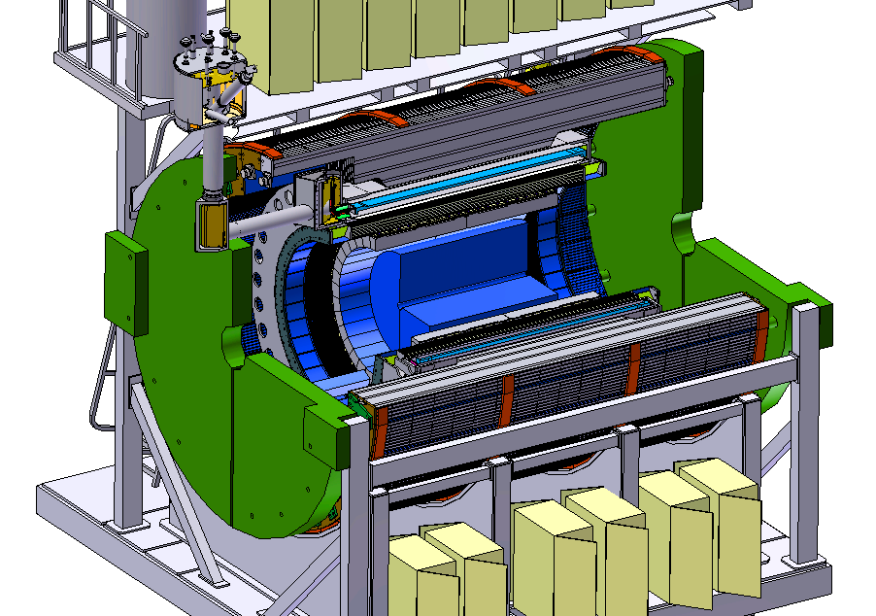

A New Detector at RHIC
BaBar Magnet 1.5 T
Coverage |η| < 1.1
All silicon tracking
Heavy flavor tagging
Electromagnetic
Calorimeter
Hadronic Calorimeter
High data acquisition rate capability, 15 kHz
Sampling 0.6 trillion Au+Au interactions in one-year
Maximizing efficiency of RHIC running

Slide 38
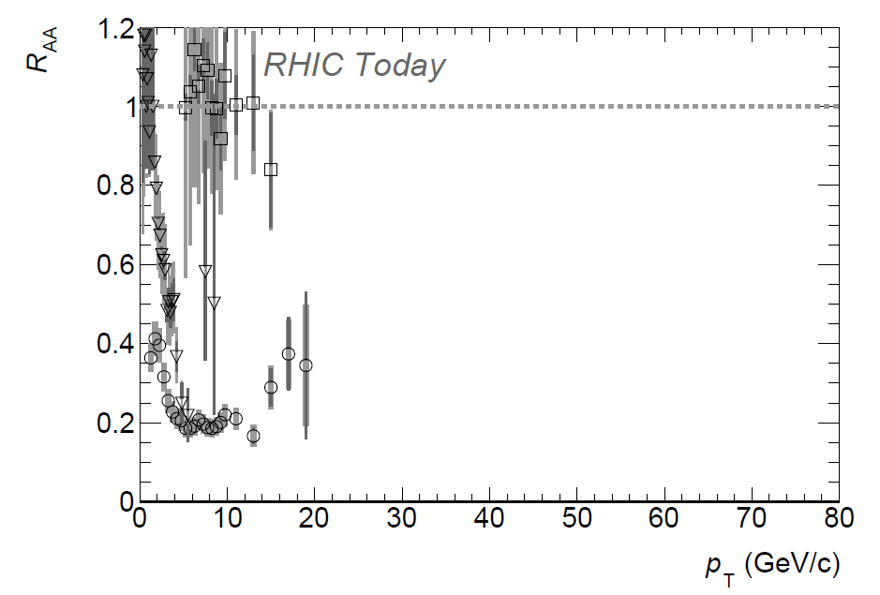
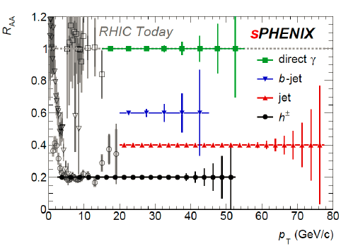
Precision Imaging of QGP Over Key Kinematics
Jet probe precision data
RHIC – 2021-2022
LHC – 2020-2023

Slide 39
The Future

Slide 40
Well worth reading for young people…
A roadmap for the future. Note that large $0.5 - $1.5B projects take 7-15 years at least.
Capitalize on key investments.
Future facilities.
science.energy.gov/~/media/np/nsac/pdf/2015LRP/2015_LRPNS_091815.pdf

Slide 41
DOE Shown Heavy Ion Timeline

Slide 42
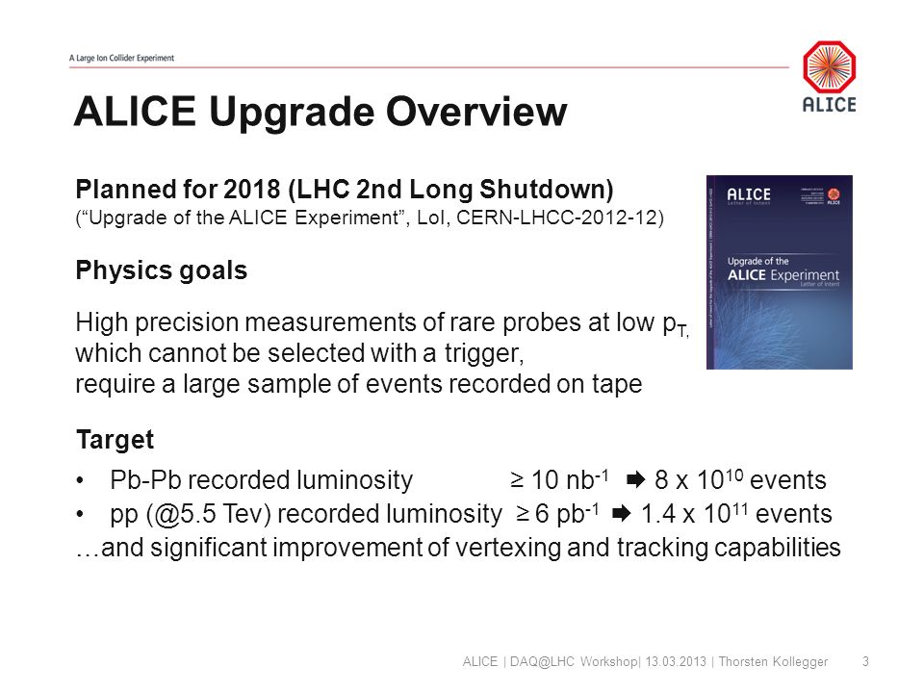
LHC Super-High Luminosity (statistics, statistics, statistics)
Major heavy ion related upgrades – ALICE will have enormous event samples for all soft → hard observables

Slide 43
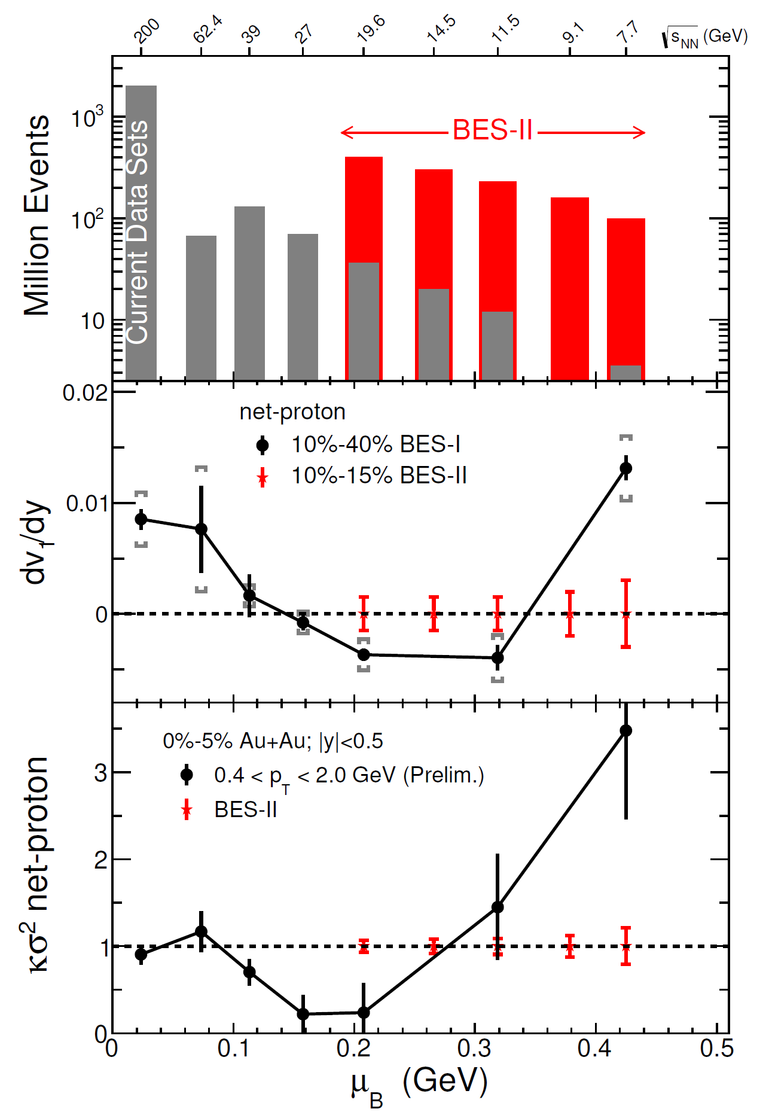
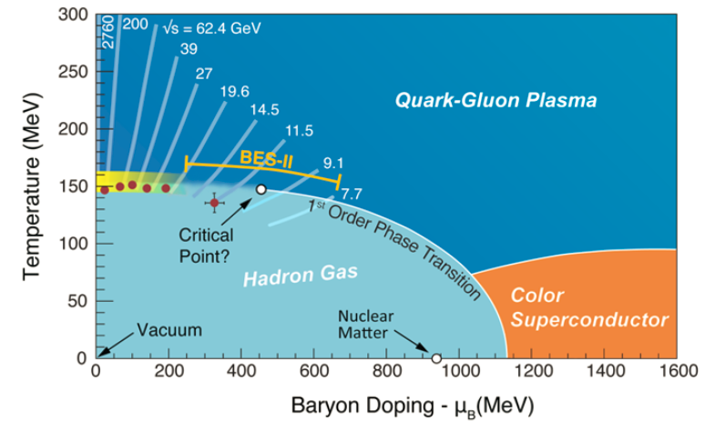
Beam Energy Scan – Phase II
Accelerator upgrade to increase luminosity at these lower energies.
New precision in phase diagram mapping.

Slide 44
A New Detector at RHIC
BaBar Magnet 1.5 T
Coverage |η| < 1.1
All silicon tracking
Heavy flavor tagging
Electromagnetic
Calorimeter
Hadronic Calorimeter
High data acquisition rate capability, 15 kHz
Sampling 0.6 trillion Au+Au interactions in one-year
Maximizing efficiency of RHIC running

Slide 45
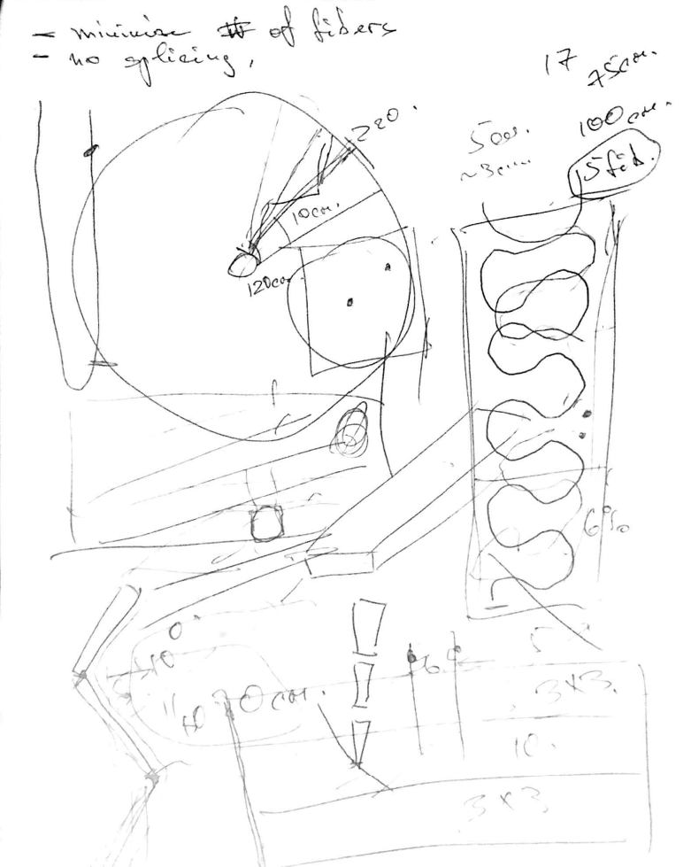
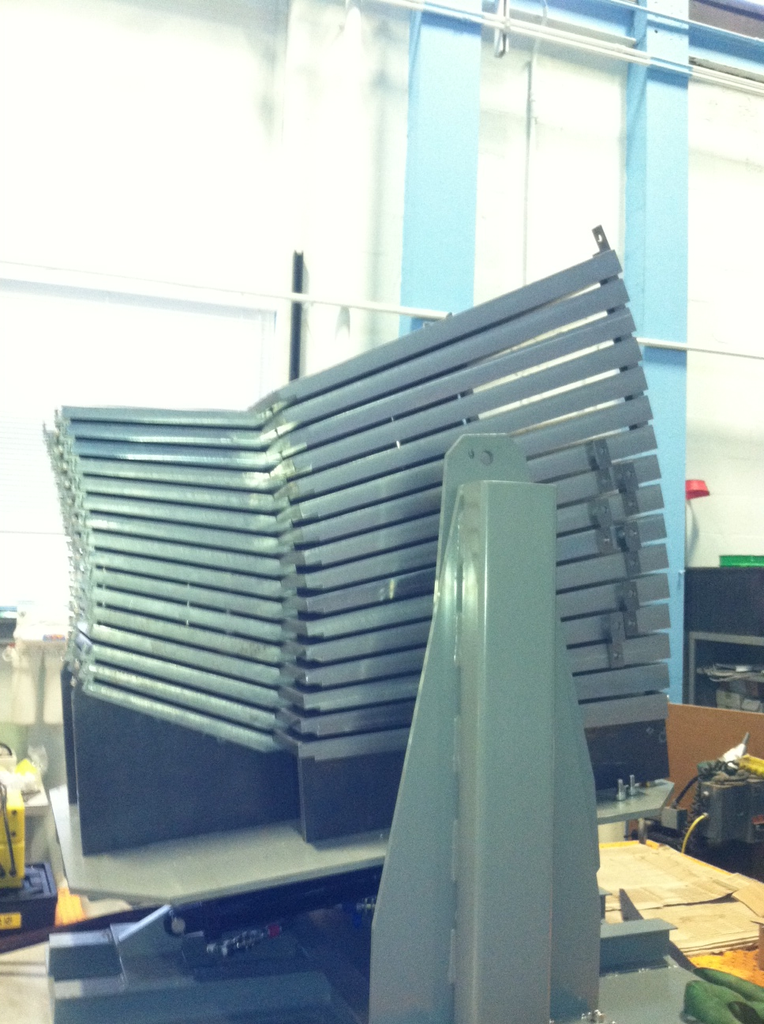
Very Fun to Build Something New!
Napkin Drawing → Prototype → Detector → Physics

Slide 46
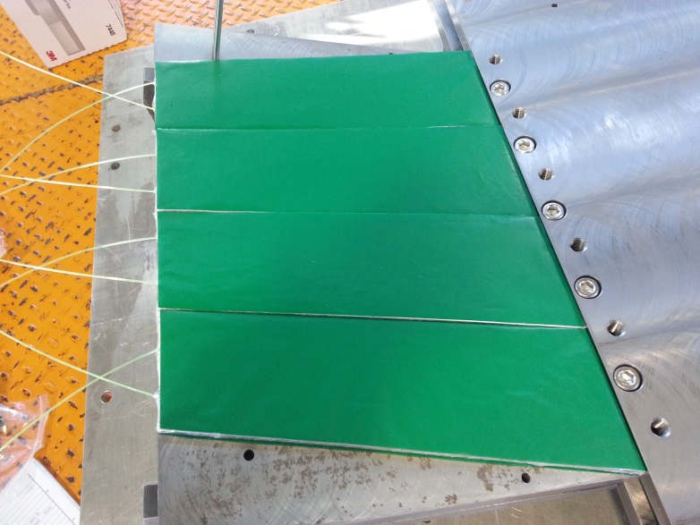
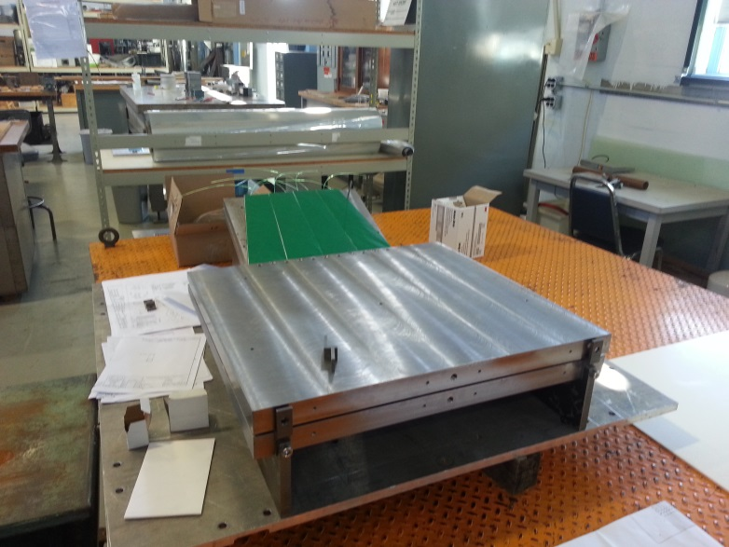
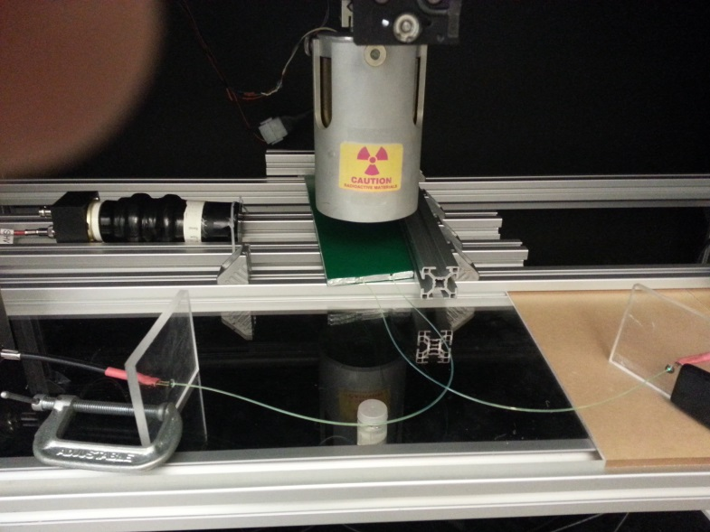
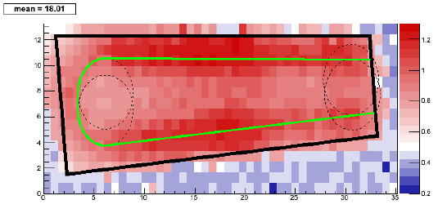
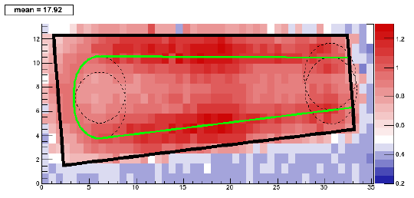
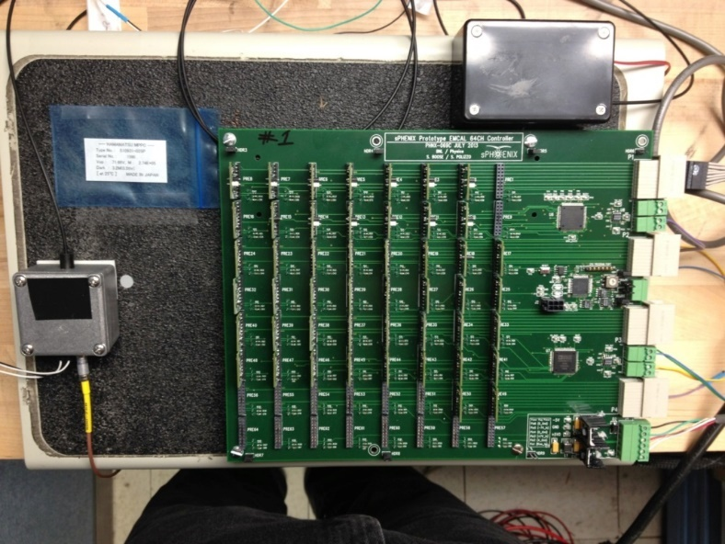
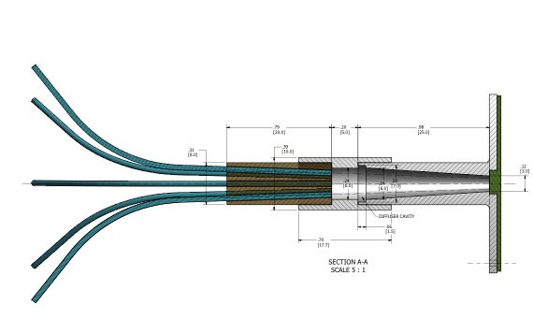
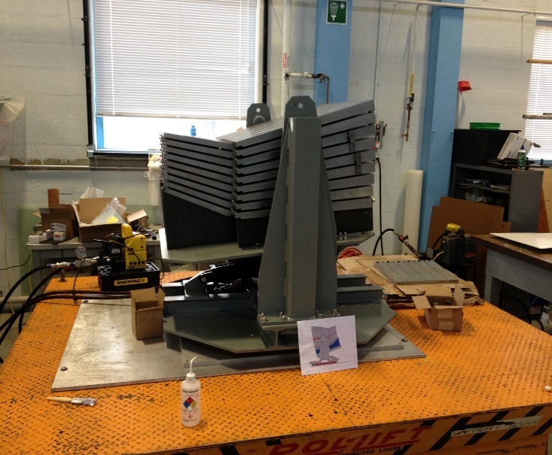
Top fiber
Bottom fiber
If you have the chance to get involved in hardware
(even a little) it is well worth while.

Slide 47

Electron-Ion Collider
Exciting future program.
Very broad (lectures last week).
One example – diffractive imaging
Can we image the proton to connect
to our measurements of flow in p+p, p+A?

Slide 48

Stay Curious

Slide 49
Nominal Lectures
Fini

Slide 50
Extra Slides

Slide 51

Hadronization in AMPT
200 quarks/antiquarks → ~ 100 mesons
Just from parton cascade
Just after hadronization
Coalescence just by closest spatial partner
(no momentum space)

Slide 52

Hydrodynamic Results for d+Au Energy Scan
2+1D QGP Volume in Central d+Au
LHC
3 fm
4 fm
t = 3 fm/c
Orjuela-Koop, Belmont, Yin, Nagle: Phys. Rev. C 93, 044910 (2016)
RHIC
2 fm
2 fm
t = 2 fm/c
200 GeV
62 GeV
7.7GeV
20 GeV

Slide 53







RHIC Jet Probes
LHC Jet Probes
QGP Influence
Bare Color Charges
RHIC Jet Probes
LHC Jet Probes
QGP Influence
Resolution [1/fm]
Thermal Mass Gluons
Perfect Fluid Only
Critical microscope resolution at RHIC.
Also, overlap between RHIC and LHC for simultaneous description.
Parton virtuality evolves quickly and is influenced by the
medium at the scale it probes
Thick lines indicate where the QGP significantly influences virtuality evolution

Slide 54
Heavy Quarks

Slide 55
Why are heavy quarks so special?
QCD is flavor blind, so why are charm and beauty quarks interesting?
Very difficult to produce charm (beauty) quark-antiquark pairs via thermal production in the QGP
g+g → ccbar or bbbar
However, high energy gluons from the incoming nuclei can do the trick. Production dominated by “initial hard scattering” and perturbatively (pQCD) calculable even at low pT due to mass scale.
Cannot be destroyed via strong interaction with light quarks and gluons (i.e. QGP).

Slide 56

http://www.lpthe.jussieu.fr/~cacciari/fonll/fonllform.html

Slide 57


Alternative Fluid Probe:
Put a pebble in the stream
and watch something out of equilibrium then equilibrate.
Charm Quark
Perfect Fluid?
Beauty Quark
“Does the Charm Flow at RHIC?”
At the time, many said this idea was “ridiculous”.

Slide 58

Langevin Model - Drag and Diffusion
Teaney and Moore
http://journals.aps.org/prc/abstract/10.1103/PhysRevC.71.064904

Slide 59


Slide 60
Open Charm
Measuring single leptons from semi-leptonic decay of D and B
Measuring D→πK and subtract combinatorics
Measuring the above two with a displaced vertex measurement

Slide 61
Example – Many ways to measure heavies

Slide 62

Charm: Really moves with the medium

Slide 63

Charm: Really moves with the medium
Lower momentum – drag and diffusion
Higher momentum – jet quenching energy loss

Slide 64


QGP Constituent Mass Dependence
Energy Loss Mechanisms
^
q → scattering of leading parton which then radiates
e → energy transfer from parton to QGP particle
^
Collisional
Radiative
Limit of infinitely massive scattering centers yields all radiative e-loss.
Medium parton

Slide 65

Need measurements at both RHIC and the LHC

Slide 66
Hadron Formation
Via Coalescence

Slide 67

Universe time=0 + 6 microseconds
Cooper-Frye – End of Story?
How are color neutral hadrons really formed?
Fundamental question without too many tools.
Quarks + Gluons
Bound Hadrons

Slide 68
Color Strings → Hadrons
Jet fragmentation occurs when particle pairs tunnel out of the vacuum from the flux tube potential energy.
Analogous to Schwinger mechanism in QED.
Production of qq leading to pions is much more likely than qq qq (diquark antidiquark) leading to protons and antiprotons.
d
d
π⁻
d
u
u
d
π⁺
proton
d
antiproton
uu
d
uu
d

Slide 69


Baryon Anomaly
In proton+proton and e⁺e⁻ reactions at moderate p_{T},
baryons and antibaryons are suppressed relative to mesons.
In heavy ion reactions, there is anomalous baryon production.
Central Au-Au
(anti)proton/pion
Proton-Proton

Slide 70


From Above or Below?
Lower p_{T} partons combine to form higher p_{T} hadrons, instead of higher p_{T} partons fragmenting into lower p_{T} hadrons.
fragmenting parton:
p_{h} = z p, z<1
recombining partons:
p₁+p₂=p_{h}
Qualitative explanation for baryon enhancement.

Slide 71

Baryon Issue in Elliptic Flow
v₂ results at low p_{T} agrees with hydrodynamic calculations, but at higher p_{T} there is a split of mesons and baryons.
Baryons
Mesons
Feature not expected from hydrodynamics + Cooper-Frye.

Slide 72

Rescaling by Valence Quarks
If one rescales the data by the number of valence quarks
(2 for mesons and 3 for baryons),
one sees a remarkable scaling!

Slide 73
Too strong a conclusion in my opinion.
Mechanism of hadronization remains elusive.

Slide 74

Coalescence models are very crude because we fundamentally do not know how this works in QCD.
Completely ignoring gluons.
Simple harmonic oscillator potential.

Slide 75

Contrast Deuteron Coalescence
In BBN, deuteron coalescence process is well know n+p→d+γ.
In heavy ion reactions, we can have off-shell n+p→d and we know the deuteron wavefunction.
What is the required space and momentum distribution of partons to form a hadron?
Very Simple Picture
Not so Simple Picture

Slide 76
Conclusions and Terminology
Perhaps at moderate p_{T} hadrons are formed from localized distribution of uncorrelated partons.
Some call it coalescence of constituent quarks?
What is a constituent quark outside a hadron? Mass?
Some call it coalescence of valence quarks?
What is a valence versus a sea quark outside a hadron?
What is true is that you need a certain minimum number of objects (partons?) to have the right quantum numbers in some region of real and momentum space to form the hadron.
We still need to understand the full implications.

Slide 77
Heavy Quarkonia

Slide 78

Screening Effects
Different states “melt” at different temperatures due to different binding energies.
The ψ’ and χ_{c} melt below or at T_{c}
the J/ψ melts above T_{c} and
eventually the Υ(1s) melts.
hep-ph/0105234 - “indicate ψ’ and the χ_{c} dissociate below the deconfinement point.”

Slide 79





Quarkonia Thermometer
Many states constrains the temperature
PHENIX, STAR, and CMS data consistent with melting of Υ(2s,3s)
Need more statistics
N_{part}

Slide 80


Quarkonia
Bound states of cc and bb can be Debye color screened in the QGP as one increases the temperature (melting)
J/ψ Suppression
Bizarre twist
Less suppression at LHC with higher temperature.
Quark deconfinement and charm recombination at LHC.
LHC
RHIC

Slide 81

Heavy Quarkonia Recombination
J/ψ Suppression
Less J/ψ suppression at LHC with higher temperature
Charm recombination dominant effect, not screening.
Color conductivity in QGP!
LHC
RHIC
C
Look to Upsilons for Debye Screening,
no recombination at RHIC
C

Slide 82
Collected Randomness

Slide 83

Probes of the Medium
Sometimes a high energy photon is created in the collision. We expect it to pass through the plasma without pause.

Slide 84
Probes of the Medium
Sometimes we produce a high energy quark or gluon.
If the plasma is dense enough we expect the quark or gluon to be swallowed up.

Slide 85
Need translation from thermodynamic variables to particle spectra to be observed.
Sudden freezeout
(Cooper-Frye formula)
Continuous particle
emission (Hirano, Hama)
Hadronic afterburner
via Boltzmann eq.
QGP Fluid
QGP Fluid
QGP Fluid
Hadronic
Cascade
(RQMD,
UrQMD)
Escaping
probability P
Hadron Fluid
λ=0
T_{f.o.}
Teaney,
Lauret,
Shuryak
Bass,
Dumitru…
λ=infinity
τ
f_{free}(x,p)=Pf(x,p)

Slide 87

Navier Stokes
One attempt: D. Teaney
1st correction to thermal distribution function of an expanding gas
⇒ estimate viscous corrections to spectra and elliptic flow using boost invariant blast wave model
Γ_{s} = 4η/3sT (sound attenuation length)
pQCD: Γ_{s}/τ = 0.18/(τT) ~ 0.18
(for α_{s} = 0.5 ?)
AdS/CFT: Γ_{s}/τ = 1/(3πτT) ~ 0.11
What we urgently need is viscous
hydro but experts tell us this is
really hard ⇒ 3 years away (always?)
Lack of Proof ≠ Proof of Lack

Slide 88
Initial State Energy Loss
E866 at Fermilab
Drell-Yan production in proton-A collisions is sensitive to parton energy loss.
μ⁺
γ*
μ⁻
Δx
Need to separate shadowing from energy loss, and then
-dE/dx = 2.32 ± 0.52 ± 0.5 GeV/fm
hep-ex/0109014

Slide 89

Fragmentation Functions
dN/dz * z
Light quarks (u,d)
blue = Fields-Feynman
black dash = Lund fragmentation
Heavy quarks (c,b)
red = Peterson function
black dash = Lund fragmentation
Bowler correction not shown
δ(1-z) is obvious
For charm quarks, the Peterson and Lund fragmentation roughly agree and give an average
<z> ~ 0.8.
z

Slide 90
Hadron Re-interaction
HERMES considers an alternative description.
Suppression due to quark-nucleon scattering (t < t^{π}_{f}) and hadron-nucleon scattering (t > t^{π}_{f}).
A hadron with large z originates from a quark emitting only a few gluons. The emission of only a few gluons corresponds to a small formation time.
Opposite to other models!
q
They consider good agreement with N¹⁴ data in a model in which the “interaction of the struck quark with the nuclear medium is very small.”
hep-ex/0012049

Slide 91

Hadronization Time Scales
What if the quark or gluon jet begins to fragment inside the medium?
Then the fragmented hadrons can interact with the hadron gas medium, rescatter, and thus suppression high momentum hadrons.
Hadronization time =
time to build up the hadronic wavefunction
τ (light) ~ 1.2 (E/GeV) * fm/c
PHENIX p⁰
Nuclear systems are excellent laboratories for testing formation time issues. However, calculations seem to have factors of 2 floating around.
Gallmeister et al., nucl-th/0202051

Slide 92



Quarks, Gluons and the Strong Interaction
Proton is a composite object made of quarks and gluons.
“Three quarks on a lark.” James Joyce
Up Down Strange
Charm Bottom Top

Slide 93



High energy back-to-back quarks (jets) can blast out through the fluid.
These jets → bound quark states too.

Slide 94
Gluon Saturation
probe rest frame
target rest frame
gg→g
r/γ
λ_{c} ~1/x
Transverse size of the quark-antiquark cloud
is determined by r ~ 1/Q ~ 2 10⁻¹⁴cm/ Q (GeV)
Wavefunction of low x gluons overlap and the self-coupling gluons fuse, thus saturating the density of gluons in the initial state
Fluctuations from dipole increase and the unitary limit of the photon cross section in deep inelastic scattering is the equivalent to saturation.
¹ J.P Blaizot, A.H. Mueller, Nucl. Phys. B289, 847 (1987).

Slide 95
Saturation in the Proton
HERA deep inelastic scattering data has been interpreted in the context of gluon saturation models.
Lowest x data is at modest Q² (should QCD+DGLAP work?)
Recent HERA running may not resolve these issues since machine changes limit the coverage at low-x.
Future Electron-Ion Collider at RHIC or HERA upgrade may be necessary.
K. Golec-Biernat, Wuesthoff, others

Slide 96


Experimental Comparisons
In this saturation regime (sometimes termed the Color Glass Condensate), with one parameter (saturation scale Q_{s}) defines the physics. In this classical approximation one can calculate the collision output distribution of gluons. If one assumes a mapping of partons to hadrons, one can compare with data.

Slide 97
Saturation Regime?
The agreement appears impressive, but at the lowest energy one is no where near the saturation condition.
Also, when the particle yield is matched, the transverse energy per particle is a factor of 2 too large. Perhaps this is longitudinal work, but no detailed calculation accounts for this yet.

Slide 98
Lower x?
For a 2 ←→ 2 parton scattering process (LO), if both partons scatter at 90 degrees, then x₁=x₂= 2p_{T}/E_{cm}
x₂
p_{T} ~ 2 GeV
E_{cm} ~ 200 GeV
x ~ 0.04
x₁
One can probe lower x values if x1 >> x2 and look at particles away from 90 degrees (forward rapidity).
Rapidity y=0 (x~0.01), y=2.0 (x~0.001), y=4.0 (x~0.0001) for pT ~ 2 GeV.
x₂
x₁

Slide 99

Suppression Factor R
Binary
Collisions
b
R = 1 (binary collision scaling)
Participant
In deuteron-Gold collisions, forward rapidity probes low x in the Gold nucleus. BRAHMS observes a suppression of particles that could be related to saturation of the gluon density in the Gold nucleus.

Slide 100

d+Gold Probes
Suppression of forward hadrons generically consistent with saturation of low-x gluons.
d
d
d
Au
Au
Au
Au
Au
Au
Suppression Factor
x ~ 10⁻¹
x ~ 10⁻²
x ~ 10⁻³

Slide 101

MonoJets?
STAR Experiment
“Mono-jet”
π⁰
P_{T} is balanced by many gluons
Dilute parton system (deuteron)
Dense gluon field (Au)
Tagged photons and jets at forward angles will give precise information on x dependence of saturation effect.

Slide 102

No MonoJets at y=2?
PHENIX has measured the correlation between y=2 hadrons and y=0 hadrons.
There appears to be no decrease in away side partners as predicted by saturation models.
However, these predictions were for more forward rapidity (probing lower x) regions.

Slide 103




What do they have in common?
Scaling of the total p-p
cross section
Shadowing of structure
functions in nuclei
Growth of low x gluons
in the proton
x
Particle production in
nucleus-nucleus reactions

Slide 104

Saturation Summary
Interesting hints at non-linear saturation effects of partons in protons at HERA. Current HERA running does not focus on this physics, and facility will soon be shut down.
Interesting hints in proton (deuteron) nucleus reactions at RHIC, but at a rather soft scale. Photon Jet or Jet Jet correlations that pin down x₁ and x₂ may shed more light.
Key future is much larger x reach at high Q² at the LHC, or with Deep Inelastic Scattering at future electron ion collider (EIC or eRHIC).

Slide 105
Canonical Ensemble
Statistical Model using Grand Canonical Ensemble
One can use the GCE even when energy and other quantum numbers are conserved. The temperature and chemical potentials simply reflect characteristics of the system. Fluctuation calculations are not valid.
If the volume of the system is large, GCE is appropriate. For small volumes, you must conserve quantum numbers (for example strangeness) in every event !
Thus the Canonical Ensemble is relevant. In the CE, strangeness is suppressed for very small volumes and reaches the GCE limit for large volumes.
Volume (fm³)

Slide 106

“A particularly striking aspect of this apparent ‘chemical equilibrium’ at the quark-hadron transition temperature is the observed enhancement of hadrons containing strange quark relative to proton-included collisions.
Since the hadron abundances appear to be frozen in at the point of hadron formation, this enhancement signals a new and faster strangeness-producing process before or during hadronization, involving intense rescattering among quarks and gluons.”

Slide 107

Strangeness Suppression
factor ~2
RHIC
Becattini et al hep-ph/0011322, hep-ph/0002267

Slide 108


Strange Patterns
The enhancement of total strangeness appears quite similar at AGS, SPS, and now RHIC !
This challenges any model QGP model for enhancement. All systems are approaching something that looks statistically equilibrated, and we already see this trend in proton induced collisions.

Slide 109

Strangeness Enhancement
NA57 (open)
STAR (filled)

Slide 110


Equation of State
One can test many kinds of EoS in hydrodynamics.
Typical EoS in hydro model
Lattice QCD simulations
H: resonance gas(RG)
Q: QGP+RG
p=e/3
From P.Kolb and U.Heinz(’03)
F.Karsch et al. (’00)
Latent heat

Slide 111

https://urqmd.org/

Slide 112


Slide 113
Limiting Temperature
The very rapid increase of
hadron levels with mass yields
an exponential level density
and would thus imply a
“limiting temperature”
T_{H} ~ 170 MeV
Hagedorn, S. Fraustchi, Phys.Rev.D3:2821-2834,1971

Slide 114


Approximate Chiral Symmetry
Up and Down quarks have very small neutral current masses (< 15 MeV). These masses are of interest to electroweak symmetry breaking (i.e. Higgs).
However, there is spontaneous breaking of chiral symmetry in the QCD vacuum we live in. A condensate of qqbar pairs results in the observed hadronic masses.
At high temperature this condensate goes away and thus hadronic masses should change near the transition.
T=1.4T_{c}
1.0 T/T_{c}

Slide 115
What Are
We Colliding -
Protons and Nuclei?

Slide 116
Limitless Gluons?
When protons are viewed at short wavelength, there is a large increase in low x gluons.
Is there a limit to the low x gluon density?

Slide 117

What about Nuclei?
Nucleon structure functions are known to be modified in nuclei.
Can be modeled as recombination effect due to high gluon density at low x (in the frame where the nucleus is moving fast).
Fermi Effect
enhancement
Saturation?
EMC effect
shadowing
RHIC probes
x

Slide 118
Gluon Number Density
Gluon number density:
ρ_{g} = A xG_{N}(x,Q²)/πR²
Gluon density depends on the nuclear overlap area
(πR² α A^{2/3}) and the momentum scale (Q²) since DGLAP evolution requires:
G(x, Q²) ~ ln (Q² / Λ_{QCD}²)
HERA tests gluon density in the proton at very low x. RHIC can test similar gluon density at significantly higher x values. LHC heavy ion collisions probe even higher gluon densities.

Slide 119
Gluon Saturation – Fields Only

Slide 120



Spatial eccentricity e2, e3 (equation) and translation
Interesting side note on AMPT

Slide 121

Hadron Gas ?
What interactions can lead to equilibration in < 1 fm/c?
Hadronic transport models (e.g. RQMD, HSD, ...) with hadron formation times ~1 fm/c, fail to describe data.
Hydrodynamic
STAR
PHOBOS
HSD Calculation
pT>2 GeV/c
RQMD
Clearly the system is not a hadron gas. Not surprising.

Slide 122

Hadron Formation Time
These string + hadronic transport models under-predict the collective motion by a factor of 4-10.
RHIC data
Elliptic Flow (v₂)
UrQMD
Formation Time τ (fm/c)
Only if we violate quantum mechanics and allow hadronic
wavefunctions to fully form in τ→0 can we reproduce the data.

Slide 123

Modified Fragmentation

Slide 124
What have we learned?
Jet quenching is experimentally so dramatic, sometimes we forget to ask what in detail we have learned.
The most basic thing we learn is the time integrated density of color charges for scattering that induces radiation.
Assuming only radiative energy loss, matching the high pT hadron suppression, indicates dN/dy(gluons) ~ 1000 or possibly dN/dy(quarks,gluons) ~ 2000.

Slide 125

Soft Singularity
“In the presently available RHIC range p_{T} < 15 GeV a reliable quantitative prediction of quenching can hardly be made. It is the soft singularity that causes instability of the pQCD description.” BDMS

Slide 126

Plasmon Cutoff
No gluon modes propagate below the plasma frequency. Provides a potential natural scale for the infrared cutoff.
No gluon modes propagate below the plasma frequency. This would also then be true for 0th order gluon radiation – normal hadronization process !

Slide 128



Slide 129
Changing the Medium, New Probes
Many basic goals of the field have remained the same over the last 20 years.
However, the character of the system created is a strong function of energy.
Many new probes and theoretical handles are available at higher energies.
Bevalac-LBL
2.2 GeV
AGS-BNL
4.8 GeV
SPS-CERN
17.3 GeV
TEVATRON-FNAL
38.7 GeV
RHIC-BNL
200.0 GeV
LHC-CERN
2760.0 GeV
Nuclear Fragmentation
Resonance Production
Strangeness Near Threshold
Resonances Dominate
Large Net Baryon Density
Strangeness Important
Charm Production Starts
250
RHIC/LHC
200
quark-gluon plasma
150
SPS
AGS
Temperature Tch [MeV]
100
Low Net Baryon Density
Hard Parton Scattering
hadron gas
LBL/SIS
50
atomic nuclei
0
0
200
400
600
800
1000
1200
Beauty Production
High Energy Jets
Net Baryon Density ~ Potential μ_{B} [MeV]

Slide 130


Slide 131


Slide 132

End of the World!
Can be dismissed with some basic General Relativity
much less than
Planck length !
Even if it could form, it would evaporate by Hawking Radiation in
10⁻⁸³ seconds !

Slide 133

Start with Simpler System
OPAL Event Display
Electron-Positron Annihilation

Slide 134

e+e- → qq → hadron jets
Quark radiates gluons and eventually forms
hadrons in a jet cone.
q
e⁺
e⁻
q
(Mueller 1983)
QCD calculation of gluon multiplicity times a hadron scale factor gives excellent agreement with data.

Slide 135

Bjorken Energy Density
At t=t_{form}, the hatched volume contains all particles w/ b<dz/t_{form}:
At y=b||=0, E=m_{T}, thus:
We can equate dN<m_{T}> & dE_{T} and have:
Two nuclei pass through one another leaving a region of produced particles between them.

Slide 136

Side Comment on Phase Space and Boltzmann

Slide 137


Warning signs…
What are the odds on either of these plates?

Slide 139


http://arxiv.org/abs/0902.4154
Pocket equation (good/bad)
X1 = x2 = 2 x (sqrt(m2+pt2))/sqrt(s_NN)
LHC charm / beauty at pT=0
X1 = 0.001 (0.002)

Slide 140



Viscous Hydrodynamics + Cascade
Similar Flow Fingerprint?
Small QGP?
ALICE Experiment
p+Pb @ LHC
PHENIX
d+Au @ RHIC

Slide 142



Critical Point Hints
Minimum in v₁ slope was predicted as consequence of the softening of the equation of state in the transition region.
Net-proton fluctuations, proximity to critical point?
Possible Scenario
Near Critical Point
BES-2 Data Taking 2019-2020

Slide 143

Kinetic Energy → Thermal Energy
https://en.wikipedia.org/wiki/Crush,_Texas
Crush, Texas, was a temporary "city" established as a one-day publicity stunt in 1896. William George Crush, general passenger agent of the Missouri-Kansas-Texas Railroad (popularly known as the Katy), conceived the idea to demonstrate a train wreck as a spectacle.^{[1]} No admission was charged, and train fares to the crash site were at the reduced rate of US$2 from any location in Texas. As a result, about 40,000 people showed up on September 15, 1896, making the new town of Crush, Texas, temporarily the second-largest city in the state. Unexpectedly, the impact caused both engine boilers to explode, resulting in several fatalities and numerous injuries among the spectators.

Slide 144
Simplest Goals
Frank Wilczek:
“In the quest for evidence of the quark-gluon plasma, there are two levels to which one might aspire. At the first level, one might hope to observe phenomena that are very difficult to explain from a hadronic perspective but have a simple qualitative explanation based on quarks and gluons.
But there is a second, more rigorous level that remains a challenge for the future. Using fundamental aspects of QCD theory, one can make quantitative predictions for the emission of various kinds of “hard” radiation from the quark gluon plasma. We will not have done justice to the concept of weakly interacting plasma of quarks and gluons until some of the predictions are confirmed by experiment.”

Slide 145

Strangeness Enhancement
Hadronic rescattering can equilibrate overall strangeness (ie. K⁺, K⁻, Λ) in 10-100 fm/c and strange antibaryons (Λ, Ξ, Ω) in over 1000 fm/c !
Quark-gluon plasma may equilibrate all strange particles in 3-6 fm/c !
Heavy Ion collision lifetime is of order 10-15 fm/c before free streaming.

Slide 146

Strangeness Enhancement
Strangeness is enhanced in high multiplicity pp events, but not up to statistical equilibrium.
Experiment E735
dN_{ch}/dη
K/π
Ratio
Ratio
N_{ch}
p_{t} (GeV/c)
Watch out for autocorrelations. Higher multiplicity events have gluon jets which have higher strangeness!
Autocorrelations in small systems is an issue we will revisit.

Slide 147
Thermal / Statistical Model
The statistical model works,
with a remaining strangeness suppression.
Phase space population or equilibration?

Slide 148
Grand Canonical Ensemble
We start out with a system completely out of equilibrium and lots of kinetic energy.
We can try to use the Grand Canonical Ensemble to calculate the abundances of all the final measured particles.
Fermions or Bosons
Depends on Temperature and Chemical Potential.

Slide 149
Grand Canonical Ensemble
Infinite heat bath with which my system can exchange energy and particles, hence we have a temperature and chemical potential.
My system.

Slide 150

Heavy Ions GCE
Works very well again, but now almost no additional suppression of strangeness.
Consider canonical ensemble in smaller systems?

Slide 152
The Proton
https://arxiv.org/abs/1605.09418

Slide 153
Global Constraint Analysis
Global constraint methods using Bayesian sampling as done in Climate Modeling for example.
Includes particle spectra, elliptic flow, two-particle quantum correlations, …
(Speed of Sound)²
Temperature [MeV]
Experimental confirmation of Lattice QCD Equation of State

Slide 154


Global Constraint Analysis
Expect η/s to increase at higher temperatures
even just from running of α_{s}
Key lesson about when and when not to include scenarios (story of High Voltage Power Lines)…

Slide 155


Slide 156

https://lhapdf.hepforge.org/

Slide 157

https://www.jyu.fi/fysiikka/en/research/highenergy/urhic/eps09

Slide 158

https://sites.google.com/site/revihy/

Slide 159

Version without string melting…

Slide 160

http://ntc0.lbl.gov/~xnwang/hijing/index.html

Slide 161
https://urqmd.org/

