Slide 1
Nominal Lecture #2 Start

Slide 2
The Perfect Liquid

Slide 3

The Key Paradigm in the Field
What do we mean by Perfect?
What evidence is there?

Slide 4
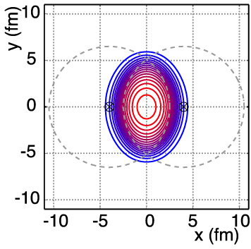
Non-Central A+A Geometry
v₂ = “elliptic flow”

Slide 5
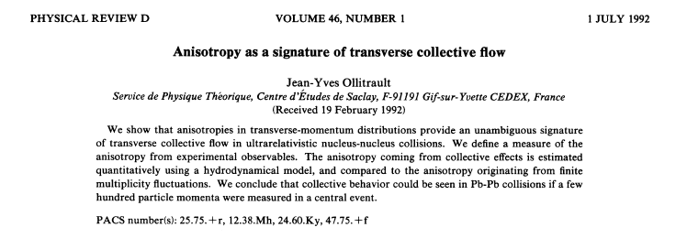
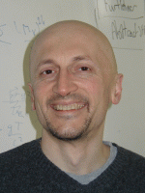
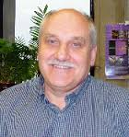
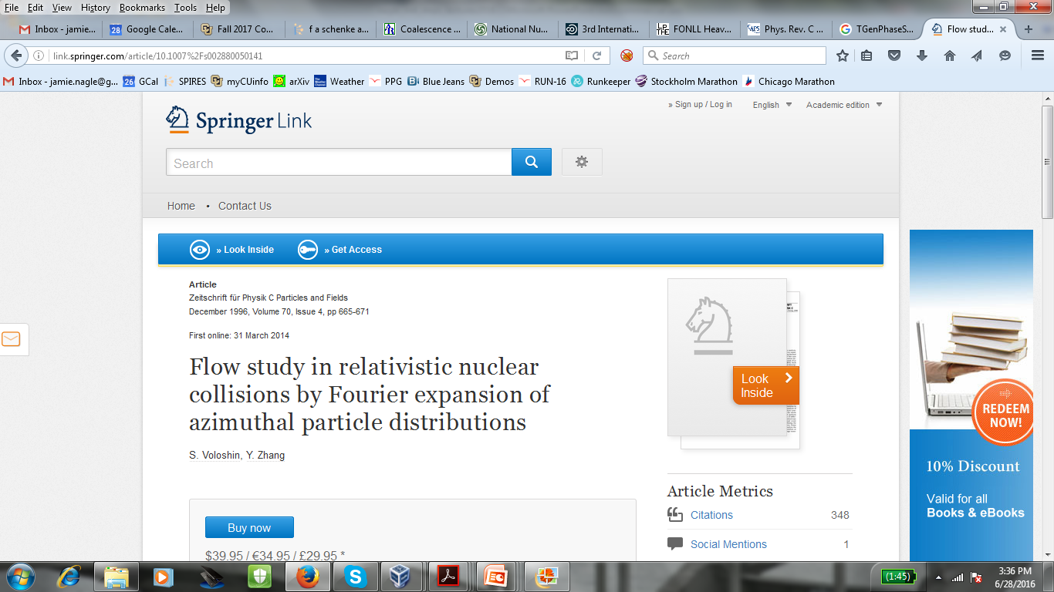
Always Read the Original Material
Common problem – not reading the original references…
V = Voloshin (?)

Slide 6

How do experiments measure v2?
An entire lecture could be on these details…
http://journals.aps.org/prc/abstract/10.1103/PhysRevC.80.014904
Short introduction to some experimental basics

Slide 7
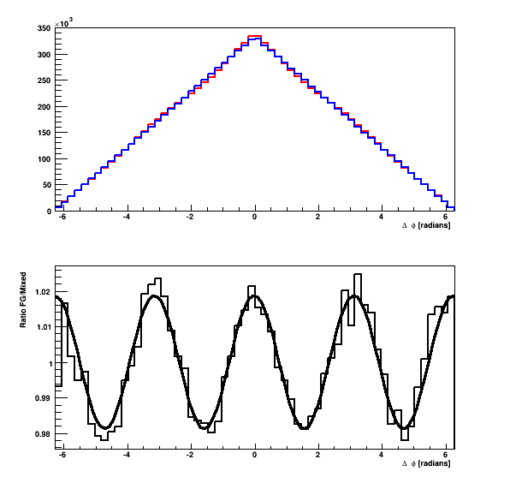
Two Particle Correlations
Two independent particles that come from a common source distribution 1 + 2v₂cos[2(φ-ψ₂)]
Random Case
Resulting Δφ
Distribution
Divide the two FG/BG
Oscillation
1 + 2v₂² cos(2Δφ)
→
Near Side Peak
Δφ = 0
←
Away Side Peak
Δφ = π

Slide 8
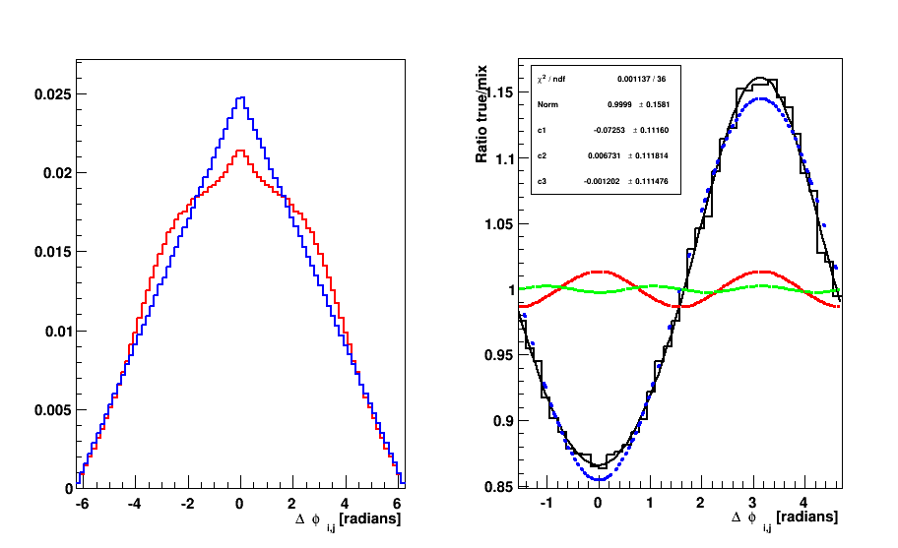
Complications and Other Contributions?
Momentum Conservation
https://root.cern.ch/doc/master/classTGenPhaseSpace.html

Slide 9
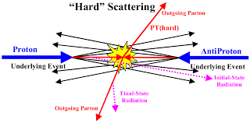
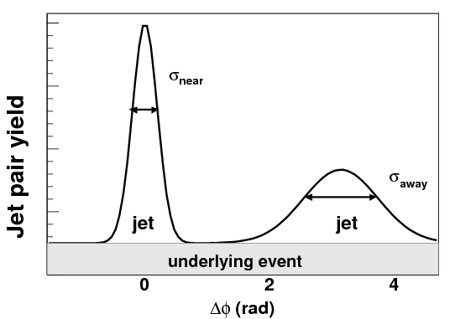
Jet Correlations
Multi-particle correlations – same jet,
opposite jet, etc.
Require large pseudorapidity gap

Slide 10


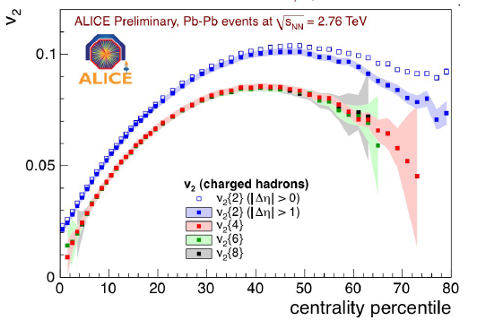
How to Separate “Flow” and “Non-Flow”
Cumulants are not “like magic”…

Slide 11
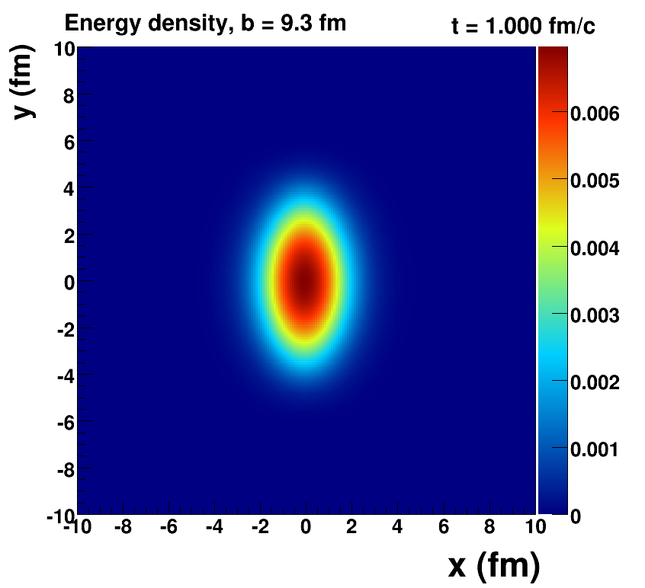
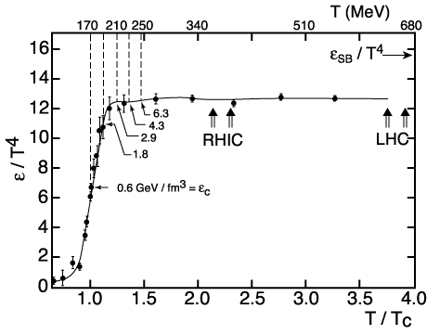
Ideal Hydrodynamics
How Large is the Flow Really?
Key Inputs:
Initial Geometry
QCD Equation of State
Assumes early thermalization [not proven]
Assumes no dissipation (shear/bulk viscosity = 0)

Slide 12
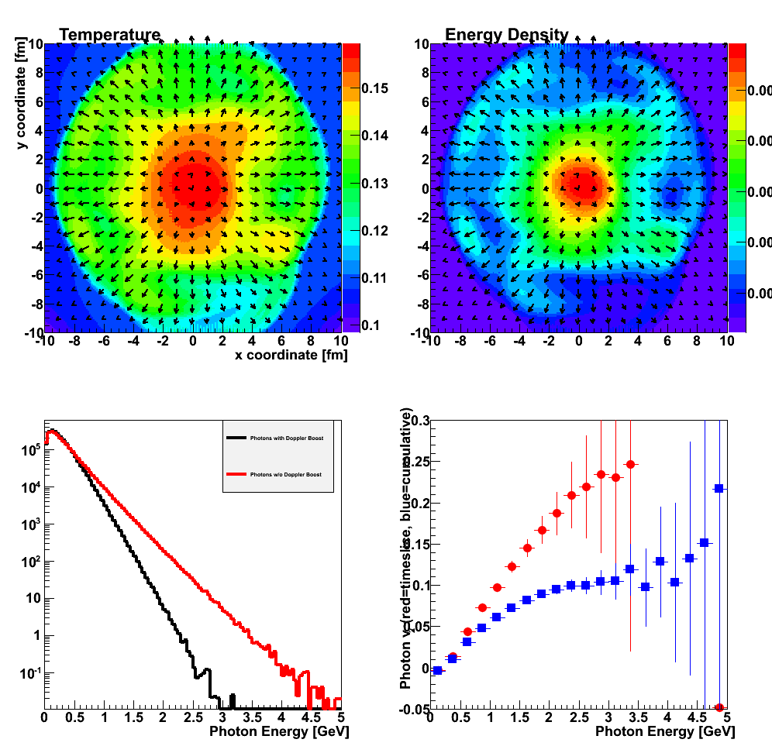
Fluid cells “freeze-out” below T_{freeze}
Isotropic hadrons in cell rest frame, then boosted
Temperature Profile + Fluid Cell Velocity Vectors

Slide 13
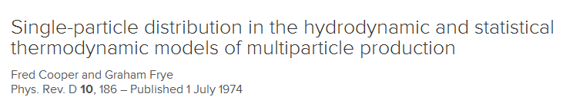

Fluid → Hadrons
An important, but not often discussed, assumption in the calculations.
http://journals.aps.org/prd/abstract/10.1103/PhysRevD.10.186

Slide 14
Two particles separated far in rapidity
Just like the Universe event horizon problem
A causes B (at very early time)
B causes A (at very early time)
C causes A and B (Exam google search story)
Initial elliptical interaction region expands at the speed of light and so each rapidity slice has approximately the same geometry.

Slide 15
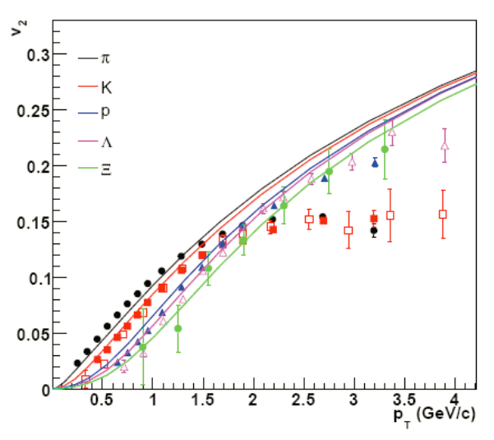
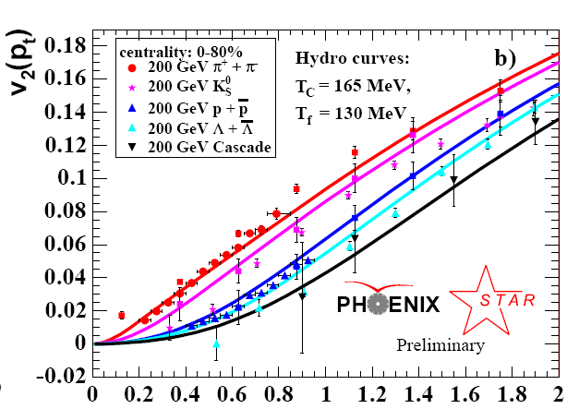
Perfect Fluidity Discovery - 2005
v₂
Agreement of ideal hydrodynamics with experimental data.
p_{T} (GeV)
Heavier particles get a larger momentum boost from the fluid
velocity and so heavier hadron v₂ pattern shifted to higher p_{T}.

Slide 16
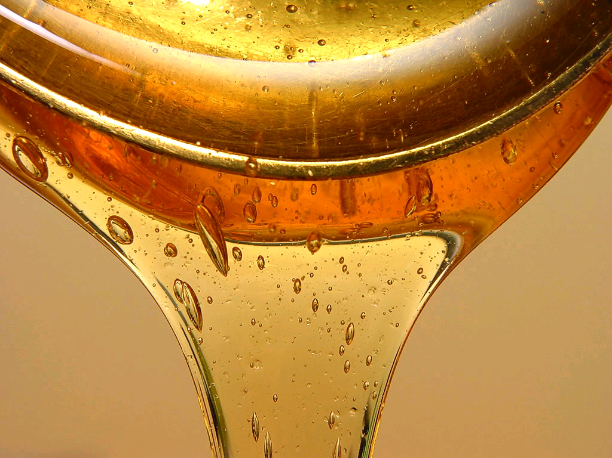
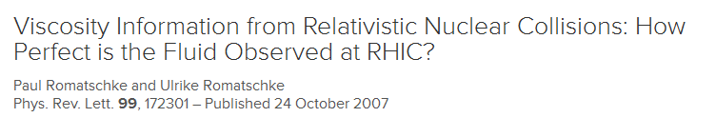
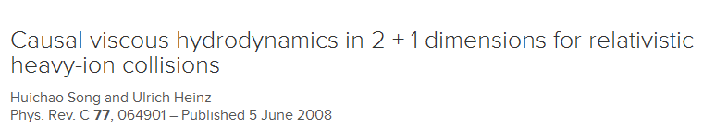
What About Viscosity?
Relativistic Viscous Hydrodynamics
major unsolved numerical problem,
until 2007

Slide 17
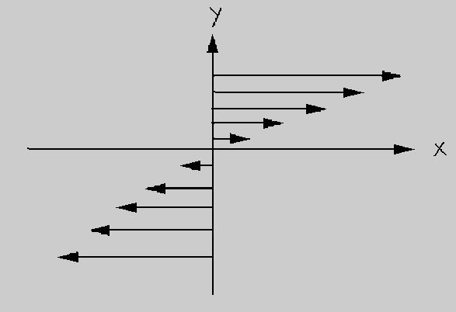
Shear Viscosity

Slide 18
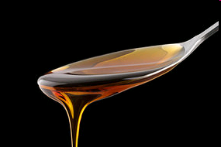
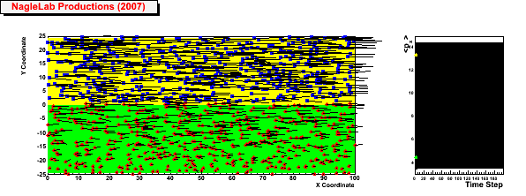
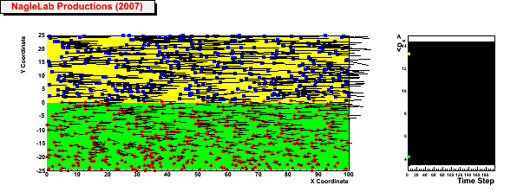
Viscosity Review
Honey – viscosity decreases at higher temperatures
viscosity increases with stronger coupling
Weak coupling (σ=0)
Inhibited
diffusion
↓
Small
viscosity
↓
Perfect fluid
↓
Strong Coupled QGP
(i.e. sQGP)
<p_{x}> top region
<p_{x}> bottom region
Strong coupling (σ ↑)

Slide 19
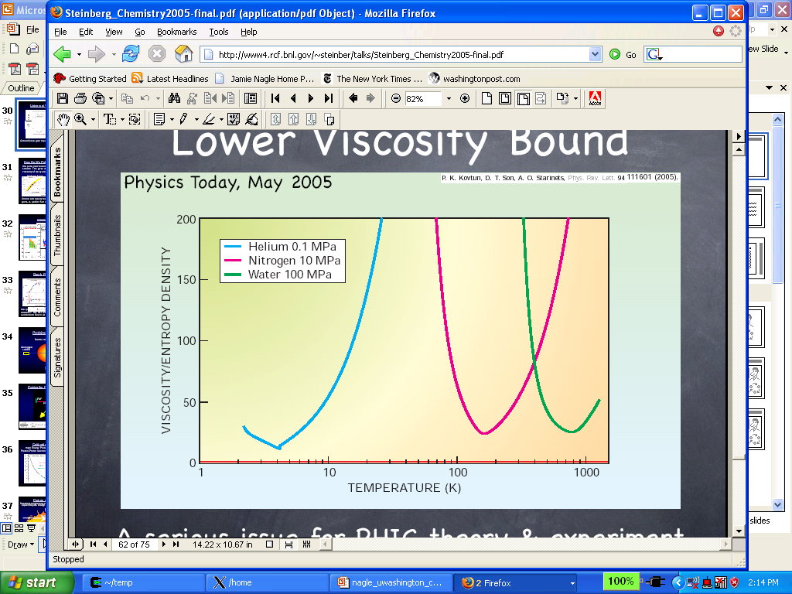
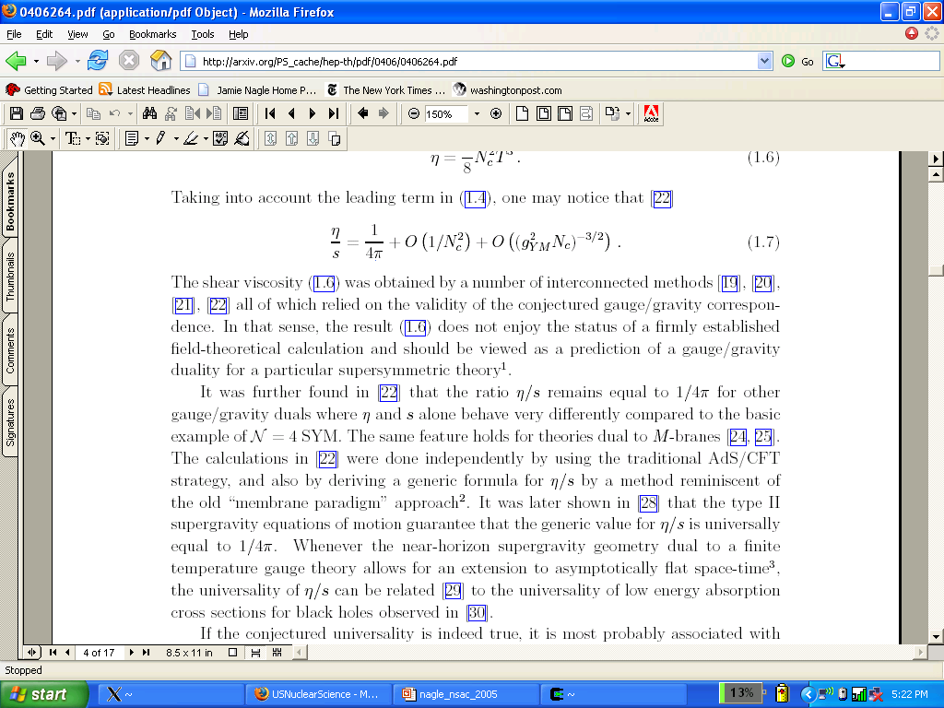
What is η/s for the Quark-Gluon Plasma
String Theory
Lowest Bound!
QGP?
Gas-Liquid Phase Transition
Superfluidity Transition

Slide 20
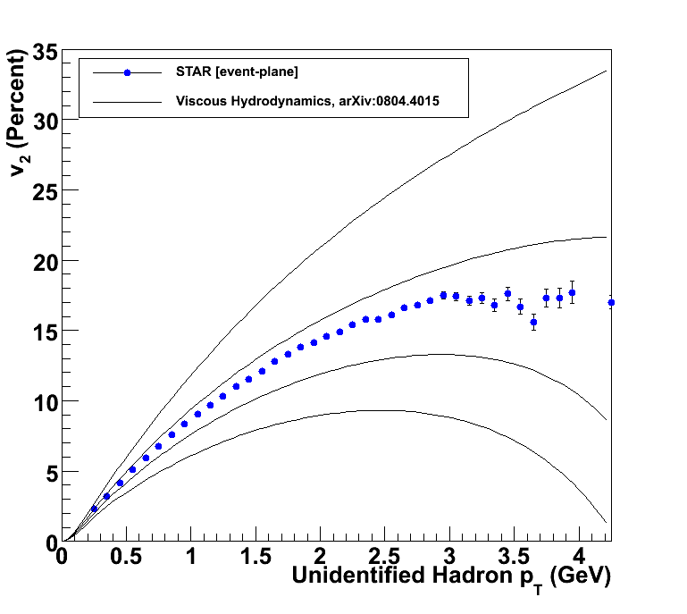
How to Quantify QGP η/s?
Relativistic viscous hydrodynamics compared to data
Luzum, Romatschke, Phys. Rev. C78, 034915 (2008)
η/s ~ 0
η/s = 1/4π
η/s = 2 x 1/4π
η/s = 3 x 1/4π

Slide 21
What dominates the uncertainty?
At the time, different experimental flow methods gave different v₂ results. Now these differences are understood from non-flow contributions and fluctuations.

Slide 22
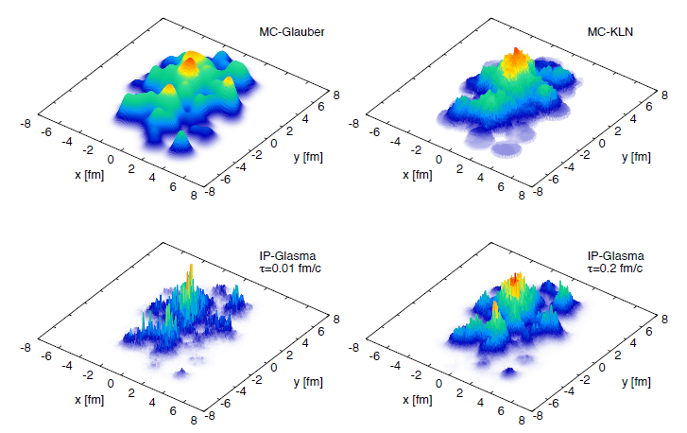
What dominates the uncertainty?
The v₂ you get out is directly related to the ε₂ of the initial geometry you put in.
Different initial geometry models yield 20%
ε₂ differences resulting in 100% η/s differences.
Different models of the initial geometry.
Uncertainty by considering model A and model B.

Slide 23
Systematic Uncertainties
Not much help in many practical situations…
Example: Two model inputs give different results.
Uncertainty = 1 RMS = Difference / sqrt(12)
= Difference / 2
= Cannot determine

Slide 24
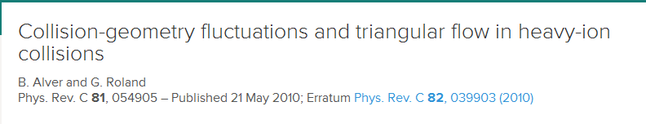
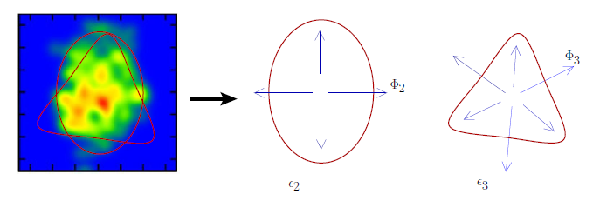
Alver and Roland Revolution 2010
http://journals.aps.org/prc/abstract/10.1103/PhysRevC.81.054905
Fluctuations in geometry yield not only elliptical shapes, but triangular, quadrangular, etc.

Slide 25
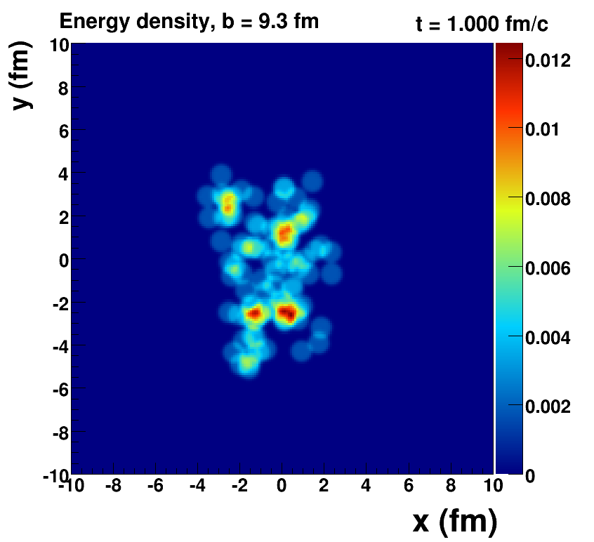
Romatschke=viscous hydrodynamics, McCumber=lumpy conditions + animation

Slide 26
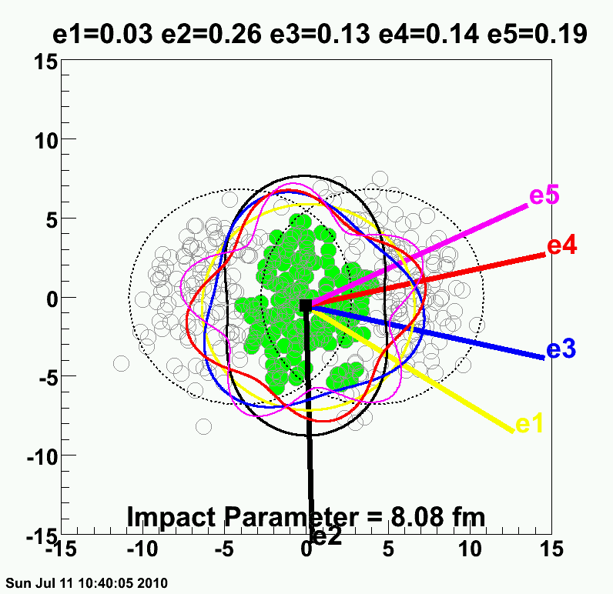
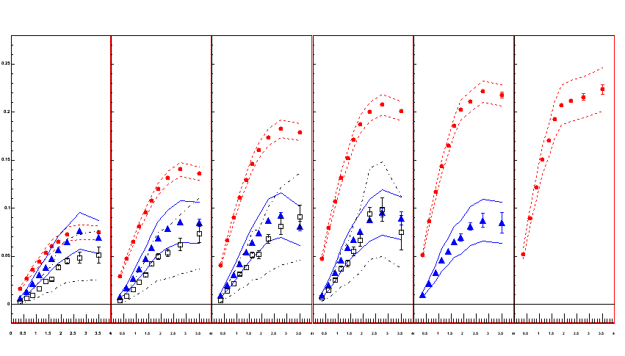
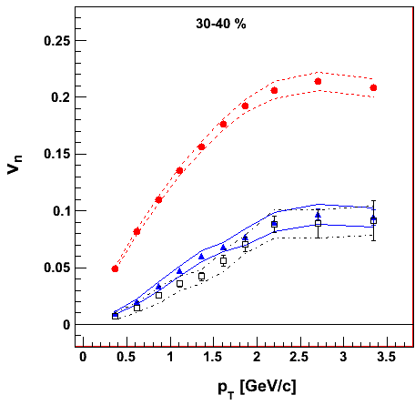
PHENIX Experiment
v₂ {Φ₂ forw.η}
v₃ {Φ₃ forw.η}
v₄ {Φ₄ forw.η}
TT
Au+Au at 30-40% Central
0.20
Elliptic
ε₂ ≈ 2 x ε₃ ≈ 2 x ε₄
Triangular
0.10
Early geometric features survive through QGP evolution because of very small dissipation
0.0
Quadrangular
0.0
1.0
2.0
3.0

Slide 27
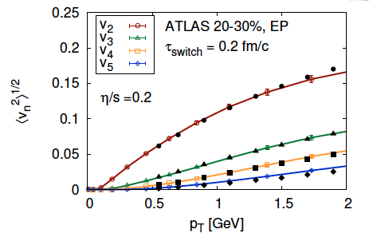
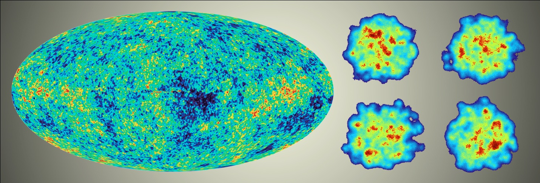
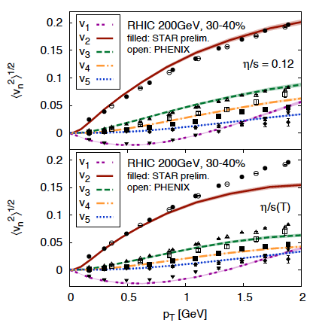
Detailed Fingerprint of Early Time
Calculation from Bjoern Schenke

Slide 28
Global Constraint Analysis
Global constraint methods using Bayesian sampling as done in Climate Modeling for example.
Includes particle spectra, elliptic flow, two-particle quantum correlations, …
(Speed of Sound)²
Temperature [MeV]
Experimental confirmation of Lattice QCD Equation of State

Slide 29
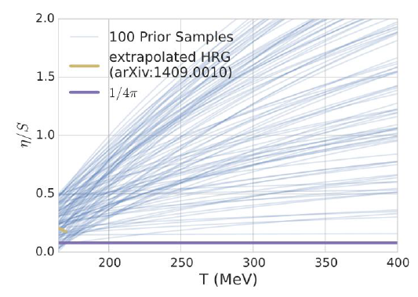
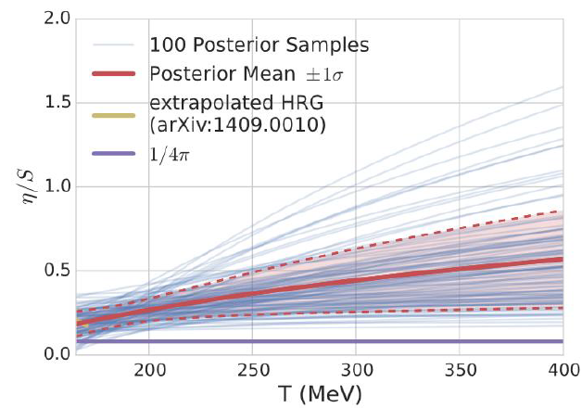
Global Constraint Analysis
Expect η/s to increase at higher temperatures
even just from running of α_{s}
Key lesson about when and when not to include scenarios
(story of High Voltage Power Lines)…

Slide 30
Power of the LHC
Particle production dN/dη approximately 2.5x higher
Also ability to measure
over 5 units
(compare to PHENIX 0.7 and STAR 2.0)
Order of magnitude more particles per event,
opens ability to measure
v₂ event-by-event!

Slide 31
Power of RHIC – changing the energy
Flow of protons decreases a little at lower energies.
Anti-protons decrease much more from annihilation.
Lower collision energy, more net baryons piling up.
Larger chemical potential.
Possible change to 1st order transition!

Slide 32
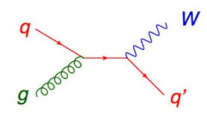
Direct Photon Puzzle
Quarks/Gluons in QGP scatter to create photons
Predict too few photons
γ
Not Black-Body because photons are not in equilibrium.
They escape giving information on QGP interior.
Hydrodynamics has local temperature of q/g and thus one can calculate the photon emission, then boost by fluid velocity.

Slide 33
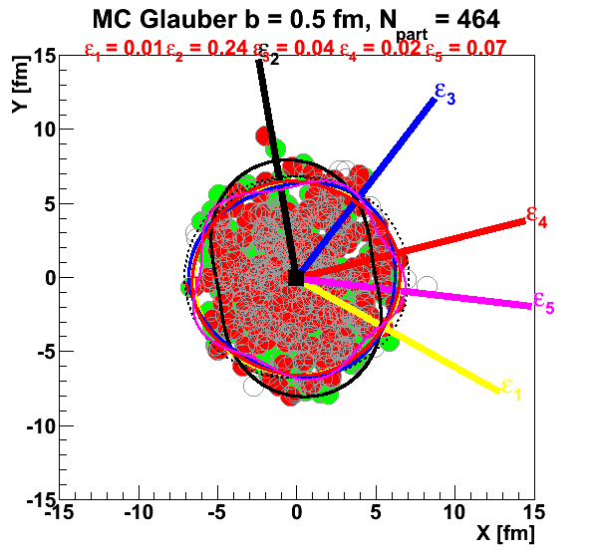
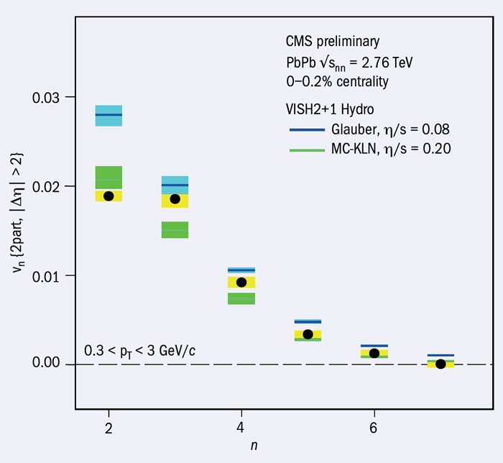
Ultra-Central Puzzle
Ultra-Central A+A geometry driven by fluctuations
ε₂ = ε₃ = ε₄ = ε₅ (good exercise to check)
Hydrodynamics always damps finer structures
v₂ > v₃ > v₄ > v₅
v2 ≈ v3

Slide 34
The Biggest Puzzle
In the last couple of years, many of these signatures of collectivity are now seen in proton+nucleus collisions at RHIC and the LHC, and now also in proton+proton collisions at the LHC.
The “Smallest System”
Biggest Puzzle

Slide 35
Alternatives

Slide 36
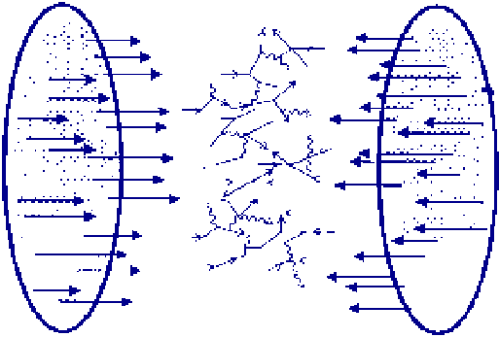
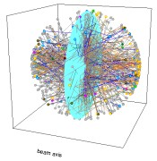
Alternatives to the Hydrodynamic Paradigm
Kinetic theory – well defined particles
Parton cascade programs

Slide 37
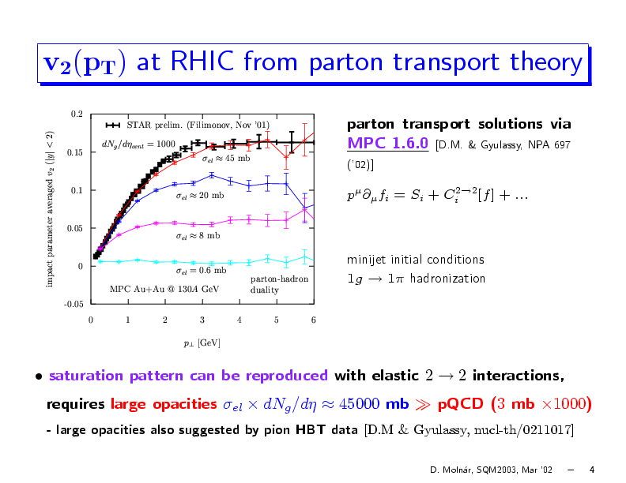
Weak Coupled Parton Cascade
What interactions can lead to equilibration in < 1 fm/c?
Perturbative calculations of gluon scattering lead to long equilibration times (> 2.6 fm/c) and small v₂.
R. Baier, A.H. Mueller, D. Schiff, D. Son, Phys. Lett. B539, 46 (2002).
MPC 1.6.0, D. Molnar, M. Gyulassy, Nucl. Phys. A 697 (2002).
v₂
2-2 processes with
pQCD σ = 3 mb
p_{T} (GeV/c)
Early conclusion – kinetic theory will not work.

Slide 38
AMPT with Zhang Parton Cascade
Parton Cascade with
σ=3 mb gives
reasonable agreement,
particularly at LHC
Why is this different from decade earlier result?
LHC
RHIC
Old: 100 hadrons from 100 gluons [parton-hadron duality]
New: 100 hadrons from 200 (anti) quarks [coalescence]
Also, different p_{T} dependent formation time, hadronic rescattering afterwards – many knobs in the model

Slide 39
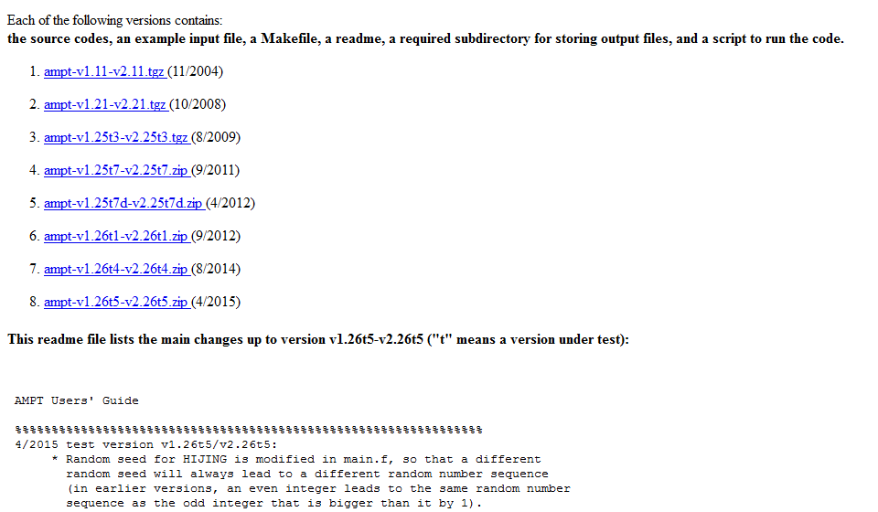
http://myweb.ecu.edu/linz/ampt/

Slide 40
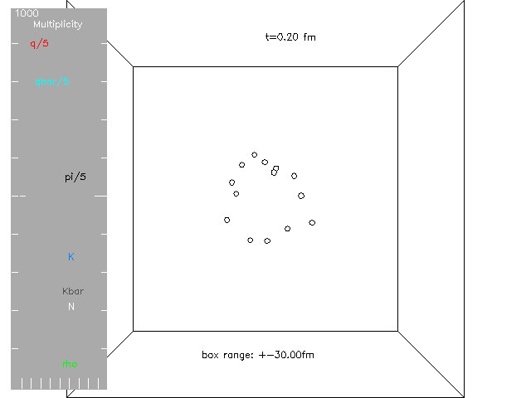
AMPT with String Melting
No gluons!

Slide 41
AMPT and Coalescence
Particle type flow dependence not from boost via fluid velocity, but from coalescence mechanism and hadronic re-scattering.

Slide 42
Small QGP

Slide 43

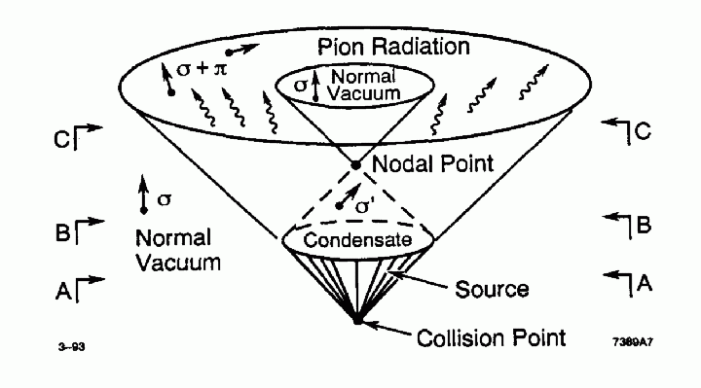
Remember your History
The idea about small QGP was somewhat lost, but maybe not for good scientific reasons.
No particles → think fields / disturbed vacuum
Maybe the small number of final state particles is just not relevant…

Slide 44
Two-Particle Correlation Basics
Jet Correlations…
Same jet
Opposing jet
Flow Correlations…
Elliptic (v₂)
Triangular (v₃)
etc.
Δη
0
0
Δφ
π

Slide 45
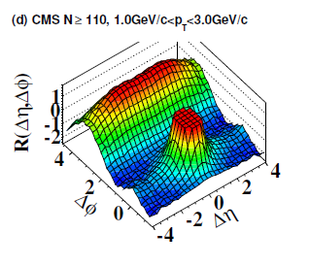
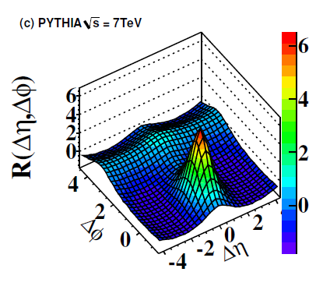
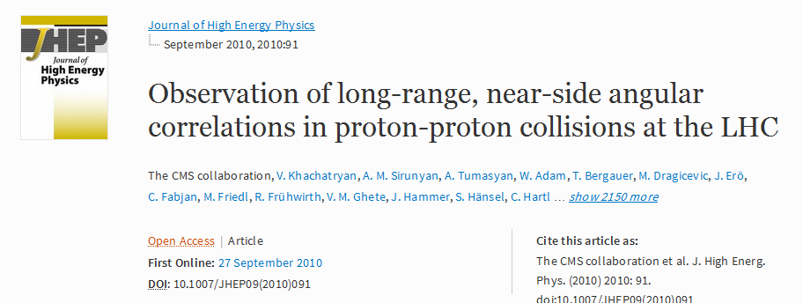
CMS Proton-Proton Hint
http://link.springer.com/article/10.1007%2FJHEP09%282010%29091

Slide 46

Pb+Pb at the LHC
Near side jet peak and dominant flow correlations,
including long-range
near-side ridge
p+p at the LHC
Near and away side jet peaks dominant.
And yet, clear small
long-range near-side ridge

Slide 47

Looks Similar, but Maybe Different Origin
“Momentum Domains”
Think Color Electric Fields
Non-Geometry correlations in momentum space
1/Q_{s}
Important in small systems with a
finite number of these domains!

