Slide 1
Lecture #1 Start

Slide 2
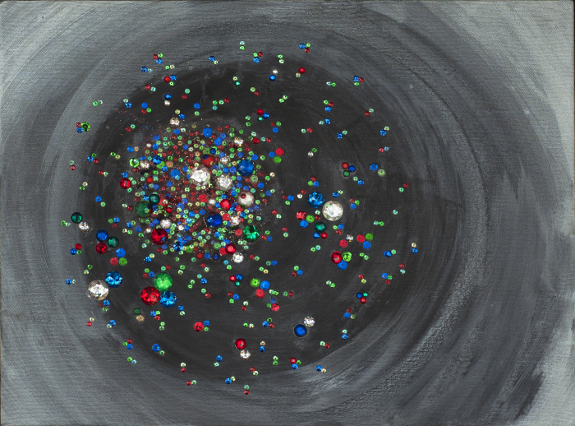


Heavy Ion Experiment
What is it all about…
Artwork by Sarah Szabo
National Nuclear Physics
Summer School 2016
Jamie Nagle
University of Colorado

Slide 3
Lecture Philosophy
Less is more.. (i.e. not comprehensive by any means)
Keep It Simple Stupid (KISS) principle…
Even the experts often miss the big questions…
Take away goals…
- an appreciation for the science
- excitement of the field
- some details on experimental methods
- open questions and opportunities for discovery by young people such as yourselves
Let me know if there are specific things you want to hear

Slide 4

Simplest Goals
Emergent Phenomena…
Collectivity…
What is the underlying origin?
For this flock of birds, it is all short range interactions (amazing!)

Slide 5

Emergent Phenomena
Connection from the QCD Lagrangian to
phenomena of confinement and asymptotic
freedom was fundamental
Connection from QCD to the emergent phenomena of near perfect fluidity of the Quark-Gluon Plasma is just as fundamental
Perfect fluidity tells us the nature of the QGP,
more importantly we need to reconcile:
Most important discovery in field: perfect fluid
&
Crucial part of QCD: weak coupling at short distances

Slide 6
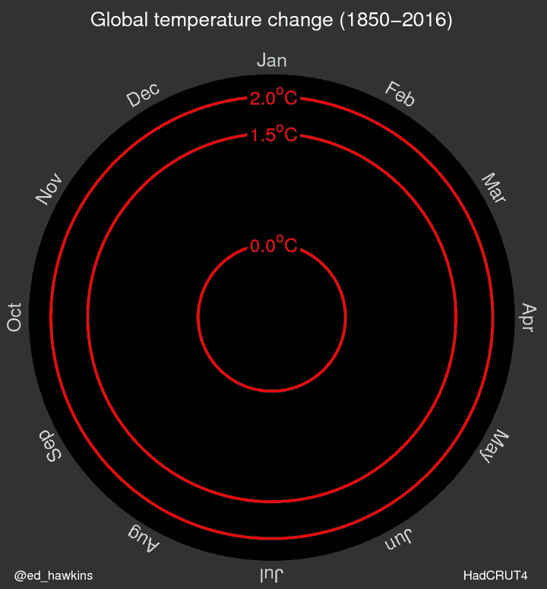

Slide 7

Easy Tools
https://www.lcdf.org/gifsicle/
Wild animations are distracting, but key visualizations stick with people.
Make your own!
Create your own ideas and borrow only selectively. The more important the talk, the more important it is to show your thoughts…
Data thief programs allow you to choose which data sets to show, re-fit your model, etc.
http://arohatgi.info/WebPlotDigitizer/app/

Slide 8
Side note to students…
1) Data visualization is very important
2) Leads to breakthroughs via more intuitive and physical picture
3) Most talks only get across 2-3 items that a given audience member will recall later

Slide 9

A Brief History of Time (in Heavy Ions)
History can be boring,
though often early in a new field that is when the most basic questions are discussed openly.
Later people often focus
too much on the latest details.

Slide 10
Lattice QCD Thermodynamics with Physical Quark Masses
Annual Review of Nuclear and Particle Science
Vol. 65: 379-402 (Volume publication date October 2015)
First published online as a Review in Advance on July 30, 2015
DOI: 10.1146/annurev-nucl-102014-022157
R.A. Soltz,¹ C. DeTar,² F. Karsch,^{3,4} Swagato Mukherjee,³ and P. Vranas¹
Annual Review Articles of
Relevance Here…
Hard-Scattering Results in Heavy-Ion Collisions at the LHC
Annual Review of Nuclear and Particle Science
Vol. 64: 383-411 (Volume publication date October 2014)
First published online as a Review in Advance on August 1, 2014
DOI: 10.1146/annurev-nucl-102912-144532
Edwin Norbeck,^{1,}* Karel Šafařík,² and Peter A. Steinberg³
Topology, Magnetic Field, and Strongly Interacting Matter
Annual Review of Nuclear and Particle Science
Vol. 65: 193-214 (Volume publication date October 2015)
First published online as a Review in Advance on June 5, 2015
DOI: 10.1146/annurev-nucl-102313-025420
Dmitri E. Kharzeev^{1,2}
Collective Flow and Viscosity in Relativistic Heavy-Ion Collisions
Annual Review of Nuclear and Particle Science
Vol. 63: 123-151 (Volume publication date October 2013)
First published online as a Review in Advance on June 13, 2013
DOI: 10.1146/annurev-nucl-102212-170540
Ulrich Heinz¹ and Raimond Snellings²
First Results from Pb+Pb Collisions at the LHC
Annual Review of Nuclear and Particle Science
Vol. 62: 361-386 (Volume publication date November 2012)
First published online as a Review in Advance on July 20, 2012
DOI: 10.1146/annurev-nucl-102711-094910
Berndt Müller,¹ Jürgen Schukraft,² and Bolesław Wysłouch³

Slide 11
The Color Glass Condensate
Annual Review of Nuclear and Particle Science
Vol. 60: 463-489 (Volume publication date November 2010)
DOI: 10.1146/annurev.nucl.010909.083629
Francois Gelis,¹ Edmond Iancu,¹ Jamal Jalilian-Marian,² and Raju Venugopalan³
From Gauge-String Duality to Strong Interactions:A Pedestrian's Guide
Annual Review of Nuclear and Particle Science
Vol. 59: 145-168 (Volume publication date November 2009)
First published online as a Review in Advance on June 3, 2009
DOI: 10.1146/annurev.nucl.010909.083602
Steven S. Gubser¹ and Andreas Karch²
Coalescence Models for Hadron Formation from Quark-Gluon Plasma
Annual Review of Nuclear and Particle Science
Vol. 58: 177-205 (Volume publication date November 2008)
DOI: 10.1146/annurev.nucl.58.110707.171134
Rainer Fries,^{1,2} Vincenzo Greco,^{3,4} and Paul Sorensen⁵
What Do Electromagnetic Plasmas Tell Us about the Quark-Gluon Plasma?
Annual Review of Nuclear and Particle Science
Vol. 57: 61-94 (Volume publication date November 2007)
First published online as a Review in Advance on April 4, 2007
DOI: 10.1146/annurev.nucl.57.090506.123124
Stanisław Mrówczyński¹ and Markus H. Thoma²
Viscosity, Black Holes, and Quantum Field Theory
Annual Review of Nuclear and Particle Science
Vol. 57: 95-118 (Volume publication date November 2007)
First published online as a Review in Advance on April 20, 2007
DOI: 10.1146/annurev.nucl.57.090506.123120
Dam T. Son¹ and Andrei O. Starinets²
Glauber Modeling in High-Energy Nuclear Collisions
Annual Review of Nuclear and Particle Science
Vol. 57: 205-243 (Volume publication date November 2007)
First published online as a Review in Advance on May 9, 2007
DOI: 10.1146/annurev.nucl.57.090506.123020
Michael L. Miller,¹ Klaus Reygers,² Stephen J. Sanders,³ and Peter Steinberg⁴

Slide 12
Results from the Relativistic Heavy Ion Collider
Annual Review of Nuclear and Particle Science
Vol. 56: 93-135 (Volume publication date November 2006)
First published online as a Review in Advance on May 17, 2006
DOI: 10.1146/annurev.nucl.56.080805.140556
Berndt Müller
Department of Physics, Duke University, Durham, North Carolina 27708; email: muller@phy.duke.edu
James L. Nagle
Hydrodynamic Models for Heavy Ion Collisions
Annual Review of Nuclear and Particle Science
Vol. 56: 163-206 (Volume publication date November 2006)
First published online as a Review in Advance on June 5, 2006
DOI: 10.1146/annurev.nucl.54.070103.181236
P. Huovinen
Department of Physics, University of Virginia, Charlottesville, Virginia 22904 and Helsinki Institute of Physics, University of Helsinki, FIN-00014, Finland; email: ph4h@virginia.edu
P.V. Ruuskanen
Phase Transitions in the Early and Present Universe
Annual Review of Nuclear and Particle Science
Vol. 56: 441-500 (Volume publication date November 2006)
First published online as a Review in Advance on August 2, 2006
DOI: 10.1146/annurev.nucl.56.080805.140539
D. Boyanovsky,^{1,2,3} H.J. de Vega,^{3,2,1} and D.J. Schwarz⁴
FEMTOSCOPY IN RELATIVISTIC HEAVY ION COLLISIONS: Two Decades of Progress
Annual Review of Nuclear and Particle Science
Vol. 55: 357-402 (Volume publication date December 2005)
DOI: 10.1146/annurev.nucl.55.090704.151533
Michael Annan Lisa
Department of Physics, The Ohio State University, Columbus, Ohio 43210; email: lisa@mps.ohio-state.edu
Scott Pratt
DIRECT PHOTON PRODUCTION IN RELATIVISTIC HEAVY-ION COLLISIONS
Annual Review of Nuclear and Particle Science
Vol. 55: 517-554 (Volume publication date December 2005)
DOI: 10.1146/annurev.nucl.53.041002.110533
Paul Stankus
LATTICE QCD AT FINITE TEMPERATURE
Annual Review of Nuclear and Particle Science
Vol. 53: 163-198 (Volume publication date December 2003)
DOI: 10.1146/annurev.nucl.53.041002.110609
E. Laermann¹ and O. Philipsen²

Slide 13
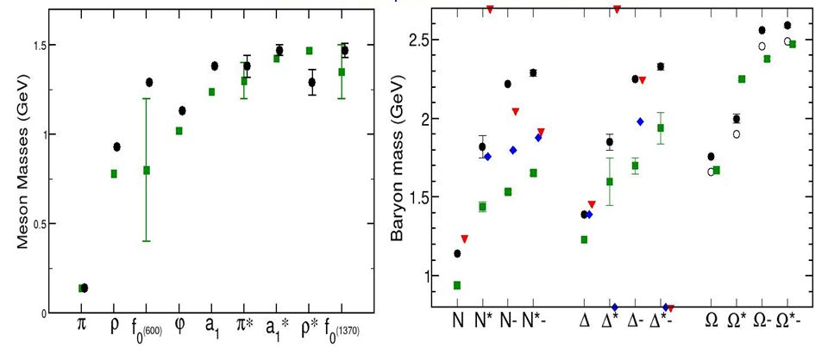
Start in 1950s → Hadron Zoo
Mesons
Baryons
More and more hadrons being discovered.
Too many to be fundamental particles?
Hadrons are strings (interesting history).

Slide 14
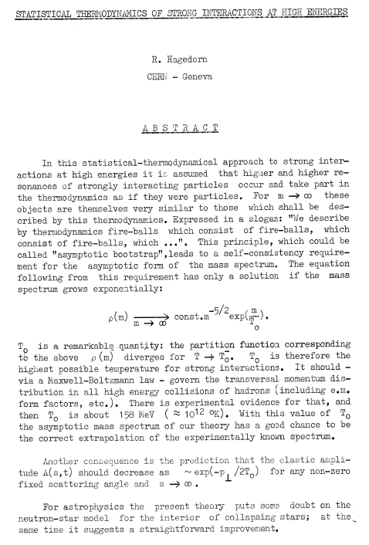
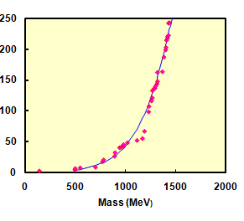
Circa 1965 Hagedorn observed that these hadrons had an exponentially increasing density of states ρ(n)
ρ(n)
http://cds.cern.ch/record/346206
Modern era compilation from PDG by Zajc

Slide 15
Think about adding more and more energy to a system…
Excite more states
Give states more energy,
i.e. a higher Temperature
Equiparition Theorem
With exponentially increasing number of states, all the energy goes in to equally exciting these states, and not more energy per state.
http://cds.cern.ch/record/346206

Slide 16
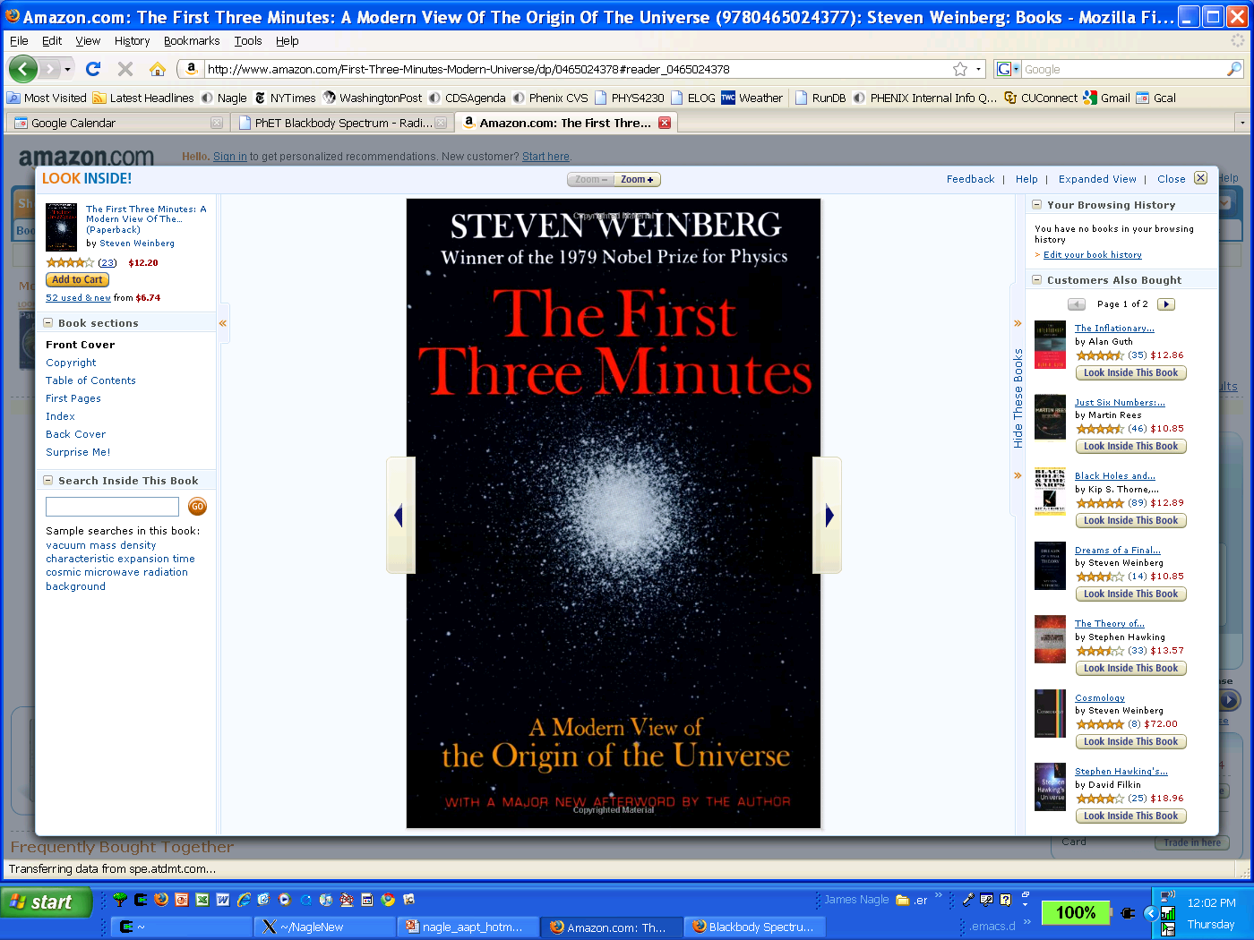
“Ultimate Temperature in the Early Universe”
K. Huang & S. Weinberg, Phys Rev Lett 25, 1970.
“…a veil, obscuring our view of the very beginning”
Steven Weinberg, The First Three
Minutes (1977).

Slide 17
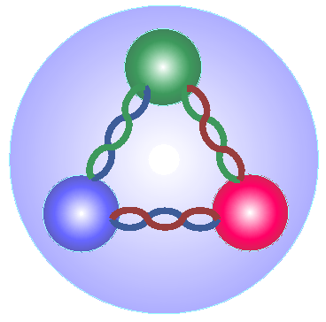
Quark Model
up
up
strange
up
down
up
up
up
down
Proton
Δ++
Λ
New degrees of freedom inside hadrons.
Rapidly people started to think about Quark Matter
as being relevant at these very high temperatures.

Slide 18
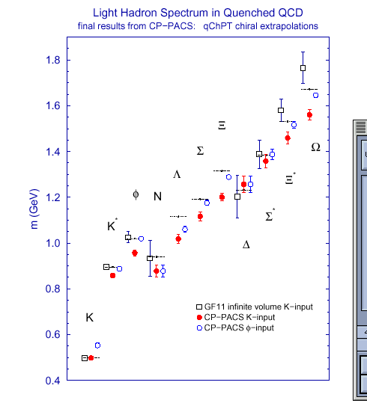
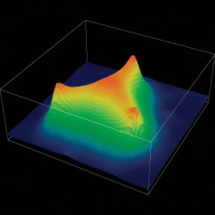
We have strong evidence that QCD is the
correct theory of the strong interaction
Perturbative Calculations
Lattice Calculations
The field is about understanding
emergent phenomena from QCD,
just like condensed matter physics from QED.

Slide 19
Quark-Gluon Plasma

Slide 20
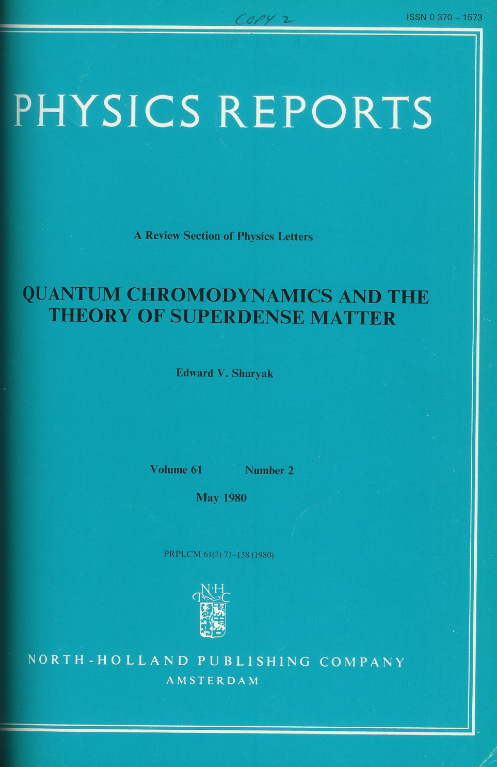
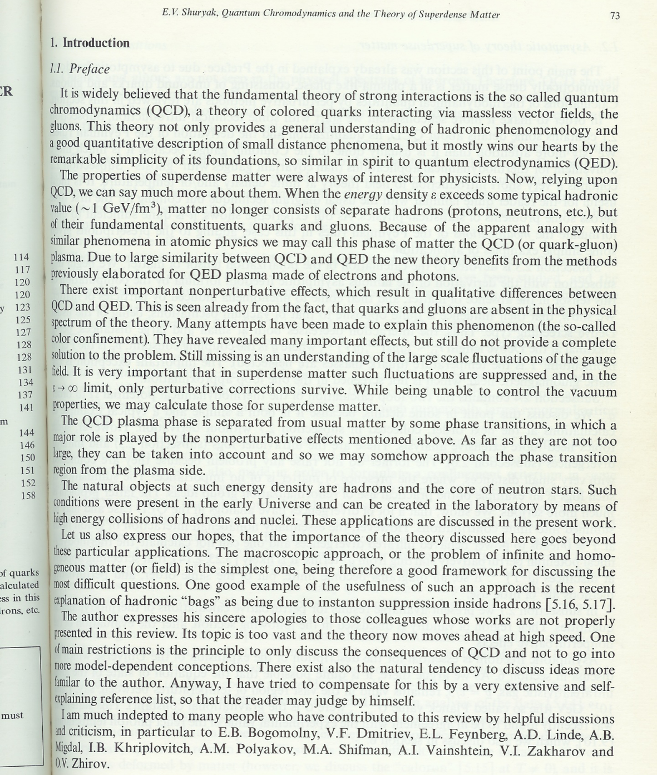
Birth of a Name
Edward Shuryak publishes first “review” of thermal QCD and coins a phrase:
“Because of the apparent analogy with similar phenomena in atomic physics, we may call this phase of matter the
QCD (or quark-gluon) plasma”

Slide 21
Melting the Hadrons
Can we melt the hadrons and liberate these quark and gluon degrees of freedom?
Energy density for “g” massless d.o.f.
Hadronic Matter: quarks and gluons confined
For T ~ 200 MeV, 3 pions with spin=0
Quark Gluon Matter:
8 gluons;
2 quark flavors, antiquarks,
2 spins, 3 colors
37 !

Slide 22
No Limiting Temperature
Lattice QCD calculations indicate that as one increases the energy input, it is very hard to move the temperature above approximately 170 MeV.
However, eventually the temperature does exceed the
“limiting temperature” with a rapid jump in the
effective degrees of freedom!
ε/T⁴
Question: why only 2 or 3 flavors?
T/T_{c}
(F. Karsch, hep-lat/0106019)

Slide 23
Free Quarks?
No one has ever seen a free quark.
QCD is a “confining” gauge theory.
“Coulomb” “Confining”
V(r)
r

Slide 24
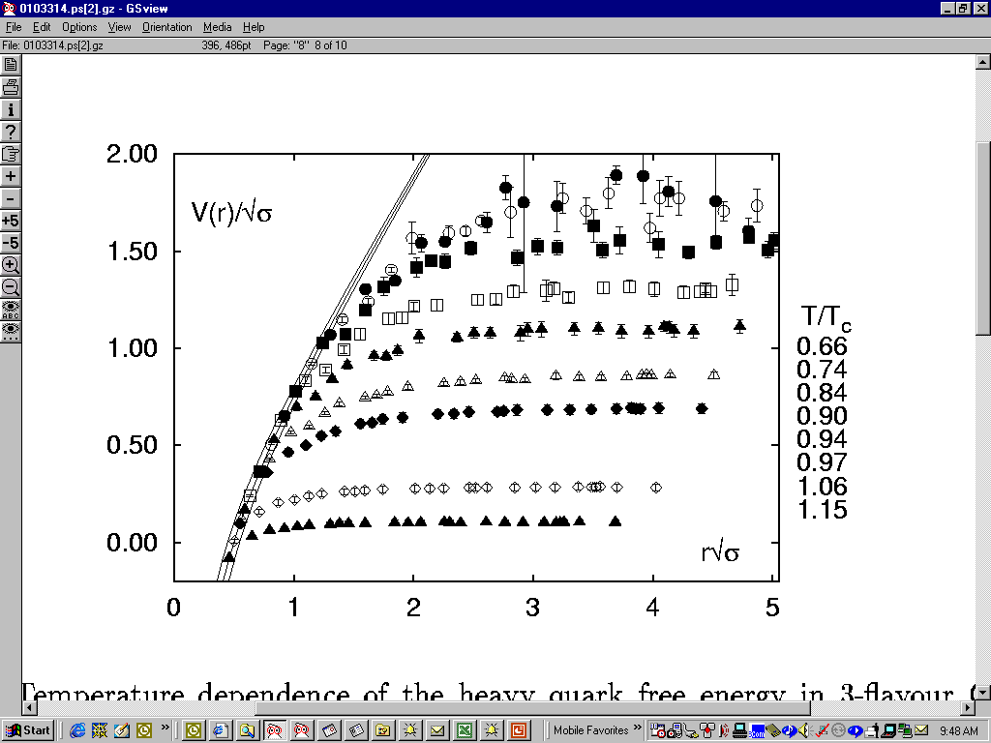
Lattice Thermodynamics
Lattice QCD (for heavy quarks as a test) show a screening of the long range confining potential gradually as one passes the transition temperature.
T =0
0.66 T_{C}
0.90 T_{C}
1.06 T_{C}
F. Karsch, hep-ph/0103314

Slide 25
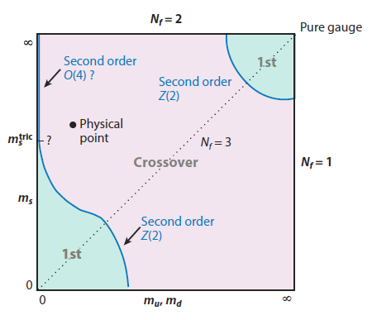
Transition Order?
∞
Yaffe-Svetizky, (’83)
Pisarski and Wilczek, Phys.Rev.D (’84)
1st
N_{f} = 2 (m_{s}= ∞, m_{u,d} = 0 ）
2nd order (O(4) universality)
N_{f} = 3 (m_{s} = 0, m_{u,d} = 0 )
1st order (fluctuation/instanton induced)
2nd
m
_{s}
cross over
1st
N_{f} = 2+1 (m_{s} >> m_{u,d} ≠0 )
1st order or crossover
0
m
∞
_{u,d}
Recent lattice QCD results for a realistic strange quark mass indicate a smooth cross over transition for zero net baryon density.
This has substantial implications.

Slide 26
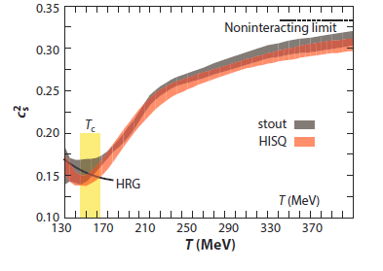
Speed of Sound
Speed of sound drops near transition (“soft point in EoS”) and actually goes to zero in first order transition.
Sound wave transmits energy. In true mixed phase, all energy is absorbed into rearranging constituents.

Slide 27
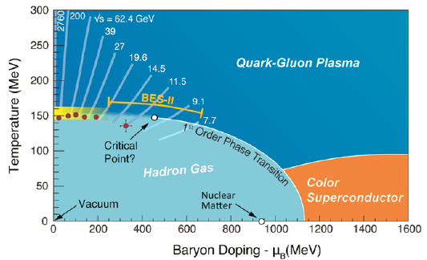
Phase Diagram of Nuclear Matter

Slide 28
QGP
and
Cosmology

Slide 29
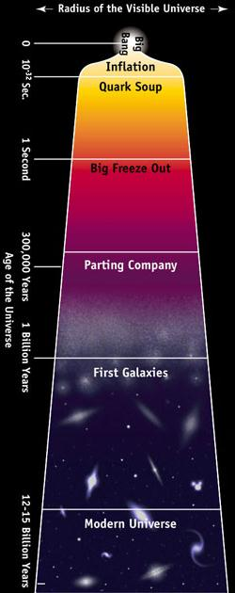
Brief History of Time
Too hot for quarks to bind!!!
Standard Model (N/P) Physics
Quark Gluon Plasma
Too hot for nuclei to bind
Nuclear/Particle (N/P) Physics
Hadron Gas
Nucleosynthesis builds nuclei up to He
Nuclear Force…Nuclear Physics
E/M Plasma
Universe too hot for electrons to bind
E-M…Atomic (Plasma) Physics
Today’s Cold Universe
Gravity…Newtonian/General Relativity
Solid Liquid Gas

Slide 30
Quark nuggets and strangelets
Inhomogeneous nucleosynthesis
Cold dark matter clumps
Damping of gravitational waves at the QCD transition

Slide 31
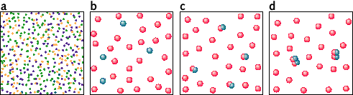
Supercooling and Bubbles
If the plasma-to-hadrons transition were strongly first order, bubble formation could lead to an inhomogeneous early universe, thus impacting big bang nucleosynthesis (BBN).
Are the bubbles too small and close together such that diffusion before nucleosynthesis erases the inhomogeneities? (200 MeV to 2 MeV)
This line of investigation was
quite active when the dark
matter issue raised questions
about the implied baryon
content in the universe from BBN.

Slide 32
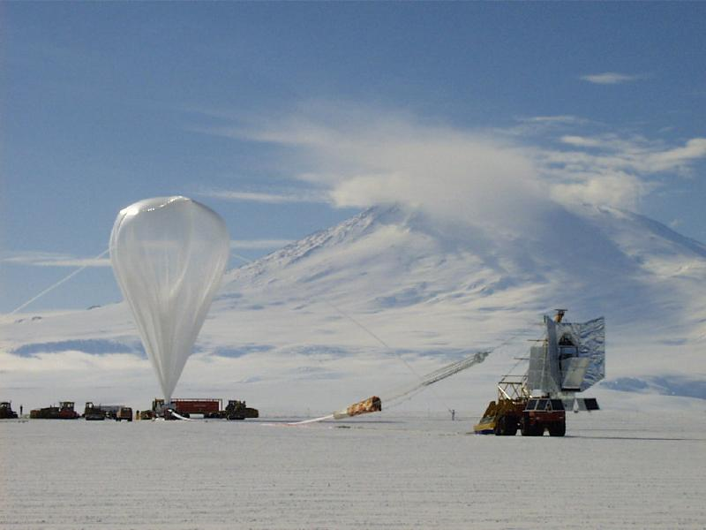
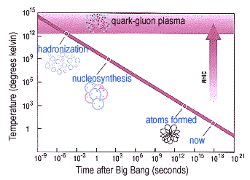
No BBN Problem
Physics Today, July 2001: Cosmic Microwave Background Observations
“The value deduced from the second harmonic in the acoustic oscillations for
W_{B}=0.042 ± 0.008 (cosmic baryon mass density) is in very good agreement with the value one gets by applying the theoretical details of primordial big bang nucleosynthesis to the observations of cosmic abundances of deuterium.”
In addition, Lattice QCD now confirms a smooth cross over transition.
Boomerang Experiment

Slide 33
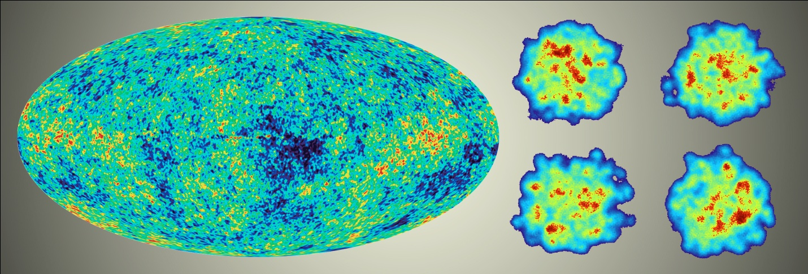
Big Bang versus Little Bangs
Heavy Ion Case:
QGP initial condition fluctuations
Universe Case:
Fluctuations pre-inflation…
and not impacted by QGP
Study structures that survive to understand earlier epoch

Slide 34
Heavy Ion
Experiments

Slide 35
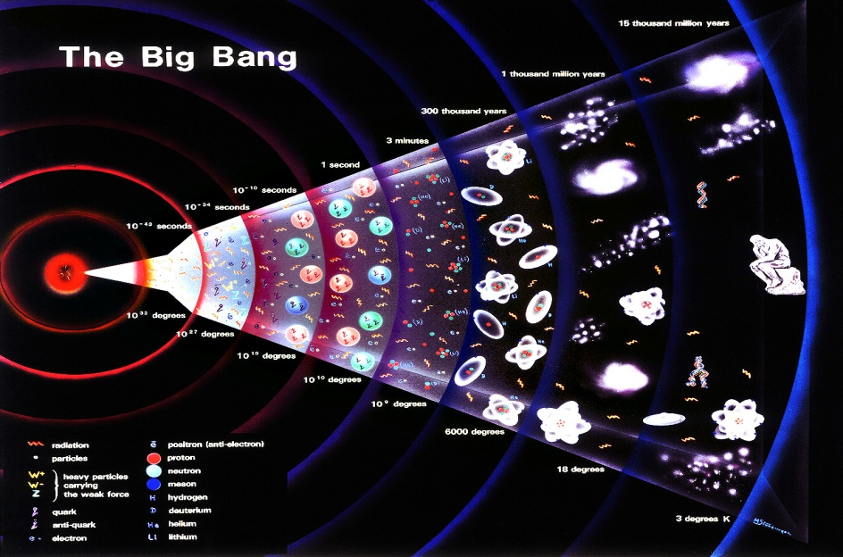
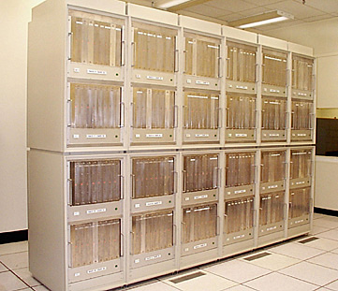
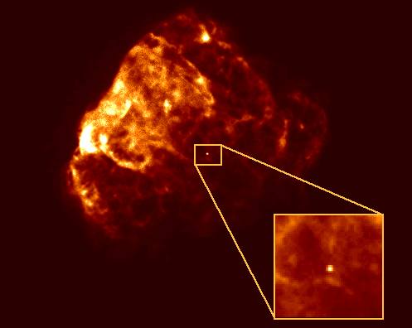
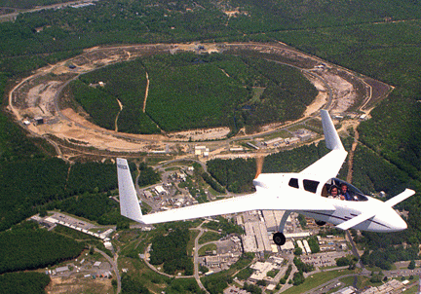
How to Access This Physics?
Big Bang
Only one chance…
Lattice QCD
Who wants to wait?…
RHIC
Neutron stars

Slide 36
Neutron star mergers… maybe the waiting is over
http://science.energy.gov/~/media/np/nsac/pdf/201603/Weinstein_LIGO_20160323.pdf

Slide 37
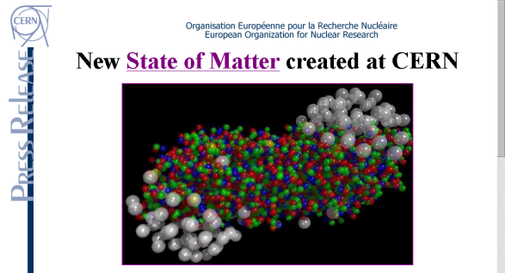

Heavy Ion Machine History
Bevalac-LBL and SIS-GSI fixed target
max. 2.2 GeV
AGS-BNL fixed target
max. 4.8 GeV
SPS-CERN fixed target
max. 17.3 GeV
TEVATRON-FNAL (fixed target p-A)
max. 38.7 GeV
RHIC-BNL collider
max. 200.0 GeV
LHC-CERN collider
max. 2760.0 GeV
1992
Au-Au
E864/941, E802/859/866/917, E814/877,
E858/878, E810/891, E896, E910 …
1994
Pb-Pb
NA35/49, NA44, NA38/50/51, NA45,
NA52, NA57, WA80/98, WA97, …
2000
Au-Au
BRAHMS, PHENIX, PHOBOS, STAR
2010
Pb-Pb
ALICE, ATLAS, CMS,
LHCb (pA)

Slide 38
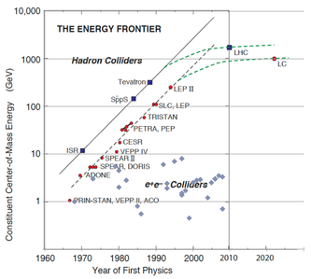
Particle Physics
the energy frontier
Machine with
highest energy
for point-like
interactions
dominates
the world!
Nuclear Physics – studying a state of matter (thermodynamics, many-body physics) and how that emerges from underlying QCD theory

Slide 39
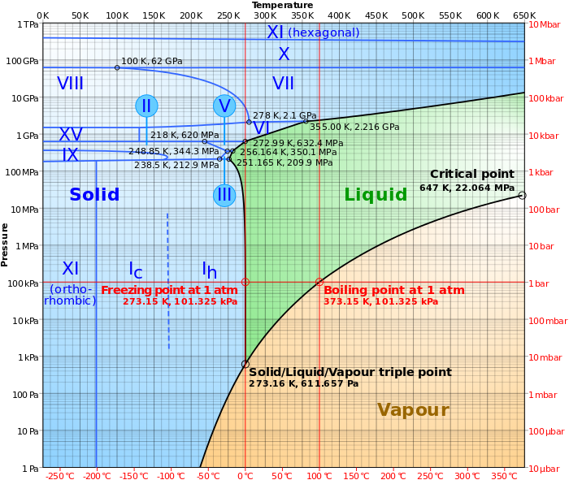
Think of mapping out a phase diagram with only one temperature?

Slide 40
Phase Diagram of Nuclear Matter

Slide 41
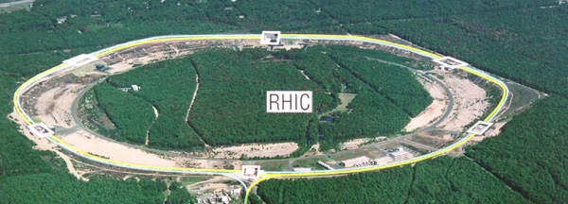
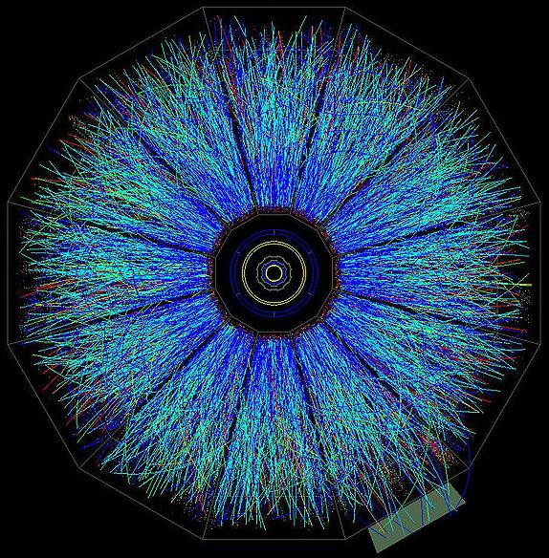
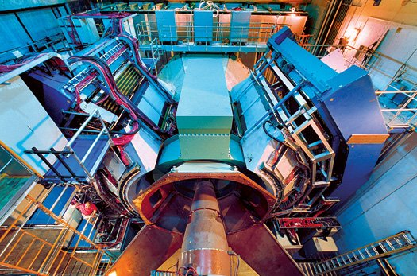
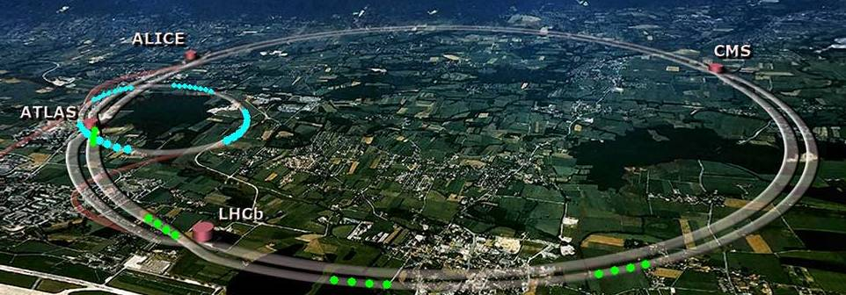
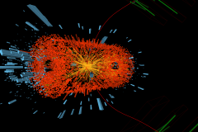
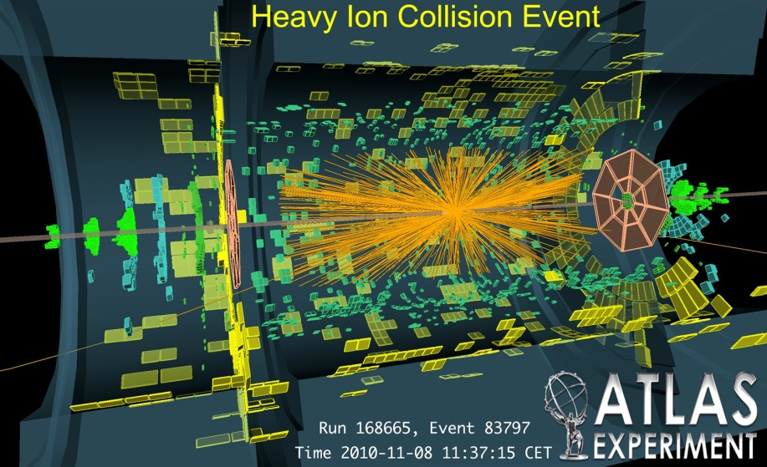
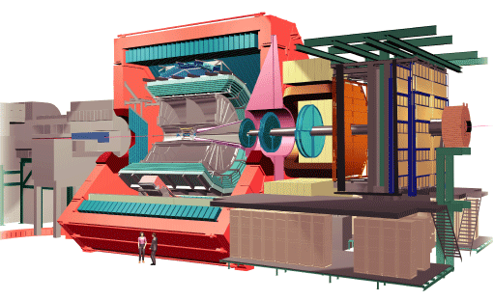
Laboratory Microscopes
Experimental Tools
RHIC
PHENIX
STAR
LHC
CMS
ALICE

Slide 42
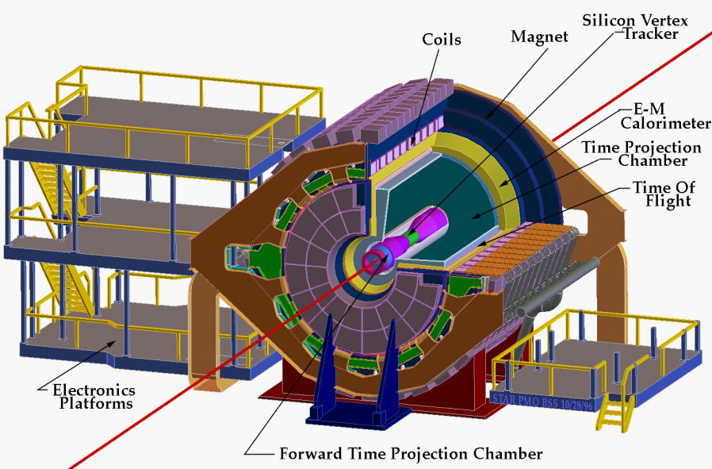
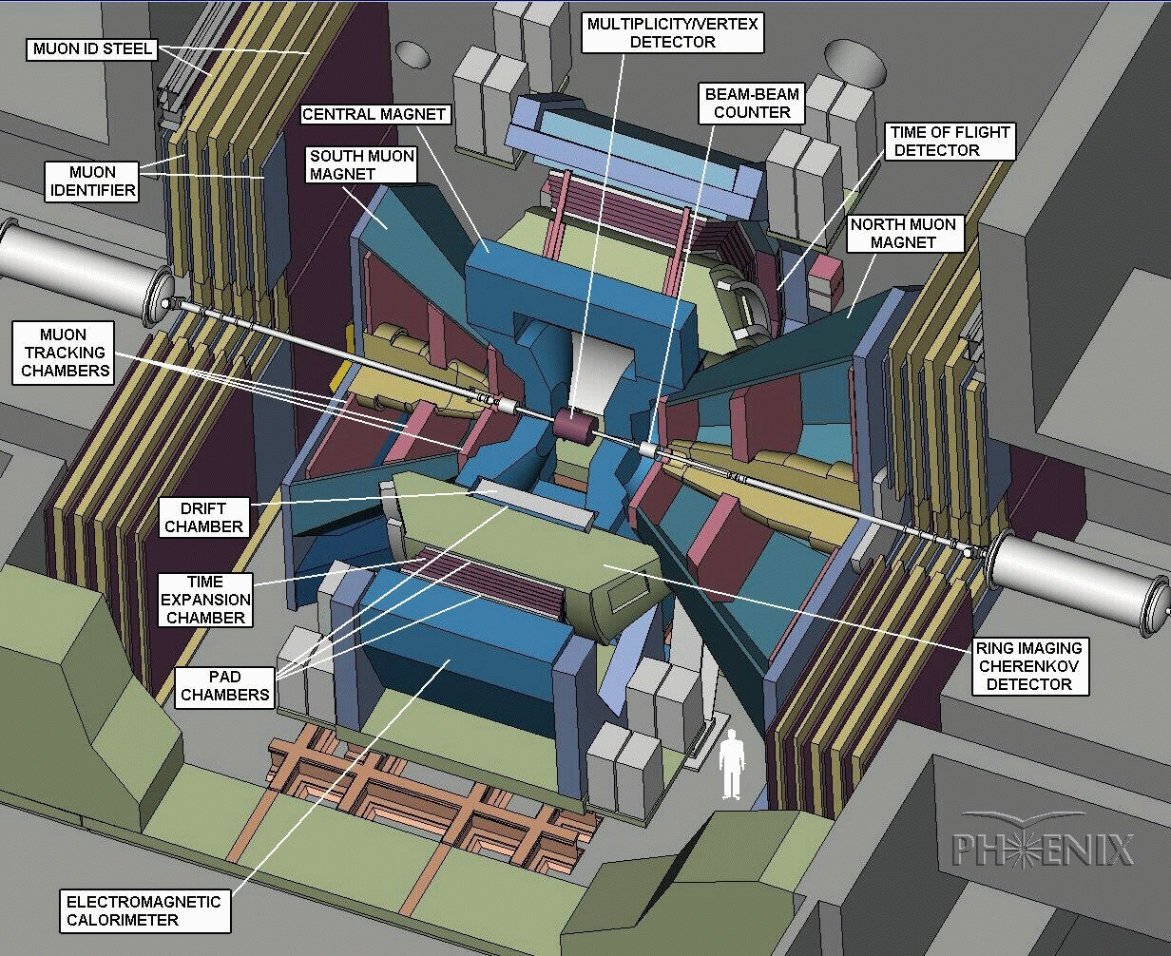
STAR
Hadronic Observables over a Large Acceptance
Event-by-Event Capabilities
Solenoidal magnetic field
Large coverage Time-Projection Chamber
Silicon Tracking, RICH, EMC, TOF
PHENIX
Electrons, Muons, Photons and Hadrons Measurement Capabilities
Focus on Rare Probes: J/ψ, high-p_{T}
Two central spectrometers with tracking and electron/photon PID
Two forward muon spectrometers

Slide 43
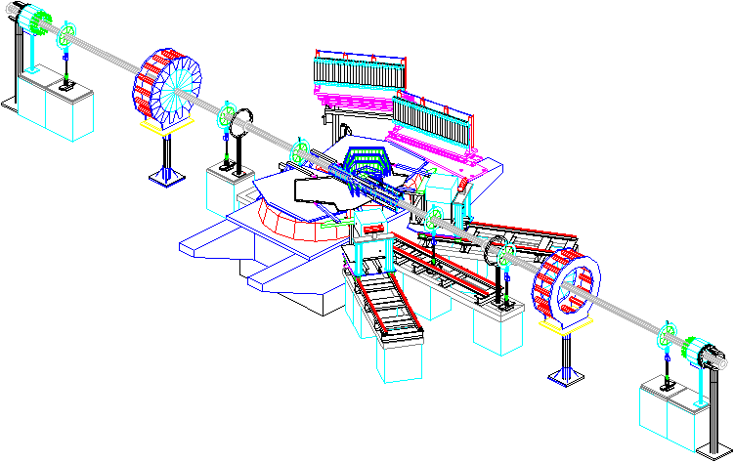
BRAHMS
Hadron PID over broad rapidity acceptance
Two conventional beam line spectrometers
Magnets, Tracking Chambers, TOF, RICH
PHOBOS
Charged Hadrons in Central Spectrometer
Nearly 4π coverage multiplicity counters
Silicon Multiplicity Rings
Magnetic field, Silicon Strips, TOF
Paddle Trigger Counter
TOF
Spectrometer
Ring Counters
Octagon+Vertex
Biggest contributions – intellectually independent thinking!

Slide 44
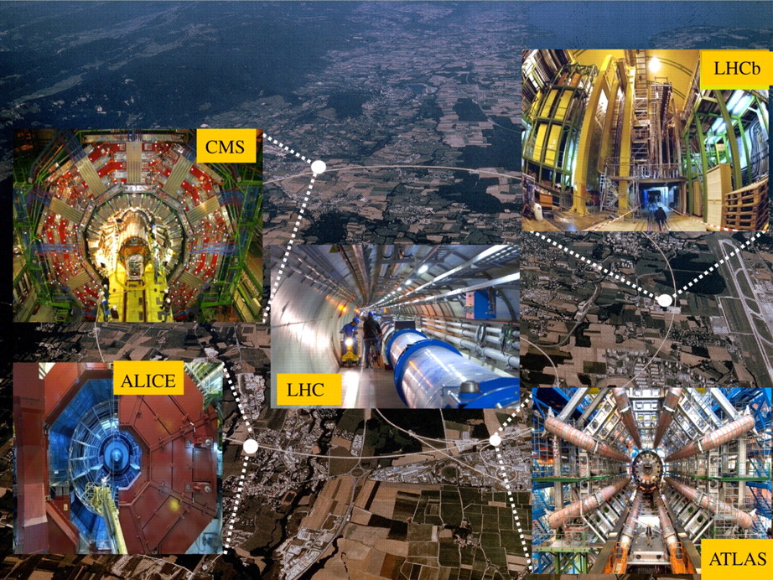

Slide 45
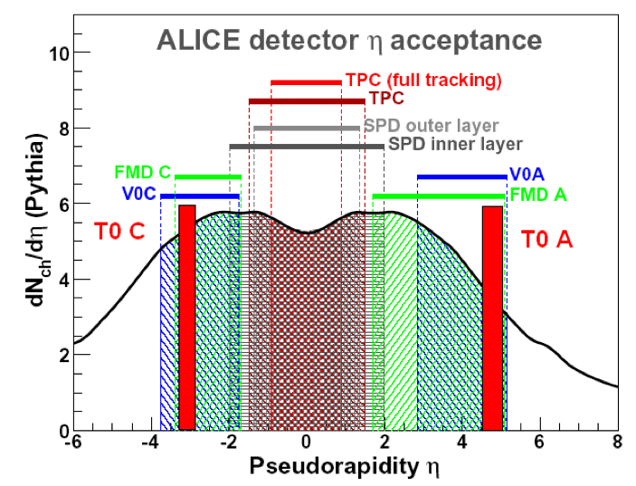
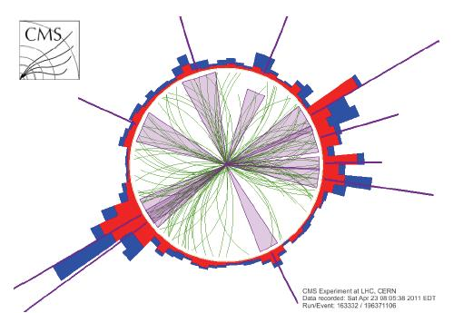
ALICE – dedicated heavy ion detector
Key advantages – particle identification, focused 1000+ people
ATLAS & CMS –
full calorimetry, tracking,
different approaches and analysis philosophies

Slide 46
Collision Dynamics

Slide 47
Structure of the Proton
See the whole proton
Momentum transfer
Q² = 0.1 GeV²
Wavelength λ = h/p
See the quark substructure
Q² = 1.0 GeV²
See many partons (quarks and gluons)
Q² = 20.0 GeV²

Slide 48
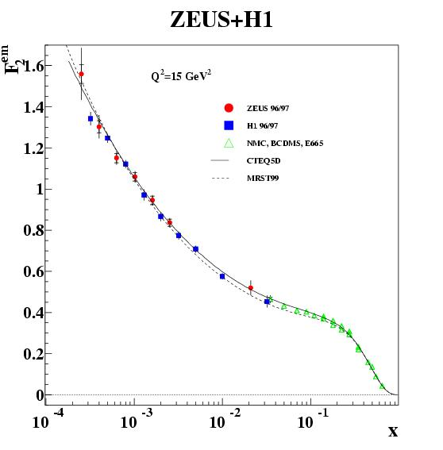
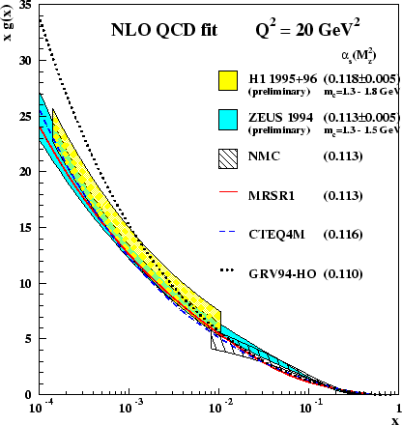
Parton Distribution Functions
Quarks
Gluons
sea
valence
Structure functions rise rapidly at low-x
More rapid for gluons than quarks
Watch out for side-by-side plots with different vertical scales (left 1.7 and right 30!)

Slide 49
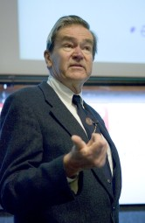
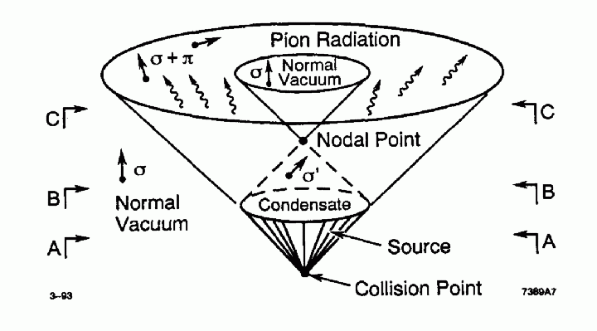

QGP in Proton+Proton Reactions?
Bjorken speculated that in the “interiors of large fireballs produced in very high-energy pp collisions, vacuum states of the strong interactions are produced with anomalous chiral order parameters.”
Time
“Baked Alaska”
http://www-minimax.fnal.gov/

Slide 50
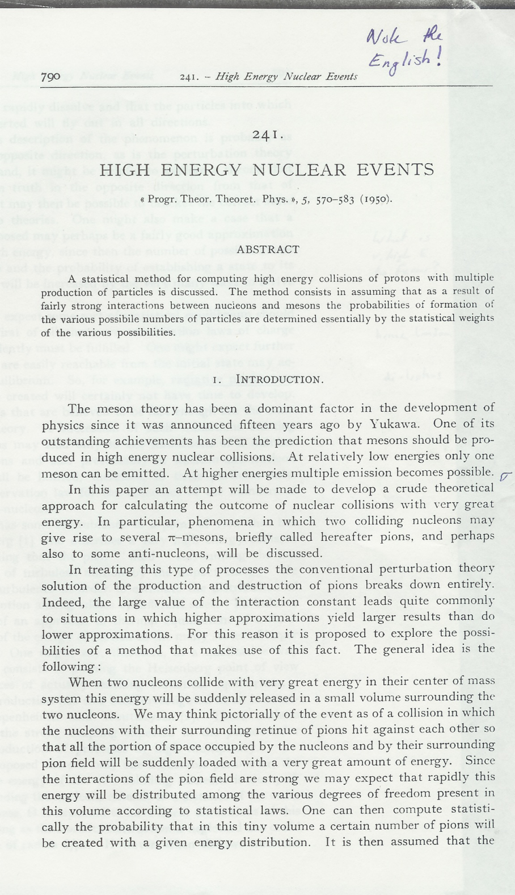
Fermi (1950)
“High Energy Nuclear Events”, Prog. Theor. Phys. 5, 570 (1950)
Groundwork for statistical approach to particle production in strong interactions:
“Since the interactions of the pion field are strong, we may expect that rapidly this energy will be distributed among the various degrees of freedom present in this volume according to statistical laws.”

Slide 51
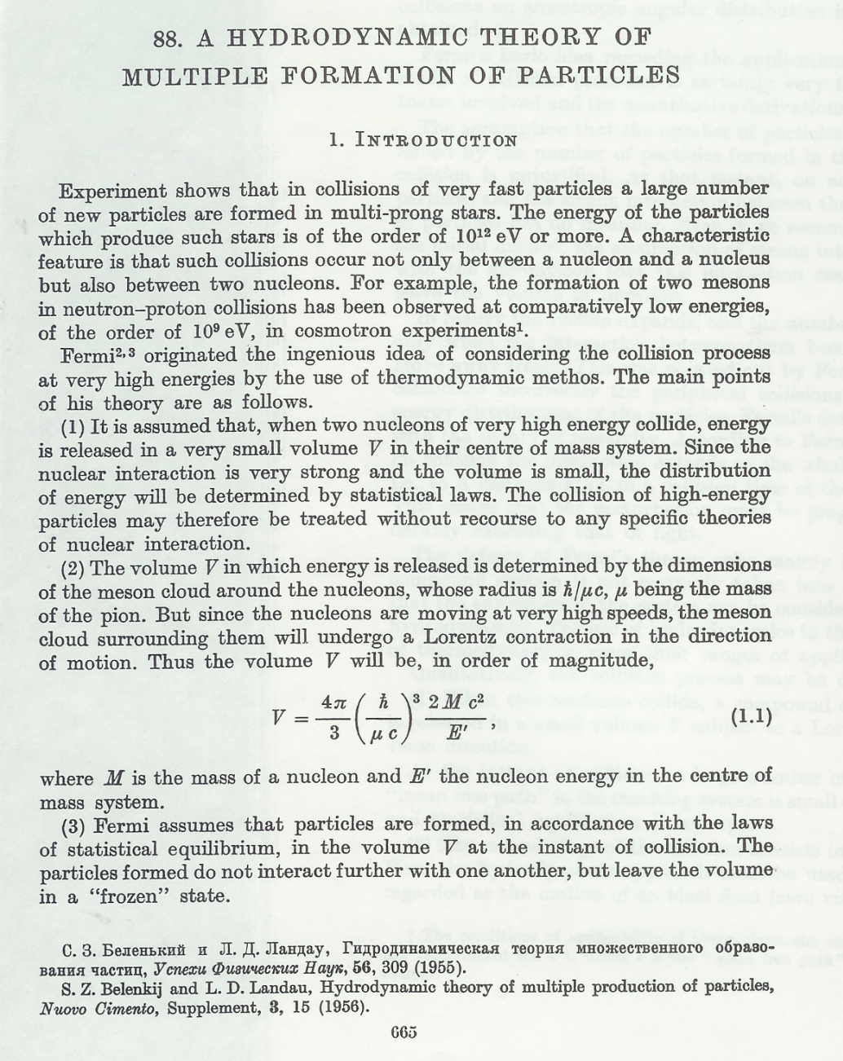
Landau (1955)
Significant extension of Fermi’s approach
Considers fundamental roles of
Hydrodynamic evolution
Entropy
“The defects of Fermi’s theory arise mainly because the expansion of the compound system is not correctly taken into account…(The) expansion of the system can be considered on the basis of relativistic hydrodynamics.”

Slide 52
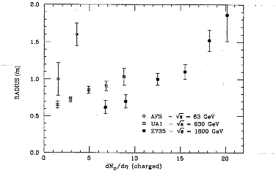
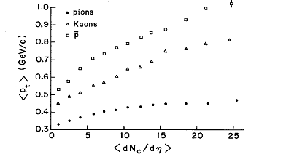
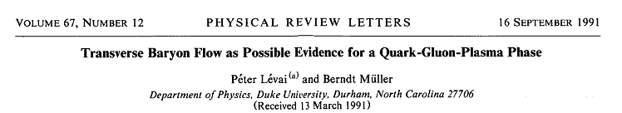
QGP Signatures?
Experiments (E735, UA1, others) observe substantially larger source volumes in high multiplicity pp (ppbar) events via particle correlations and boosted p_{t} spectra.
p
k
Radius (fm)
<p_{t}> (GeV/c)
π
dN_{ch}/dη (charged)
dN_{ch}/dη (charged)

Slide 53
Why Heavy Ions?
High energy density may be achieved in proton-proton collisions, but the partonic re-interaction time scale is only of order 1-3 fm/c
It is difficult to select events with different geometries and avoid autocorrelations
We will see that probes with long paths through the medium are key observables
We should not rule out p+p reactions, but rather study the similarities and differences with A+A reactions -- spoiler alert: this is a big issue

Slide 54
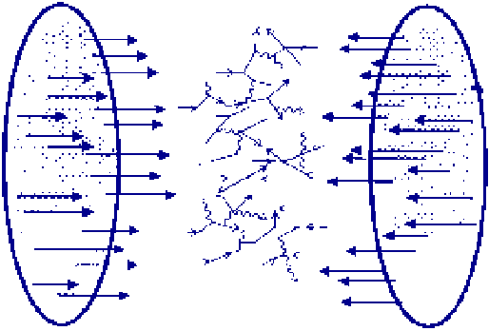
RHIC and LHC = Gluon Colliders
20,000 gluons, quarks, and antiquarks
are made physical in the laboratory !
What is the nature of this ensemble of partons?
New emergent phenomena?

Slide 55




Heavy Ion Time Evolution
1. Initial Nuclei Collide
2. Partons are Freed from Nuclear Wavefunction
3. Partons interact and potentially form a Quark-Gluon Plasma
4. System expands and cools off
5. System Hadronizes and further Re-Scatters
6. Hadrons and Leptons stream towards our detectors

Slide 56

0 fm/c
2 fm/c
7 fm/c
>7 fm/c
Diagram from Peter Steinberg

Slide 57
Initial Conditions

Slide 58


Monte Carlo

Slide 59



Glauber Model and Characterization

Slide 60

https://tglaubermc.hepforge.org/

Slide 61
Collision Characterization
The impact parameter determines the number of nucleons that participate in the collision.
Binary collisions
Participating nucleons
Zero Degree Calorimeter
n
Participants
Spectators
Spectators
n
n
p
p
p
Participants = 2 x 197 - Spectators

Slide 62


Relate experimental observables to averages from the Monte Carlo Glauber.
Ncoll (binary collisions), Npart (participants), Nspec (spectators)
b (impact parameter), elliptical shape, orientation, overlap area,..
ALICE Centrality Paper – good resource
http://arxiv.org/abs/1301.4361

Slide 63
d+Au
Sometimes the neutron
misses
http://journals.aps.org/prc/abstract/10.1103/PhysRevC.90.034902

Slide 64

How much energy goes into QGP?
At RHIC out of a maximum energy of 39.4 TeV
in central Gold+Gold reactions,
26 TeV
is made available for heating the system.

Slide 65

Bjorken Energy Density
10 GeV/fm³
πR²
2cτ
Early energy density well above expected QGP transition
* Side note about errata or lack thereof…

Slide 66
Collision Dynamic Summary
Depositing majority of kinetic energy into new medium
Energy density appears above phase transition value
Energy is distributed into particle production
statistically
- No sharp global feature distinct from smaller hadron
collisions, but instead gradual changes

