Slide 1



Small System Collisions
and Collectivity
When is too small, too small?
(TE)HEP Science Coffee
Jamie Nagle
University of Colorado

Slide 2
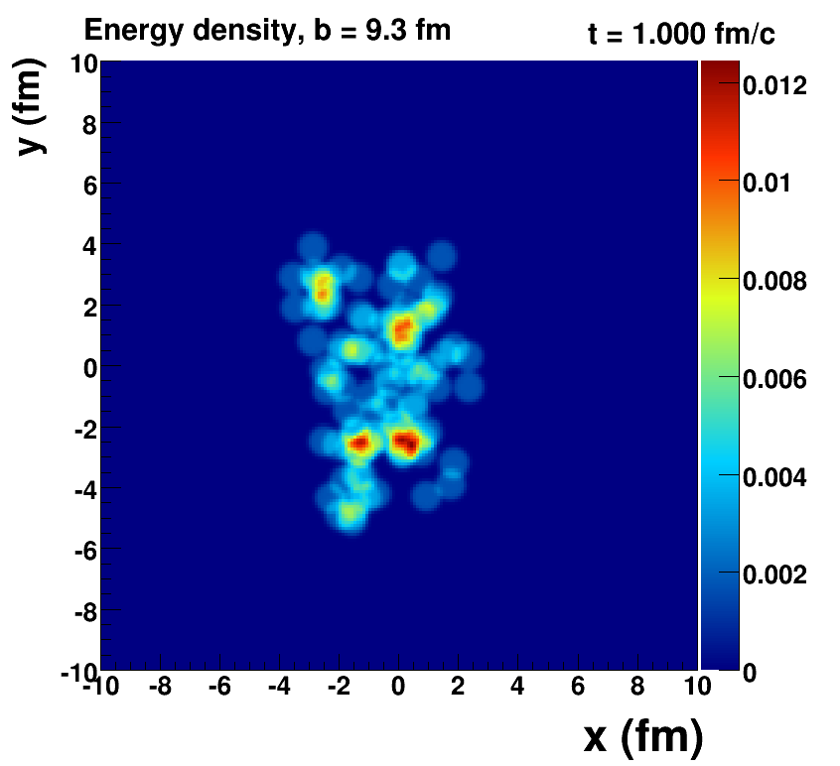
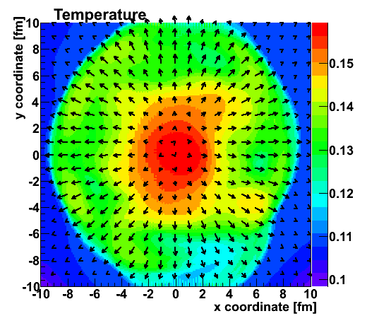
Heavy Ion Fluid Paradigm
Quantum fluctuations in the Initial State
2nd Order, 3-Dimensional, Relativistic Viscous Hydrodynamics
Precision Lattice Equation of State
RHIC and LHC precision measures of higher moments

Slide 3
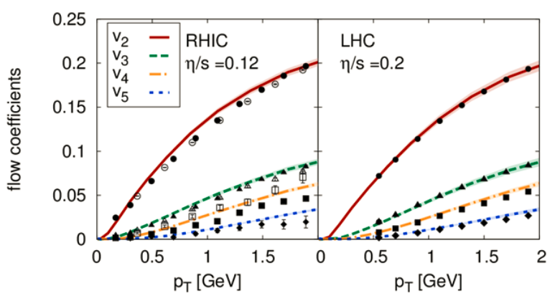
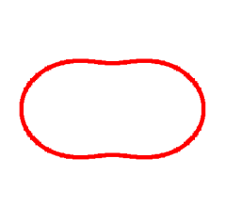
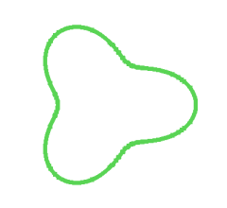
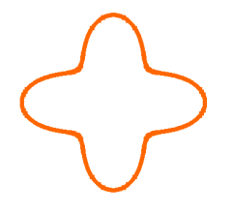
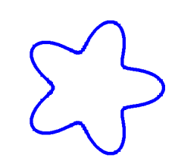
Detailed Description of 99% of Particles
η/s=1.5/4π
η/s=2.5/4π

Slide 4
Two-Particle Correlation Basics
Jet Correlations…
Same jet
Opposing jet
Flow Correlations…
Elliptic (v₂)
Triangular (v₃)
etc.
Δη
0
0
Δφ
π

Slide 5
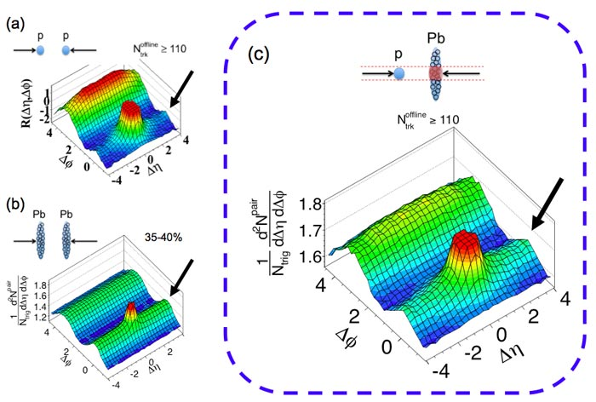
Pb+Pb at the LHC
Near side jet peak and dominant flow correlations, including long-range
near-side ridge
p+p at the LHC
Near and away side jet peaks dominant.
And yet, clear small
long-range near-side ridge

Slide 6
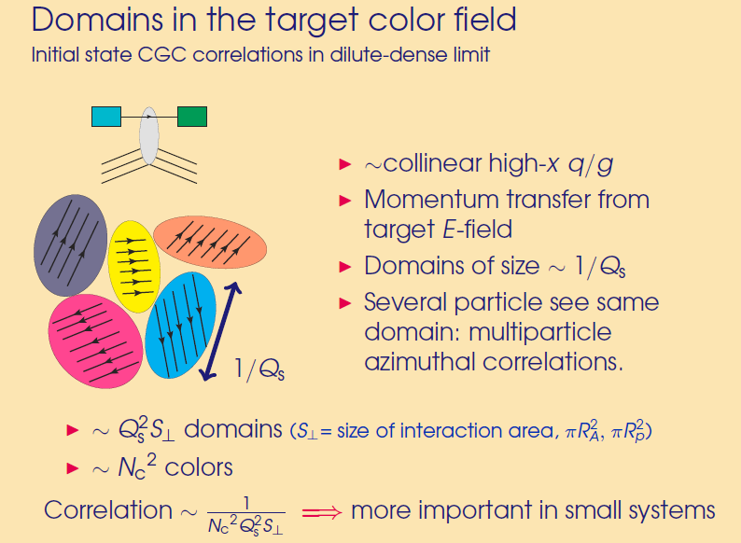
Looks Similar, but Maybe Different Origin
“Momentum Domains”
Think Color Electric Fields
Non-Geometry correlations in momentum space
1/Q_{s}
Important in small systems with a
finite number of these domains!

Slide 7
Fall 2012 Revolution – p+Pb Collisions
Very clear ridge
Higher moments
Particle dependence
Cumulants
Almost every Pb+Pb collective flow signature by
ALICE, ATLAS, CMS now seen in p+Pb!

Slide 8
December 23, 2012
Hello Anne, Jiangyong, Julia, ShinIchi, Mike, Nathan, Peter, and Dave,
Happy holidays, good egg nog and crispy potato pancakes!
I have been reading with great interest the 3 experimental papers on LHC p+Pb and the possible explanation of hydrodynamic expansion of the system. I am quite curious if this can be the right underlying physics and how the different moments arise and higher order corrections might be needed to viscous hydrodynamic calculations.
http://arxiv.org/abs/arXiv:1210.5482 (CMS)
http://arxiv.org/abs/arXiv:1212.2001 (ALICE)
http://arxiv.org/abs/arXiv:1212.5198 (ATLAS)
http://arxiv.org/abs/arXiv:1211.0845 (hydro in p+Pb)
My holiday question to all of you is what can we measure with PHENIX at RHIC to test this picture further. What do PHENIX d+Au results already tell us? If there is something PHENIX can measure and be part of this interesting discussion and provide constraints, we might try a targeted analysis with a relatively short time scale
(3-4 months). Let me know what you think!
Sincerely, Jamie

Slide 9
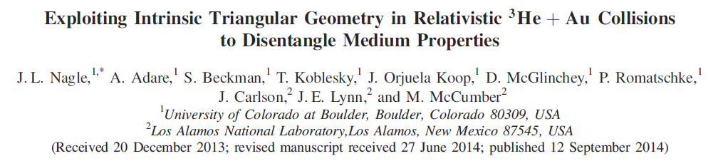
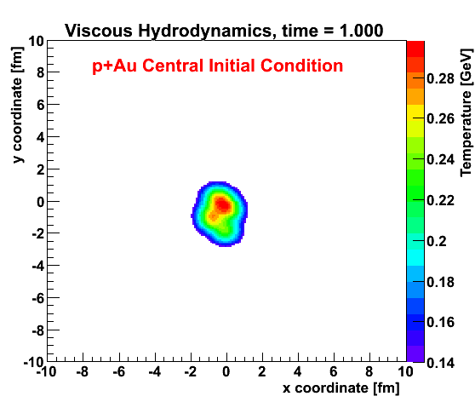
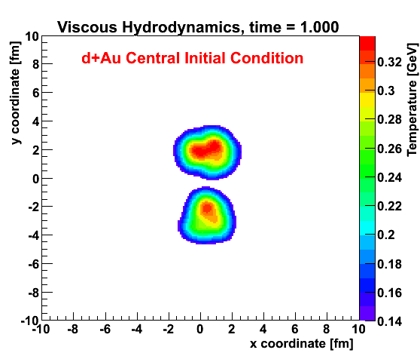
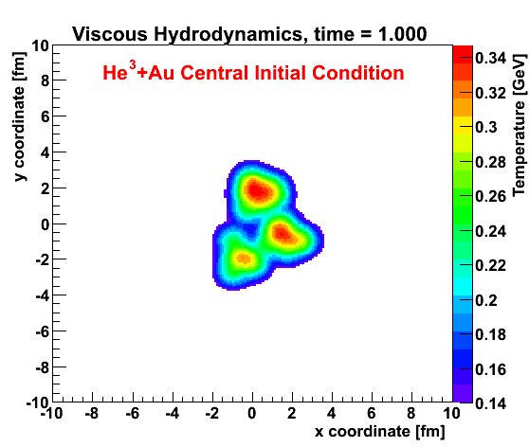
Geometry Tests at RHIC
http://journals.aps.org/prl/abstract/10.1103/PhysRevLett.113.112301

Slide 10
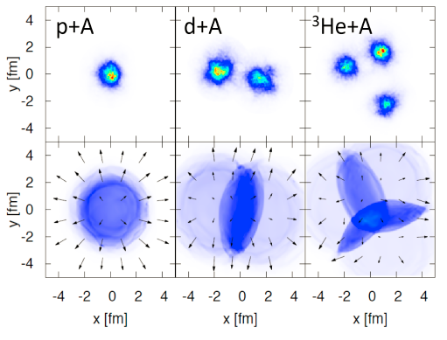
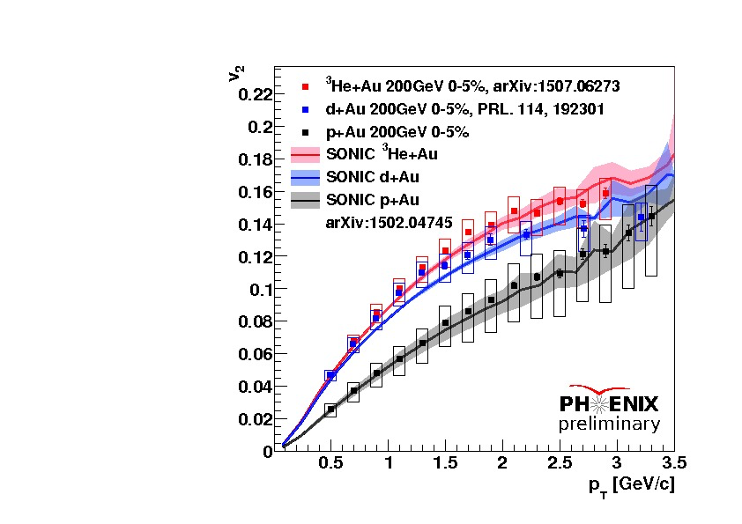
Glauber +Hydrodynamics+Cascade Predictions
Romatschke, Nagle et al. , http://journals.aps.org/prl/abstract/10.1103/PhysRevLett.113.112301

Slide 11
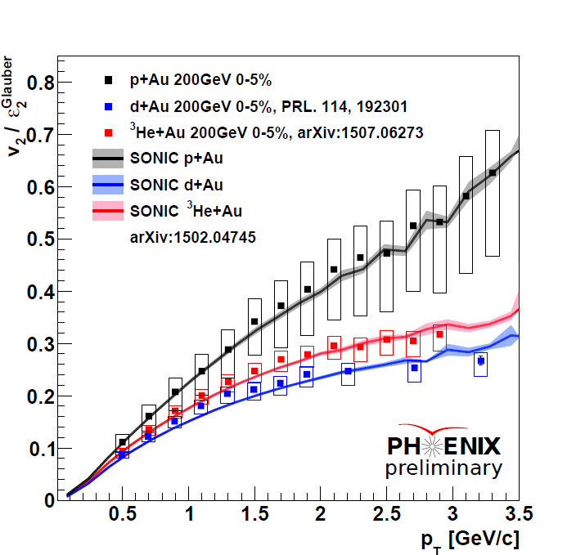
Ideal Hydrodynamics “v₂ α ε₂”
Why doesn’t scaling hold?
How does hydrodynamics describe this scale breaking?

Slide 12
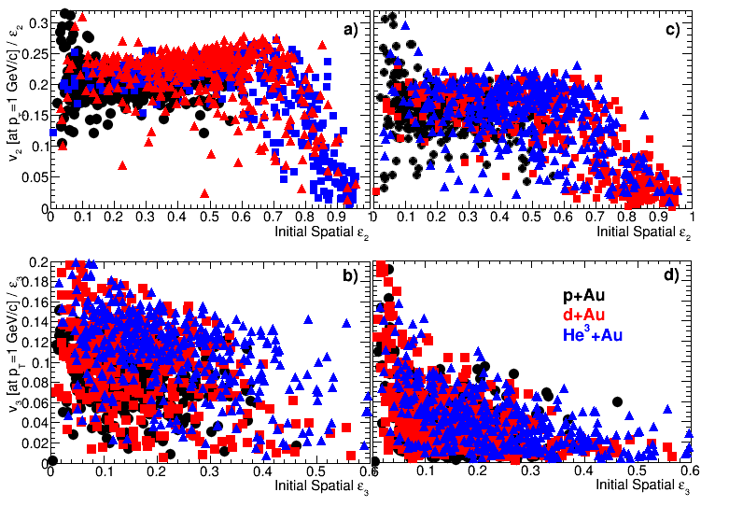
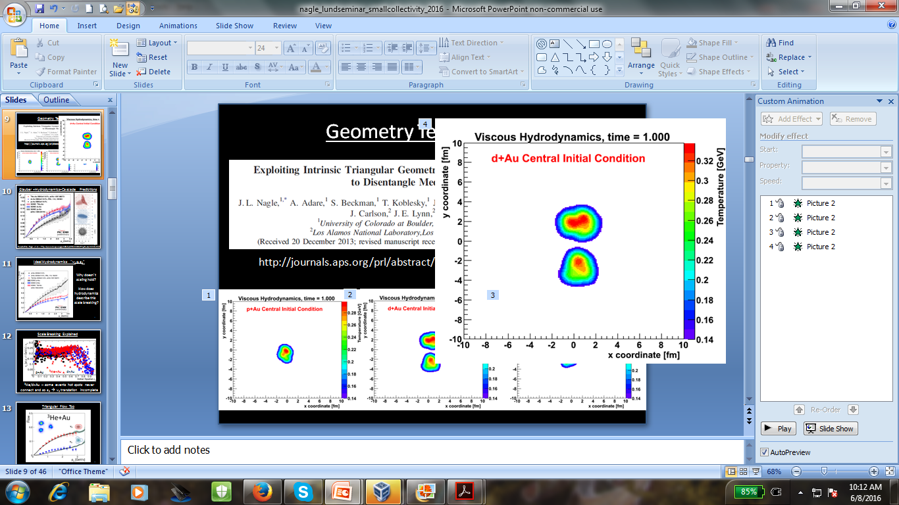
Scale Breaking Explained
p+Au
³He+Au
d+Au
³He/d+Au – some hot spots never connect and ε₂ → v₂ translation incomplete

Slide 13
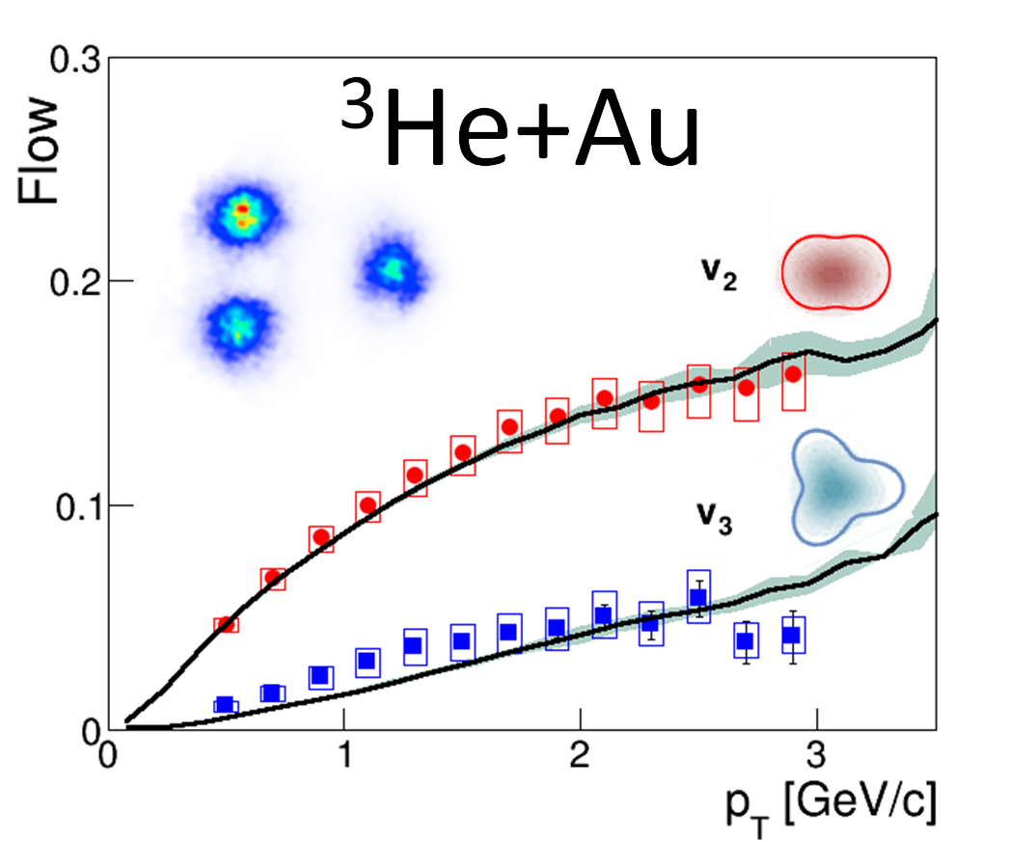
Triangular Flow Too

Slide 14
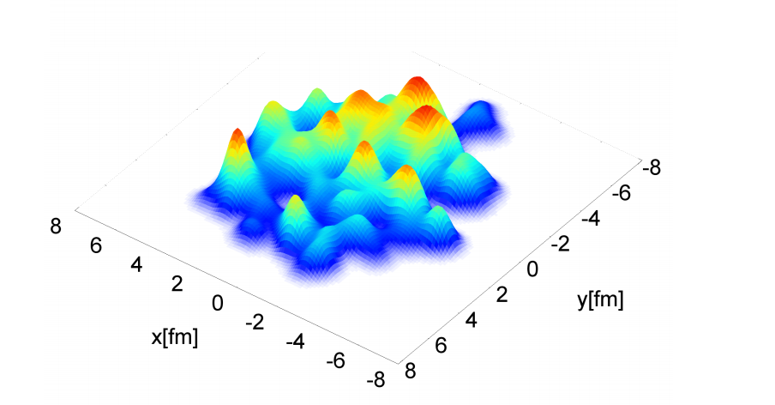
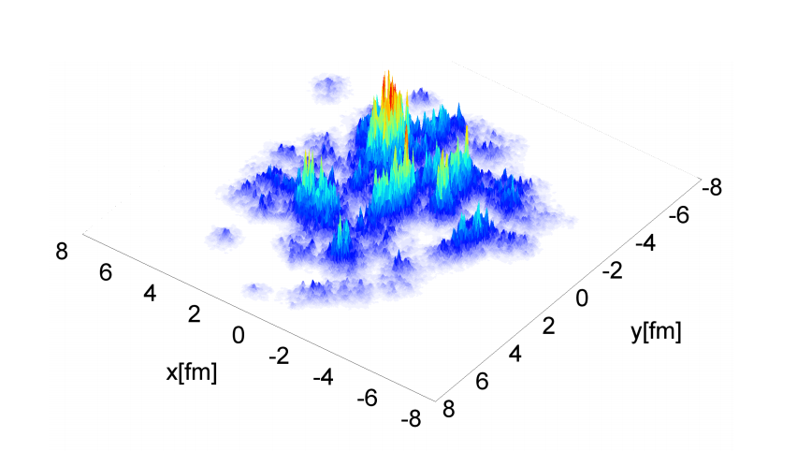
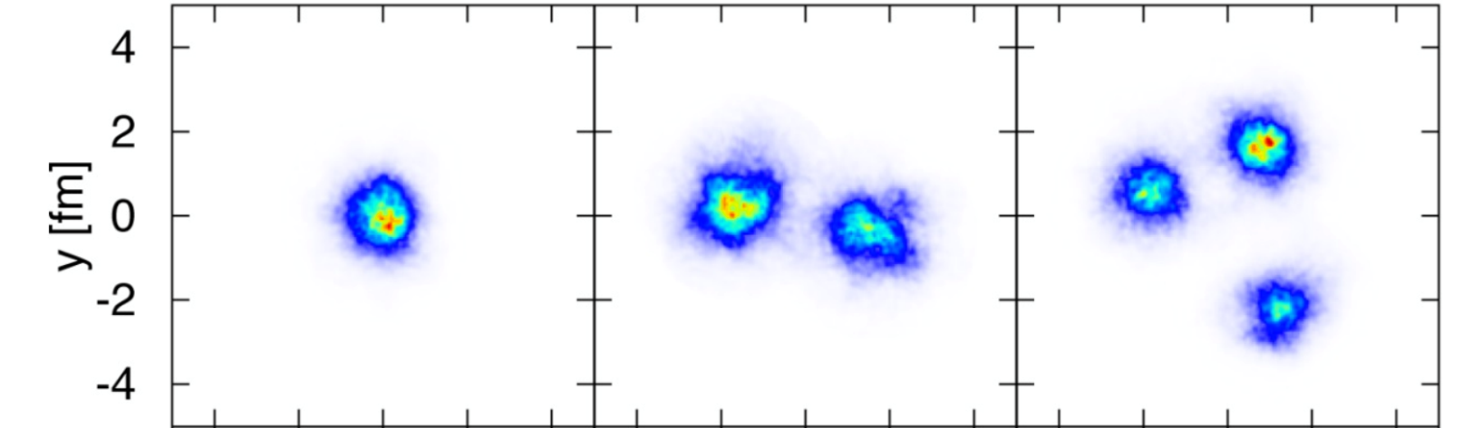
Initial Geometry Uncertainty
MC Glauber
IPGlasma
p+Au
d+Au
³He+Au)
ε₂^{IPGlasma} = 0.10
ε₂^{Glauber} = 0.23
ε₂^{IPGlasma} = 0.59
ε₂^{Glauber} = 0.54
ε₂^{IPGlasma} = 0.55
ε₂^{Glauber} = 0.50

Slide 15
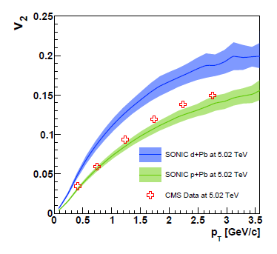
Benefits of an LHC d+Pb Run
10% geometry uncertainty
130% geometry uncertainty

Slide 16
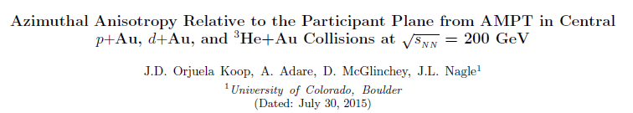
Is Hydrodynamics Valid in such Small Systems?
Alternatives?
Parton Cascade (AMPT) in Small Systems
http://arxiv.org/abs/1501.06880
Useful inputs from Zi-Wei Lin and Denes Molnar
AMPT motivation, He et al. (arXiv:1502.05572v3)

Slide 17
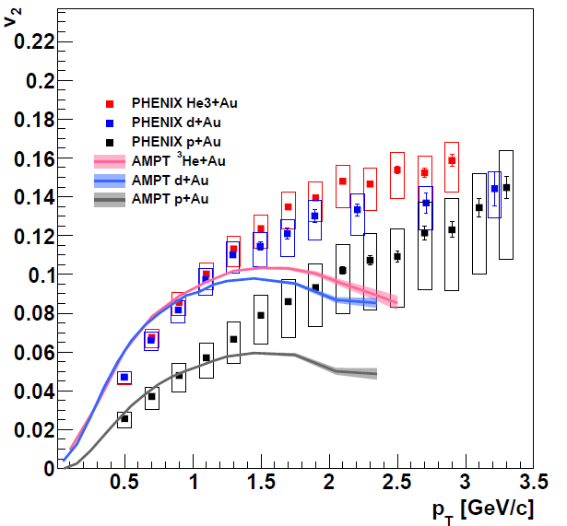
AMPT Predictions
Modified
Initial Glauber including ³He wavefunction
(same I.C. as SONIC)
String melting
Lots of partons
= 1.5 mb
Hadron Cascade
Orjuela Koop et al. http://arxiv.org/abs/1501.06880

Slide 18
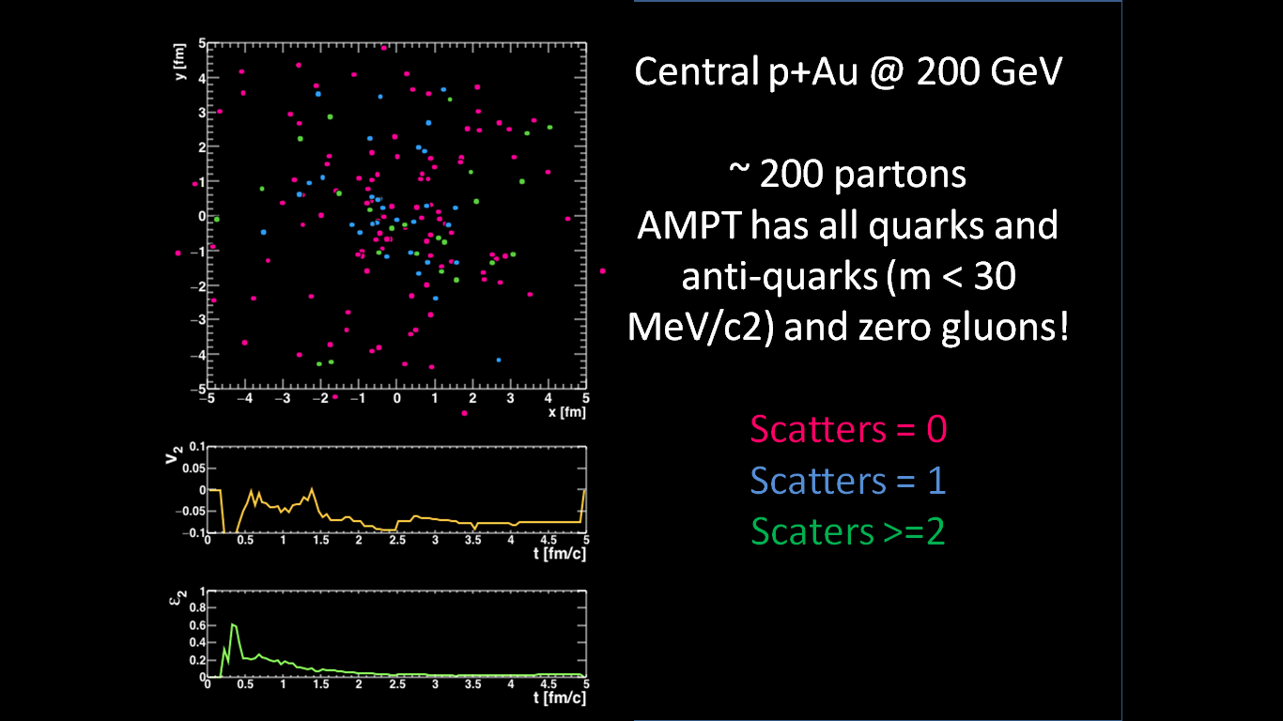
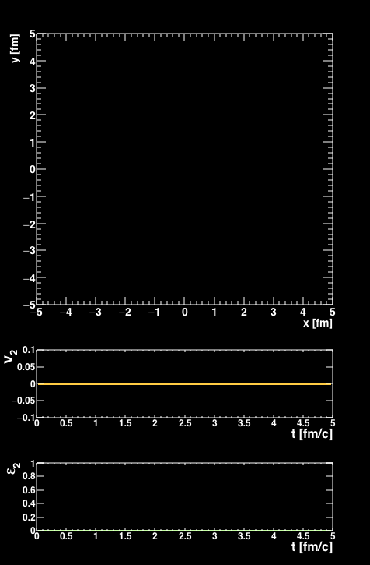
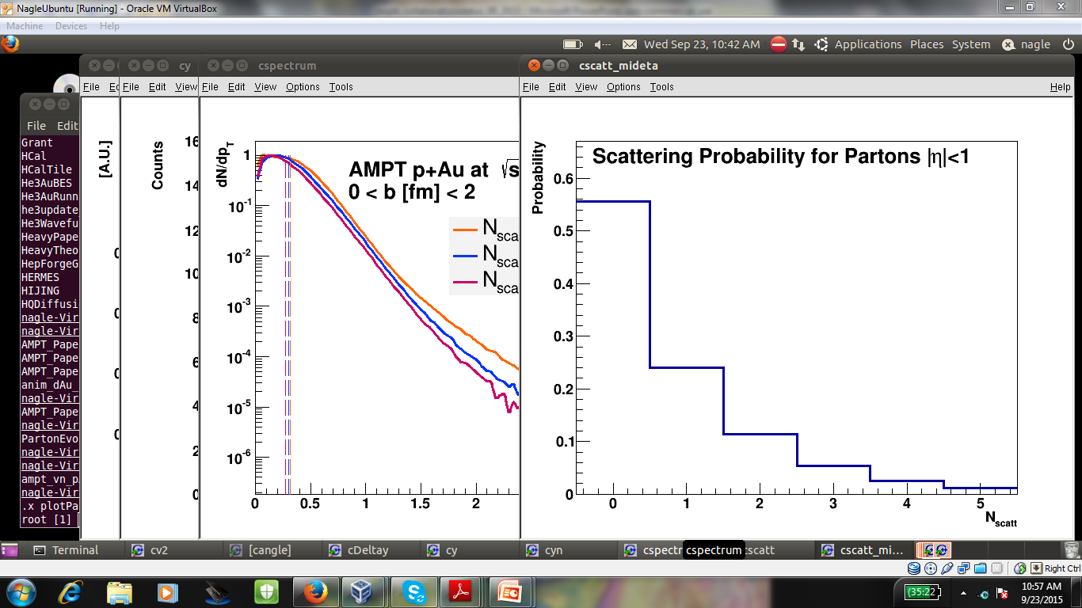
Central p+Au @ 200 GeV
~ 200 partons
AMPT has all (anti)quarks
m < 30 MeV/c²
and zero gluons!
Scatters = 0
Scatters = 1
Scaters >=2
~ 45 parton-parton scatterings
55% of partons do not scatter

Slide 19
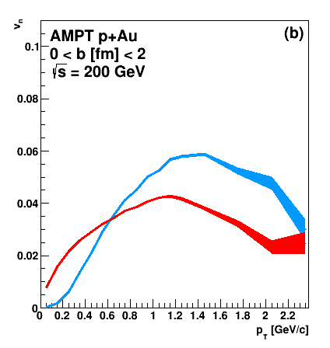
Hadronization in AMPT
200 quarks/antiquarks → ~ 100 mesons
Just from parton cascade
Just after hadronization
Coalescence just by closest spatial partner
(no momentum space)

Slide 20
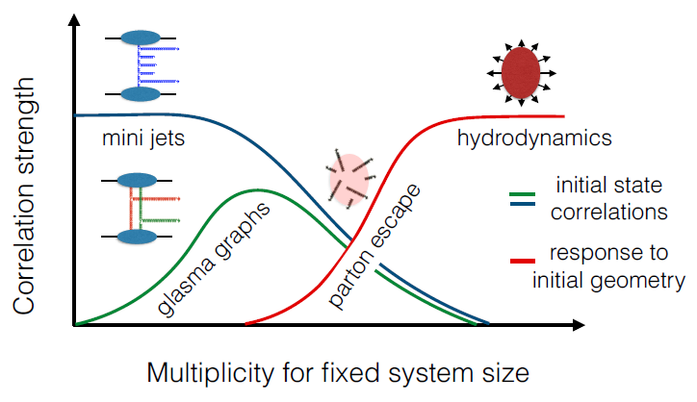
Momentum domain picture seems disfavored
Initial geometry + interactions
But what kind of interactions?
?
Diagram from Soeren Schlichting

Slide 21
# of particles/scatters → too small for fluid?
Very large density gradients in hydrodynamics
AMPT has a very unphysical picture →
all quarks (where are the gluons?),
spatial coalescence, and yet…
Now pushing the limits even further
p+p developments at the LHC
d+Au energy scan at RHIC

Slide 22
Push Further: d+Au Energy Scan at RHIC
v₂
Orjuela-Koop, Belmont, Yin, Nagle: Phys. Rev. C 93, 044910 (2016)
superSONIC
20 GeV
39 GeV
Hydro With
Pre-Equilibrium
Hydro Without
Pre-Equlibrium
SONIC
AMPT σ =1.5 mb
AMPT σ =0 mb
AMPT Parton
+ Hadron
62 GeV
200 GeV
AMPT Hadron
Only
PHENIX

Slide 23
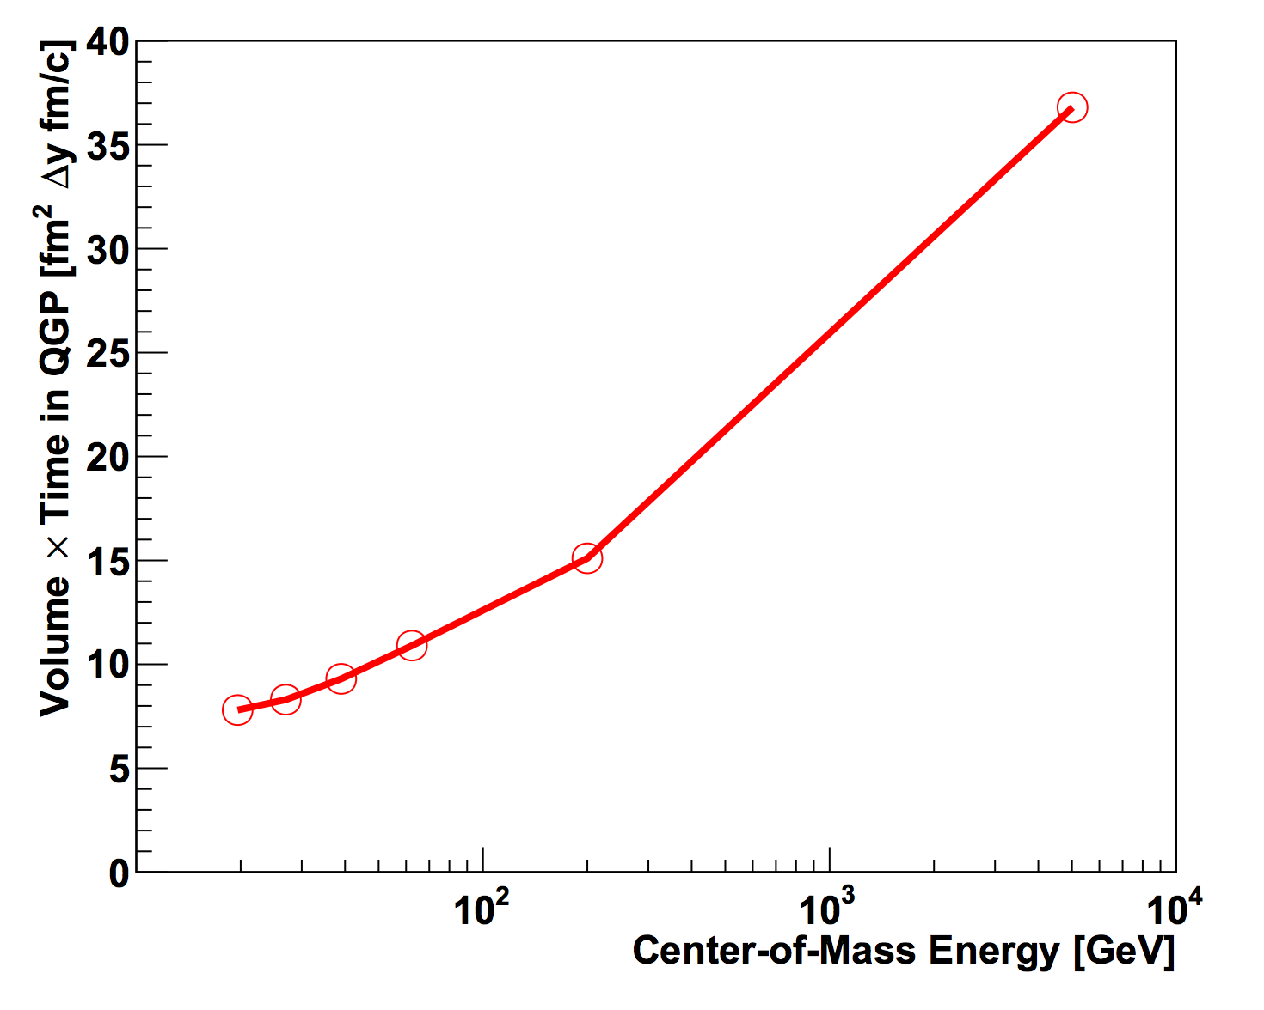
Hydrodynamic Results for d+Au Energy Scan
2+1D QGP Volume in Central d+Au
LHC
3 fm
4 fm
t = 3 fm/c
Orjuela-Koop, Belmont, Yin, Nagle: Phys. Rev. C 93, 044910 (2016)
RHIC
2 fm
2 fm
t = 2 fm/c
200 GeV
62 GeV
7.7GeV
20 GeV

Slide 24

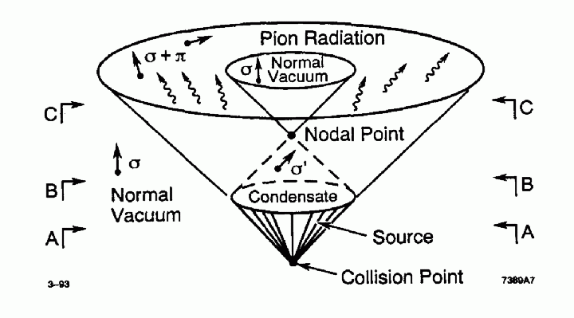
Bjorken Baked Alaska Picture
Proposed looking for disoriented chiral fields in proton + antiproton collisions at the Tevatron
No particles → think fields / disturbed vacuum
Maybe particle # and mean free path arguments are just not relevant (?)

Slide 25
Phase Transitions
1st order – bubbles, mixed phase, supercooling
However, QCD transition at zero net baryon density is a smooth crossover…
2+1D QGP Volume in Central d+Au
LHC
Maybe it is okay to just have a shorter and shorter duration (influence) QGP stage
4 fm
3 fm
t = 3 fm/c
Orjuela-Koop, Belmont, Yin, Nagle: Phys. Rev. C 93, 044910 (2016)
2 fm
2 fm
RHIC
t = 2 fm/c
200 GeV
20 GeV
62 GeV
7.7GeV

Slide 26
Some things to think about…

Slide 27
Extras

Slide 28
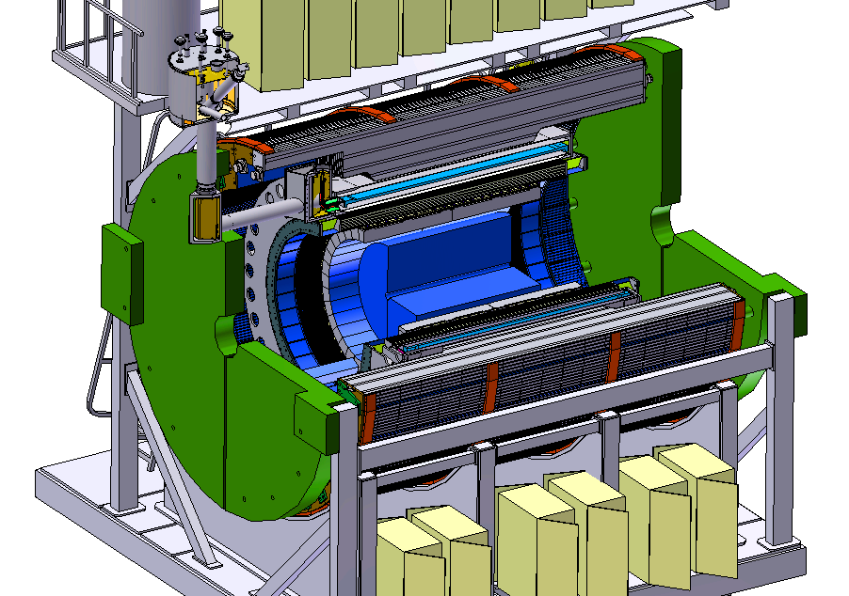

Advertising the Future at RHIC
BaBar Magnet 1.5 T
Coverage |η| < 1.1
All silicon tracking
Heavy flavor tagging
Electromagnetic
Calorimeter
Hadronic Calorimeter
Successful DOE Science Review
in June 2015!
Goal is to use jet probes to connect particle and fluid pictures as a function of scale

Slide 29
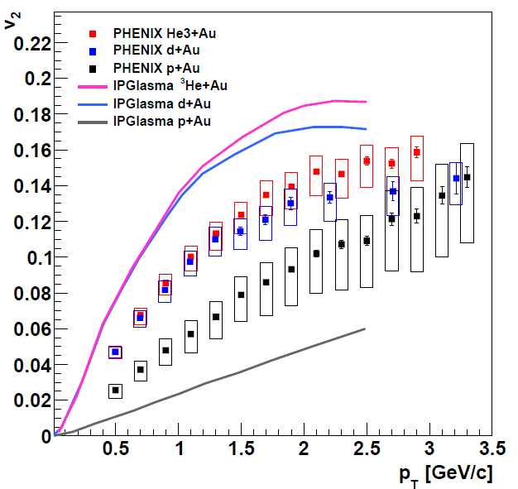
IP Glasma+Hydrodynamics Predictions
With larger η/s, one can match ³He/d+Au.
p+A is because initial ε₂ is very small.
Possible solution is giving proton more substructure
Schenke, Venugopalan, http://www.sciencedirect.com/science/article/pii/S0375947414003522

Slide 30
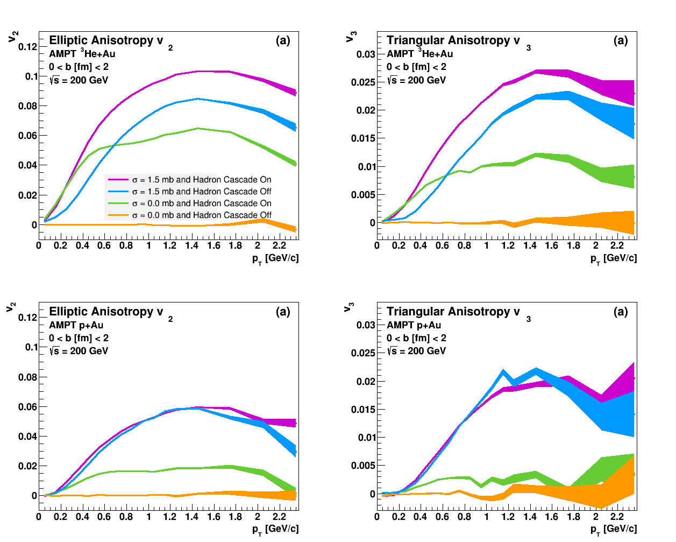
Contributions for Each Stage
No Parton or Hadron Cascade
Hadron Cascade Only
Parton Cascade → Hadrons
Also Hadron Cascade

Slide 32
Definitive evidence for geometry, not initial momentum correlations
However, competing final state explanations
needs work to discriminate.

Slide 33
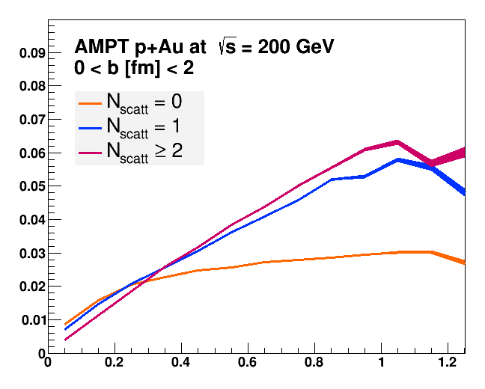
AMPT – Just the Partons (ZPC)
v₂
Prob. to Not Scatter (φ)
Why isn’t this flat with p_{T} since σ=1.5 mb is momentum independent?
Parton p_{T} (GeV/c)

Slide 34
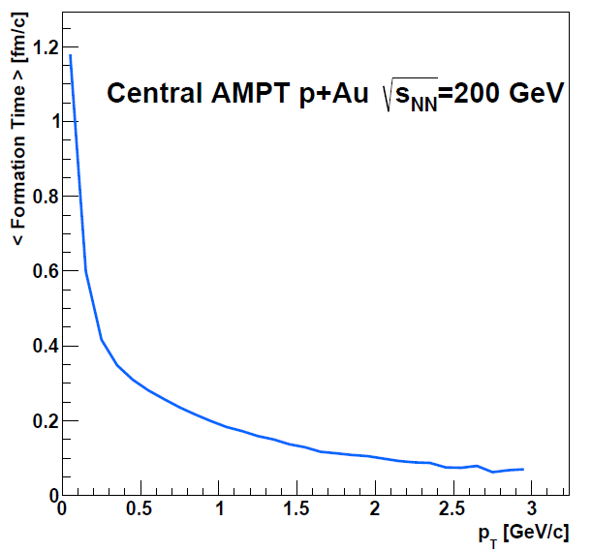
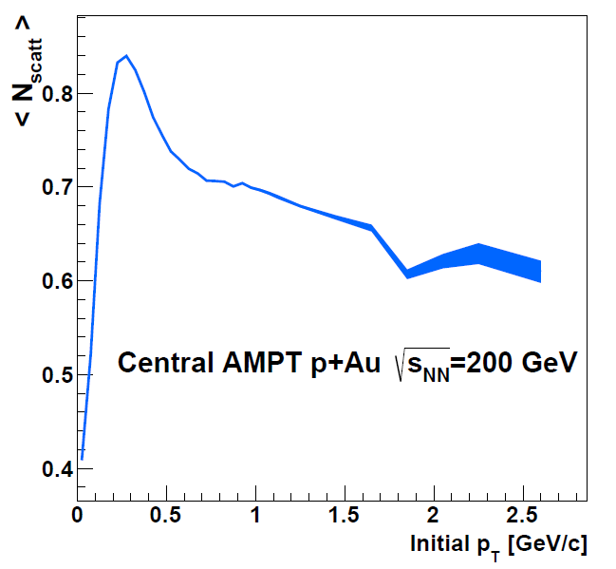
Parton Formation Time
<N_{scatt}>
Formation Time
Low p_{T} partons do not interact for > 1 fm/c
v₂(p_{T}) depends on formation time
Not yet clear why <N_{scatt}> drops for high p_{T} partons

Slide 35
Different Picture in ³He+Au

Slide 36
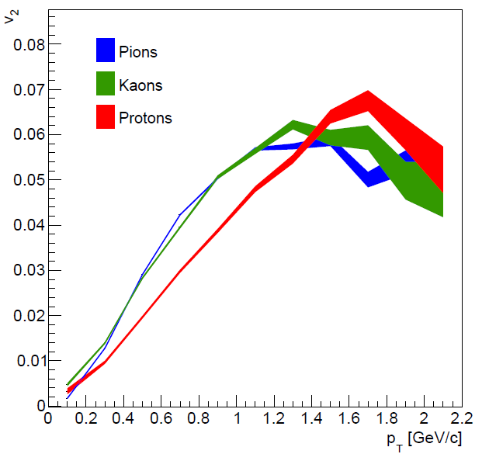
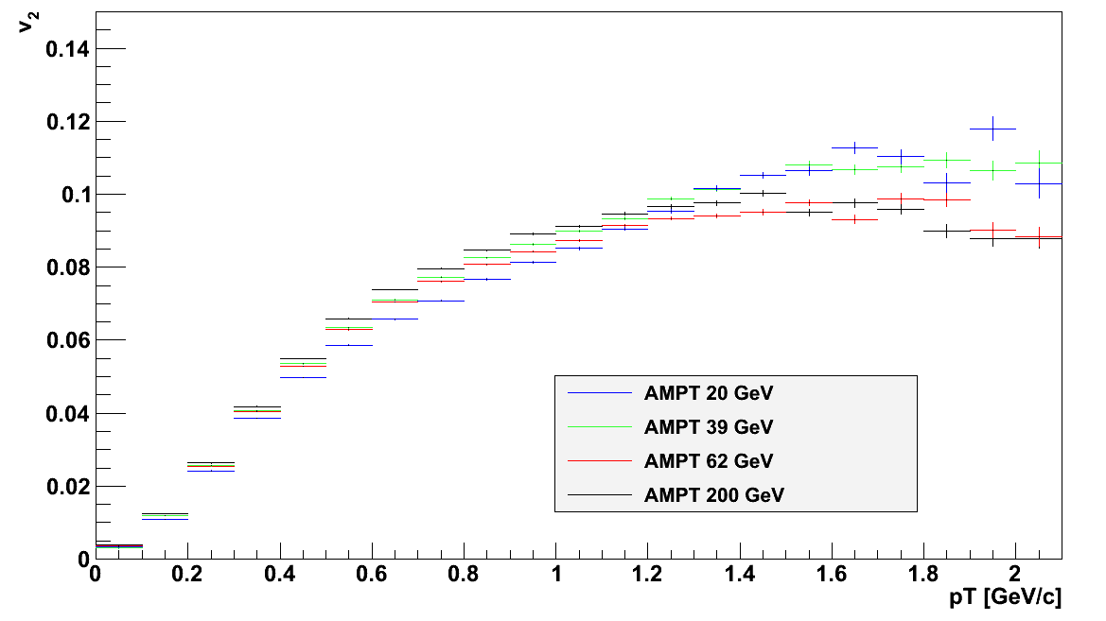
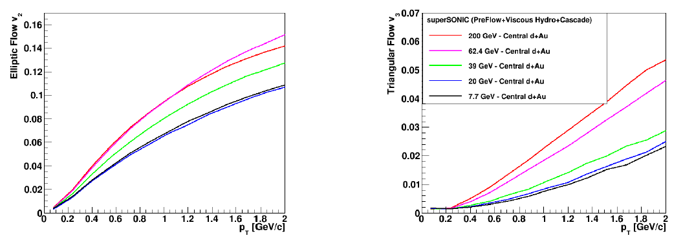
Further Discriminating (?) Tests
Species dependence signature of velocity field, though coalescence can mimic some features (all?)
AMPT p+Au
AMPT p+Au
superSONIC
predictions
PHENIX proposed d+Au energy scan 20-200 GeV and will run in 2016.

Slide 37
Geometry Rules – but what final-state mechanism

Slide 38
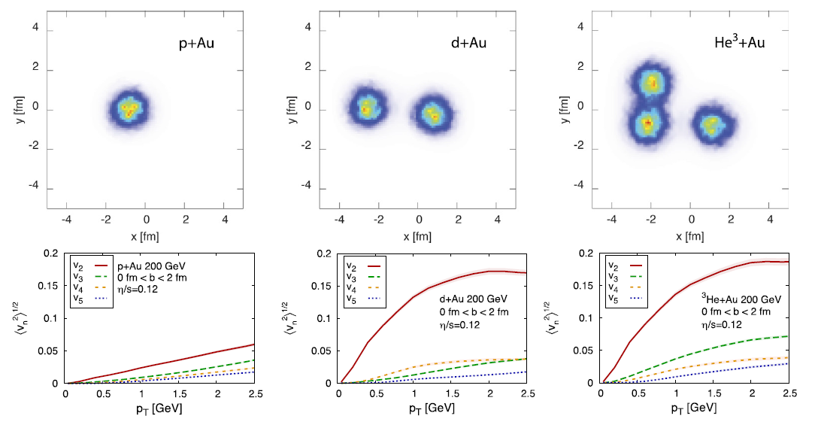

Slide 39
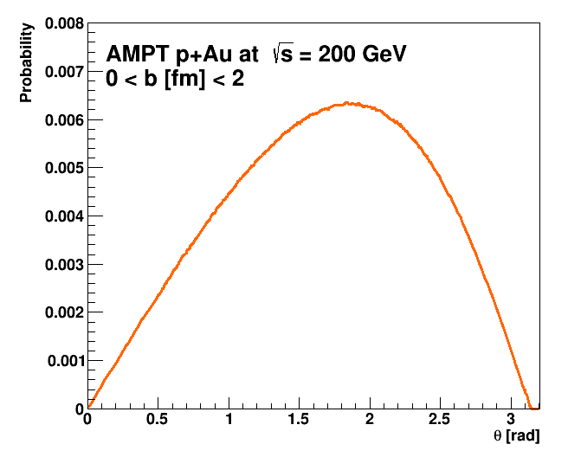

Slide 42
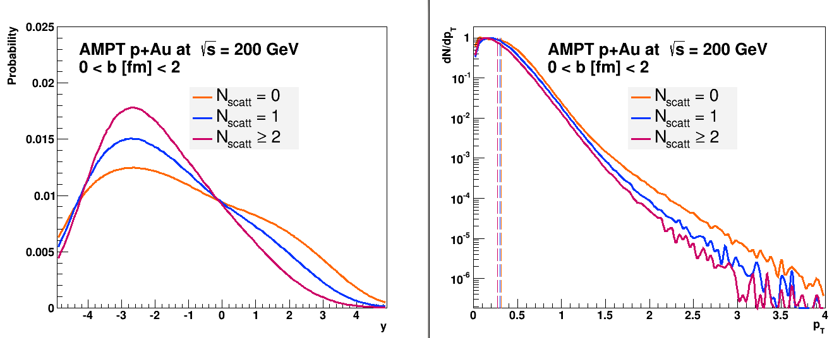

Slide 43
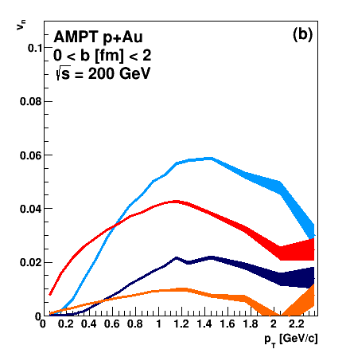

Slide 44
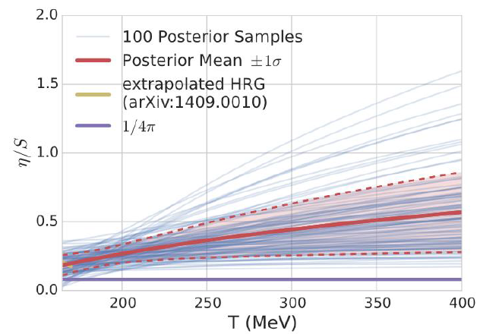
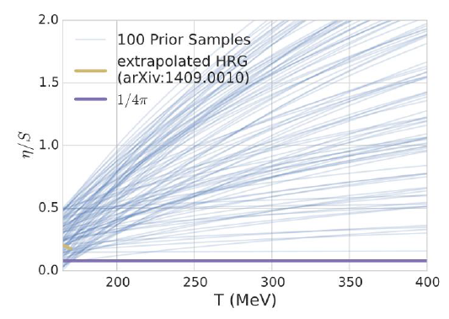
Quantitative Constraints
(Speed of Sound)²
η/s
Temperature [MeV]
Temperature [MeV]

Slide 45
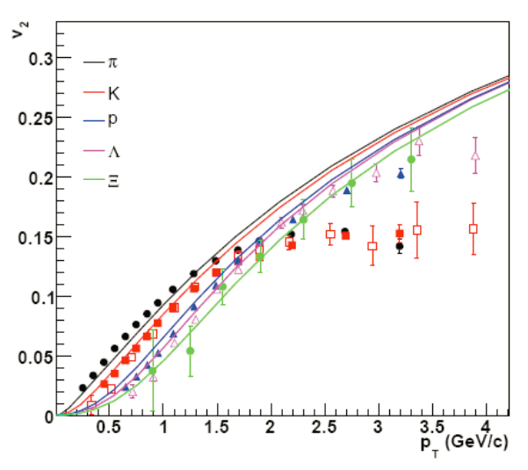
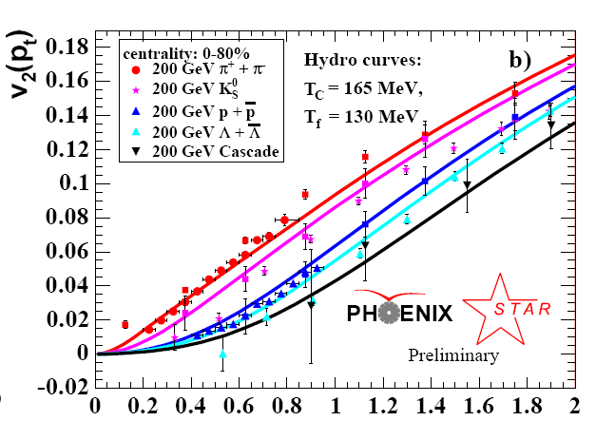
Flow paradigm review …
Higher moments
Mass ordering
Cumulants (2,4,6)…
Correlations between moments
v₂
Temperature Profile + Velocity Vectors
v2
p_{T} (GeV)

Slide 46
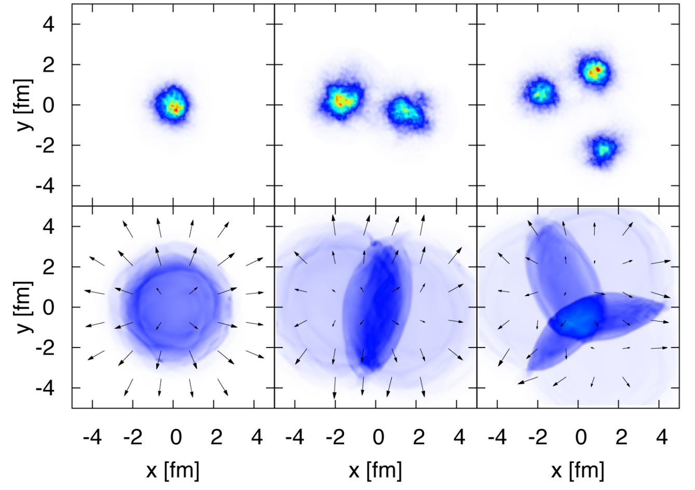
Initial State Geometry + Interactions
Bjoern Schenke
Hydrodynamics is one model for the interactions
v₂(³HeAu) ~ v₂(dAu) > v₂(pAu)
v₃(³HeAu) > v₃(dAu) > v₃(pAu)

