Slide 1


How does the
Quark-Gluon Plasma really work?
Jamie Nagle
University of Colorado - Boulder
Florida State University December 08, 2016

Slide 2
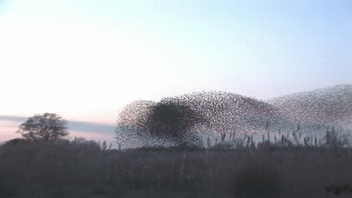
How does this work?
Emergent Phenomena… Collectivity…
What is the underlying origin?
For this flock of birds, it is all short range interactions

Slide 3
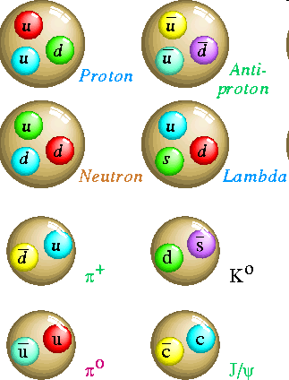
Quantum Chromodynamics
Hadrons are composite objects made of quarks and gluons
QCD is a “confining” gauge theory, with an effective potential
V(r)
“Coulomb” “Confining”
r
No one has ever seen a free quark

Slide 4
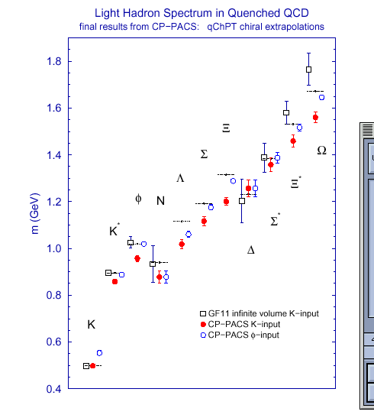
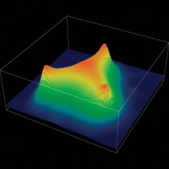
Strong evidence that QCD is the
correct theory of the strong interaction
Perturbative Calculations
Lattice Calculations
The field is about understanding
emergent phenomena from QCD,
just like condensed matter physics from QED.

Slide 5
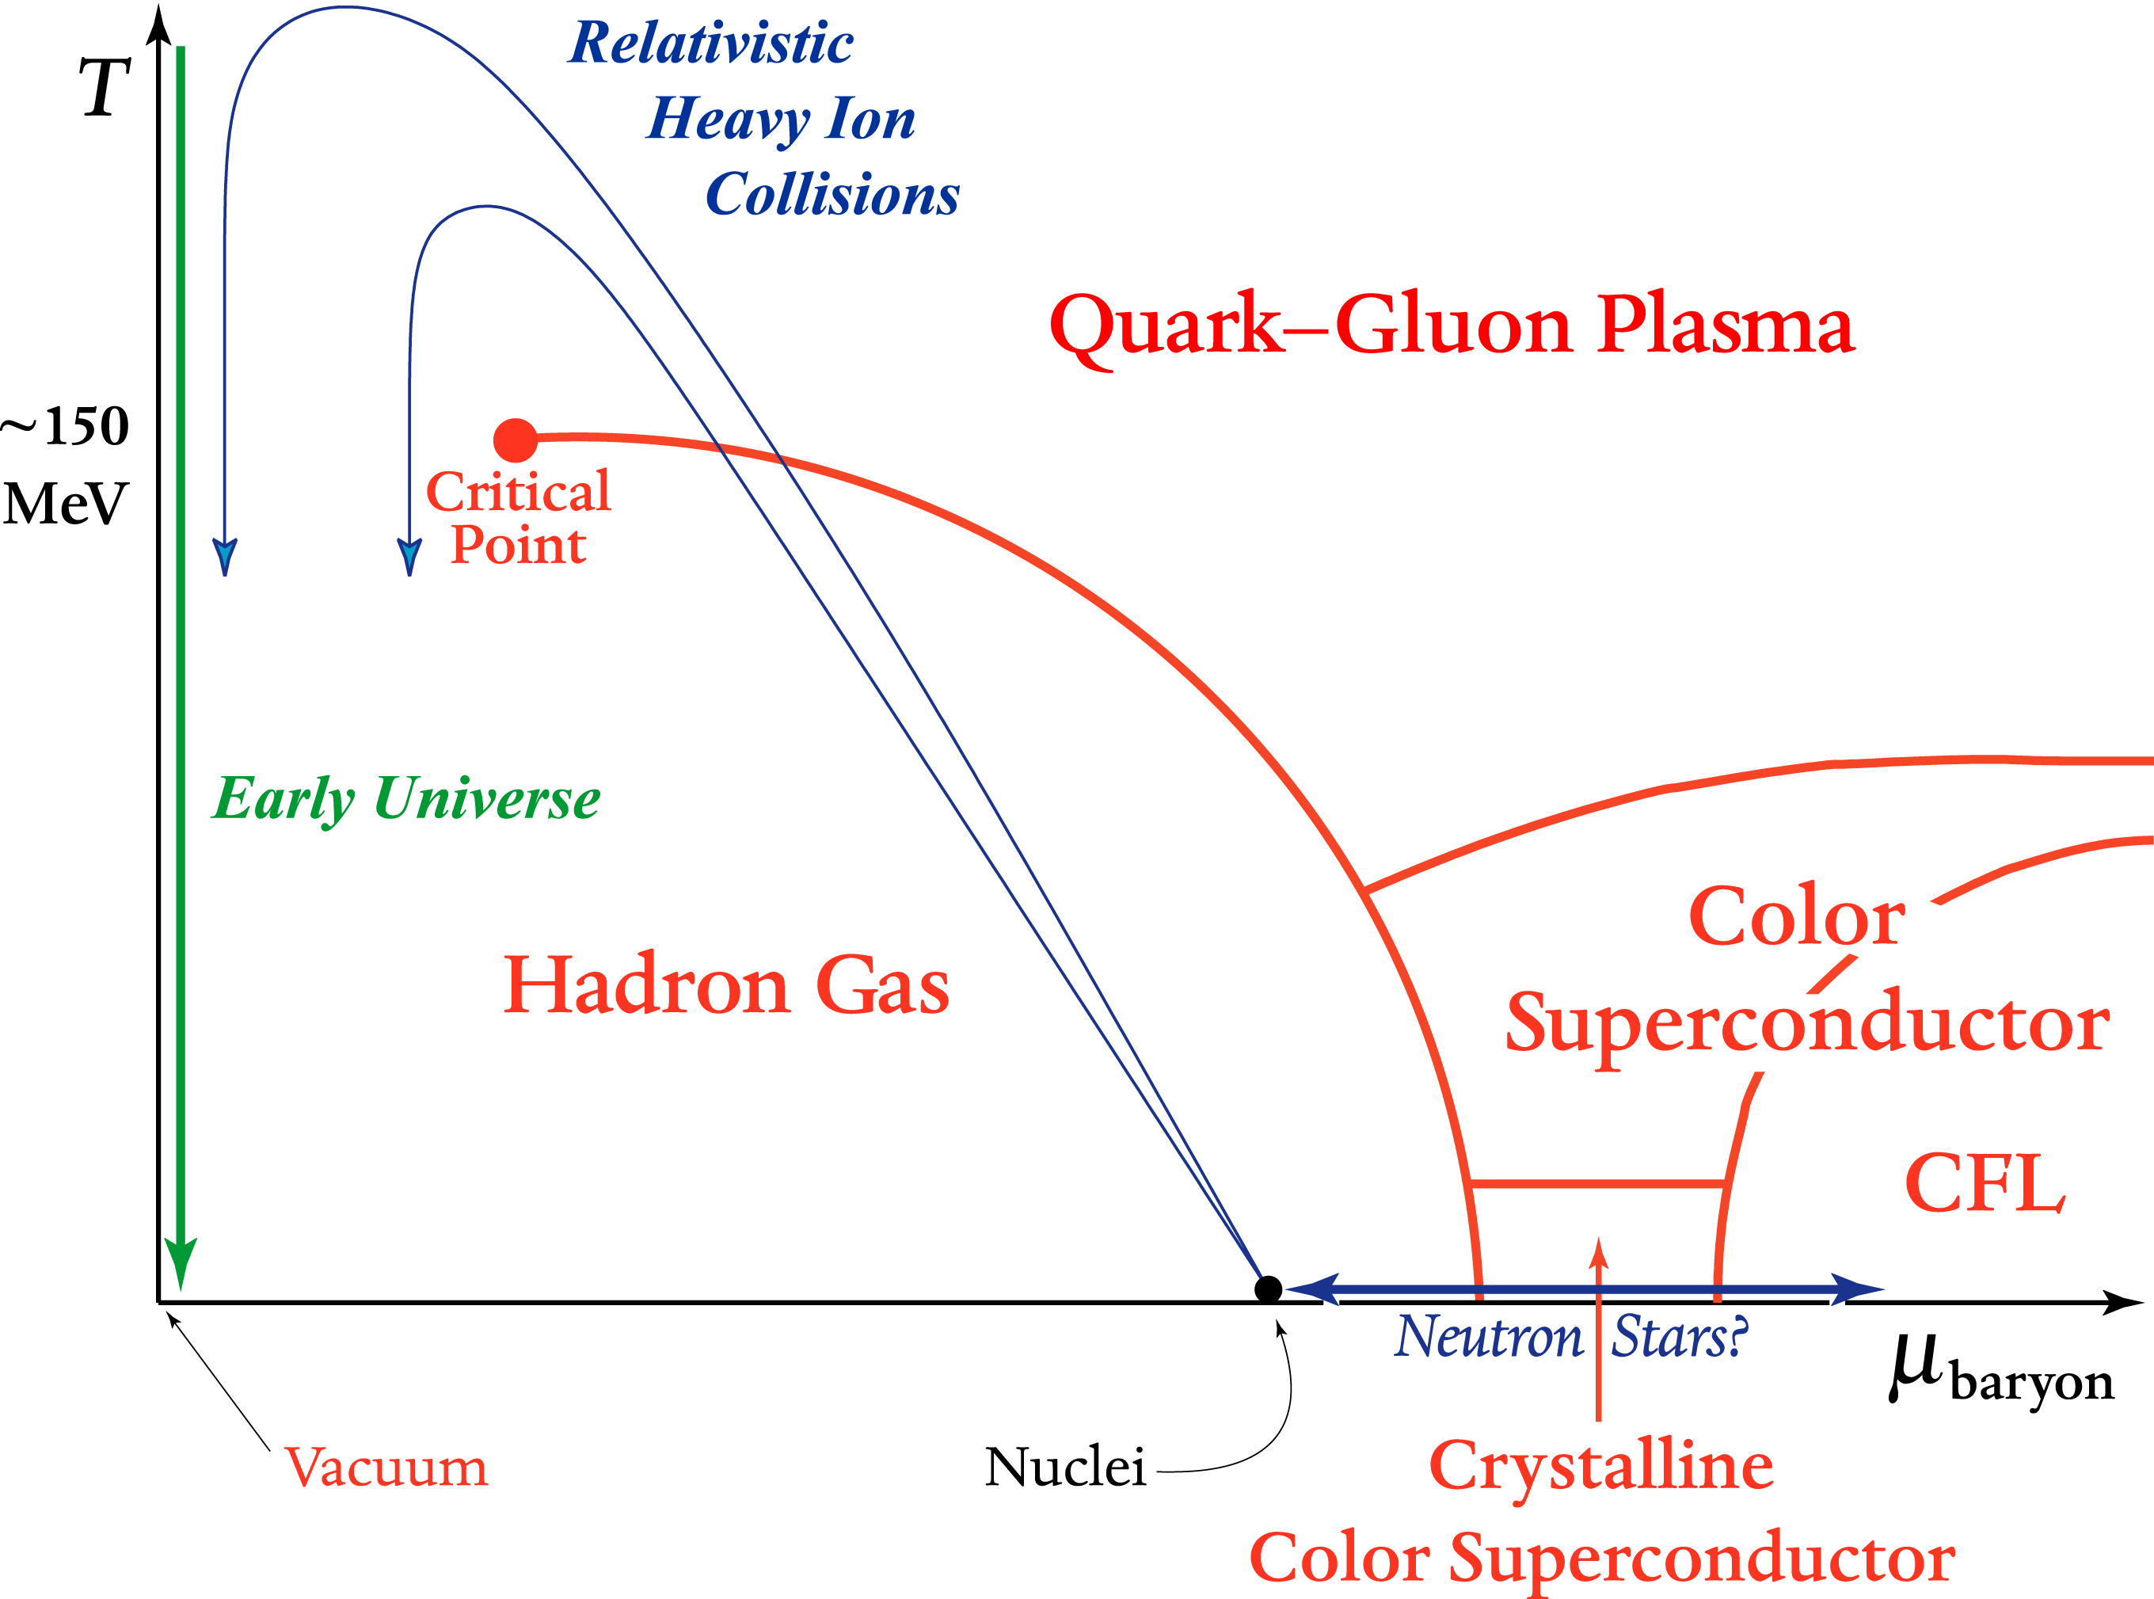
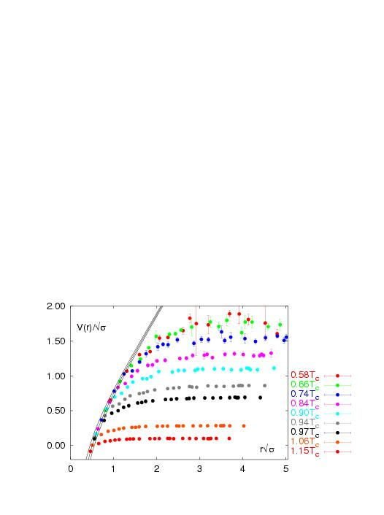
What about Hot QCD Matter?
Quark Gluon Plasma without color confinement
V(r)
r
Lattice QCD
V(r)/√σ
Screening of long range confining potential expected at high enough temperature or density
r√σ

Slide 6
Energy density for “g” massless degrees of freedom
Hadronic Matter:
3 π with spin=0
Quark Gluon Plasma:
8 gluons;
2 quark flavors, antiquarks, 2 spins, 3 colors
Degrees of Freedom increases x10
Lattice indicates smooth cross over, not 1st/2nd order
Weakly interacting
quarks & gluons (?)

Slide 7
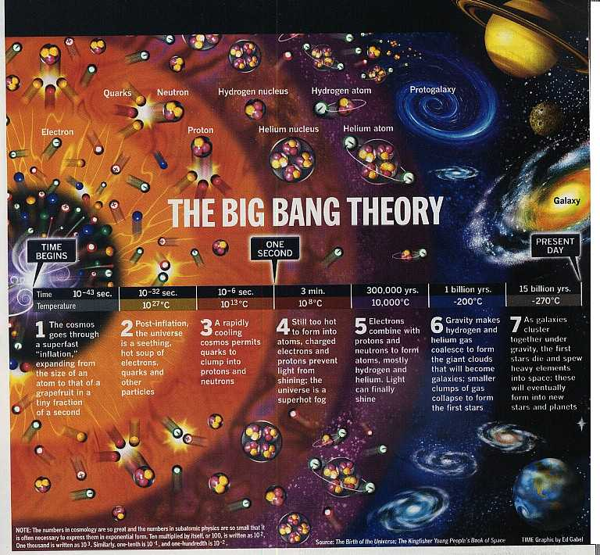
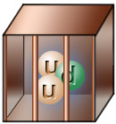
Very early in the universe, quarks and gluons were free in a plasma state
As the universe cooled, they were confined and have remained that way since

Slide 8
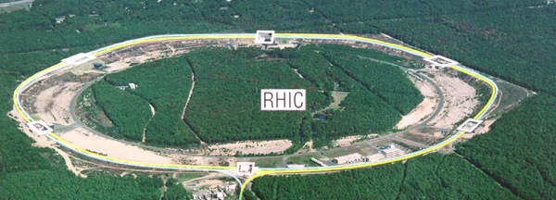
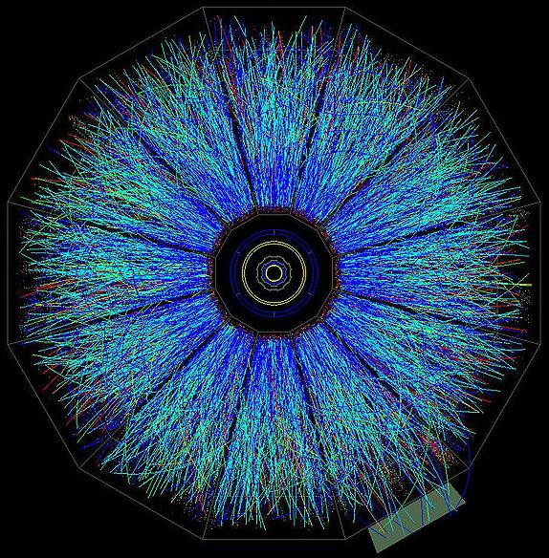
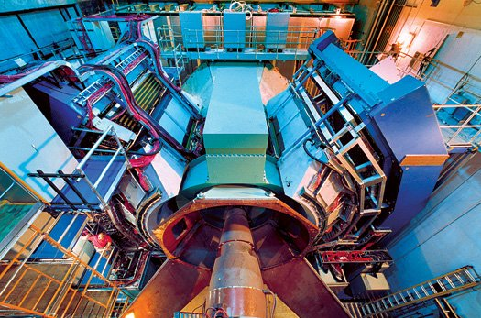
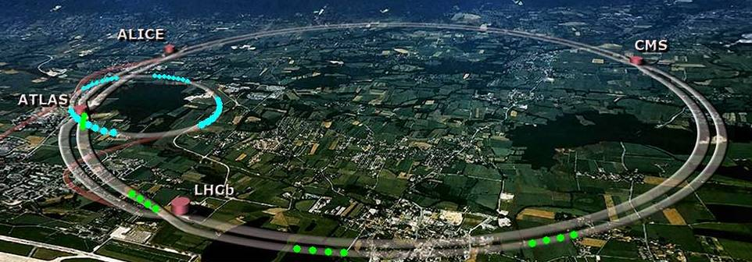
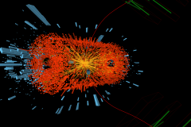
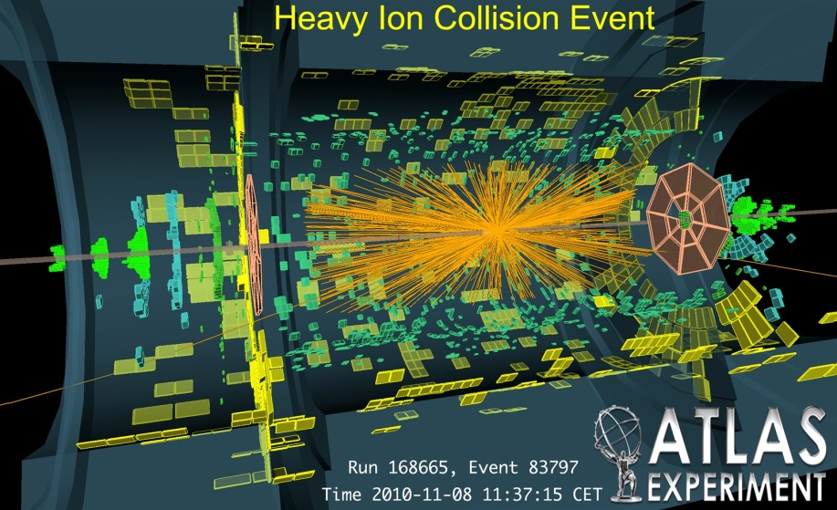
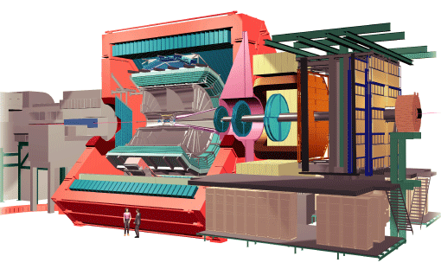
Laboratory Microscopes
RHIC
PHENIX
STAR
LHC
CMS
ALICE

Slide 9
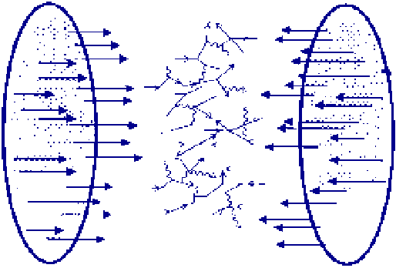
10,000 virtual gluons, quarks, and antiquarks
from the nuclear wavefunctions
are made physical in the laboratory !

Slide 10
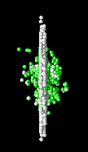
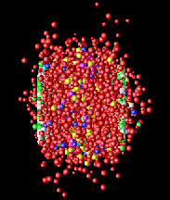
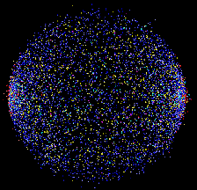
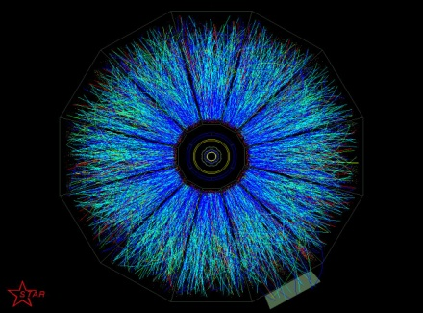
Time Evolution
0 fm/c
5 fm/c
10 fm/c
>15 fm/c

Slide 11
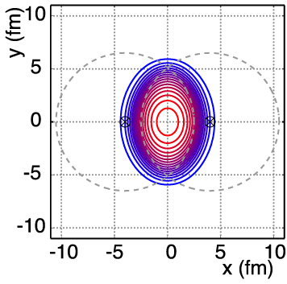
Non-Central A+A Geometry
v₂ = “elliptic flow”

Slide 12
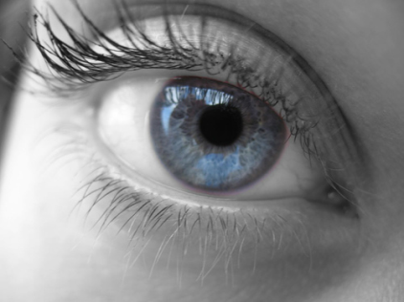
Large Elliptic Flow
Literally “seen” in first days at RHIC

Slide 13
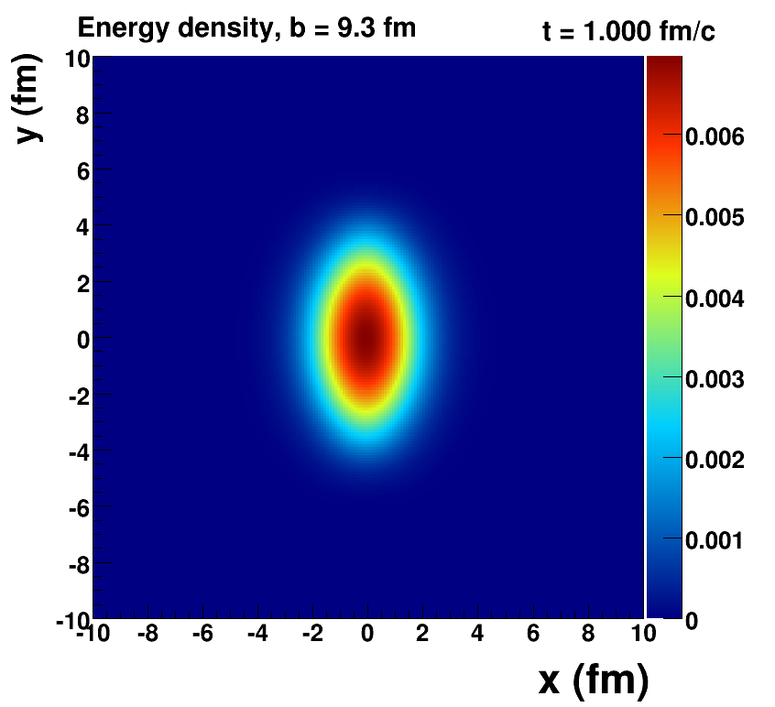
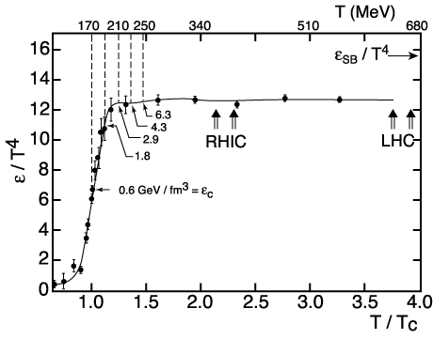
How Large is the Flow Really?
Assume early thermalization and run ideal hydrodynamics (i.e. no dissipation → zero shear + zero bulk viscosity)
Key Inputs:
Initial Geometry
QCD Equation of State

Slide 14
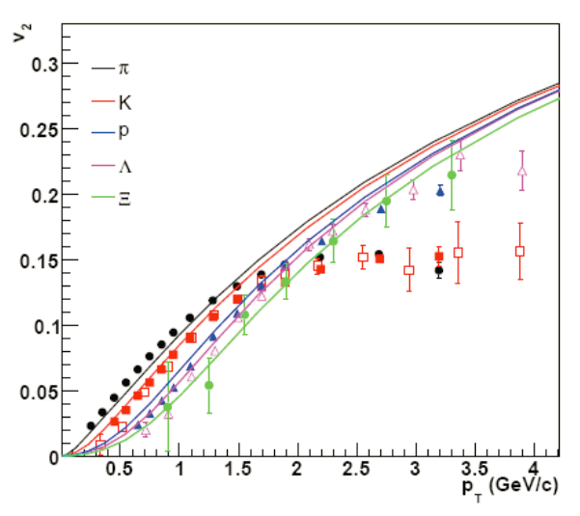
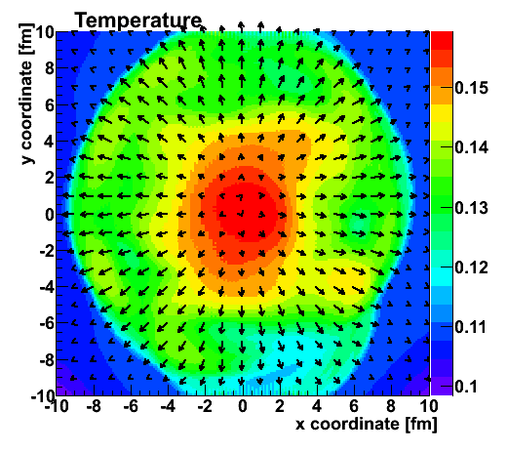
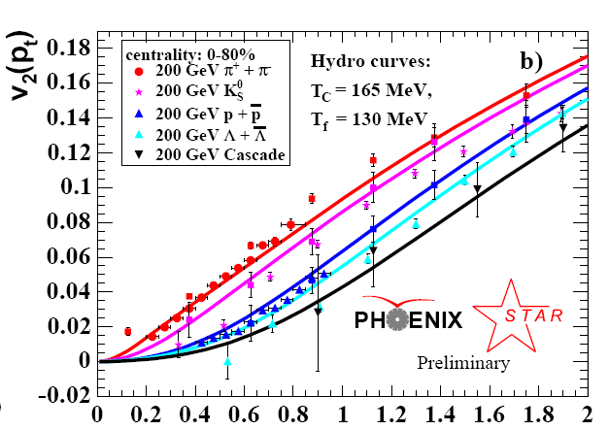
Fluid cells “freeze-out” below T_{f}
Isotropic hadrons in cell rest frame, then boosted
v₂
Temperature Profile + Velocity Vectors
v2
p_{T} (GeV)
Characteristic “fingerprint” flow pattern
Circa 2005: Quark-Gluon Plasma = Perfect Fluid

Slide 15
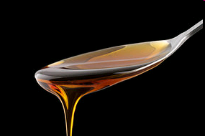
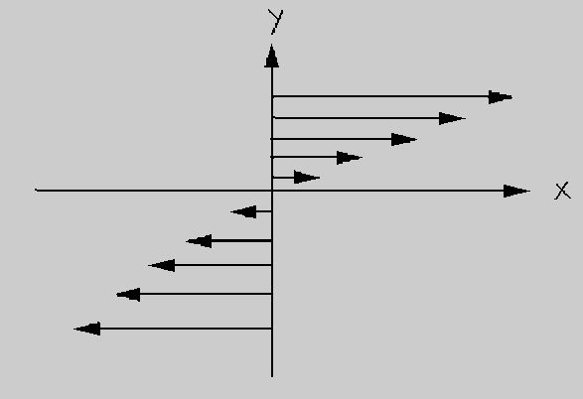
Viscosity Review
Honey – viscosity decreases at higher temperatures
viscosity increases with stronger coupling

Slide 16
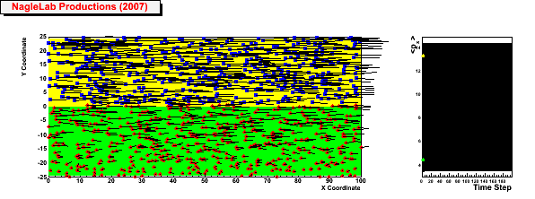
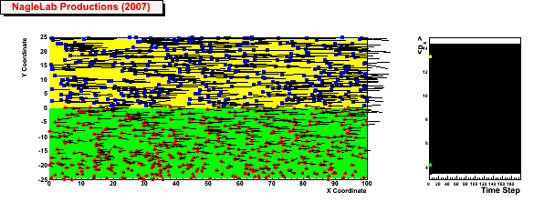
Viscosity Review
Honey – viscosity decreases at higher temperatures
viscosity increases with stronger coupling
Weak coupling (σ=0)
Inhibited
diffusion
↓
Small
viscosity
↓
Perfect fluid
↓
Strong Coupled QGP
(i.e. sQGP)
<p_{x}> top region
<p_{x}> bottom region
Strong coupling (σ ↑)

Slide 17
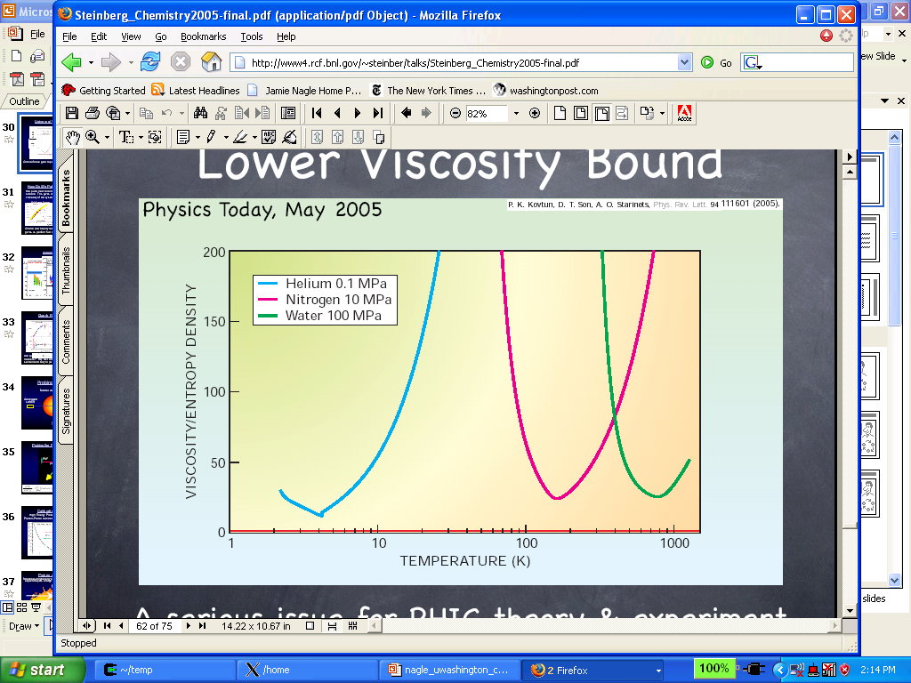
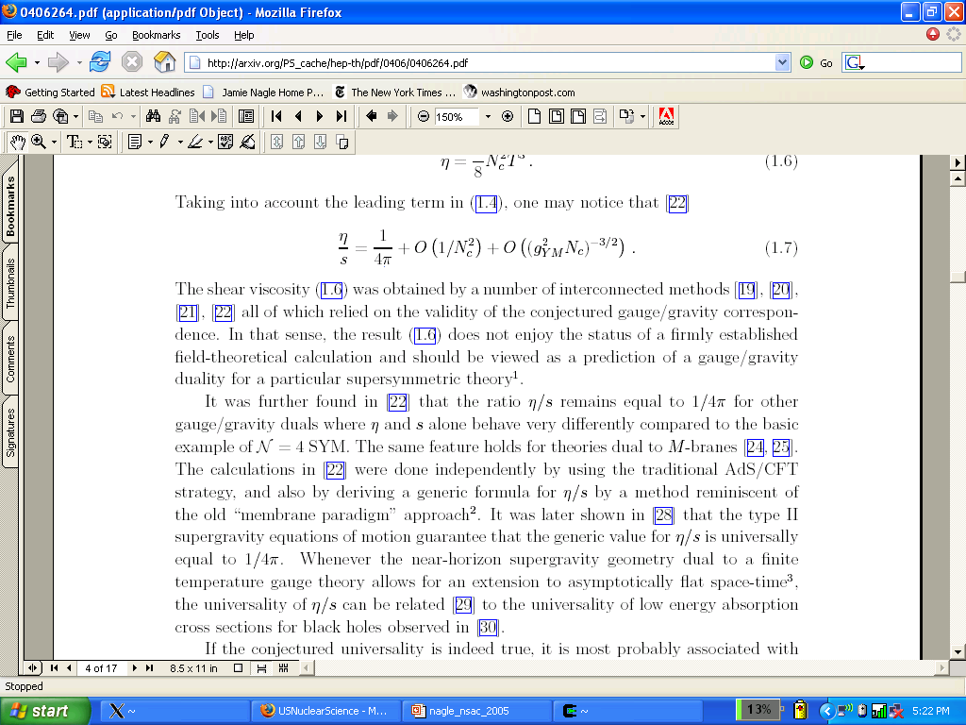
What is η/s for QCD matter at a trillion Kelvin?
String Theory
Lowest Bound!
QGP?
Gas-Liquid Phase Transition
Superfluidity Transition

Slide 18
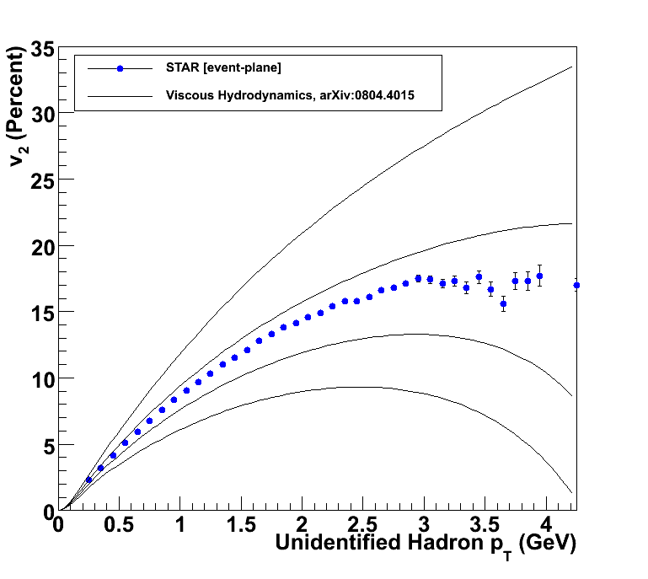
How to Quantify QGP η/s?
Relativistic viscous hydrodynamics compared to data
Luzum, Romatschke, Phys. Rev. C78, 034915 (2008)
η/s ~ 0
η/s = 1/4π
η/s = 2 x 1/4π
η/s = 3 x 1/4π

Slide 19
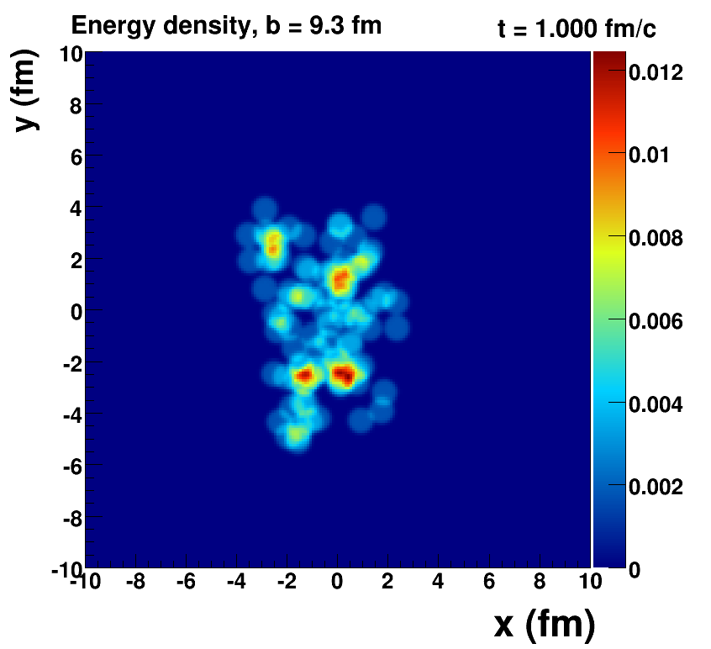
Romatschke=viscous hydrodynamics, McCumber=lumpy conditions + animation

Slide 20
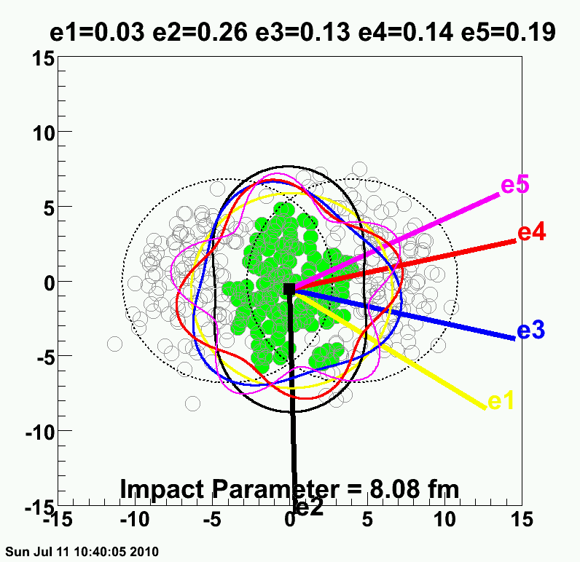
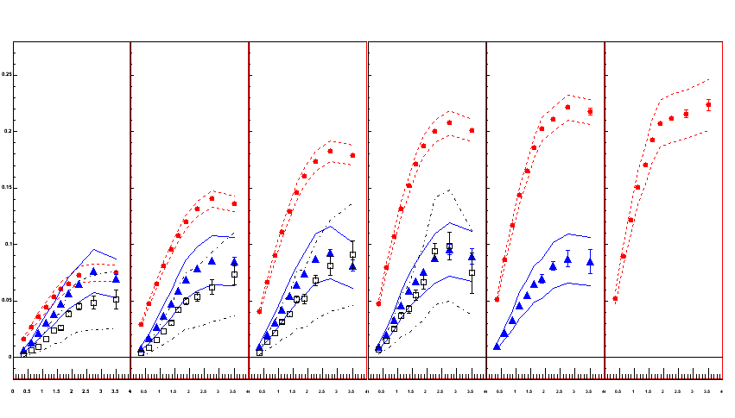
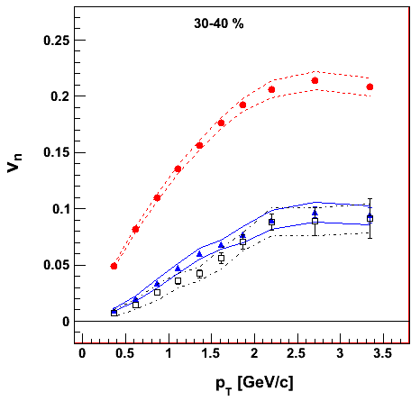
PHENIX Experiment
v₂ {Φ₂ forw.η}
v₃ {Φ₃ forw.η}
v₄ {Φ₄ forw.η}
TT
v_{n} {EP}
Au+Au at 30-40% Central
200 GeV AuAu – 30-40% Central
PHENIX Preliminary
0.20
Elliptic
Triangular
ε₂ ≈ 2 x ε₃ ≈ 2 x ε₄
0.10
Early geometric features survive through QGP evolution because of very small dissipation
0.0
Quadrangular
0.0
1.0
2.0
3.0
p_{T} (GeV/c)

Slide 21
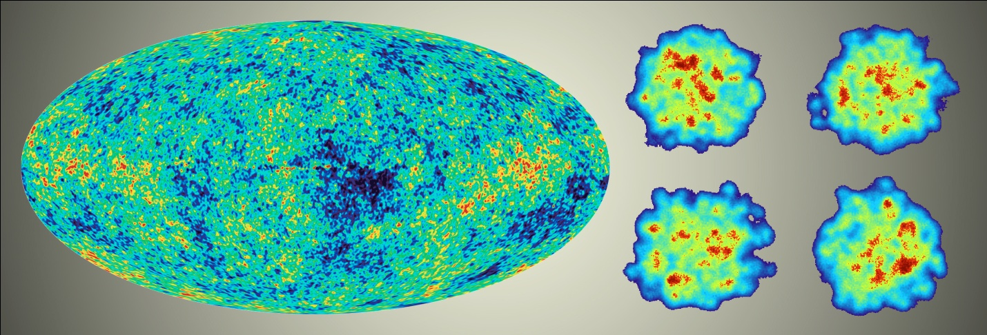
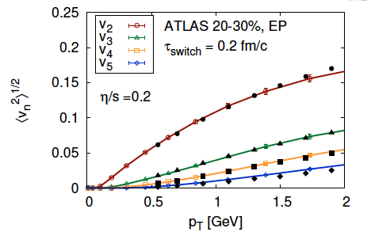
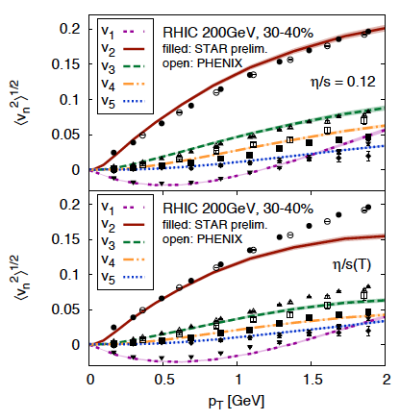
Detailed Fingerprint of Early Time
Quantum Fluctuations
Survive Evolution!
Calculation from Bjoern Schenke

Slide 22
“Little Bang” Standard Model
Discovery: Quark Gluon Plasma = Near Perfect Fluid
Standard Model with Hydrodynamic Evolution
Precision: Predictions of Flow Patterns
but…
How does it equilibrate so quickly (or does it)?
What are the degrees of freedom or quasiparticles?

Slide 23
Back to Discovery
A+A
Enough particles to equilibrate, QGP, collective motion
p+A
Not enough particles to equilibrate, control experiment

Slide 24
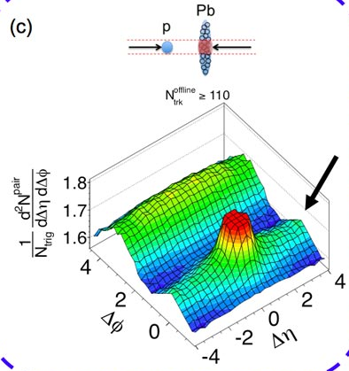
Fall 2012 Revolution – p+Pb Collisions
Signal similar to that seen in A+A
Could it be flow?
Alternative proposal of higher order “glasma” diagrams as initial state momentum domains – nothing to do with geometry!

Slide 25
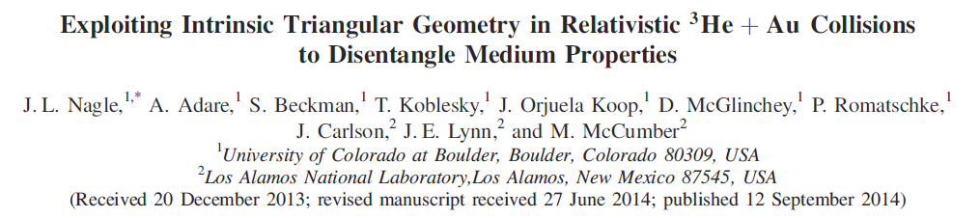
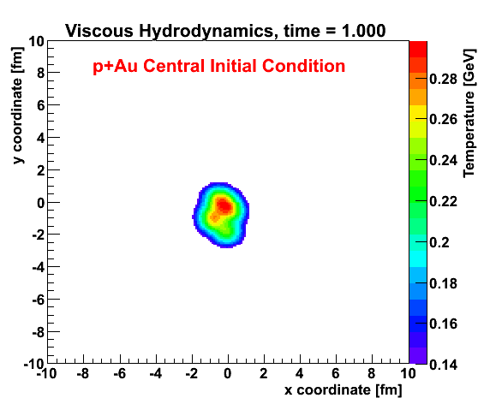
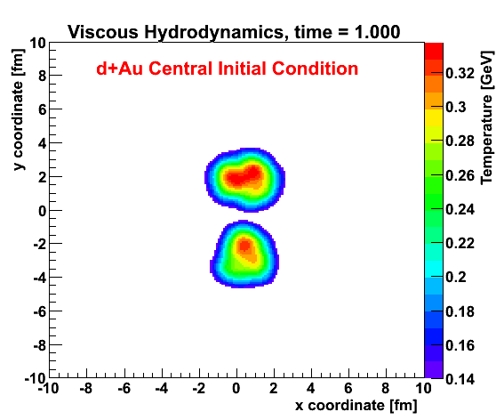
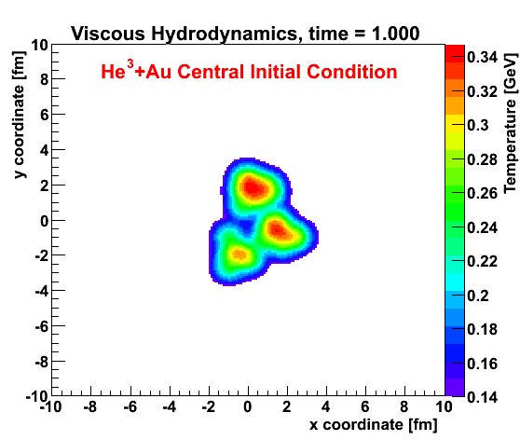
Geometry Tests at RHIC
http://journals.aps.org/prl/abstract/10.1103/PhysRevLett.113.112301

Slide 26
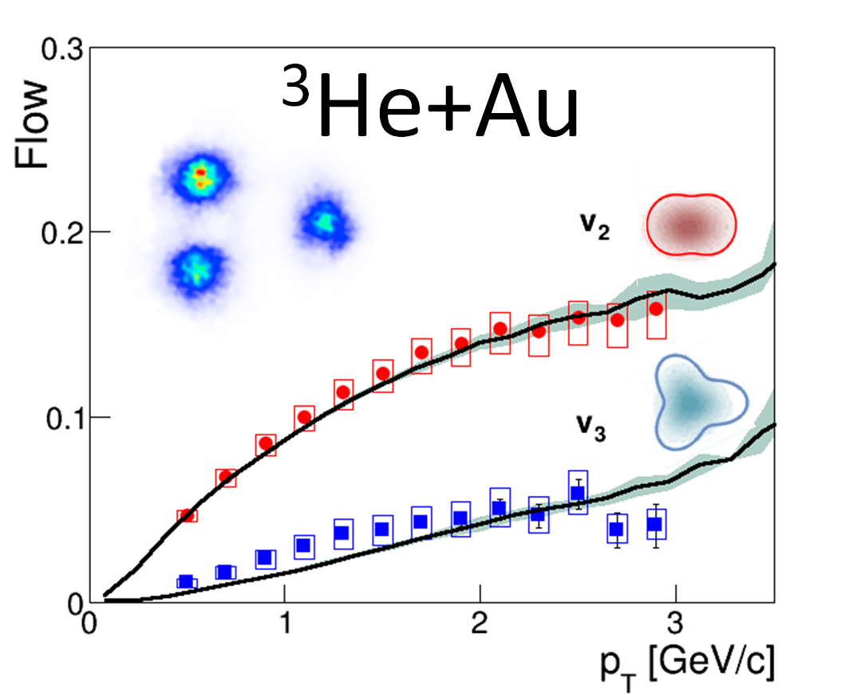
Phys.Rev.Lett. 115 (2015) no.14, 142301

Slide 27
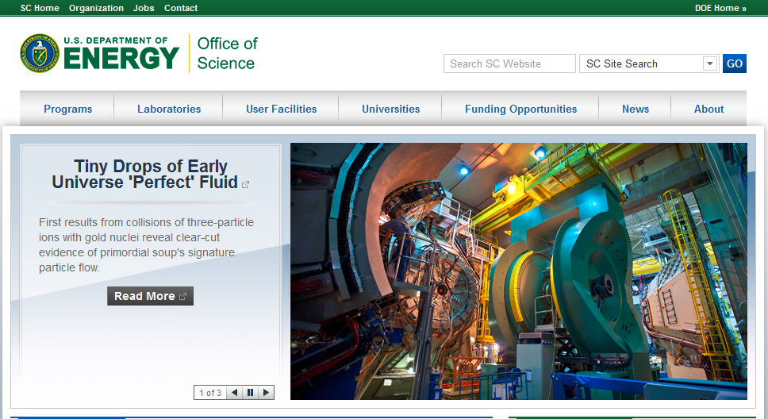

Slide 28
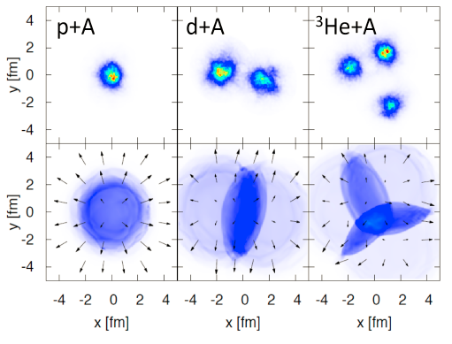
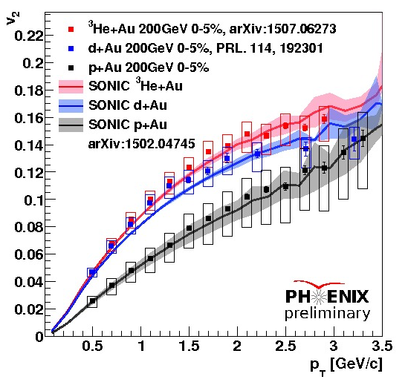
Flow Pattern Predictions
Romatschke, Nagle et al. , http://journals.aps.org/prl/abstract/10.1103/PhysRevLett.113.112301

Slide 29
New p+p @ 13 TeV data
Similar phenomena now observed in
high multiplicity
Proton + Proton
Reactions at LHC
Could even this be flow?
Does that have to imply equilibrated QGP?

Slide 30

Proton Imagined on the Yoctosecond Time Scale
https://arxiv.org/abs/1607.01711

Slide 31
Scientific Method
Thought – Is the flow pattern everywhere?
Hypothesis – Lower energy → no QGP → no flow pattern
Theory Predictions - published calculations in 5 scenarios
Proposal – d+Au Beam Energy Scan (20, 39, 62, 200 GeV)
push Brookhaven to have a special 5 week run
Data Taking – triggers enhanced central collisions by x100
Analysis – data recorded spring 2016, results very soon!
Exploring the Beam Energy Dependence of Flow-Like Signatures in Small System d+d+Au Collisions
J.D. Orjuela Koop, R. Belmont, P. Yin, J.L. Nagle (Colorado U.). Dec 21, 2015. 8 pp.
Published in Phys.Rev. C93 (2016) no.4, 044910

Slide 32

Emergent Phenomena
Connection from the Strong Force (QCD)
to the phenomena of confinement and
asymptotic freedom was fundamental
Connection from QCD to the emergent phenomena of near perfect fluidity of the Quark-Gluon Plasma is just as fundamental
Perfect fluidity tells us the nature of the QGP,
more importantly we need to reconcile:
Most important discovery in field: perfect fluid
&
Crucial part of QCD: weak coupling at short distances

Slide 33



What happens to a colored object
(far out of equilibrium) as it
traverses the QGP?
Think deep-inelastic scattering of QGP

Slide 34






Jet Probes of QGP Structure
Bare Color Charges
Parton virtuality evolves quickly and is influenced by the
medium at the scale it probes
Thermal Mass Gluons
Perfect Fluid Only
RHIC Jet Probes
LHC Jet Probes
QGP Influence
Unique critical microscope resolution at RHIC.
Measurement overlap between RHIC and LHC
very important too.
Thick lines indicate where the QGP influences virtuality evolution

Slide 35

A New Detector at RHIC
BaBar Magnet 1.5 T
Coverage |η| < 1.1
Inner MAPS tracker
Outer Fast TPC
Electromagnetic
Calorimeter
Hadronic Calorimeter
Sampling 0.6 trillion Au+Au interactions in one-year
Maximizing efficiency of RHIC running
CD-0 Approval , September 27, 2016 !

Slide 36


Precision Imaging of QGP Over Key Kinematics

Slide 37


Precision Imaging of QGP Over Key Kinematics
b
b
Upsilon states are differentially sensitive to local color charge density.
Again, precision is the key!

Slide 38


Very Fun to Build Something New!

Slide 39








Top fiber
Bottom fiber

Slide 40



Sometimes it is better to borrow something working!

Slide 41

Electron Ion Collider
Critical to understanding nature of proton and heavy nuclei
Key to picture of gluonic initial starting point for QGP
Detector built around BaBar magnet and sPHENIX serves as excellent foundation for EIC detector
http://arxiv.org/abs/arXiv:1402.1209
http://arxiv.org/abs/1212.1701

Slide 42
Summary
Discovery of Quark-Gluon Plasma as Perfect Fluid
Precision Description of Flow
“Little Bang” Standard Model
New Questions about Small QGP
New Opportunities to Discover the How and Why of the QGP

Slide 43

Science and Society
Scientific Method is something we need to respect and utilize as input to policy.
As a society,
we embrace
ignorance at our peril.

Slide 45



Nuclear Physics
Long Range Plan – strong support in DOE, funding increases
Nuclear – old school, but still relevant (Moniz)
Nuclear – branching out… FRIB ($700), JLAB 12 GeV ($300M),
Double beta decay, sPHENIX, Electron-Ion Collider

Slide 48






Photon-Tagged Jets
γ
Golden channel where photon
calibrates quark energy
q
E_{quark}
E_{photon}

Slide 49


Answering the Why and How?
When does the strongly coupled bulk (lower momentum IR)
transition to a weakly coupled probe (higher momentum UV)?

