Slide 1
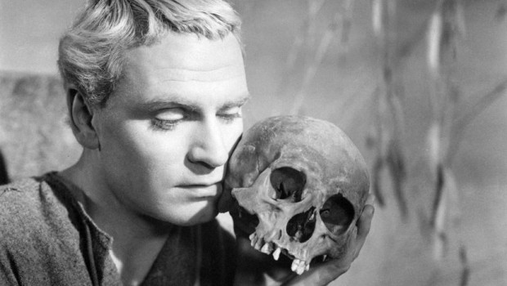
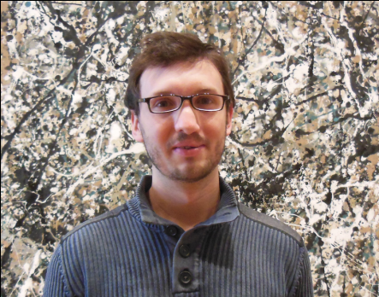
Collective
^
To Be or Not to Be
Collective
Jamie Nagle, Darren McGlinchey, Javier Orjuela Koop
University of Colorado

Slide 2
Hydrodynamics (SONIC) in Small Systems
http://journals.aps.org/prl/abstract/10.1103/PhysRevLett.113.112301
Parton Cascade (AMPT) in Small Systems
http://arxiv.org/abs/1501.06880
Useful inputs from Zi-Wei Lin and Denes Molnar
AMPT motivation, He et al. (arXiv:1502.05572v3)

Slide 3
Initial Momentum or Geometry Correlations
Initial State QCD Physics
Non-Geometry correlations directly in momentum space
Initial Geometry rules
Bjoern Schenke
1/Q_{s}
Hydrodynamics is one model for final-state interactions
Published predictions
v₂(³HeAu) ~ v₂(dAu) > v₂(pAu)
Important in small systems!
Not published…
v₂(pAu) > v₂(d,³HeAu)

Slide 4
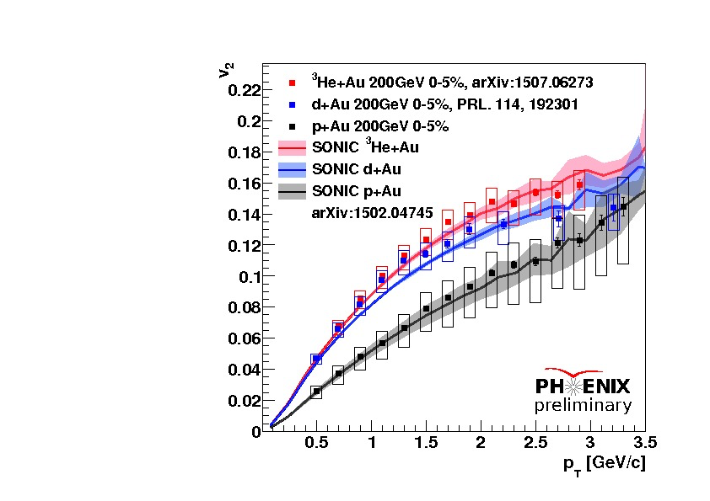
Glauber +Hydrodynamics+Cascade Predictions
Romatschke, Nagle et al. , http://journals.aps.org/prl/abstract/10.1103/PhysRevLett.113.112301

Slide 5
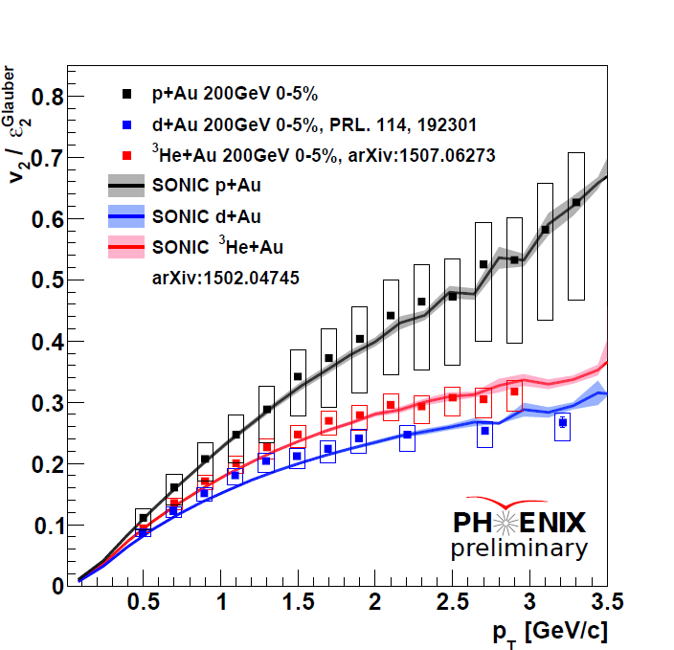
No Simple Eccentricity Scaling

Slide 6
No Simple Eccentricity Scaling
p+Au
³He+Au
d+Au
³He/d+Au – some events hot spots never connect and so ε₂ → v₂ translation incomplete

Slide 7
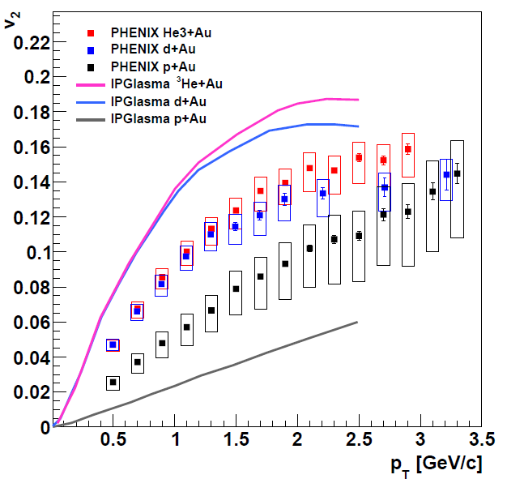
IP Glasma+Hydrodynamics Predictions
With larger η/s, one can match ³He/d+Au.
p+A is because initial ε₂ is very small.
Possible solution is giving proton more substructure
Schenke, Venugopalan, http://www.sciencedirect.com/science/article/pii/S0375947414003522

Slide 8
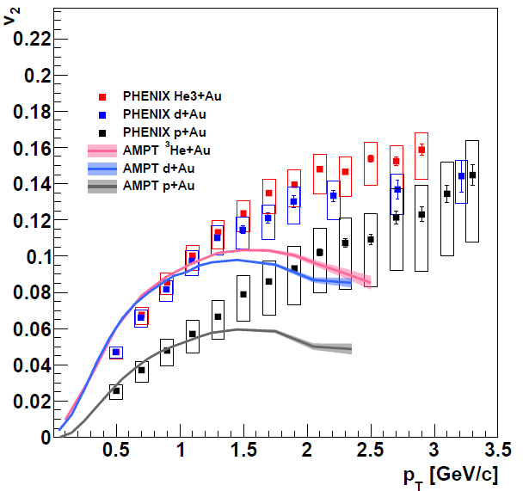
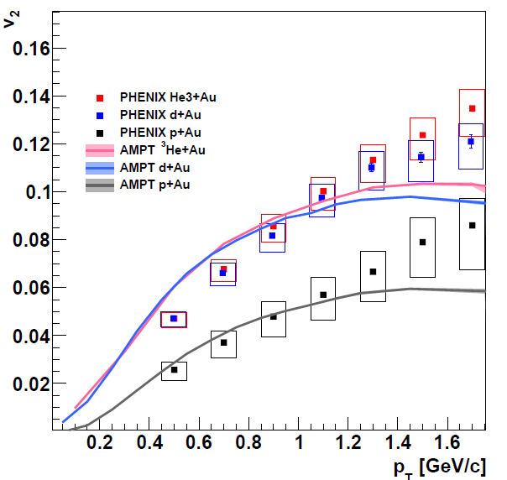
AMPT Predictions
Modified
Initial Glauber including ³He wavefunction
(same I.C. as SONIC)
String melting
Lots of partons
= 1.5 mb
Hadron Cascade
Orjuela Koop et al. http://arxiv.org/abs/1501.06880

Slide 9
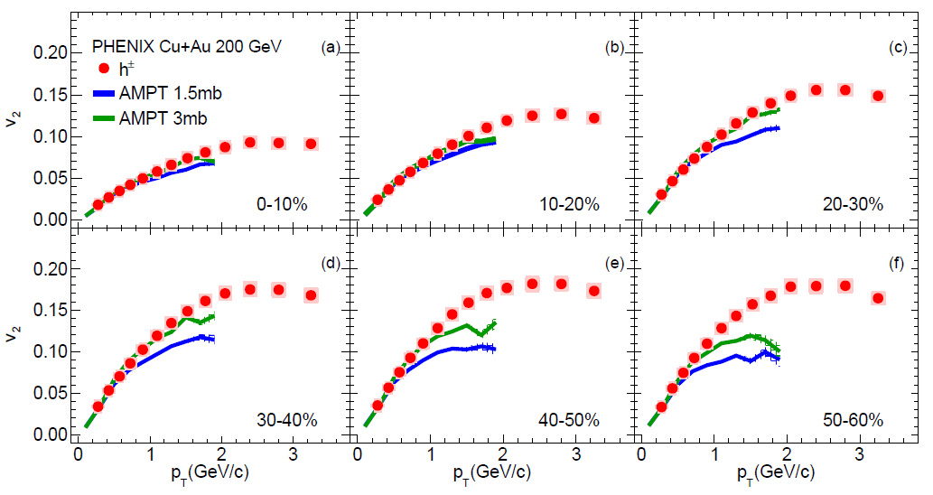
AMPT (same code) Cu+Au @ 200 GeV
PHENIX arXiv:1509.07784

Slide 10
AMPT Details
Central p+Au
55% of partons have zero scatters

Slide 11
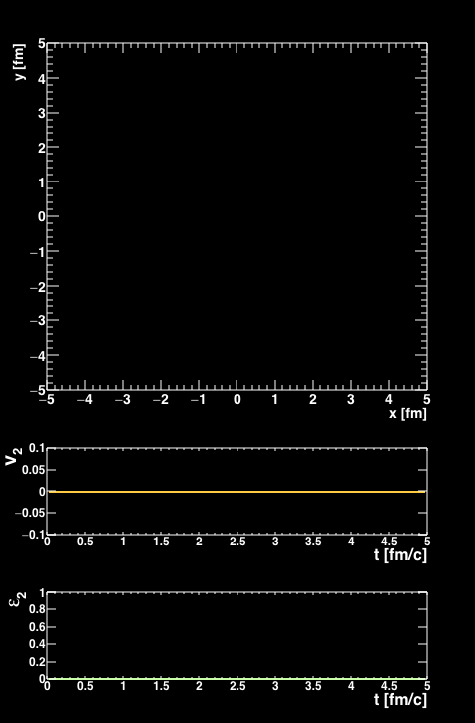
Central p+Au @ 200 GeV
~ 200 partons
AMPT has all (anti)quarks
m < 30 MeV/c²
and zero gluons!
Scatters = 0
Scatters = 1
Scaters >=2
~ 45 parton-parton scatterings

Slide 12
AMPT – Just the Partons (ZPC)
v₂
Prob. to Not Scatter (φ)
Why isn’t this flat with p_{T} since σ=1.5 mb is momentum independent?
Parton p_{T} (GeV/c)

Slide 13
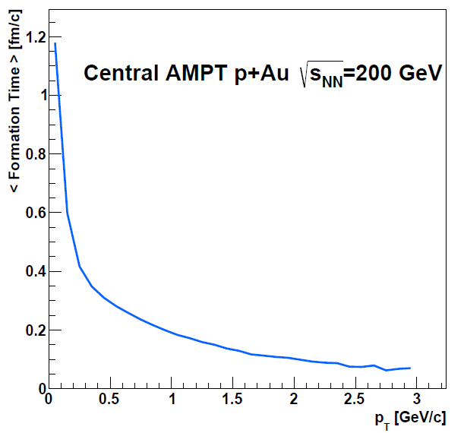
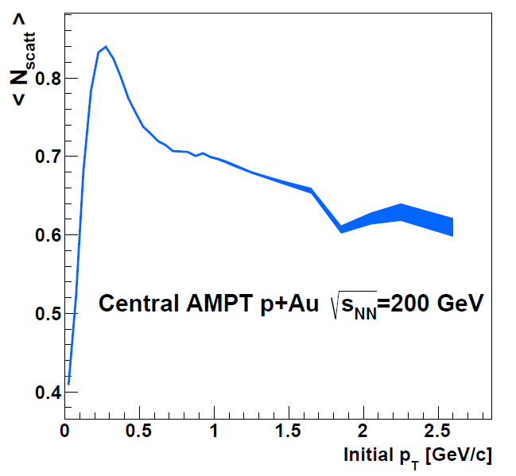
Parton Formation Time
<N_{scatt}>
Formation Time
Low p_{T} partons do not interact for > 1 fm/c
v₂(p_{T}) depends on formation time
Not yet clear why <N_{scatt}> drops for high p_{T} partons

Slide 14
Hadronization in AMPT
200 quarks/antiquarks → ~ 100 mesons
Just from parton cascade
Just after hadronization
Coalescence just by closest spatial partner
(no momentum space)
How to assign a
theory uncertainty?

Slide 15
Contributions for Each Stage
No Parton or Hadron Cascade
Hadron Cascade Only
Parton Cascade → Hadrons
Also Hadron Cascade

Slide 17
Different Picture in ³He+Au

Slide 18
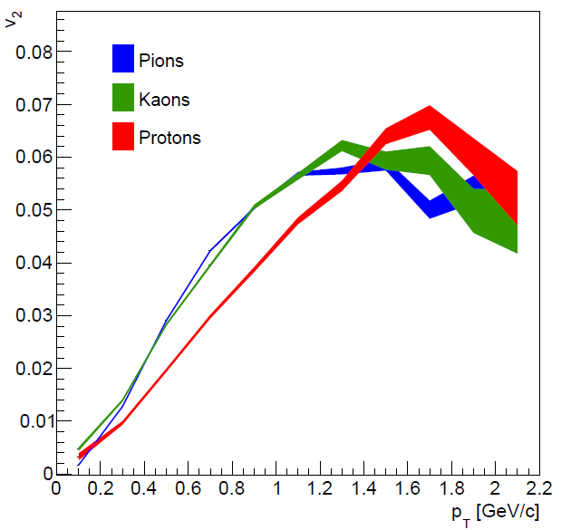
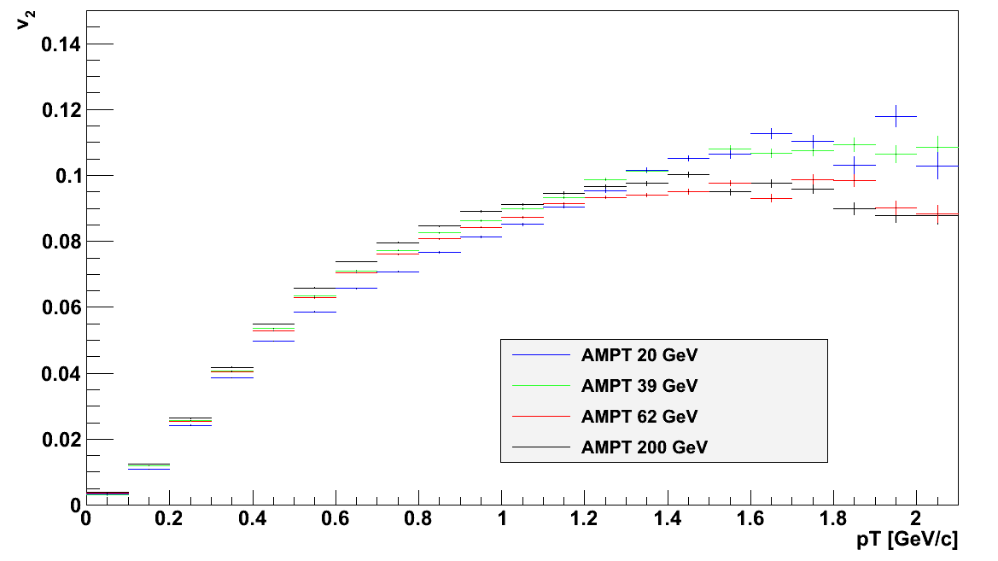
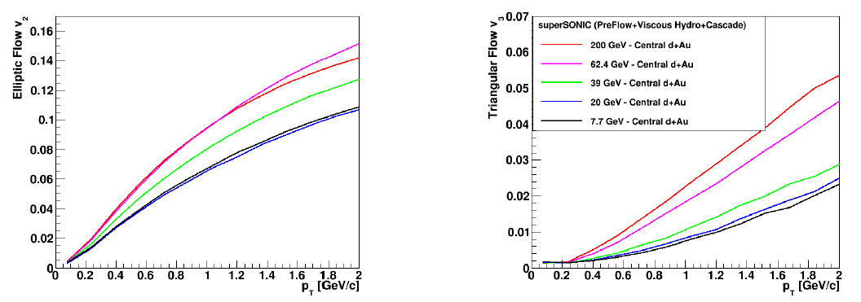
Further Discriminating (?) Tests
Species dependence signature of velocity field, though coalescence can mimic some features (all?)
AMPT p+Au
AMPT p+Au
superSONIC
predictions
PHENIX proposed d+Au energy scan 20-200 GeV and will run in 2016.

Slide 19
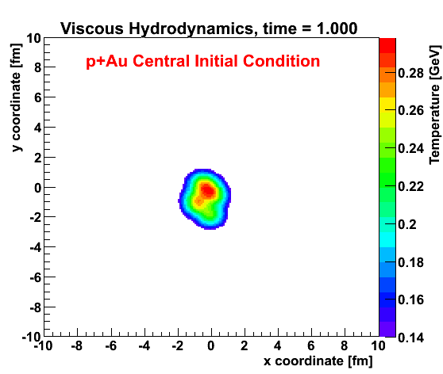
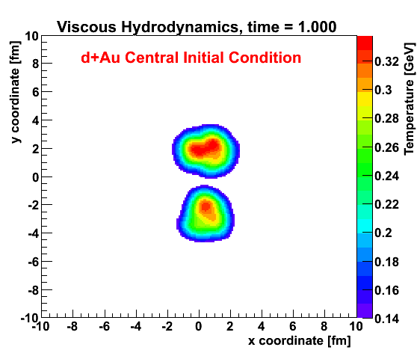
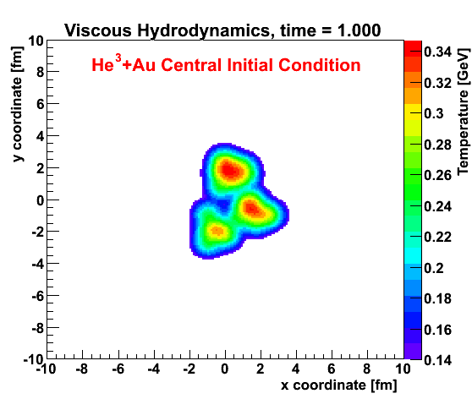
Definitive evidence for geometry, not initial momentum correlations
However, competing final state explanations
needs work to discriminate.

Slide 20
Extras

Slide 21
Geometry Rules – but what final-state mechanism

Slide 22
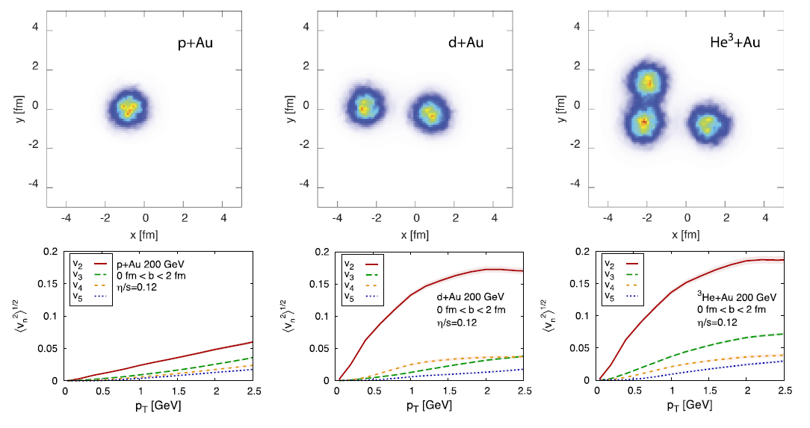

Slide 26
