Slide 1
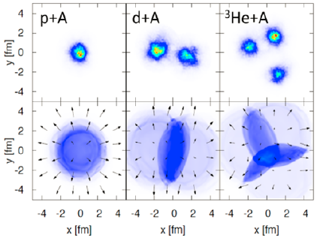
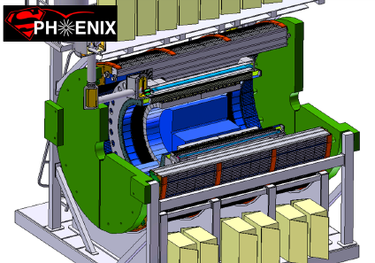
PHENIX Beam Use Proposal
Run-16 and Run-17
Jamie Nagle
for the PHENIX Collaboration

Slide 2
Outline
Highlights of a few recent accomplishments
Run-14 data taking report
Run-15 data taking report
Run-16 Beam Use Request
sPHENIX and no PHENIX Run-17 Request

Slide 3
Highlights of a few recent accomplishments

Slide 4
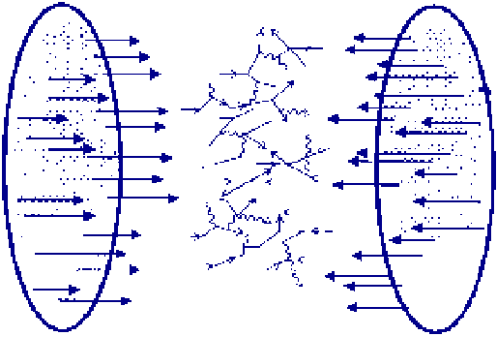
Scientific Paradigm (Shift)
A+A
Enough particles to equilibrate, QGP, collective motion
p+A
Not enough particles to equilibrate, control experiment (?)

Slide 5
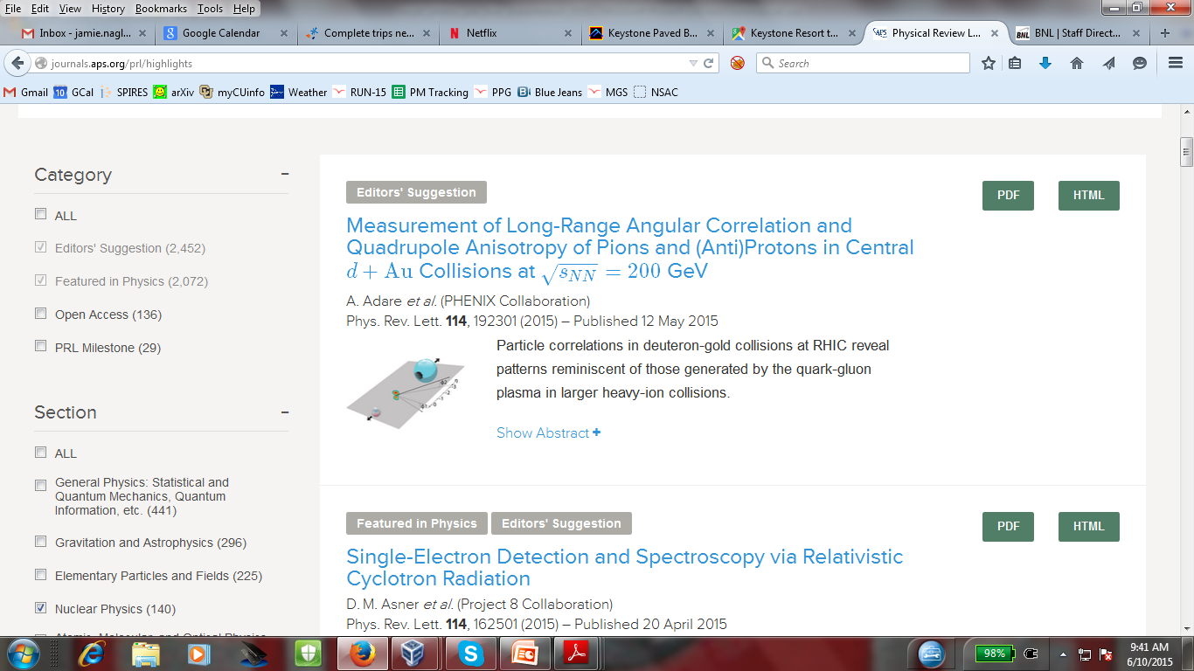
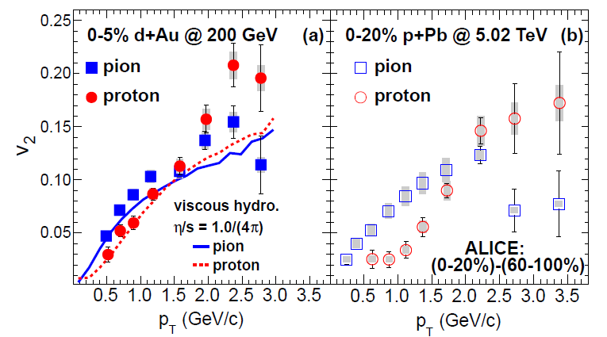
Definitive Confirmation of Long-Range Correlations in d+Au
http://journals.aps.org/prl/abstract/10.1103/PhysRevLett.114.192301
Compelling motivation for ³He+Au and p+Au running

Slide 6
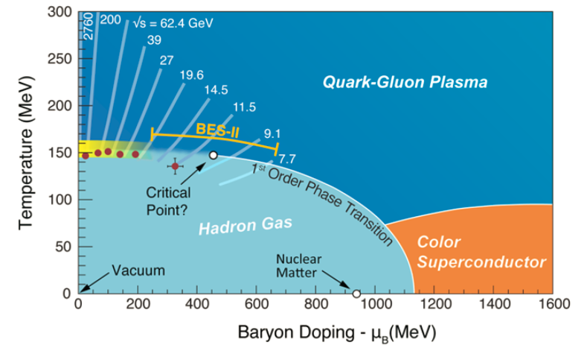
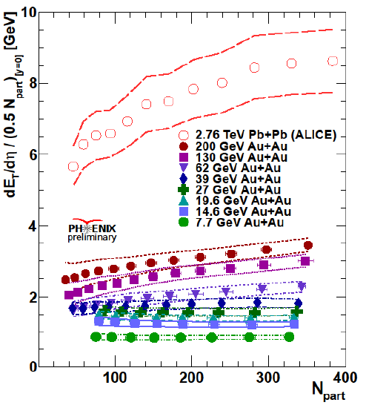
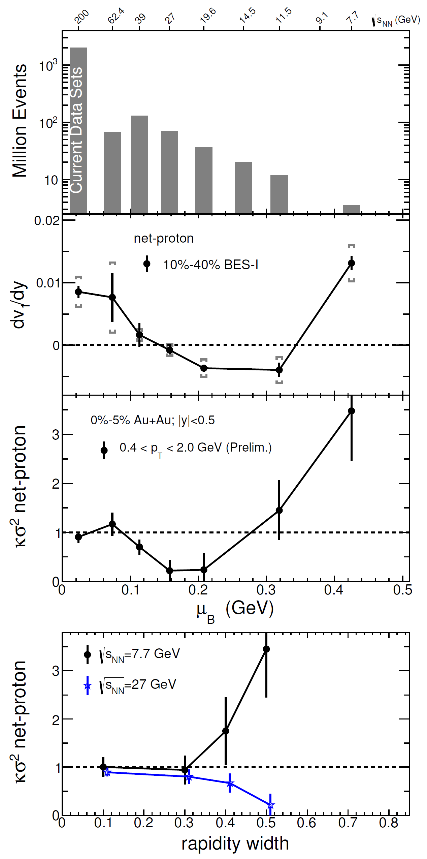
PHENIX Beam-Energy Scan Results
All data sets
fully reconstructed

Slide 7
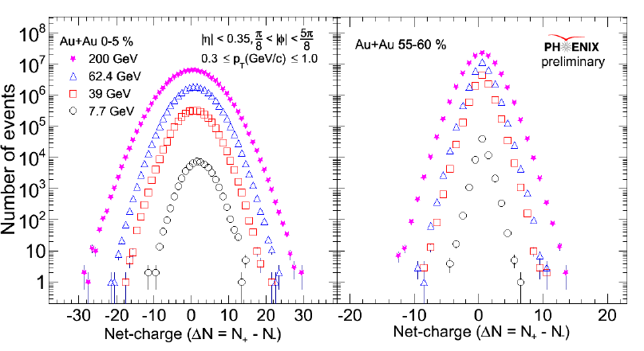
Charged Fluctuations
PHENIX manuscript with final results to be submitted
in the next 2-3 weeks!

Slide 8
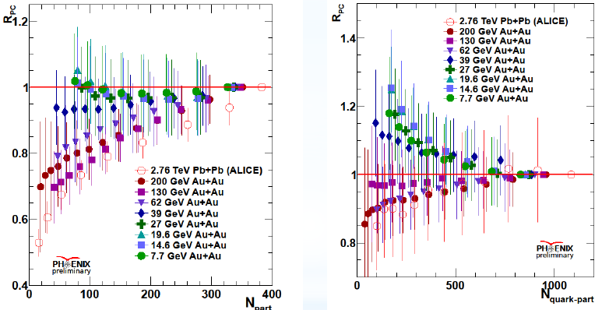
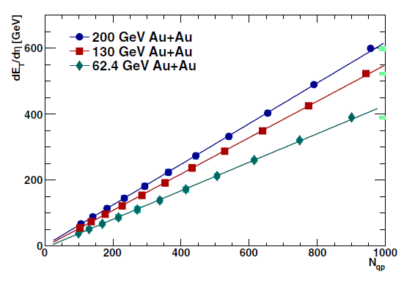
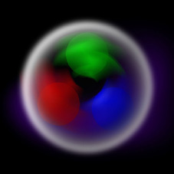
E_{T} and Constituent Quarks
http://journals.aps.org/prc/abstract/10.1103/PhysRevC.89.044905
Transverse energy production scales with the
number of constituent quark participants!
For E < 62 GeV, the scaling reverts to nucleon participants!

Slide 9
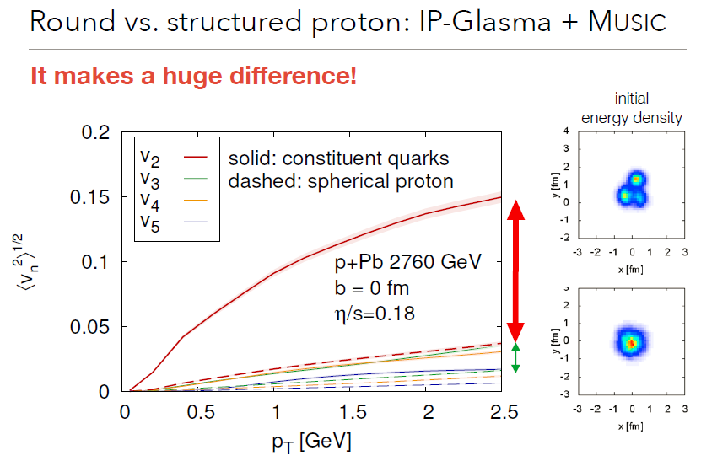
Connect to Small System Studies
Slide from Bjoern Schenke
Flow in p+A may depend on whether energy is deposited via a single nucleon participant or three constituent quarks

Slide 10
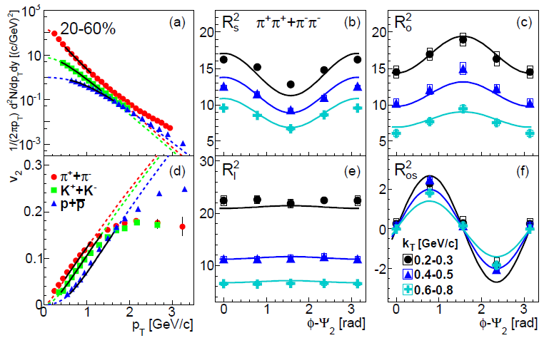
Au+Au @ 200 GeV Space-Time Constraint
Submitted http://arxiv.org/abs/1504.05168
Also, Kaon HBT results and with azimuthal dependencies…

Slide 11
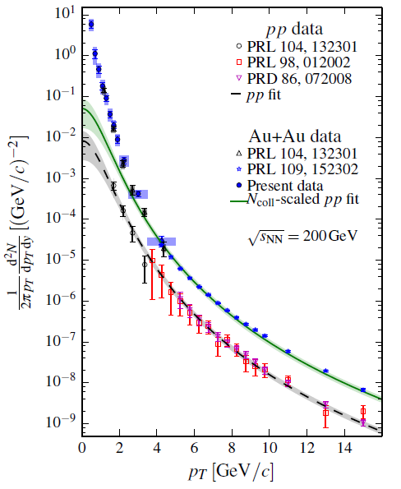
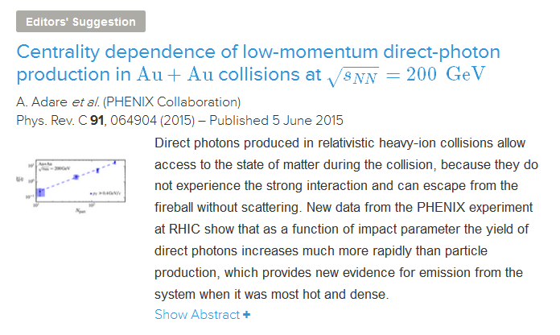
Au+Au @ 200 GeV Space-Time Thermal Constraint
http://dx.doi.org/10.1103/PhysRevC.91.064904

Slide 12
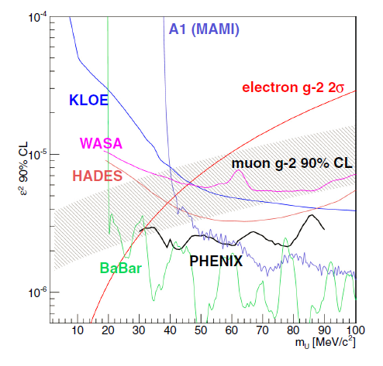
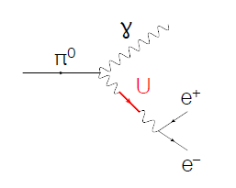
Real Photons, Virtual Photons, Dark Photons (?)
Muon g-2 experiment (E821) has 3.6σ
result beyond the Standard Model
One explanation is the dark photon –
Low mass, weak coupling
http://journals.aps.org/prc/abstract/10.1103/PhysRevC.91.031901

Slide 13
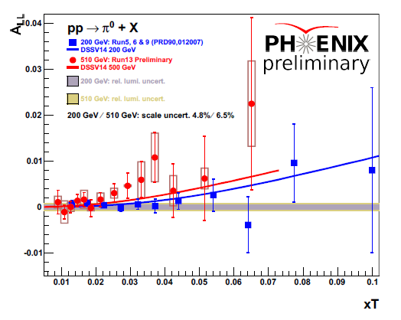
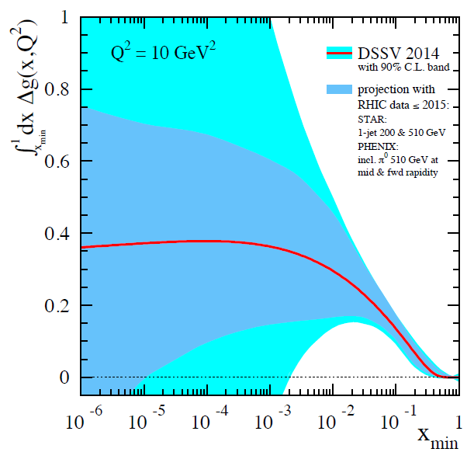
Gluon Spin Results
http://journals.aps.org/prd/abstract/10.1103/PhysRevD.90.012007 http://journals.aps.org/prd/abstract/10.1103/PhysRevD.91.032001
RHIC Spin Program White Paper
http://arxiv.org/abs/1501.01220
Publication of full p+p @ 200 GeV results
Moving quickly to finalize Run-13 p+p @ 510 GeV results

Slide 14
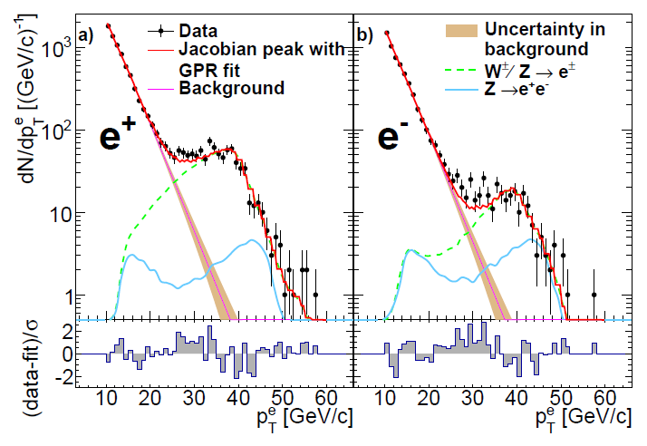
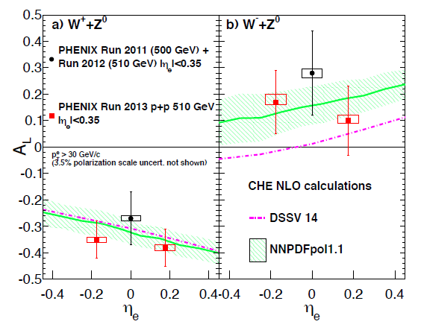
W Analysis Update
Final W→e results Run-11, 12, 13 submitted
Submitted http://arxiv.org/abs/1504.07451
Focused effort of forward W→μ results for final result

Slide 15
15 PHENIX Papers Published in Last 12 Months
Charged-pion cross sections and double-helicity asymmetries in polarized p+p collisions at s√=200 GeV
Phys.Rev. D91 (2015) 3, 032001
2. Search for dark photons from neutral meson decays in p+p and d + Au collisions at sNN−−−−√= 200 GeV
Phys.Rev. C91 (2015) 3, 031901
3. Cross section and transverse single-spin asymmetry of η mesons in p↑+p collisions at s√=200 GeV at forward rapidity
Phys.Rev. D90 (2014) 7, 072008
4. Low-mass vector-meson production at forward rapidity in p+p collisions at s√=200 GeV
Phys.Rev. D90 (2014) 5, 052002
5. Cross section for bb¯ production via dielectrons in d+Au collisions at sNN−−−√=200 GeV
Phys.Rev. C91 (2015) 1, 014907
6. Centrality dependence of low-momentum direct-photon production in Au+Au collisions at sNN−−−√=200 GeV
Phys.Rev. C91 (2015) 6, 064904
7. Measurement of K0S and K∗0 in p+p, d+Au, and Cu+Cu collisions at sNN−−−√=200 GeV
Phys.Rev. C90 (2014) 5, 054905
8. Heavy-quark production and elliptic flow in Au+Au collisions at sNN−−−√=62.4 GeV
Phys.Rev. C91 (2015) 4, 044907
9. Measurement of long-range angular correlation and quadrupole anisotropy of pions and (anti)protons in central d+Au collisions at sNN−−−√=200 GeV
Phys.Rev.Lett. 114 (2015) 192301
10. Measurement of Υ(1S+2S+3S) production in p+p and Au+Au collisions at sNN−−−√=200 GeV
Phys.Rev. C91 (2015) 2, 024913
11. Inclusive double-helicity asymmetries in neutral-pion and eta-meson production in p⃗ +p⃗ collisions at s√=200 GeV
Phys.Rev. D90 (2014) 1, 012007
12. Azimuthal-angle dependence of charged-pion-interferometry measurements with respect to second- and third-order event planes in Au+Au collisions at sNN−−−√=200 GeV
Phys.Rev.Lett. 112 (2014) 22, 222301
13. Transverse-energy distributions at midrapidity in p+p , d+Au , and Au+Au collisions at sNN−−−−√=62.4–200 GeV and implications for particle-production models
Phys.Rev. C89 (2014) 4, 044905
14. Measurement of transverse-single-spin asymmetries for midrapidity and forward-rapidity production of hadrons in polarized p+p collisions at s√=200 and 62.4 GeV
Phys.Rev. D90 (2014) 1, 012006
15. System-size dependence of open-heavy-flavor production in nucleus-nucleus collisions at sNN−−−√=200 GeV
Phys.Rev. C90 (2014) 3, 034903

Slide 16
Run-14 Au+Au and ³He+Au @ 200 GeV
data taking report

Slide 17
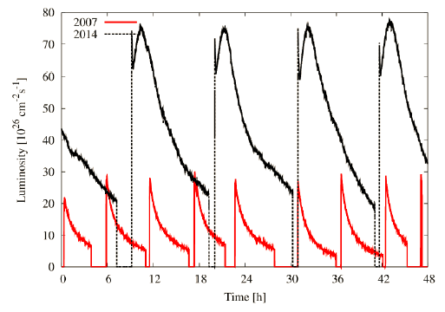
Recall Run-14 Fantastic RHIC Performance!

Slide 18
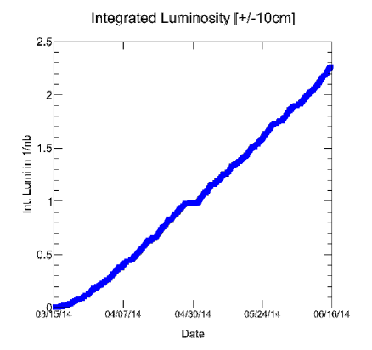
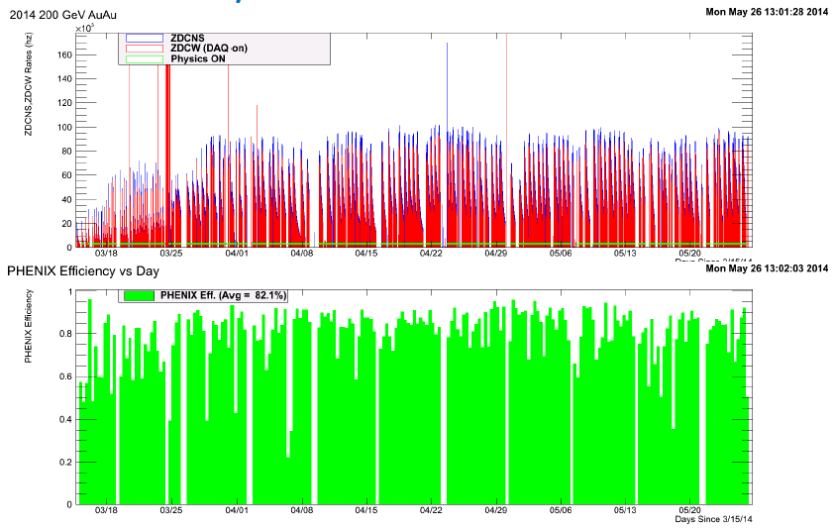
Au+Au @ 200 GeV Goals Exceeded!
Our goal was 1.5 nb⁻¹
within |z|< 10 cm.
Recorded 2.3 nb⁻¹
(over 14 billion events)
within |z|<10 cm.
Exceeded goal by 55% !!!
Note we recorded 85% of all collisions that took place within |z|<10 cm.
PHENIX uptime

Slide 19
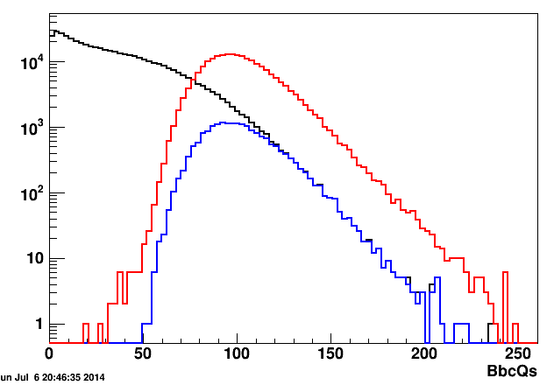
At the time of the 2014 PAC meeting, the Au+Au success led PHENIX to propose switching to a short ³He+Au run
PAC endorsed; ALD made it so…
0-5% Central 3He+Au
PHENIX BBC Charge (Au-going)
1.6 billion events within |z|<10 cm recorded.
Central trigger gave x7 statistics enhancement;
essentially recorded every single central event!

Slide 20
Geometric Motivation
Figure from Bjoern Schenke

Slide 21
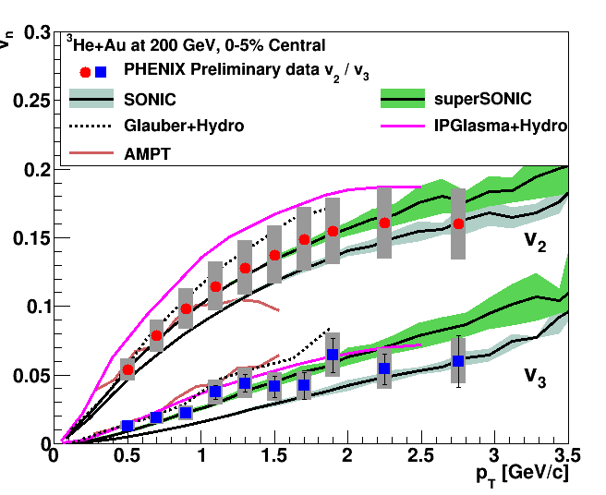
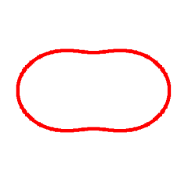
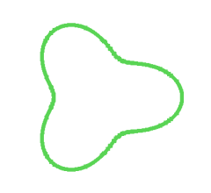
PHENIX Preliminary Result
Final result to be submitted in next 2-3 weeks!

Slide 22
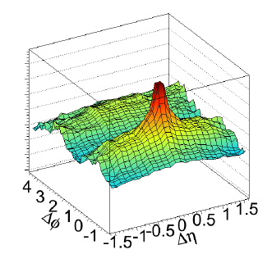
³He+Au Central two-particle long range correlations
(as seen by PHENIX VTX only tracks)

Slide 23
Run-15 p+p, p+Au, p+Al
data taking report

Slide 24
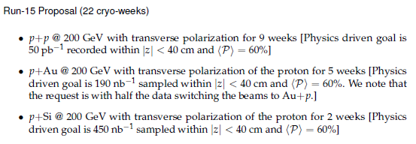
Recall the PHENIX Run-15 Request
* It was decided to run p+Au the entire 5 weeks and
not reverse the beams to Au+p.
* C-AD suggested Al instead of Si where they projected a 30% higher beam intensity.

Slide 25
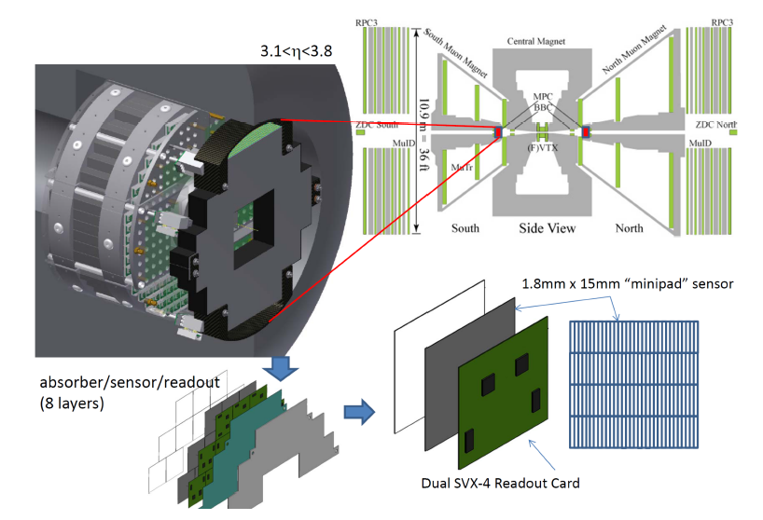
MPC-EX Upgrade
The PHENIX MPC Crystal Calorimeter (|η|=3.1-3.8) has played a critical role in our forward (low-x) and transverse spin physics program
MPC-EX upgrade adds novel silicon tracking / preshower detector to enable direct photon identification and π⁰→γγ to higher momentum
Full detector available for physics in Run-15
Note two detectors
(north and south)
In p+p doubles statistics.
In p+A, covers
low-x and high-x

Slide 26
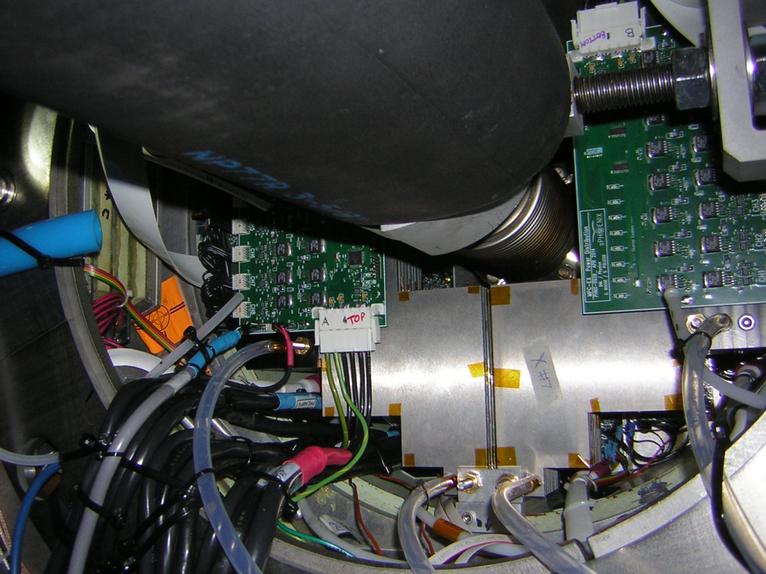
MPC-EX Section in Situ
Beam pipe

Slide 27
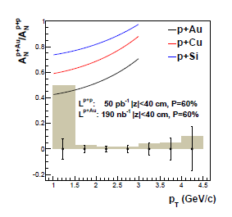
p+Au with transversely polarized proton
New theory developments… Transverse polarization A_{N} in p+A scales with the saturation scale for p_{T} < Q_{s}
Completely unique RHIC access to saturation physics
p+Au measurement with projected uncertainties in
190 nb⁻¹ |z|<40cm
Testing geometric scaling with Al target nuclei
Comparable uncertainties with 2 week runs

Slide 28
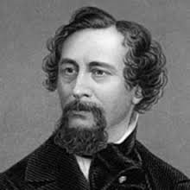

“It was the best of times, it was the worst of times…”
- Charles Dickens: A Tale Of Two Cities (1859)
“Yes IT WAS…”
- Doug Fields: PHENIX Run Coordinator (2015)

Slide 29
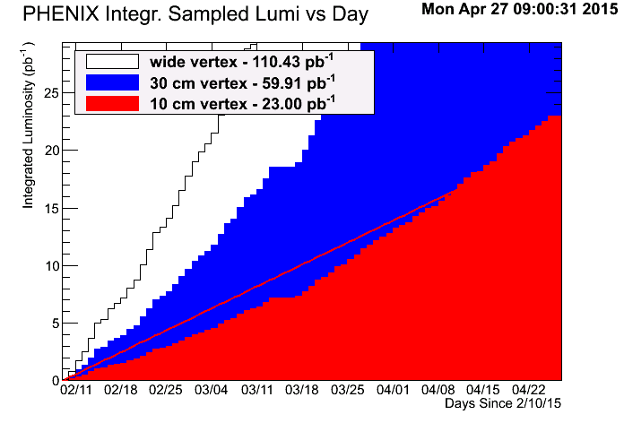
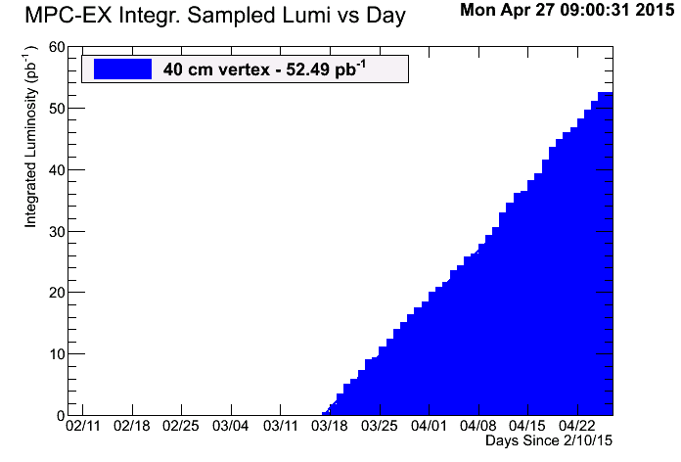
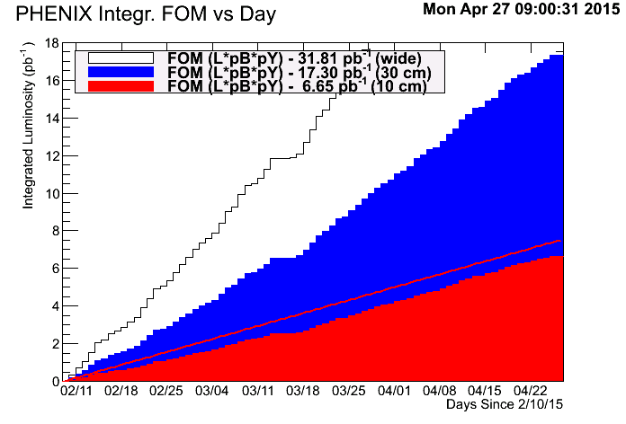
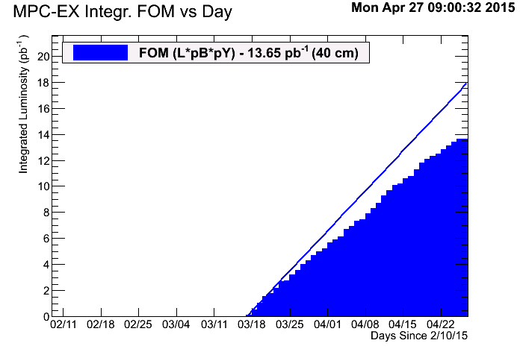
p+p @ 200 GeV – “best of times”
Luminosity
FoM

Slide 30
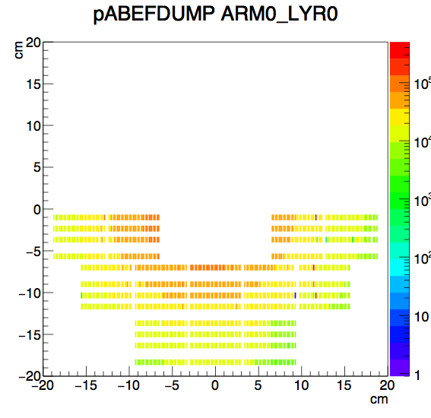
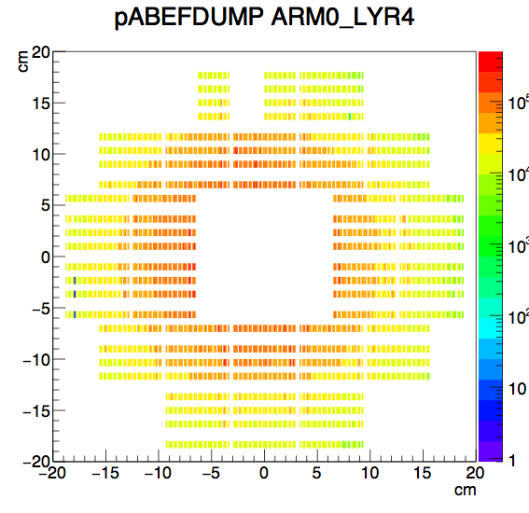
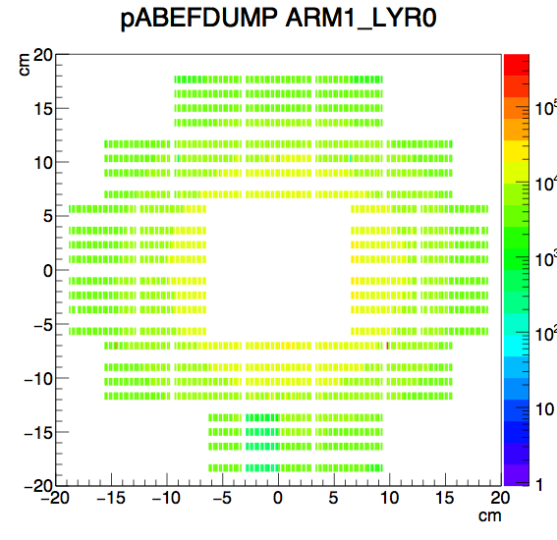
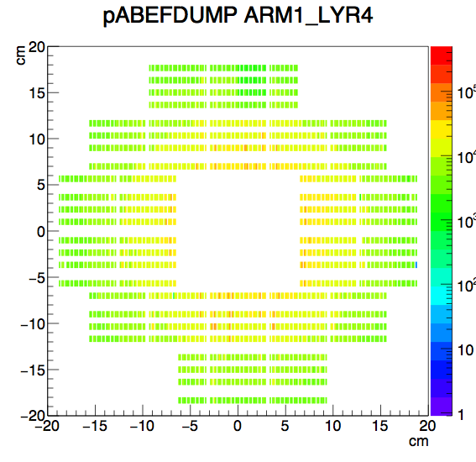
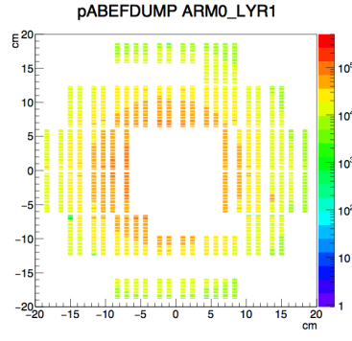
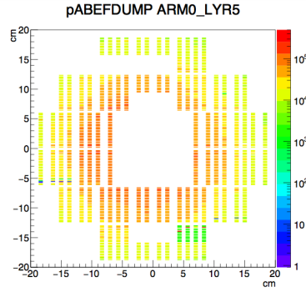
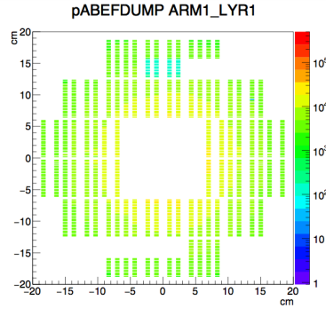
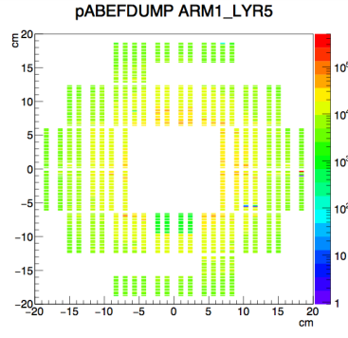
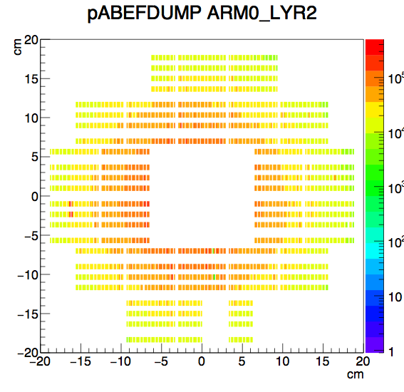
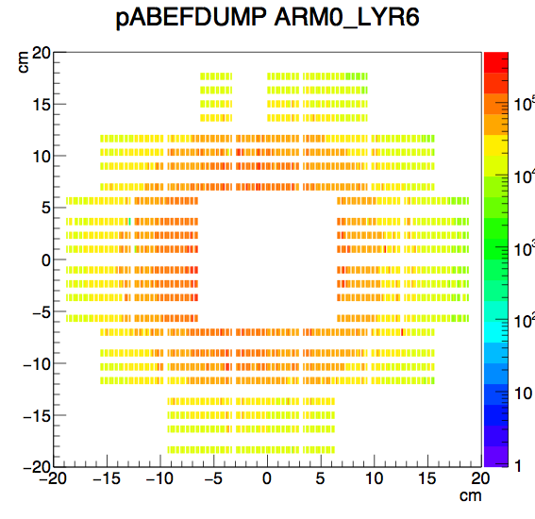

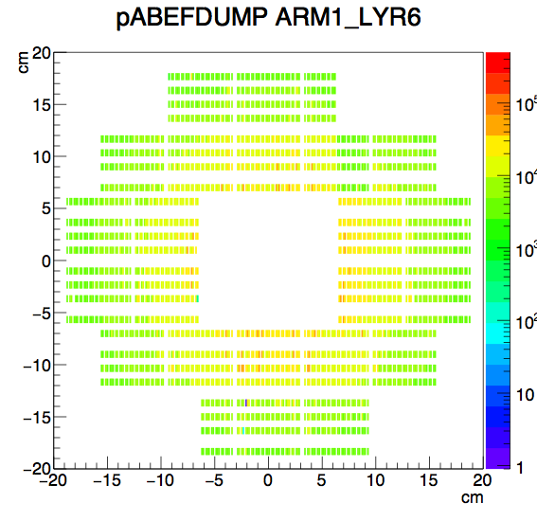




MPC-EX
South: Au going direction
North: p going direction
Si minipad channels calibrated using MIP peak:
Plots on left and right show relative density of MIP hits by arm/layer.
First steps towards full calibration and shower reconstruction.

Slide 31
Slide from Wei Le, Rice University
Strongly encouraged by PAC last year to look for this effect at RHIC – we strongly agreed.
Only one experiment has observed this effect in p+p.

Slide 32
FVTX Multiplicity Trigger
Online Coarse Track
~ 3/4 active wedges
Trigger : #track > Threshold

Slide 33

FVTX Multiplicity Trigger
Alignment of silicon detectors (VTX and FVTX) is complete and data production is underway.
We are very excited to look at this dataset.

Slide 34

Start of p+Au running….
First week was very good. Rapid switchover, declaration of physics by C-AD, good luminosity.
Then abort kicker-prefire event May 11, 2015
House of PHENIX

Slide 35








Store
19050
May 11
Damaged South
Impacted North
19116/18
May 28
We got lucky
No addt’l damage
19134
June 1
The end of the
MPC in Run 15
MPC-EX South (high-x Au)
MPC-EX North (low-x Au)

Slide 36

Silicon VTX Damage too
Consistent with a hit in the upper-east quadrant
Reminder on VTX layering and indexing
B0, B1 (pixels) and B2, B3 (stripixels)

Slide 37


Slide 38




What does it all mean?
Luminosity
FoM
PHENIX p+Au goals met… except for MPC-EX (high-x) program

Slide 39


p+Au and Centrality Trigger
Huge central statistics enhancement

Slide 40
What does it all mean- part 2?
MPC is likely repairable for Run-16
VTX is a very different story… (unclear)
Strong implications for HF program in Au+Au @ 200 GeV,
and less so for HF program at 62 GeV (lower occupancy)
ALD has requested that PHENIX, together with
Jamie Dunlop, should set up a special task force including
appropriate members of C-AD to develop a plan for repairing the damaged detector systems before Run 16 and optimal protection of the detector during the run.

Slide 41

Current p+Al Running
PHENIX management has painfully decided to turn off the silicon detector (VTX).
We simply cannot assess the full risk to the detectors with important implications for Run-16.
This is a bitter pill for the collaboration since we strongly pushed this proposal last year to the PAC.

Slide 42


We are still taking p+Al data, with a diminished program, and working hard to ensure some key measurements.

Slide 43
Run-16
Beam Use Request

Slide 44


What did the PAC (you) say last year?
http://www.bnl.gov/npp/docs/pac0614/Overall%20recommendations%20final.pdf

Slide 45

PHENIX Proposal for Run-16
We present a plan assuming 10 week so Au+Au @ 200 GeV
The optimum for PHENIX is to run Option A and Option B both

Slide 46

Run-16 Au+Au @ 200 GeV [Default?]
No new PHENIX detector capabilities
Run-14 was so successful, hard to beat
Most likely scenario, we record
1.8 nb⁻¹ (compared with our 2.3 nb⁻¹ from Run-14)
Also, serious concern about VTX status (i.e. Run-15 damage) and thus high-occupancy efficiency

Slide 47
Option A
62 GeV Program

Slide 48

Why 62 GeV?
Heavy Flavor electrons enhanced (not suppressed)
in Au+Au collisions at 62 GeV !
Published http://journals.aps.org/prc/abstract/10.1103/PhysRevC.91.044907

Slide 49

Strange Heavy Quark Trends
Nuclear modification factor uncertainties dominated by lack of p+p RHIC reference
Quenching theory predicts suppression
What about charm flow?
Elliptic flow,
Uncertainties are too large

Slide 50

Published http://journals.aps.org/prc/abstract/10.1103/PhysRevC.91.044907

Slide 51


Projections with PHENIX Silicon Detectors
Published
Projected

Slide 52

Heavy-Flavor Flow (?) at 62 GeV
Key information on whether enhancement is
initial state or from final state flow

Slide 53

p+p @ 62 GeV
Existing ISR data
Provides critical baseline for heavy flavor measurements
Significant cancellation of systematics in R_{AA}

Slide 54
Polarized p+p @ 62 GeV (LT)
Non-zero A_{LT} in Semi-Inclusive DIS
Huang, et. al. PRL. 108, 052001 (2012)
Non-zero A_{LT} in Inclusive Hadron Production
with a lepton probe
Also HERMES on proton target, arXiv:1107.4227
arXiv:1502.0139
A non-zero A_{LT} in p+p has never been observed
A non-zero A_{LT} provides strong motivations for future measurements at RHIC in inclusive hadron, jet, and prompt photon channels, and stimulate further theoretical developments.

Slide 55


Slide 56
Option B
Small System Beam Energy Scan

Slide 57
Smallest QGP Droplet? Turn Effects Off?
Data sets in hand to explore range of geometries
(1, 2, 3 hot spots)
How much energy is required to observe such collective behavior?
Interesting connection to how the energy is deposited too…
Recall these pictures are for N_{cq} constituent quarks giving three small hot spots, and the PHENIX data indicating the N_{cq} scaling breaks < 39 GeV

Slide 58
The “Wiggler”
Coherent electron Cooling (CeC) test is key for EIC
The Coherent electron Cooling Proof-of-Principle project was planning to install the electron beam line including the undulator in IP2 this summer for first beam tests during RHIC Run-15. We are also planning to run pA during Run-15 and this asymmetric configuration limits the available aperture in the undulator.
We are now proposing to set up the electron beam line parallel to the RHIC IR but separate from RHIC to avoid this potential interference. All the tests on the electron beam can still be completed. During the summer of 2015 the undulator section would then be moved parallel to itself into the RHIC beam for the full cooling tests during Run-16. For this to work we would need your agreement to schedule only symmetric RHIC beam configurations during Run-16.
Thus we have not proposed any
p+A or ³He+A running in Run-16.
Thus, we propose a d+Au Beam Energy Scan
(see later slides on p+A)

Slide 59


What does Hydro + Hadronic Cascade Predict?
Calculation from superSONIC (Paul Romatschke) –http://arxiv.org/abs/1502.04745

Slide 60
What does Hydro + Hadronic Cascade Predict?

Slide 61

What does AMPT Predict?
20
39
200
62

Slide 62

Measurement Projections

Slide 63
sPHENIX || PHENIX Run-17

Slide 64

Brookhaven Lab Timeline (a few months ago)
Plan to remove PHENIX after
Run-16 for installation of sPHENIX

Slide 65

Brookhaven Lab Timeline (now)
Plan to remove PHENIX after
Run-16 for installation of sPHENIX

Slide 66

DOE Science Review Success
sPHENIX Proposal http://arxiv.org/abs/1501.06197

Slide 67


BaBar Magnet arrives at BNL

Slide 68

Full Steam Ahead

Slide 69
sPHENIX || PHENIX Run-17
The Collaboration and the Laboratory have made a physics prioritized choice,
noting that this results in
Physics left on the floor….

Slide 70
Polarized p+A in Run-16
If the physics were optimized around PHENIX alone, we
would replace Option B (d+Au Beam Energy Scan) with
Polarized p+Au Beam Energy Scan!
This would only be possible
without “wiggler” installation
AND
with a resolution of the p+A abort kicker pre-fire issue (e.g. moving the abort kicker, which most likely needs to be done before sPHENIX as well)

Slide 71

Example – Probing Gluon Saturation Scale
With lower energy polarized p+A

Slide 72
PHENIX BUP Summary
Outstanding C-AD delivered performance in Run-14
Very good data set in Run-15 p+p and p+Au
Lost p+Au high-x MPC-EX physics
Lost most all p+Al physics
Exciting physics program for Run-16
There is significant physics left on the floor…
Bright future with sPHENIX on the horizon

Slide 73
EXTRAS

Slide 74

Polarized p+p @ 62 GeV
One option is to run with longitudinal polarization
Some reduction in uncertainties over previous running
Potentially more interesting to run something completely new
(see next slide)

Slide 75

p + A Flow Test
Glauber + Hydro prediction, factor of two smaller v₂ in p+Au
http://journals.aps.org/prl/abstract/10.1103/PhysRevLett.113.112301

Slide 76


Polarized p+p @ 500 GeV
p+p @ 500 GeV Longitudinal
p+p @ 500 GeV Transverse
Increased precision for forward rapidity
W→μ
Time for additional absorber to further rejection backgrounds
Possible Low-mass DY measurement with sufficient significance
Lots of debate about meaning of low-mass DY at higher p_{T} (where better S/B)

Slide 77

HBT Data – Implications on Equation-of-State
Submitted http://arxiv.org/abs/1410.2559

Slide 78

Au+Au @ 200 GeV Space-Time Thermal Constraint
Thermal photon v₂ and v₃ to be submitted soon
Analysis of photon yields in Au+Au @ 62 GeV underway

Slide 79


Slide 80


http://www.sciencedirect.com/science/article/pii/S0370269315004128

Slide 81


Photons via Conversion Electron Pairs
As in our Au+Au @ 200 GeV analysis, we can measure direct photons via conversion electron pairs in the VTX
Measurement of direct photon yield and possible v₂ and v₃ with early time closer to T_{c} is
very exciting
Applying proven techniques and utilizing energy flexibility
of RHIC machine
(w/ stochastic cooling benefits too)
Au+Au @200 GeV data
Peripheral
Total
PhiV<0.1
PhiV>0.6
Mee(GeV/c2)
Minimum Bias
Mee(GeV/c2)

Slide 82


https://www.bnl.gov/isd/documents/86352.pdf

Slide 83


Constraining Gluon nPDFs
Strong indications of low-x shadowing/saturation physics with d+Au J/ψ, e-μ correlations, h-h correlations, single muons, electrons, …
And yet, all have final state interactions.
Golden channel direct photon
MPC-EX Direct Photon
Gluon nPDF
Au Nucleus
Using full statistical / systematic constraint method on EPS09 nPDFs, blue bands indicate projected measurement (1, 2 σ level)

Slide 84


Slide 85

Geometry Control
p+Au
d+Au
He3+Au
Comparison of different geometries provides key tests of underlying physics (initial conditions, equilibration time, medium properties, etc.)

Slide 86




Slide 87



PHENIX Forward Silicon (FVTX)
DCA Analysis looks good
Detector meeting resolution specifications
arXiv:1311.3594 (accepted NIM)
South Reconstructed Coords Per Station
FVTX Run-14
Live > 95%
Internal alignment
within 4 μm
North Reconstructed Coords Per Station

Slide 88



PHENIX Barrel Silicon (VTX)
Run-14
Repairs successful
Pixel Live > 80%, Very Stable
Strip-pixel > 85%
DCA Resolution from Run-14 alignment exceeds
100 μm specification
Full VTX / FVTX alignment with MILLEPEDE complete
Run-14 Au+Au
Distance Closest Approach 2D
σ=86μm

Slide 89


Charm may be balance of flow and energy loss…
Significantly different energy loss
(different density)

Slide 90




QGP Strongest coupling near T_{c}
Slide from Ralf Rapp at QM14
Enhanced Photon Rates in Hydro
Paper….
upscale photon rates by factor of 2, up to 3 for T_{pc} ± 30MeV
RHIC LHC
getting close(r) to the data (more so with fireball)

Slide 91



http://journals.aps.org/prc/abstract/10.1103/PhysRevC.91.024904

Slide 92

sPHENIX Proposal http://arxiv.org/abs/1501.06197

