Slide 1


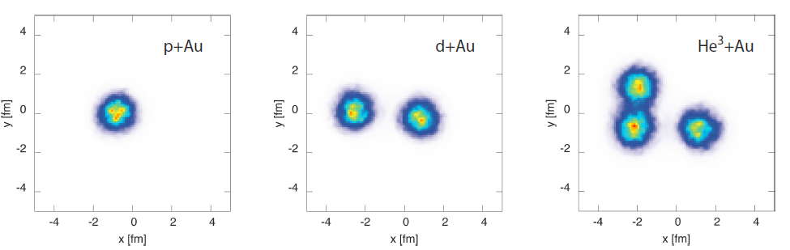
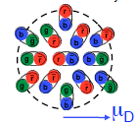
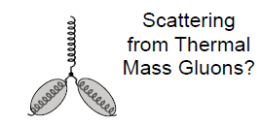
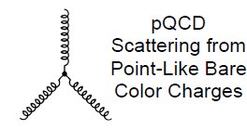
Must do physics in hot QCD:
Probing the QGP across length scales…
x1/10
x2
x5
x100
Jamie Nagle, University of Colorado
Lawrence Berkeley National Laboratory
Heavy Ion Tea Seminar
February 03, 2015

Slide 2
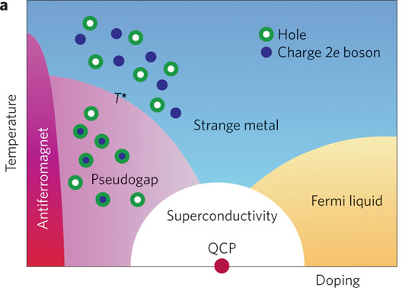
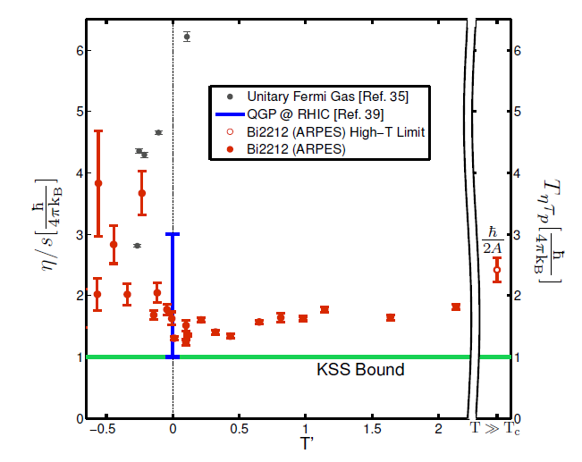
Exciting emergent phenomena
Must do, explore as function of Temperature, Doping
Must do, probe at different length scales
Key challenge for emergence of quasiparticle picture
Gravity/Gauge tools for strongly correlated system
Experiment and theory picture need convergence
(High T_{c} Superconductivity)
http://arxiv.org/abs/1409.5820
Notes:
For example, it's been almost 20 years since high-temperature superconductors were discovered and there still is no consensus on what's carrying the current in them.
studies the interaction between infrared light and matter in magnetic fields to examine novel effects in these materials and to probe their dynamic properties as a function of wavelength.
ARPES techniques, get eta/s figure → recent…

Slide 3
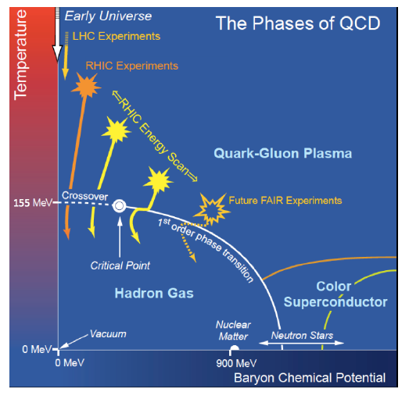
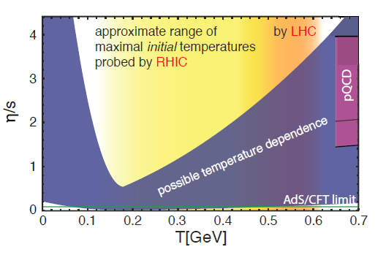
Exciting emergent phenomena
Must do, explore as function of Temperature, Doping
Must do, probe at different length scales
Key challenge for emergence of quasiparticle picture
Gravity/Gauge tools for strongly correlated system
Experiment and theory picture need convergence
(perfect fluidity of QGP)
(μ_{B})
(Jets, Upsilons)
STAR BES II
baryon doping
sPHENIX microscope probing with key resolving power

Slide 4

Emergent Phenomena
Connection from the QCD Lagrangian to
phenomena of confinement and asymptotic
freedom was fundamental
Connection from QCD to the emergent phenomena of near perfect fluidity of the Quark-Gluon Plasma near the phase transformation is just as fundamental
Pinning down the fluid perfection (η/s) tells us the nature of the QGP,
while leaving open the “how” and “why” questions

Slide 5
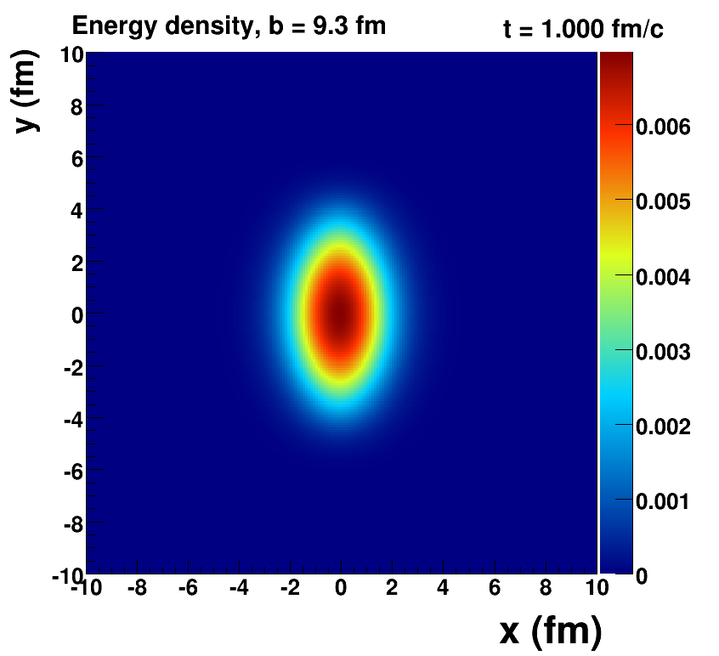
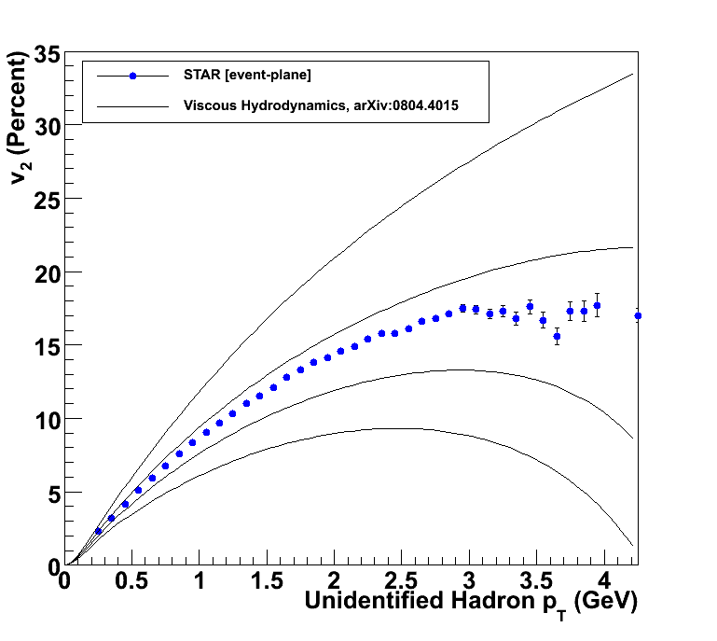
Early Discoveries
Luzum, Romatschke, Phys. Rev. C78, 034915 (2008)
η/s ~ 0
η/s = 1/4π
η/s = 2 x 1/4π
η/s = 3 x 1/4π
Near Perfect Fluid nature of Quark-Gluon Plasma

Slide 6
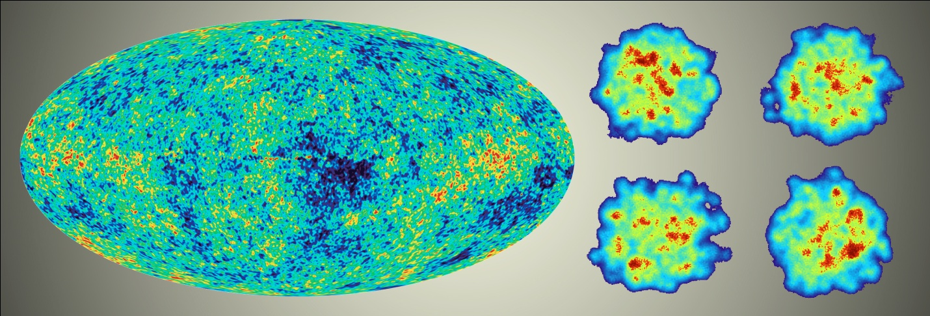
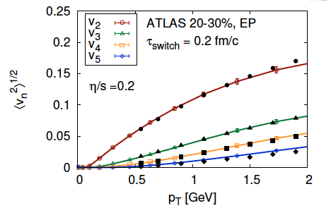
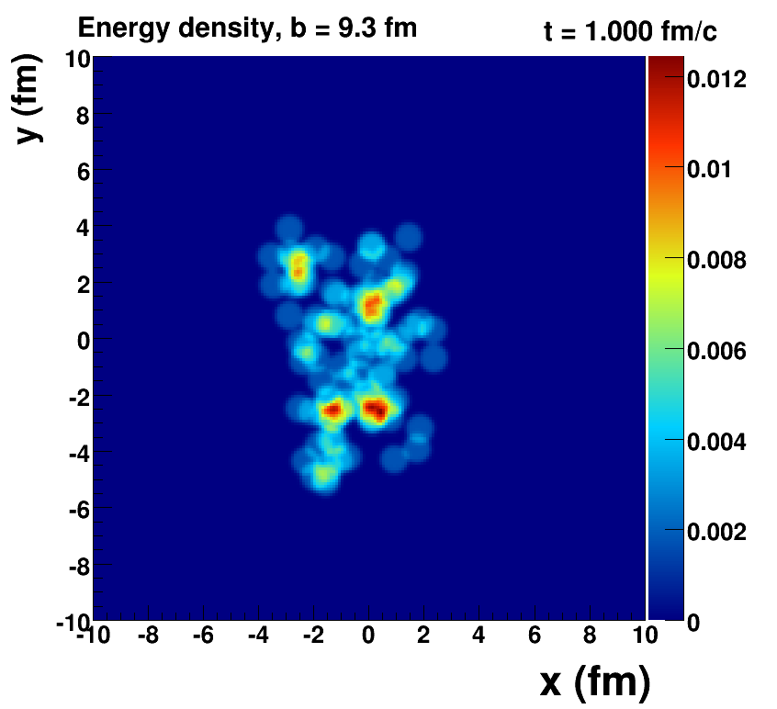
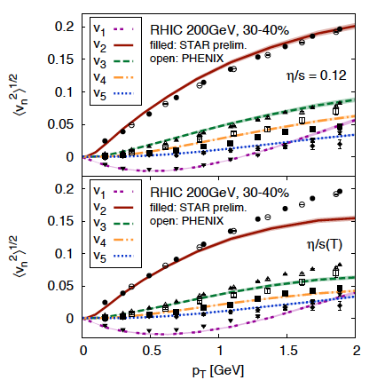
Enormous Progress
Quantum Fluctuations
Survive Evolution!
Calculation from Bjoern Schenke

Slide 7
“Little Bang” Model
Discovery: Quark Gluon Plasma = Near Perfect Fluid
Standard Model with Hydrodynamic Evolution
Precision: Predictions of Flow Patterns
but…
How does it equilibrate so quickly?
What are the degrees of freedom or quasiparticles?

Slide 8
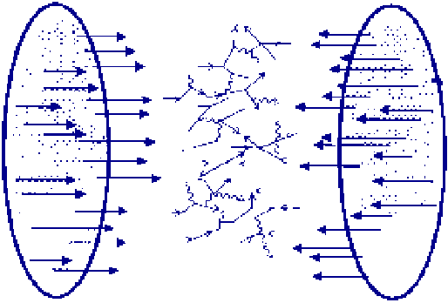
Back to Discovery (?)
A+A
Enough particles to equilibrate, QGP, collective motion
p+A
Not enough particles to equilibrate, control experiment

Slide 9
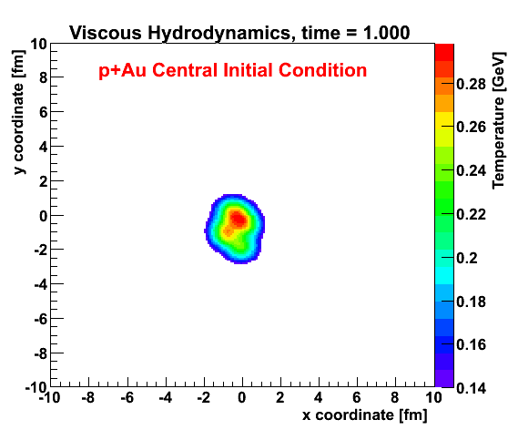
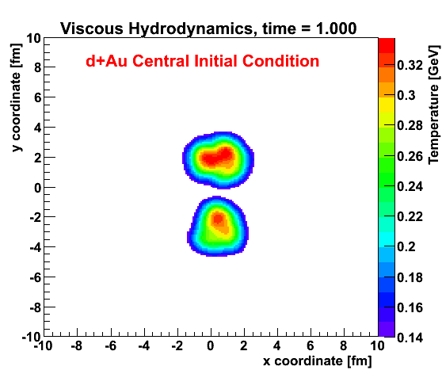
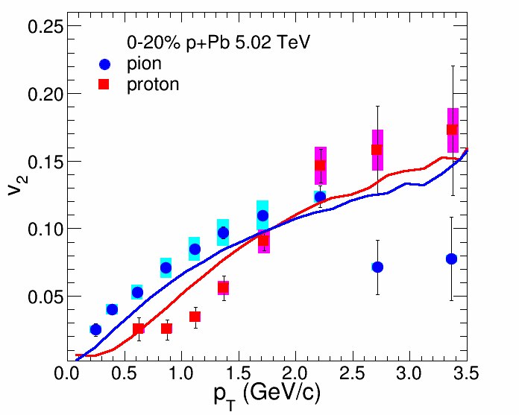
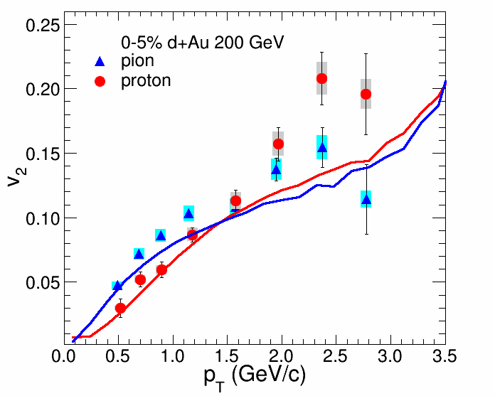
Viscous Hydrodynamics + Cascade
Similar Flow Fingerprint?
Small QGP?
ALICE Experiment
p+Pb @ LHC
PHENIX
d+Au @ RHIC

Slide 10
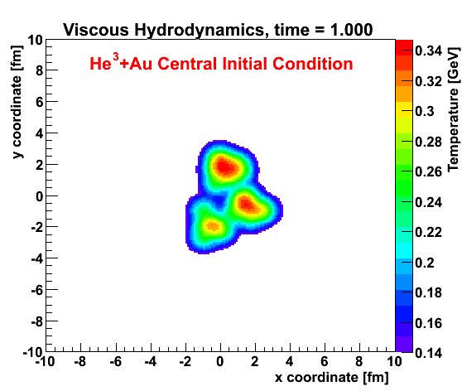
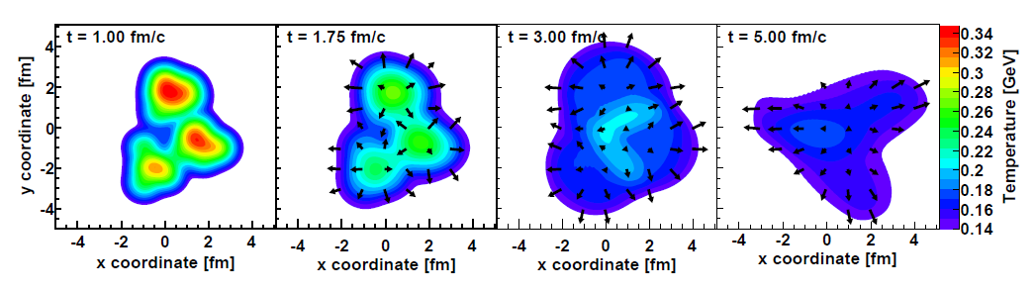
Geometry Engineering
Proposal to run “triangular” system
at RHIC
Small systems challenge our picture of required time and size scales
http://arxiv.org/abs/arXiv:1312.4565

Slide 11
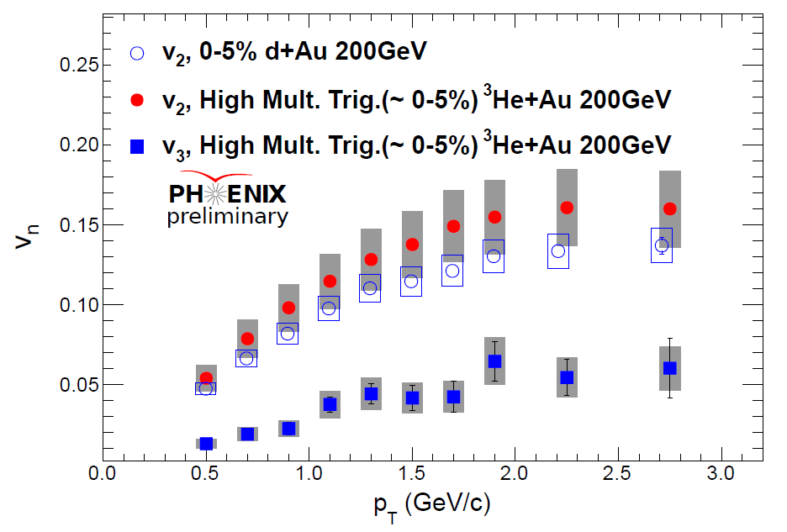
Glauber IC + Hydro (η/s=1/4π) + Hadronic Cascade (PRL 2014)
Dashed Lines – adding pre-flow (Paul Romatschke IS2014)

Slide 12
IP Glasma + MUSIC (η/s = 1.5 x 1/4π)
Schenke, Venugopalan: arXiv:1407.7557

Slide 13
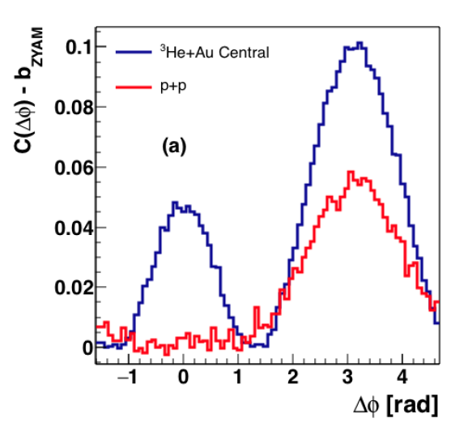
AMPT σ=1.5 mb
AMPT results [Javier Orjuela-Koop et al., arXiv:1501.06880]

Slide 14

Would you like one, two, or three QGPs with your tea?
Surely your joking!

Slide 15
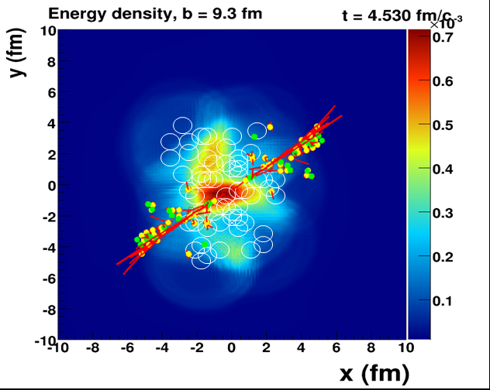

Answering the Why and How?
When does the strongly coupled bulk (lower momentum IR)
transition to a weakly coupled probe (higher momentum UV)?

Slide 16
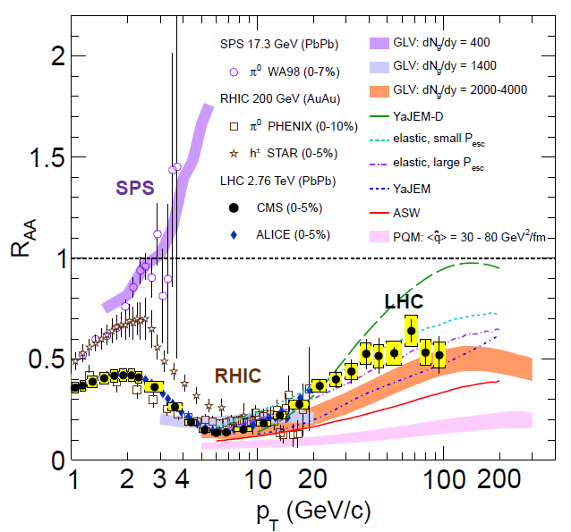
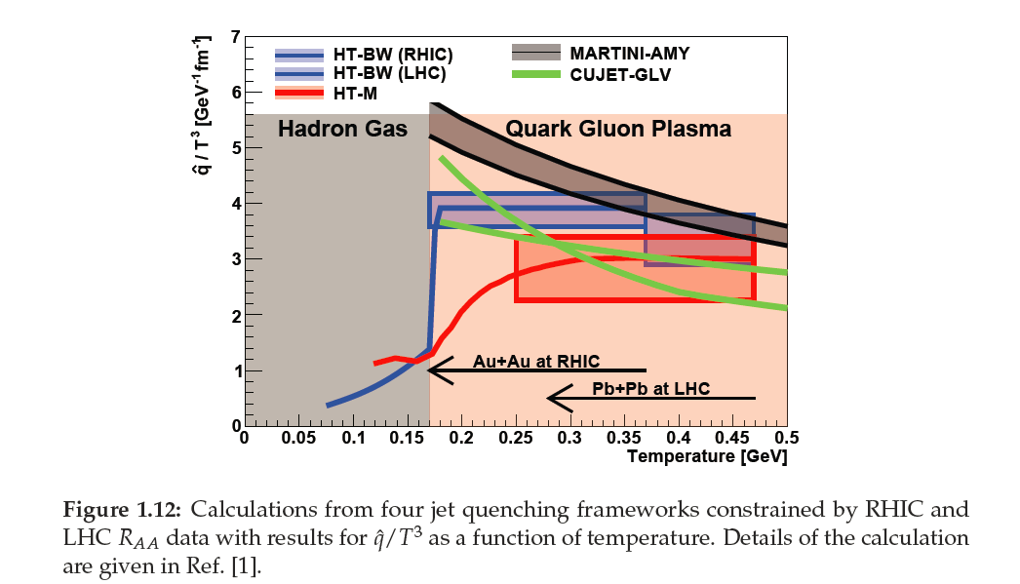
Jets Interact with the Medium
Theory is
under-constrained.
Different underlying physics for
rise at high p_{T}.

Slide 17
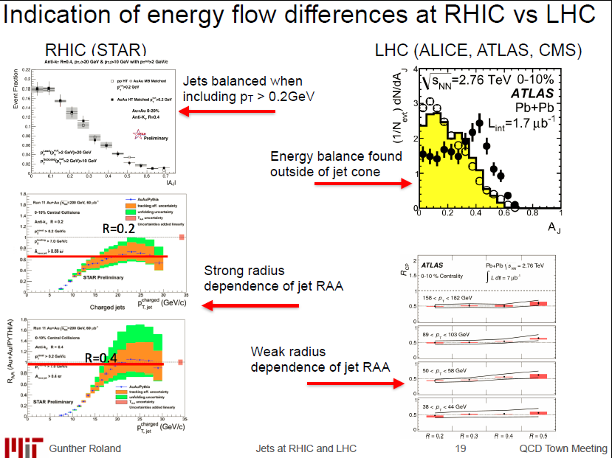
Reconstructed Jet data – intriguing…

Slide 18
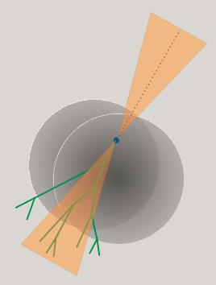
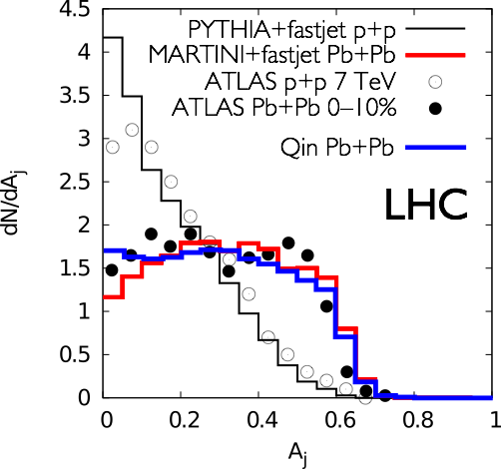
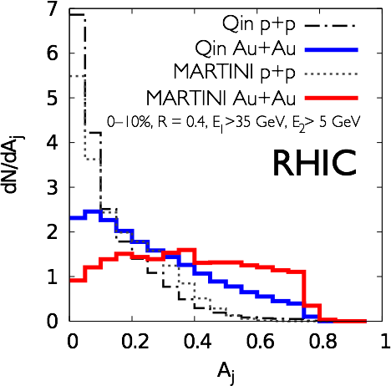
RHIC and LHC Leverage

Slide 19
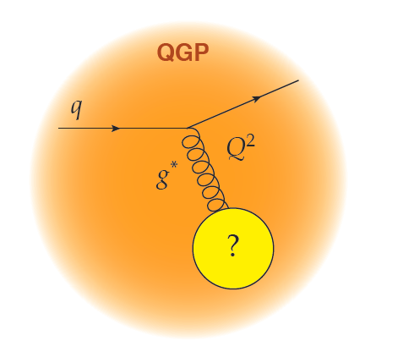
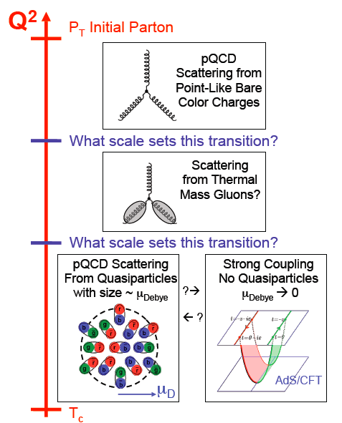
Probing different length scales
Do the highest energy
jets at LHC see
point-like color charges?
1/λ
What sets this scale?
  the exchange gluon momentum?
  total coherent energy loss?
  impact of deconfinement?
Do the lowest energy jets at RHIC scatter from coherent fields or only excite sound waves?

Slide 20
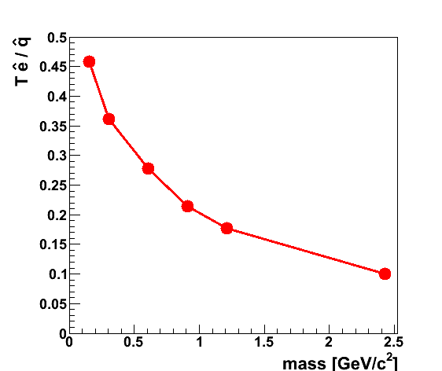
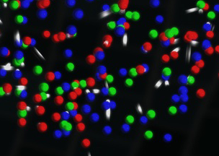
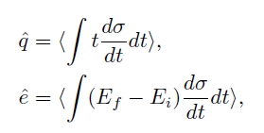
QGP Constituent Mass Dependence
qhat → scattering of leading parton → radiation e-loss
ehat → energy transferred to the QGP medium
C.E. Coleman-Smith, B. Muller: http://arxiv.org/abs/arXiv:1209.3328
Jet E_{T} = 30 GeV
T = 350 MeV
α_{s} = 0.3
Limit of infinitely massive scattering centers yields all radiative e-loss.
Medium parton

Slide 21
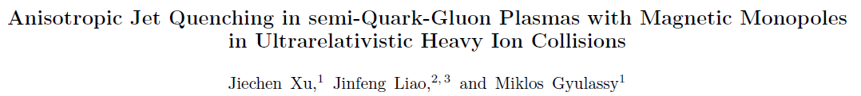
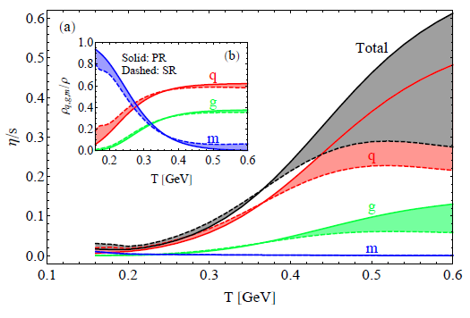
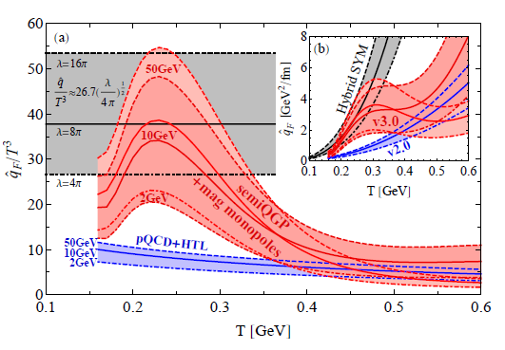
Deeper Connections

Slide 22
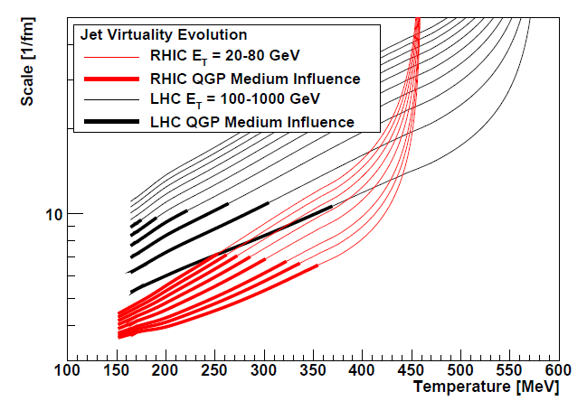
Bare Color
Charges
Thermal Mass
Gluons
Color
Magnetic
Monopoles?
Most Perfect Fluid

Slide 23
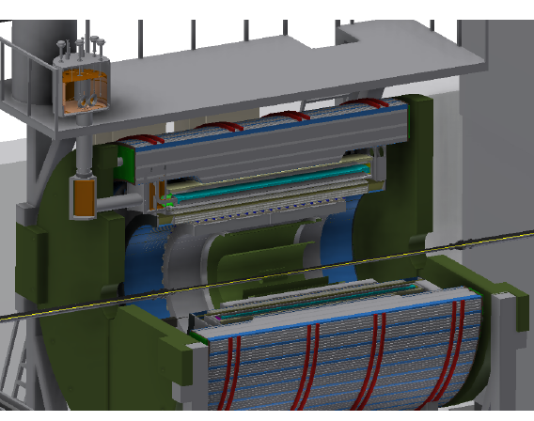

A New Detector at RHIC
BaBar Magnet 1.5 T
Coverage |η| < 1.1
All silicon tracking
Heavy flavor tagging
Electromagnetic
Calorimeter
Two longitudinal
Segment Hadronic Calorimeter
High data acquisition rate capability, 15 kHz
http://arxiv.org/abs/1501.06197

Slide 24
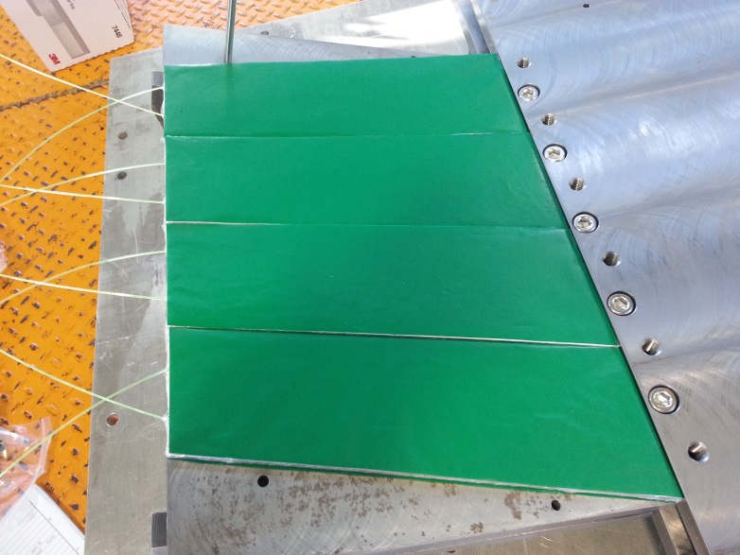
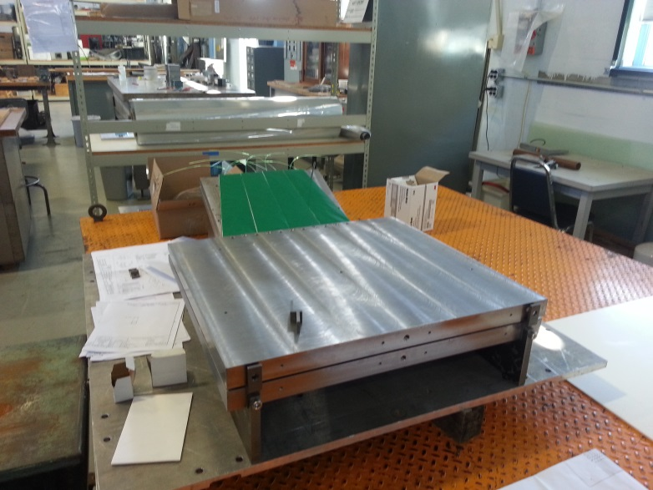
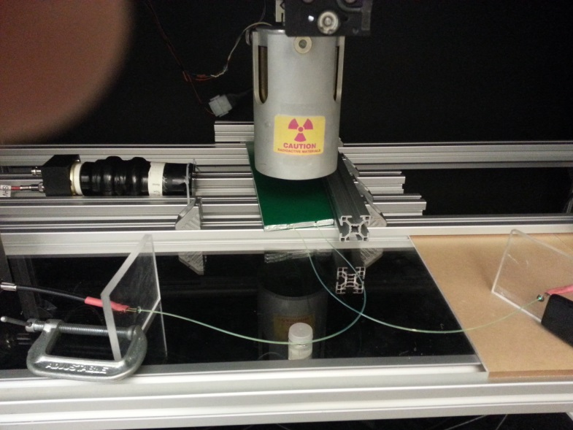
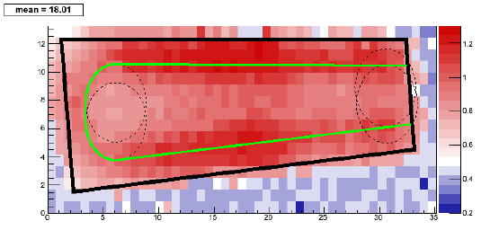
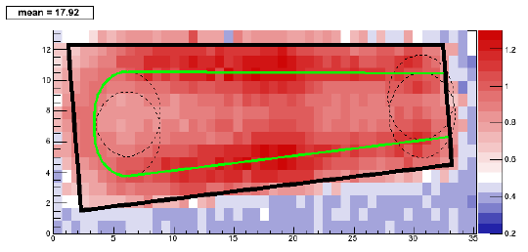
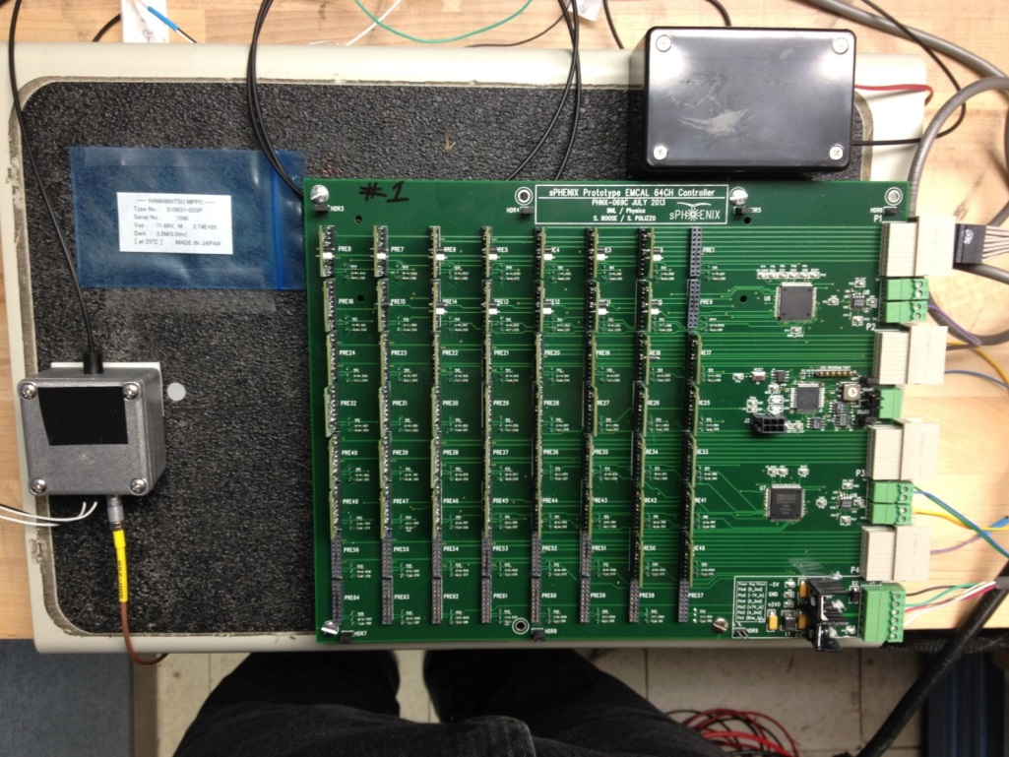
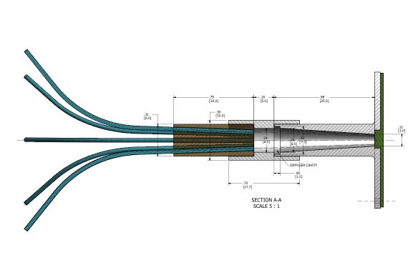
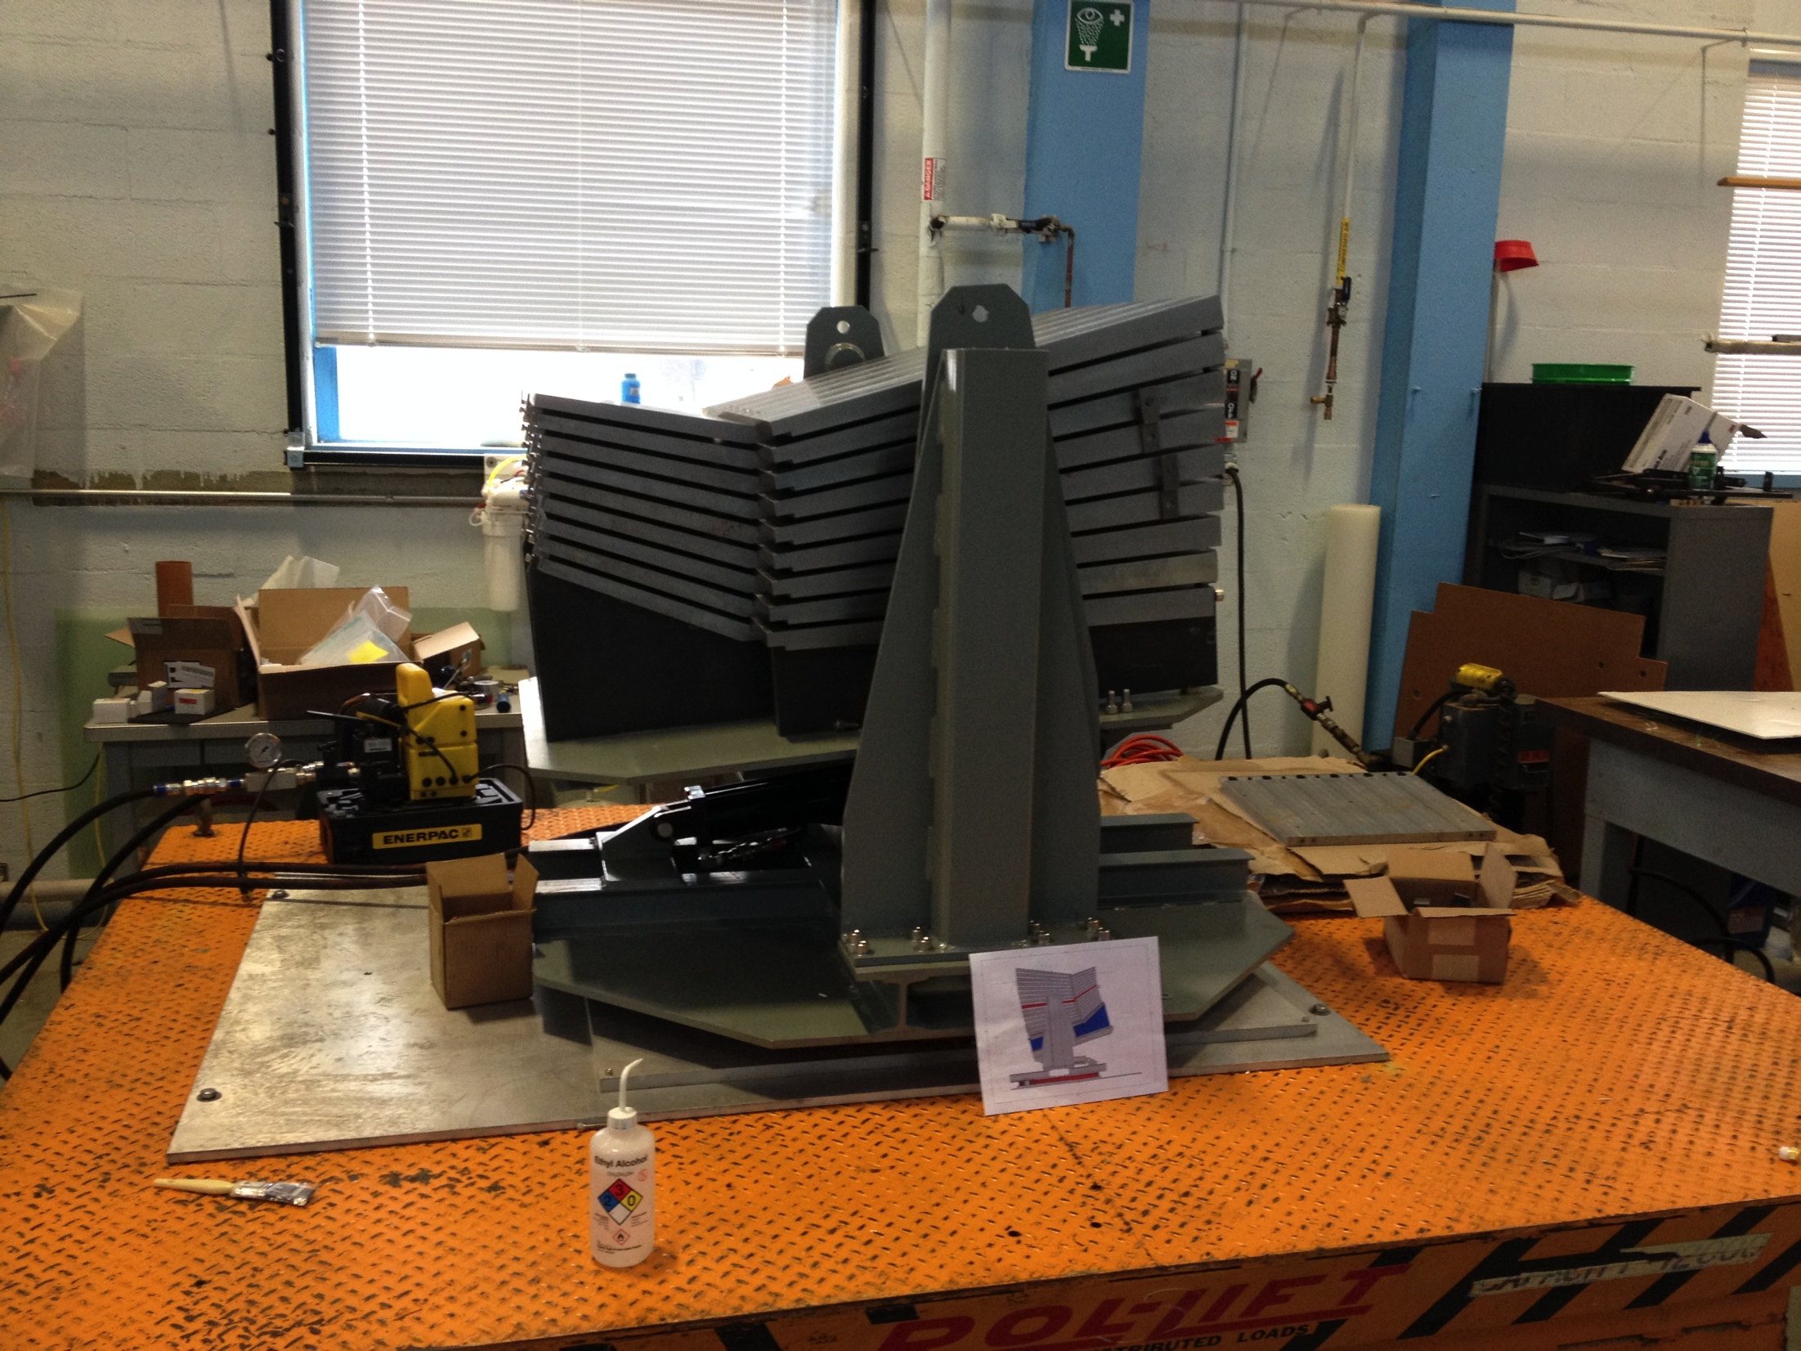
Top fiber
Bottom fiber

Slide 25
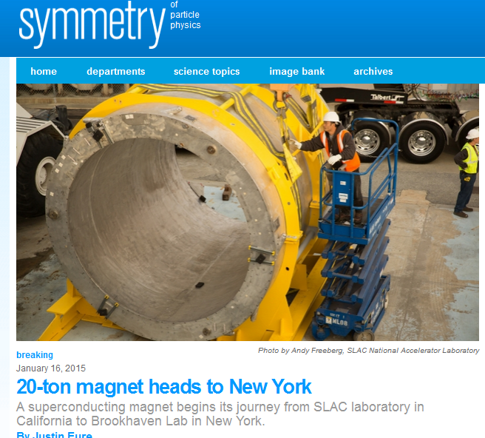
http://www.symmetrymagazine.org/article/january-2015/20-ton-magnet-heads-to-new-york

Slide 26
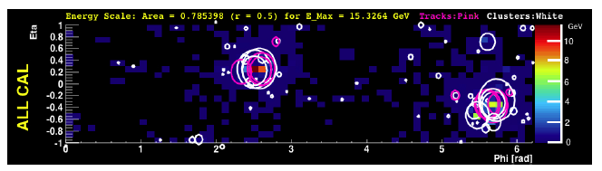



Jet Capabilities and Flexibility
Full Calo. Trigger in p+p/p+A
Quarks/Gluons

Slide 27


Critical Knobs to Turn
How do the parton shower and medium evolve together?
Can we observe the strongest coupling near T_{c} definitively
What are the inner workings?
(quasiparticles, fields, modes)

Slide 28

Rate, Rate, Rate
RHIC II + sPHENIX can record
100 billion events
within |z|<10cm in 22-weeks
Run-14 performance so successful, same delivery would allow sampling of 200 billion events for jets and direct photons
New C-AD projection will allow Au+Au sampling of
0.6 trillion events
Critical similar statistics in
p+p and p+A
10⁷ jets > 20 GeV recorded
10⁴ photons > 20 GeV recorded
e.g. 10⁵ photons > 20 GeV sampled from 0.6 trillion evts (S/B > 3)

Slide 29

sPHENIX + RHIC Luminosity → 0.6 trillion Au+Au collisions

Slide 30
RHIC Today
RHIC Tomorrow
LHC Today
LHC Tomorrow
Hadrons
Jets
R_{AA}
D Mesons
B Mesons
b Jets
Dijets (P_{T,1})
Ensemble-based
measurements
and x+hadron
correlations
add low p_{T} reach
X+Jet
γ+Jets (p_{T}^{γ})
Z⁰+Jets (p_{T}^{Z})
Double b-Tag (p_{T,1})
10
10²
10³
p_{T} [GeV/c]

Slide 31
RHIC Today
RHIC Tomorrow
LHC Today
LHC Tomorrow
Hadrons
Jets
R_{AA}
D Mesons
B Mesons
b Jets
Dijets (P_{T,1})
Ensemble-based
measurements
and x+hadron
correlations
add low p_{T} reach
X+Jet
γ+Jets (p_{T}^{γ})
Z⁰+Jets (p_{T}^{Z})
Double b-Tag (p_{T,1})
10
10²
10³
p_{T} [GeV/c]

Slide 32

Flat or not flat – what is the physics?
Precision at LHC and doubling the p_{T} range at RHIC

Slide 33


Slide 34



Enhanced Sensitivity at RHIC
Trigger Jet R=0.2
I_{AA}
Away Side Jet
R=0.2, 0.4, 0.7
Look for jet energy shifted to larger radius or underneath and equilibrated.
JEWEL predicts huge effect at RHIC.
Good purity even for large R jets!
I_{AA}
Reco. jets
fakejets

Slide 35

Direct Photons: Enhanced Sensitivity at RHIC
Vitev at al.
LHC
RHIC
Direct photons at RHIC particularly attractive…
Good signal to background without isolation cut
Much lower underlying event for detailed large angle scatter, medium response, etc.
Good statistics for differential measures, e.g. as function L

Slide 36


Beauty Tagged Jets at RHIC
Variety of proven techniques: soft lepton tagging, track counting, secondary vertex reconstruction
Key tests of mass dependence of radiative energy loss
Again, crucial to have overlapping energy ranges with RHIC and LHC

Slide 37


Proton+Nucleus Surprises
sPHENIX provides discriminating power on p+A physics explanations
Enabled by p+p/p+A Hcal triggering (as done in CMS for example)
x₂ ~ 0.06
sPHENIX covers up to
very high Bjorken x₂.

Slide 38


Quarkonia
Bound states of cc and bb can be Debye color screened in the QGP as one increases the temperature (melting)
J/ψ Suppression
Bizarre twist
Less suppression at LHC with higher temperature.
Quark deconfinement and charm recombination at LHC.
LHC
RHIC

Slide 39


Upsilon Probes
Inverse Length [1/fm]
Precision measurement at LHC (and more to come).
Needs precision RHIC p+p, p+A, A+A to map out temperature and coupling dependence

Slide 40



p_{T} Dependence
p+A Dependence

Slide 41

Excellent timing with Run-3 at LHC

Slide 42
A+A collisions release thousands of virtual gluons from the nuclear wavefunction
“The Hammer”
p+A may in fact be a
mini-hammer
A+A
p+A
e+A
Electron-Ion Collider
Tickling the nucleus
Individual hard kicking of partons

Slide 43

Electron Ion Collider Detector Concept
http://arxiv.org/abs/1402.1209
Built around the BaBar Magnet and sPHENIX Calorimetry
BaBar magnet has extra coil density near the ends – with proper flux return shaping, provides good analyzing power at very forward angles
sPHENIX EMCal meets EIC detector specifications

Slide 44







Laboratory Microscopes
RHIC
PHENIX
STAR
Is sPHENIX a must have microscope?
Aren’t there already a lot of microscopes?
Key answers about the emergence of
perfect fluidity in the region of strongest coupling and with focus on the transition scales
will be lost without this new microscope at RHIC.
With such a powerful accelerator at RHIC,
U.S. in well placed to maintain leadership and new discovery potential.
LHC
CMS
ALICE

Slide 45

























Summary
Amazing emergent phenomena from QCD abound.
New tools at RHIC and LHC point to a bright future.
‘How’ and ‘why’ questions on the QGP will be left with incomplete answers without a
State-of-the –Art Jet Detector at RHIC in conjunction with
ongoing LHC program

