Slide 1

Hot QCD Physics and the
Perfect Fluid Future
Jamie Nagle (University of Colorado)
Santa Fe, New Mexico
APS Division of Nuclear Physics Meeting, October 28-31, 2015

Slide 2
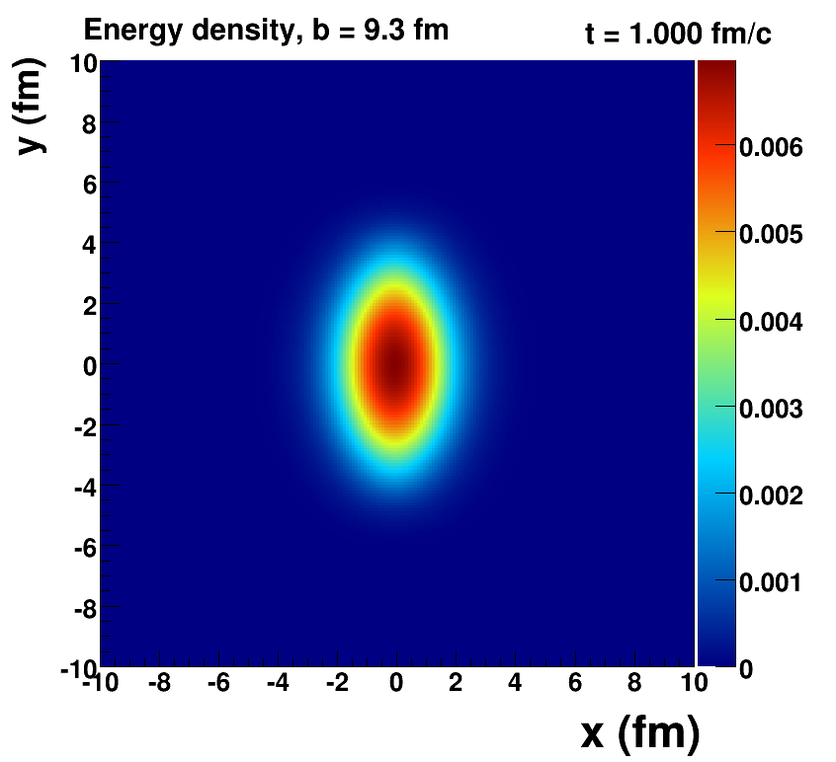
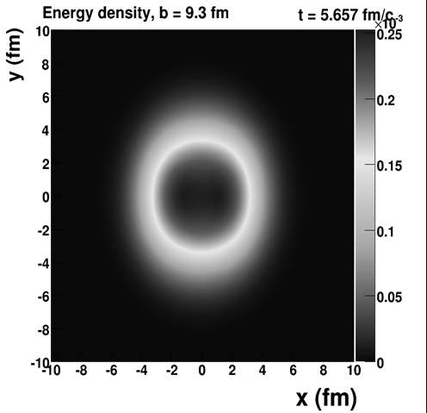

Hot QCD Physics in 2007
Perfect Liquid?
Ideal hydrodynamics, smooth initial conditions,
elliptic flow only, qualitative statement on perfect fluidity
First discovery stage QGP observations

Slide 3
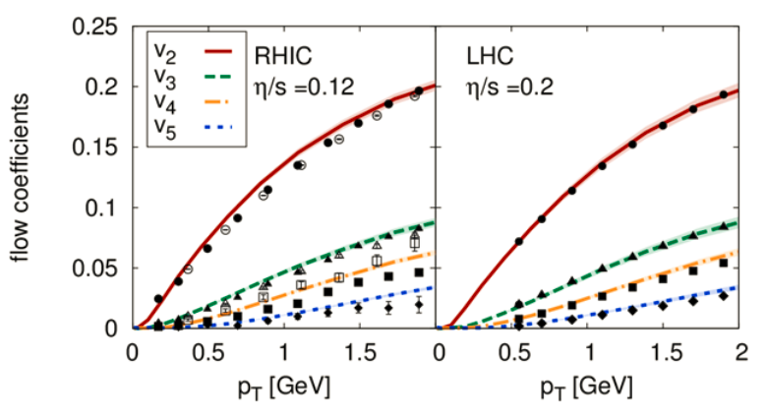
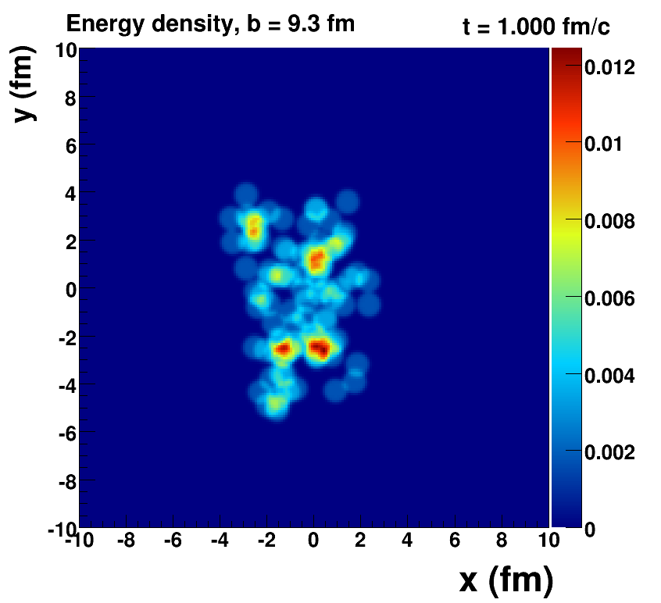
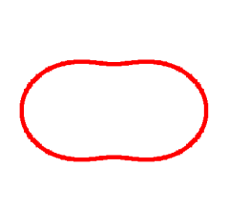
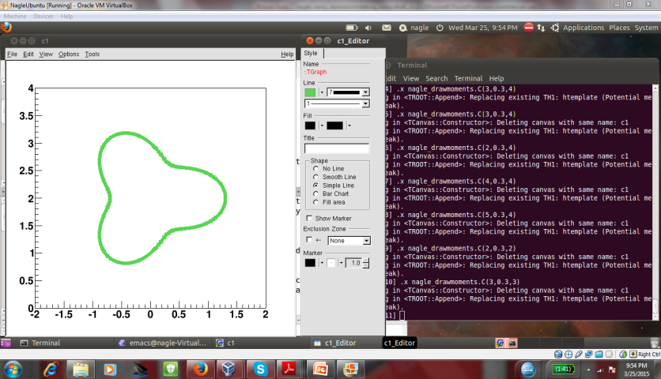
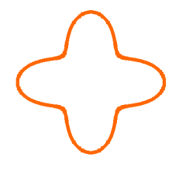
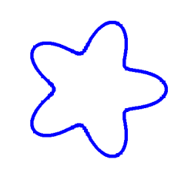
The world has changed since 2007
η/s=1.5/4π
η/s=2.5/4π
Quantum fluctuations in the Initial State
2nd Order, 3-Dimensional, Relativistic Viscous Hydrodynamics
Precision Lattice Equation of State
RHIC and LHC precision measures of higher moments

Slide 4
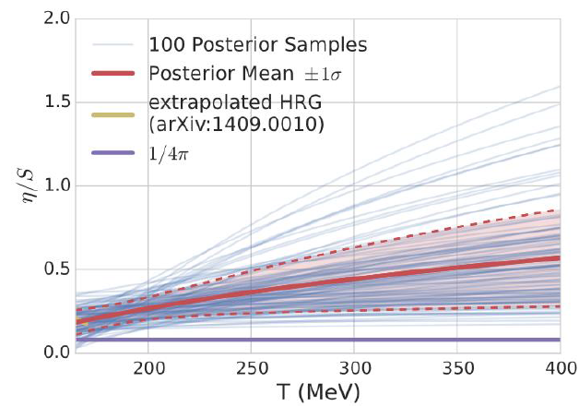
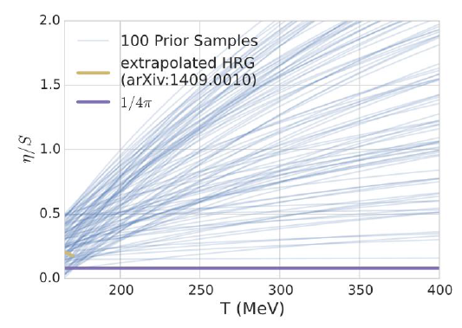
Quantitative Constraints
(Speed of Sound)²
η/s
Temperature [MeV]
Temperature [MeV]
Using latest climate / cosmology techniques,
multi-variate analysis on RHIC & LHC data.
Experimental confirmation of QCD Equation of State!

Slide 5
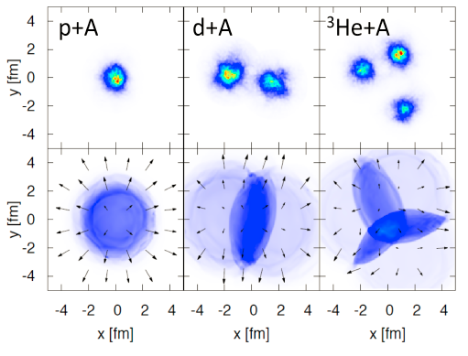
What is the smallest droplet of QGP?
Discovery at LHC → high multiplicity p+p/p+A
Collective-Like Patterns
RHIC as the world’s most versatile collider
is now engineering the droplet geometry (1,2,3)

Slide 6
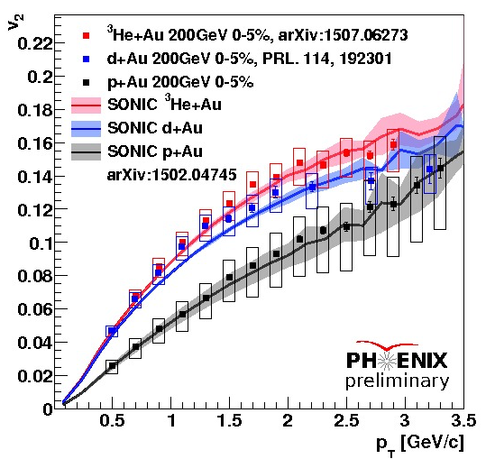
Flow predictions born out with RHIC data

Slide 7
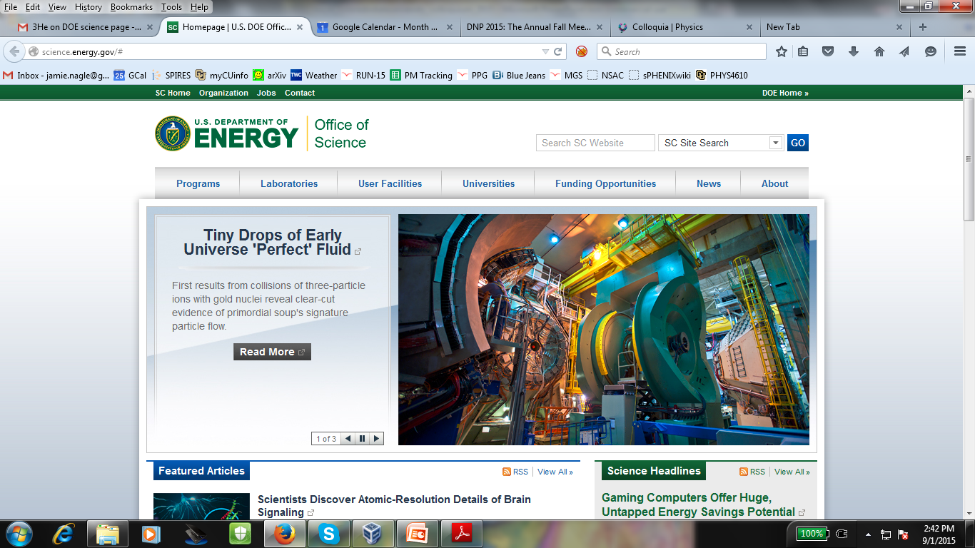
What is the smaller droplet of QGP?
What is the lowest energy forming QGP? d+Au energy scan.

Slide 8
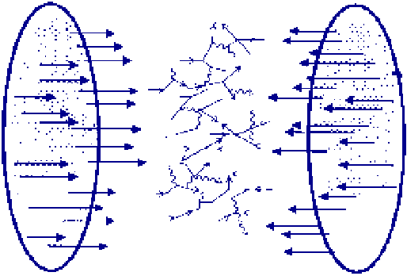
A+A collisions release thousands of virtual gluons from the nuclear wavefunction
“The Hammer”
p+A may in fact be a
mini-hammer
A+A
p+A
e+A
Electron-Ion Collider
Tickling the nucleus
Individual hard kicking of partons
or scattering from collective gluonic matter

Slide 9
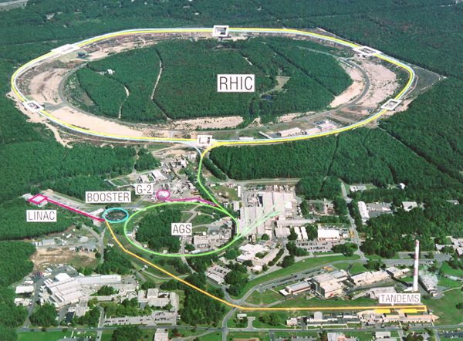
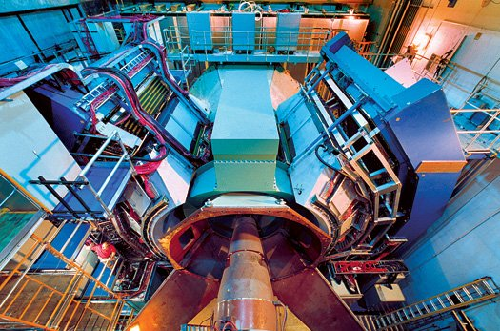
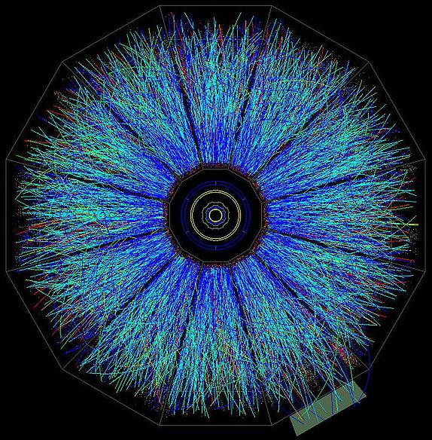
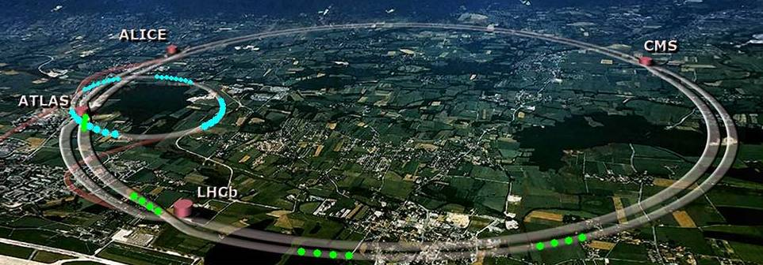
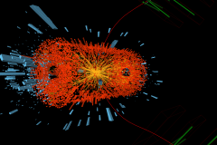
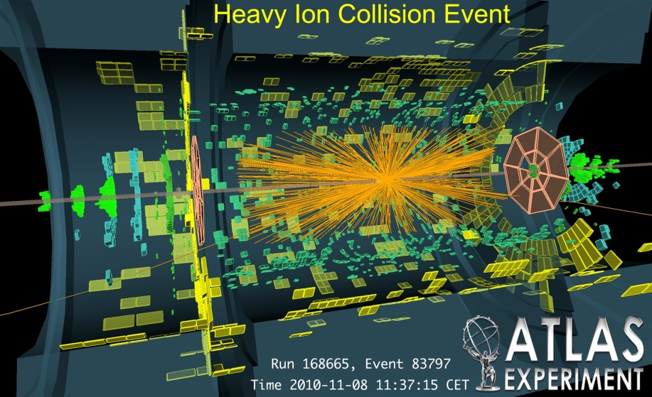
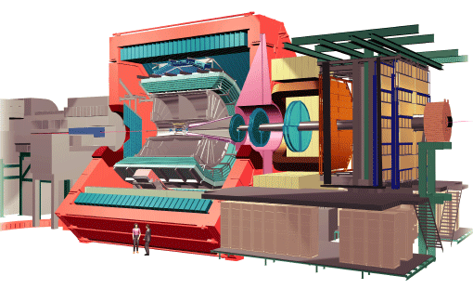
Impressive Strides in QGP Understanding
Enabled by RHIC luminosity upgrade (x20)
Enabled by RHIC extending energy range 7-200 GeV (x26)
Enabled by LHC extending energy range to 2.76 TeV (x14)
Major advances in quantitative modeling and theory
RHIC
PHENIX
STAR
LHC
CMS
ALICE

Slide 10

Emergent Phenomena
Connection from the QCD Lagrangian to
phenomena of confinement and asymptotic
freedom was fundamental
Connection from QCD to the emergent phenomena of near perfect fluidity of the Quark-Gluon Plasma near the phase transformation is just as fundamental
Pinning down η/s tells us the nature of the QGP,
more importantly we need to reconcile:
Most important discovery in field: perfect fluid
&
Crucial part of QCD: weak coupling at short distances

Slide 11
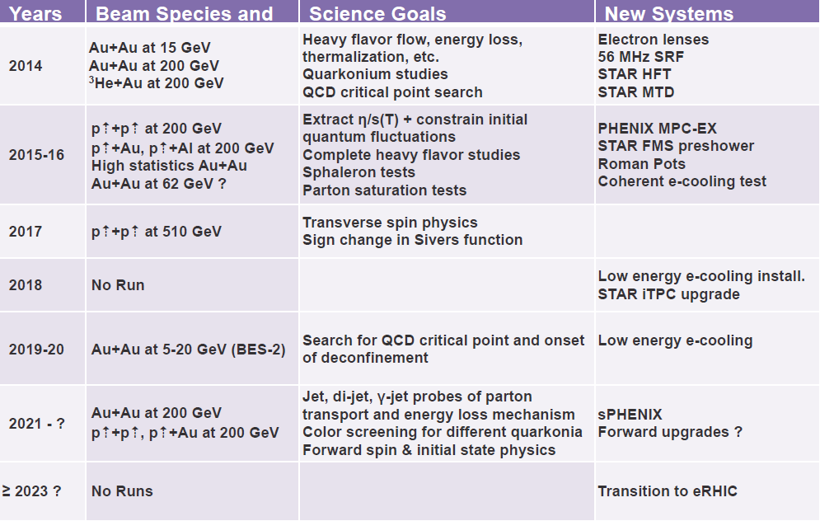
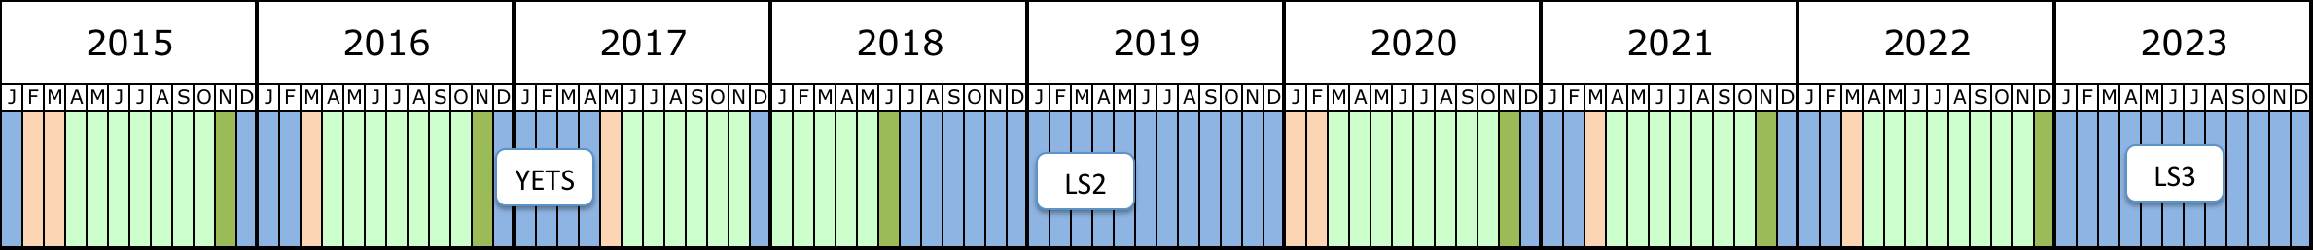

Completing the RHIC Mission
Relativistic Heavy Ion Collider
Large Hadron
Collider
Heavy Flavor Physics
2014-2016
LHC
Run 2
LHC
Run 3
2019-2020
BEScan-2
11
2021-2022
Pb+Pb
ALICE Upgrade
LHC Luminosity
2020-2023
Pb+Pb/p+Pb/Ar+Ar
Pb+Pb/p+Pb

Slide 12
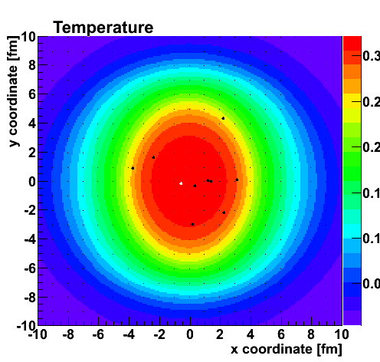
Buoys (Heavy Quarks) in the Plasma
Heavy Flavor Physics
2014-2016
Charm – Anticharm Pairs Drag/Diffuse in Perfect Fluid

Slide 13
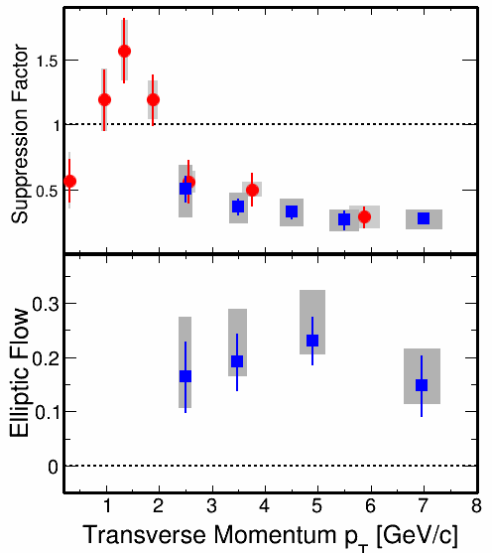
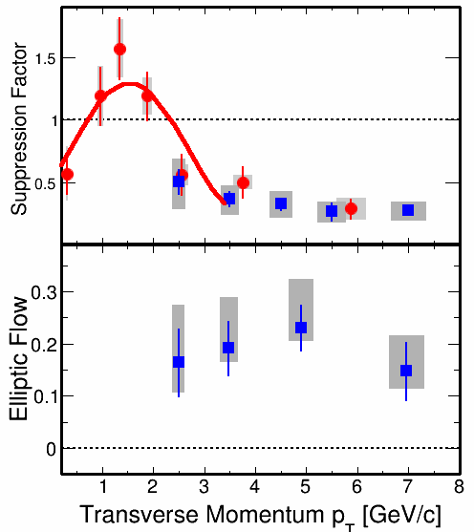
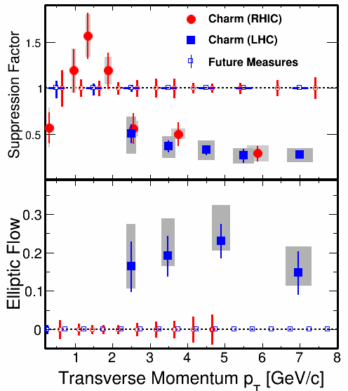
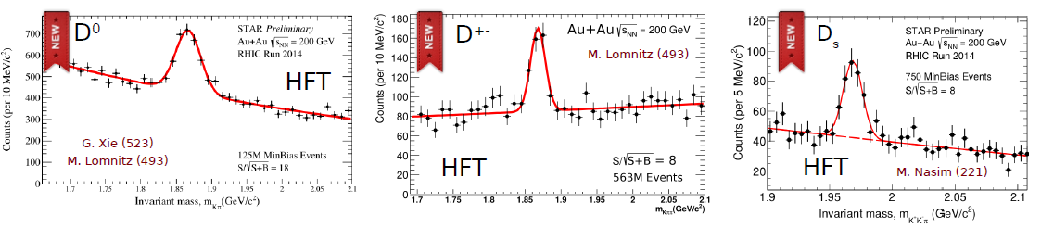
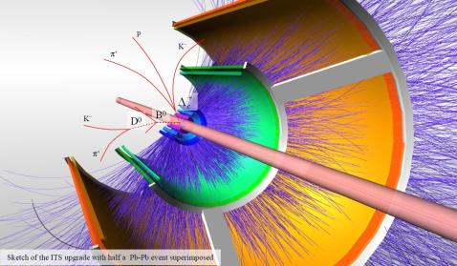
Heavy Quarks Flow
Models require strongest coupling near T_{c}
Precision data to extract QGP drag coefficients
Charm precision data
RHIC – 2014-2016
LHC – ALICE upgrades 2020-23
LHC – ALICE upgrades 2020-23
US Expertise at RHIC applied at LHC
US Leadership Roles

Slide 14
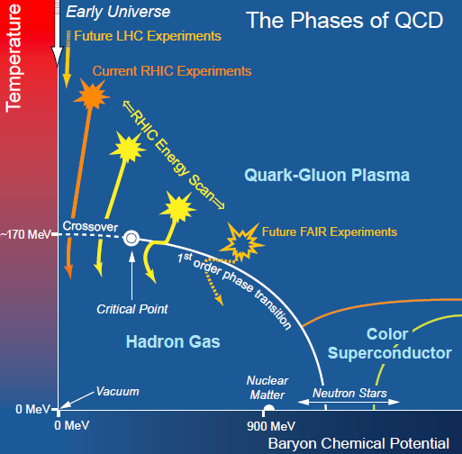
Doping the QGP with Quarks
Lower collision energies yield QGP with
larger baryon
chemical potential (μ_{B})
2007 - priority to have pilot Beam Energy Scan
Energies Run:
7.7, 11.5, 14.5, 19.6, 27, 39, 62, 200 GeV
What did we learn?

Slide 15

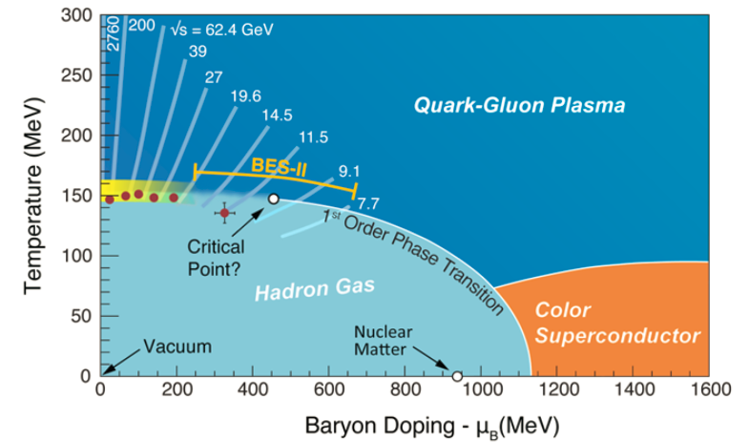
Not just a cartoon anymore
Trajectories – hydrodynamic model constrained by data
Red points – measured hadronic freeze-out points
Confirmed that all energies have droplets in QGP phase
Lattice QCD indicates if Critical Point exists, μ_{B} > 200 MeV

Slide 16
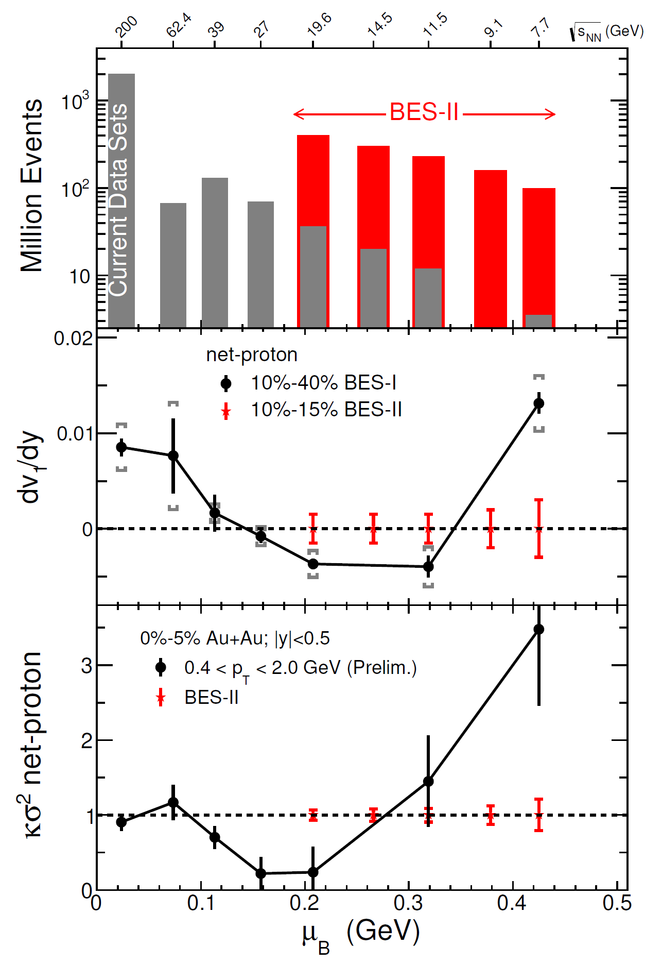
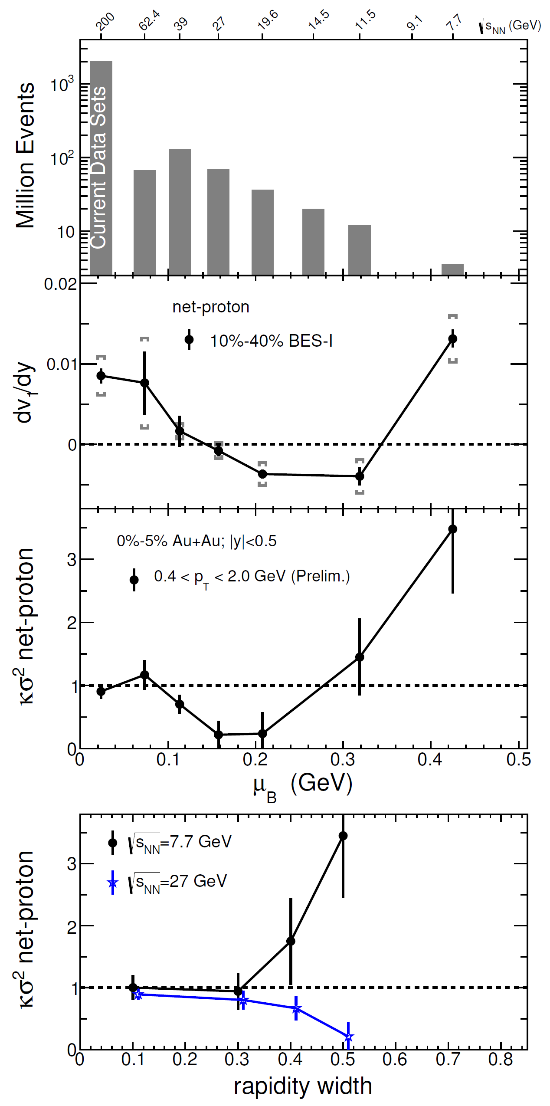
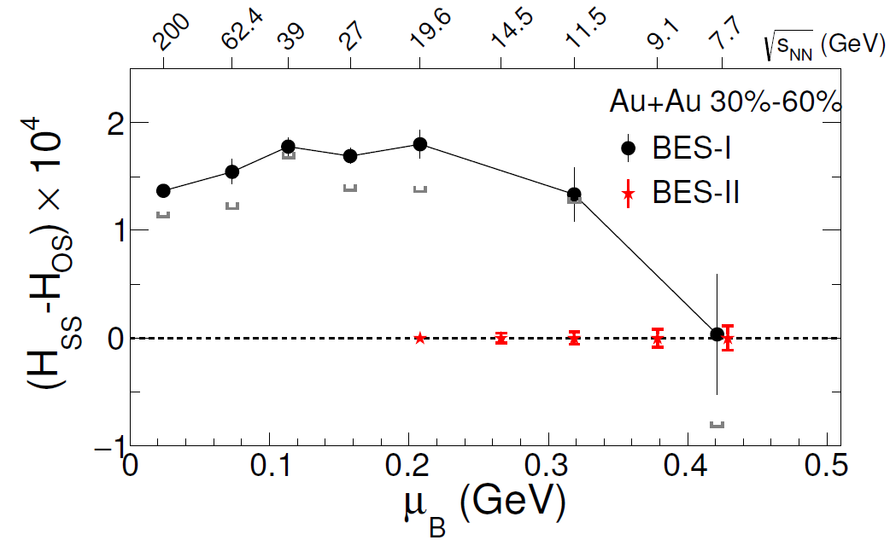
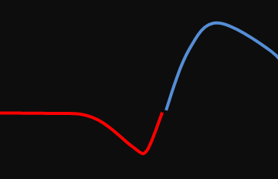
Critical Point Hints
Minimum in v₁ slope was predicted as consequence of the softening of the equation of state in the transition region.
Net-proton fluctuations, proximity to critical point?
Possible Scenario
Near Critical Point
BES-2 Data Taking 2019-2020

Slide 17
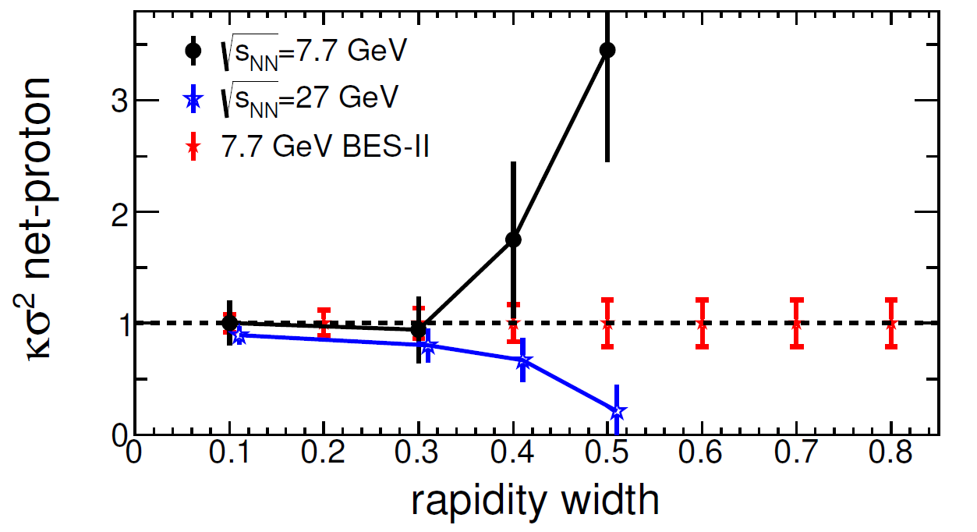
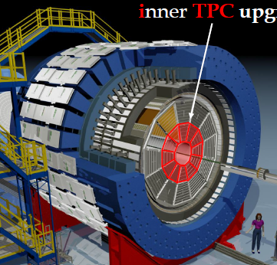
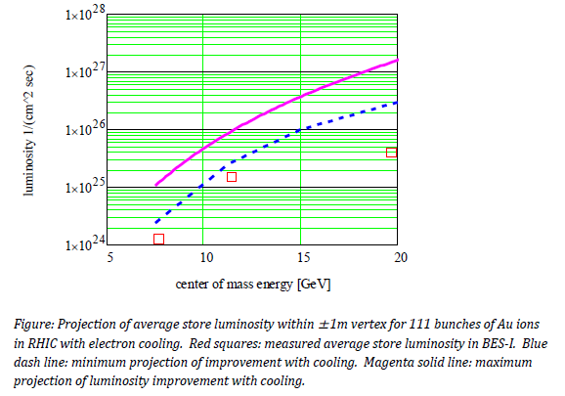
Precision Search for Critical Point
STAR
iTPC Upgrade
Luminosity (cm⁻²sec⁻¹)
BES-2 Projection
RHIC electron cooling
20 year program → 2 years
Maximum
Minimum
BES I
BES-2 Data Taking 2019-2020
√s_{NN} (GeV)

Slide 18
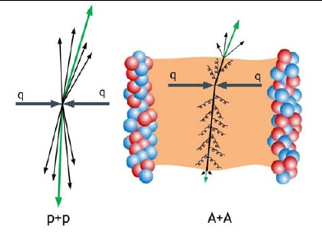
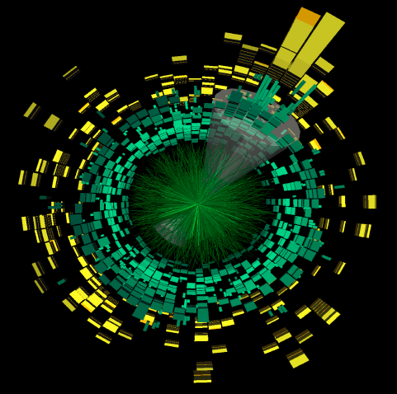
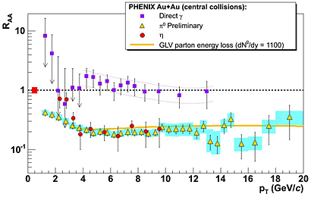
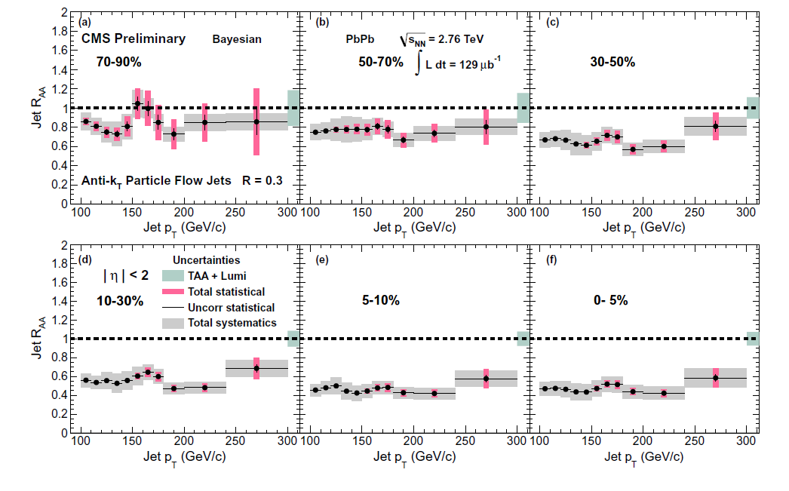
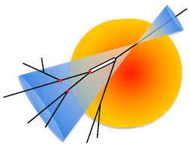
Jet Quenching Discovery → Precision
Leading hadron
LHC – Reconstructed Jets
Photons
Leading hadron

Slide 19
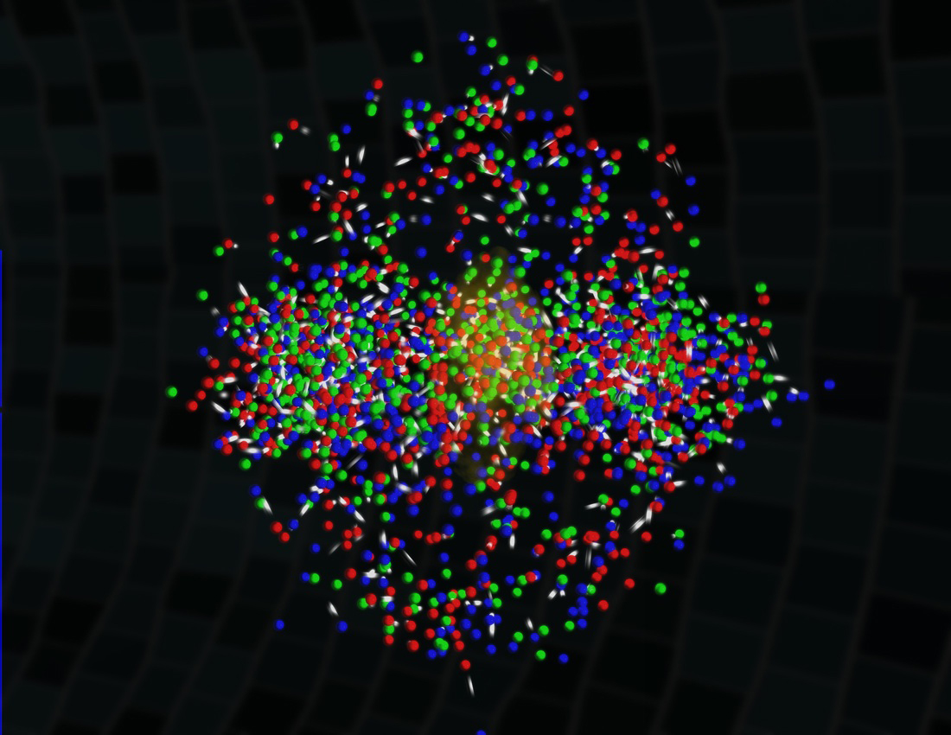
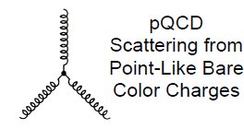

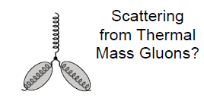
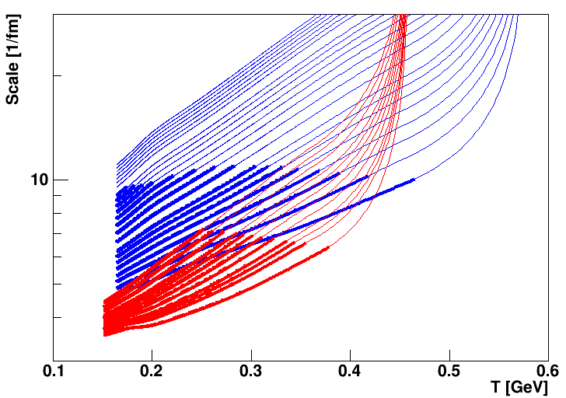
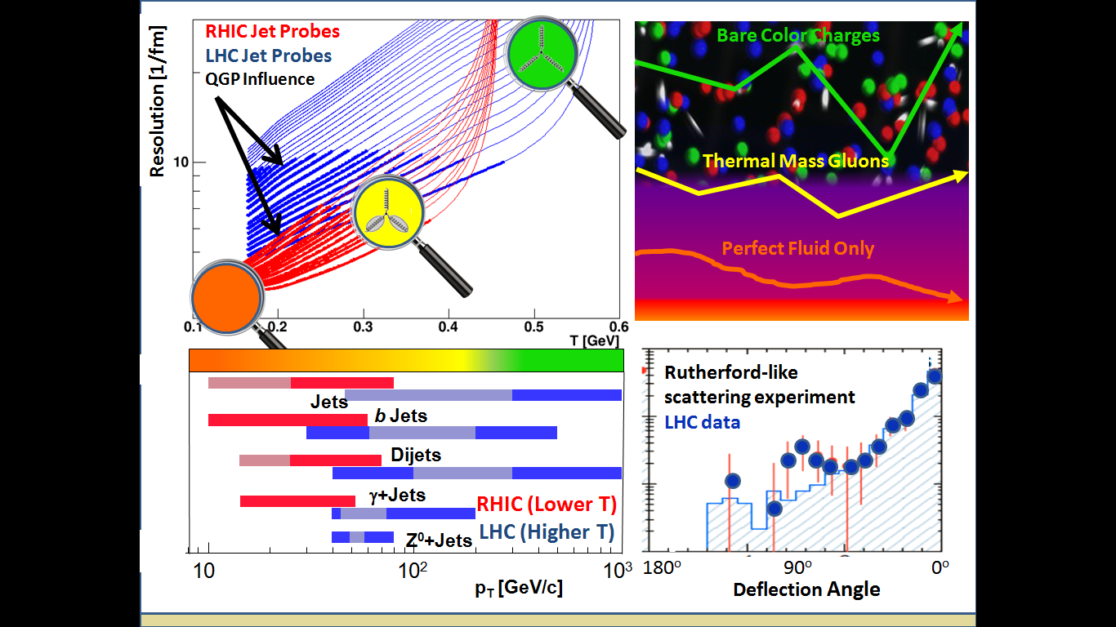
Jet Probes of QGP Structure
Bare Color Charges
Parton virtuality evolves quickly and is influenced by the
medium at the scale it probes
Thermal Mass Gluons
Perfect Fluid Only
RHIC Jet Probes
LHC Jet Probes
QGP Influence
Unique critical microscope resolution at RHIC.
Measurement overlap between RHIC and LHC
very important too.
Thick lines indicate where the QGP influences virtuality evolution

Slide 20
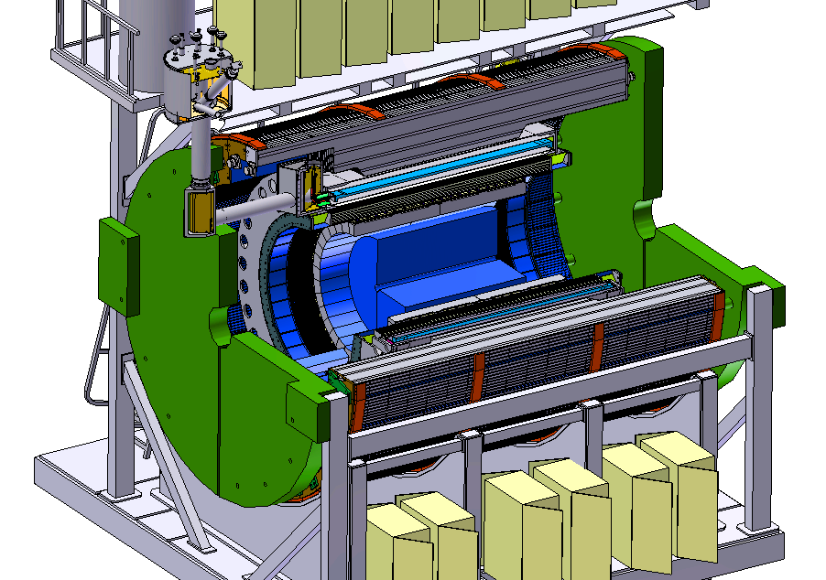
A New Detector at RHIC
BaBar Magnet 1.5 T
Coverage |η| < 1.1
All silicon tracking
Heavy flavor tagging
Electromagnetic
Calorimeter
Hadronic Calorimeter
Successful DOE Science Review
in June 2015!
High data acquisition rate capability, 15 kHz
Sampling 0.6 trillion Au+Au interactions in one-year
Maximizing efficiency of RHIC running

Slide 21
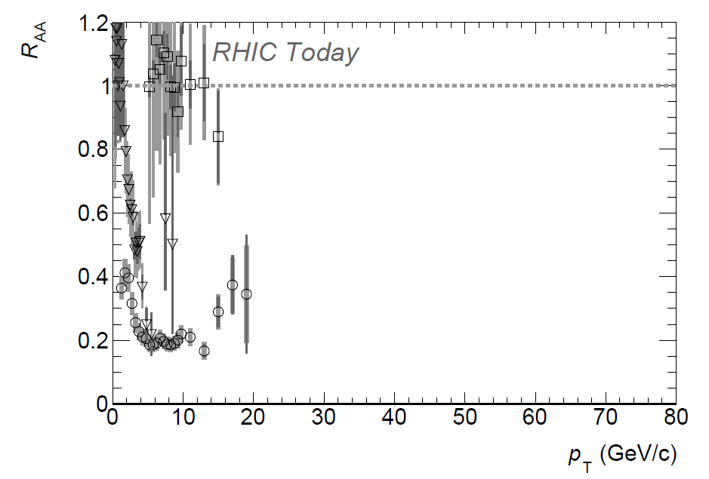

Precision Imaging of QGP Over Key Kinematics
Jet probe precision data
RHIC – 2021-2022
LHC – 2020-2023

Slide 22


Precision Imaging via Very Heavy Quarkonia
b
b
Mapping out
Temperature dependence of plasma screening
Υ(1s) should melt at LHC,
but not at RHIC!
Upsilon precision data
sPHENIX – 2021-2022
CMS – 2020-2023

Slide 23




Theory
None of this would be possible (past, present, future) without enormous advances in theory !
Many examples abound…
3-D Relativistic Viscous Hydrodynamics
Detailed lattice QCD Equation of State
Gluon saturation initial conditions
AdS/CFT pre-equilibrium calculations
Langevin drag / diffusion for heavy quarks
Lattice QCD for extraction of T, μ_{B}
Perturbative parton-QGP interactions
[JET Topical Collaboration]
AdS/CFT strong coupling heavy quark calculations
Lattice QCD pushed to finite μ_{B}
Chiral Magnetic Effect embedded in hydrodynamics
Heavy quark recombination in full space-time evolution
…

Slide 24
RHIC
1) With low-energy cooling, RHIC is the best tool we will have in our lifetimes to explore experimentally the phase diagram of QCD.
2) With sPHENIX, RHIC is the best tool we will have in our lifetimes to explore experimentally the
most perfect liquid ever created.
LHC
3) Enormous leverage for US of expertise and synergy of techniques and detector work between RHIC and LHC. Highest T and smallest scale probes.

Slide 25

2007
Perfect Liquid?
2015
A mature field…
An informed view of the key remaining questions and how to top out.

Slide 26


Electron Ion Collider
Saturation physics via Lorentz contracted nucleus
or in the frame of evolution of photon fluctuating into color dipole. At high multiplicity, just about the QCD vacuum and one might even observe collectivity in e+A

Slide 27


Santa Fe Open Space
With careful planning, we can take both trails

Slide 28

Backup Material

Slide 29


Slide 30


RHIC-II performance is here!
Unfortunate that because RHIC did it
3 years earlier and for 1/7 the cost, there are no fireworks…

Slide 31






Photon-Tagged Jets
sPHENIX unique mapping of path (L) dependence of
parton-QGP interactions.
Key to resolving strongest coupling near transition temperature and why.
γ
Golden channel where photon calibrates quark
γ (E=20 GeV), S/B is 20x better at RHIC
Underlying event 2.5x smaller
q
E_{quark}
E_{photon}

Slide 32

Jet – Medium Interactions
Coupling Strength
pQCD α_{s} running,
are probes weakly coupled at all scales?
Strongest coupling near T_{c} as
Perfect Fluid Emerges

Slide 33

Hot QCD Physics and the
Perfect Fluid Future
Properties
Properties
Phases
Phases
Jamie Nagle (University of Colorado)
Santa Fe, New Mexico
APS Division of Nuclear Physics Meeting, October 28-31, 2015

Slide 34



Beauty-Tagged Jets
Beauty Quark
Forward radiation
suppressed, dead-cone.
Key handle on what is being scattered from in medium
EIC will test parton energy loss in cold nuclear matter, and with specific tag on virtuality (charm quarks too)!

Slide 35



Slide 36


Emergent Phenomena
Now it is critical to probe QGP (High T_{c} Superconductors)
at different length scales and
change the net baryon density (doping) to get full insight.
Discovery of High T_{c} Superconductors was huge!
However, we still do not know what really
carries the charge.
Discovery of QGP as perfect fluid was huge!
We know a lot about how QGP behaves,
but not so much about how it really works.
Notes:
For example, it's been almost 20 years since high-temperature superconductors were discovered and there still is no consensus on what's carrying the current in them.
studies the interaction between infrared light and matter in magnetic fields to examine novel effects in these materials and to probe their dynamic properties as a function of wavelength.
ARPES techniques, get eta/s figure → recent…

Slide 37


Critical Knobs to Turn
How do the parton shower and medium evolve together?
Can we observe the strongest coupling near T_{c} definitively
What are the inner workings?
(quasiparticles, fields, modes)

Slide 38


Heavy Quarkonia Recombination
J/ψ Suppression
Less J/ψ suppression at LHC with higher temperature
Charm recombination dominant effect, not screening.
Color conductivity in QGP!
LHC
RHIC
C
Look to Upsilons for Debye Screening,
no recombination at RHIC
C

Slide 39
Laboratory Microscopes
RHIC
PHENIX
STAR
Is sPHENIX a must have microscope?
Aren’t there already a lot of microscopes?
Key answers about the emergence of
perfect fluidity in the region of strongest coupling and with focus on the transition scales,
in temperature and length,
will be lost without this new microscope at RHIC.
With such a powerful accelerator at RHIC,
U.S. is well placed to maintain leadership and new discovery potential.
LHC
CMS
ALICE

Slide 40


QGP Constituent Mass Dependence
^
qhat → scattering of leading parton → radiation e-loss
ehat → energy transferred to the QGP medium
q → scattering of leading parton which then radiates
e → energy transfer from parton to QGP particle
^
Collisional
Radiative
Limit of infinitely massive scattering centers yields all radiative e-loss.
Medium parton

Slide 41


Probing different length scales
Do the highest energy
jets at LHC see
point-like color charges?
1/λ
What sets this scale?
  the exchange gluon momentum?
  total coherent energy loss?
  impact of deconfinement?
Do the lowest energy jets at RHIC scatter from coherent fields or only excite sound waves?

Slide 42


Deeper Connections

Slide 43



RHIC and LHC Leverage

Slide 44

Using Coleman-Smith’s dijet asymmetry the effective coupling is varied, how well can our projected measurement for 35 GeV jets with R = 0.3 constrain this parameter.
Of course, many observables need to be included since there is
more than one unknown. The key is over-constraining the problem.

Slide 45


Super-Strong Coupling near T_{c}?
“Jet Quenching is a few times stronger near T_{c} relative to the
QGP at T > T_{c}.”
Liao and Shuryak, PRL (2009)
“The surprisingly transparent sQGP at the LHC [compared to RHIC]”
Horowitz and Gyulassy, NPA (2011)
“Large v₂ is striking in that it exceeds expectations of pQCD models even at 10 GeV/c.”
PHENIX, PRL (2010)

Slide 46

Chiral Magnetic Effect Signature
Topological domains with QGP chiral symmetry restoration
Effect goes away when chiral symmetry is no longer restored
BES-2 Data Taking 2019-2020

Slide 47

Less QGP, More Hadronic Phase
Low η/s QGP phase transfers fluctuations from the initial overlap density into final-state
Lower temperature, less QGP to create triangular flow
200 GeV
11.5 GeV
Some QGP signatures go away in less dense collisions
Large system exhibits some QGP behavior even at the lowest energies

Slide 48
RHIC Jet Probes
LHC Jet Probes
QGP Influence
Bare Color Charges
RHIC Jet Probes
LHC Jet Probes
QGP Influence
Resolution [1/fm]
Thermal Mass Gluons
Perfect Fluid Only
Critical microscope resolution at RHIC.
Also, overlap between RHIC and LHC for simultaneous description.
Parton virtuality evolves quickly and is influenced by the
medium at the scale it probes
Thick lines indicate where the QGP significantly influences virtuality evolution

Slide 49






