Slide 1
What can we learn from
³He+A and p(d)+A
collisions at RHIC?
Jamie Nagle
University of Colorado, Boulder, USA

Slide 2
Prejudice
A+A
Enough particles to equilibrate, QGP, collective motion
p+A
Not enough particles to equilibrate, control experiment

Slide 3
p+A
Proton Projectile
Nucleus Participants

Slide 4
MC Glauber – initial energy density of participants, large eccentricities from fluctuations

Slide 5
IP Glasma– initial energy density only in region where nucleons overlap, much smaller eccentricities

Slide 6
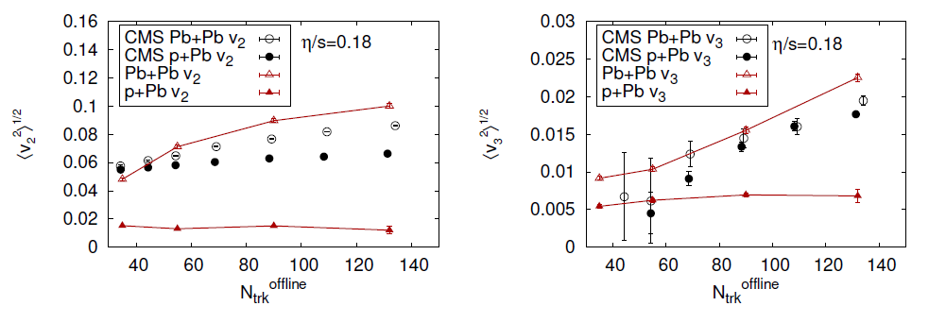
Initial Geometry + Hydrodynamics
IP Glasma + Hydro – under-predicts p+Pb v₂ and v₃ by x3
One could enhance the
effect by including
fluctuating proton shape,
still smaller initial size

Slide 7
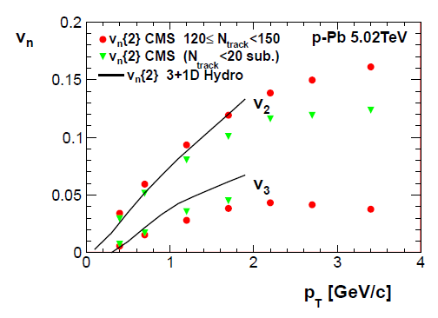
Glauber + Hydro (Bozek) – qualitative description of v₂ and v₃
no pre-equilibrium, no hadronic cascade, 3-dimensional

Slide 8
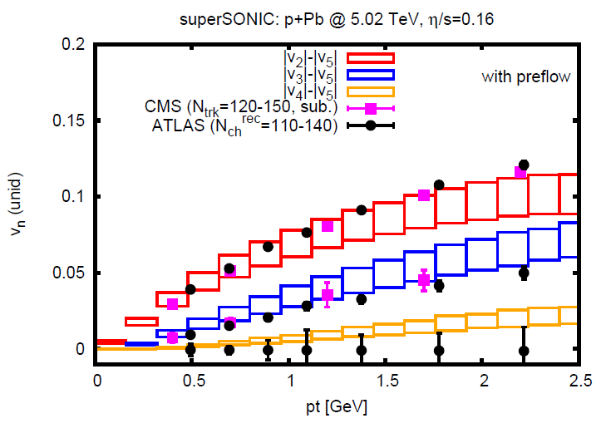
http://arxiv.org/abs/1502.04745
Glauber + PreFlow + Hydro + Hadronic Cascade
[superSONIC] (Romatschke)
qualitative description of v₂ and v₃

Slide 9
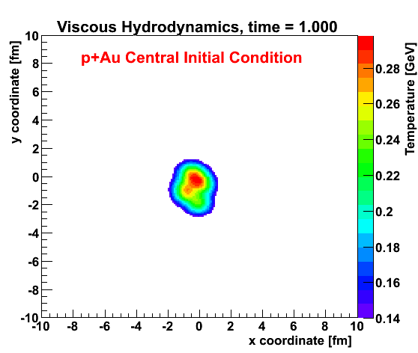
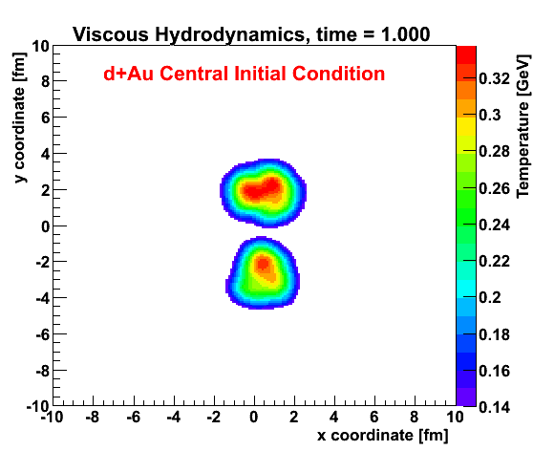
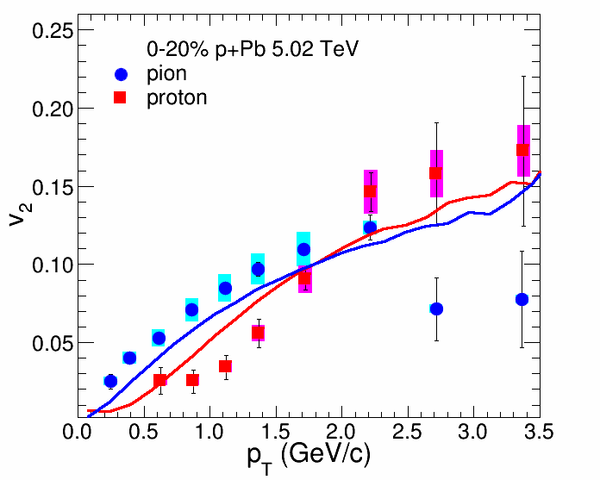
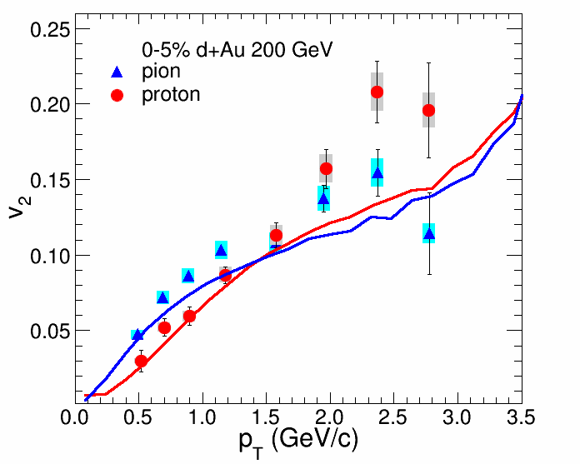
Viscous Hydrodynamics + Cascade
Similar Flow Fingerprint?
Small QGP?
ALICE Experiment
p+Pb @ LHC
PHENIX
d+Au @ RHIC

Slide 10
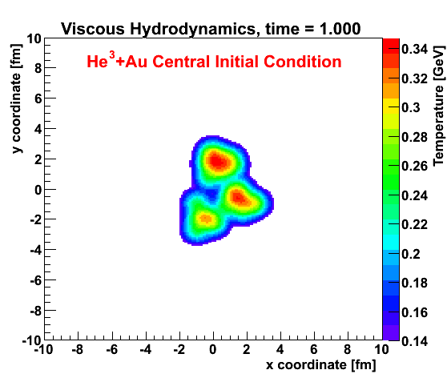
Geometry Engineering
Proposal to run “triangular” system
at RHIC
Small systems challenge our picture of required time and size scales
http://arxiv.org/abs/arXiv:1312.4565

Slide 11
Motivation → Ideas → Predictions → Experiment
PHENIX Look Back at d+Au (Christmas 2012)
Idea for ³He+Au (January 2013)
PHENIX Proposal (May 2013)
Theory Predictions (December 2013 - http://arxiv.org/abs/1312.4565)
Running (June 2014)
First Results (December 2014)
One of the fun parts of science… idea, hypothesis, test
http://arxiv.org/abs/1408.2549
Publicly available Helium-3 three-nucleon configurations from Joe Carlson, J. Lynn

Slide 12
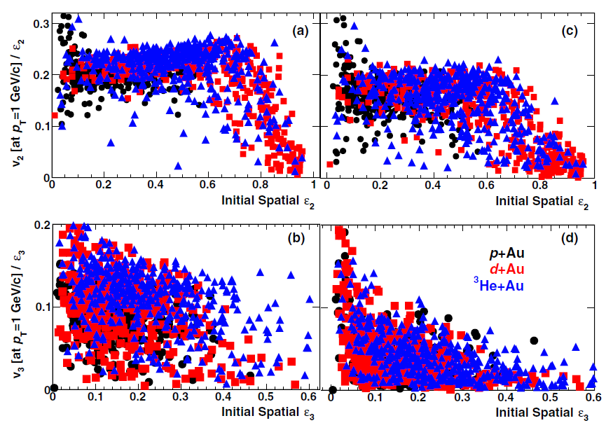
Looking under the hood
T_{f} = 150 MeV
T_{f} = 170 MeV
v₂
ε₂
v₃
ε₃

Slide 13
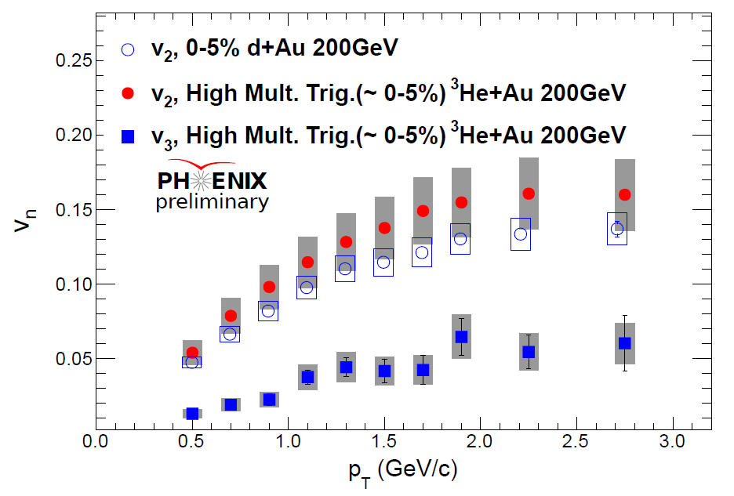
2014
Data
Centrality trigger key
to necessary statistics
v₂ d+Au ~ v₂ ³He+Au
Finite v₃ in ³He+Au

Slide 14
Sincere Request
In addition to exploring new ways to look at the ³He+Au data, it is very important to have some standard measures (2,4 particle cumulants, standardized centrality selections, etc.).
Needed for good quantitative science.
40-88% on ZDC
Example
0-20% on ZDC
PHENIX 5% Central Trigger
PHENIX BBC Au-Going Charge [3He+Au]

Slide 15
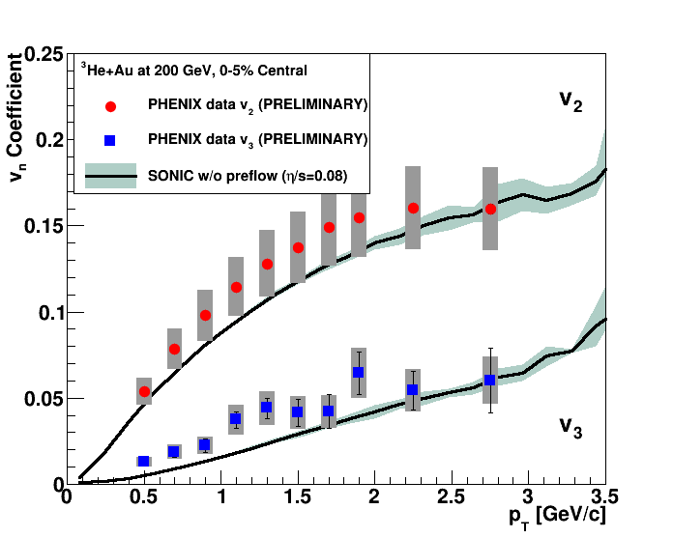
Glauber IC + Hydro (η/s=1/4π) + Hadronic Cascade [SONIC]
PREDICTION
(JN et al., Phys.Rev.Lett. 113 (2014) 11, 112301)

Slide 16
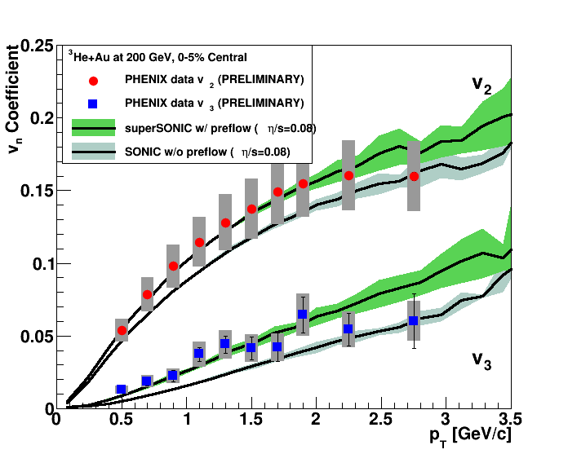
http://arxiv.org/abs/1502.04745
Glauber IC + PreFlow + Hydro (η/s=1/4π) + Hadronic Cascade [superSONIC]

Slide 17
IP Glasma gives very different eccentricity from Glauber in pA
However, in d+Au and ³He+Au,
the eccentricity is driven by the 2 and 3 hot stops,
not their individual geometry
Note though that the IPGlasma has a smaller hot spots
with higher energy density that result in
more rapid radial expansion

Slide 18
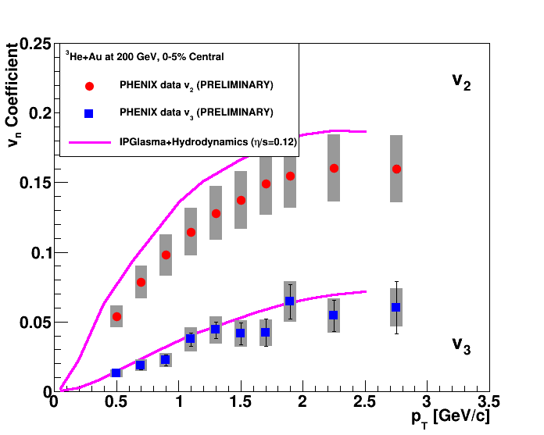
Bjoern Schenke, Raju V.
http://arxiv.org/abs/1407.7557
IP Glasma + MUSIC (η/s = 1.5 x 1/4π)
Much larger initial radial expansion, but also no late cascade

Slide 19
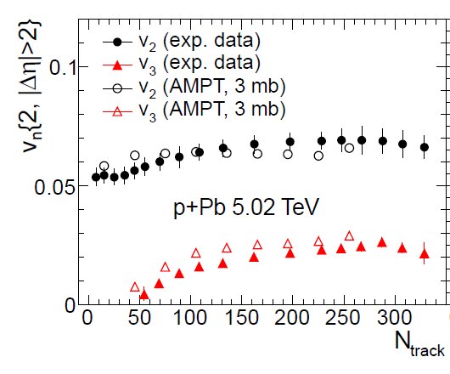
Bzdak, Ma (http://arxiv.org/abs/1406.2804) AMPT and p+Pb

Slide 20
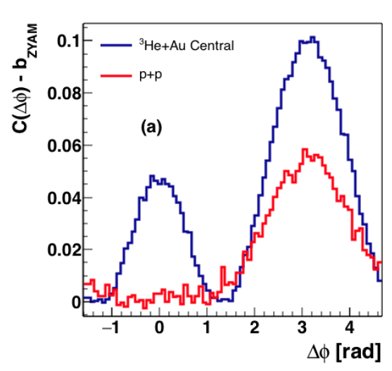
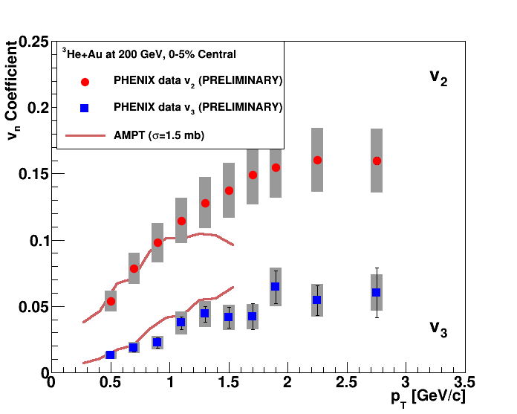
http://arxiv.org/abs/1501.06880
p_{T} = 1 GeV
AMPT v2.21 results [Javier Orjuela-Koop et al., arXiv:1501.06880]
String melting on, σ=1.5 mb, only mod. for ³He into Glauber

Slide 21
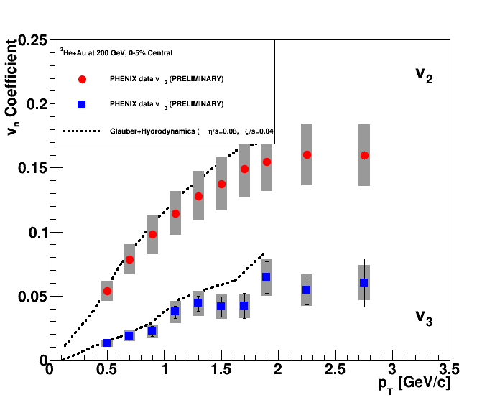
http://arxiv.org/abs/1503.00468
New paper from Bozek with Glauber IC + 3-d Hydrodynamics
No hadronic cascade

Slide 22
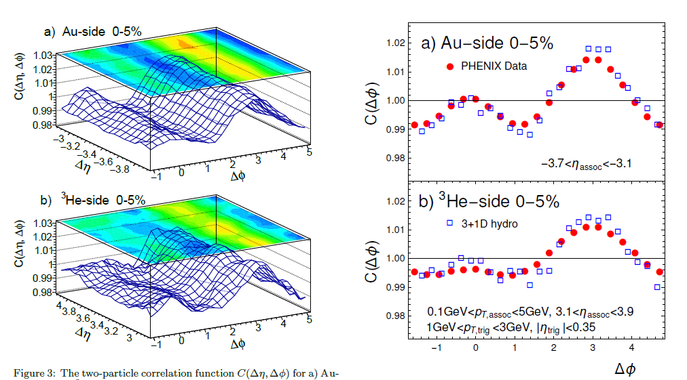
http://arxiv.org/abs/1503.00468

Slide 23
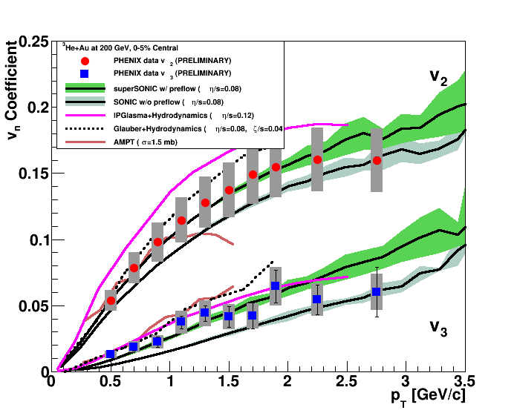
What have we learned? Need to design control experiments to test different inputs.
e.g. same IC model in p,d,³He+A, same η/s, must have hadronic stage (known to exist)

Slide 24
Applicability of Hydrodynamics?
Niemi et al.: http://arxiv.org/abs/1404.7327
Romatschke: http://arxiv.org/abs/1502.04745
Needs clear resolution

Slide 25
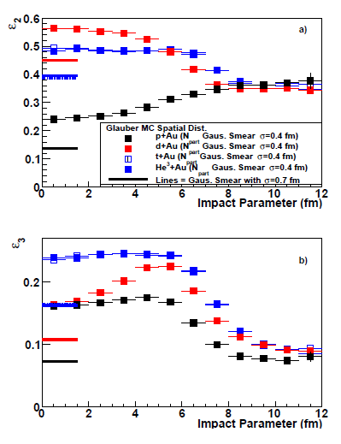
Comparing Systems
v₂ d+Au ~ v₂ ³He+Au
Expected
v₂ p+Au << v₂ ³He/d+Au

Slide 26
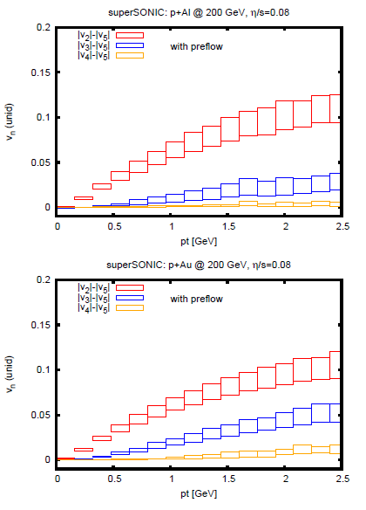
superSONIC predicts for p+Al and p+Au
Data taking for those systems at RHIC in the next couple of months!
Comparison of geometries at the same energy is key to discriminating competing explanations

Slide 27
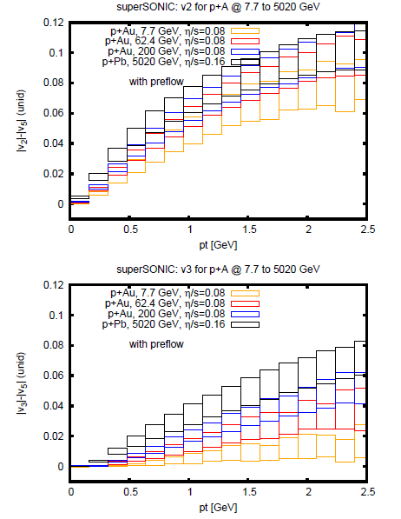
Does the signal
go away?
Considering proposal of d+A at 10, 39, 62 GeV to really see what happens in nature…

Slide 28
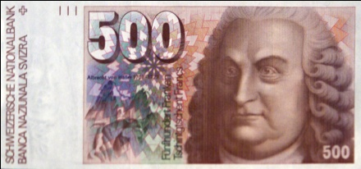
Important to investigate high multiplicity p+p at RHIC energies
What would it really cost to run d/³He+Pb at LHC?
Millions of CHF might be well justified.
LHC d/³He+Pb workshop?

Slide 29
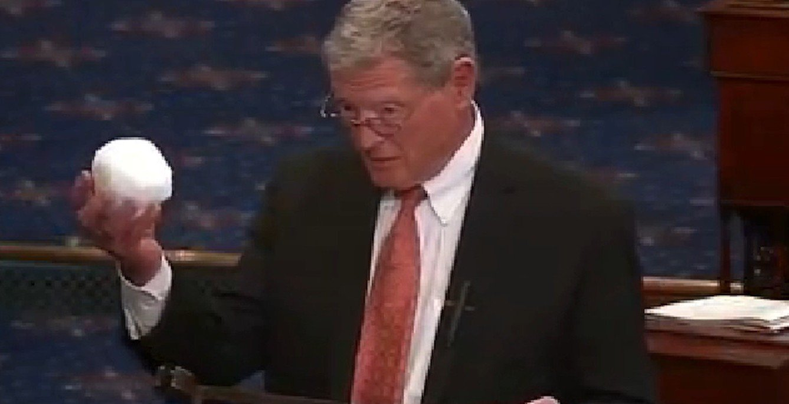
Escape Mechanism
Antenna
Opaque system boiling off particles will have anisotropic emission.
However, … think at least one step ahead and check…
Good to push on alternative ideas, but one snowball does not enable one to conclude that everyone else is wrong.

Slide 30
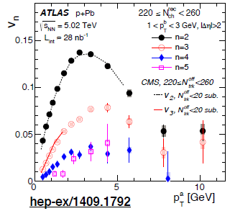
OTHER SIGNALS?
Makes sense to run all the usual signal codes and ask the same questions!
Autocorrelation?
Quenching?
Theory groups use pre-equilibrium + hydro space-time and calculate jet quenching observables.
What observables are most sensitive

Slide 31
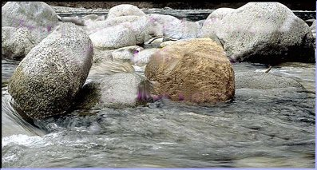
Fluid Probe:
Put a pebble in the stream
and watch something out of equilibrium then equilibrate.
Charm Quark
Perfect Fluid?
Beauty Quark
“Does the Charm Flow at RHIC?”
At the time, many said this idea was “ridiculous”.

Slide 32
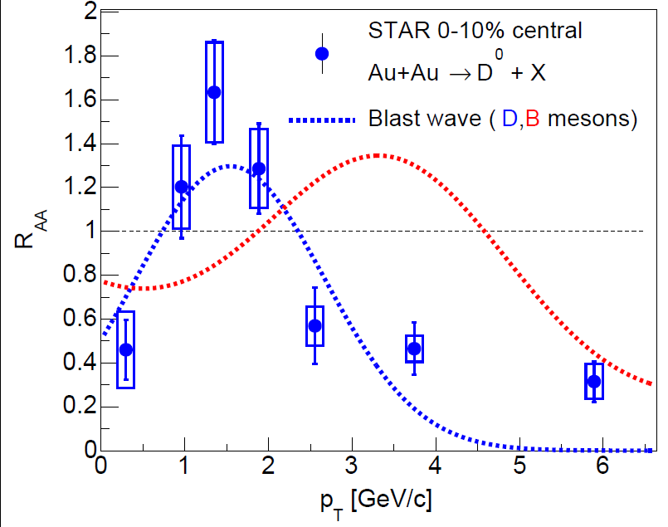
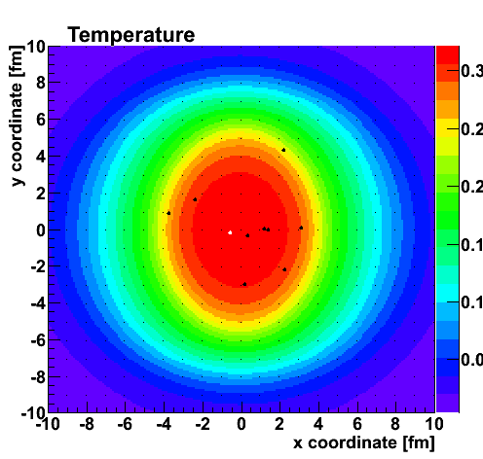
Ratio Au+Au / p+p
Charm quarks pushed out by blast wave of fluid
Decade old prediction

Slide 33
Summary
Of Thoughts

