Slide 1
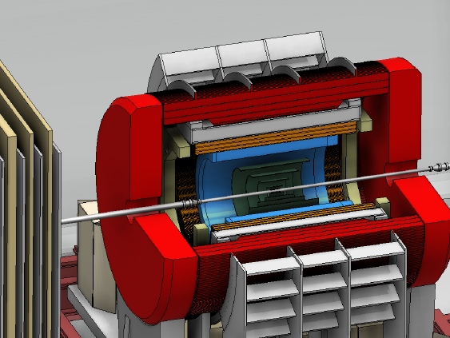
sPHENIX in World Context
Jamie Nagle (University of Colorado, Boulder)

Slide 2
Brookhaven Lab Proposed 10 Year Plan

Slide 3
LHC Physics in the Next Ten Years
Run 2
Run 3
Pb+Pb
Pb+Pb/p+Pb
Pb+Pb/p+Pb/Ar+Ar
RHIC
sPHENIX measurements well timed with
LHC Run-3 measurements
Very good for enabling theory focus
on simultaneous understanding

Slide 4
Future LHC Physics Capabilities
David Silvermyr (ORNL)
ALICE Major Upgrades – Pb+Pb 10 nb⁻¹ = 70 billion evts
Similar strategy to sPHENIX in terms of unbiased data sample
Focus different from sPHENIX’s on jet physics
ATLAS and CMS HI
Data samples 20-30x now

Slide 5
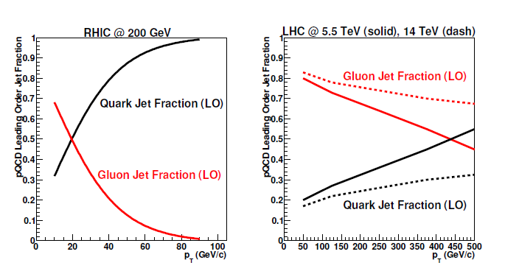
RHIC and LHC Together
It is fundamental to making major (paradigm changing) advances in the field to probe the QGP (through different temperature evolutions) at a range of length scales.
That program requires sPHENIX for precision overlapping and unique measurements from both RHIC and LHC
Kinematic differences also play a major role with sPHENIX changing the data landscape and constraining the underlying physics and QGP properties

Slide 6
RHIC with sPHENIX and STAR
sPHENIX DAQ bandwidth 10 kHz STAR DAQ bandwidth 2 kHz
Deadtimeless DAQ Competition of different trigger priorities
Full digitized calorimeter information for EMCal high tower and patch trigger
Level-1 triggered (full flexibility)
sPHENIX A+A can record 50B and sample 200B Full out MB currently, STAR would record 10B
HCal enables full jet patch trigger in p+p, p+A Utilizes EMCal trigger in p+p, p+A and A+A
HCal enables fragmentation function measure
with p and E independent
HCal enables charged hadron triggering
HCal enables good photon isolation cuts Utilizes EmCal and Tracks
HCal rejects electron backgrounds Electron ID with TPC, TOF, EMCal
HCal acts as magnetic flux return
HCal in detector with tracking – both ATLAS/ Only STAR/ALICE jet types
CMS jets and STAR/ALICE jets for comparison
Upsilon large acceptance and mass resolution STAR MTD 1/7 of acceptance, lower resolution
sPHENIX huge data sample with jets with very good statistics in the energy range 20-70 GeV, includes key overlap with LHC jet range and methods
HCal resolution best in upper range, sPHENIX uniquely enables FF measurement, enables to dial the surface engineering bias to do full tomography

Slide 7
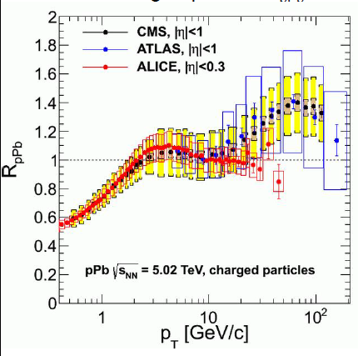
Proton+Nucleus Surprises
sPHENIX provides discriminating power on p+A physics explanations
Enabled by p+p/p+A Hcal triggering (as done in CMS for example)
x₂ ~ 0.06
x₂ ~ 0.6
R_{pAu}
sPHENIX covers up to very high Bjorken x₂.

Slide 8
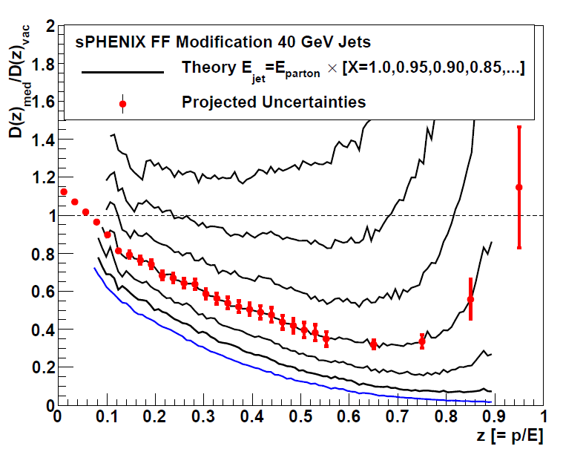
Unique Measurement Example
Predictions that Fragmentation Function D(z) = p / E_{parton} will have dramatic high-z suppression
If E_{jet} < E_{parton} in A+A due to out of cone radiation or
medium excitation or … then shifting z denominator
sPHENIX enables precision measurement
Cannot be done otherwise at RHIC
Coupled with precision measure at LHC across different jet energies and different QGP couplings →Definitive Answers
arXiv:0710.3073

Slide 9
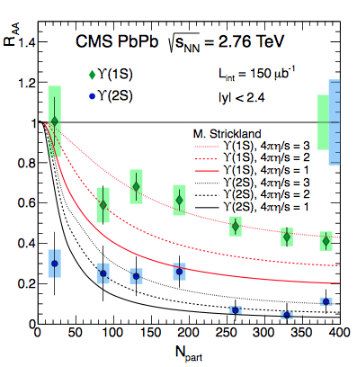
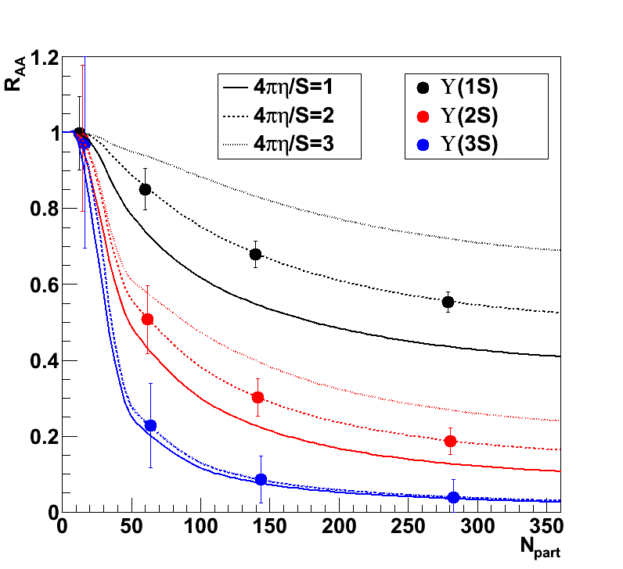
World Upsilon Look Forward
Current RHIC & LHC Picture
Picture in 2023
CMS with reduced uncertainties
sPHENIX with unique combination of lever arm and precision
Constraining key QGP properties

Slide 10
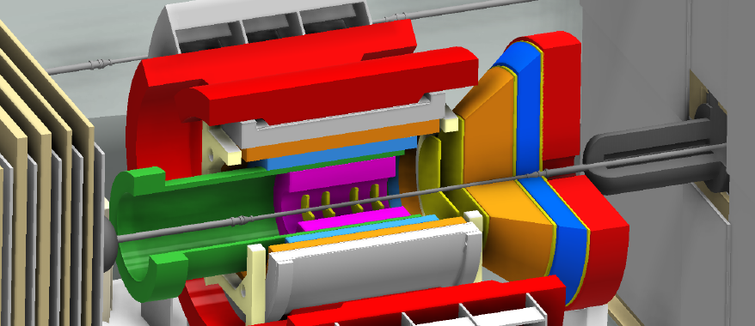
Electron Ion Collider (EIC) Detector Concept
Built around the BaBar Magnet and sPHENIX Calorimetry
BaBar magnet has extra coil density near the ends – with proper flux return shaping, provides good analyzing power at very forward angles
sPHENIX EMCal meets EIC detector specifications
http://arxiv.org/abs/arXiv:1402.1209

Slide 11
EIC Concept Review (January 10, 2014)
Reviewers: Sam Aronson (BNL); Krishna Kumar (UMass-Amherst); Jianwei Qiu (BNL); Veljko Radeka (BNL); Paul E. Reimer (ANL); Jim Thomas (LBNL); Glenn Young (JLab)
“The review team was unanimous in its praise for the LOI.
It was clear (and encouraging) to the review team that key elements of the LOI were prepared and presented by some of the more junior members of the collaboration. The review team found merit in the path chosen by the PHENIX Collaboration in responding to the Laboratory’s plans for evolving the facility from RHIC to eRHIC.
This approach allows for a cost-effective way of providing the capability to address the physics agenda of eRHIC from Day-1 of eRHIC operation.
We thought it well demonstrated that [this EIC detector] would be a good day-one detector capable of addressing almost all of the physics that can be covered by eRHIC. It also appears to be a solid foundation for future upgrades so that it can explore the full physics potentials available as eRHIC itself evolves.”

Slide 12
World Context Summary
The impact of the planned scientific program on the advancement of nuclear physics in the context of current and
planned world-wide capabilities
sPHENIX is crucial to the advancement of our knowledge of the QGP in key areas
sPHENIX will provide key measurements that will add uniquely to our picture of strongly interacting matter
‘How’ and ‘why’ questions on the QGP will be left with incomplete answers without sPHENIX

Slide 14
Extras

Slide 16
STAR Jet Program
Slide from Joern Putschke at QM 2014

Slide 17
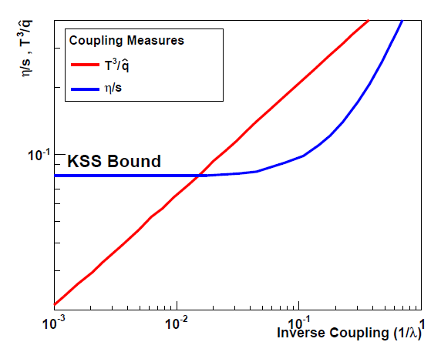
Coupling Measures
η/s
^
T³/q
“Small Shear Viscosity Implies Strong Jet Quenching”
A. Majumder, B. Muller, X.N. Wang, PRL (2007).
Measure both sides to check strong versus weak case.

Slide 19
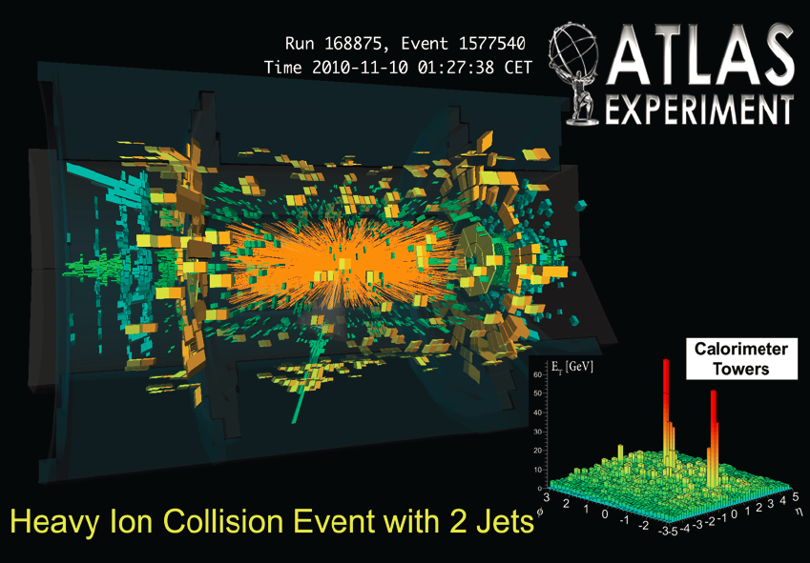
Why Hadronic Calorimetry?
ATLAS and CMS heavy ion jet observables come from calorimeter measurements
Ability to try different methods (supplementing with tracking) is also an advantage
Critical to have EMCal + HCAL with continuous coverage (no gaps, spokes, holes) with large acceptance to see both jets and γ-jet and at very high rate. Then add in tracking information as key additional handle for systematic studies
Also, when measuring fragmentation functions, hadron p_{T} and jet energy measures are independent
Crucial for triggering in p+p, p+A without jet bias

