Slide 1
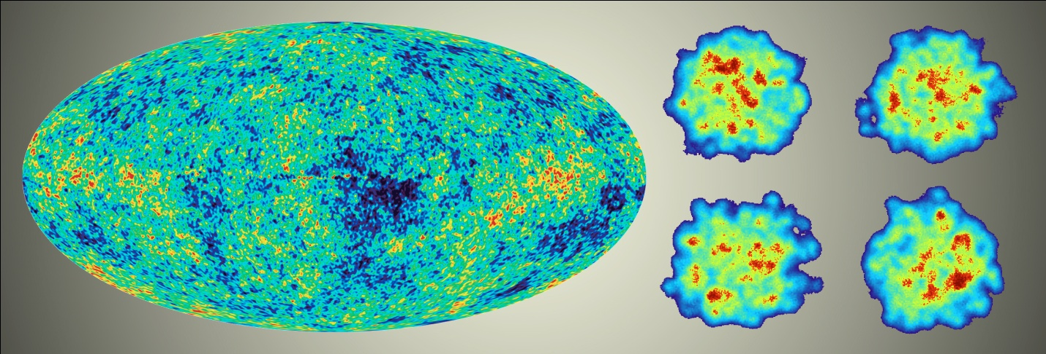
Discovery to Precision to Discovery:
Quark-Gluon Plasma Physics
Jamie Nagle
University of Colorado, Boulder, USA
Colloquium at the University of New Mexico April 18, 2014

Slide 2
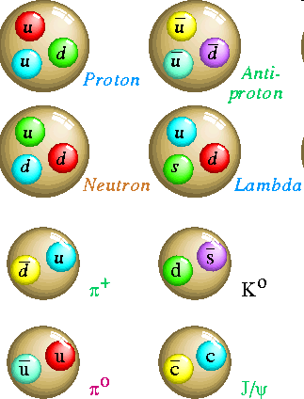
Quantum Chromodynamics
Hadrons are composite objects made of quarks and gluons
QCD is a “confining” gauge theory, with an effective potential
V(r)
“Coulomb” “Confining”
r
No one has ever seen a free quark

Slide 3
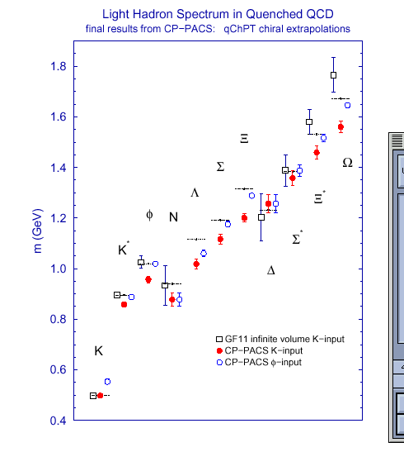
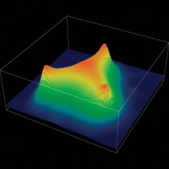
We have strong evidence that QCD is the
correct theory of the strong interaction
Perturbative Calculations
Lattice Calculations
And yet, there is much about the strongly interacting world we cannot calculate from the QCD Lagrangian

Slide 4
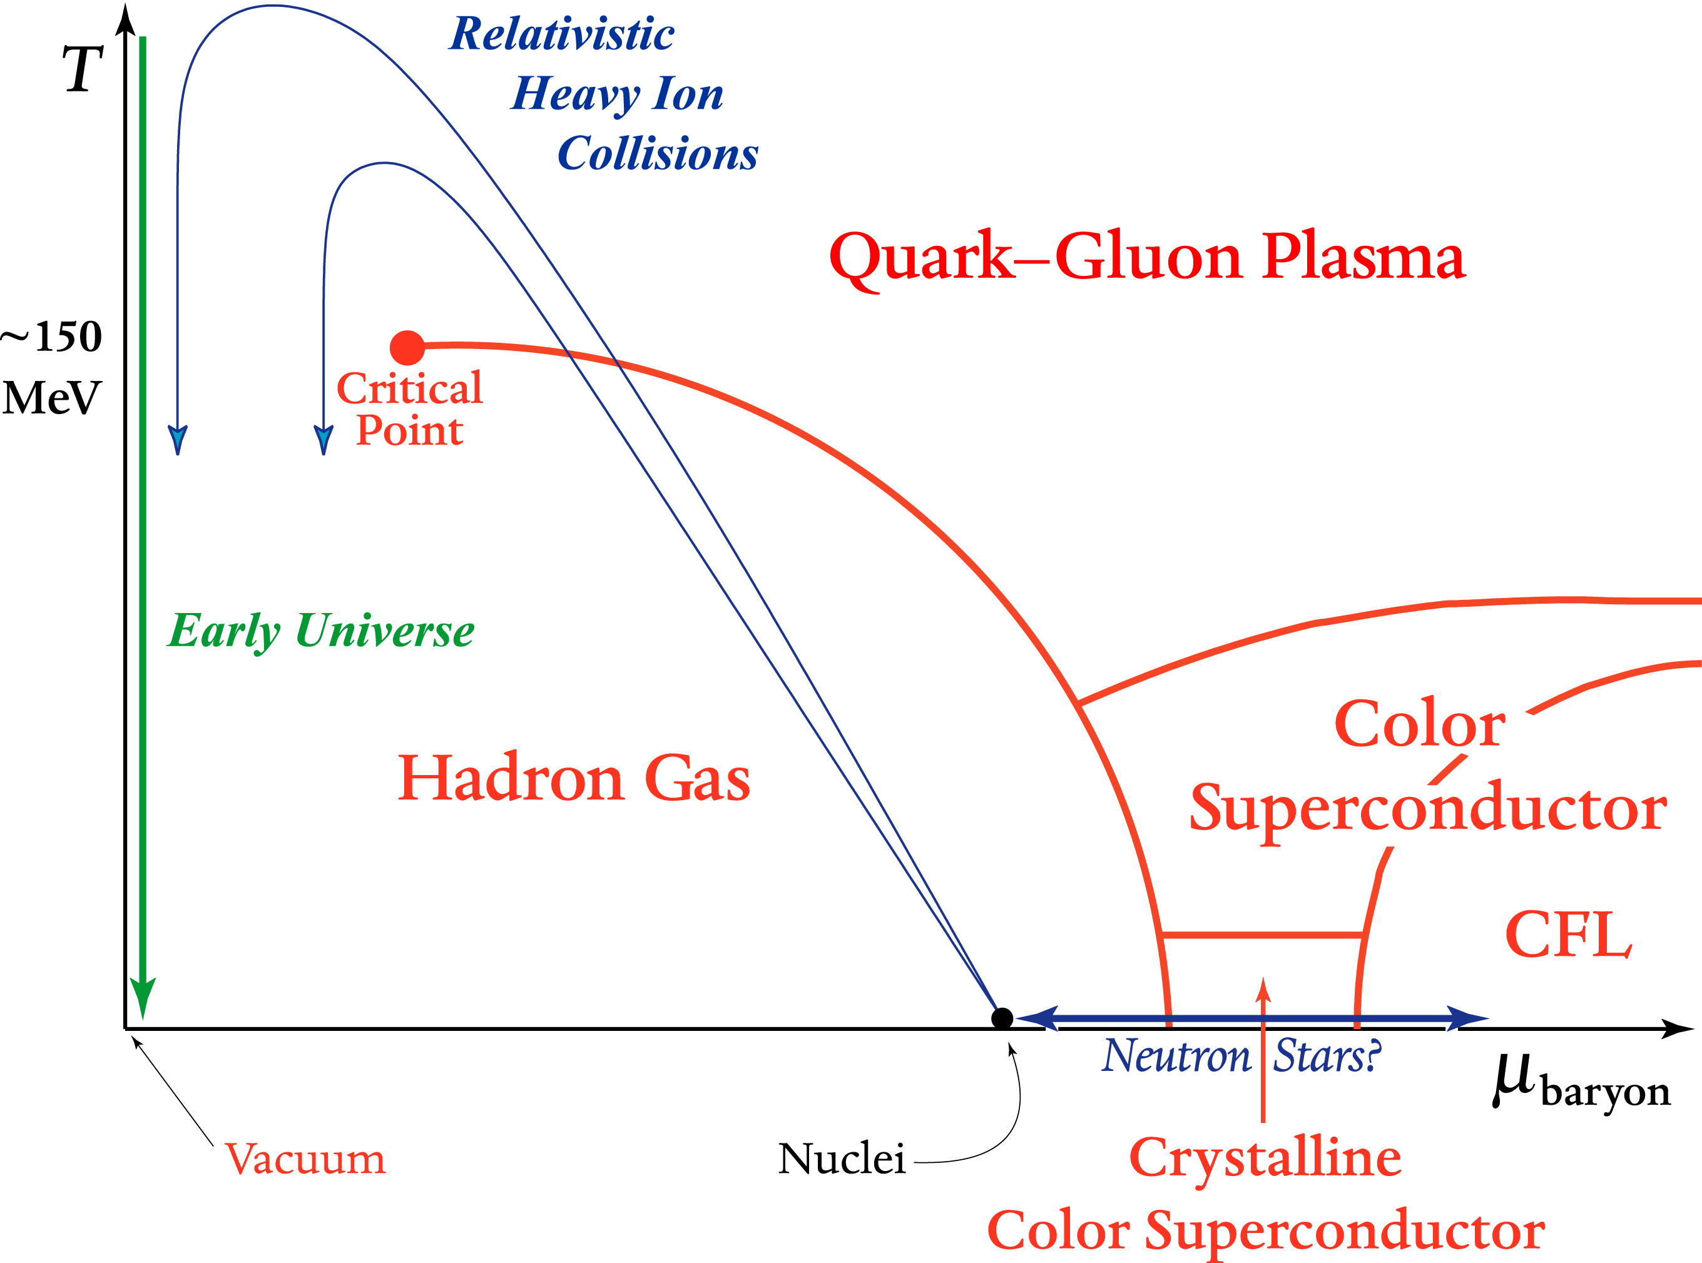
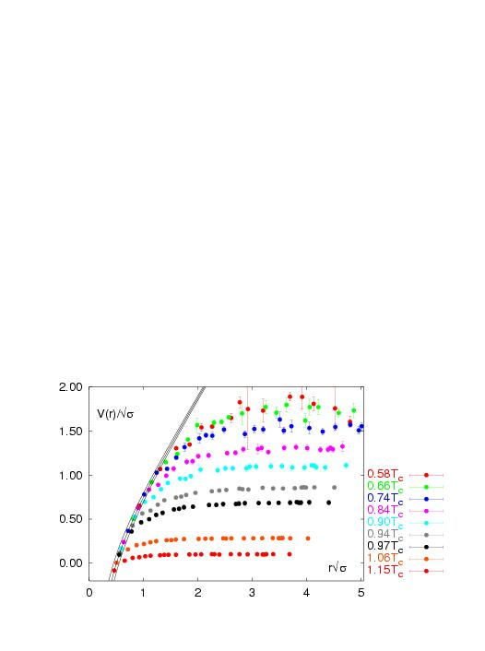
What about Hot QCD Matter?
Quark Gluon Plasma without color confinement
V(r)
r
Lattice QCD
V(r)/√σ
Screening of long range confining potential expected at high enough temperature or density
r√σ

Slide 5
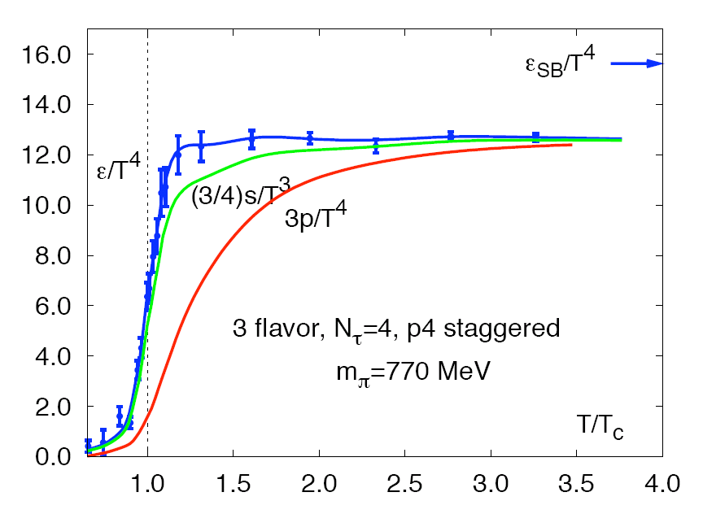
Energy density for “g” massless degrees of freedom
Hadronic Matter:
3 π with spin=0
Quark Gluon Plasma:
8 gluons;
2 quark flavors, antiquarks, 2 spins, 3 colors
Lattice QCD
Degrees of Freedom increases x10
Lattice indicates smooth cross over, not 1st/2nd order
Weakly interacting
quarks & gluons (?)

Slide 6
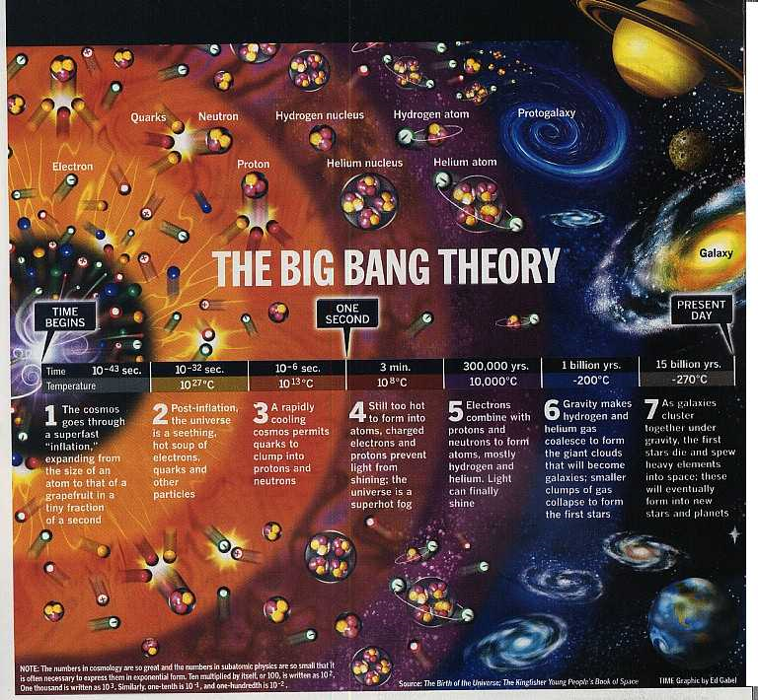
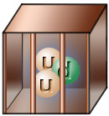
Very early in the universe, quarks and gluons were free in a plasma state
As the universe cooled, they were confined and have remained that way since

Slide 7
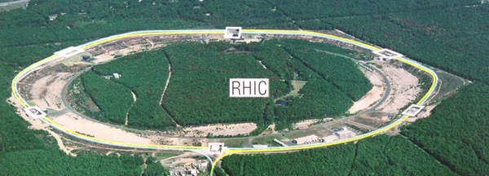
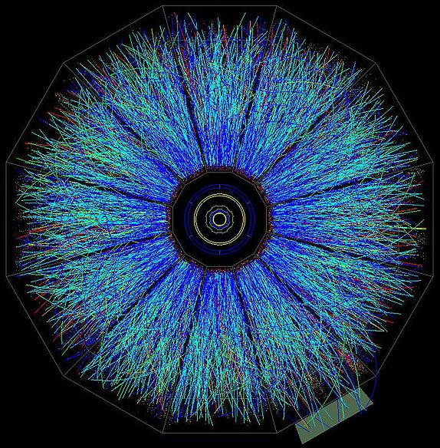
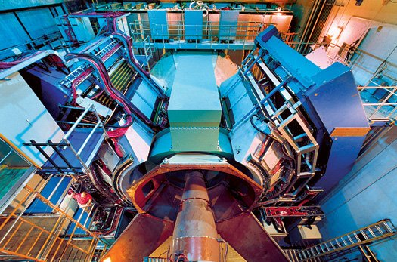
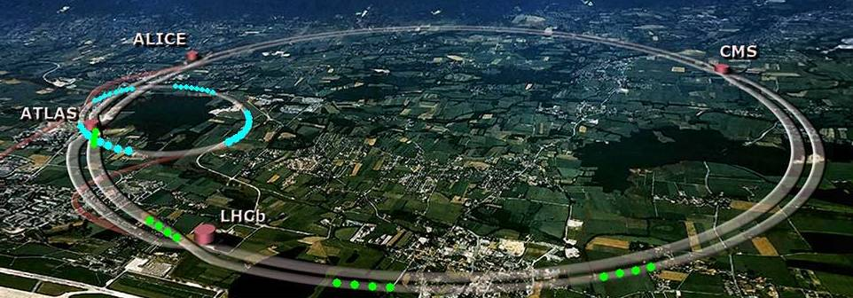
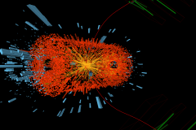
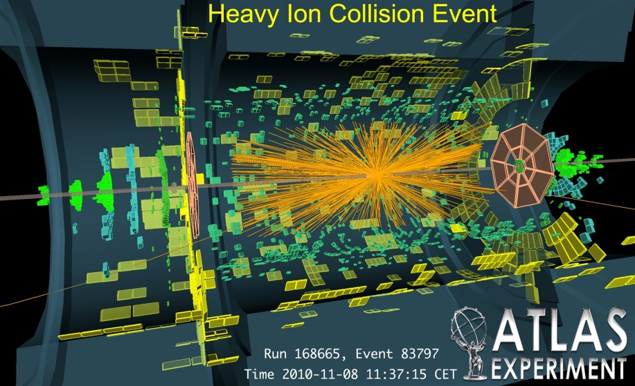
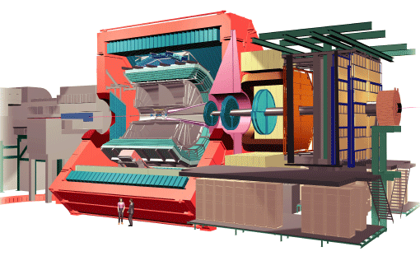
Laboratory Microscopes
RHIC
PHENIX
STAR
LHC
CMS
ALICE

Slide 8
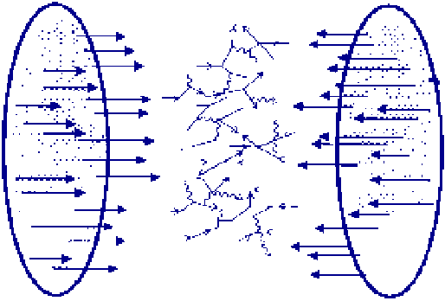
10,000 virtual gluons, quarks, and antiquarks
from the nuclear wavefunctions
are made physical in the laboratory !

Slide 9
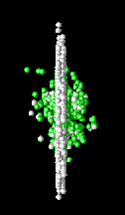
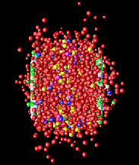
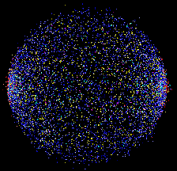
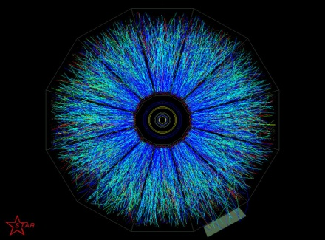
Time Evolution
0 fm/c
5 fm/c
10 fm/c
>15 fm/c

Slide 10
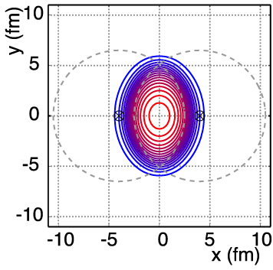
Non-Central A+A Geometry
v₂ = “elliptic flow”

Slide 11
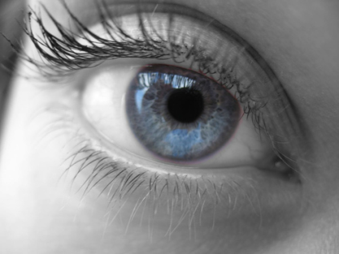
Large Elliptic Flow
Literally “seen” in first days at RHIC

Slide 12
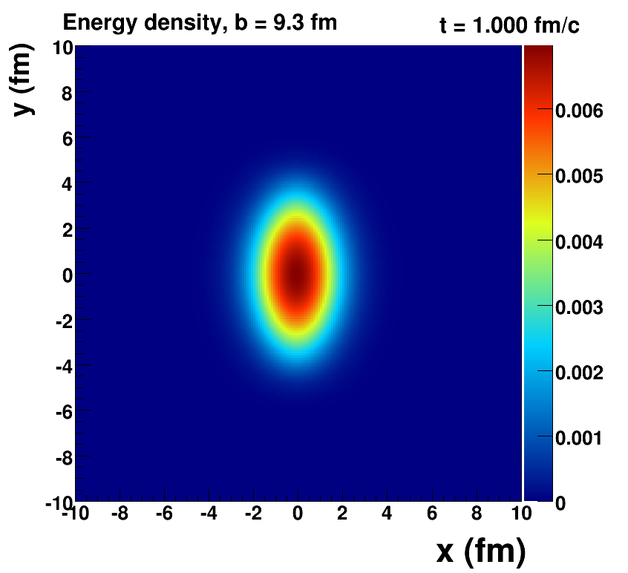
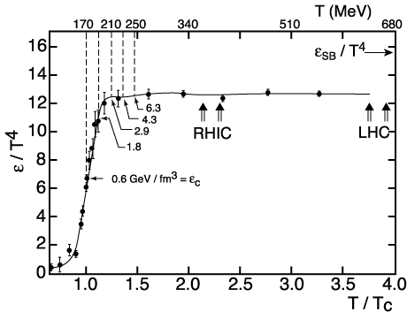
How Large is the Flow Really?
Assume early thermalization and run ideal hydrodynamics (i.e. no dissipation → zero shear + zero bulk viscosity)
Key Inputs:
Initial Geometry
QCD Equation of State

Slide 13
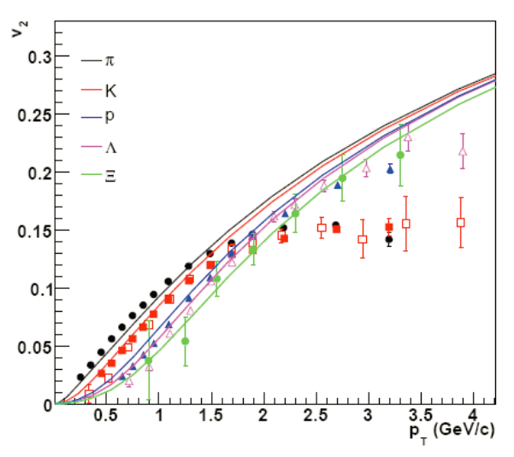
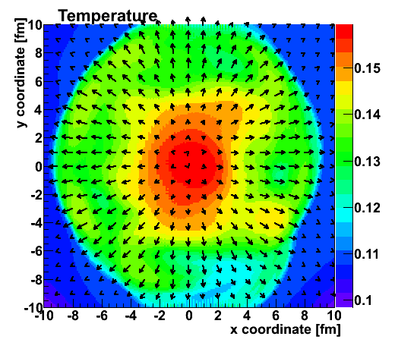
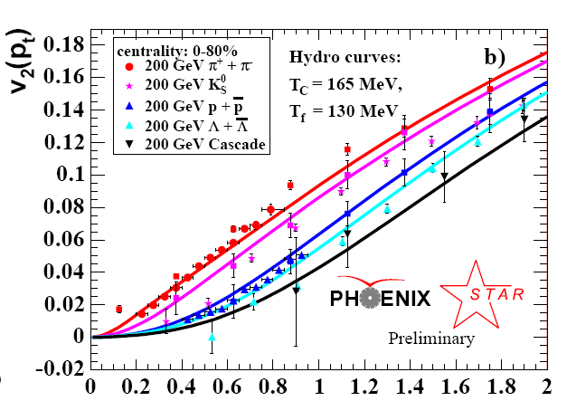
Fluid cells “freeze-out” below T_{f}
Isotropic hadrons in cell rest frame, then boosted
v₂
Temperature Profile + Velocity Vectors
v2
p_{T} (GeV)
Characteristic “fingerprint” flow pattern
Circa 2005: Quark-Gluon Plasma = Perfect Fluid

Slide 14
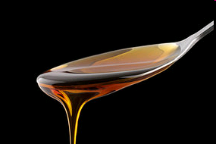
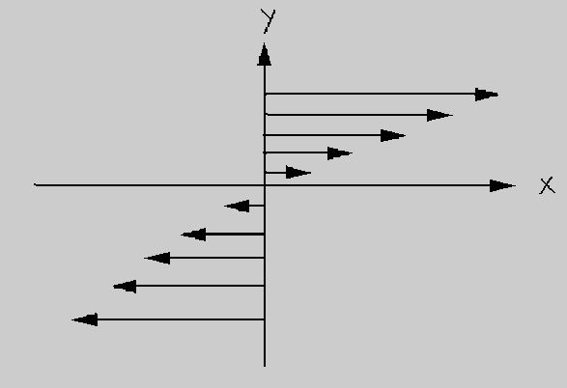
Viscosity Review
Honey – viscosity decreases at higher temperatures
viscosity increases with stronger coupling

Slide 15
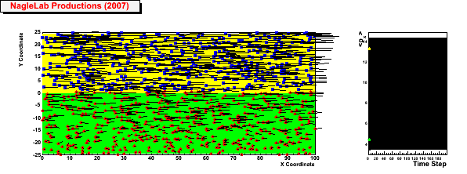
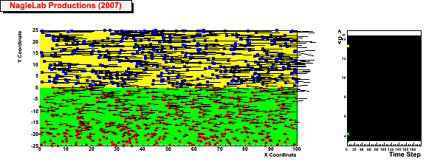
Viscosity Review
Honey – viscosity decreases at higher temperatures
viscosity increases with stronger coupling
Weak coupling (σ=0)
Inhibited
diffusion
↓
Small
viscosity
↓
Perfect fluid
↓
Strong Coupled QGP
(i.e. sQGP)
<p_{x}> top region
<p_{x}> bottom region
Strong coupling (σ ↑)

Slide 16
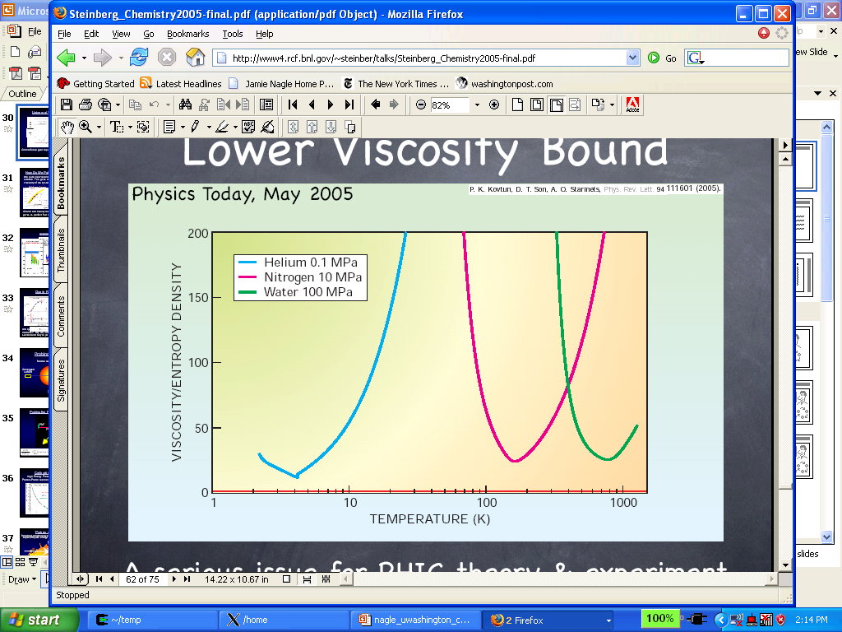
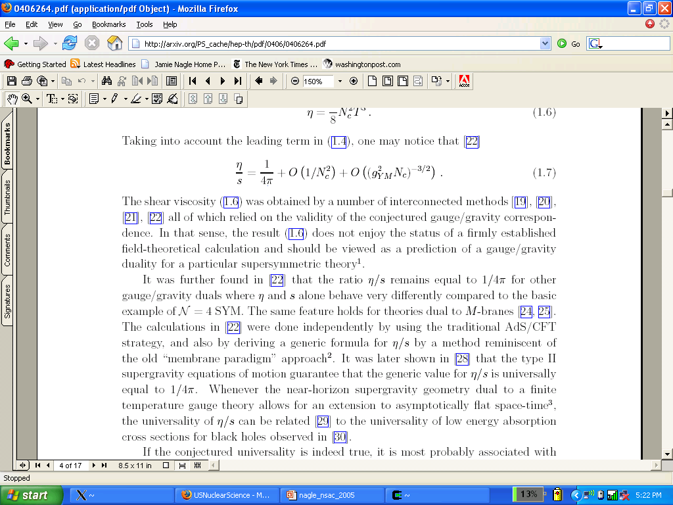
What is η/s for QCD matter at a trillion Kelvin?
String Theory
Lowest Bound!
QGP?
Gas-Liquid Phase Transition
Superfluidity Transition

Slide 17
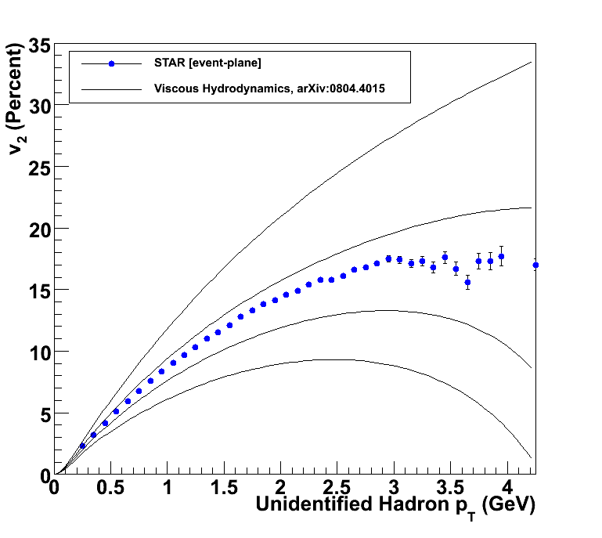
How to Quantify QGP η/s?
Relativistic viscous hydrodynamics compared to data
Luzum, Romatschke, Phys. Rev. C78, 034915 (2008)
η/s ~ 0
η/s = 1/4π
η/s = 2 x 1/4π
η/s = 3 x 1/4π

Slide 18
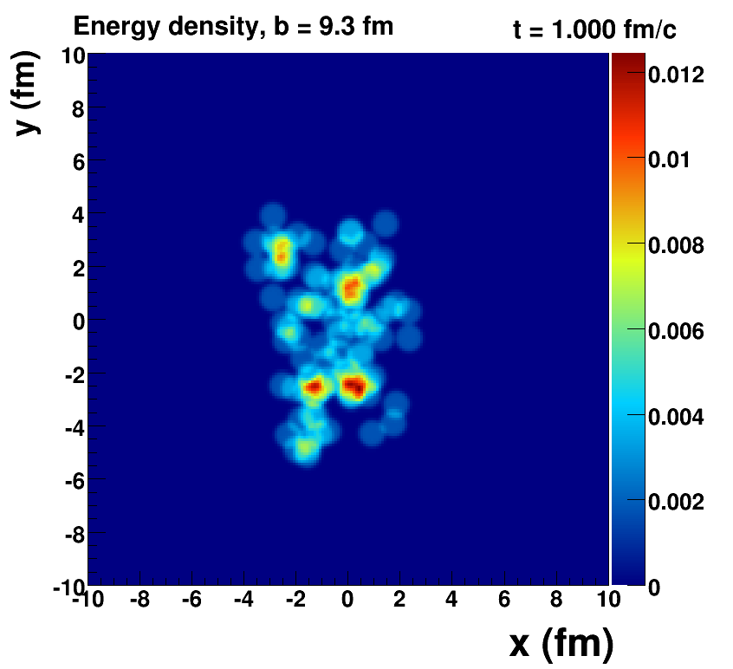
Romatschke=viscous hydrodynamics, McCumber=lumpy conditions + animation

Slide 19
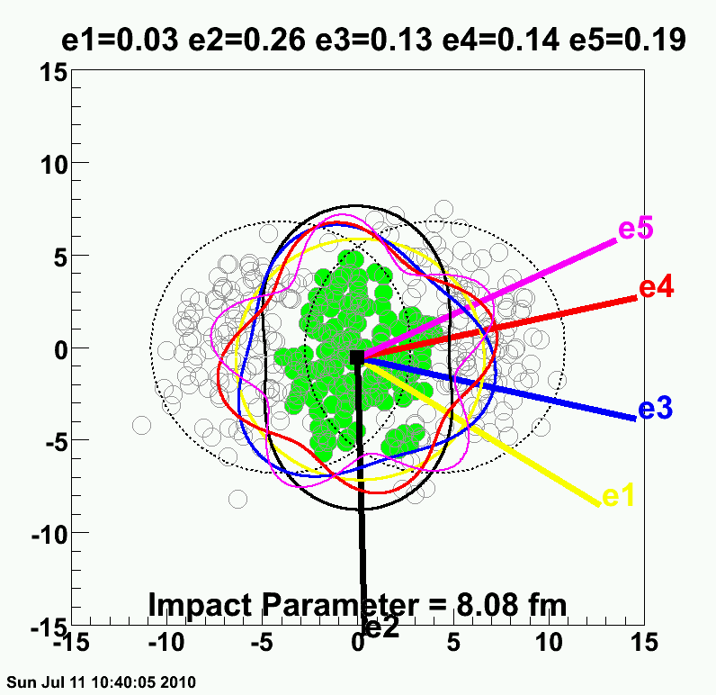
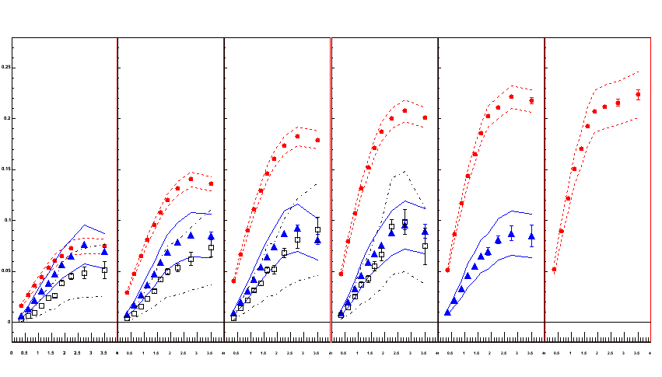
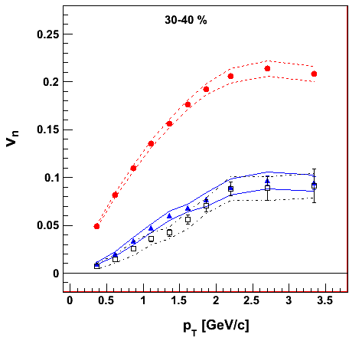
PHENIX Experiment
v₂ {Φ₂ forw.η}
v₃ {Φ₃ forw.η}
v₄ {Φ₄ forw.η}
TT
v_{n} {EP}
Au+Au at 30-40% Central
200 GeV AuAu – 30-40% Central
PHENIX Preliminary
0.20
Elliptic
Triangular
ε₂ ≈ 2 x ε₃ ≈ 2 x ε₄
0.10
Early geometric features survive through QGP evolution because of very small dissipation
0.0
Quadrangular
0.0
1.0
2.0
3.0
p_{T} (GeV/c)

Slide 20
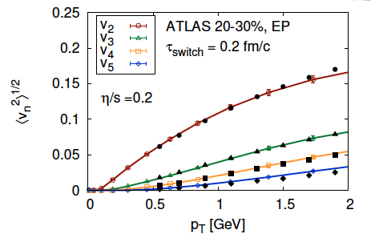
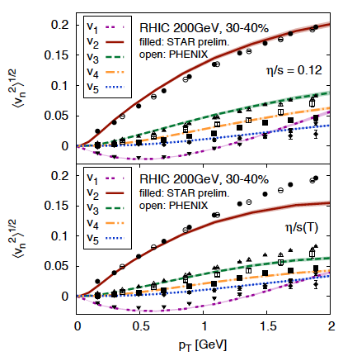
Detailed Fingerprint of Early Time
Quantum Fluctuations
Survive Evolution!
Calculation from Bjoern Schenke

Slide 21
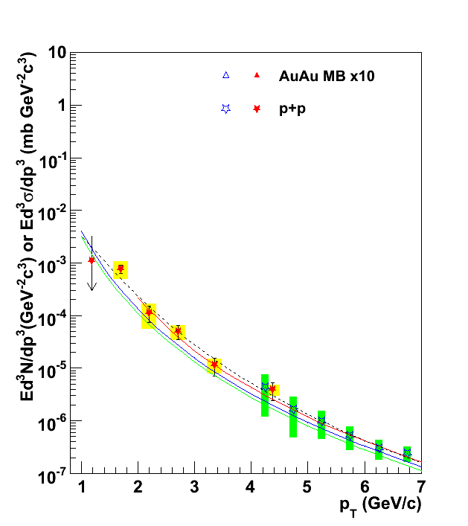
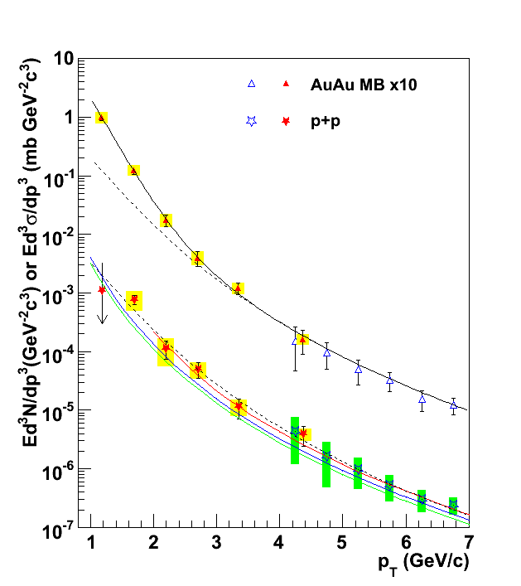
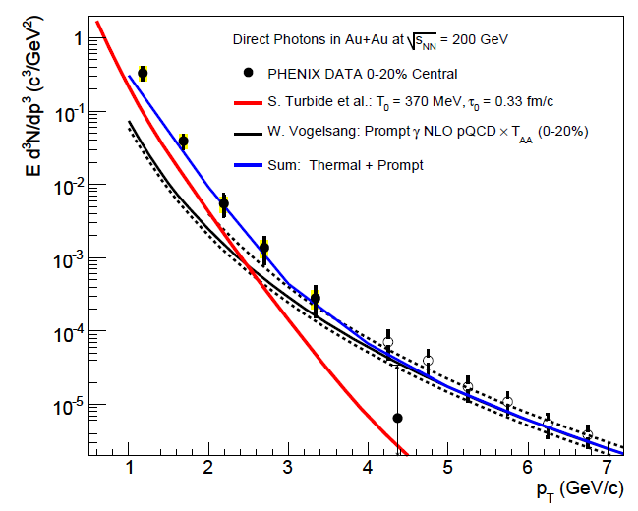
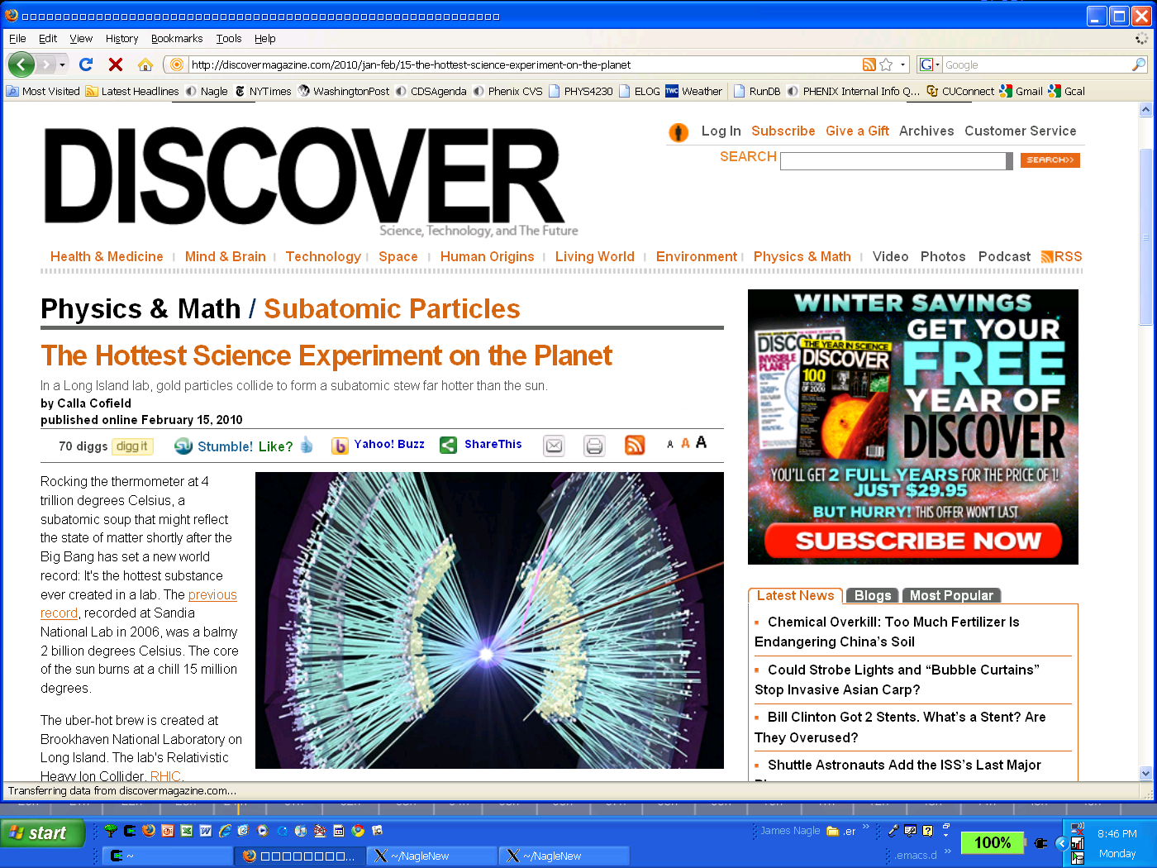
Thermal Photon Emission
T_{AA} scaled pp + Exponential
Gold-Gold
Direct Photons
Proton-Proton
Direct Photons
Fit to pp
NLO pQCD (W. Vogelsang)
PHENIX: Phys.Rev.Lett. 104 (2010) 132301

Slide 22
“Little Bang” Standard Model
Discovery: Quark Gluon Plasma = Near Perfect Fluid
Standard Model with Hydrodynamic Evolution
Precision: Predictions of Flow Patterns
but…
How does it equilibrate so quickly?
What are the degrees of freedom or quasiparticles?

Slide 23
Back to Discovery (?)
A+A
Enough particles to equilibrate, QGP, collective motion
p+A
Not enough particles to equilibrate, control experiment

Slide 24
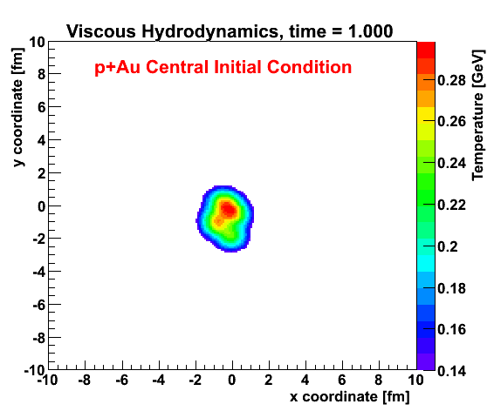
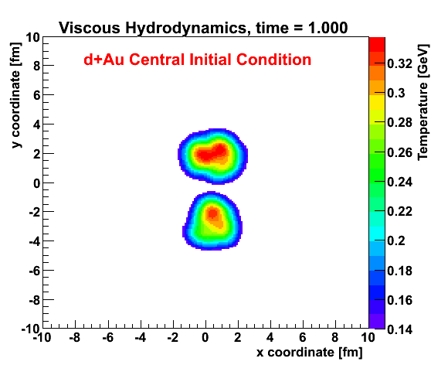
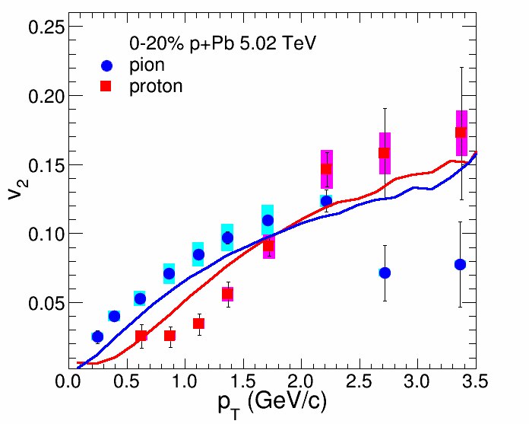
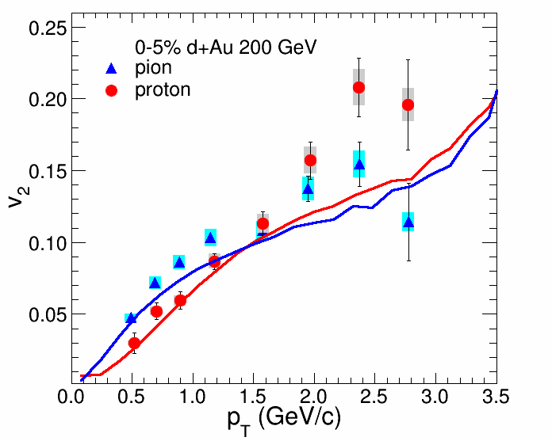
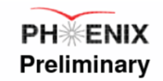
Viscous Hydrodynamics + Cascade
Similar Flow Fingerprint?
Small QGP?
ALICE Experiment
p+Pb @ LHC
PHENIX
d+Au @ RHIC

Slide 25


Geometry Engineering
Proposal to run “triangular” system
at RHIC
Small systems challenge our picture of required time and size scales
http://arxiv.org/abs/arXiv:1312.4565

Slide 26


Alternative Fluid Probe:
Put a pebble in the stream
and watch something out of equilibrium then equilibrate.
Charm Quark
Perfect Fluid?
Beauty Quark
“Does the Charm Flow at RHIC?”
At the time, many said this idea was “ridiculous”.

Slide 27



Ratio Au+Au / p+p
Charm quarks pushed out by blast wave of fluid
Decade old prediction

Slide 28


Answering the Why and How?
When does the strongly coupled bulk (lower momentum IR)
transition to a weakly coupled probe (higher momentum UV)?

Slide 29



What happens to a colored object
(far out of equilibrium) as it
traverses the QGP?
Think deep-inelastic scattering of QGP

Slide 30

As high energy quarks or quark-antiquark pairs traverse the QGP, what do they see?
Do the highest energy
jets at LHC see
point-like color charges?
1/λ
Do the lowest energy jets at RHIC scatter from coherent fields or only excite sound waves?

Slide 31



Coupling Measures
η/s
^
T³/q
“Small Shear Viscosity Implies Strong Jet Quenching”
A. Majumder, B. Muller, X.N. Wang, PRL (2007).
Measure both sides to check strong versus weak case.

Slide 32


sPHENIX Proposal
Major new detector project at RHIC
Large coverage calorimetry coupled with high rates
http://arxiv.org/abs/arXiv:1207.6378

Slide 33

RHIC Jet Rates
Sampling 50 billion Au+Au
events in one year
10⁷ jets > 20 GeV
10⁶ jets > 30 GeV
80% are dijet events
10⁴ direct γ > 20 GeV
A+B
p+A (different nuclei)
U+U
Differential measures

Slide 34



RHIC Jet Discriminating Power
C. Young, B. Schenke; G-Y Qin, B. Mueller

Slide 35


Comprehensive picture across scales and QGP temperatures spanned by RHIC and LHC needed
Lever Arm, Strongest Coupling Near T_{c}?
What is the Underlying Physics?
Example RHIC precision measurement

Slide 36


Very Fun to Build Something New!

Slide 37








Top fiber
Bottom fiber

Slide 38



Sometimes it is better to borrow something working!

Slide 39


Spin Physics Program
Very early realization to expand RHIC program with spin polarized protons
Simple picture of three spin ½ quarks determining spin ½ proton not correct
Quarks
Gluons
Orbital Angular Motion
Proposal for polarized Electron Ion Collider turning online in 2025

Slide 40

Electron Ion Collider
Critical to understanding nature of proton and heavy nuclei
Key to picture of gluonic initial starting point for QGP
Detector built around BaBar magnet and sPHENIX serves as excellent foundation for EIC detector
http://arxiv.org/abs/arXiv:1402.1209
http://arxiv.org/abs/1212.1701

Slide 41

President’s FY12 Budget indicated bad news for Nuclear Physics
Crisis assessment subcommittee – what would we do?
FY13 Budget had +$50M increase for NP, passed by Congress
FY14 Proposed +4% increase, more good news
One of the best running periods ongoing now
Exciting scan of QCD phase diagram
sPHENIX running!
Transition to Electron Ion Collider

Slide 42


Powerful Microscopes → New Ideas
g-2 experiment – tantalizing hint for new physics
One idea: TeV scale particles (SUSY) → Frontier is LHC
Another idea: MeV scale particles with very weak coupling
(e.g. Dark Photon)
Coupling
Mass

Slide 43
Summary
Discovery of Quark-Gluon Plasma as Perfect Fluid
Precision Description of Flow
“Little Bang” Standard Model
New Questions about Small QGP
New Opportunities to Discover the How and Why of the QGP

Slide 45


Quarkonia
Bound states of cc and bb can be Debye color screened in the QGP as one increases the temperature (melting)
J/ψ Suppression
Bizarre twist
Less suppression at LHC with higher temperature.
Quark deconfinement and charm recombination at LHC.
LHC
RHIC

Slide 46





Quarkonia Thermometer
Many states constrains the temperature
PHENIX, STAR, and CMS data consistent with melting of Υ(2s,3s)
N_{part}

Slide 47


sPHENIX Upsilon Measurements
Au+Au Central
Extremely exciting LHC Upsilon results
Key to map out temperature dependence with precision

