Slide 1
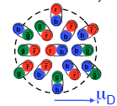
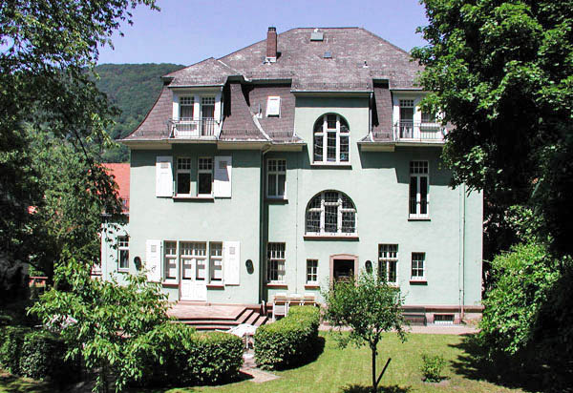
Probing the QGP across length scales…
Jamie Nagle, University of Colorado
Search your feelings…
You know it to be true
x1/10
x2
x5
x100
"Ab initio approaches in many-body QCD confront heavy-ion experiments" Heidelberg, Germany on December, 2014.

Slide 2
Proton + Nucleus Collision
Projectile, Target Participants

Slide 3
MC Glauber – initial energy density of participants, large eccentricities from fluctuations

Slide 4
IP Glasma– initial energy density only in region where nucleons overlap, much smaller eccentricities

Slide 5
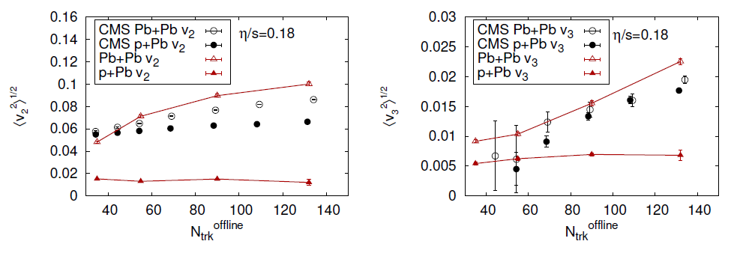
Initial Geometry + Hydrodynamics
IP Glasma + Hydro – under-predicts p+Pb v₂ and v₃ by x3
One could enhance the
effect by including
fluctuating proton shape,
still smaller initial size

Slide 6
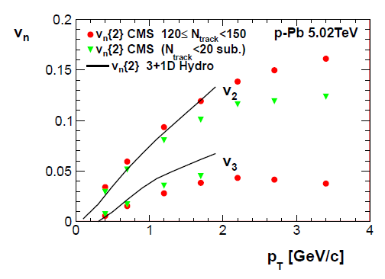
Glauber + Hydro (Bozek) – qualitative description of v₂ and v₃
no pre-equilibrium, no hadronic cascade
Romatschke et al. Hydro + Cascade

Slide 7
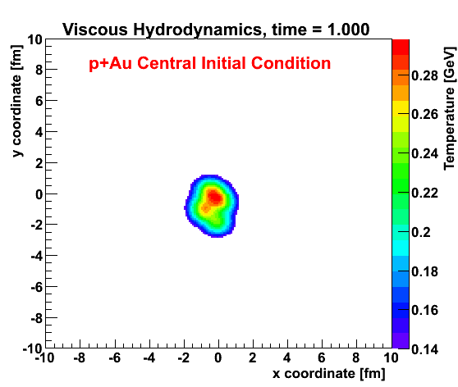
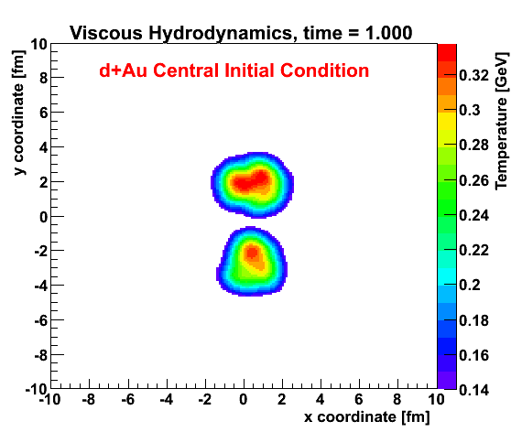
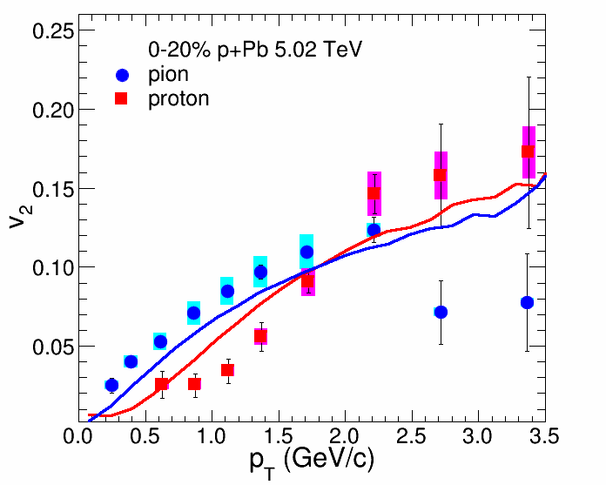
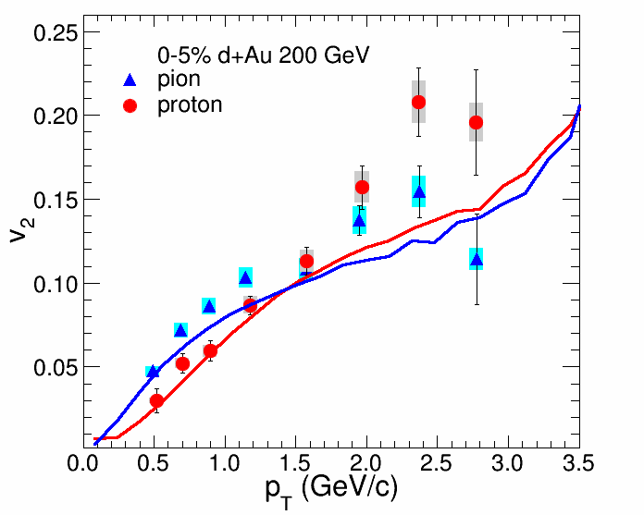
ALICE Experiment
p+Pb @ LHC
PHENIX
d+Au @ RHIC

Slide 8
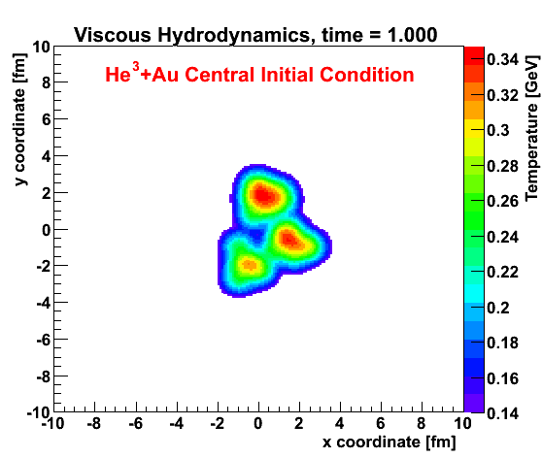
Geometry Engineering
Proposal to run “triangular” system
at RHIC
Small systems challenge our picture of required time and size scales
http://arxiv.org/abs/arXiv:1312.4565

Slide 9
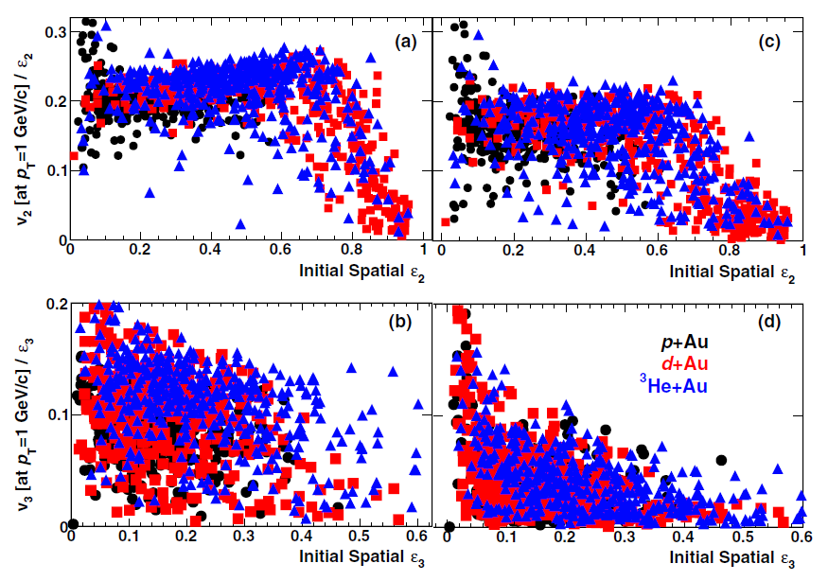
Not Enough Time?
T_{f} = 150 MeV
T_{f} = 170 MeV
v₂
ε₂
v₃
ε₃

Slide 10
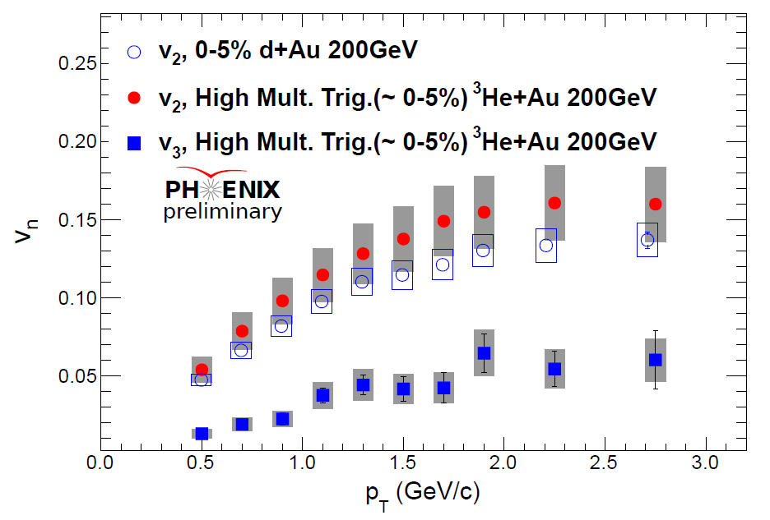
Glauber IC + Hydro (η/s=1/4π) + Hadronic Cascade (PRL 2014)
Dashed Lines – adding pre-flow (Romatschke’s AdS/CFT calc.)

Slide 11
IP Glasma gives very different eccentricity from Glauber in pA
(Schenke, Venugopalan)
However, in d+Au and ³He+Au,
the eccentricity is driven by the 2 and 3 hot stops,
not their individual geometry
Note though that the IPGlasma has a smaller hot spots
with higher energy density that result in
more rapid radial expansion

Slide 12
IP Glasma + MUSIC (η/s = 1.5 x 1/4π)
Much larger initial radial expansion, but also no late cascade

Slide 13
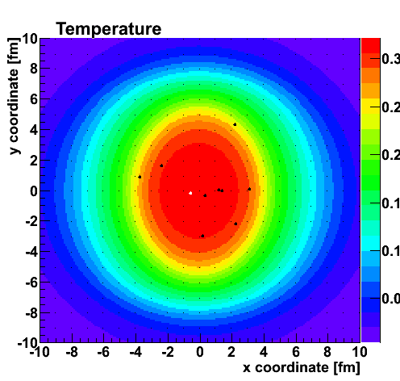
Need to look for all the usual signals in p(d/He)+A
And with theory tools understand new ones…
d/He+Pb Workshop for LHC ?

Slide 14
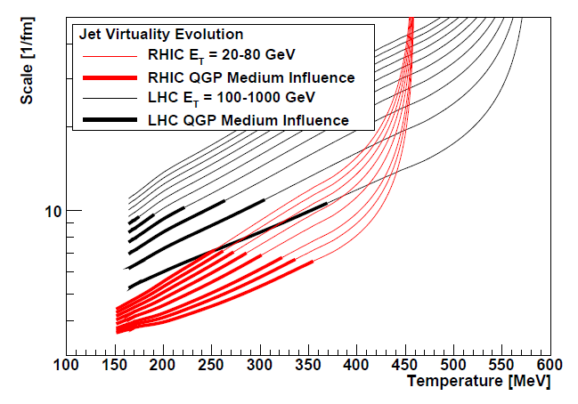
Bare Color
Charges
Thermal Mass
Gluons
Color
Magnetic
Monopoles?
Most Perfect Fluid
Key part of RHIC and LHC future program

Slide 15
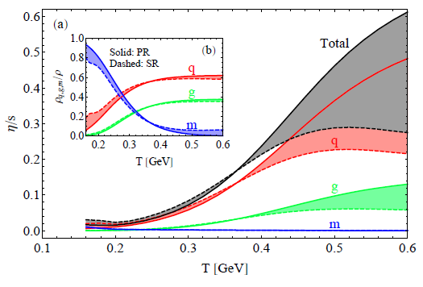
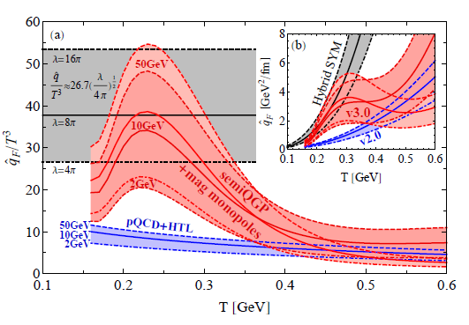
Deeper Connections

Slide 16
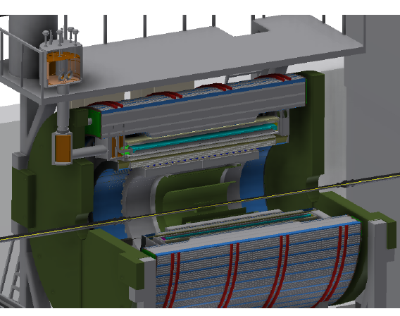
Key Probes at RHIC and LHC
BaBar Magnet 1.5 T
Coverage |η| < 1.1
All silicon tracking
Heavy flavor tagging
Electromagnetic
Calorimeter
Two longitudinal
Segment Hadronic Calorimeter
High data acquisition rate capability ~ 15 kHz
http://www.phenix.bnl.gov/phenix/WWW/publish/documents/sPHENIX_proposal_19112014.pdf

Slide 17
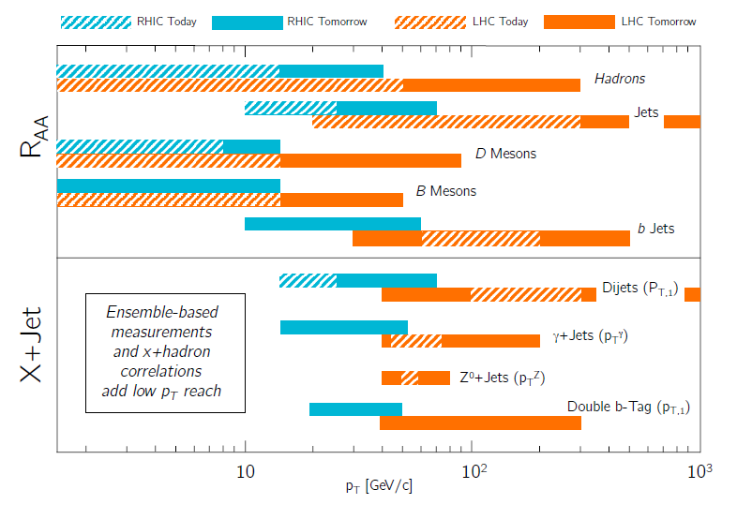
G. Roland – QCD Town Meeting

Slide 18
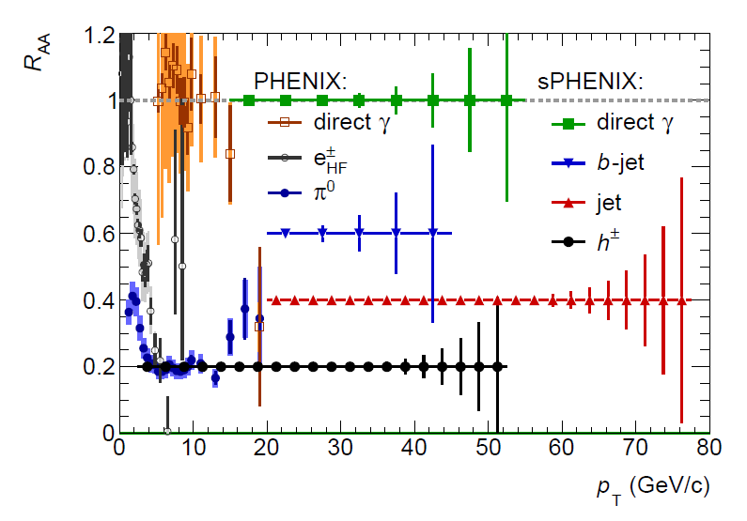
sPHENIX + RHIC Luminosity → 0.6 trillion Au+Au collisions

Slide 19
Flat or not flat – what is the physics?
Precision at LHC and doubling the p_{T} range at RHIC

Slide 20
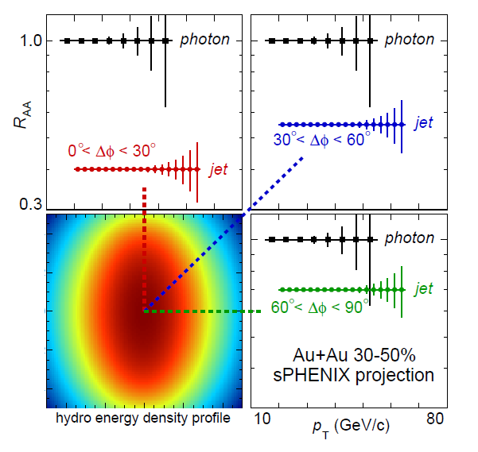

Slide 21
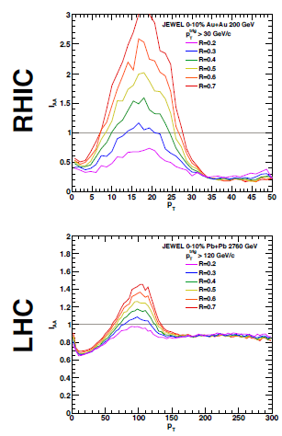
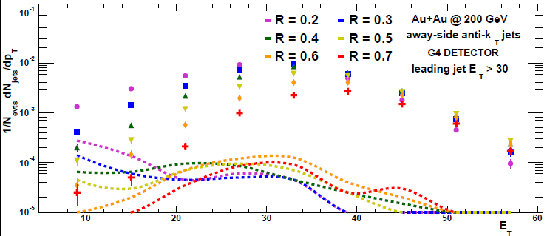
Enhanced Sensitivity at RHIC
Trigger Jet R=0.2
I_{AA}
Away Side Jet
R=0.2, 0.4, 0.7
Look for jet energy shifted to larger radius or underneath and equilibrated.
JEWEL predicts huge effect at RHIC.
Good purity even for large R jets!
I_{AA}
Reco. jets
fakejets

Slide 22
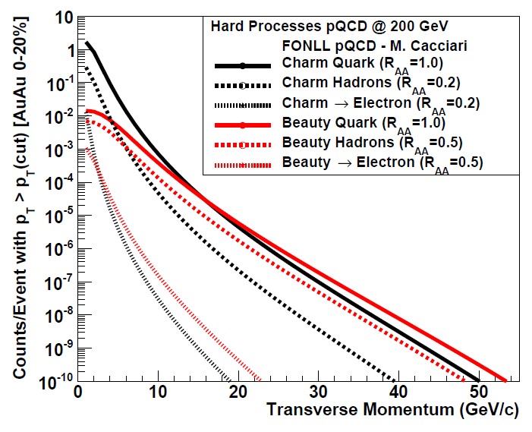
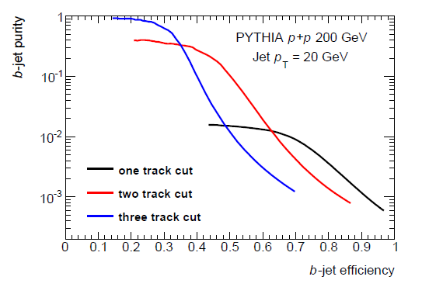
Beauty Tagged Jets at RHIC
Variety of proven techniques: soft lepton tagging, track counting, secondary vertex reconstruction
Key tests of mass dependence of radiative energy loss
Again, crucial to have overlapping energy ranges with RHIC and LHC

Slide 23
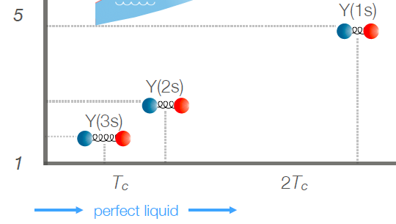
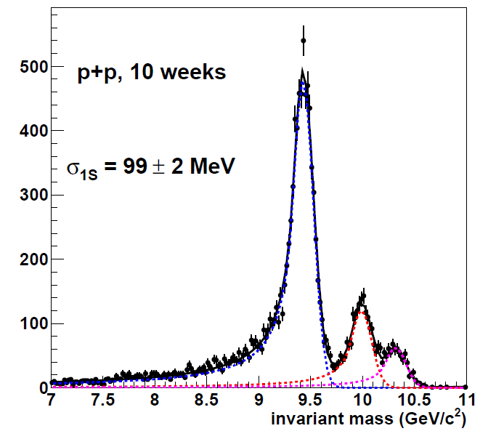
Upsilon Probes
Inverse Length [1/fm]
Precision measurement at LHC (and more to come).
Needs precision RHIC p+p, p+A, A+A to map out temperature and coupling dependence

Slide 24
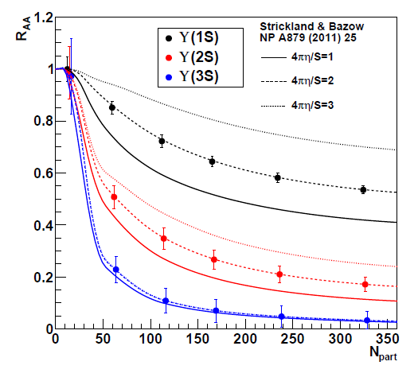
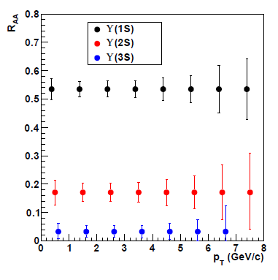
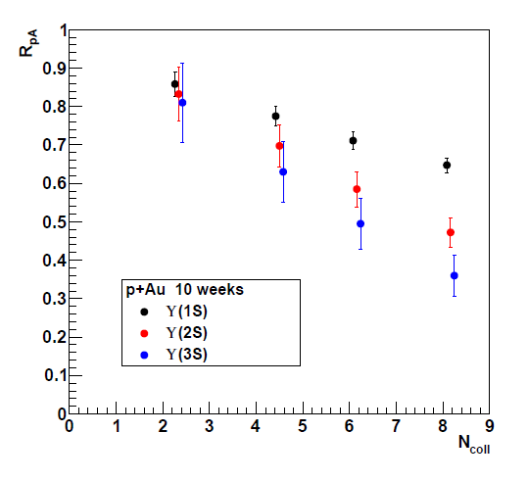
p_{T} Dependence
p+A Dependence

Slide 25
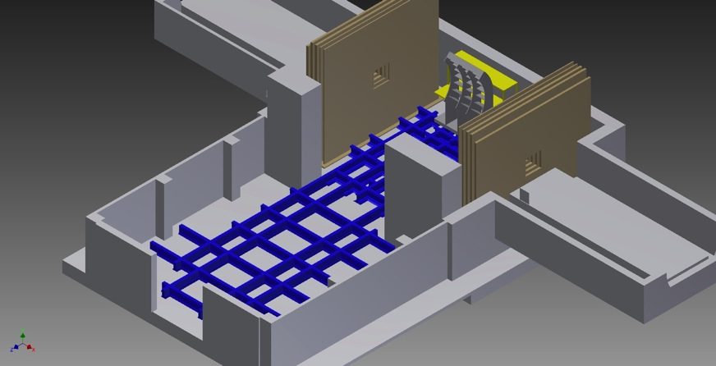
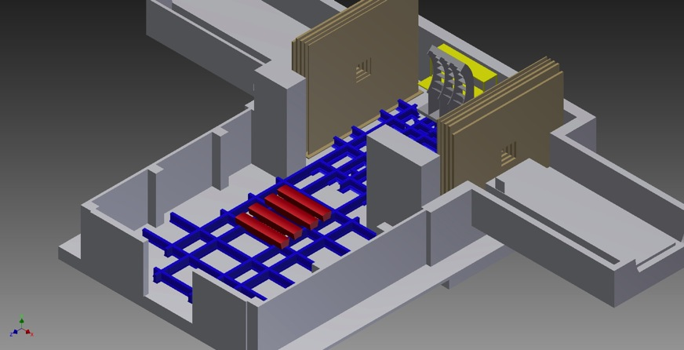
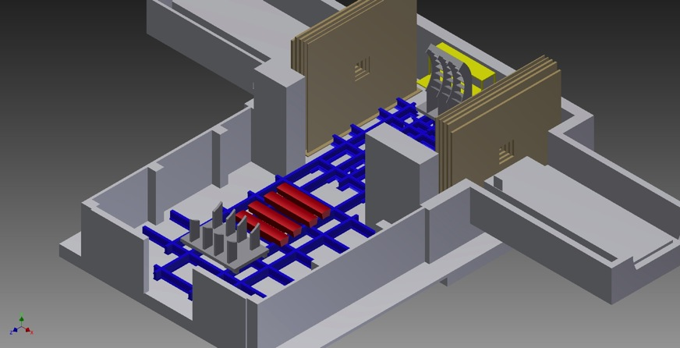
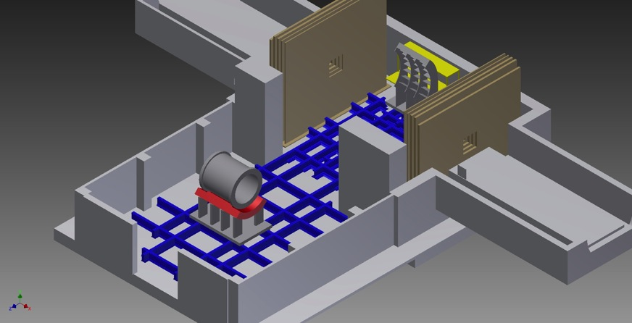
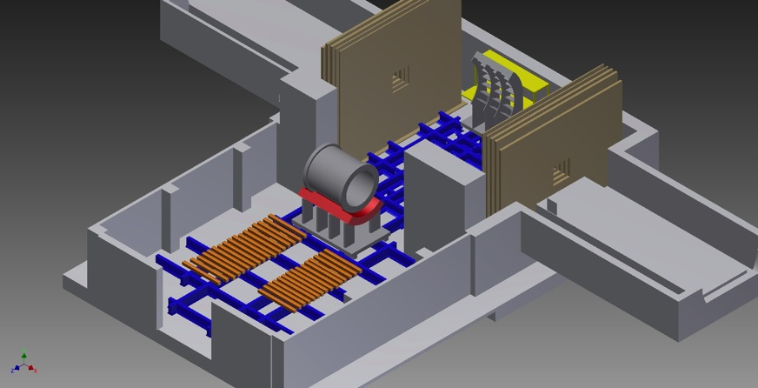
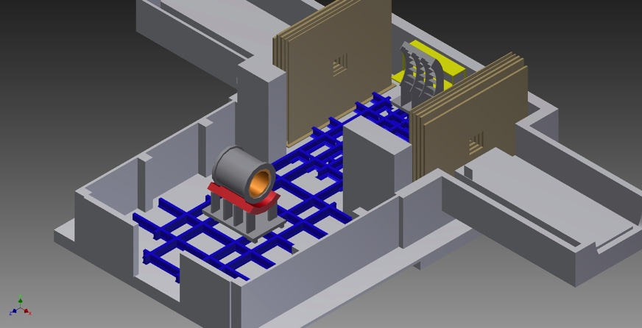
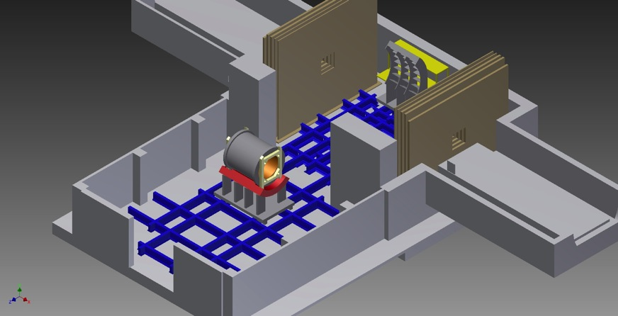
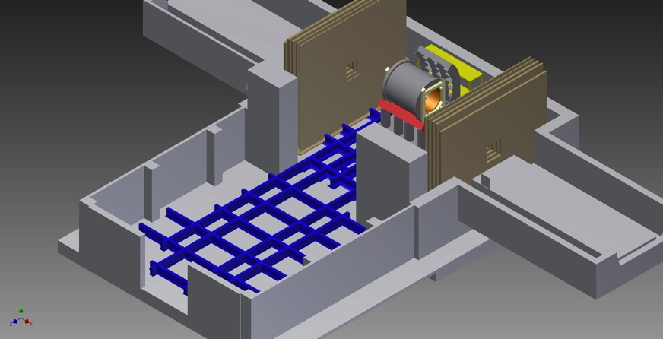
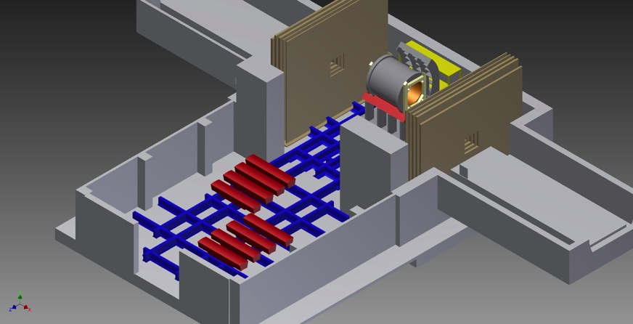
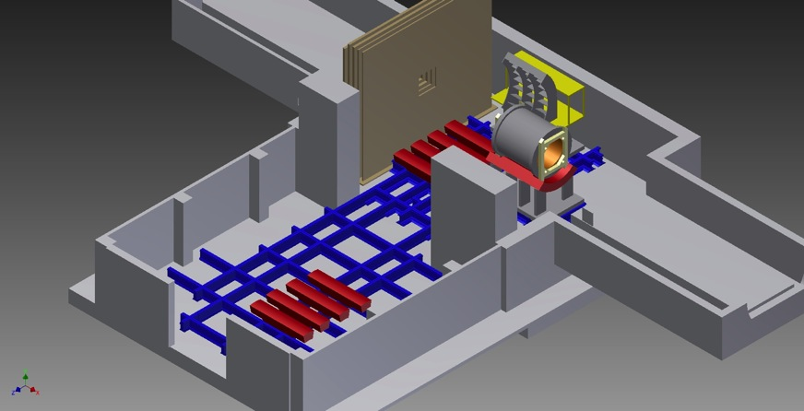
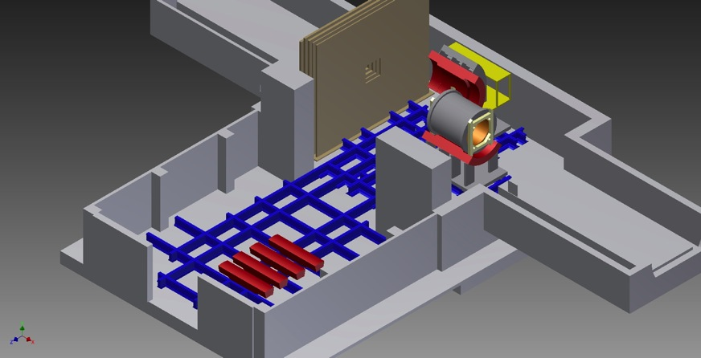
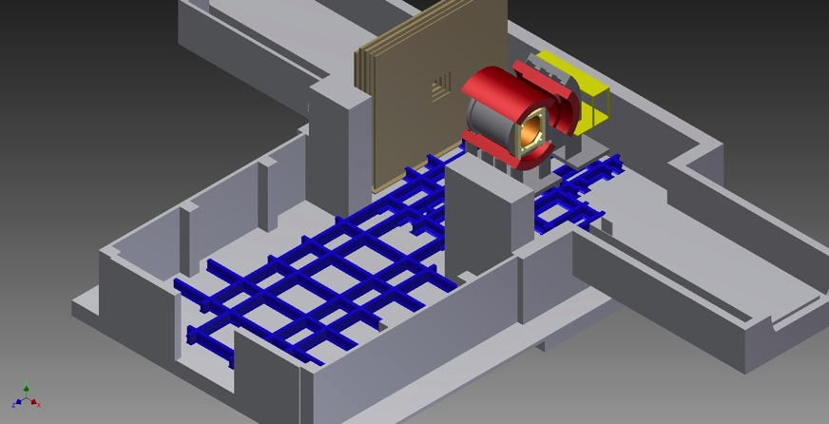
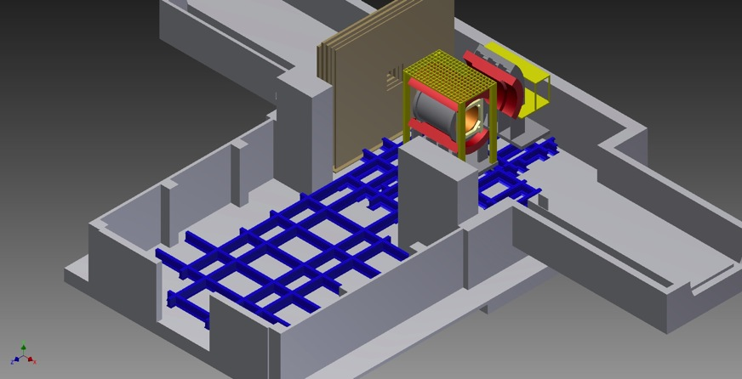
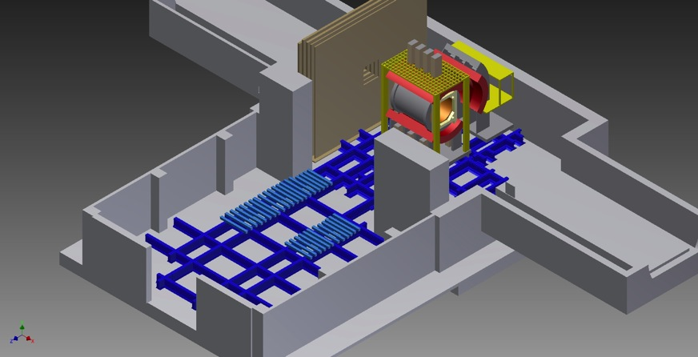
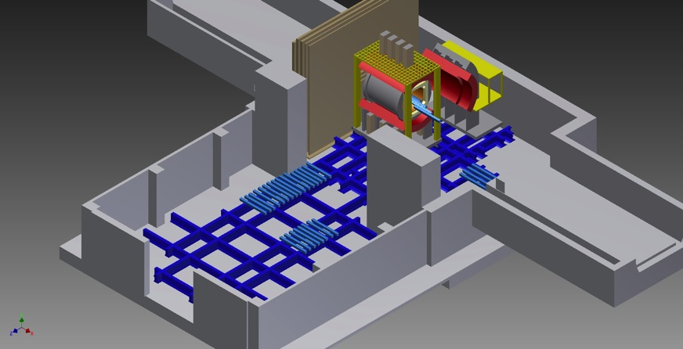
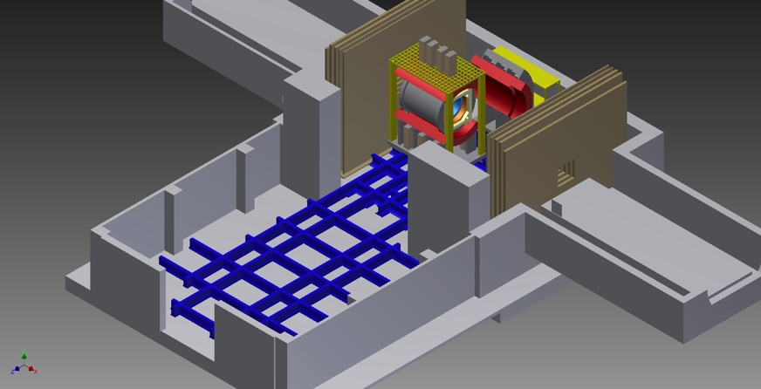
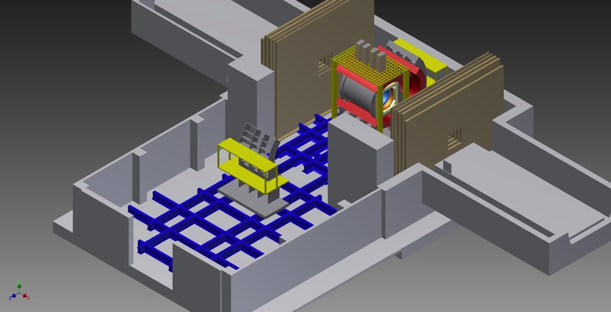
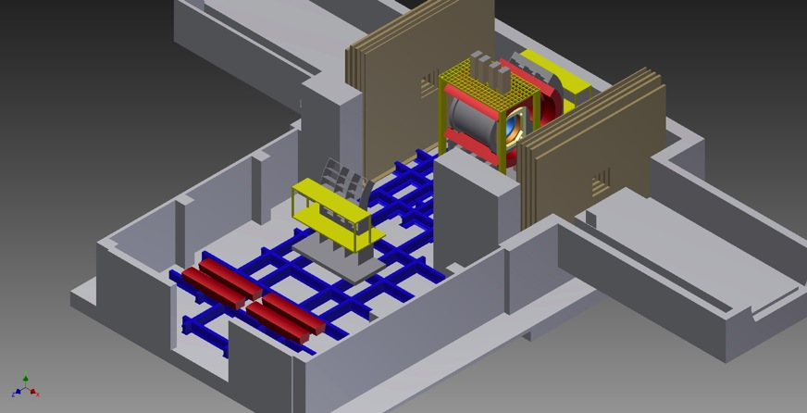
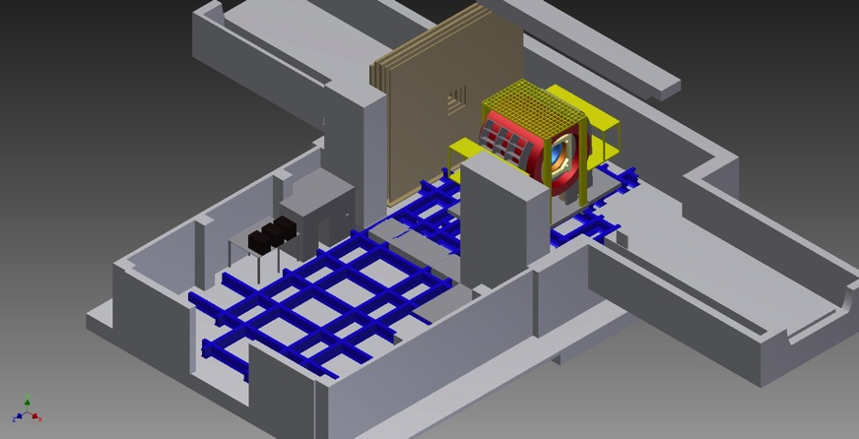
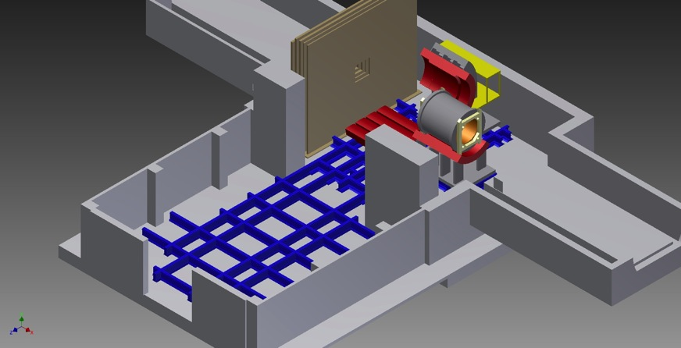
Summary
p+Au, p+Al at RHIC this spring
Bringing the full picture into view
Full connection of RHIC and LHC small system data needed
‘How’ and ‘why’ questions on the QGP will be left with incomplete answers without sPHENIX in conjunction with
ongoing RHIC and LHC program

