Slide 1

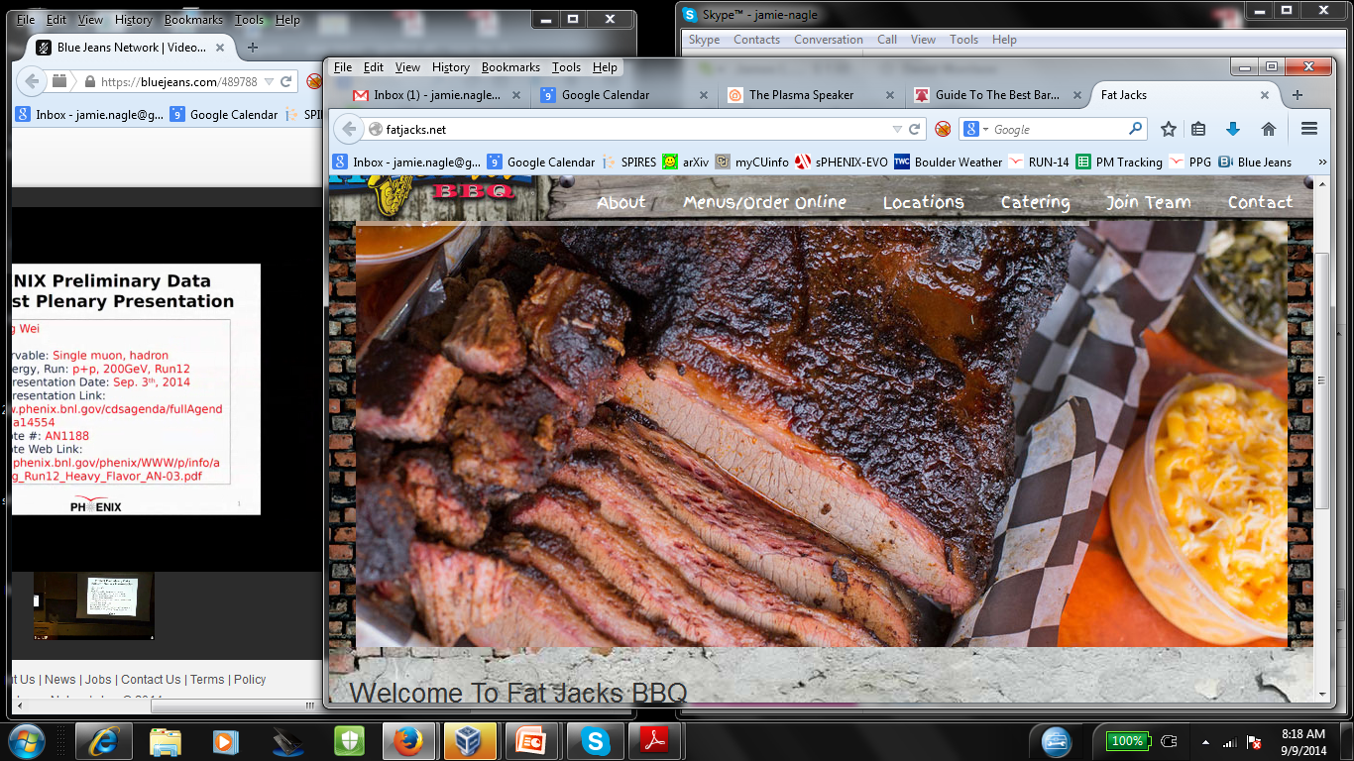
What jets studies at RHIC can tell us about QGP properties
Probing
Jamie Nagle
University of Colorado
Fat Jacks in Philly
ALICE
ATLAS
sPHENIX
STAR
CMS
sPHENIX
CMS
THEORY
ALICE
STAR
ATLAS
APS Division of Nuclear Physics: 2014 Long-range plan
Joint Town Meetings on QCD
Temple University
September 13-15, 2014

Slide 2
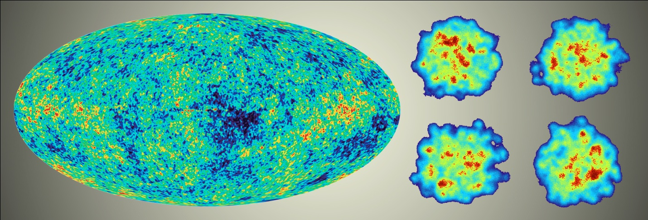
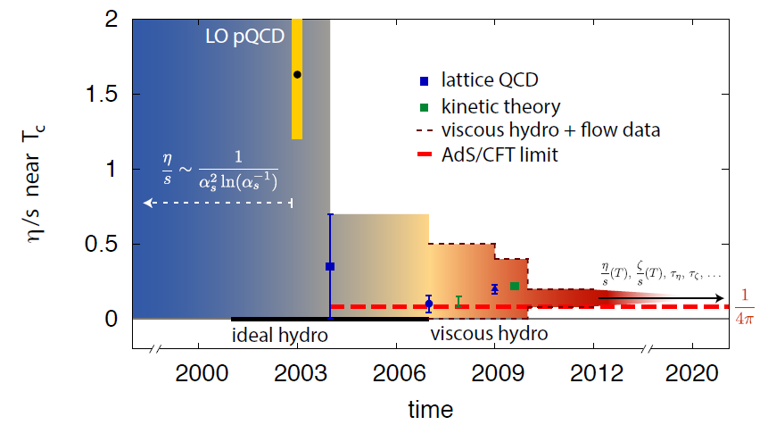
Great Accomplishments in the Field
“Little Bang” Standard Model of Quark-Gluon Plasma
SM allows us to ask a new class of questions
Note the critical role of theory and modeling,
and theory-experiment collaboration

Slide 3

Emergent Phenomena
Connection from the QCD Lagrangian to
phenomena of confinement and asymptotic
freedom was fundamental
Connection from QCD to the emergent phenomena of near perfect fluidity of the Quark-Gluon Plasma near the phase transformation is just as fundamental
Pinning down the η/s tells us the nature of the QGP,
while leaving
open the
“how” and “why” questions

Slide 4
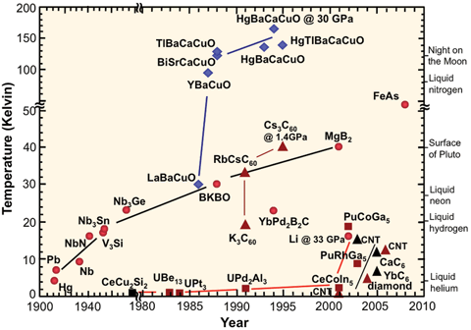
How and Why Questions
High Temperature superconductivity
Nobel prize for discovery…
and another Nobel prize awaiting the
answer to the “how” and “why” questions
“One shouldn’t work on semiconductors,
that is a filthy mess; who knows
whether any semiconductors exist.”
Wolfgang Pauli [1931]
Perhaps like thinking on heavy ion collisions
before perfect fluid discovery…

Slide 5
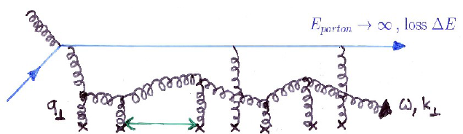
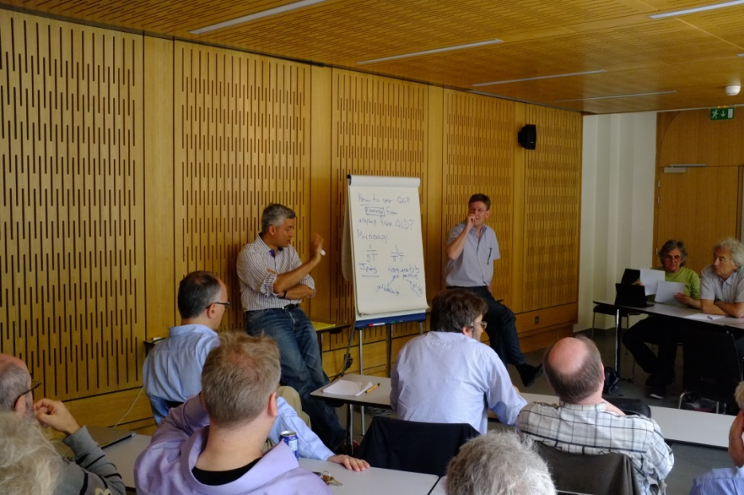
Probing the QGP across Length Scales
Hard Scattered Partons Traversing the QGP
(Jets, Dijets, γ-Jet, Fragmentation, Medium Response)
Length scale set by initial energy, coherent energy lost
20-50 GeV (0.01-0.004 fm), 1-5 GeV (0.2-0.05 fm)
Beauty Quarkonia
Length scale set by size of state (Υ(1s,2s,3s) ~ 0.28, 0.56, 0.78 fm)
Krishna refers to this as
microscopy of the QGP
Critical to push jets to lower energy, looking for hard radiation to understand what it’s being scattered from?

Slide 6
RHIC Probing Region of Strongest Coupling
The textbook (or Wiki entry) on the Quark-Gluon Plasma will be incomplete without
a fundamental explanation for how the perfect fluid emerges at strong coupling near T_{c}
from an asymptotically free theory of quarks and gluons
Jet observables at RHIC enabled by the sPHENIX upgrade
are critical to providing this explanation by probing the QGP near 1-2 T_{c} and over a broad ranges of scales
Measurements of jets only at the LHC will leave these questions with an incomplete answer
(particularly right where the coupling may be strongest)

Slide 7
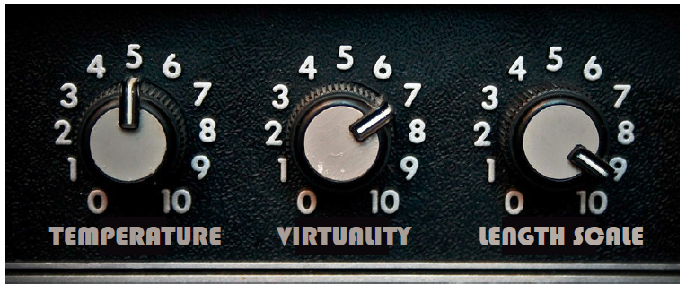
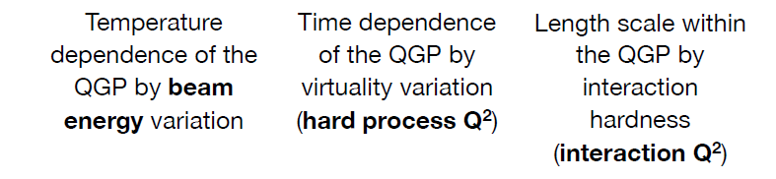
Critical Knobs to Turn
How do the parton shower and medium evolve together?
Can we observe the strongest coupling near T_{c} definitively
What are the inner workings?
(quasiparticles, fields, modes)

Slide 8
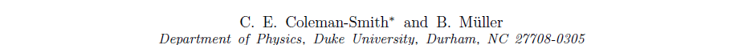
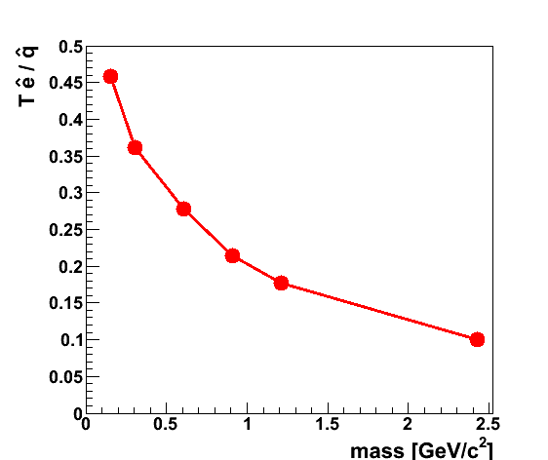
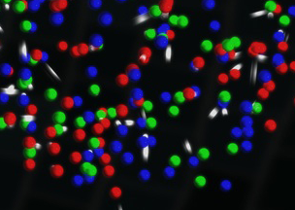
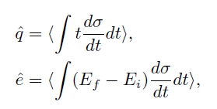
QGP Constituent Mass Dependence
http://arxiv.org/abs/arXiv:1209.3328
qhat → scattering of leading parton → radiation e-loss
ehat → energy transferred to the QGP medium
Jet E_{T} = 30 GeV
T = 350 MeV
α_{s} = 0.3
Limit of infinitely massive scattering centers yields all radiative e-loss.
Medium parton

Slide 9
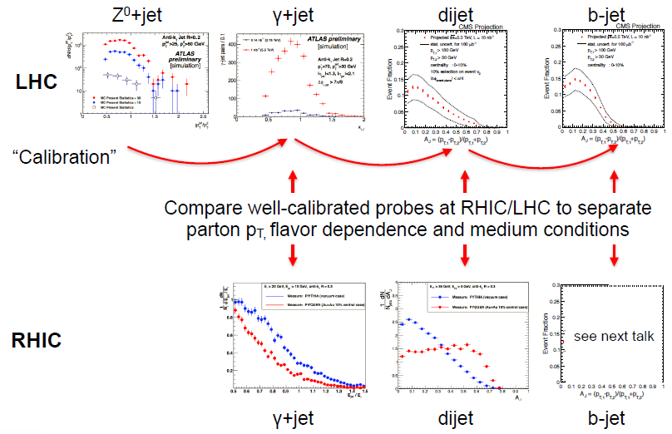
No one key Observable, Instead a Data Army
Bulk QGP Constraints (η/s example)
Very close coordinated effort by experimentalists and theorists
spectra, v₂ → v_{n}, HBT → HBT versus Ψ_{n}, direct photons → photon v_{n}
Over-constraining the theory →
Current “Standard Little Bang” Model
Path to precision QGP bulk properties
Jet Probe Physics
Not one key observable alone.
It is the army of observables in
concert with theory that has
the physics pay-off.
Nicely shown in Gunther’s talk

Slide 10
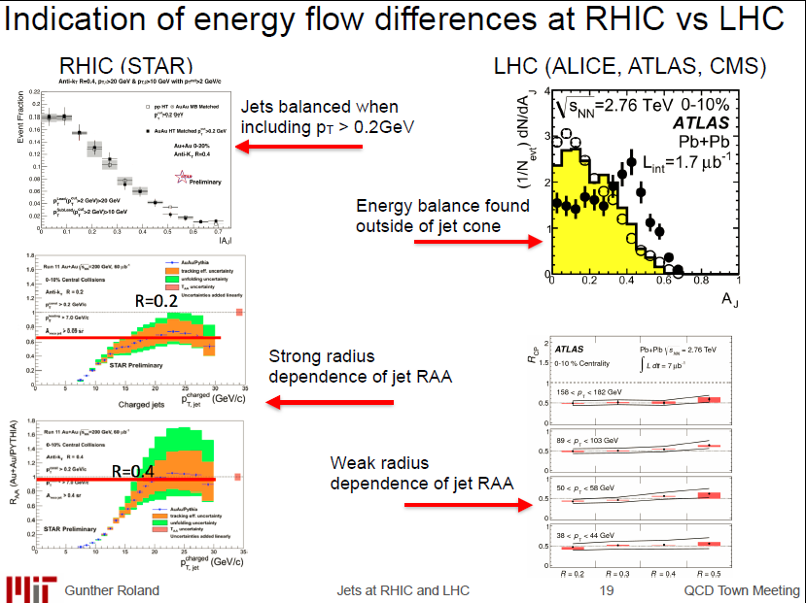
RHIC and LHC Jet Observables

Slide 11
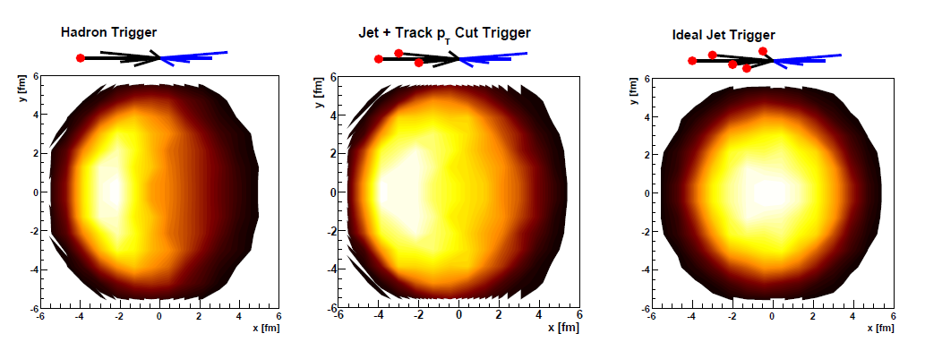
Jet Geometry Engineering
Thorsten Renk has explored the ability to engineer
the surface and energy loss bias to gain more information.
Works particularly well at RHIC due to steeply falling jet spectrum.
Key to measure jets with no minimum p_{T} selection and no trigger bias. Thus, one can explore the full range of engineered geometries.
Systematic measurements enabled “tomography”

Slide 12
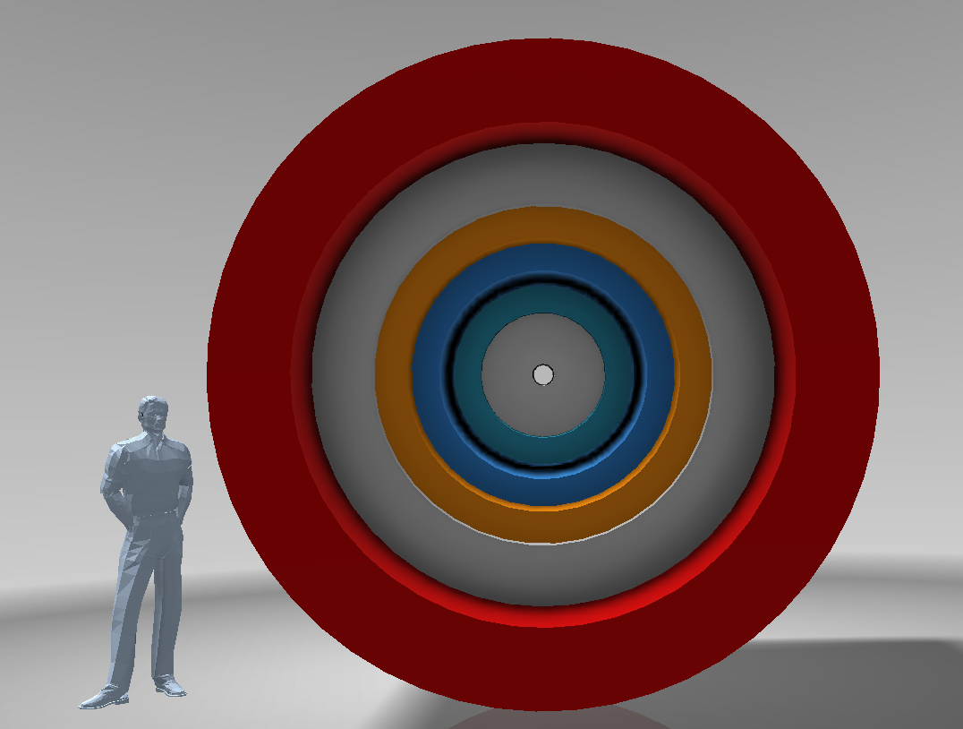

sPHENIX in a Nutshell
BaBar Magnet 1.5 T
Coverage |η| < 1.1
All silicon tracking
Heavy flavor tagging
Electromagnetic
Calorimeter
Two longitudinal
Segment Hadronic Calorimeter
Common Silicon Photomultiplier readout for Calorimeters
Full clock speed digitizers, digital information for triggering
High data acquisition rate capability ~ 15 kHz

Slide 13
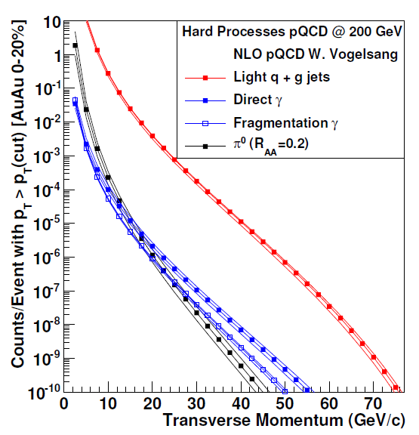
RHIC II Luminosities → Opening New Doors
RHIC II + sPHENIX can record
50 billion events
within |z|<10cm in 20-weeks
Run-14 performance so successful, same delivery would allow sampling of 200 billion events for jets and direct photons
New C-AD projection will allow Au+Au sampling of
0.5 trillion events
Critical similar statistics in
p+p and p+A
10⁷ jets > 20 GeV recorded
10⁴ photons > 20 GeV recorded
e.g. 10⁵ photons > 20 GeV sampled from ½ trillion evts (S/B > 3)

Slide 14
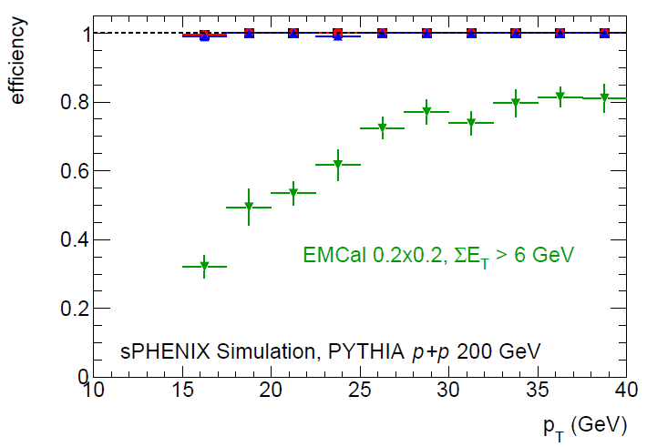
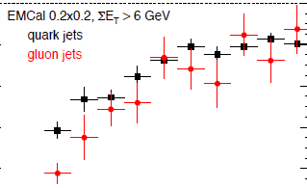
Jets Near Term and Long Term
LHC Run-3 provides great jet statistics for fully differential measurements (e.g. jets > 120 GeV)
Similarly great jet statistics at RHIC for jets > 20 GeV!
Benefits of strong sPHENIX and STAR programs (different jet approaches with overlap too)
Full Calo. Trigger
Run-14 + 16:
STAR mb ~ 400 jets > 50 GeV
EMCal triggered ~ 8,000 jets
Run-2020’s
STAR min. bias ~ 1,200 jets > 50 GeV in central events
sPHENIX min. bias ~ 9,000 jets > 50 GeV in central events
sPHENIX full calorimeter Trigger ~ 50,000 jets > 50 GeV in central events
Quarks/Gluons

Slide 15
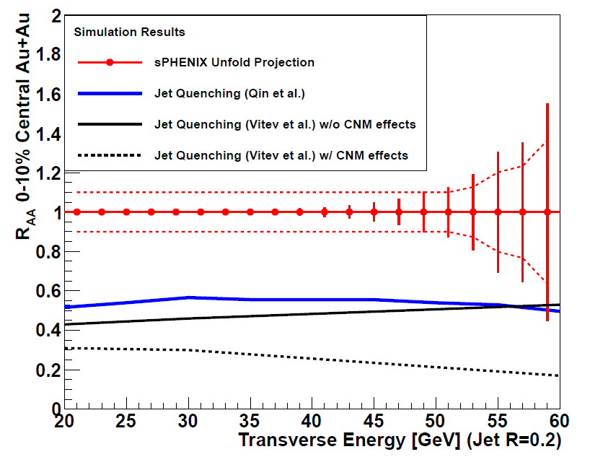
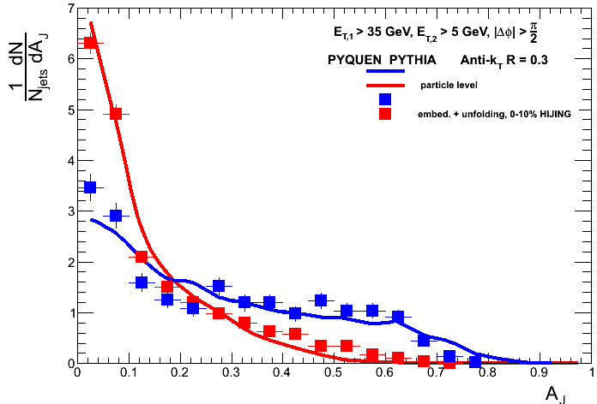
Jet Observables
50 billion MB events
E₁ > 35 GeV, R = 0.3
Truth = solid lines
Boxes = Measure + Unfold
PYTHIA (vacuum case)
PYQUEN (quenched case)
Full suite of jet observables. With and without tracking information.
Single hadrons (up to 40 GeV/c)
Di-hadrons
Hadron-jet
Jet-hadron
Jet (narrow) – jet (wide)
Photon – hadron
Photon – jet
Very differential
All centralities and geometries
Same energy p+p, p+A

Slide 16
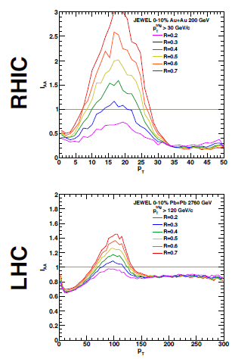
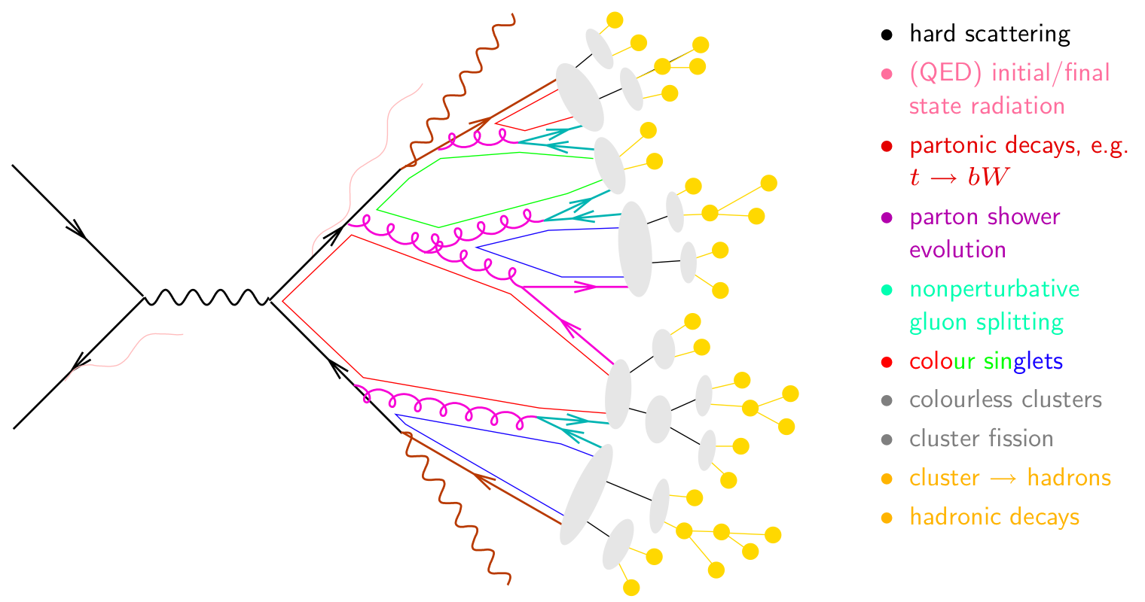
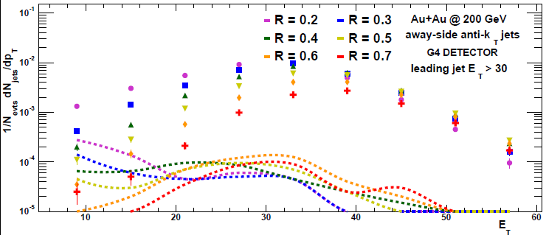
Jet Observables
Trigger Jet R=0.2
I_{AA}
Away Side Jet
R=0.2, 0.4, 0.7
Look for jet energy shifted to larger radius or underneath and equilibrated.
JEWEL predicts huge effect at RHIC.
Good purity even for large R jets!
I_{AA}
Reco. jets
fakejets

Slide 17
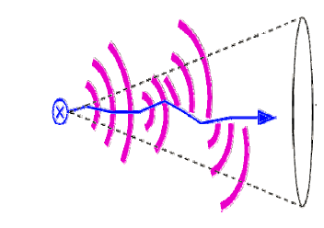
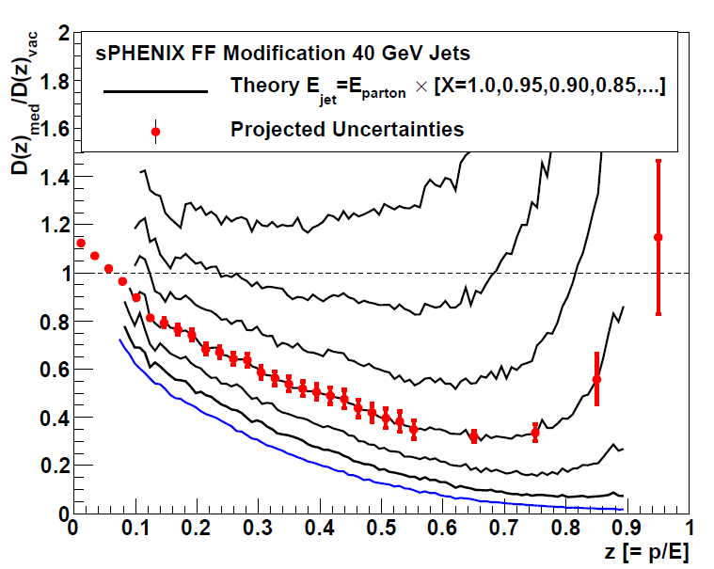
Unique Measurements
Predictions that Fragmentation Function D(z) = p / E_{parton} will have dramatic high-z suppression
If E_{jet} < E_{parton} in A+A due to out of cone radiation or
medium excitation or … then shifting z denominator
sPHENIX enables precision measurement
Cannot be done otherwise at RHIC
Coupled with precision measure at LHC across different jet energies and different QGP couplings →Definitive Answers
arXiv:0710.3073

Slide 18
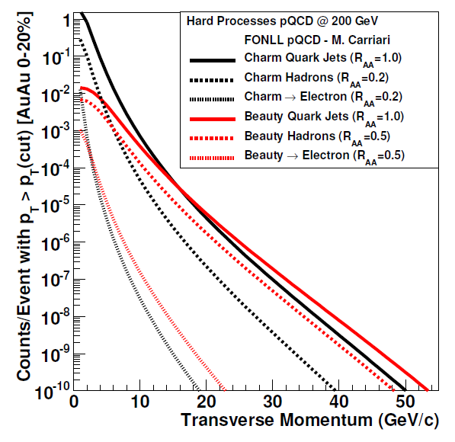
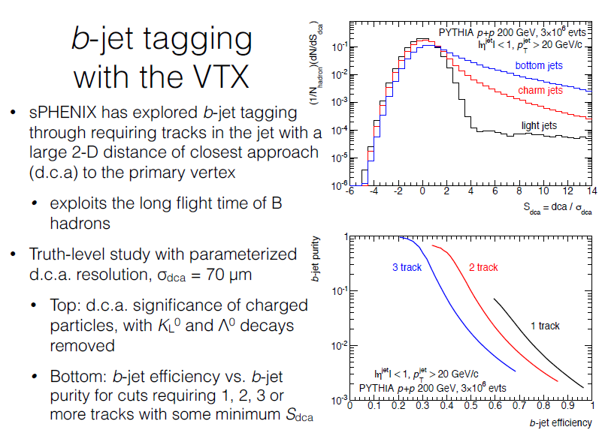
Beauty Tagged Jets at RHIC and LHC
Variety of proven techniques: soft lepton tagging, track counting, secondary vertex reconstruction
Charm
Beauty
Key tests of mass dependence of radiative energy loss
Again, crucial to have overlapping energy ranges with RHIC and LHC

Slide 19
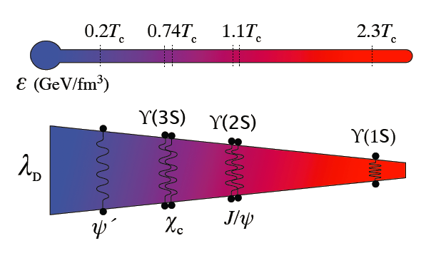
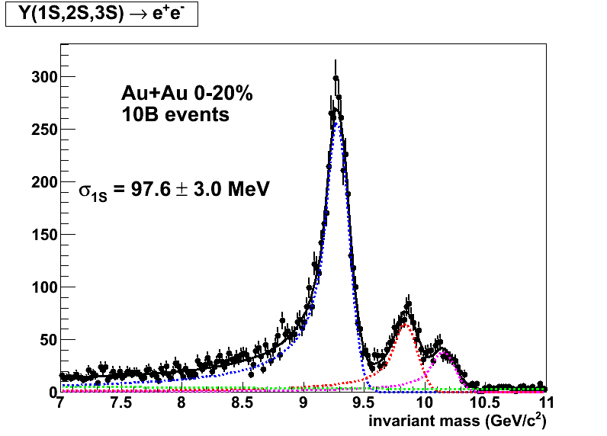
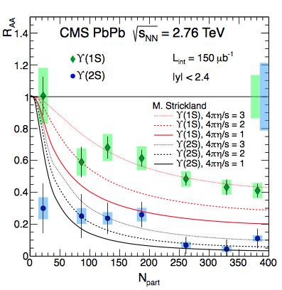
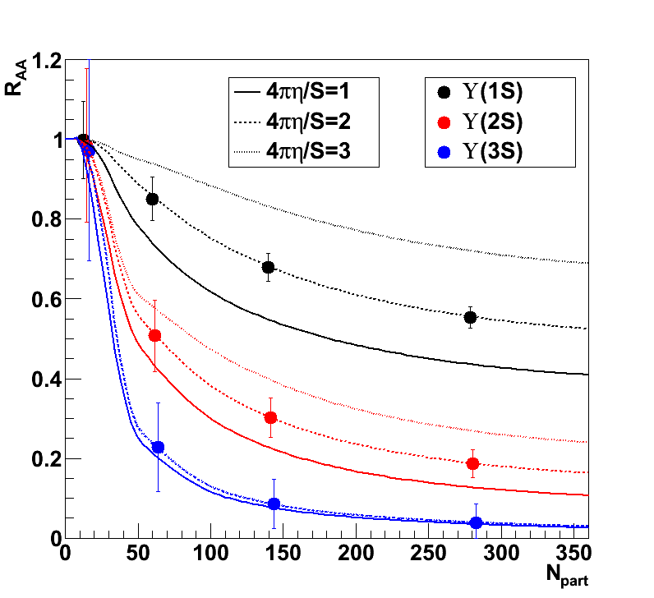
Another Key Length Scale Probe
sPHENIX
Updated
Tracking
Configuration
Expect x10 reduction in statistical uncertainties with LHC Run-3

Slide 20
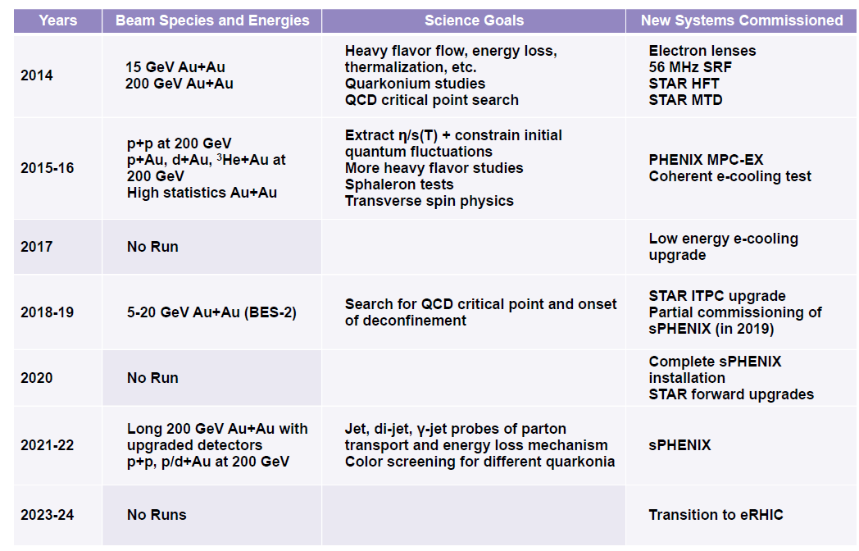
Brookhaven Lab Proposed 10 Year Plan
Excellent timing with Run-3 at LHC

Slide 21
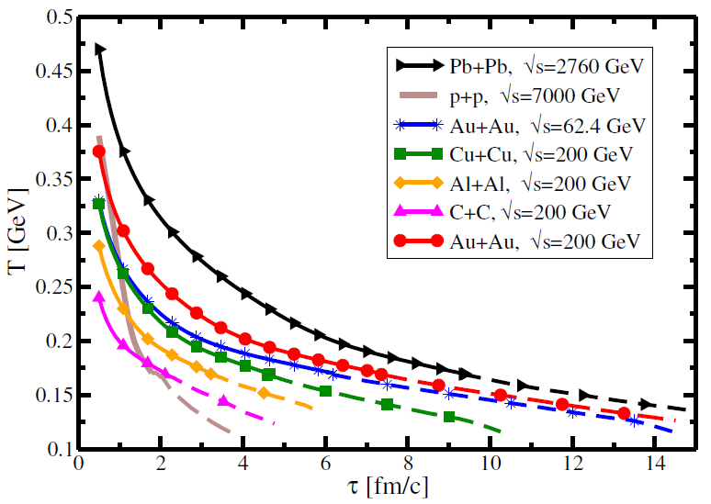
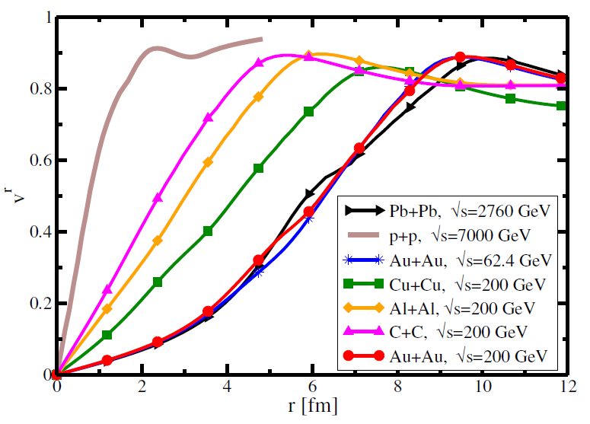
Not Leaving Key Physics on the Floor
Only two years of sPHENIX running?
Extending the program
- Lower Energy Running (39, 62 GeV)
Energy Hadron p_{T} Jet E_{T}
200 40 GeV/c 70 GeV
100 23 GeV/c 35 GeV
62.4 18 GeV/c
39 12 GeV/c
Lighter Ion Running (C+C, Al+Al)
Strengthened p+A program
arXiv:1409.0040

Slide 22
World Context Summary
The impact of the planned scientific program on the advancement of nuclear physics in the context of
current and planned
world-wide capabilities
sPHENIX is crucial to the advancement of our knowledge of the QGP in key areas
sPHENIX will provide key measurements that will add uniquely to our picture of strongly interacting matter
‘How’ and ‘why’ questions on the QGP will be left with incomplete answers without sPHENIX
in conjunction with STAR at RHIC
and ALICE, ATLAS, CMS at LHC

Slide 23
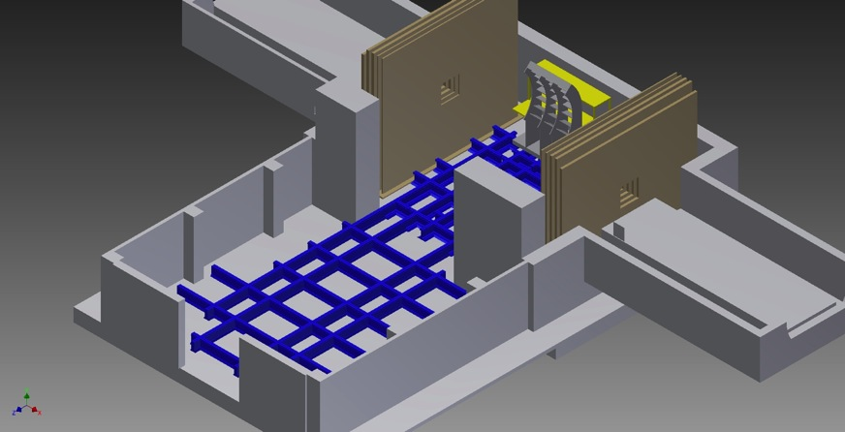
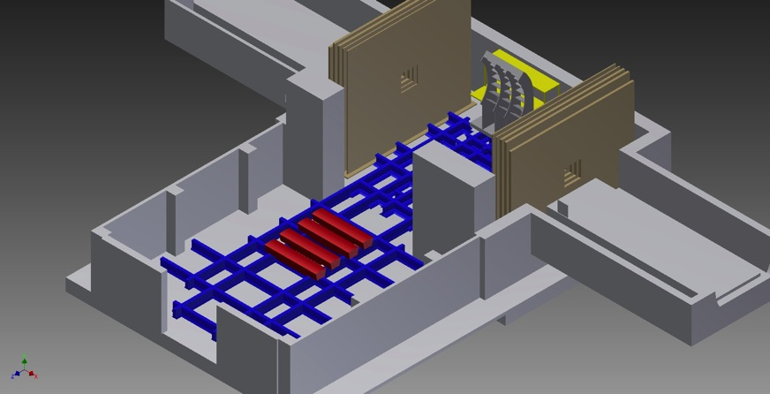
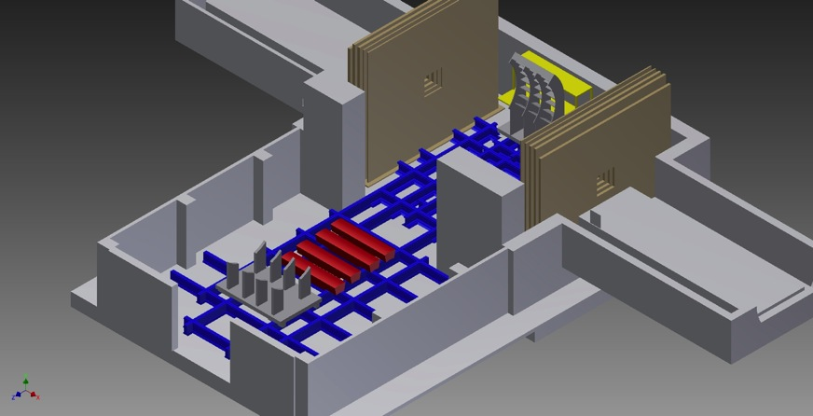

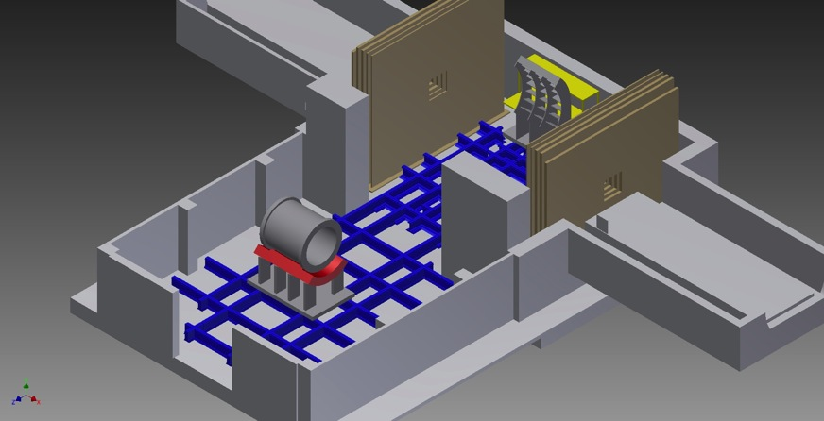
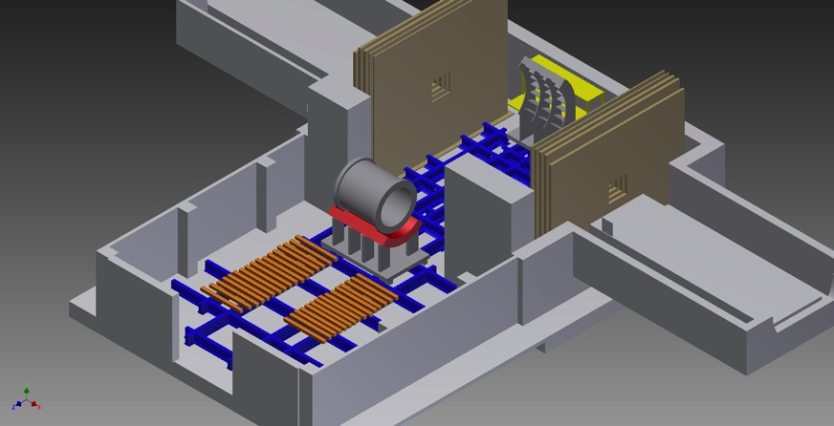

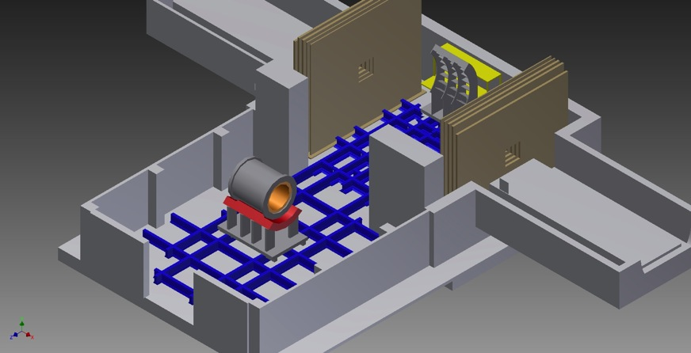
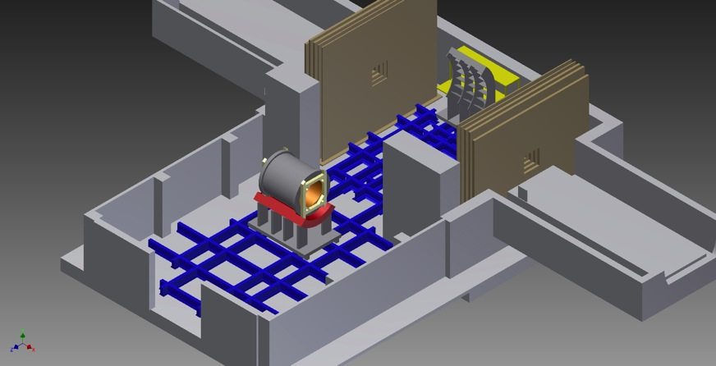
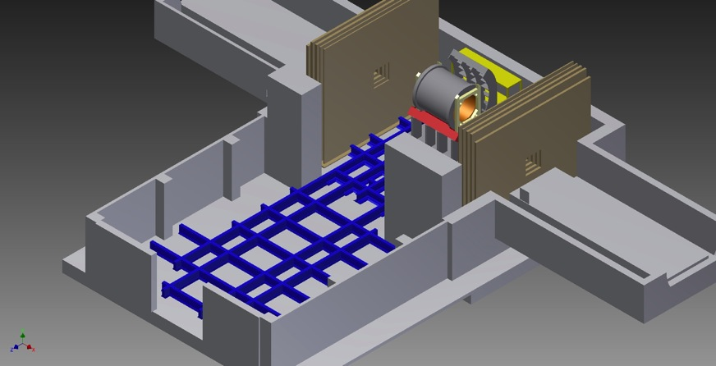
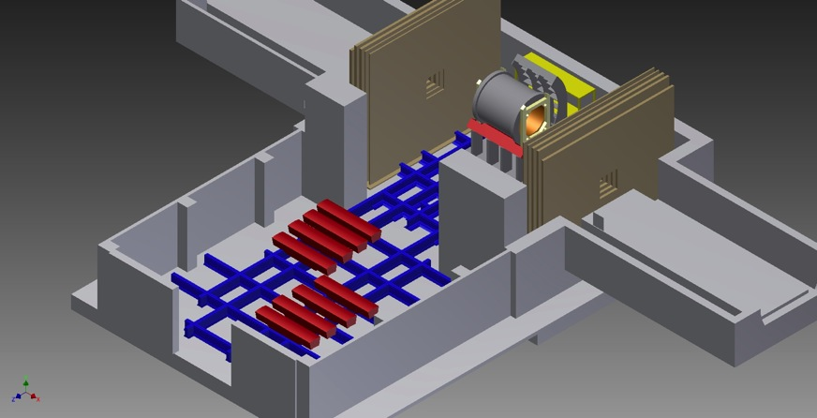
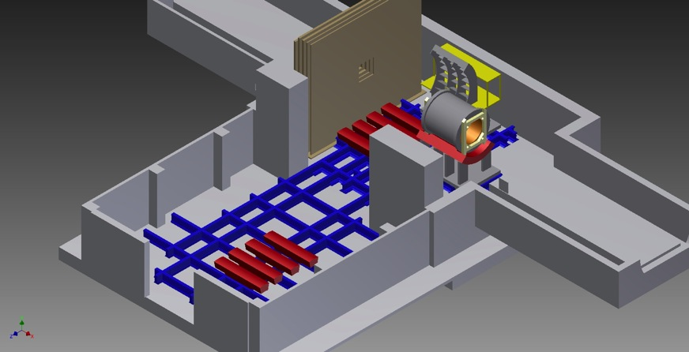
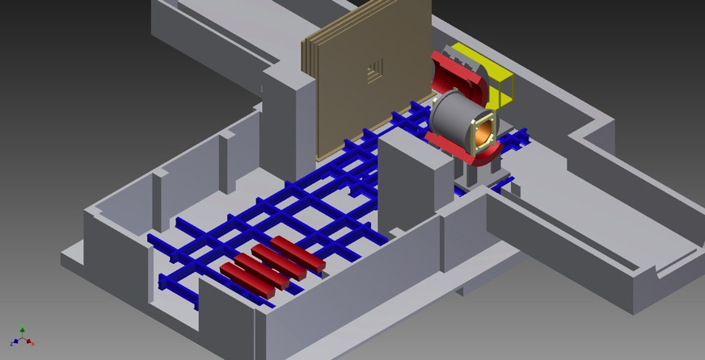
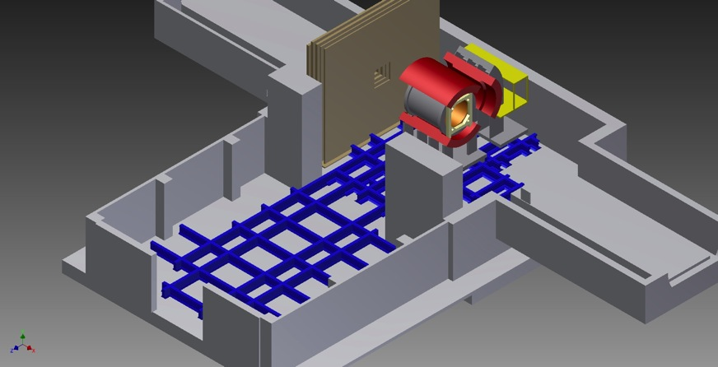
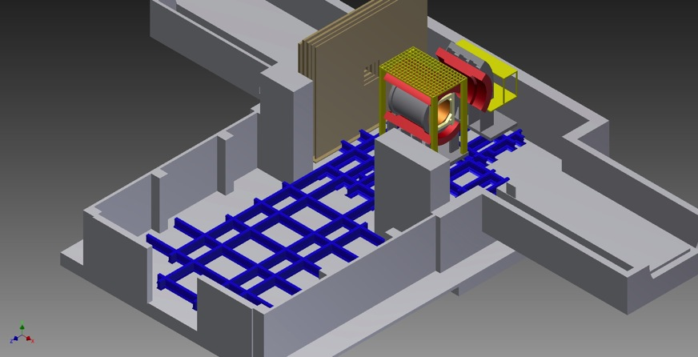

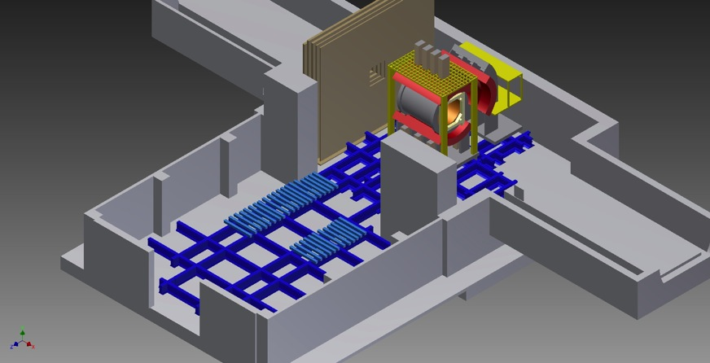
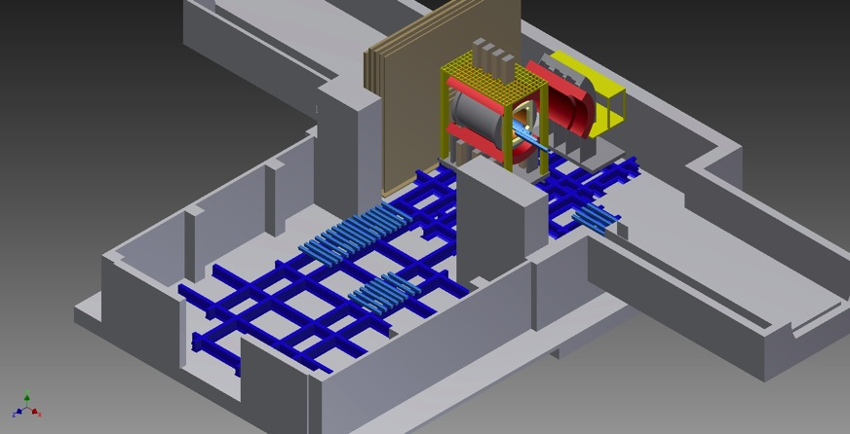







sPHENIX to Reality
Now witness the firepower of this fully operational sPHENIX

Slide 24
20 minutes → 20 slides
EXTRAS

Slide 25


Electron Ion Collider (EIC) Detector Concept
Built around the BaBar Magnet and sPHENIX Calorimetry
BaBar magnet has extra coil density near the ends – with proper flux return shaping, provides good analyzing power at very forward angles
sPHENIX EMCal meets EIC detector specifications
http://arxiv.org/abs/arXiv:1402.1209

Slide 26
EIC Concept Review (January 10, 2014)
Reviewers: Sam Aronson (BNL); Krishna Kumar (UMass-Amherst); Jianwei Qiu (BNL); Veljko Radeka (BNL); Paul E. Reimer (ANL); Jim Thomas (LBNL); Glenn Young (JLab)
“The review team was unanimous in its praise for the LOI.
It was clear (and encouraging) to the review team that key elements of the LOI were prepared and presented by some of the more junior members of the collaboration. The review team found merit in the path chosen by the PHENIX Collaboration in responding to the Laboratory’s plans for evolving the facility from RHIC to eRHIC.
This approach allows for a cost-effective way of providing the capability to address the physics agenda of eRHIC from Day-1 of eRHIC operation.
We thought it well demonstrated that [this EIC detector] would be a good day-one detector capable of addressing almost all of the physics that can be covered by eRHIC. It also appears to be a solid foundation for future upgrades so that it can explore the full physics potentials available as eRHIC itself evolves.”

Slide 27


Connections, Impact, Public Visibility
2005 AIP Story of the Year
Viscosity/Entropy Density
QGP
String Theory Limit
In Search of Perfect Fluids
(May 2010)
Ultra-Hot QCD
Perfect Liquid
String Theory (AdS/CFT)
Holography
Cold Matter, Atomic Gases
Strongly Correlated Electrons
27

Slide 28


Strongest QGP Coupling Near 1-2 T_{c}?
Lattice Trace Anomaly
P/T⁴ deviation from Free Gas
Data from Phys. Rev. D80, 014504 (2009)
RHIC and LHC give a key lever arm in Temperature.
If the QGP properties are not different, why not?

Slide 29


Perfect Fluidity
Many systems have minimum shear viscosity to entropy density near phase transformation
Theory for
Quark-Gluon Plasma
is not yet well constrained
on this question

Slide 30


Indications of Stronger Coupling at RHIC
There are indications that the QGP is most strongly coupled as created at RHIC
What are the underlying changes in QGP properties near the transition?
Calculation from Bjoern Schenke

Slide 31


Super-Strong Coupling near T_{c}?
“Jet Quenching is a few times stronger near T_{c} relative to the
QGP at T > T_{c}.”
Liao and Shuryak, PRL (2009)
“The surprisingly transparent sQGP at the LHC [compared to RHIC]”
Horowitz and Gyulassy, NPA (2011)
“Large v₂ is striking in that it exceeds expectations of pQCD models even at 10 GeV/c.”
PHENIX, PRL (2010)

Slide 32

NTC = Near Tc Enhancement
Thorsten Renk:
“Comparing weak coupling scenarios with data, NTC is favored. An answer to this question will require a systematic picture across several different high p_{T} observables.”
http://arxiv.org/pdf/1402.5798.pdf
Theorists need to work on acronyms.

Slide 33


At what length scale is the medium probed?
Do the highest energy
jets at LHC see
point-like color charges?
1/λ
What sets this scale?
  the exchange gluon momentum?
  total coherent energy loss?
  impact of deconfinement?
Do the lowest energy jets at RHIC scatter from coherent fields or only excite sound waves?
W. Horowitz

Slide 34





PRL 2011
Guangyou Qin, Berndt Muller
Larger modification
at RHIC,
more of parton shower equilibrated into medium.

Slide 35



RHIC Jet Discriminating Power
Major new detector project at RHIC
Large coverage calorimetry coupled with high rates
http://arxiv.org/abs/arXiv:1207.6378

Slide 36


Calorimeter Measure Unbiased on FF
Quark and Gluons have very different fragmentation functions
sPHENIX calorimetric measurement gives the
same energy scale and resolution.
Critical for extracting longitudinal redistribution of energy.

Slide 37


Theory Tools
A host of Monte Carlo parton shower codes are now available to fully interpret the combined set of sPHENIX, RHIC and LHC jet observables.
The close collaboration between experimentalists and theorists is necessary to incorporate the full suite of observables and test the basic physics and then constrain the detail parameters.
Continued RHIC and LHC data up through sPHENIX program fuels this collaboration.
YaJEM (now publicly available)
JEWEL (now publicly available)
MARTINI
CUJET
MATTER
Q-PYTHIA
VNI

Slide 38

Physics → sPHENIX → Knowledge
How does sPHENIX enable access to this physics?

Slide 39
sPHENIX Run Plan
Two years of physics running 2021 and 2022 with 30-cryo week runs
20 weeks Au+Au @ 200 GeV
10+ weeks p+p @ 200 GeV [comparable baseline statistics]
10+ weeks p+Au @ 200 GeV [comparable baseline/new physics stats]
sPHENIX maintains very high PHENIX DAQ rate
sPHENIX maintains fast detector capability – no pile up problems
If we just record Au+Au minimum bias events (no trigger bias), in 20 weeks with current RHIC performance and PHENIX livetime, we record 50 billion events within |z| < 10 cm [optimal for silicon tracking]
Note this is not sampled, but recorded. Full range of differential measurements and centralities with no trigger biases.

Slide 40

Direct Photon-Jet/h
sPHENIX has excellent direct photon capabilities
In Au+Au central collisions for p_{T} > 20 GeV, direct photons dominate S/B > 3
Simple isolation cuts with full calorimetry give additional handle and enable p+p and p+A comparison measurements
LHC
RHIC

Slide 41


Tracking & Jets (like a mini-CMS)
One can use pure calorimetric jets, hybrid track jets, combinations in between

Slide 42

Additional Studies in Progress
Example – hadron triggered jet ←→ jet triggered hadrons
jet
hadron
Exploring maximum jet R value with good purity in central and mid-central Au+Au
Can also measure FF of opposing jet
Bias to longer path length, much higher statistics to compare with γ-jet/h
sPHENIX very high rates, trigger on hadrons in HCal in p+p and p+A
Example – jets > 30 GeV with associated hadron pT > 10 GeV
jet
Exploring maximum jet R value with good purity in central and mid-central Au+Au
One can measure the relative change in FF for z > 0.3
Is energy really lost outside the cone or lost within the cone (to the UE)

Slide 43

Fragmentation Functions
sPHENIX combination of excellent tracking and calorimetric jet reconstruction enable FF measurements
Very beneficial that numerator (charge track) and denominator (jet energy) are measured separately. Dramatically reduces high-z backgrounds
Again, key measurement across all Au+Au centralities and with different jet definitions
Key to compare with γ-h
sPHENIX statistics
for Au+Au in 20 weeks

Slide 44

JEWEL Monte Carlo Investigation
Goal: JEWEL → HEPMC output → GEANT-4 sPHENIX
Work by Mike McCumber (LANL) and Kurt Hill (Colorado)
Thanks to help from Korinna Zapp and Urs Wiedemann
Works in Progress (needs further checks)
Qualitative match to RHIC hadron R_{AA}, LHC hadron R_{AA}, single R=0.2-0.4 jet R_{AA}

Slide 45
sPHENIX b-jet Tagging
Slide from Dennis Perepelitsa

Slide 46

RHIC and LHC Together
It is fundamental to making major (paradigm changing) advances in the field to probe the QGP (through different temperature evolutions) at a range of length scales.
That program requires sPHENIX for precision overlapping and unique measurements from both RHIC and LHC
Kinematic differences also play a major role with sPHENIX changing the data landscape and constraining the underlying physics and QGP properties

Slide 47


Proton+Nucleus Surprises
sPHENIX provides discriminating power on p+A physics explanations
Enabled by p+p/p+A Hcal triggering (as done in CMS for example)
x₂ ~ 0.06
x₂ ~ 0.6
R_{pAu}
sPHENIX covers up to very high Bjorken x₂.

Slide 48


More than 2 Years of Running?
Strengthening the program
- better tracking (Upsilon, b-tag)
- additional forward calorimeter coverage (instrument end return)
Extending the program
- Lower Energy Running (39, 62 GeV)
Energy Hadron p_{T} Jet p_{T}
200 40 GeV/c 70 GeV
100 23 GeV/c 35 GeV
62.4 18 GeV/c
39 12 GeV/c
- Lighter Ion Running (C+C, Al+Al)
Needs discussion with theory community
(QCD Town Meeting)
How does this fit in with STAR plans in 2020s?
Please calculate up to 40 GeV/c

Slide 49


Slide 50
What is the Medium Made of?
Cartoon of QGP medium (free gas of partons in JEWEL)
Hard Scattered
Parton Probe
QGP Partons
at temperature T
Recoil Partons from QGP
JEWEL has two options:
write out recoil parton
(energy not conserved, extra extracted from QGP)
2) do not write them out
(energy not conserved, lost into QGP)

Slide 51

Recoils Important – Lesson on Medium?
No matter how large the jet R, jet energy lost to QGP
Boost in jet energy particularly with large R values gained from QGP

Slide 52

LHC Physics in the Next Ten Years
Run 2
Run 3
Pb+Pb
Pb+Pb/p+Pb
Pb+Pb/p+Pb/Ar+Ar
RHIC
sPHENIX measurements well timed with
LHC Run-3 measurements
Very good for enabling theory focus
on simultaneous understanding

