Slide 1

Recent sPHENIX / ePHENIX Meeting in Japan
RHIC Strategy Meeting in Detroit
デトロイト
2013
Jamie Nagle, University of Colorado
August 25, 2013

Slide 2

What does the future hold?
Hard Probes unravel the secret inner workings of the sQGP
Maybe Berndt, Xin-Nian, and Dave know
from their trip to China

Slide 3
sPHENIX is motivated by interest in dissecting
how the quark-gluon plasma works and
how its nature evolves with temperature
Is the QGP a perfect fluid with
no quasi-particles at any scale?

Slide 4
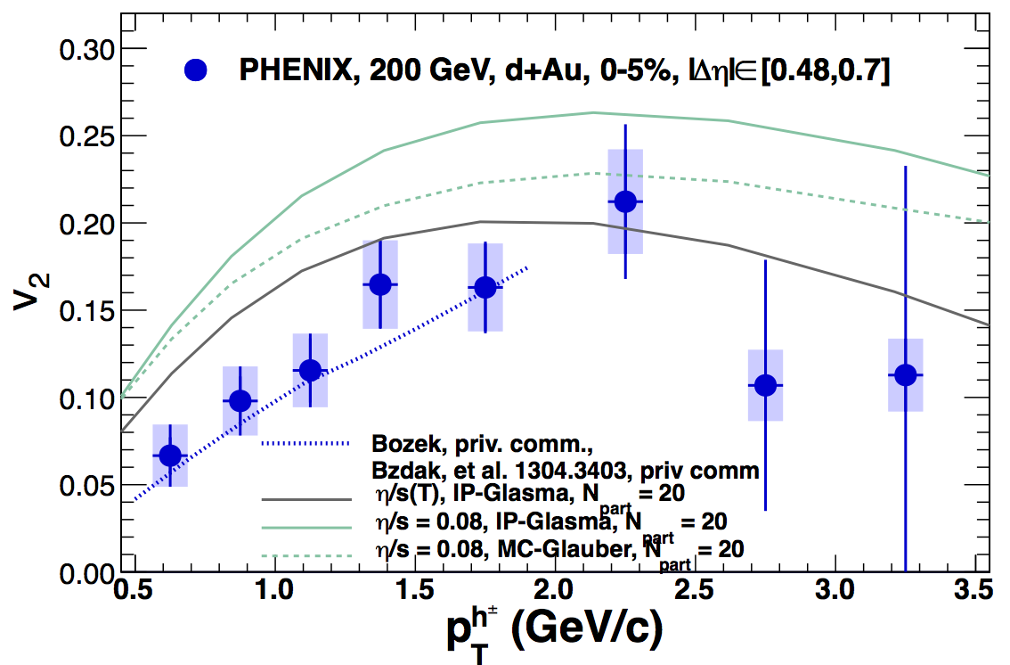
Can even d+Au/p+Pb produce a nearly inviscid fluid?
These developments in the past year underscore the need for measurements to address
why and how perfect fluidity arises

Slide 5
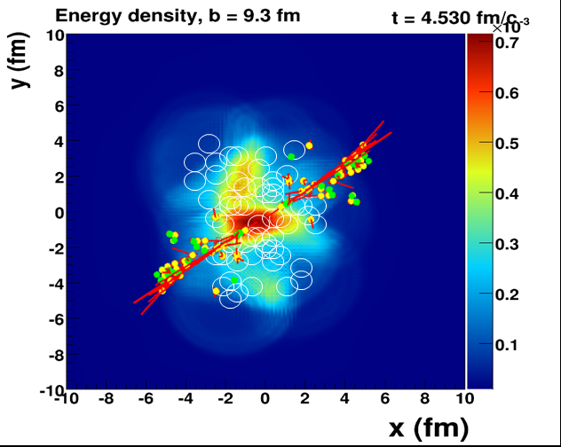
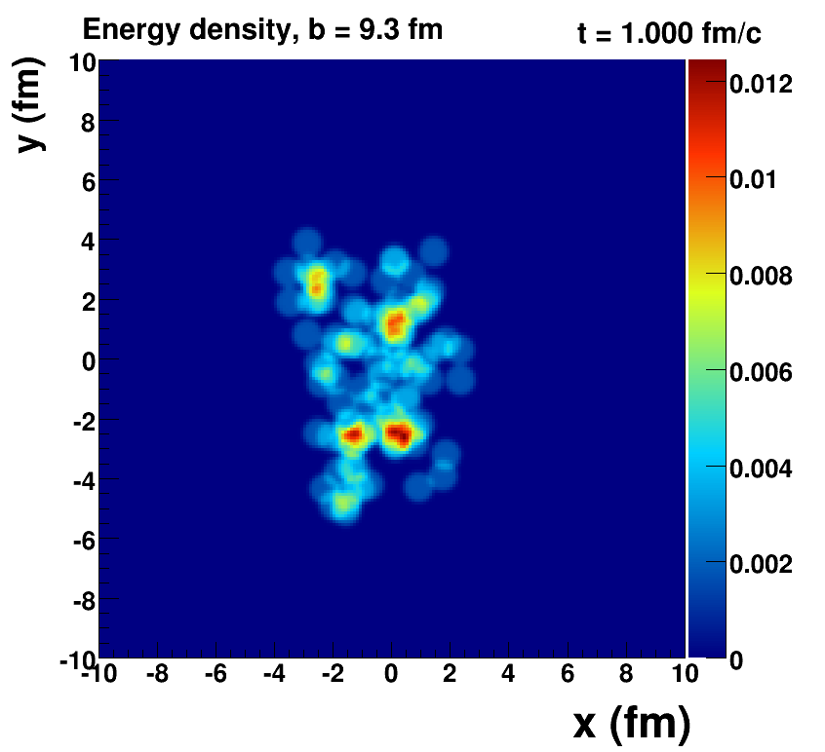

Probing the Medium
When does the strongly coupled bulk (lower momentum IR)
transition to a weakly coupled probe (higher momentum UV)?

Slide 6
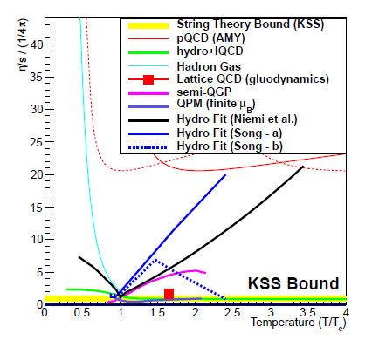
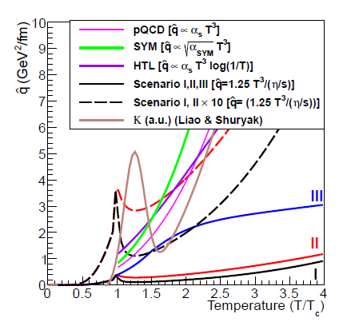
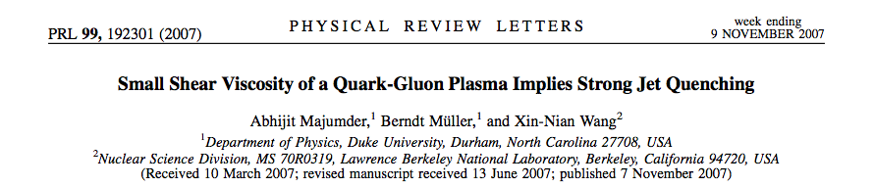
At what scale does bulk coupling relate to probe coupling?

Slide 7
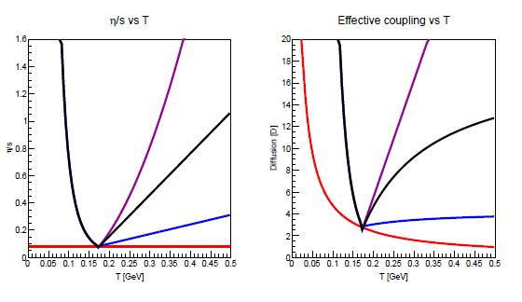
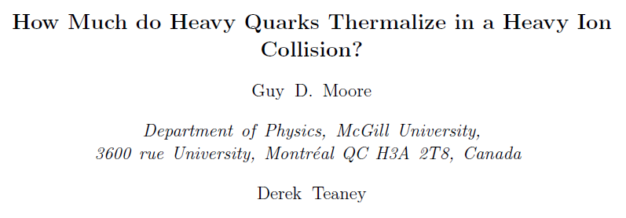
At what scale does bulk coupling relate to probe coupling?
η/s
Charm Diffusion (D)
Temperature [GeV]
Temperature [GeV]

Slide 8
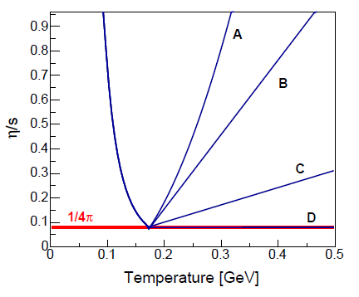
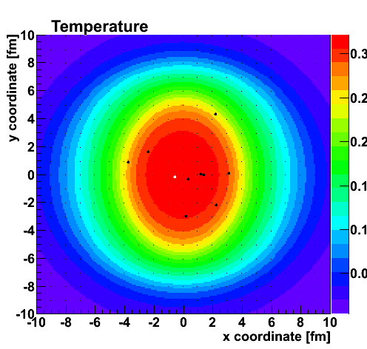
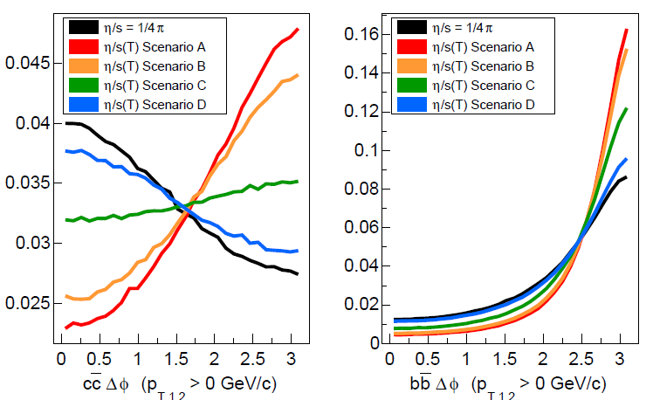
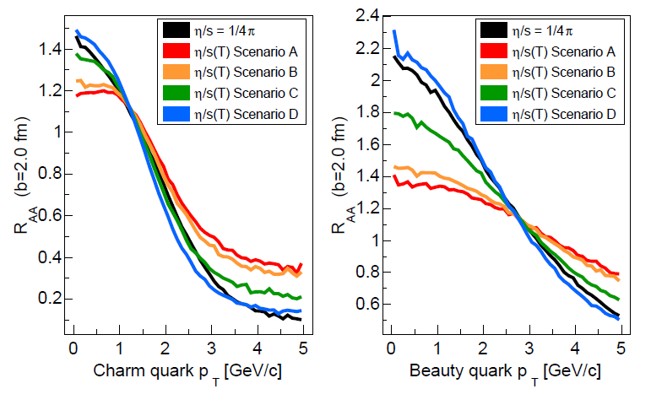
Charm and Beauty – sensitivity to early time!
Beauty R_{AA} sensitive to
early time coupling!
Charm-AntiCharm Correlations sensitive to
early time coupling!

Slide 9

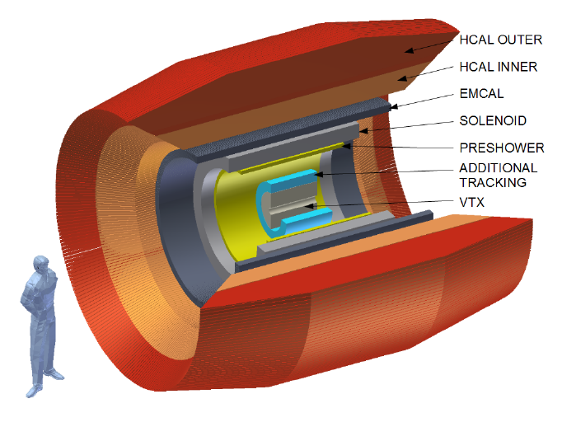
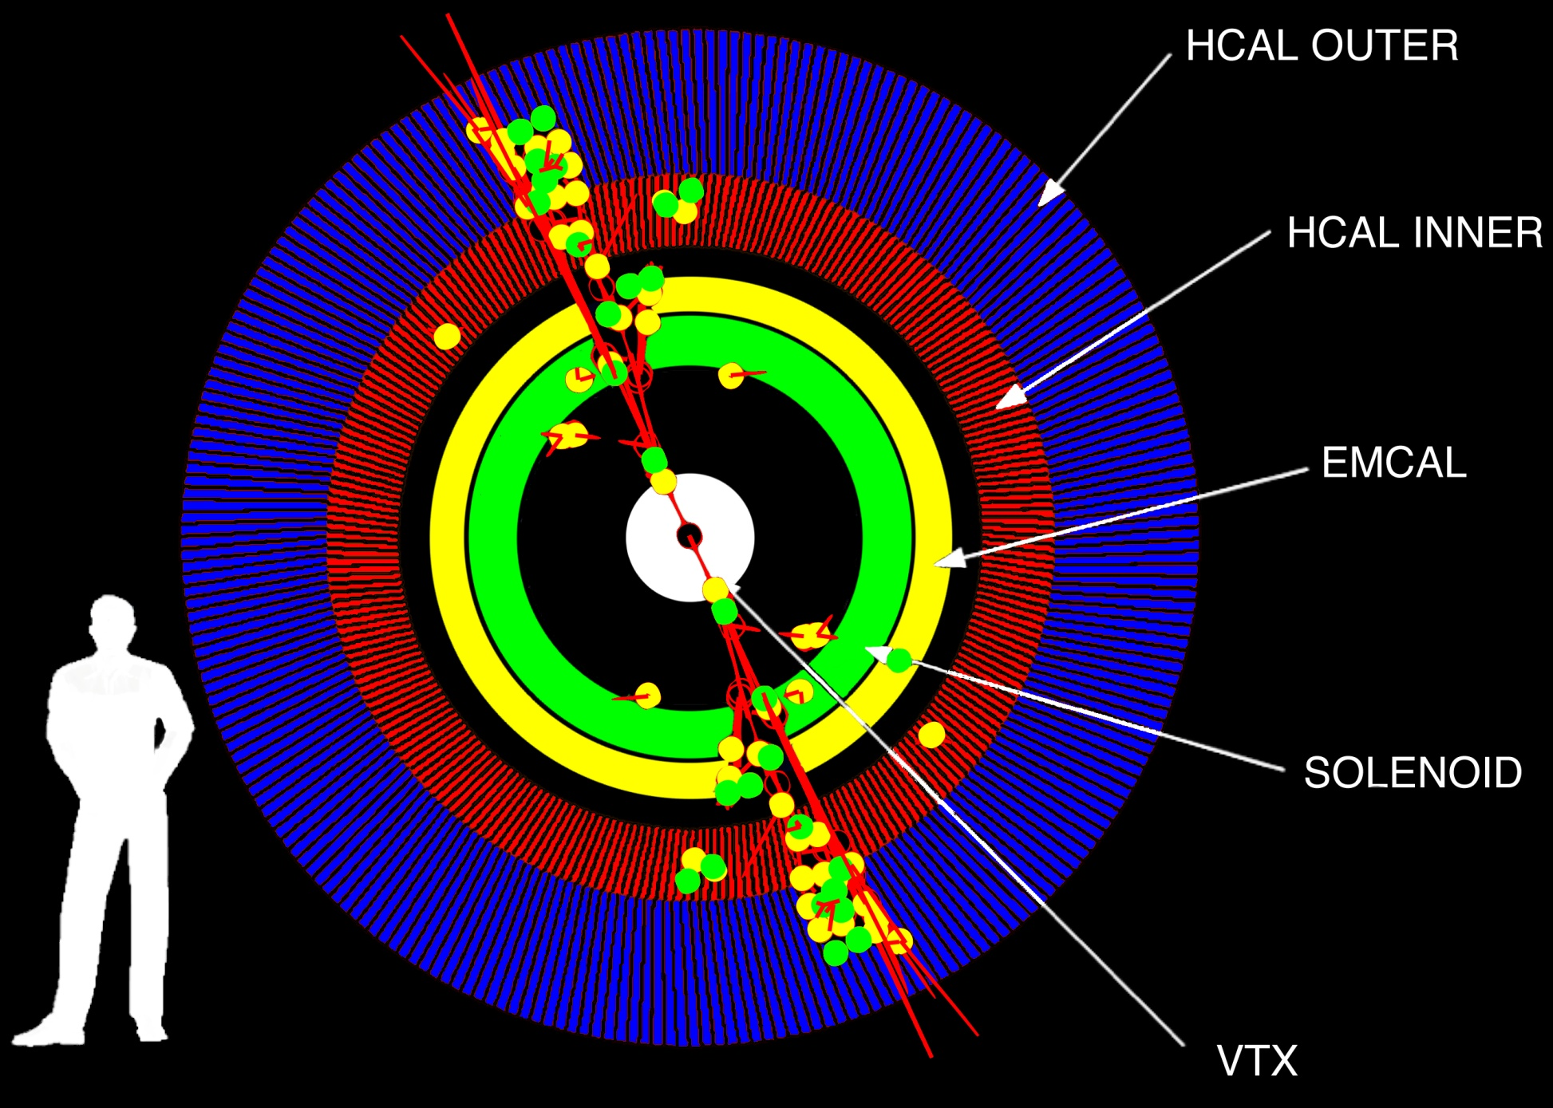
Major Upgrade to PHENIX Proposed
Taking advantage of significant technology advances (exciting synergies with LHC upgrades)
http://arxiv.org/abs/arXiv:1207.6378

Slide 10
External review of sPHENIX MIE, October 5–6, 2012
Committee members: Miklos Gyulassy (Columbia), Xin-Nian Wang (LBNL), Raju Venugopalan (BNL), John Harris (Yale), Jimmy Proudfoot (Argonne), Mike Harrison (BNL), Bolek Wyslouch (MIT)
The Committee ... “strongly endorses the science case for this program.”
- emphasize broad physics program of sPHENIX
- emphasize uniqueness of the RHIC measurements
- more GEANT4 studies of full jet reconstruction
- test beam to validate EMCal/HCal design
- reduce technical risk on solenoid (biggest issue)
“

Slide 11
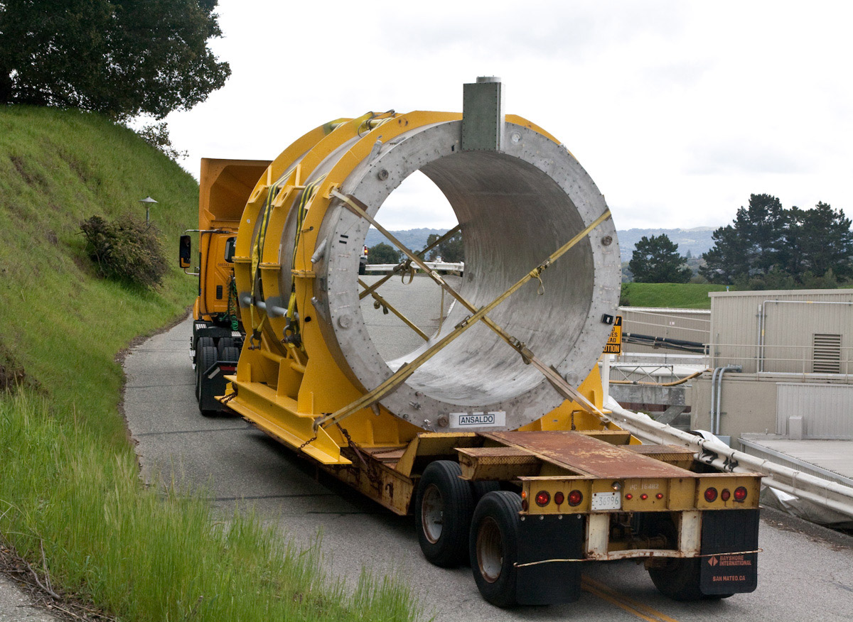
BaBar Solenoid
Excellent foundation for sPHENIX and ePHENIX:
inner radius 140 cm, length 385 cm, field 1.5 T
Just moving to SLAC station A
Soon to Brookhaven
Reduces technical risk associated with acquiring new superconducting research magnets

Slide 12
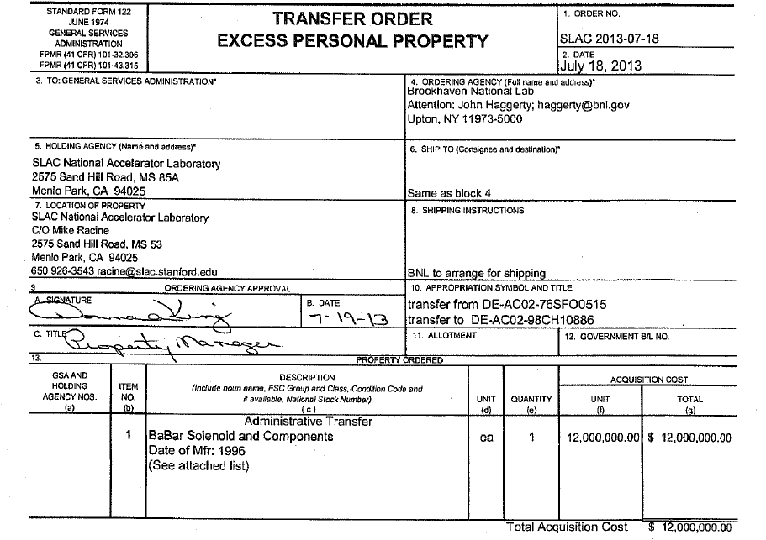

Slide 13
A broad physics program of the sQGP
What are the inner workings of the sQGP?
Are the key degrees of freedom quasi-particles? excitations? other?
full jet probes and high statistics dijets
where does jet energy lost go?
direct photons
photon-jet, photon-hadron, jet-hadron correlations
high statistics upsilons, high statistics open heavy flavor

Slide 14

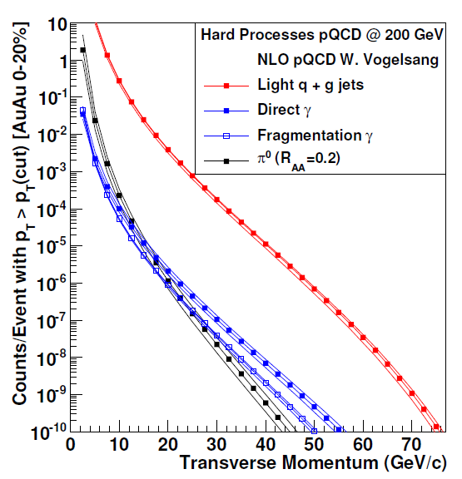
sPHENIX Rates: Jets, Dijets, γ-Jet
Sampling 50 billion Au+Au
events in one year
(can record 20 billion without selective triggers)
10⁷ jets > 20 GeV
10⁶ jets > 30 GeV
80% are dijet events
10⁴ direct γ > 20 GeV
A+B
p+A (different nuclei)
U+U
Differential measures
Jets Rates for Au+Au @ 100 GeV and Unique Flexibility of RHIC Enable Additional Lever Arm

Slide 15
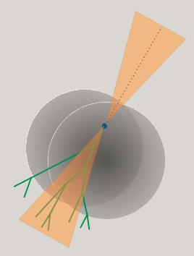
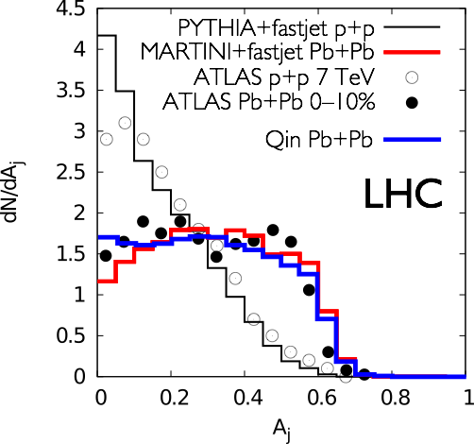
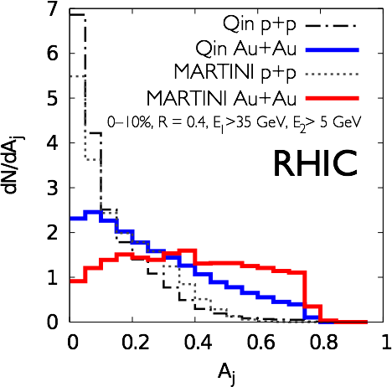
RHIC Jet Discriminating Power
C. Young, B. Schenke; G-Y Qin, B. Mueller

Slide 16
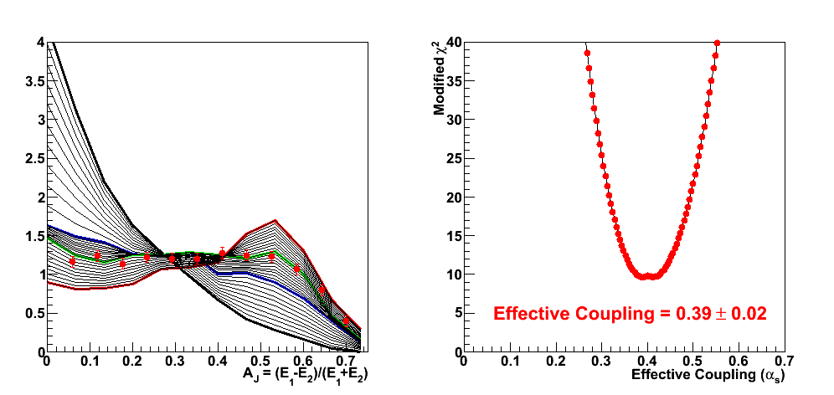

Comprehensive picture across scales and QGP temperatures spanned by RHIC and LHC needed
Lever Arm, Strongest Coupling Near T_{c}?
What is the Underlying Physics (not just η/s value)?
Example RHIC precision measurement
Chris-Coleman Smith

Slide 17
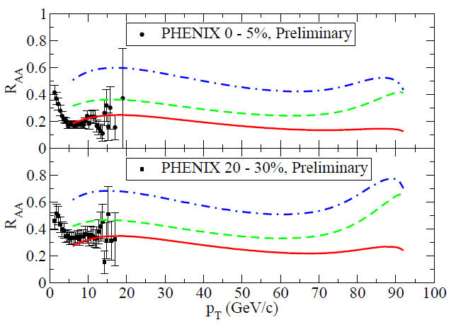
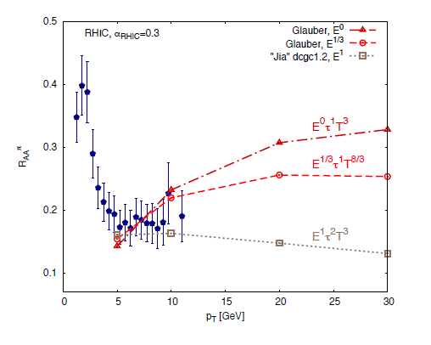
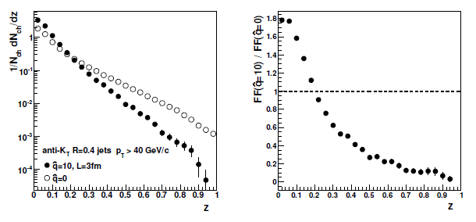
D(z)

Slide 18
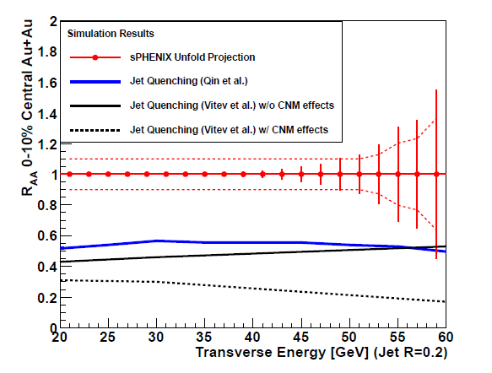
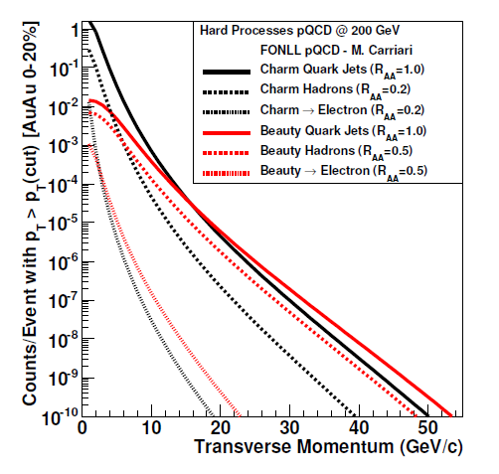
Jet R_{AA} high statistics…
Good first measurements
Good heavy quark jet rates
However, difficulty in tag jet
sPHENIX has great D meson acceptance and DCA tag, but loses S/B without Kaon ID.

Slide 19
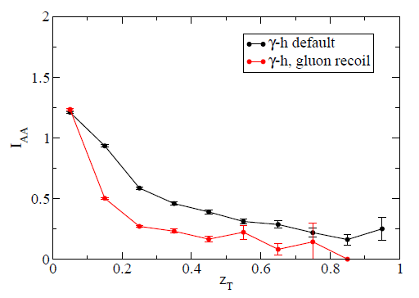
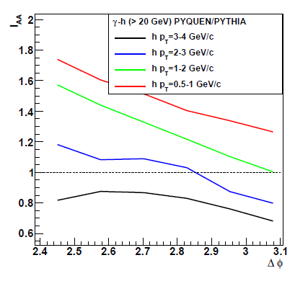
http://arxiv.org/abs/arXiv:1212.0646
Can measure not only γ-h I_{AA}, but also angular dependence…

Slide 20
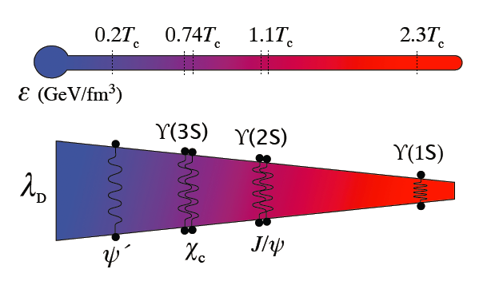
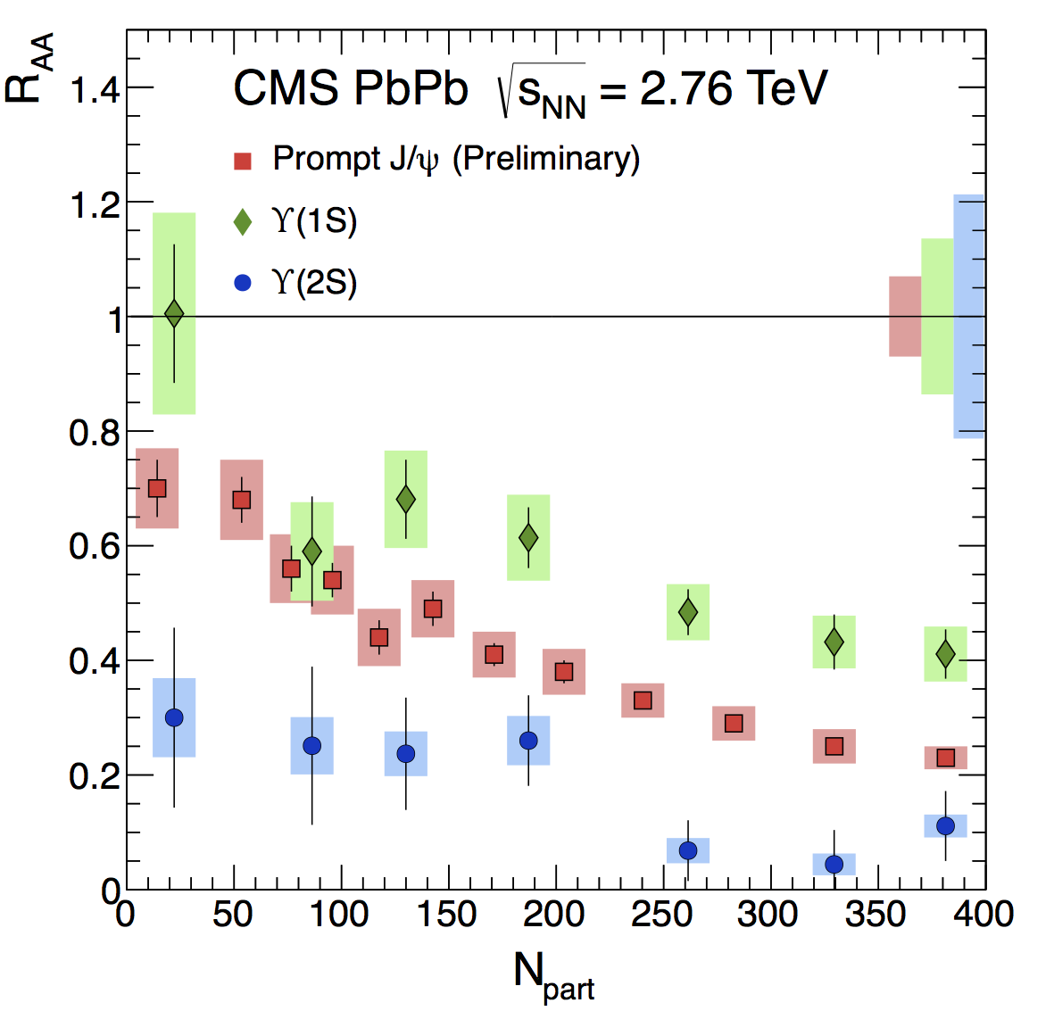
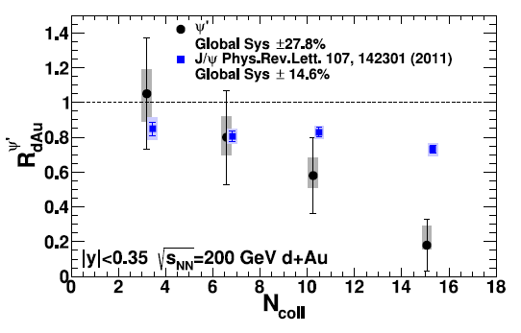



Quarkonia Thermometer
CMS data consistent with melting of Υ(2s,3s)
Controls: PHENIX d+Au
J/ψ
ψ’
N_{part}

Slide 21
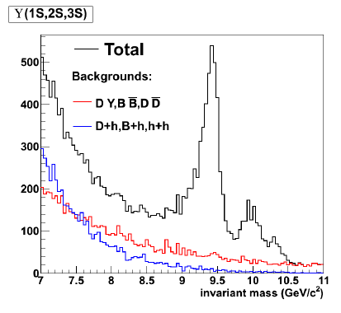
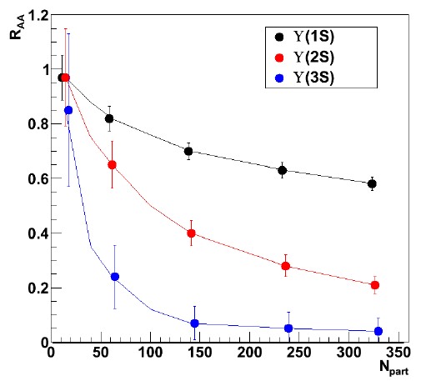
sPHENIX Upsilon Measurements
Au+Au Central
Extremely exciting LHC Upsilon results
Key to map out temperature dependence
sPHENIX will have similar statistics to LHC
and > 7x STAR MTD measurement
Needs additional tracking + preshower

Slide 22
There are arguments that fully reconstructed jets are not in the end the most sensitive to medium properties.
Single hadrons
Di-hadron correlations
Photon-hadron correlations
Multi-hadron correlations
Hadron-flow correlations (v₂, v₃, v₄, v₅)
Reco Jet spectrum
Reco Jet-hadron correlations
Reco-Jet – underlying event correlations (v₂, v₃, v₄, v₅)
Quarkonia – underlying event correlations
Quarkonia – Reco-Jet correlations
….
sPHENIX can do all that with 25 billion recorded events (no trigger bias) with very large acceptance. And in p+p, p+A too.

Slide 23
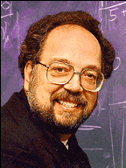
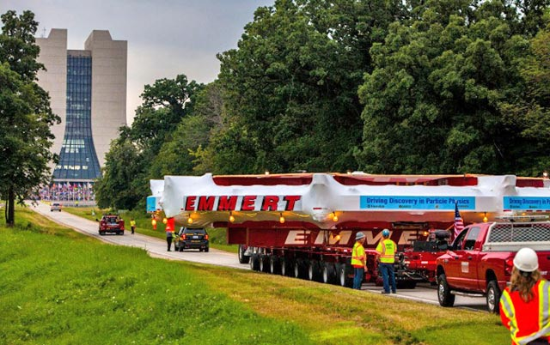
My g-2 Analogy
Years ago when g-2 was proposing a factor of 10 improvement with more running at BNL, the BNL PAC noted that the experiment would have uncertainties much smaller than those from theory.
Bill Marciano confidently stated that given the time to build and run the experiment, theory would be much lower.
Fermilab believed that to be the case!

Slide 24
What is our theory projection?
Where do we really have a solid connection between theory and experiment?
If things are not perturbatively describable, do we “jump into a black hole”?

Slide 25
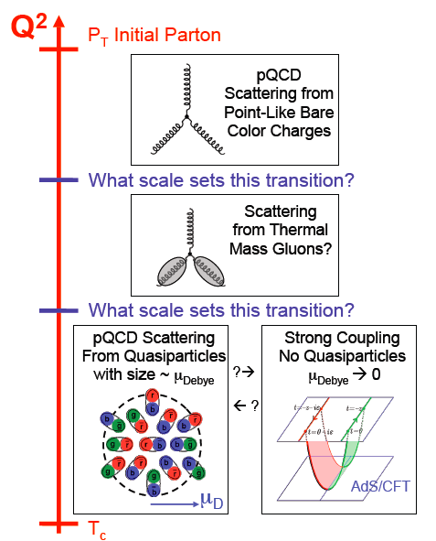
As high energy quarks or quark-antiquark pairs traverse the QGP, what do they see?
Do the highest energy
jets at LHC see
point-like color charges?
1/λ
Do the lowest energy jets at RHIC scatter from coherent fields or only excite sound waves?

Slide 26
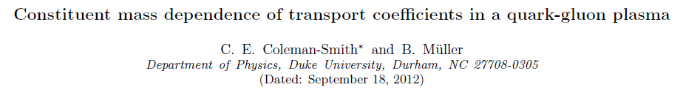
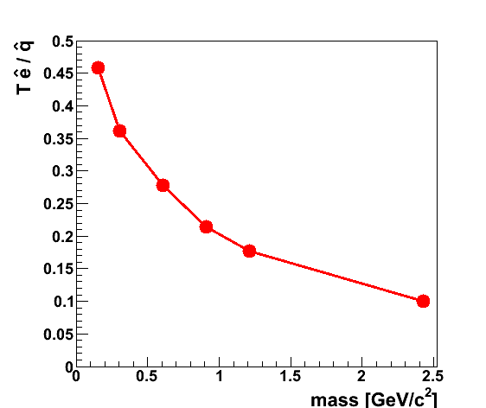
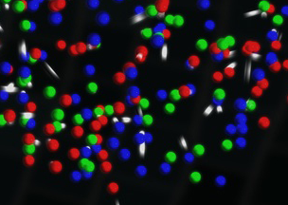
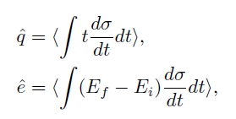
Sensitivity to Medium Composition (at a given Scale)
http://arxiv.org/abs/arXiv:1209.3328
qhat → scattering of lead parton → radiation e-loss
ehat → energy transferred to the QGP medium
Jet E_{T} = 30 GeV
T = 350 MeV
α_{s} = 0.3
Limit of infinitely massive scattering centers yields all radiative e-loss.
Medium parton

Slide 27
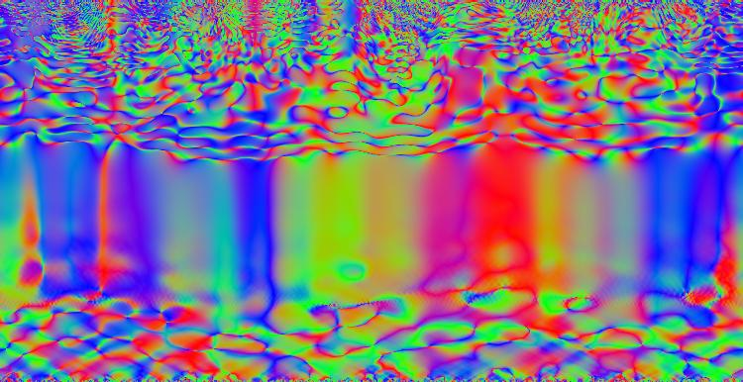
Is there experimental evidence for influence of
strong Color E+M fields?
Is the perturbative qhat / ehat prescription appropriate at the earliest times?
What is the influence of pre-equilibrium times?
How to connect these with experimental observables?

Slide 28
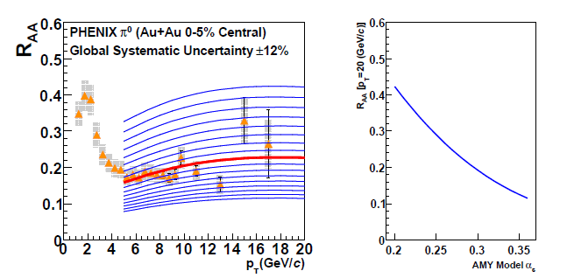
Qhat constraint… the past
Not the key observables, but pinning down the right picture
Very strong historical evidence for the power of energy reach of observables… (both up and down)

Slide 29
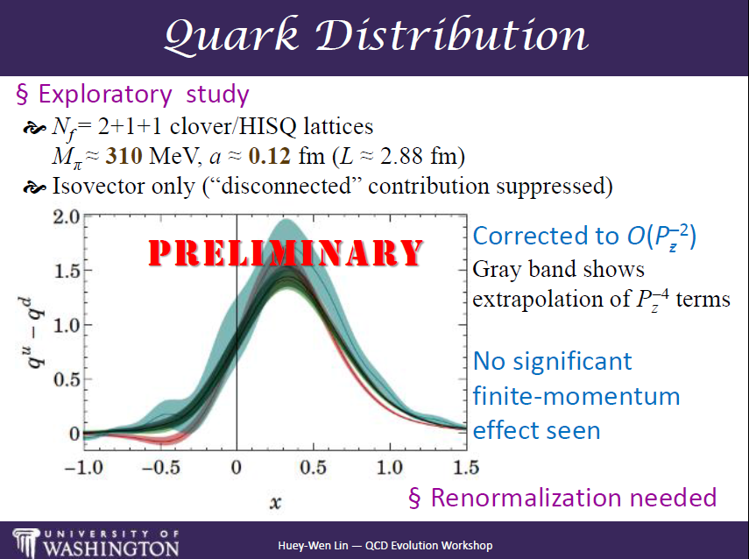
Lattice Revolution: Non-perturbative Connection

Slide 30
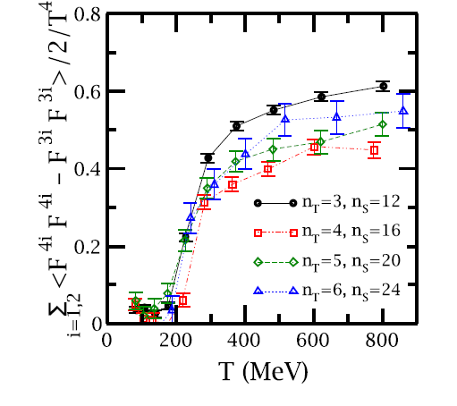
Lattice Revolution: Non-perturbative Connection
→ Revolution in Jet Quenching Theory (?) ←
http://arxiv.org/abs/arXiv:1303.0318
If they can calculate parton distribution functions and helicity distribution functions on the lattice in 10 years, what can be done for jet quenching observables?

Slide 31
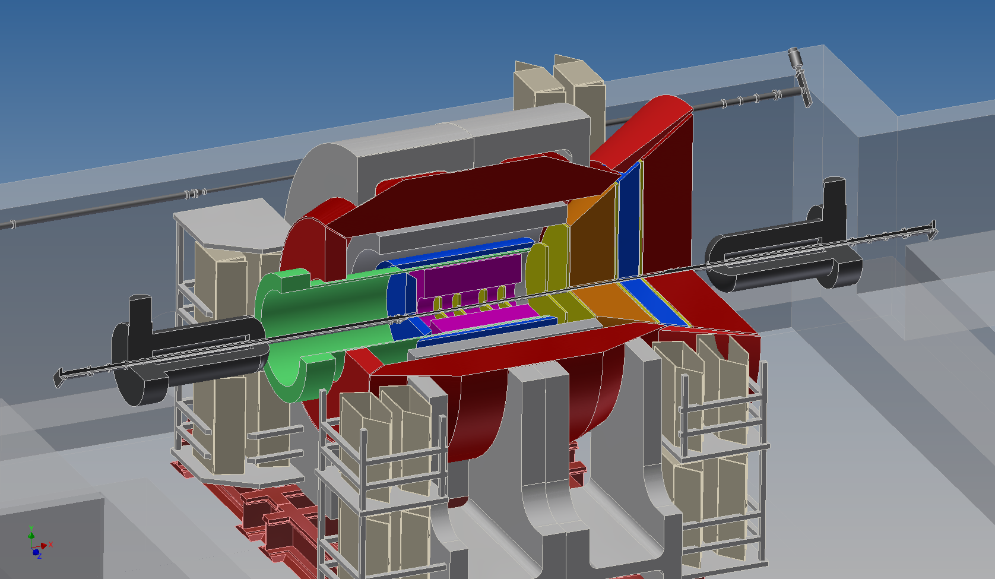

ePHENIX – built on the sPHENIX foundation
1954 Japanese original, Dr. Yamane estimates that Godzilla is 50 meters tall

Slide 32
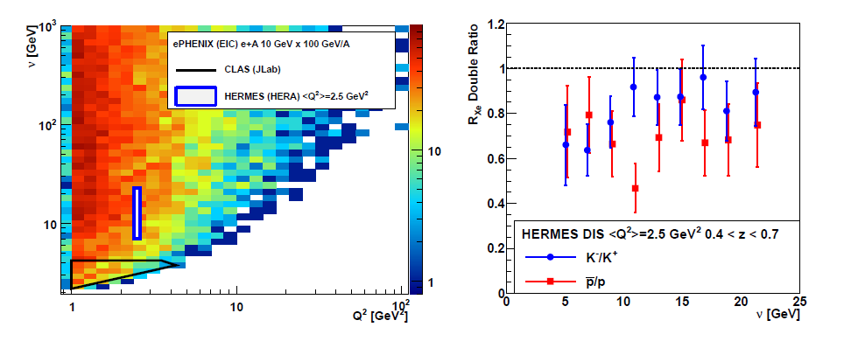
ePHENIX DIS on heavy nuclei…. Large range in struck quark energy in nuclear rest frame and initial virtuality.
Good to see virtuality evolution plot and prediction

Slide 33
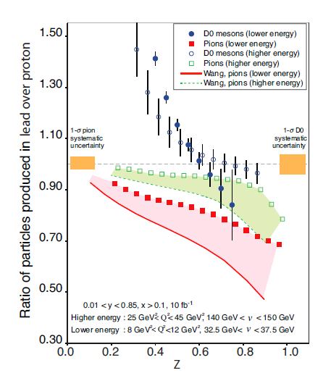
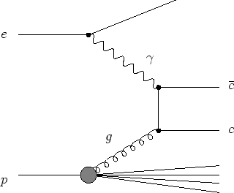
Calculation done as if scattering off intrinsic charm, so that scattered electron gives ν,
denominator for z.
Broken with photon-gluon fusion. Is that still worth measuring?

Slide 34
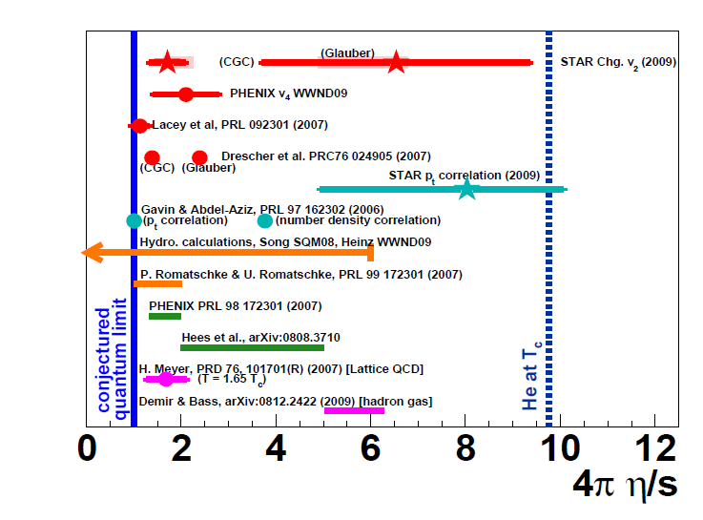
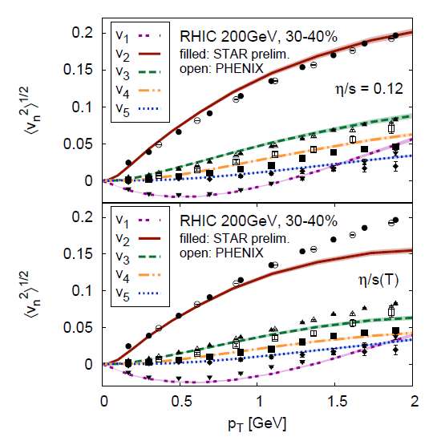
Two action items:
1. Write some text regarding analogy of theory on h/s (factor of 10 differences in 2009). Theory advances, higher moments, ruling out some pictures…
http://arxiv.org/pdf/0907.4513v2.pdf
Now η/s pinned down to < ±50%, thus indicating the tools exist to attack the temperature dependence and more

Slide 35

Reasonable
Representation…

Slide 36

Perhaps a version of Xin-Nian’s figure with a larger box from 5 years ago and today would be a good proximity…
Then argue that progress for tools to go to the next step…
Can we attach evolution, m_{D}, scattering from ?

Slide 37


Read Thorsten’s paper and get his code…
Try thinking through connecting sPHENIX capabilities /
statistics with these different “bias is good” observables…
sPHENIX can dial the range between these extremes…
And sPHENIX has discovered color plots!

Slide 38
Summary
sPHENIX will have unprecedented
RHIC measurement capabilities
Very strong argument for key insights with
large collision energy span combined with LHC
(almost 100% parallel in previous examples)
How to gain fundamental new insights
from these hard probes?
How to translate that into precision constraints?
Open for discussion…

Slide 39
Extras…

Slide 40

Why?
Bag Model EOS?
http://arxiv.org/abs/arXiv:1002.1165

Slide 41


Is there experimental evidence for influence of
strong E+M fields?
RHIC
LHC
http://arxiv.org/abs/1301.0099

