Slide 1

PHENIX Beam Use Proposal
Run-14 and Run-15
Jamie Nagle
for the PHENIX Collaboration
Curiosity driven program…
Quantitative assessments…
Taking maximal advantage of RHIC
uniqueness and versatility
?

Slide 2
Run-13 Report
Last year, PAC recommended highest priority was to integrate sufficient luminosity for p+p @ 500 GeV
for a definitive W measurement (750 pb⁻¹ delivered)
Note that this translates into 250 pb⁻¹ sampled by PHENIX within|z|<30 cm
The entire Run-13 has been p+p @ 500 GeV
following the PAC guidance
Multiple machine / polarization issues early on…
Goal seemed very far away, and then some key breakthroughs and an extension of the run

Slide 3
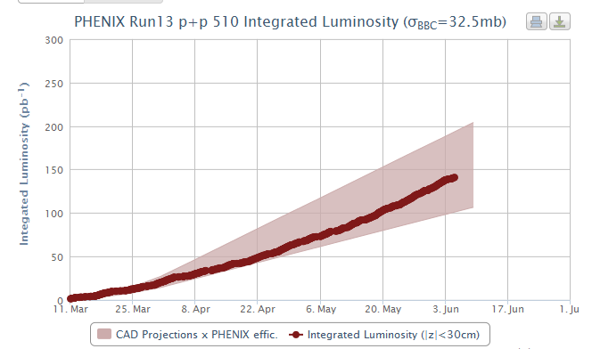
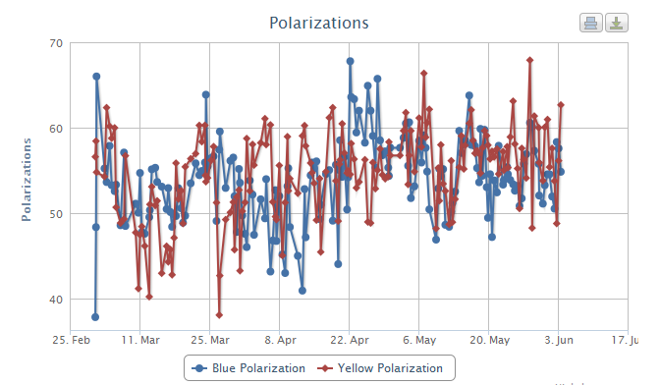
Early May, polarization issues had been largely resolved and luminosities delivered were nearing or exceeding CA-D projected maximum values.
More modest goal of 150 pb⁻¹ was set
(compare to 250 pb⁻¹)
and ~150 pb⁻¹ is
now on tape!
PHENIX Integrated Luminosity
250 pb⁻¹
150 pb⁻¹
50 pb⁻¹
Beam Polarization
55%

Slide 4
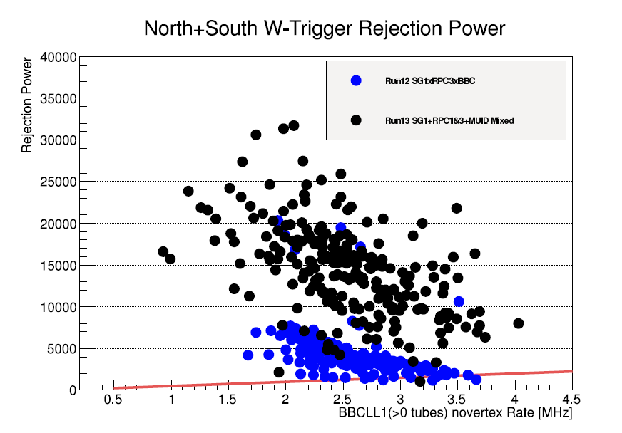
PHENIX Detector Performance in Run-13
W→μ trigger now fully implemented and gave more than sufficient rejection for full luminosity sampling
High DAQ livetime > 90%
Good PHENIX uptime ~ 70%
FVTX working very well and
demonstrated benefit for W background rejection
Major problem with VTX cooling leak.
Since not critical for p+p @ 500 GeV physics goals, decision to remove and maximize time for readiness in Run-14.

Slide 5
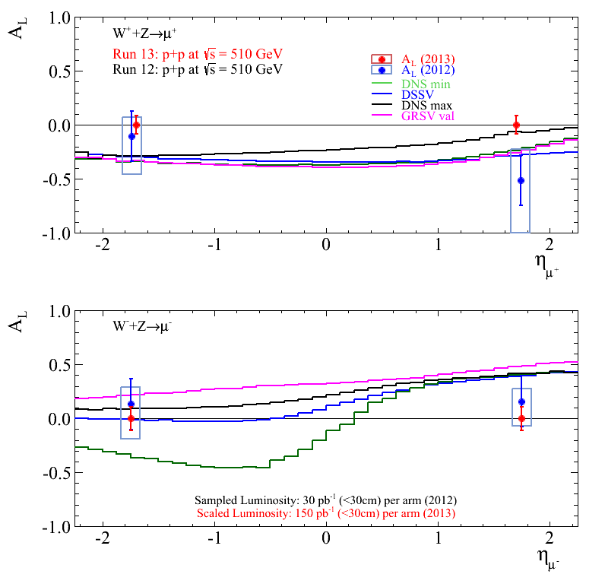
Producing W→μ data set is nearly real-time.
Full data set production expected to be finished in 2-3 weeks.
One month long SpinFest at RIKEN in July 2013 is planned and expect first look at full statistics physics result.
Conservative S/B projected uncertainties from Run-13 150 pb⁻¹
We are very hopeful that the PHENIX and STAR data combined will result in exciting new insights on the u(ubar), d(dbar) spin contributions

Slide 6
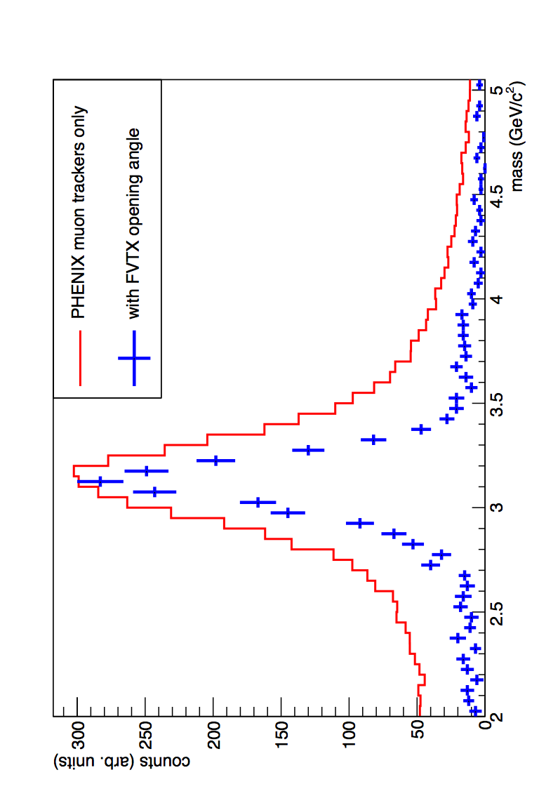
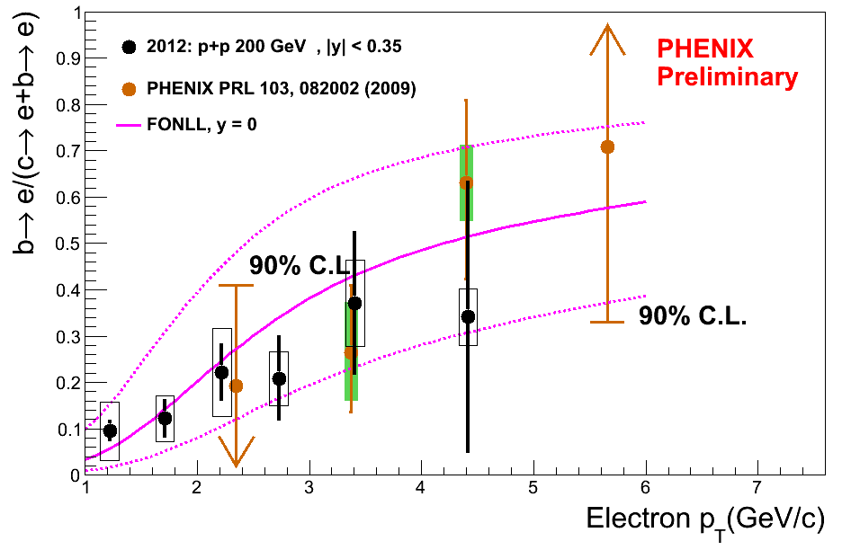
Run-14/15 Key Detector Upgrades (Silicon Vertex Detectors)
FVTX (forward rapidity) commissioning run in Run-12
> 96% live active area
Fast analysis results indicate performance exceeding specifications
Displaced vertex results for open heavy flavor from Run-12 Cu+Au expected soon
improved dimuon
mass resolution
and S/B
VTX commissioning run in Run-11
Preliminary p+p charm/beauty results
Significant detector performance issues have slowed progress
Repair plans in place for
Run-14 readiness

Slide 7
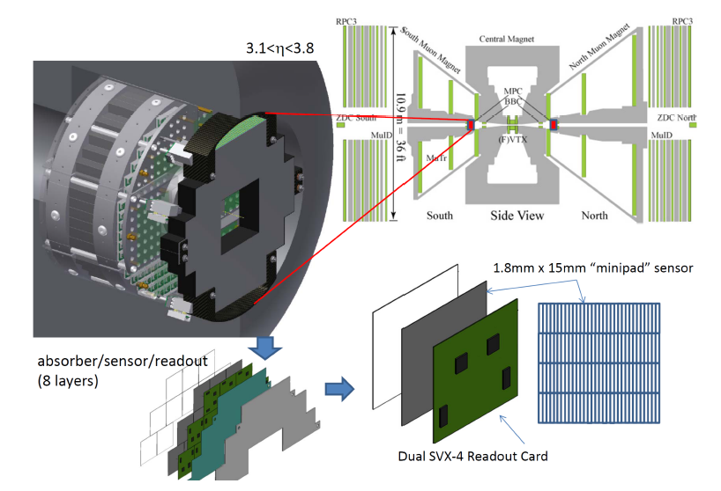
MPC-EX Upgrade
The PHENIX MPC Crystal Calorimeter (|η|=3.1-3.8) has played a critical role in our forward (low-x) and transverse spin physics program
MPC-EX upgrade adds novel silicon tracking / preshower detector to enable direct photon identification and π⁰→γγ to higher momentum
Beam test in fall, and section available for integration tests in Run-14
Full detector available for physics in Run-15

Slide 8
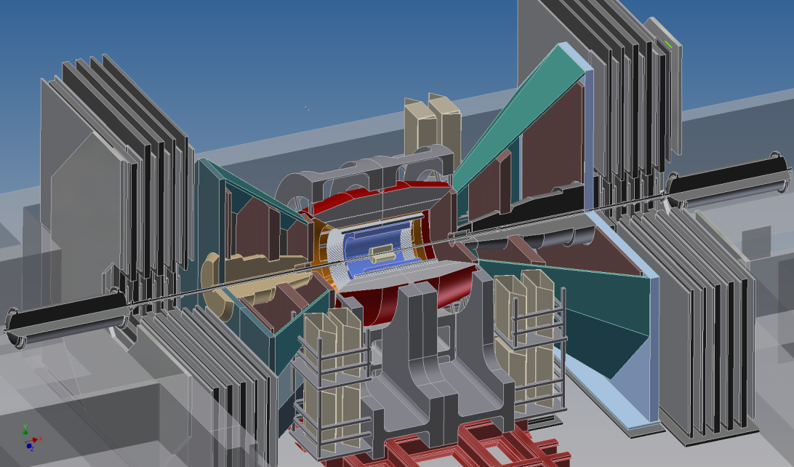
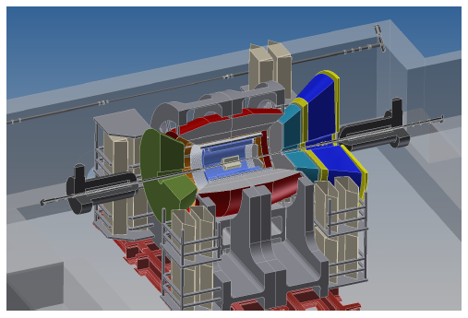
sPHENIX & ePHENIX
Major changes in PHENIX detector
Greatly increased acceptance (x20-50 in many channels)
and key new detector capabilities
Some current PHENIX capabilities no longer available
after 2016 – 2017…
sPHENIX
ePHENIX

Slide 9
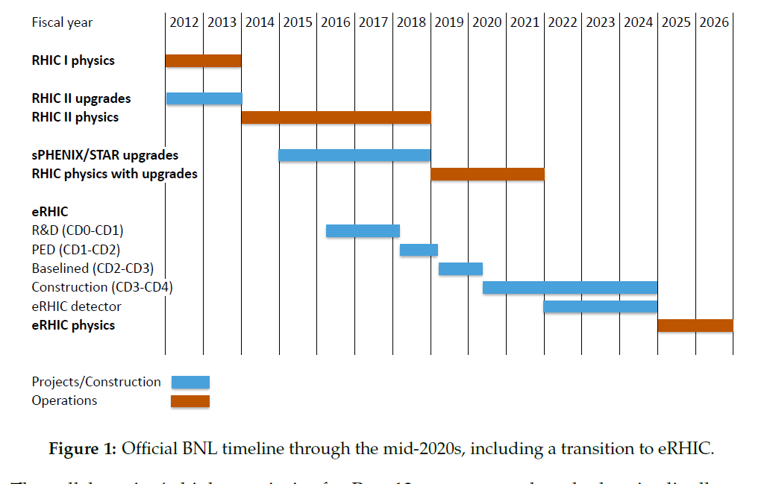
Brookhaven Lab Timeline
1-year shutdown
to install sPHENIX
sPHENIX
physics
ePHENIX physics
Run-14/15/16: Thinking in terms of definitive measurements
(not hints to return to later)

Slide 10
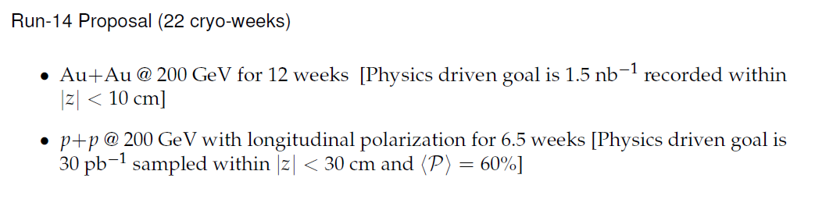
Run-14 Request
In the scenario of only 15 cryo-weeks, we would only be able to run Au+Au @ 200 GeV

Slide 11
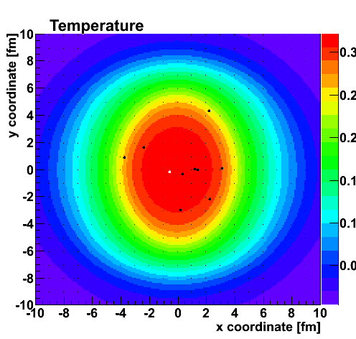
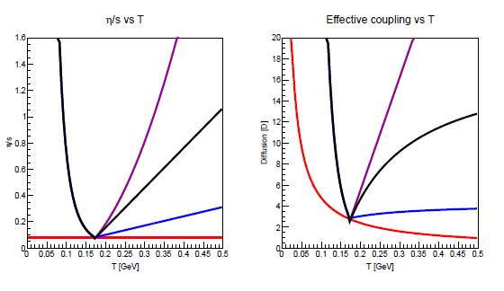
Relating Perfect Fluidity to Charm Quark Diffusion
η/s
Charm Diffusion (D)
Temperature [GeV]
Temperature [GeV]

Slide 12
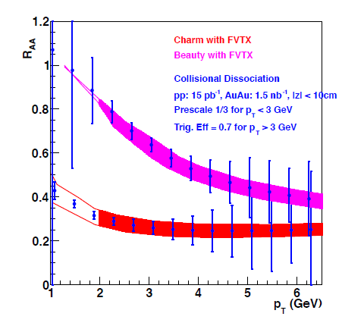
Run-14 Au+Au @ 200 GeV Request
1.5 nb⁻¹ request is driven by charm / beauty physics
FVTX first Au+Au data set
Example projected uncertainties in collisional dissociation model
Bands include unfolding systematic uncertainties
Beauty
Charm
12 weeks is our estimate to obtain the physics driven goal
(see backup slides for full details)

Slide 13
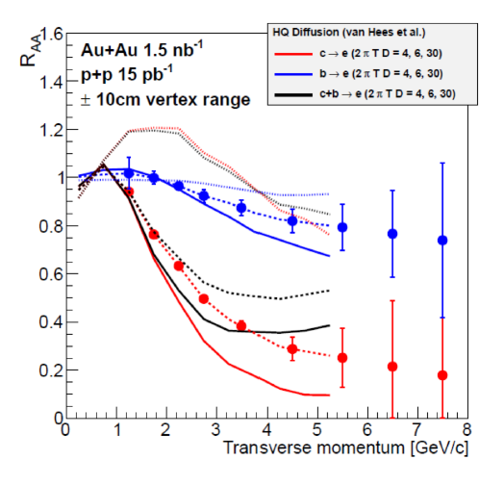
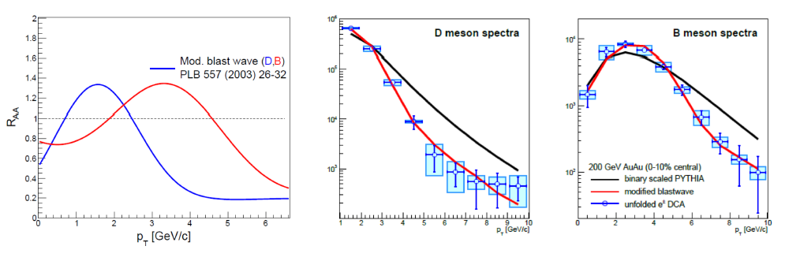
VTX projected uncertainties and sensitivity relative to heavy quark
diffusion parameter
Beauty
Charm
Charm
Beauty
In extreme scenario of beauty quarks following flow field, very different prediction

Slide 14
Example full unfolding from DCA electrons to parent mesons
Au+Au data set will also provide a factor of 2.5
more statistics for all measurements
For J/ψ and ψ’, significantly improved
mass resolution and background rejection
Definitive Heavy Quark + Quarkonia Au+Au Data Set

Slide 15
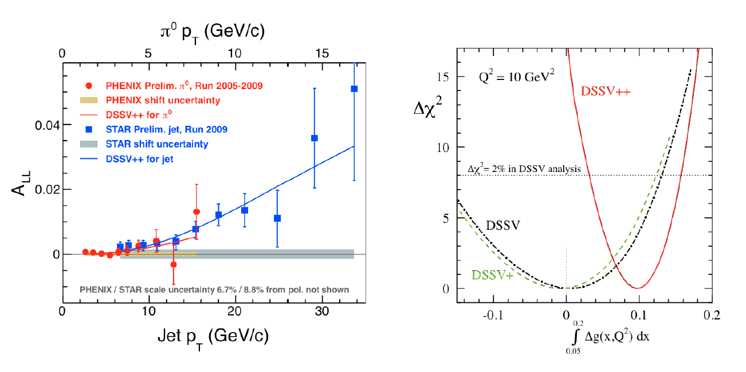
Run-14 p+p (Long. Pol) @ 200 GeV Request
First indication of non-zero gluon contribution to proton spin!
PHENIX publication of these results in the next month.
Critical to improve the low-x (low p_{T} π⁰ A_{LL}) constraint!

Slide 16
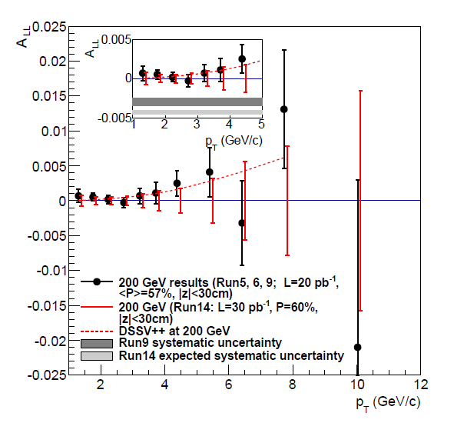
p+p (long. pol.) @ 200 GeV for 6.5 weeks
(30 pb⁻¹ |z|<30cm)
Doubling statistical precision, and more importantly significantly reduced systematic uncertainty
Also provides timely baseline measure for Au+Au data

Slide 17
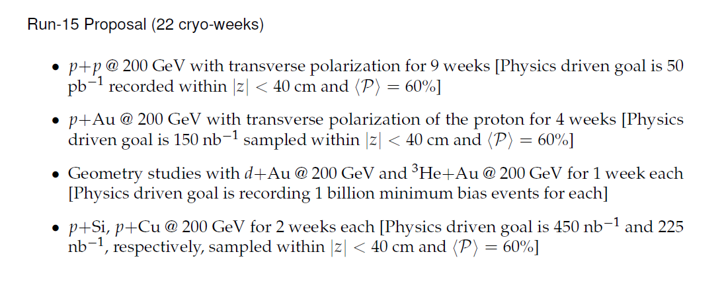
Run-15 Request
In the scenario of only 15 cryo weeks, we would only be able to run a shorter p+p and p+Au @ 200 GeV
Note that not utilizing additional collision combinations greatly diminishes the utility of the measurements and does not fully exploit the uniqueness of RHIC

Slide 18
Transverse Spin Physics
Single spin asymmetries A_{N} in transversely polarized p+p collisions may contain key information on the parton’s transverse motion in the transversely polarized proton
(i.e. language already hinting at orbital angular motion)
Different theoretical approaches
(TMD factorization and Collinear twist-three factorization)
TMDs include Sivers and Collins functions
Direct photon A_{N} is an excellent clean test
almost exclusively sensitive to Sivers
Also, good measure of twist-three quark-gluon correlator T_{q,F}

Slide 19
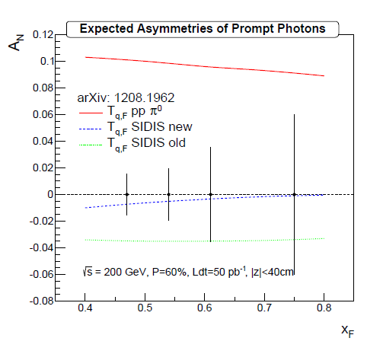
p+p (transverse pol.) @ 200 GeV for 9 weeks
(50 pb⁻¹ |z|<40cm)
Utilize unique capabilities of MPC-EX upgrade
Direct photon with no final state interactions
Uncertainties clearly resolve sign disagreement for T_{q,F}

Slide 20
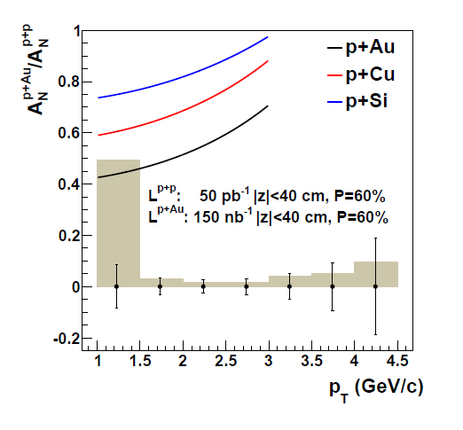
p+Au with transversely polarized proton
New theory developments… Transverse polarization A_{N} in p+A scales with the saturation scale for p_{T} < Q_{s}
Completely unique RHIC access to saturation physics
p+Au measurement with projected uncertainties in
4 weeks (150 nb⁻¹ |z|<40cm)
Testing geometric scaling with Si, Cu target nuclei
Comparable uncertainties with 2 week runs

Slide 21
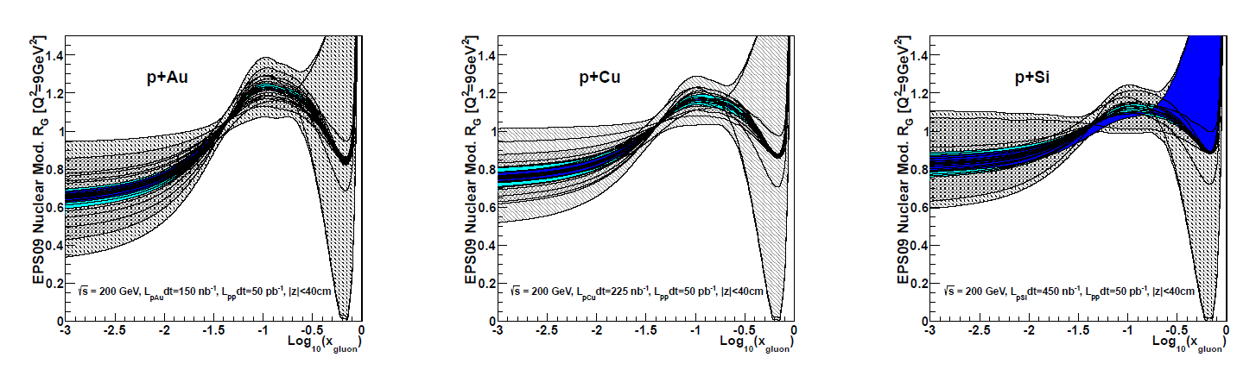
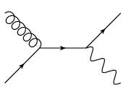
Constraining Gluon nPDFs
Strong indications of low-x shadowing/saturation physics with d+Au J/ψ, e-μ correlations, h-h correlations, single muons, electrons, …
And yet, all have final state interactions.
Golden channel direct photon
MPC-EX Direct Photon
Gluon nPDF
Au Nucleus
Using full statistical / systematic constraint method on EPS09 nPDFs, blue bands indicate projected measurement (1, 2 σ level)

Slide 22
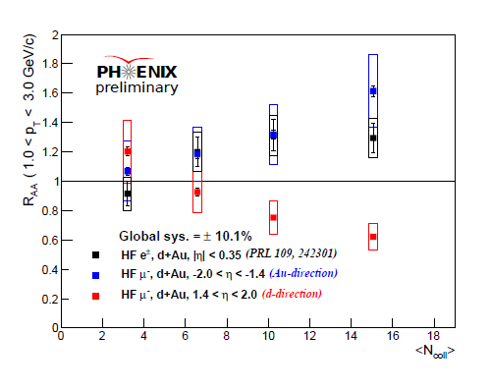
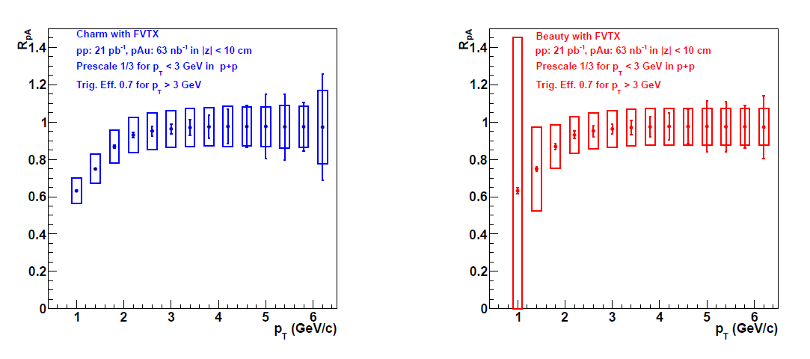
Open Heavy Flavor Probes of nPDFs and More
Another handle on gluon nPDF
and critical baseline for quarkonia
Measure open charm and beauty at forward/backward rapidity with FVTX
Can we run p+Au and Au+p for systematic checks (a la LHC p+Pb)?
Anti-shadowing?
Gluon
Saturation?
Charm
Beauty

Slide 23
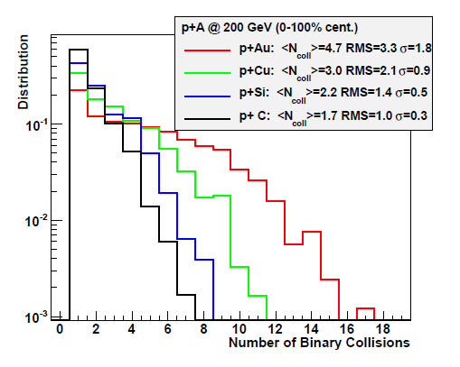
Geometry Test
DIS measures give geometry averaged nPDF
Utilized d+Au centrality measures to date…
Excellent opportunity to validate with direct photons nPDF of different nuclei

Slide 24
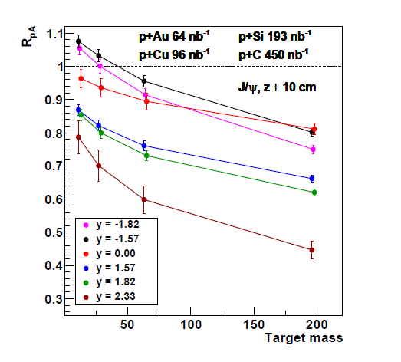
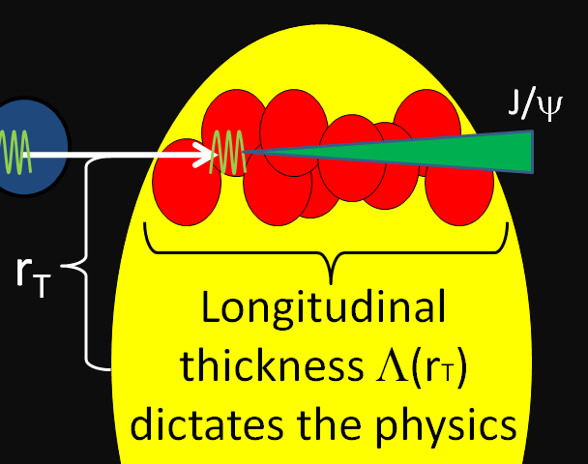
Quarkonia in Medium (Cold or Hot)
J/ψ and ψ’ are hard to explain w/ nPDF & σ_{breakup}
Instead of d+Au centrality selection, another method to change nuclear density is with different targets
Also combined with improved S/B and for the first time ψ’ at forward and backward rapidity (FVTX)

Slide 25
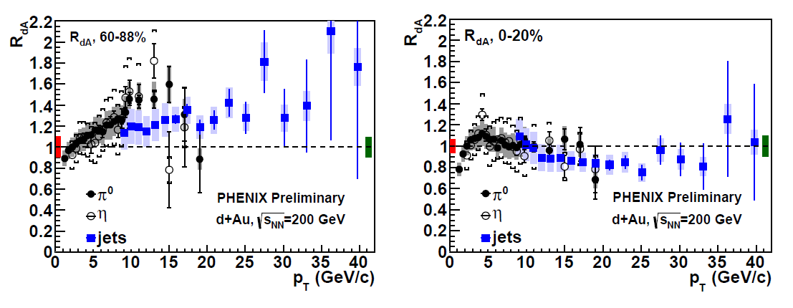
Cracking the Geometry Code
Are there competing partonic effects at play at high p_{T}?
Are there auto-correlations beyond those accounted for between centrality measure and particle of interest?
2 weeks of p+Si gives <N_{coll}> ~ (d+Au 60-88% central), better statistical precision, and no centrality categorization required (i.e. definitive test)

Slide 26
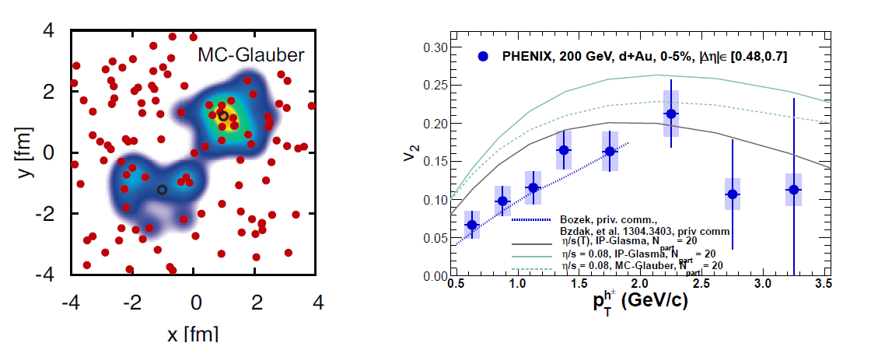
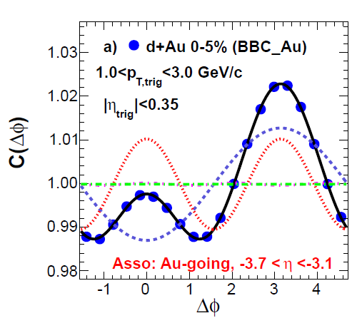
Can a nearly inviscid fluid be created in p(d) + A too?
Hydrodynamic flow? Glasma diagrams? Something else?
LHC has highest parton densities…
RHIC has unique access to geometry controls…

Slide 27
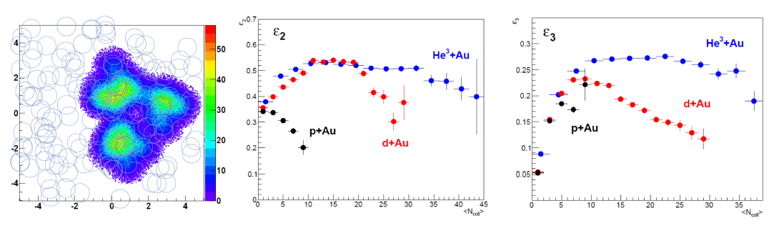
Geometry Control
He³ + Au
Large PHENIX Acceptance: VTX, FVTX, MPC-EX
1 billion events with larger acceptance detectors will yield 20++ times the statistics of current measurements
Only takes ~ 1 week with high rate PHENIX DAQ
Low luminosity requirement. How quickly can CA-D switch?

Slide 28
PHENIX BUP Summary
Exciting physics program for Run-14 and Run-15
Lots of debate within PHENIX because of all the
top science opportunities
Running periods need to be sufficient to make definitive measurements
Run-15 in particular emphasizes the truly unique RHIC capabilities to provide definitive new insights

Slide 29
Additional Material
Explanations of Weeks to Physics Goals

Slide 30
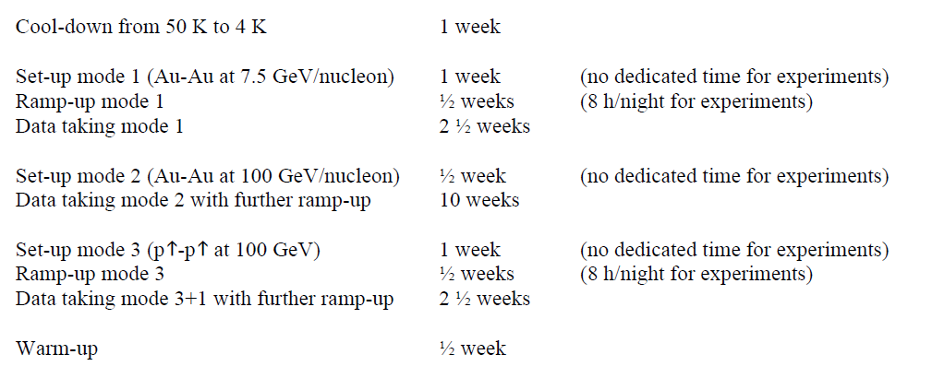
How are the number of weeks for Run-14 calculated?
We have attempted to closely follow CA-D guidance as provided at:
http://www.rhichome.bnl.gov/RHIC/Runs/RhicProjections.pdf
Example with Run-14 and 22 cryo-weeks (following chart on page 2 in doc.)
100 GeV/nucleon)
11
2
2
2
6 1/2
1 + 1 + 0.5 + 11 + 1 + 0.5 + 6.5 + 0.5 = 22 cryo-weeks
Note that we quote 12 weeks of Au+Au physics running in our request
Past experience has a very quick turn on for Au+Au (optimist view)

Slide 31
How did we calculate 12 weeks Au+Au for 1.5 nb⁻¹ recorded by PHENIX within |z| < 10 cm.
(VTX/FVTX optimal acceptance)
Physics driven goal (set by desire to decompose charm and beauty contributions over a wide p_{T} range).
Low to moderate p_{T} electrons/muons come from minimum bias data sample (no Level-1 trigger selection).
Excellent DAQ bandwidth 5 kHz even with silicon detectors.
Thus, the key is running time and luminosity exceeding 5 kHz for
|z|< 10 cm (mostly true with current projections)
Evts / week = 5000 x 60x60x24x7 x 0.7 x 0.55 = 1.16 B = 0.17 nb⁻¹/wk
Note 0.7 (PHENIX Uptime), 0.55 (RHIC Uptime)
Thus, it might only take 9 weeks to achieve this goal.
However, there is some ramp-up time for luminosity to exceed the 5 kHz DAQ bandwidth. There is also some vertex trigger resolution.
Based on past experience, scale luminosity/wk x 0.75
and that gives the 12 week request.

Slide 32
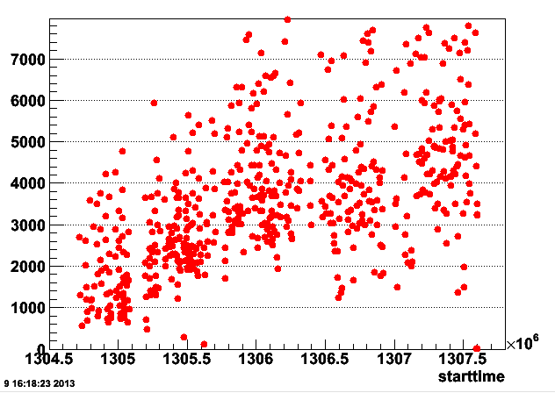
Run-11 Au+Au @ 200 GeV Performance
Au+Au interaction rate within
|z| < 10 cm
Time Tag throughout Run-11
CA-D Quoted Run-11 Achieved: L (peak) 50×10²⁶ [31 kHz] L(ave) = 30×10²⁶ [18 kHz]
Fraction of all interactions within |z| < 10 cm → 0.30
Thus, within |z| < 10 cm these correspond to peak 9 kHz and average 6 kHz

Slide 33
How did we calculate 6.5 weeks p+p for 30 pb⁻¹ recorded by PHENIX within |z| < 30 cm.
(Central Arm π⁰ acceptance)
Physics driven goal (set by desire substantially improve low-x constraint on gluon contribution to proton spin).
For the p+p @ 200 GeV, we took the first two weeks at the minimum (9.3 pb⁻¹ per week) and then 4.5 weeks at the mean of the minimum/maximum, and that gives us the total for 6.5 weeks. The Figure 5 has a slower ramp on than the minimum, on the other hand it is quite possible to achieve higher than the mean of the min/max for the running duration afterwards.
We then fold in the PHENIX uptime and the z-vertex selection factors.

Slide 34
How are the number of weeks calculated (Run-15)?
Cool-down from 50 K to 4 K 1 week
Set-up mode 1 (p-p at 100 GeV/nucleon) 1 week (no dedicated time for experiments)
Ramp-up mode 1 ½ week (8 h/night for experiments)
Data taking mode 1 9 weeks
Set-up mode 2 (p-Au @ 100 GeV/nucleon) 1 week (no dedicated time for experiments)
Ramp-up mode 2 ½ week (8 h/night for experiments)
Data taking mode 2 4 weeks
Set-up/Ramp-up/Data taking mode 3 d-Au 1 week (note very low luminosity requirement)
Set-up/Ramp-up/Data taking mode 4 He³-Au 1 week (note very low luminosity requirement)
Mode 5 (p+Si/Al, p+Cu) 2.5 weeks (what fits depends on earlier perform.)
Warm-up ½ week
1 + 1 + 0.5 + 9 + 1 + 0.5 + 4 + 1 + 1 + 2.5 + 0.5 = 22
Exact switching times and ramp-up for p+A needs more guidance. Aggressive physics driven schedule. Modes 3-5 will need prioritization depending on running time and switching time.

Slide 35
Phil Pile requested values for RHIC delivered luminosities corresponding to the PHENIX BUP requests.
They are provided below. Of course, the physics projections require the PHENIX recorded/sampled luminosities within specified z-vertex cuts and the PHENIX uptime.
Run-14: p+p @ 200 GeV Long --> delivered = 30 pb^-1 x (1/0.7) x (1/0.6) = 71 pb^-1
Run-15: p+p @ 200 GeV Trans --> delivered = 50 pb^-1 x (1/0.7) x (1/0.7) = 102 pb^-1
Run-15: p+Au @ 200 GeV Trans --> delivered = 150 nb^-1 x (1/0.7) x (1/0.7) = 306 nb^-1
Run-15: p+Si @ 200 GeV Trans --> delivered = 450 nb^-1 x (1/0.7) x (1/0.7) = 918 nb^-1
Run-15: p+Cu @ 200 GeV Trans --> delivered = 225 nb^-1 x (1/0.7) x (1/0.7) = 459 nb^-1
These values above have a straightforward correspondence as outlined in the BUP.
For the Run-14 Au+Au request, the main physics driver is bandwidth limited at 5 kHz by the PHENIX DAQ. Thus, what matters is the RHIC uptime and when the luminosity within |z| < 10 cm exceeds this 5 kHz limit. See earlier slide.
For the Run-15 d+Au and Run-15 He³+Au these are again bulk observables and come from the minimum bias trigger sample. Thus, the calculation to get 1 billion events is simply 5000 (DAQ rate) x 60 x 60 x 24 x 5 (days) x 0.7 (PHENIX uptime) x 0.6 (RHIC delivery). The luminosities required during these 5 days much less than 10% of the minimum value quoted for delivered luminosities.

Slide 36
EXTRAS

Slide 37
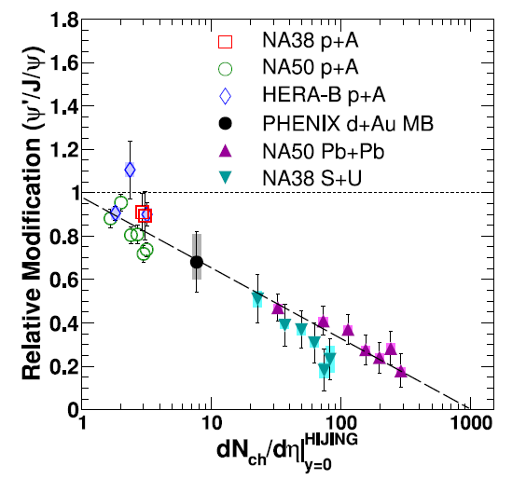
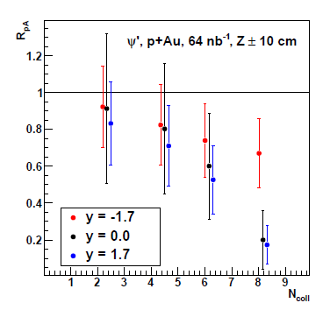
ψ’ Physics Implications
http://arxiv.org/abs/arXiv:1305.5516
Projections Run-15

Slide 38
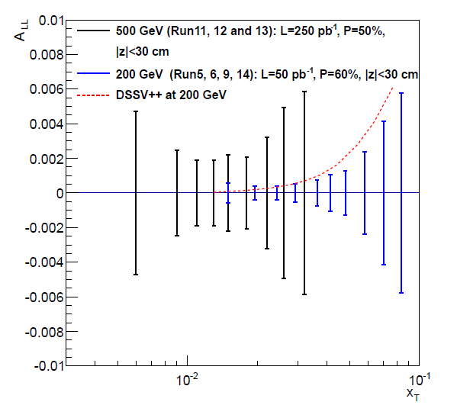
Why does a smaller p+p @ 200 GeV data set constrain the low-x gluon spin contributions better than larger p+p @ 500 GeV data set?

Slide 39
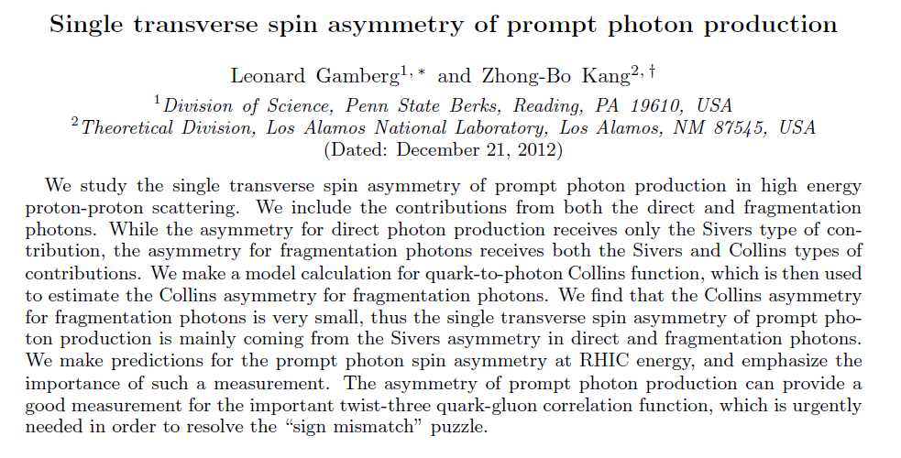

Slide 40
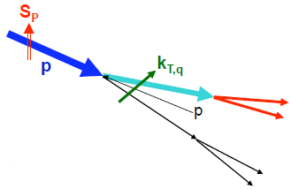
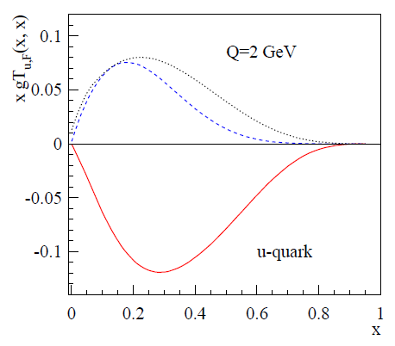
Transverse Motion of Partons in a Proton
  TMD: Correlation between nucleon spin and parton k_{T}.
  Twist-3: Quark-gluon correlations in polarized hadron
Two theoretical approaches to the correlation between parton k_{T} and proton spin:
Phys. Rev. D 41, 83 (1990) Phys. Rev. D 43, 261, (1991)
“Sivers” distribution
Phys. Rev. D 59, 014004 (1998)
Approaches are related and
shown to be equivalent at
intermediate k_{T}.
Extracted from SIDIS data (extrapolated x>0.3)
Extracted from
(Assuming that transverse motion
dominates the hadronic A_{N})
Two Possibilities:
Transverse motion not responsible for hadronic A_{N}
SIDIS extrapolation to large x not valid

Slide 41
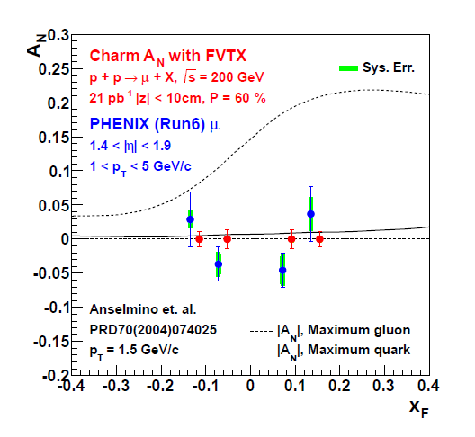

Slide 42
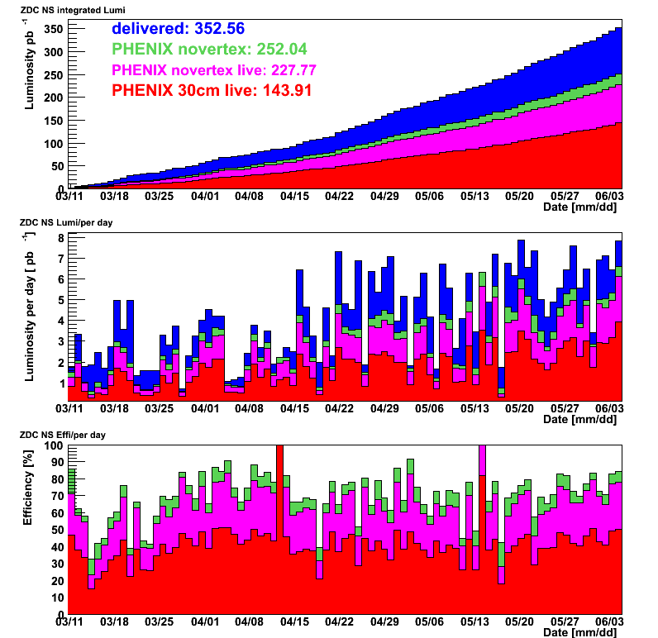
June 3, 2013

