Slide 1
Upgrade Program
Jamie Nagle
University of Colorado, Boulder

Slide 2
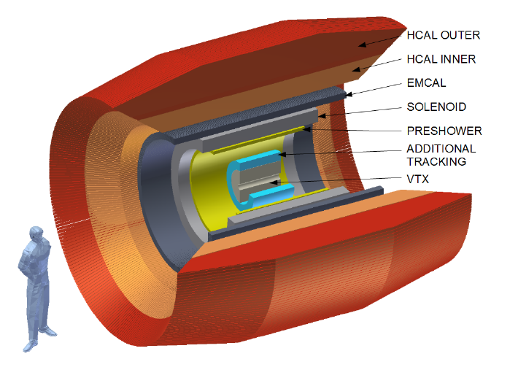
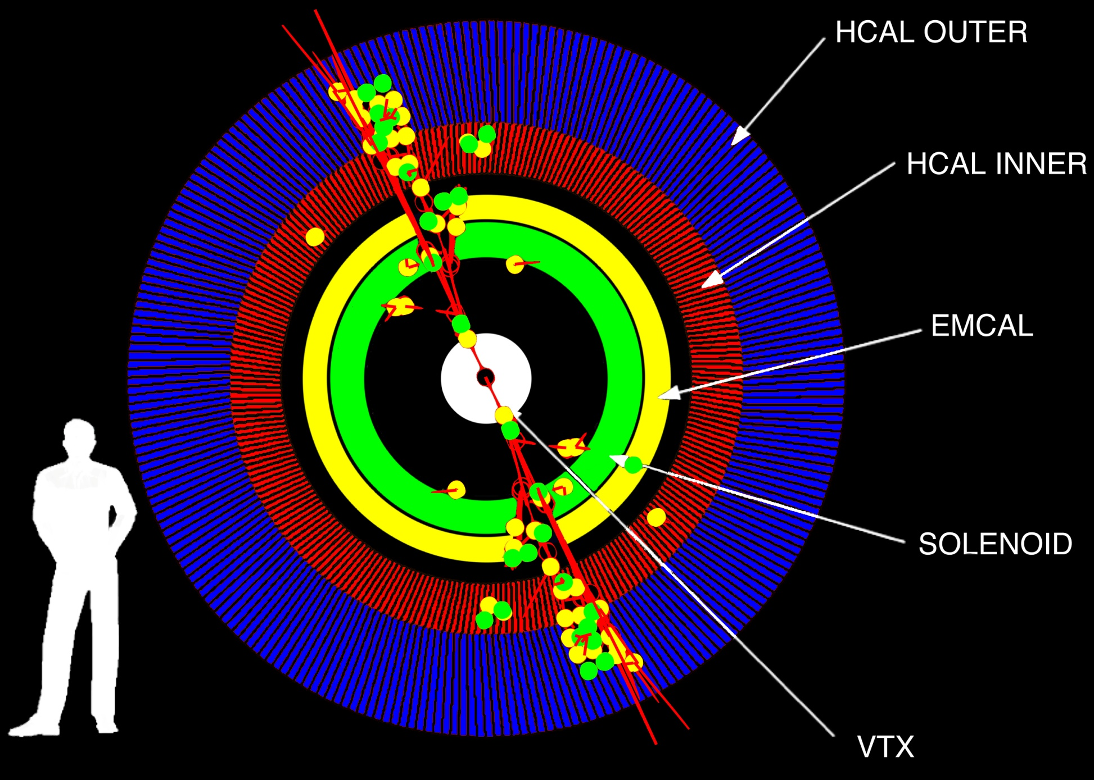
Major upgrade to the PHENIX detector
advancing a fundamental understanding of the nature of the strongest coupled fluid, the underlying dynamics (quasi-particles), and the temperature dependencies.
http://arxiv.org/abs/arXiv:1207.6378

Slide 3
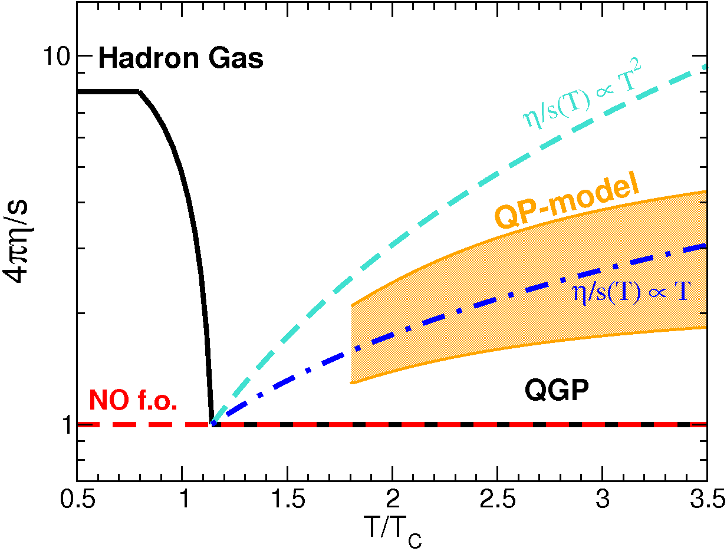
sQGP Fundamentals as a Function of Temperature
LHC
RHIC
“Jet Quenching is a few times
stronger near T_{c}
relative to the QGP at T > T_{c}.”
Liao and Shuryak, PRL (2009)
“The surprisingly transparent sQGP
at the LHC [compared to RHIC]”
Horowitz and Gyulassy, NPA (2011)
Plumari et al., arxiv:1103.5611[hep-ph].

Slide 4
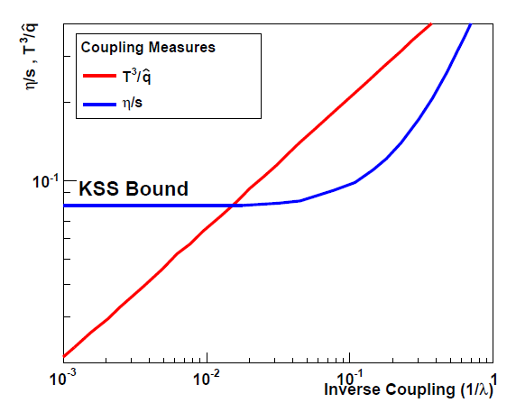
Coupling Measures with Jets
η/s
^
T³/q

Slide 5
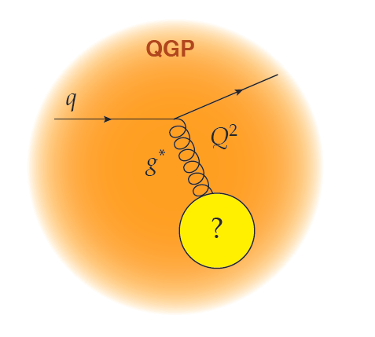
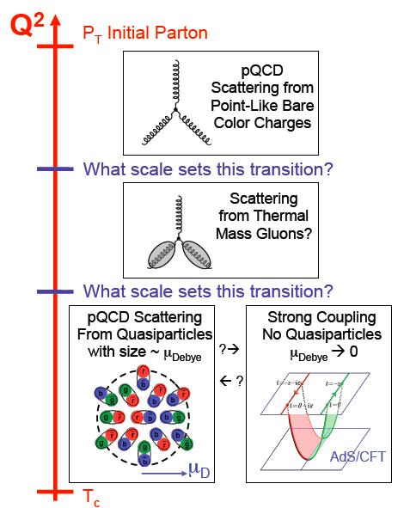
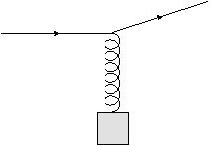
At what length scale is the medium probed?
q
1/λ
Q²
g*
?
What sets this scale?
the exchange gluon momentum?
total coherent energy loss?
impact of deconfinement?
W. Horowitz

Slide 6
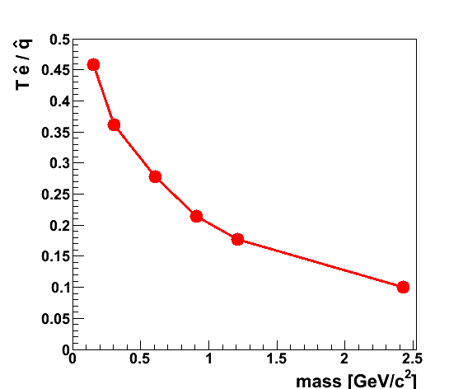
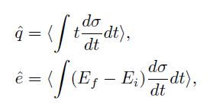
Sensitivity to Medium Composition (at a given Scale)
http://arxiv.org/abs/arXiv:1209.3328
qhat → scattering of lead parton → radiation e-loss
ehat → energy transferred to the QGP medium
Jet E_{T} = 30 GeV
T = 350 MeV
α_{s} = 0.3
Limit of infinitely massive scattering centers yields all radiative e-loss.
Medium parton

Slide 7
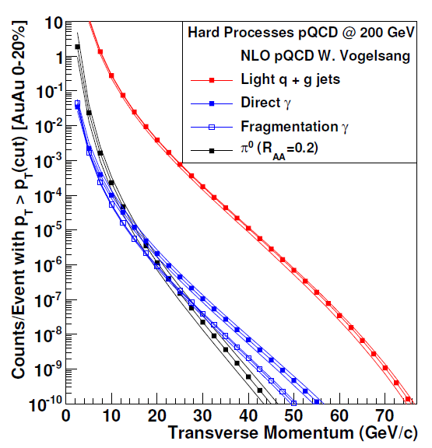
sPHENIX Rates: Jets, Dijets, γ-Jet
Sampling 50 billion Au+Au
events in one year
(can record 20 billion without selective triggers)
10⁷ jets > 20 GeV
10⁶ jets > 30 GeV
80% are dijet events
10⁴ direct γ > 20 GeV
A+B
p+A (different nuclei)
U+U
Differential measures
Jets Rates for Au+Au @ 100 GeV and Unique Flexibility of RHIC Enable Additional Lever Arm

Slide 8
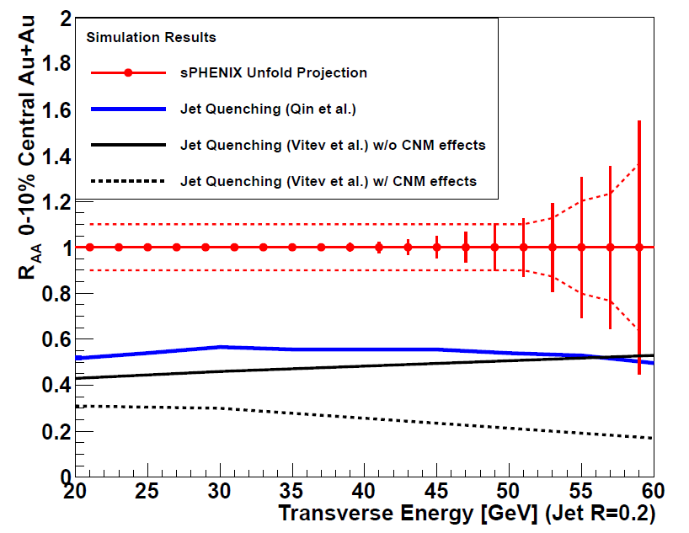
Inclusive Jet and Dijet Observables
Dijet Asymmetry
E_{T1} > 35 GeV
Varying medium coupling
Theory (Coleman-Smith)
50 billion MB events sampled
Exciting prospect to couple these observables with direct γ, single and multi-hadron, flow fluctuation observables too.
Next stage for heavy flavor jets.

Slide 9
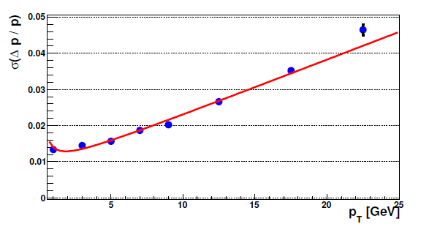
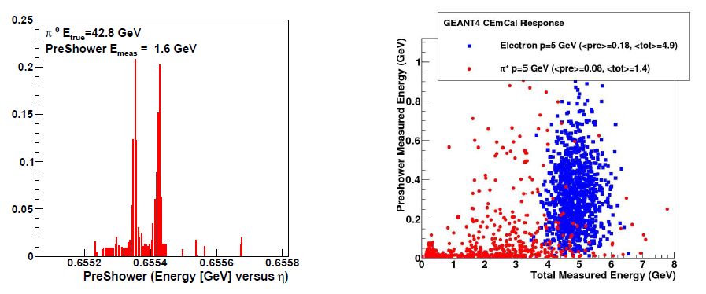
Strong Foreign Interest: Tracking and EMCal Pre-Shower
Additional Outer
Tracking Layers
Preshower for e-ID and γ/π⁰
Two additional layers added to GEANT-4 sPHENIX simulation gives momentum resolution for Upsilon state separation. Studies underway to determine pattern recognition needs.
Pre-shower gives electron ID for Upsilon, and heavy flavor electron tagging and γ / π⁰ separation.
Goal is to have these non-DoE funded and available on Day-1

Slide 10
Forward sPHENIX and Evolution to ePHENIX
Next stage forward spectrometer under design – enabled by open geometry of central solenoid. p+A and transversely polarized p+p is the focus. Task force writing detailed physics and design report (somewhat longer time scale).
ePHENIX task force….
Lots of real work,
very engaged…
Really investigating the barrel first stage requirements for enabling a world class EIC program for 5-10 GeV electron beam. Direct coupling with EIC task forces and with EIC R&D projects. Included details in MIE Appendix, and world-class program builds on sPHENIX foundation.
Abhay Deshpande (chair), Christine Aidala, Ken Barish, Sasha Bazilevsky, Kieran Boyle, Tom Hemmick, Dave Morrison, Itaru Nakagawa, Joe Seele, Ralf Seidl and Craig Woody.

Slide 11
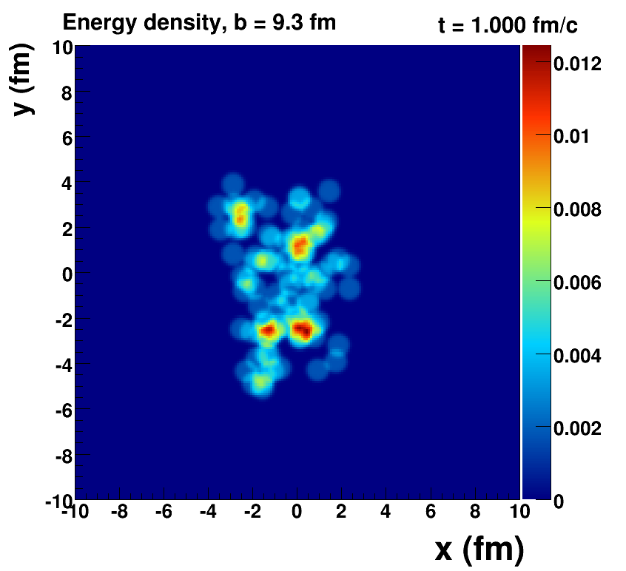
Summary
Just completed BNL Internal Review for sPHENIX MIE, October 5-6
Very excited collaboration eager to turn this proposal into a physics reality
Then we can enjoy the physics desserts!

