Slide 1
sPHENIX Future
30 minutes for this presentation is an impossibly short duration to discuss everything in sufficient (any) detail. Plan to give overview of
key points and then afterwards you can ask for more information….

Slide 2
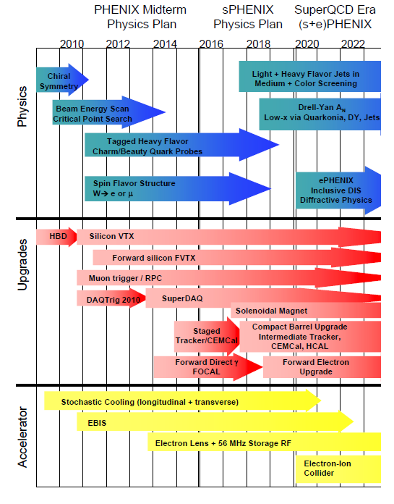
Experiments charged in December 2009 with producing Decadal Plans
PHENIX handed in Plan on October 1, 2010
and then it was reviewed by PAC in June 7, 2011.
http://www.phenix.bnl.gov/phenix/WWW/docs/decadal/2010/phenix_decadal10_full_refs.pdf
http://www.phenix.bnl.gov/phenix/WWW/docs/decadal/2010/phenix_decadal10_full_refs.pdf

Slide 3
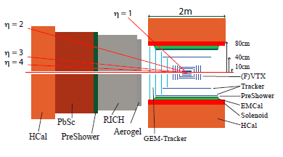
PHENIX Decadal Plan
(beyond the midterm upgrades, that are now in place)
entailed an ambitious upgrade to study the sQGP with a
new compact, large acceptance and high rate detector (sPHENIX).
As presented in the Decadal Plan
As the PAC noted
last year,
the entire upgrade package is expensive.
Broad program including high statistics Upsilons , large Dijet and γ-jet rates with full calorimetry, charm/beauty tagging of jets,
γ/π⁰ separation to 40 GeV/c, fragmentation functions,
forward p+A low-x jet, γ, quarkonia, forward transverse spin probes, staged into ePHENIX detector for 5-10 GeV electron beam at EIC.

Slide 4
PAC recommendations (2011)
“With most of the observables underpinning the RHIC program being accessible also to the LHC, it is crucial that the decadal plans document how the measurements at RHIC can uniquely advance the field. This implies, in particular, that the decadal plans should build more prominently on the fact that RHIC operates in a particularly interesting energy regime, closer than the LHC to the phase boundary, where precision measurements will constrain key quantities in what is arguably the more interesting regime.”
“Theoretical physicists, including in particular existing coordinated phenomenological efforts like the JET topical collaboration, should be more actively engaged in the decadal planning process.”
“The PAC expects to see a near-complete decadal plan from each collaboration prior to a potential meeting in early 2012.” [no charge was given on this front – i.e. a RHIC Decadal Plan]
“PHENIX correctly recognizes that despite its superb track record of delivering timely and interesting physics with a small aperture device, all their physics goals will require large aperture measurements with highly selective triggers which are fully efficient for the top RHIC-II luminosity. The PHENIX decadal upgrade plan is thus appropriately ambitious.”
Tim Hallman and DoE in late June 2011 said any such project must be staged and that we should aggressively pursue a first stage
~ $20M MIE proposal to be handed in July 1, 2012.

Slide 5
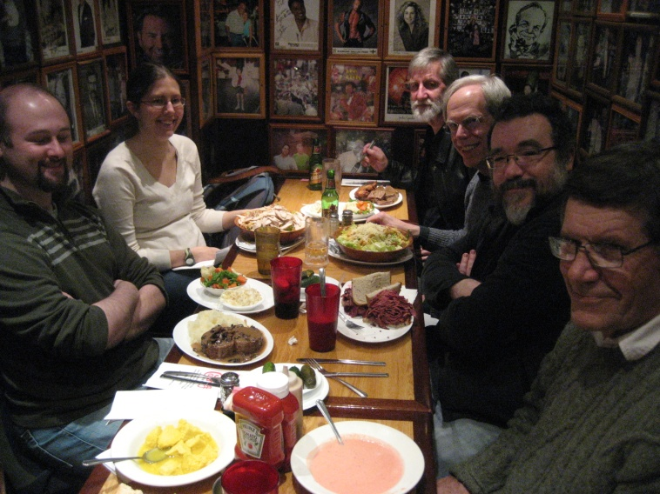
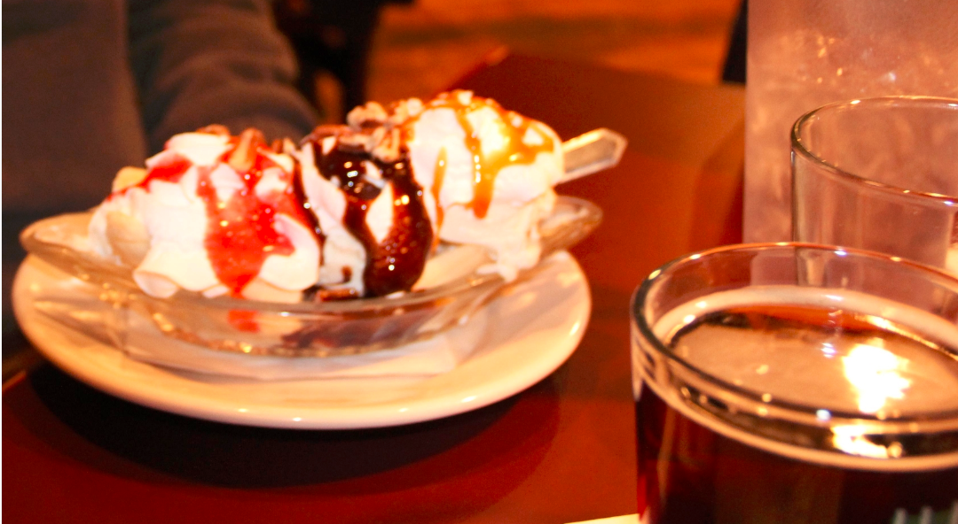
Lots of Excitement and Hard Work!
September 2011 – Brookhaven workfest
December 2011 – Boulder workfest
January 2012 – Tennessee workfest
February 2012 – Columbia workfest
March 2012 – Florida State collab. meeting
April 2012 – Boulder workfest
May 2012 – Brookhaven/Boulder writing
30+ people working with sPHENIX
focus for 5 days at each workfest
And a lot of food
was involved…

Slide 6
1. Write a $20M MIE proposal by July 2012 for a first stage of sPHENIX
→ The MIE funded portion must provide compelling and unique world class physics by itself (or with projects with funding in-hand)
Enable further staged upgrades to sPHENIX for more capabilities including forward physics for spin and cold nuclear matter
Lay the foundation for further staged upgrades to evolve into a compelling EIC (ePHENIX) detector
After considering many options based on physics, detector costs and integration, ... we are pursuing a first stage with a
2 Tesla Magnetic Solenoid (70 cm inner radius), full coverage (|η|<1.0) Electromagnetic and Hadronic calorimetry.
This enables a world-class jet physics program, and also with incremental upgrades recovers the other Decadal Plan physics including a world-class ePHENIX program.
MIE Proposal is for the first stage (focused on jet program).
The design from the very start is to enable the broader program.
Start with MIE justification!

Slide 7
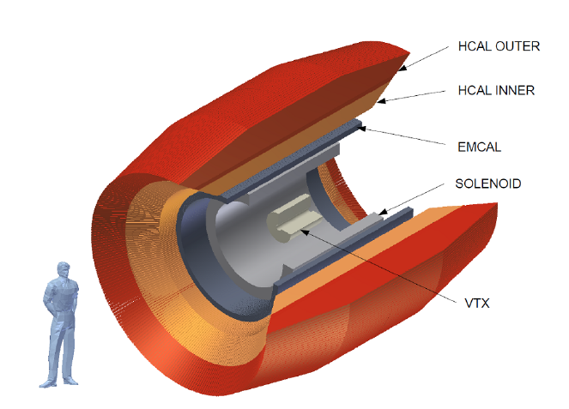
sPHENIX
First Stage in MIE Proposal

Slide 8
The textbook (or Wiki entry) on the Quark-Gluon Plasma will be incomplete without
a fundamental explanation for how the perfect fluid emerges at strong coupling near T_{c}
from an asymptotically free theory of quarks and gluons.
Jet observables at RHIC enabled by the sPHENIX upgrade
are critical to providing this explanation by probing the QGP near 1-2 T_{c} and at distances comparable to the thermal scale.
Measurements of jets only at the LHC will leave these questions with an incomplete answer
(particularly right where the coupling may be strongest).

Slide 9
Strong versus Weak Coupling
Water (100 MPa)
Nitrogen (3.4 MPa)
Helium (0.1 MPa)
QCD Weak Case
I
II
III
RHIC
Perfect Fluid
String Theory Bound
How does the Quark-Gluon Plasma transition from
Strong to Weak?
Is this transition associated with changes in
quasi-particles, excitations, strong fields?

Slide 10
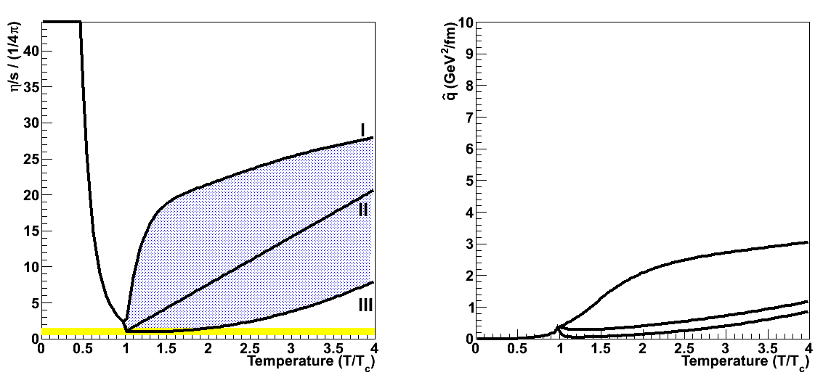
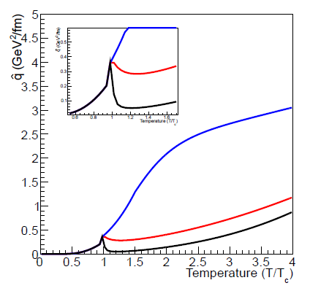
Mapping Out Strong Coupling with Jet Probes
“Small Shear Viscosity Implies Strong Jet Quenching”
A. Majumder, B. Muller, X.N. Wang, PRL (2007).
Scenario #1 (x10)
reveals
peak in q !
^
Key is independently measuring both sides of this equation!

Slide 11
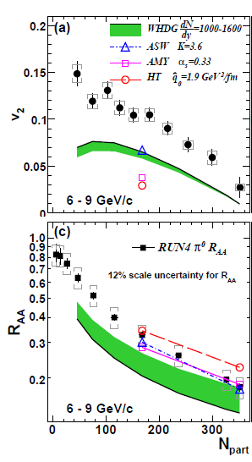
Super-Strong Coupling near Transition Temperature?
“Jet Quenching is a few times stronger near T_{c} relative to the
QGP at T > T_{c}.”
Liao and Shuryak, PRL (2009)
“The surprisingly transparent sQGP at the LHC [compared to RHIC]”
Horowitz and Gyulassy, NPA (2011)
“Large v₂ is striking in that it exceeds expectations of pQCD models even at 10 GeV/c.”
PHENIX, PRL (2010)

Slide 12
RHIC jet physics measurements are critical to exploring along the temperature axis
(in concert with LHC measurements).
Also, pushing / probing the medium along two other axes.
Temperature
Length Scale Probed
in Medium
Virtuality of Parton

Slide 13
Hard Parton Virtuality
T
λ
(length scale probed)
Q²
(virtuality of hard process)
“RHIC” Scenario
T₀=300 MeV
Parton E_{T} = 30 GeV
“LHC” Scenario
T₀=390 MeV
Parton E_{T} = 200 GeV
LHC Scenario
B. Muller. Nucl.Phys., A855:74–82, 2011, RHIC/AGS Users Meeting 2011

Slide 14
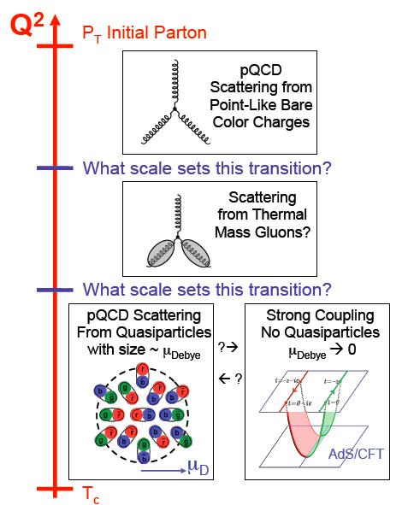
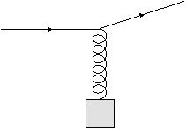
At which length scale is the medium probed?
q
Q²
g*
?
What sets this scale?
the exchange gluon momentum?
total coherent energy loss?
impact of deconfinement?
W. Horowitz

Slide 15
Theoretical Guidance on Observables/Sensitivity
March 3-4, 2012 at Duke University
lots of interest from theoretical community.
Follow up EVO meetings.

Slide 16
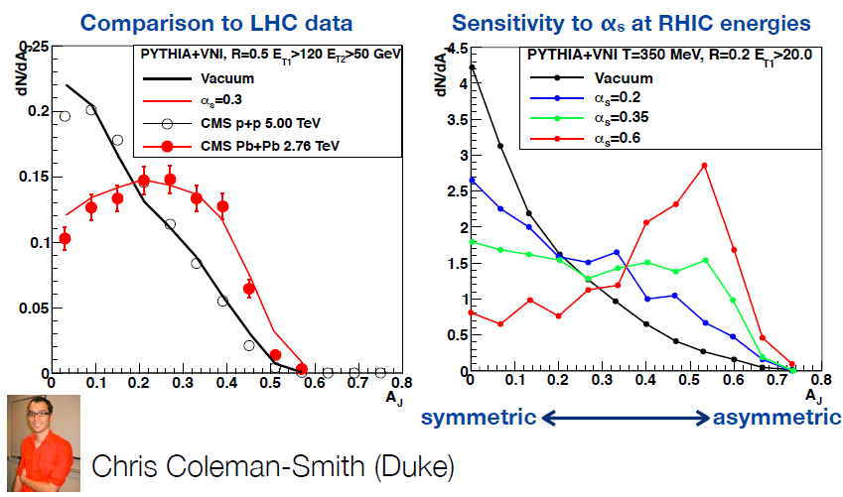
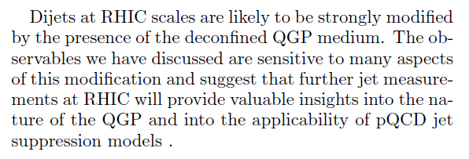

Slide 17
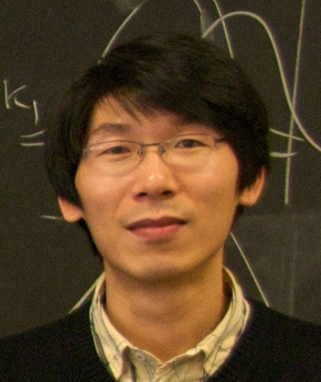
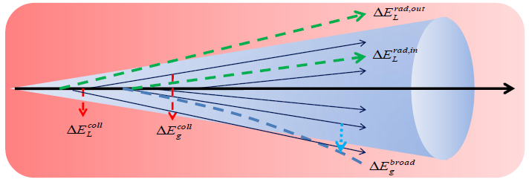
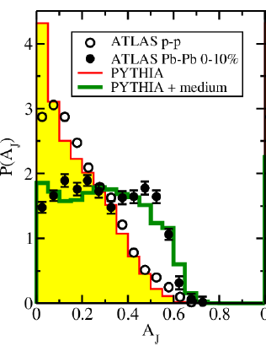
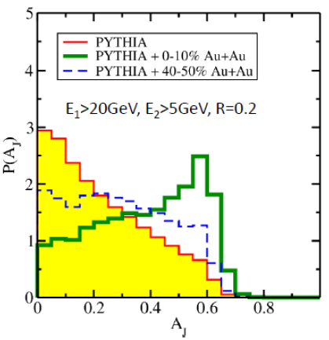
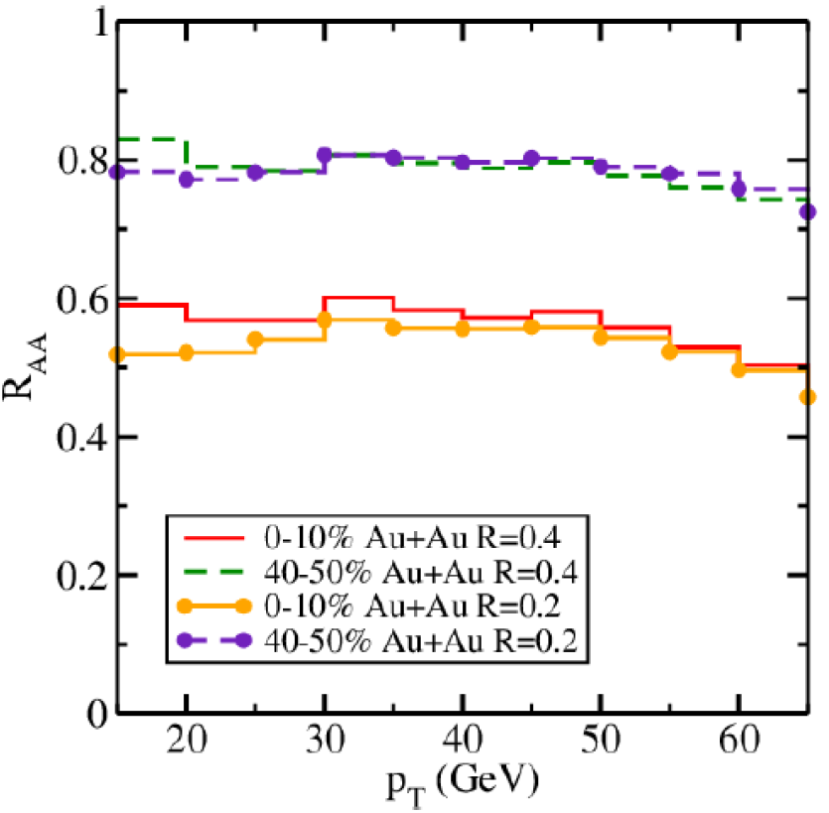
PRL 2011
Guangyou Qin, Berndt Muller
Larger modification
at RHIC
More of parton shower equilibrated into medium.

Slide 18
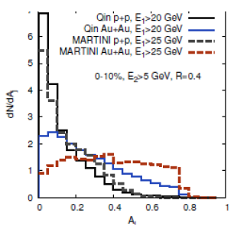
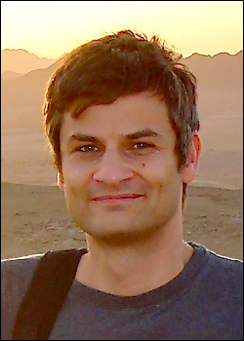
Ivan Vitev et al.
Radiative E-loss only
Radiative + Collisional E-loss
±10% changes in coupling strength
E₁ > 35 GeV, E₂ > 5 GeV
MARTINI + MUSIC (dash)
Qin + Muller (solid)
Au+Au 0-10%, anti-kT R = 0.4
Bjorn Schenke, Clint Young et al.
Large effects!
Different models matching LHC data disagree on RHIC predictions.

Slide 19
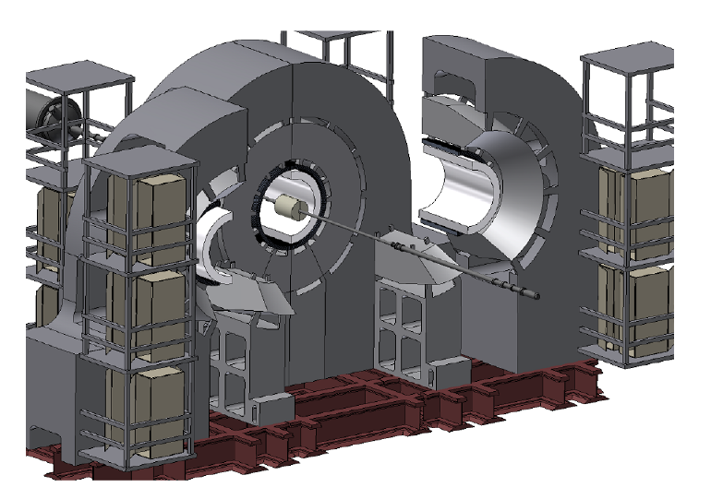
sPHENIX MIE Proposal
Major change to the PHENIX detector.
Removal of outer PHENIX central arms, keep VTX inner tracking.

Slide 20
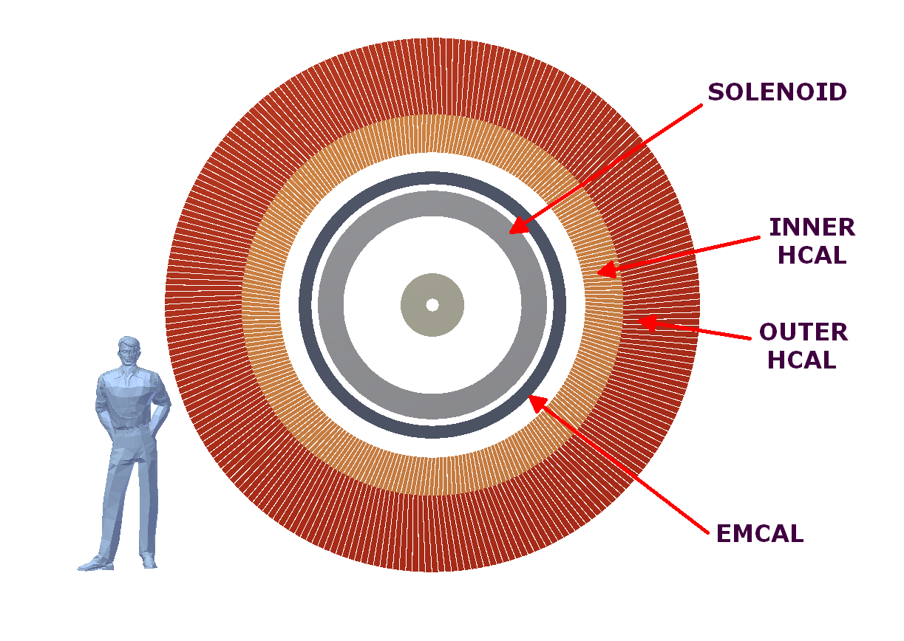
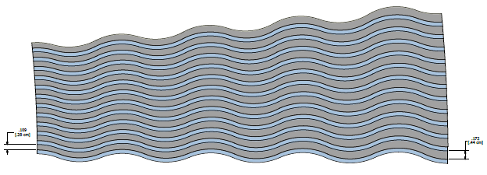
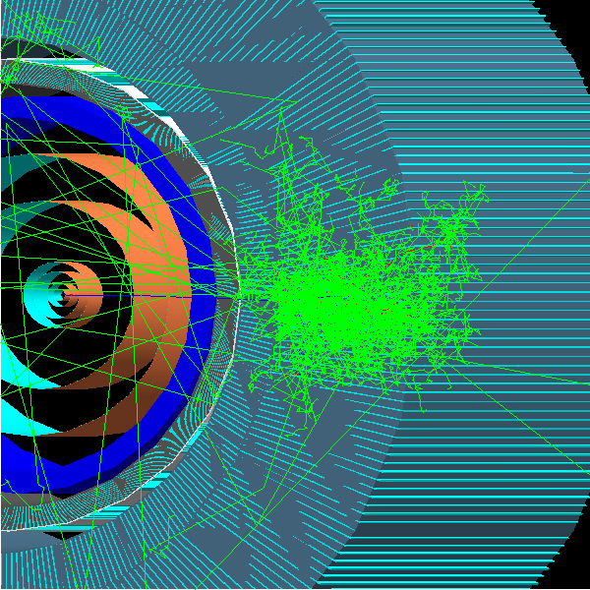
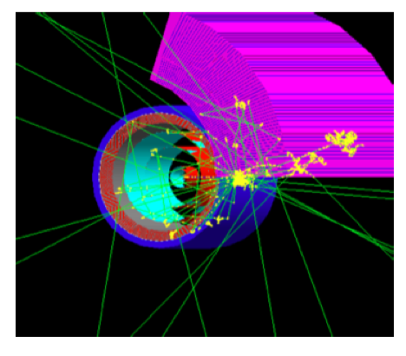
Magnet
Solenoid 2 Tesla, R_{inner} = 70 cm
Accordion Tungsten-Fiber EMCal
SBIR with Tungsten Heavy Powder
Prototype being constructed, EIC R&D
10 cm total thickness
14%/sqrt(E) resolution
Full GEANT-4 simulation results
Silicon Photomultiplier (SiPM) readout
Fe-Scintillator HCal
Acts as flux return for magnetic field
Prototype being constructed
1 meter total thickness
75%/sqrt(E) resolution
Full GEANT-4 simulation results
Common SiPM/electronics to EMCal

Slide 21
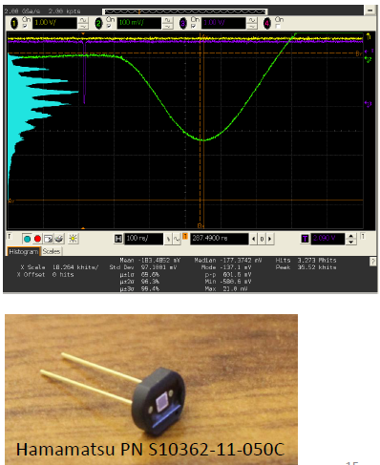
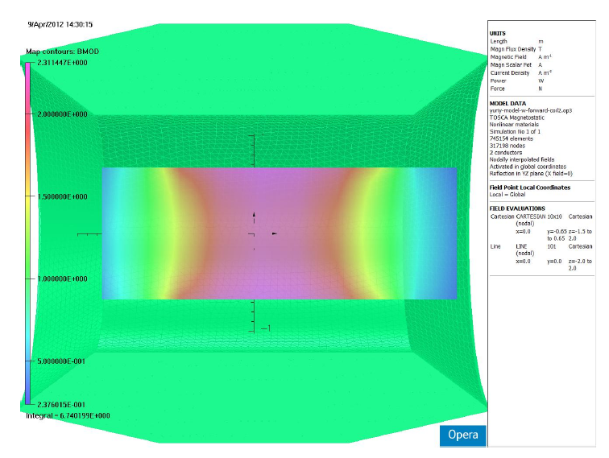
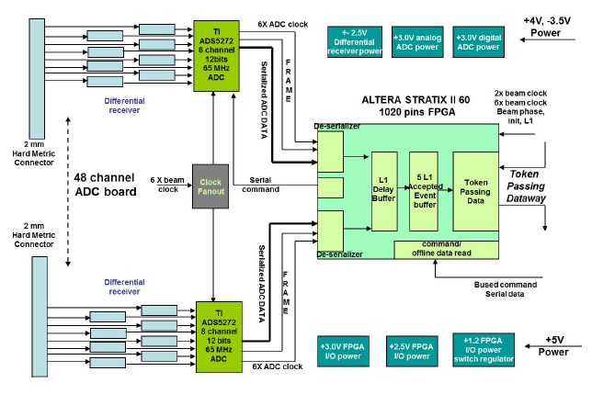
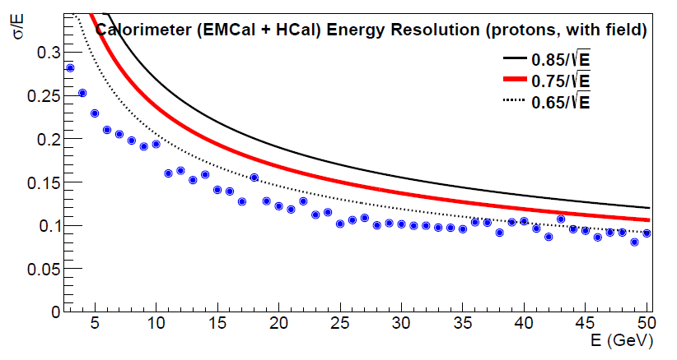
Flash Examples

Slide 22
Detailed Costing for MIE
Magnet quote from CMS Magnet Vendor
Specific SiPM quotes
Full electronics costing
Hcal steel, scintillator, fiber, and assembly costing
Tungsten Heavy Powder company detailed quote including assembly
With full overhead, project averaged contingency of 40%, management, engineering, labor, … the total is ~ $24M in new funds and another $6M of existing BNL labor re-direct.
Working closely with BNL Project Specialists for detailed WBS.
Very far advanced for CD-0, in part since we want to move forward on an aggressive time scale (as recommended by the PAC).

Slide 23
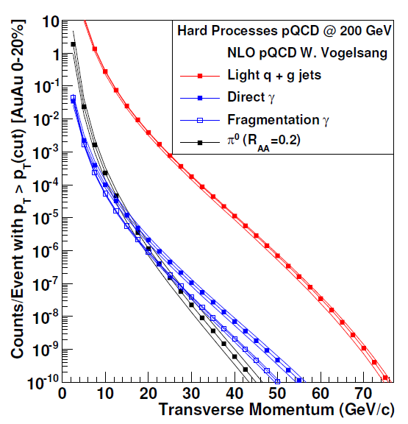
Can we measure these key observables?
 | Au+Au (central 20%) | p+p | d+Au
>20GeV | 10⁷ jets 10⁴ photons | 10⁶ jets 10³ photons | 10⁷ jets 10⁴ photons
>30GeV | 10⁶ jets 10³ photons | 10⁵ jets 10² photons | 10⁶ jets 10³ photons
>40GeV | 10⁵ jets | 10⁴ jets | 10⁵ jets
>50GeV | 10⁴ jets | 10³ jets | 10⁴ jets
Huge rates allow differential measurements with geometry
(v₂, v₃, A+B, U+U, …) &
precise control measurements (d+Au & p+p).
Over 80% as dijets into |η|<1.0
Rates based on full stochastic cooling, but no additional accelerator upgrades.
Note, first ATLAS dijet paper based on ~ 1k pairs.

Slide 24
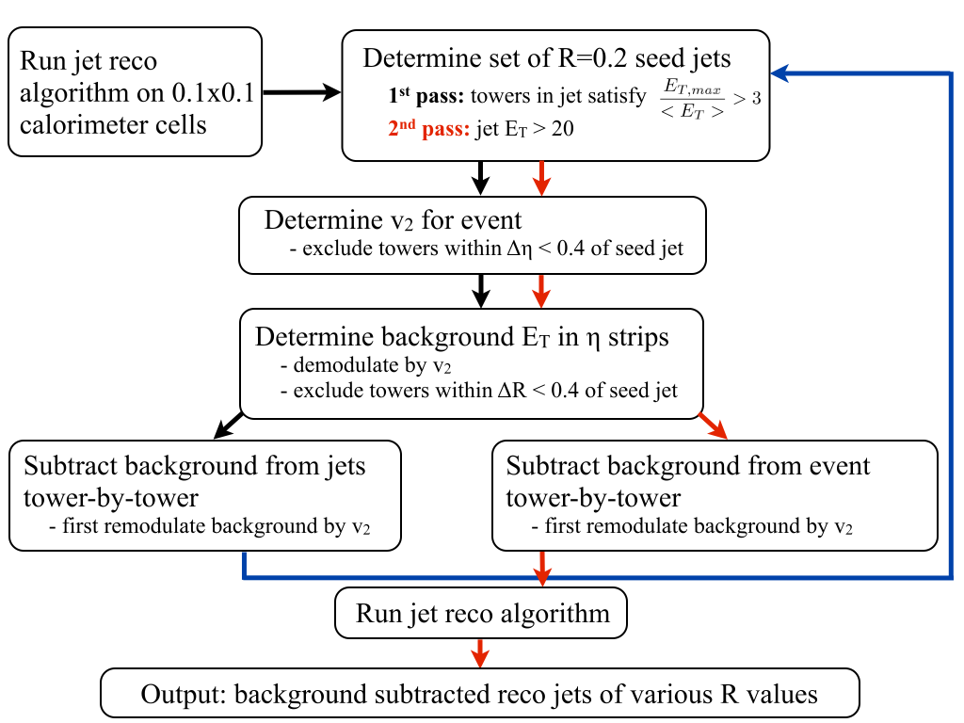
Are jet measurements at RHIC dominated by “fake jets”?
arXiv:1203.1353
Positive referee report:
“very useful study regarding the practicality and efficiency of jet reconstruction at RHIC energies. The paper is scientifically sound, well written, and suitable for publication.”
Over 1 billion HIJING events run, tagging of fragmentation call jets, full ATLAS-type background subtraction method.

Slide 25
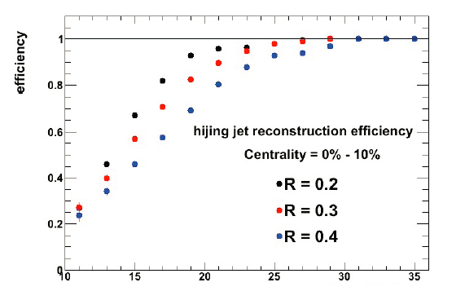
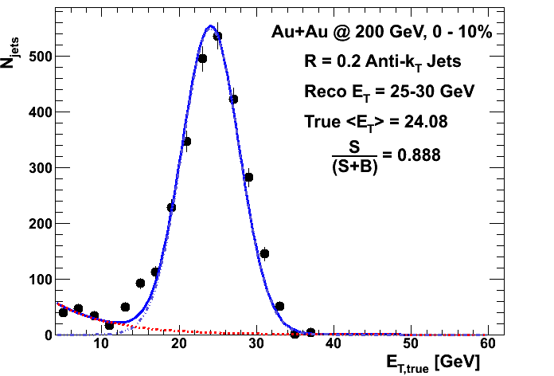
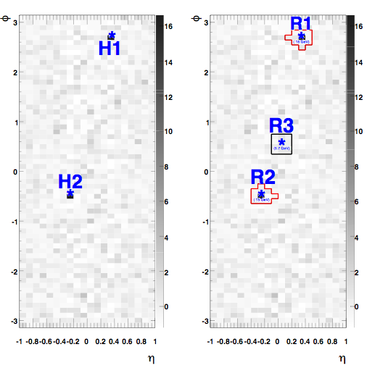
Full HIJING Event Analysis
truth jets
reconstructed jets
18GeV
16GeV
6GeV
Jets reconstructed 25-30 GeV dominated by real jets (known from HIJING truth)
at 24 GeV (shift from resolution).
And this is with no fake rejection (expected to give X10 more suppression).
19GeV
Jet Transverse Energy (GeV)
Very good jet finding efficiency even in the most central Au+Au events for
E_{T} > 20 GeV
15GeV

Slide 26
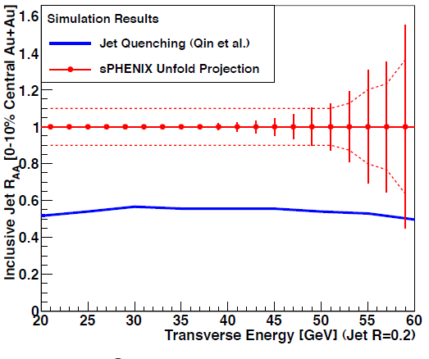
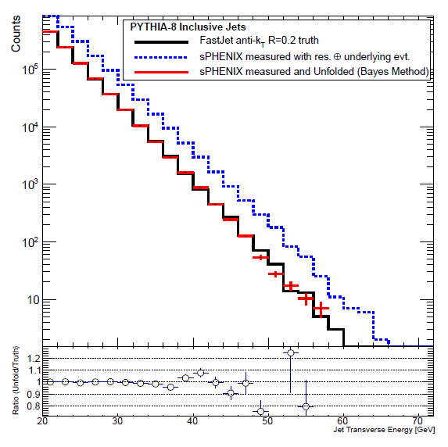
Jet Spectra
In region above fake jet contributions, we can measure the inclusive jet spectra.
Example ROOUNFOLD Iterative Bayes Method shows very good result.
Full GEANT-4 simulation with FastJet Reconstruction gives good resolution.
Jet Transverse Energy (GeV)
Jet R_{AA} measurable with high stats

Slide 27
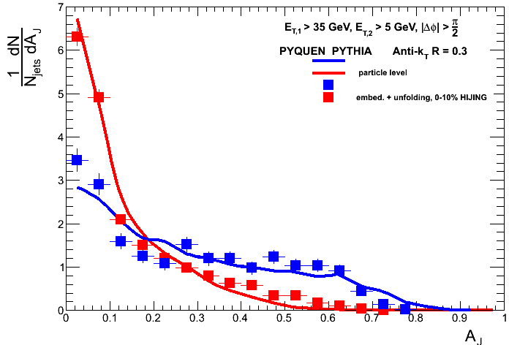
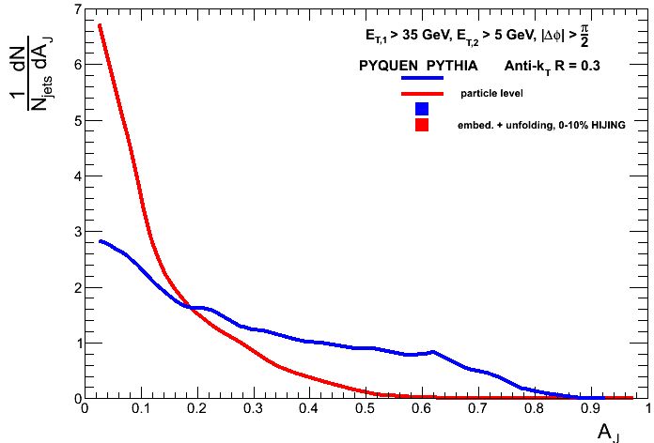
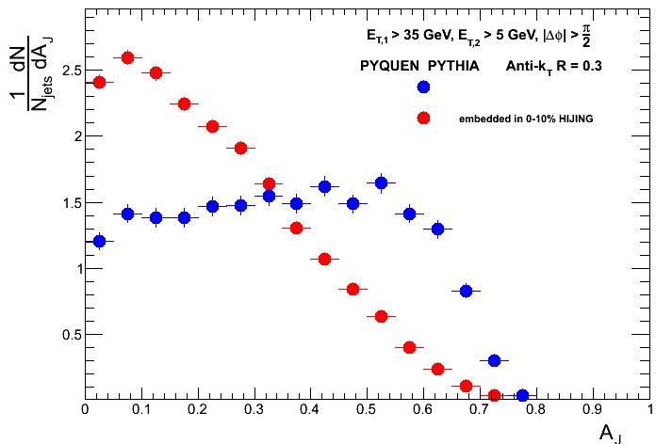
PYTHIA (vacuum case)
PYQUEN (quenched case)
Full jets + HIJING background + detector resolution + FastJet + underlying event subtraction
Very easily discriminated (large effect)
Full 2-d unfold in progress, and example trigger unfold gets most of the way there.
Excellent ability to constrain coupling to medium and check parton shower modification.
E₁ > 35 GeV, R = 0.3
Truth = solid lines
E₁ > 35 GeV, R = 0.3
Truth = solid lines
Boxes = Measure + Unfold
Dijet A_{J} (E1-E2)/(E1+E2)
Dijet A_{J} (E1-E2)/(E1+E2)
E₁ > 35 GeV, R = 0.3
Measured
Dijet A_{J} (E1-E2)/(E1+E2)

Slide 28
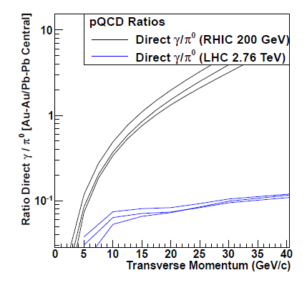
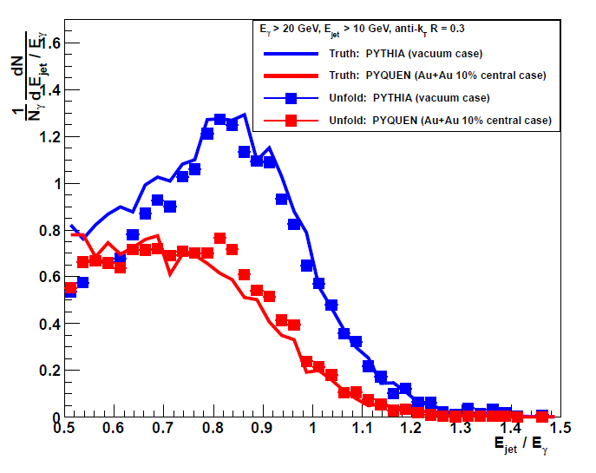
Gamma-Jet
For p_{T} > 15 GeV, direct photons dominate at RHIC
Direct γ – jet correlations
PYTHIA (vacuum)
PYQUEN (quenching)
– hadron correlations
Track with VTX where the energy goes!
h 0.5-1 GeV
h 1-2 GeV
h 2-3 GeV
h 3-4 GeV
Δφ
Δφ
Δφ
Δφ

Slide 29
Evolution
All jet and γ-jet physics results in this talk can be measured with this first stage MIE …
Evolution with additional tracking layers (RIKEN funded) adds capability for high-z fragmentation functions
Evolution with additional pre-shower on EMCal allows for π⁰ R_{AA} measurement up to p_{T} = 40 GeV/c and electron-ID for Upsilon measurements (with resolution to separate 3 states) and tagging of charm/beauty jets
Evolution with forward detector allows for key transverse spin and cold nuclear matter p+A measurements
Evolution into Electron-Ion Collider detector (ePHENIX) with world class capabilities for electron beam 5-10 GeV

Slide 30
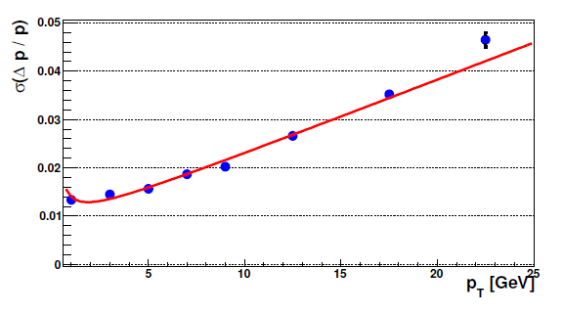
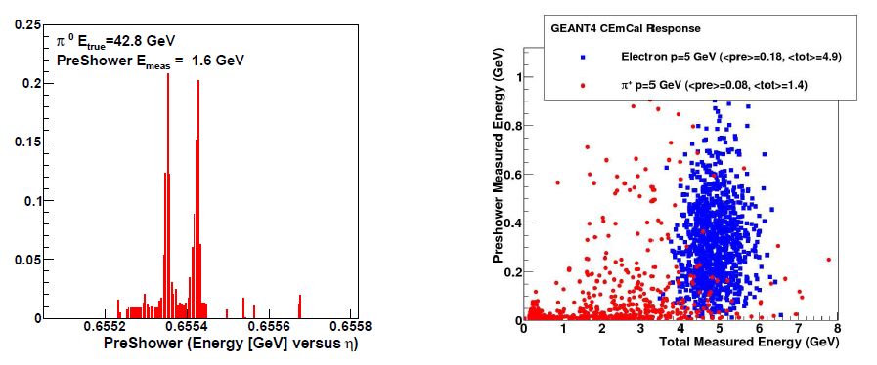
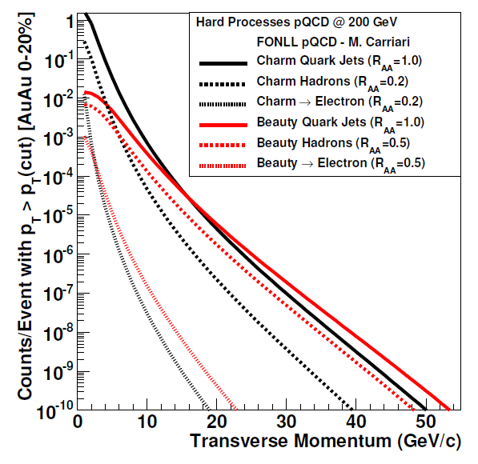
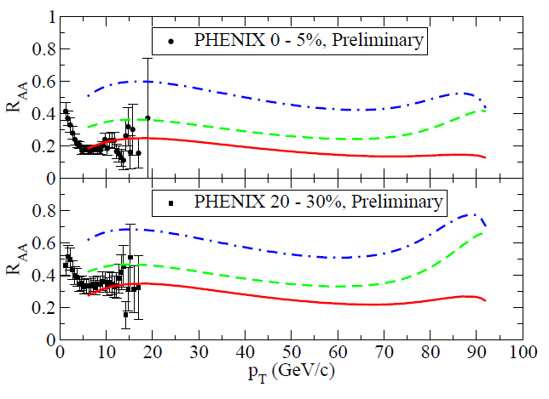
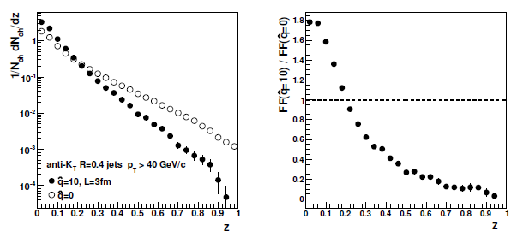
Additional Tracking
(RIKEN funded on same time scale)
Preshower for e-ID and γ/π⁰

Slide 31
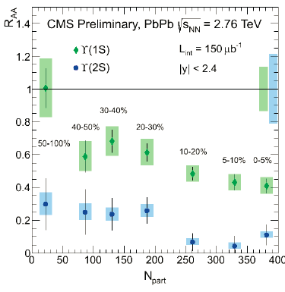
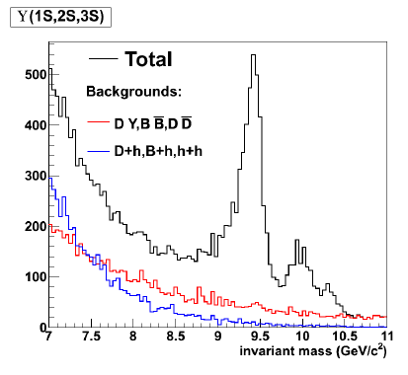
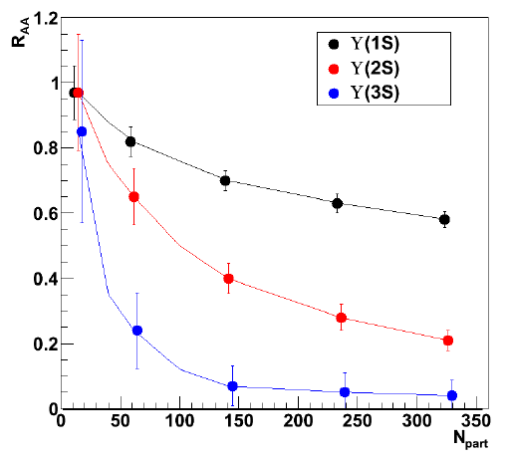
Extremely exciting LHC Upsilon results
Key to map out temperature dependence
sPHENIX will have similar statistics to LHC
and > 7x STAR MTD measurement
Needs additional tracking + preshower
Au+Au Central

Slide 32
Forward sPHENIX and Evolution to ePHENIX
Next stage forward spectrometer under design – enabled by open geometry of central solenoid. p+A and transversely polarized p+p is the focus. Task force writing detailed physics and design report (somewhat longer time scale).
ePHENIX task force….
Lots of real work,
very engaged…
Really investigating the barrel first stage requirements for enabling a world class EIC program for 5-10 GeV electron beam. Direct coupling with EIC task forces (Tom Hemmick can tell you much more) and with EIC R&D projects. Included details in MIE Appendix, and world-class program builds on sPHENIX foundation.
Abhay Deshpande (chair), Christine Aidala, Ken Barish, Sasha Bazilevsky, Kieran Boyle, Tom Hemmick, Dave Morrison, Itaru Nakagawa, Joe Seele, Ralf Seidl and Craig Woody.

Slide 33
We had a 2 hour meeting with DoE in Washington DC (including ALD)
on May 15, 2012 (Tim Hallman, Jehanne Gillo, Jim Sowinski)
Tim's reaction to the sPHENIX presentations was positive: “Entirely timely to be thinking about these important questions.” “Important topic to be pursued at RHIC.” “[sPHENIX] has landed on a key topic [jet measurements] and it would be very disappointing, even tragic, to not answer these questions.”
“Excited and alarmed at how far you are in thinking about the detector“
“CD-0 is a demonstration of mission need... don't want to go forward until ONP understands how to fund it” [i.e. decision from Tribble II] Jehanne remarked: “Looks like an exciting approach to the detector design. I appreciate the technical design and the conservative approach.”
“The project looks really cool.”

Slide 34
What do we want from you?
Time of great uncertainty and doubt… Best plan is to push forward with what physics gets you the most excited and motivated. Is that right?
The MIE proposal is essentially done and undergoing internal PHENIX review. Will be handed in to BNL management on July 1, 2012. Glad to distribute the document to the PAC members.
We believe it is crucial to have a detailed outside review by BNL on a short time scale (and not tied to resolving the Tribble II panel decision which could take quite some time). This can serve as important input into the RHIC future plan to be presented. Also, it is critical to keep the collaboration energized at a time when doubt rules the world (Drachma or Euro, paper or plastic, RHIC or FRIB or neither).
PAC review of Decadal Plan in 2011 (1 hour presentation) and this MIE (30 minute presentation) is simply insufficient.
Need sPHENIX plans to be integral part of RHIC decade plan. If not ?

Slide 35
Extras

Slide 36
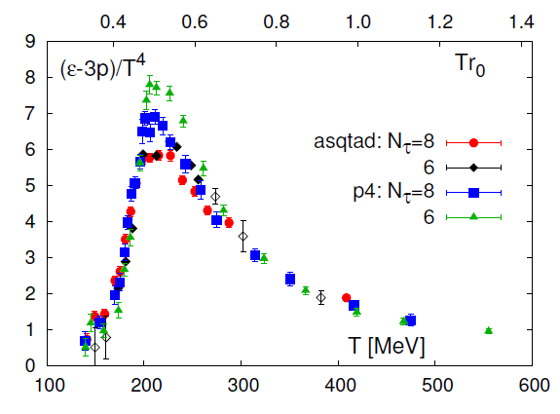
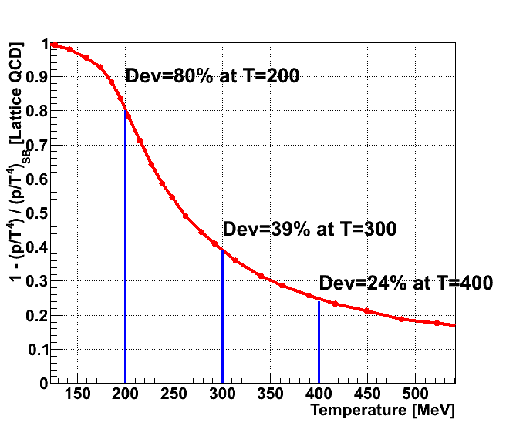
Is the medium coupling strongest near 1-2 T_{c}?
Data from Phys. Rev. D80, 014504 (2009)
Trace anomaly – mixed information.
Perturbatively ~ g dg/dΛ ~ dα_{s}/dΛ
Deviation from conformal
Some suggested deviation of P/T⁴ from SB. Of course, AdS/CFT gives result within ~25% of SB and still very strongly coupled.
Lots of discussion of this topic at Hard Probes ‘12 in Sardinia…
Seems like a good thing to measure experimentally
η/s is another
measure, but without reliable lattice guidance.
Hydro models need significant rise

Slide 37
Complementarity of Hydrodynamics and Jets
Recent studies of η/s (T) in the literature
arXiv:1101.2442 (Niemi, Denicol, Huovinen, Molnar, Rischke)
arXiv:1103.2380 (Song, Bass, heinz)
arXiv: 1102.0680 (Nagle, Bearden, Zajc)
Models favor increase of η/s
(less strongly coupled) above T_{c}.
Exact constraints unclear until fluctuating initial conditions, initialization of stress-energy tensor, and relaxation time systematics included.
Interesting that change η/s = 1/4π to 2/4π for T > 2 T_{c} does not change the flow at all.

Slide 38
Why Hadronic Calorimetry?
All heavy ion jet publications to date (i.e. ATLAS and CMS) come from calorimeter measurements !
Ability to try different methods (supplementing with tracking) is also a big advantage.
Critical to have EMCal + HCAL with continuous coverage (no gaps, spokes, holes) with large acceptance to see both jets and γ-jet and at very high rate. Then add in tracking information as key additional handle for systematic studies.
Also, when measuring fragmentation functions, hadron p_{T} and jet energy measures are independent.

Slide 39
At which length scale is the medium probed?
T
Related to virtuality of exchange particle with medium.
λ
(length scale probed)
Q²
(virtuality of hard process)
Q²
~10⁻¹⁸ m
Electron Scattering Example
~10⁻¹⁵ m
e
Q²
1-15x10⁻¹⁵ m
~few 10⁻¹⁰ m
~few 10⁻⁵ m

